Slide 1
Chapter 1: The Only Sure Foundation
Notes:
WIN-Initiative/Stone/Getty Images

Slide 2
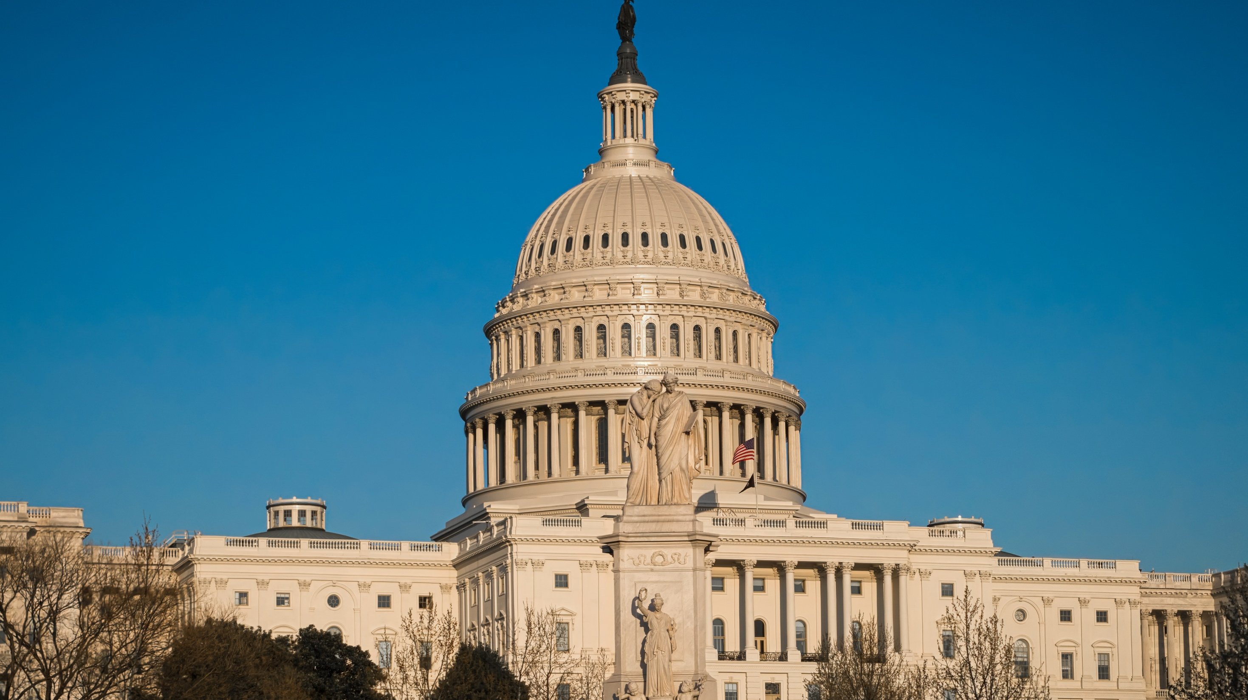
I. The Necessity of Government
Chapter 1.1
Notes:
Photo by Obi Onyeador on Unsplash
https://unsplash.com/photos/YUonZoCUAOk

Slide 3
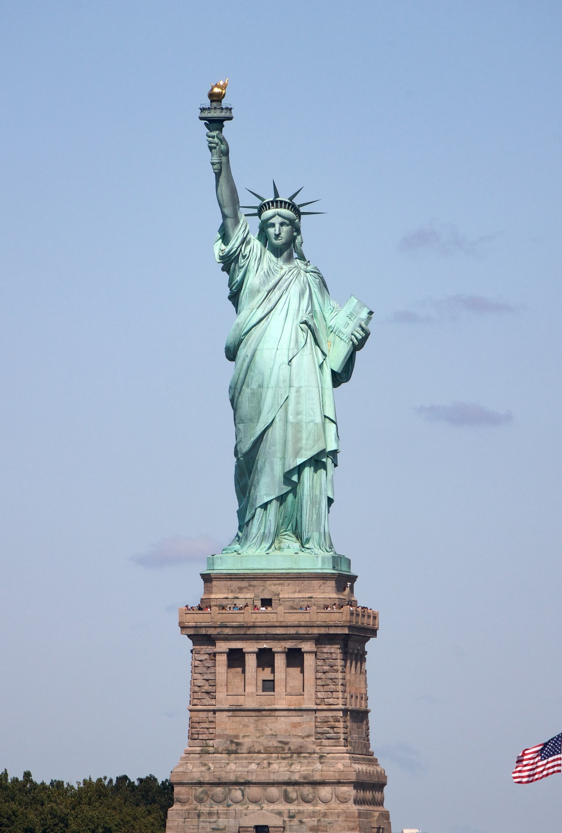
I. The Necessity of Government
Government is any system of public rule or authority.
Thousands of governments exist of various sizes and types.
While governments often disappoint, the Bible teaches that they are necessary.
Notes:
Photo by AussieActive on Unsplash
https://unsplash.com/photos/1brtlzDq-o8

Slide 4
A. Origin of Government
Government is a fundamental principle of Scripture – God’s Kingdom.
Humans have dominion over the earth because we are made in the image of God (Gen. 1:26–27).
Notes:
Photo by Ryoji Iwata on Unsplash
https://unsplash.com/photos/IBaVuZsJJTo

Slide 5
A. Origin of Government
God’s command to man to wisely rule the earth is called the Creation Mandate.
In order to fulfill this mandate, humanity needs structure and organization.
Notes:
https://unsplash.com/photos/IBaVuZsJJTo
https://unsplash.com/photos/wTD1-_u8x1g

Slide 6
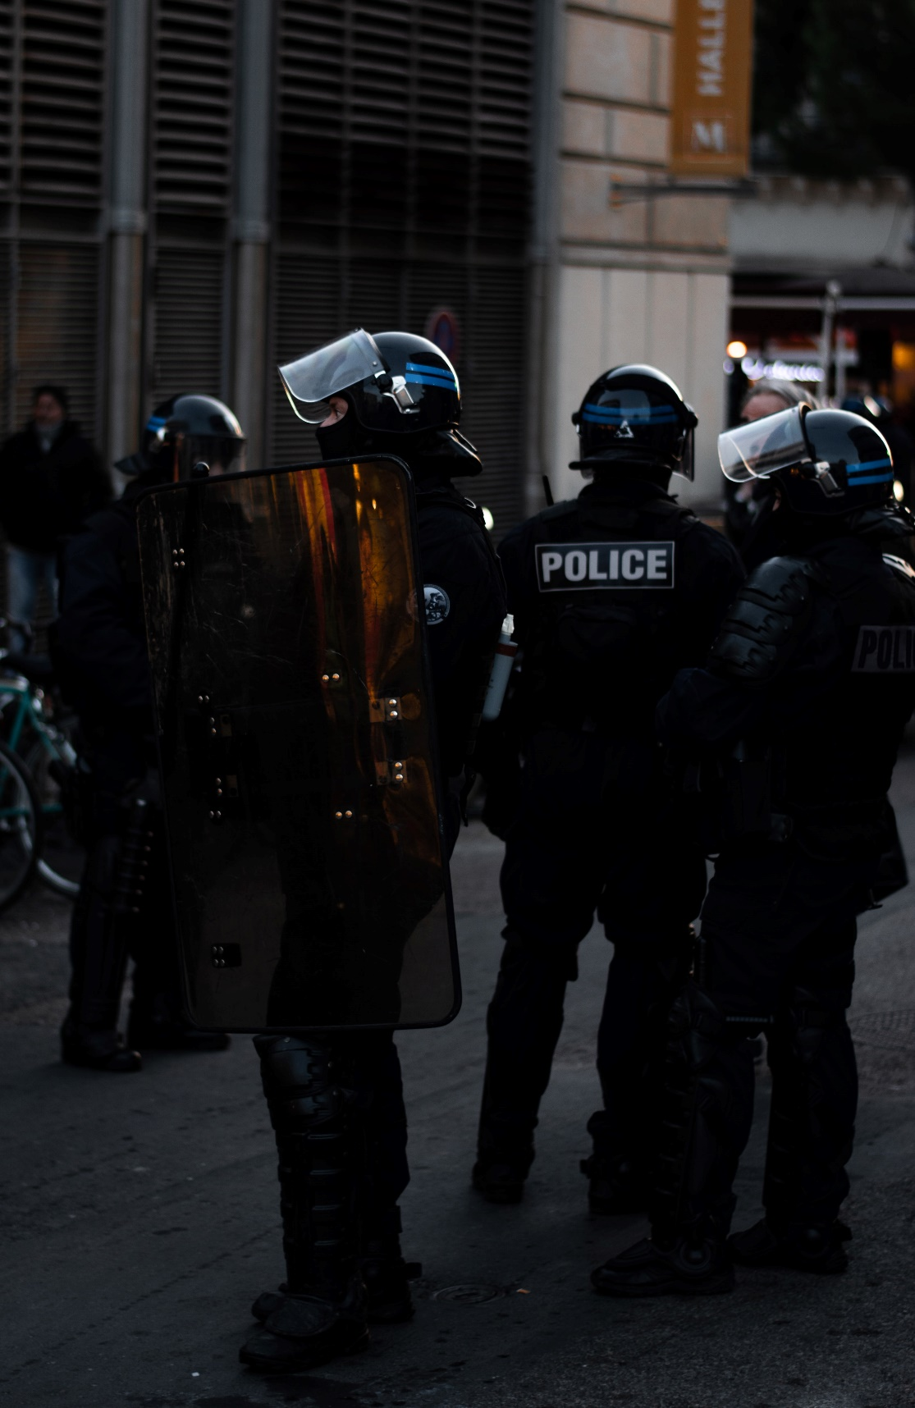
B. The Problem of Human Depravity
Government is also necessary because of human depravity – the twisting of man’s mind, will, and emotions by sin.
Anarchy is the absence of government.
Notes:
Photo by Pierre Herman on Unsplash
https://unsplash.com/photos/fGq8RpGlekM

Slide 7
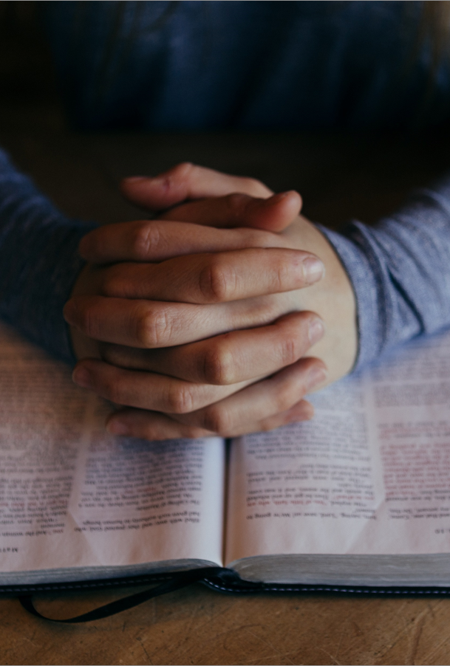
C. Human Government on the New Earth
The Bible teaches that government will continue when Christ rules the new earth (Rev. 21:24, 22:3–5).
Until then, Christians must carefully consider how to make their government as just as possible.
Notes:
Photo by Patrick Fore on Unsplash
https://unsplash.com/photos/b_SHPU5M3nk

Slide 8
Section Review – Chapter 1.1
1–2. In the first paragraph of the chapter, two characteristics of an ideal ruler are mentioned. What are they?
The ideal ruler is just and fears God. (p. 3)
3. Define government.
Any system of public rule or authority (p. 3)

Slide 9
Section Review – Chapter 1.1
4–5. Explain the Creation Mandate. How does it relate to government?
The Creation Mandate is God’s first command to humans; it orders them to practice good and wise dominion over God’s world. Government is part of this dominion. (p. 4)
6. Why does human depravity demand government?
The sinful tendencies of human depravity make government necessary to suppress evil. (p. 4–5)

Slide 10
Section Review – Chapter 1.1
Why will government continue to exist for eternity even when people are no longer evil and in need of restraint?
Government’s purpose is not solely to restrain sin. Government is also needed to provide structure and leadership. The good government of God’s Son will exist throughout eternity.

Slide 11
II. The Obligations of Government
Chapter 1.2
Notes:
Image by 272447 from Pixabay
https://pixabay.com/photos/ship-aircraft-carrier-us-navy-1056693/

Slide 12
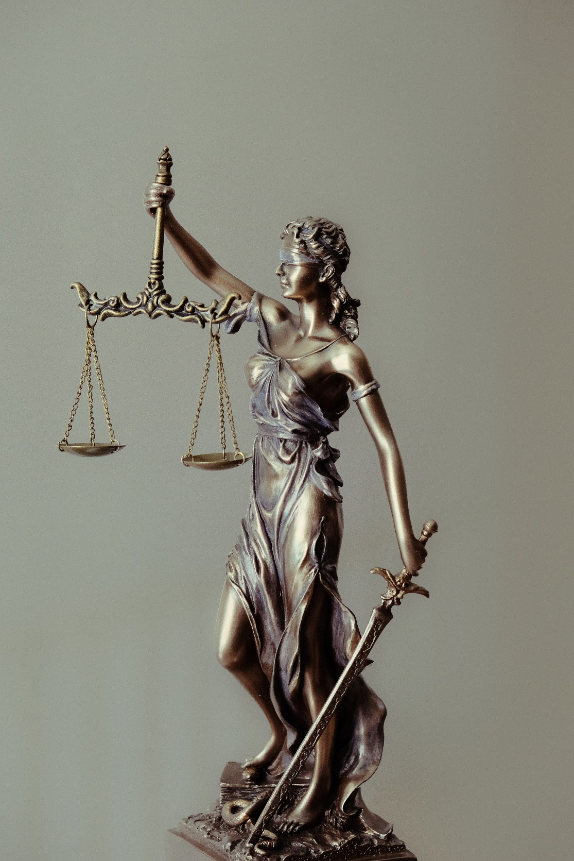
II. Obligations of the Government
The Bible describes what the government should do:
Ensure justice
Provide for national defense & public safety
Address poverty
Promote moral behavior
Provide order
Notes:
Photo by Tingey Injury Law Firm on Unsplash
https://unsplash.com/photos/L4YGuSg0fxs

Slide 13
A. Ensure Justice
To ensure justice means that government should encourage people to do right and respect the rights of others.
Justice requires equality – the laws are applied equally to all.
Confusion over what is “right” comes when people reject God.
Notes:
Image by miami car accident lawyers from Pixabay
https://pixabay.com/photos/law-lawyer-attorney-justice-judge-4617873/

Slide 14
B. Rewarding Righteousness
Just governments reward righteousness.
Righteousness is conformity to a standard—conformity to the character of God.
Notes:
Photo by Rod Long on Unsplash
https://unsplash.com/photos/DRgrzQQsJDA

Slide 15
C. Punishing Unrighteousness
While the government has a duty to punish wrongdoing, the reach of its authority is limited.
Officials must know when a government response is needed, and when it is not.
Notes:
Image by Free-Photos from Pixabay
https://pixabay.com/photos/squad-car-police-lights-city-urban-1209719/

Slide 16
D. Provide National Defense & Public Safety
Governments have the duty to protect their citizens from foreign invasions.
Governments support public safety by enforcing just laws.
Governments respond to natural disasters, support health care, and fund medical research.
Notes:
Image by Military_Material from Pixabay
https://pixabay.com/photos/firefighter-emergency-fire-2679283/

Slide 17
E. Address Poverty
The government has an obligation to help the needy.
The Bible teaches that the appropriate way to earn an income is to work.
Government programs should encourage productive work so that citizens can sustain themselves.
Notes:
Photo by Adam Thomas on Unsplash
https://unsplash.com/photos/FB1n9kXP7WA

Slide 18
F. Promote Moral Behavior
The moral code of a nation should reflect the character of God and honor the rights of the people.
All laws reflect a moral viewpoint.
Notes:
Photo by Sebastian Pichler on Unsplash
https://unsplash.com/photos/bAQH53VquTc

Slide 19
G. Provide Order
Governments are to keep order in areas such as traffic laws, record keeping, etc.
In this way, the government supports the Creation Mandate.
Notes:
Photo by Oskars Sylwan on Unsplash
https://unsplash.com/photos/99wmYtakIyg

Slide 20
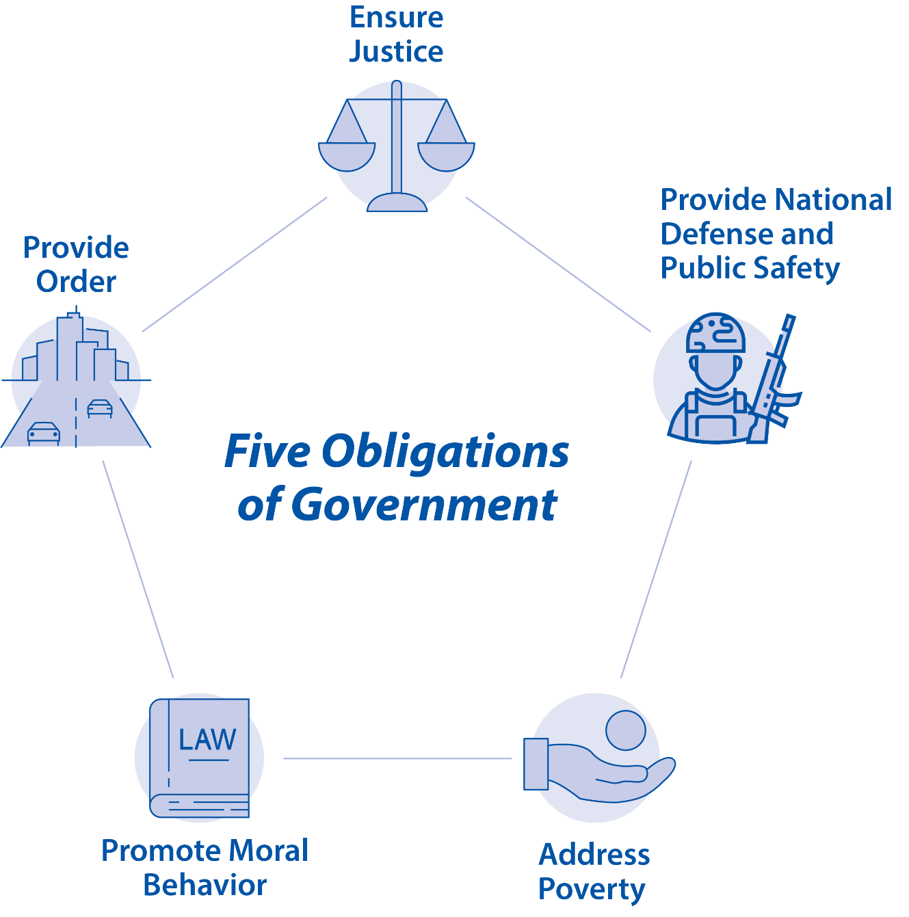
Notes:
BJU Press Art

Slide 21
Section Review – Chapter 1.2
1–5. What are five biblical obligations of government?
to ensure justice, provide national defense and public safety, address poverty, promote moral behavior, and provide order (p. 5)
6. How do governments reward righteousness?
by passing and enforcing laws that encourage people to do right and that remove obstacles to doing good (pp. 6–7)

Slide 22
Section Review – Chapter 1.2
7–8. Should the government punish every wrong action? Why or why not?
No; some sins are internal, and some sins are more appropriately dealt with by other authorities, such as parents, schools, or employers. (p. 7)
9. Summarize how government should address poverty.
Government should address poverty in a manner that doesn’t reward people for not working. (p. 8)

Slide 23
Section Review – Chapter 1.2
10–11. Should governments legislate morality? Explain.
Yes, because no law can exist in a moral vacuum. If a government is to praise good and punish evil, moral questions cannot be avoided. (p. 8)

Slide 24
Section Review – Chapter 1.2
In addition to the examples in the text, what are other ways governments provide order?

Slide 25
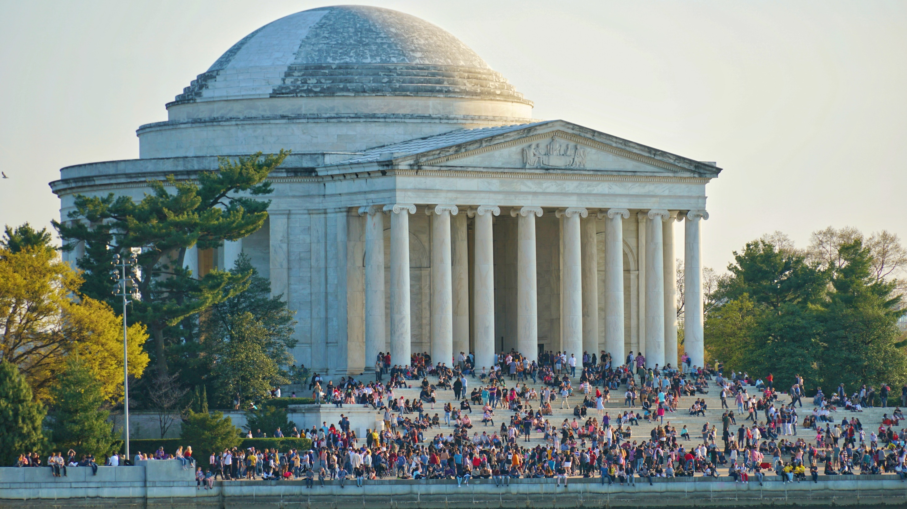
III. The Obligations of the Governed
Chapter 1.3
Notes:
Photo by David Tato on Unsplash
https://unsplash.com/photos/UwaEcIy81qE

Slide 26
A. Prayer
Christians have a duty to pray for their country and its leaders.
We should pray that government officials excel in their duties and be saved if needed.
Notes:
Photo by Ben White on Unsplash
https://unsplash.com/photos/qYanN54gIrI

Slide 27
B. Participation
God wants Christians to participate in government.
We are blessed with a style of government that freely allows believers to be involved.
Notes:
Photo by Element5 Digital on Unsplash
https://unsplash.com/photos/2i7Dn2uMEQE

Slide 28
B. Participation
In order to influence the government for good, believers must be well-educated on the mechanics and operations of the government.
Notes:
Photo by Element5 Digital on Unsplash
https://unsplash.com/photos/2i7Dn2uMEQE

Slide 29
C. Submission
The New Testament repeatedly emphasizes the believer’s obligation to obey their government (1 Peter 2:13–17; Romans 13).
However, when a government requires believers to disobey God’s Word, then believers are obligated to obey God as the higher authority.
Notes:
Photo by Martin Jernberg on Unsplash
https://unsplash.com/photos/Bl9Fvf0xB-0

Slide 30
D. Witness
The New Testament includes several examples of believers witnessing to government officials (Acts 26:22, 27; Phil. 1:13, 4:22).
Christians have a duty to testify to governments about their responsibility before God.
Notes:
Photo by Alexis Brown on Unsplash
https://unsplash.com/photos/omeaHbEFlN4

Slide 31
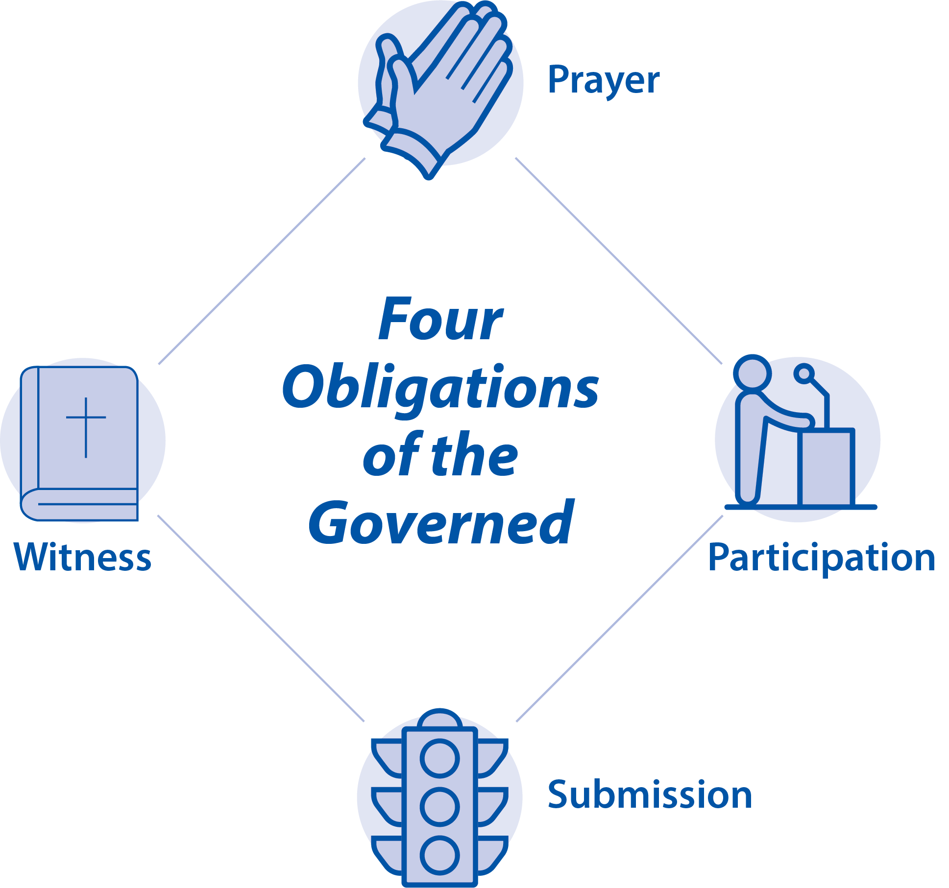
Notes:
BJU Press Art

Slide 32
Section Review – Chapter 1.3
1. Discuss the first duty that a Christian has toward his government.
Christians should pray for it and its leaders, and they should pray that government will permit Christians to pursue holiness in peace; they should also pray for the salvation of government officials. (pp. 9–10)
2. Why should a Christian fear to disobey his government?
because disobedience will cause him to violate his conscience and disobey God (p. 10)

Slide 33
Section Review – Chapter 1.3
3. How should a Christian determine whether to obey a specific command from his government?
He should not obey a law that forces him to disobey a clear biblical command. (p. 11)

Slide 34
Section Review – Chapter 1.3
Why does failure to confront rulers about wrongdoing violate the Great Commission?
If believers fail to confront rulers about rulers’ obligations, then those believers fail to take the gospel to every segment of society.

Slide 35
Section Review – Chapter 1.3
One example of extreme patriotism is given in the text. Discuss it and list other examples.
Nazism in Germany was a twisted and extreme form of patriotism. Its unquestioning support of state was very dangerous. Other instances of extreme patriotism would include many Communist controlled governments and the government of Italy during the rule of Benito Mussolini.

Slide 36
Chapter 1 Terms
Notes:
Photo by Raúl Nájera on Unsplash
https://unsplash.com/photos/TAqspfWom04

Slide 37
government
any system of public rule or authority
Notes:
Photo by Raúl Nájera on Unsplash
https://unsplash.com/photos/TAqspfWom04

Slide 38
image of God
the qualities of humans that reflect God’s own character (reason, moral capacity, spirituality, sociability, and emotion) and enable humans to exercise wise and responsible dominion over God’s world as He commanded
Notes:
Photo by Raúl Nájera on Unsplash
https://unsplash.com/photos/TAqspfWom04

Slide 39
Creation Mandate
God’s command for humans to exercise wise and responsible dominion over His world
Notes:
Photo by Raúl Nájera on Unsplash
https://unsplash.com/photos/TAqspfWom04

Slide 40
human depravity
The result of the marring of God’s image in humans; every part of each human’s being (mind, will, and emotions) has been twisted by his fall into sin.
Notes:
Photo by Raúl Nájera on Unsplash
https://unsplash.com/photos/TAqspfWom04

Slide 41
anarchy
condition in which a state has no functioning government
Notes:
Photo by Raúl Nájera on Unsplash
https://unsplash.com/photos/TAqspfWom04

Slide 42
justice
to ensure justice means that government should encourage people to do right and respect the rights of others
Notes:
Photo by Raúl Nájera on Unsplash
https://unsplash.com/photos/TAqspfWom04

Slide 43
righteousness
conformity to a standard (conformity to the character of the God of the Bible)
Notes:
Photo by Raúl Nájera on Unsplash
https://unsplash.com/photos/TAqspfWom04

Slide 44
patriotism
love and devotion to one’s country and a concern for its social, political, and spiritual welfare
Notes:
Photo by Raúl Nájera on Unsplash
https://unsplash.com/photos/TAqspfWom04

