Slide 1
Chapter 2: Forms of Government
Notes:
WIN-Initiative/Stone/Getty Images

Slide 2
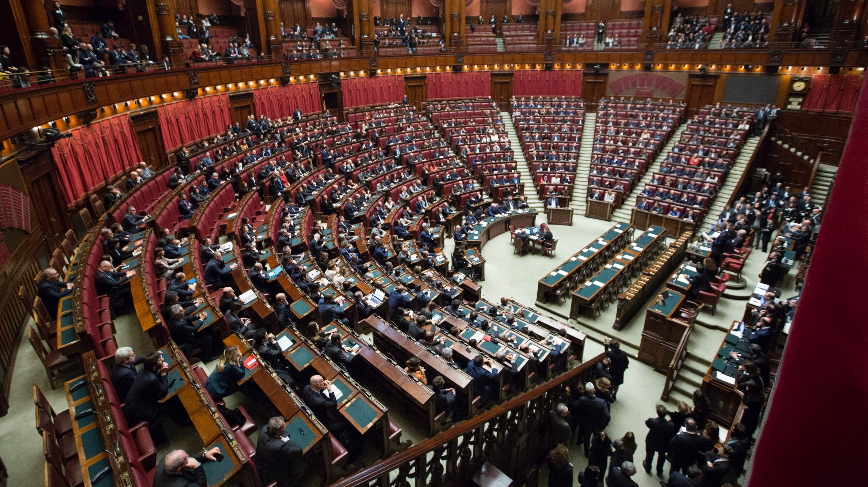
I. Types of Government
Chapter 2.1
Notes:
Photo by Marco Oriolesi on Unsplash
https://unsplash.com/photos/wqLGlhjr6Og

Slide 3
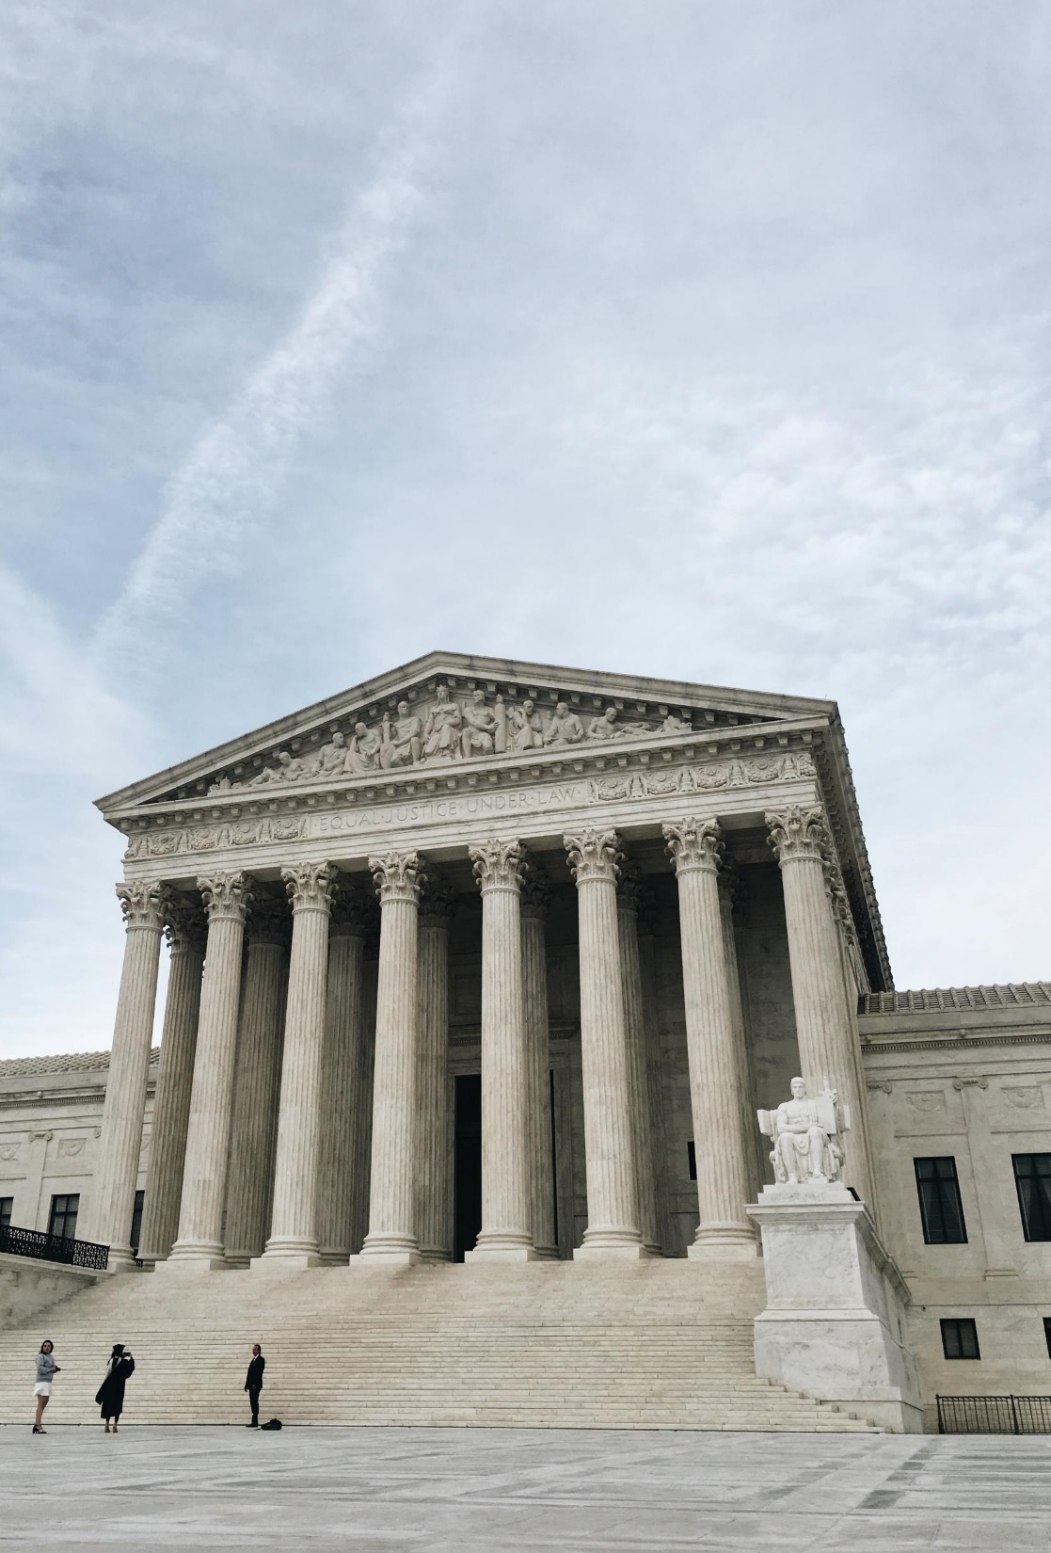
I. Types of Government
To distinguish governments from one another, we will examine the following:
Various systems of government
The relationship between levels of government
The methods used to elect leaders
Notes:
Photo by Anna Sullivan on Unsplash
https://unsplash.com/photos/BBHIPz-gPXs

Slide 4
Systems of Government
Who rules the nation?

Slide 5
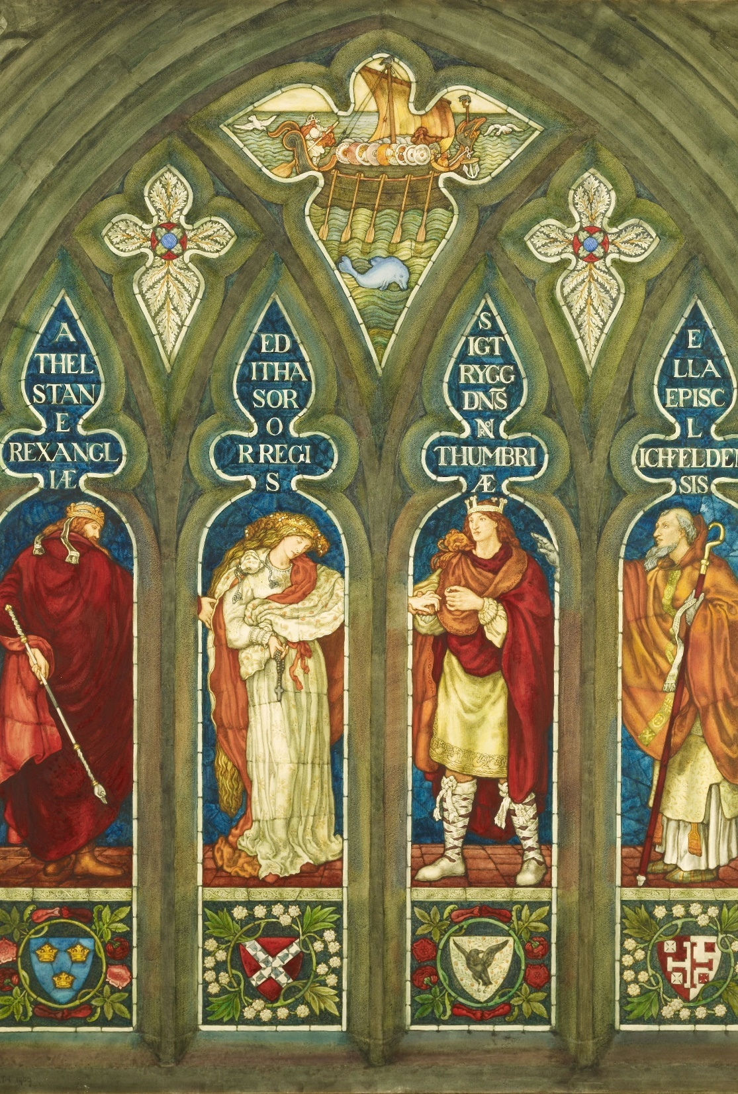
A. Monarchy
A monarchy is a form of government where a single person (king/queen) rules.
It is usually an inherited position.
The monarch rules for life.
The Marriage of Editha with Sigtrygg, King of Northumbria, 1909, Ford Madox Brown
Notes:
Photo by Birmingham Museums Trust on Unsplash
https://unsplash.com/photos/hBqLhp0GUuw
The Marriage of Editha with Sigtrygg, King of Northumbria, 1909, Ford Madox Brown

Slide 6
A. Monarchy
A monarchy is a form of government where a single person (king/queen) rules.
Monarchy was widely popular until the 19th century.
In the past, monarchies often had unchecked power – an absolute monarchy.
The Marriage of Editha with Sigtrygg, King of Northumbria, 1909, Ford Madox Brown
Notes:
Photo by Birmingham Museums Trust on Unsplash
https://unsplash.com/photos/hBqLhp0GUuw
The Marriage of Editha with Sigtrygg, King of Northumbria, 1909, Ford Madox Brown

Slide 7
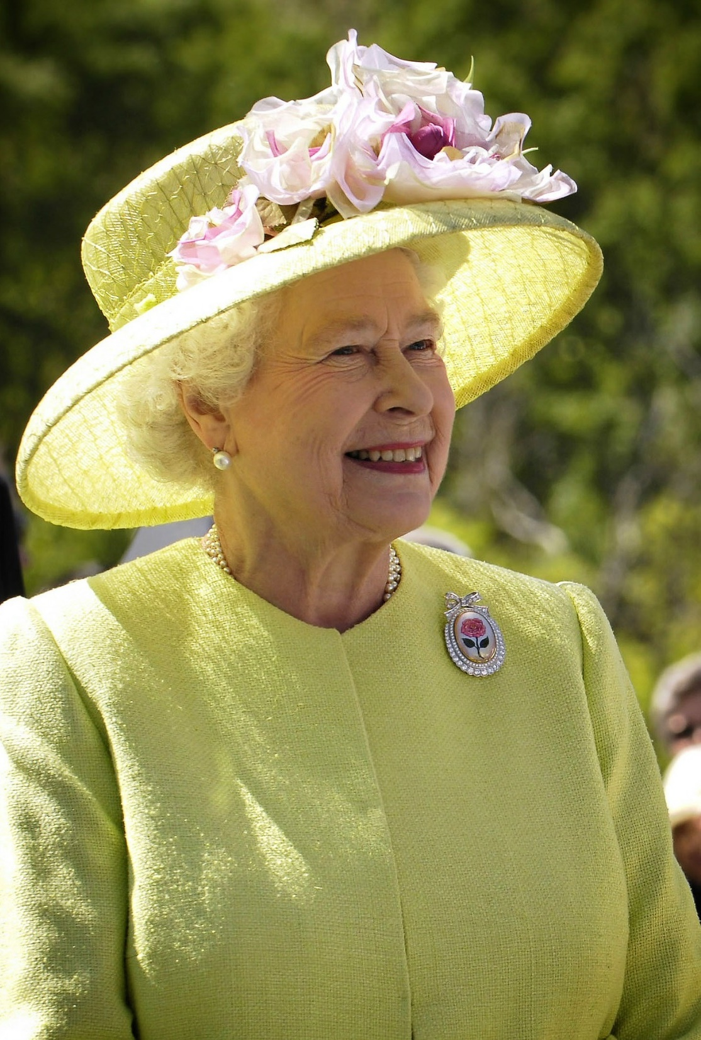
A. Monarchy
Today, most monarchies are constitutional monarchies.
They share power with an elected parliament.
Often, the position is merely ceremonial.
Queen Elizabeth II
Notes:
Image by WikiImages from Pixabay
https://pixabay.com/photos/queen-england-elizabeth-ii-portrait-63006/

Slide 8
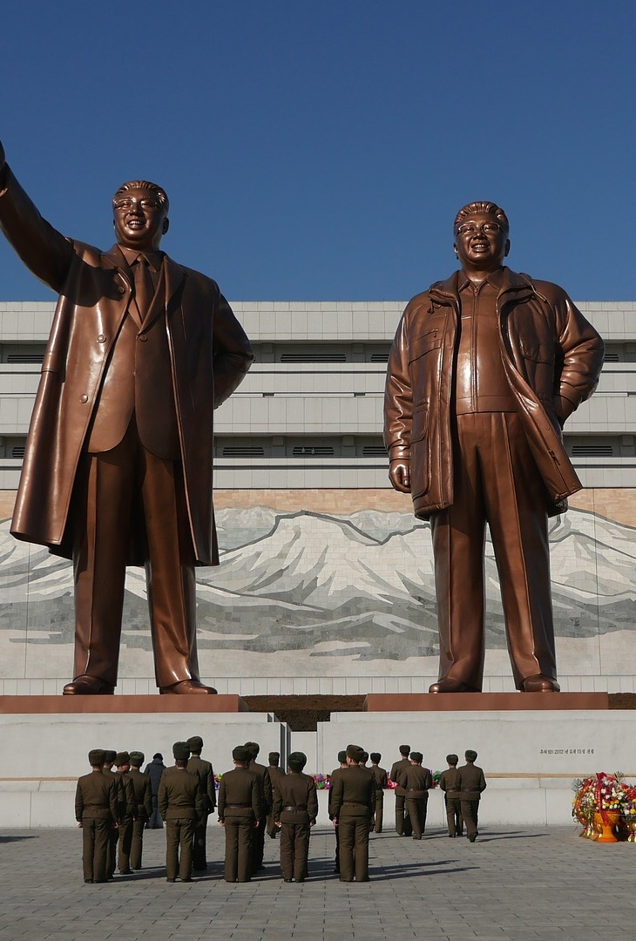
B. Dictatorship
In a dictatorship, the government rules without the consent of the people.
These types of government often seek to control their people’s lives – totalitarianism.
Unlike monarchies, dictatorships are usually non-hereditary.
Pyongyang, North Korea
Notes:
Image by Alex_Berlin from Pixabay
https://pixabay.com/photos/north-korea-pyongyang-bronze-3340884/

Slide 9
B. Dictatorship
In a dictatorship, the government rules without the consent of the people.
In an autocratic dictatorship, a single person rules with unchecked power.
In an oligarchic dictatorship, an elite group rules the nation.
Pyongyang, North Korea
Notes:
Image by Alex_Berlin from Pixabay
https://pixabay.com/photos/north-korea-pyongyang-bronze-3340884/

Slide 10
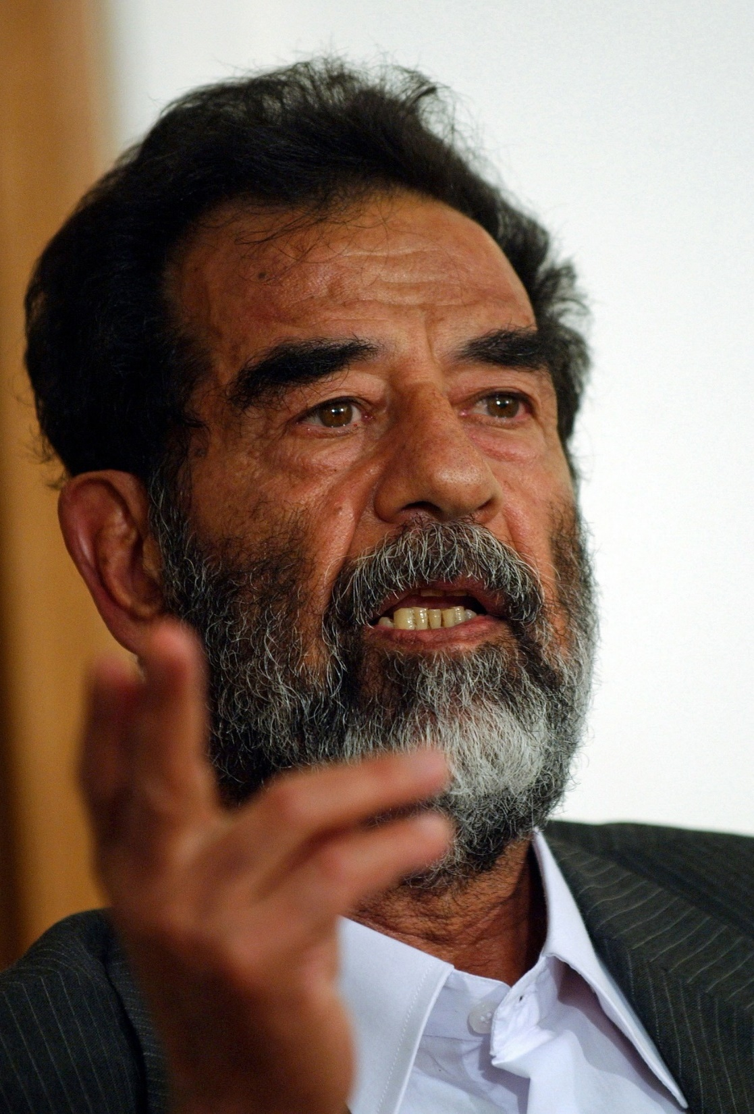
B. Dictatorship
Dictatorships are usually maintained through military force and fear.
Examples:
Adolf Hitler – Germany
Joseph Stalin – Soviet Union
Saddam Hussein – Iraq
Saddam Hussein
Notes:
Image by WikiImages from Pixabay
https://pixabay.com/photos/iraq-dictator-president-67653/

Slide 11
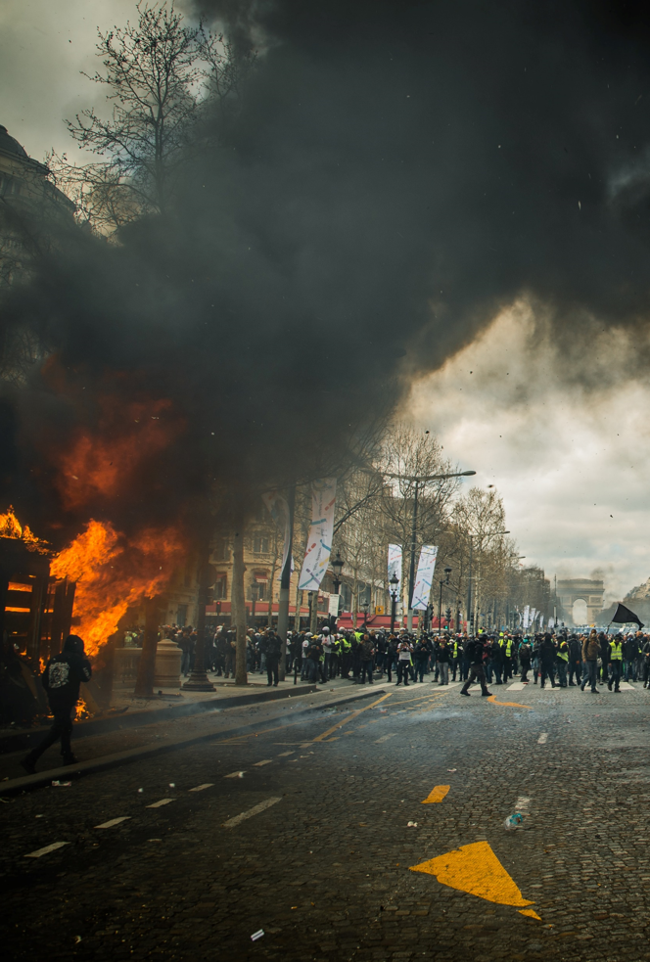
C. Anarchy
Anarchy is the absence of government.
To an anarchist, people do not need government in order to live peacefully.
Anarchists ignore the inherent sinful nature of mankind.
Notes:
Photo by Randy Colas on Unsplash
https://unsplash.com/photos/T1u5YP4blL4

Slide 12
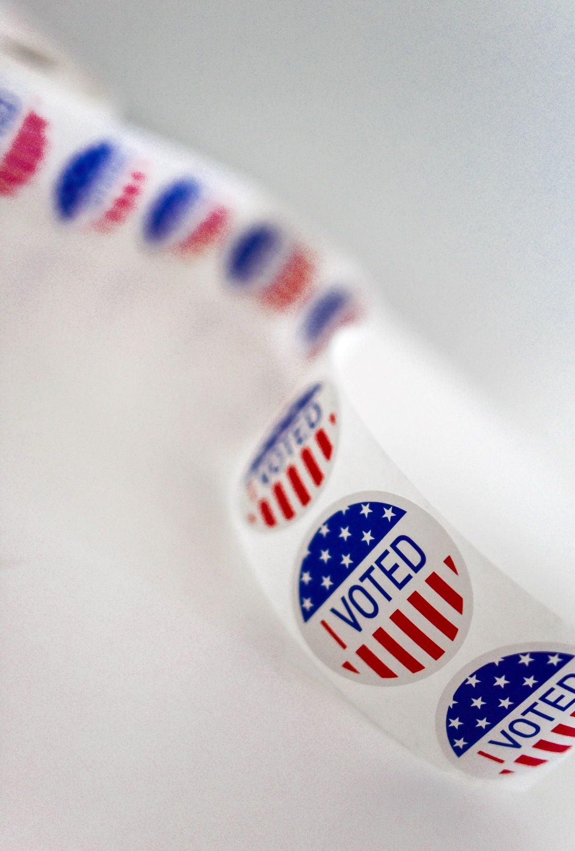
D. Popular Governments
A popular government is a system that allows the people to participate in managing the country.
There are two types of popular governments:
Democracy
Republic
Notes:
Photo by Element5 Digital on Unsplash
https://unsplash.com/photos/2i7Dn2uMEQE

Slide 13
D. Popular Governments
Democracy means that the people are the ultimate authority of the country.
In a direct democracy, the people run the government through regular assemblies.
In an indirect democracy, the people elect representatives to run the country for them.
Notes:
Photo by Element5 Digital on Unsplash
https://unsplash.com/photos/T9CXBZLUvic

Slide 14
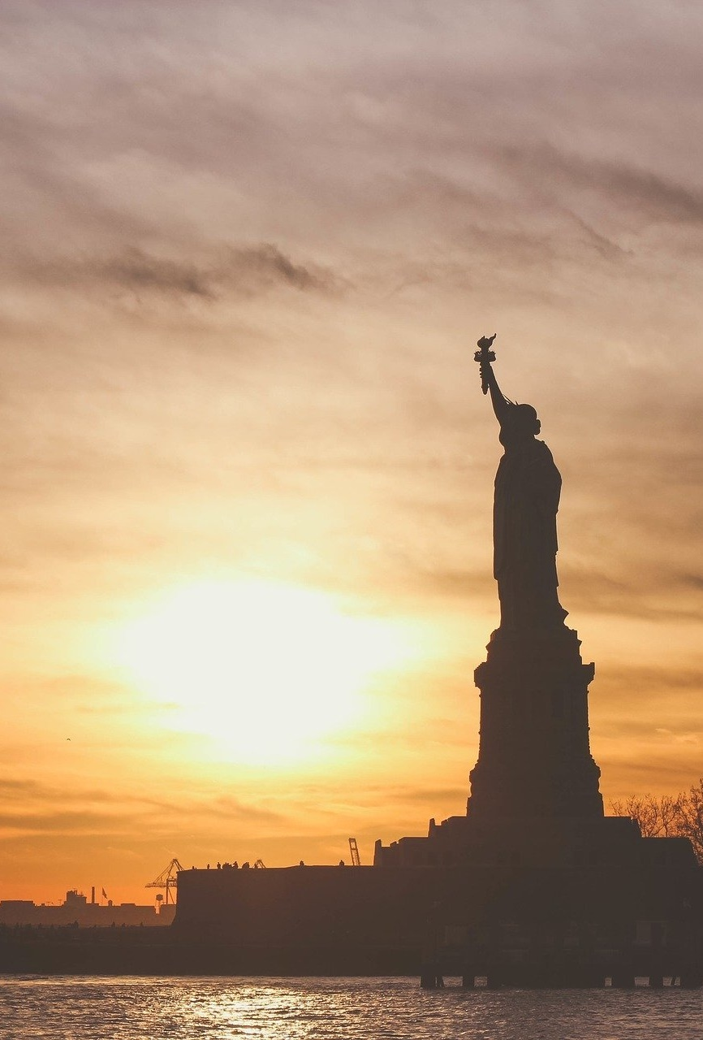
D. Popular Governments
In a republic, the people elect representatives to manage the country according to a written law – “constitutional republic.”
The United States can be described as a “democratic republic.”
Notes:
Image by Free-Photos from Pixabay
https://pixabay.com/photos/statue-of-liberty-landmark-liberty-1210001/

Slide 15
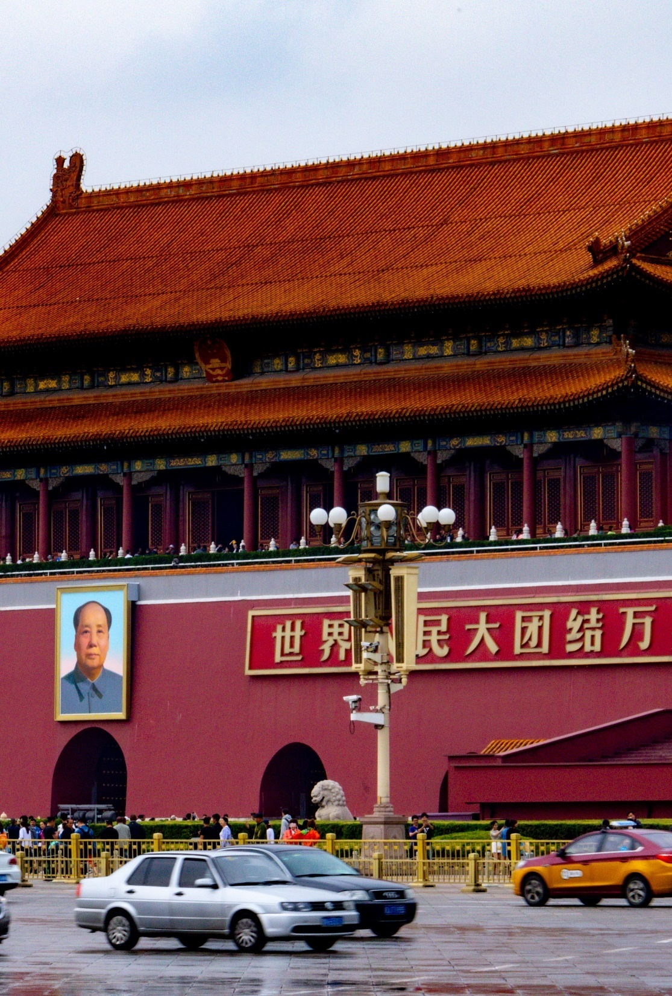
D. Popular Governments
Some nations use terms like “democratic” or “republic” in their government’s name, but don’t hold to those values.
Beijing, China
Notes:
Photo by Nick Fewings on Unsplash
https://unsplash.com/photos/zqwV28pcUTg

Slide 16
D. Popular Governments
Examples:
The Union of Soviet Socialist Republics (USSR)
The People’s Republic of China
The Democratic People’s Republic of Korea (North Korea)
Beijing, China
Notes:
Photo by Nick Fewings on Unsplash
https://unsplash.com/photos/zqwV28pcUTg

Slide 17
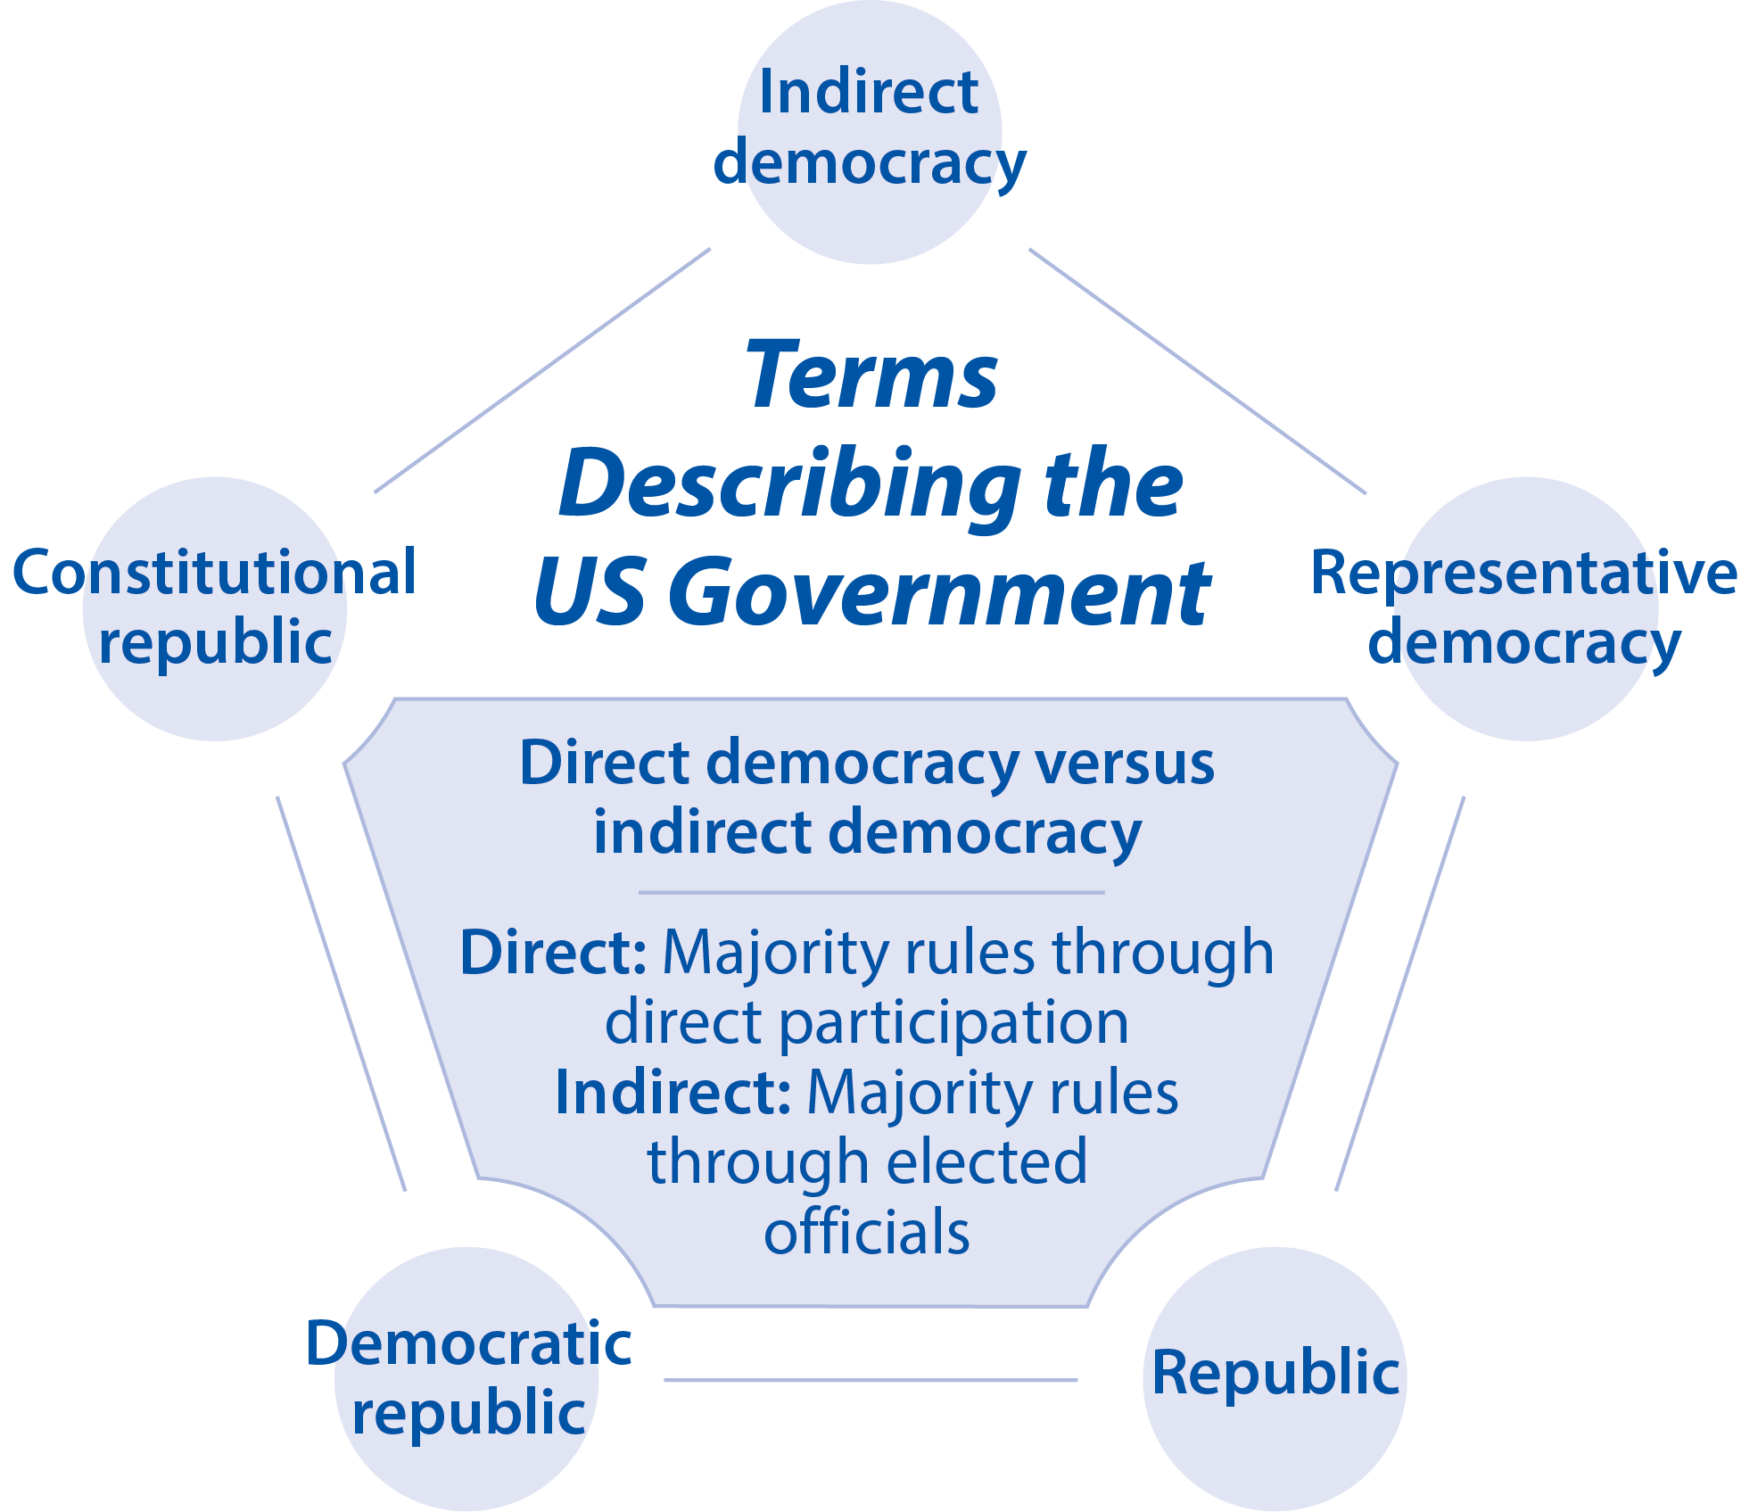

Slide 18
Relationships Between Levels of Government
How is power shared between different levels of government?

Slide 19
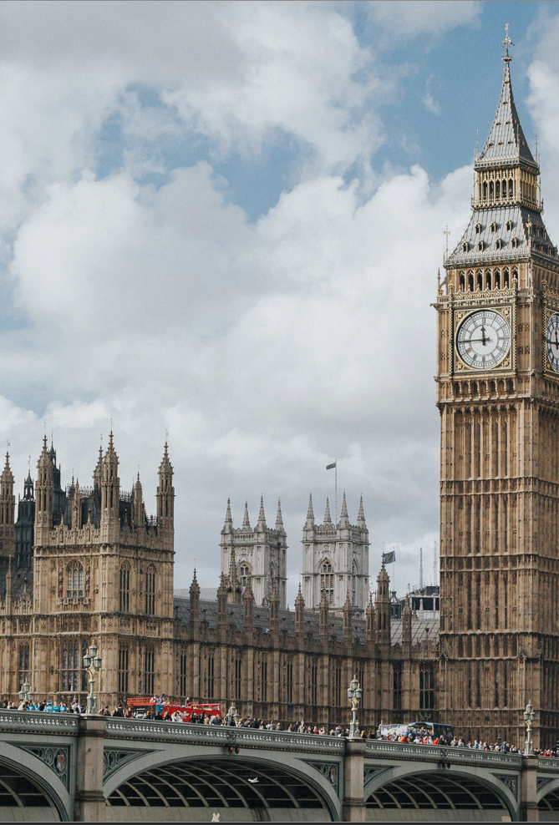
A. Unitary Governments
In a unitary system, the people completely invest their authority in a central government.
The central government can then create lower levels of government.
These lower levels are subordinate to the central government and can be disbanded at any time.
Big Ben, London
Notes:
Photo by Marcin Nowak on Unsplash
https://unsplash.com/photos/iXqTqC-f6jI

Slide 20
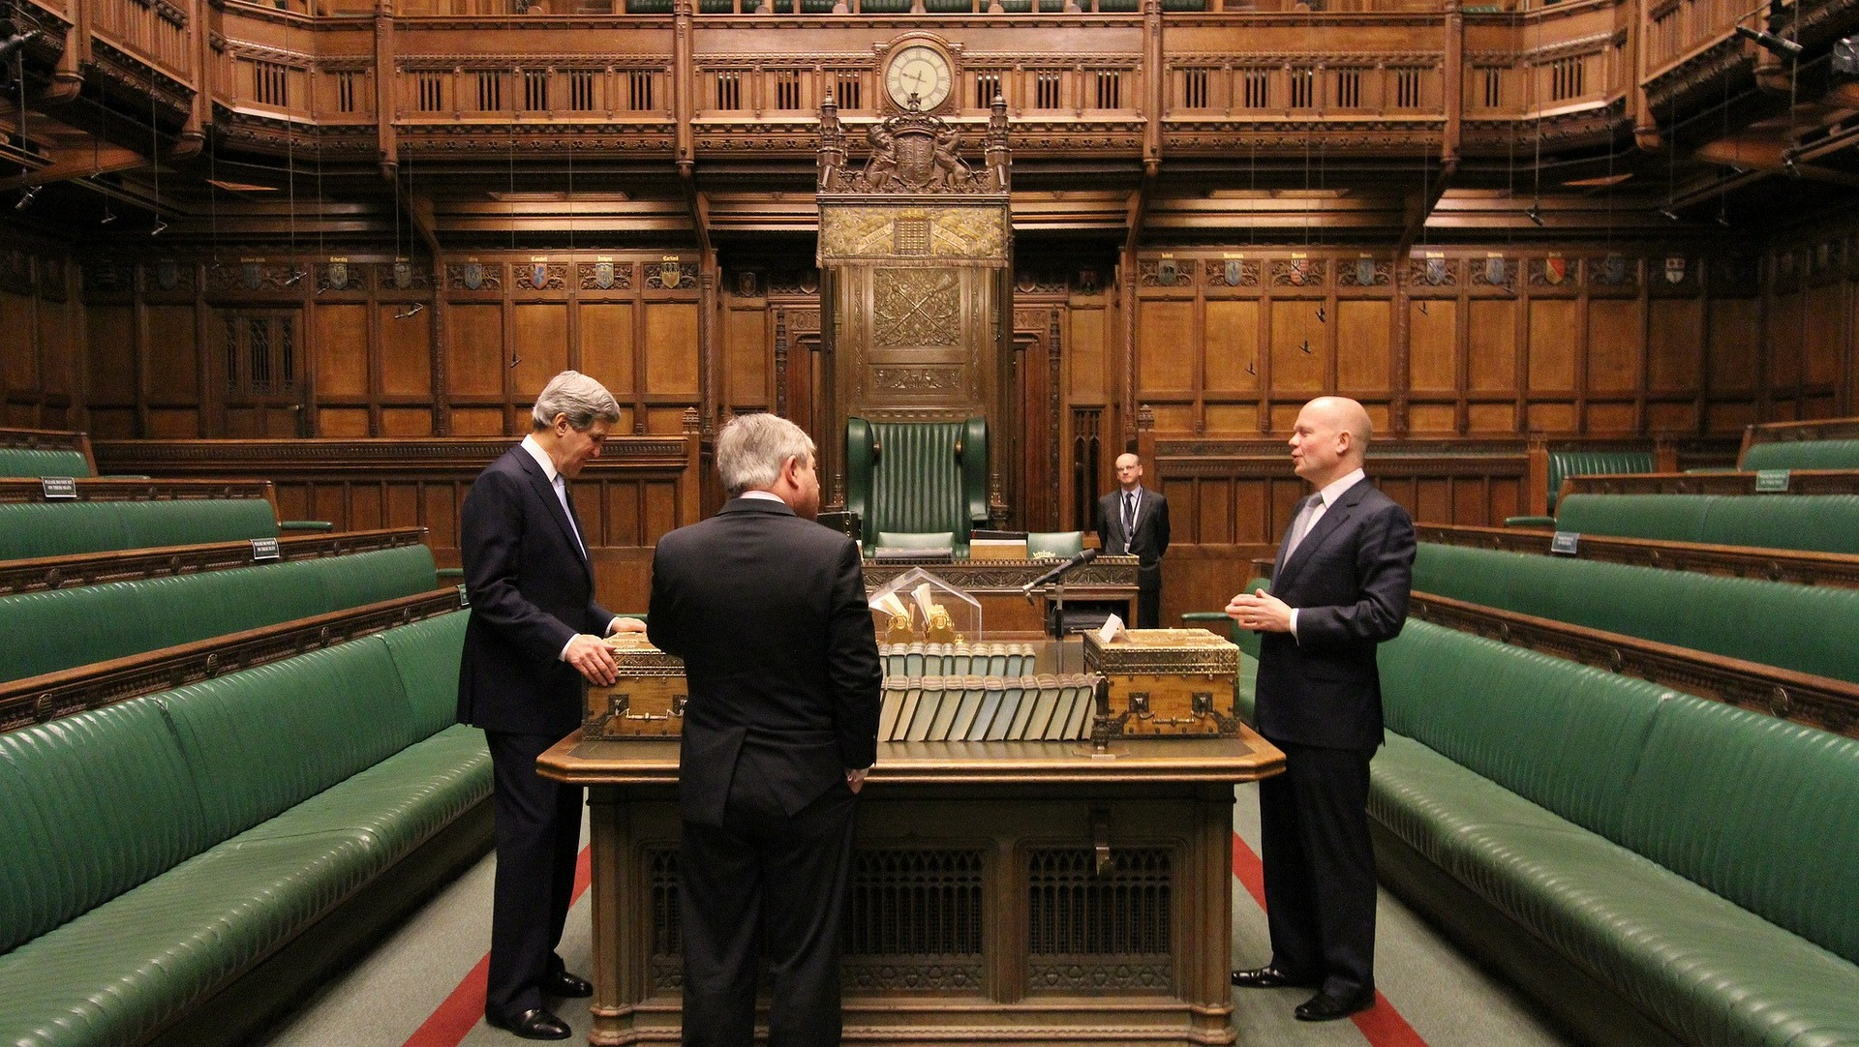
The British House of Commons
Notes:
Image by David Mark from Pixabay
https://pixabay.com/photos/london-england-great-britain-90782/

Slide 21
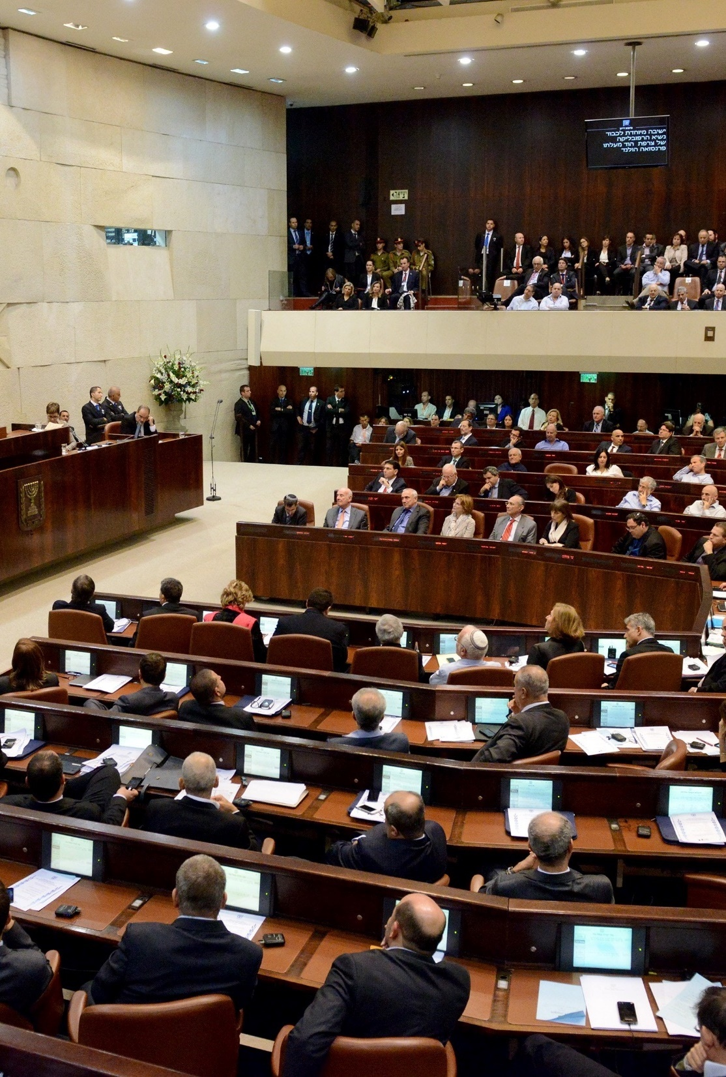
A. Unitary Governments
Examples:
Great Britain
France
Japan
Israel
The Knesset, Israel
Notes:
Photo by Rafael Nir on Unsplash
https://unsplash.com/photos/dtP89KBWrxE

Slide 22
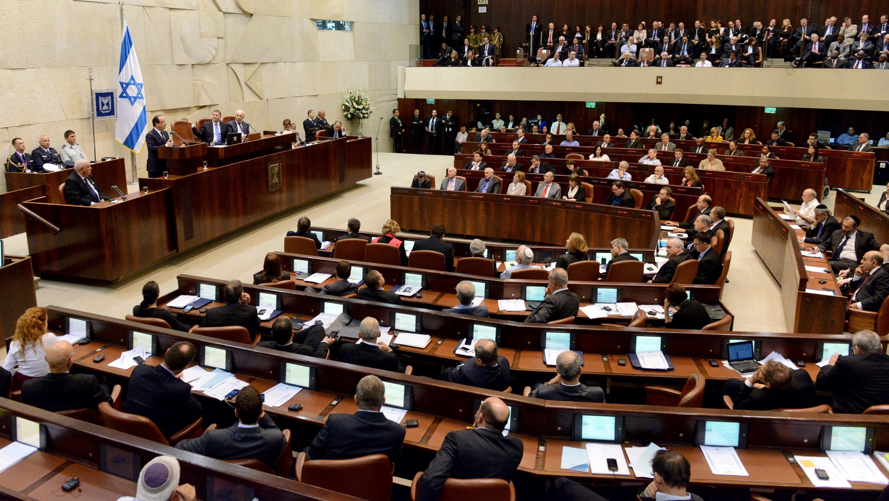
Notes:
Photo by Rafael Nir on Unsplash
https://unsplash.com/photos/dtP89KBWrxE

Slide 23
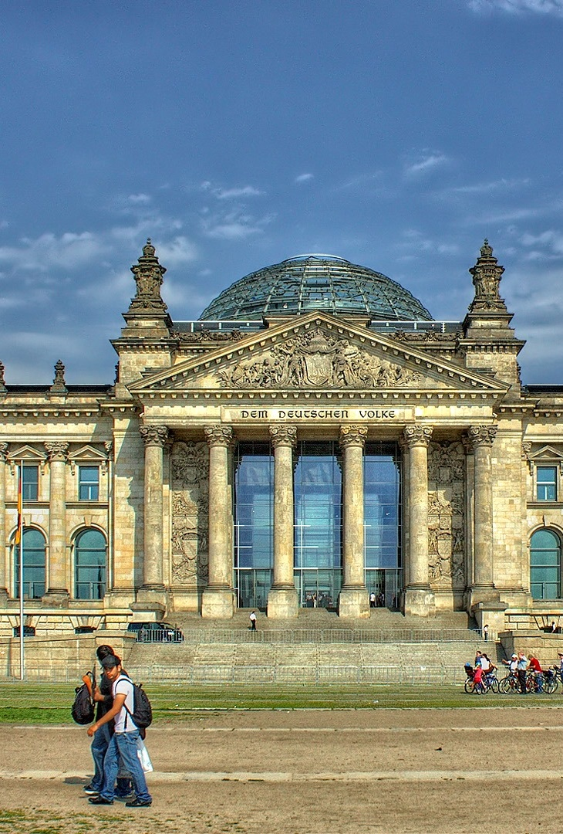
B. Federal Governments
In a federalist system, the nation’s power is split between national and regional governments.
Each level of government may have more authority than other levels in specific areas.
The Reichstag, Germany
Notes:
Image by Peter Dargatz from Pixabay
https://pixabay.com/photos/berlin-reichstag-government-51058/

Slide 24
B. Federal Governments
The federalist system is good for hindering tyranny but is less efficient than other systems.
The Reichstag, Germany
Notes:
Image by Peter Dargatz from Pixabay
https://pixabay.com/photos/berlin-reichstag-government-51058/

Slide 25
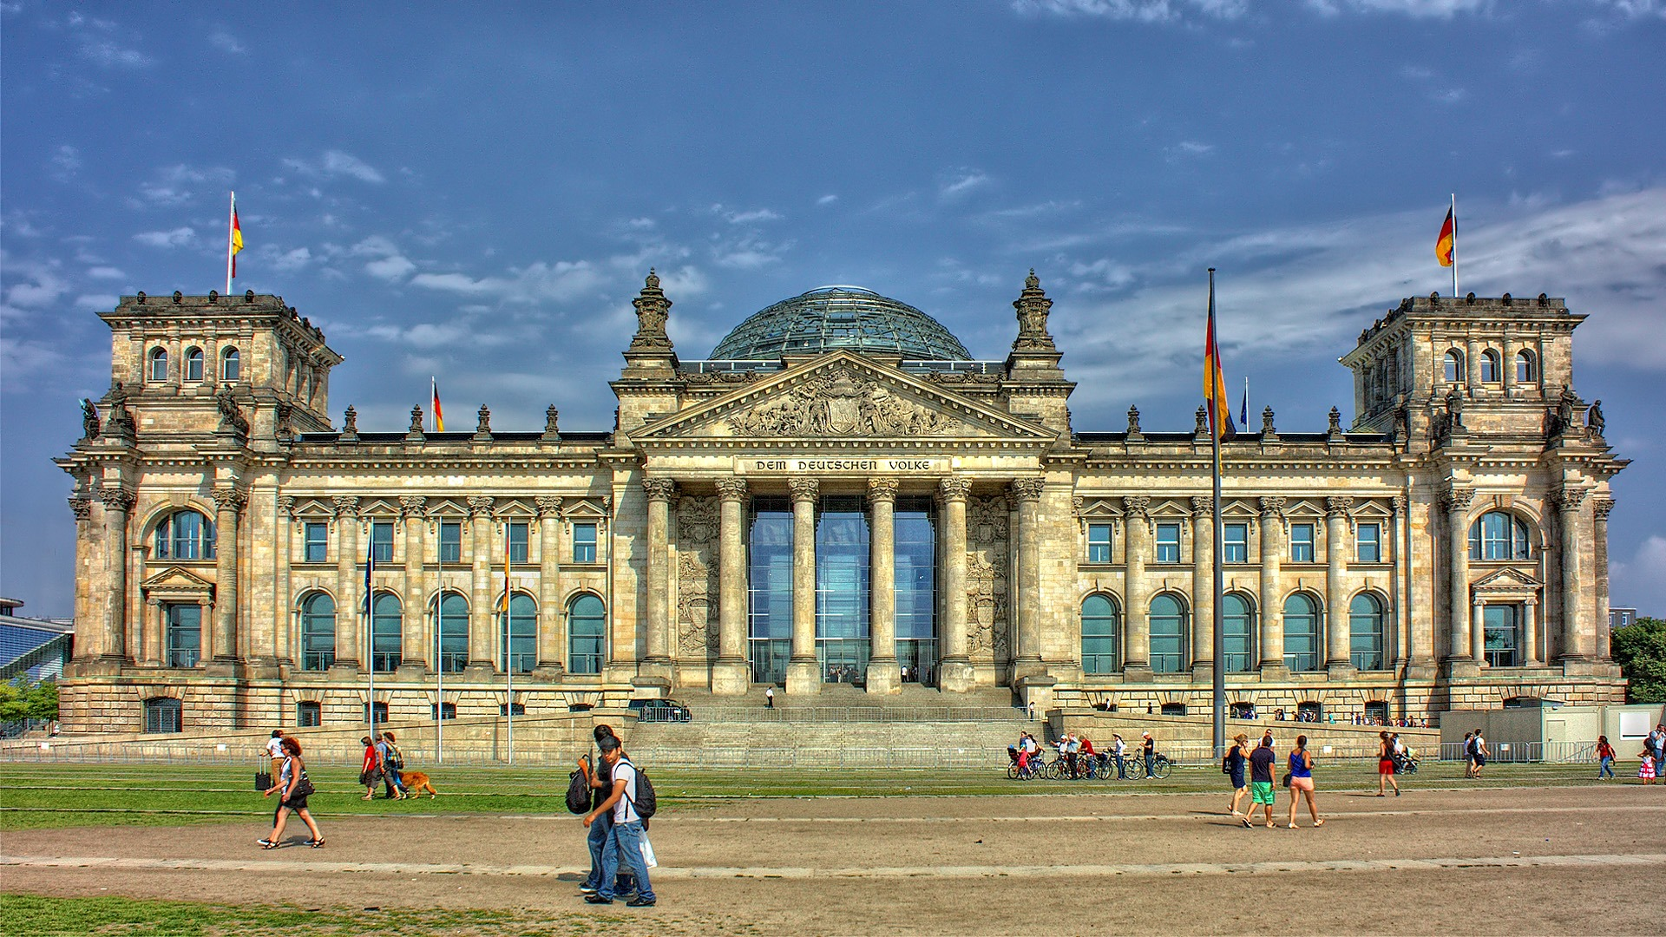
The Reichstag, Germany
Notes:
Image by Peter Dargatz from Pixabay
https://pixabay.com/photos/berlin-reichstag-government-51058/

Slide 26
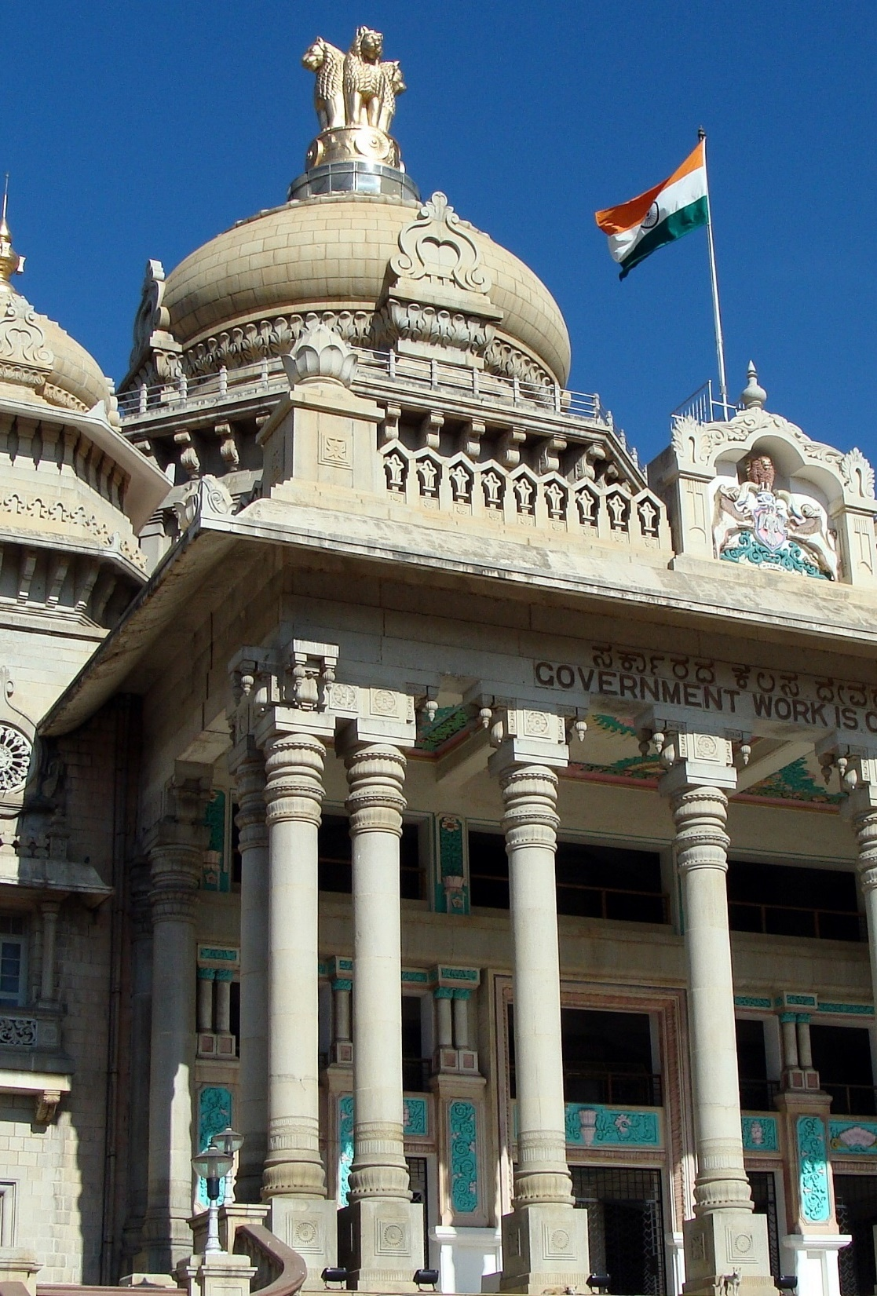
B. Federal Governments
Examples:
United States
Brazil
Germany
India
Bangalore, India
Notes:
Image by Bishnu Sarangi from Pixabay
https://pixabay.com/photos/vikasa-soudha-vidhana-soudha-245035/

Slide 27
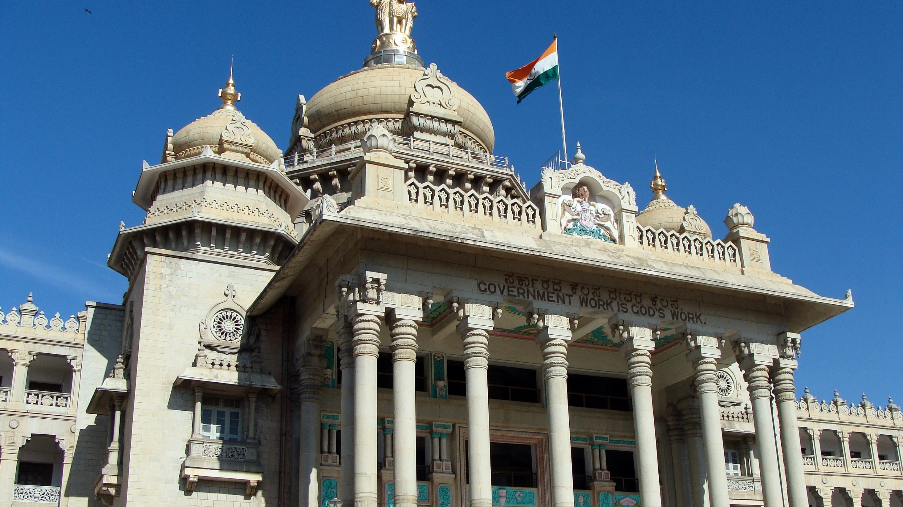
The Vidhana Soudha, state legislature of Karnataka
Notes:
Image by Bishnu Sarangi from Pixabay
https://pixabay.com/photos/vikasa-soudha-vidhana-soudha-245035/

Slide 28
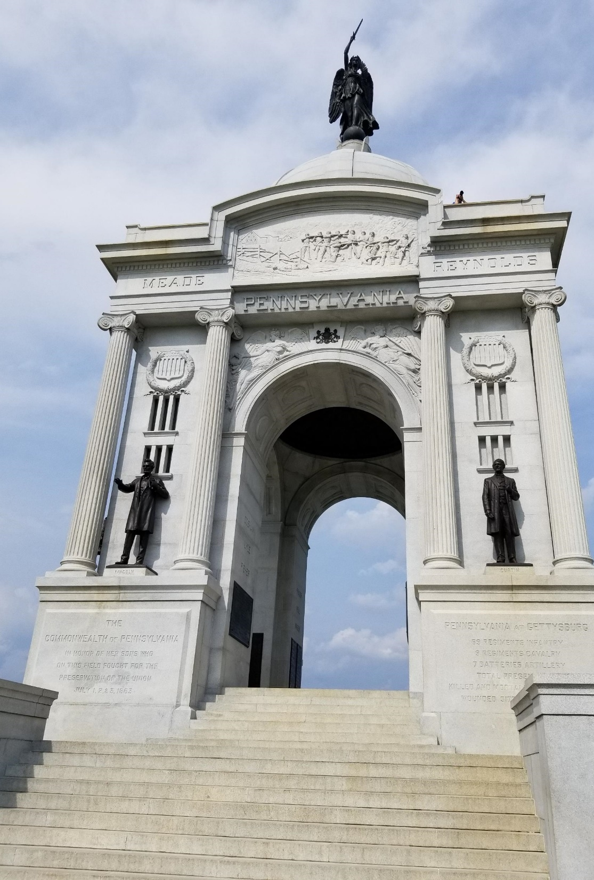
C. Confederate Governments
In a confederate government, the regional governments have more authority than the national government.
The national government is only allowed to do what the regional governments delegate to it.
A U.S. Civil War monument
Notes:
Image by Ric Foster from Pixabay
https://pixabay.com/photos/civil-war-monument-memorial-war-3389157/

Slide 29
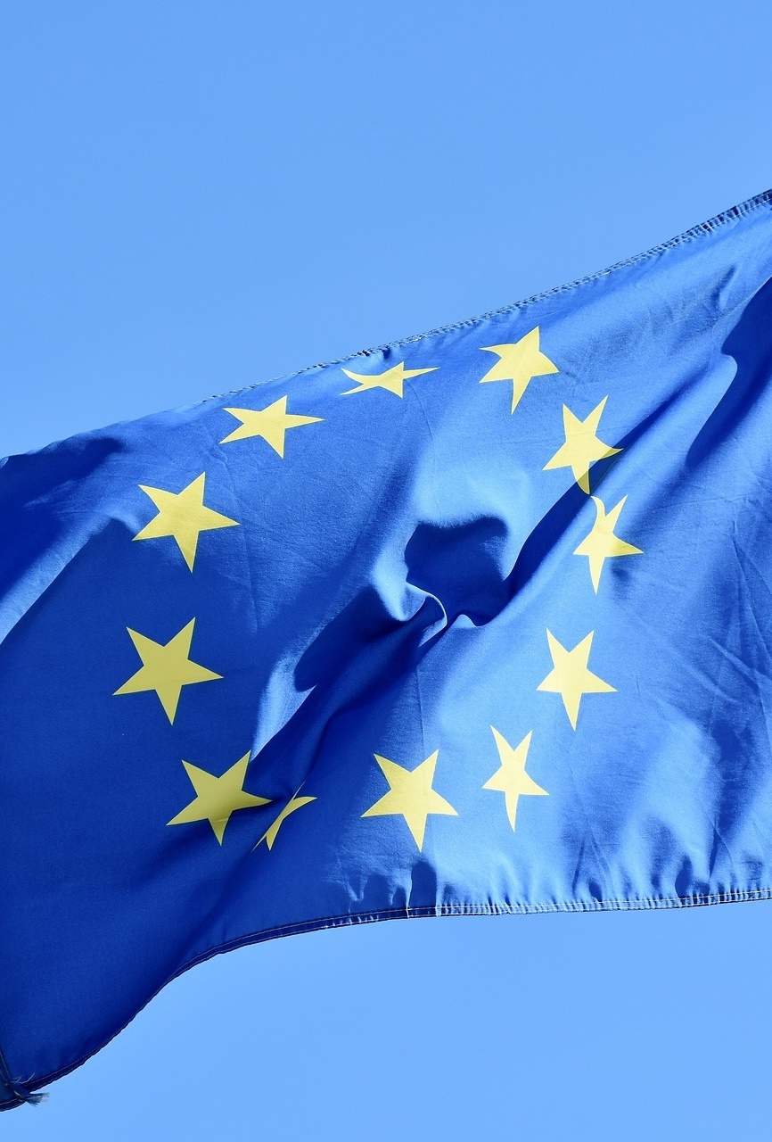
C. Confederate Governments
Examples:
US under the Articles of Confederation
Confederate States of America
European Union
The European Union flag
Notes:
Image by Capri23auto from Pixabay
https://pixabay.com/photos/flag-europe-europe-flag-eu-flag-3370970/

Slide 30
Electing the Chief Executive
How is the nation’s leader chosen?

Slide 31
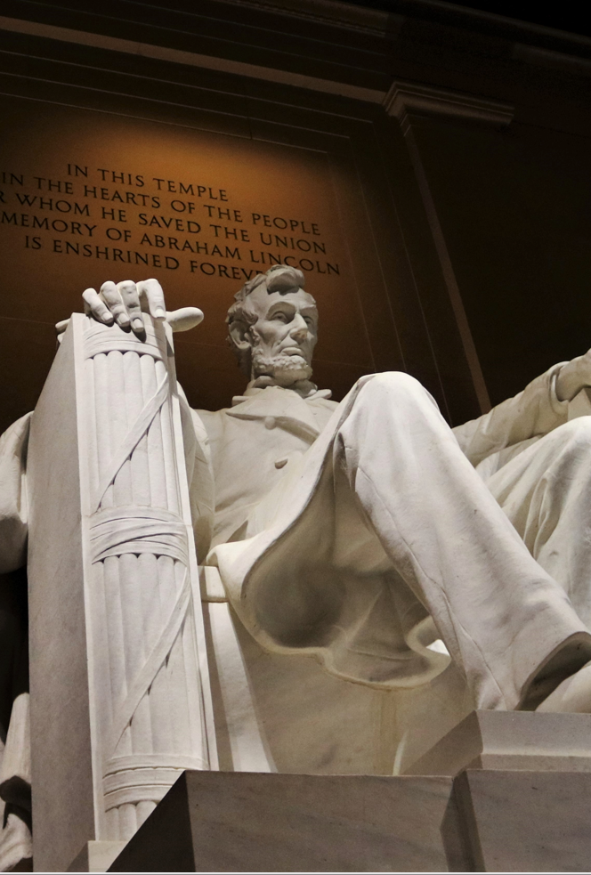
A. Presidential System
In a presidential system, the people elect the chief executive separately from the legislature.
The executive has more power in this system but is more accountable to the people.
Notes:
Photo by Kelli Dougal on Unsplash
https://unsplash.com/photos/vbiQ_7vwfrs

Slide 32
Notes:
BJU Press Art

Slide 33
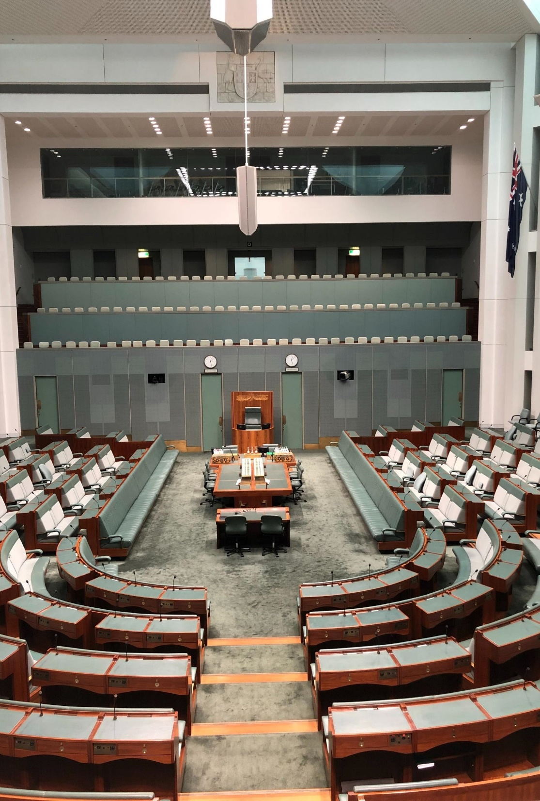
B. Parliamentary System
In a parliamentary system, the legislature and executive are elected together.
The party that wins the most seats in the parliament can appoint one of its members to become the executive.
Canberra, Australia
Notes:
Photo by Jeff Sundstrom on Unsplash
https://unsplash.com/photos/4F9_Ze9RpTk

Slide 34
B. Parliamentary System
This system is far more common than the presidential system.
Canberra, Australia
Notes:
Photo by Jeff Sundstrom on Unsplash
https://unsplash.com/photos/4F9_Ze9RpTk

Slide 35
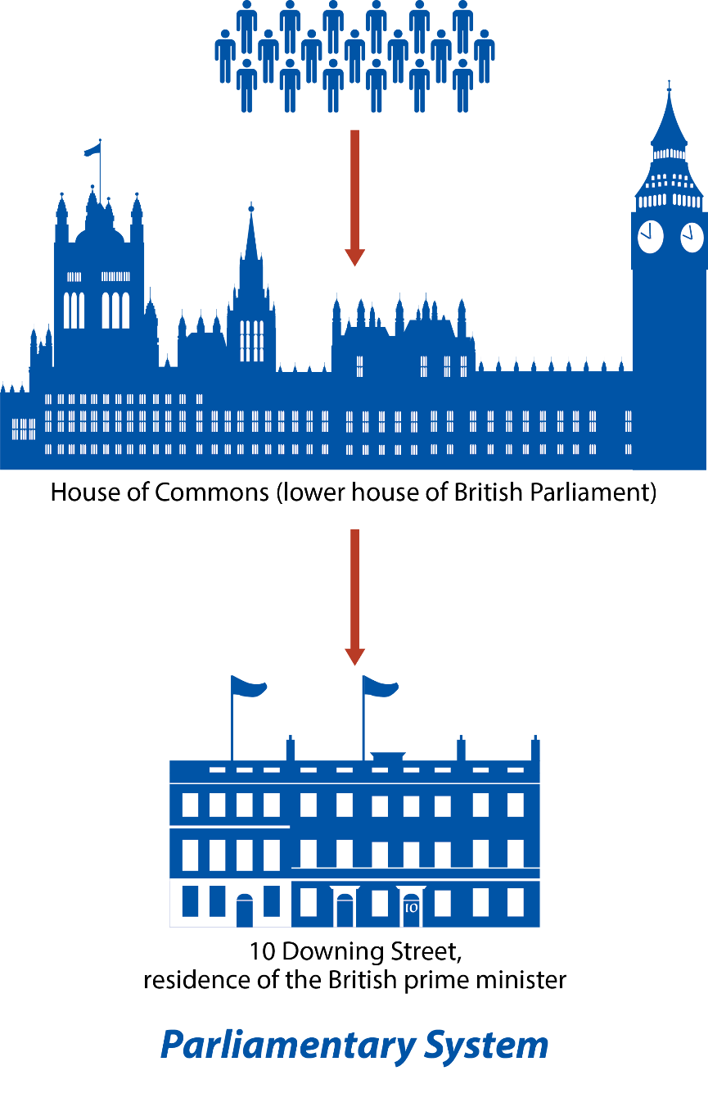
Notes:
BJU Press Art

Slide 36
Section Review – Chapter 2.1
1–3. What three broad categories are used to classify governments?
systems of government, relationship between government levels, and methods of electing an executive (pp. 17–20)
4. On what do dictatorships usually rely for power?
Dictators rely on fear imposed by military or police power. (p. 16)

Slide 37
Section Review – Chapter 2.1
5–9. Identify five terms used in this section to describe the US government.
democratic republic, constitutional republic, indirect democracy, representative democracy, and republic (p. 18)
10. Who chooses the executive head in the parliamentary system?
the majority party in parliament (p. 20)

Slide 38
Section Review – Chapter 2.1
How do a pure democracy and an indirect democracy differ?
A pure democracy allows every citizen to directly participate, but in a republic the people elect representatives to run the government.
Which do you think is better – a parliamentary system or a presidential system? Why?

Slide 39
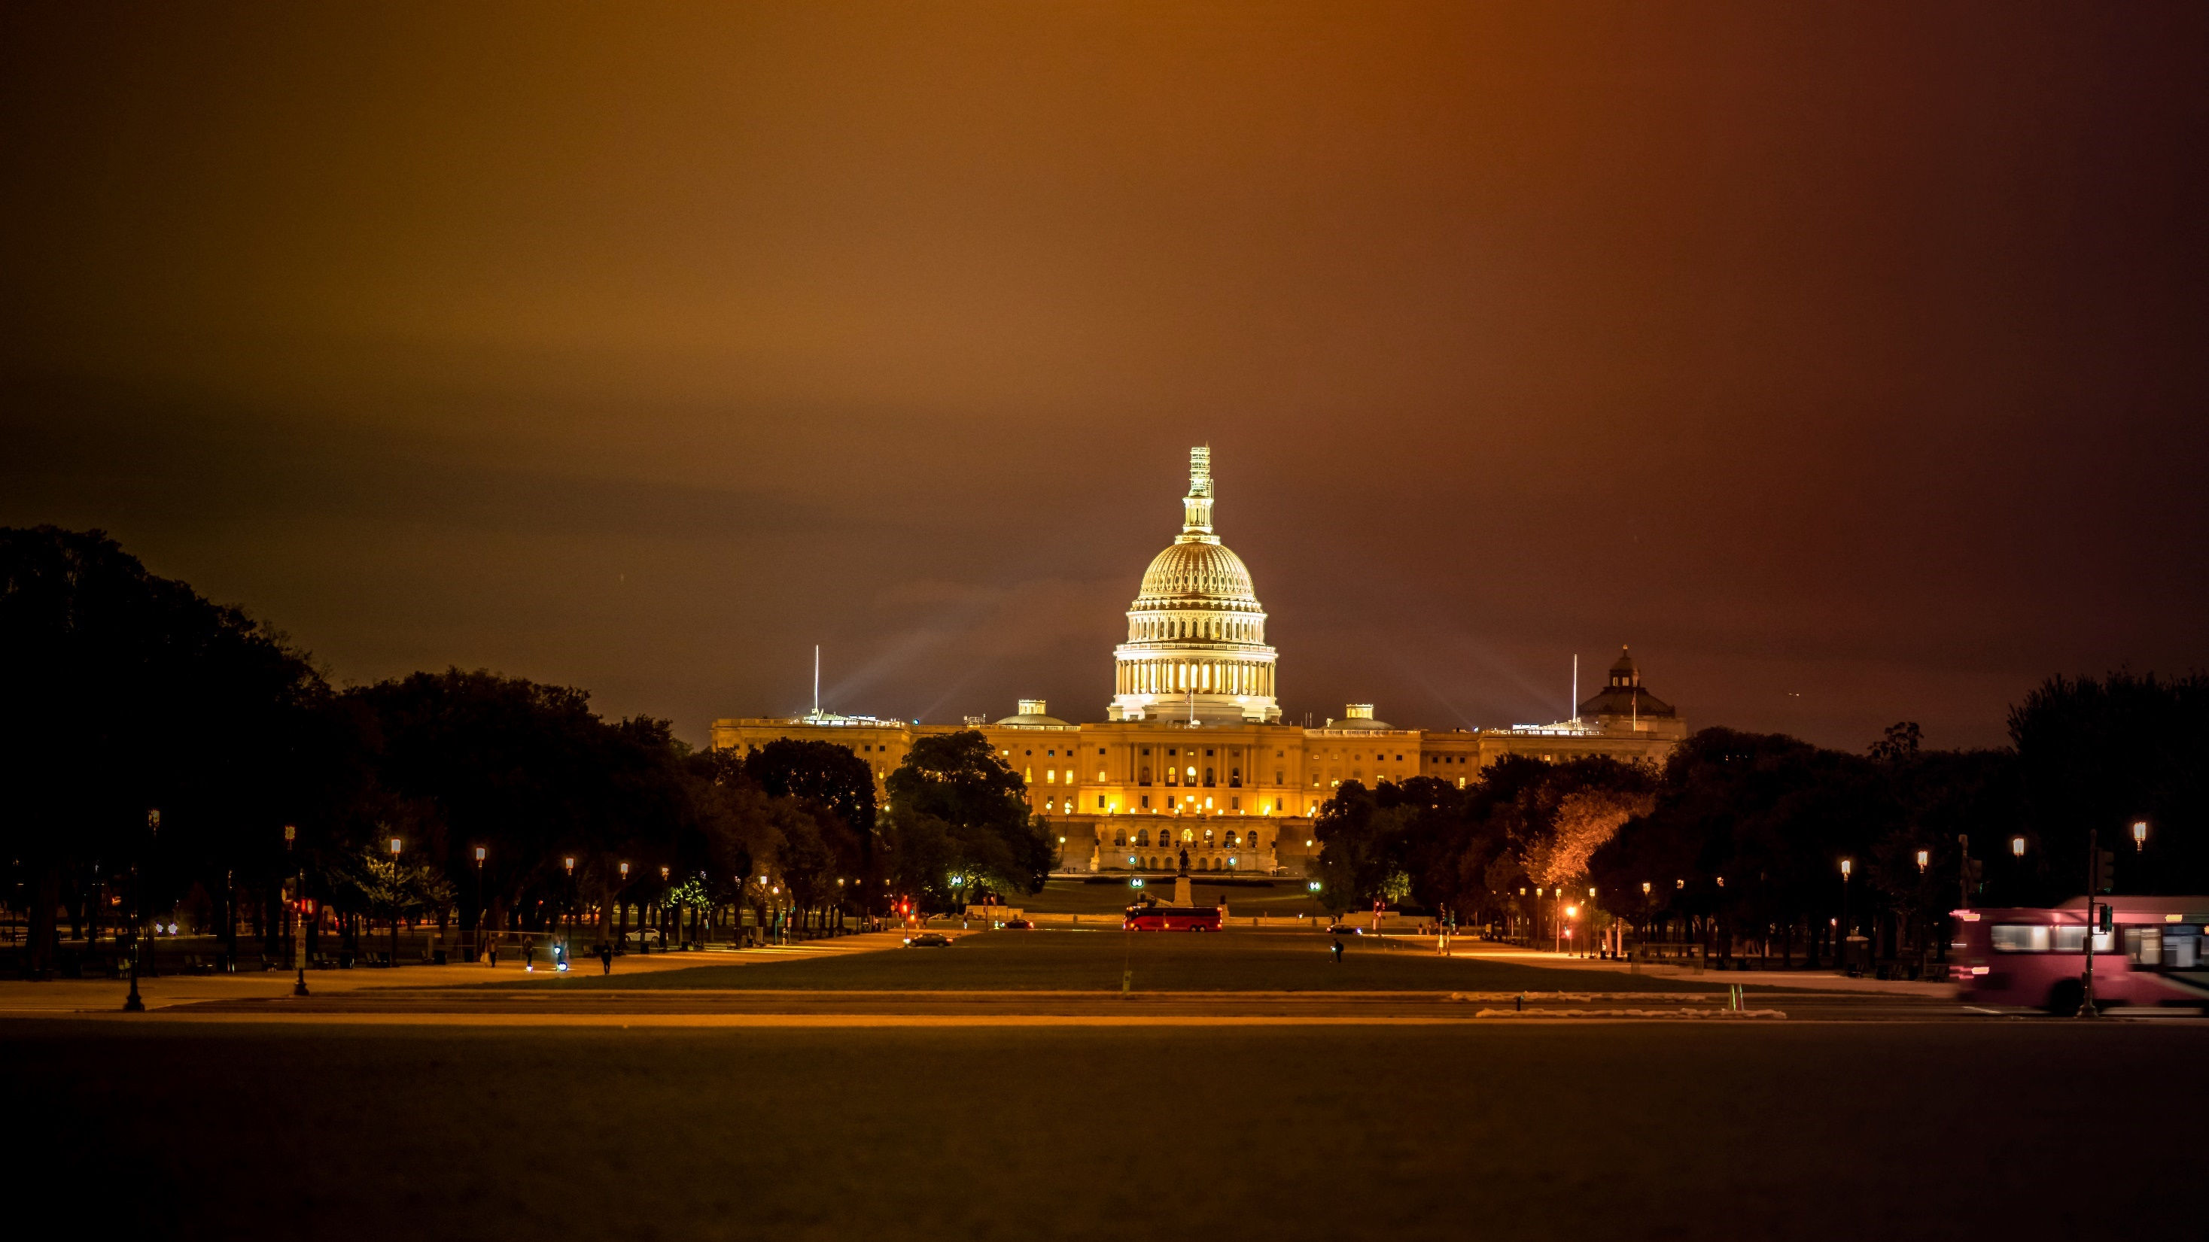
II. American Government
Chapter 2.2
Notes:
Photo by Marco Oriolesi on Unsplash
https://unsplash.com/photos/wqLGlhjr6Og

Slide 40
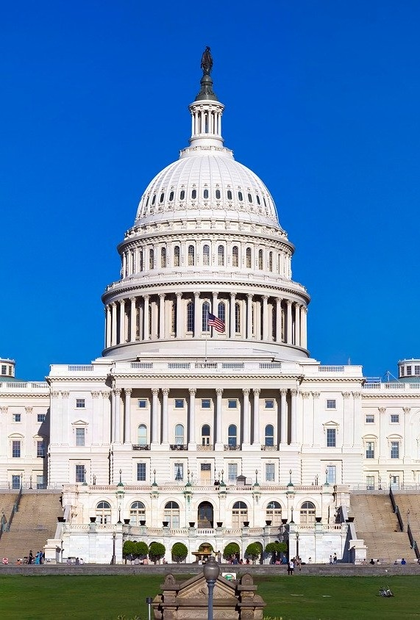
A. National Government
The Constitution assigns specific powers to the national government called delegated powers.
The national government is divided into three branches – legislative, executive, and judicial.
The Capitol Building
Notes:
Photo by Caleb Fisher on Unsplash
https://unsplash.com/photos/x4YxkJ2N1SU

Slide 41
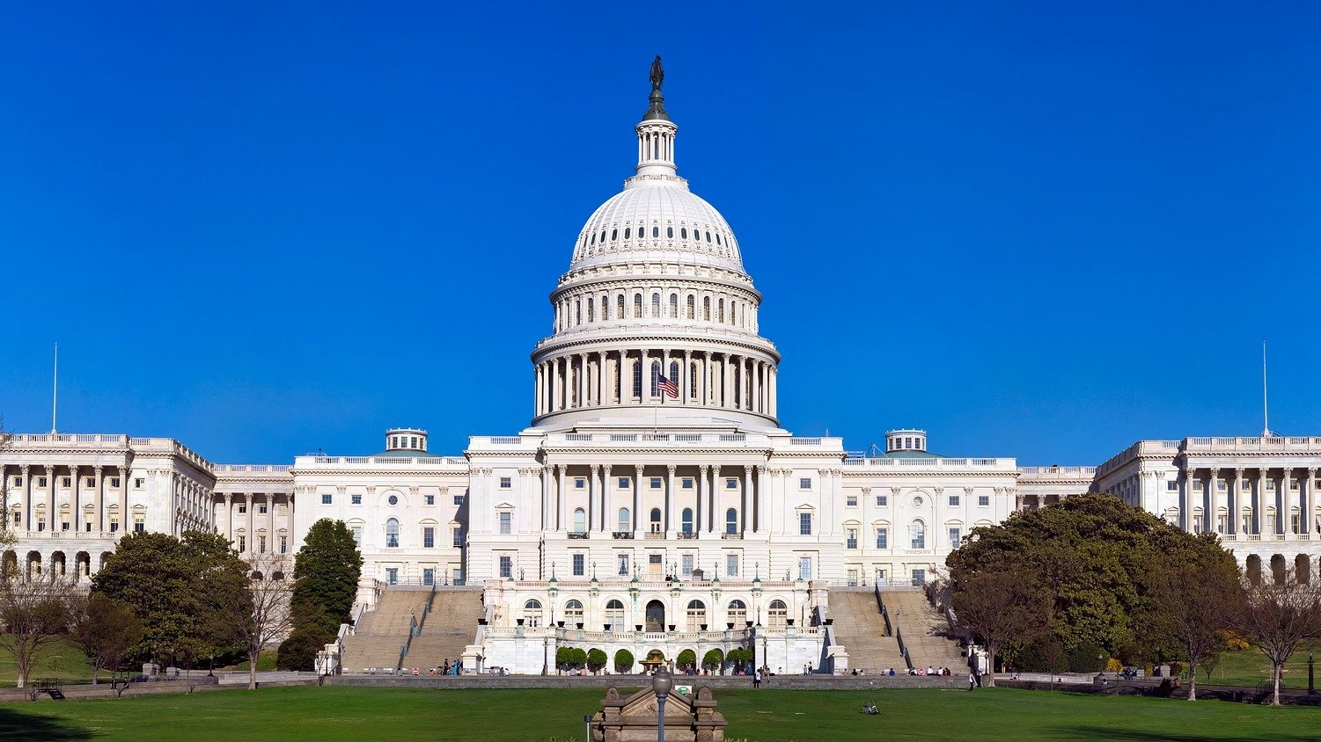
Notes:
Photo by Caleb Fisher on Unsplash
https://unsplash.com/photos/x4YxkJ2N1SU

Slide 42
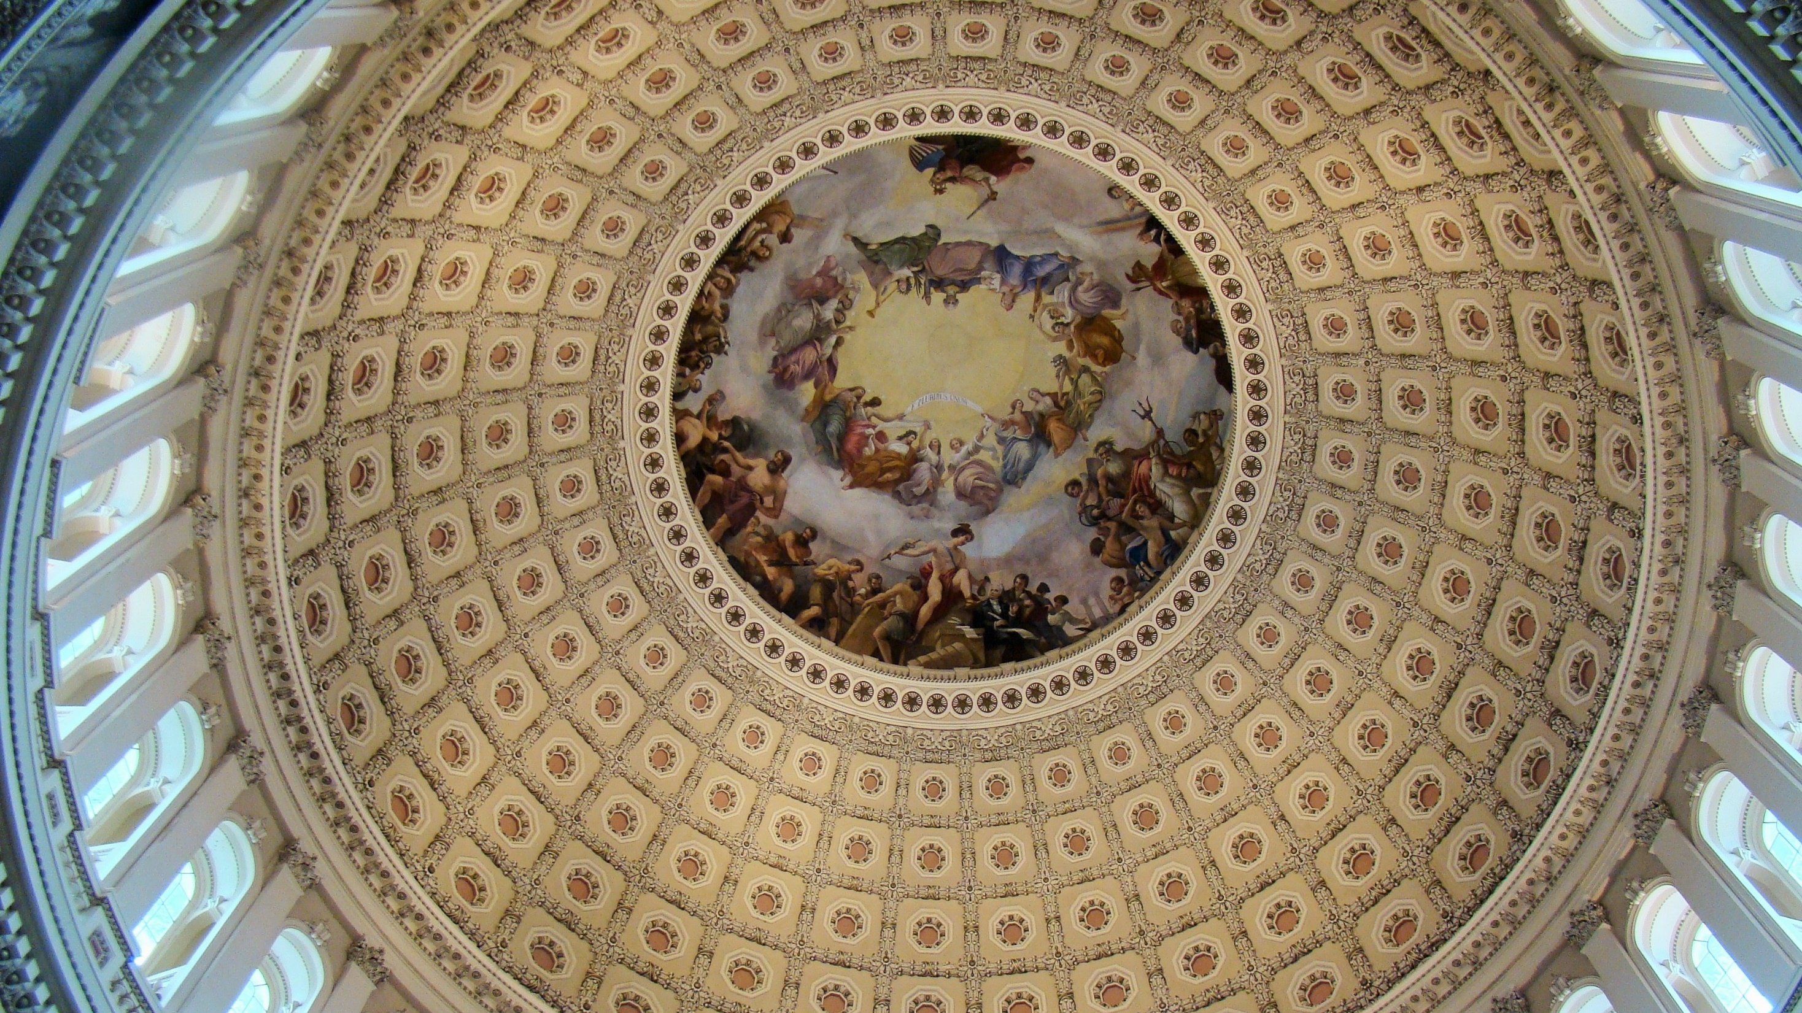
The Rotunda
Notes:
Image by dcandau from Pixabay
https://pixabay.com/photos/us-capitol-building-rotunda-art-826988/

Slide 43
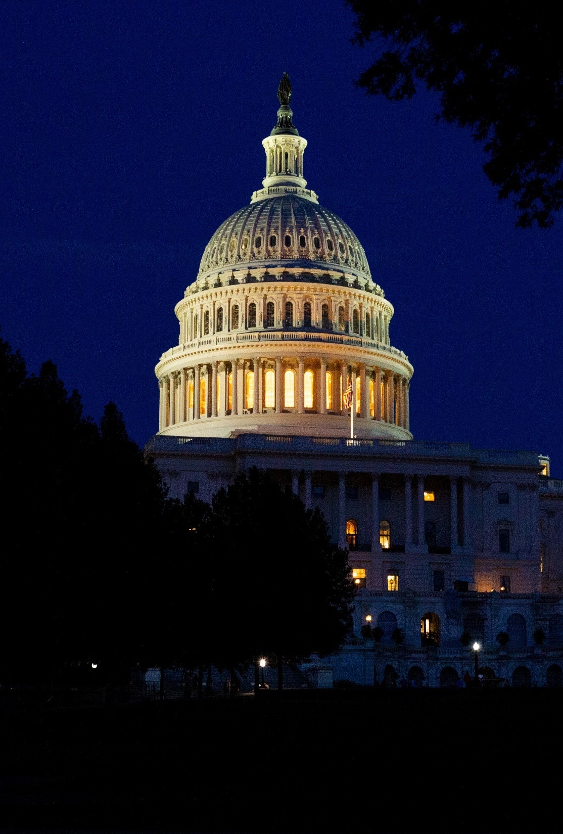
A. National Government
The nation’s legislature is called Congress and is divided into two houses:
House of Representatives (lower)
Senate (upper)
Together, they are responsible for making laws.
Notes:
Image by 1778011 from Pixabay
https://pixabay.com/photos/us-capitol-building-washington-dc-4077168/

Slide 44
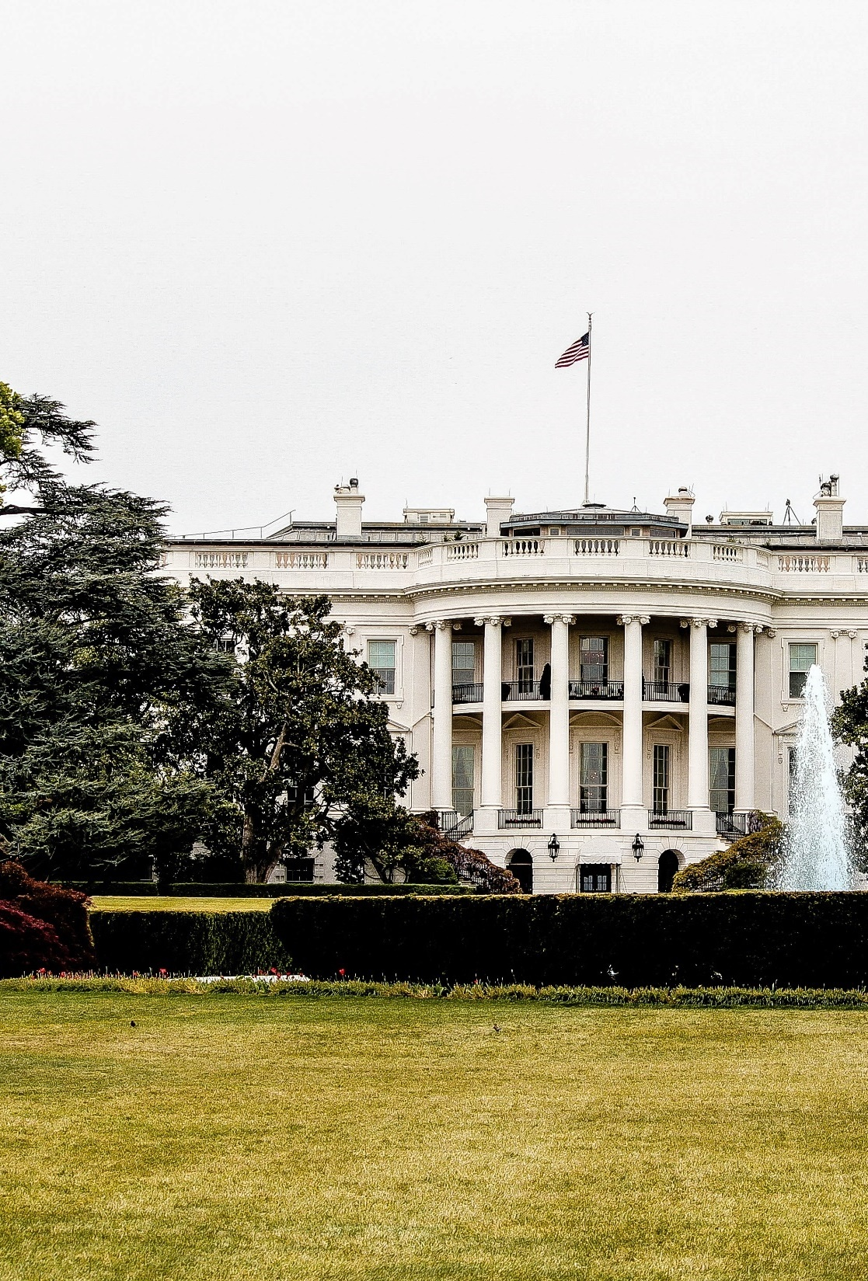
A. National Government
The executive branch is led by the president and enforces the nation’s laws.
The president also chooses (with Senate approval) advisors and department heads for the executive branch.
The White House
Notes:
Photo by René DeAnda on Unsplash
https://unsplash.com/photos/zfKlCKK-Ql0

Slide 45
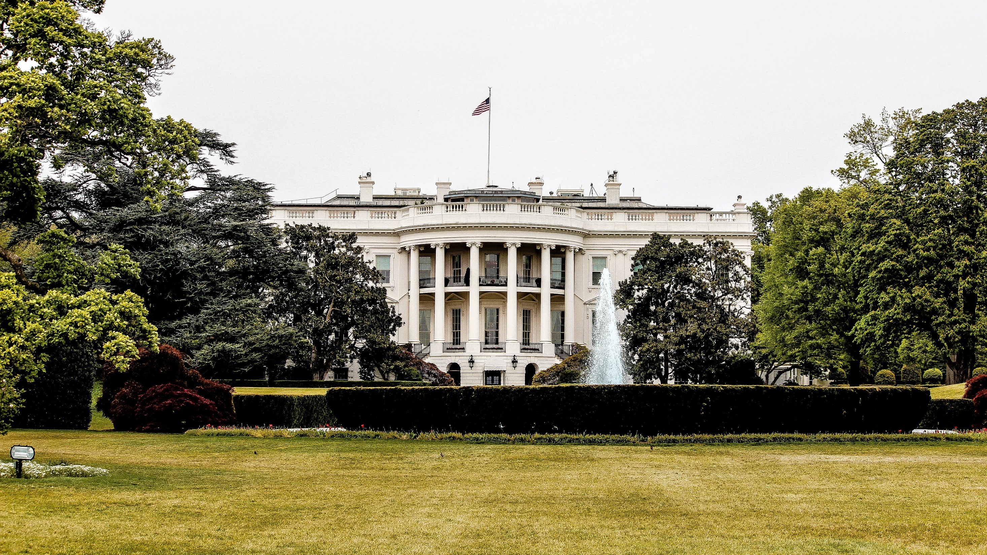
Notes:
Photo by René DeAnda on Unsplash
https://unsplash.com/photos/zfKlCKK-Ql0

Slide 46
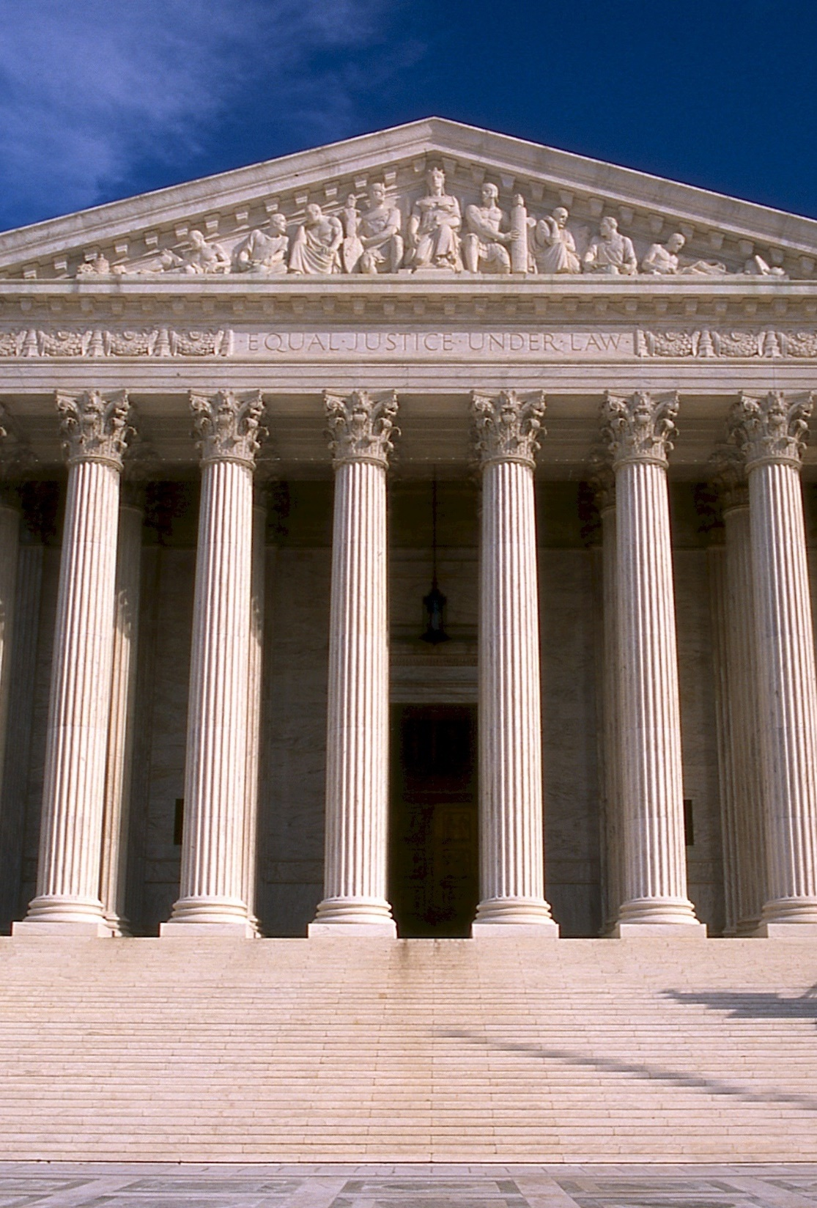
A. National Government
The judicial branch interprets the nation’s laws.
The Supreme Court is the highest court in the country and the final say on American law.
The Supreme Court Building
Notes:
Image by 272447 from Pixabay
https://pixabay.com/photos/supreme-court-building-usa-546279/

Slide 47
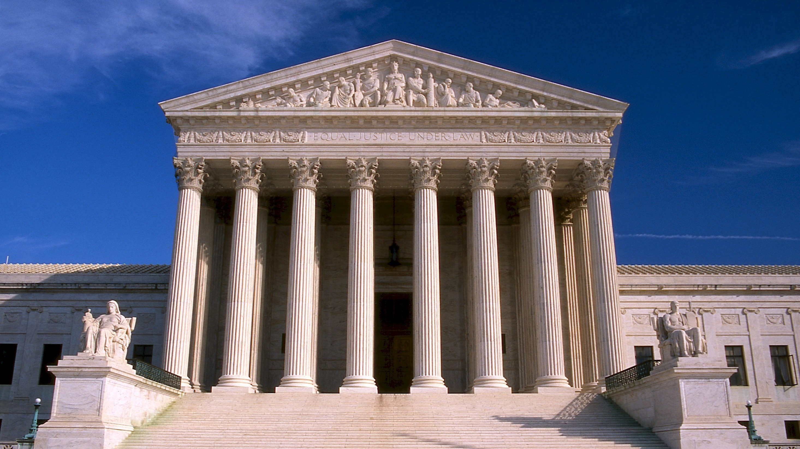
Notes:
Image by 272447 from Pixabay
https://pixabay.com/photos/supreme-court-building-usa-546279/

Slide 48
Notes:
BJU Press Art

Slide 49
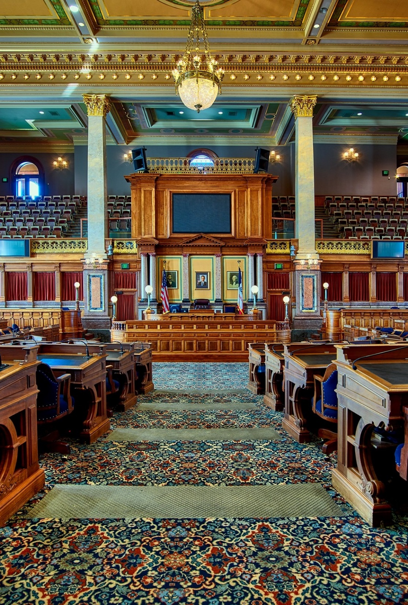
B. State Government
The United States consists of fifty united sovereign states.
States retain powers not delegated to the national government or prohibited to them by the Constitution.
Iowa House of Representatives
Notes:
Image by David Mark from Pixabay
https://pixabay.com/photos/house-of-representatives-des-moines-1731554/

Slide 50
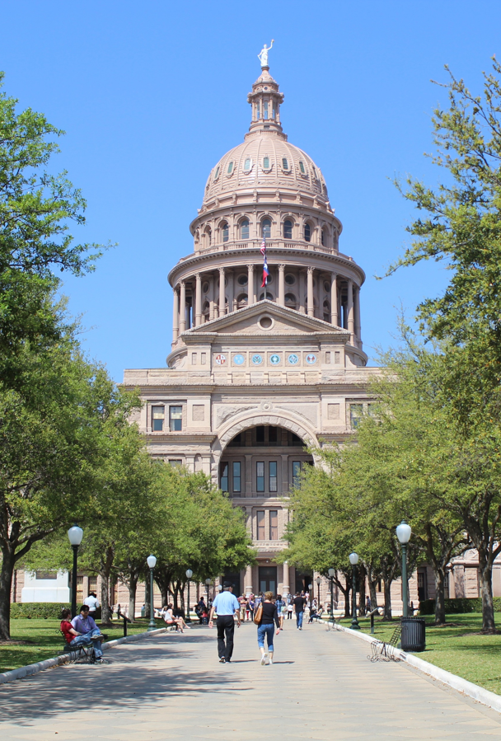
B. State Government
Each state has its own constitution which must establish a republican form of government.
Each state is further divided into local governments – counties, townships, and municipalities.
The Texas State Capitol
Notes:
Image by Kim Broomhall from Pixabay
https://pixabay.com/photos/capitol-building-austin-texas-96827/

Slide 51
Section Review – Chapter 2.2
1–3. List the three levels of American government.
national, state, and local (pp. 21–22)
4–6. List the three branches of the national government.
legislative, state, and local (pp. 21–22)

Slide 52
Section Review – Chapter 2.2
7. What powers are retained by the states?
all powers not delegated to the national government or prohibited to the states by the Constitution (p. 22)
8–10. What are three different subdivisions of local government?
counties, townships, and municipalities (p. 22)

Slide 53
Section Review – Chapter 2.2
Explain the responsibilities of each branch of the national government.
The legislative branch makes laws, the executive branch enforces laws, and the judicial branch interprets the law. (pp. 21–22)

Slide 54
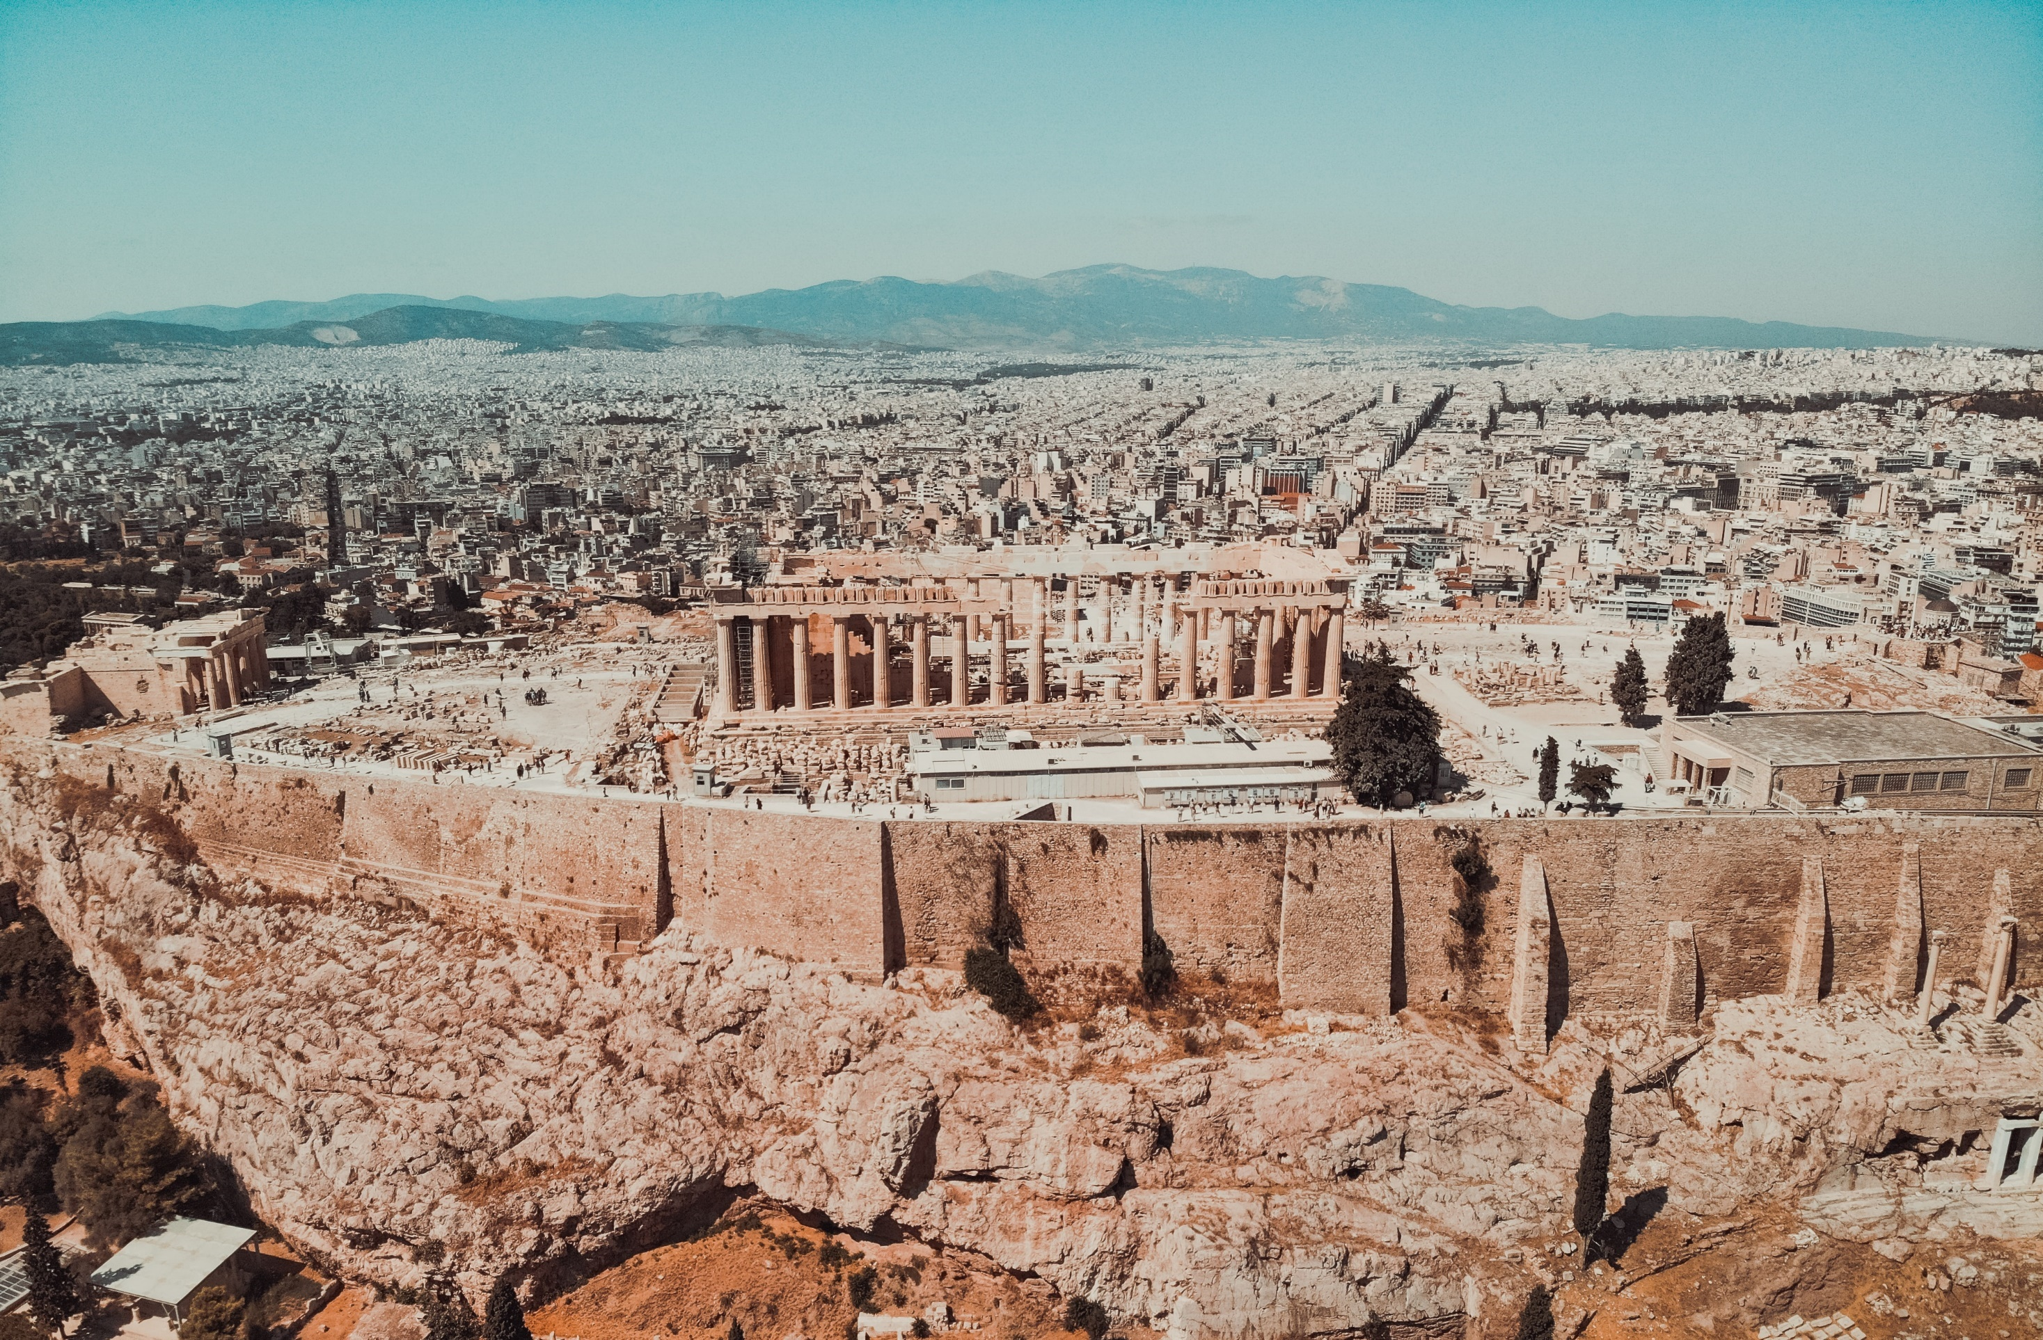
III. A Brief History of Democracy
Chapter 2.3
Notes:
Photo by Marco Oriolesi on Unsplash
https://unsplash.com/photos/wqLGlhjr6Og

Slide 55
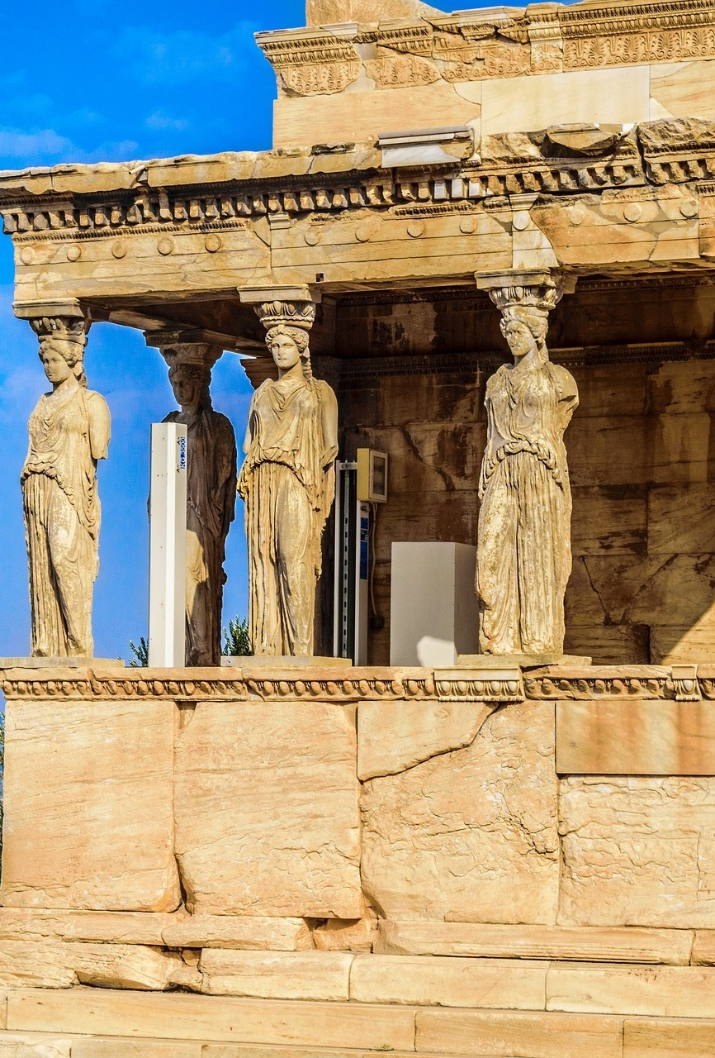
A. Athens
The word democracy comes from the Greek words demos (the people) and kratos (authority, or government).
During the fifth and fourth centuries BC, about 10–20 percent of the population ruled the city-state through direct democracy.
Athens, Greece
Notes:
Image by Ryan Grech from Pixabay
https://pixabay.com/photos/athens-caryatid-greece-temple-3411147/

Slide 56
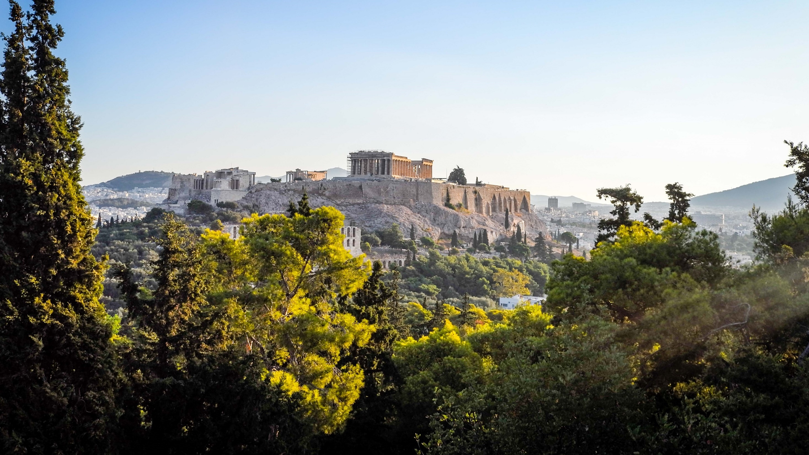
The Acropolis, Athens
Notes:
Image by Leonhard Niederwimmer from Pixabay
https://pixabay.com/photos/athens-acropolis-greece-temple-4881001/

Slide 57
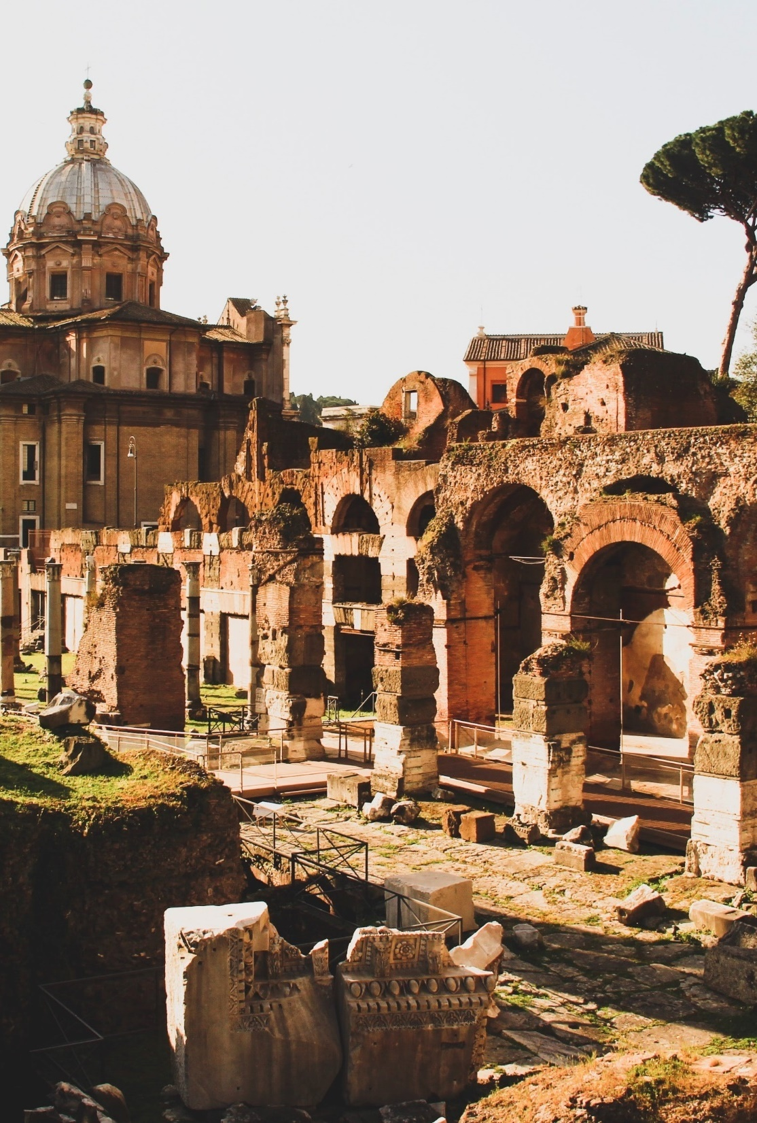
B. Rome
Between the fifth and first centuries BC, Rome was ruled by a republic.
Aristocratic families oversaw the Roman Republic, but elected officials called tribunes protected the rights of the people.
Rome, Italy
Notes:
Photo by Theo Leconte on Unsplash
https://unsplash.com/photos/y3_-hzTcxm4

Slide 58
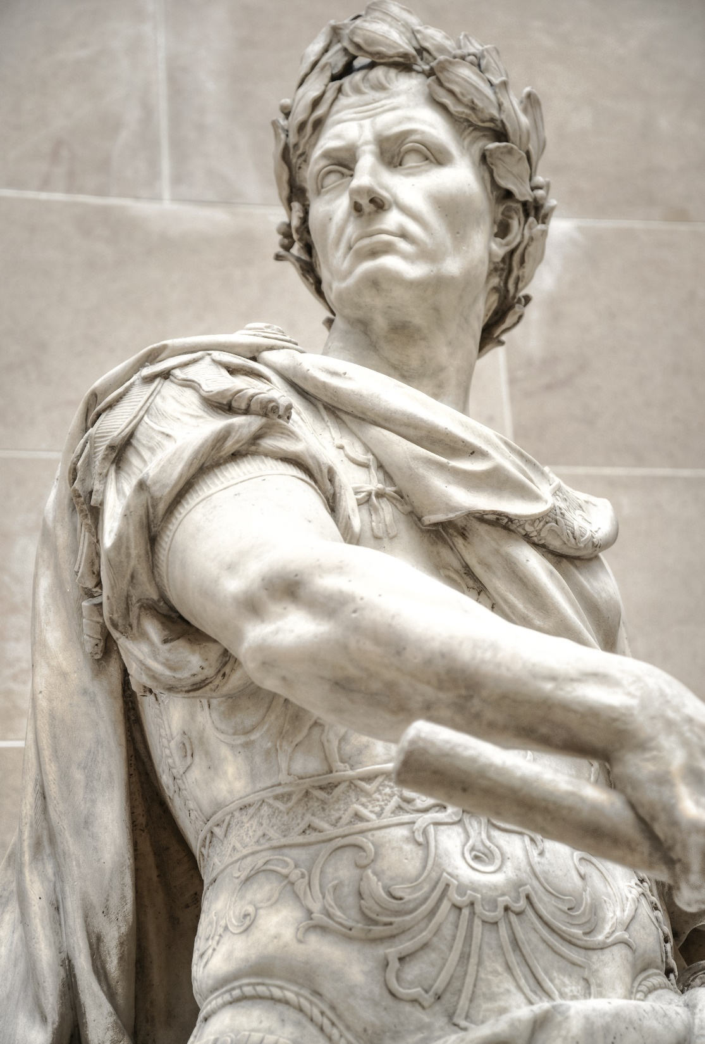
B. Rome
As Rome grew and conquered lands around the Mediterranean, the republic fell apart and was replaced by a dictatorship – the Roman Empire.
Julius Caesar
Notes:
Image by Rudy and Peter Skitterians from Pixabay
https://pixabay.com/photos/julius-caesar-roman-italy-rome-2789915/

Slide 59
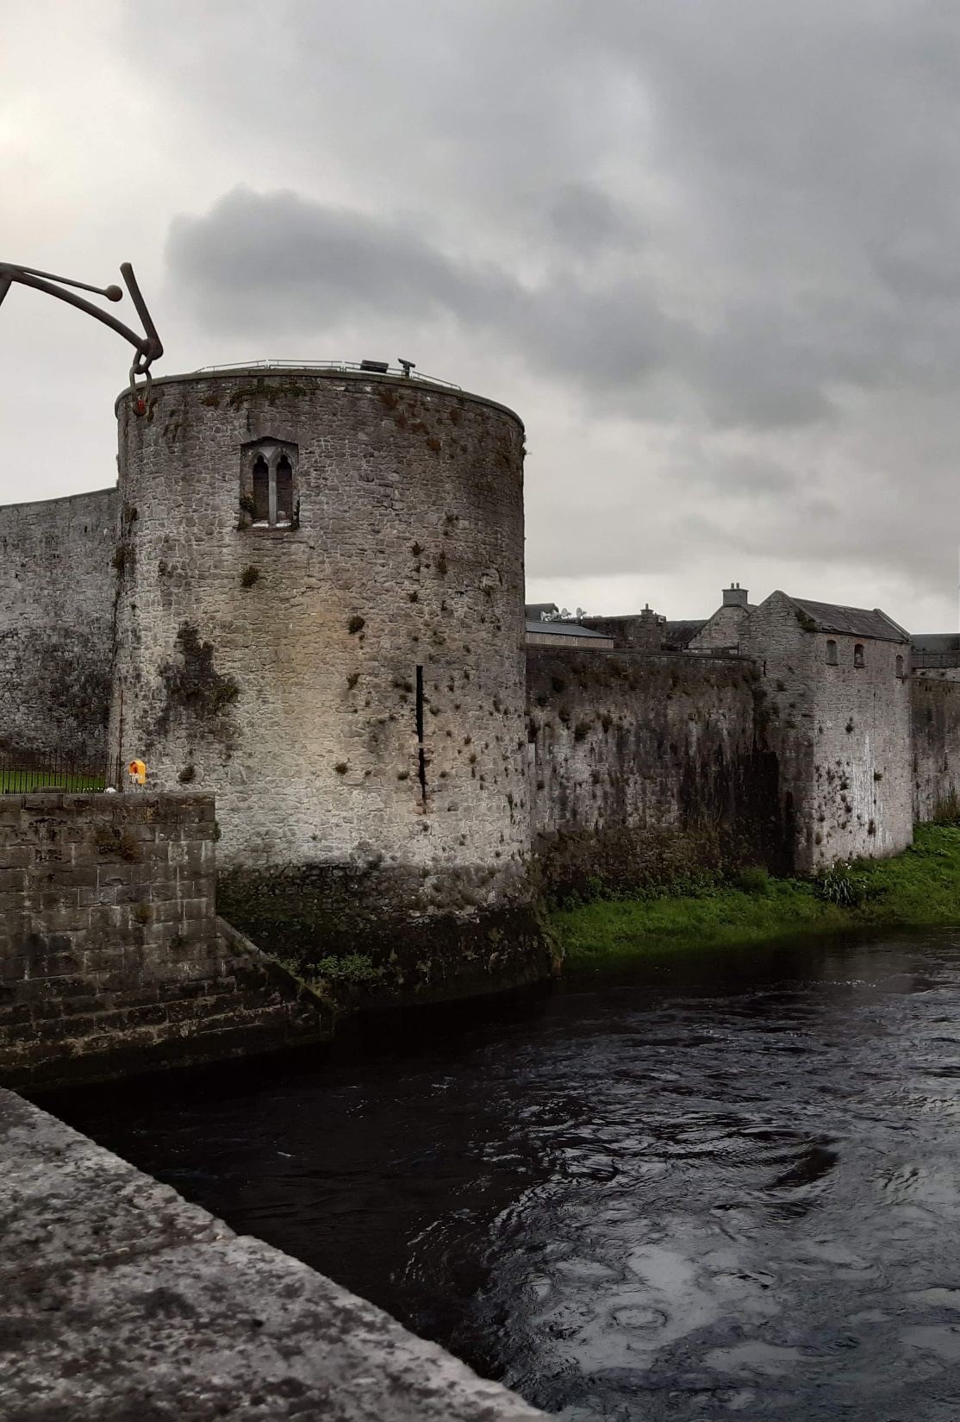
C. England and the Colonies
Due to its isolated position, England’s government developed differently from other European states.
King John’s Castle, Ireland
Notes:
Image by Honza56 from Pixabay
https://pixabay.com/photos/king-john-s-castle-castle-ireland-4519021/

Slide 60
C. England and the Colonies
In 1215, King John was forced to sign the Magna Carta (the Great Charter).
It introduced the concept of due process – procedures must be followed to protect the rights of the accused.
The Magna Carta was later nullified but laid the foundation for future reforms.
King John’s Castle, Ireland
Notes:
Image by Honza56 from Pixabay
https://pixabay.com/photos/king-john-s-castle-castle-ireland-4519021/

Slide 61
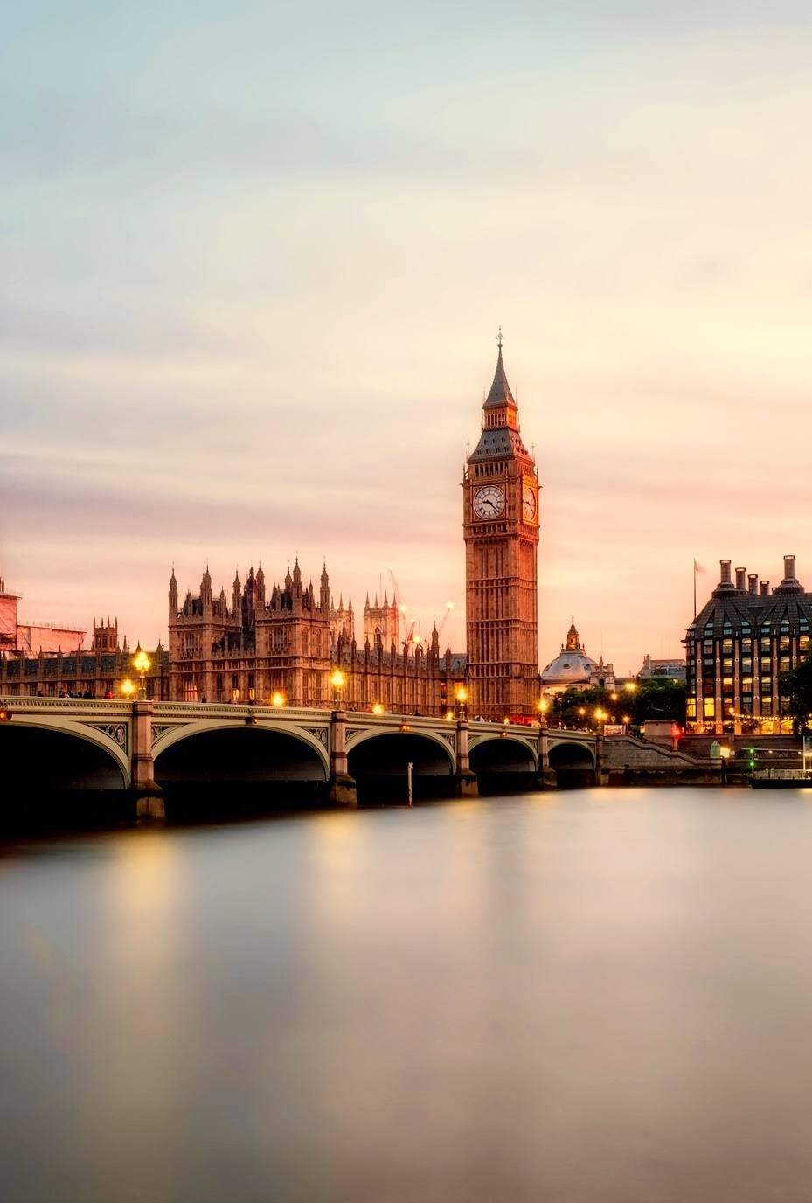
C. England and the Colonies
Democratic rule began in England with the signing of the English Bill of Rights (1689).
It established a limited monarchy.
The rights of the people were protected.
London, England
Notes:
Image by David Mark from Pixabay
https://pixabay.com/photos/london-england-great-britain-uk-2393098/

Slide 62
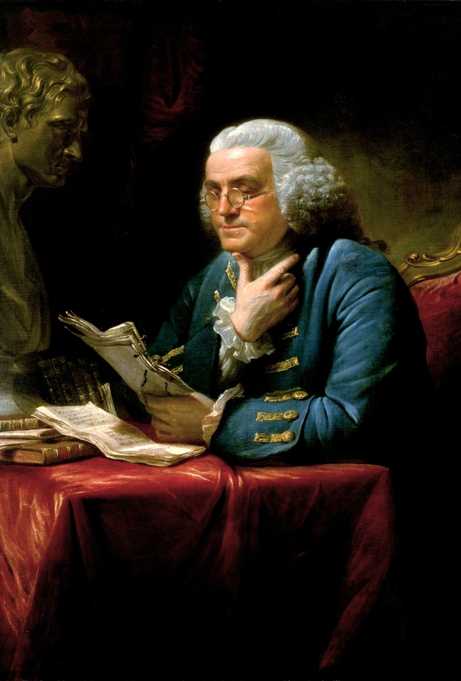
D. The US Founders’ Contributions
Many of the founders distrusted direct democracy because they felt it would lead to mob rule.
The founders chose to establish a republic.
They recognized that man’s sinfulness is the source of unstable government.
Benjamin Franklin
Notes:
Image by WikiImages from Pixabay
https://pixabay.com/photos/benjamin-franklin-1767-writer-62846/

Slide 63
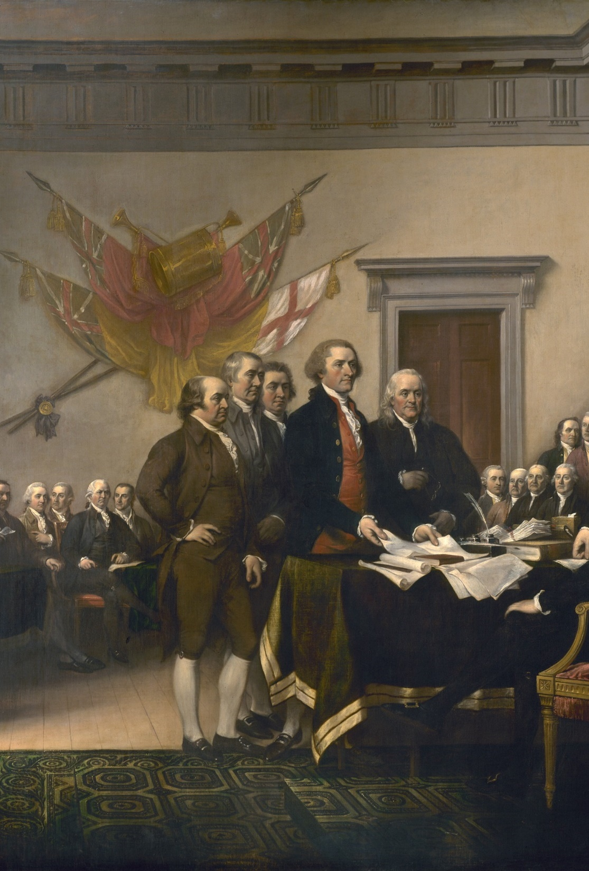
D. The US Founders’ Contributions
To prevent tyranny and mob rule, the founders placed limits on the government’s power through the Constitution.
The Bill of Rights limits the power of the government over the people.
The Electoral College limits the power of the people by indirectly electing the president.
Signing of the Declaration of Independence
Notes:
Image by WikiImages from Pixabay
https://pixabay.com/photos/declaration-of-independence-62972/

Slide 64
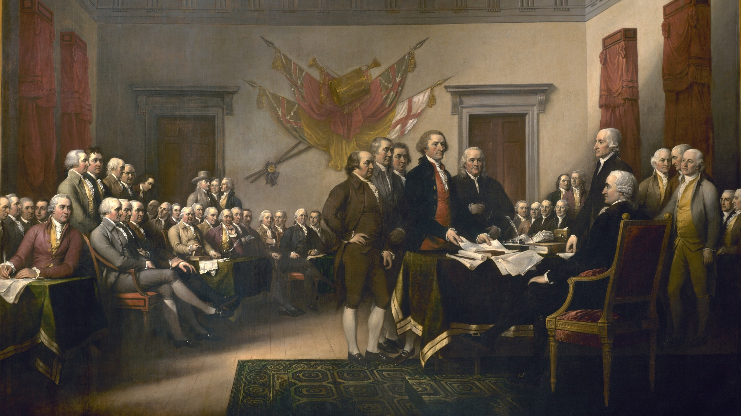
Notes:
Image by WikiImages from Pixabay
https://pixabay.com/photos/declaration-of-independence-62972/

Slide 65
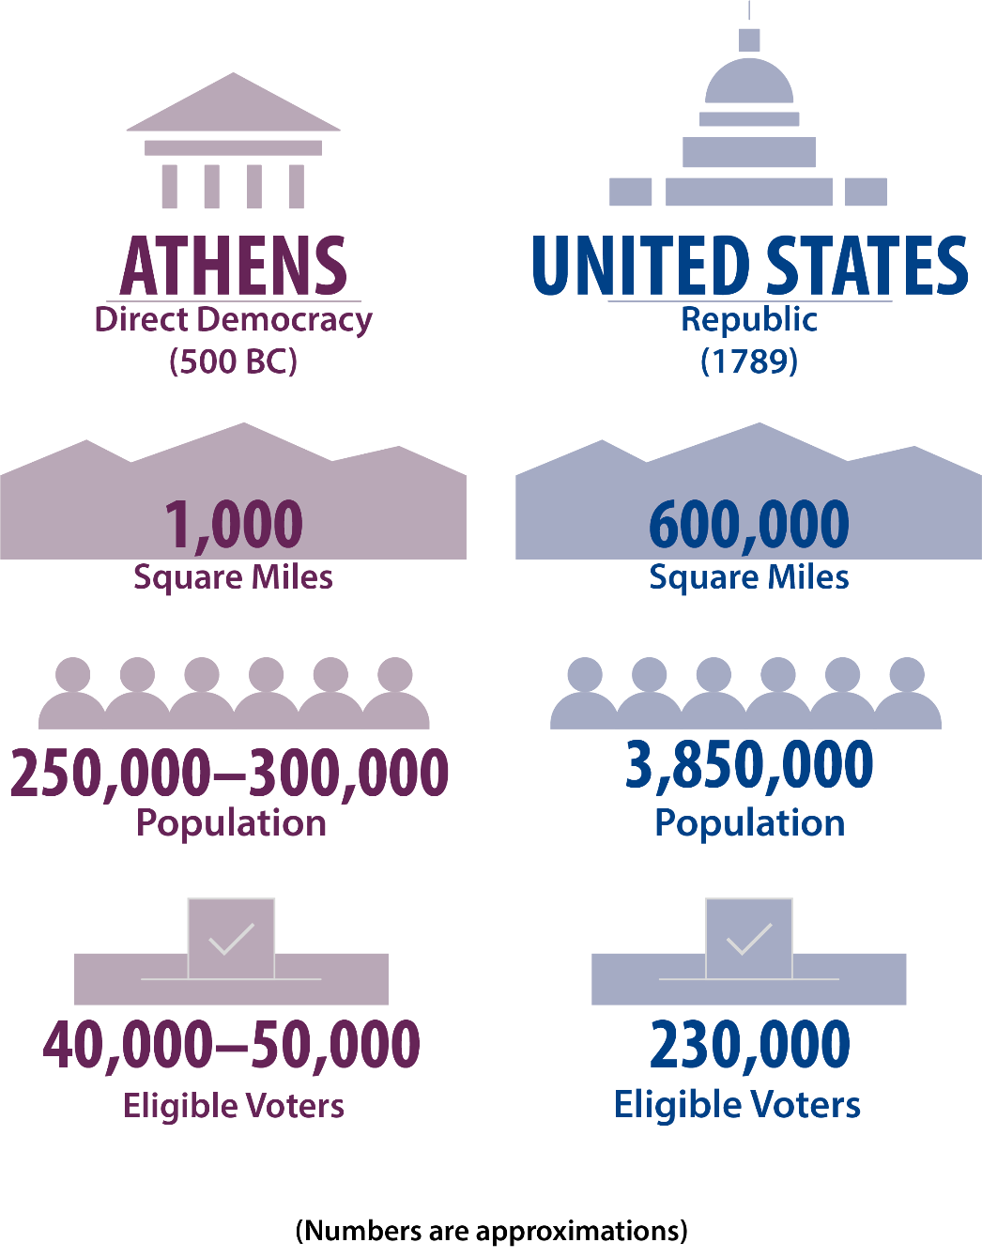
Notes:
BJU Press Art

Slide 66
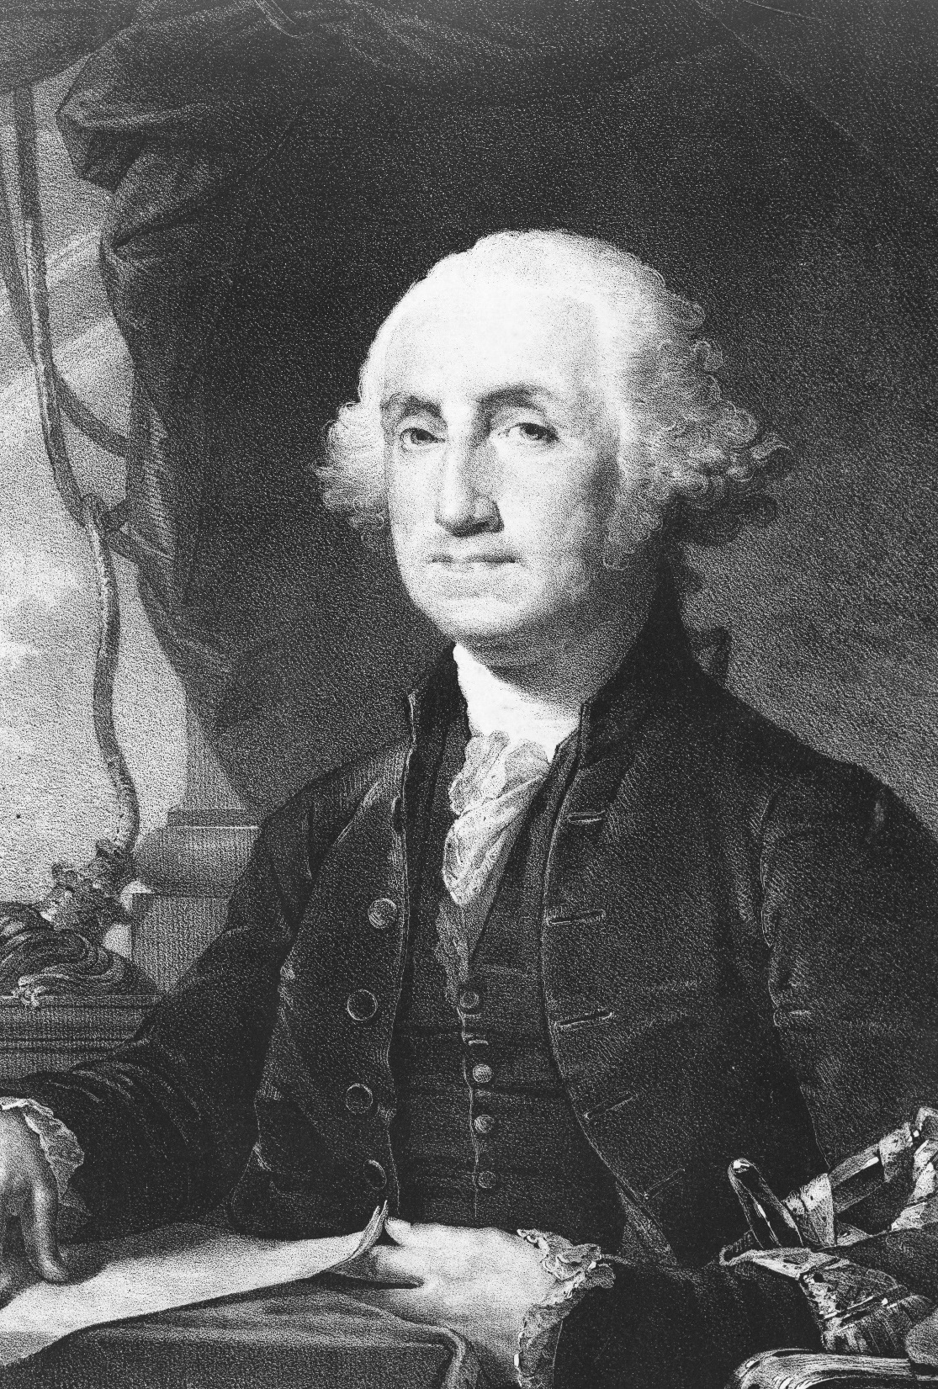
D. The US Founders’ Contributions
The United States was the first nation to successfully create a republic on a large scale.
For the founders, a republic meant a representative government ruled by a constitution and based on democratic principles.
George Washington
Notes:
Photo by Library of Congress on Unsplash
https://unsplash.com/photos/zlNc41HNy2o

Slide 67
Section Review – Chapter 2.3
1. Where did the first significant example of pure democracy occur?
Athens, Greece (p. 22)
2–3. What two major questions confronted the framers of the US Constitution?
how to incorporate democratic ideas into the new government and how to make a democratic republic work in a vast territory (p. 25)

Slide 68
Section Review – Chapter 2.3
4. What human characteristic did the nation’s founders recognize would make direct democracy a poor choice for our government?
humans’ sinful nature (p. 26)
5. What features did the founders include in the Constitution to ensure that the majority would not tyrannize the minority?
The founders divided the government into three branches and included the Bill of Rights in the Constitution. (p. 27)

Slide 69
Section Review – Chapter 2.3
Reread the feature box entitled “English Bill of Rights”. Which three of the thirteen items do you think are most important? Justify your answer.
Is the United States a democracy or a republic? Explain your answer.
The United States is both a democracy and a republic. We call it a democracy because the people hold ultimate power. We call it a republic because it is not monarchical, and it is ruled by law.

Slide 70
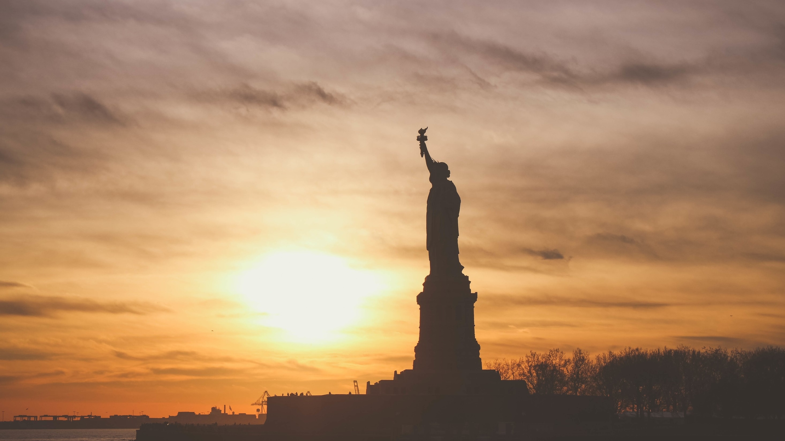
IV. Characteristics of Democracy
Chapter 2.4
Notes:
Image by Free-Photos from Pixabay
https://pixabay.com/photos/statue-of-liberty-landmark-liberty-1210001/

Slide 71
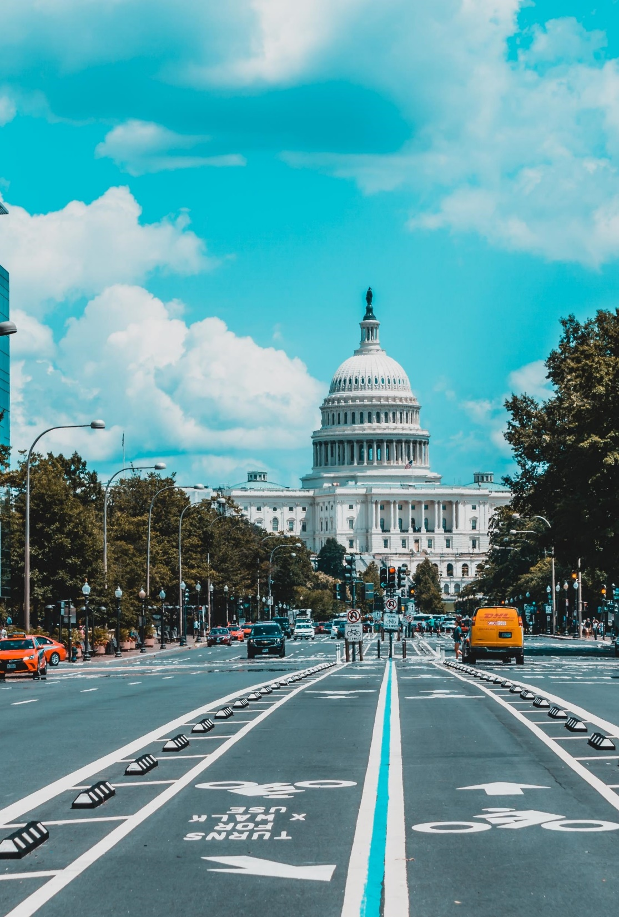
A. Majority Rule
Majority rule is the principle that the majority of the electorate makes decisions that bind the entire electorate.
A popular majority is a majority of all citizens or voters.
A representative majority is a majority of elected officials.
Notes:
Photo by Jorge Alcala on Unsplash
https://unsplash.com/photos/fbtHV94f-bA

Slide 72
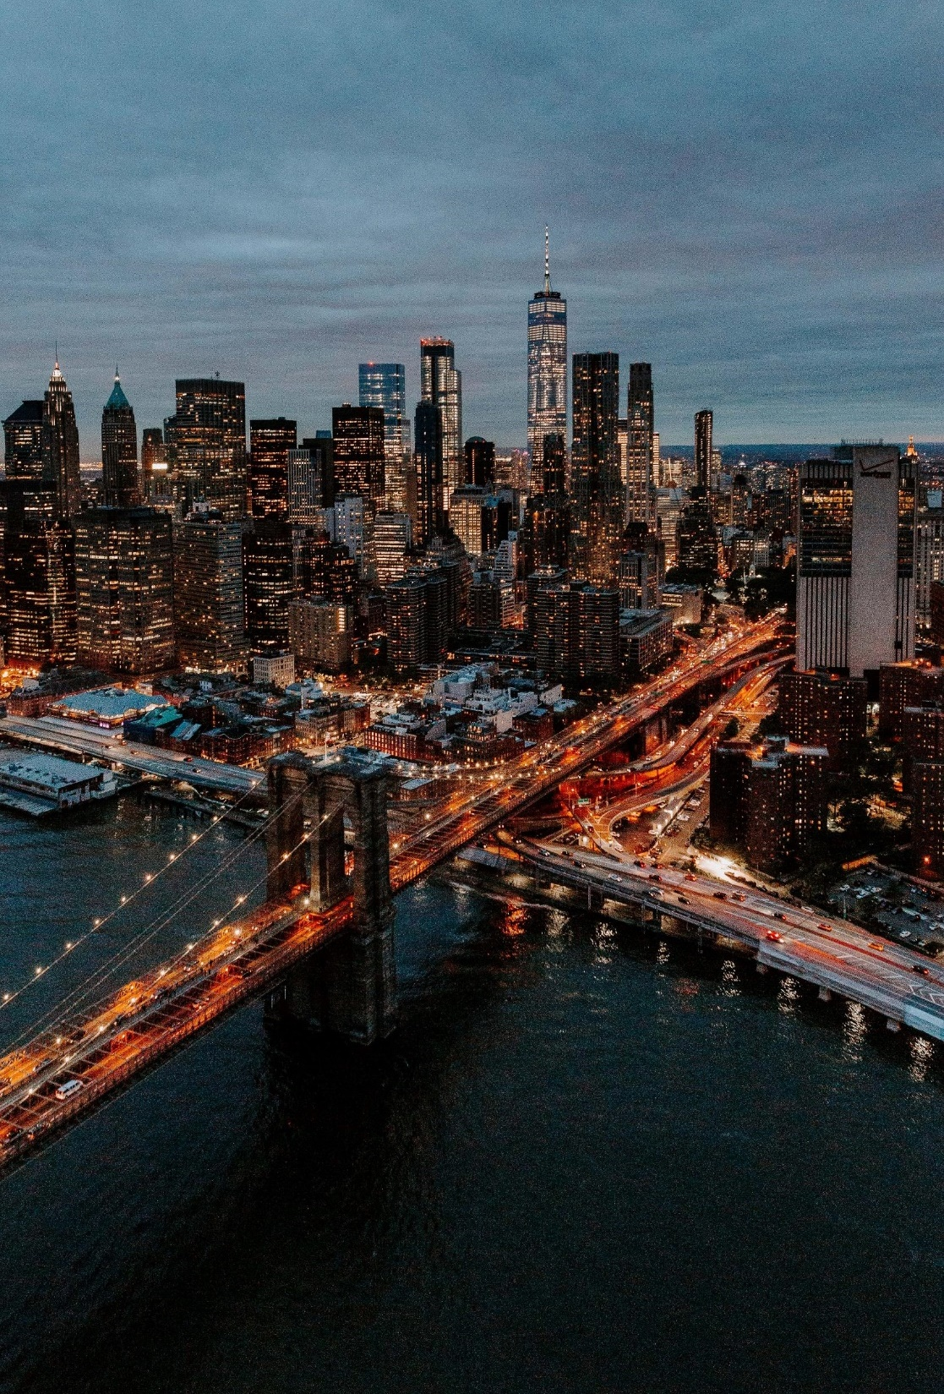
A. Majority Rule
Majority rule isn’t perfect, but it’s better than unanimity because a single vote essentially becomes the majority.
In a pluralistic society (having many diverse backgrounds and beliefs) the majority is not a fixed group – a voter may be in the majority on one issue and in the minority on the next.
Notes:
Photo by Trent Szmolnik on Unsplash
https://unsplash.com/photos/KSBbIiaRFds

Slide 73
B. Equality
The principle of equality refers to political equality rather than equality of circumstance.
This means that all citizens are equal before the law regardless of income, race, social status, etc.
The right to vote has grown to include all adult Americans.
Notes:
Photo by Dyana Wing So on Unsplash
https://unsplash.com/photos/Og16Foo-pd8

Slide 74
C. Liberty
Liberty means personal and political freedoms such as freedom of conscience, association, expression, etc.
Liberty apart from Christian morality often becomes a license to do evil.
Notes:
Photo by Ben White on Unsplash
https://unsplash.com/photos/vtCBruWoNqo

Slide 75
D. Necessity of Compromise
Compromise is necessary because there will often be differences of opinion in a democracy.
Christians should be careful not to compromise on Biblical truth but be willing to do so when dealing with nonmoral issues.
Notes:
Photo by Headway on Unsplash
https://unsplash.com/photos/5QgIuuBxKwM

Slide 76
E. Individual Worth
A democratic government also needs to recognize the worth of every individual.
Individual worth protects the minority from oppression but does not allow them to do whatever they please.
Notes:
Image by Pexels from Pixabay
https://pixabay.com/photos/architecture-new-york-city-manhattan-1853552/

Slide 77
Section Review – Chapter 2.4
1. What is the difference between a popular majority and a representative majority?
popular majority—a plurality of all the citizens (at least of those who vote); representative majority—a plurality of elected officials (pp. 29–31)

Slide 78
Section Review – Chapter 2.4
2–5. Give four observations concerning majority rule in America that show why that principle has been effective.
(1) Majority rule avoids the problem of unanimity, in which one person or group has the power to veto the wishes of everyone else. (2) Majority rule is limited by our pluralistic society. (3) Majority rule in America is restricted by the Constitution. (4) Citizens who are in the majority respect the principle of equality under the law and the minority’s political liberty. (pp. 29–32)

Slide 79
Section Review – Chapter 2.4
6–7. In what two ways are all American citizens equal?
Americans have equal rights under the law and equal voting rights. (p. 32)
What is the difference between personal and political liberty?
Personal liberty is the freedom of every citizen to think, associate, and speak as he pleases; political liberty is the freedom of every citizen to vote, campaign, and seek office as he pleases.

Slide 80
V. Conditions for Democracy
Chapter 2.5
Notes:
Image by Free-Photos from Pixabay
https://pixabay.com/photos/statue-of-liberty-landmark-liberty-1210001/

Slide 81
A. Opportunity
A democratic system must provide opportunity for people to better themselves to avoid social unrest.
The government can create a basic safety net for citizens while also providing incentives, training, and other resources for lifting people out of poverty.
Notes:
Photo by Helloquence on Unsplash
https://unsplash.com/photos/5fNmWej4tAA

Slide 82
Notes:
BJU Press Art

Slide 83
B. Educated Society
Citizens must be educated to understand the political ideas and institutions that run the country – civic thinking.
They must also be able to evaluate current events and have an appreciation for the nation’s heritage.
Notes:
Photo by MD Duran on Unsplash
https://unsplash.com/photos/1VqHRwxcCCw

Slide 84
C. Moral Responsibility
Moral responsibility strengthens a nation’s democracy.
It implies submission to the rule of law.
It provides a standard for judging the majority’s actions.
It also determines the limits of compromise.
Notes:
Photo by Sebastian Pichler on Unsplash
https://unsplash.com/photos/bAQH53VquTc

Slide 85
Section Review – Chapter 2.5
1–3. What three main conditions are necessary for a successful democracy?
opportunity (economic, educational, and political), an educated citizenry, and moral responsibility (pp. 34–38)
4. What dangers arise when people lack economic opportunity?
The poor people lose hope. If there is a small (or nonexistent) middle class, the contrast between the poor and the rich is glaring, and the two classes may eventually clash. (p. 35)

Slide 86
Section Review – Chapter 2.5
5. How does moral responsibility help moderate the majority’s power?
Moral responsibility implies submission to the rule of law and provides a standard for judging the actions of the majority. (p. 38)

Slide 87
Section Review – Chapter 2.5
Why is accurate civic thinking critical to a democratic system?
Accurate civic thinking is critical to a democratic system. The citizenry must be well-informed, well-prepared, and well-educated to think accurately. Education prepares them to make wise decisions in voting for the best candidates, to discern between good and bad legislation, and to react appropriately by praising the good and condemning the bad.

Slide 88
Section Review – Chapter 2.5
What does it mean for a Christian to be prudent when considering compromise?
It is the wisdom necessary to know how best to achieve a good goal.

Slide 89
Chapter 2 Terms
Notes:
Photo by Casey Horner on Unsplash
https://unsplash.com/photos/pArjs_G6m4Y

Slide 90
monarchy
a government in which supreme authority is invested in one who rules for life
Notes:
Photo by Tiraya Adam on Unsplash
https://unsplash.com/photos/62iAcT4zEeM

Slide 91
monarch
a leader of a government who rules for life and whose absolute authority is sometimes checked by other governmental bodies
Notes:
Photo by Tiraya Adam on Unsplash
https://unsplash.com/photos/62iAcT4zEeM

Slide 92
constitutional monarchy
a form of monarchy in which the government usually is run by a democratically elected parliament and the monarch is merely a ceremonial head of state
Notes:
Photo by Tiraya Adam on Unsplash
https://unsplash.com/photos/62iAcT4zEeM

Slide 93
dynasty
a monarchy that operates with hereditary succession
Notes:
Photo by Tiraya Adam on Unsplash
https://unsplash.com/photos/62iAcT4zEeM

Slide 94
absolute monarch
a monarch with unlimited power
Notes:
Photo by Tiraya Adam on Unsplash
https://unsplash.com/photos/62iAcT4zEeM

Slide 95
dictatorship
an authoritative form of government in which the government acts without the people’s consent or input
Notes:
Photo by Tiraya Adam on Unsplash
https://unsplash.com/photos/62iAcT4zEeM

Slide 96
totalitarianism
system of government in which an elite ruling class (such as the military, the wealthy, or a powerful family) wields absolute power, often seeking to control every aspect of the people’s lives
Notes:
Photo by Tiraya Adam on Unsplash
https://unsplash.com/photos/62iAcT4zEeM

Slide 97
autocracy
a form of dictatorial government in which one person rules with supreme authority
Notes:
Photo by Tiraya Adam on Unsplash
https://unsplash.com/photos/62iAcT4zEeM

Slide 98
oligarchy
a form of dictatorial government in which an elite group rules; the group is sometimes self-appointed and divides the governmental departments among its members.
Notes:
Photo by Tiraya Adam on Unsplash
https://unsplash.com/photos/62iAcT4zEeM

Slide 99
anarchy
condition in which a state has no functioning government
Notes:
Photo by Tiraya Adam on Unsplash
https://unsplash.com/photos/62iAcT4zEeM

Slide 100
popular government
system of government in which citizens participate and political power resides with the people, rather than with a monarchy or an elite group
Notes:
Photo by Tiraya Adam on Unsplash
https://unsplash.com/photos/62iAcT4zEeM

Slide 101
direct democracy
also called pure democracy; a form of government in which the people directly affect a government’s policies and actions through gatherings and voting
Notes:
Photo by Tiraya Adam on Unsplash
https://unsplash.com/photos/62iAcT4zEeM

Slide 102
indirect democracy
also called representative democracy; form of government in which the people elect their peers to operate the government on their behalf
Notes:
Photo by Tiraya Adam on Unsplash
https://unsplash.com/photos/62iAcT4zEeM

Slide 103
republic
state in which the supreme power rests in the people and their elected officials
Notes:
Photo by Tiraya Adam on Unsplash
https://unsplash.com/photos/62iAcT4zEeM

Slide 104
unitary system
a system in which the people give authority to one centralized level of government that then creates other levels of government to help administer the law
Notes:
Photo by Tiraya Adam on Unsplash
https://unsplash.com/photos/62iAcT4zEeM

Slide 105
federalism
system in which governmental power is divided into two or more levels, usually a central, national government and component state governments.
Notes:
Photo by Tiraya Adam on Unsplash
https://unsplash.com/photos/62iAcT4zEeM

Slide 106
confederate government
system in which regional governments retain supremacy while delegating a few tasks to the national government
Notes:
Photo by Tiraya Adam on Unsplash
https://unsplash.com/photos/62iAcT4zEeM

Slide 107
presidential system
a system in which the people directly elect the head of the executive branch independently of the legislative branch; the two branches are both separate and equal.
Notes:
Photo by Tiraya Adam on Unsplash
https://unsplash.com/photos/62iAcT4zEeM

Slide 108
parliamentary system
a system in which the legislative and executive branches are inseparably linked
Notes:
Photo by Tiraya Adam on Unsplash
https://unsplash.com/photos/62iAcT4zEeM

Slide 109
delegated powers
powers specifically given to the national government by the Constitution; define the limits of the government’s authority
Notes:
Photo by Tiraya Adam on Unsplash
https://unsplash.com/photos/62iAcT4zEeM

Slide 110
Congress
at the federal level, the legislative branch of American government; a bicameral legislature composed of a lower house called the House of Representatives and a higher house called the Senate
Notes:
Photo by Tiraya Adam on Unsplash
https://unsplash.com/photos/62iAcT4zEeM

Slide 111
House of Representatives
the lower house in Congress; representation based on state population
Notes:
Photo by Tiraya Adam on Unsplash
https://unsplash.com/photos/62iAcT4zEeM

Slide 112
Senate
the upper house in Congress; representation equal for each state, with each having two senators.
Notes:
Photo by Tiraya Adam on Unsplash
https://unsplash.com/photos/62iAcT4zEeM

Slide 113
president
the chief executive officer and head of the executive branch
Notes:
Photo by Tiraya Adam on Unsplash
https://unsplash.com/photos/62iAcT4zEeM

Slide 114
Supreme Court
the highest court of the judicial branch of the nation
Notes:
Photo by Tiraya Adam on Unsplash
https://unsplash.com/photos/62iAcT4zEeM

Slide 115
democracy
form of government in which the people participate and have a voice in how they should be ruled
Notes:
Photo by Tiraya Adam on Unsplash
https://unsplash.com/photos/62iAcT4zEeM

Slide 116
Magna Carta
a list of demands that King John of England was forced to sign in 1215; restored the feudal rights of English barons and contained principles that caused it to become a foundational document of constitutional government
Notes:
Photo by Tiraya Adam on Unsplash
https://unsplash.com/photos/62iAcT4zEeM

Slide 117
due process
certain legal rules that the government must follow to protect the rights of the accused
Notes:
Photo by Tiraya Adam on Unsplash
https://unsplash.com/photos/62iAcT4zEeM

Slide 118
English Bill of Rights
a document signed by William and Mary in 1689; limited the monarchy’s power and asserted the people’s rights; the most important development in constitutional government since the Magna Carta
Notes:
Photo by Tiraya Adam on Unsplash
https://unsplash.com/photos/62iAcT4zEeM

Slide 119
Bill of Rights
the first ten amendments to the Constitution; protects citizens’ democratic rights by limiting the power of state and national governments
Notes:
Photo by Tiraya Adam on Unsplash
https://unsplash.com/photos/62iAcT4zEeM

Slide 120
Electoral College
the system used to elect the U.S. president; each state has a number of electors equal to that state’s representation in Congress; at least 270 electoral votes are needed to win the presidency
Notes:
Photo by Tiraya Adam on Unsplash
https://unsplash.com/photos/62iAcT4zEeM

Slide 121
majority rule
a principle of government asserting that a numerical majority of the electorate can make decisions that bind the entire electorate
Notes:
Photo by Tiraya Adam on Unsplash
https://unsplash.com/photos/62iAcT4zEeM

Slide 122
popular majority
the majority of all citizens or at least the majority of all voters who participate in their government through free elections
Notes:
Photo by Tiraya Adam on Unsplash
https://unsplash.com/photos/62iAcT4zEeM

Slide 123
representative majority
a majority of elected officials
Notes:
Photo by Tiraya Adam on Unsplash
https://unsplash.com/photos/62iAcT4zEeM

Slide 124
pluralistic society
a society in which differing opinions and parties coexist freely
Notes:
Photo by Tiraya Adam on Unsplash
https://unsplash.com/photos/62iAcT4zEeM

Slide 125
equality
as a democratic principle, political or legal parity characterized by equal justice and an equal right to vote
Notes:
Photo by Tiraya Adam on Unsplash
https://unsplash.com/photos/62iAcT4zEeM

Slide 126
civic thinking
having an understanding of the political ideas and institutions that shape America’s government, an appreciation for America’s heritage, and an ability to evaluate current issues and national direction
Notes:
Photo by Tiraya Adam on Unsplash
https://unsplash.com/photos/62iAcT4zEeM

