Slide 2
Geography is a study that helps people make sense of the world and make use of it.

Slide 3
I. What is Geography?

Slide 4
History is the study of events in time.
Geography is the study of space and place.

Slide 5
I. What is Geography?
A. Branches of Geography
Geography = “earth” + “written description”

Slide 6
1. Two main branches
a. Physical geography
b. Human geography

Slide 7
physical geography
the study of the earth and its resources

Slide 8
human geography
the study of man as he lives on the earth and uses its resources

Slide 9
2. Two ways to study
a. Systematic geography: one branch at a time
b. Regional geography: one region at a time

Slide 10
B. Themes of Geography
1. Location
2. Place
3. Interaction
4. Movement
5. Region

Slide 11
C. History of Geography
1. Ancient Views of the Earth
a. Alexander the Great
b. Eratosthenes
c. Hipparchus
d. Ptolemy

Slide 12
2. The Age of Exploration
a. Columbus
b. Copernicus
c. Mercator

Slide 13
cartography
the art of mapmaking

Slide 14
3. The Modern Age
a. Increasing detail and accuracy
Topography
b. Thematic maps
c. GPS

Slide 15
II. The Geographic Grid

Slide 16
II. The Geographic Grid
A. Hemispheres
1. Equator
2. Northern and Southern Hemispheres

Slide 17
B. Latitude and Longitude
1. Latitude lines
a. Parallels
b. Run east and west
c. Degrees, minutes, seconds

Slide 18
2. Longitude
a. Meridians
b. Run north and south
c. Prime meridian (Greenwich)
d. Great circle

Slide 19
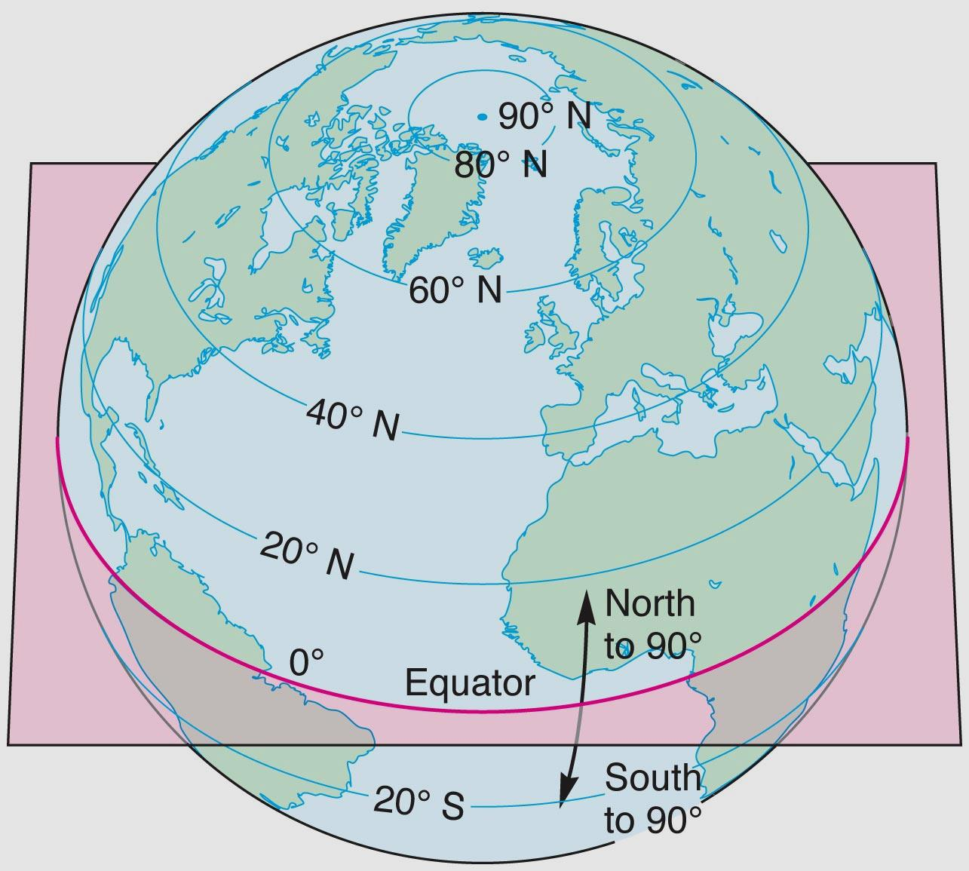
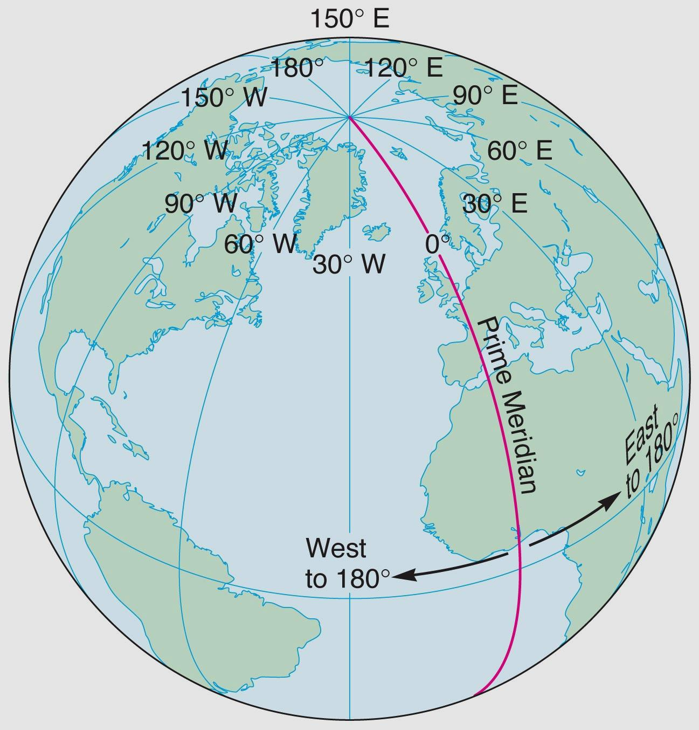
Lines of Latitude
Lines of Longitude

Slide 20
III. Map Projections

Slide 21
map projection
any method used to show the earth’s round surface on a flat map

Slide 22
III. Map Projections
A. The Problem of Distortion
1. Area
2. Shape
3. Distance
4. Direction

Slide 23
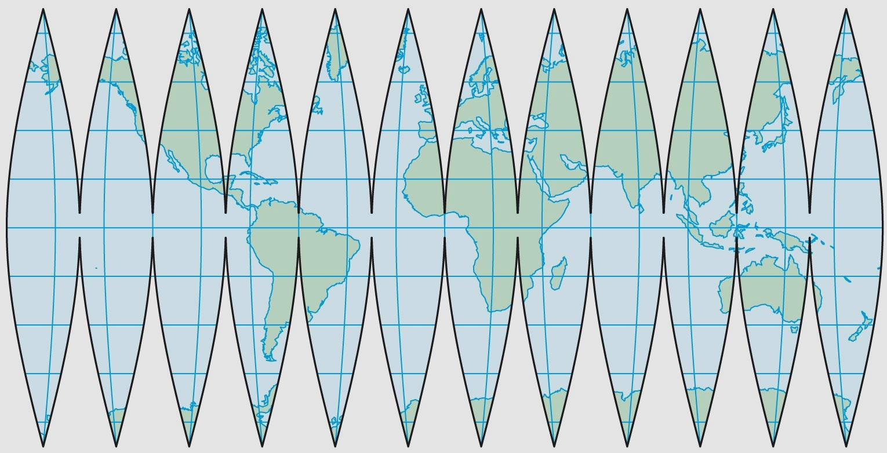
Gores

Slide 24
B. Solutions to the Problem
1. Cylindrical projections

Slide 25
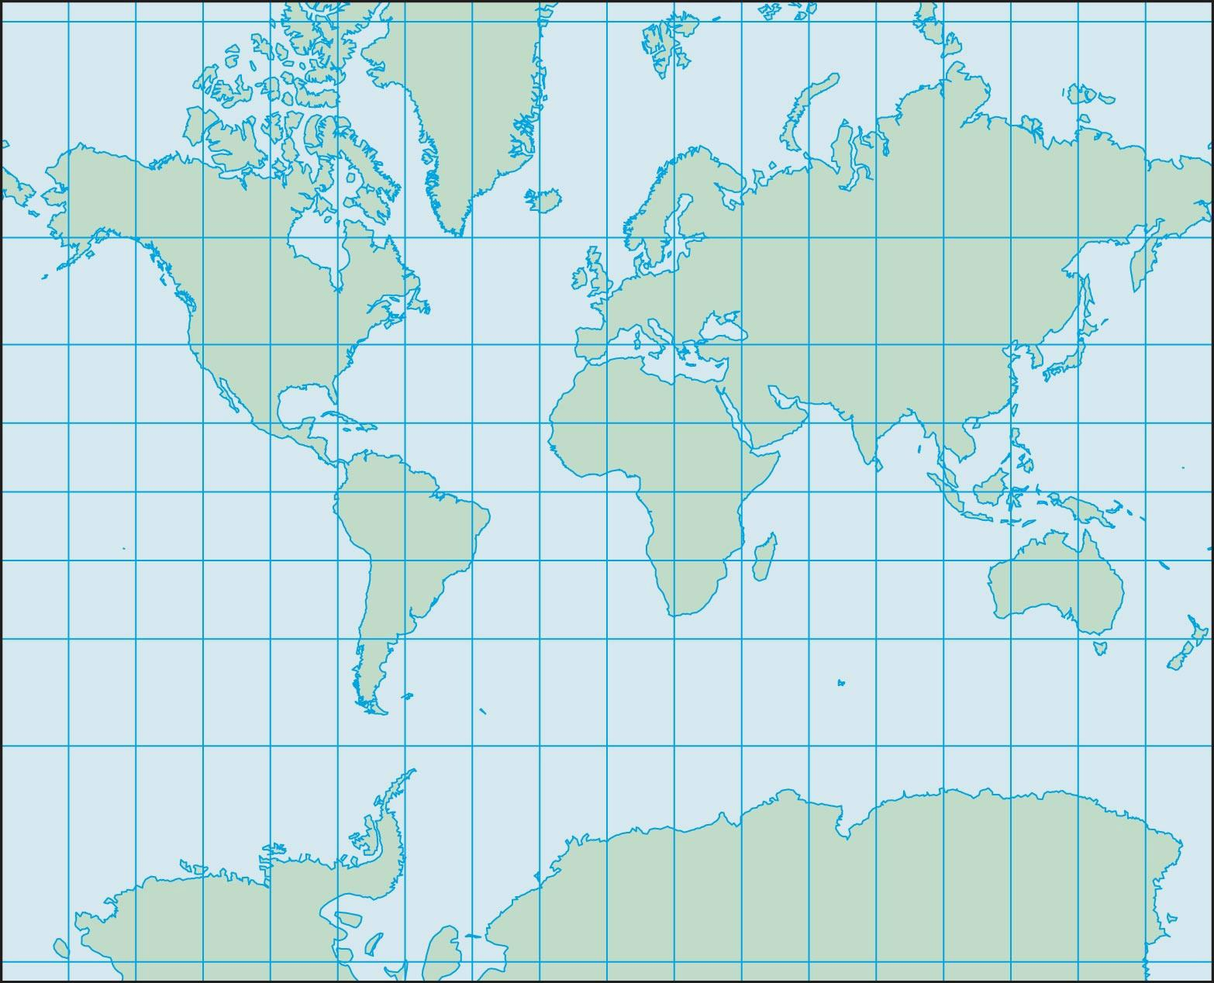
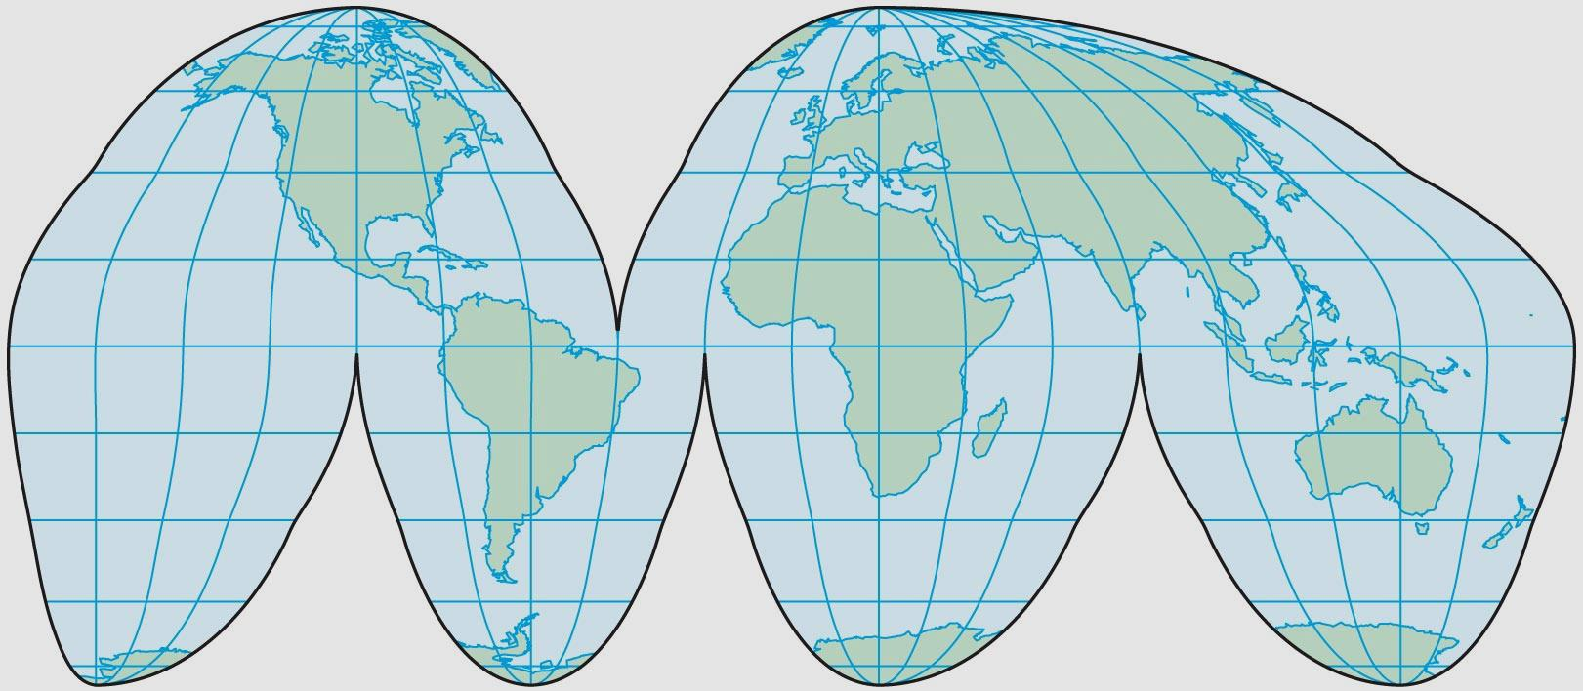
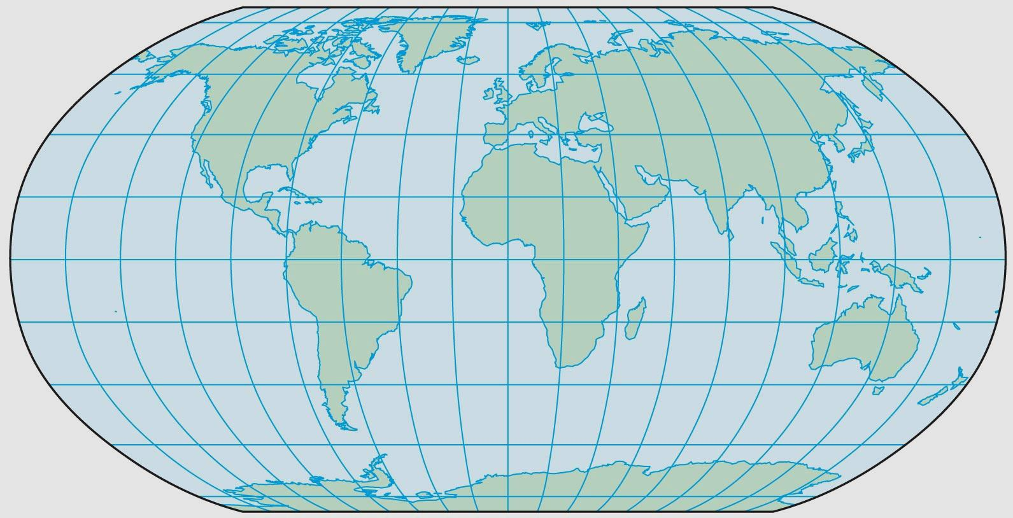
Goode’s projection
Mercator projection
Robinson’s projection

Slide 26
B. Solutions to the Problem
1. Cylindrical projections
2. Azimuthal projections

Slide 27
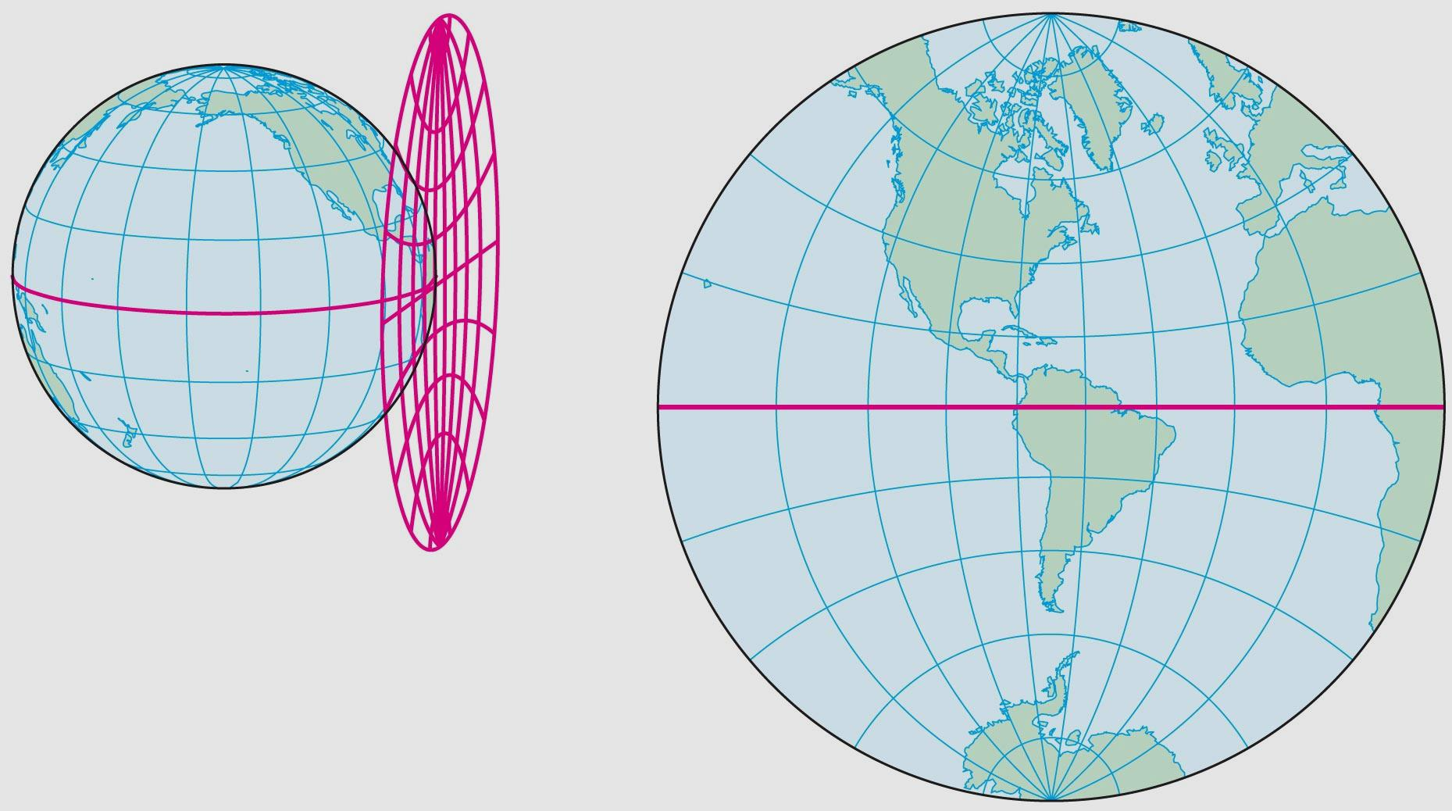
Azimuthal projection

Slide 28
B. Solutions to the Problem
1. Cylindrical projections
2. Azimuthal projections
3. Conic projections

Slide 29
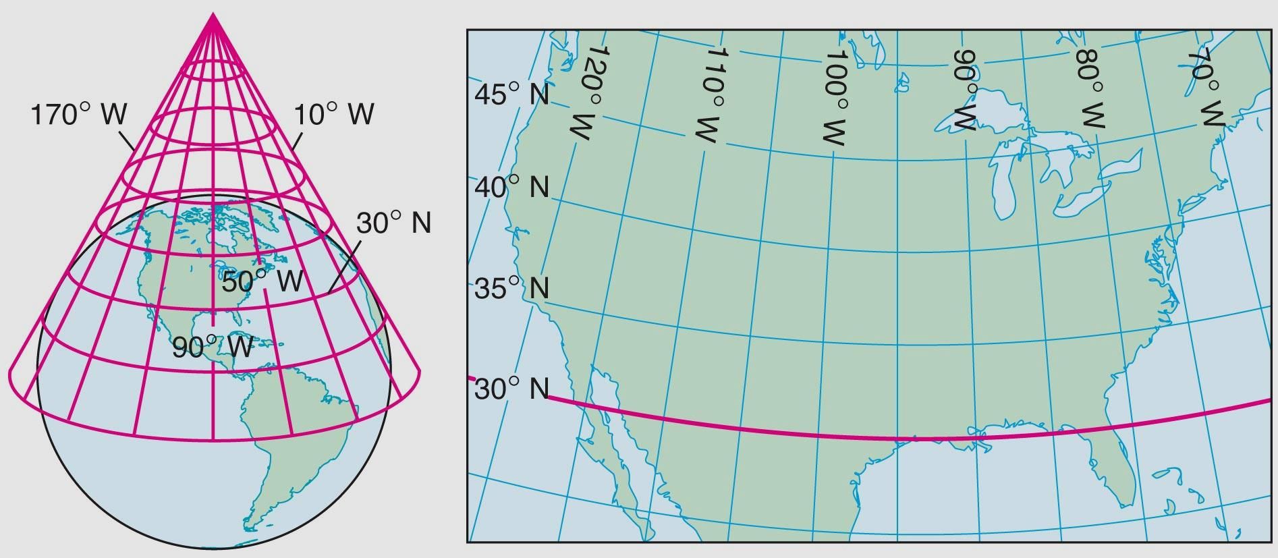
Conic projection

Slide 30
C. Types of Maps
*Mental map
1. Political maps
2. Physical maps
3. Topographic (relief) maps
4. Roadmaps

Slide 31
5. Climate maps
6. Economic or resource maps
7. Specialized maps

Slide 32
Most maps include symbols that represents various features in abbreviated form.
The meanings of the symbols are shown in a legend.

Slide 33
Maps often contain a compass rose and a scale.

Slide 34
D. GIS
1. Geographic information system
2. Data collection

Slide 35
IV. Relief Maps

Slide 36
relief
the different heights and depths of a surface or region

Slide 37
IV. Relief Maps
A. Showing the Three-Dimensional Earth
1. May actually be “raised relief”
2. Contour lines
B. Reading Relief Maps

