Slide 2
I. The Earth’s History

Slide 3
I. The Earth’s History
A. The Creation
B. The Flood
1. Cataclysm- a violent upheaval in the earth’s crust
2. Uniformitarianism- the belief that geographic processes have always been the same.

Slide 4
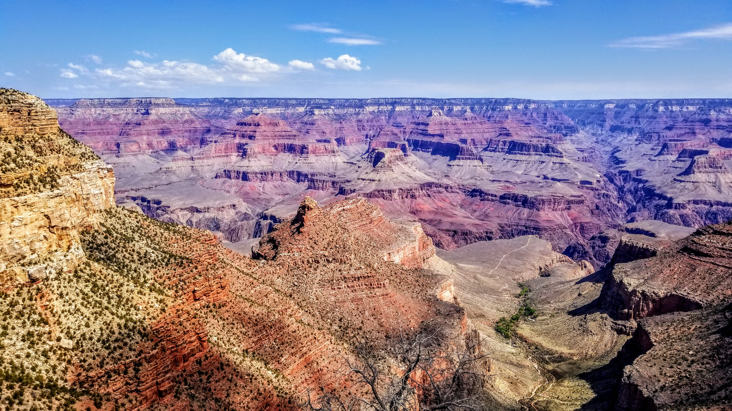

Slide 5
neocatastrophists
geologists who reject the biblical account but admit that the current condition of the earth’s surface cannot be explained by gradual, uniform processes alone

Slide 6
The impact of the Flood was greater than anything we have ever witnessed.

Slide 7
II. The Earth’s Surface

Slide 8
atmosphere
the covering of air that surrounds our planet

Slide 9
lithosphere
the solid part of the earth

Slide 10
hydrosphere
the water on the earth’s surface

Slide 11
II. The Earth’s Surface
A. The Land
1. The Earth’s Layers
a. Crust
b. Mantle
c. Core

Slide 12
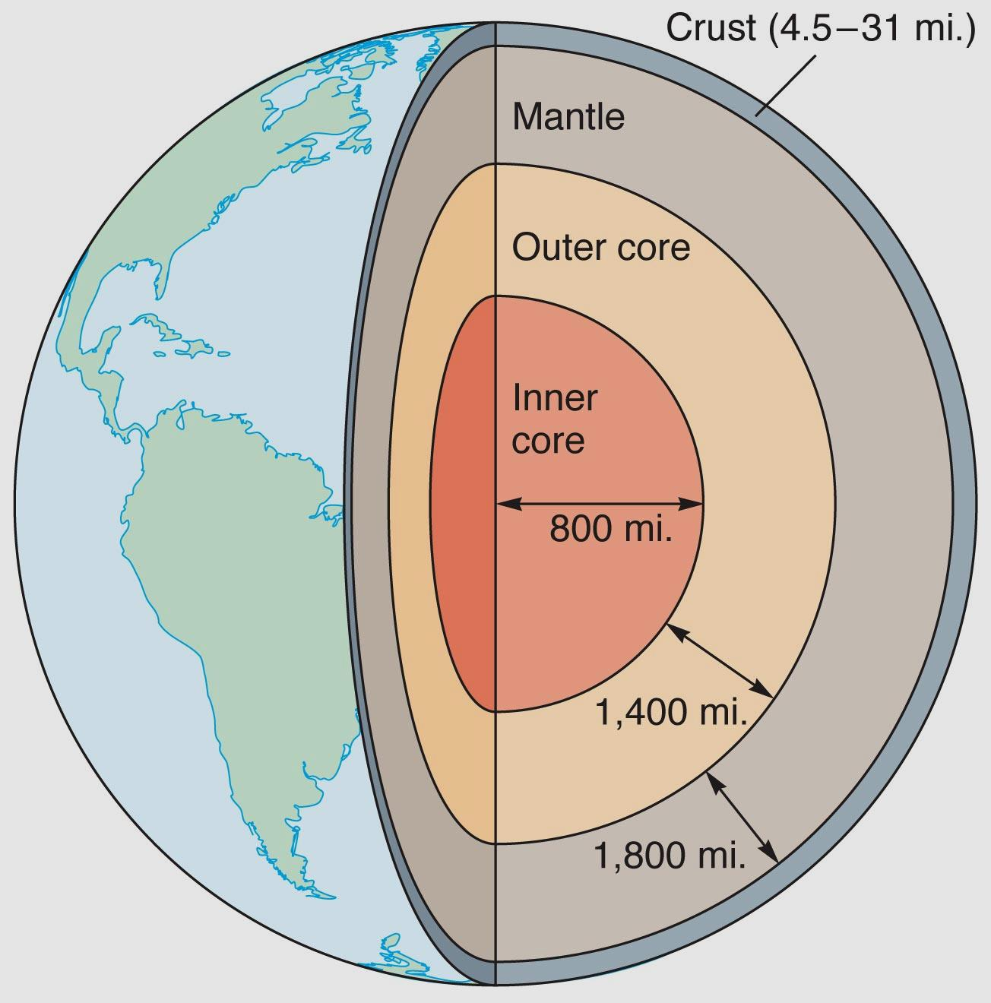
Layers of the earth

Slide 13
2. The continents
B. The Major Landforms
1. Mountains
a. Mountain ranges
b. Influence weather and vegetation
c. Influence human settlement

Slide 14
2. Plains
a. Wide areas of level land
b. Alluvium
3. Plateaus
a. Rise abruptly from surroundings
b. Tablelands, highlands

Slide 15
III. The Earth’s Waters

Slide 16
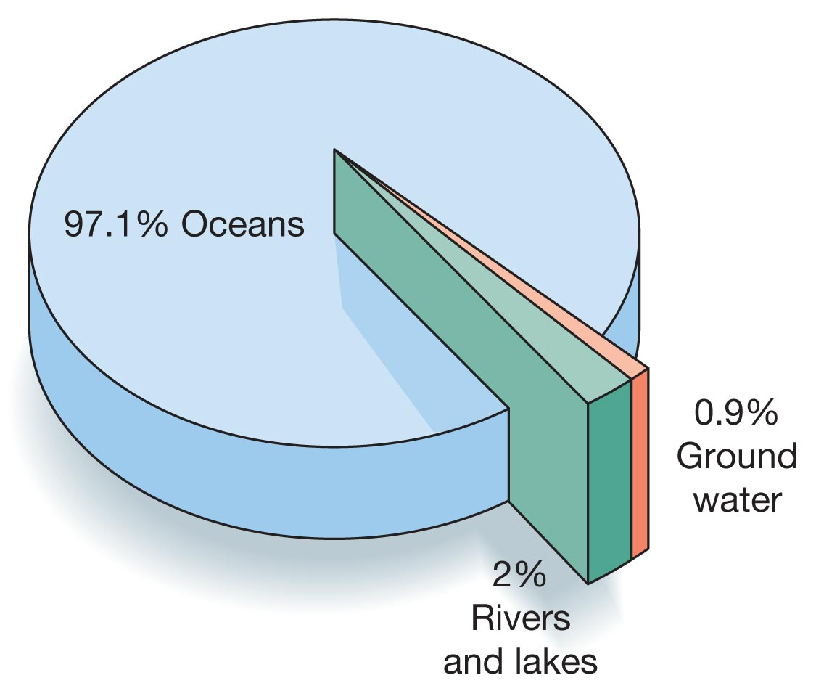

Slide 17
III. The Earth’s Waters
A. The Importance of Water
1. Less than 3% of the earth’s water is fresh
2. Means for travel and trade

Slide 18
B. The Major Bodies of Water
1. Oceans
2. Rivers

Slide 19
tributaries
rivers that “feed” other rivers

Slide 20
2. Rivers
a. Length
b. Discharge
c. Drainage area
d. Navigability
e. Effects on history

Slide 21
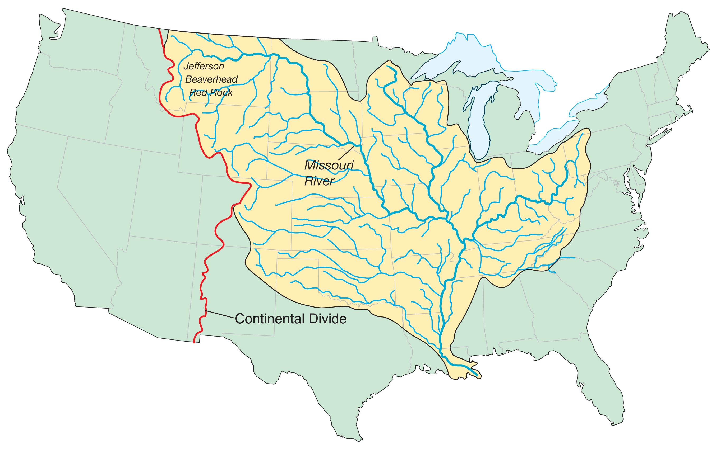

Slide 22
3. Lakes
a. Fully enclosed by land
b. Freshwater lakes
c. Salty lakes

Slide 23
4. Seas- arms of the ocean partially enclosed by land
a. Favored by sailors
b. Harbors- a sheltered body of deep water next to the shore

Slide 24
5. Wetlands

Slide 25
a. bogs- Spongy areas that look
dry but are filled with wet organic
materials

Slide 26
b. marshes- standing water with
plants and grasses.

Slide 27
c. swamps- standing water
dominated by large trees

Slide 28
IV. The Earth’s Surface–Changing Forces

Slide 29
IV. The Earth’s Surface
A. Internal Forces
1. Plate tectonics
a. Faults
b. Folds
2. Volcanic Forces

Slide 30
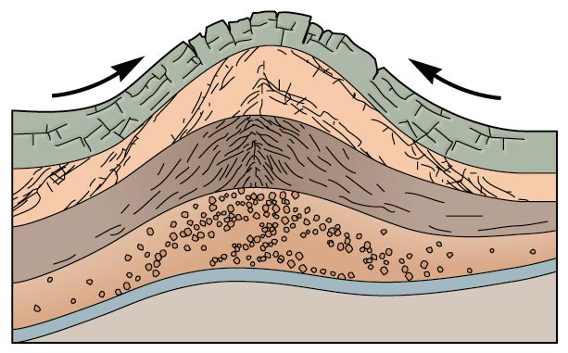

Slide 31
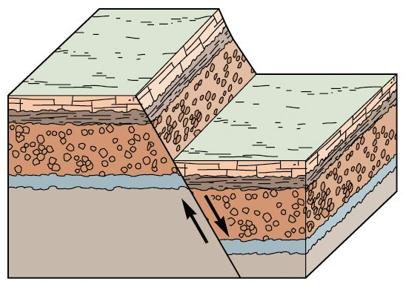

Slide 32
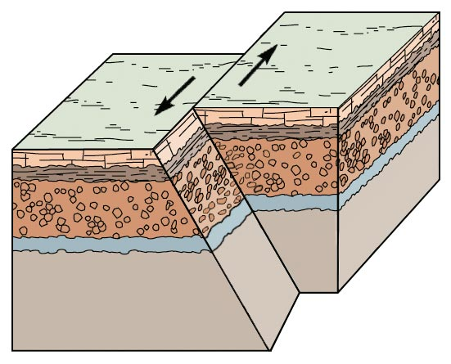

Slide 33
Deformational Mountains- Caused by tectonic forces deforming the rocks.
Depositional Mountains- Caused by volcanic deposit

Slide 35
B. External Forces
1. Weathering
a. Breaking down of rocks
b. Humus

Slide 36
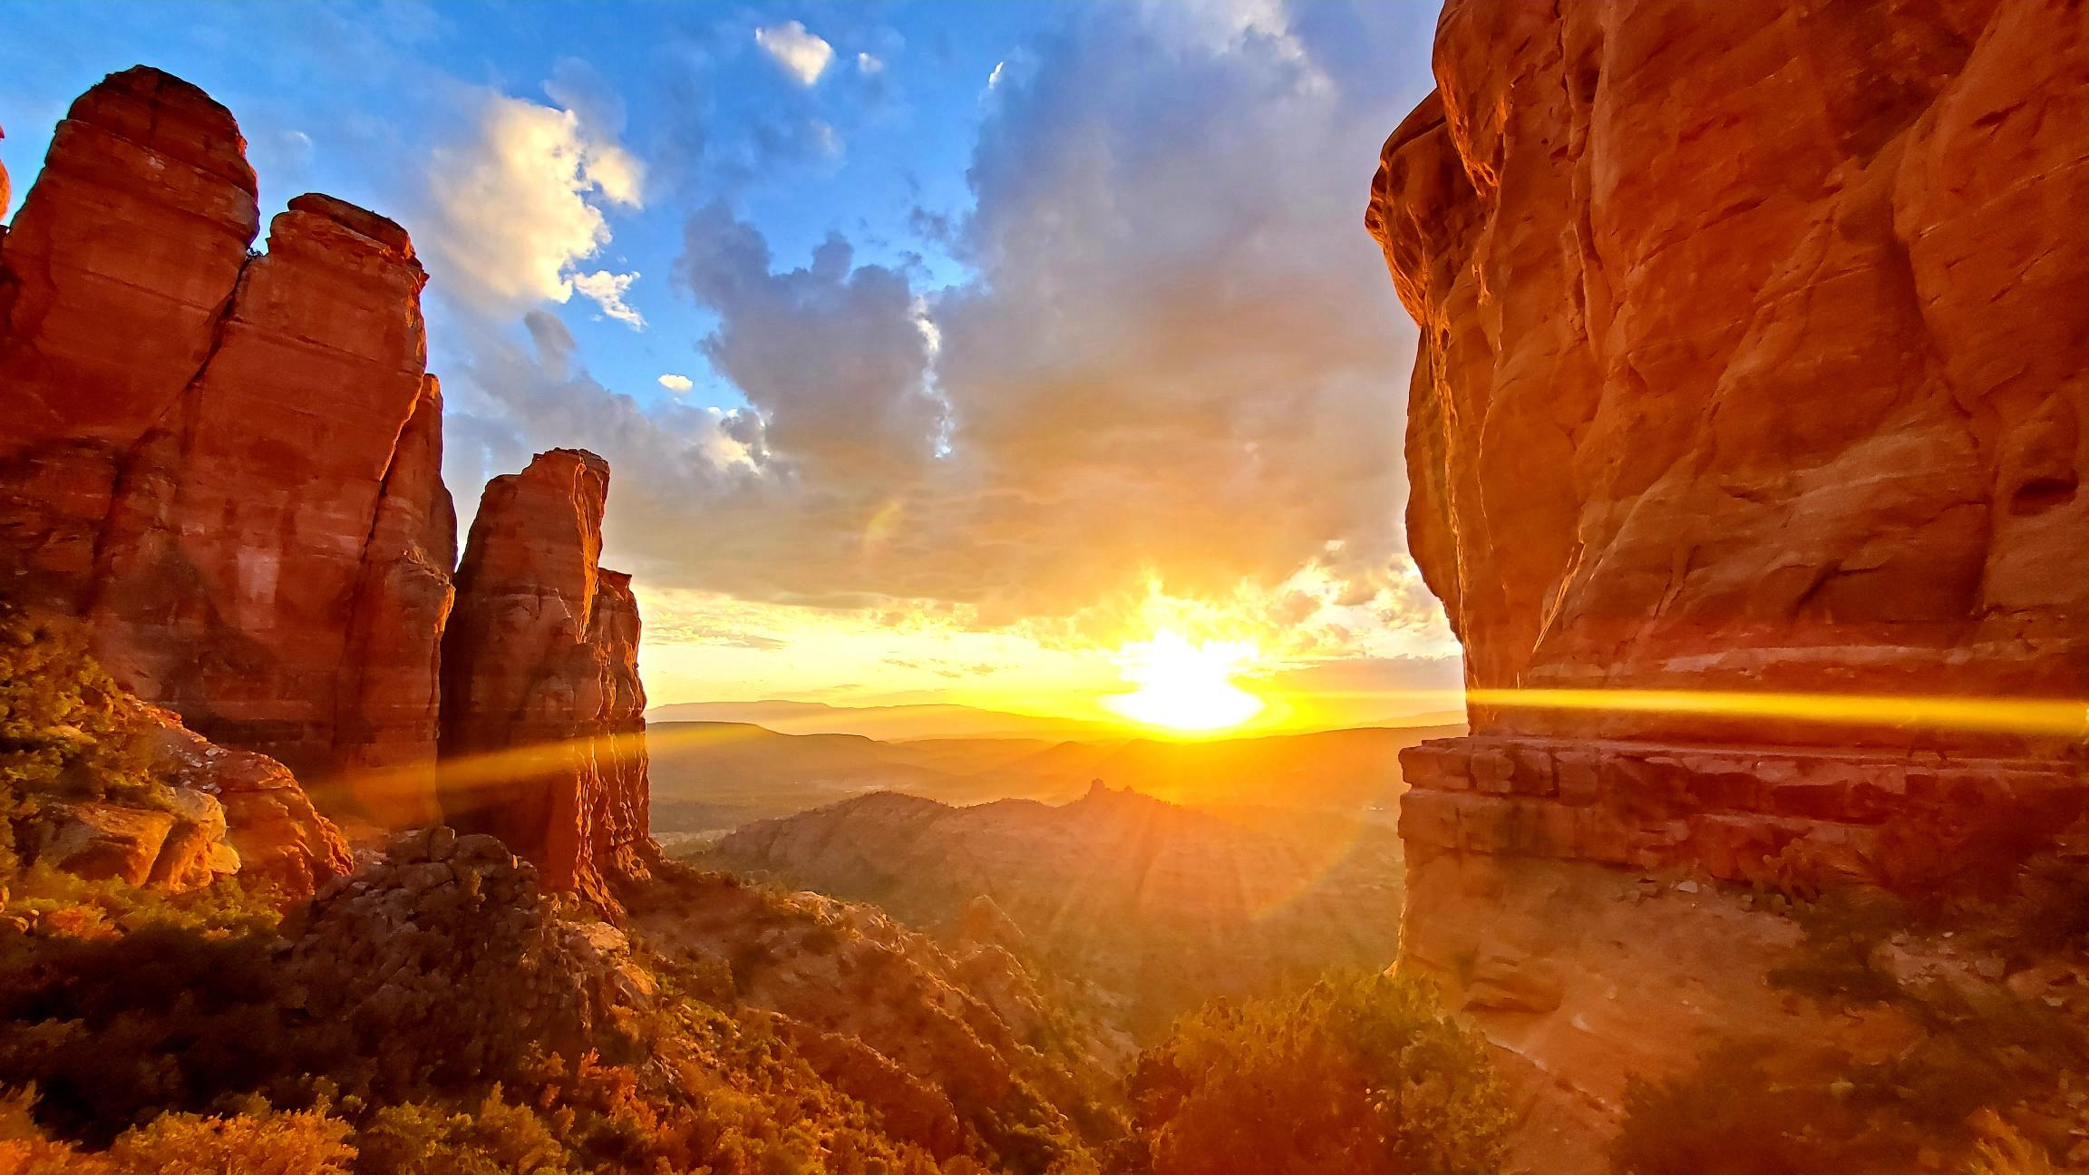

Slide 37
2. Erosion
a. Wind and water
b. Glaciers

Slide 38
V. The Earth’s Climate

Slide 39
V. The Earth’s Climate
A. Thermal Energy in Motion
1. Seasons
a. Low latitudes/tropics
b. Middle latitudes/Temperate Zone
c. High latitudes/polar regions

Slide 40
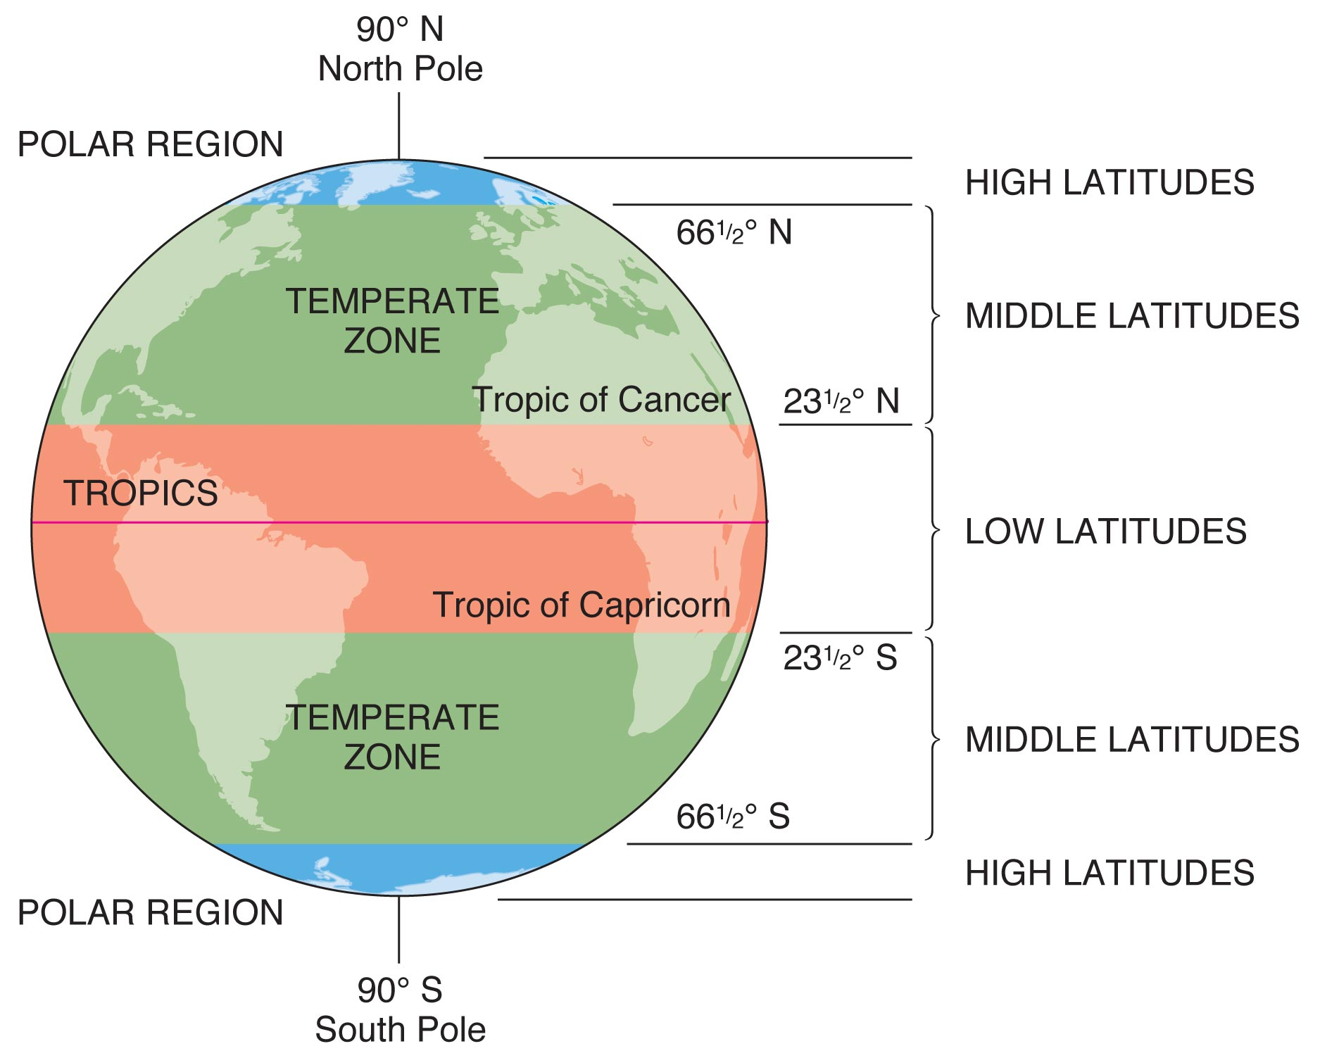

Slide 41
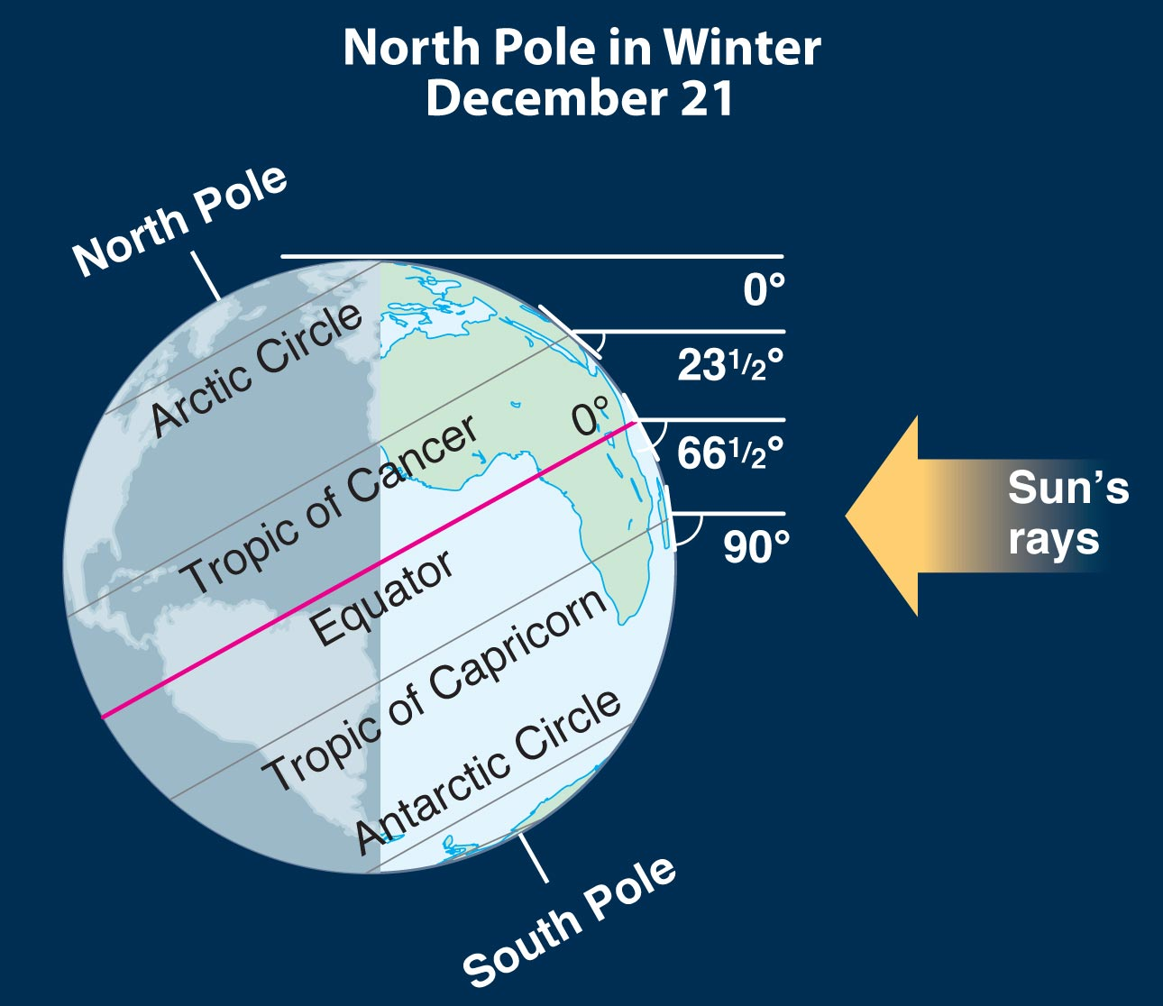

Slide 42
2. Winds
a. Warm and cold air masses
b. Coriolis Effect
c. Wind belts
3. Ocean Currents

Slide 43
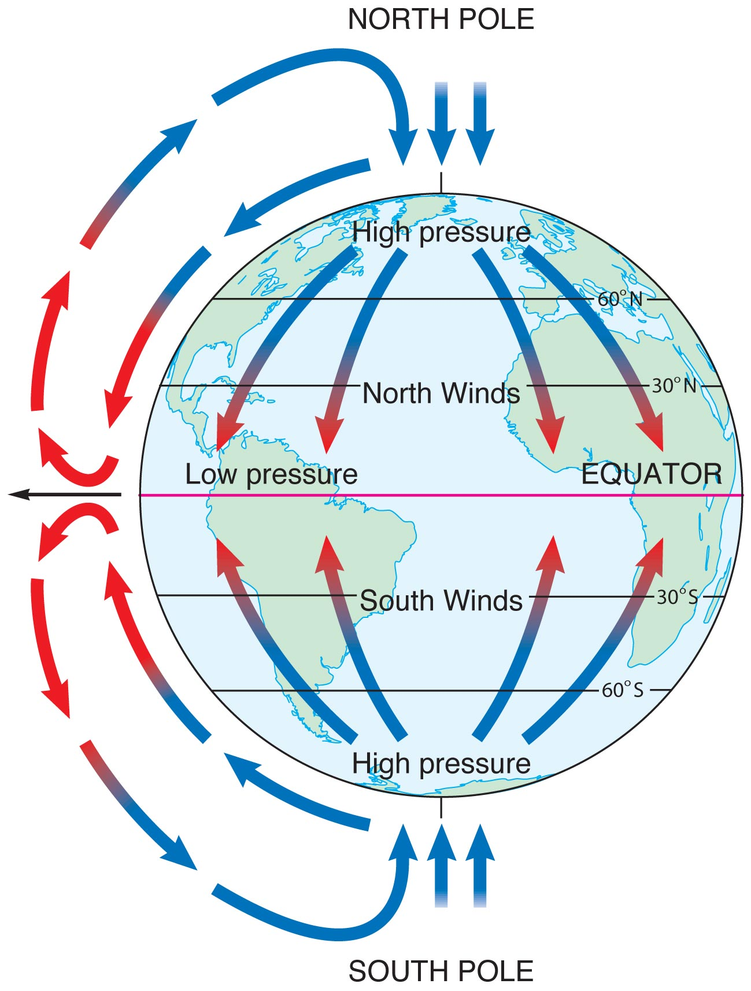

Slide 44
B. Water in Motion
1. The Hydrologic Cycle
a. Humidity
b. Dew point
c. Precipitation
d. Ground water

Slide 45
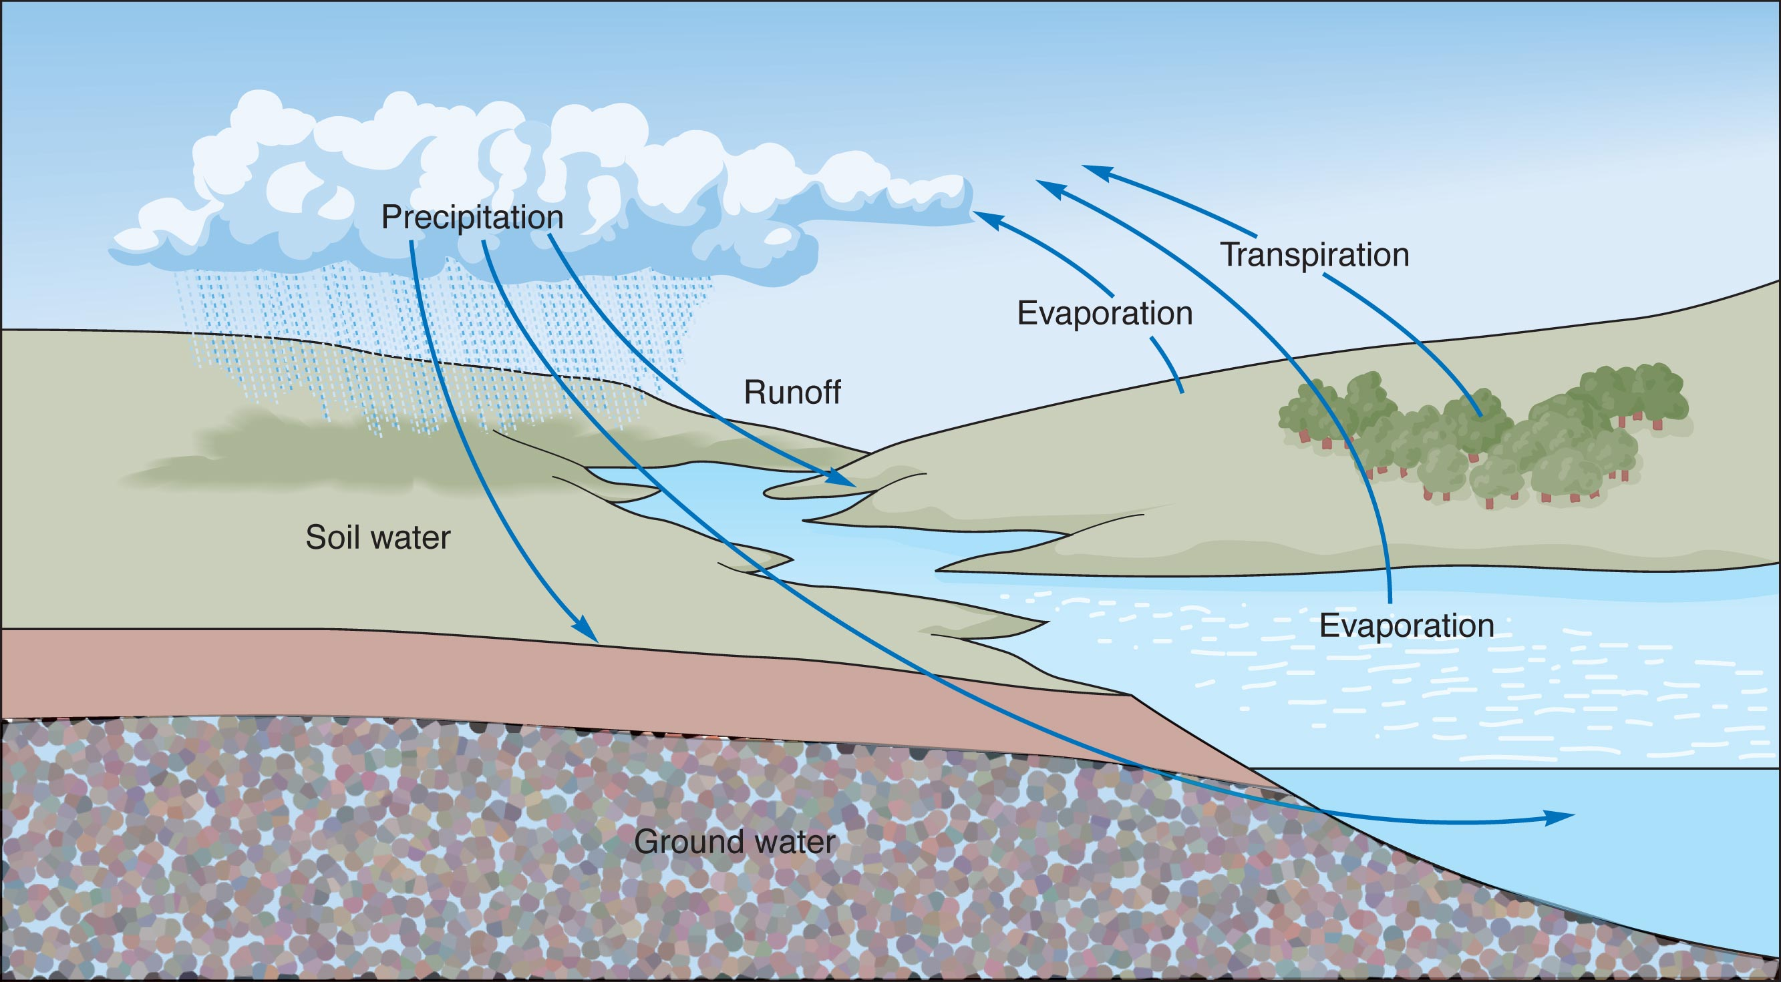
Hydrologic cycle

Slide 46
2. Causes of Precipitation
a. Orographic
Rainshadow
b. Frontal
c. Convection

Slide 47
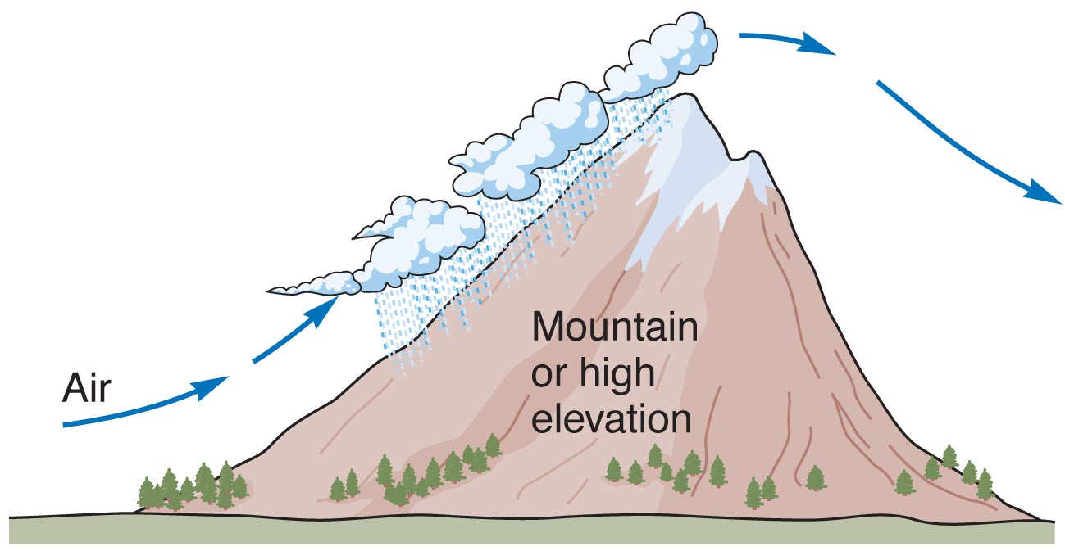

Slide 48
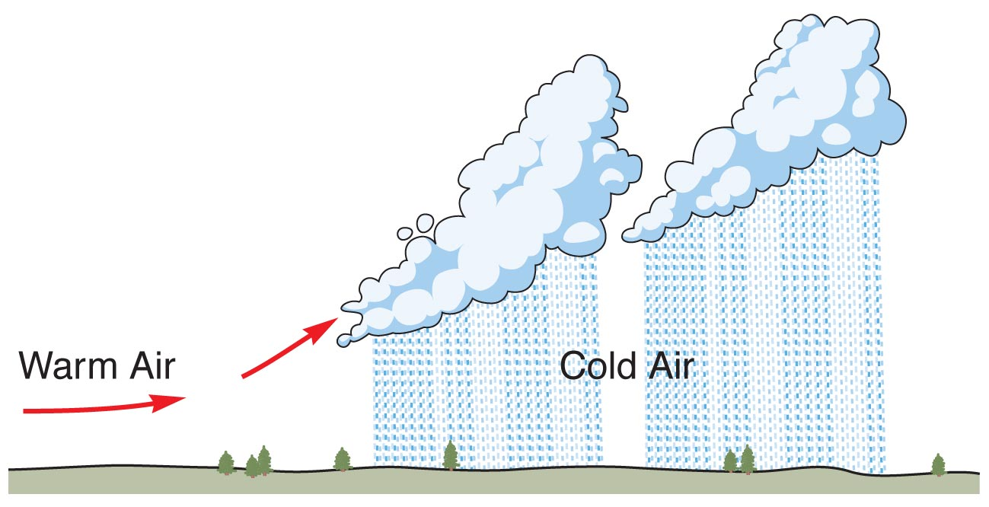

Slide 49
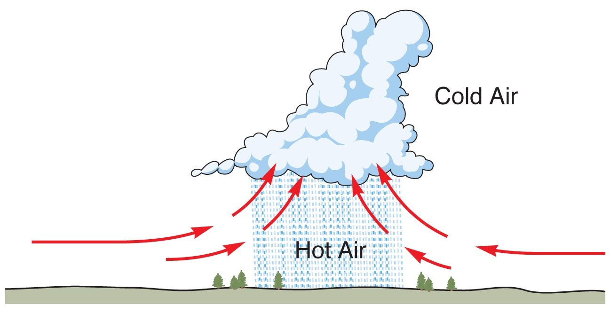

Slide 50
climate
the typical weather in a region over a long period of time

Slide 51
weather
the atmospheric conditions of a location at a specific moment in time

Slide 52
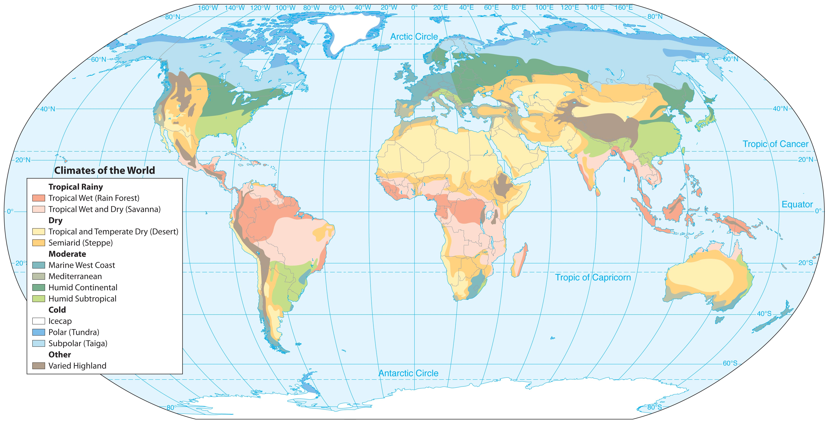

Slide 53
C. Climates
1. Tropical Rainy
2. Dry
a. Arid
b. Semiarid

Slide 54
3. Cold
a. Polar
b. Subpolar
4. Moderate
a. Humid subtropical
b. Humid continental

Slide 55
c. Mediterranean
d. Marine west coast
5. Varied Highland

Slide 56
VI. The Earth’s Vegetation

Slide 57
vegetation
the plants in an area or region

Slide 58
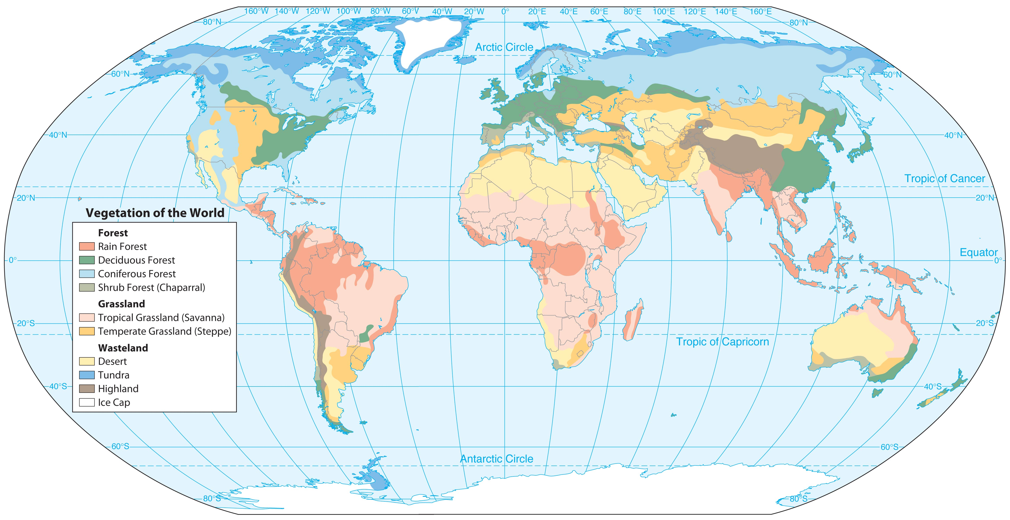

Slide 59
biome
a large geographic area that contains a particular group of plants and animals and has a specific physical environment

Slide 60
VI. The Earth’s Vegetation
A. Forests: Trees are predominant
1. Tropical Rain Forest
2. Shrub Forest
3. Coniferous Forest
4. Deciduous Forest

Slide 61
B. Grasslands: Grass is common
1. Tropical Grassland (savannah)
2. Temperate Grassland (steppe)

Slide 62
C. Wastelands: Barren most of the year
1. Desert
2. Tundra

Slide 63
D. Highland Vegetation
E. Our Place in the World’s Biomes

Slide 64
What is sustainable development?

