Slide 1
Featuring: Alka Seltzer

Slide 2
Posing a question and beginning the research
Developing a hypothesis
Experimental Design
Interpreting data
Drawing conclusions
Communicate results

Slide 3
1. Posing a question and beginning the research
A scientific question is one that can be answered by gaining evidence and data.
Scientists WONDER and are CURIOUS human beings
ALKA SELTZER – What was the starting question?

Slide 4
2. Developing a hypothesis
A hypothesis is a possible explanation for a set of observations
A hypothesis must be able to be tested
A strong hypothesis is shown as an "if... then… because..." statement
Example: IF a plant is exposed to sunlight, THEN it will grow taller than a plant that is not in sunlight BECAUSE it create more glucose during photosynthesis.
ALKA SELTZER – What was the original hypothesis?

Slide 5
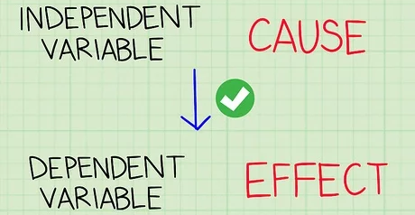
3. Experimental Design
Design will be made to test the hypothesis by a detailed step-by-step procedure and we need to identify the different variables
Variables are any factors of an experiment that can be changed
Independent Variable – the factor you want to test; the variable being changed by you ON PURPOSE
Dependent Variable – the factor being measured or observed during an experiment; the variable being changed because of the independent variable
Constants– kept the same for every treatment
ALKA SELTZER -
Independent variable was... ?
Dependent variable was…?
Some constants were…?

Slide 6
Posing a question and beginning the research
Developing a hypothesis
Experimental Design
Interpreting data
Drawing conclusions
Communicate results
We will continue examining the Scientific Method tomorrow.

Slide 7
Use remainder of class time to work on #1: Were you focused?
Will let you edit after you submit - feel free to modify answers after submission.
Due before class tomorrow.

Slide 8
Posing a question and beginning the research
Developing a hypothesis
Experimental Design
Interpreting data
Drawing conclusions
Communicate results
Let’s continue examining the Scientific Method.

Slide 9
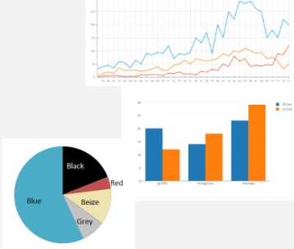
4. Interpreting Data
The qualitative and quantitative measurements made during the experiment are data
At the end of the experiment it is time to analyze the data to determine what the results of the experiment MEAN
Can be analyzed by using charts, graphs, tables, mathematical operations (mean, median, mode), etc.
ALKA SELTZER – how could we interpret the data we gained?

Slide 10
5. Drawing Conclusions
A conclusion is the last part of an experiment findings are clearly summarized
Not necessarily the end of the experiment – one conclusion can lead directly to another experiment
ALKA SELTZER – What conclusions can be drawn and how can we interpret them?

Slide 11
6. Communicate Results
Once a conclusion has been reached, results can be shared with the rest of the scientific community to verify results
Examples of communicating results:
Publish research to scientific journals
Share research with general public in news, internet, social media, etc.
Speak at a conference
Call up your science BFF and tell them all about the research

Slide 13
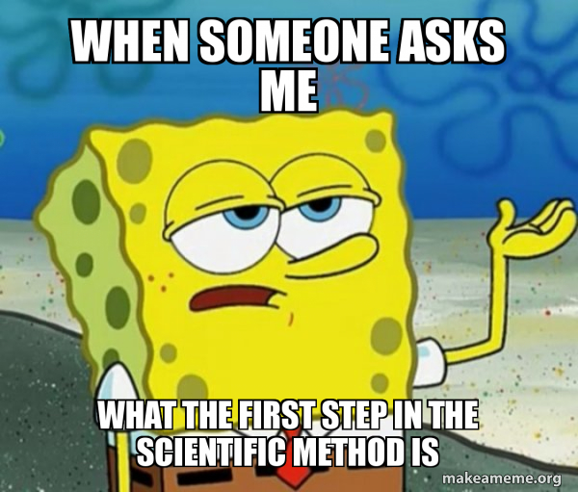
#2: Identifying Variables
Work with your small group to complete #2: Identifying Variables
Communicate with each other to determine the correct answers!
Stuck? Check Week 1 Slides (on your class home page) or raise your hands for support.
We will check our answers tomorrow.

