Slide 1
Unit I: Horizons (1488–1760)
1488
Dias rounds the Cape of Good Hope
1588
Defeat of the Spanish Armada
1492
Columbus lands in the New World
1519–22
Magellan’s fleet sails around the world
1607
Founding of Jamestown
1500
1550
1600
1519
Cortés arrives in Mexico
1620
Pilgrims come to the New World
1498
Da Gama reaches India by sailing around Africa

Slide 2
1664
England conquers New Netherland
1630–40
Great Migration of Puritans to Massachusetts Bay
1682
William Penn settles Pennsylvania
ca. 1720–ca. 1760
The Great Awakening
1650
1700
1750
1692
Salem witch trials
1733
Settlers arrive in Georgia

Slide 3
Chapter 1: New and Old Worlds Meet

Slide 4
Big Ideas
What changes in the Old World led to exploration of the New World?
What did Europeans discover in the New World, and what changes did they bring to the New World?

Slide 5
New and old worlds meet
Marco Polo’s adventures in China had spanned nearly twenty years.
His stories were told in Description of the World.
Marco Polo

Slide 6
Changes in the old world

Slide 7
Guiding questions
How did Europeans become interested in the riches of Asia?
How did European explorers travel to Asia?
How did the Protestant Reformation prompt many Europeans to travel to the New World?

Slide 8
China, Innovations, and Mercantilism
New innovations
Compass
Astrolabe
Caravel
Notes:
https://pixabay.com/photos/compass-map-direction-degrees-2946959/; pixabay/CC0

Slide 9
China, Innovations, and Mercantilism
Monarchs in Europe were gradually shifting from the feudal economic thinking prevalent during the Middle Ages to a nationalistic economic system of thought known as mercantilism.
Mercantilists believed that a nation’s wealth consisted of precious metals, especially gold.
Mercantilists were nationalists who believed that a country could increase its wealth by increasing its surplus of gold.

Slide 10
China, Innovations, and Mercantilism
Mercantilists sought to achieve a “favorable balance of trade,” that is, to export more than they imported, thereby collecting even more gold.

Slide 11
Sugar and spice
The Portuguese led the way in 1488 when Bartolomeu Dias sailed southward along the west coast of Africa and rounded its southern cape, which he optimistically called Good Hope.
Bartolomeu Dias
Notes:
World History 4th/279tr; "Bartolomeu Dias, South Africa House" by RedCoat/Wikimedia Commons/GNU FDL/CC-BY-SA-3.0

Slide 12
Sugar and spice
A decade later, Vasco da Gama followed up Dias’s discovery by sailing to India.
Vasco da Gama returned to Portugal with a cargo of spices worth sixty times the cost of his expedition.

Slide 13
Sugar and spice
Spaniards looked in another direction for trade with Asia.
Christopher Columbus reasoned that the shortest route to the East was west.
Christopher Columbus
Notes:
US History 5th/5b; "Christopher Columbus"/Wikimedia Commons/Public Domain

Slide 14
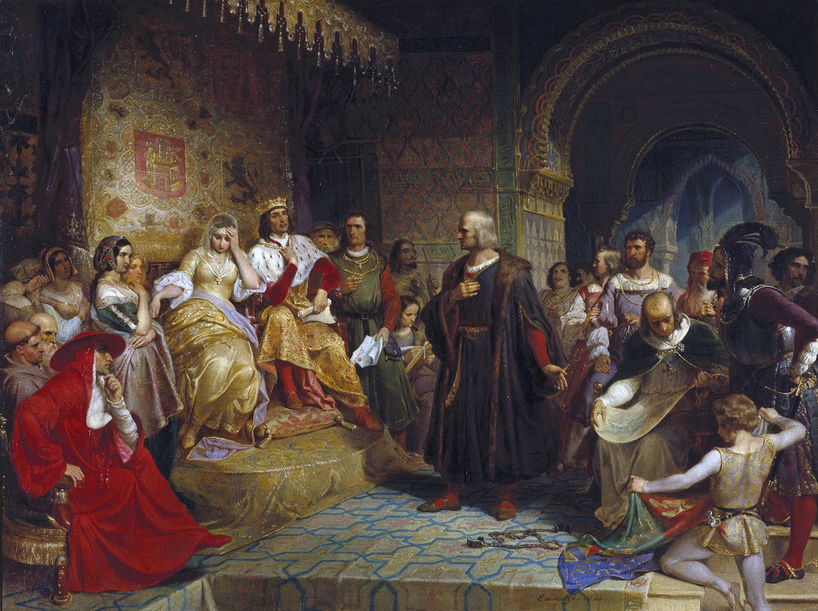
Columbus petitioning Queen Isabella
Notes:
https://commons.wikimedia.org/wiki/File:Emanuel_Gottlieb_Leutze_-_Columbus_Before_the_Queen.JPG; Columbus Before the Queen by Emanuel Leutze, 1843/Wikimedia Commons/Public Domain

Slide 15
Sugar and spice
Columbus sailed west and landed in the Bahamas.
Columbus was certain that he was on an island of the Indies, off the coast of mainland Asia; thus, he called the people los indios—Indians.
Amerigo Vespucci made at least two voyages to the Caribbean and South America.
In 1507 a German mapmaker named this area not Columbus, but “America” in honor of Amerigo.

Slide 16
Sugar and spice
In 1497, the Italian explorer Giovanni Caboto—known to the English for whom he sailed as John Cabot—reached Newfoundland in his search for a passage to China.
John Cabot
Notes:
https://en.wikipedia.org/wiki/File:JohnCabotPainting.jpg; Detail of John Cabot from a mural painting in the Palazzo Ducale by Giustino Menescardi, 1762/Wikimedia Commons/Public Domain

Slide 17
Sugar and spice
Ferdinand Magellan determined that he could reach the Spice Islands of the East by sailing south around the Americas.
Magellan died in the Philippines, but his crew was the first to circumnavigate the world!

Slide 18
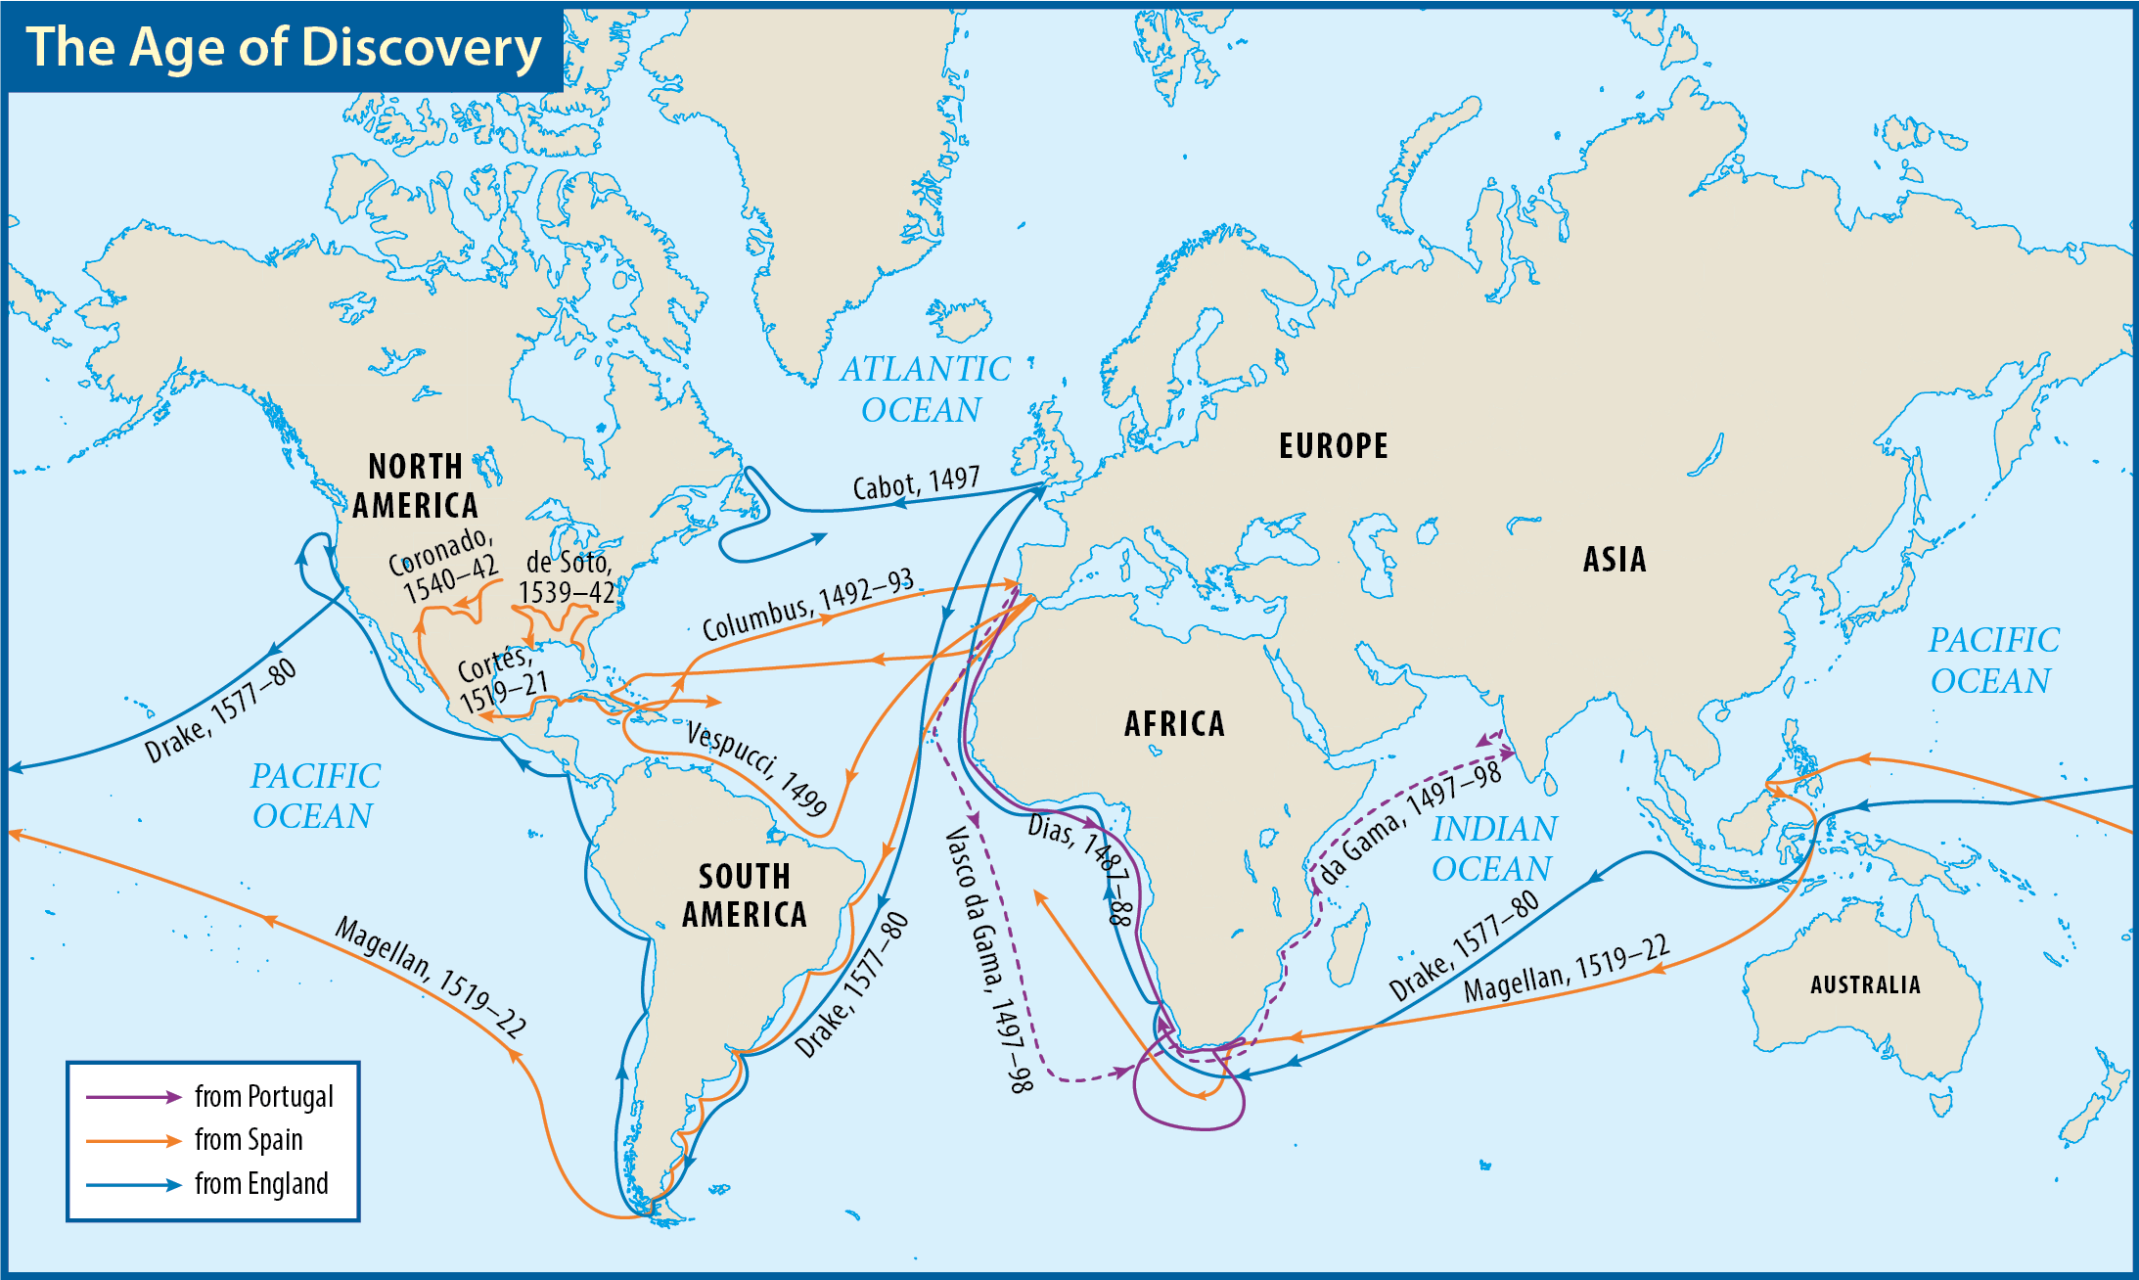
Map Resources

Slide 19
Religious change
Martin Luther stood against the corruptions of the Roman Catholic Church.
Luther preached that salvation was a work of God.
The Protestant Reformation pressed for changes in the culture of Europe.
As the Reformation spread across Europe, theological battle lines often became actual battle lines.
Martin Luther

Slide 20
Religious change
Geneva, Switzerland, soon became one of the leading centers of the Reformation.
John Calvin was Geneva’s most influential teacher.
Calvin’s ideas proved to be very influential in Europe.
John Calvin

Slide 21
Section review
Who was responsible for stirring European interest in China before the Age of Discovery? How did he do so?
Marco Polo; by his description of China and its wonders in Description of the World (p. 3)
How did the Crusades affect European trade?
As European participants in the Crusades returned to Europe, they brought products from Asia. This sparked an increase in trade between the two continents. (p. 4)

Slide 22
Section review
What name was given to the economic system during the age of exploration and colonization whereby colonies were exploited for the benefits and wealth they could bring to the mother country?
mercantilism (p. 4)
How did Columbus’s plan for reaching Asia differ from da Gama’s?
Da Gama reached Asia by sailing east around the southern tip of Africa; Columbus wanted to sail west and reach Asia directly. (p. 5)

Slide 23
Section review
What was Martin Luther’s main disagreement with the Roman Catholic Church?
Luther came to realize that salvation from sin was a gift of God received by faith in Christ’s death and resurrection; the Roman Catholic Church taught that salvation was given by the Church and that one had to work through the system of penance to receive it. (p. 7)

Slide 24
Section review
Explain the innovations in technology that made exploration much easier for the Europeans.
The compass enabled sailors to know in which direction they were heading. The astrolabe allowed sailors to determine their ship’s latitude on the ocean. The caravel, a small light ship with two or three triangular sails, was extremely maneuverable.

Slide 25
Section review
How did the teachings of men such as Luther and Calvin support the ideals of (a) freedom, (b) individualism, and (c) equality?
a. Freedom: Luther taught that believers were free from the illegitimate religious authority of the Roman Catholic Church. Calvin believed that liberty was important, and he suggested that the government be elected by the citizens to protect that liberty.

Slide 26
Section review
b. Individualism: Luther emphasized that Christians should take responsibility for their own spiritual wellbeing. He and Calvin encouraged Christians to read the Bible for themselves.
c. Equality: Luther and Calvin believed that all Christians needed to be educated so that everyone could read the Bible. Also, Calvin taught that all vocations were sacred callings, not just the ministerial vocations.

Slide 27
Contacts in the new world

Slide 28
Guiding questions
What civilizations did Europeans discover in the New World?
What Spanish explorers made discoveries in the New World, and why was Spain’s approach to governing its colonies unwise?
How did other European nations settle the New World, and how did English settlements differ from the Spanish and the French?

Slide 29
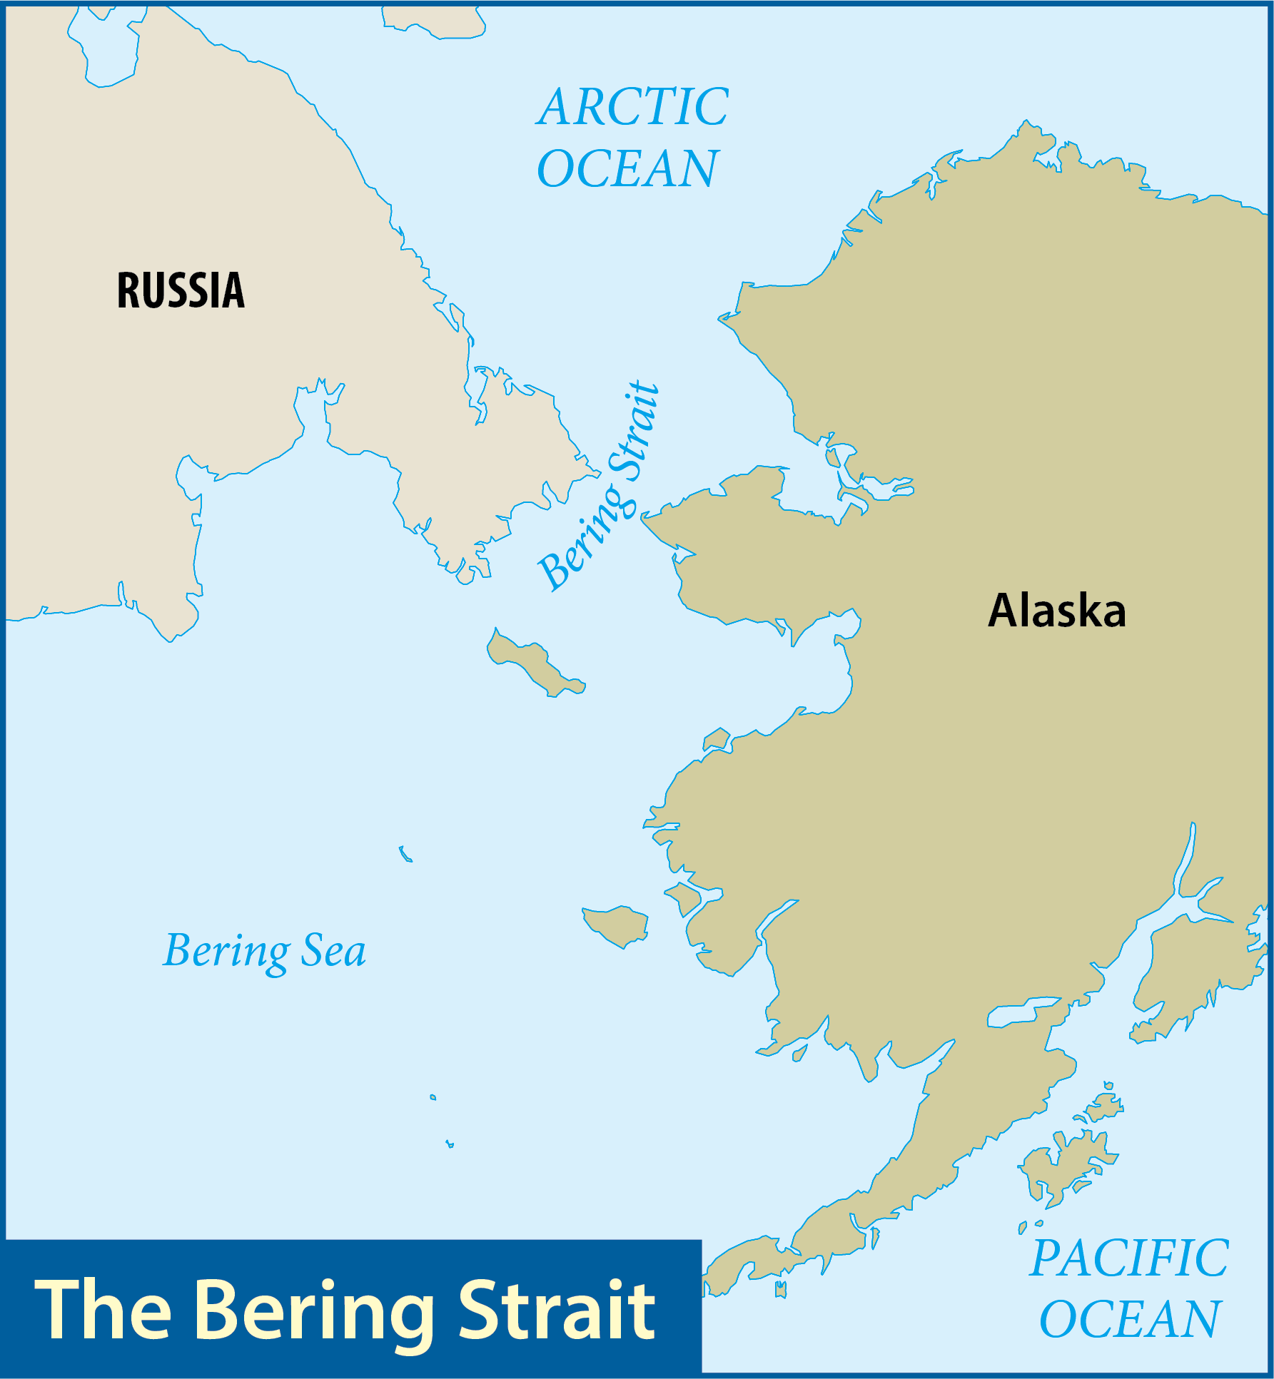
Map Resources

Slide 30
First peoples
Some historians think American Indians crossed the narrow Bering Strait in small boats or on foot over a bridge of ice.
Historians of American Indians usually group them into tribes and culture areas.
Notes:
https://pixabay.com/photos/teepee-tent-indigenous-3495990/; pixabay/CC0

Slide 31
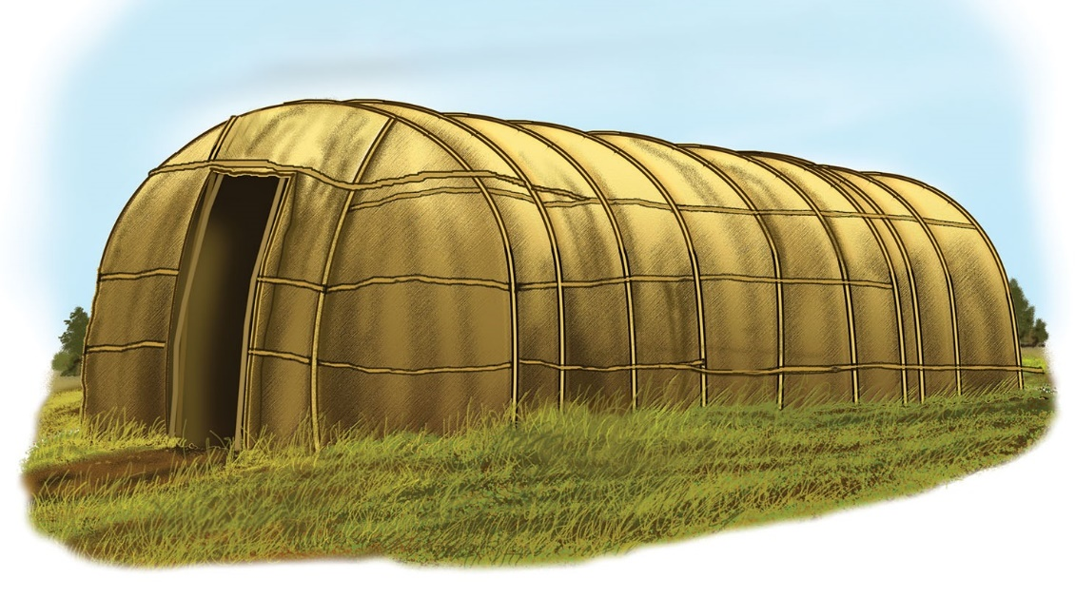
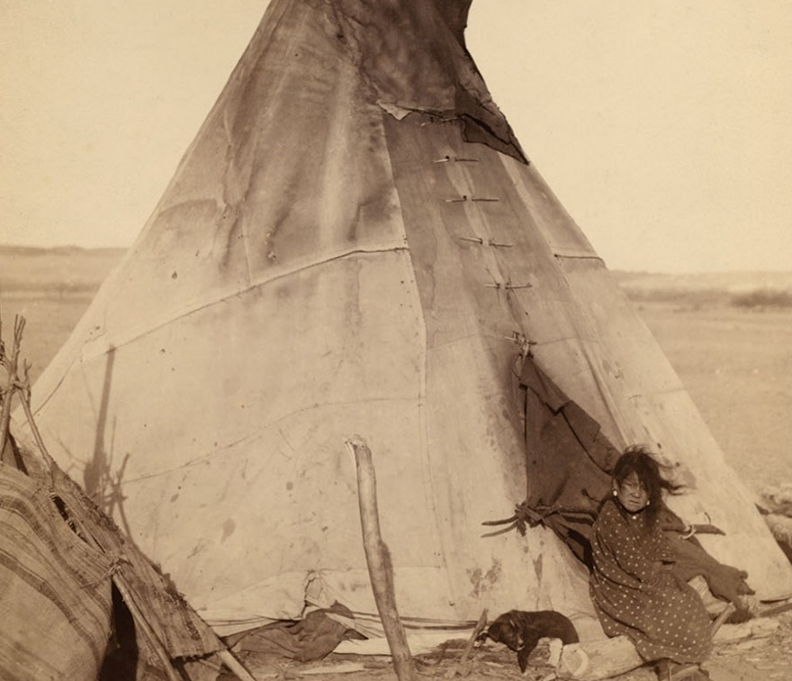
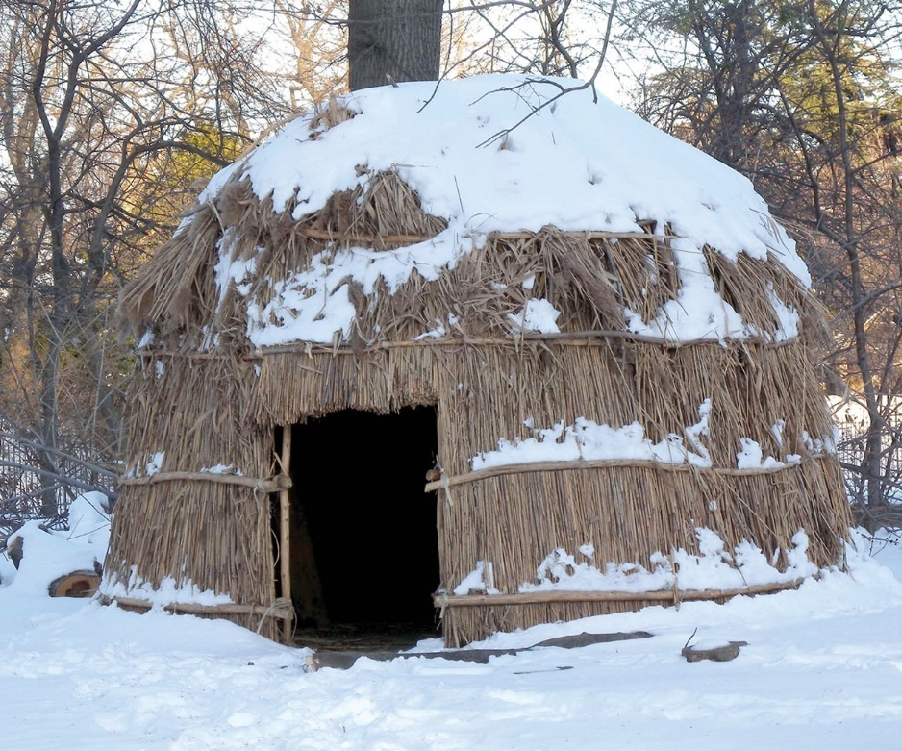
tipi
longhouse
wigwam
Notes:
US History 5th/9bl; BJU Press Art
US History 5th/9bc; "Lefferts Wigwam jeh" by Jim.hendersen/Wikimedia Commons/Public Domain
US History 5th/9br; "Oglala girl in front of a tipi"/Wikimedia Commons/Library of Congress/Public Domain

Slide 32
The pueblos
The Pueblo Indians lived in small villages made up of two or three family groups or clans.
Some of the Pueblo Indians lived in caves along the rims or under ledges of canyons of the Southwest and became known as the cliff dwellers.
Notes:
https://pixabay.com/photos/mesa-verde-colorado-balcony-house-986408/; pixabay/CC0

Slide 33
The pueblos
Some of the tribes among the Pueblos were the Zuni, the Hopi, and the Taos.
Pueblo Indians were farmers, growing maize (corn), squash, and beans.
Notes:
https://pixabay.com/photos/mesa-verde-colorado-balcony-house-986408/; pixabay/CC0

Slide 34
The mound builders
Two successive cultures developed in what is now called the Midwest: the Adena culture (1000 BC to AD 200) and the Hopewell culture (AD 500 to 1600).
They were noted for the hundreds of large mounds they built; hence, they were called the Mound Builders.
Notes:
https://pixabay.com/photos/landscape-burial-mounds-trees-sky-330381/; pixabay/CC0

Slide 35
The mound builders
The Mound Builders developed an extensive, almost continent-wide trading network.
Notes:
https://pixabay.com/photos/landscape-burial-mounds-trees-sky-330381/; pixabay/CC0

Slide 36
Eastern Woodlands Indians
The Eastern Woodlands Indians lived in the Southeast and along the Atlantic coast into the Northeast.
These tribes were probably the first Indians the English, French, Dutch, and Swedish settlers encountered in the New World.
inside a longhouse
Notes:
https://pixabay.com/photos/native-american-house-history-2448140/; pixabay/CC0

Slide 37
Eastern Woodlands Indians
They were a politically skillful people, not unorganized and uncivilized.
In the Southeast, this group included the Cherokees, Chickasaws, Choctaws, Creeks, and Seminoles.
Northern tribes of Eastern Woodlands Indians included the Mohawks, Oneidas, Senecas, Cayugas, Onondagas, and Tuscaroras.
inside a longhouse
Notes:
https://pixabay.com/photos/native-american-house-history-2448140/; pixabay/CC0

Slide 38
The Spanish century
Hernando Cortés was the first great conquistador.
He landed in Mexico and discovered the Aztec empire.
The great Aztec king, Montezuma, hearing of the Spanish arrival, sent representatives offering gifts.
Cortés conquered the Aztecs.
Montezuma
Notes:
https://pixabay.com/photos/aztec-montezuma-king-brown-king-545744/; pixabay/CC0

Slide 39
The Spanish century
Far more devastating to the native populations than firearms were the European diseases, to which the Indians had little immunity.
The Indian population dropped by an estimated 90 percent between the sixteenth and seventeenth centuries.

Slide 40
The Spanish century
Francisco de Coronado commanded an expedition that left Mexico in 1540 to explore what would later be the southwestern United States.
His expedition did not find gold, but one of its parties did discover and explore the Grand Canyon.
Notes:
https://pixabay.com/photos/grand-canyon-scenery-landscape-1246248/; pixabay/CC0

Slide 41
The Spanish century
In 1513, Juan Ponce de León sailed northwest from Puerto Rico in search of more rumored wealth.
He claimed Florida for Spain.
In 1565, the Spanish established the settlement of St. Augustine.
It is the oldest permanent city settled by Europeans in the present United States.
St. Augustine
Notes:
https://pixabay.com/photos/castle-san-marcos-landmark-fort-1592757/; pixabay/CC0

Slide 42
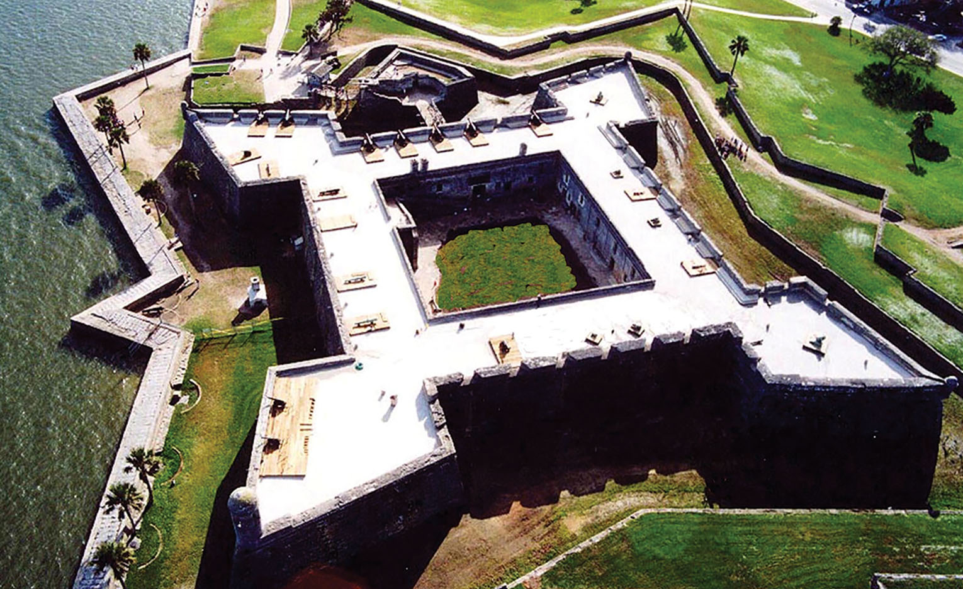
Castillo de San Marcos
Notes:
US History 5th/14t “Castillo de San Marcos”/Wikimedia Commons/Public Domain

Slide 43
The Spanish century
In 1539, Hernando de Soto landed at present-day Tampa Bay, Florida, where he began a meandering trek through Florida.
Traveling through the Deep South, he eventually discovered the Mississippi River.
Hernando de Soto
Notes:
https://commons.wikimedia.org/wiki/File:DeSoto-Hernando-1791.jpeg; Engraving of Hernando de Soto from Retratos de loas epañoles ilustres: con un epitome de sus vidas, 1791/Wikimedia Commons/Public Domain

Slide 44
International competition
Spain’s Catholic king Philip II (ruled 1556–98) was bent on crushing Protestantism in western Europe—and he had much success in doing so.
Philip II
Notes:
https://commons.wikimedia.org/wiki/File:Titian_-_King_Philip_II_of_Spain_-_Google_Art_Project.jpg; Portrait of King Philip II of Spain by Titian/Wikimedia Commons/Public Domain

Slide 45
International competition
Protestant sea captains like England’s Sir Francis Drake attacked Spanish outposts.
They called themselves the Sea Dogs.
Drake was the most famous admiral during Queen Elizabeth I’s rule.
Sir Francis Drake
Notes:
https://commons.wikimedia.org/wiki/File:1590_or_later_Marcus_Gheeraerts,_Sir_Francis_Drake_Buckland_Abbey,_Devon.jpg; Portrait of Sir Francis Drake by Marcus Gheeraerts the Younger, ca. 1590/Wikimedia Commons/Public Domain

Slide 46
International competition
In 1493, Pope Alexander VI divided the world in half, giving Portugal rights to lands east of the “line of demarcation” and giving Spain the lands west of the line.
His ruling shut the English out of the New World.
Pope Alexander VI
Notes:
https://commons.wikimedia.org/wiki/File:Pope_Alexander_Vi.jpg; Portrait of Pope Alexander VI by Cristofano dell'Altissimo/Wikimedia Commons/Public Domain

Slide 47
International competition
In 1588, the Spanish Armada, 130 ships and about 30,000 men, entered the English Channel.
The Spanish admiral’s attempt to outrun the English guns by sailing around Ireland ended when a fierce storm, which the relieved English later called the “Protestant Wind,” destroyed much of Spain’s fleet.
Notes:
https://commons.wikimedia.org/wiki/File:Spanish_Armada.jpg; Defeat of the Spanish Armada by Philip James de Loutherbourg, 1796/Wikimedia Commons/Public Domain

Slide 48
International competition
The defeat of the Spanish Armada was both dramatic in its scope and decisive in its results.
It secured the future for Protestants in England.
It brought about the end of the Spanish century and the beginning of English dominance on the seas and eventually in North America.

Slide 49
The English foothold
In the 1580s, Sir Walter Raleigh favored the colonization of North America.
Although Raleigh himself never came to North America, he sponsored an expedition of colonists to settle on Roanoke Island, located along North Carolina’s Outer Banks.
The fate of the “Lost Colony” has never been determined.

Slide 50
New France
The sparse French settlements in Canada, or New France, were largely dependent on the mother country for their success.
Though the French fur trade was profitable, it was more suited for frontiersmen.

Slide 51
New Netherland
The area of the North Atlantic coast of North America that is now New York was discovered and claimed for the Dutch by Henry Hudson in 1609.
The area was named New Netherland, and its main town was named New Amsterdam (now New York City).
Henry Hudson
Notes:
https://commons.wikimedia.org/wiki/File:HenryHudson.jpg; Illustration of Henry Hudson from Cyclopaedia of Universal History, 1885/Wikimedia Commons/Public Domain

Slide 52
New Netherland
The most famous governor of New Netherland was a one-legged firebrand named Peter Stuyvesant.
In 1664, the English seized the colony and renamed it New York.
Peter Stuyvesant
Notes:
Dover Electronic Clip Art; Engraving by Charles Burt/Dover Publications/Public Domain

Slide 53
English dominance in north America
The English came in greater numbers than their rivals to the south and north, and by the 1620s they were coming as families.
English patterns of self-government became an early, integral part of colonial life.

Slide 54
Section review
What were the three basic groups of American Indians that explorers encountered in the New World, and where was each generally located?
Pueblos—Southwest (p. 10) Mound Builders—Midwest (pp. 10–11) Eastern Woodlands Indians—Southeast and along the Atlantic coast into the Northeast (p. 11)
What European nation first dominated the exploration of the New World?
Spain (p. 11)

Slide 55
Section review
What great Indian empire formerly ruled Mexico? What Spaniard is responsible for conquering it?
the Aztecs; Hernando Cortés (p. 12)
Who financed the first two English attempts to settle North America? Where were these settlements located?
Sir Walter Raleigh; Roanoke Island, located on what is now the Outer Banks of North Carolina (p. 15)

Slide 56
Section review
Which European power furthered its control over North America by promising Dutch colonists preservation of life, liberty, and property in return for their surrender?
England (p. 17)

Slide 57
Section review
Assess the impact of European diseases on Indians in the New World.
Europeans brought measles, mumps, and whooping cough. Today these diseases are generally manageable, fairly easily treated, and rarely fatal. However, among a population that had never been exposed to them, those same diseases were often deadly. Indians were also exposed to typhus, cholera, influenza, and perhaps the most deadly disease, smallpox.

Slide 58
Section review
Why was the defeat of the Spanish Armada in 1588 important to the history of European settlement in North America?
Spain’s defeat ended the Spanish century. No longer would Spain dominate exploration and settlement in North America. Consequently, North America would bear the stamp of England and Protestantism rather than that of Spain and Catholicism.

Slide 59
People, Places, and Things to Remember
Marco Polo
compass
astrolabe
caravel
mercantilism
Bartolomeu Dias
Vasco da Gama
Christopher Columbus
Amerigo Vespucci
John Cabot
Ferdinand Magellan
circumnavigate
Martin Luther
Protestant Reformation
John Calvin
Bering Strait
Pueblo Indians
Mound Builders

Slide 60
People, Places, and Things to Remember
Eastern Woodlands Indians
Hernando Cortés
conquistador
Montezuma
Francisco de Coronado
Juan Ponce de León
St. Augustine
Hernando de Soto
Philip II
Francis Drake
Elizabeth I
Sea Dogs
Spanish Armada
Walter Raleigh
Roanoke Island
Lost Colony
New France
Henry Hudson

Slide 61
People, Places, and Things to Remember
New Netherland

