Slide 1
Chapter 2: Thirteen Colonies

Slide 2
Big Ideas
What motivated English settlement?
How did English settlements differ from other European settlements?
What characterized the New England colonies?
How did the middle colonies differ from other English colonies?
What characterized the southern colonies?

Slide 3
Why the English Came

Slide 4
Guiding question
What five motivations resulted in English settlers coming to the North American colonies?

Slide 5
Why the English came
Many of them were fortune seekers drawn by dreams of quick riches.
Englishmen traveled to the colonies for the opportunity to own land.
The Virginia Company offered headrights to those who paid for their passage or who fulfilled an indenture.
Englishmen desired political freedom.
The Magna Carta, a document signed by King John in 1215, had limited the power of the English monarch.

Slide 6
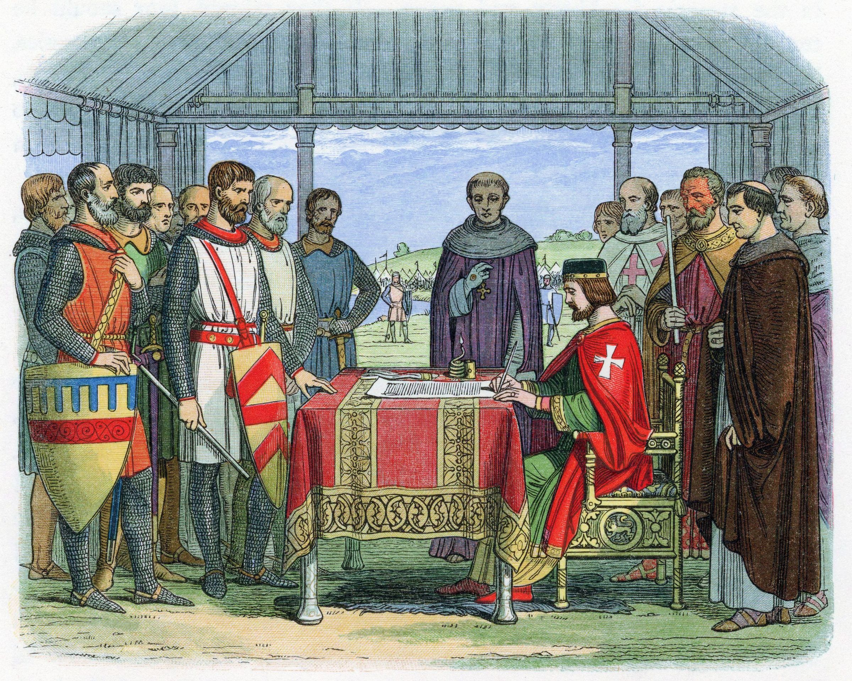
King John signing the Magna Carta in 1215
Notes:
US History 5th/20; "A Chronicle of England - Page 226 - John Signs the Great Charter"/Wikimedia Commons/Public Domain

Slide 7
Why the English came
Religious freedom also became a powerful force in attracting settlers to America.
Many were frustrated by the Church of England.
One other reason some settlers came to America was a longing for adventure.

Slide 8
Section review
List five reasons why the English and others came to America.
riches, land, political freedom, religious freedom, adventure (p. 20)
What political document guaranteed certain basic rights to some Englishmen?
Magna Carta (p. 20)

Slide 9
Section review
Why did English believers become frustrated with the Church of England?
The Church of England embraced aspects of the Reformation but continued several Roman Catholic practices.

Slide 10
English Settlements Made Permanent

Slide 11
Guiding questions
What struggles did members of the Virginia colony endure and what is the significance of the year 1619 to this colony?
What three types of colonial administrations were developed by the British?

Slide 12
English Settlements Made Permanent
Sir Walter Raleigh’s Roanoke expedition was the last individual effort of an Englishman to establish a colony.
Joint-stock companies allowed individuals to work together to start colonies.
In 1606, King James I granted a charter to such a group, the London Company, permitting them to colonize Virginia.
James I
Notes:
https://en.wikipedia.org/wiki/File:James_I_of_England_404446.jpg; Portrait of James I of England by Paul van Somer I, ca. 1620/Wikimedia Commons/Public Domain

Slide 13
Jamestown
Jamestown became the first permanent English settlement in the New World.
By the end of the first winter, over half of the colonists had died in this hostile land.
Notes:
https://pixabay.com/photos/jamestown-fort-fortress-british-395227/; pixabay/CC0

Slide 14
Jamestown
Indians of the Powhatan Confederacy also complicated the settlers’ existence.
A shaky peace came to the area in 1614 with the marriage of Pocahontas, the daughter of the Powhatan chief, to Englishman John Rolfe.
Notes:
https://pixabay.com/photos/jamestown-fort-fortress-british-395227/; pixabay/CC0

Slide 15
Jamestown
Captain John Smith enforced the kind of discipline necessary for the survival of Jamestown.
The winter of 1609–10 was known as the “starving time” because death due to hunger became a way of life.
In 1618, colonists elected a law-making body, the House of Burgesses, which became the first self-governing assembly in the New World.
Notes:
https://pixabay.com/photos/jamestown-fort-fortress-british-395227/; pixabay/CC0

Slide 16
Jamestown
The first Africans in British North America were treated like indentured servants, working for a period and then receiving their freedom.
Slave labor was later used throughout the colonies from New England to Georgia.
Notes:
https://pixabay.com/photos/jamestown-fort-fortress-british-395227/; pixabay/CC0

Slide 17
Jamestown
The Africans’ journey to the New World was later called the Middle Passage because it was the middle part of the trade route taken by many of the ships.
A ship in 1619 brought eligible women who could be purchased as wives.
One source of difficulty for the Virginians was Indian relations.
Notes:
https://pixabay.com/photos/jamestown-fort-fortress-british-395227/; pixabay/CC0

Slide 18
Jamestown
There were three types or categories of English colonial administration.
A charter colony was governed by a trade company that received its authorization from the king.
A proprietary colony had a proprietor appointed by the king.
A royal colony was controlled directly by the king.
Notes:
https://pixabay.com/photos/jamestown-fort-fortress-british-395227/; pixabay/CC0

Slide 19
Section review
Which Englishman tried to establish a colony on Roanoke Island?
Sir Walter Raleigh (p. 21)
What was the first permanent English settlement in the New World?
Jamestown (p. 21)

Slide 20
Section review
Who ensured the survival of that settlement by enforcing a biblical principle, and what was that principle?
John Smith; that if one would not work, he should not eat (2 Thess. 3:10) (p. 22)

Slide 21
Section review
Name and define the three categories of colonial government.
A charter colony was governed by a trade company that received its authorization from the king; a proprietary colony was governed by a proprietor or proprietors appointed by the king; a royal colony was governed directly by the king through his appointed governor. (p. 24)

Slide 22
Section review
After rereading “Precious Stink” in the margin of this section, assess the importance of tobacco to Virginia.
It was America’s first cash crop and was very profitable. By the late 1630s, 1.5 million pounds of tobacco were exported annually. It was so crucial to the Virginia economy that the price of goods was measured not in shillings or dollars but in pounds of tobacco. One person aptly declared, “Virginia was founded upon smoak.”

Slide 23
Section review
How did the trials and successes of Jamestown manifest the core values of freedom, individualism, equality, and growth? What contradictions to these values began to develop?
Freedom: The colony had its own representative government. People were free to determine their own fate in the New World. Even indentured servants could gain their freedom.
Individualism: The people were forced to be self-reliant. Indentured servants could have their own land, but they had to work for it.

Slide 24
Section review
Equality: Everyone was required to work and contribute to the success of the colony.
Growth: As the colony succeeded, the wealth of the people increased.
Contradiction: These core values were denied to the Indians who settled the land first and the Africans who eventually became slaves in Virginia.

Slide 25
The New England Colonies

Slide 26
Guiding questions
How did the Pilgrims differ from the Puritans?
How were each of the New England colonies founded?

Slide 27
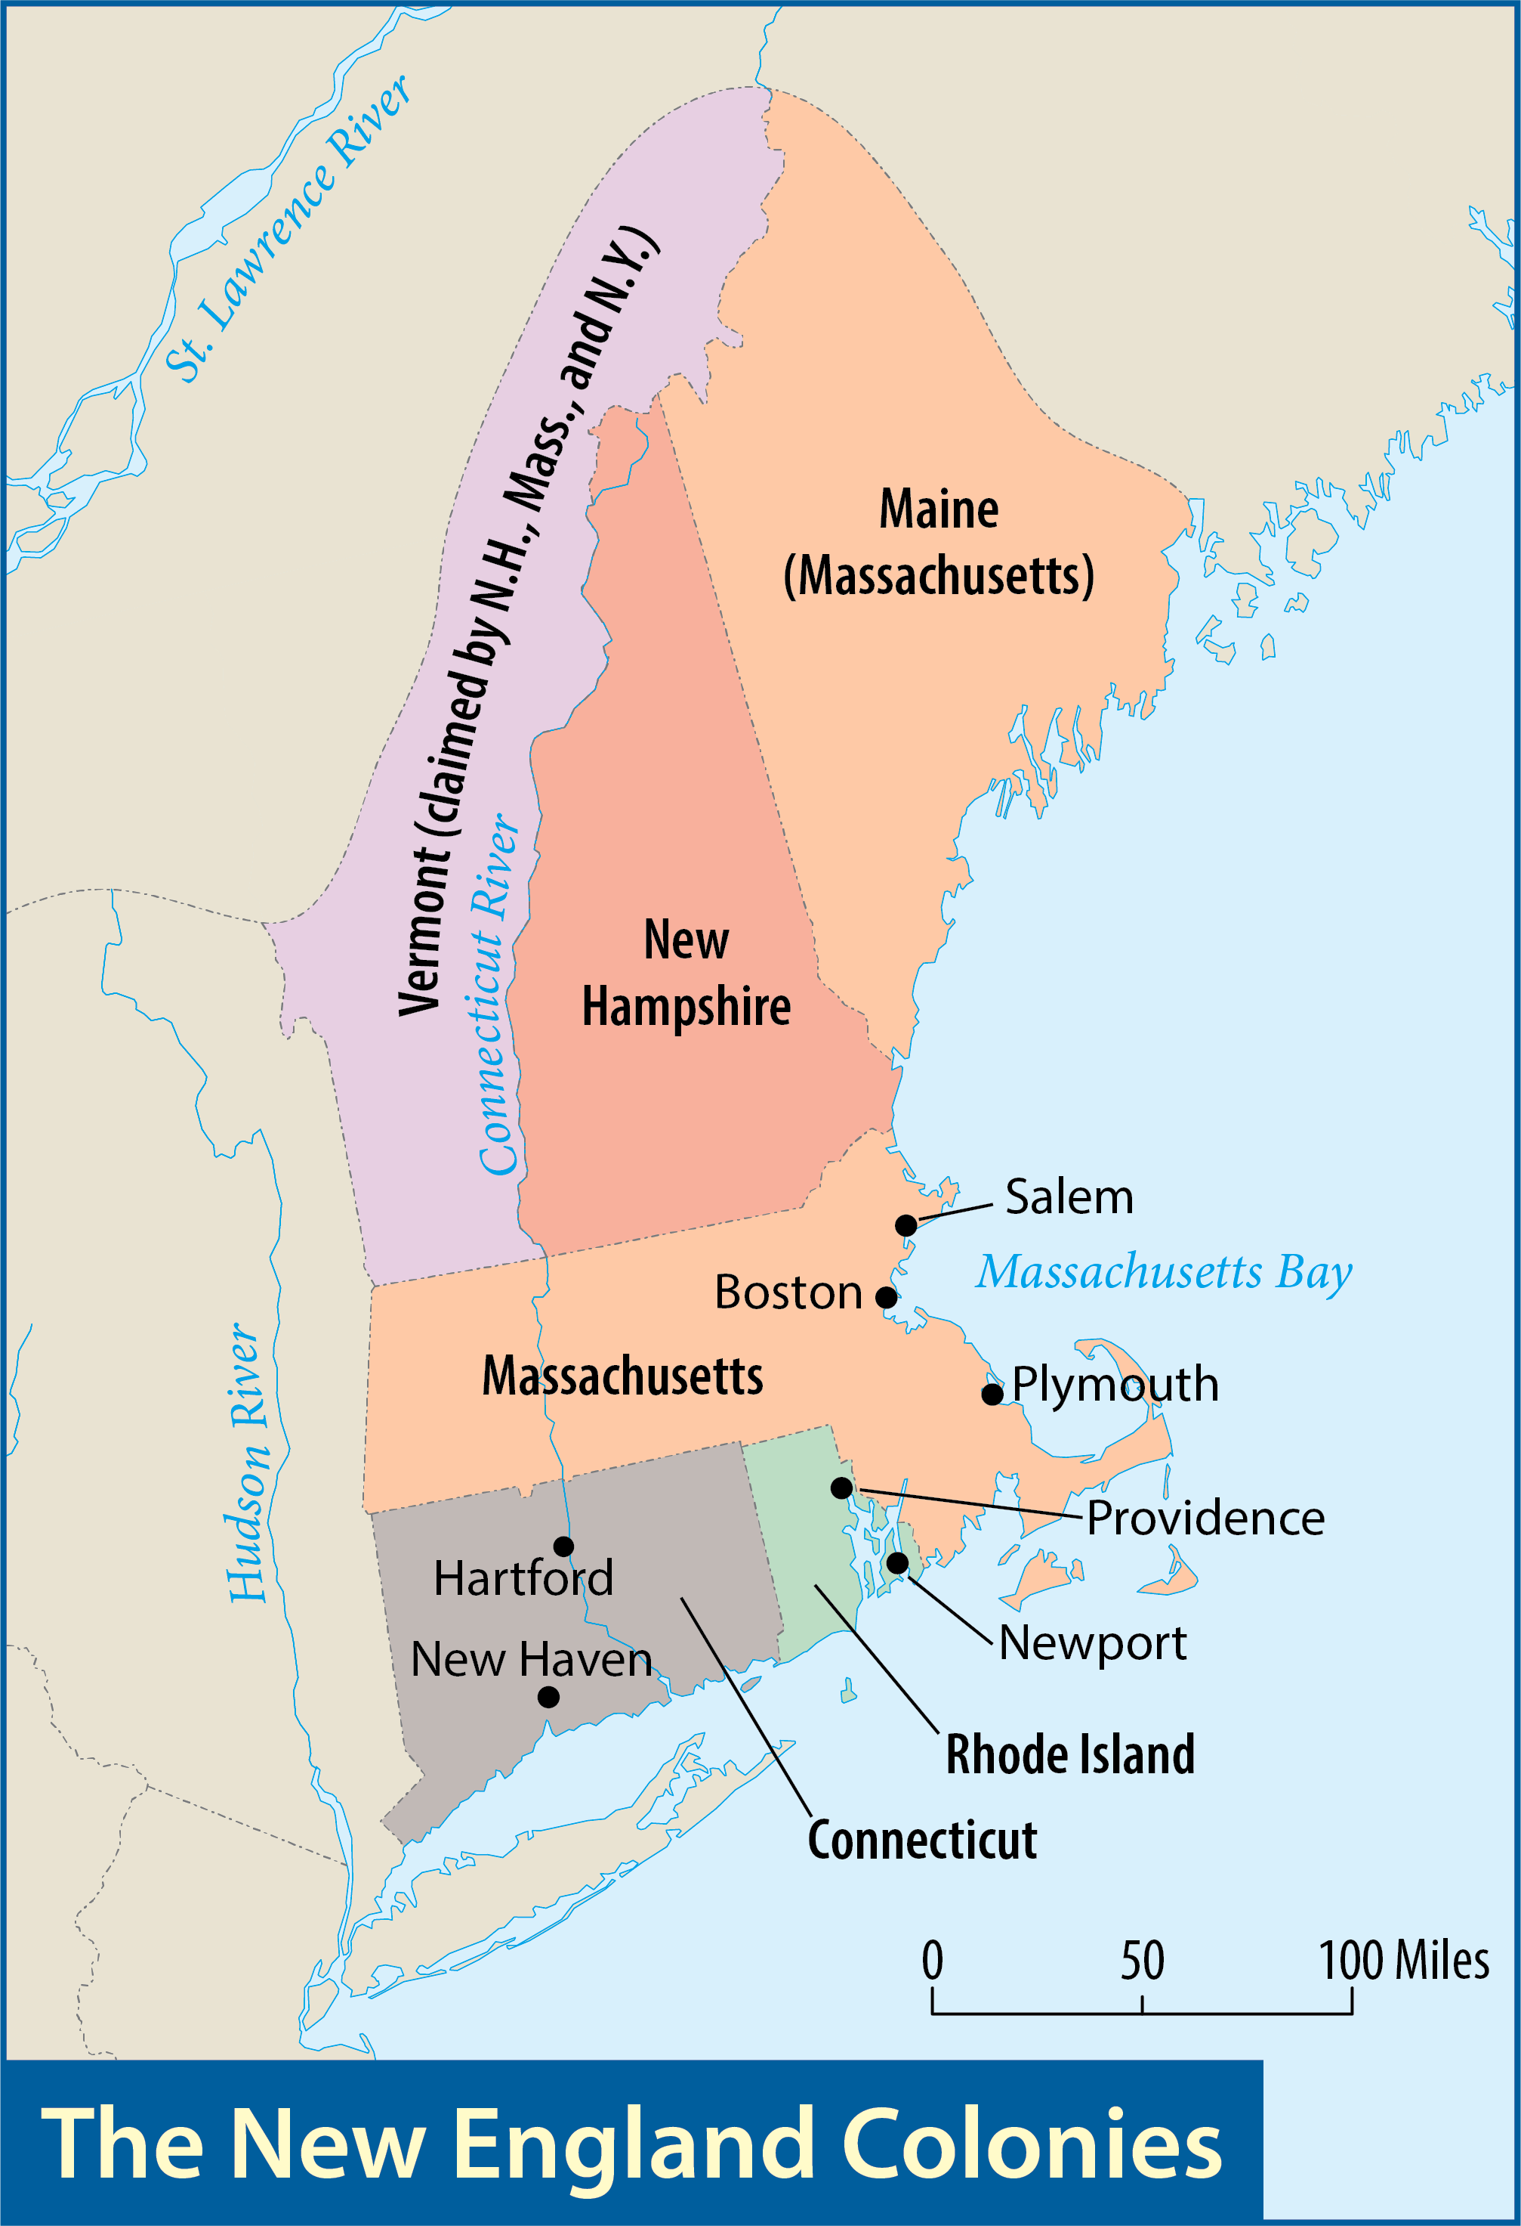
Map Resources

Slide 28
Massachusetts
In 1614, Captain John Smith, who had been commissioned by the Virginia Company to explore the coast far north of Jamestown, found a region rich with furs and fish.
Smith’s account of that land, which he called New England, stimulated interest in the region.

Slide 29
The pilgrims
The first English settlers to New England arrived in November 1620.
The Mayflower, swept off its course to Virginia by a fierce storm, anchored off Cape Cod, Massachusetts.
On board the ship were Christians known as Pilgrims.
Notes:
US History 5th/26r; "Robert Walter Weir - Embarkation of the Pilgrims - Google Art Project"/Wikimedia Commons/Public Domain

Slide 30
The pilgrims
Two religious groups opposed the problems of the Anglican Church.
The Puritans wanted to purify the state church from within.
The Separatists believed that Christians needed to separate from the official church.
The Pilgrims were Separatists.
Notes:
https://pixabay.com/photos/church-derbyshire-england-rural-4437112/; pixabay/CC0

Slide 31
The pilgrims
When the Pilgrims landed at Plymouth, the leaders devised a contract of government to guide them.
The Mayflower Compact was the first document of self-government in America.
William Bradford, who became governor of Plymouth in 1621, later wrote the history of the colony in his book Of Plymouth Plantation.
Notes:
US History 5th/27l; "The Mayflower Compact 1620 cph.3g07155"/LOC/Wikimedia Commons/Public Domain

Slide 32
The pilgrims
The first months at Plymouth were devastating ones.
Squanto provided the settlers with lifesaving information about crop fertilization in order to increase food production.
In 1691, Plymouth merged with the rest of Massachusetts, which by then had become a royal colony.
Notes:
https://pixabay.com/photos/plymouth-massachusetts-settler-1581569/; pixabay/CC0

Slide 33
The puritans
In 1629, the Massachusetts Bay Company received a royal charter to settle on land in the New World.
In 1630, a thousand Puritans arrived in America to establish the Massachusetts Bay Colony.
The driving force behind the Puritan colony was its governor, John Winthrop.
John Winthrop

Slide 34
The puritans
Winthrop declared that the colony was responsible to represent God: “We shall be as a city upon a hill.”
At the heart of this goal of establishing a community of believers was the Puritans’ belief in the covenant.
John Winthrop

Slide 35
The puritans
In 1636, Harvard College was established near Boston to train young men for the ministry.
The Puritans emphasized the scriptural principles of working hard and not being lazy.
John Harvard
Notes:
https://en.wikipedia.org/wiki/File:John_Harvard_statue.jpg; Alain Edouard/Wikimedia Commons/CC BY-SA 3.0

Slide 36
Connecticut
In 1636, Puritan minister Thomas Hooker moved three congregations under his leadership into the Connecticut River Valley.
The Fundamental Orders of Connecticut (1639), which has been called the first written constitution in America, established a framework for representative self-government in Connecticut.
Notes:
https://commons.wikimedia.org/wiki/File:Hooker_and_Company_Frederic_Edwin_Church.jpeg; Hooker and Company Journeying Through the Wilderness from Plymouth to Hartford in 1636 by Frederic Edwin Church, 1846/Wikimedia Commons/Public Domain

Slide 37
Rhode Island
In 1631, Roger Williams arrived in Massachusetts and soon gained a reputation as a troublemaker for his unusual ideas.
Williams fled Massachusetts and wintered with Indians.
Providence, the town Williams founded, later became the capital of Rhode Island.
Roger Williams

Slide 38
Rhode Island
Roger Williams was a key figure in the development of the modern idea of religious liberty.
Roger Williams

Slide 39
Rhode Island
Another leading dissenter, Anne Hutchinson, eventually fled to Rhode Island.
She had been teaching what Puritan leaders considered to be heresy.
A few of Hutchinson’s supporters went with her to Rhode Island, where they established a small settlement in 1638.
Anne Hutchinson
Notes:
https://en.wikipedia.org/wiki/File:Anne_Hutchinson_on_Trial.jpg; Anne Hutchinson on Trial by Edwin Austin Abbey, 1896/Wikimedia Commons/Public Domain

Slide 40
New Hampshire
In 1638, the first significant settlement in New Hampshire was established.
It did not become a separate colony until 1679, when the king made it a royal colony.

Slide 41
Section review
What was the difference between Puritans and Separatists?
Puritans remained in the Church of England (Anglican Church) and wanted to purify it of its Roman Catholic elements; Separatists wanted to be totally independent of the Church of England and all other churches so they could worship as they saw fit. (pp. 25–26)

Slide 42
Section review
Why did the English Separatists leave the Netherlands (Holland)?
They feared that the Dutch language and customs threatened the preservation of their language and culture among their children. In addition, the worldly atmosphere in Holland threatened the spiritual well-being of their children and congregation. (p. 26)

Slide 43
Section review
Which dissenter settled in Rhode Island on land he purchased from Indians?
Roger Williams (p. 30)
Which other dissenter also fled to Rhode Island after being banished from Massachusetts?
Anne Hutchinson (p. 31)

Slide 44
Section review
Reread the 1643 explanation regarding the establishment of Harvard College (see p. 29). Analyze that statement.
The Puritans stated that after taking care of initial needs (building homes and churches, taking care of living necessities, and establishing a government), they wanted to provide for education. One of the reasons for education was to train ministers to replace those in the colony who would die.

Slide 45
Section review
Since the Puritans had come to the New World to worship as they saw fit, why did they not allow dissenters the same freedom of worship?
The Puritans wanted the freedom to worship according to the mandates of Scripture. They did not believe absolute religious freedom was biblical. They thought it was wrong for the government to grant permission for people to worship contrary to Scripture. Roger Williams advocated a religious diversity that the Puritans rejected. Anne Hutchinson insisted on teaching concepts that were contrary to Scripture.

Slide 46
The Middle Colonies

Slide 47
Guiding questions
What role did the Dutch and English have in establishing the colonies of New York and New Jersey?
Who was William Penn and why did he establish a colony?
How did Delaware become a colony?

Slide 48
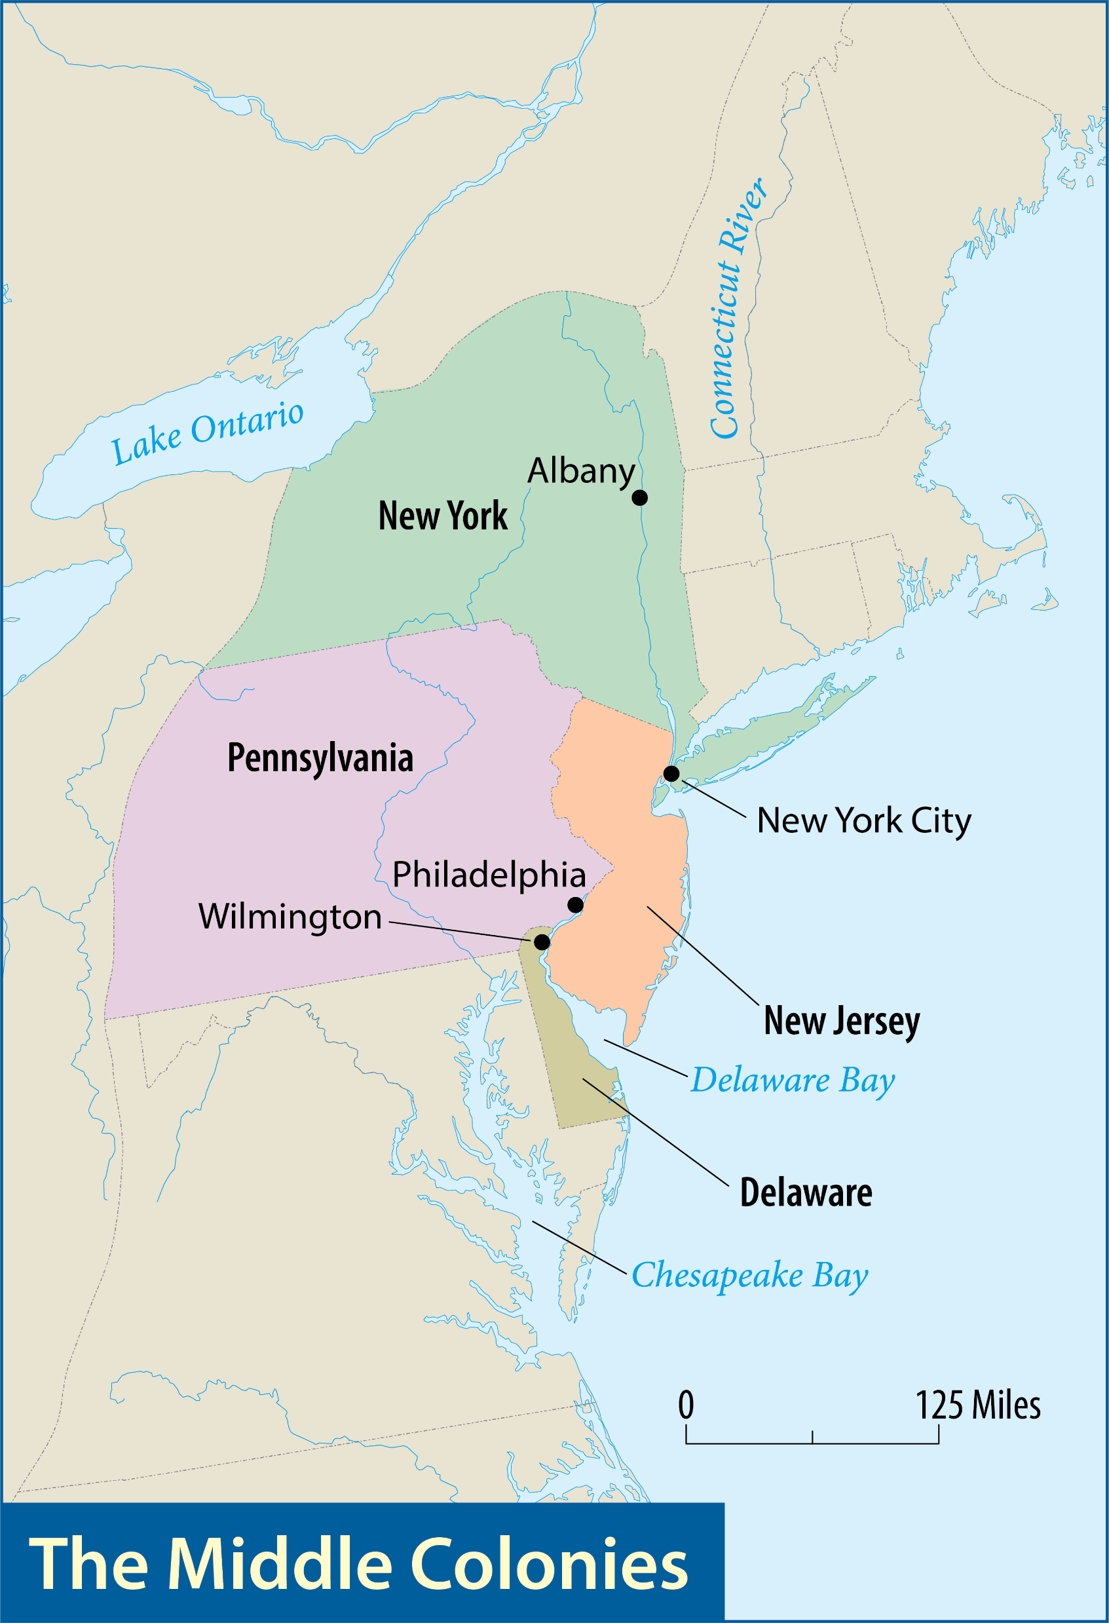
Map Resources

Slide 49
The middle colonies
No other segment of the colonies reflected the cultural diversity of British North America quite like the middle colonies.

Slide 50
New York and new jersey
In 1609, Henry Hudson claimed land for the Dutch, and the land became known as New Netherland.
In 1626, Dutchman named Peter Minuit “purchased” Manhattan Island from a group of Indians, and New Amsterdam (now New York City) was born.
Peter Minuit
Notes:
US History 5th/32t; BJU Press Art

Slide 51
New York and new jersey
England invaded New Netherland in 1664.
The area was renamed New York, to honor James, the duke of York, who was the brother of King Charles II.
The duke of York gave the southern portion of his new territory to two friends, and it eventually became New Jersey.
James, Duke of York
Notes:
https://en.wikipedia.org/wiki/File:James_II_by_Peter_Lely.jpg; Portrait of James II of England from the school of Peter Lely, ca. 1650-1675/Wikimedia Commons/Public Domain

Slide 52
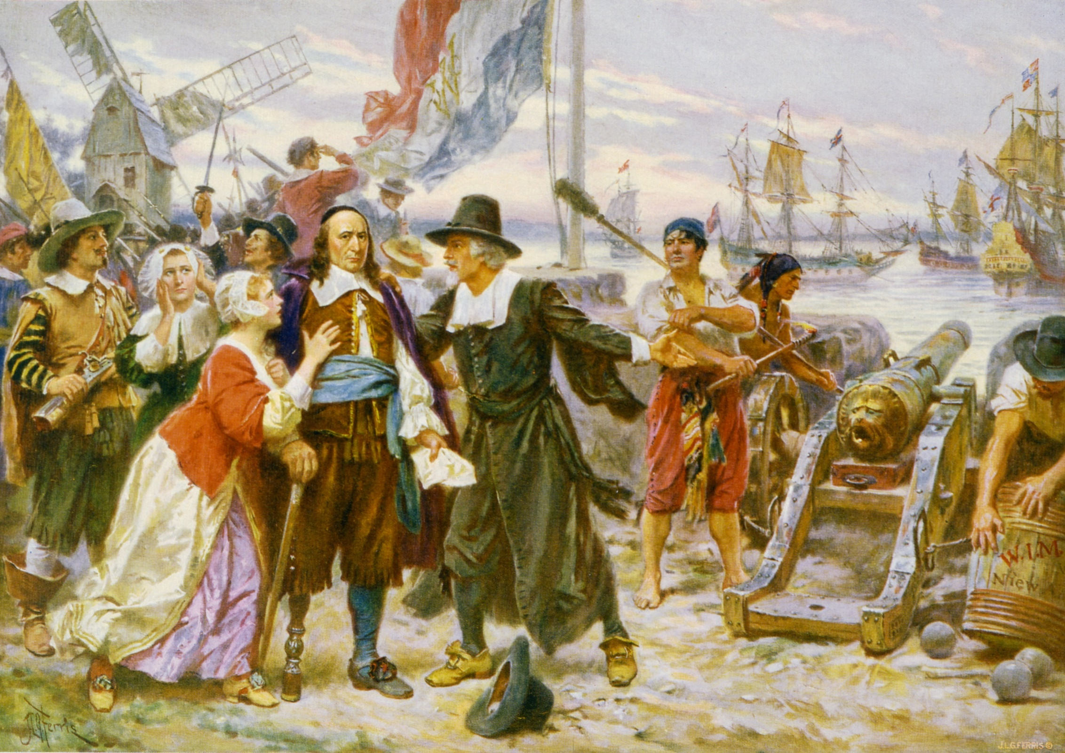
The Fall of New Amsterdam to the English
Notes:
https://en.wikipedia.org/wiki/File:The_fall_of_New_Amsterdam_cph.3g12217.jpg; Library of Congress, LC-USZC4-12217

Slide 53
Pennsylvania
Pennsylvania was the product of one man’s vision and labor—William Penn.
He was a member of a religious group called the Society of Friends, or Quakers.
In 1681, King Charles II granted Penn sole proprietorship over a large section of land north of Maryland.
William Penn

Slide 54
Pennsylvania
The king appropriately named the forested area Pennsylvania (meaning “Penn’s woodland”).
That grant was the beginning of Penn’s “Holy Experiment” in America.
Penn’s constitution, Frame of Government of Pennsylvania, provided religious toleration and political liberty for the colony.
William Penn

Slide 55
Pennsylvania
Philadelphia—the “city of brotherly love”—rapidly became an important trading center.
William Penn

Slide 56
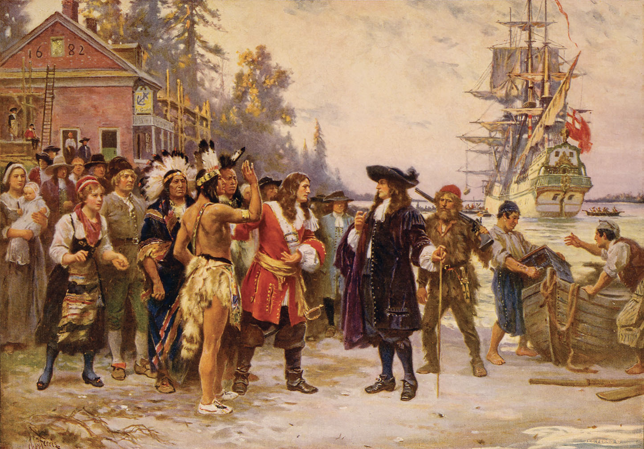
William Penn arriving in Philadelphia
Notes:
US History 5th/33t; Library of Congress, LC-USZC4-12141

Slide 57
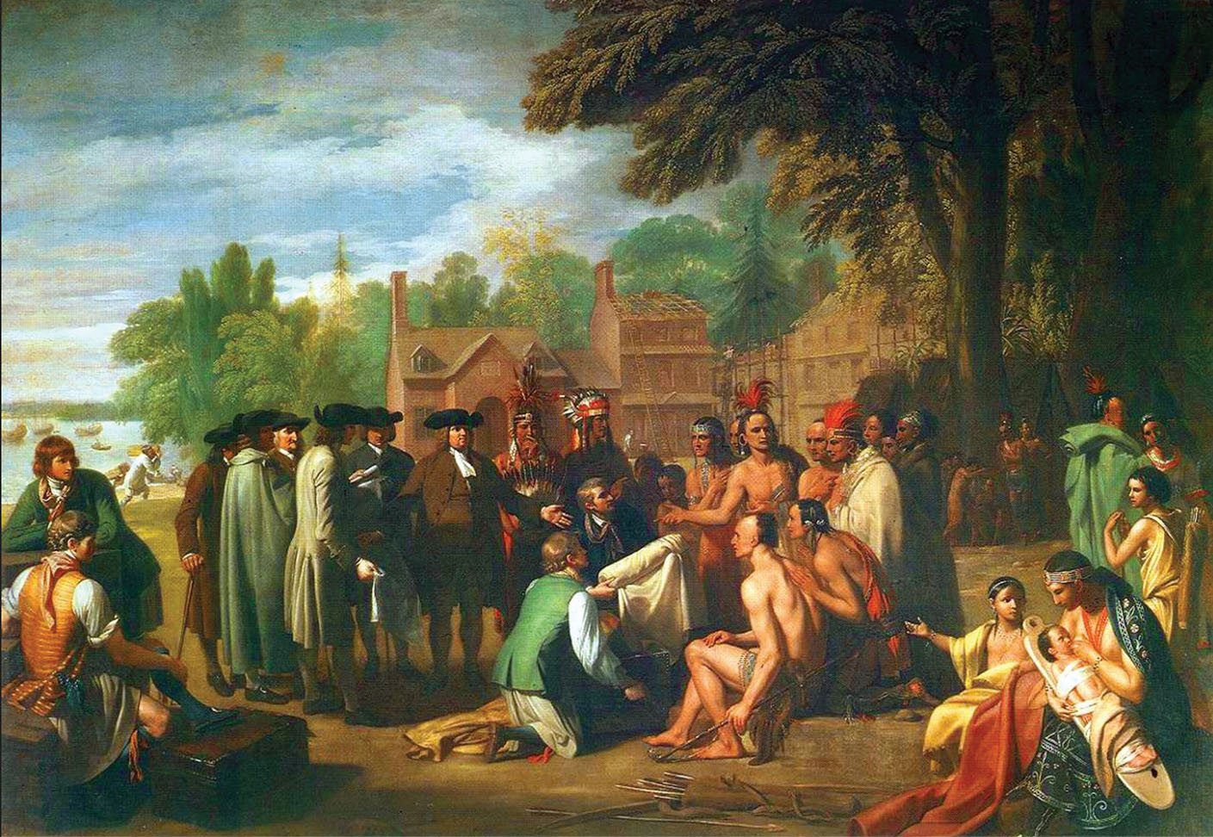
William Penn signing a treaty with the Indians
Notes:
US History 5th/33b; "The Treaty of Penn with the Indians" by Benjamin West/Pennsylvania Academy of Fine Arts, Philadelphia/Wikimedia Common/Public Domain

Slide 58
Delaware
William Penn’s land also included what is now called Delaware.
However, the settlers there resisted being ruled by Quakers in Philadelphia.
The colony was eventually granted the right to form its own legislature and it became a separate colony in 1704.

Slide 59
Section review
What nationality originally settled New York?
the Dutch (p. 31)
Which nation eventually took control of New York?
England (p. 32)

Slide 60
Section review
Describe William Penn’s relationship with the Indians.
He paid the Indians for the land the king had granted him. He made friends with them and thereby avoided the attacks that were common in other colonies. (p. 33)
What was another name for the city of Philadelphia?
the “city of brotherly love” (p. 33)

Slide 61
Section review
Compare William Penn’s treatment of Indians with that of Roger Williams.
Both paid the Indians for land on which they established settlement. Both developed good relationships with neighboring tribes.

Slide 62
Section review
Why was Pennsylvania unable to maintain the Quaker ideals that William Penn envisioned for the colony?
Because Penn allowed a diversity of religious views in his colony, he could not prevent the Quakers from becoming a minority of the population. Many of the religious ideals of the Quaker society were lost as people with other views began to dominate Pennsylvanian society.

Slide 63
The Southern Colonies

Slide 64
Guiding questions
How did the Carolinas become colonies?
What were two purposes for the founding of Georgia?

Slide 65
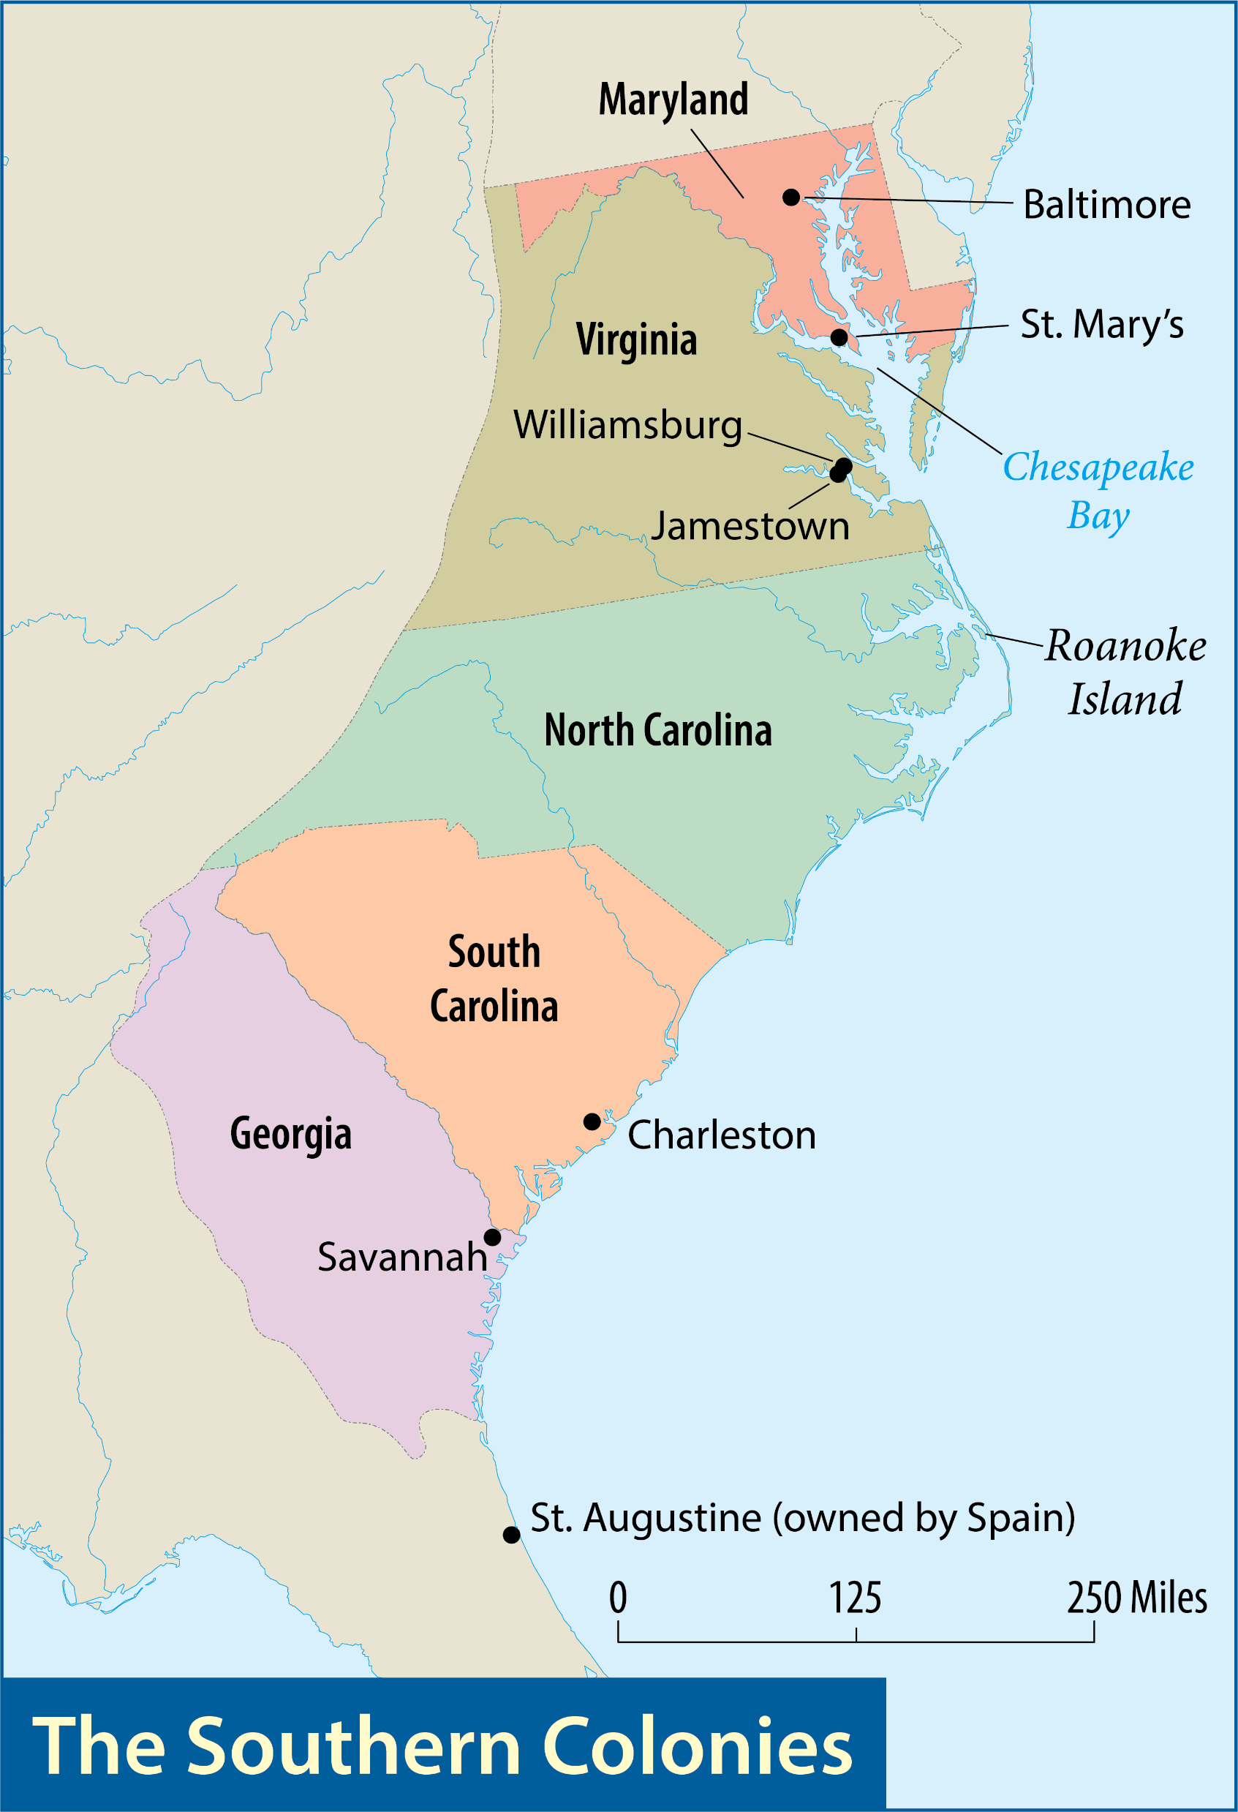
Map Resources

Slide 66
The Southern Colonies
The southern colonies were Virginia, Maryland, the Carolinas, and Georgia.

Slide 67
Maryland
The first group of settlers arrived in Maryland in 1634.
Their proprietor was Cecilius Calvert, who held the title Lord Baltimore.
The colony’s leaders established religious toleration through the Toleration Act of 1649.
Cecilius Calvert
Notes:
https://commons.wikimedia.org/wiki/File:Cecil_Calvert,_2nd_Baron_Baltimore.jpg; Drawing of Cecil Calvert from The Story of Our Nation by Ella Hines Stratton, 1902/Wikimedia Commons/Public Domain

Slide 68
The Carolinas
In 1663, the English king, Charles II, gave the land between Virginia and Spanish Florida to eight noblemen.
Two areas of settlement emerged: the area to the north and the area to the south at a harbor settlement named Charles Town.
Charles II
Notes:
https://commons.wikimedia.org/wiki/File:King_Charles_II_by_John_Riley.jpg; Portrait of King Charles II by John Riley/Wikimedia Commons/Public Domain

Slide 69
The Carolinas
In 1719, South Carolina became a royal colony.
Proprietors continued to rule North Carolina until 1729, when it, too, became a royal colony.
Charles II
Notes:
https://commons.wikimedia.org/wiki/File:King_Charles_II_by_John_Riley.jpg; Portrait of King Charles II by John Riley/Wikimedia Commons/Public Domain

Slide 70
Georgia
Settlement of this southernmost colony of British North America did not begin until 1733.
The British established Georgia:
to create a military buffer against Spanish Florida.
to provide a colony where debtors, who often languished in English jails, could start a new life.
James Oglethorpe

Slide 71
Georgia
Georgia’s founder, James Oglethorpe, wanted to focus more on reforming prisoners than on punishing them.
James Oglethorpe

Slide 72
The Emerging America
Individualism: Americans value self-reliance and self-determination. They value and celebrate the accomplishments of individuals like Smith, Bradford, Winthrop, Williams, Calvert, Penn, and Oglethorpe.
Freedom: Americans value self-government and the liberty to worship freely.
Growth: Americans are willing to invest hard work and endure difficulties to establish and expand their position in the world.

Slide 73
The Emerging America
Equality: Some Americans value providing people with equal opportunities. Unfortunately, this did not apply to slaves. From early colonization, America has endured a slow and torturous climb toward equality.

Slide 74
Section review
Who was the proprietor of Maryland?
Cecilius Calvert or Lord Baltimore (p. 34)
What was the religious motive in planting the Maryland colony?
to provide a refuge for English Catholics (p. 34)

Slide 75
Section review
What were the two purposes the British had in founding Georgia?
to provide a military buffer against Spanish Florida; to be a colony where debtors could start a new life (p. 35)

Slide 76
Section review
Analyze the entry from John Wesley’s journal and the information provided about the Wesleys. Why are their experiences so unusual?
Both brothers were unconverted at the time they came to America to minister. Furthermore, the Moravians ministered to them by providing an example of kindness and courage.

Slide 77
Section review
Using the four core values of individualism, freedom, growth, and equality, briefly describe the emerging America revealed in this chapter.
Individualism: Americans value self-reliance and self-determination. They value and celebrate the accomplishments of individuals like Smith, Bradford, Winthrop, Williams, Calvert, Penn, and Oglethorpe.
Freedom: Americans value self-government and the liberty to worship freely.

Slide 78
Section review
Growth: Americans are willing to invest hard work and endure difficulties to establish and expand their position in the world.
Equality: Some Americans value providing people with equal opportunities. Unfortunately, this did not apply to slaves. From early colonization, America has endured a slow and torturous climb toward equality.

Slide 79
People, Places, and Things to Remember
Church of England
headrights
indenture
joint-stock companies
Jamestown
Pocahontas
John Smith
starving time
House of Burgesses
charter colony
proprietary (colony)
royal colony
Middle Passage
New England
Mayflower
Pilgrims
Puritans
Separatists

Slide 80
People, Places, and Things to Remember
Mayflower Compact
William Bradford
Squanto
John Winthrop
covenant
Harvard College
Roger Williams
Anne Hutchinson
middle colonies
William Penn
southern colonies
Cecilius Calvert (Lord Baltimore)

