Slide 1
Chapter 3: Christianity, the Church, and Government
Notes:
WIN-Initiative/Stone/Getty Images

Slide 2
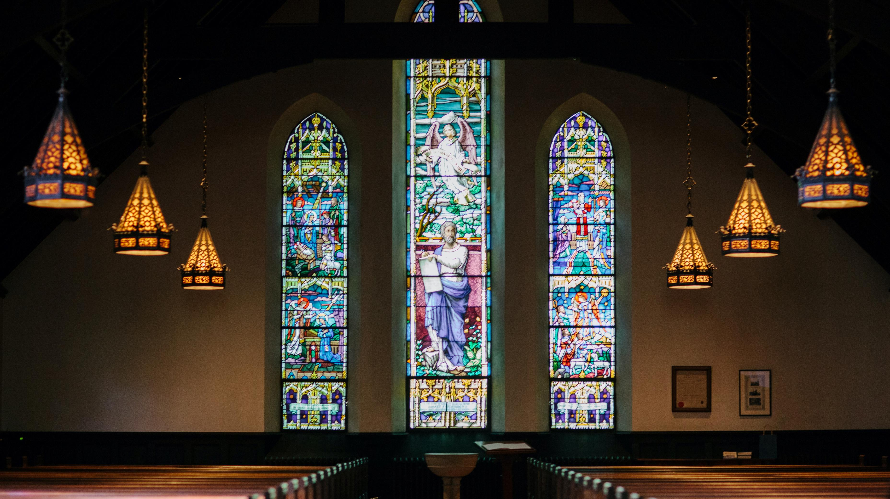
I. Christianity and Government in History
Chapter 3.1
Notes:
Photo by Karl Fredrickson on Unsplash
https://unsplash.com/photos/JRsZWmRd_Ws

Slide 3
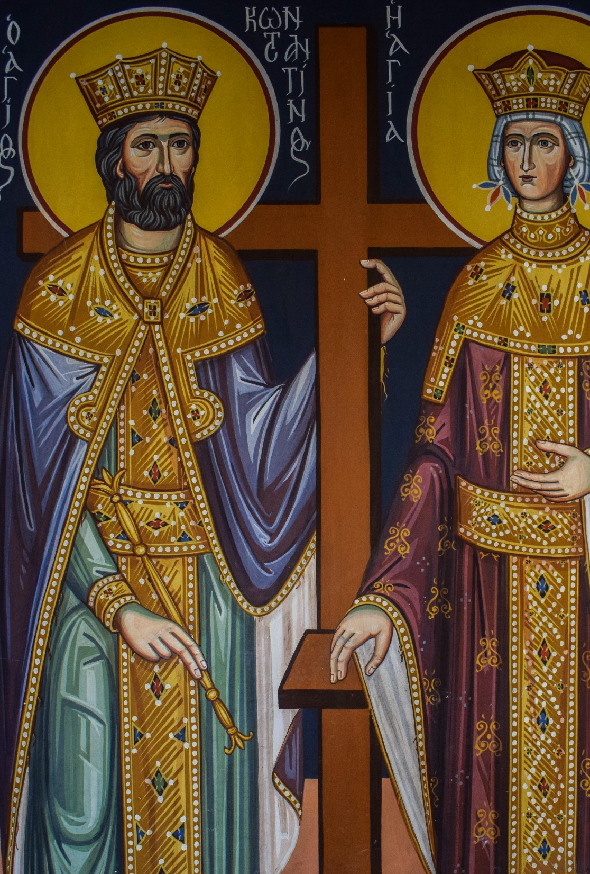
A. Jesus and Constantine
The early Church faced widespread persecution in the Roman Empire.
This ended when Emperor Constantine embraced Christianity in AD 313.
Emperor Constantine and St. Helen
Notes:
Image by Dimitris Vetsikas from Pixabay
https://pixabay.com/photos/st-constantine-and-st-helen-saint-2016117/

Slide 4
A. Jesus and Constantine
Constantine’s conversion raised new questions about the relationship of a Christian ruler and the government.
During the Middle Ages, most governments viewed religious freedom as a dangerous evil.
Emperor Constantine and St. Helen
Notes:
Image by Dimitris Vetsikas from Pixabay
https://pixabay.com/photos/st-constantine-and-st-helen-saint-2016117/

Slide 5
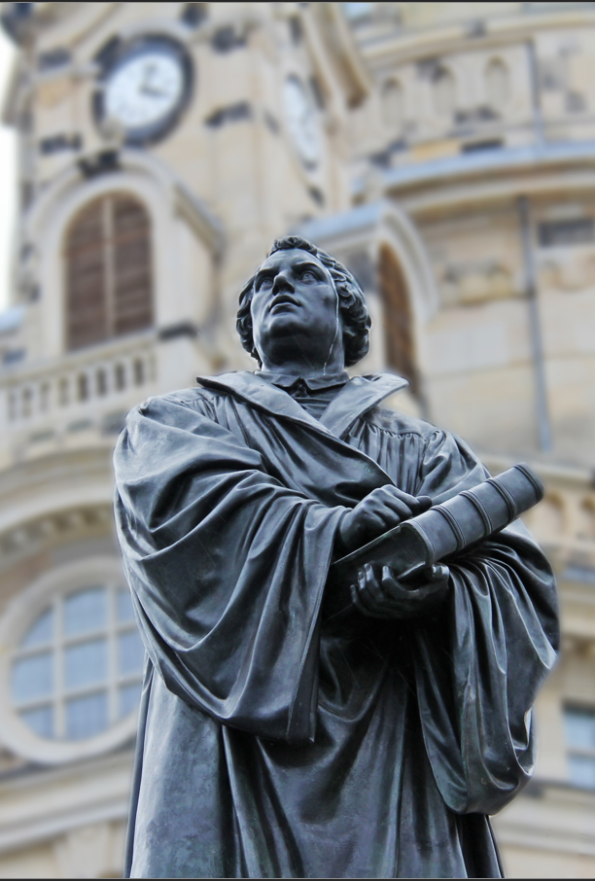
B. The Reformation
The Reformation shattered the religious unity of Europe.
Despite this, many Christians continued to believe that peace and stability could only come from complete religious unity.
Statue of Martin Luther
Notes:
Image by Sharon Ang from Pixabay
https://pixabay.com/photos/martin-luther-church-pray-617287/

Slide 6
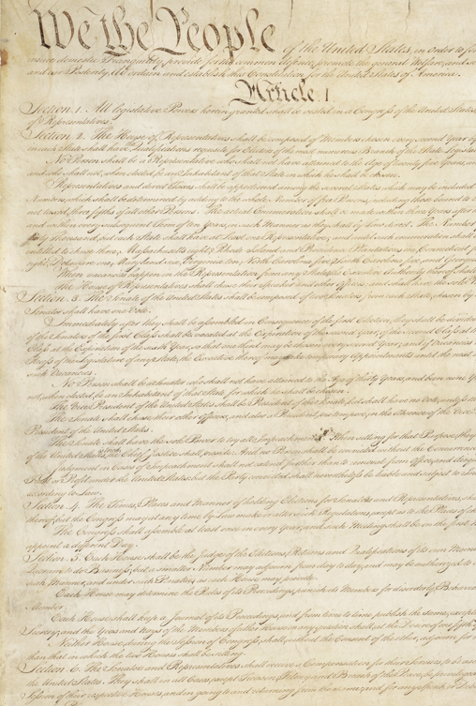
C. John Locke
The British philosopher John Locke (1632–1704) promoted the idea of religious toleration.
Locke believed that all people shared certain moral truths in common called natural law.
Locke asserted that natural law would be enough to hold a society together.
Notes:
Image by WikiImages from Pixabay
https://pixabay.com/photos/constitution-united-states-usa-62943/

Slide 7
D. Early America
English colonists established local governments that protected their right to worship God as they saw fit – such as the Mayflower Compact.
Many of Locke’s ideas greatly influenced the Constitution – especially the 1st Amendment.
Notes:
Photo by Aaron Burden on Unsplash
https://unsplash.com/photos/9zsHNt5OpqE

Slide 8
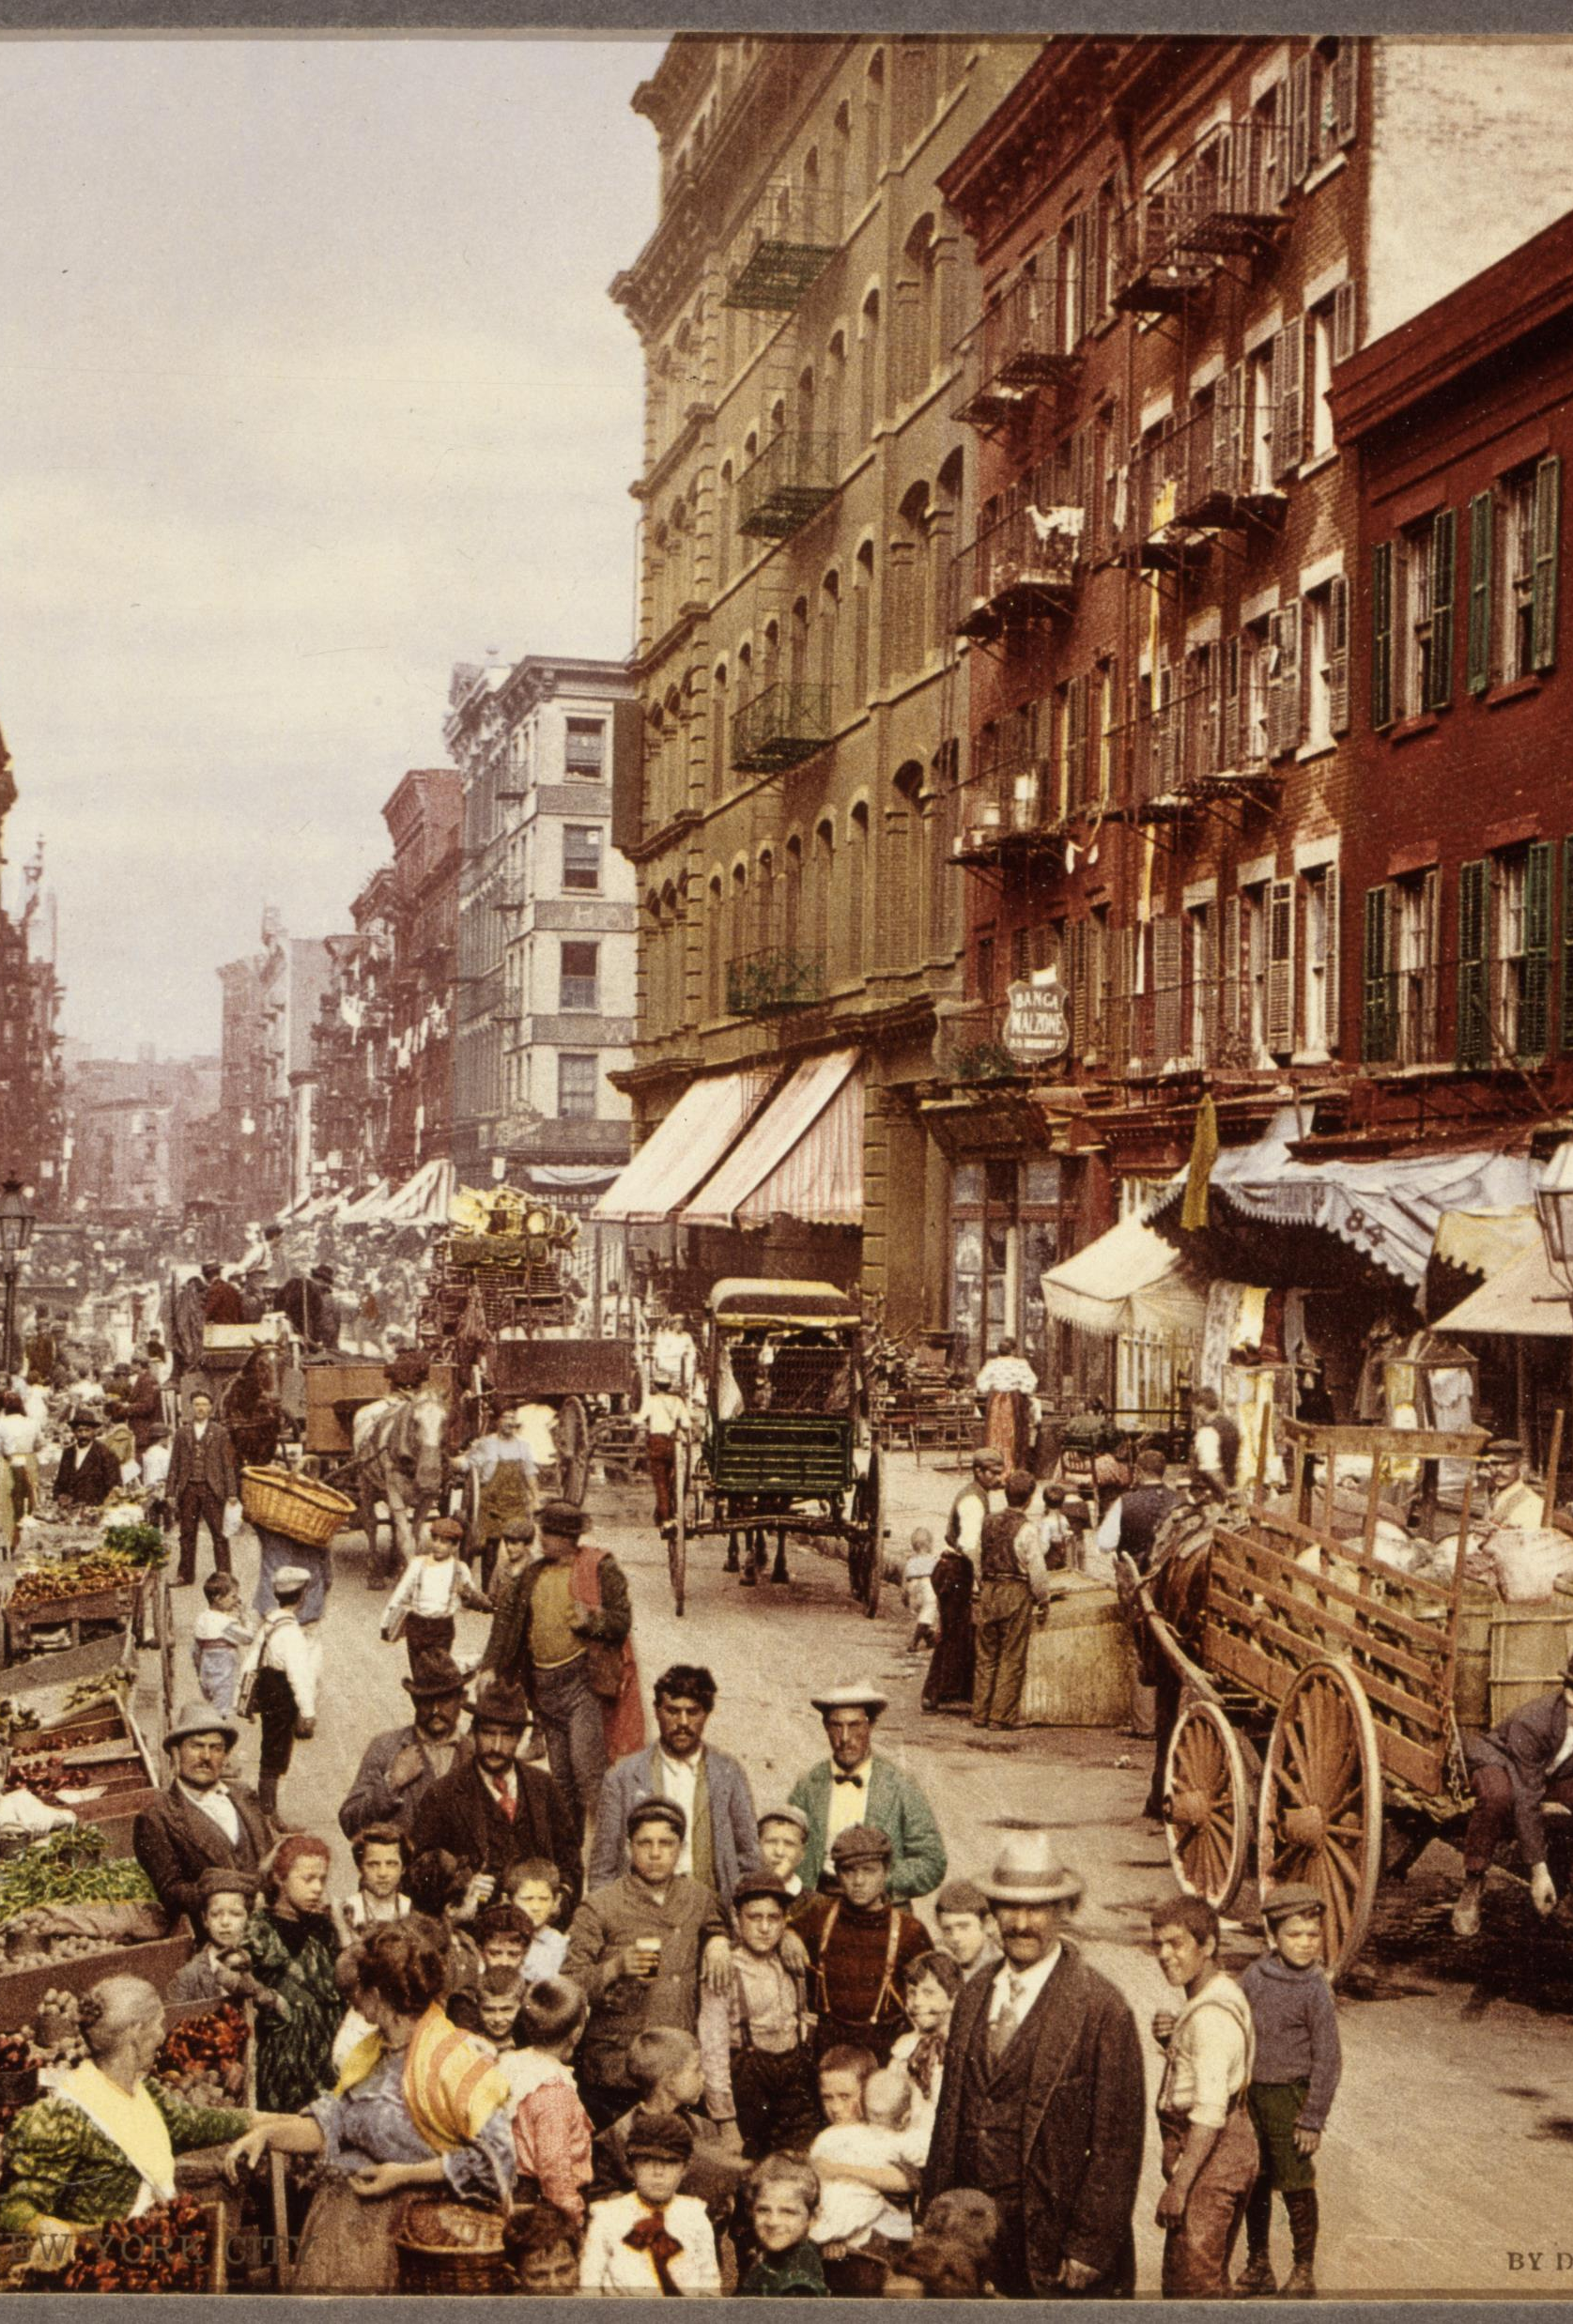
E. Rise of Pluralism
Until the late 19th Century, America was dominated by Evangelical Protestants.
Waves of immigration and social changes have made the country far more religiously diverse.
This diversity of religious and political beliefs is called pluralism.
New York City, 1890
Notes:
Image by 272447 from Pixabay
https://pixabay.com/photos/new-york-city-1890-vintage-559753/

Slide 9
Section Review – Chapter 3.1
1. Why did it become difficult for Christians to serve in the Roman government and military?
Roman military and government service often involved offering sacrifices to pagan gods and worshipping the emperor. (p. 41)
2. Why did many medieval and early modern Christians believe that states need a common religion?
They believed that stable states need a shared morality and that shared morality is impossible to achieve without a shared religion. (p. 41)

Slide 10
Section Review – Chapter 3.1
3. Why did the Reformation result in religious wars in Europe?
The Reformation shattered the illusion of religious unity in Europe, but many people still valued a shared religion. In each nation the religion of the ruler became the religion of the nation. Religion thus became a highly contentious political matter. (pp. 41–42)
4–5. What was John Locke’s solution to Europe’s religious conflict? What was his basis for shared morality?
religious toleration; natural law (p. 42)

Slide 11
Section Review – Chapter 3.1
6. What is natural law?
The belief that all people have a conscience and recognize that certain moral truths are built into nature. (p. 42)

Slide 12
Section Review – Chapter 3.1
Locke’s religious toleration approach worked when various forms of Christianity were the primary competing religious options. Would his approach work in a society with greater religious diversity?
Answers should mention that different religious worldviews lead to great disagreement about what is moral and immoral.

Slide 13
Section Review – Chapter 3.1
Why was the Mayflower Compact significant?
It established a temporary government for the Pilgrims’ pioneer community. The principle of social contract, that the government is formed by the consent of the governed, is a key component of the document and is at the heart of American political thought and practice.

Slide 14
II. The Bible, the Church, and Pluralism
Chapter 3.2
Notes:
Image by Free-Photos from Pixabay
https://pixabay.com/photos/urban-people-crowd-citizens-438393/

Slide 15
II. The Bible, the Church, and Pluralism
Pluralism poses a serious challenge to John Locke’s theory.
Secularism’s basic thesis is that religion is a private matter that should stay out of public spaces.
Questions of morality are answered differently by various groups because their values are different.
Notes:
Image by S. Hermann & F. Richter from Pixabay
https://pixabay.com/photos/church-window-window-church-2217785/

Slide 16
A. Church and State
Secularists assume that separation of church and state means “no religion in public life.”
Secularism views religious arguments on political matters as irrelevant and believes they should be ignored.
Notes:
Image by Pexels from Pixabay
https://pixabay.com/photos/praying-god-christianity-belief-2179326/

Slide 17
A. Church and State
If the state has dominance over the church, then the government can restrict the actions of Christians.
Example: North Korea
If the government chooses an unbiblical moral stance, conflict with the church is inevitable.
Pyongyang, North Korea
Notes:
Image by Alex_Berlin from Pixabay
https://pixabay.com/photos/north-korea-pyongyang-bronze-3340884/

Slide 18
A. Church and State
In the Middle Ages, the Catholic Church attempted to do the opposite by imposing its authority over states.
Since God has given the authority to rule to governments, churches should not seek to control them (Rom. 13:1).
St. Peter’s Basilica
Notes:
Photo by Clay Banks on Unsplash
https://unsplash.com/photos/t9E_lvAooWM

Slide 19
A. Church and State
The concept of separation of church and state has biblical support.
The Kingdom of Israel had a separate king and high priest.
New Testament believers were not associated with any state.
The Western Wall, Jerusalem
Notes:
Photo by Sander Crombach on Unsplash
https://unsplash.com/photos/uTjrKwK6N-s

Slide 20
A. Church and State
In an ideal society, the church would be separated from the government in its authority but have significant influence.
In this relationship, the church’s influence would be persuasive, not coercive.
Notes:
Photo by Ben White on Unsplash
https://unsplash.com/photos/gGbuETcoKjw

Slide 21
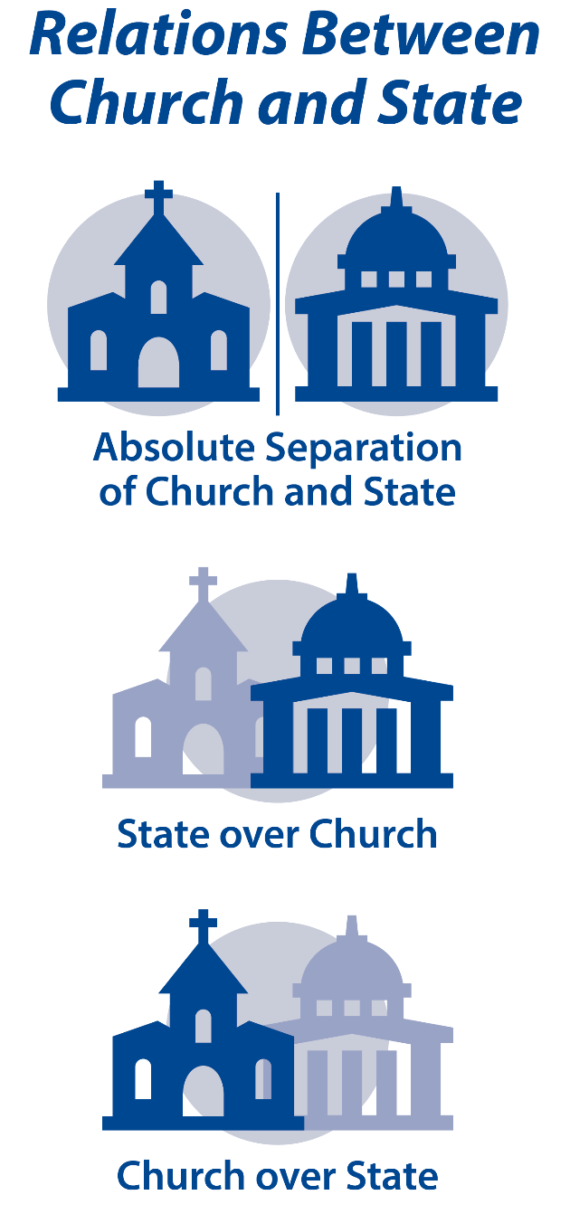
Notes:
BJU Press Art

Slide 22
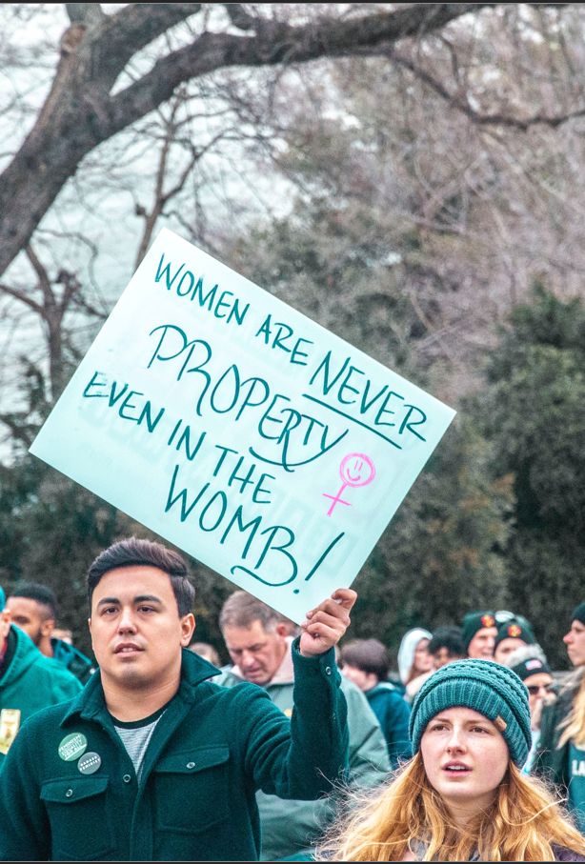
B. Christians and Political Issues
It is very unpopular today for Christians to voice concern over moral issues such as abortion.
Society often makes some sins seem plausible and commonplace.
Notes:
Photo by Maria Oswalt on Unsplash
https://unsplash.com/photos/tTFp69z5DTg

Slide 23
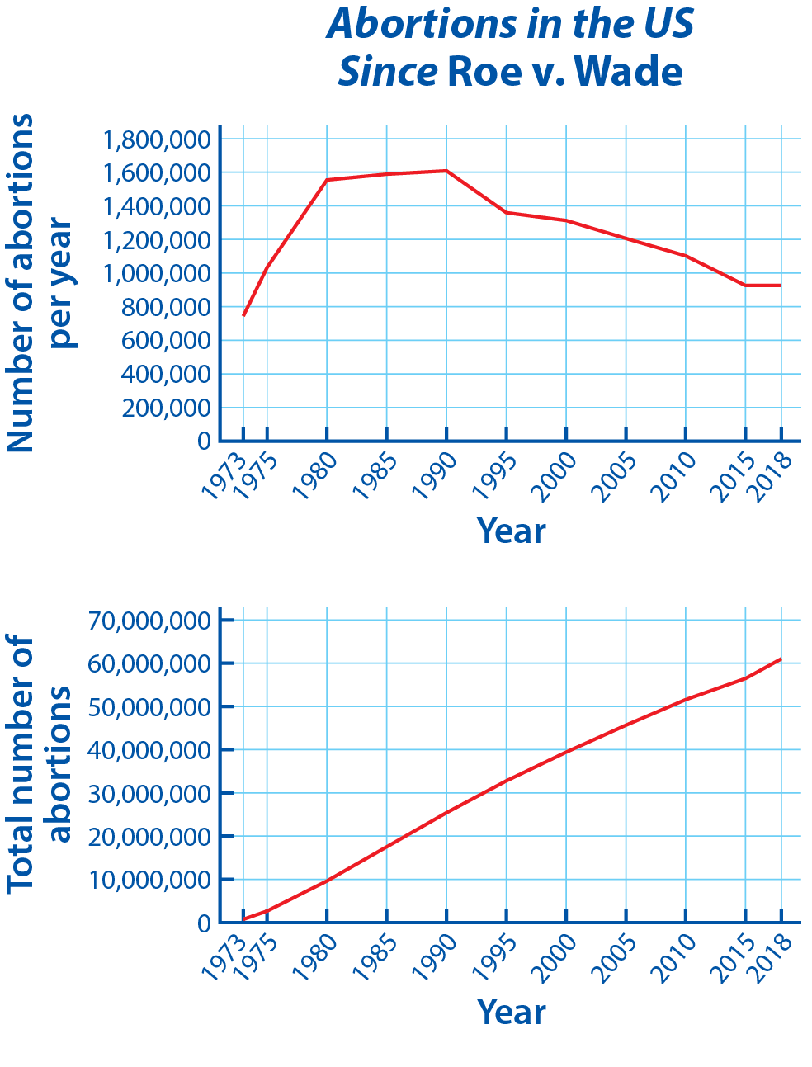
Notes:
BJU Press Art

Slide 24
C. Natural Law
Natural-law arguments are not invalid; they simply do not go far enough.
Reasoning from natural law will not necessarily convince people any better than arguing from Scripture.
Notes:
Photo by Sarah Noltner on Unsplash
https://unsplash.com/photos/4U3d6u_p-fE

Slide 25
D. Applying Scripture to Political Matters
Because natural law is not enough, Scripture should be applied to all aspects of life.
Example: no-fault divorce
Notes:
Image by StockSnap from Pixabay
https://pixabay.com/photos/people-girl-alone-sitting-wood-2604834/

Slide 26
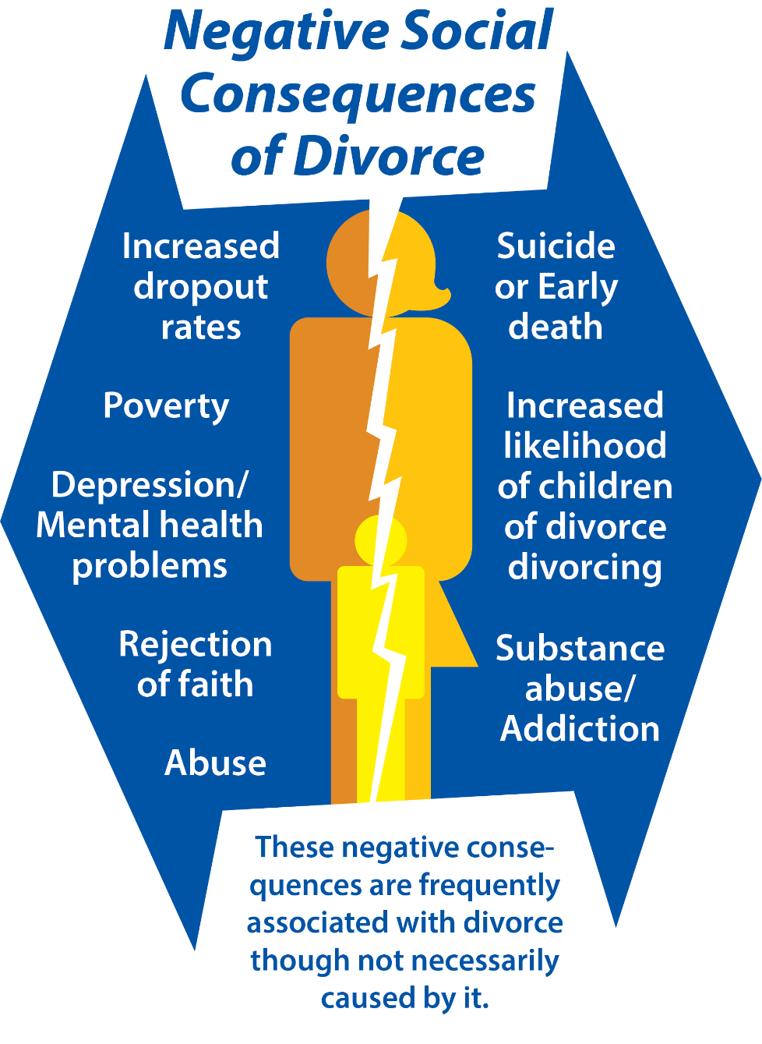
Notes:
BJU Press Art

Slide 27
E. Addressing the Issue of Pluralism
Pluralism has created serious challenges for Christians.
Disagreement over morals can create culture wars – a conflict between groups with different ideals, beliefs, and philosophies.
Notes:
Photo by Jake Weirick on Unsplash
https://unsplash.com/photos/MSKqOpeNSt4

Slide 28
F. Go and Do
How can Christians gain influence in political matters despite pluralism?
Understand the political process
Seek to persuade unbelievers
Understand the perceptions of others
Engage in political discussion with humility and respect
Notes:
Photo by Samuel Martins on Unsplash
https://unsplash.com/photos/3U7HcqkIbb4

Slide 29
F. Go and Do
How can Christians gain influence in political matters despite pluralism?
Be willing to face persecution if necessary
View the gospel as the ultimate solution
Notes:
Photo by Samuel Martins on Unsplash
https://unsplash.com/photos/3U7HcqkIbb4

Slide 30
Section Review – Chapter 3.2
1. What is the basic thesis of secularism?
Religion is a private matter that should stay out of public spaces. (p. 44)
2. Why do Christians traditionally view abortion as murder?
They believe that every person, even the unborn, bears the image of God. (pp. 47–48)

Slide 31
Section Review – Chapter 3.2
3–4. Cite two reasons why Christians cannot accept the removal of religious influence from public life.
First, the Bible applies to all of life, not just to private, religious matters. Second, legislation is based on a moral position. (pp. 48–49)
5. Why is it impossible to say that moral questions should be limited to the private realm?
Moral decisions affect other people, not just an individual. (p. 49)

Slide 32
Section Review – Chapter 3.2
Why do secularists seek the absolute separation of church and state?
They seek to remove all religious influence from public life.

Slide 33
Section Review – Chapter 3.2
How should Christians seek to gain influence in political matters?
They should understand the political process. They should seek to persuade unbelievers and rely on the fact that right and wrong are written on the human heart. Christians should also try to understand opponents’ positions to reveal the errors in their reasoning. Above all, Christians must rely on the gospel’s power to transform lives.

