Slide 1
Chapter 4: Constitutional Beginnings
Notes:
WIN-Initiative/Stone/Getty Images

Slide 2
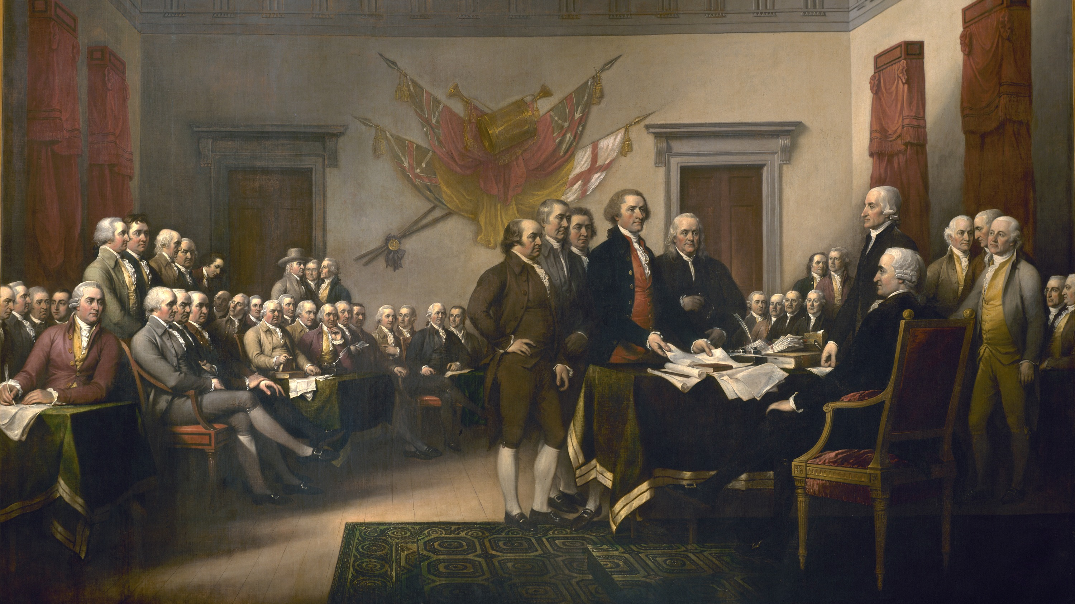
I. Colonial and Confederation Eras
Chapter 4.1
Notes:
Image by WikiImages from Pixabay
https://pixabay.com/photos/declaration-of-independence-62972/

Slide 3
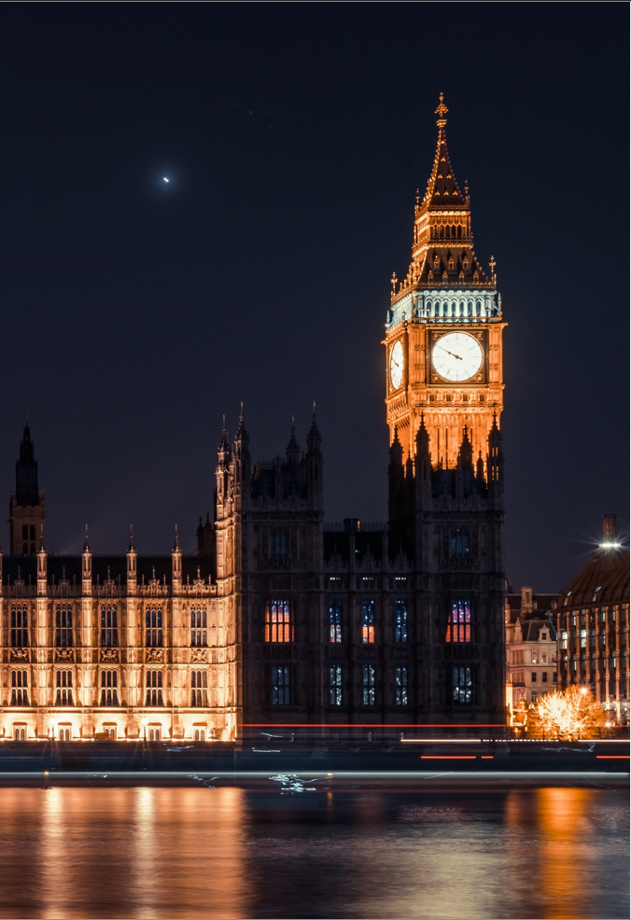
A. Political Influence and Innovation
Early American culture and government was greatly influenced by England.
  Local governments
  Legislatures – such as the House of Burgesses
  Limited government
Notes:
Image by Free-Photos from Pixabay
https://pixabay.com/photos/big-ben-houses-of-parliament-london-919013/

Slide 4
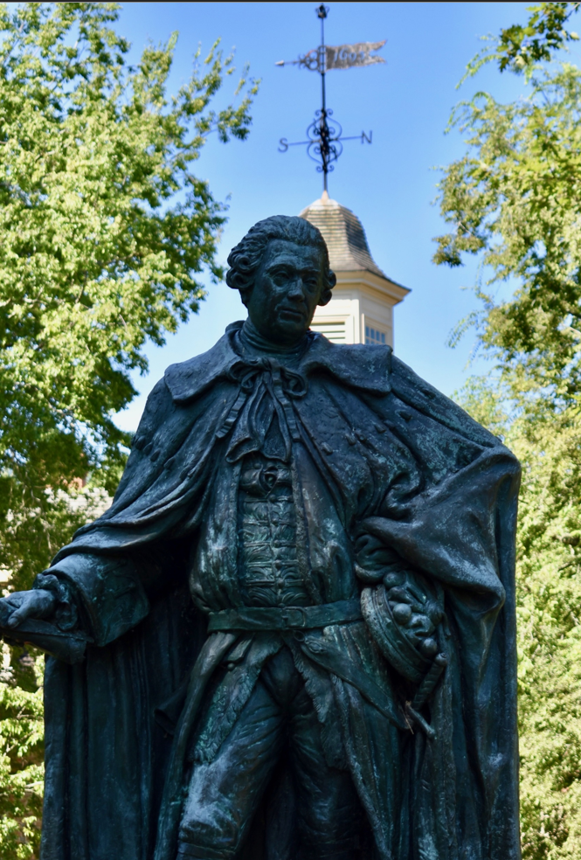
A. Political Influence and Innovation
After the 1688 Glorious Revolution in England, American legislatures began to take more power from royal governors.
The English government allowed the American colonies to develop without much interference until the mid-18th century.
Notes:
Image by Greg Garnhart from Pixabay
https://pixabay.com/photos/w-m-campus-statue-william-mary-2731100/

Slide 5
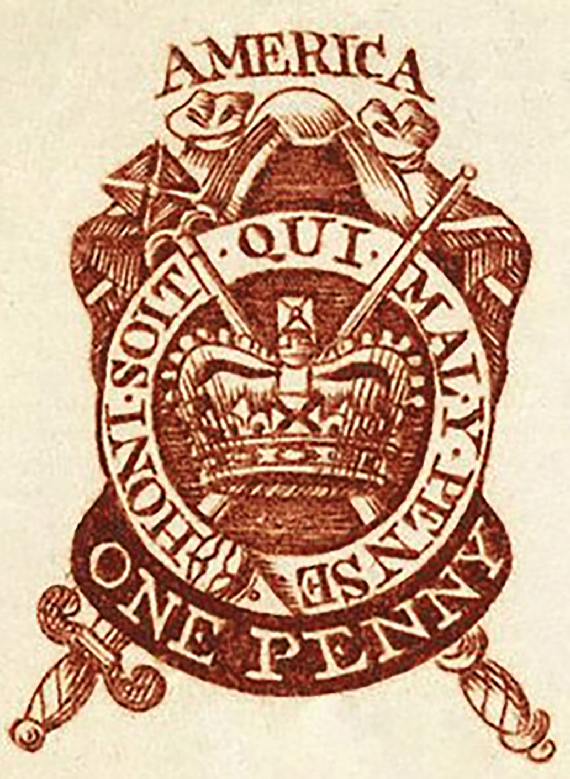
B. Tension and War in America
After the French and Indian War, tensions between the colonists and England increased over new British policies.
  Stamp Act
  Quartering Act
  Boston Massacre
  Tea Act & Boston Tea Party
  The Coercive Acts
Notes:
“1765 one penny stamp”/Wikimedia Commons/Public Domain

Slide 6
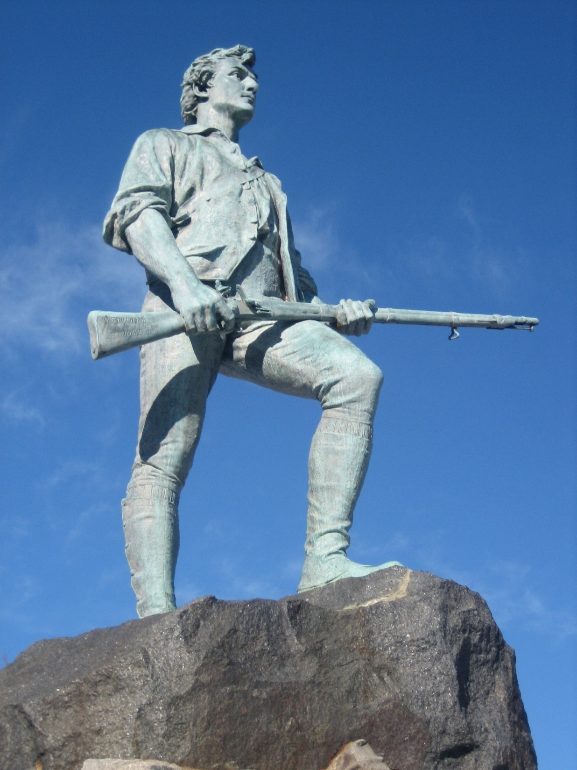
B. Tension and War in America
American colonists responded by organizing boycotts and creating the First Continental Congress (1774).
By the time the Second Continental Congress met, the fighting had already begun.
Notes:
Image by Carol Colman from Pixabay
https://pixabay.com/photos/lexington-massachusetts-180975/

Slide 7
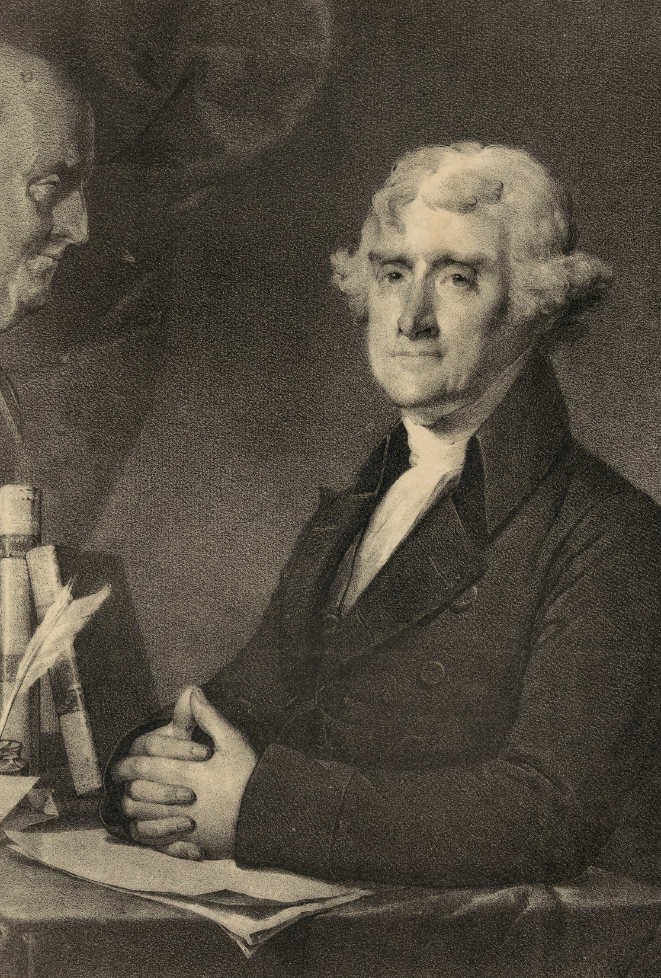
C. American Independence - 1776
The Second Continental Congress organized the American military under the leadership of George Washington.
It also set up a committee to write the Declaration of Independence – written by Thomas Jefferson.
Notes:
Photo by Library of Congress on Unsplash
https://unsplash.com/photos/8qI-Wte_S30

Slide 8
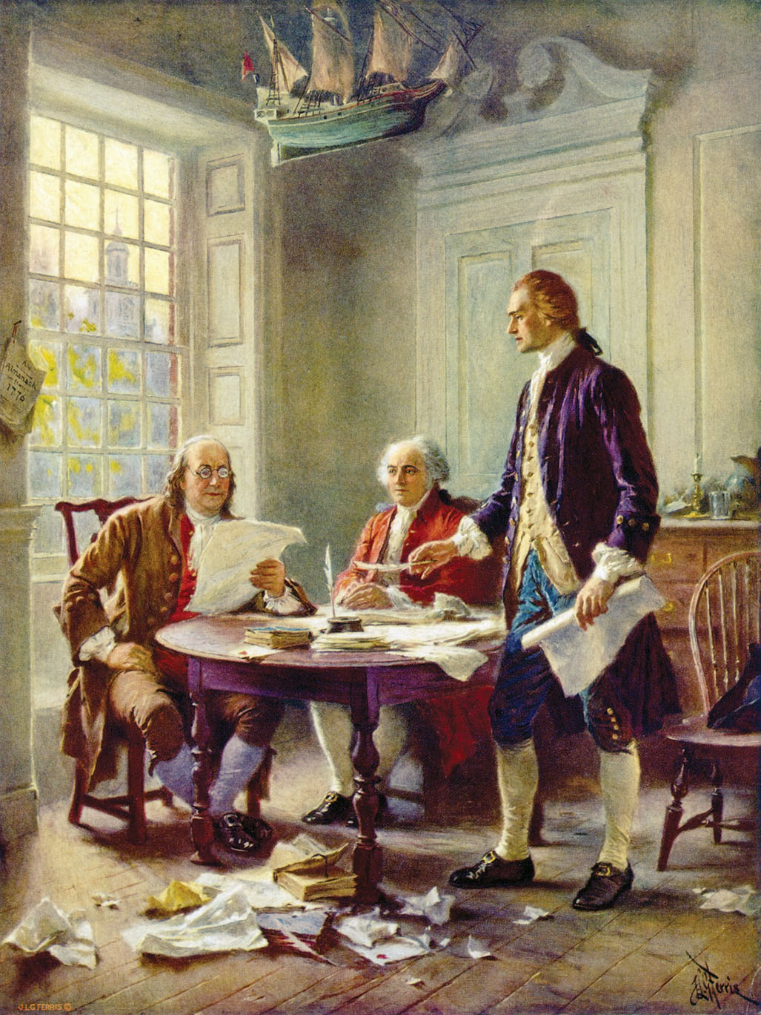
C. American Independence - 1776
Jefferson’s writing reflected the ideas of the Age of Enlightenment which emphasized reason and thought.
  All humans “are created equal”
  All humans “are endowed by their Creator with certain unalienable rights” – “life, liberty and the pursuit of happiness”
Notes:
“Writing the Declaration of Independence, 1776” by Jean Leon Gerome Ferris/Library of Congress/Wikimedia Commons/Public Domain

Slide 9
C. American Independence - 1776
Jefferson’s writing reflected the ideas of the Age of Enlightenment which emphasized reason and thought.
  Governments are established “to secure these rights”
  If governments become “destructive of these ends, they may rightfully be abolished and replaced”
Notes:
“Writing the Declaration of Independence, 1776” by Jean Leon Gerome Ferris/Library of Congress/Wikimedia Commons/Public Domain

Slide 10
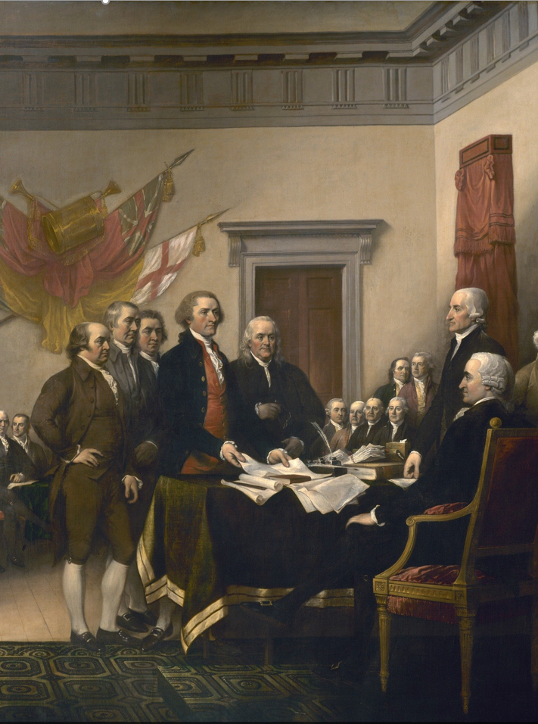
C. American Independence - 1776
On July 2, 1776, Congress approved the Declaration and the final draft was created on July 4th.
John Hancock was the first to sign it.
Notes:
Image by WikiImages from Pixabay
https://pixabay.com/photos/declaration-of-independence-62972/

Slide 11
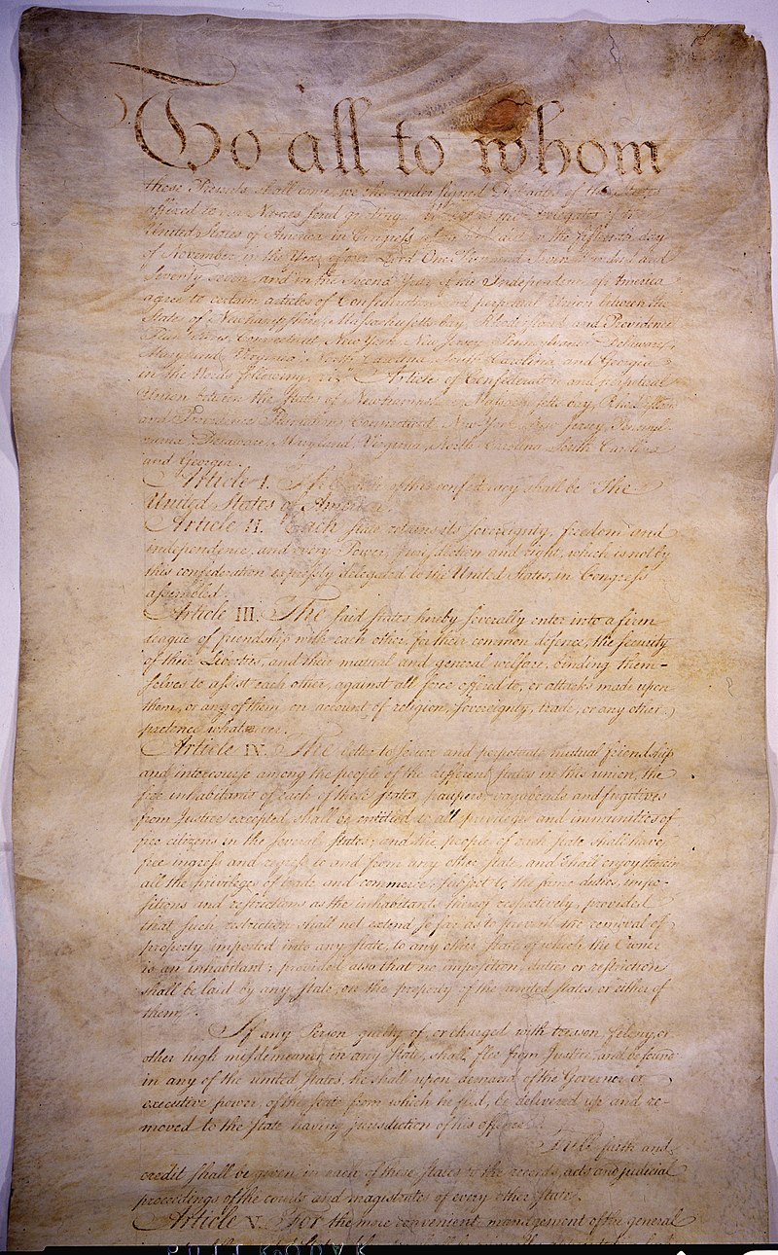
D. The Articles of Confederation
After declaring independence, the Second Continental Congress established a central government – the Articles of Confederation.
Adopting the Articles of Confederation required the unanimous approval of the states – ratification.
Notes:
By The U.S. National Archives - Articles of Confederation, Public Domain, https://commons.wikimedia.org/w/index.php?curid=65457102
https://commons.wikimedia.org/w/index.php?search=articles+of+confederation&title=Special%3ASearch&go=Go&ns0=1&ns6=1&ns12=1&ns14=1&ns100=1&ns106=1#/media/File:Articles_of_Confederation_(3695598804).jpg

Slide 12
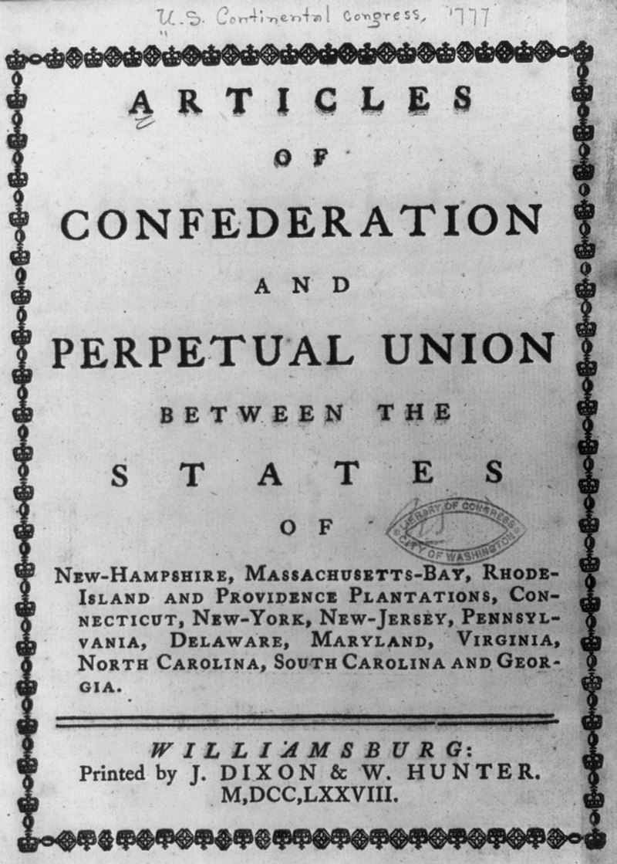
D. The Articles of Confederation
The national government consisted of a unicameral (one-house) legislature.
There was no judiciary or executive branch.
The national government was very weak and unable to enforce its own policies.
Notes:
By Miscellaneous Items in High Demand, PPOC, Library of Congress - Library of CongressCatalog: https://lccn.loc.gov/2005696018Image download: https://cdn.loc.gov/service/pnp/cph/3b00000/3b07000/3b07200/3b07209r.jpgOriginal url: https://www.loc.gov/pictures/item/2005696018/, Public Domain, https://commons.wikimedia.org/w/index.php?curid=67564451
https://commons.wikimedia.org/w/index.php?search=articles+of+confederation&title=Special%3ASearch&go=Go&ns0=1&ns6=1&ns12=1&ns14=1&ns100=1&ns106=1#/media/File:Articles_of_Confederation_and_Perpetual_Union_between_the_states_of_New_Hampshire_..._LCCN2005696018.jpg

Slide 13
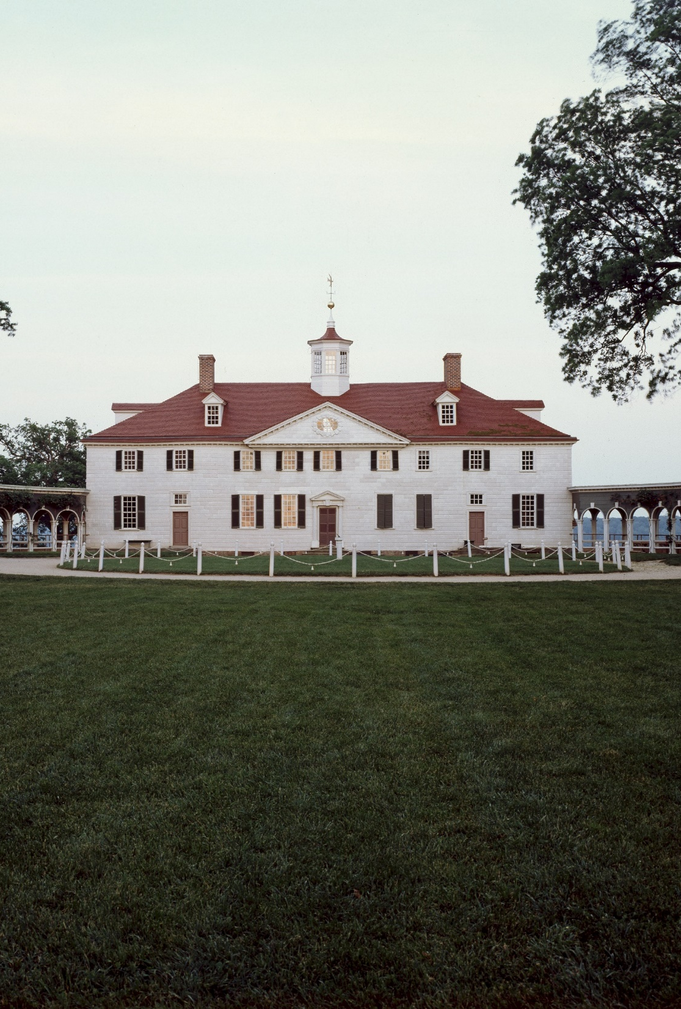
E. Calls for Change
It was soon apparent to many American leaders that changes needed to be made to the national government.
In 1785, representatives from Virginia and Maryland met at Mount Vernon, the home of George Washington, to discuss their disputes.
Notes:
Image by 272447 from Pixabay
https://pixabay.com/photos/mount-vernon-estate-3717966/

Slide 14
E. Calls for Change
Encouraged by the success of that meeting, more representatives met at the Annapolis Convention the following year.
While poorly attended, the delegates agreed to meet again in Philadelphia the next year.
Notes:
Image by 272447 from Pixabay
https://pixabay.com/photos/mount-vernon-estate-3717966/

Slide 15

Mount Vernon
Notes:
Image by 272447 from Pixabay
https://pixabay.com/photos/mount-vernon-estate-3717966/

Slide 16
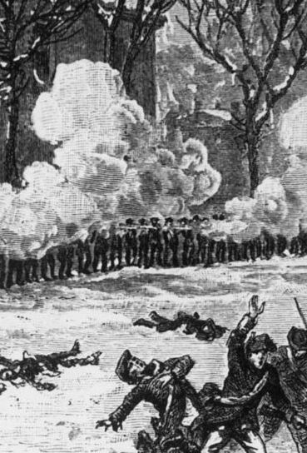
E. Calls for Change
In 1786, a popular uprising of indebted farmers in Massachusetts called Shay’s Rebellion further reinforced the need for reform.
Notes:
By Shockabrah - Own work, CC BY-SA 4.0, https://commons.wikimedia.org/w/index.php?curid=58001789
https://commons.wikimedia.org/w/index.php?sort=relevance&search=Shay%E2%80%99s+Rebellion&title=Special:Search&profile=advanced&fulltext=1&advancedSearch-current=%7B%7D&ns0=1&ns6=1&ns12=1&ns14=1&ns100=1&ns106=1#/media/File:Shay's_Rebellion.jpg
A 19th century depiction of Shays' troops being repulsed from the armory at Springfield, Massachusetts in early 1787; differing from accounts of the event as it was widely reported that no muskets were fired from either side but rather grapeshot was fired from cannons.

Slide 17
Section Review – Chapter 4.1
1–3. In what three major areas did England influence American colonial government?
local government, legislative government, and limited government (p. 55)
4–5. What two events in 1760 brought about changes in British colonial rule that would eventually lead to American independence?
Montreal surrendered to the British; George III ascended to the throne (p. 56)

Slide 18
Section Review – Chapter 4.1
6. Beginning in 1773, what were some actions Americans took in an attempt to obtain relief from Britain’s tightening control?
tea boycott began; Boston Tea Party occurred; First and Second Continental Congress convened (pp. 57–58)
7–8. What two significant political factors during the War for Independence profoundly molded the nature of the United States government following the war?
a weak legislative central government (the Second Continental Congress) and strongly independent state governments (p. 62)

Slide 19
Section Review – Chapter 4.1
9. What was the crucial weakness of the Articles of Confederation?
the inability of the national government to enforce its policies (p. 63)

Slide 20
Section Review – Chapter 4.1
Is natural law apart from Scripture a sufficient basis for human law? Why or why not?
Though medieval Christians and Enlightenment philosophers would answer yes, Reformation leaders tended to disagree. They believed that both creation and the minds of unregenerate people are corrupted by the Fall. This corruption, their followers would say, skews people’s perception of natural law. This is more evident today than at the time of our nation’s founding because religious pluralism has increased. The various viewpoints in modern America result in many competing value systems.

Slide 21
Section Review – Chapter 4.1
How did Shay’s Rebellion impact America?
Fear of anarchy spread throughout the states; many became convinced that the Articles of Confederation must be revised to handle the problems with governing.

Slide 22
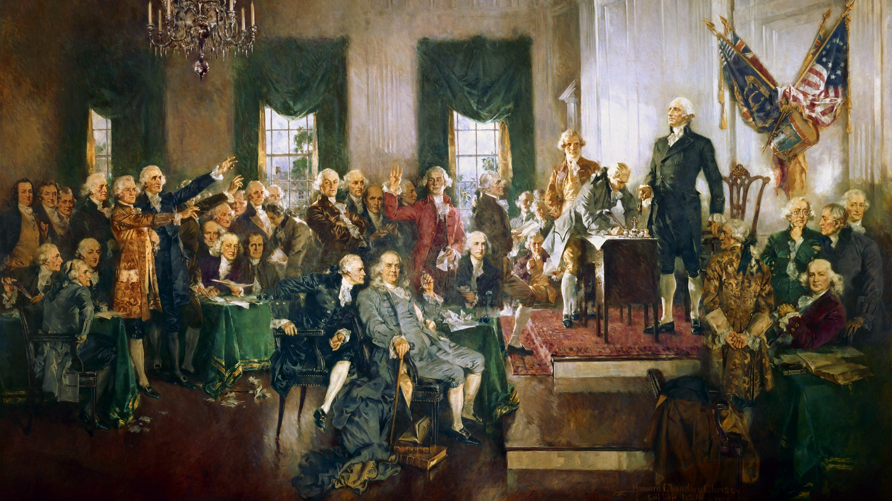
II. Constitutional Convention
Chapter 4.2
Notes:
Image by Gerd Altmann from Pixabay
https://pixabay.com/illustrations/usa-america-constitution-signing-1779925/

Slide 23
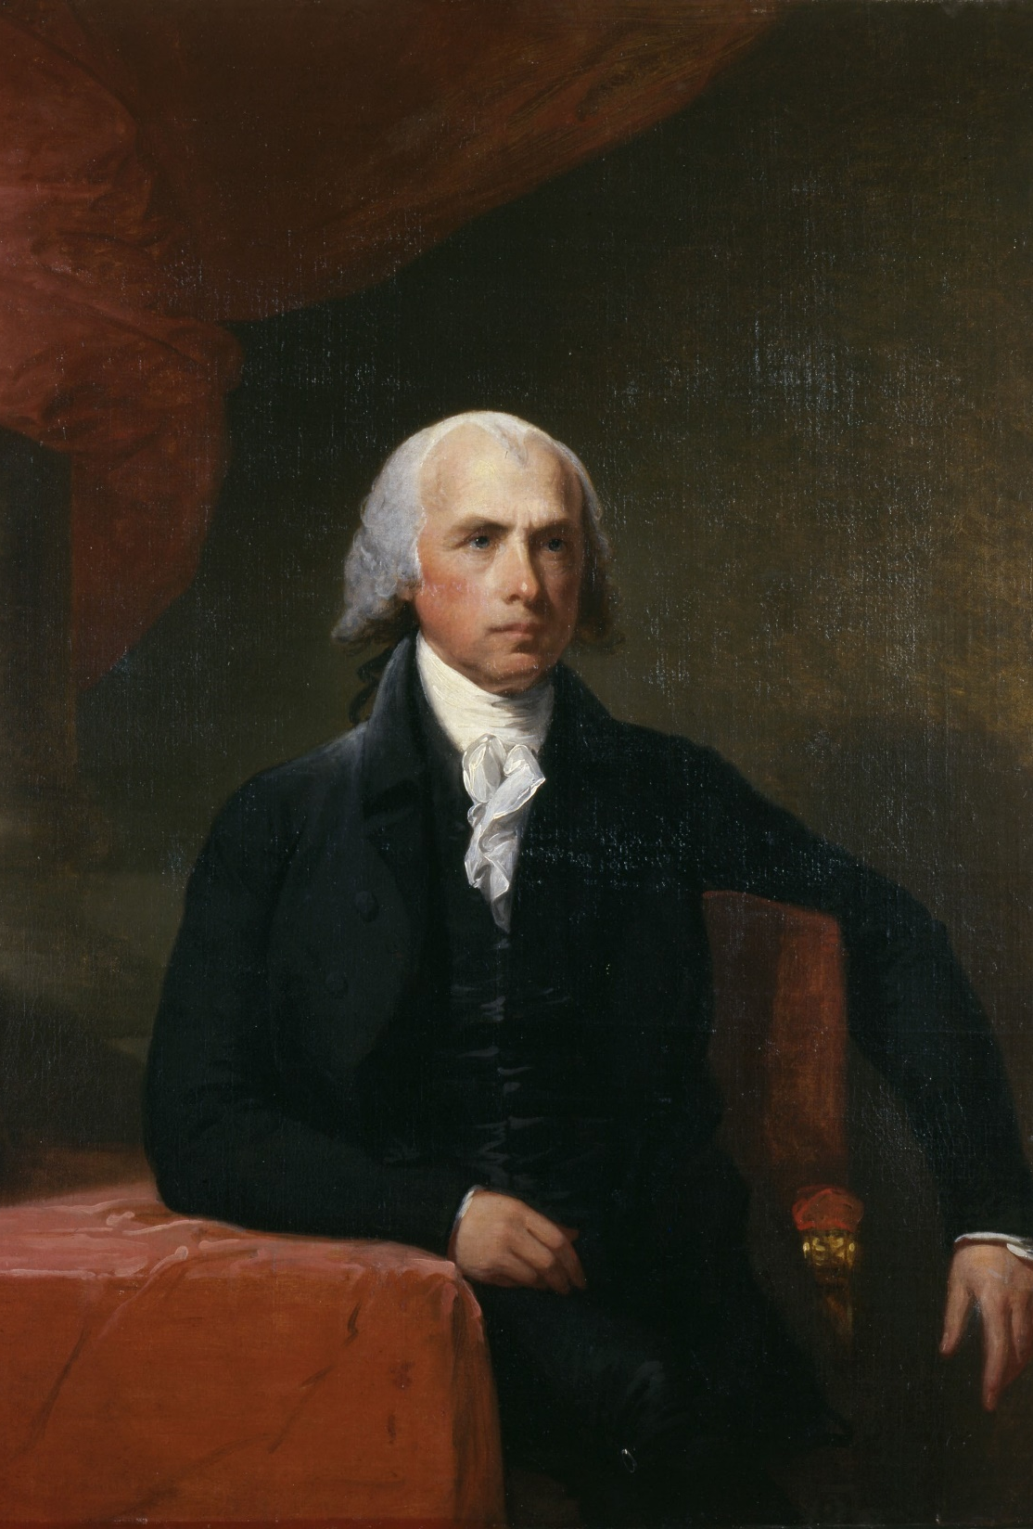
A. Towards a New Government
The Constitutional Convention began in 1787.
George Washington was elected to head the convention.
James Madison played an important role at the convention and took the most detailed notes of its activities.
James Madison
Notes:
By Gilbert Stuart - Photo taken of the portrait at Bowdoin College Museum of Art, accession number 1813.54[1], Public Domain, https://commons.wikimedia.org/w/index.php?curid=6024848
https://commons.wikimedia.org/w/index.php?sort=relevance&search=James+Madison&title=Special:Search&profile=advanced&fulltext=1&advancedSearch-current=%7B%7D&ns0=1&ns6=1&ns12=1&ns14=1&ns100=1&ns106=1&searchToken=2zk1nd72bhikm4coa4aocdlmi#%2Fmedia%2FFile%3AJames_Madison_by_Gilbert_Stuart.jpg

Slide 24
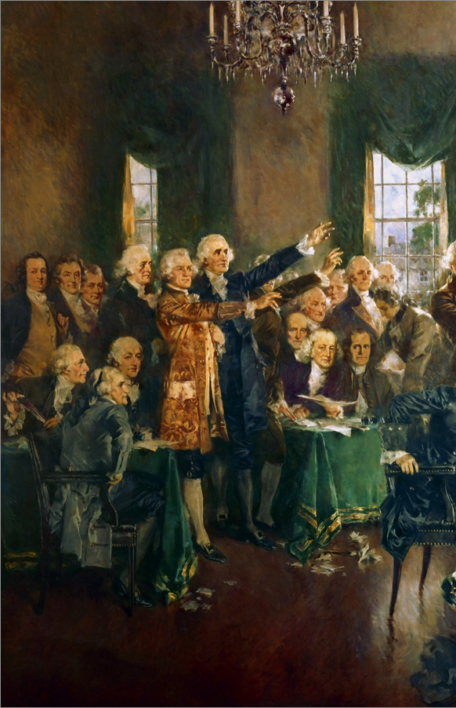
A. Towards a New Government
The delegates soon decided that they would scrap the Articles of Confederation completely.
They agreed that the new government should have separate legislative, judicial, and executive branches.
Notes:
Image by Gerd Altmann from Pixabay
https://pixabay.com/illustrations/usa-america-constitution-signing-1779925/

Slide 25
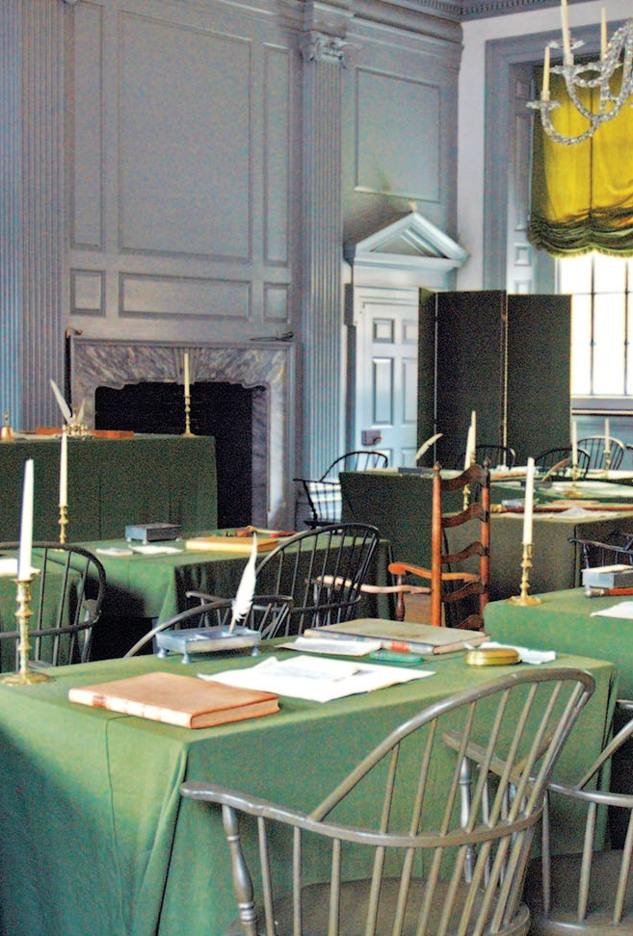
B. Conflicts and Compromises
After the opening sessions, the delegates found there were three major issues that required compromise:
  Representation
  Slavery
  Commerce
The Assembly Room
Notes:
“Independence Hall Assembly Room” by Dan Smith/Wikimedia Commons/CC-BY-SA 2.5

Slide 26
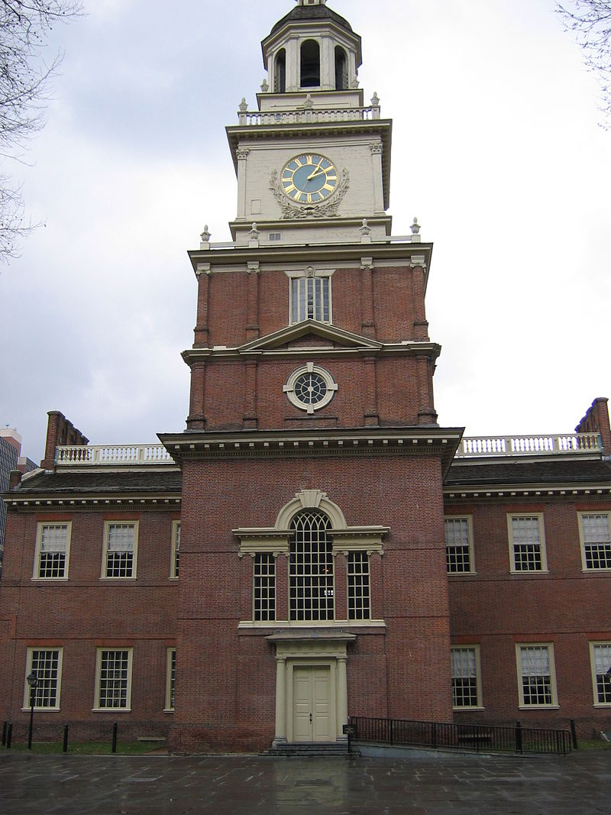
Representation
James Madison introduced the Virginia Plan which advocated for a bicameral legislature based on population.
Smaller states responded with the New Jersey Plan which called for a unicameral legislature.
Independence Hall
Notes:
CC BY-SA 3.0, https://commons.wikimedia.org/w/index.php?curid=46500
https://commons.wikimedia.org/w/index.php?sort=relevance&search=Independence+Hall&title=Special:Search&profile=advanced&fulltext=1&advancedSearch-current=%7B%7D&ns0=1&ns6=1&ns12=1&ns14=1&ns100=1&ns106=1#/media/File:Independence_hall_1_bs.jpg

Slide 27
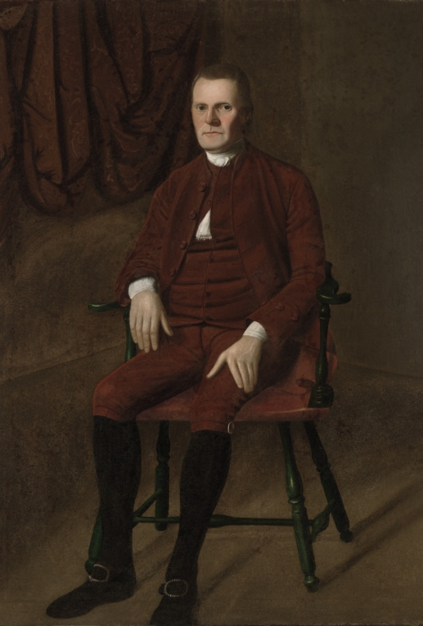
Representation
To break the deadlock, Roger Sherman introduced the Connecticut Compromise or Great Compromise.
  There would be a bicameral legislature.
  Representation in the House of Representatives would be based on population.
  Representation in the Senate would be equal.
Roger Sherman
Notes:
By Ralph Earl - Yale University Art Gallery [1], Public Domain, https://commons.wikimedia.org/w/index.php?curid=14616294
https://commons.wikimedia.org/w/index.php?sort=relevance&search=Roger+Sherman&title=Special:Search&profile=advanced&fulltext=1&advancedSearch-current=%7B%7D&ns0=1&ns6=1&ns12=1&ns14=1&ns100=1&ns106=1&searchToken=594cqlhnuj57yuwhlf4cyyxqp#%2Fmedia%2FFile%3ARoger_Sherman_1721-1793_by_Ralph_Earl.jpeg

Slide 28
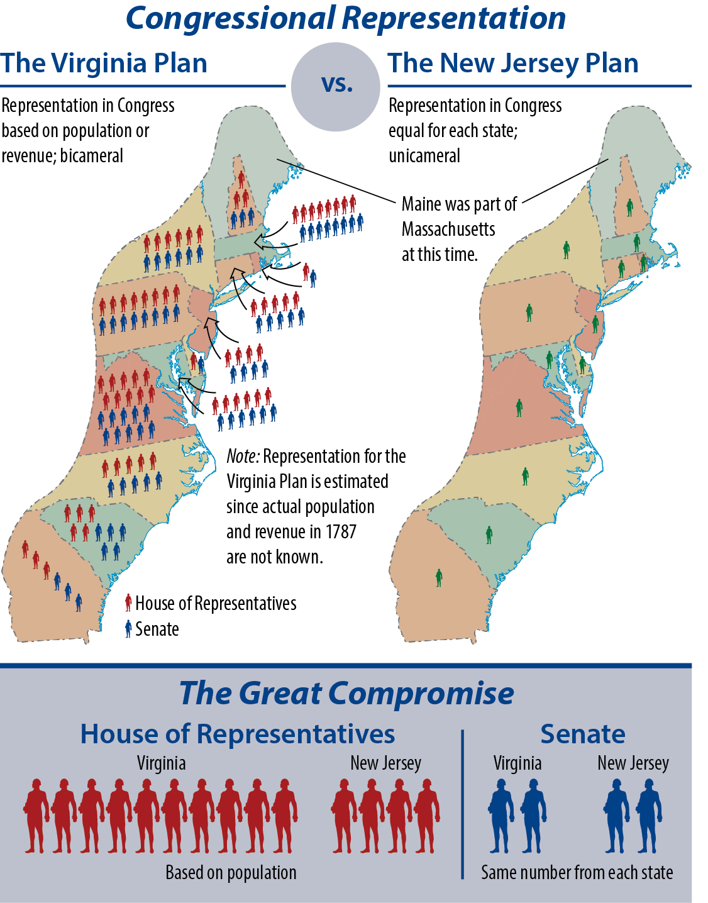
Notes:
BJU Press Art

Slide 29
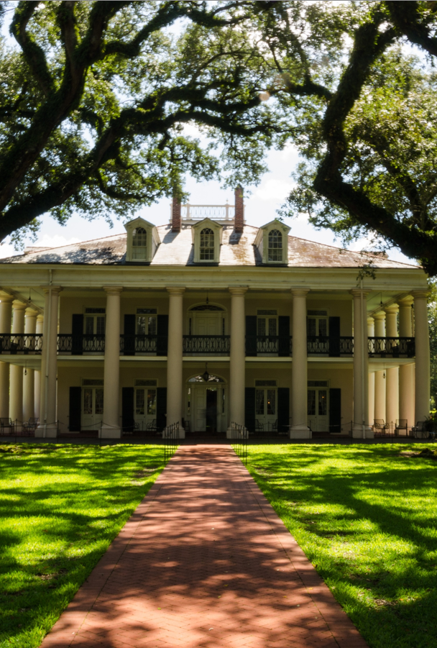
Slavery
States with large slave populations wanted slaves to be counted for determining congressional representation – though they could not vote.
Small states opposed counting slaves because it would increase the power of slave states.
Notes:
Image by USA-Reiseblogger from Pixabay
https://pixabay.com/photos/oak-alley-plantation-usa-america-1647335/

Slide 30
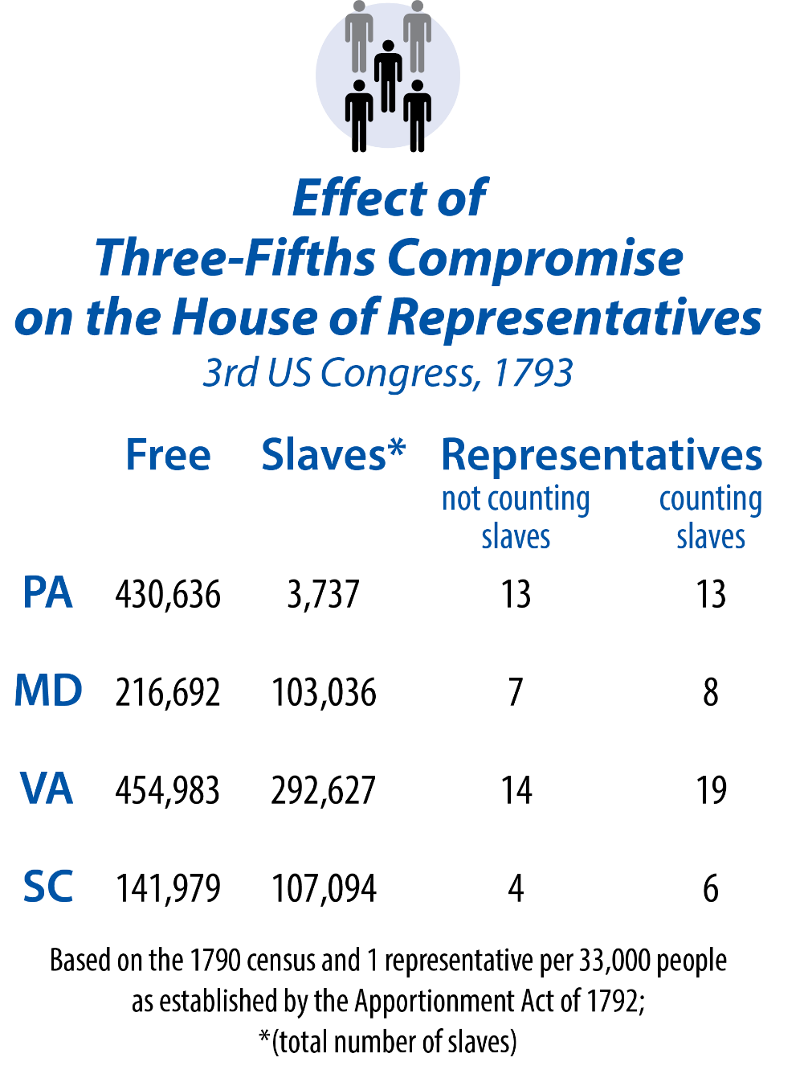
Notes:
BJU Press Art

Slide 31
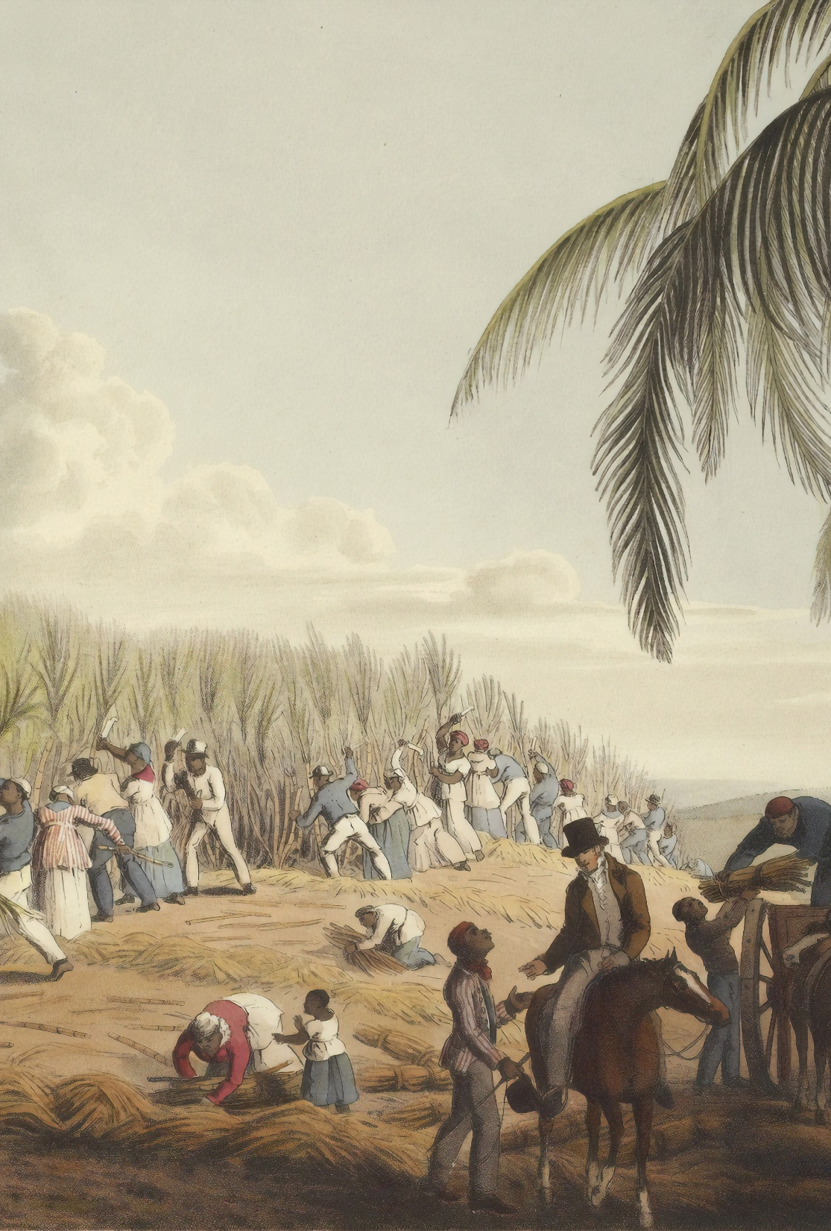
Slavery
The delegates agreed to adopt the Three-Fifths Compromise which allowed 3/5 of slaves to be counted for representation.
This agreement did not solve the issue of slavery – it merely postponed it.
Notes:
Photo by British Library on Unsplash
https://unsplash.com/photos/atIgjLlFryg

Slide 32
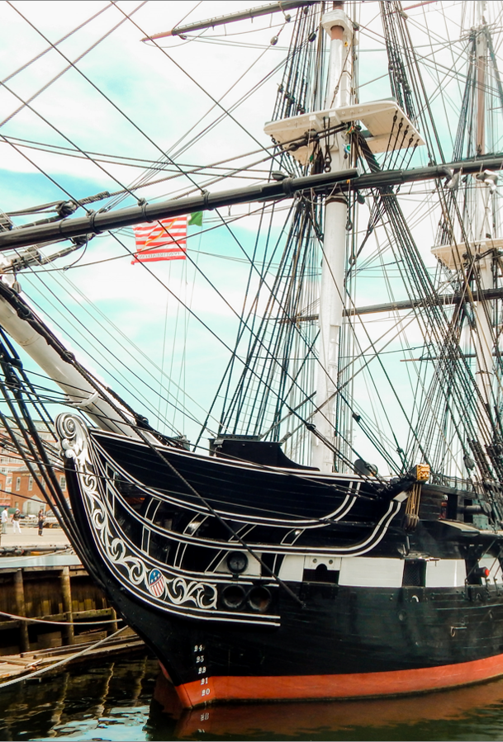
Commerce
The convention agreed to give Congress the power to regulate interstate and foreign commerce.
In exchange, the national government was forbidden from interfering with the slave trade for 20 years or impose any export taxes on the states.
Notes:
Photo by Sarah Brown on Unsplash
https://unsplash.com/photos/mvRKPeJuHJg

Slide 33
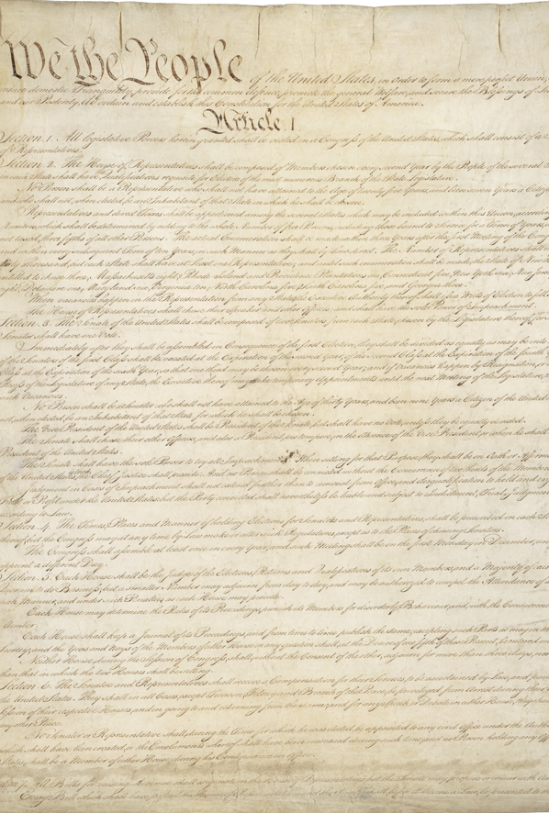
Other Agreements
The Electoral College was created to elect the president.
The power to make treaties was given to the president but required approval of Congress.
The Constitution was finished on September 17, 1787.
Notes:
Image by WikiImages from Pixabay
https://pixabay.com/photos/constitution-united-states-usa-62943/

Slide 34
Section Review – Chapter 4.2
1–2. What two key procedural rules, established at the beginning of the Constitutional Convention, greatly facilitated the convention’s progress?
a rule of secrecy outside the convention hall; organization of the convention as a committee of the whole (pp. 66–67)
3. Who is known as the Father of the Constitution?
James Madison (p. 67)

Slide 35
Section Review – Chapter 4.2
4. What major agreement did the Constitutional Convention reach after only five days of meeting?
The convention would establish a new national government – restructured and redefined. (p. 67)
5. What questions should a Christian legislator ask himself when asked to compromise?
Is the issue a moral one? Is it something that should be legislated? Is the disagreement over the goal
or the means to reach it? (p. 72)

Slide 36
Section Review – Chapter 4.2
Identify the three major areas in which delegates to the Constitutional Convention had to compromise, and explain the reasoning behind those compromises.
representation (Some wanted representation based on state population, but others wanted equal representation, so the delegates compromised by establishing a bicameral legislature in which one house had equal representation and the other house had representation by population.)

Slide 37
Section Review – Chapter 4.2
Identify the three major areas in which delegates to the Constitutional Convention had to compromise, and explain the reasoning behind those compromises.
slavery (Some wanted to count slaves toward representation, but others did not, so the delegates compromised by counting three-fifths of any state’s slaves toward representation but taxing them at the same rate.)

Slide 38
Section Review – Chapter 4.2
Identify the three major areas in which delegates to the Constitutional Convention had to compromise, and explain the reasoning behind those compromises.
commerce (The delegates reached compromises to make interstate and international trade easier.)

Slide 39
Section Review – Chapter 4.2
Why do people in a free society need to make political compromise?
Compromise is an important part of the political process. Disagreements are common and addressing those issues is essential for governing to take place.

Slide 40
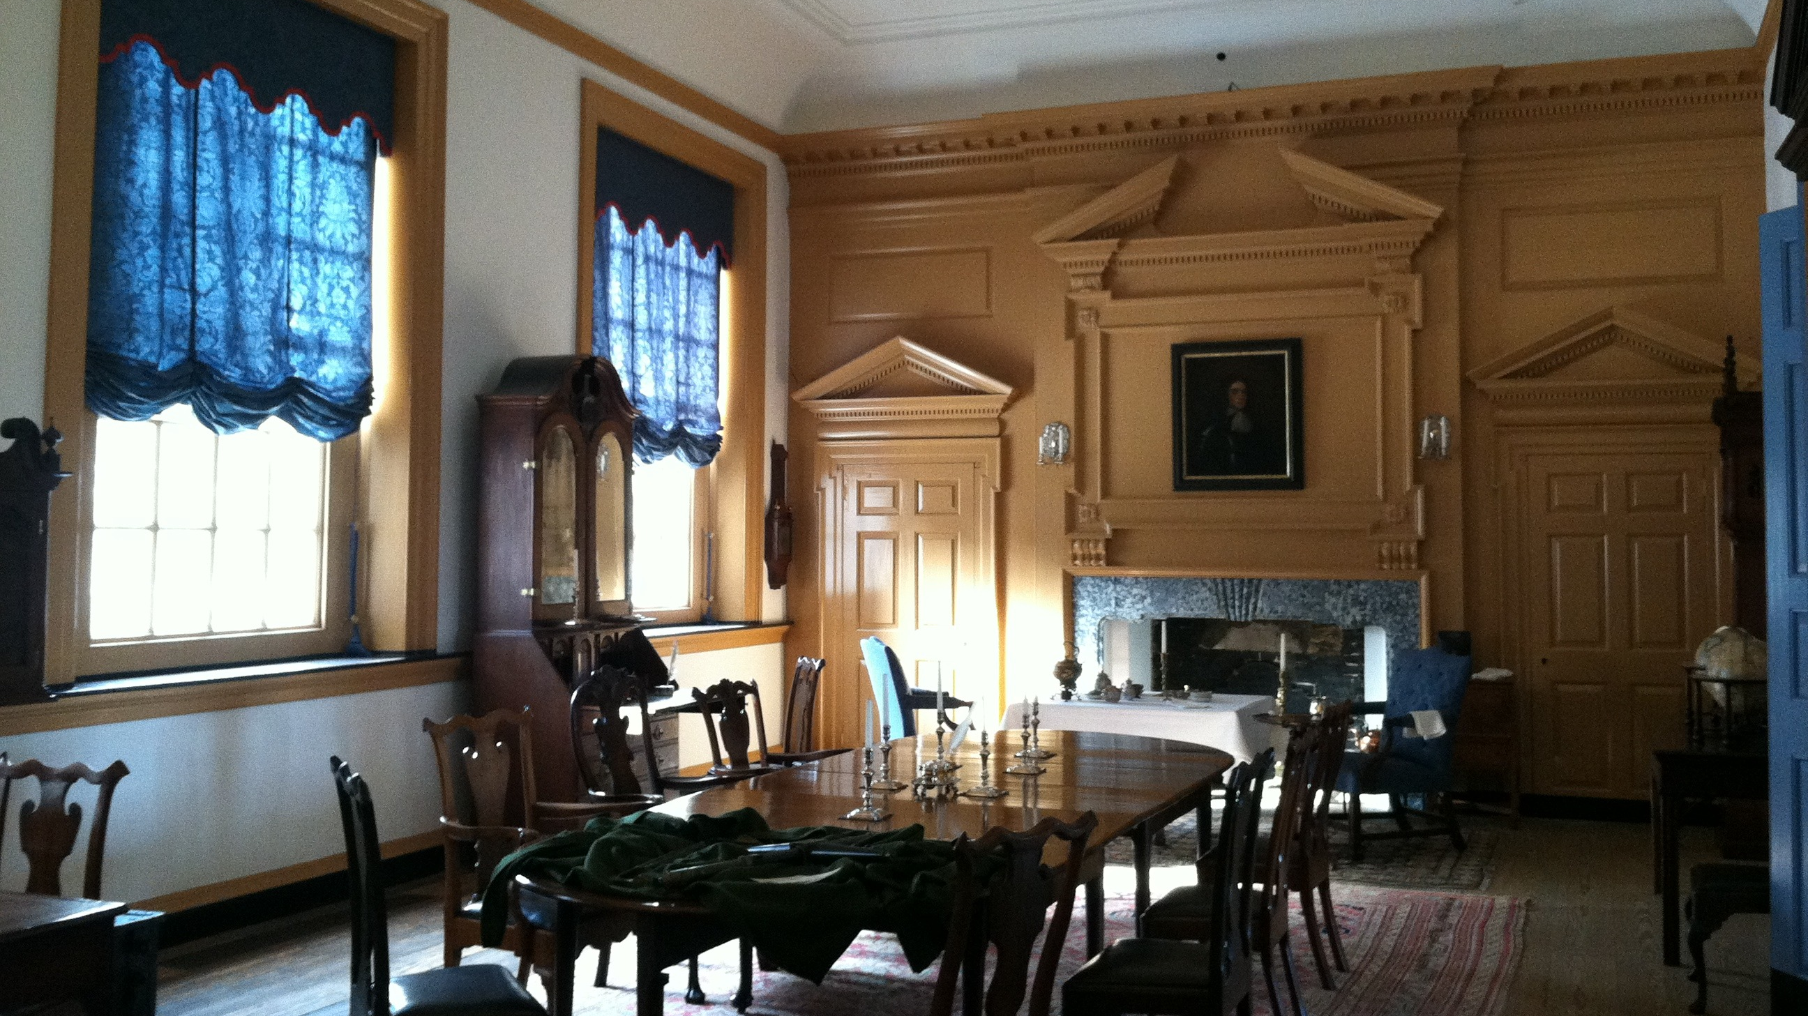
III. Ratification Controversy
Chapter 4.3
Notes:
Image by Robert Jones from Pixabay
https://pixabay.com/photos/philadelphia-pennsylvania-interior-321436/

Slide 41
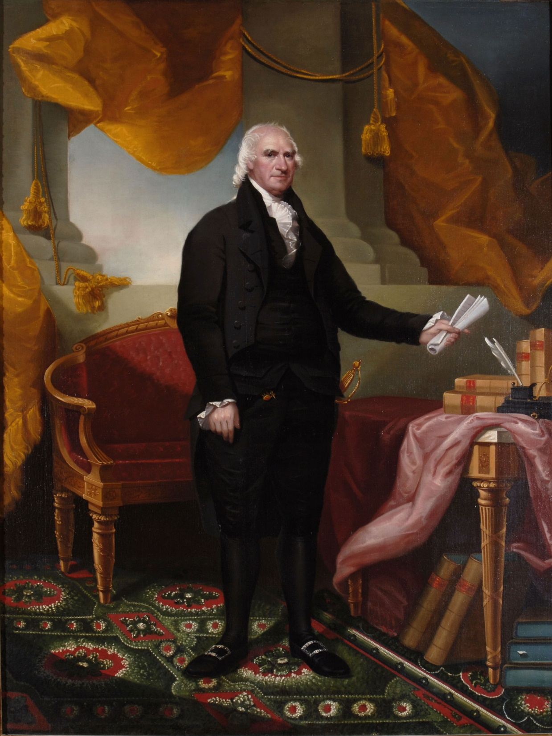
III. Ratification Controversy
While at least nine states were required to adopt the Constitution for it to be ratified, in practice, all major states needed to approve it.
Supporters of the Constitution were known as Federalists while its opponents were called Anti-Federalists.
George Clinton
Notes:
By Ezra Ames - http://www.hallofgovernors.ny.gov/GeorgeClinton, Public Domain, https://commons.wikimedia.org/w/index.php?curid=26379353
https://en.wikipedia.org/wiki/George_Clinton_(vice_president)#/media/File:George_Clinton,_governor_of_New_York_(portrait_by_Ezra_Ames).png

Slide 42
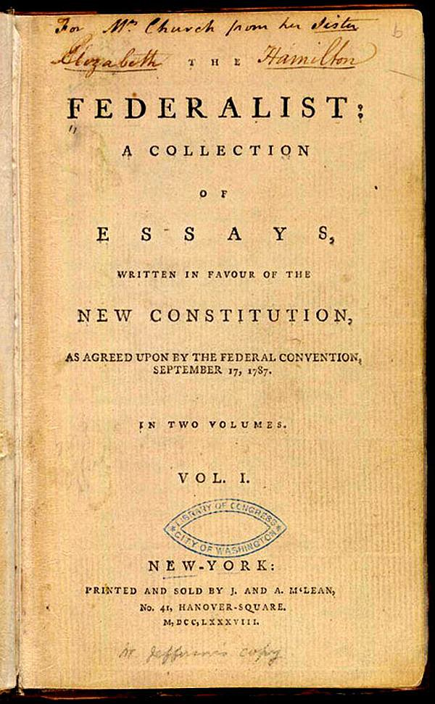
A. The Federalist Papers
Each side wrote a series of essays supporting its cause.
Alexander Hamilton, James Madison, and John Jay wrote the Federalist Papers, which argued in favor of the Constitution.
Notes:
By Publius (pseudonym) [Alexander Hamilton, John Jay, James Madison]. - http://www.americaslibrary.gov/aa/madison/aa_madison_father_2_e.html., Public Domain, https://commons.wikimedia.org/w/index.php?curid=15839433
https://commons.wikimedia.org/w/index.php?sort=relevance&search=federalist+papers&title=Special:Search&profile=advanced&fulltext=1&advancedSearch-current=%7B%7D&ns0=1&ns6=1&ns12=1&ns14=1&ns100=1&ns106=1&searchToken=6ic47biqm31g8te1oomwwvrn1#%2Fmedia%2FFile%3AThe_Federalist_%281st_ed%2C_1788%2C_vol_I%2C_title_page%29.jpg

Slide 43
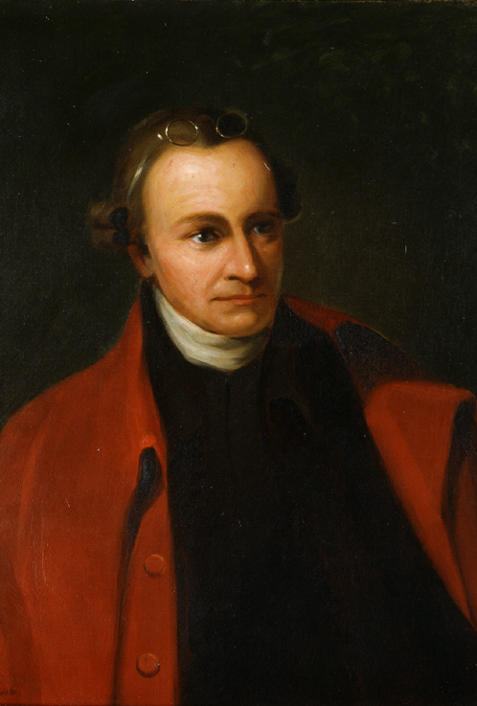
B. Battles in Virginia and New York
The closest battles for ratification occurred in Virginia and New York.
Anti-Federalist leaders such as Patrick Henry and Edmund Randolph opposed the Constitution.
Some felt it reduced the power of states too much, while others objected to the lack of a bill of rights.
Patrick Henry
Notes:
By George Bagby Matthews (1857 - 1943), after Thomas Sully (1783-1872) - http://www.senate.gov/artandhistory/art/artifact/Painting_31_00011.htm, Public Domain, https://commons.wikimedia.org/w/index.php?curid=17801328
https://commons.wikimedia.org/w/index.php?title=Special:Search&limit=20&offset=20&ns0=1&ns6=1&ns12=1&ns14=1&ns100=1&ns106=1&search=patrick+henry&advancedSearch-current=%7B%7D&searchToken=7afatzbqkmg2u4a8upj9yngyf#%2Fmedia%2FFile%3APatrick_henry.JPG

Slide 44
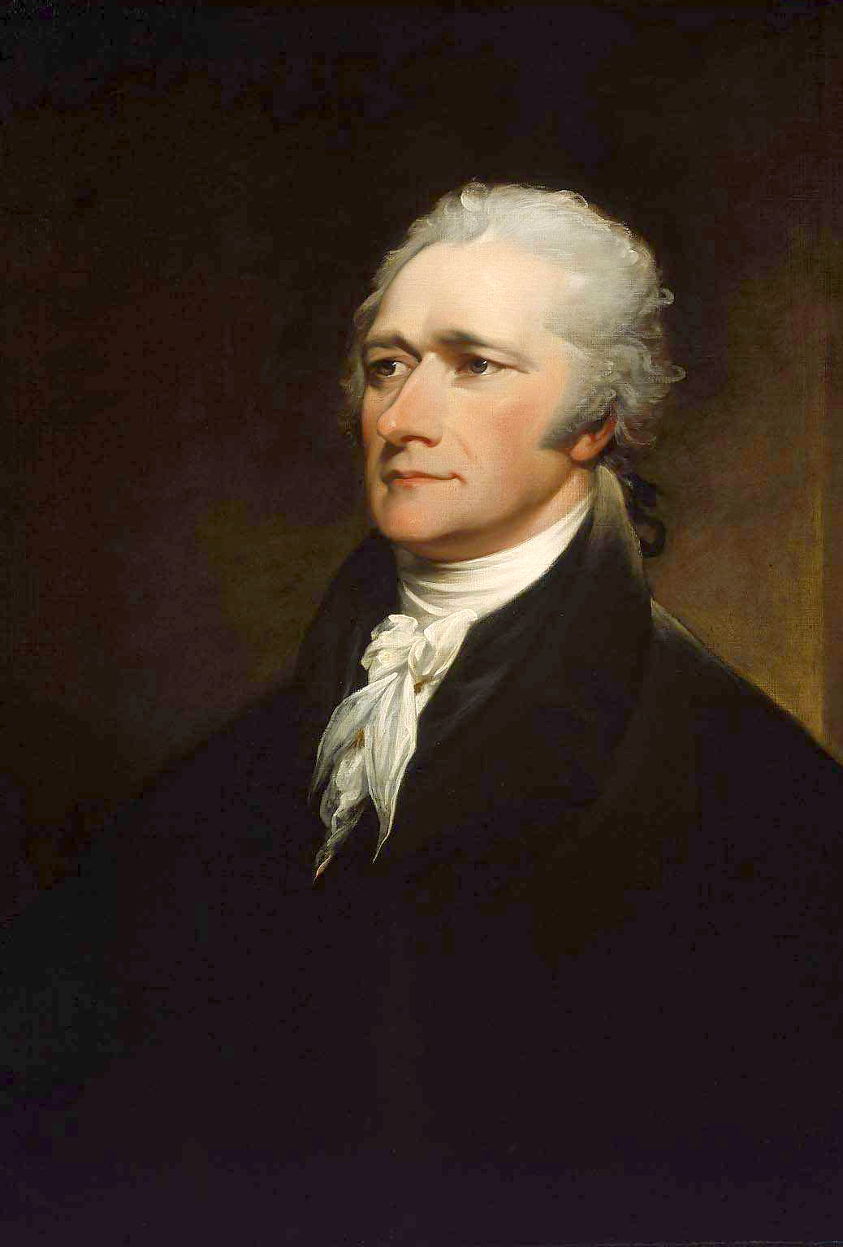
B. Battles in Virginia and New York
After promising to create a bill of rights after the Constitution was ratified, the Federalists won in Virginia.
Anti-Federalist support in New York collapsed soon after.
Alexander Hamilton
Notes:
https://commons.wikimedia.org/wiki/File:John_Trumbull_-_Alexander_Hamilton_-_Google_Art_Project.jpg; John Trumbull – Alexander Hamilton – Google Art Project/Wikimedia Commons/Public Domain

Slide 45
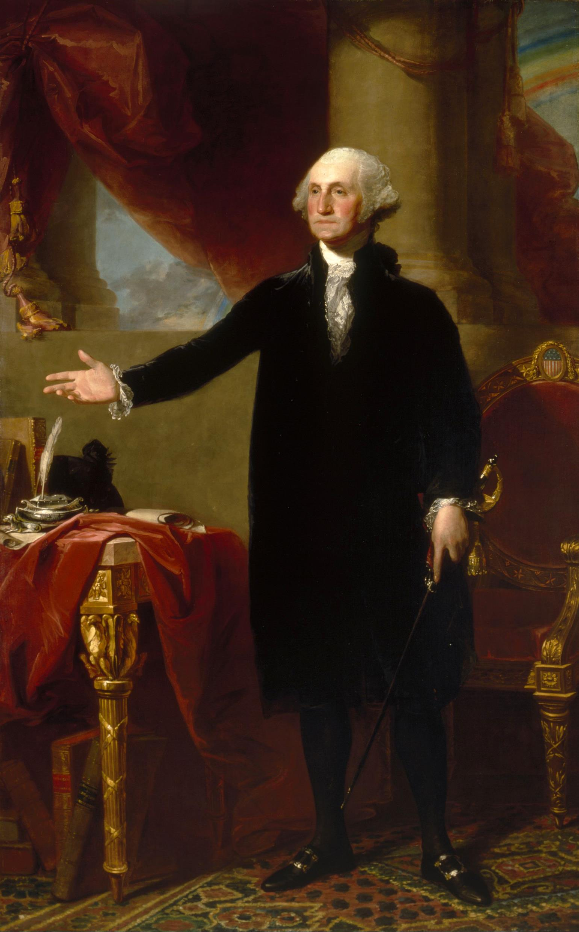
C. A Nation Rises
In 1789, George Washington was unanimously elected as the nation’s first president.
Much of the success of the United States can be credited to the durability and flexibility of the Constitution.
George Washington
Notes:
By Gilbert Stuart - http://www.nga.gov/exhibitions/2005/stuart/philadelphia.shtm, Public Domain, https://commons.wikimedia.org/w/index.php?curid=33579
https://commons.wikimedia.org/w/index.php?title=Special:Search&search=george+washington+portrait&fulltext=1&ns0=1&ns6=1&ns12=1&ns14=1&ns100=1&ns106=1&searchToken=852ruiewqczsfpry6v44twasw#%2Fmedia%2FFile%3AGilbert_Stuart%2C_George_Washington_%28Lansdowne_portrait%2C_1796%29.jpg

Slide 46
Section Review – Chapter 4.3
1–5. Who were the main leaders of the Anti-Federalists?
George Clinton, Patrick Henry, Edmund Randolph, George Mason, and Richard Henry Lee (p. 75)
6–8. Who were the main leaders of the Federalists?
Alexander Hamilton, James Madison, and John Jay (p. 73)

Slide 47
Section Review – Chapter 4.3
9–10. What were the two most crucial state conventions in the ratification of the Constitution?
the conventions in Virginia and New York (p. 75)
11–12. What factors led to the final approval of the Constitution in the two most crucial states?
A few undecided Virginia delegates were swayed by Madison’s promise to do everything possible to obtain a bill of rights, and some New York Anti-Federalists switched sides after the Virginia Anti-Federalists failed to block ratification.
(pp. 75–77)

Slide 48
Section Review – Chapter 4.3
Explain the two major arguments Patrick Henry presented against adoption of the Constitution. Do you agree or disagree with those arguments? Defend your answer.
It curbed state power and it lacked a bill of rights.

Slide 49
Section Review – Chapter 4.3
How significant were The Federalist Papers? Explain your answer.
They were crucial to ratifying the Constitution. They not only addressed the objections of Anti-Federalists, they also provided a commentary on the principles of republican government. In addition, they helped persuade many people that the Constitution should be adopted.

