Slide 1
Chapter 5:
The United States Constitution
Notes:
WIN-Initiative/Stone/Getty Images

Slide 2
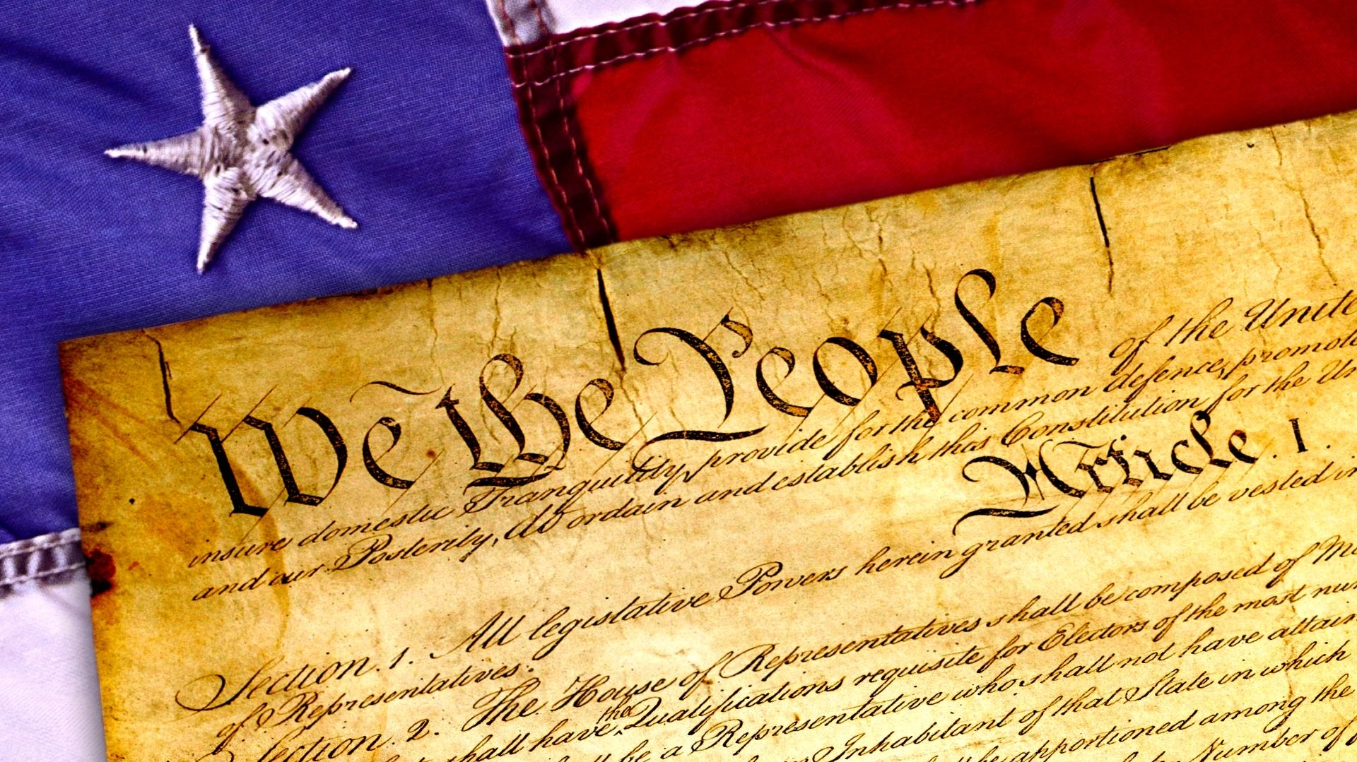
I. Practical Aspects
Chapter 5.1
Notes:
Image by Wynn Pointaux from Pixabay
https://pixabay.com/illustrations/constitution-4th-of-july-july-4th-1486010/

Slide 3
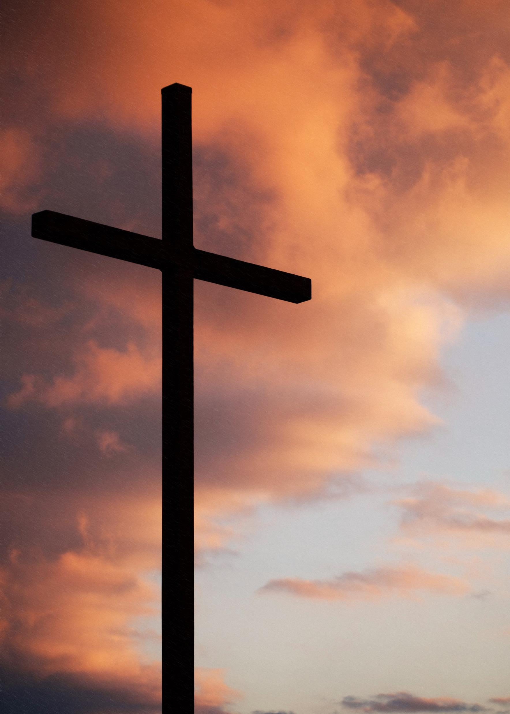
A. Realistic View of Human Nature
While the Constitution is not a Christian document (it never mentions God), it is influenced by Christian principles.
The Founders recognized humans’ desire for freedom, but also their tendency to sin.
Notes:
Photo by Aaron Burden on Unsplash
https://unsplash.com/photos/Ncn1jiEe-Wc

Slide 4
A. Realistic View of Human Nature
This distrust of human nature led the Founders to include checks and balances, separation of powers, and other restraints.
Notes:
Photo by Aaron Burden on Unsplash
https://unsplash.com/photos/Ncn1jiEe-Wc

Slide 5
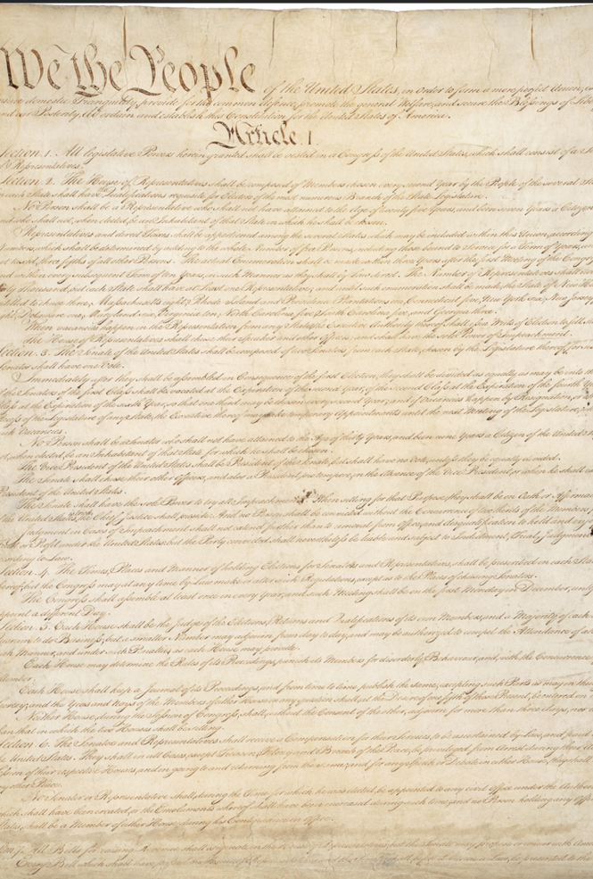
B. Constitutional Interpretation
The Constitution is brief and general – this helps it stay relevant and able to adapt to change.
Because it is vague, the Constitution is often open to various kinds of interpretations.
Notes:
By Constitutional Convention - U.S. National Archives and Records Administration, Public Domain, https://commons.wikimedia.org/w/index.php?curid=15795309
https://commons.wikimedia.org/w/index.php?sort=relevance&search=us+constitution&title=Special:Search&profile=advanced&fulltext=1&advancedSearch-current=%7B%7D&ns0=1&ns6=1&ns12=1&ns14=1&ns100=1&ns106=1&searchToken=2lezmkb5myrucey9x1lixcjgi#%2Fmedia%2FFile%3AConstitution_of_the_United_States%2C_page_1.jpg

Slide 6

B. Constitutional Interpretation
Those who prefer a more literal interpretation of the Constitution are known as strict constructionists.
Others who take a broader and more flexible view are known as broad constructionists.
Notes:
Photo by Christin Hume on Unsplash
https://unsplash.com/photos/Hcfwew744z4

Slide 7
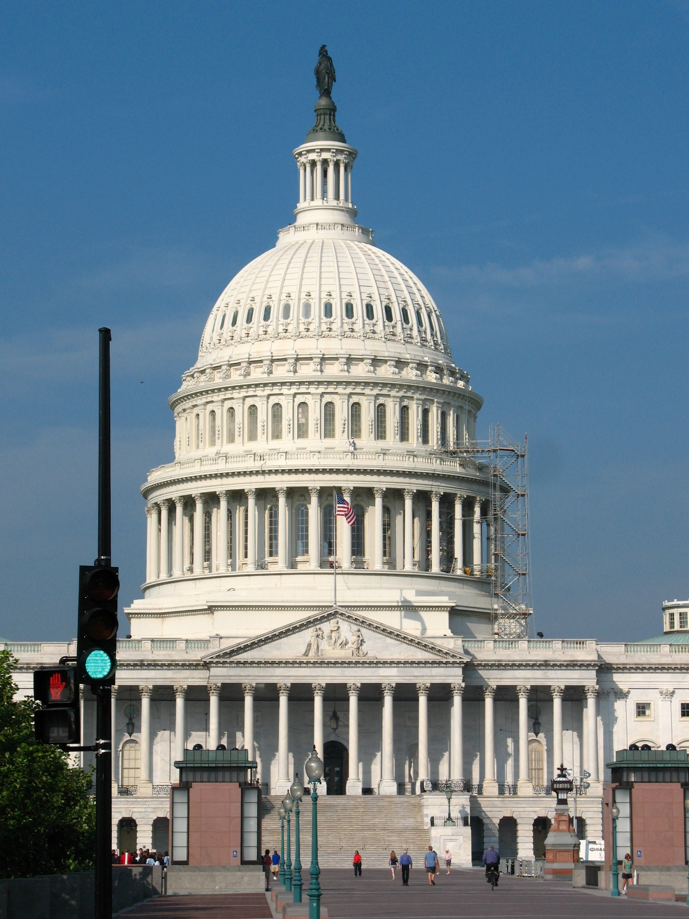
C. Adapting the Constitution
What the Constitution means is often determined by what judges say it means.
The “necessary and proper clause” gives power to Congress to make laws that are needed to carry out its responsibilities.
Notes:
Photo by Dan Dennis on Unsplash
https://unsplash.com/photos/4OYPIAKuM3k

Slide 8
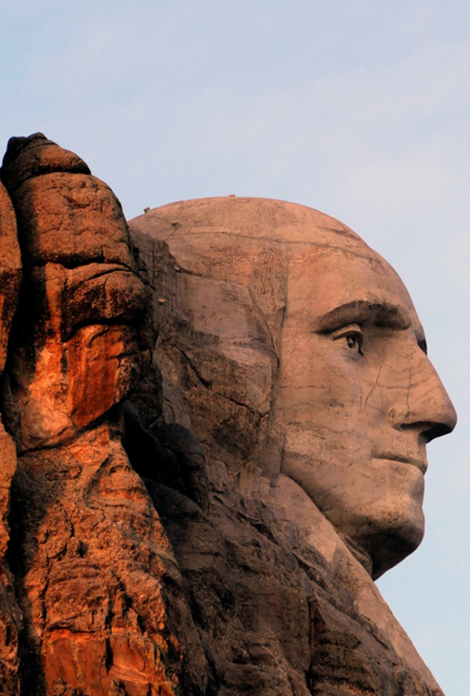
C. Adapting the Constitution
Presidents sometimes set traditions that end up becoming law such as Washington’s limit of two terms.
At other times, they may assume new powers to expand the responsibilities of their office.
Notes:
Image by 272447 from Pixabay
https://pixabay.com/photos/monument-mountain-mount-rushmore-2228305/

Slide 9
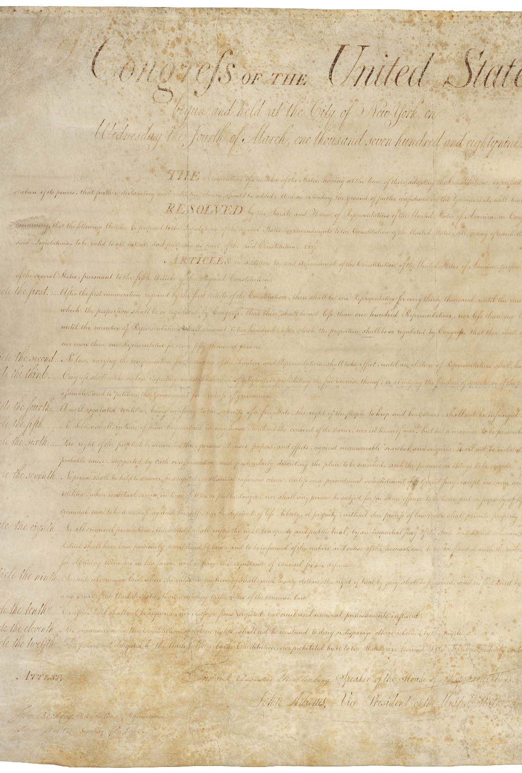
D. The Amendment Process
Article V of the Constitution describes the process for creating changes to the document.
There are two phases to the amendment process: proposal & ratification.
Notes:
Public Domain, https://commons.wikimedia.org/w/index.php?curid=661313
https://commons.wikimedia.org/w/index.php?sort=relevance&search=bill+of+rights&title=Special:Search&profile=advanced&fulltext=1&advancedSearch-current=%7B%7D&ns0=1&ns6=1&ns12=1&ns14=1&ns100=1&ns106=1&searchToken=aofbcy0xek7f45g3fjzs9yog8#%2Fmedia%2FFile%3ABill_of_Rights_Pg1of1_AC.png

Slide 10
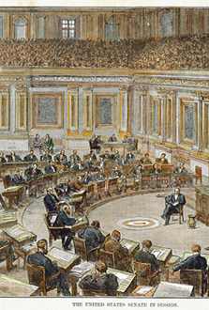
D. The Amendment Process
Amendment proposal is the formal introduction of an amendment and may be done in two ways:
  Two-thirds vote in both houses of Congress
  National convention called by two-thirds of the states
Notes:
Public Domain, https://commons.wikimedia.org/w/index.php?curid=842514
https://commons.wikimedia.org/w/index.php?sort=relevance&search=US+senate+chamber&title=Special:Search&profile=advanced&fulltext=1&advancedSearch-current=%7B%7D&ns0=1&ns6=1&ns12=1&ns14=1&ns100=1&ns106=1&searchToken=dfzca1qw688akn5adxt3fax94

Slide 11
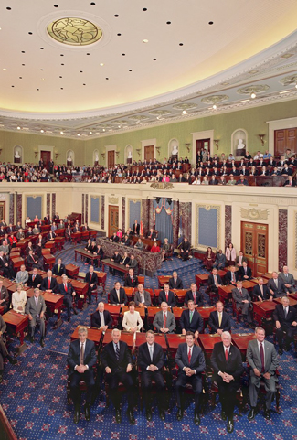
D. The Amendment Process
Ratification is the process of formally approving an amendment and can be done in two ways:
  Approval of three-fourths of the states’ legislatures
  Approval of three-fourths of special state ratification conventions
Notes:
By Transferred from en.wikipedia to Commons. Transfer was stated to be made by User:pmax7., Public Domain, https://commons.wikimedia.org/w/index.php?curid=3350777
https://commons.wikimedia.org/w/index.php?sort=relevance&search=US+senate+chamber&title=Special:Search&profile=advanced&fulltext=1&advancedSearch-current=%7B%7D&ns0=1&ns6=1&ns12=1&ns14=1&ns100=1&ns106=1&searchToken=1k0cut6e28g7r1rgbx4mu2795#%2Fmedia%2FFile%3AUS_Senate_Session_Chamber.jpg

Slide 12
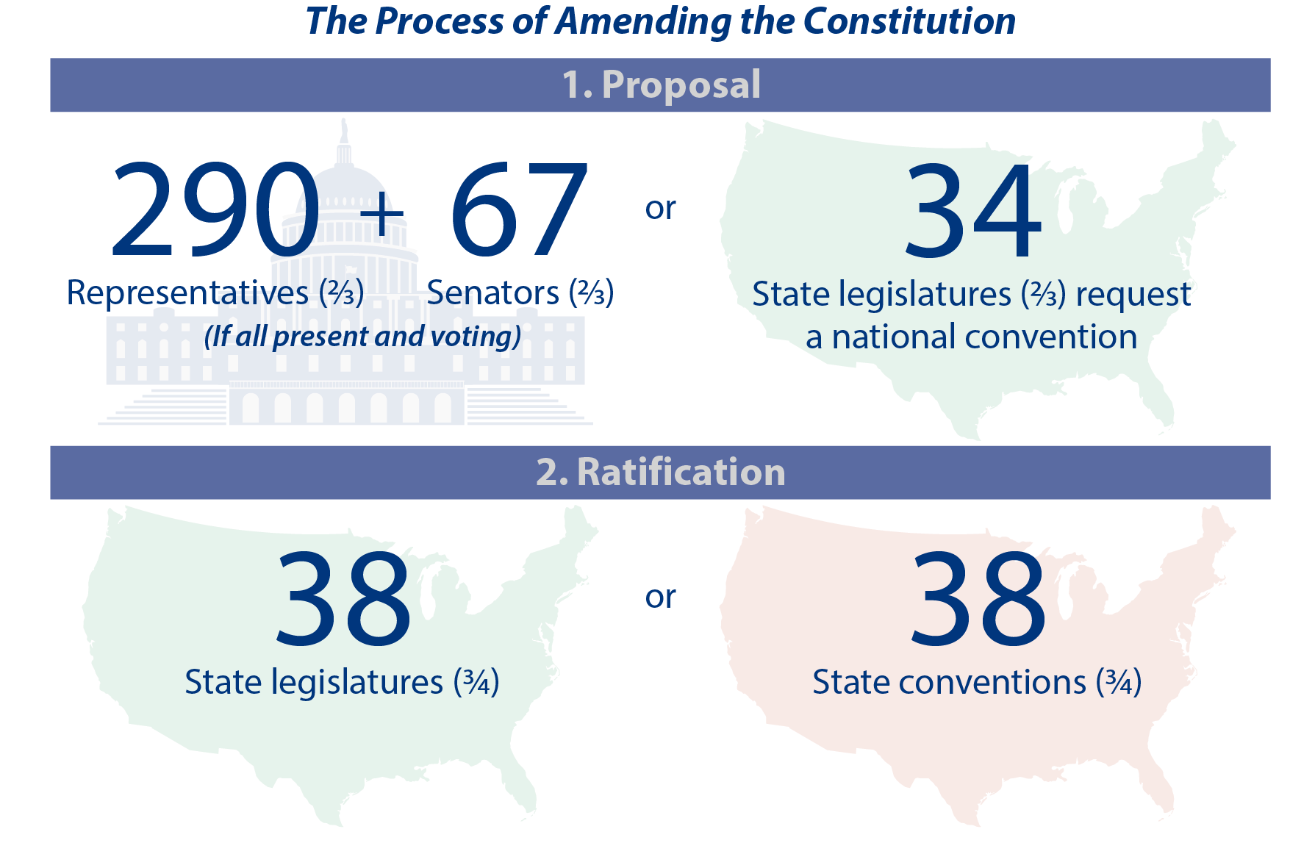
Notes:
BJU Press Art

Slide 13
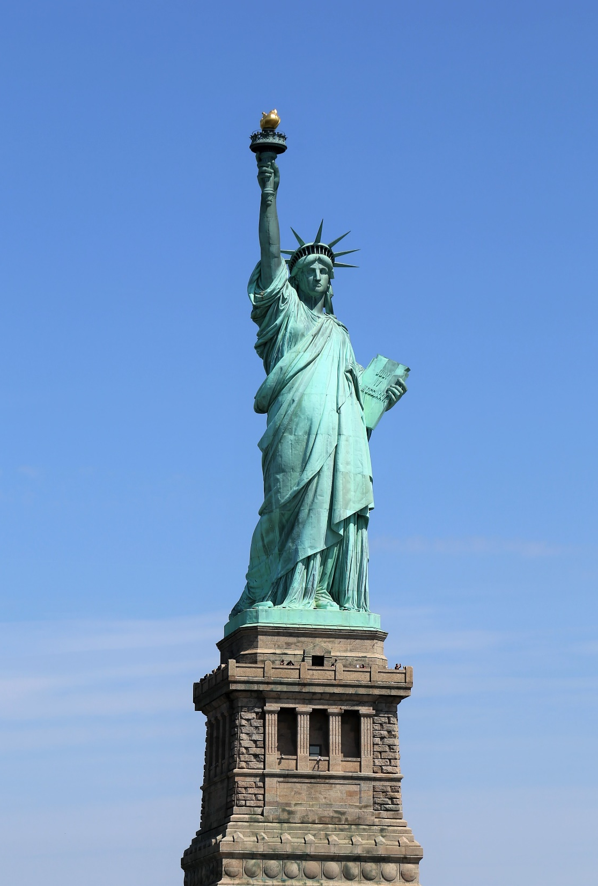
D. The Amendment Process
Generally, Congress sets a limit of seven years before a proposed amendment expires.
Including the Bill of Rights, which were passed shortly after ratification of the Constitution, there have been twenty-seven amendments.
Notes:
Photo by Vinayak Sharma on Unsplash
https://unsplash.com/photos/uX3r0OzFTIU

Slide 14
Section Review – Chapter 5.1
1. What is the difference between a strict constructionist and a broad constructionist?
A strict constructionist relies on a close adherence to the text of the Constitution, with a minimum of expanded interpretation; a broad constructionist broadly interprets the Constitution, reading into it things that the text does not explicitly say.
(p. 82)

Slide 15
Section Review – Chapter 5.1
2. Explain the “necessary and proper” clause.
The “necessary and proper clause” gives Congress the authority to make laws that are necessary to complete its tasks. (p. 84)
3–4. What are the two major phases in the amendment process?
proposal and ratification (p. 85)

Slide 16
Section Review – Chapter 5.1
5. What are the various ways an amendment may pass through these phases?
An amendment is proposed either by a two-thirds vote in both houses of Congress or by a special national convention called by two-thirds of the states. An amendment is ratified either by three-fourths of the states’ legislatures or by three-fourths of special state ratification conventions. (p. 85)

Slide 17
Section Review – Chapter 5.1
How did a knowledge of human nature help the framers of the Constitution?
Knowing humans’ tendency to be corrupted by power, the framers divided authority within the national government and included checks and balances.

Slide 18
Section Review – Chapter 5.1
Read the feature box entitled “How Should We Interpret the Constitution?” After reading each quote, identify whether that quote supports a broad constructionist view or a strict constructionist one. Which of the two views do you support? Why?
Woodrow Wilson and Barack Obama are broad constructionists. Joseph Story and Keith E. Whittington
are strict constructionists.

Slide 19
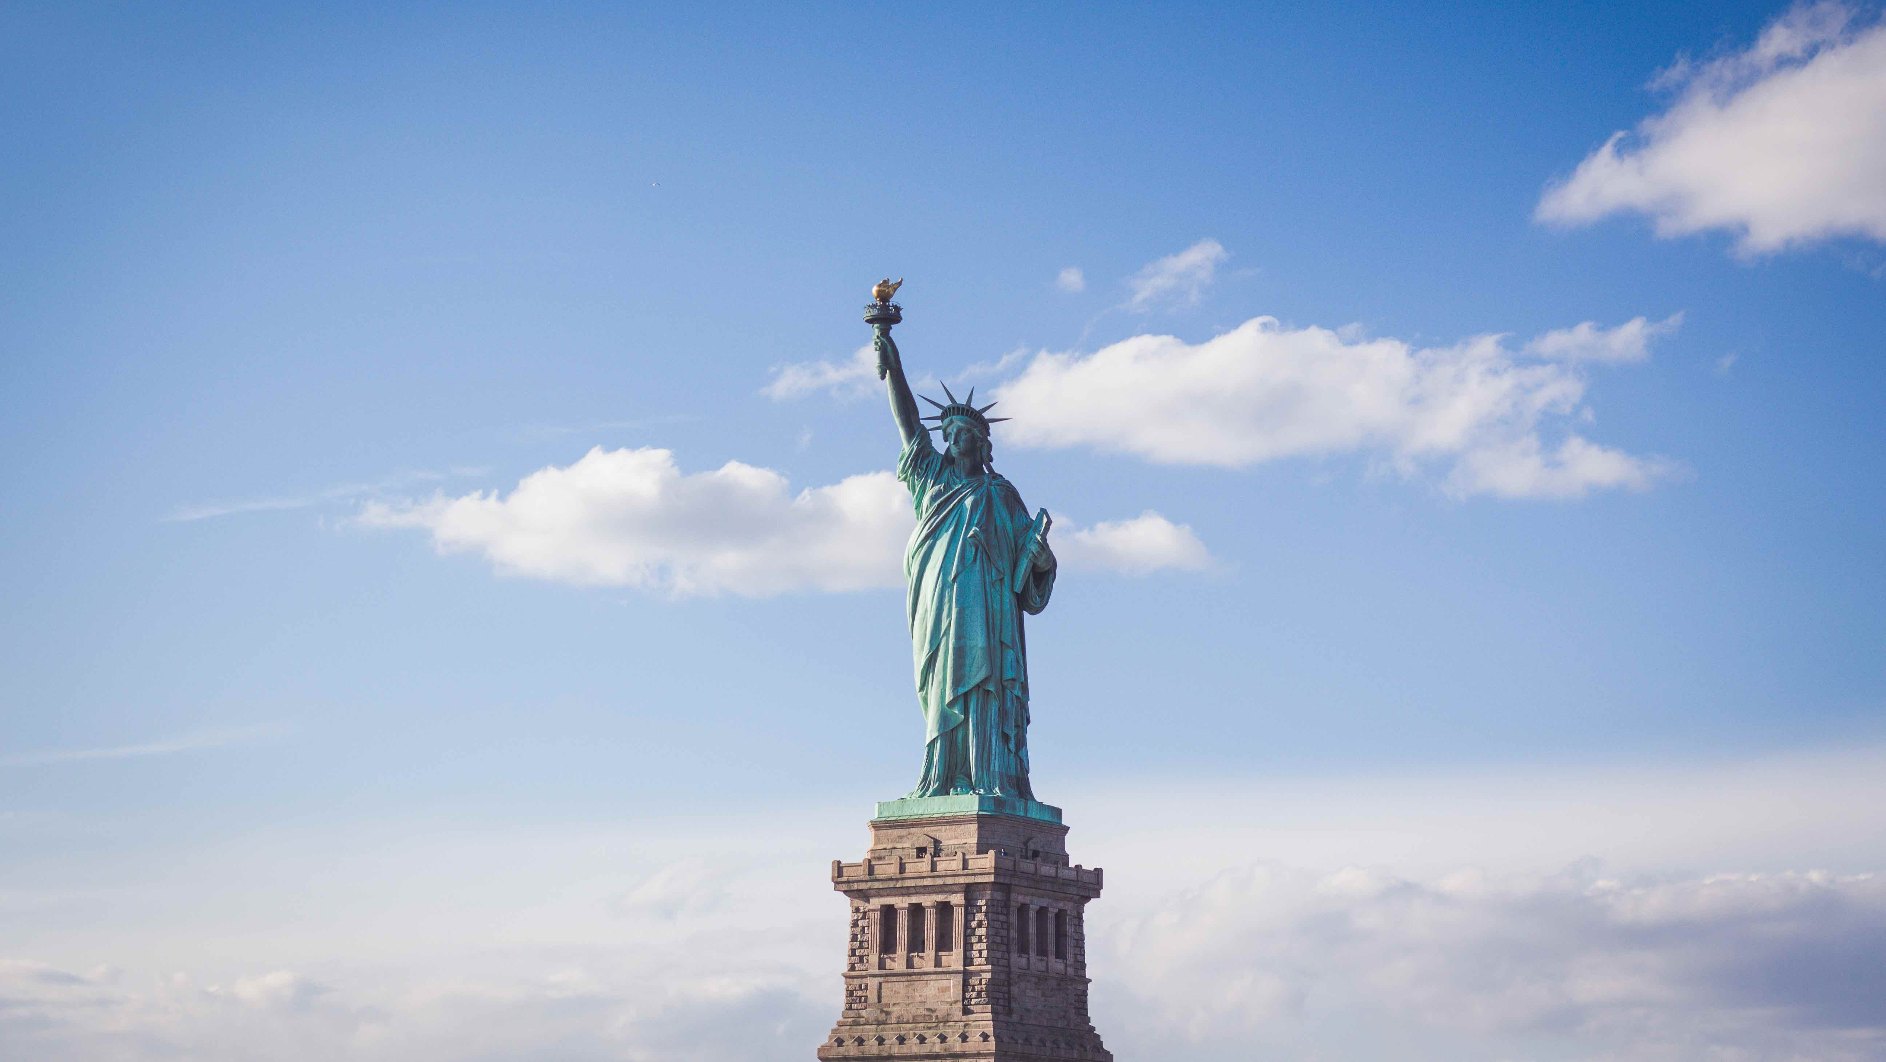
II. Foundational Principles
Chapter 5.2
Notes:
Photo by Ferdinand Stöhr on Unsplash
https://unsplash.com/photos/PeFk7fzxTdk

Slide 20
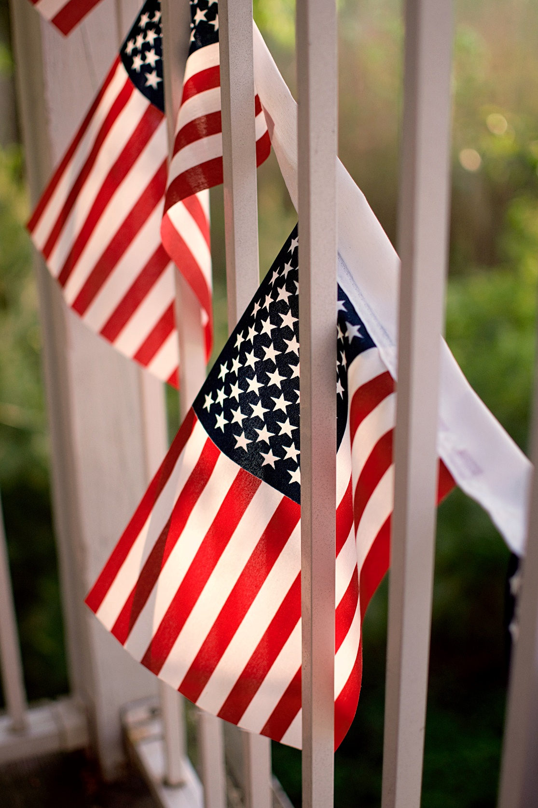
A. Limited Government
The power of the government is limited to the powers that the people have given it through law.
Because the Constitution is a written document, rulers are bound to its laws.
Notes:
Photo by twinsfisch on Unsplash
https://unsplash.com/photos/9aKn5vwKJ2Q

Slide 21
A. Limited Government
The central purpose of limited government is to protect individual freedom.
Notes:
Photo by twinsfisch on Unsplash
https://unsplash.com/photos/9aKn5vwKJ2Q

Slide 22
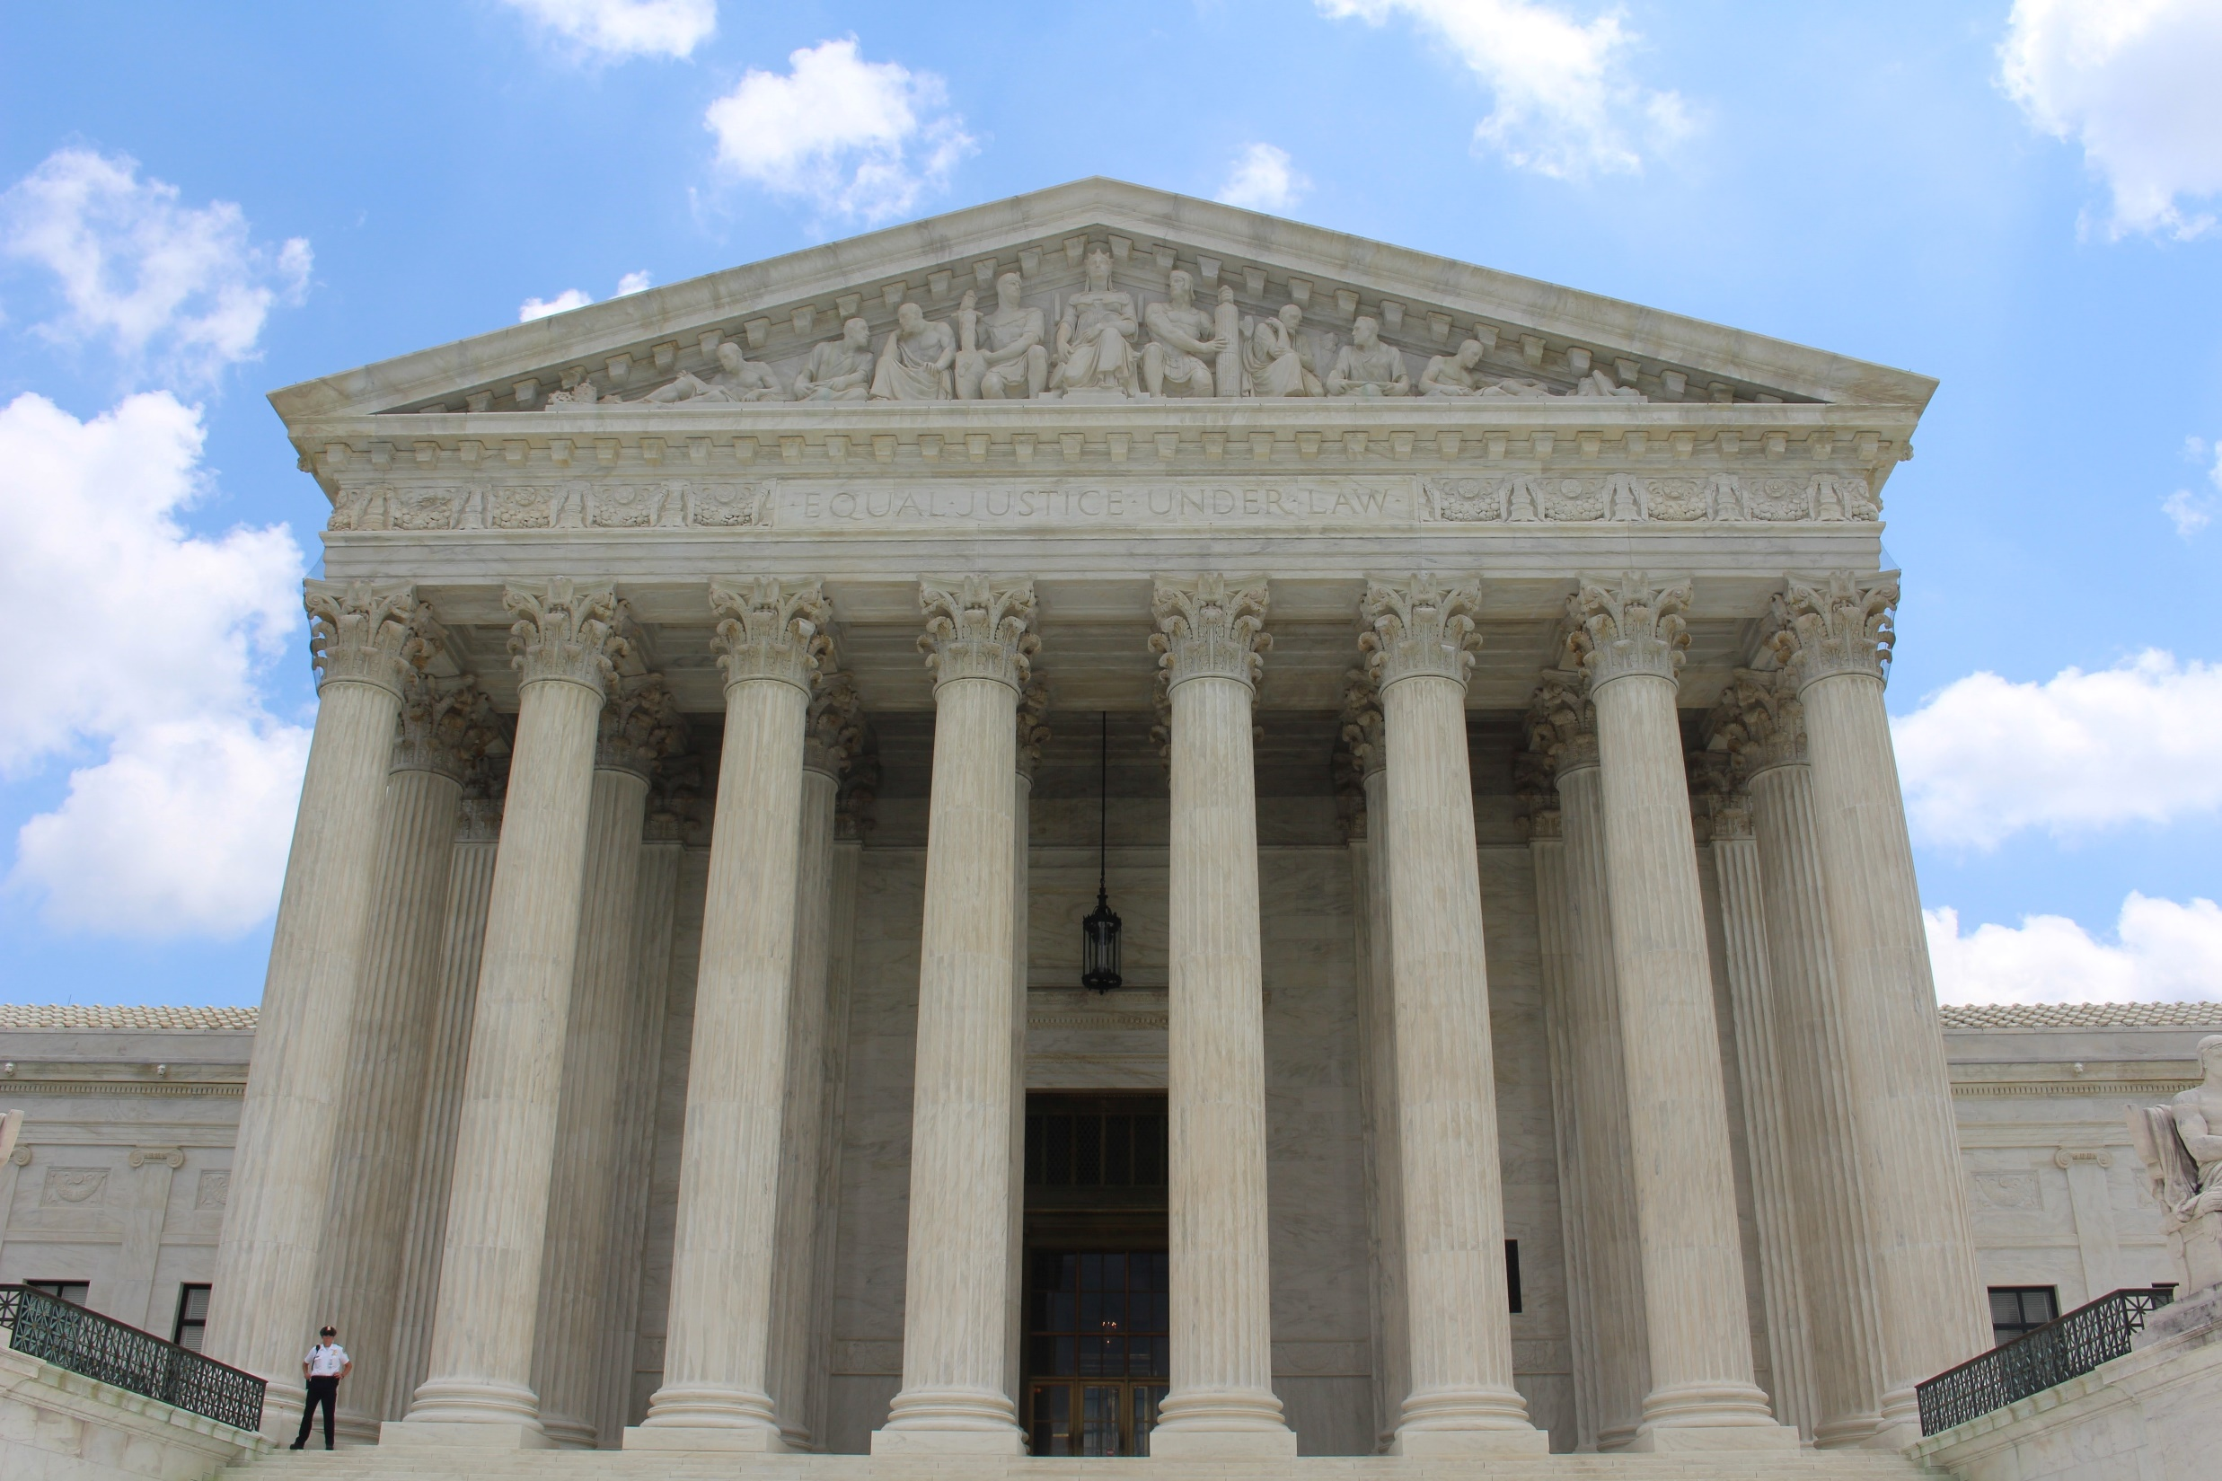
B. Separation of Powers
The national government is divided into three branches:
  Legislative
  Executive
  Judicial
Separation of powers prevents any individual or group from gaining too much control.
Notes:
Photo by Claire Anderson on Unsplash
https://unsplash.com/photos/Vq__yk6faOI

Slide 23
B. Separation of Powers
While each branch is distinct, they overlap in many areas of responsibility and often must cooperate.
Notes:
Photo by Claire Anderson on Unsplash
https://unsplash.com/photos/Vq__yk6faOI

Slide 24
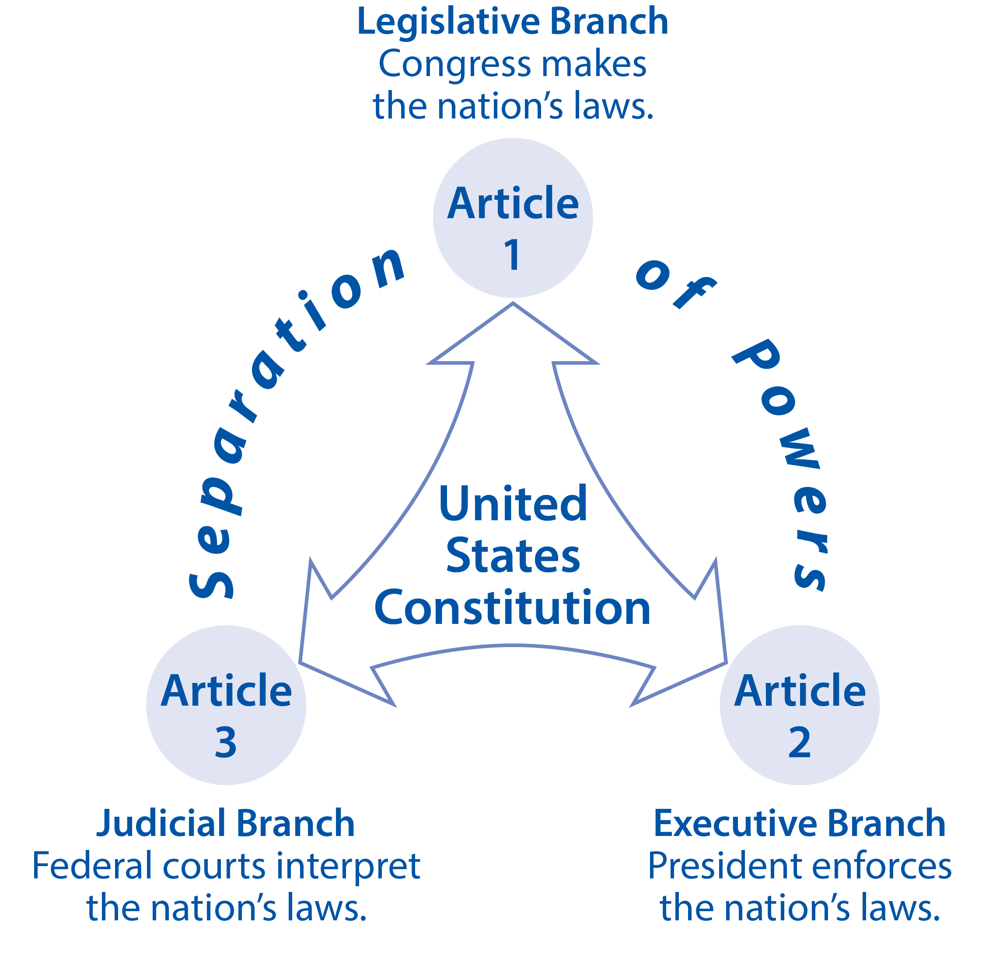
Notes:
BJU Press Art

Slide 25
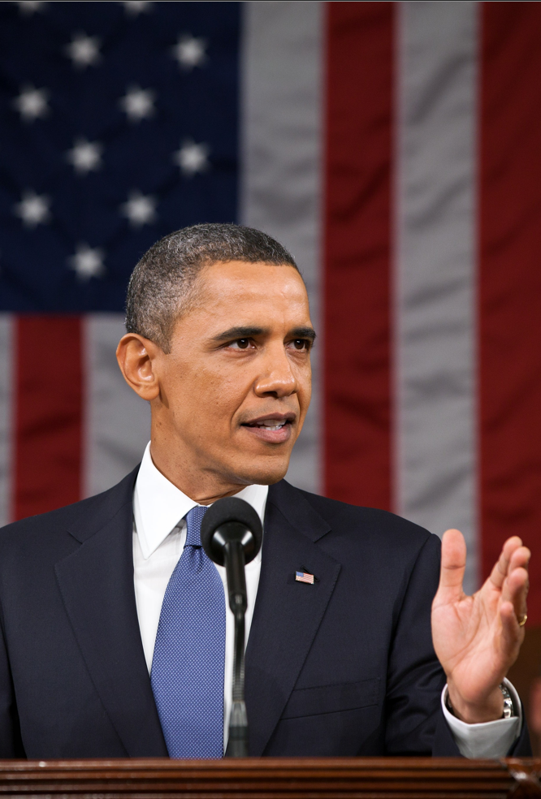
C. Checks and Balances
Each branch has the ability to check the power of the other two branches.
  The president can veto laws passed by Congress.
  Congress may charge a high official using the power of impeachment.
Notes:
Image by Welcome to all and thank you for your visit ! ツ from Pixabay
https://pixabay.com/photos/barack-obama-official-portrait-1174489/

Slide 26
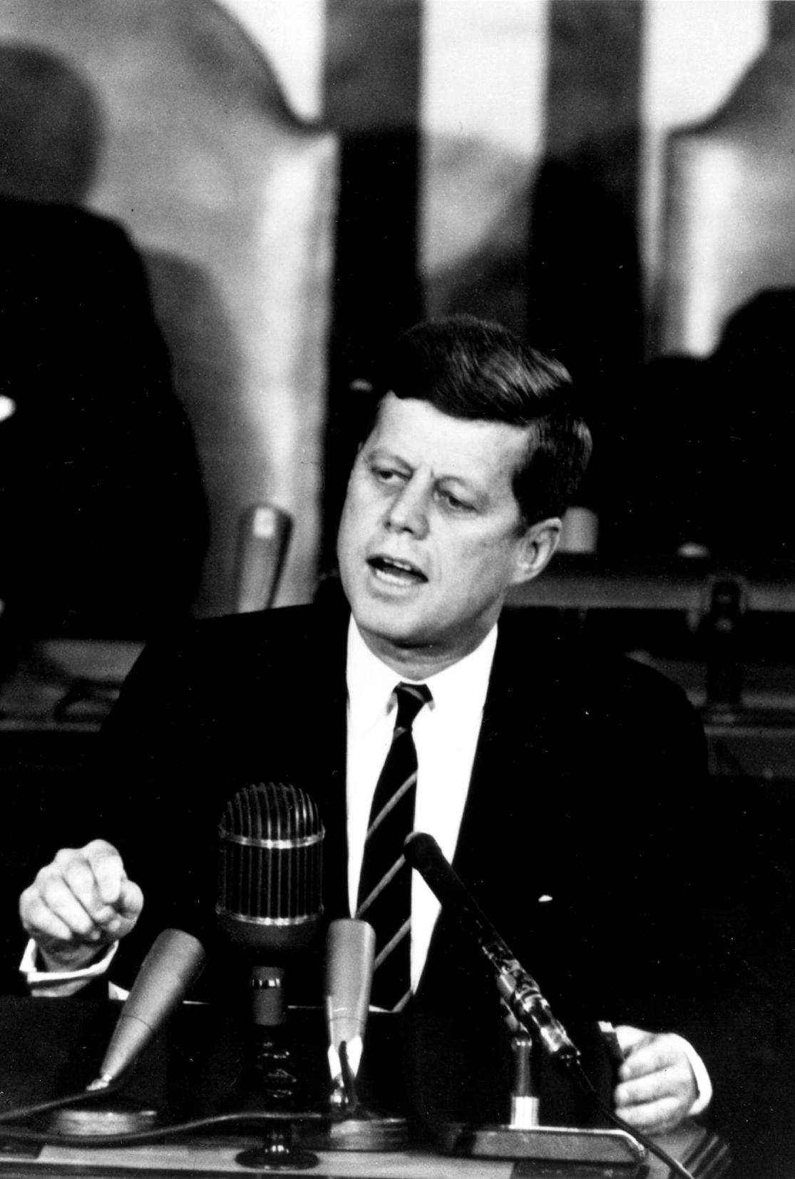
C. Checks and Balances
While checks and balances hinder the concentration of power, the system is inefficient and can lead to gridlock.
Despite this, the benefits outweigh the disadvantages.
Notes:
Image by 272447 from Pixabay
https://pixabay.com/photos/president-john-f-kennedy-american-396982/

Slide 27
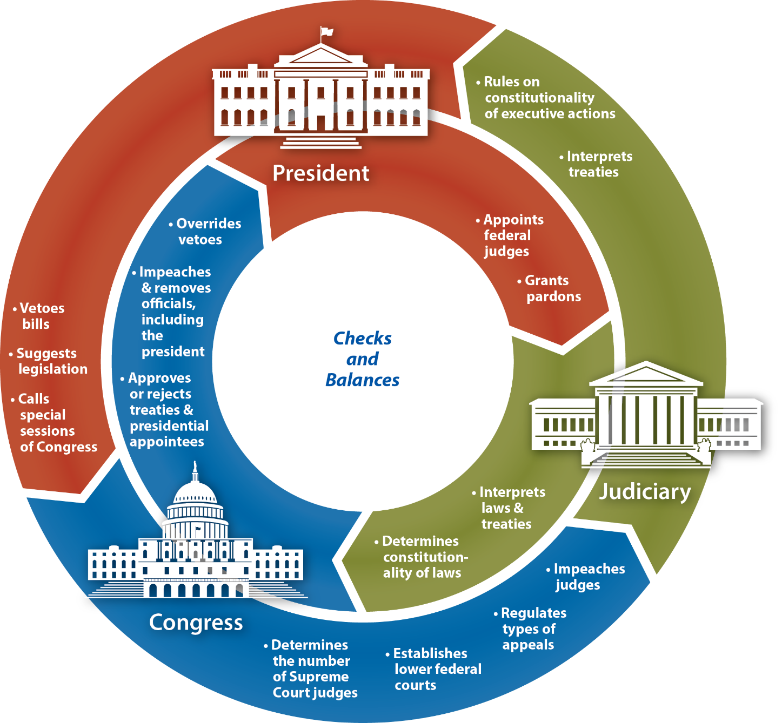
Notes:
BJU Press Art

Slide 28
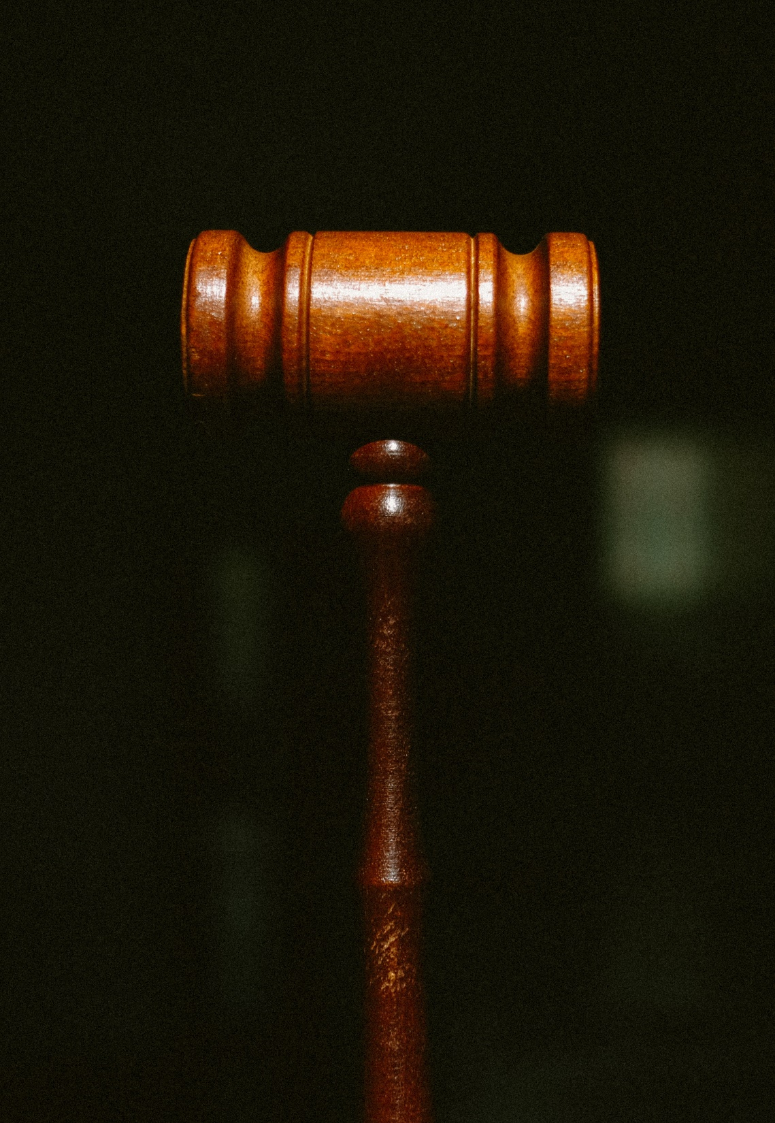
D. Judicial Review
Judicial review allows the judicial branch to examine laws or actions taken by the other two branches and strike them down.
Judicial review is not found in the Constitution but was assumed by the Supreme Court in the Marbury v. Madison court case in 1803.
Notes:
Photo by Tingey Injury Law Firm on Unsplash
https://unsplash.com/photos/S2rcAJbBxX0

Slide 29
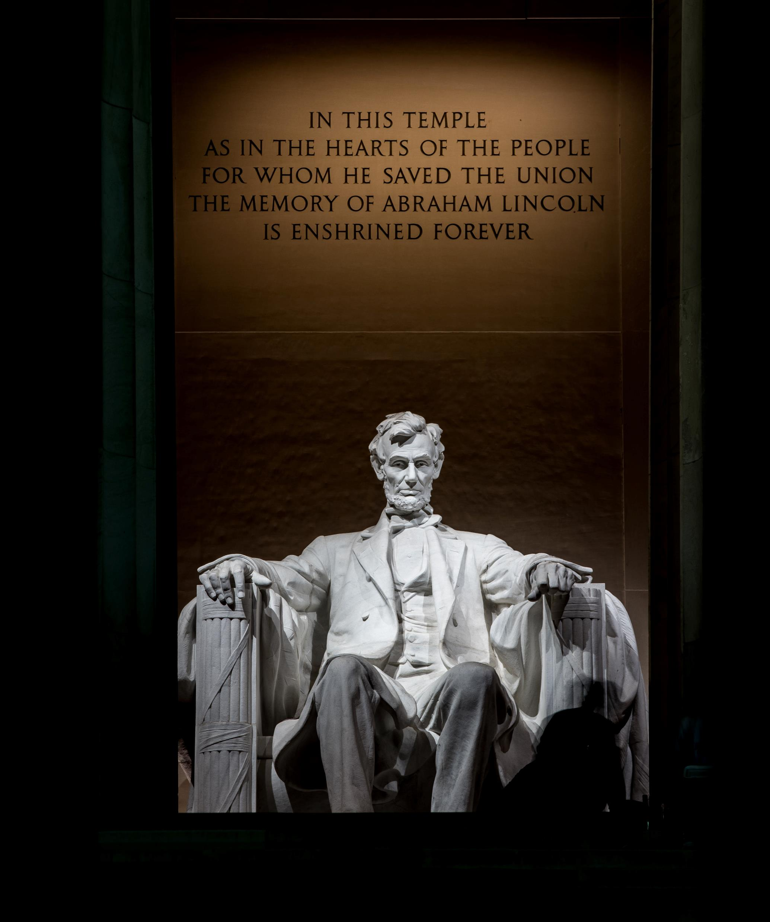
E. Federalism
Federalism is the division of power between national and state levels of government.
Federalism helps promote national unity while still allowing local governments to handle local affairs.
Notes:
Photo by Casey Horner on Unsplash
https://unsplash.com/photos/VWROahMpBGw

Slide 30
E. Federalism
Since America’s rise to world power, state and local power has decreased in favor of making the national government stronger.
Notes:
Photo by Casey Horner on Unsplash
https://unsplash.com/photos/VWROahMpBGw

Slide 31
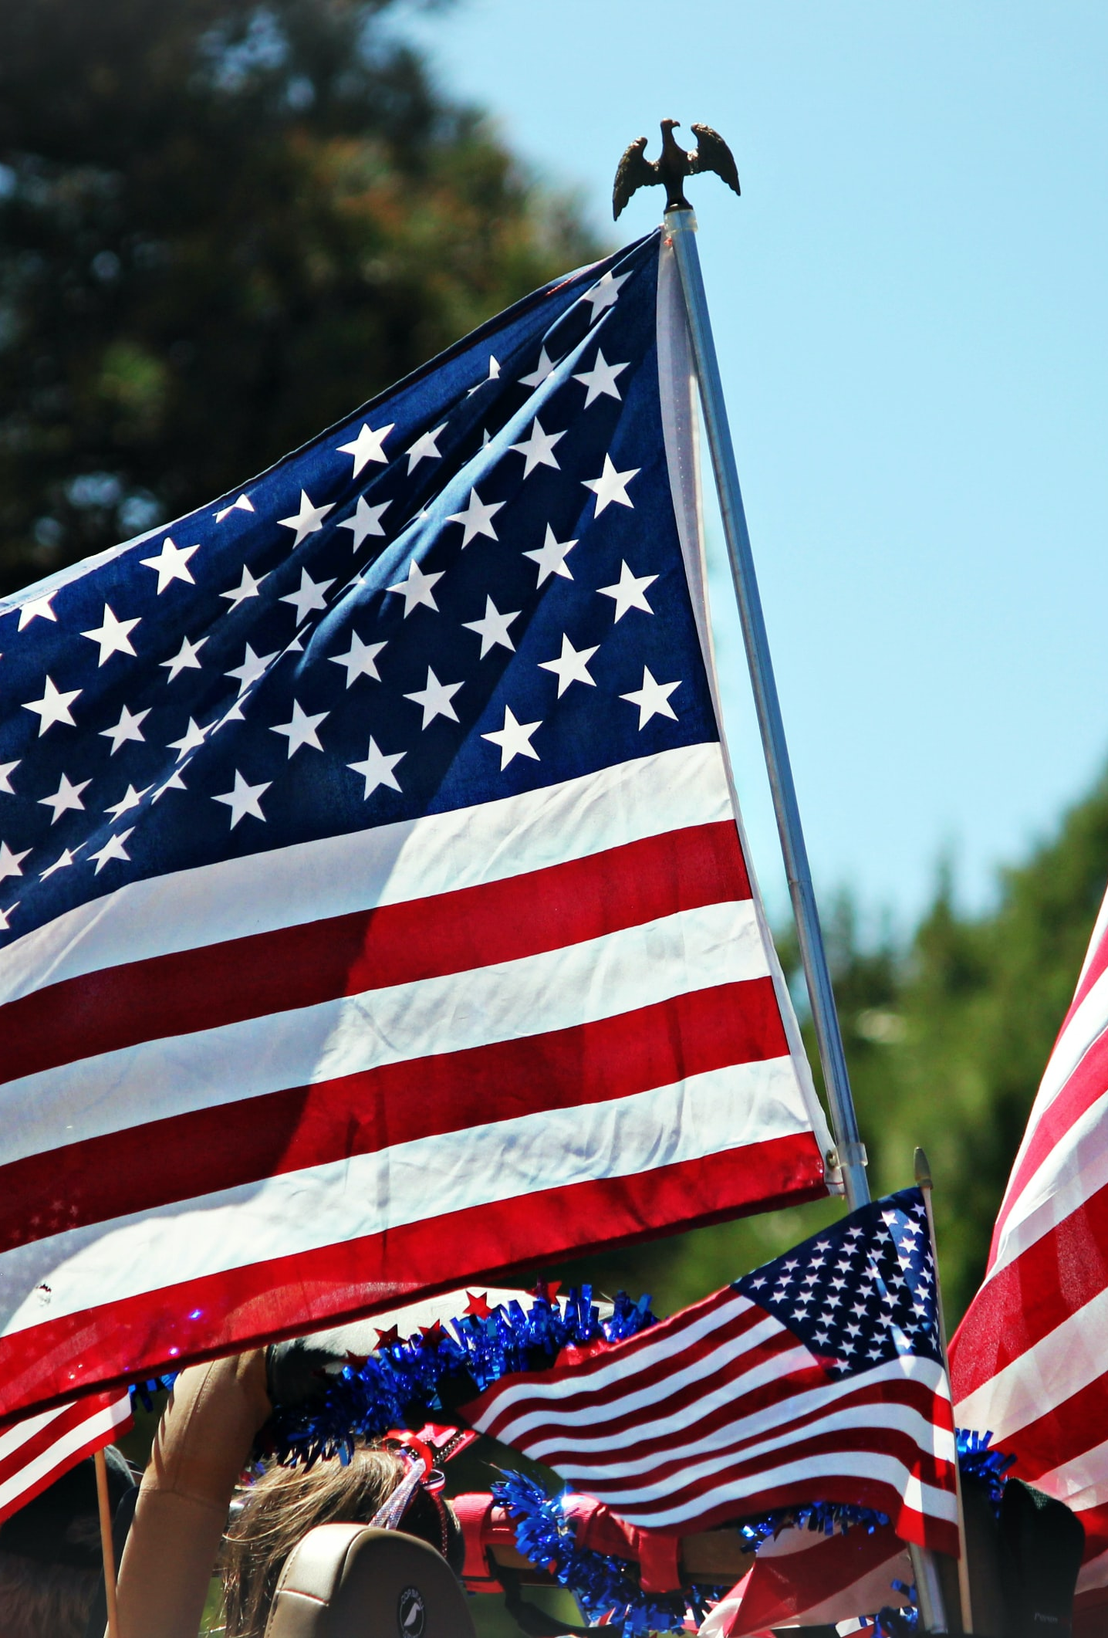
F. Popular Sovereignty
Popular sovereignty is the idea that the people are the ultimate source of their government’s authority.
This concept is not explicitly stated in the Constitution but is alluded to in phrases such as “We the people” and other concepts like the amendment process.
Notes:
Photo by Sheri Hooley on Unsplash
https://unsplash.com/photos/pOR3_BLtGq4

Slide 32
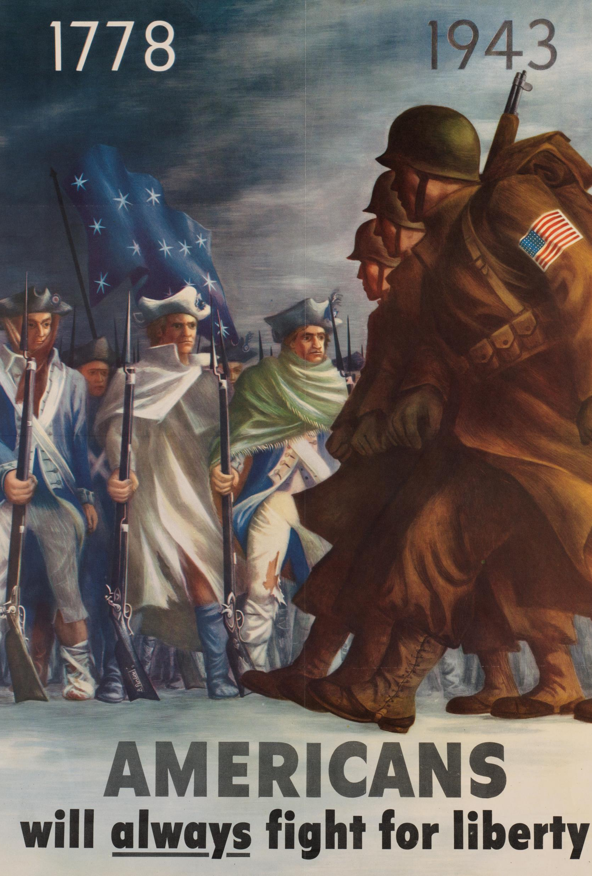
G. Conclusion
Christians can find much in the Constitution to be thankful for.
For the freedoms and liberties in the Constitution to continue, each generation much commit to defend the law.
Notes:
Photo by Boston Public Library on Unsplash
https://unsplash.com/photos/o_ez64ErEbQ

Slide 33
Section Review – Chapter 5.2
1–6. What six basic principles are the foundation of the Constitution?
limited government, separation of powers, checks and balances, judicial review, federalism, and popular sovereignty (pp. 87–93)
7. What is the difference between separation of powers and checks and balances?
Separation of powers divides the national government into three distinct branches. “Checks and balances” refers to the power that each branch exerts over the others. (pp. 88–90)

Slide 34
Section Review – Chapter 5.2
8–9. What is the obvious disadvantage of checks and balances? What benefits overshadow this disadvantage?
Checks and balances make the government inefficient, but they limit government power and protect personal liberty.
(pp. 89–90)

Slide 35
Section Review – Chapter 5.2
10–11. What is popular sovereignty? Where is this principle most accurately expressed in the Constitution?
Popular sovereignty is the belief that the people are the ultimate source of their government’s power. This principle is expressed in the Constitution through its plans for representation and the amendment process. (pp. 92–93)

Slide 36
Section Review – Chapter 5.2
Why did Hamilton believe that judicial review is necessary?
Hamilton believed that judicial review is necessary to limit legislative authority.

Slide 37
Section Review – Chapter 5.2
Was the Seventeenth Amendment a good change or a bad one? Defend your opinion.

Slide 38
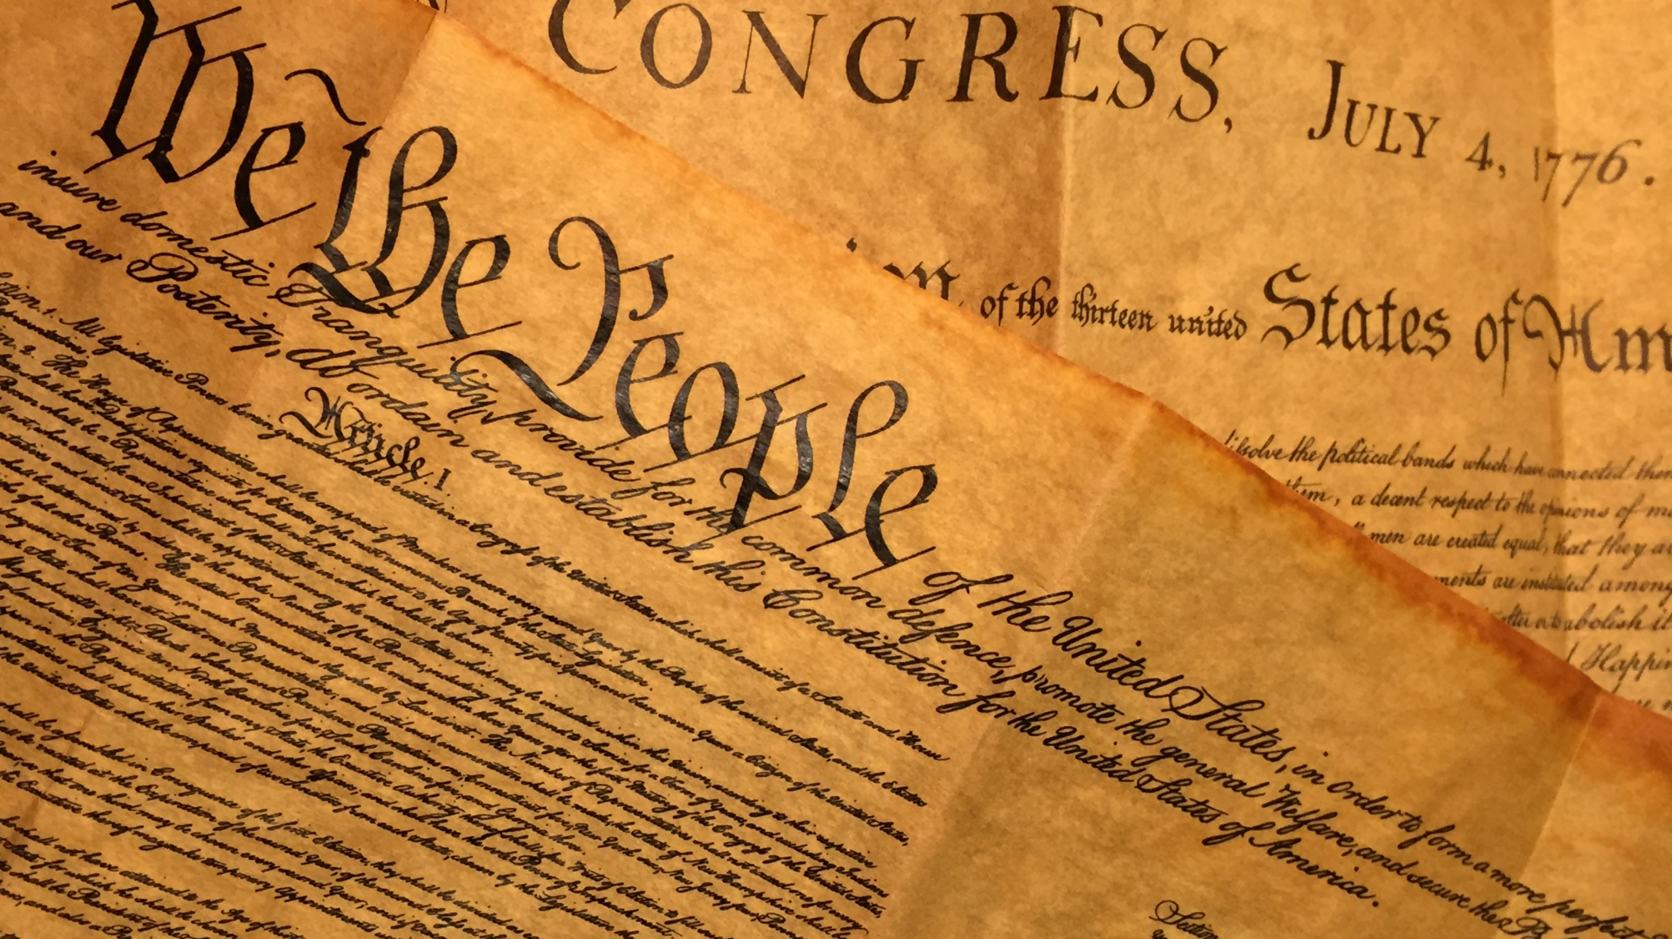
III. Examining the United States Constitution
Chapter 5.3
Notes:
Image by Lynn Melchiori from Pixabay
https://pixabay.com/photos/paper-document-old-writing-vintage-3212015/

Slide 39
The United States Constitution
Preamble
Article I: The Legislative Branch
Article II: The Executive Branch
Article III: The Judicial Branch
Article IV: Interstate Relations
Article V: Amending the Constitution
Article VI: Constitutional and National Supremacy
Article VII: Ratifying the Constitution
The Bill of Rights (Amendments I–X)
Amendments XI–XXVII

Slide 40
Preamble
The Preamble introduces the Constitution by explaining its nature and purpose.

Slide 41
Article I: The Legislative Branch
Section 1—Authority
  Article I deals with the legislative branch of government, whose primary function is to make laws.
  This power belongs to Congress, which has two houses: an upper house called the Senate and a lower house called the House of Representatives.
  A two-house legislative system is called a bicameral system.

Slide 42
Article I: The Legislative Branch
Section 2—The House of Representatives
  A counting of the population, called a census, is taken every ten years to determine how many representatives each state may elect.
Section 3—The Senate
  The vice president of the United States shall be president of the Senate, but shall have no vote, unless they be equally divided.
  The Senate elects its own president pro tempore, who serves as leader of the Senate when the vice president is absent.

Slide 43
Article I: The Legislative Branch
Section 6—Benefits and Restrictions
  Congressmen receive allowances for travel, office expenses, and the franking privilege (the right to send official mail free of charge).
Section 7—Lawmaking
  If the president neither signs nor vetoes a bill that comes to him, it becomes law in ten days as long as Congress remains in session.
  If he does not sign a bill and Congress adjourns within ten days, the bill is vetoed automatically; this is called a pocket veto.

Slide 44
Article I: The Legislative Branch
Section 8—The Enumerated Powers of Congress
  Congress has the power to tax.
  It has the power to borrow money.
  It has the power to regulate trade with foreign nations, within the country, and with the Indians.
  It has the power to regulate naturalization and bankruptcy laws.
  Naturalization is the process by which a foreign-born person gains citizenship.

Slide 45
Article I: The Legislative Branch
Section 8—The Enumerated Powers of Congress
  It has the power to control the currency system and the standard weights and measurements used in the country.
  It has the power to punish those who illegally interfere in the currency system.
  It has the power to provide needed offices and roads for postal service.
  It has the power to issue copyrights and patents.

Slide 46
Article I: The Legislative Branch
Section 8—The Enumerated Powers of Congress
  It has the power to establish federal courts other than the Supreme Court.
  It has the power to determine what acts committed at sea are crimes and to commit offenders operating in U.S. waters or attacking U.S. ships to federal courts for trial.
  It alone has the power to declare war.
  It may create an army, but it cannot vote to use money to support the army more than two years ahead of time.

Slide 47
Article I: The Legislative Branch
Section 8—The Enumerated Powers of Congress
  It has the power to create a navy and vote for money to
  support it.
  It has the power to make the rules for the armed services.
  It may call the state militias into service for the national government under certain conditions.
    The modern militia, known as the National Guard, is actually under the control of the army and air force.

Slide 48
Article I: The Legislative Branch
Section 8—The Enumerated Powers of Congress
  It has the power to organize, arm, and discipline militias, but the states appoint officers and train these troops.
  It has the power to make laws for the District of Columbia and for all other federal properties, such as forts or bases.
  It has the power to do what it believes is “necessary and proper” to carry out any listed power.
    This “necessary and proper clause” is sometimes also called the elastic clause.

Slide 49
Article I: The Legislative Branch
Section 9—Powers Forbidden to the Federal Government
  Congress could not interfere with the slave trade until 1808, and it could not tax slavery out of existence by levying heavy taxes on slaves.
  Congress may not take away a person’s right to the writ of habeas corpus except in time of extreme danger.
    A writ of habeas corpus forces authorities who arrest a person to quickly bring him before a judge and charge him with a crime or else release him.

Slide 50
Article I: The Legislative Branch
Section 9—Powers Forbidden to the Federal Government
  Congress cannot pass a bill of attainder, which permits punishment without a trial, or an ex post facto law, which makes the law retroactive.
  Congress cannot levy an unequal direct tax.
  Congress cannot tax the states’ exports.
  Congress cannot give preference to any port or state through its laws, and it cannot tax trade between the states, even if that trade is carried on by sea or another water passage.

Slide 51
Article I: The Legislative Branch
Section 9—Powers Forbidden to the Federal Government
  Money from the Treasury can be spent only if Congress approves, and a record of income and expenditures must be published.
  An appropriation is a certain amount of money set apart for a certain purpose.
  The United States cannot grant titles of nobility (duke, earl, baron, etc.), nor can its officeholders accept titles or other honors from foreign countries without Congress’s permission.
Section 10—Powers Denied to the States

Slide 52
Questions on Article I
1–6. What are the purposes of government as outlined by the Constitution’s Preamble?
to form a more perfect union, to establish justice, to ensure domestic tranquility, to provide for the common defense, to promote the general welfare, and to secure the blessings of liberty to Americans and their children (p. 94)

Slide 53
Questions on Article I
7. What is the primary function of the legislative branch?
to make laws (p. 94)
8–9. What are the respective roles of the House and Senate when a major federal official has committed a crime?
The House files charges (impeachment), and the Senate acts as a trial court. With a two-thirds agreement, the Senate can convict the offender and disqualify him from office. (p. 96)

Slide 54
Questions on Article I
10. What is a veto?
the rejection of a bill by the president after it has passed through Congress (p. 98)
11. How can Congress override a veto?
by gaining a two-thirds vote in support of the bill from both houses (p. 98)

Slide 55
Questions on Article I
12–14. In Section 9 of Article I, Congress has limitations regarding three legal powers. Identify these (see clauses 2
and 3).
Congress may not suspend writs of habeas corpus (except in times of extreme danger) or pass bills of attainder or ex post facto laws. (p. 101)

Slide 56
Questions on Article I
Which power of Congress do you think is the greatest? Why?

Slide 57
Article II: The Executive Branch
Section 1—The Authority and Office of the President
  Article II deals with the executive branch of government, whose primary function is to carry out (enforce) the nation’s laws.
  The Electoral College, composed of electors from each state, elects the president.

Slide 58
Article II: The Executive Branch
Section 2—The Powers and Duties of the President
  Included among the president’s powers is the power to grant reprieves (temporary postponement of punishment) and pardons (complete forgiveness of a crime and its consequent punishment).
Section 3—The Duties of the President
Section 4—The Process of Impeachment

Slide 59
Questions on Article II
1. What is the primary function of the executive branch?
to carry out (enforce) the nation’s laws (p. 103)
2–4. What are the three qualifications for becoming president?
must be a natural-born citizen, be at least thirty-five years old, and have been a US resident for at least fourteen years
(p. 104)

Slide 60
Questions on Article II
5. How long is the president’s term of office?
four years (p. 103)

Slide 61
Questions on Article II
6. What is the current line of presidential succession if the president is removed from office?
(a) vice president, (b) Speaker of the House of Representatives, (c) president pro tempore of the Senate, and (d) members of the cabinet in the order of the creation of their departments, beginning with the secretary of state (p. 104)

Slide 62
Questions on Article II
7. What powers does the president possess with which he can influence judicial decisions?
The president appoints certain judges. He may grant pardons and reprieves or offer amnesty. (p. 105)

Slide 63
Questions on Article II
Which presidential power do you think holds the greatest potential for abuse? Why?

Slide 64
Article III: The Judicial Branch
Section 1—Authority
  Traditionally, the function of the judicial branch has been to interpret the law.
Section 2—Jurisdiction and Procedure
  Original jurisdiction means that a case can start in the court in question and that the court has first opportunity to hear and decide the case.
  Appellate jurisdiction means that the case must first have been tried in a lower court before it can be appealed in a higher court.

Slide 65
Article III: The Judicial Branch
Section 3—Treason

Slide 66
Questions on Article III
1. What is the traditional function of the judicial branch?
to interpret the law (p. 107)
2. What is the only court specifically identified in the Constitution?
the Supreme Court (p. 107)

Slide 67
Questions on Article III
3. What constitutional requirements limit the abuse of accusations of treason?
The definition of treason is limited to levying war against the United States or giving aid and comfort to its enemies. Conviction demands the testimony of two witnesses or a public confession in court. (p. 108)

Slide 68
Questions on Article III
What do you think is the greatest weakness of the Supreme Court?

Slide 69
Article IV: Interstate Relations
Section 1—Full Faith and Credit
Section 2—Rights and Responsibilities
  A governor can request that a criminal who fled to another state be returned to the state where the crime was committed to stand trial.
  The process of returning the criminal is called extradition.

Slide 70
Article IV: Interstate Relations
Section 3—Powers of Congress
Section 4—Requirements and Guarantees

Slide 71
Questions on Article IV
1. What is each state required to respect?
the public records, laws, and court decisions of other states
(p. 108)
2. What request does not have to be respected by other states?
an extradition request (p. 108)

Slide 72
Questions on Article IV
3. What kind of government are new states required to have?
a republican government (p. 109)

Slide 73
Article V: Amending the Constitution
Two-thirds of both houses of Congress may present proposed amendments, or two-thirds of the states may call a convention to propose such amendments to the Constitution.
Ratification requires approval by three-fourths of the state legislatures or three-fourths of the states in their own conventions.

Slide 74
Questions on Article V
1–2. What groups have the power to propose amendments?
both houses of Congress; a national convention (called at the request of two-thirds of the states) (p. 110)
3. How much approval is needed to ratify an amendment?
three-fourths of the state legislatures or three-fourths of state conventions (p. 110)

Slide 75
Questions on Article V
4. What provision of the Constitution can never be changed without the consent of a state?
States cannot be deprived of their equal number of representatives in the Senate. (p. 110)

Slide 76
Questions on Article V
Why do you think the framers purposefully make it hard for amendments to be ratified?
to prevent the people (or the government) from making whimsical or dangerous changes to the Constitution

Slide 77
Article VI: Constitutional and National Supremacy
Known as the supremacy clause, this clause upholds the U.S. Constitution as the supreme (highest) law of the nation.

Slide 78
Questions on Article VI
1. What provision did the Constitution make for debts contracted before its ratification?
All prior debts were valid against the United States, as they were under the Confederation. (p. 110)
2–3. What is the second clause of Article VI known as, and what does it state?
the supremacy clause; the US Constitution, the laws of the US government, and treaties are the supreme law of the land
(p. 110)

Slide 79
Questions on Article VI
4. What can never be a qualification for seeking public office?
a religious test (p. 110)

Slide 80
Questions on Article VI
Does the third clause of Article VI prohibit citizens from taking a candidate’s religion into account when deciding whom to support? Explain your answer.
No; the government cannot impose a religious qualification,
but citizens may take a candidate’s religion into account
when voting in elections.

Slide 81
Article VII: Ratifying the Constitution
Nine of the thirteen states had to ratify the Constitution to begin the operation of the new form of government.

Slide 82
Questions on Article VII
1. How many states had to ratify the Constitution before it took effect?
nine (p. 111)
2–3. Which of the original thirteen states did not have a representative sign the Constitution? Why?
Rhode Island; it sent no delegates to the convention. (p. 111)

Slide 83
The Bill of Rights (Amendments I–X)
Amendment I: Freedom of Expression
  Slander (defaming a person verbally) or libel (defaming a person in writing) are not included, and neither is any speech advocating the violent overthrow of the American government.
Amendment II: The Right to Bear Arms
Amendment III: No Quartering of Troops

Slide 84
The Bill of Rights (Amendments I–X)
Amendment IV: No Unreasonable Searches and Seizures
Amendment V: Rights of the Accused
  In a trial, a grand jury, composed of a panel of citizens, considers the prosecution’s case against the accused.
  A person cannot be imprisoned, have his property taken away, or be sentenced to death without a fair and proper trial (due process).
  Private property can be “condemned [taken] for the public good” (by eminent domain), but it has to be paid for.

Slide 85
The Bill of Rights (Amendments I–X)
Amendment VI: Rights of the Accused in Criminal Trials
  The court calls a witness to appear by serving a subpoena (a document requiring a person to appear in court as a witness).
Amendment VII: Rights of Citizens in Civil Trials
Amendment VIII: No Cruel, Unusual, or Unjust Punishment
  Bail (money held by a court to ensure an accused person’s appearance at court) may be required, but it must not be excessive.

Slide 86
The Bill of Rights (Amendments I–X)
Amendment IX: Unspecified Rights of the People
Amendment X: Reserved Rights of the States or the People

Slide 87
Amendments XI–XXVII
Amendment XI: Suing States
Amendment XII: Separate Ballots for President and Vice President

Slide 88
Amendments XI–XXVII
Reconstruction Amendments (XIII–XV)
  Amendment XIII: Slavery Abolished
  Amendment XIV: Citizenship Defined
  Amendment XV: Black Voting Rights

Slide 89
Amendments XI–XXVII
Reconstruction Amendments (XIII–XV)
  Attempts to circumvent Amendment XV:
    literacy tests—required voters to be literate to vote
    white primaries—restricted party primaries and candidate selection to whites only
    grandfather clauses—allowed previous voters and their relatives to vote without facing a literacy test or other requirements
    gerrymandering—drew district lines so that black districts’ votes had less impact

Slide 90
Amendments XI–XXVII
Progressive Amendments (XVI–XIX)
  Amendment XVI: Income Tax
  Amendment XVII: Direct Election of Senators
  Amendment XVIII: Prohibition
  Amendment XIX: Women’s Suffrage
    The right to vote is also called suffrage, or the franchise.

Slide 91
Amendments XI–XXVII
Amendment XX: Lame-Duck Amendment
  A “lame-duck” is an official who is still in office but has not been reelected.
Amendment XXI: Repeal of Prohibition

Slide 92
Amendments XI–XXVII
Amendment XXII: Presidential Terms Limit
Amendment XXIII: Voting Rights for Washington, D.C.
Amendment XXIV: Poll Tax Abolished

Slide 93
Amendments XI–XXVII
Amendment XXV: Presidential Succession and Disability
Amendment XXVI: Eighteen-Year-Old Vote
Amendment XXVII: Congressional Pay Raises

Slide 94
Questions on the Amendments
1. What are the first ten amendments usually called?
the Bill of Rights (p. 112)

Slide 95
Questions on the Amendments
2–6. According to Amendment V, what are five rights of the accused?
A grand jury must determine whether there is enough evidence to warrant a jury trial; no person can be tried twice for the same crime if a legal judgment was reached in the first trial; no person can be forced to give evidence against himself; no person can be imprisoned, have his property confiscated, or be sentenced to death without a fair and proper trial; private property cannot be taken by the government unless fair compensation is given.
(p. 113)

Slide 96
Questions on the Amendments
7. What was the primary reason for separate ballots, for president and vice president, in the Electoral College?
In 1800 the votes for president and vice president were tied. The change was to prevent this from occurring again. (p. 115)
8–11. In spite of the Fifteenth Amendment, four tactics were often used in some Southern states to prevent blacks from voting. Name these.
grandfather clauses, white primaries, literacy tests, and gerrymandering (p. 117)

Slide 97
Questions on the Amendments
12–13. What are Amendments XVI–XIX also called? Why?
Progressive Amendments; because they were passed during the Progressive Era (p. 117)
14. Who elected senators prior to Amendment XVII?
the state legislatures (p. 117)

Slide 98
Questions on the Amendments
15. What is the only amendment that repealed another amendment?
Amendment XXI (pp. 119–120)

Slide 99
Questions on the Amendments
Why did some fear that the Bill of Rights might endanger rights rather than protect them? How did the Bill of Rights address this concern?
They feared that unenumerated rights would not be considered rights. Amendments IX and X made it clear that this was not the case and that unlisted rights are reserved to the states and the people.

