Slide 1
Chapter 5
cytology

Slide 2
What are cells, and how do they contribute to life?

Slide 3
cytology
the study of cells

Slide 4
Modeling the Cell
Spontaneous generation
Preformation
Robert Hooke
“cell”
Other scientists

Slide 5
Cell Theory
Cells are the structural and functional units of all living things.
Cells come only from other preexisting cells.
These two statements contain a lot of information!
A very reliable and predictable model!

Slide 6
Organizing with cells
Unicellular organism: made of only one cell
Bacteria, protozoans; some algae, fungi
Some live in colonies

Slide 7
Multicellular organism: Made of two or more cells that depend on each other
Some algae & fungi; plants, animals, humans
Tissues
Organs
Organ systems

Slide 8
Cell’s Parts and Processes
Organelles
Eukaryotic: cells with membrane-surrounded organelles
Humans, animals, plants, fungi, protists

Slide 9
Prokaryotic: organelles do not have surrounding membranes
Bacterium
The cell model is still developing

Slide 10
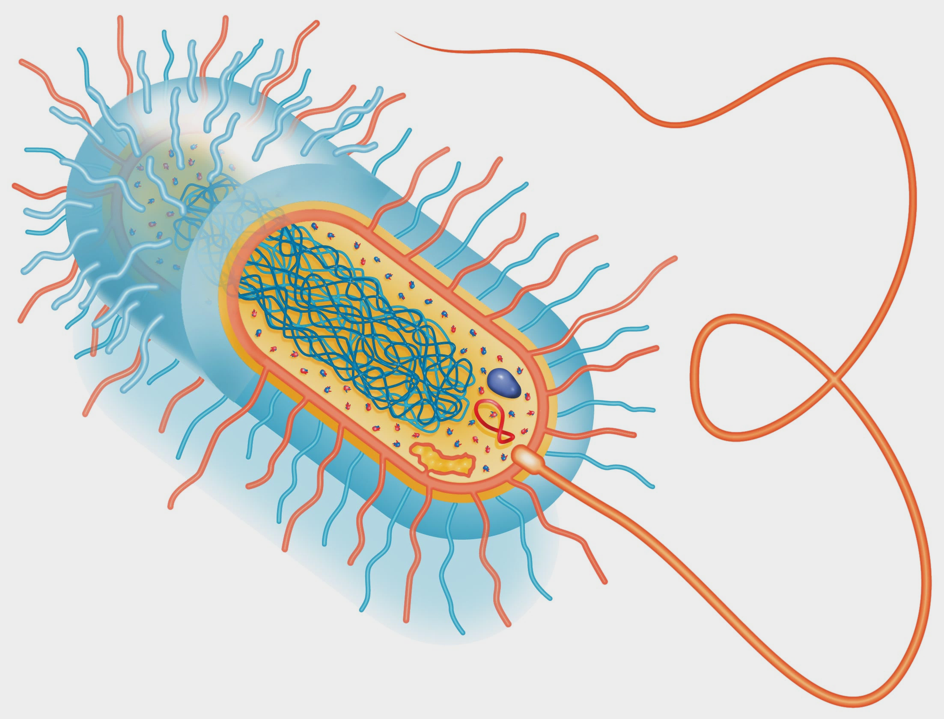

Slide 11
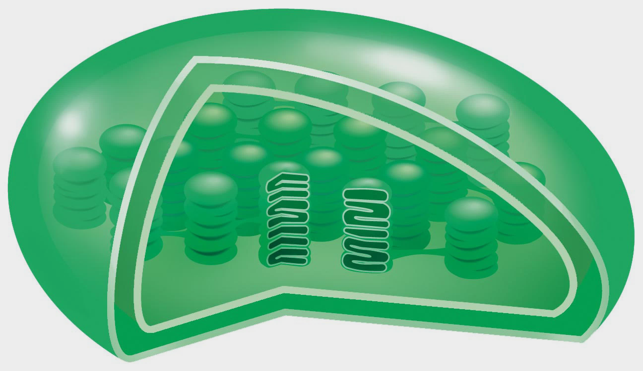
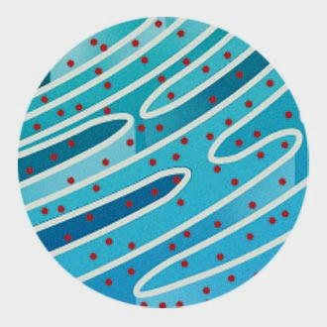
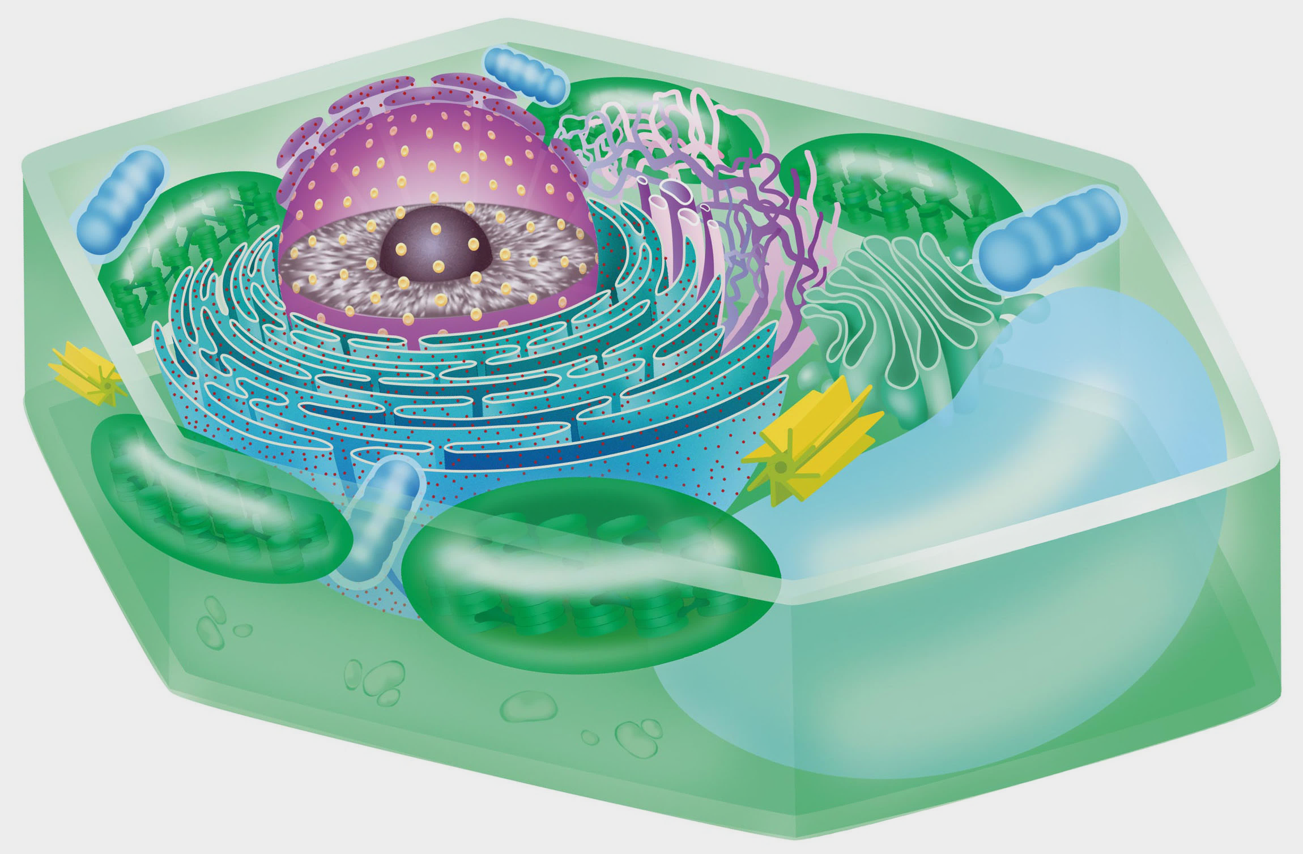

Slide 12
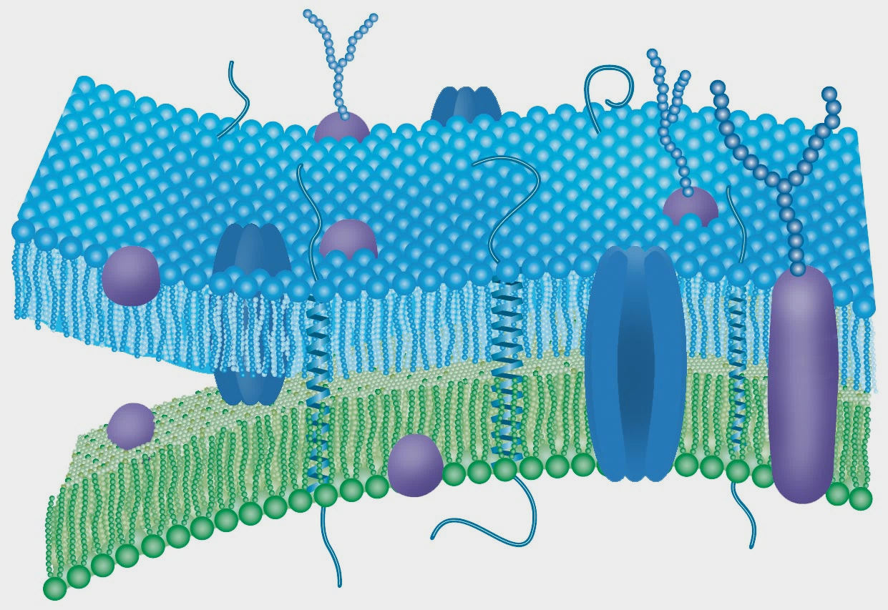
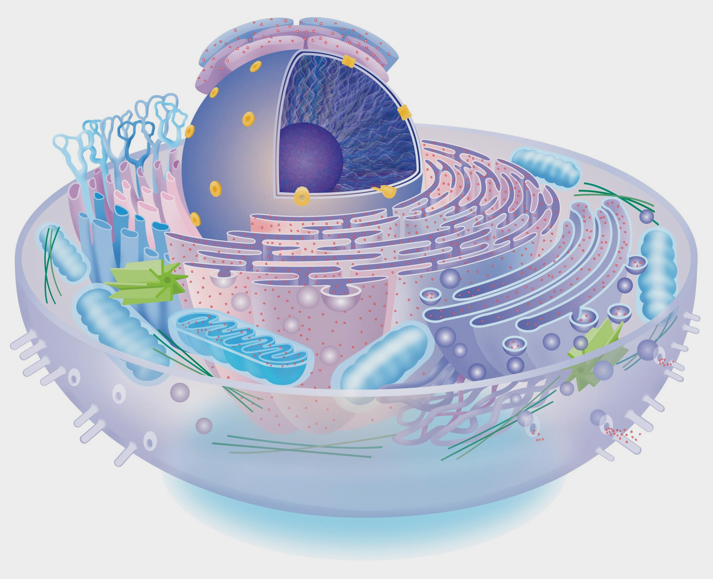

Slide 13
5A
1.
Which part of the cell theory refers to the flow of energy through a cell? to the flow of information through a cell?

Slide 14
5A
2.
(True or False) As discoveries were made that couldn’t be explained by spontaneous generation, scientists came up with an updated version of the spontaneous generation model.

Slide 15
How do cells interact with their environment?

Slide 16
homeostasis
the internal balance of a system that keeps conditions stable

Slide 17
Balance in the Cell
Dynamic equilibrium: the balance of changes and motions in a system
Various things can affect the homeostasis of a cell
Optimal range
Range of tolerance
Limits of tolerance

Slide 19
Positive feedback: when a substance involved in a cellular process causes the process to speed up
Negative feedback: when a substance produced by a cellular process causes the process to slow down or stop

Slide 20
Solutions and the Cell
Cells are always in some sort of solution.
Concentration
Osmosis: the diffusion of a solvent through a semipermeable membrane
A membrane that allows certain substances to pass through it but not others

Slide 21
Cell membranes are semipermeable membranes.
Hypertonic: a solution that is more concentrated than the cytoplasm of a cell
Hypotonic: a solution that is less concentrated than the cytoplasm of a cell
Isotonic: when cells and the solution that they are in have the same concentration of solutes

Slide 22
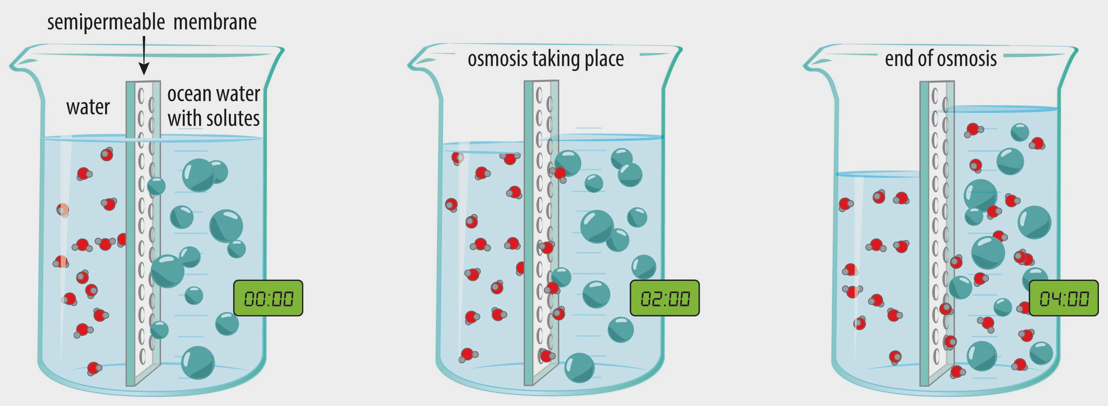

Slide 23
passive transport
the movement of molecules across a membrane without the use of chemical energy

Slide 24
Transport Across the Membrane
Particles move from areas of high concentration to areas of low concentration
Cells expend no energy

Slide 25
Four factors determine whether a particle can be passively transported across a cell membrane:
Particle size
Particle shape
Particle polarity
Membrane composition
Diffusion and osmosis are types of passive transport

Slide 26
Facilitated diffusion: molecules move through the cell membrane with the help of transport proteins
Respond to the concentrations of the solutions inside and outside the cell

Slide 27
active transport
the movement of molecules across a membrane using chemical energy

Slide 28
Energy is applied to the transport protein before the protein will move the particle across the membrane.
Endocytosis: the cell membrane forms a sack around the particles and then pinches off to become a vesicle
Exocytosis: the vesicle fuses with the cell membrane, opens up, and releases its contents

Slide 30
5B
1.
When you catch a cold, your body fights the cold virus and tries to eliminate it as quickly as possible. Why does your body react this way to a virus?

Slide 31
5B
2.
Two of the most important parts of your blood are red blood cells and plasma. They are usually isotonic. What would happen to the red blood cells if the plasma became hypotonic?

Slide 32
Chapter 5
1.
Not every part of an organism is made of cells; some parts are made from secretions or products of cells. Does this observation fit with the cell theory? Why or why not?

Slide 33
Chapter 5
2.
Suppose it’s the year 2185 and scientists have discovered that something smaller than the cell is the foundation of all living things. How would this discovery affect the cell theory?

