Slide 2
I. Primary Industries

Slide 3
Primary industries are the most basic industries.
They take materials from the earth that are needed for food, clothes, and shelter.

Slide 4
I. Primary Industries
A. Agriculture
1. Farming (mostly moderate climates)
a. Subsistence farmers
b. Cash crops
c. Commercial farmers

Slide 5
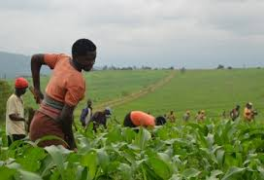

Slide 6
2. Animal Husbandry (mostly semiarid climates)
a. Nomadic herding
b. Ranching
B. Fishing and Forestry

Slide 7
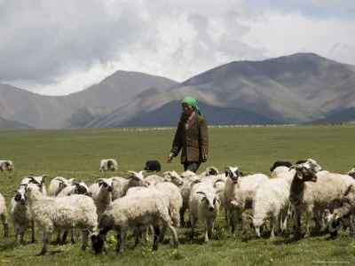

Slide 8
natural resources
useful substances found in the earth

Slide 9
1. Fishing
a. Capture
b. Aquaculture
2. Forestry

Slide 10
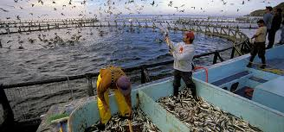

Slide 11
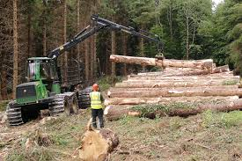

Slide 12
C. Mining
1. Metals

Slide 13
Metals have four useful properties: they are shiny, malleable, ductile, and conductive.
The three types of metals are precious metals, common metals, and alloys.

Slide 14
C. Mining
1. Metals
a. Gold, silver, platinum
b. Copper, lead, iron, and aluminum are common metals
c. Alloys: bronze, brass, steel

Slide 15
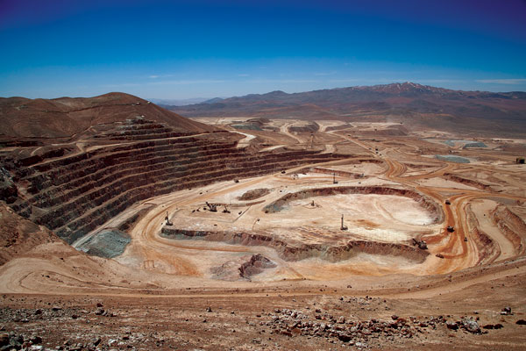
Copper Mine

Slide 16
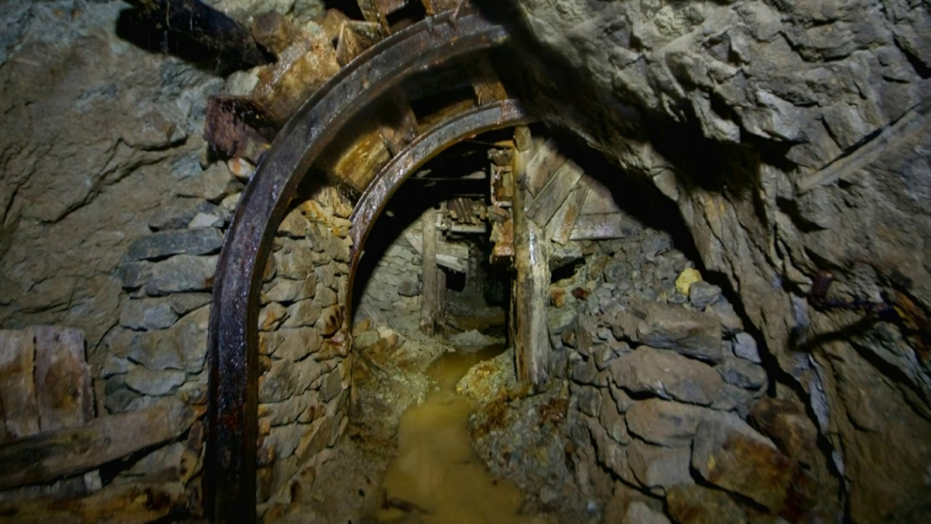
Lead Mine

Slide 17
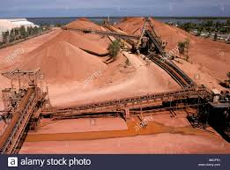
Bauxite Mine

Slide 18
2. Nonmetal minerals
a. Limestone
b. Sulfur
c. Other minerals
d. Uranium

Slide 19
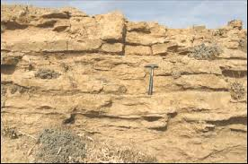
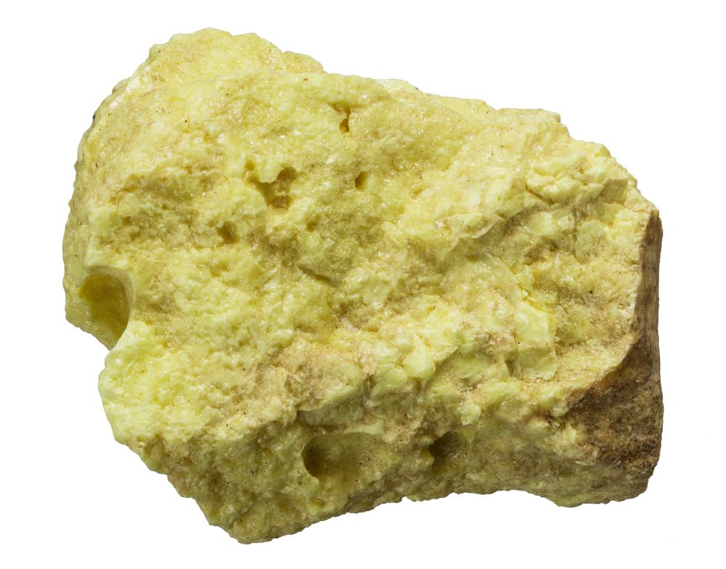
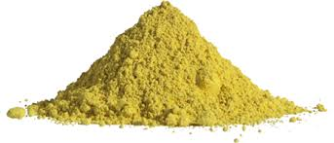
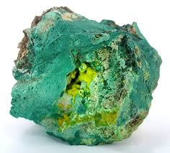
Sulfur
Limestone
Uranium

Slide 20
3. Fossil and Hydrocarbon Fuels
a. Coal
b. Petroleum
c. Natural gas

Slide 21
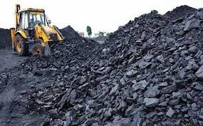

Slide 22
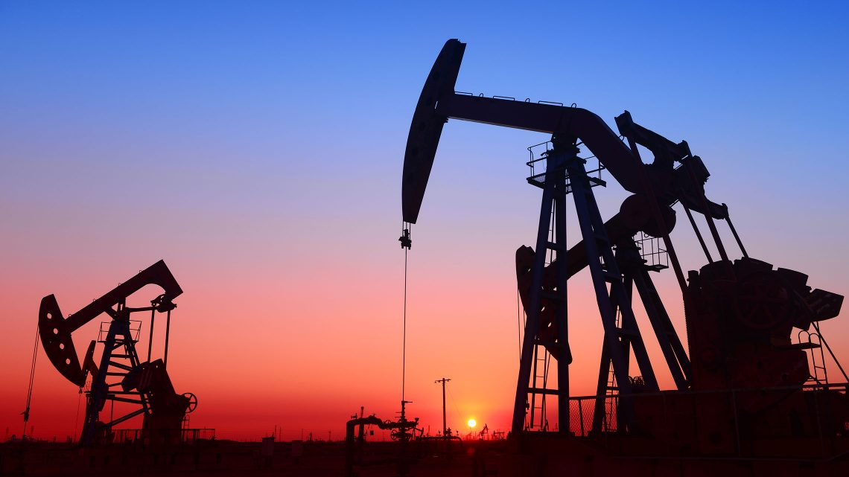

Slide 23
What are some alternative sources of energy?

Slide 25
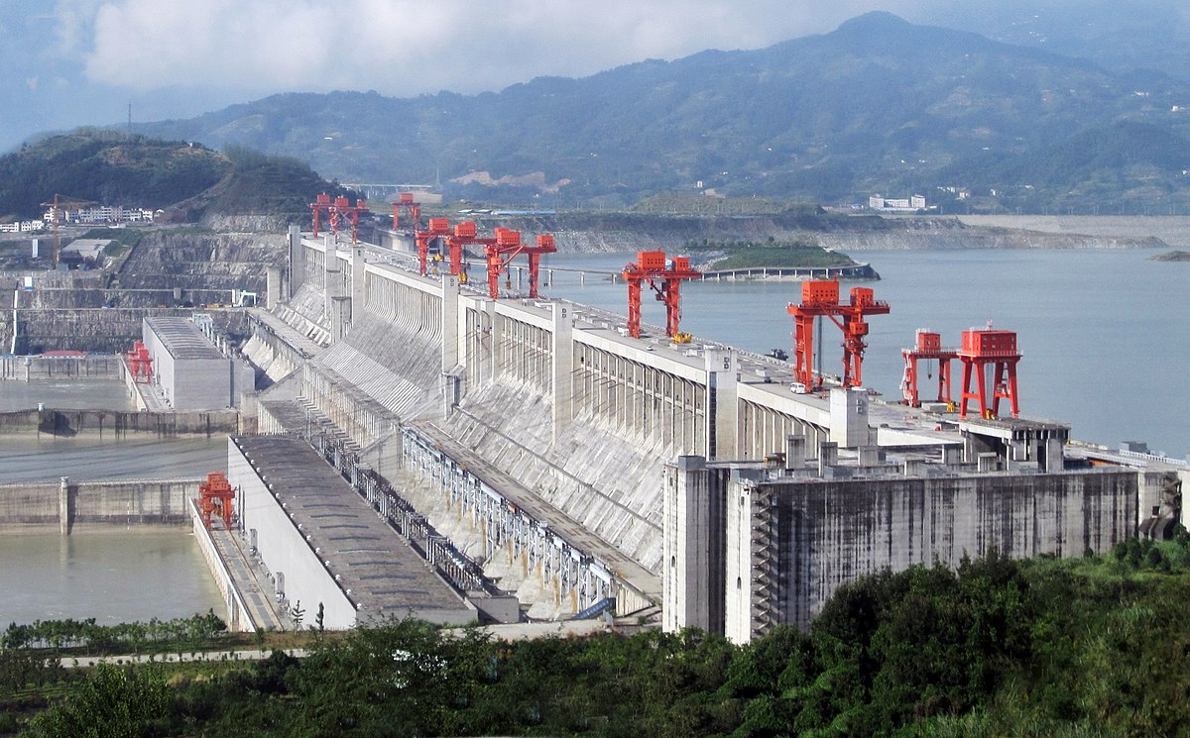

Slide 26
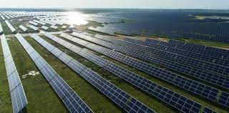

Slide 27
II. Secondary Industries

Slide 28
Secondary industries take raw materials and change them into a useful form.

Slide 29
II. Secondary Industries
A. Construction
B. Manufacturing
1. Industrial Revolution

Slide 30
technology
the application of science to industry

Slide 31
2. Durable and Nondurable Manufacturing
a. Nondurable: products that generally last less than a year
b. Durable: products that generally last more than a year

Slide 32
III. Tertiary Industries

Slide 33
Service industries employ the majority of American workers.
The U.S. Department of Labor recognizes five categories of service jobs.

Slide 34
III. Tertiary Industries
A. Infrastructure: the basic energy and equipment needs of industries
1. Utilities
2. Transportation
a. Water Transportation

Slide 35
b. Land Transportation
c. Air Transportation
3. Communication
a. Print Media
b. Electronic Media

Slide 36
B. Trade
1. Wholesale businesses
2. Retail businesses
C. Finance
D. General Services
E. Government

Slide 37
IV. The Wealth of Nations

Slide 38
economics
the study of the process by which people and countries make decisions

Slide 39
IV. The Wealth of Nations
A. Who Makes the Choices
1. Capitalism
a. Capital: money and equipment necessary to build industries
b. Free market

Slide 40
2. Socialism
a. Command economy
b. Communism: an extreme form
3. Mixed Economies

Slide 41
B. How Countries Measure Wealth

Slide 42
Real wealth is the ability to produce new things.

Slide 43
B. How Countries Measure Wealth
1. Gross domestic product (GDP)
2. Per capita GDP

Slide 44
C. How Countries Distribute Wealth Among Themselves
1. Developed and Developing Countries

Slide 45
development
the effective use of raw materials, labor, and capital

Slide 46
1. Developed and Developing Countries
a. Value added
b. Group of 8 (G-8) countries
2. Division of Labor

Slide 47
3. The Hope of Prosperity
a. Labor
b. Government
c. Righteousness

Slide 48
D. How Countries Wage Trade Wars
1. Economic self-sufficiency does not work
2. Trade is beneficial
3. Markets
4. Exports and imports

Slide 49
balance of trade
the difference between the value of a country’s exports and imports

Slide 50
tariffs
taxes on imports and exports

Slide 51
embargo
a ban on importing or exporting certain products or trading with a particular country

