Slide 2
I. Culture: The Ways of Society

Slide 3
society
a group of people who share common characteristics, relationships, institutions, and culture

Slide 4
culture
a society’s total way of life, including all of its traditions and institutions

Slide 5
traditions
the customs or usages that society passes down from one generation to the next

Slide 6
institutions
the formal organizations by which society transmits traditions

Slide 7
I. Culture: The Ways of Society
A. Language–The Foundation of Culture
*God’s response at Babel
1. Spoken Languages
a. Dialects
b. Language families

Slide 8
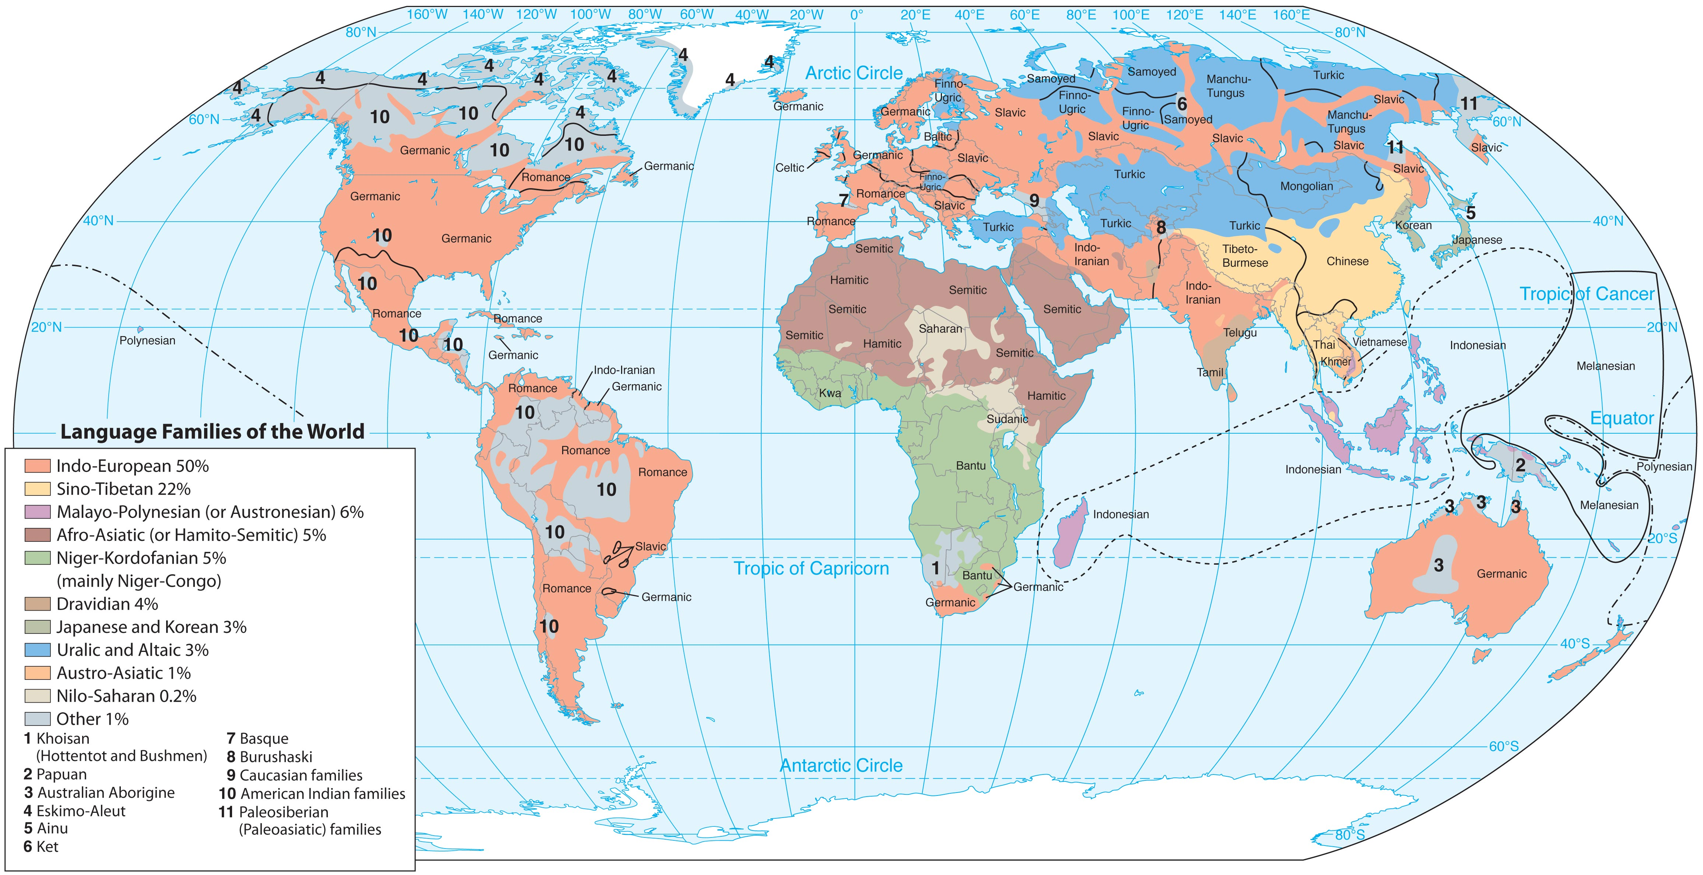

Slide 9
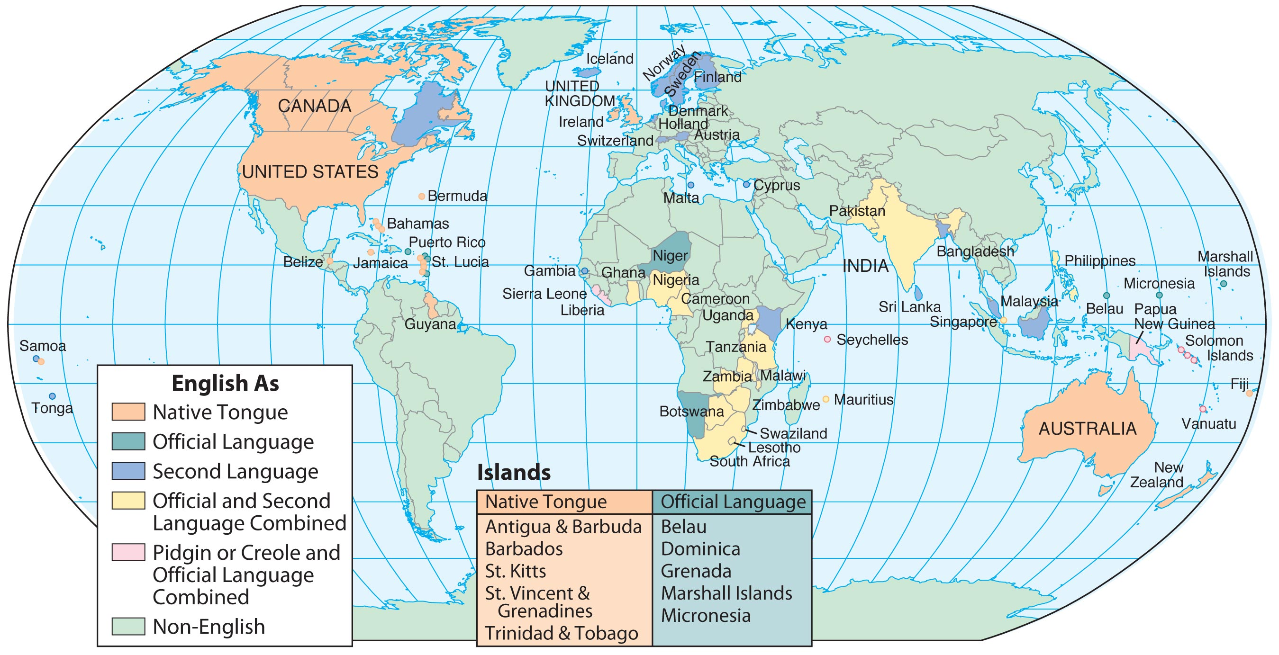

Slide 10
2. Written Languages
B. Regions–The Locations of Culture
1. Culture regions
2. Subregions

Slide 11
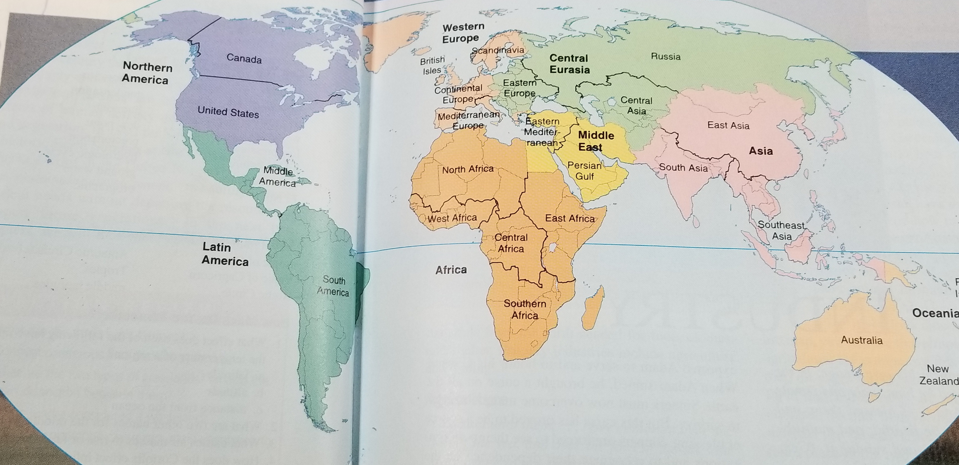

Slide 12
Some cultural institutions, rather than glorifying God, glorify either the group or the individual.

Slide 13
C. Institutions–The Transmission of Culture
1. The Family
a. Nuclear family
b. Extended family

Slide 14
2. Religion
a. Some people do not distinguish between their religion and their culture
b. Guides all other expressions of culture

Slide 15
c. Top three world religions
1. Christianity
2. Islam
3. Hinduism

Slide 16
Biblical Christianity alone offers satisfying and consistent answers to mankind’s most troubling problems.

Slide 17
nation
a large group of people with a common history and language

Slide 18
How is a “nation” different from a country, state, or tribe?

Slide 19
3. The Nation
a. Nation-state- has own government
b. Empire- nations ruling other nations
c. Political maps- shows boundaries of nations
d. Civil wars- a war with-in a country
e. International wars- wars with other countries

Slide 20
Political boundaries
Natural boundaries- rivers, mountains, etc.
Geometric boundaries- Connect geographic points
or follow lines of longitude or latitude

Slide 21
4. Mass media
a. Cultural convergence- a growing similarity between cultures
b. Undermining of traditional institutions

Slide 22
II. Demography: The Statistics of Society

Slide 23
demography
the study of human populations and their characteristics

Slide 24
vital statistics
official records of births, marriages, divorces, and deaths

Slide 25
II. Demography: The Statistics of Society
A. Vital Statistics
1. Natural Increase
a. Crude birthrate
b. Crude death rate
c. Rate of natural increase

Slide 26
2. Life Expectancy
a. Historical changes
b. Infant mortality

Slide 27
B. Community Statistics
1. Urbanization
a. Urban areas and rural areas
b. Growth of urban areas at the expense of rural areas
c. Suburbs

Slide 28
2. Population Density
a. Average number of people who live on each square mile (or kilometer) of land
b. Arable land
c. Physiological density

Slide 29
III. Politics: The Governance of Society

Slide 30
III. Politics: The Governance of Society
A. Duties of Government
1. Basic responsibility: preserve order and protect its citizens by promoting good and punishing evil
2. Justice

Slide 31
3. Defense

Slide 32
anarchy
a condition in which no form of governing authority exists and people are doing whatever they want

Slide 33
B. Types of Government
1. Authoritarian Government
a. Absolute monarch
b. Dictatorship
c. Totalitarian government

Slide 34
2. Elected Government
a. Direct (pure) democracy
b. Indirect (representative) democracy
c. Constitutional monarchy
d. Republic

Slide 35
foreign policy
the set of principles that guides a government’s international relations

Slide 36
C. Relations Among Governments
1. The threat of war
a. Active troop strength
b. Annual defense spending
c. Sphere of influence
d. National interests

Slide 37
Concerns of U.S. Foreign Policy
Seven leading world powers
Militarized states
Rogue nations

Slide 38
diplomacy
the art of negotiating agreements between nations

Slide 39
2. Negotiating Peace
a. Peace treaties
b. Military alliances
c. NATO
d. United Nations
*Security Council

Slide 40
e. Self-determination
f. Territorial integrity

