Slide 2
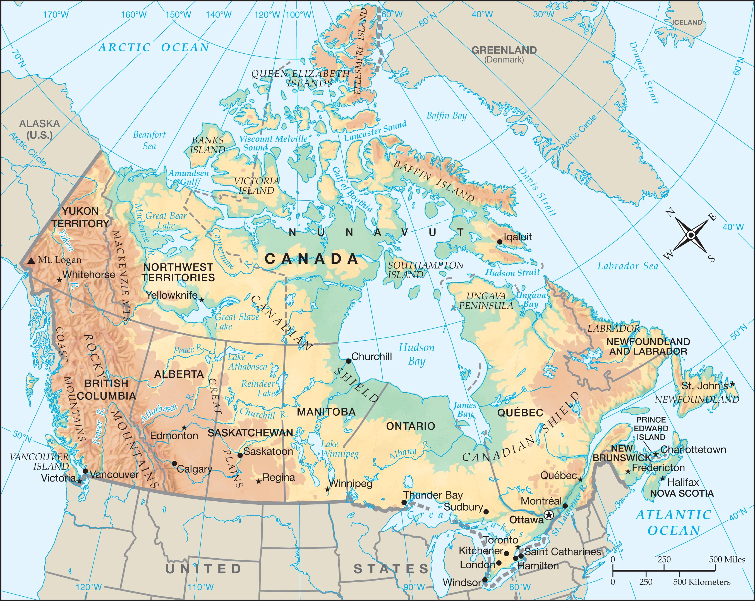

Slide 3
I. The Maritime Provinces

Slide 4
Canada has the second-largest land area of any country in the world.
Canada has much in common with the United States.
Most live within 100 miles of US

Slide 5
maritime
bordering the sea

Slide 6
I. The Maritime Provinces
A. Newfoundland
1. The Grand Banks- great fishing
a. Fishing
b. First European settlement

Slide 7
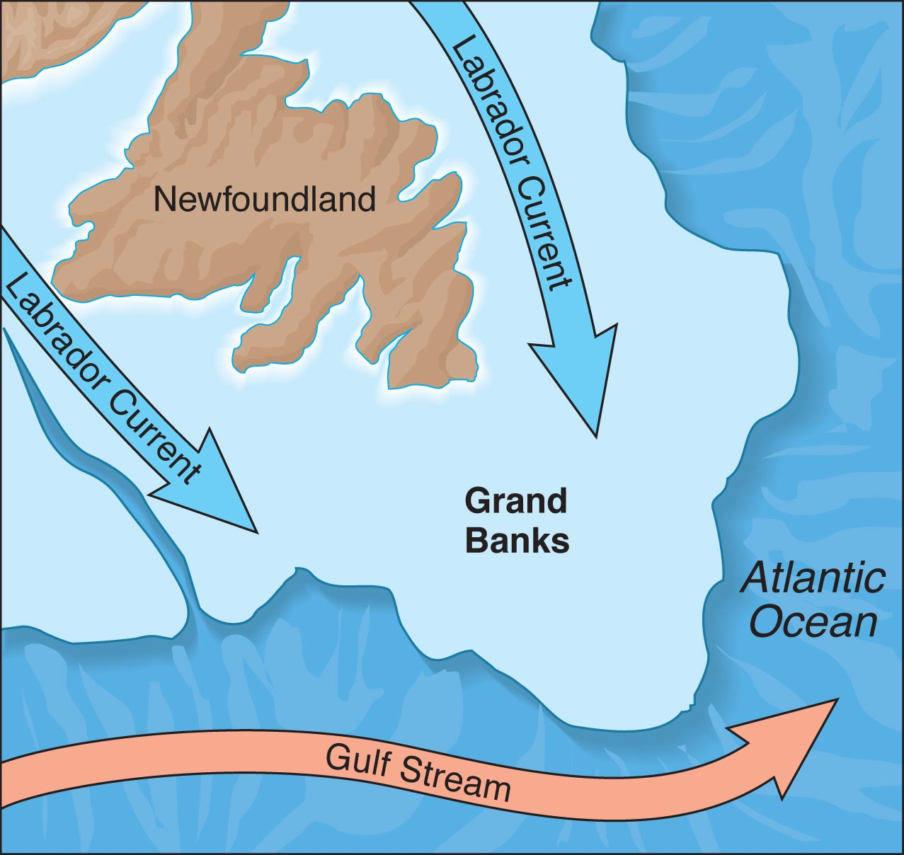

Slide 9
2. Labrador
a. Cold but beautiful
b. Natural resources

Slide 10
B. Nova Scotia
1. French Acadians
2. Capital: Halifax
3. Bay of Fundy- highest tides in the world

Slide 11
C. New Brunswick
1. French Acadians: 40%
2. Many are of Loyalist ancestry
3. Capital- Fredericton

Slide 12
D. Prince Edward Island- “Spud Island”
1. “Canada’s Million-Acre Farm”
2. Connected to mainland by a bridge
3. Produce potatoes and beef
4. Canada’s smallest province
5. Capital- Charlottetown
6. Highest population density

Slide 13
II. The Central Provinces

Slide 15
The Canadian Shield covers most of eastern Canada. Mining is important there.
Taigas are coniferous forests that are found in Canada’s subpolar climate.

Slide 16
II. The Central Provinces
A. Quebec- Canada’s largest province
1. History
2. Cultural “mosaic”
3. Sole official language: French

Slide 17
4. Cities of the St. Lawrence Valley
a. Quebec
b. Montreal- Largest city in Canada
5. Land’s End
6. Locks allow large ships to travel the St. Lawrence Seaway to the Great Lakes

Slide 18
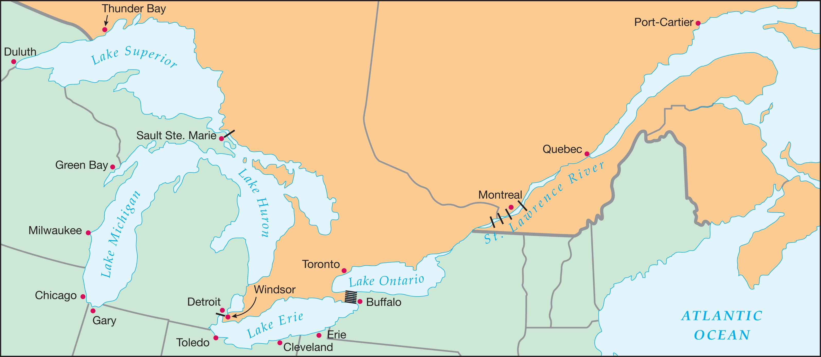

Slide 19
Ontario is the most populous province of Canada.
Its people have a strong British heritage.
Means shining waters

Slide 20
B. Ontario
1. Northern Ontario
2. Canada’s Population Centers
a. Most people live between Lake Huron and Lake Ontario
b. Toronto- largest metropolitan area
Capital of Ontario

Slide 21
3. Ottawa
a. National capital
b. British North America Act (1867)- Formed the Canadian Confederation c. Dominion of Canada

Slide 22
Britain won the Seven Years’ War
Thus taking over Canada from the French.

Slide 23
Canada has never had a civil war, but the union of its provinces has historically been fragile.
Canada retains the British monarch as their head of state.

Slide 24
III. The Western Provinces

Slide 25
The Trans-Canada Highway links the East and the West.
The Central Plains and Rocky Mountains of the United States extend northward into Canada.

Slide 27
III. The Western Provinces- breadbasket
A. Manitoba
1. Winnipeg
2. Métis
3. Much of Manitoba is covered by the Canadian Shield

Slide 28
B. Saskatchewan
1. Saskatchewan Plain
2. Leading wheat producer
3. Uranium and wilderness

Slide 29
C. Alberta-
1.Calgary- Gateway to the Canadian Rockies
2.Oil reserves That exceed that of Saudi Arabia
3.Calgary Stampede-Famous Rodeo
4. Capital - Edmonton

Slide 30
D. British Columbia- Capital is Victoria
1. Western Cordillera
2. Pacific Coast
a. Natural resources
b. Vancouver
c. Insular Mountains
3. Biggest industry is tourism

Slide 31
IV. The Canadian Territories

Slide 33
Eskimos and Indians are the two native peoples of Canada.

Slide 34
IV. The Canadian Territories
A. Yukon Territory
1. Mining
2. Alaska Highway

Slide 35
B. Northwest Territories-
1. Mackenzie River
2. Archipelagos
3. The site of a diamond rush
C. Nunavut
1. Only 28 villages
2. Baffin Island- largest Island in the archipelago

Slide 36
