Slide 1
Chapter 4: Religion in the American Colonies

Slide 2
Big Ideas
What is an established denomination and what is a non-established denomination?
Which non-established denominations were prominent in the American colonies?
How did colonial Christians worship?
Was the evangelization of Indian tribes effective?
How did the Great Awakening affect the American colonies?

Slide 3
Established denominations

Slide 4
Guiding questions
What religious struggles occurred in the English church under English kings?
What were the main factions within the Anglican Church?
What was the Puritan view of the covenant? Why did Puritanism decline?
What conditions resulted in the Salem witch trials?

Slide 5
Established Denominations
Denominations that enjoyed state (government) support and protection were called established denominations.
Notes:
https://pixabay.com/photos/st-peter-s-church-interior-3946433/; pixabay/CC0

Slide 6
English background
King Henry VIII broke from the Roman Catholic Church and established the Church of England (Anglican Church).
Under Edward VI, Protestant leaders pushed for drastic changes that offended many English people.
Edward VI
Notes:
US History 5th/55br; Edward VI of England c. 1546"/Wikimedia Commons/Public Domain

Slide 7
English background
Catholic Queen Mary attempted to reinstate Catholicism in England.
Queen Elizabeth I made the Anglican Church the official English church again.
Elizabeth I
Notes:
US History 5th/56r; "Portrait of Elizabeth I of England" by George Gower/Wikimedia Commons/Public Domain

Slide 8
English background
The Puritans were staunch Protestants who agreed wholeheartedly with the Anglican creed.
Low-church Anglicans agreed doctrinally with the Puritans but saw no problem with the church’s ceremonies and structure.
High-church Anglicans believed that the church’s traditional practices, notably its rule by bishops, were divinely ordained.
The Separatists believed that the whole Church of England was corrupt and that true Christians must separate from it.

Slide 9
Puritanism in America
New England Puritanism was the most influential religious movement in colonial history.

Slide 10
Puritan Beliefs
The Puritans believed the basic doctrines of the Reformation: the authority of the Bible alone, justification by faith alone, and that all believers could serve as their own priests.
The covenant idea affected every aspect of Puritan society.
New England Puritans adopted a congregational form of church government.
Most of the Puritans in America came to be called simply Congregationalists.

Slide 11
Puritan Decline
The Puritans declined in religious fervor after the original generation of settlers died.
The early Puritans were committed to constructing a holy commonwealth.
The Half-Way Covenant allowed outwardly moral church members who had not owned the covenant to present their children for baptism.
It was a serious compromise of the principles of the original Puritans.

Slide 12
Puritan Decline
Several other factors contributed to the spiritual decline in New England.
Financial success increased materialism.
Harvard College reduced its emphasis on spiritual matters.

Slide 13
Puritan decline
The Salem witch trials resulted from the claims of several young girls in Salem Village, Massachusetts, that witches were afflicting them.
Before the hysteria was over, at least twenty people were dead, and the reputation of Massachusetts suffered permanent damage.
Notes:
https://en.wikipedia.org/wiki/File:Witchcraft_at_Salem_Village.jpg; Illustration of Witchcraft at Salem Village from Pioneers in the settlement of America by Wiliam A. Crafts, 1876/Wikimedia Commons/Public Domain

Slide 14
Anglicanism in America
The early Virginians were usually low-church Anglicans, agreeing doctrinally with the Puritans but having no objection to Anglican forms of worship.
In 1693, Anglicans established the College of William & Mary.
By the Revolutionary War, Anglican churches existed in every colony, and Anglicanism had become the established (government-supported) church in Virginia, Maryland, the Carolinas, Georgia, and parts of New York and New Jersey.

Slide 15
Anglicanism in America
When the Great Awakening took place in the 1700s, the Anglican Church was the least affected of all the Protestant denominations.

Slide 16
Section review
From what did Puritans want to “purify” the Church of England?
from certain practices, such as the church’s use of bishops and elaborate garments for priests, and ceremonies that they considered Roman Catholic, and therefore corrupt (p. 56)
What is the “heart” of Puritan theology?
the idea of the covenant (p. 56)

Slide 17
Section review
Explain the type of church government adopted by New England Puritans.
They used the congregational form. Each congregation elected its own officers and the churches remained independent of each other. (p. 57)

Slide 18
Section review
What were the provisions of the Half-Way Covenant?
Church members who had never owned the covenant (professed their personal faith in Christ as Savior) could present their children for baptism and thereby for church membership. “Half-way” members, however, could not take the Lord’s Supper. (p. 57)

Slide 19
Section review
Why did the Puritan commonwealth fail?
The descendants of the Puritans did not maintain the vibrant, personal faith of their forefathers. As a result, Puritans failed to establish the pure Christian society they envisioned.

Slide 20
Section review
Examine the information about the Salem witch trials. What do you think were the major reasons they occurred?
Fear and hysteria were combined with acceptance of inaccurate testimony. Incentives for people to falsely confess witchcraft in order to save their lives served to perpetuate these trials.

Slide 21
Non-established denominations

Slide 22
Guiding questions
Who were the leading English Separatists and what did they teach?
In addition to the Separatists, what other non-established religious groups developed in America?

Slide 23
Non-Established Denominations
The Separatists and the Roman Catholics formed the non-established denominations.
These groups did not have state (government) support and protection.

Slide 24
Baptists
In 1639, Roger Williams founded what is considered the first Baptist church in America.
The Baptists grew slowly at first, and they suffered persecution from colonial authorities.
Baptists baptize only professing believers and then only by immersing them in water.
Roger Williams

Slide 25
Quakers
The Quakers, or the Society of Friends, originated with the Englishman George Fox.
Quakers teach that an “inner light” is a spark of divinity and that man is saved through obeying its leading rather than through the atonement of Christ.
George Fox
Notes:
US History 5th/60; "Religious denominations of the world- comprising a general view of the origin, history, and condition, of the various sects of Christians, the Jews and Mahometans, as well as the pagan forms of (14803203463)"/Wikimedia Commons/Public Domain

Slide 26
Quakers
Believers sat in silence—often in a circle—and waited for the “inner light” to move one member to give a word of testimony or exhortation.
Many of the Quakers lived in Rhode Island, but the center of colonial Quakerism was Pennsylvania.
a Quaker meeting
Notes:
http://www.loc.gov/pictures/resource/pga.04249/; Library of Congress, LC-USZ62-5808

Slide 27
Lutherans
The Lutherans, followers of the teachings of the great German reformer Martin Luther, came to America in trickles rather than in floods.
Swedish Lutherans of New Sweden (Delaware)
Dutch Lutherans in New Amsterdam
German Lutherans in Pennsylvania

Slide 28
Anabaptist Groups
The Mennonites, followers of the Dutch teacher Menno Simons, were the largest Anabaptist group.
The Amish were a more conservative branch of the Mennonites.
Many of the Mennonites and Amish fled to the New World and established farms and towns in Pennsylvania.
Menno Simons
Notes:
https://commons.wikimedia.org/wiki/File:Meno_simonis.jpg; Engraving of Menno Simons from Zweihundert deutsche Männer in Bildnissen und Lebensbeschreibungen edited by Hugo Bürkner/Wikimedia Commons/Public Domain

Slide 29
some Mennonites and Amish still use only a horse and buggy for transportation and follow farming practices that date back to the 1700s.
Notes:
https://pixabay.com/photos/farmer-horses-agriculture-farming-554470/; pixabay/CC0

Slide 30
Other Protestant Groups
Presbyterians originated in the British Isles.
The Dutch Reformed came to the New World with the settling of New Amsterdam.
French Reformed (Huguenots) settled throughout the colonies, especially after the French king, Louis XIV, abolished their freedom of worship in 1685.
The German Reformed Church, from southern Germany, also migrated to the American colonies.

Slide 31
Other Protestant Groups
The Moravians were followers of the teachings of preacher John Huss of Bohemia.
They emphasized the importance of conversion, the need for personal piety, and the necessity of living a holy life.
Evangelism was also a primary concern.
Notes:
https://pixabay.com/photos/north-carolina-historic-956674/; pixabay/CC0

Slide 32
Roman Catholics
Most Protestants in the colonies feared Roman Catholicism.
The center of colonial Catholicism was Maryland.
In 1790, the Roman Catholic Church made John Carroll bishop of Baltimore, America’s first Catholic bishop.
John Carroll
Notes:
https://commons.wikimedia.org/wiki/File:John_Carroll_Gilbert_Stuart.jpg; Portrait of Archbishop John Carroll by Gilbert Stuart, ca. 1806/Wikimedia Commons/Public Domain

Slide 33
Section review
What were the four most important Separatist groups to settle in the colonies?
the Pilgrims, the Baptists, the Quakers, and the Presbyterians (p. 60)
In what colony did the German Reformed settle?
Pennsylvania (p. 62)
Which colony was the center of Catholicism?
Maryland (p. 62)

Slide 34
Section review
From the four core values (freedom, individualism, equality, and growth), choose two and explain how they encouraged the development of non-established denominations.
Freedom: As Americans came to cherish freedom, it seemed inconsistent not to grant citizens the freedom to worship in the denomination of their choice.
Individualism: As individualism grew in America, it became harder to insist that all Americans conform in their worship to a few established denominations.

Slide 35
Section review
Equality: Privileging certain denominational groups and forbidding others directly contradicted the American ideal of equality.
Growth: Religious freedom, which allowed diverse religious views, led to the development and growth of non-established denominations.

Slide 36
Section review
Explain the statement given above: “Most Protestants in the colonies feared Roman Catholicism.”
Some of that feeling was simple prejudice, but much of it resulted from opposition to the unbiblical teachings of the Roman Catholic Church and the persecution of Protestantism in Catholic countries. Also, the Roman Catholic countries of France and Spain threatened the existence of the colonies.

Slide 37
Worship and Indian missions

Slide 38
Guiding questions
What were the main features of a typical colonial church building?
What was the typical order of service in a colonial church?
What methods were used to evangelize the Indians? How effective were those efforts?

Slide 39
buildings
Many early churches resembled barns.
The interiors of early colonial churches were likewise plain.
Some members could reserve pews by paying an annual rental fee.
Churches often reserved the balcony for certain groups such as servants, slaves, and free blacks.
Notes:
US History 5th/63; BJU Press Art

Slide 40
services
Churches usually held two services on Sunday, one in the morning and one in the afternoon.
A catechism is a summary of a denomination’s doctrine using a question-and-answer format.
Early churches contained no instruments.
The sermon was the centerpiece of the church service.
Notes:
https://pixabay.com/photos/vermont-shelburne-building-93276/; pixabay/CC0

Slide 41
Indian missions
Many devout Christians attempted to reach the Indians with the gospel.
John Eliot ministered to the Algonquin Indians.
He translated the entire Bible into the Algonquin language.
David Brainerd preached to the Indians in New York, New Jersey, and Pennsylvania.
David Brainerd
Notes:
US History 5th/65r; "David Brainerd on horseback"/Wikimedia Commons/Public Domain

Slide 42
Indian missions
A chief shortcoming of some missionary efforts was the tendency to think that Indians had to be “civilized” before they could be converted.
David Brainerd
Notes:
US History 5th/65r; "David Brainerd on horseback"/Wikimedia Commons/Public Domain

Slide 43
Section review
What is a catechism?
a summary of a denomination’s doctrine using questions and answers (p. 64)
Why did many colonial churches lack musical instruments?
Some Christians thought the Bible prohibited musical instruments in church; others simply could not afford to import instruments from England. (p. 64)

Slide 44
Section review
What was the central focus of the typical colonial worship service? Evaluate this focus.
The sermon was the central focus because the preaching made the hearers aware of their sin, led to salvation (Rom. 10:17), provided food for spiritual growth, offered strength to persevere in the present life, and offered hope for the future, both in this life and in the next; this focus was correct and is still correct today.

Slide 45
Section review
Some have criticized missionary efforts during this period for attempting to “civilize” the people to whom the missionaries ministered. What are some positive and negative aspects of this attempt?
Positive: Certain Indian customs could not be reconciled with biblical morality and therefore, needed to be abolished. Some aspects of a civilizing mission are simply efforts to teach others to love their neighbor. Literacy is a beneficial skill that enables people to have direct access to God’s Word.

Slide 46
Section review
Negative: Some missionaries assume that their culture is thoroughly Christian, but in fact it too has become corrupted by the Fall. A missionary may fail to recognize the beneficial aspects of the native culture. Some missionaries confuse civilizing with conversion.

Slide 47
The great awakening

Slide 48
Guiding questions
What were the spiritual conditions in the colonies prior to the Great Awakening?
Who were the leaders of the Great Awakening?
What were the results of the Great Awakening?

Slide 49
The Great Awakening
Religious revivals have occurred a number of times in American history.
The first significant one became known as the Great Awakening.
It was a powerful social, political, and religious force that permanently altered the course of American history.

Slide 50
Background
Religious life in the North American colonies had begun to wither by the early 1700s.
The colonies needed a spiritual awakening.

Slide 51
Early Stirrings
In 1720, Dutch Reformed pastor Theodore J. Frelinghuysen emphasized personal conversion and the holiness of life that an awareness of God’s holiness brings.
Presbyterian Gilbert Tennent began to preach about the need for conversion and holy living.
Gilbert Tennent had graduated from “the Log College.”
Notes:
US History 5th/67; BJU Press Art

Slide 52
Jonathan Edwards
The greatest theologian of the Great Awakening—and perhaps of American history—was Jonathan Edwards.
In 1734, Edwards began preaching a series of sermons on justification by faith.
His most famous sermon was “Sinners in the Hands of an Angry God.”
Jonathan Edwards
Notes:
World History 5th/331b; "Jonathan Edwards engraving" by R Babson & J Andrews/Wikimedia Commons/Public Domain

Slide 53
Jonathan Edwards
Edwards documented the impact of the Great Awakening in his book A Faithful Narrative of the Surprising Work of God.
He also wrote Religious Affections.
Jonathan Edwards
Notes:
World History 5th/331b; "Jonathan Edwards engraving" by R Babson & J Andrews/Wikimedia Commons/Public Domain

Slide 54
George Whitefield
George Whitefield was the Great Awakening’s outstanding evangelist.
In 1740, Whitefield preached to thousands daily, and many of those thousands were converted.
He had a powerful, melodious, persuasive voice.
George Whitefield
Notes:
World History 4th/335; George Whitefield, by John Russell (died 1806), given to the National Portrait Gallery, London in 1917/Wikimedia Commons/Public Domain

Slide 55
Results of the Awakening
Church growth was the most visible result.
The number of religious colleges increased.
The Awakening transformed the spiritual life of the churches.
The Great Awakening brought division to America’s churches.
It was the first truly national movement in American history.
The Awakening also advanced personal liberty.

Slide 56
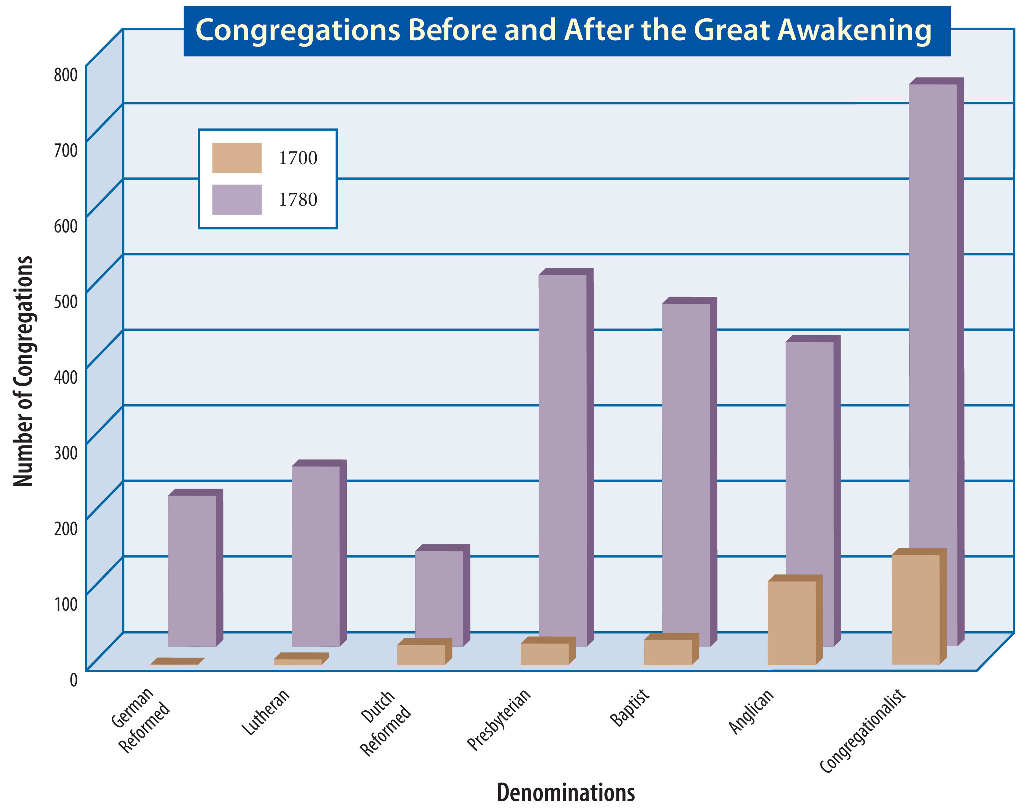
Notes:
US History 5th/69; BJU Press Art

Slide 57
Section review
Who was the greatest theologian of the Great Awakening?
Jonathan Edwards (p. 67)
What was the most famous sermon preached by Jonathan Edwards?
“Sinners in the Hands of an Angry God” (p. 55)
Who was the most outstanding evangelist of the Great Awakening?
George Whitefield (p. 68)

Slide 58
Section review
Assess the spiritual results of the Great Awakening.
Positive spiritual results included: salvation of many sinners; growth of churches; establishment of religious schools; decline of influence of the Half-Way Covenant; and increased unity among churches.
The negative results were that some divisions occurred and there was some resistance to the Great Awakening (most notably among Anglicans).

Slide 59
Section review
Assess the political results of the Great Awakening.
It was the first truly national movement in American history; it advanced personal liberty; it resulted in greater freedom of worship; it was a democratic influence in the churches; and it set a precedent for the constitutional rights of free speech and the freedom of assembly.

Slide 60
People, Places, and Things to Remember
Puritans
low-church Anglicans
high-church Anglicans
Separatists
congregational form of church government
Congregationalists
Half-Way Covenant
Salem witch trials
non-established denominations
Roger Williams
Baptists
Quakers
George Fox
Lutherans
Mennonites
Amish
Presbyterians
Huguenots

Slide 61
People, Places, and Things to Remember
Moravians
Great Awakening
Jonathan Edwards
George Whitefield

