Slide 1
Unit II: Forge (1689–1801)
1754–63
The French and Indian War
1765
The Stamp Act
1770
The Boston Massacre
1755
1760
1765
1770
1767
The Townshend Acts

Slide 2
1774
The Intolerable Acts
1791
Bill of Rights ratified
1775–83
The American Revolution
1787
Constitution adopted by the convention
1775
1780
1785
1790
1776
The Declaration of Independence
1783
The Treaty of Paris

Slide 3
Chapter 5: the rising storm

Slide 4
Big Ideas
What was the significance of the early conflicts that arose between the British and the French?
What were the consequences of a British victory in the French and Indian War?
What events resulted in a movement toward American independence from Britain?

Slide 5
The rising storm
In 1682, Robert de LaSalle claimed the vast region of Louisiana.
New France was never heavily populated with French settlers.
The French posed a serious threat to the thirteen colonies.
The French had strong Indian alliances.
The frontier was vulnerable to attack.
The American colonies failed to unite.

Slide 6
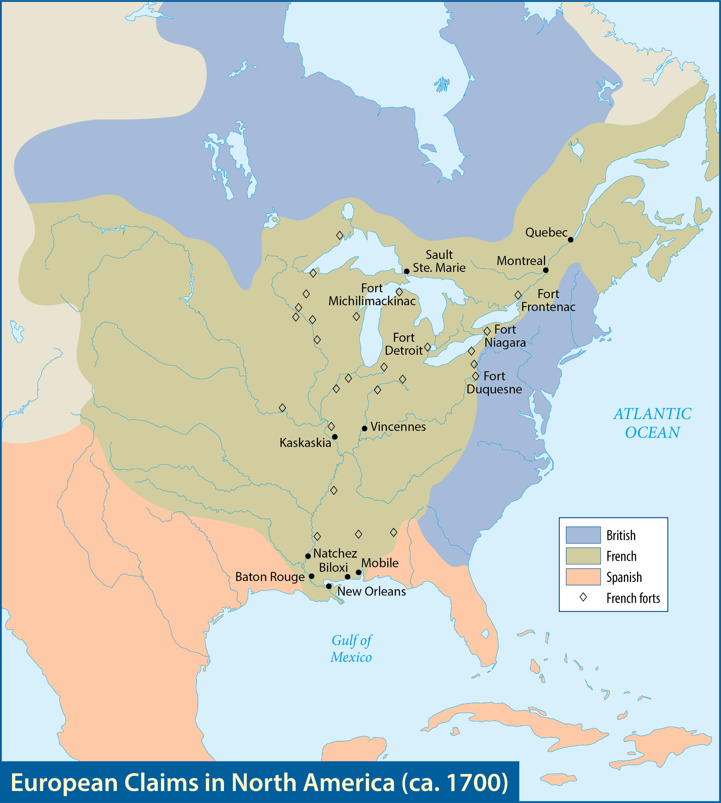
Map Resources

Slide 7
Frontier feuds

Slide 8
Guiding questions
How did the French threaten the British colonies?
What four wars were fought in America between the French and the British?

Slide 9
King William’s War (1689–97)
French settlers and Indians inflicted considerable damage and fear upon the English settlements.
The French continued to build forts along the Mississippi and St. Lawrence Rivers.
William III
Notes:
World History 4th/315l; "King William III of England, (1650-1702)" by Sir Godfrey Kneller/Wikimedia Commons/Public Domain

Slide 10
Queen Anne’s War (1702–13)
France’s Indian allies attacked several New England settlements, and the English colonists responded by raiding Canadian villages.
England won a series of decisive victories in Europe.
France lost control of much of eastern Canada.
Anne

Slide 11
King George’s War (1744–48)
A truce was declared in Europe in 1748, and the fighting ended.
Open conflict would erupt again in 1754 and would not only settle old problems in America but also create new ones.
George II
Notes:
https://commons.wikimedia.org/wiki/File:George_II_by_Thomas_Hudson.jpg; Portrait of George II of Great Britain by Thomas Hudson, 1744/Wikimedia Commons/Public Domain

Slide 13
Section review
Which two European nations became the most bitter rivals in North America?
England and France (p. 75)
What three factors increased the danger of the French threat to the thirteen colonies?
The French alliances with the Indians increased the Indian threat for the colonies; as the American frontier was ill-defined and isolated, it was open to French attack; the colonies failed to present a united front. (pp. 75–76)

Slide 14
Section review
Why was friction between England and France inevitable in North America?
As the French expanded their claims in Canada, the Great Lakes region, and the Mississippi River basin, and as the English moved farther west, friction was inevitable. (p. 76)

Slide 15
Section review
Assume you were Reverend John Williams in the story given in this chapter entitled “A Redeemed Captive.” How do you think you would have reacted in this situation? Would your actions be justified in view of biblical principles?

Slide 16
Section review
Persecution comes as a result of faithfulness (2 Tim. 3:12). A Christian should be patient in suffering and put his hope in Christ (Rom. 8:17–18; James 5:7–11). A Christian can even rejoice in suffering because God uses suffering in a Christian’s life to make him more like Christ. Suffering can result in a believer receiving praise and honor from God (James 1:2–5; I Pet. 1:6–7). Finally, when pressured to deny Christ, a Christian should remain faithful in confessing Christ (Luke 12:8–12; Heb. 10:23; I John 2:23).

Slide 17
The French and Indian war

Slide 18
Guiding questions
What were the causes and the events of the French and Indian War?
What were the strengths and weaknesses of each nation relating to the war?
What were the results of the war?

Slide 19
The French and Indian War
In 1754, the French and Indian War began in the New World.
It spread to Europe two years later, and there it was called the Seven Years’ War.
The conflict began in western Pennsylvania with a small incident involving Colonel George Washington.
Colonel George Washington
Notes:
US History 5th/78; "Portrait of George Washington" by Charles Willson Peale/Wikimedia Commons/Public Domain

Slide 20
The spark
Washington and his troops surprised a small group of French soldiers and defeated them.
A much larger force of French soldiers and Indian warriors was waiting at the newly constructed Fort Duquesne.
Washington retreated and hastily built Fort Necessity.
Washington surrendered.
Fort Necessity
Notes:
https://commons.wikimedia.org/wiki/File:Fort_Necessity_101114.jpg; Wilson44691/Wikimedia Commons/CC0 1.0

Slide 22
Two sides
The French borrowed methods of forest fighting from the Indians and practiced guerrilla warfare against the British.
British colonists outnumbered French colonists by more than twenty to one.
The British navy could control the waterways and thereby hinder the arrival of French reinforcements and supplies.

Slide 23
Two sides
The Albany Congress attempted to establish political unity when it met at Albany, New York.
Benjamin Franklin proposed his “Albany Plan” for centralized colonial rule, including a president chosen by the king and a congress chosen by the separate colonies.
The plan was rejected.
Benjamin Franklin
Notes:
https://commons.wikimedia.org/wiki/File:BenFranklinDuplessis.jpg; Portrait of Benjamin Franklin after Joseph Duplessis, 1778/Wikimedia Commons/Public Domain

Slide 24
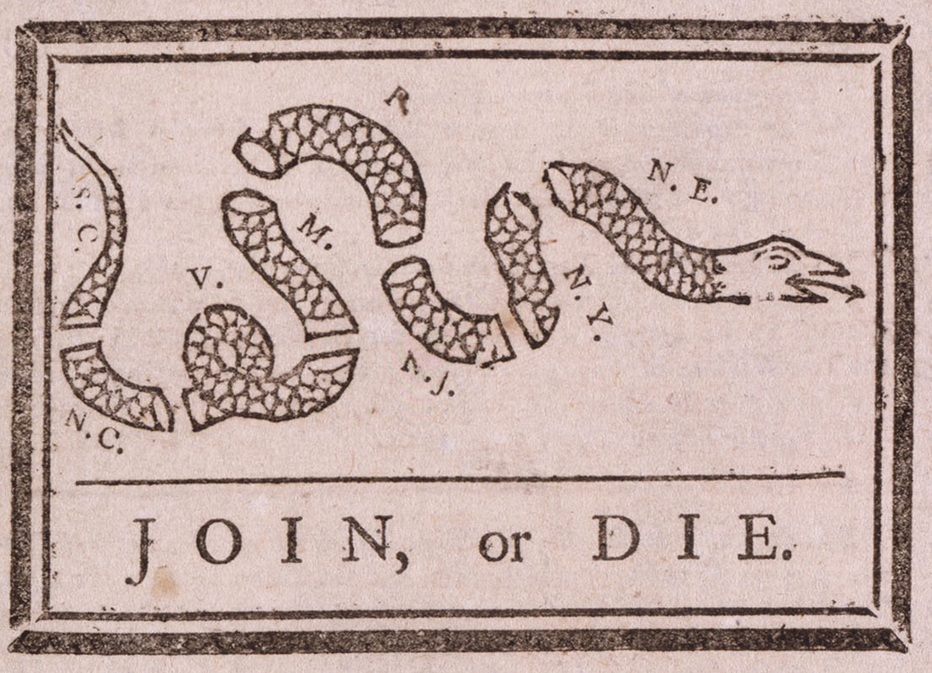
This 1754 appeal by Ben Franklin is the earliest political cartoon.
Notes:
US History 5th/79; Library of Congress

Slide 25
Braddock’s Defeat
The government sent General Edward Braddock and a thousand seasoned British troops to capture Fort Duquesne.
The French and Indians hid in the trees and thick brush and poured deadly fire into the British ranks.
Braddock was shot, and the officers led by Colonel Washington organized a retreat.
Edward Braddock
Notes:
http://www.loc.gov/pictures/resource/ds.05283/; Library of Congress, LC-DIG-ds-05283

Slide 26
Montcalm
The French assigned command of their forces in America to the Marquis de Montcalm.
Montcalm engineered a series of stinging defeats on the British from 1756 to 1758.
Marquis de Montcalm
Notes:
https://commons.wikimedia.org/wiki/File:Louis-Joseph_marquis_de_Montcalm.jpg; Print of Louis-Joseph, Marquis de Montcalm from the McCord Museum, M822/Wikimedia Commons/Public Domain

Slide 27
Pitt’s Plan
In 1757 William Pitt became leader of the British government.
Pitt let Prussia bear the brunt of the fighting in Europe.
Britain used its superb navy to isolate the French forces.
Pitt also replaced old, incompetent commanders with young, energetic officers.
William Pitt
Notes:
US History 5th/80c; Library of Congress

Slide 28
Turnaround
General James Wolfe had tremendous military talents.
Wolfe was told to attack the French-Canadian capital, Quebec.
English troops captured Fort Duquesne and renamed it Fort Pitt (modern Pittsburgh).
James Wolfe
Notes:
https://commons.wikimedia.org/wiki/File:James_Wolfe.jpeg; Portrait of James Wolfe attributed to Joseph Highmore/Wikimedia Commons/Public Domain

Slide 29
Battle of Quebec
In 1759, the two greatest commanders of the war, Montcalm and Wolfe, fought the Battle of Quebec.
British soldiers scaled the cliffs and swarmed the Plains of Abraham.
In the brief but deadly battle, the British won a great victory.
Notes:
https://commons.wikimedia.org/wiki/File:Canadian_militiamen_and_British_soldiers_repulse_the_American_assault_at_Sault-au-Matelot.jpg; The Fight at the Sault-au-Matelot by Charles William Jefferys from The Father of British Canada, 1916/Wikimedia Commons/Public Domain

Slide 30
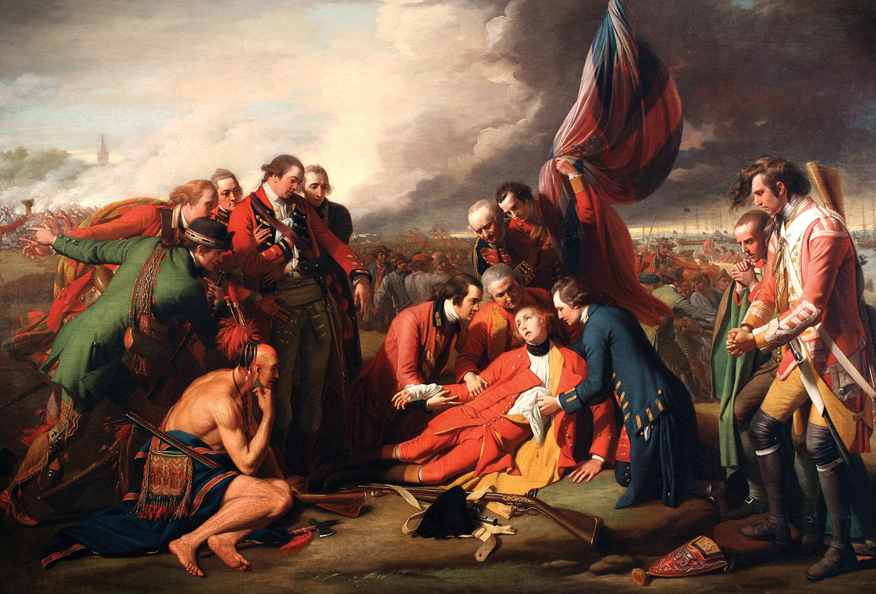
both Wolfe and Montcalm were severely wounded and died.
Notes:
US History 5th/74; "The Death of General Wolfe" by Benjamin West/Wikimedia Commons/Public Domain

Slide 31
The Treaty of Paris
The Treaty of Paris (1763) drastically changed the geography of North America.
France surrendered all its Canadian and American lands.
Spain surrendered Florida to the British but obtained French lands west of the Mississippi.

Slide 32
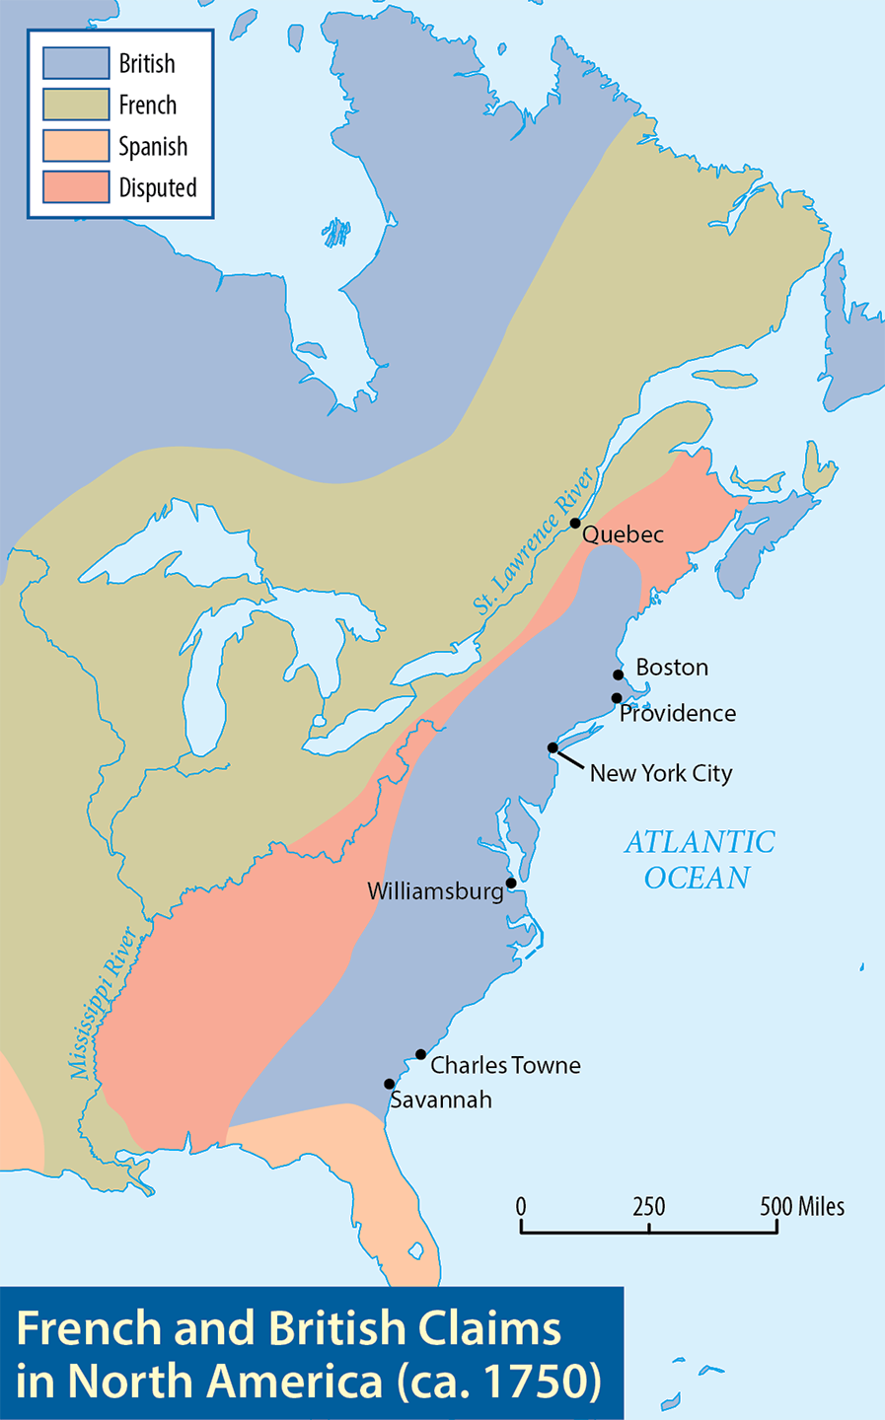
Map Resources

Slide 33
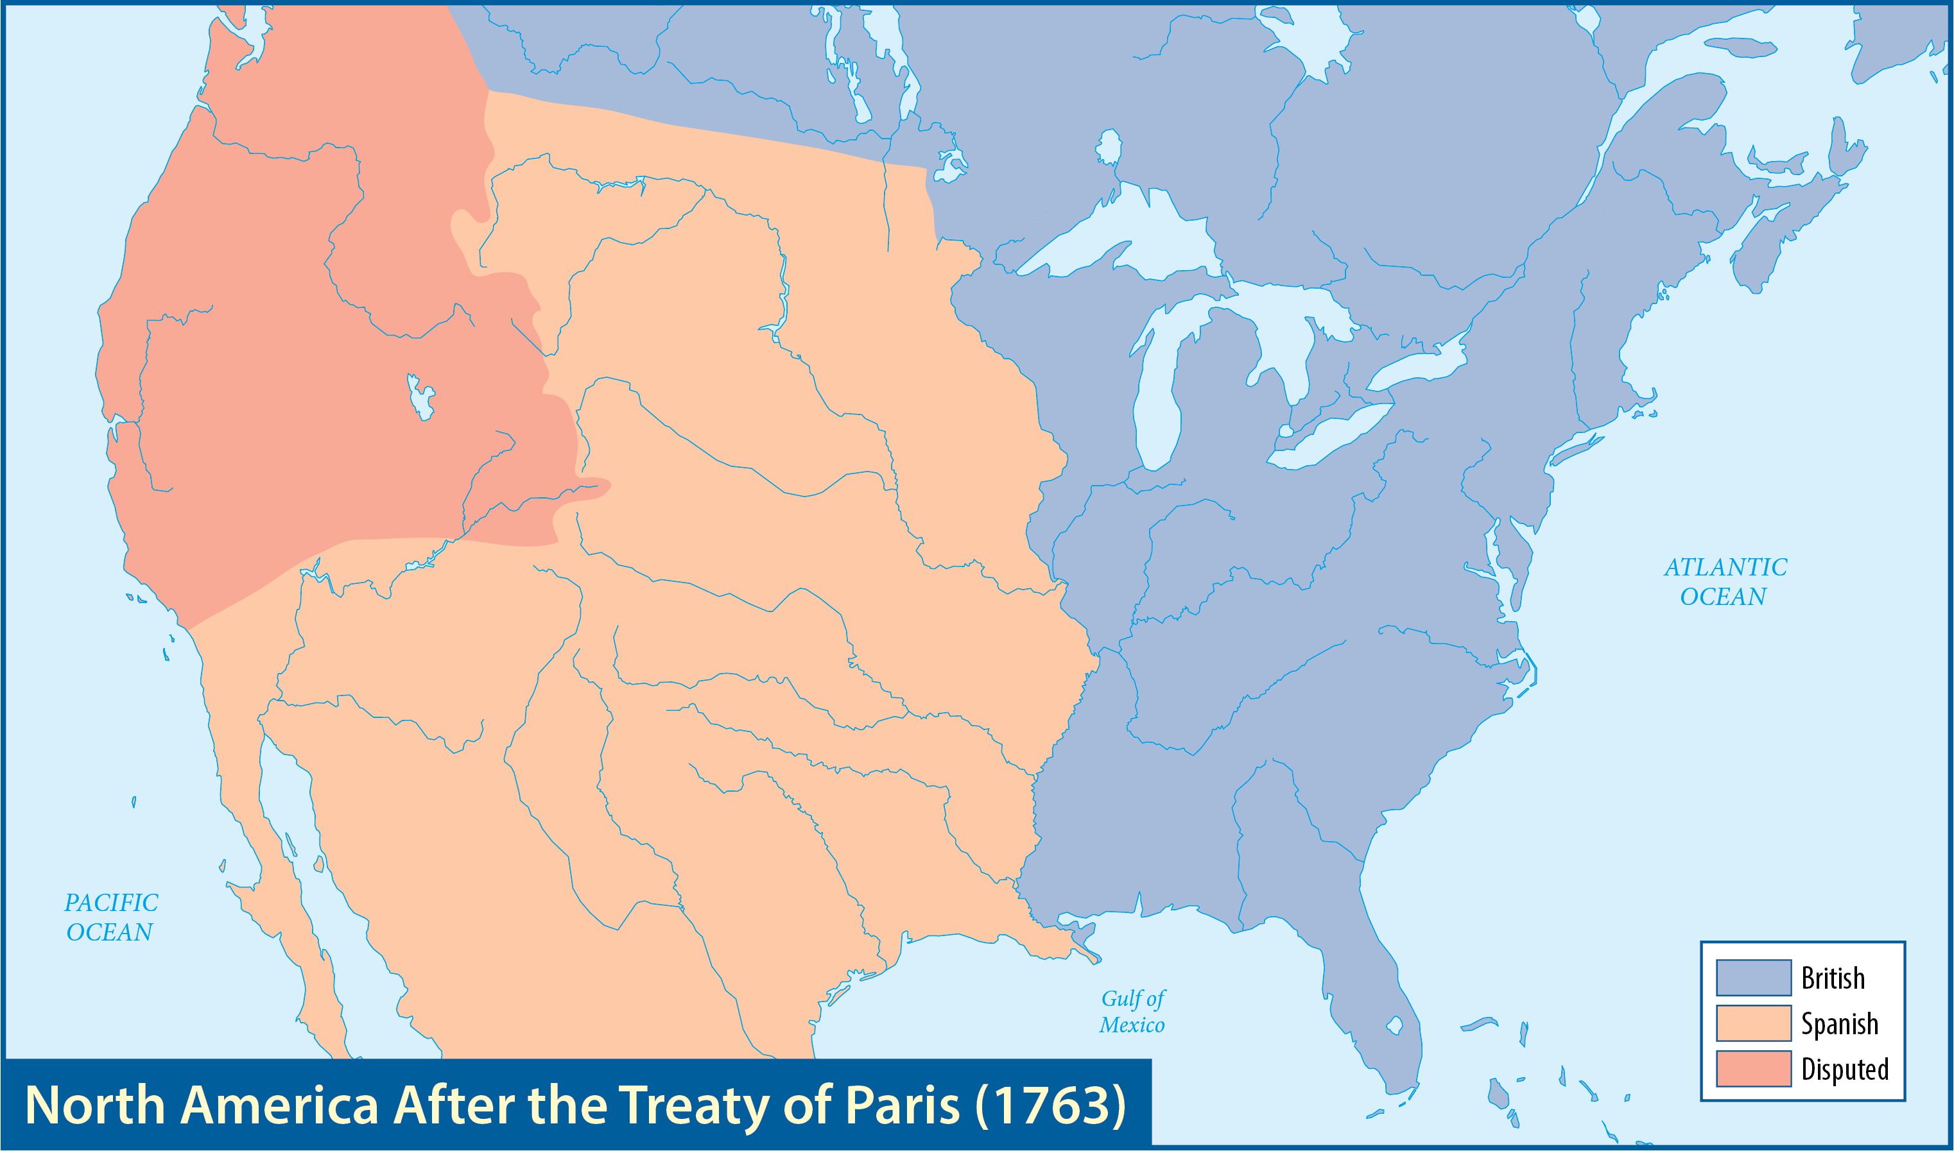
Map Resources

Slide 34
The Treaty of Paris
The British had borrowed heavily to fight, and now the debts needed to be repaid.
When George III came to the throne in 1760, the British government announced its intention to carefully analyze the financial and political affairs of the colonies.
The colonies resented the interference.
George III
Notes:
US History 5th/83; "King George III in coronation robes" by Allan Ramsay/Wikimedia Commons/Public Domain

Slide 35
Pontiac’s War (Pontiac’s Rebellion)
An Ottawa Indian chief named Pontiac formed an alliance with other Indian tribes.
Pontiac and his forces waged a devastating war against British soldiers and settlers.
Pontiac was unable to hold his alliance together, and he eventually made peace with the British.
Pontiac
Notes:
https://commons.wikimedia.org/wiki/File:Pontiac-chief-artist-impression-414px.jpg; Portrait of Pontiac, Chief of the Ottawa by John Mix Stanley/Wikimedia Commons/Public Domain

Slide 36
Section review
What was the French and Indian War called in Europe?
Seven Years’ War (p. 78)
What was the chief British disadvantage in the French and Indian War?
the lack of unity in the colonies (p. 79)

Slide 37
Section review
Why was General Edward Braddock defeated so decisively at Fort Duquesne?
He tried to have his men fight in the open, ordered fashion of European warfare while the French and the Indians attacked guerrilla-style from the shelter of the woods. (pp. 79–80)

Slide 38
Section review
What was William Pitt’s three-part plan to win the French and Indian War?
(1) let Prussia bear the brunt of the fighting in Europe, (2) use the British navy to isolate the French forces in America and India, and (3) replace older, incompetent commanders with young, energetic officers (p. 80)

Slide 39
Section review
Who were the two greatest military commanders of the French and Indian War?
the Marquis de Montcalm (France) and General James Wolfe (Great Britain) (p. 80)

Slide 40
Section review
How did the Treaty of Paris change North America?
France had to surrender its land in Canada and all claims to the Mississippi and Ohio River valleys to Britain. The British also acquired Florida from Spain, a French ally. Spain gained the French lands west of the Mississippi River, including the city of New Orleans. (p. 81)

Slide 41
Section review
List and assess the French advantages during the French and Indian War.
In the early stages of the war, the French enjoyed a friendlier relationship with their Indian allies than the British had with their Iroquois allies. The French also had an important advantage in that they understood the Indians and Indian warfare better than the British army did. The French borrowed methods of forest fighting from the Indians and practiced guerrilla warfare against the British, whereas the British originally tried to fight in the open, ordered style used in Europe.

Slide 42
Section review
List and assess the British advantages during the French and Indian War.
British colonists outnumbered French colonists by more than twenty to one. British colonists also had invested much in the New World. They had roots in America—land, businesses, and families. Above all, the British navy could control the waterways and thereby stop the arrival of French reinforcements and supplies.

Slide 43
The growing rift

Slide 44
Guiding questions
Describe the events that led many American colonists to become alienated from Britain.
Compare and contrast British and American views of Parliament’s actions.
Evaluate the colonists’ protests against British restrictions and their response to the Boston Massacre.

Slide 45
A Sense of Nation
Geography was an important factor in breaking the ties with the Old World.
Private ownership of property was significant.
The colonists had diverse heritages.
The Great Awakening provided religious and cultural unity.
Another crucial force in the development of American nationalism was the strength of colonial self-government.
These assemblies held the all-important power of the purse.

Slide 46
A Sense of Nation
The many forces would be magnified by a sense of confidence and optimism.

Slide 47
Taxes and Tensions
Britain wanted greater control over the colonies.
In one parliamentary act after another during the 1760s and 1770s, the British pursued a policy of coercion instead of cooperation.

Slide 48
The Proclamation Line (1763)
Parliament issued the Proclamation of 1763 prohibiting the colonists from settling beyond the Appalachian Mountains.
The goal was to diminish conflicts with the Indians.
Expansion continued because there was little concern about enforcement.
Notes:
https://pixabay.com/photos/outdoors-park-landscape-1251155/; pixabay/CC0

Slide 49
The Sugar Act (1764)
George Grenville and the British Parliament passed the Sugar Act.
This act placed a tariff on certain goods (such as sugar, molasses, and coffee) that were imported into the colonies.
The goal was to raise money to protect the colonies.
George Grenville
Notes:
https://commons.wikimedia.org/wiki/File:Lord_Grenville_(NYPL_Hades-265504-478631).tiff; The Miriam and Ira D. Wallach Division of Art, Prints and Photographs: Print Collection, The New York Public Library. "Lord Grenville." The New York Public Library Digital Collections. 1790. http://digitalcollections.nypl.org/items/510d47db-1194-a3d9-e040-e00a18064a99

Slide 50
The Sugar Act (1764)
The British government intended to collect the money.
Britain could enforce the tax with their standing army.
George Grenville
Notes:
https://commons.wikimedia.org/wiki/File:Lord_Grenville_(NYPL_Hades-265504-478631).tiff; The Miriam and Ira D. Wallach Division of Art, Prints and Photographs: Print Collection, The New York Public Library. "Lord Grenville." The New York Public Library Digital Collections. 1790. http://digitalcollections.nypl.org/items/510d47db-1194-a3d9-e040-e00a18064a99

Slide 51
The Stamp Act (1765)
Grenville proposed a stamp tax for newspapers, diplomas, and a variety of legal and commercial documents.
The Stamp Act levied the first internal tax ever imposed on the colonies.
Colonists were being taxed without their consent, and the traditional power of the colonial legislatures was being bypassed.
Notes:
US History 5th/85t “Proof sheet of one penny stamps Stamp Act 1765” by Board of Stamps/Wikipedia/Public Domain

Slide 52
The Stamp Act (1765)
Colonel Isaac Barré stood in the House of Commons and declared that Britain’s infringement on the rights of the colonists had “caused the blood of these sons of liberty to recoil within them.”
A growing body of opponents to British rule snatched Barré’s phrase and proudly called themselves the Sons of Liberty.
Isaac Barré
Notes:
https://commons.wikimedia.org/wiki/File:Col_Barre.jpg; Portrait of Colonel Isaac Barré, ca. 1765/Wikimedia Commons/Public Domain

Slide 53
The Quartering Act (1765)
Parliament passed the Quartering Act, which officially subjected the colonies to a standing army in peacetime and further required that the colonists feed and house them.
The colonists concluded that they were being oppressed by an unlawful military occupation to enforce illegal taxation.
Notes:
https://pixabay.com/photos/arundel-castle-guards-soldiers-5400598/; pixabay/CC0

Slide 54
Colonial Opposition
Patrick Henry became the “Voice of the Revolution.”
Delegates from nine colonies met in New York for the Stamp Act Congress.
They formally denounced the Stamp Act and the seizure of colonial rights that it represented.
Patrick Henry
Notes:
US History 5th/85b; "Patrick henry" by George Bagby Matthews/Wikimedia Commons/Public Domain

Slide 55
Colonial opposition
The Sons of Liberty, led by Samuel Adams, hung an effigy of the royal stamp distributor for Massachusetts.
Parliament repealed the hated Stamp Act.
Parliament passed the Declaratory Act which stated that Parliament had the right to pass any law regarding the colonies that it desired.

Slide 56
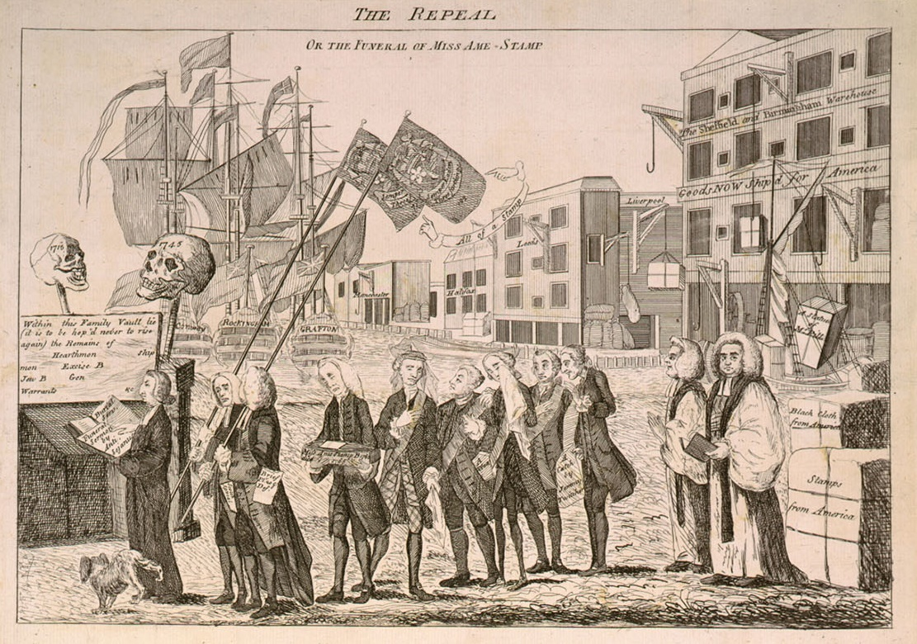
Victorious colonists celebrated the repeal of the Stamp Act by conducting a mock funeral for it.
Notes:
US History 5th/87b; Library of Congress

Slide 57
Townshend Acts (1767)
Charles Townshend, the head of the British Treasury, proposed a series of taxes and enforcement measures that had far-reaching political consequences.
The Townshend Acts placed taxes on glass, paint, paper, and tea.
Charles Townshend
Notes:
https://commons.wikimedia.org/wiki/File:CharlesTownshend.jpg; Portrait of Charles Townshend by Joshua Reynolds, ca. 1765/Wikimedia Commons/Public Domain

Slide 58
Townshend Acts (1767)
The acts strengthened the writs of assistance.
It was proposed that the revenue raised from those taxes should pay the salaries of royal officials, including the governor.
Charles Townshend
Notes:
https://commons.wikimedia.org/wiki/File:CharlesTownshend.jpg; Portrait of Charles Townshend by Joshua Reynolds, ca. 1765/Wikimedia Commons/Public Domain

Slide 59
Townshend Acts (1767)
Colonists organized boycotts.
“No taxation without representation” became a rallying cry for many colonists.

Slide 60
First Bloodshed
Lord North became the British prime minister in 1770.
In the late winter of 1770, Americans were shot by the British at the Boston Massacre.
A confrontation resulted in the death of a young boy.
A few minor confrontations between dockworkers and British soldiers heightened tensions.
Lord North

Slide 61
First Bloodshed
On March 5, a band of Patriots hurled sticks and snowballs at seven soldiers.
After one soldier fired his gun, the other British soldiers spontaneously fired into the crowd.
As the smoke cleared, five colonists lay dead or dying in the square.
Notes:
https://en.wikipedia.org/wiki/File:Boston_Massacre,_03-05-1770_-_NARA_-_518262.tif; National Archives, 518262

Slide 62
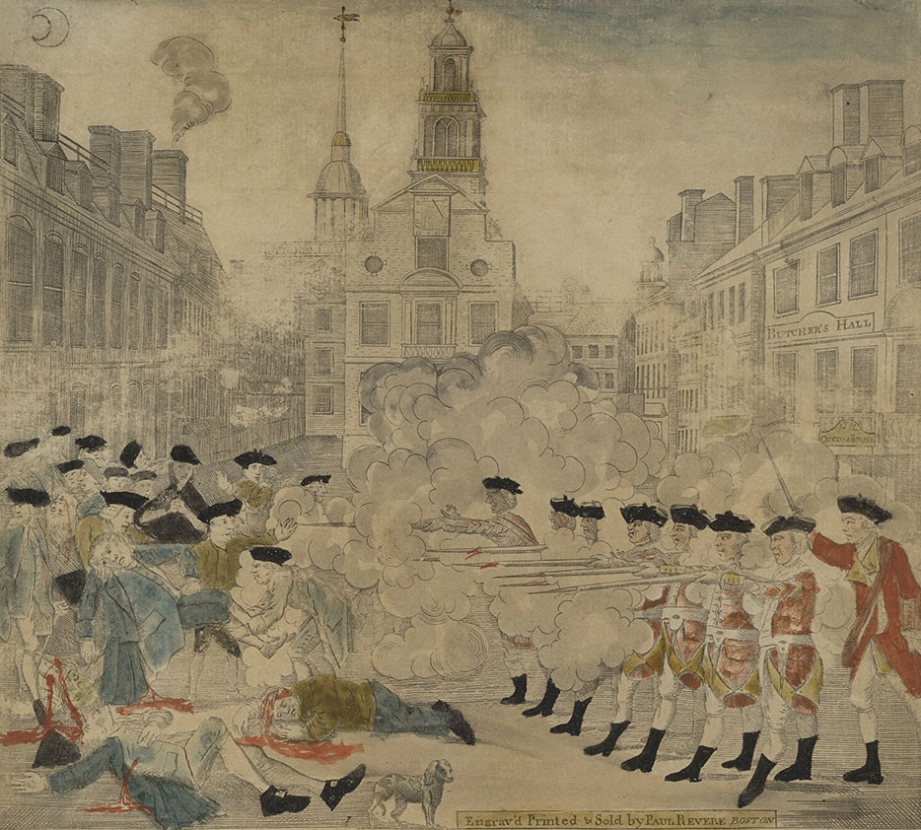
Paul Revere’s Boston Massacre engraving
Notes:
US History 5th/89; “Boston Massacre high-res”/ Library of Congress/Wikimedia Commons/ Public Domain

Slide 63
First Bloodshed
Nine British soldiers were placed on trial for murder.
John Adams believed that everyone was entitled to a fair trial.
Though some colonists resented John Adams’s defense of the soldiers, he was recognized as an outstanding lawyer.
John Adams
Notes:
US History 5th/52; "Official Presidential portrait of John Adams" by John Trumbull/Wikipedia/Public Domain

Slide 64
Section review
What is “the power of the purse”?
the power of colonial assemblies to control colonial financial matters such as taxes, military appropriations, and salaries for royal officials (p. 84)
Why did Parliament establish the Proclamation Line of 1763? Why did the colonists oppose it?
Parliament hoped that the line would reduce conflicts between the colonists and the Indians. The colonists thought that the line intruded on their local governments. It denied westward expansion into lands the colonists viewed as their own. (p. 84)

Slide 65
Section review
Name six acts of Parliament after the French and Indian War that created tension between Great Britain and its colonies.
the Proclamation of 1763, the Sugar Act, the Stamp Act, the Quartering Act, the Declaratory Act, the Townshend Acts (pp. 84–85, 87–88)
What city was the site of a “massacre” in 1770?
Boston (p. 88)

Slide 66
Section review
Explain a possible reason for the power and eloquence of Patrick Henry’s “liberty or death” speech.
Henry might have been influenced by the preaching of George Whitefield and Samuel Davies. Many phrases and allusions in his speech were obviously from the Bible.
Assume you were John Adams. Defend your decision to work as an attorney for the British soldiers charged with murder in the Boston Massacre.
Everyone is entitled to a fair trial.

Slide 67
People, Places, and Things to Remember
Louisiana
French and Indian War
Seven Years’ War
George Washington
Fort Duquesne
guerrilla warfare
Albany Congress
Benjamin Franklin
Edward Braddock
Marquis de Montcalm
William Pitt
James Wolfe
Battle of Quebec
Treaty of Paris (1763)
George III
Pontiac
power of the purse
Proclamation of 1763

Slide 68
People, Places, and Things to Remember
Sugar Act
Stamp Act
internal tax
Sons of Liberty
Quartering Act
Patrick Henry
Stamp Act Congress
Samuel Adams
Declaratory Act
Townshend Acts
boycotts
no taxation without representation
Boston Massacre
John Adams

