Slide 1
Chapter 7:
State and Local Government
Notes:
WIN-Initiative/Stone/Getty Images

Slide 2
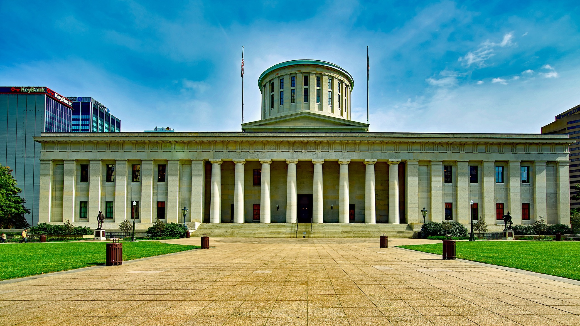
I. State Governments
Chapter 7.1
Notes:
Image by David Mark from Pixabay
https://pixabay.com/photos/ohio-statehouse-capitol-columbus-1937448/

Slide 3
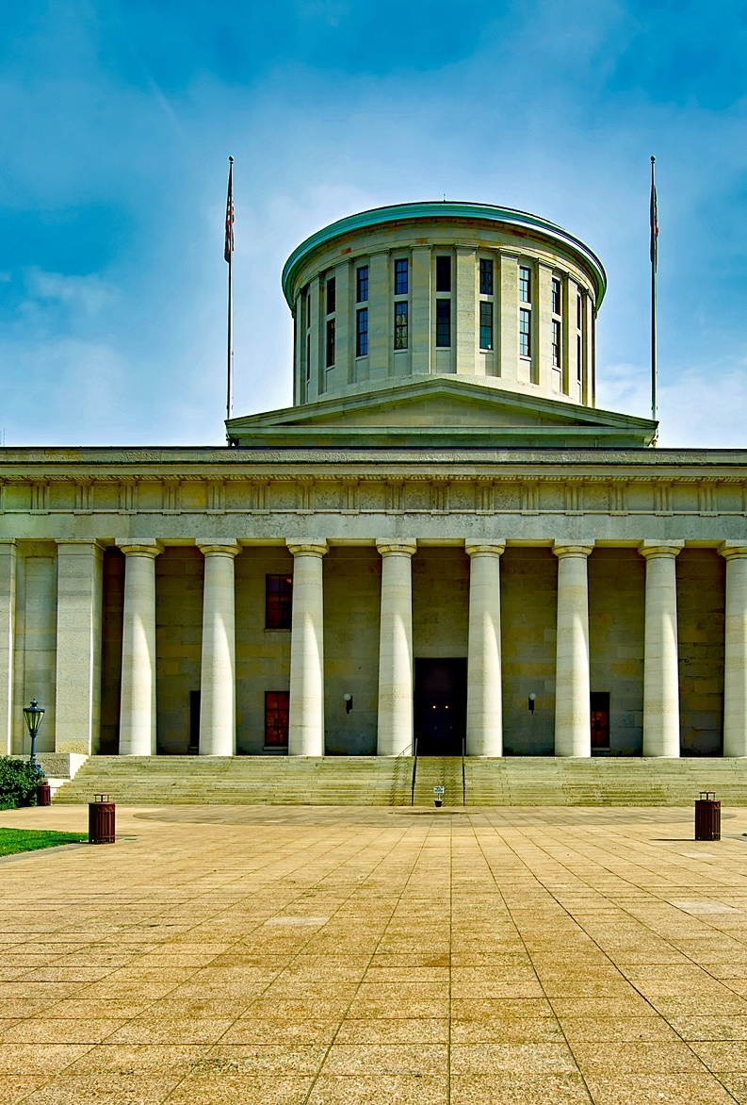
I. State Governments
According to the Tenth Amendment, the states retain all powers not delegated to the national government or prohibited to the states.
The power of each state is also limited by its own constitution.
State Capitol, Columbus, Ohio
Notes:
Image by David Mark from Pixabay
https://pixabay.com/photos/ohio-statehouse-capitol-columbus-1937448/

Slide 4
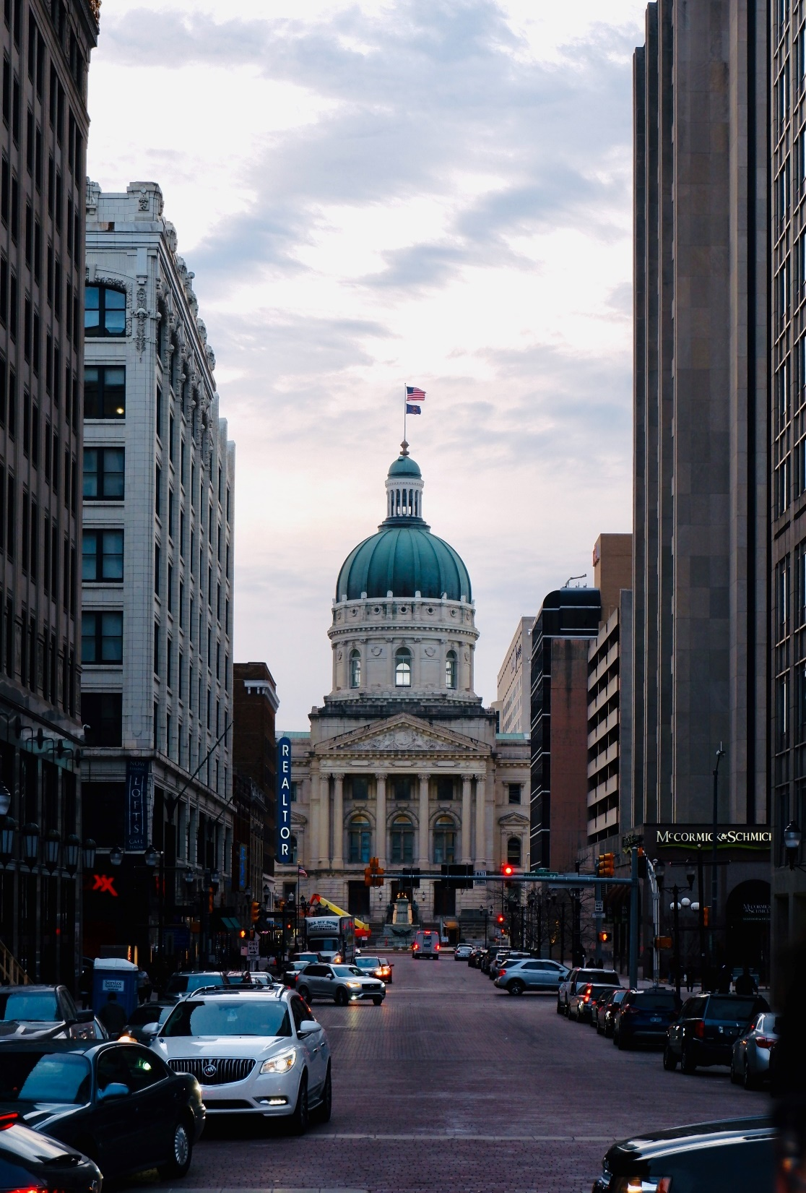
I. State Governments
Like the federal government, state governments are organized under a system of separation of powers.
Each state has three basic responsibilities:
  Public safety
  Commercial regulation
  Political subdivision oversight
State Capitol, Indianapolis, Indiana
Notes:
Photo by Abe Baali on Unsplash
https://unsplash.com/photos/Akc-Y0DCTKQ

Slide 5
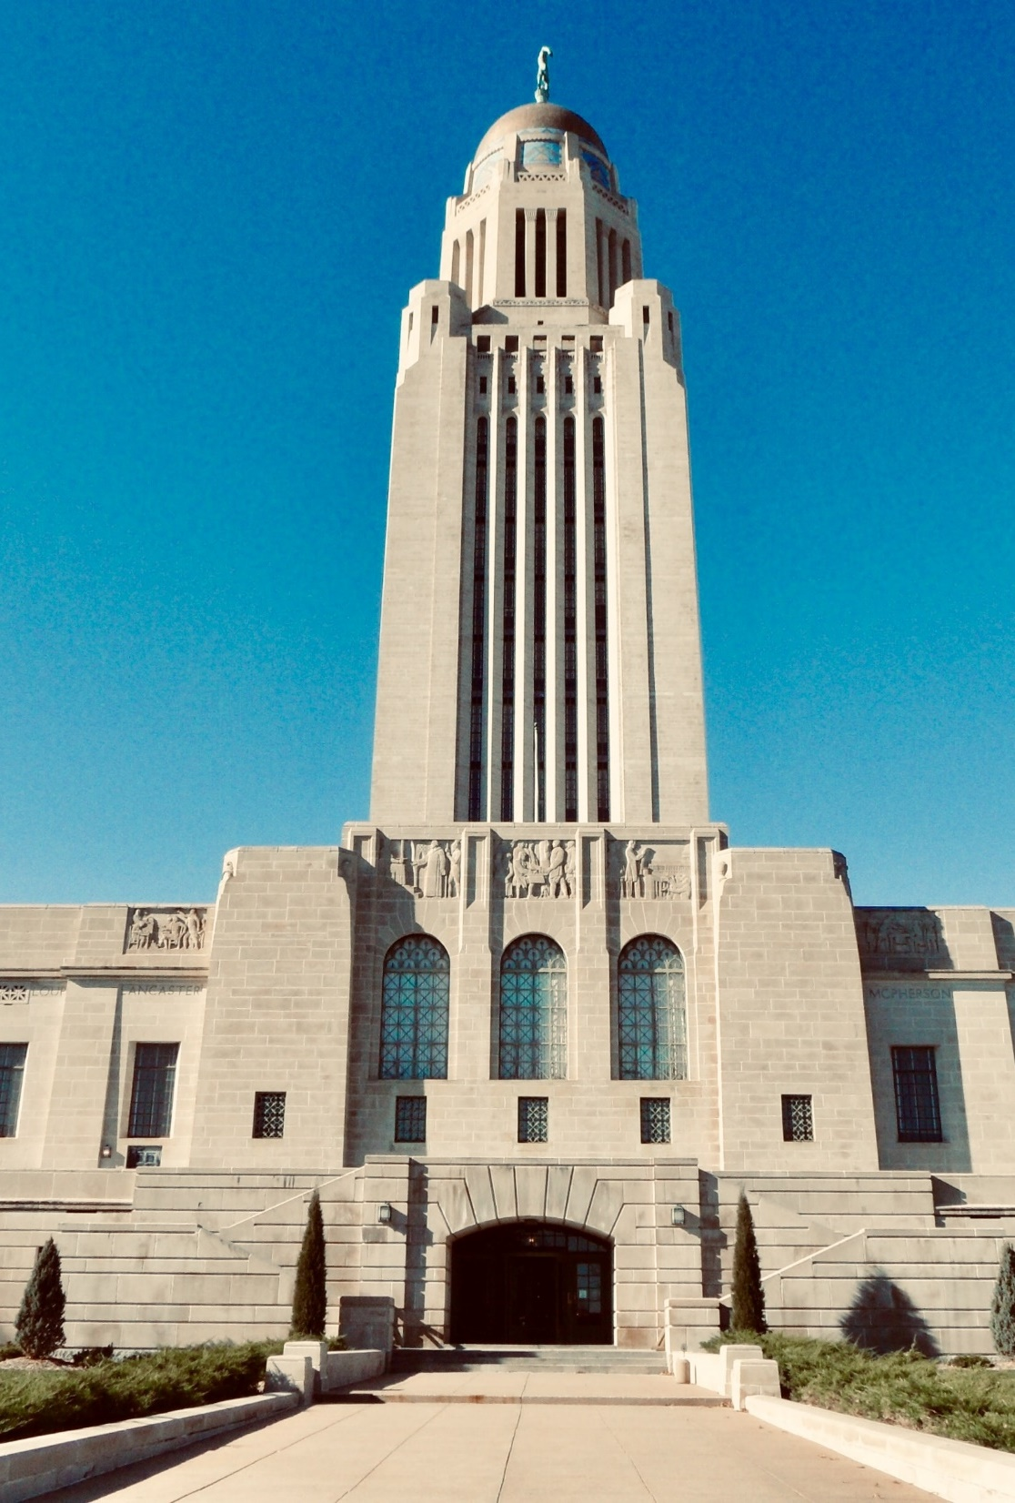
A. State Legislatures
In all but one state, the legislatures are bicameral.
Nebraska has the nation’s only unicameral legislature.
State Capitol, Lincoln, Nebraska
Notes:
Photo by Pieter van de Sande on Unsplash
https://unsplash.com/photos/0218pyFjv3U

Slide 6
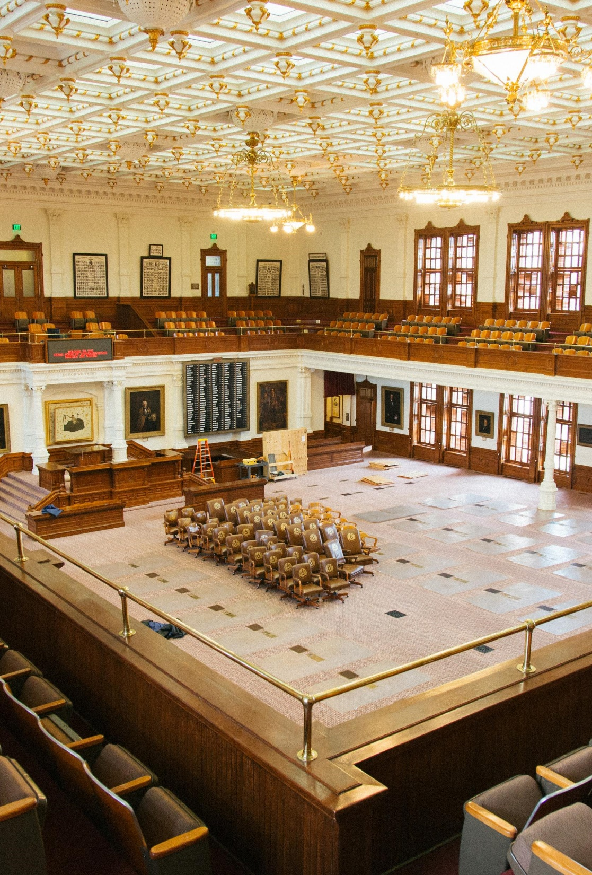
A. State Legislatures
State legislatures generally have all the powers not given to the other two branches of the state governments.
  Taxing
  Maintain public schools
  Regulate business, industry, commerce
  Provide police protection
  Approve gubernatorial (the governor’s) appointments
The Texas Legislature
Notes:
Photo by Kyle Glenn on Unsplash
https://unsplash.com/photos/TELAb4duebI

Slide 7
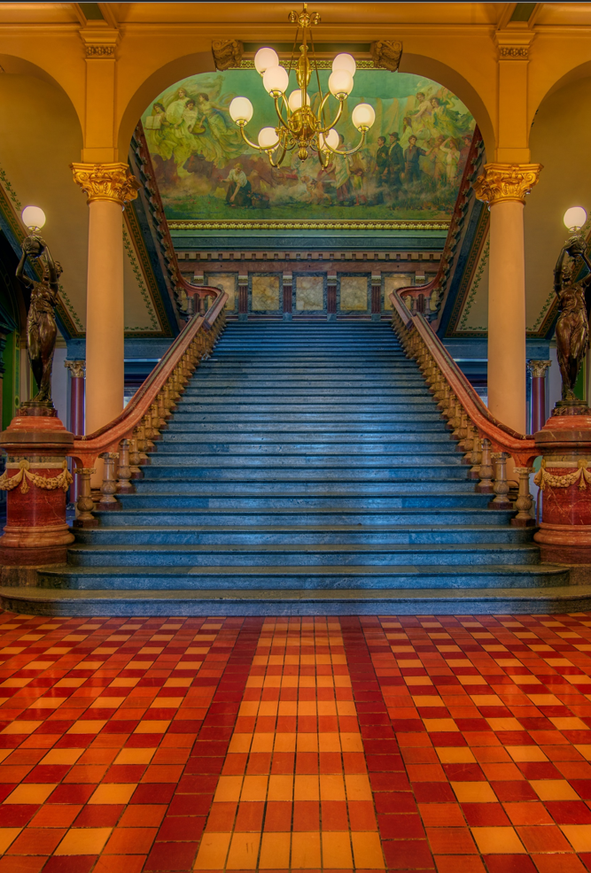
B. State Executives
The governor is the chief executive of a state’s executive branch.
The powers of the governor include:
  Veto power
  Supervise the executive branch’s staff
  Commander in chief of the state militia
  Pardon and commute sentences
  Suggest legislation
State Capitol, Des Moines, Iowa
Notes:
Image by 1778011 from Pixabay
https://pixabay.com/photos/grand-staircase-iowa-state-capitol-4058773/

Slide 8
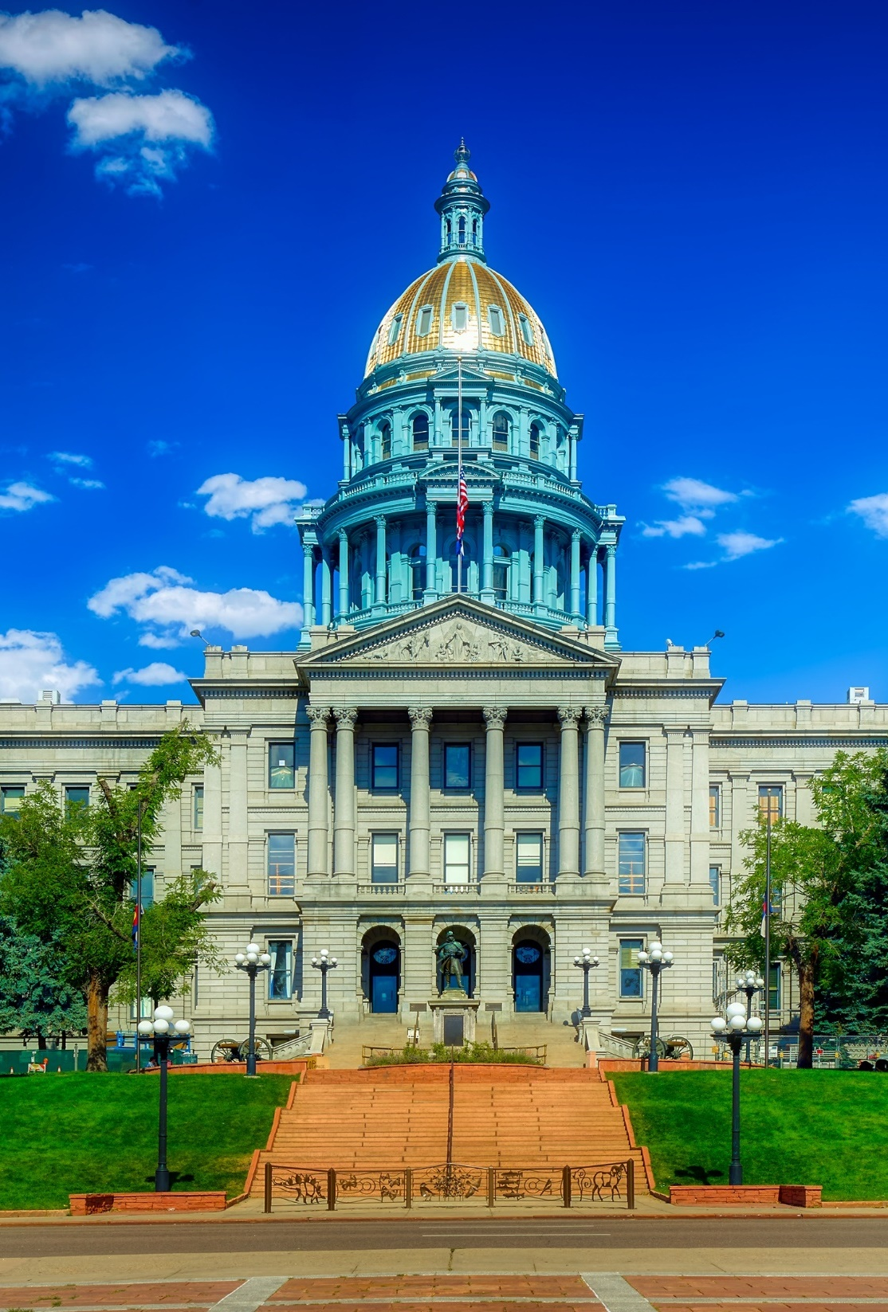
B. State Executives
Governors are often the leader of their state parties.
They also act as the face of the state and promote its welfare.
Most governors are elected to four-year terms.
Most states have a lieutenant governor who assists the governor.
State Capitol, Denver, Colorado
Notes:
Image by 1778011 from Pixabay
https://pixabay.com/photos/colorado-state-capitol-building-4058772/

Slide 9
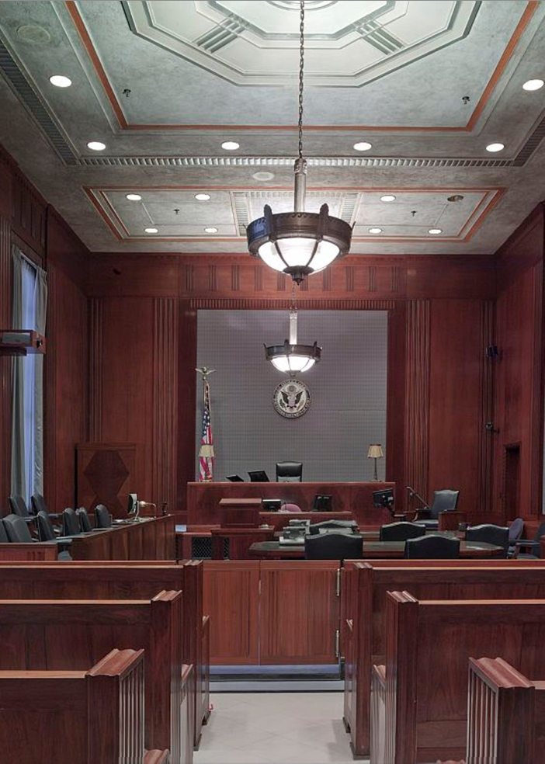
C. State Judiciary
The state judiciary is responsible for interpreting the law and overseeing criminal cases.
The highest state court is a supreme court.
Notes:
Image by David Mark from Pixabay
https://pixabay.com/photos/courtroom-benches-seats-law-898931/

Slide 10
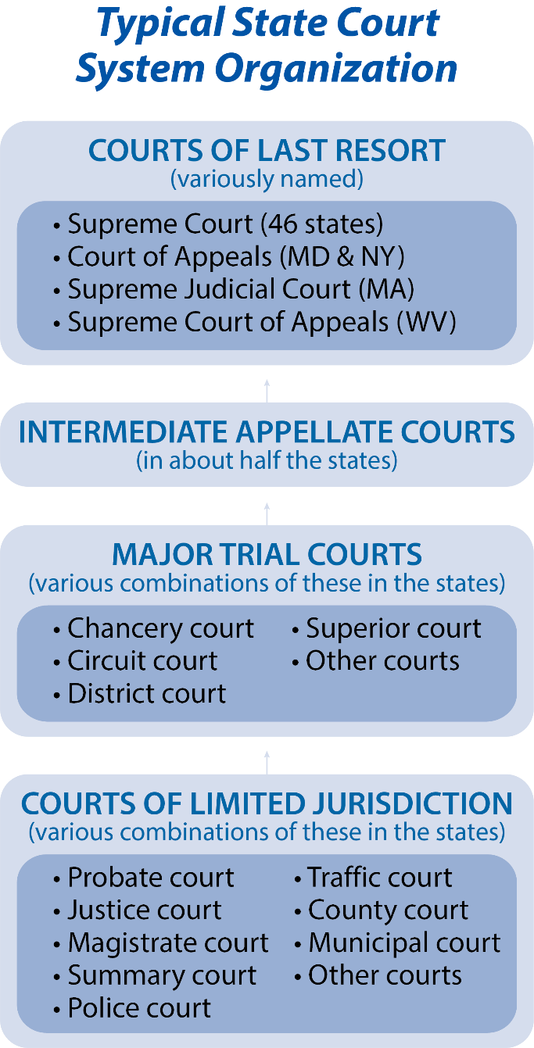
Notes:
BJU Press Art

Slide 11
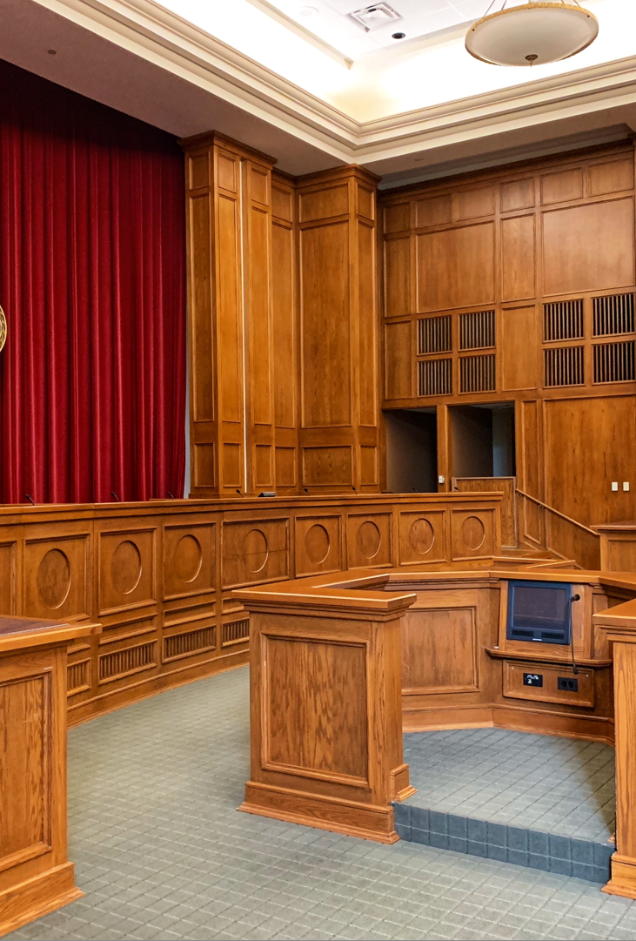
C. State Judiciary
Most state judges are chosen in one of three ways:
  Popular election
  Appointment by the governor
  Appointment by the legislature
State courts generally hear cases that involve anything outside the exclusive jurisdiction of federal courts.
Notes:
Photo by David Veksler on Unsplash
https://unsplash.com/photos/HpmDAS1Dozs

Slide 12
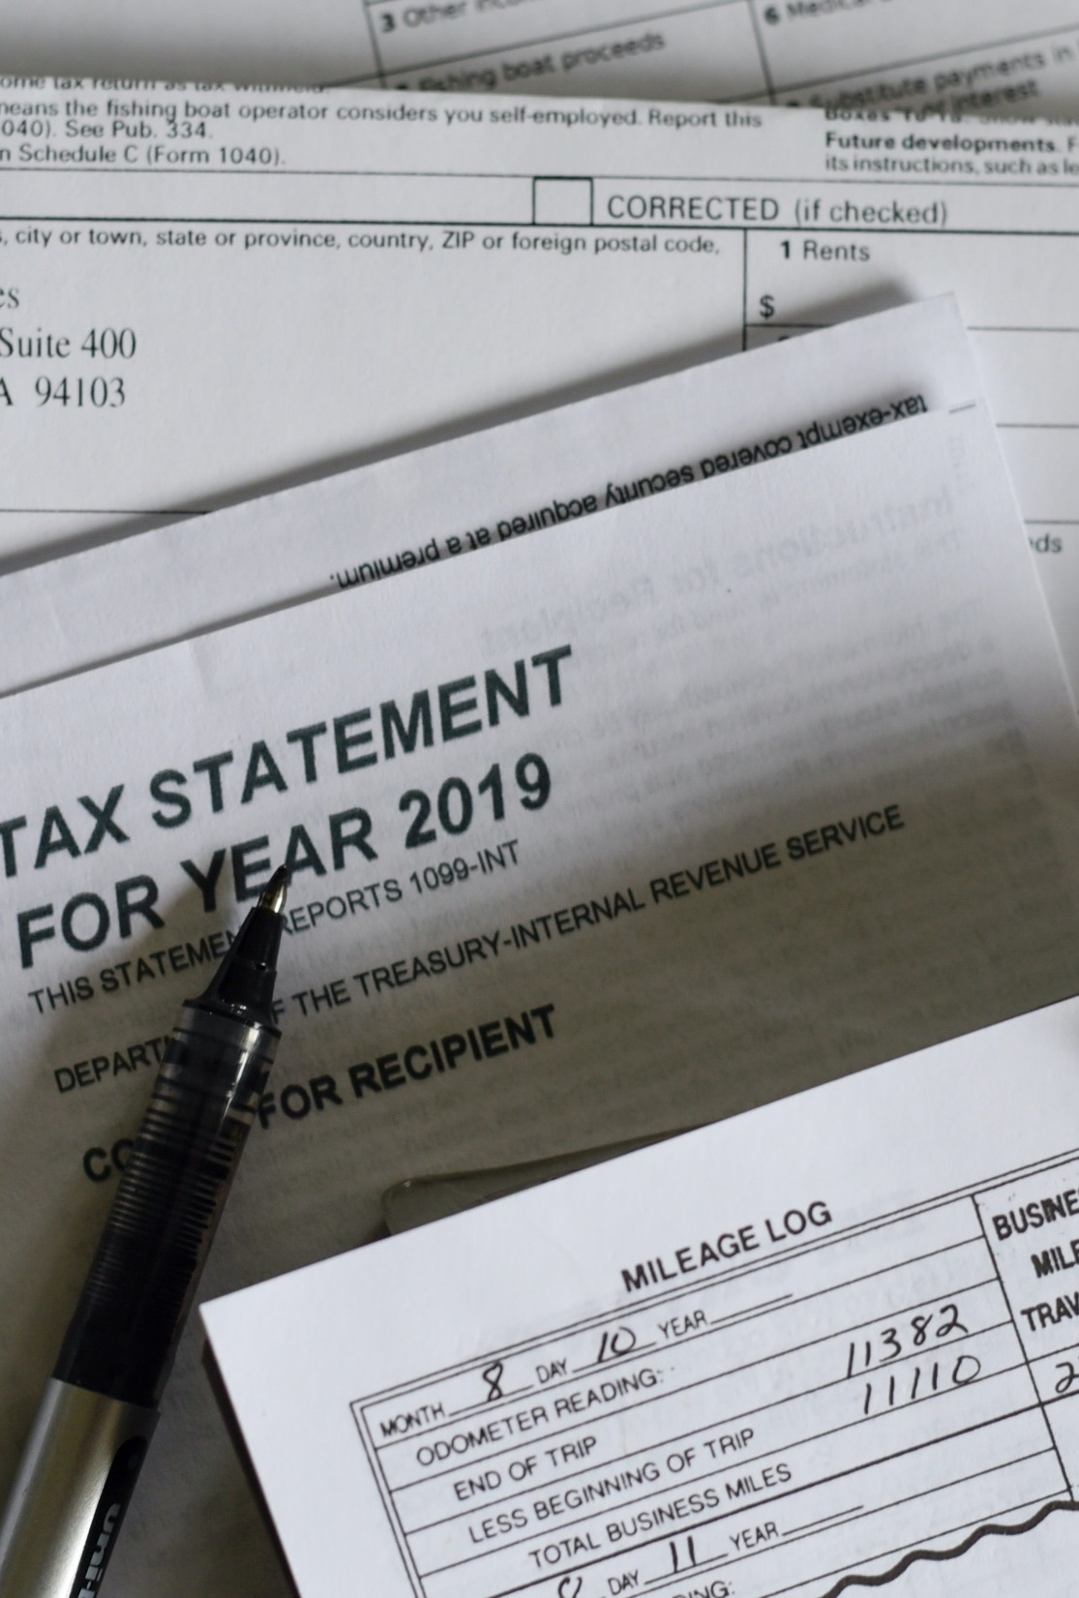
D. State Financing
State governments are financed through a variety of revenue sources:
  Taxes
  Federal grants
  Service charges
Most states also receive income from lotteries.
Notes:
Photo by Olga DeLawrence on Unsplash
https://unsplash.com/photos/5616whx5NdQ

Slide 13
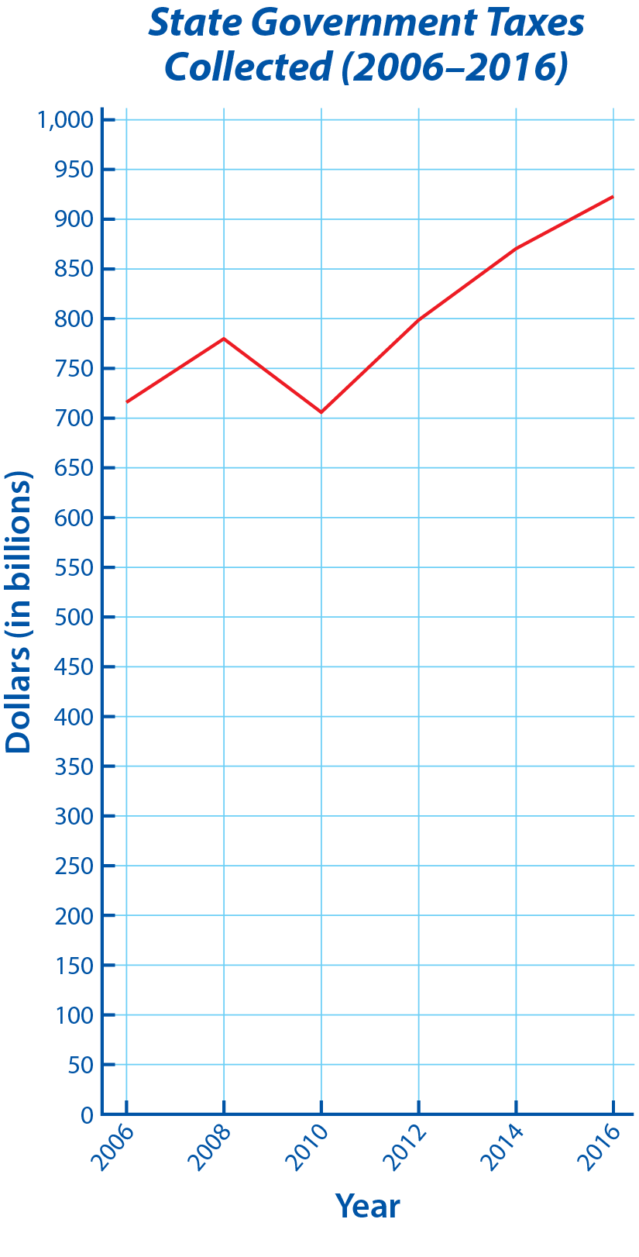
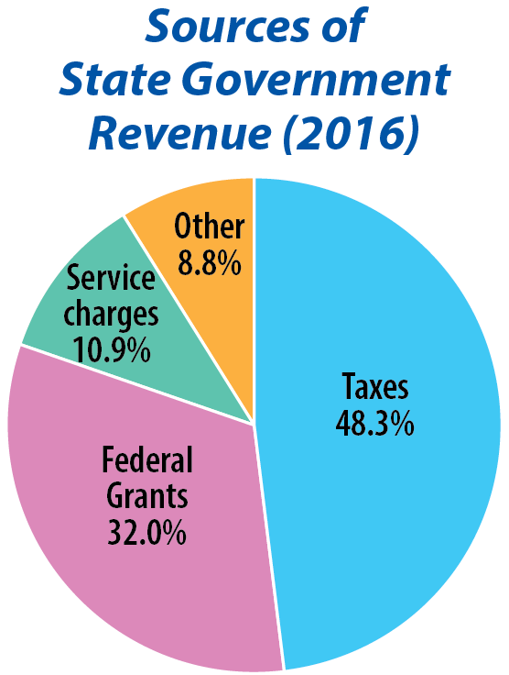
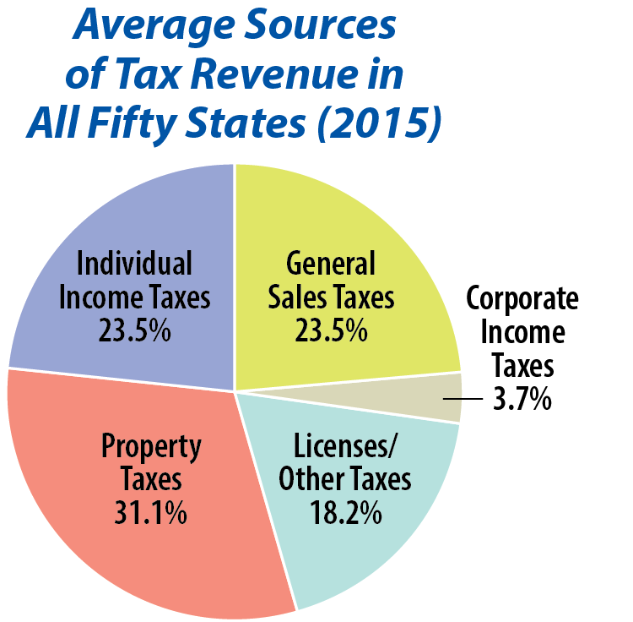
Notes:
BJU Press Art

Slide 14
Section Review – Chapter 7.1
1. Summarize what the Tenth Amendment says about the power of the states.
The states constitutionally retain all powers not delegated to the national government or prohibited to the states. (p. 141)
2–4. What are the three broad responsibilities of state governments?
Public safety, commercial regulation, and political subdivision oversight (p. 142)

Slide 15
Section Review – Chapter 7.1
5. Which is the only state legislature that is not bicameral?
Nebraska’s legislature (p. 143)

Slide 16
Section Review – Chapter 7.1
6. Explain the Missouri Plan for selecting state judges.
The Missouri Plan of selecting judges combines the election and appointment methods. It typically calls for a nonpartisan commission to review a list of potential judges. The members then give the governor the names of those that they consider the most qualified. The governor appoints one of those individuals to fill the judicial vacancy. At the next election, the people vote whether to retain the judge. (p. 145)

Slide 17
Section Review – Chapter 7.1
7. What is the single largest source of state revenue?
taxes (p. 146)

Slide 18
Section Review – Chapter 7.1
What do you think is the best way to choose state judges? Justify your answer.
Some will argue that judges should be directly accountable to the people and thus be elected. Others say the most qualified candidates might not be the most well-known ones or the best campaigners and that appointment is better. Some will favor the Missouri Plan because it combines election and appointment.

Slide 19
Section Review – Chapter 7.1
What is the fairest way to finance state government? Support your answer.

Slide 20
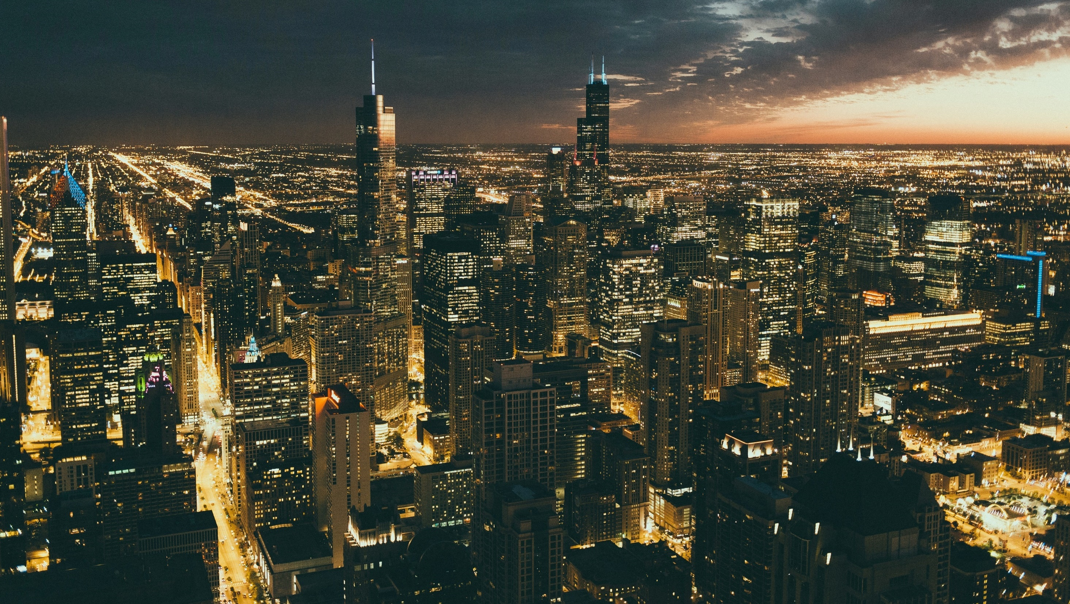
II. Local Governments
Chapter 7.2
Notes:
Photo by Anthony Fomin on Unsplash
https://unsplash.com/photos/TTtXAis6NjE

Slide 21
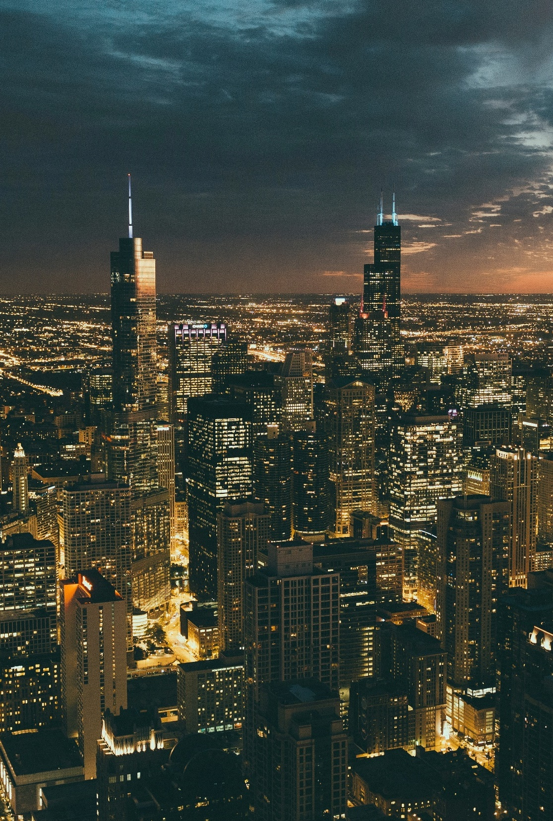
II. Local Governments
Local government is the level of government which affects the everyday lives of citizens the most.
There are over 89,000 local governments in the United States.
Chicago, Illinois
Notes:
Photo by Anthony Fomin on Unsplash
https://unsplash.com/photos/TTtXAis6NjE

Slide 22
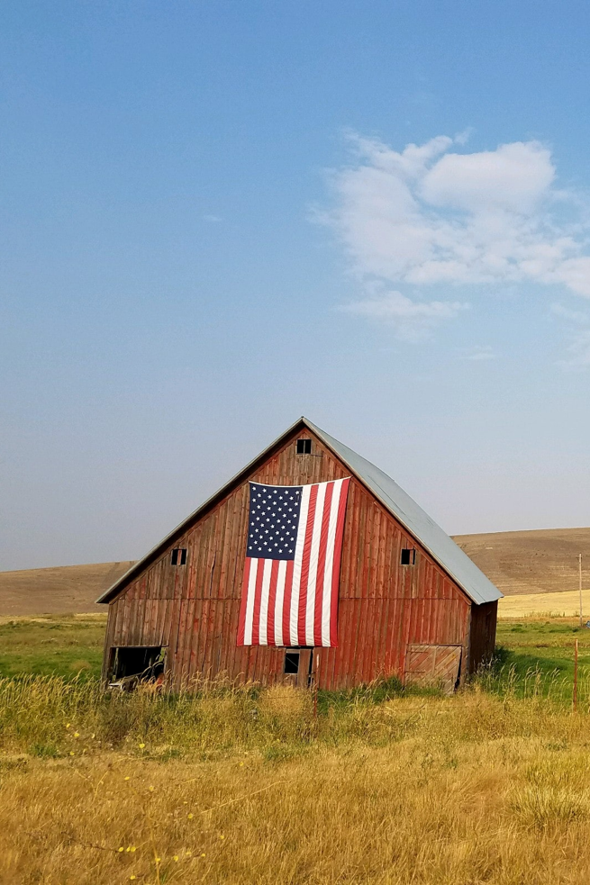
A. County Governments
All states have county governments to help administer state laws and policies.
In Louisiana, counties are called parishes while in Alaska and New York City, they’re called boroughs.
Notes:
Photo by specphotops on Unsplash
https://unsplash.com/photos/c07Bw2XG7oE

Slide 23
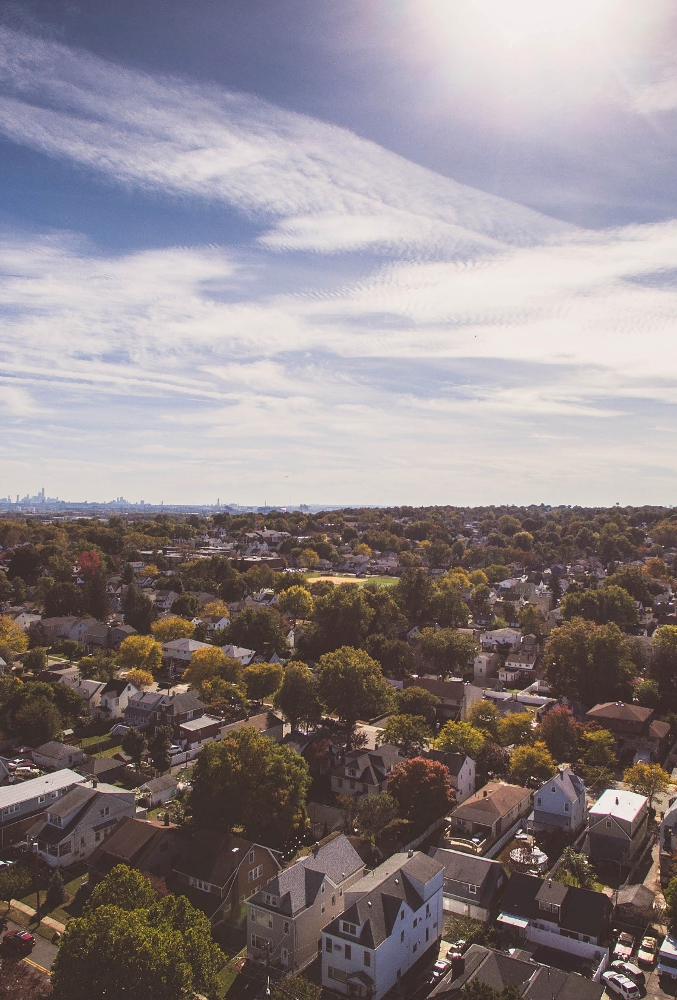
A. County Governments
Each state can determine how many counties it will have.
Generally, voters in each county elect a governing board.
Commissioners are elected from different subdivisions of the county.
Notes:
Photo by Matt Donders on Unsplash
https://unsplash.com/photos/boz4mBOeR2U

Slide 24

A. County Governments
Some counties elect a single county executive.
This is more common in a unified government where management of the city and county are handled by the same government.
Notes:
Image by Narcis Ciocan from Pixabay
https://pixabay.com/photos/mayor-signature-sign-adult-917149/

Slide 25

A. County Governments
County responsibilities include:
  Taxation
  Health and zoning ordinances
  Welfare
  County roads
  Law enforcement
  Education
Notes:
Photo by Ivan Aleksic on Unsplash
https://unsplash.com/photos/PDRFeeDniCk

Slide 26
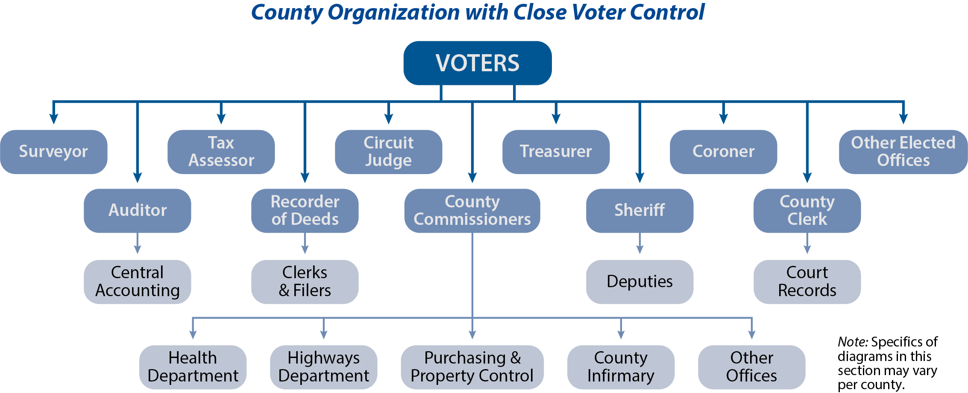
Notes:
BJU Press Art

Slide 27
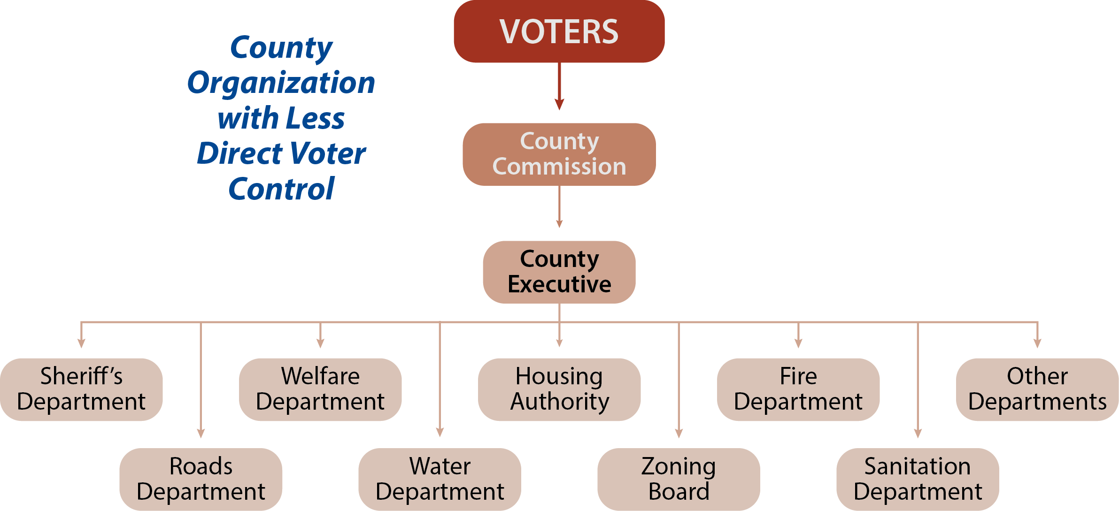
Notes:
BJU Press Art

Slide 28
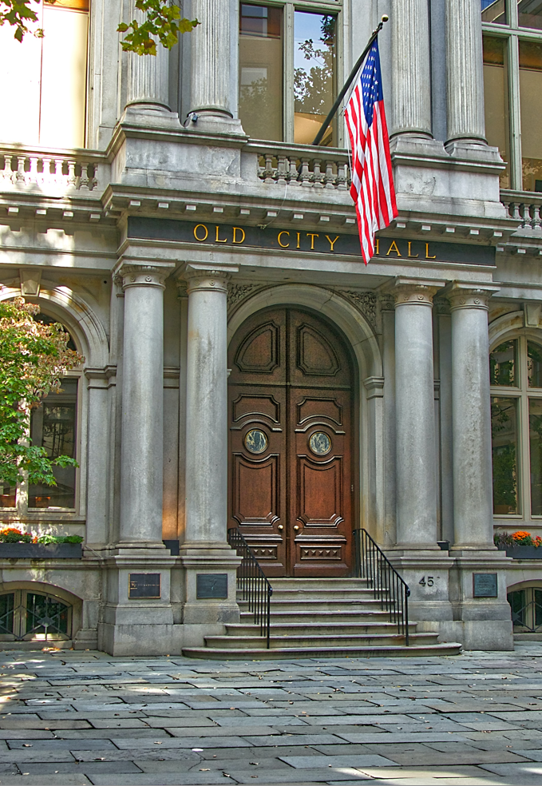
B. Municipal Governments
Municipal governments are local governments for cities, towns, and villages.
Typically, these governments are organized in one of three ways:
  Mayor-Council Government
  Council-Manager Government
  Commission Government
Notes:
Photo by Pascal Bernardon on Unsplash
https://unsplash.com/photos/jyIgc5wGnGE

Slide 29
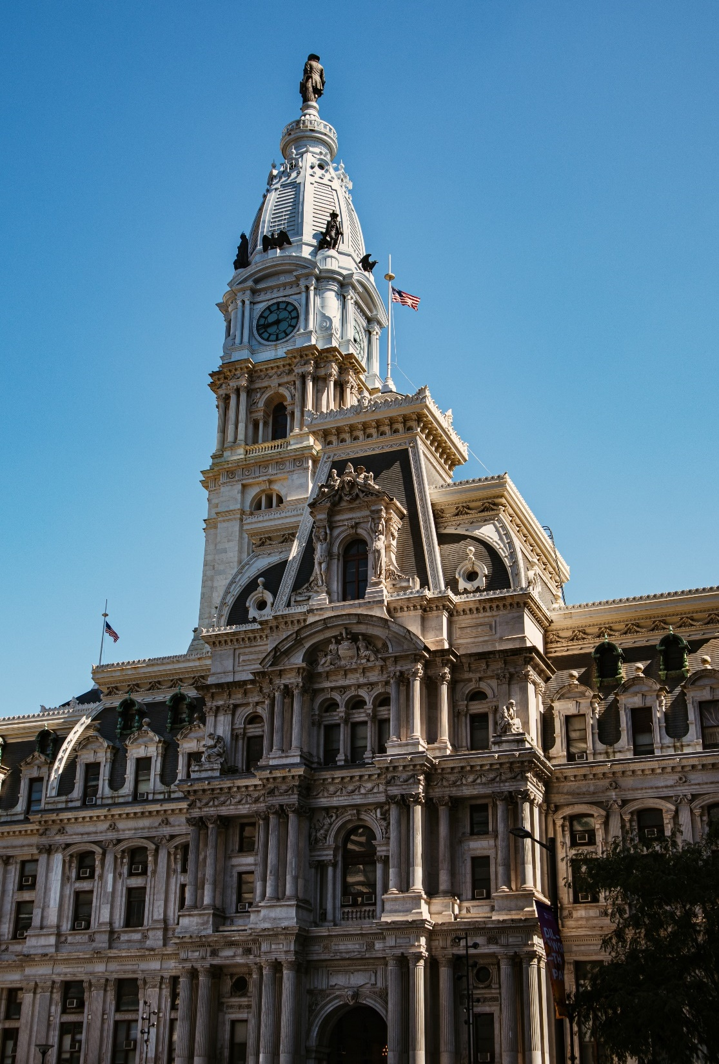
B. Municipal Governments
In a mayor-council government, power is shared between an elected mayor and a council of elected members.
In a council-manager government, the city is run by a council that also hires a professional manager to administer the city.
Notes:
Photo by Alejandro Barba on Unsplash
https://unsplash.com/photos/QNZCnG04k6s

Slide 30
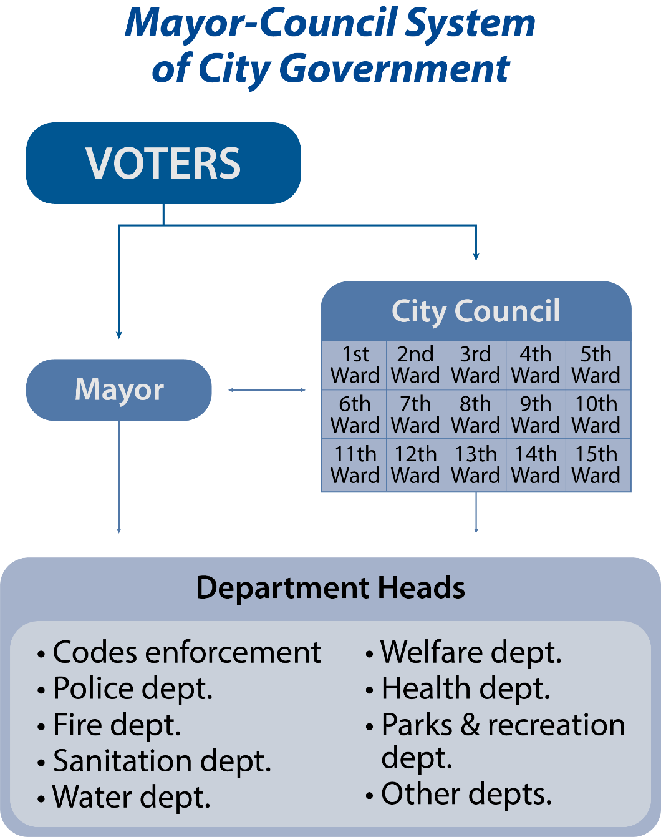
Notes:
BJU Press Art

Slide 31
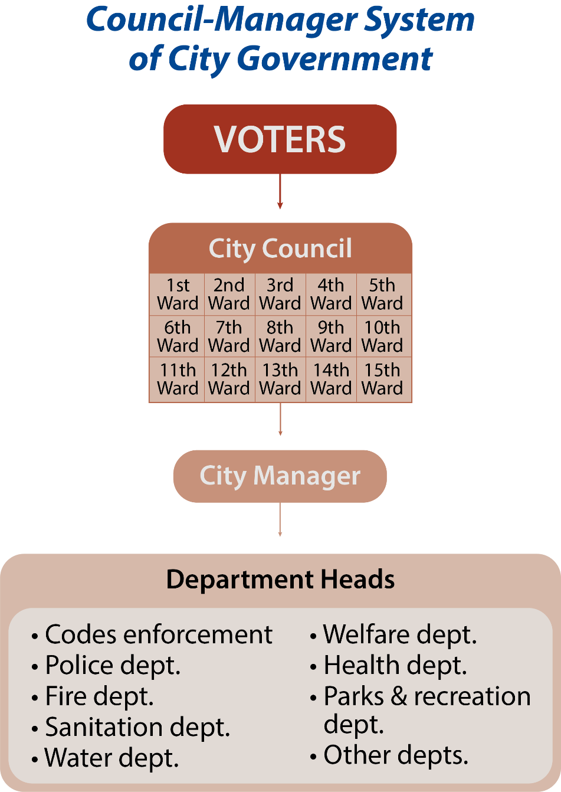
Notes:
BJU Press Art

Slide 32
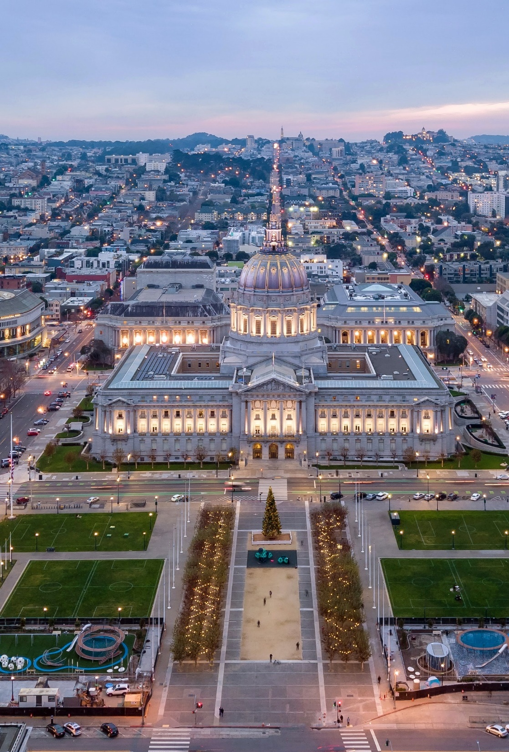
B. Municipal Governments
A commission government is a body of five to seven elected commissioners who manage the government.
Smaller municipalities such as villages might elect a board of trustees.
Notes:
Photo by Gordon Mak on Unsplash
https://unsplash.com/photos/Rs2XFDMhh-I

Slide 33

B. Municipal Governments
Some New England communities use the town meeting method of managing their government.
Voters gather and elect selectmen to make and implement policy.
Notes:
Photo by Balazs Busznyak on Unsplash
https://unsplash.com/photos/-6X9cjiNjXc

Slide 34

C. Special Districts
A special district is independent of any city or county government in order to provide specific government functions within its boundaries.
  School districts
  Fire departments
  Library systems
  Housing authorities
Notes:
Image by Falkenpost from Pixabay
https://pixabay.com/photos/george-peabody-b%C3%BCcherei-1629308/

Slide 35
Section Review – Chapter 7.2
1–2. What are two additional names used for counties?
Parish and borough (p. 148)
3–5. What are the three most common forms of municipal government organization?
Mayor-council, council-manager, and commission government
(p. 150)

Slide 36
Section Review – Chapter 7.2
6–8. Give three examples of special districts.
(any three) school districts, fire departments, soil-conservation districts, mosquito-abatement programs, cemetery commissions, library systems, sanitation districts, housing authorities, public transit systems, and seaports (p. 151)

Slide 37
Section Review – Chapter 7.2
Which form of municipal government do you think is best? Support your answer.
Some students will say the mayor-council forms gives voters control over the mayor and the council but gives them little control over department heads. The council-manager form promises greater efficiency and fewer problems with politics but gives voters little direct influence on the manager or department heads.

Slide 38
Section Review – Chapter 7.2
In Chapter 1 of this text we listed five obligations of governments. List them and assess whether or not you think your state government fulfills these obligations.
The five obligations of government are to ensure justice, to provide national defense and public safety, to address poverty, to promote moral behavior, and to provide order.

Slide 39
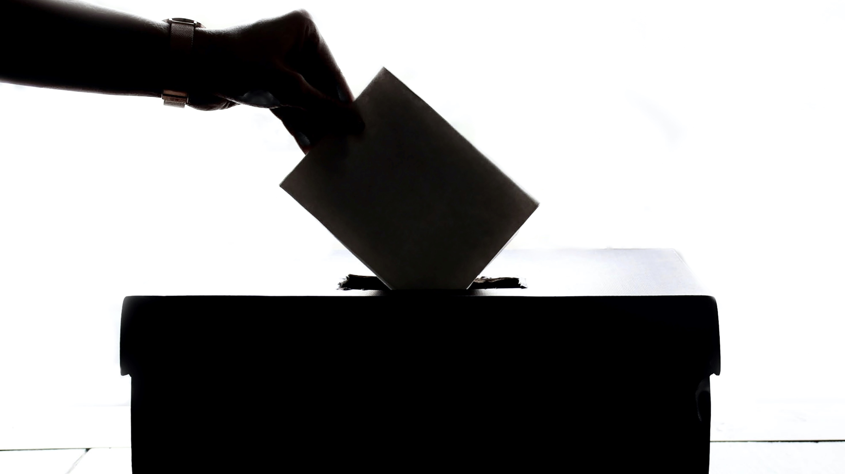
III. State and Local Politics
Chapter 7.3
Notes:
Photo by Element5 Digital on Unsplash
https://unsplash.com/photos/T9CXBZLUvic

Slide 40
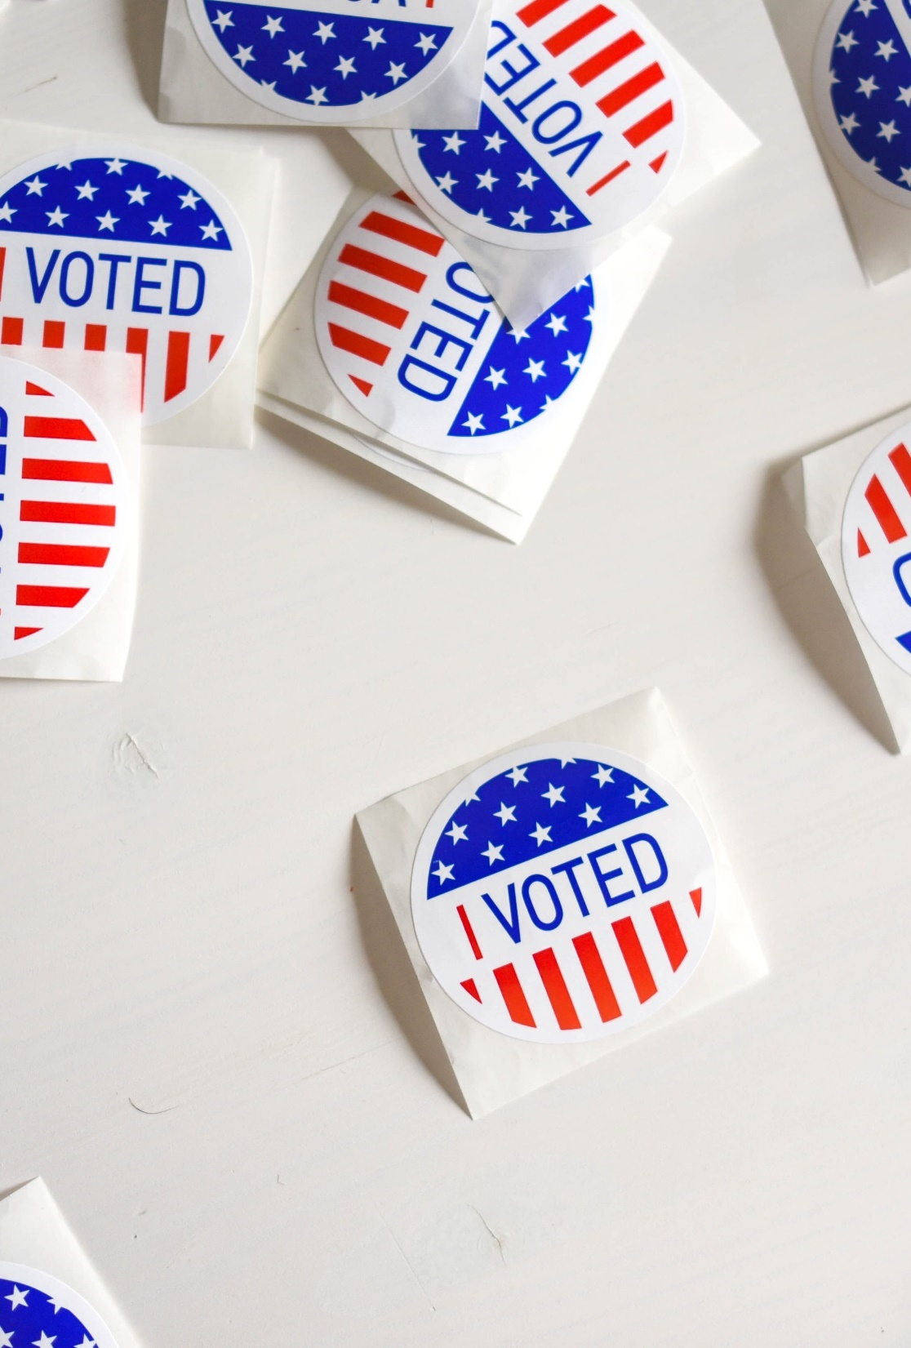
III. State and Local Politics
The term grass roots often refers to the lowest level of a group or activity.
Political organization at the grass roots level emphasizes participation – particularly by voting.
Notes:
Photo by Element5 Digital on Unsplash
https://unsplash.com/photos/ls8Kc0P9hAA

Slide 41
III. State and Local Politics
The purpose of a political party is to rally support for candidates, get them elected, and implement the party’s agenda.
Notes:
Photo by Element5 Digital on Unsplash
https://unsplash.com/photos/ls8Kc0P9hAA

Slide 42
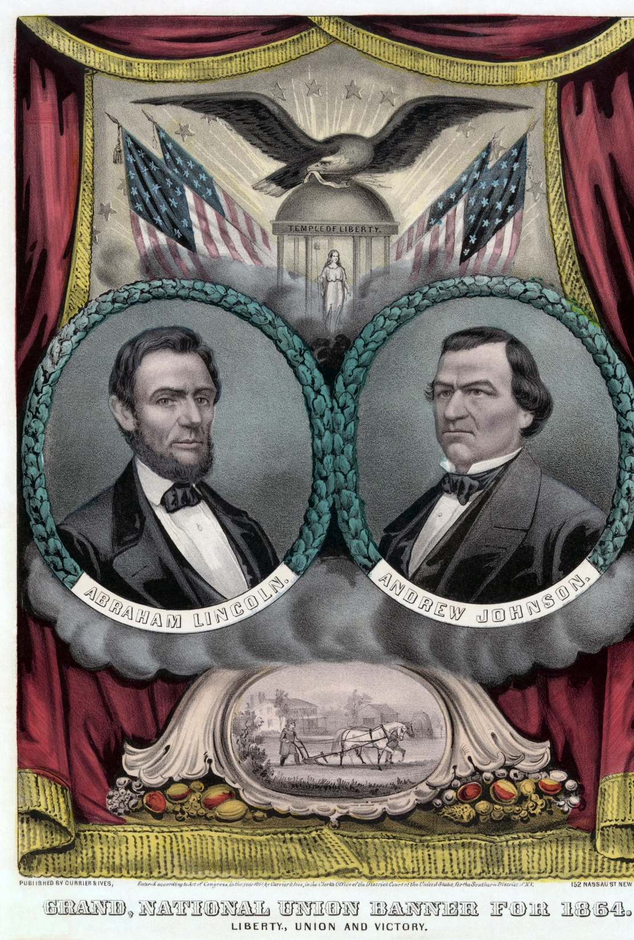
A. Political Party Organization
A political party is a group that advances certain common political goals and tries to gain power to implement those goals.
Anyone can be a part of any party or label themselves “independent.”
Notes:
By Currier and Ives - This image is available from the United States Library of Congress's Prints and Photographs divisionunder the digital ID ppmsca.17562. https://commons.wikimedia.org/w/index.php?search=Republican+Party+%28United+States%29&title=Special:Search&go=Go&ns0=1&ns6=1&ns12=1&ns14=1&ns100=1&ns106=1&searchToken=dhaxq82dxyvcrf7n8frkonjy9#%2Fmedia%2FFile%3ARepublican_presidential_ticket_1864b.jpg

Slide 43
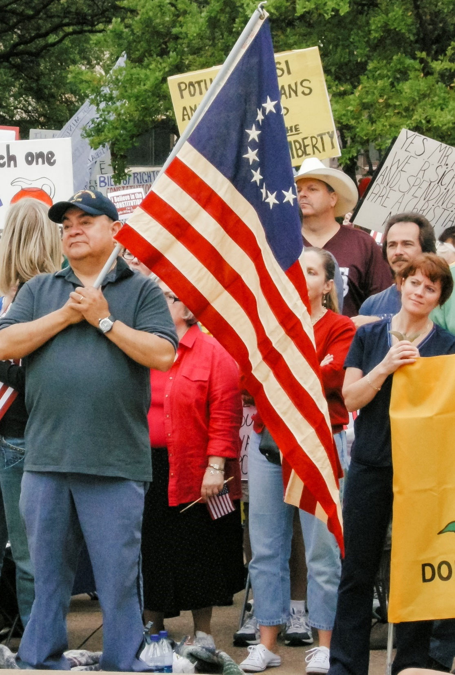
A. Political Party Organization
Political parties are often made up of different factions that compete for influence within the party.
The strongest party is usually the one that can unite its various factions around a single candidate.
Notes:
By Matthew T Rader - Tea Party Protest in Dallas, Texas - April, 2009 Own work, CC BY-SA 4.0, https://commons.wikimedia.org/w/index.php?curid=88622531
https://commons.wikimedia.org/w/index.php?search=tea+party&title=Special:Search&go=Go&ns0=1&ns6=1&ns12=1&ns14=1&ns100=1&ns106=1&searchToken=83zds3il9j3rnspbc5nle0wu9#%2Fmedia%2FFile%3ATea_Party_Protest_in_Dallas%2C_Texas_-_April%2C_2009.jpg

Slide 44
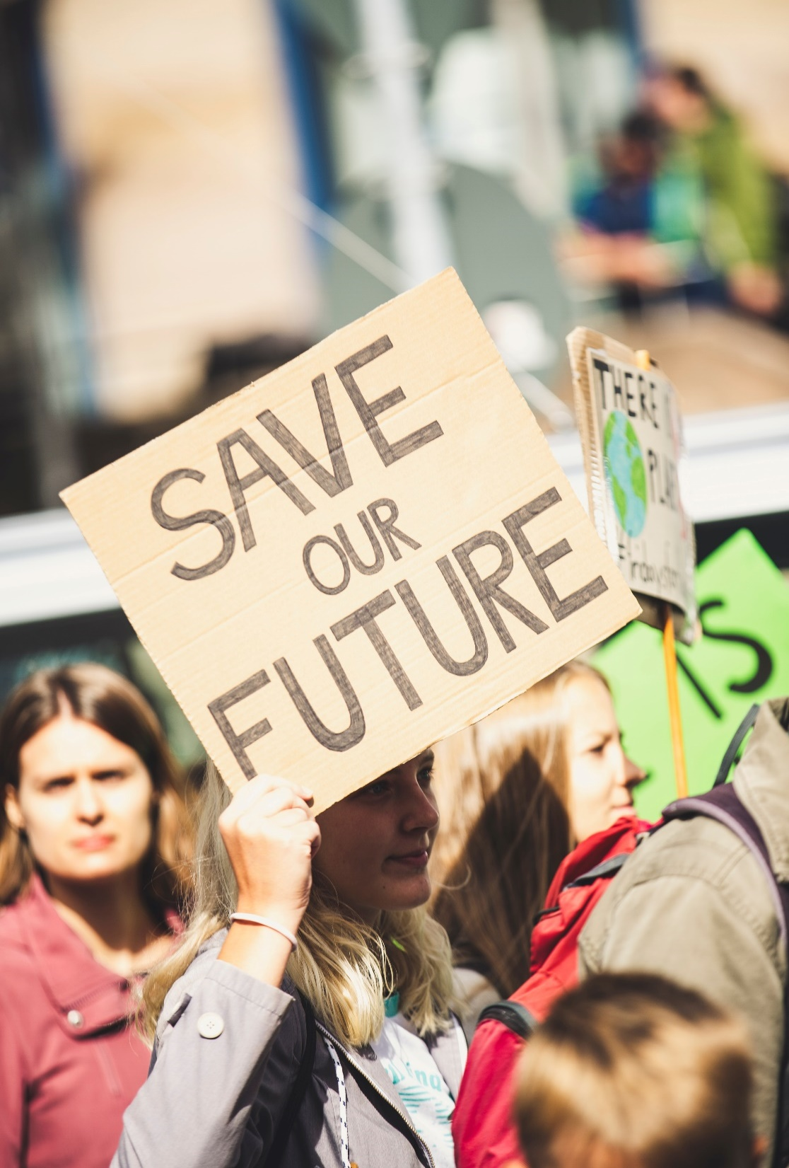
A. Political Party Organization
The lowest level of party organization is the precinct.
Members of the party gather at a polling place to elect officers.
They may also submit proposals to the county party organization.
Notes:
Photo by Markus Spiske on Unsplash
https://unsplash.com/photos/xH8_bSnpH5Q

Slide 45
A. Political Party Organization
Officers from the precinct meet regularly as a county committee.
The county committee elects officers to represent them at the state level.
Notes:
Photo by Markus Spiske on Unsplash
https://unsplash.com/photos/xH8_bSnpH5Q

Slide 46
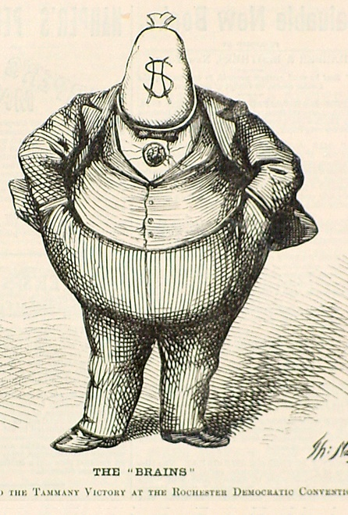
A. Political Party Organization
The state executive committee works with the chairman of the state party to raise funds for campaigns and to win elections.
In the past, some states and cities were operated by political machines – authoritarian organizations known for exchanging favors for votes.
Notes:
By Harper & Brothers; illustration by Thomas Nast - Source, Public Domain, https://commons.wikimedia.org/w/index.php?curid=48782690
https://commons.wikimedia.org/w/index.php?sort=relevance&search=boss+tweed&title=Special:Search&profile=advanced&fulltext=1&advancedSearch-current=%7B%7D&ns0=1&ns6=1&ns12=1&ns14=1&ns100=1&ns106=1&searchToken=9jwnf1je2le6xb94x871vlps4#%2Fmedia%2FFile%3ANast-Boss-Tweed-1871.jpg

Slide 47
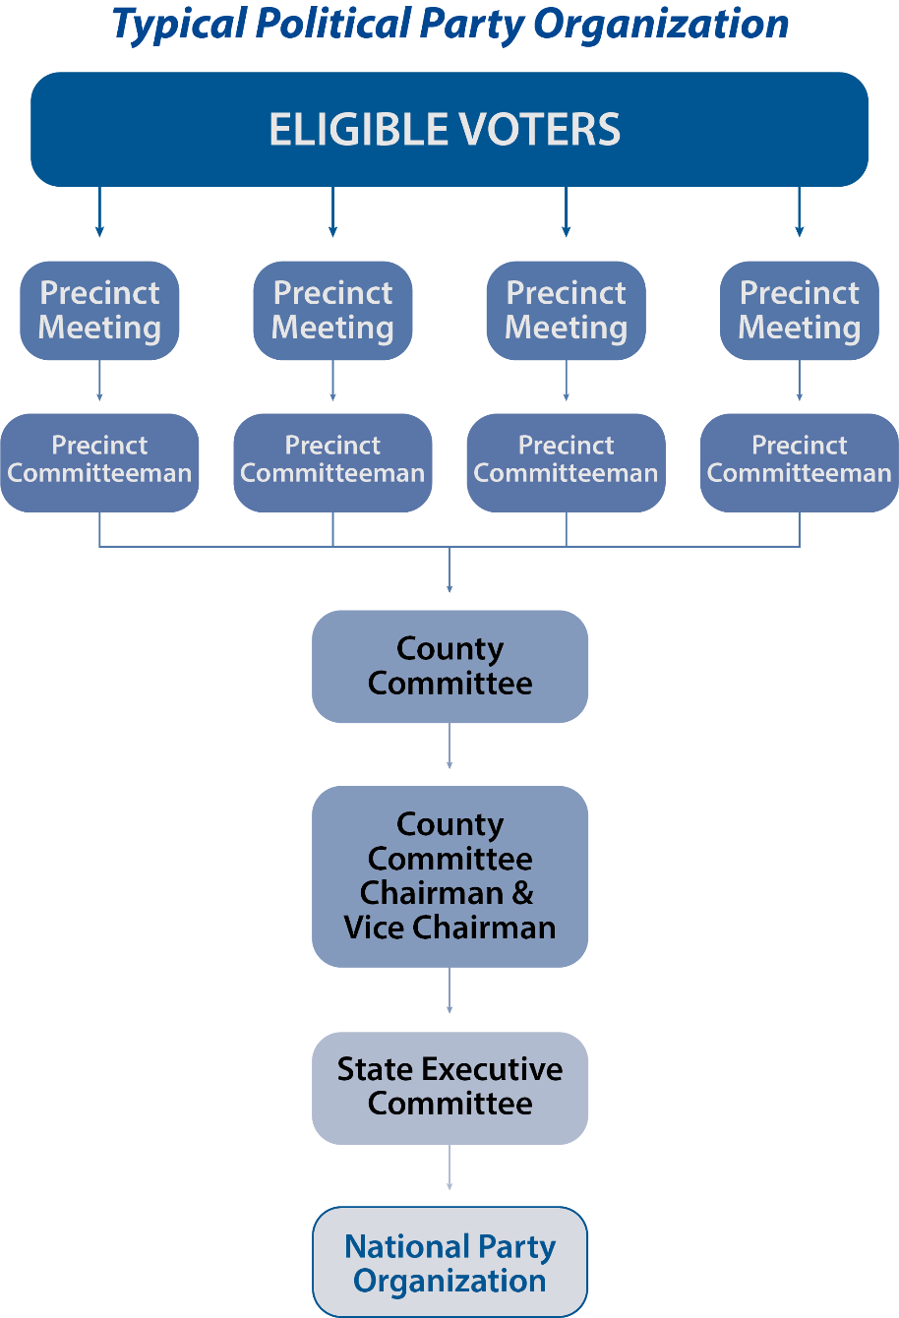
Notes:
BJU Press Art

Slide 48
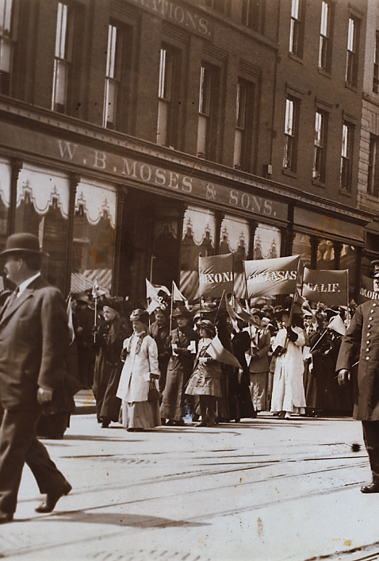
B. Elections
The right to vote (suffrage) is one of the most valuable privileges of a free people.
State and local governments are responsible for organizing elections.
Sadly, many Americans do not exercise their right to vote.
Notes:
By American Press Association (Photographer) - This image is available from the New York Public Library's Digital Library under the digital ID b19806373: digitalgallery.nypl.org → digitalcollections.nypl.org, Public Domain, https://commons.wikimedia.org/w/index.php?curid=82917715
https://commons.wikimedia.org/w/index.php?sort=relevance&search=womens+suffrage+march&title=Special:Search&profile=advanced&fulltext=1&advancedSearch-current=%7B%7D&ns0=1&ns6=1&ns12=1&ns14=1&ns100=1&ns106=1&searchToken=9l38ljamm17o3wex5o0csx9ih#%2Fmedia%2FFile%3AWoman_Suffrage_Procession_1913.png

Slide 49
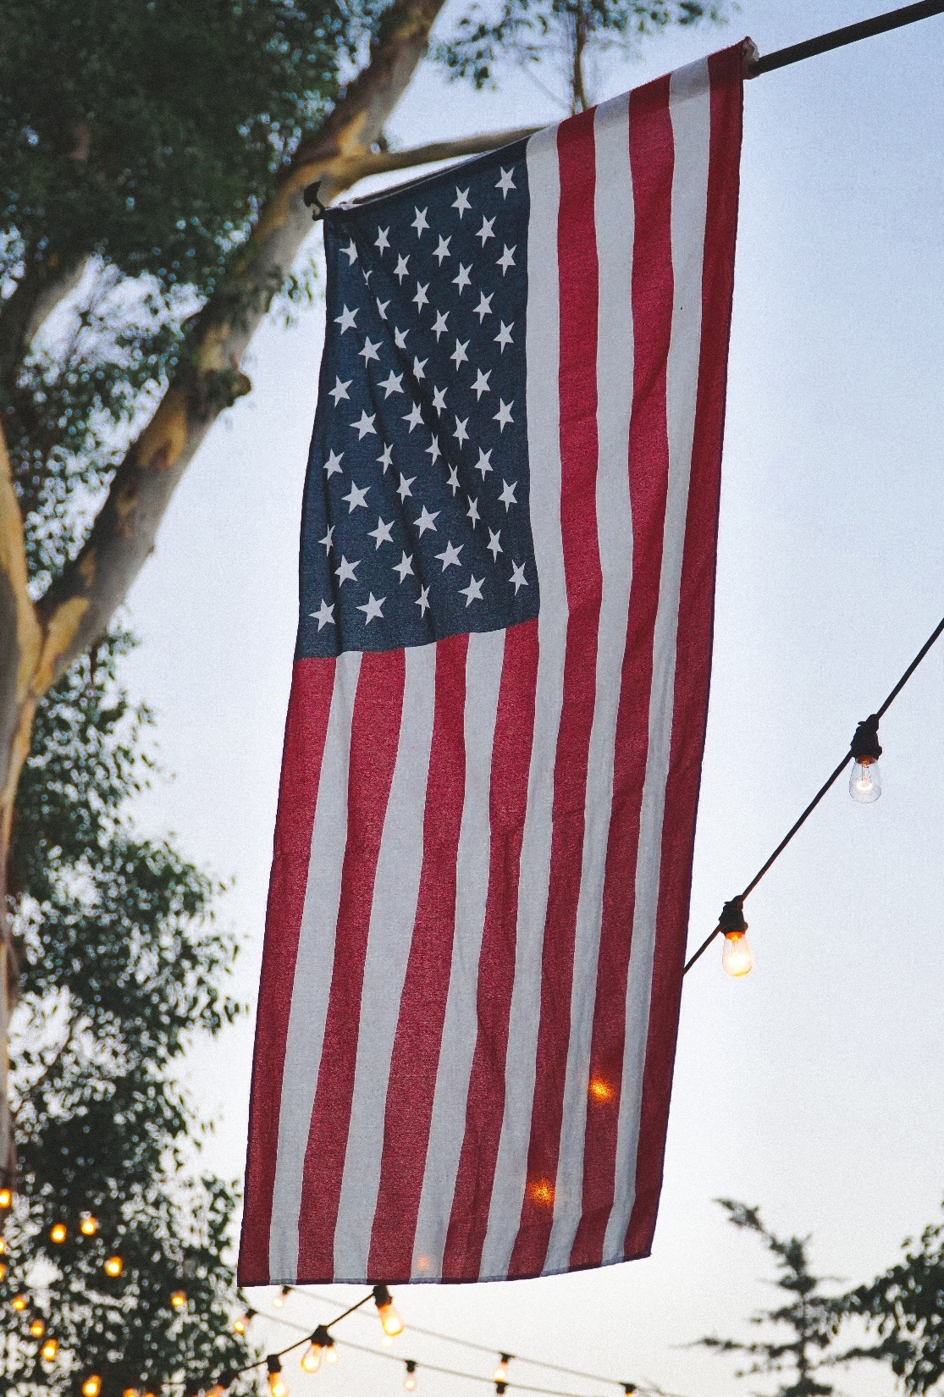
B. Elections
Most states require voters to register before an election.
Most states require the following:
  Be a citizen of the United States
  Be a citizen of the state or city where voting
  Be at least 18 years old
  Be registered to vote
Notes:
Photo by Matt Botsford on Unsplash
https://unsplash.com/photos/Jf4lKpDgklI

Slide 50
B. Elections
Voting methods vary by state and even within the same state.
Most states allow early voting of some kind before Election Day.
Notes:
Photo by Matt Botsford on Unsplash
https://unsplash.com/photos/Jf4lKpDgklI

Slide 51

B. Elections
There are two basic types of elections:
  Primary elections – determines which candidate will represent each party
  General elections – the winner fills the government office
Notes:
Photo by Kelsey Knight on Unsplash
https://unsplash.com/photos/SFRw5GChoLA

Slide 52
B. Elections
There are several kinds of primary elections:
  Open primary – registered voters can vote in either party’s primary, but only one of them, which sometimes results in crossover voting
  Closed primary – only voters registered with a particular party may participate in that party’s primary election
Notes:
Photo by Kelsey Knight on Unsplash
https://unsplash.com/photos/SFRw5GChoLA

Slide 53
B. Elections
There are several kinds of primary elections:
  Semiclosed primary – allows independents to choose a ballot from one of the two parties
Notes:
Photo by Kelsey Knight on Unsplash
https://unsplash.com/photos/SFRw5GChoLA

Slide 54
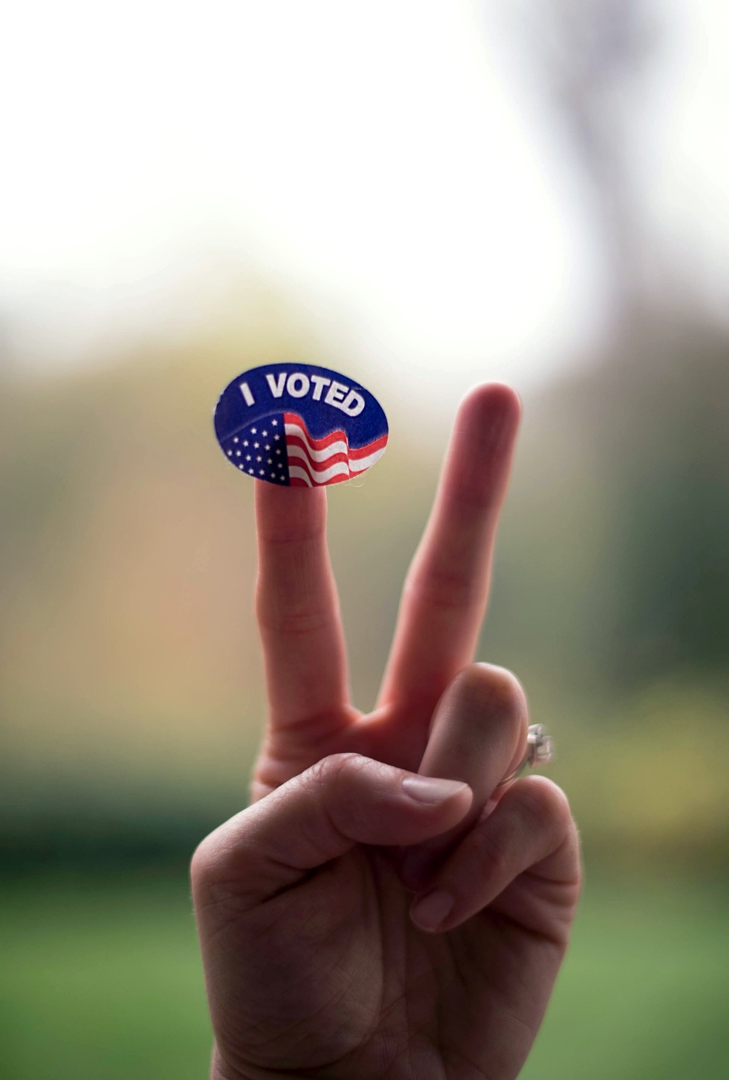
B. Elections
In most states, the candidate with the most votes wins the election.
Some states require a winning candidate to receive a majority of votes.
If no candidate has a majority, then there must be a runoff election.
Notes:
Photo by Jennifer Burk on Unsplash
https://unsplash.com/photos/-9fzXwDVrbQ

Slide 55
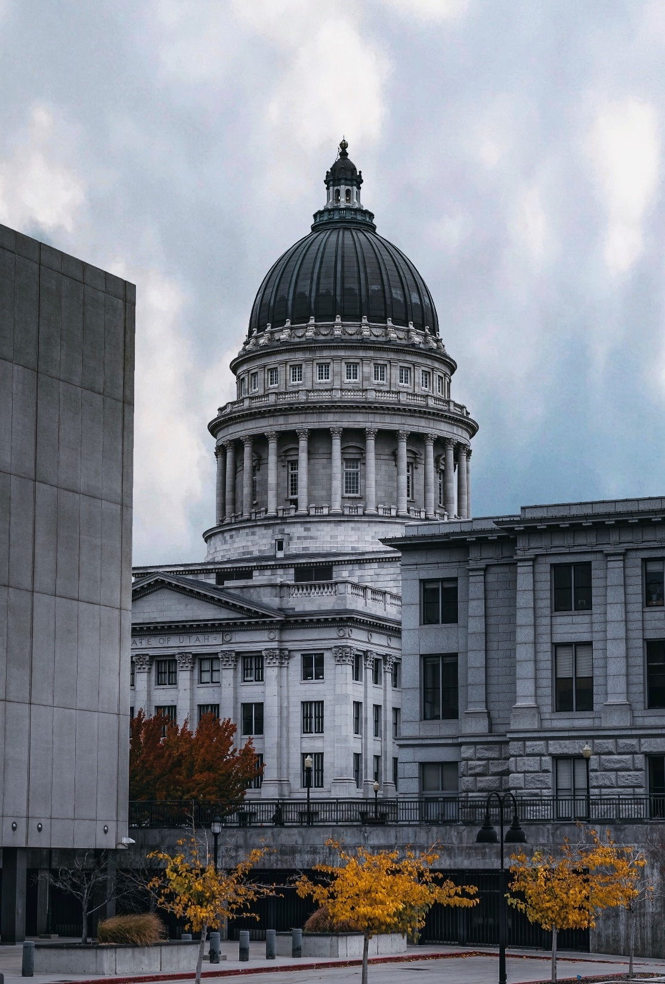
B. Elections
Some states use a primary system called the Top-Two method (or jungle primary) which lists all candidates on a single ballot.
The two that receive the most votes go on to the general election.
Notes:
Photo by Saul Flores on Unsplash
https://unsplash.com/photos/DN7LtwFXbAs

Slide 56
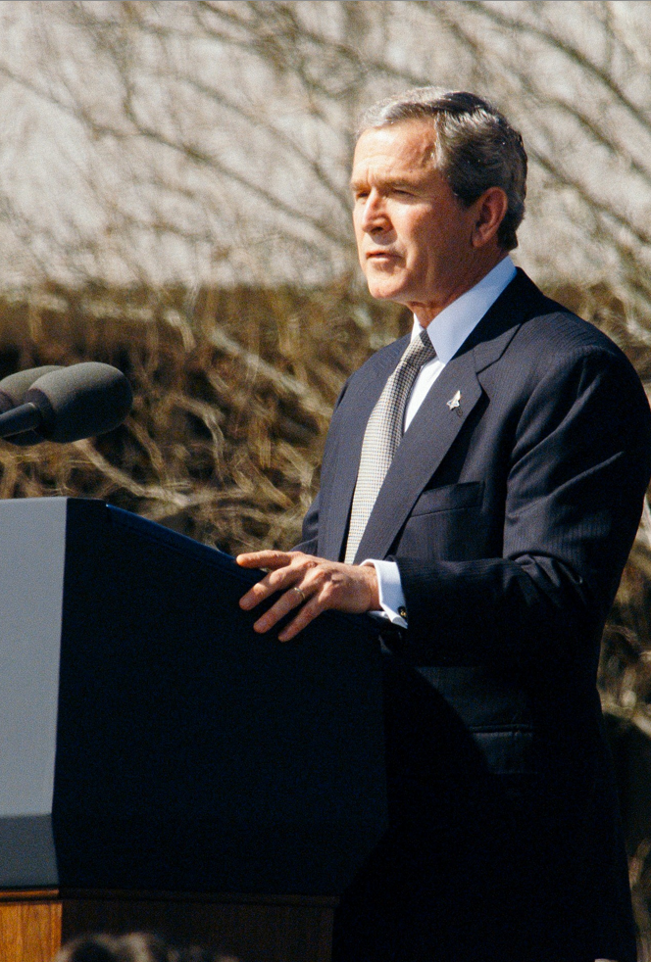
B. Elections
The winners of the primary face off in the general election.
Typically, voter turnout in a general election is higher than for primaries.
Notes:
Photo by History in HD on Unsplash
https://unsplash.com/photos/DhwKbmdlJa0

Slide 57
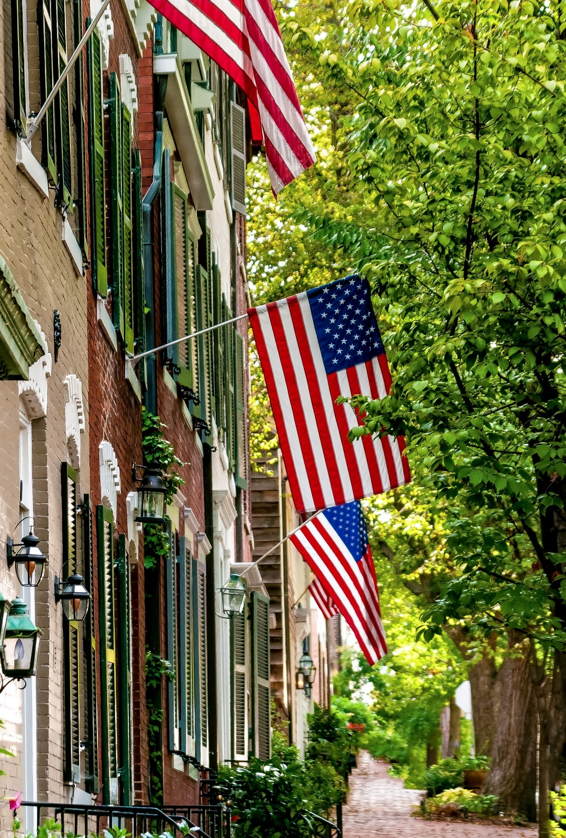
C. Recall, Referendum, and Initiative
Some states give voters extra powers over elections and laws.
  Recall – allows voters to remove an elected official through a special election
  Referendum – allows voters to repeal changes made to their state constitution or local laws
Notes:
Photo by Stephen Walker on Unsplash
https://unsplash.com/photos/BcyITySIw4A

Slide 58
C. Recall, Referendum, and Initiative
Some states give voters extra powers over elections and laws.
  Initiative – voters can propose changes to their state constitution or local laws
Notes:
Photo by Stephen Walker on Unsplash
https://unsplash.com/photos/BcyITySIw4A

Slide 59
Section Review – Chapter 7.3
1. What does the term grass roots mean?
The term grass roots is often used to refer to the lowest level of a group or activity. (p. 152)
2. What is a political party?
A political party is a group that advances certain common political goals and tries to gain power to implement those goals by selecting candidates in the hope of winning elections.
(p. 152)

Slide 60
Section Review – Chapter 7.3
3. What is the lowest level of political party organization?
the local precinct (p. 152)
4–5. Explain the two types of referendums in state government.
The two types of referendums are legislative and veto. Examples of legislative referendums are when a state legislature is required to submit a law to the electorate for a direct yes or no vote to decide an important matter. A veto referendum allows the electorate to repeal a piece of legislation or a constitutional amendment. (p. 158)

Slide 61
Section Review – Chapter 7.3
6. What is an initiative?
An initiative is a means whereby a legally specified number of voters can propose changes to their constitution or laws.
(p. 158)

Slide 62
Section Review – Chapter 7.3
What are the advantages and disadvantages of the ability to recall an elected official?
An advantage of recall is voters’ ability to remove an unqualified or dishonest official from office. A disadvantage may be that a person or group can persuade voters to remove an elected official because that official opposes or supports an issue. Sometimes this is done by distorting the official’s views.

Slide 63
Section Review – Chapter 7.3
Do you think an initiative is a good idea?
Some may say the initiative is a great way to place power in the hands of the people. Others may say that it is dangerous because it changes the ways that some laws are enacted.

Slide 64
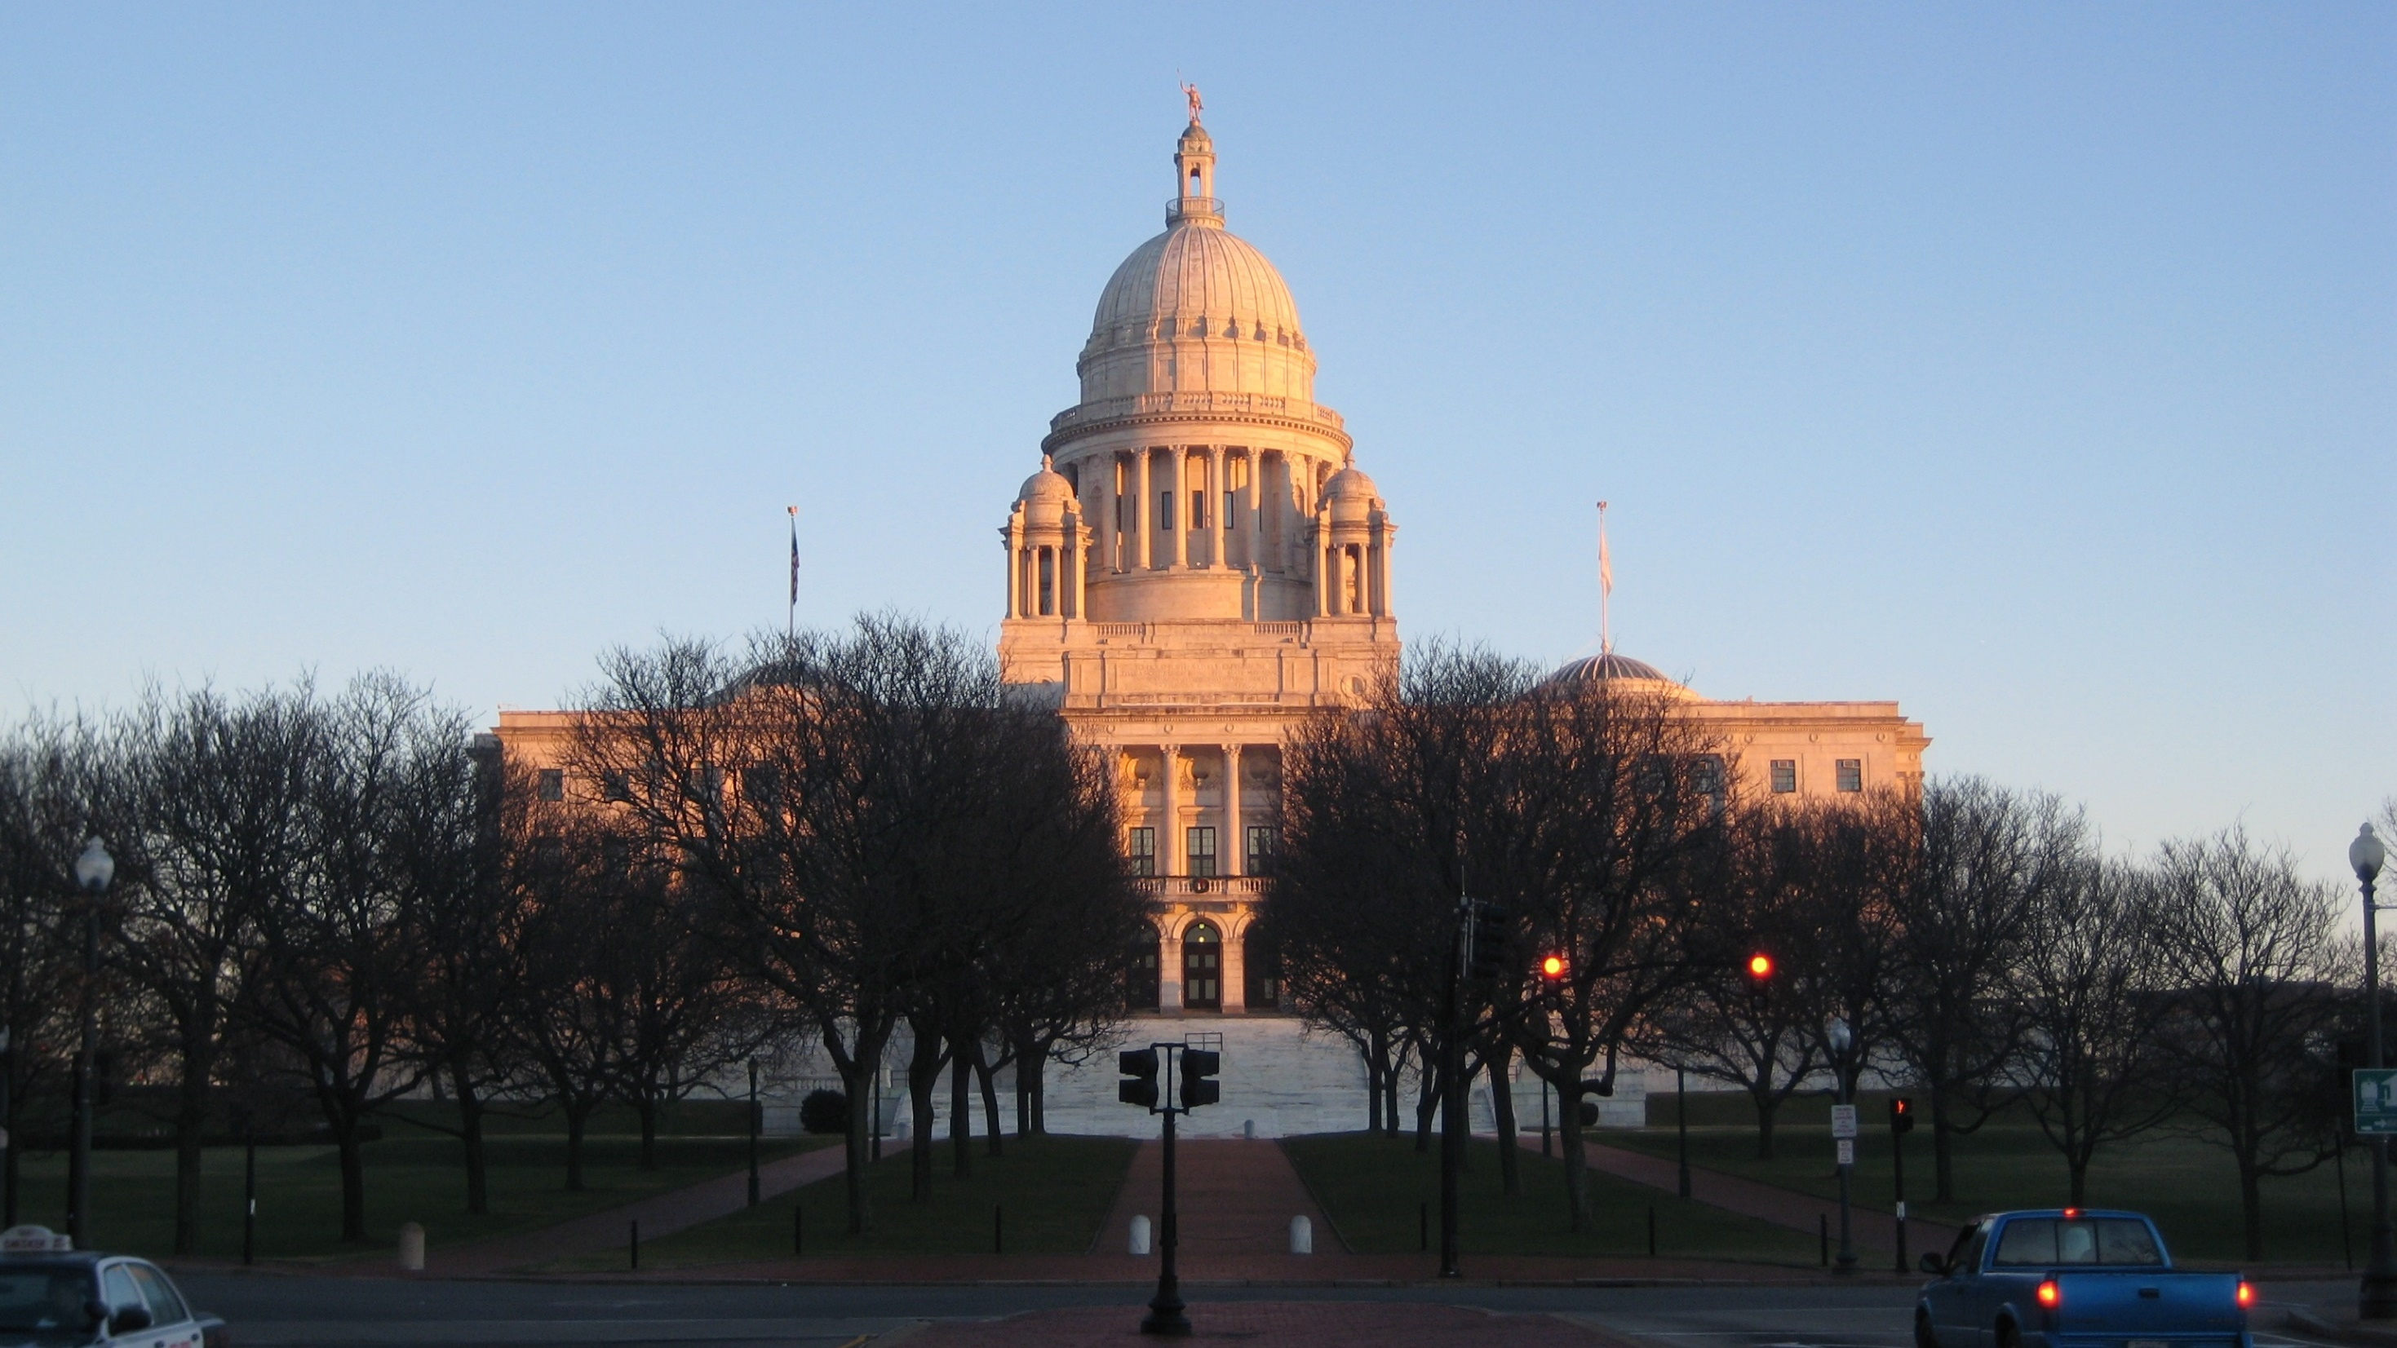
IV. Interstate and Intergovernmental Relationships
Chapter 7.4
Notes:
Image by Peter Nelson from Pixabay
https://pixabay.com/photos/rhode-island-state-house-providence-2832284/

Slide 65
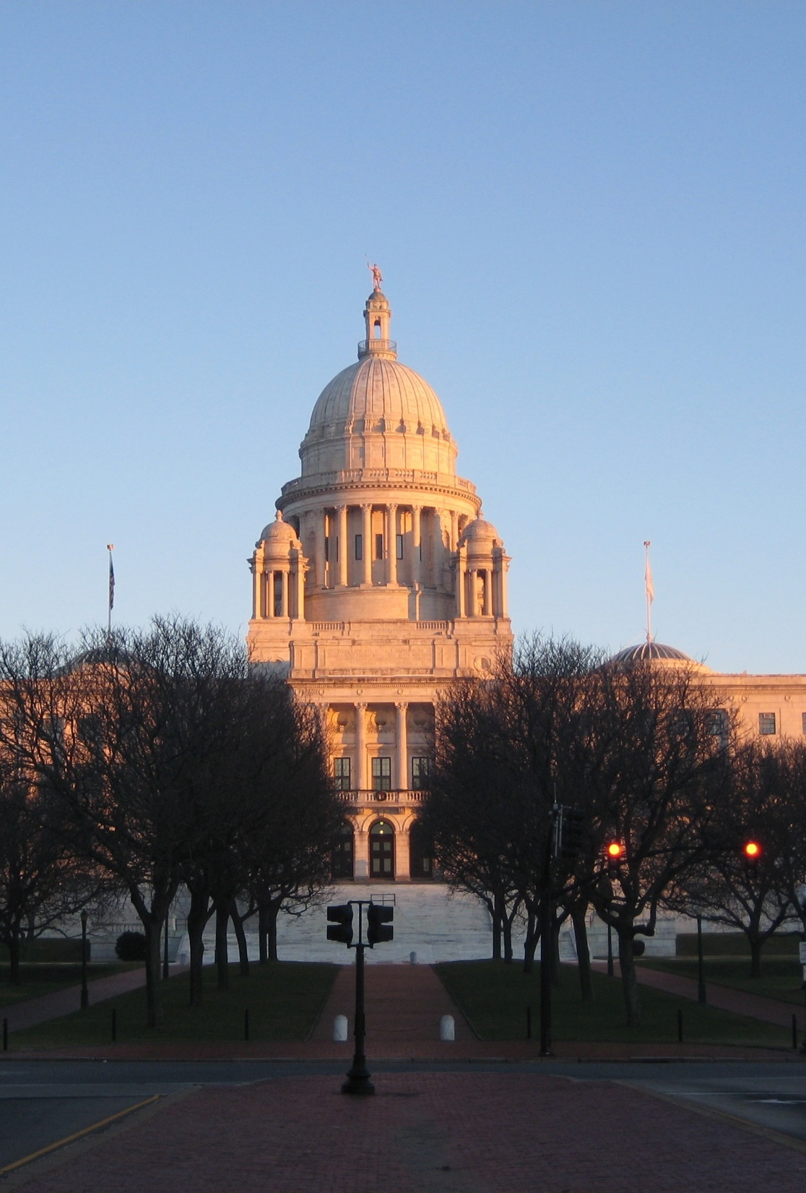
A. Interstate Relationships
States are required to maintain cooperation with one another by Article IV, Section 1 – the full faith and credit clause.
An example of this is the requirement of each state to recognize driver’s licenses from other states.
Notes:
Image by Peter Nelson from Pixabay
https://pixabay.com/photos/rhode-island-state-house-providence-2832284/

Slide 66
A. Interstate Relationships
In 2015, the Supreme Court ruled that banning homosexual marriages was unconstitutional thereby making such marriages legal in all fifty states.
Notes:
Image by Peter Nelson from Pixabay
https://pixabay.com/photos/rhode-island-state-house-providence-2832284/

Slide 67

A. Interstate Relationships
The privileges and immunities clause (Article IV, Section 2) requires that privileges enjoyed by US citizens must be respected in every state.
No state can restrict a nonresident’s legal activities.
Notes:
Image by Thomas Geider from Pixabay
https://pixabay.com/photos/city-new-york-city-nyc-ny-cities-1813929/

Slide 68
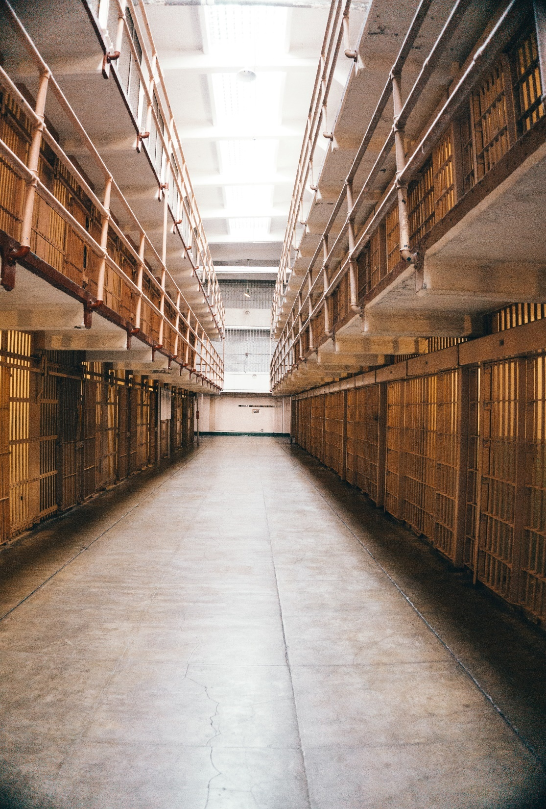
A. Interstate Relationships
Extradition is the legal process of returning an alleged criminal to the state in which he is charged.
In 1987, the Supreme Court ruled that the national government had the authority to force a state to extradite a fugitive.
Notes:
Photo by Emily-Jo Sutcliffe on Unsplash
https://unsplash.com/photos/dAvT0Zak7ag

Slide 69
A. Interstate Relationships
Reciprocity is a legal arrangement where a group of states agree to recognize the privileges of each other’s citizens.
  Teaching licenses
  Conceal carry licenses
Notes:
Photo by Emily-Jo Sutcliffe on Unsplash
https://unsplash.com/photos/dAvT0Zak7ag

Slide 70
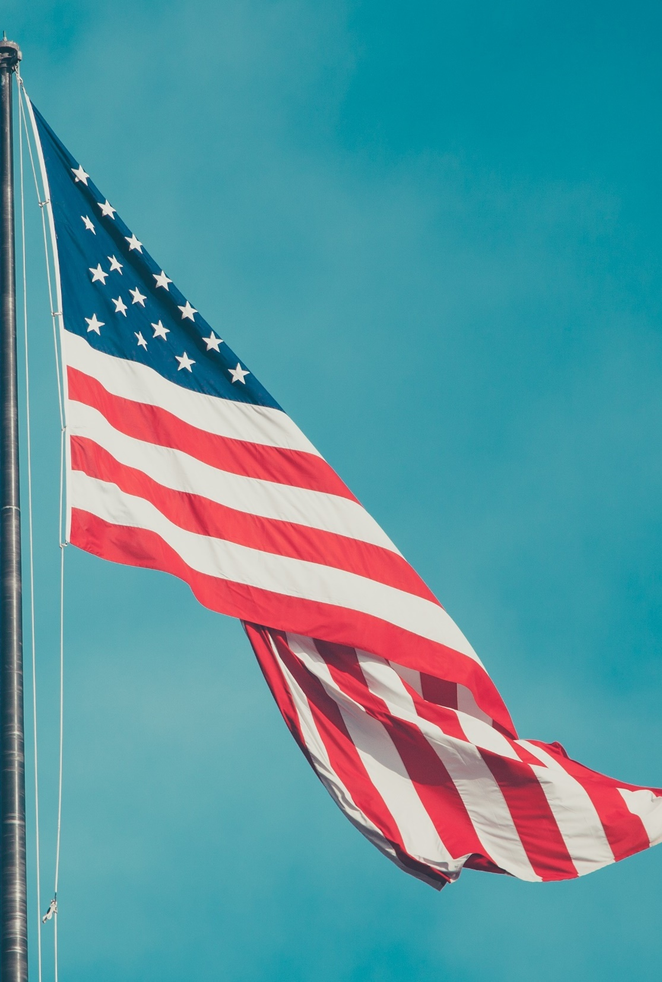
B. Intergovernmental Relationships
The relationship between the states and the national government was meant to be one of cooperation.
Over the years, the power of the national government has grown at the expense of the states.
Notes:
Image by fancycrave1 from Pixabay
https://pixabay.com/photos/american-flag-usa-symbol-national-820418/

Slide 71
Section Review – Chapter 7.4
1. Explain the full faith and credit clause.
The full faith and credit clause states that public acts, records, and judicial proceedings from one state shall be recognized in all states. (p. 159)
2. Define extradition.
Extradition is the legal process of returning an alleged criminal to the state in which he is charged. (p. 161)

Slide 72
Section Review – Chapter 7.4
3. What is reciprocity?
Reciprocity is a legal arrangement whereby one or more states recognize as valid certain privileges granted or conditions stipulated by one or more other states. (p. 161)
4–5. What amendment establishes the proper relationship between state and national governments? What was the amendment designed to prevent?
the Tenth Amendment; to prevent the national government from obtaining too much power (p. 162)

