Slide 1
Chapter 8:
The Structure of Congress
Notes:
WIN-Initiative/Stone/Getty Images

Slide 2
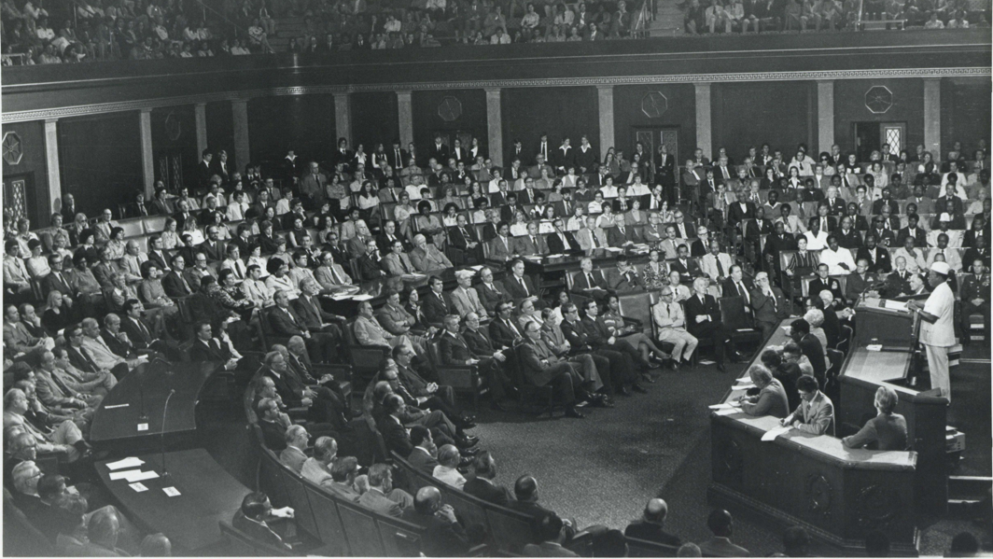
I. Framework
Chapter 8.1
Notes:
By Carl Albert Research and Studies Center, Congressional Collection - http://www.ou.edu/carlalbertcenter/congressional-collection, CC BY-SA 4.0, https://commons.wikimedia.org/w/index.php?curid=80352184
https://commons.wikimedia.org/w/index.php?sort=relevance&search=Session+of+Congress&title=Special:Search&profile=advanced&fulltext=1&advancedSearch-current=%7B%7D&ns0=1&ns6=1&ns12=1&ns14=1&ns100=1&ns106=1&searchToken=a7r2hu499kkwwjfd8bam6nnz5#%2Fmedia%2FFile%3ACarl_Albert%2C_William_R._Tolbert%2C_Jr._%28President_of_Liberia%29_and_others_at_a_joint_session_of_Congress._September_23%2C_1976.jpg

Slide 3
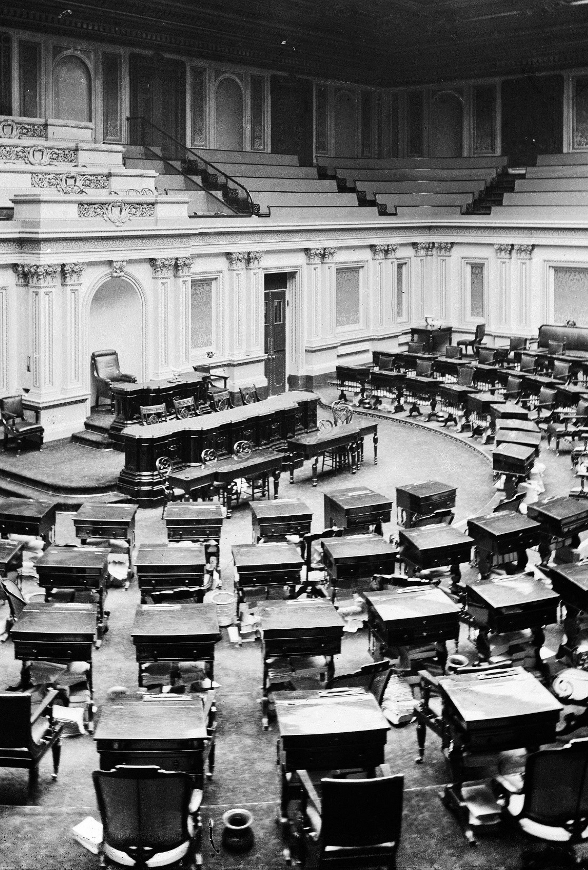
A. Bicameral Structure
The Great Compromise at the Constitutional Convention led to the creation of a bicameral Congress.
This structure provides a more cautious pace in passing laws.
Notes:
By Brady-Handy Photograph Collection (Library of Congress) - This image is available from the United States Library of Congress's Prints and Photographs divisionunder the digital ID cwpbh.03299.This tag does not indicate the copyright status of the attached work. A normal copyright tag is still required. See Commons:Licensing for more information., Public Domain, https://commons.wikimedia.org/w/index.php?curid=25700924
https://commons.wikimedia.org/w/index.php?sort=relevance&search=United+States+Senate+Chamber&title=Special:Search&profile=advanced&fulltext=1&advancedSearch-current=%7B%7D&ns0=1&ns6=1&ns12=1&ns14=1&ns100=1&ns106=1&searchToken=33kc03ezwsb4uy2ldsuqxr14i#%2Fmedia%2FFile%3AUS_Senate_Chamber_c1873.jpg

Slide 4
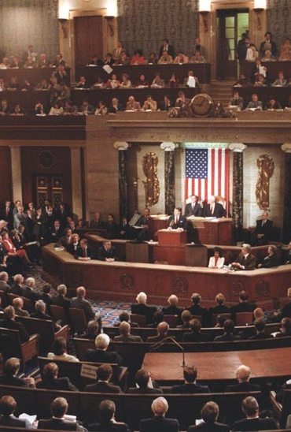
A. Bicameral Structure
The House of Representatives is the more democratic of the two houses because it is based on population.
To keep representation accurate, a census is taken every ten years and adjustments are made.
Notes:
Public Domain, https://commons.wikimedia.org/w/index.php?curid=2744464
https://commons.wikimedia.org/w/index.php?sort=relevance&search=United+States+House+of+Representatives+Chamber&title=Special:Search&profile=advanced&fulltext=1&advancedSearch-current=%7B%7D&ns0=1&ns6=1&ns12=1&ns14=1&ns100=1&ns106=1&searchToken=denc4zu9r2lnvgah6etx3339e#%2Fmedia%2FFile%3AReagan_delivers_State_of_the_Union_address_1983.jpg

Slide 5
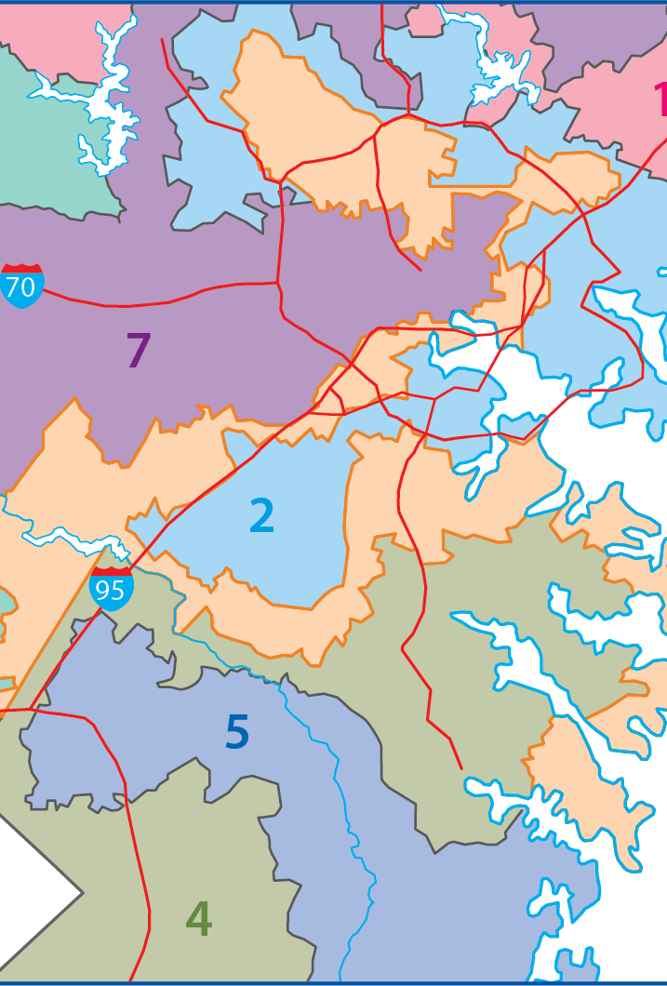
A. Bicameral Structure
After those adjustments, state legislatures redraw congressional districts in a process called reapportionment.
Redrawing district lines to favor a political party is called gerrymandering.
Map Resources

Slide 6
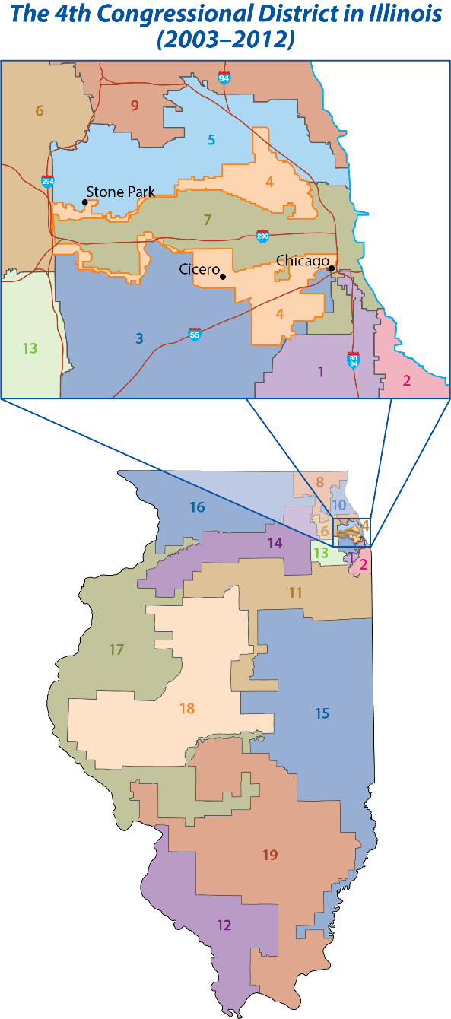
Map Resources

Slide 7
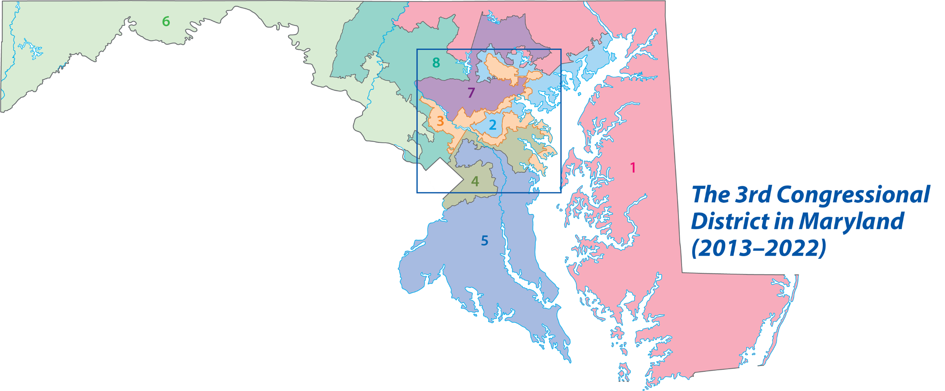
Map Resources

Slide 8
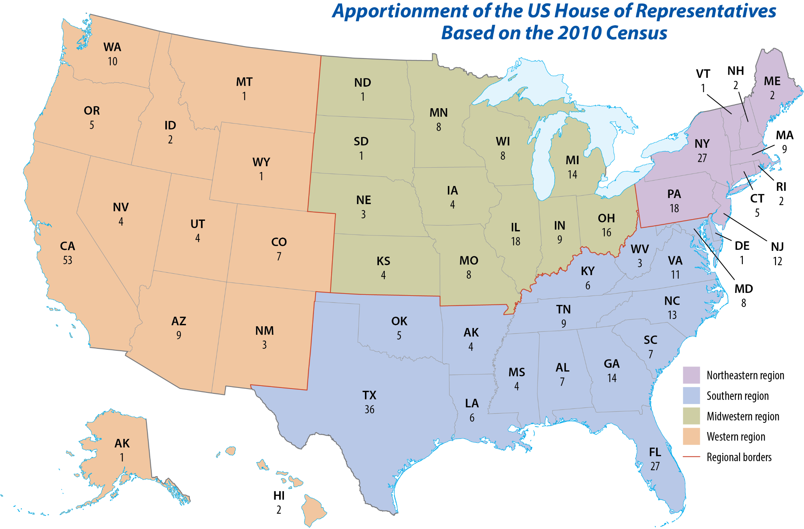
Map Resources

Slide 9
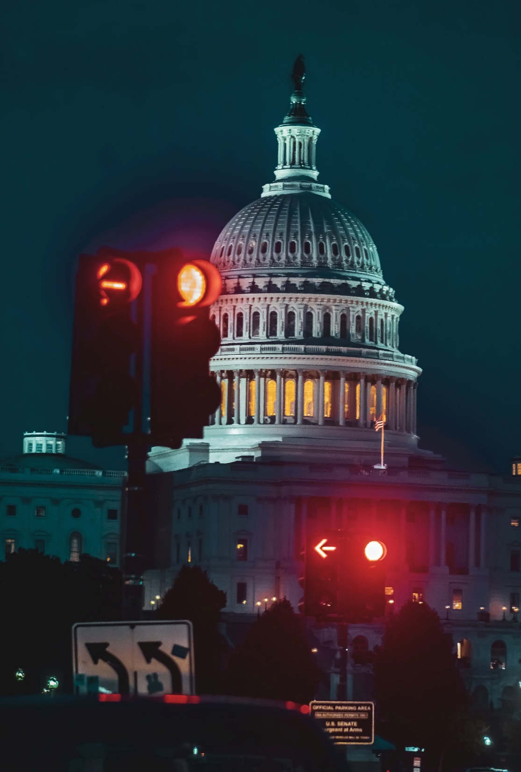
A. Bicameral Structure
House requirements include:
  Be at least twenty-five years old
  Have been a US citizen for no fewer than seven years
  Be a resident of the state to be represented
Members of the House serve two-year terms.
Notes:
Photo by Jing Xi Lau on Unsplash
https://unsplash.com/photos/eovT-nGBWWY

Slide 10
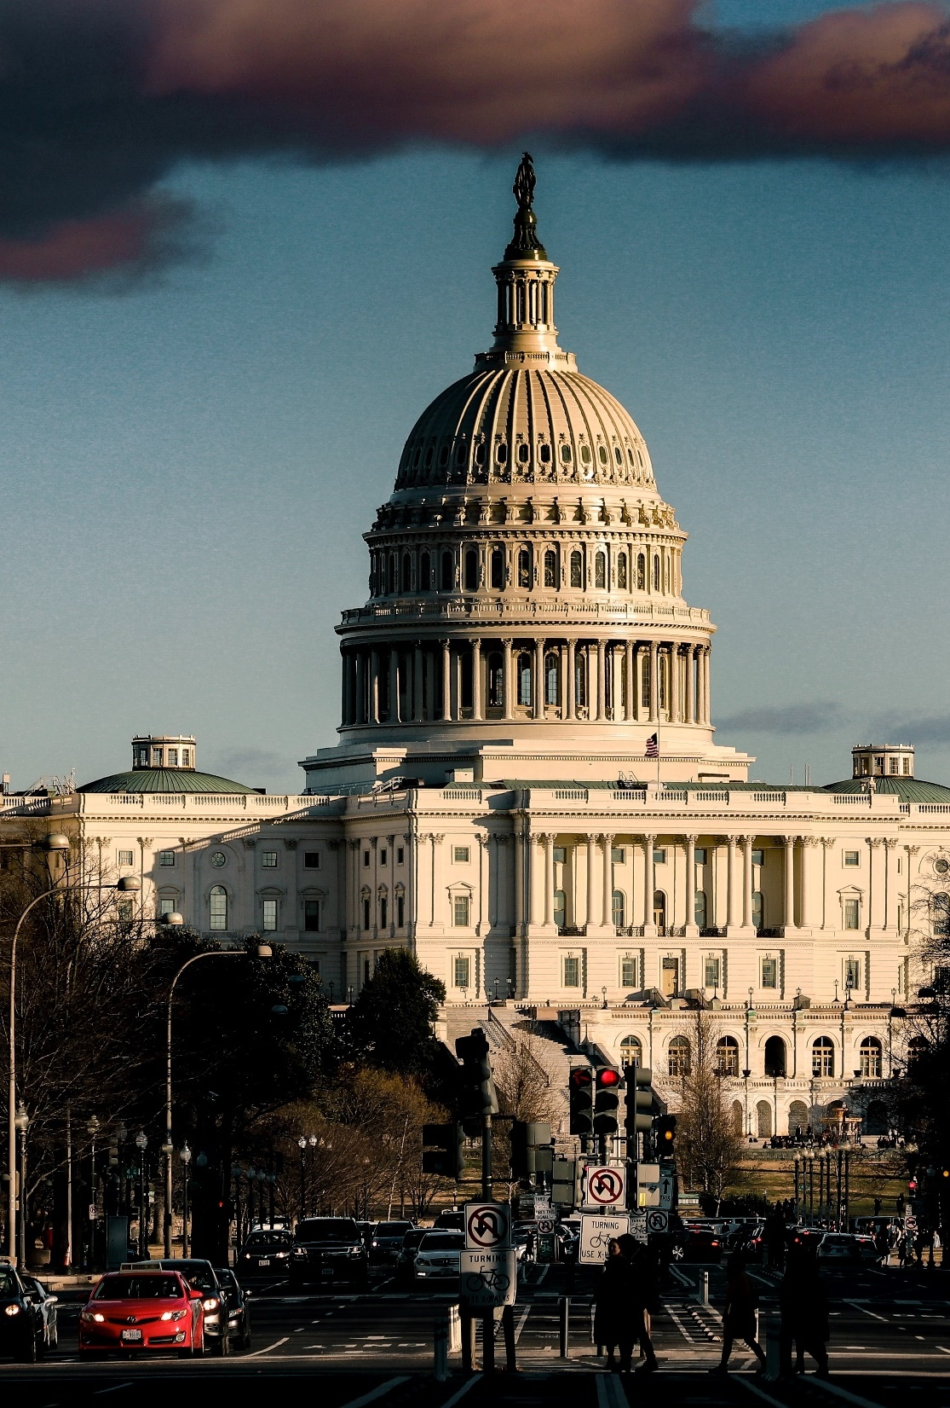
A. Bicameral Structure
Each member of the House represents a congressional district.
Each district has one representative, thus making it a single-member district.
Notes:
Photo by ElevenPhotographs on Unsplash
https://unsplash.com/photos/qsKrZzSC3vM

Slide 11
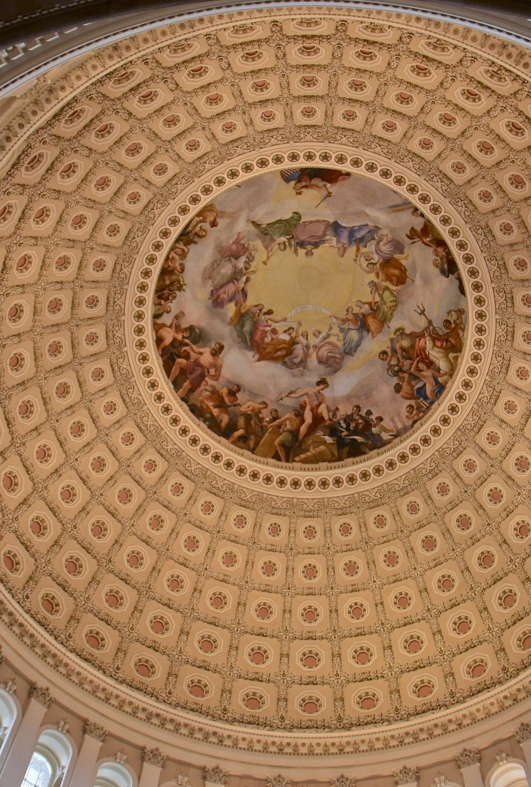
A. Bicameral Structure
Senators are elected on a statewide, or at-large, basis.
The Senate was intended to be a check and balance on the House.
Before the Seventeenth Amendment, senators were elected by state legislatures.
Notes:
Image by KaraSuva from Pixabay
https://pixabay.com/photos/capitol-dome-government-694806/

Slide 12
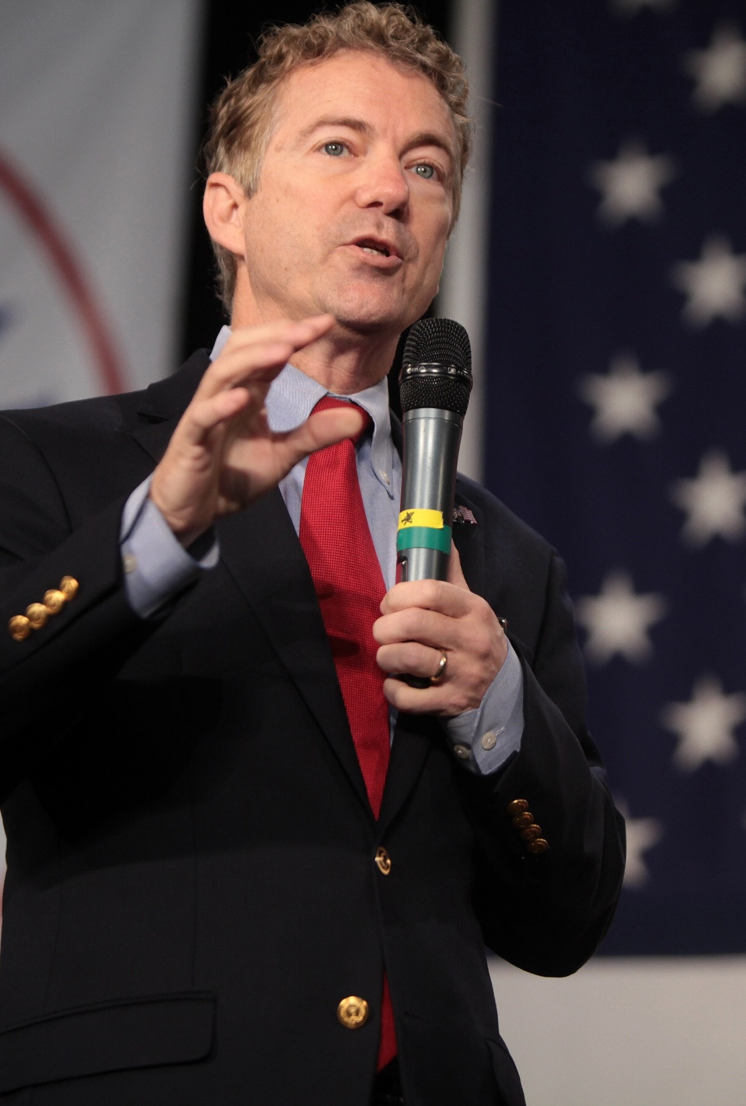
A. Bicameral Structure
Senate requirements include:
  Be at least thirty years old
  Have been a US citizen for at least nine years
  Be a resident of the state being represented
Members of the Senate serve six-year terms.
Rand Paul
Notes:
By Gage Skidmore from Peoria, AZ, United States of America - Rand Paul, CC BY-SA 2.0, https://commons.wikimedia.org/w/index.php?curid=44808102
https://commons.wikimedia.org/w/index.php?sort=relevance&search=rand+paul&title=Special:Search&profile=advanced&fulltext=1&advancedSearch-current=%7B%7D&ns0=1&ns6=1&ns12=1&ns14=1&ns100=1&ns106=1&searchToken=36u6mowguso0wb51lt6qivkcu#%2Fmedia%2FFile%3ARand_Paul_%2822092563783%29.jpg

Slide 13
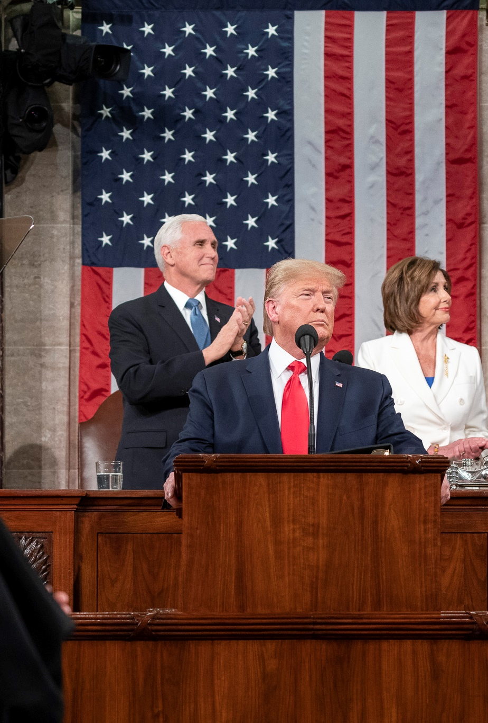
A. Bicameral Structure
Almost all members of Congress are part of either the Republican or Democratic political parties.
Even with control of both houses, some presidents have found it difficult to implement their agendas.
Notes:
By The White House from Washington, DC - State of the Union 2020, Public Domain, https://commons.wikimedia.org/w/index.php?curid=86675327
https://commons.wikimedia.org/w/index.php?title=Special:Search&limit=250&offset=0&ns0=1&ns6=1&ns12=1&ns14=1&ns100=1&ns106=1&search=state+of+the+union+address+trump&advancedSearch-current=%7B%7D&searchToken=8tep9bcv9frerca7h7aoeh7ve#%2Fmedia%2FFile%3AState_of_the_Union_2020_%2849493998961%29.jpg

Slide 14
A. Bicameral Structure
When members of different parties unite to support or oppose a bill, they form a coalition.
Notes:
By The White House from Washington, DC - State of the Union 2020, Public Domain, https://commons.wikimedia.org/w/index.php?curid=86675327
https://commons.wikimedia.org/w/index.php?title=Special:Search&limit=250&offset=0&ns0=1&ns6=1&ns12=1&ns14=1&ns100=1&ns106=1&search=state+of+the+union+address+trump&advancedSearch-current=%7B%7D&searchToken=8tep9bcv9frerca7h7aoeh7ve#%2Fmedia%2FFile%3AState_of_the_Union_2020_%2849493998961%29.jpg

Slide 15
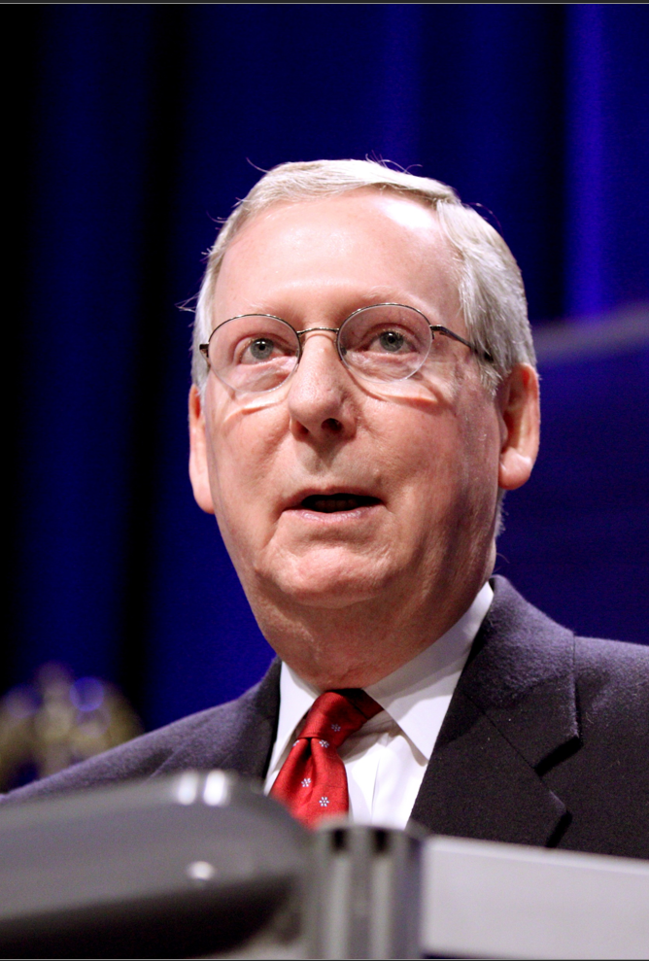
B. Leadership
Each party chooses leaders to coordinate party action in a meeting called a caucus (or conference).
  Majority leader & majority whip
  Minority leader & minority whip
The Senate also has an honorary position called president pro tempore.
Mitch McConnell
Notes:
By Gage Skidmore from Peoria, AZ, United States of America - Mitch McConnell, CC BY-SA 2.0, https://commons.wikimedia.org/w/index.php?curid=64192371
https://commons.wikimedia.org/w/index.php?title=Special:Search&limit=100&offset=0&ns0=1&ns6=1&ns12=1&ns14=1&ns100=1&ns106=1&search=Mitch+McConnell&advancedSearch-current=%7B%7D&searchToken=c5x4smnn4bcen0254gpcsilnc#%2Fmedia%2FFile%3AMitch_McConnell_%285437435397%29.jpg

Slide 16
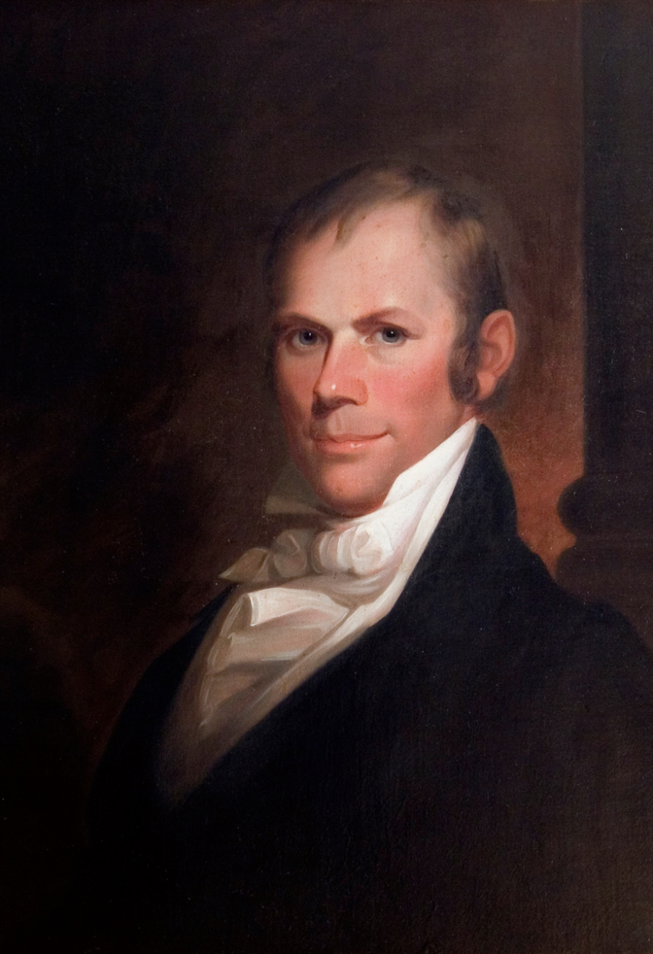
B. Leadership
The Speaker of the House is the most powerful position in the House of Representatives.
The speaker manages the business of the House and is elected by the whole House every two years.
Henry Clay
Notes:
By Matthew Harris Jouett - Transylvania University, Public Domain, https://commons.wikimedia.org/w/index.php?curid=1053731
https://commons.wikimedia.org/w/index.php?sort=relevance&search=Henry+Clay&title=Special:Search&profile=advanced&fulltext=1&advancedSearch-current=%7B%7D&ns0=1&ns6=1&ns12=1&ns14=1&ns100=1&ns106=1&searchToken=dtkzjfsxs3zx3jnygwqx5mi18#%2Fmedia%2FFile%3AHenry_Clay.JPG

Slide 17
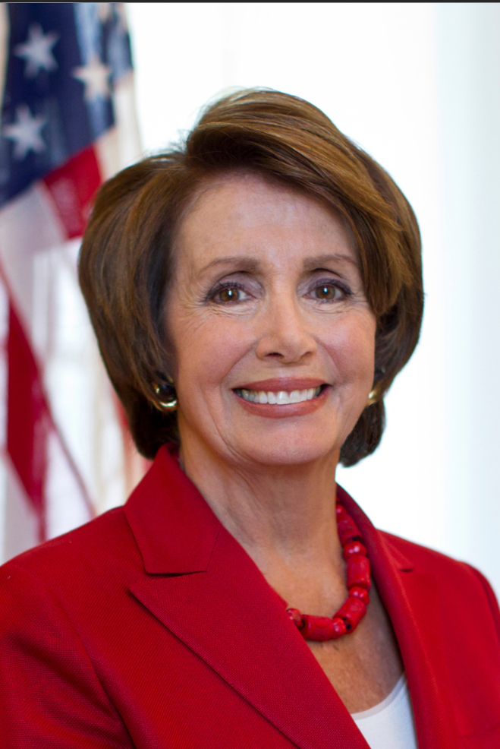
C. Controversial Issues
Some voters feel that term limits should be instituted to remove long-time “career” politicians from Congress.
A Constitutional amendment is required to make term limits law.
Nancy Pelosi
Notes:
By Unknown author - https://lh4.googleusercontent.com/-t0secF_x6s8/Ua9BHjLT1LI/AAAAAAAAAGI/VzpqCPRHYwc/s1226-no/OFFICIAL+HEAD+SHOT+300+DPI.jpg, Public Domain, https://commons.wikimedia.org/w/index.php?curid=30652317
https://commons.wikimedia.org/w/index.php?title=Special:Search&limit=20&offset=20&ns0=1&ns6=1&ns12=1&ns14=1&ns100=1&ns106=1&search=Nancy+Pelosi&advancedSearch-current=%7B%7D&searchToken=9qtophodlbc69nm5q4g39gxkx#%2Fmedia%2FFile%3ANancy_Pelosi_2012.jpg

Slide 18
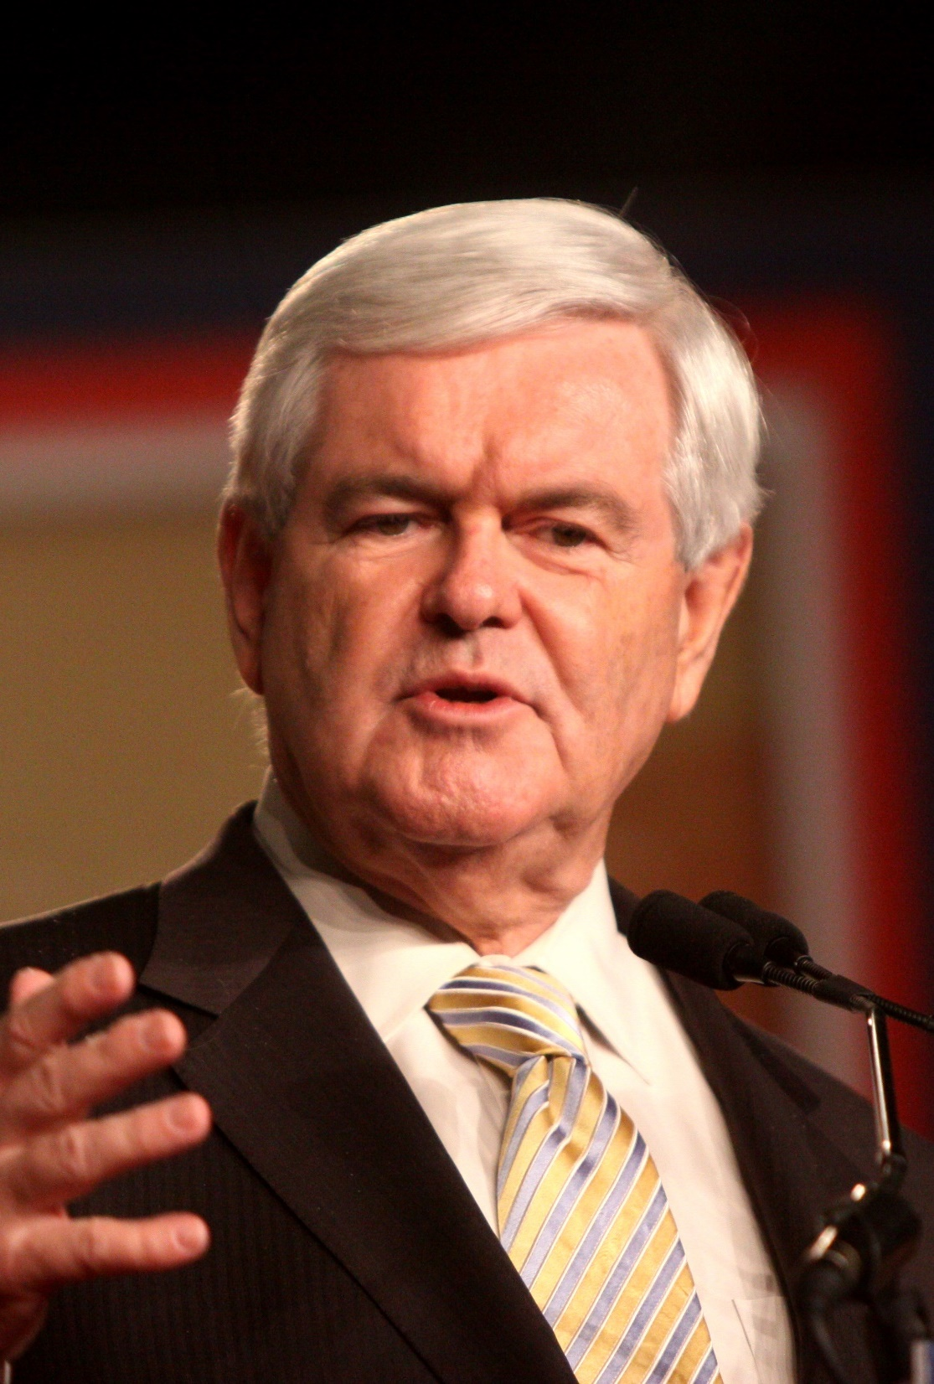
C. Controversial Issues
Americans have criticized Congress for having too many “perks”.
  High pay
  Franking privilege (free postage)
  Large staff
  Junkets (seemingly unnecessary trips)
Newt Gingrich
Notes:
By Gage Skidmore from Peoria, AZ, United States of America - Newt Gingrich, CC BY-SA 2.0, https://commons.wikimedia.org/w/index.php?curid=63985122
https://commons.wikimedia.org/w/index.php?sort=relevance&search=newt+gingrich&title=Special:Search&profile=advanced&fulltext=1&advancedSearch-current=%7B%7D&ns0=1&ns6=1&ns12=1&ns14=1&ns100=1&ns106=1&searchToken=cjxsk8pxejhyvz4r2cy00io3k#%2Fmedia%2FFile%3ANewt_Gingrich_%286183047914%29.jpg

Slide 19
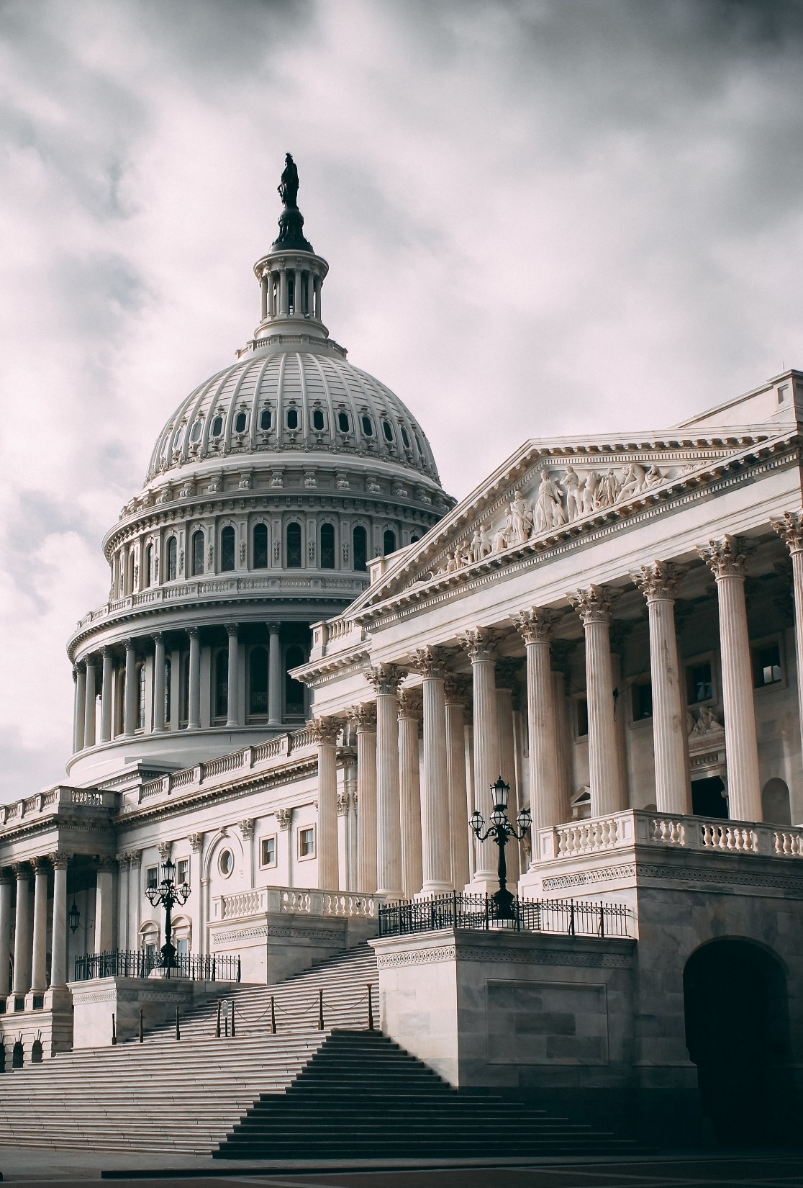
D. Congressional Sessions
Congresses are numbered each time a new House is elected.
Each Congress convenes for a session at least once a year.
Since the Twentieth Amendment, a new session of Congress begins in January of odd-numbered years.
Notes:
Photo by Harold Mendoza on Unsplash
https://unsplash.com/photos/6xafY_AE1LM

Slide 20
Section Review – Chapter 8.1
1. How does the census affect the composition of Congress?
It causes reapportionment, in which district lines are redrawn to reflect population changes; the census can change the number of representatives from each state. (pp. 168–169)
2. What are some major differences between the House of Representatives and the Senate?
Answers should be based on the table on page 173 called “Differences Between the House and Senate.” (p. 173)

Slide 21
Section Review – Chapter 8.1
3–6. Explain the significance of each of the following Speakers: Frederick Muhlenberg, Henry Clay, Sam Rayburn, and Nancy Pelosi.
Muhlenberg was the first Speaker; Clay was the first powerful Speaker; Rayburn was the longest-serving Speaker; and Pelosi was the first female Speaker. (pp. 173–174)

Slide 22
Section Review – Chapter 8.1
Why are the majority leader in the Senate, the Speaker of the House in the House of Representatives, and the whips in both houses important to the political process?
The majority leader in the Senate controls the flow of legislation there; the Speaker of the House presides in that chamber and makes decisions about legislation, debate, and service on committees. The whips assist majority and minority leaders by communicating with party members about legislation and encouraging their attendance during key votes. They also try to unite party members behind the party’s position on specific bills.

Slide 23
Section Review – Chapter 8.1
How has the role of women in Congress changed during America’s history?
The first woman to serve in the House of Representatives began her first term in 1917; thus, for more than a century of our nation’s history there were no women in Congress. The first woman to serve in the Senate was appointed in 1922 but only served for a day. The first woman was elected to the Senate in 1932. Eventually more women were elected to Congress, and now there are well over one hundred serving in the House of Representatives and the Senate.

Slide 24
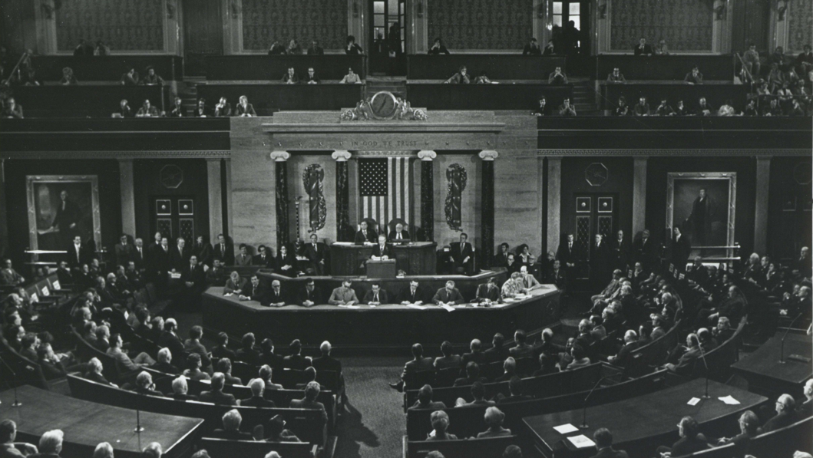
II. Legislative Workings
Chapter 8.2
Notes:
By CarlAlbertArchives - Carl Albert Center, CC BY-SA 4.0, https://commons.wikimedia.org/w/index.php?curid=82273629
https://commons.wikimedia.org/w/index.php?title=Special:Search&limit=500&offset=0&ns0=1&ns6=1&ns12=1&ns14=1&ns100=1&ns106=1&search=joint+session+of+Congress&advancedSearch-current=%7B%7D&searchToken=3nh3sfzcym6i3ir77vfqfv5pf#%2Fmedia%2FFile%3ACAC_CC_001_18_11_0000_1059.jpg

Slide 25
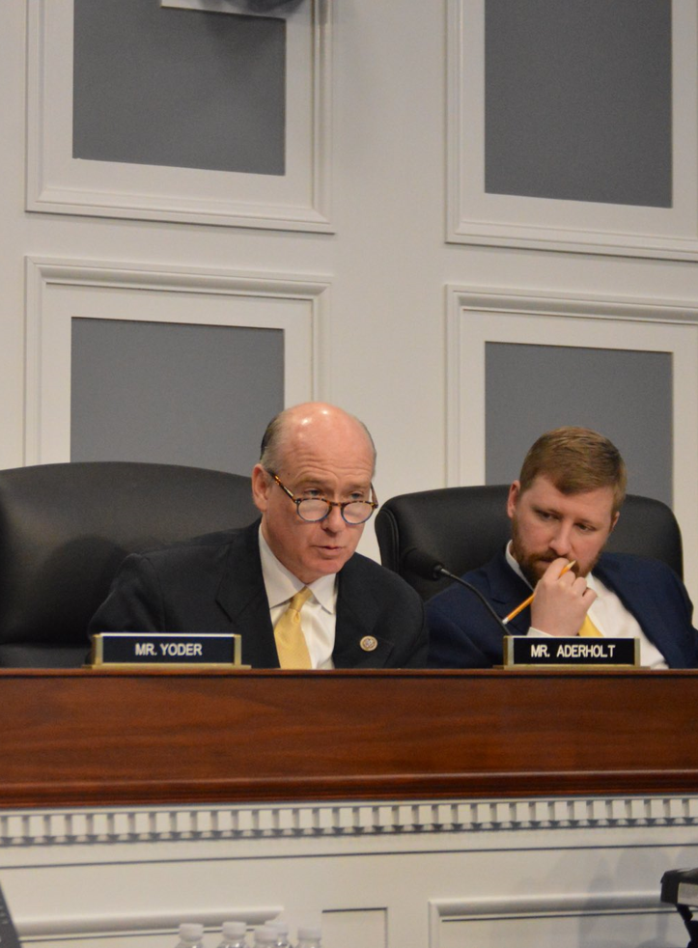
A. Committees
There are four types of committees in Congress:
  Standing committees are permanent committees that are generally more powerful than other types.
  Select committees are created for a specific temporary purpose.
Notes:
By United States House of Representatives - Office of Robert Aderholt - https://twitter.com/Robert_Aderholt/status/971528603673546752, Public Domain, https://commons.wikimedia.org/w/index.php?curid=86314514
https://commons.wikimedia.org/w/index.php?title=Special:Search&limit=500&offset=0&ns0=1&ns6=1&ns12=1&ns14=1&ns100=1&ns106=1&search=Congress+committee&advancedSearch-current=%7B%7D&searchToken=9xieurcooeiswoll1munzpqdw#%2Fmedia%2FFile%3ARobert_Aderholt_in_sub-committee_meeting.jpg

Slide 26
A. Committees
There are four types of committees in Congress:
  Joint committees consist of members of the House and Senate and serve as advisory boards to other committees.
  Conference committees devise a compromise on different versions of a bill that emerged from both houses.
Notes:
By United States House of Representatives - Office of Robert Aderholt - https://twitter.com/Robert_Aderholt/status/971528603673546752, Public Domain, https://commons.wikimedia.org/w/index.php?curid=86314514
https://commons.wikimedia.org/w/index.php?title=Special:Search&limit=500&offset=0&ns0=1&ns6=1&ns12=1&ns14=1&ns100=1&ns106=1&search=Congress+committee&advancedSearch-current=%7B%7D&searchToken=9xieurcooeiswoll1munzpqdw#%2Fmedia%2FFile%3ARobert_Aderholt_in_sub-committee_meeting.jpg

Slide 27
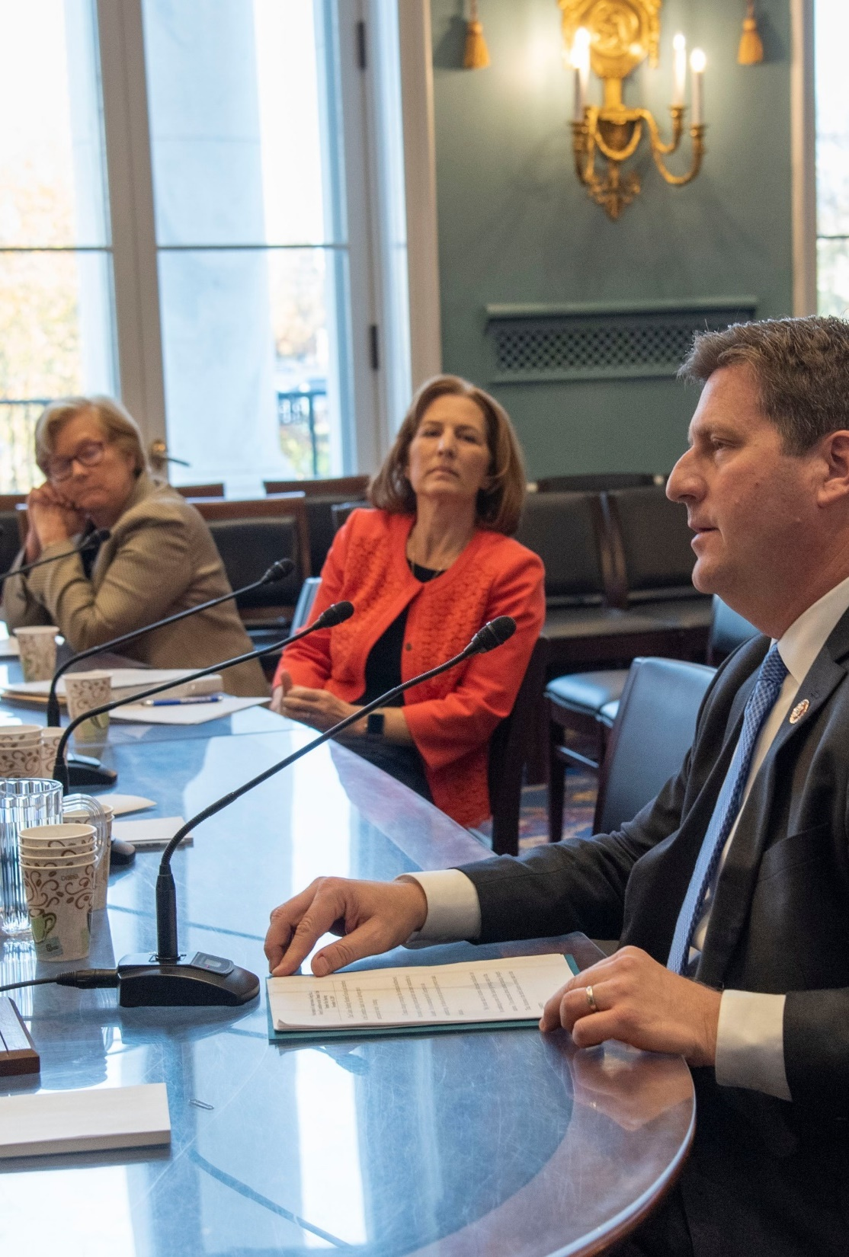
A. Committees
Committees provide certain advantages to Congress:
  They permit Congress to increase its workload and give more careful attention to proposals.
  Committees encourage expertise in a particular area.
Notes:
By United States House of Representatives - From the Office of Greg Stanton - https://twitter.com/RepGregStanton/status/1195100869055963136, Public Domain, https://commons.wikimedia.org/w/index.php?curid=86430368
https://commons.wikimedia.org/w/index.php?title=Special:Search&limit=500&offset=0&ns0=1&ns6=1&ns12=1&ns14=1&ns100=1&ns106=1&search=Congress+committee&advancedSearch-current=%7B%7D&searchToken=9xieurcooeiswoll1munzpqdw#%2Fmedia%2FFile%3AGreg_Stanton_at_United_States_House_Select_Committee_on_the_Climate_Crisis.jpg

Slide 28
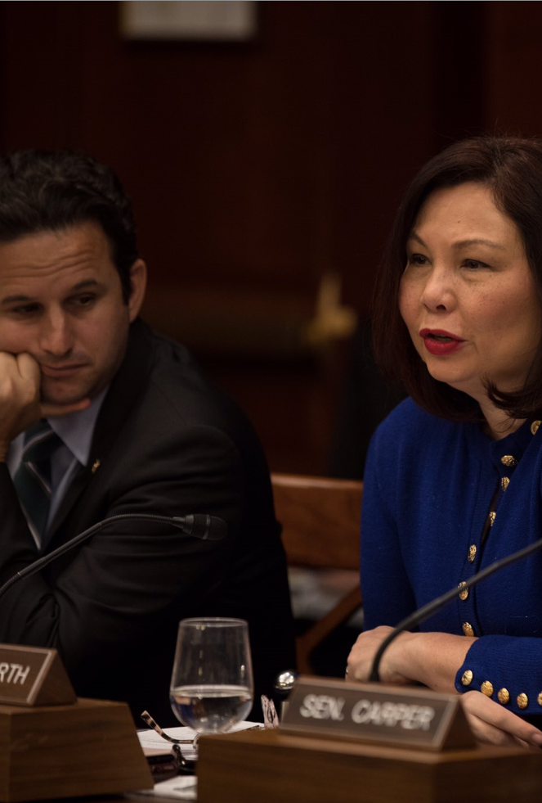
A. Committees
Membership in committees is determined by the percentage of seats held by each party in Congress.
Senior members have priority and tend to receive the best assignments.
Each committee is led by a chair who has significant power over which bills will be considered.
Notes:
By Tammy Duckworth - https://twitter.com/SenDuckworth/status/1197666217844195329, Public Domain, https://commons.wikimedia.org/w/index.php?curid=88502838
https://commons.wikimedia.org/w/index.php?title=Special:Search&limit=500&offset=0&ns0=1&ns6=1&ns12=1&ns14=1&ns100=1&ns106=1&search=Congress+committee&advancedSearch-current=%7B%7D&searchToken=9xieurcooeiswoll1munzpqdw#%2Fmedia%2FFile%3ATammy_Duckworth_-_during_Senate_Democrat%27s_Climate_Committee_meeting.jpg

Slide 29
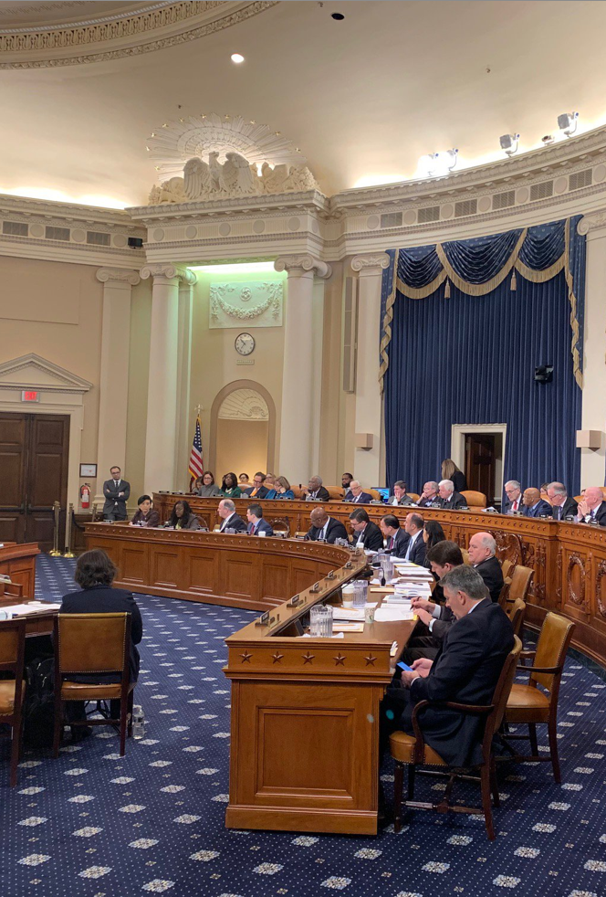
B. Making Laws
Congress’s chief constitutional function is to make laws.
Only a member of the House or Senate may submit a proposed law – a bill.
Notes:
By United States House of Representatives - Office of David Schweikert - https://twitter.com/RepDavid/status/1090274768778027008, Public Domain, https://commons.wikimedia.org/w/index.php?curid=86418994
https://commons.wikimedia.org/w/index.php?title=Special:Search&limit=500&offset=0&ns0=1&ns6=1&ns12=1&ns14=1&ns100=1&ns106=1&search=Congress+committee&advancedSearch-current=%7B%7D&searchToken=9xieurcooeiswoll1munzpqdw#%2Fmedia%2FFile%3AWays_and_Means_first_of_2019.jpg

Slide 30
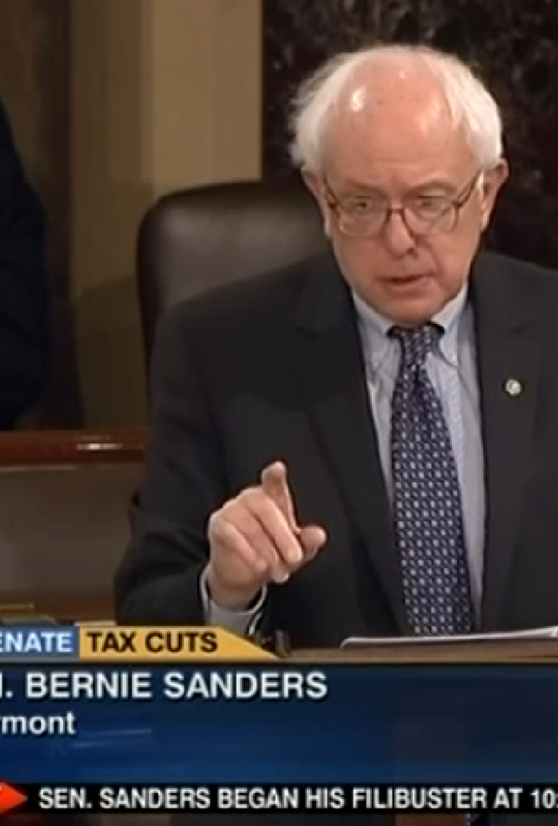
B. Making Laws
The Senate generally moves more slowly than the House.
A senator may delay a bill through a filibuster which is done by giving a long speech.
Filibusters can be defeated by ending the debate through a successful cloture motion.
Notes:
By C-SPAN - C-SPAN, Public Domain, https://commons.wikimedia.org/w/index.php?curid=44100523
https://commons.wikimedia.org/w/index.php?title=Special:Search&limit=500&offset=0&profile=default&search=senate+filibuster&advancedSearch-current=%7B%7D&ns0=1&ns6=1&ns12=1&ns14=1&ns100=1&ns106=1&searchToken=waf5mlnfx29g7w0ppc8jq9nt#%2Fmedia%2FFile%3ASenator_Bernie_Sanders_Engaging_in_a_Filibuster.png

Slide 31
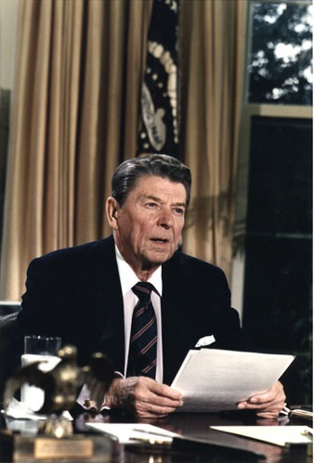
B. Making Laws
Once a bill passes Congress, it goes to the president, who has four options:
  He can sign the bill, making it law.
  He can veto the bill, killing it.
Notes:
https://commons.wikimedia.org/wiki/File:Reagan_Challenger.jpg
“Reagan Challenger”/Wikimedia Commons/Public Domain

Slide 32
B. Making Laws
Once a bill passes Congress, it goes to the president, who has four options:
  He can ignore the bill, but if Congress is in session the bill becomes law within ten days.
  If Congress is not in session and he does not sign it, the bill dies in what is known as a pocket veto.
Notes:
https://commons.wikimedia.org/wiki/File:Reagan_Challenger.jpg
“Reagan Challenger”/Wikimedia Commons/Public Domain

Slide 33
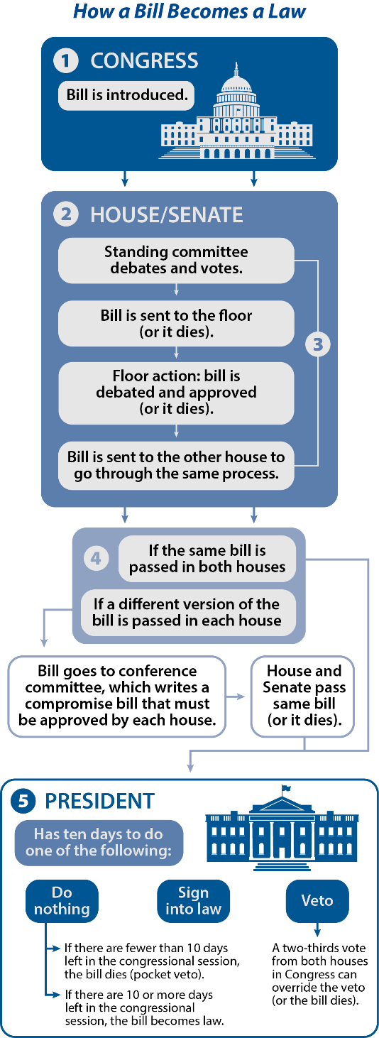
Notes:
BJU Press Art

Slide 34
Section Review – Chapter 8.2
1–4. Identify the four types of congressional committees and describe the function served by each.
standing committees: permanent and the most powerful; select committees: temporary and created for a specific purpose, usually to investigate a problem; joint committees: usually permanent and composed of members of both houses to advise other committees; conference committees: temporary, drawn from both chambers, and created to devise compromises on bills that have passed both chambers in different forms
(pp. 178–179)

Slide 35
Section Review – Chapter 8.2
5. What is Congress’s chief constitutional function?
to make laws (p. 181)

Slide 36
Section Review – Chapter 8.2
6–8. Explain the three basic steps required for a bill to receive congressional approval.
(a) must receive approval of a standing committee in both the House and Senate; (b) must receive approval of both chambers; (c) and must have any differences between the House and Senate versions of the bill resolved by a conference committee (and the revised bill approved by both chambers) (pp. 181–184)

Slide 37
Section Review – Chapter 8.2
Why are committee chairmanships important?
Committee chairs have a major voice in deciding which bills the committee will consider, the order in which the bills will be discussed, whether a hearing will be held, and whether witnesses should testify. In addition, the chair manages debate and has much control over the committee expenditures. He also selects subcommittee chairmen and recommends majority-party members for conference committees.

Slide 38
Section Review – Chapter 8.2
Read the quote by Supreme Court Justice Joseph Story on page 181. Explain his statement. Do you agree or disagree?
Students may mention that legislation should account for the many differences among states without giving preference to one state. Some will agree that all states should be considered when making laws. Others may prefer to highlight issues in their state of residence or may insist that the more populated states should have more influence.

Slide 39
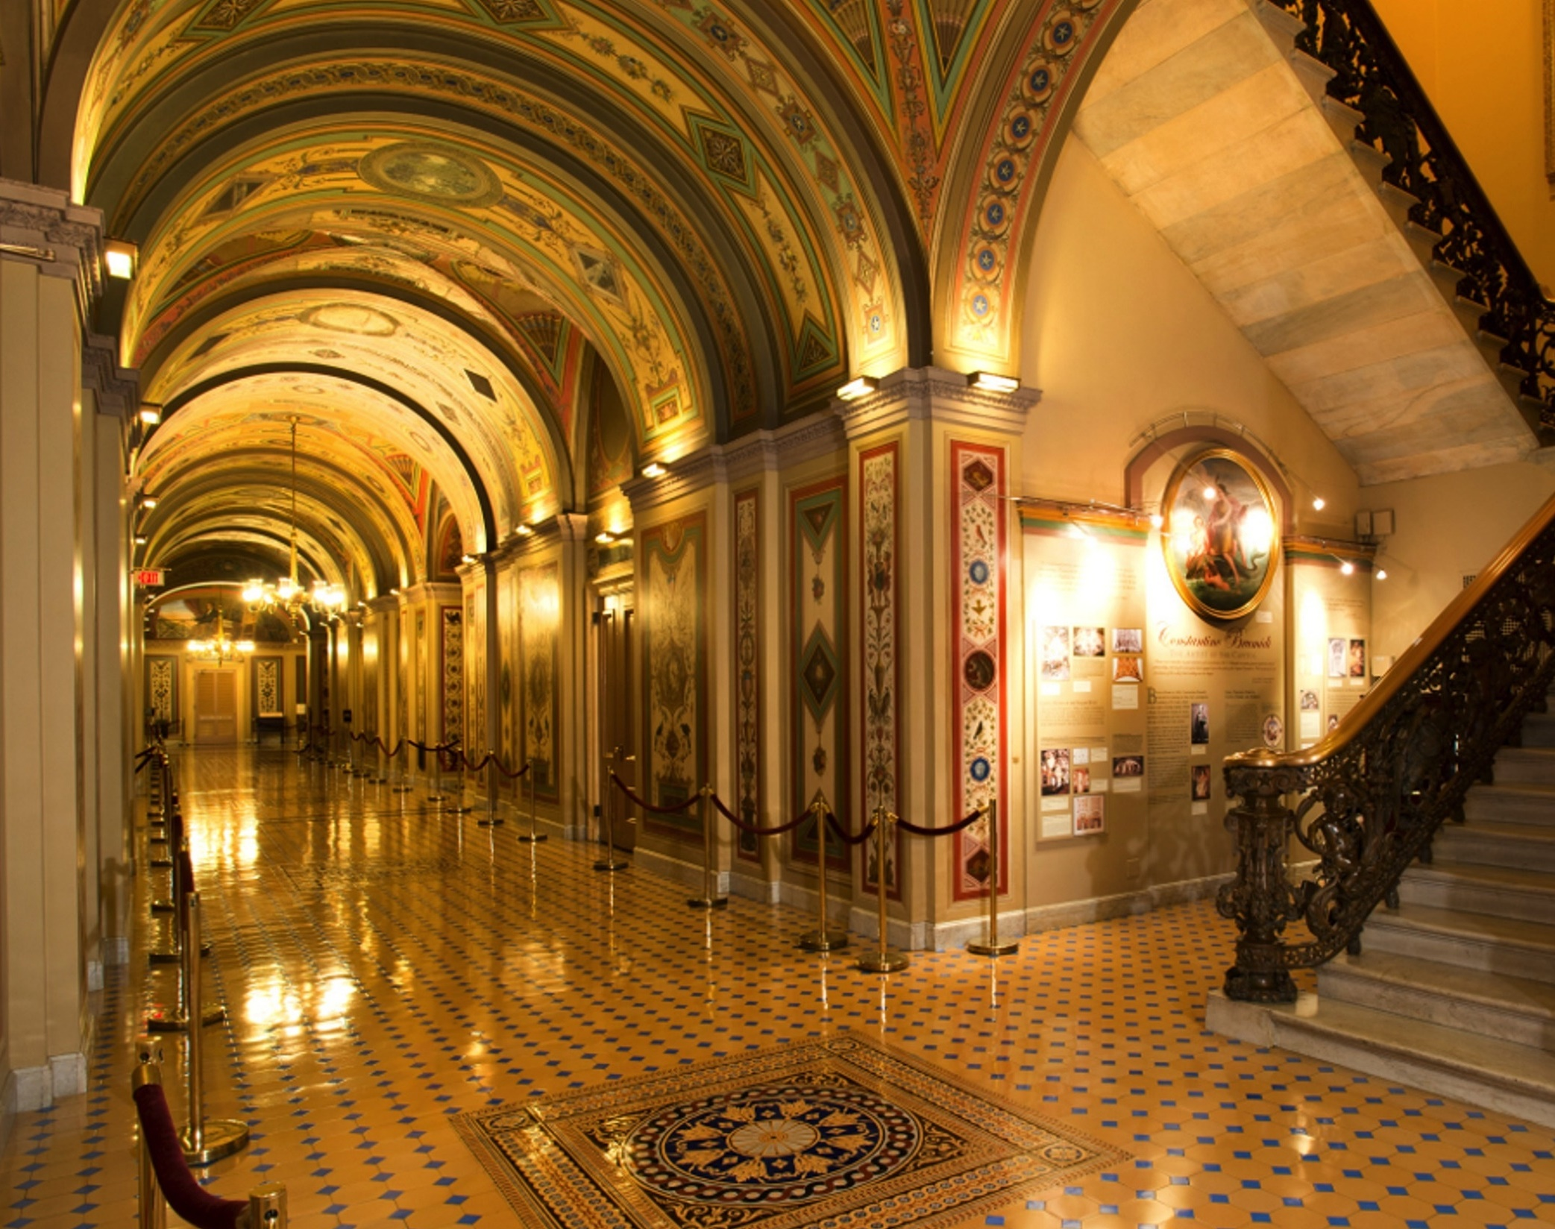
Chapter 8 Terms
Notes:
Image by David Mark from Pixabay
https://pixabay.com/photos/washington-dc-capitol-buildings-85541/

Slide 40
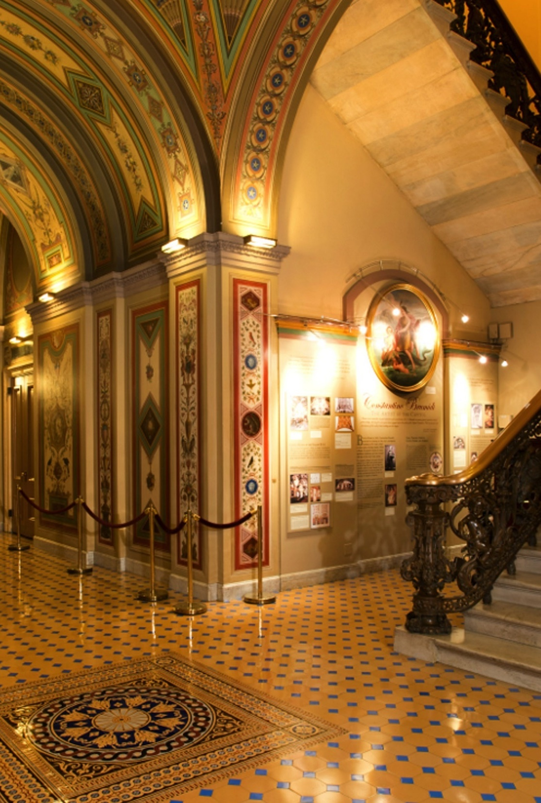
bicameral
describes a legislative branch of the national government or of a state government that is divided into two separate houses, an upper chamber and a lower chamber
Notes:
Image by David Mark from Pixabay
https://pixabay.com/photos/washington-dc-capitol-buildings-85541/

Slide 41
census
official government count of the United States population, taken every ten years and used to determine the number of representatives for each state
Notes:
Image by David Mark from Pixabay
https://pixabay.com/photos/washington-dc-capitol-buildings-85541/

Slide 42
reapportionment
the process of redrawing the boundaries of congressional districts to reflect population shifts
Notes:
Image by David Mark from Pixabay
https://pixabay.com/photos/washington-dc-capitol-buildings-85541/

Slide 43
gerrymandering
the redrawing of district boundaries to favor a particular party or group of people that controls a state legislature
Notes:
Image by David Mark from Pixabay
https://pixabay.com/photos/washington-dc-capitol-buildings-85541/

Slide 44
congressional district
geographic area represented by a House member
Notes:
Image by David Mark from Pixabay
https://pixabay.com/photos/washington-dc-capitol-buildings-85541/

Slide 45
single-member district
a legislative district from which only one representative is elected
Notes:
Image by David Mark from Pixabay
https://pixabay.com/photos/washington-dc-capitol-buildings-85541/

Slide 46
at large
representing an entire state rather than a particular district
Notes:
Image by David Mark from Pixabay
https://pixabay.com/photos/washington-dc-capitol-buildings-85541/

Slide 47
Seventeenth Amendment
the constitutional amendment that provided for the direct popular election of senators
Notes:
Image by David Mark from Pixabay
https://pixabay.com/photos/washington-dc-capitol-buildings-85541/

Slide 48
coalition
a temporary alliance formed by members of different parties who unite to support or oppose a bill because of some common interest
Notes:
Image by David Mark from Pixabay
https://pixabay.com/photos/washington-dc-capitol-buildings-85541/

Slide 49
caucus
a meeting of all members of a party in the House or Senate, also called a conference by Republicans.
Notes:
Image by David Mark from Pixabay
https://pixabay.com/photos/washington-dc-capitol-buildings-85541/

Slide 50
conference
a meeting of all members of a party in the House or Senate
Notes:
Image by David Mark from Pixabay
https://pixabay.com/photos/washington-dc-capitol-buildings-85541/

Slide 51
majority leader
the leader chosen by the party with the most members in the House or Senate; in the House, he is next to the Speaker in authority, but in the Senate, he is the most powerful member
Notes:
Image by David Mark from Pixabay
https://pixabay.com/photos/washington-dc-capitol-buildings-85541/

Slide 52
majority whip
in the House and the Senate, the assistant majority leader chosen by the party with the most seats; responsibilities include overseeing communication, tracking votes, and summarizing bills
Notes:
Image by David Mark from Pixabay
https://pixabay.com/photos/washington-dc-capitol-buildings-85541/

Slide 53
minority leader
the leader chosen by the party with the second-most members in the House or the Senate
Notes:
Image by David Mark from Pixabay
https://pixabay.com/photos/washington-dc-capitol-buildings-85541/

Slide 54
minority whip
in the House and the Senate, the assistant minority leader chosen by the party with the second-most seats; responsibilities include overseeing communication, tracking votes, and summarizing bills
Notes:
Image by David Mark from Pixabay
https://pixabay.com/photos/washington-dc-capitol-buildings-85541/

Slide 55
president pro tempore
honorary position given to the most senior member of the Senate’s majority party; serves as elected leader of the Senate when the vice president is absent
Notes:
Image by David Mark from Pixabay
https://pixabay.com/photos/washington-dc-capitol-buildings-85541/

Slide 56
Speaker of the House
head of the House of Representatives who presides over the House, manages House business, and is the official spokesman for the House; elected by the House members
Notes:
Image by David Mark from Pixabay
https://pixabay.com/photos/washington-dc-capitol-buildings-85541/

Slide 57
term limits
limits on the number of terms an elected official can serve
Notes:
Image by David Mark from Pixabay
https://pixabay.com/photos/washington-dc-capitol-buildings-85541/

Slide 58
franking privilege
the right of members of Congress to send official mail free of charge
Notes:
Image by David Mark from Pixabay
https://pixabay.com/photos/washington-dc-capitol-buildings-85541/

Slide 59
junkets
seemingly unnecessary trips made by members of Congress at the taxpayers’ expense
Notes:
Image by David Mark from Pixabay
https://pixabay.com/photos/washington-dc-capitol-buildings-85541/

Slide 60
standing committees
permanent committees in Congress
Notes:
Image by David Mark from Pixabay
https://pixabay.com/photos/washington-dc-capitol-buildings-85541/

Slide 61
select committees
temporary congressional committees created for a specific purpose, generally to investigate particular problems
Notes:
Image by David Mark from Pixabay
https://pixabay.com/photos/washington-dc-capitol-buildings-85541/

Slide 62
joint committees
permanent committees composed of House and Senate members; act as advisory boards to other congressional committees, particularly on tax matters
Notes:
Image by David Mark from Pixabay
https://pixabay.com/photos/washington-dc-capitol-buildings-85541/

Slide 63
conference committees
ad hoc (temporary) committees drawn from both chambers of Congress that meet to work out a compromise regarding different versions of a bill, or a proposed law, that emerged from both houses
Notes:
Image by David Mark from Pixabay
https://pixabay.com/photos/washington-dc-capitol-buildings-85541/

Slide 64
chair
the head of a congressional committee
Notes:
Image by David Mark from Pixabay
https://pixabay.com/photos/washington-dc-capitol-buildings-85541/

Slide 65
filibuster
tactic used in the Senate to prevent or delay a bill’s passage; usually involves one or more senators giving long speeches
Notes:
Image by David Mark from Pixabay
https://pixabay.com/photos/washington-dc-capitol-buildings-85541/

Slide 66
cloture
a motion made by sixteen or more senators to stop debate on a piece of legislation; if sixty or more senators support the motion, cloture is passed;
often used to end a filibuster
Notes:
Image by David Mark from Pixabay
https://pixabay.com/photos/washington-dc-capitol-buildings-85541/

Slide 67
veto
the power of the president to reject a bill that was approved by Congress
Notes:
Image by David Mark from Pixabay
https://pixabay.com/photos/washington-dc-capitol-buildings-85541/

Slide 68
pocket veto
the automatic veto of a bill if the president leaves the bill unsigned for ten days during a congressional adjournment
Notes:
Image by David Mark from Pixabay
https://pixabay.com/photos/washington-dc-capitol-buildings-85541/

