Slide 2
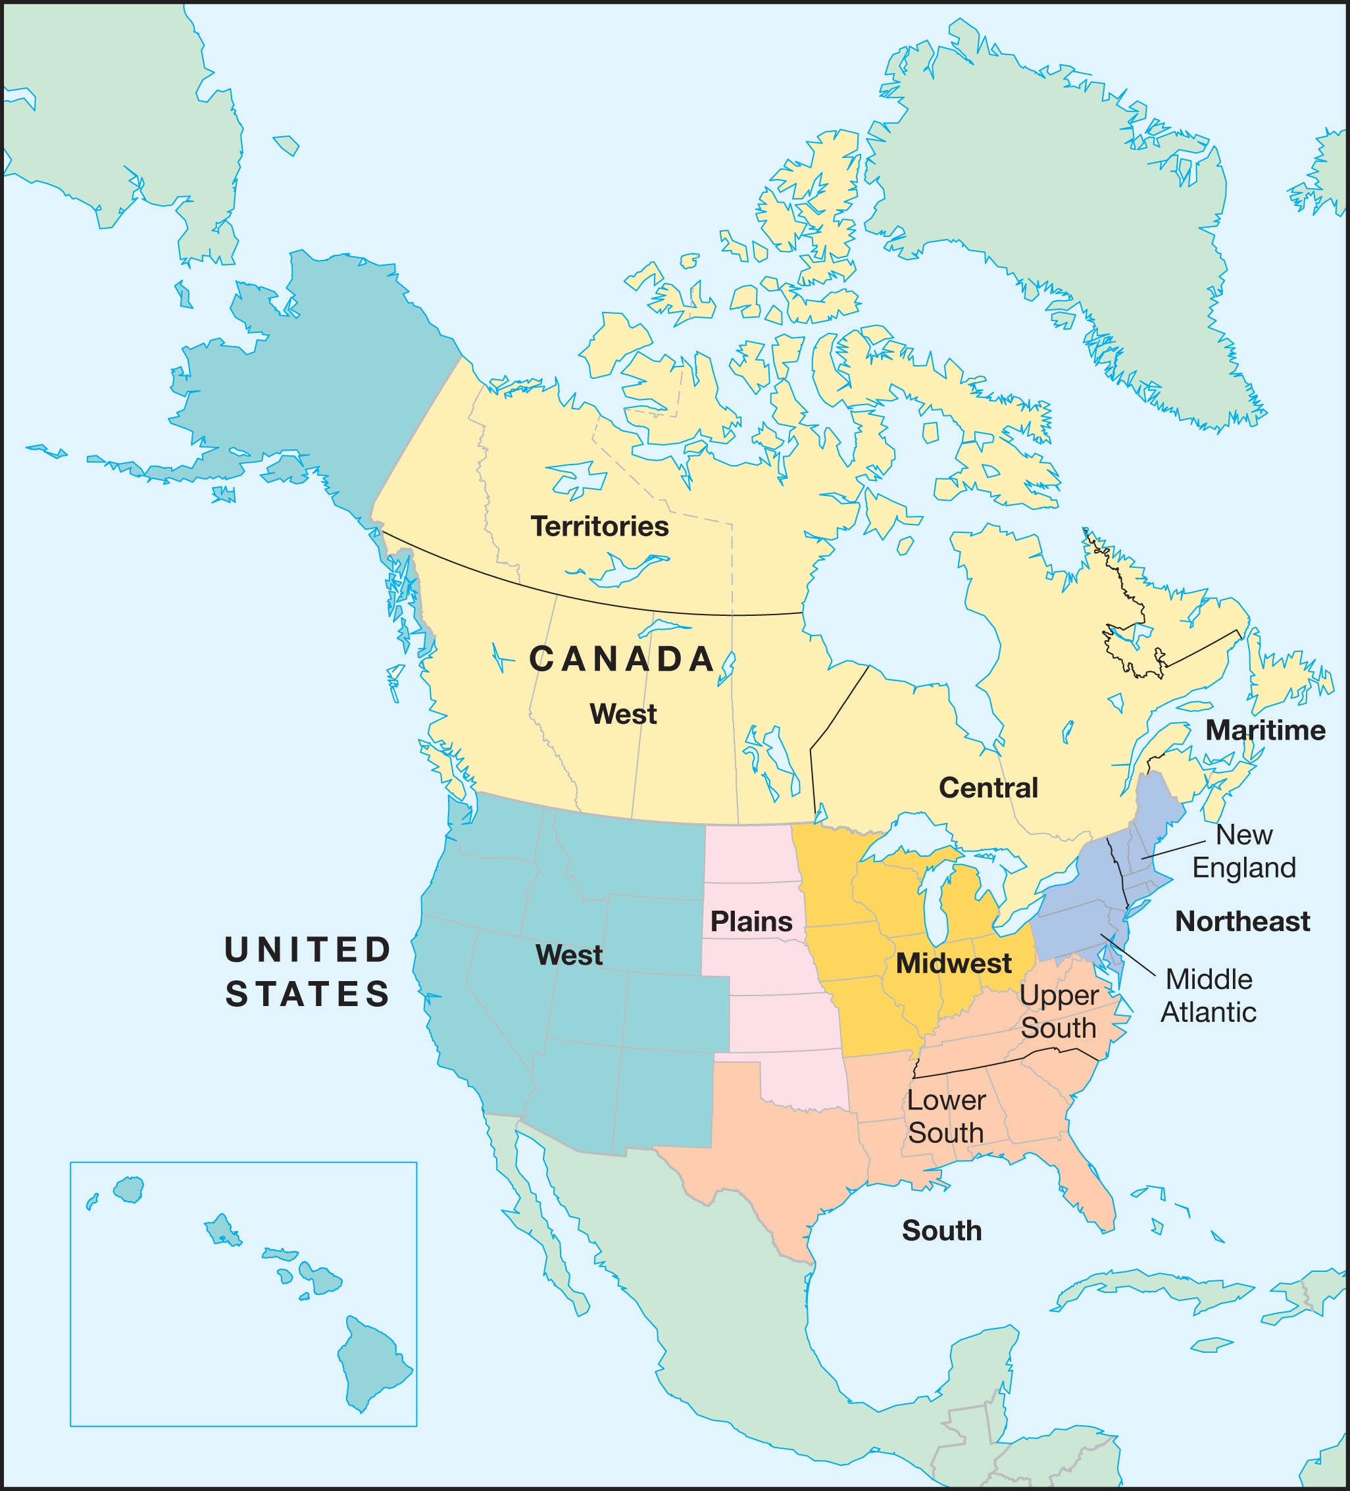

Slide 3
I. The Northeast

Slide 4
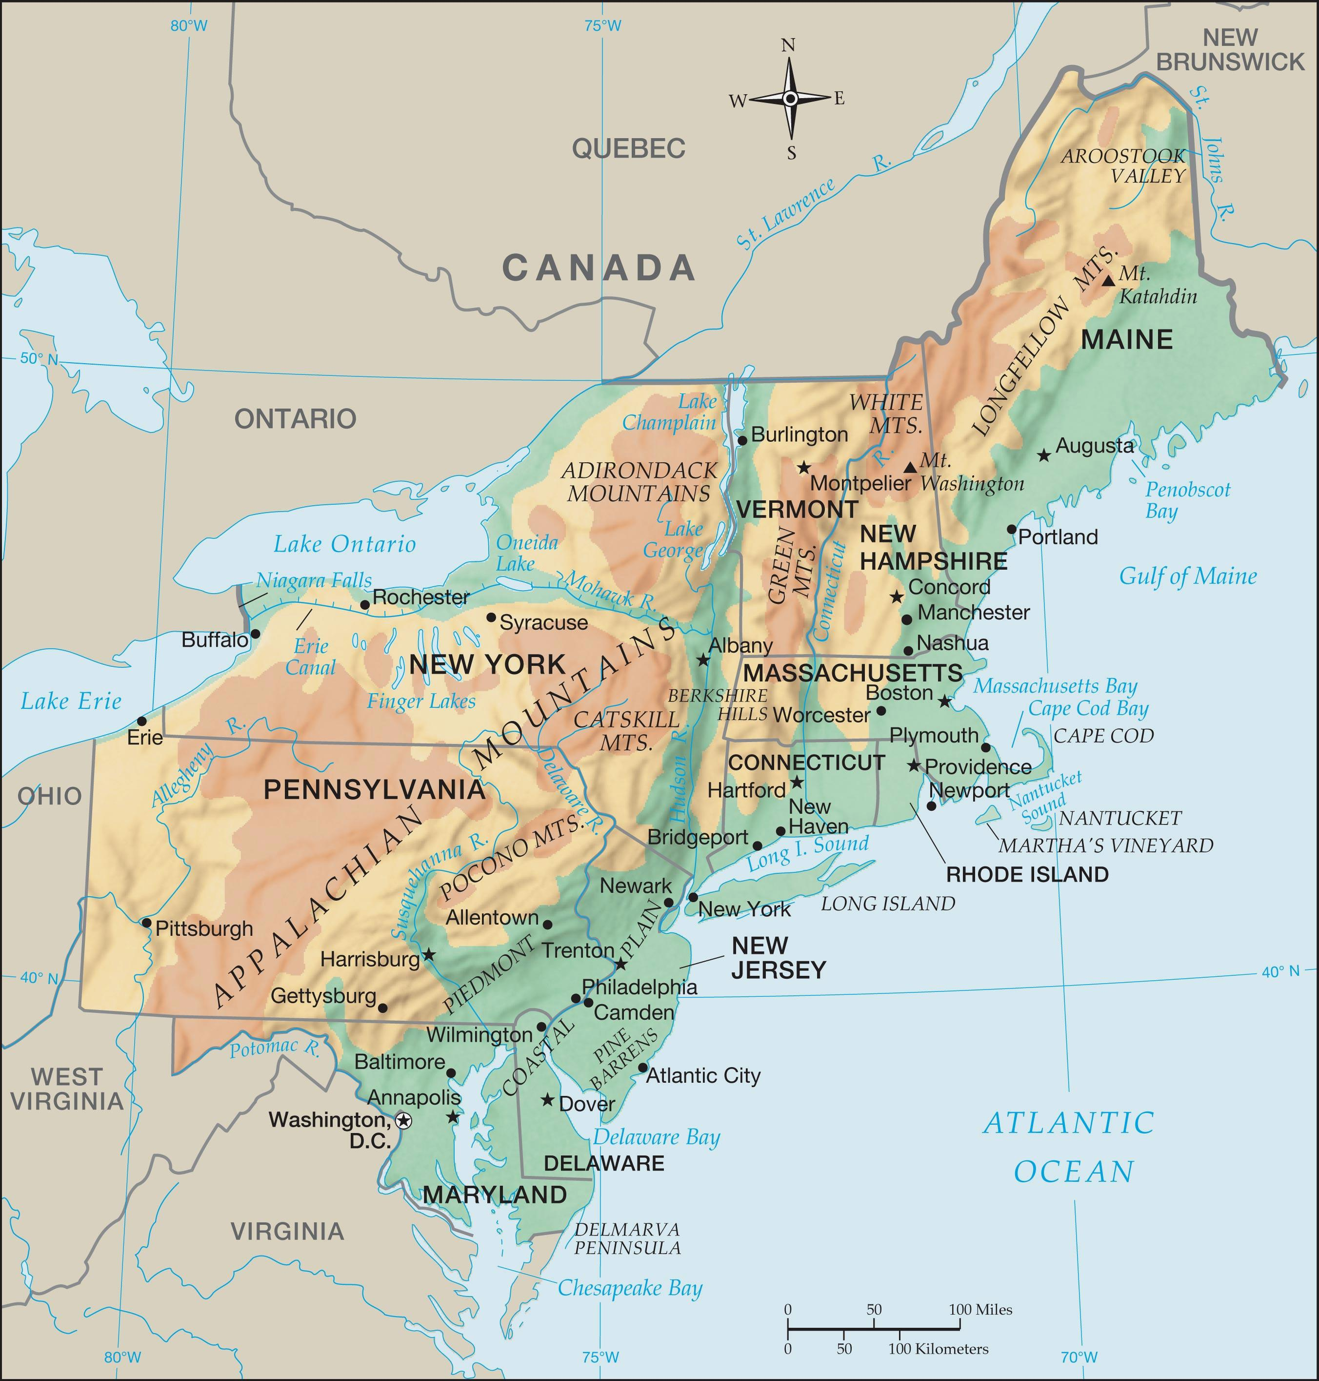

Slide 5
The Northeast can be divided into two subregions, New England and the Middle Atlantic.
This region has a large population and much historical significance.

Slide 6
9 of the original 13 colonies were in the Northeast.
John Cabot who claimed the area for England named it New England.

Slide 7
They divided their settlements into townships and held town meetings which became the basis for self government.

Slide 8
I. The Northeast
A. New England
1. Climate
2. Terrain
New England Uplands- a low rocky plateau that rises above the coast.

Slide 9
3. Lower New England
The Mayflower Compact- laid foundation for self government.
a. Massachusetts
b. Rhode Island- Founded by Roger Williams. Smallest state
c. Connecticut- Yale University

Slide 10
4. Upper New England-
Low places in the mountains called notches.
a. New Hampshire
b. Vermont- Once divided by NY and NH.
c. Maine- Largest New Eng state, lobster

Slide 11
B. The Middle Atlantic
Megalopolis an urban area of many cities that join together to form one urban area
1. New York- Finger Lakes- long glacier-made lakes

Slide 12
2. Pennsylvania- Independence Hall and Liberty Bell in Philadelphia.
Hershey- home of largest chocolate factory.
Pittsburgh- steel mills

Slide 13
3. New Jersey- Pine Barrens and Truck farms- gives it the name “Garden State”
4. Maryland- Baltimore is site of Fort
McHenry – “Star Spangled Banner”
5. Delaware- Delmarva Peninsula- DE, MD and VA

Slide 14
II. The South

Slide 15
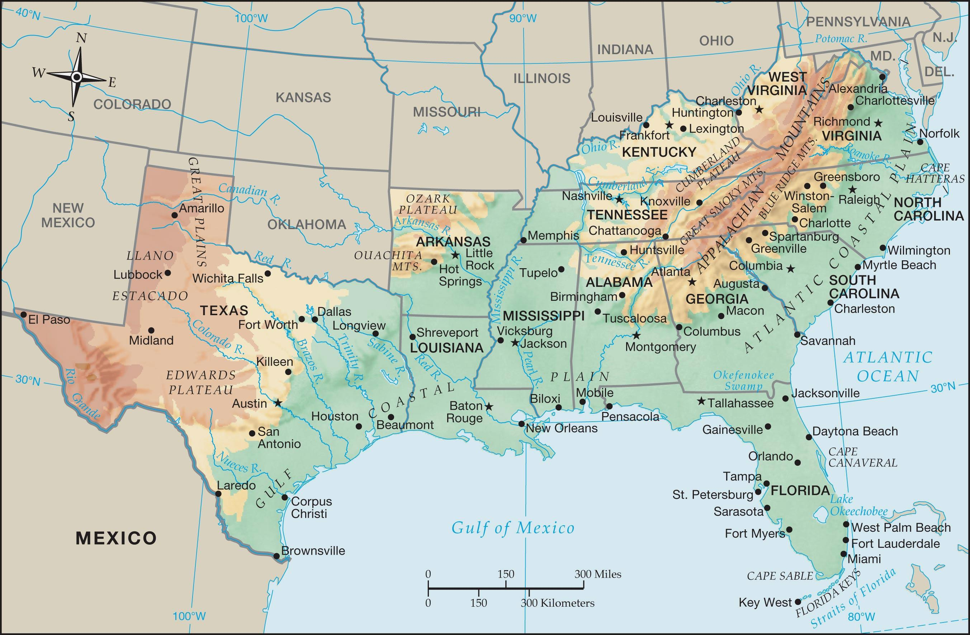

Slide 16
The South is one of the most rapidly growing parts of the United States.

Slide 17
II. The South
A. The Upper South
1. Virginia- Shenandoah Valley- breadbasket of Virginia
2. West Virginia- separated from VA in 1863
3.North Carolina- Barrier Islands of Outer Banks

Slide 18
4. Kentucky- Bluegrass State, Mammoth Cave- world’s largest
5. Tennessee- Volunteer State, Three Great States (3 geographic regions), Divided twice by Tennessee River
6. Arkansas- Ozark Mountains

Slide 19
B. The Lower South- largest % of minorities
1. South Carolina- lead in peaches
2. Georgia- lead in peanuts and pecans
3. Florida- Key West- southernmost part of the 48 states.

Slide 20
4. Alabama
5. Mississippi
6. Louisiana- bayous- swampy areas
Cajuns- ancestors of French people from Maine
Creoles- mix of black and European

Slide 21
7. Texas- The east has forest and cotton
farms.
4 of the nation’s 10 busiest ports
3 of the nation’s 10 largest cities

Slide 22
III. The Midwest

Slide 23
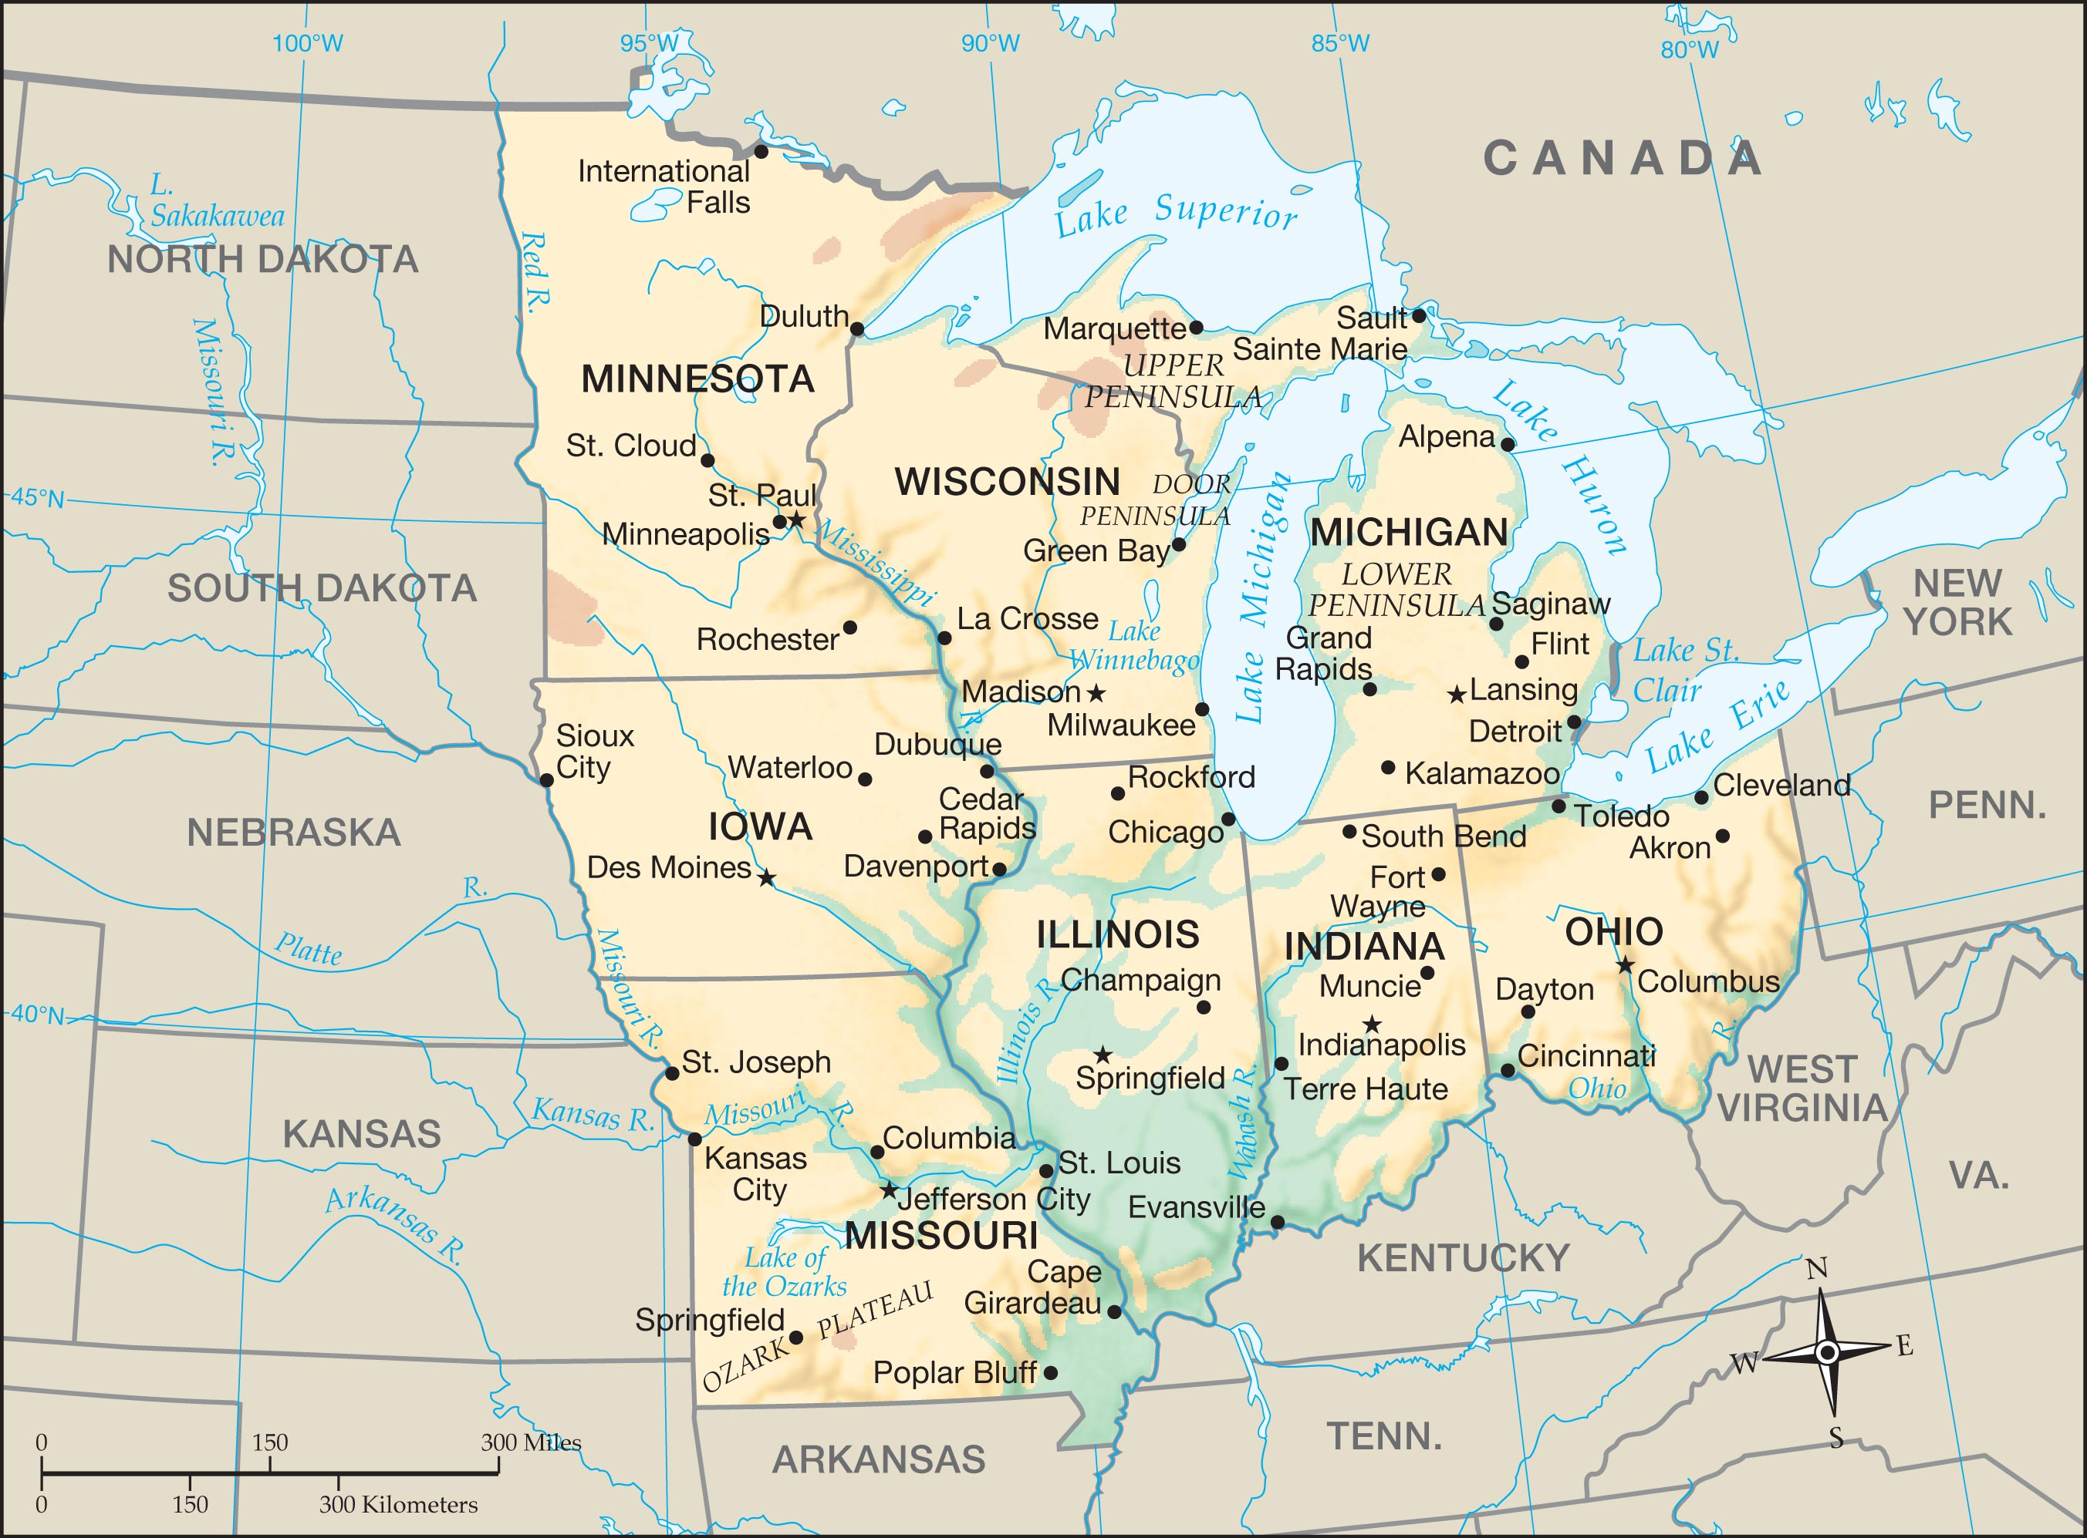

Slide 24
III. The Midwest
A. Ohio
B. Indiana

Slide 25
C. Illinois- prairies- rolling hills with high grasses
D. Michigan- shoreline on 4 Great Lakes
Detroit is motor city.
E. Wisconsin- “America’s Dairyland” produces ¼ of all cheese in America

Slide 26
F. Minnesota- “Land of 10,000 Lakes”, Mesabi range- rich iron ore, twin cities of Minneapolis and St. Paul
G. Iowa
H. Missouri- “Gateway to the West”
Gateway Arch-largest monument in the nation

Slide 27
IV. The Plains

Slide 28
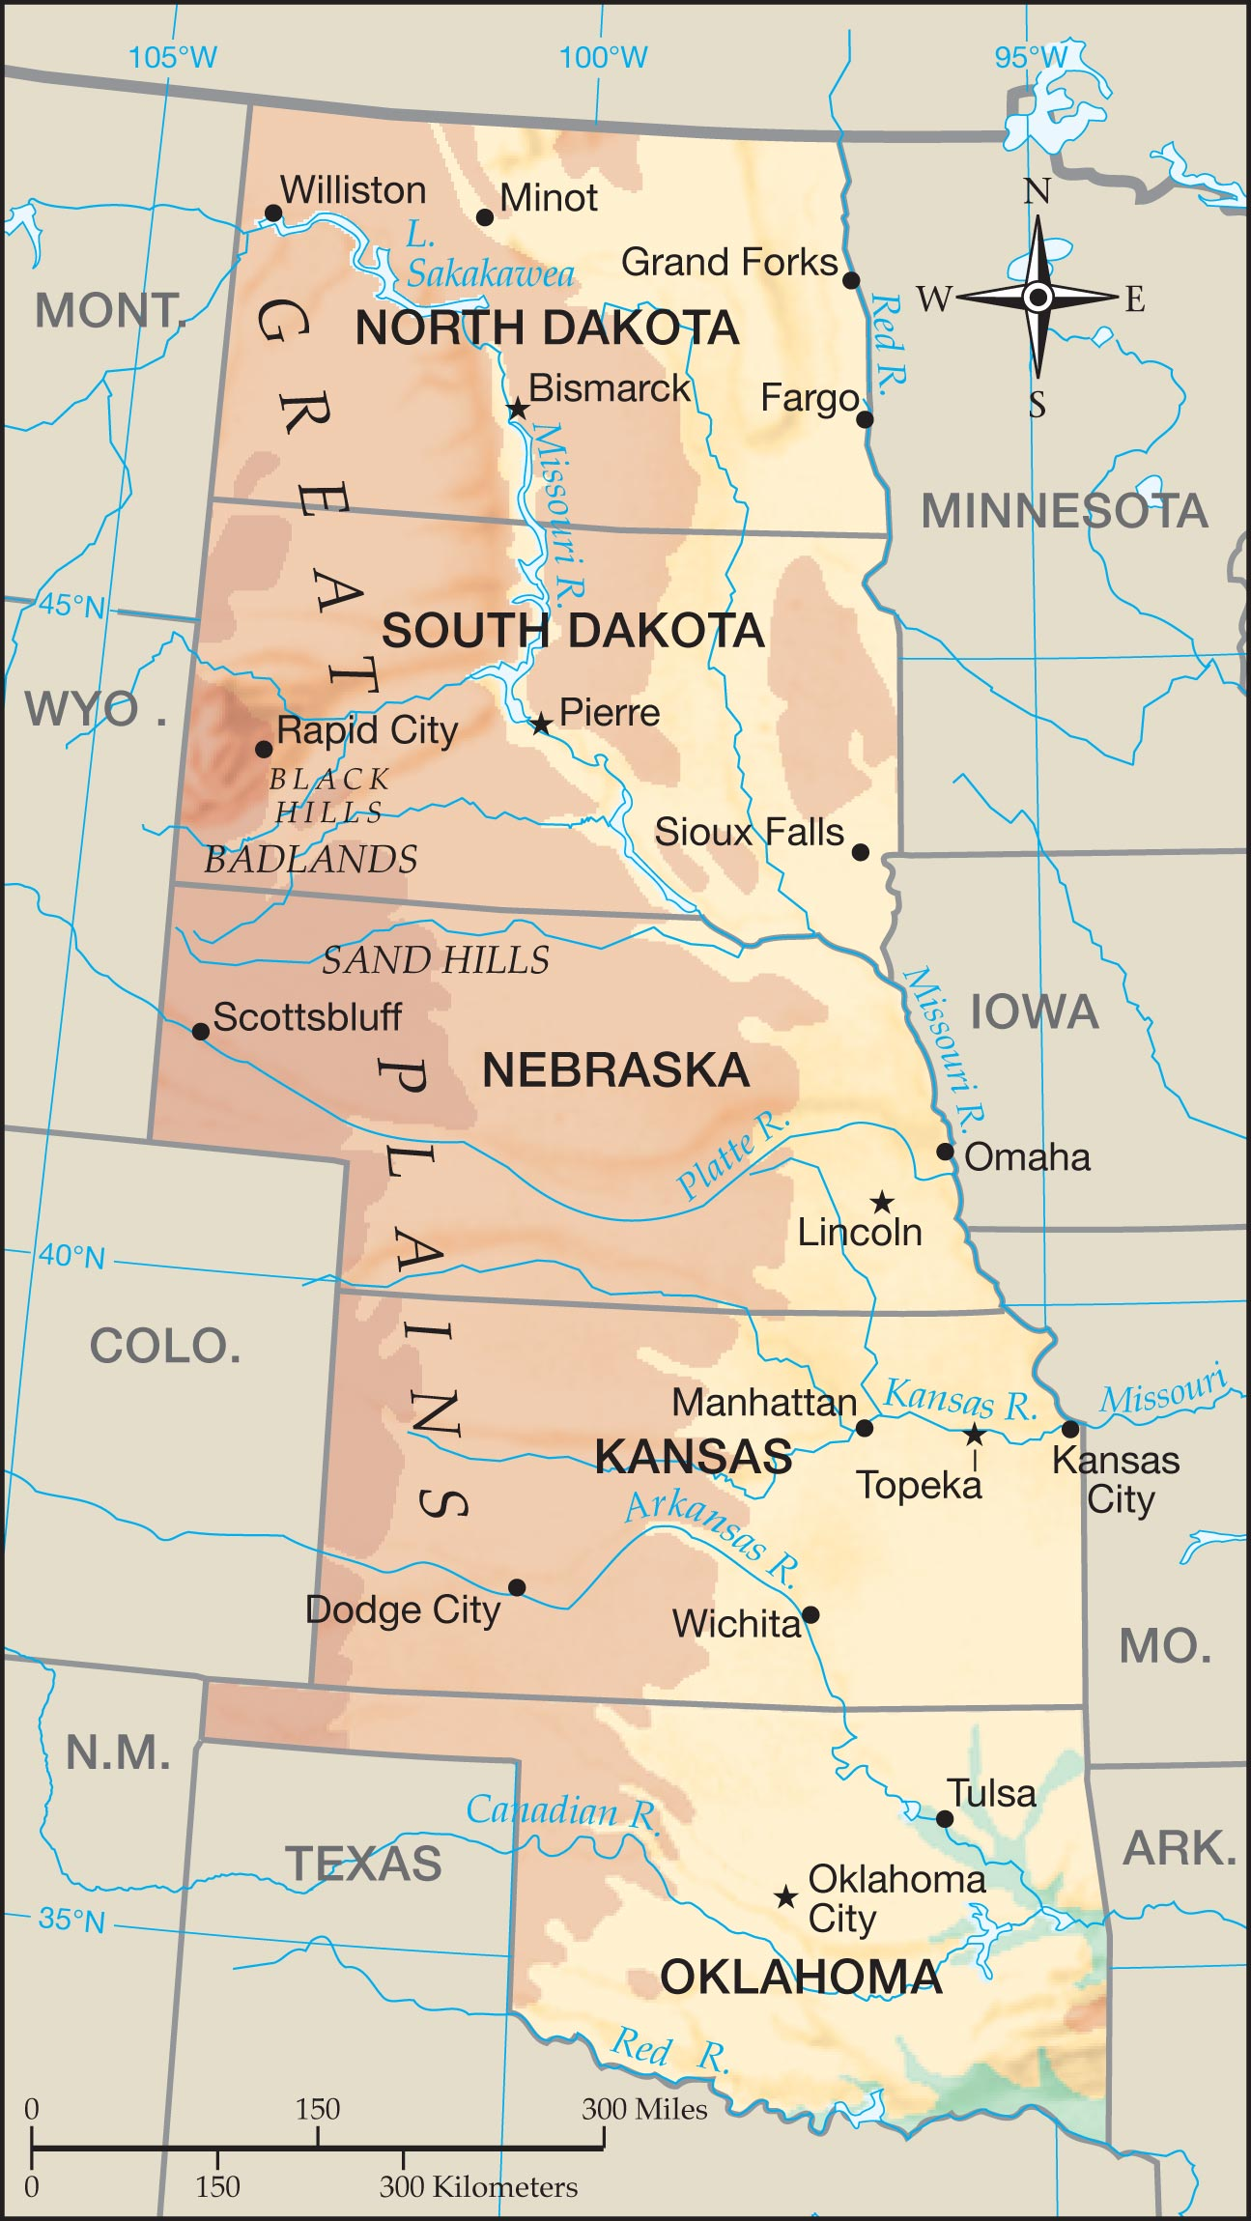

Slide 29
IV. The Plains
A. North Dakota
B. South Dakota- Badlands in the west
Mt. Rushmore- 4 presidents

Slide 30
C. Nebraska- only state with a unicameral legislature
D. Kansas
E. Oklahoma

Slide 31
V. The West

Slide 32
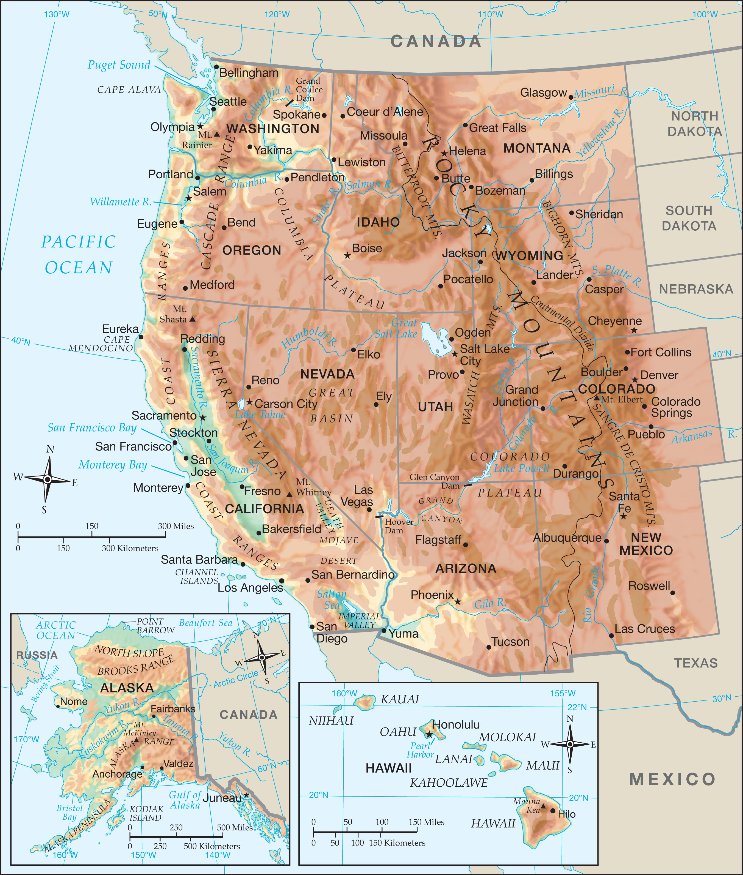

Slide 33
V. The West
A. Continental West
1. Montana
2. Wyoming- geyser Old Faithful

Slide 34
3. Idaho- potatoes
4. Colorado- Denver is the “Mile High City”
5. Utah- Salt Lake City- Headquarters of Mormonism
Great Salt Lake- Only slightly less salty than the Dead Sea

Slide 35
6. New Mexico
7. Arizona
8. California- if a country it would be among the top ten economies in the world.

Slide 36
9. Nevada- Hoover Dam creates Lake Meade. More than 90% owned by federal government.
10. Oregon
11. Washington- Puget Sound, Mount Ranier

Slide 37
B. Outlying States
1. Alaska- More than twice the size of Texas.
Alaskan Range continues into the ocean where it becomes the Aleutian Islands.
2. Hawaii- 2400 miles west of the mainland

