Slide 1
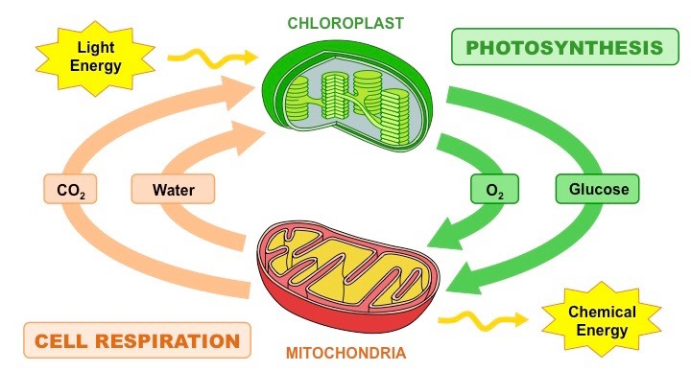
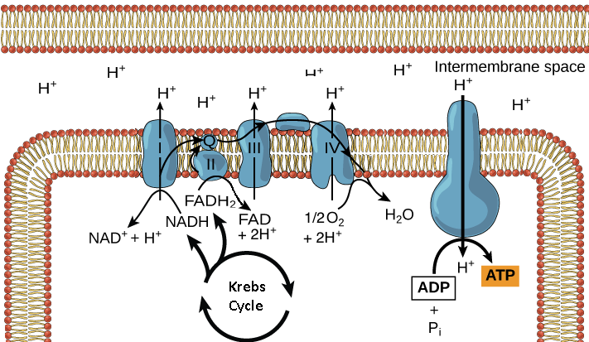
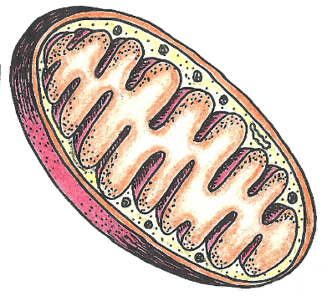
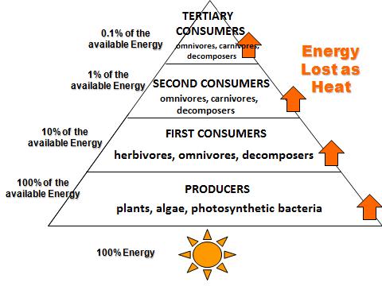
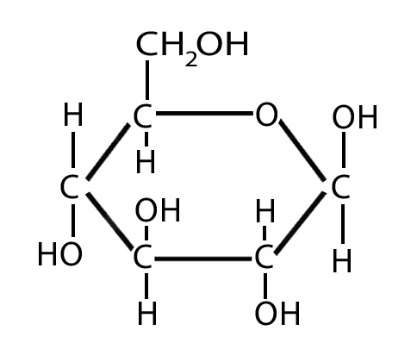
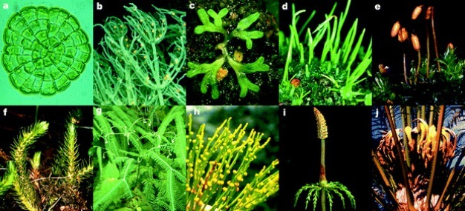
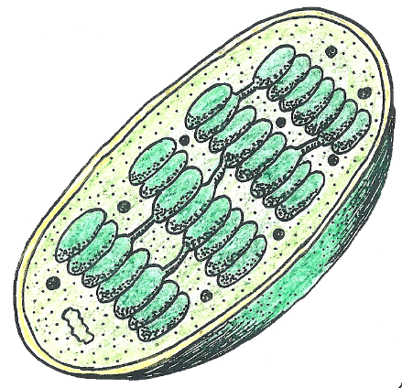
Photosynthesis & Cellular Respiration
Mizzz Foster © 2020

Slide 2
Photosynthesis & Cellular Respiration
Photosynthesis and Cellular Respiration are vital chemical reactions which work together in a cycle to keep organisms alive on Earth.
The products of one reaction are the reactants of the other reaction.
The reactants of one reaction are the products of the other.
The presentation will begin with an overview and detailed explanation of photosynthesis followed by cellular respiration.

Slide 3
What is Photosynthesis?
An endothermic chemical reaction in which light energy is converted into chemical energy by photosynthetic organisms.
Endothermic reactions store energy in the bonds of the product molecules.
Chemical Reaction:
6CO₂ + 6H₂O + light energy > C₆H₁₂O₆ + 6O₂

Slide 4
Why is photosynthesis an endothermic chemical reaction?
Photosynthesis stores the sun’s energy in the carbon to carbon bonds of glucose.
The sun’s energy is light energy, the glucose formed during photosynthesis is chemical energy.
Energy
Energy
Energy
Energy

Slide 5
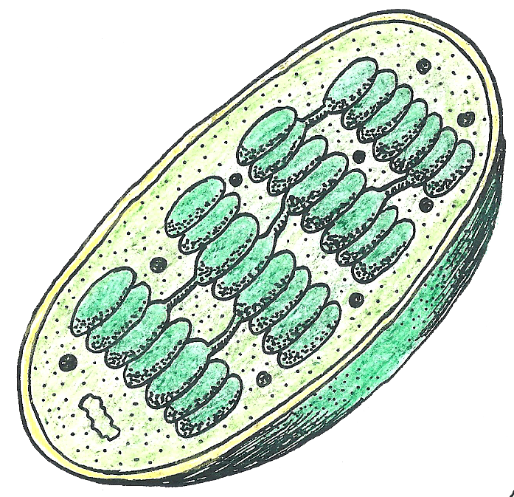
Where does photosynthesis take place?
Photosynthesis takes place in photosynthetic bacteria and organisms who have a chloroplast.
Inside the chloroplast the first steps of photosynthesis take place within the thylakoid membrane and the chloroplast’s stroma.
Stroma
Grana
Ribosome
Outer membrane
Inner membrane
cDNA
Thylakoid

Slide 6
Which organisms perform photosynthesis?
Autotrophic producers; photosynthetic bacteria, plants, photosynthetic protists, diatoms, plankton, and algae.

Slide 7
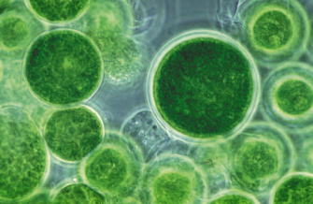
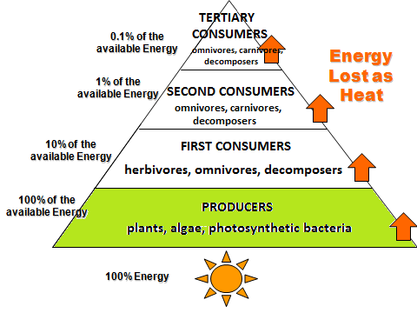
Photosynthetic Organism Labels
“Autotrophs”
“Producers”
Organisms who can harness light energy and create stored chemical energy.
Organisms who harness light energy in order to form chemical energy.
How are these two labels different?

Slide 8
STEPS OF PHOTOSYNTHESIS
Light Dependent Reactions (Thylakoid)
Light Independent Reaction (Stroma)
Stroma
Thylakoid

Slide 9
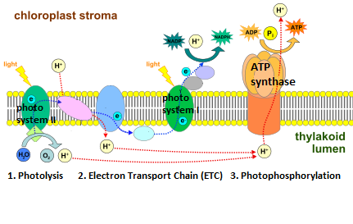
LIGHT DEPENDENT REACTIONS (can only take place when light energy is available)
1. Photolysis = At photosystem II water is split using light energy to create oxygen, release hydrogen and electrons.

Slide 10
LIGHT DEPENDENT REACTIONS (can only take place when light energy is available)
2. Electron Transport Chain = At photosystem I, electrons are used to bond hydrogen to NADPH (energy carrier).

Slide 11
LIGHT DEPENDENT REACTIONS (can only take place when light energy is available)
3. Photophosphorylation = At the ATP synthase hydrogen atoms shoot through the enzyme to bond P to ADP to form ATP.
ATP synthase is a protein.

Slide 12
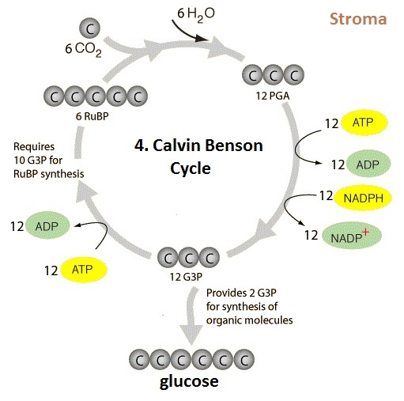
LIGHT INDEPENDENT REACTIONS (take place as long as NADPH and ATP is available, any time of day)
4. Calvin – Benson Cycle = Chemical reaction in which the carbon atoms of carbon dioxide, ATP and NADPH are used to form glucose.

Slide 13
Overview of Photosynthesis
Photosynthesis is the first step in converting the sun’s light energy into chemical energy (glucose) which can be used by organisms.
Photosynthesis is performed by the autotrophic producers in the food chain.
photosynthesis

Slide 14
Overview of Photosynthesis
The products of photosynthesis are not only used as energy for the consumers, but the producers also use the glucose to make ATP by cellular respiration to have energy to grow, reproduce and live.
When primary consumers eat producers, cellular respiration breaks down the glucose molecules in order to release the energy stored in the carbon to carbon bonds.
cellular respiration
cellular respiration
cellular respiration
cellular respiration
photosynthesis

Slide 15
What is Cellular Respiration? (aerobic respiration)
An exothermic chemical reaction in which chemical energy is converted into ATP, kinetic and heat energy by ALL life forms.
Exothermic reactions release the energy from the chemical bonds of molecules.
CHEMICAL REACTION:
C₆H₁₂O₆ + 6O₂ > 6CO₂ + 6H₂O + ATP energy

Slide 16
Why is cellular respiration an exothermic chemical reaction?
Cellular respiration breaks the bonds of glucose and releases the energy to be used by the organism.
The energy released from glucose is used to produce ATP, the energy currency of ALL life.
Energy
Energy
Energy
Energy

Slide 17
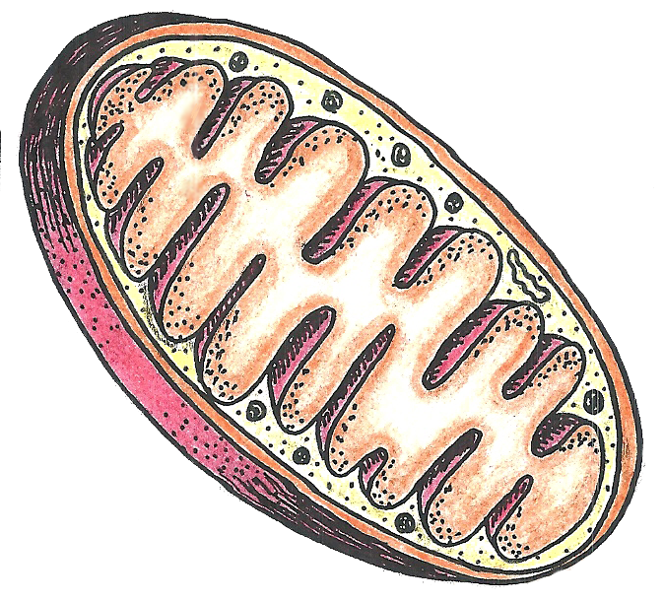
Where does cellular respiration take place?
Cellular respiration takes place in all organisms who have mitochondria.
The first step is glycolysis which starts in the cytoplasm, the products of glycolysis then enter the mitochondria to complete the reaction.
Folded cristae
Mitochondrial matrix

Slide 18
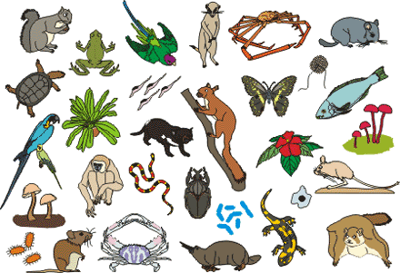
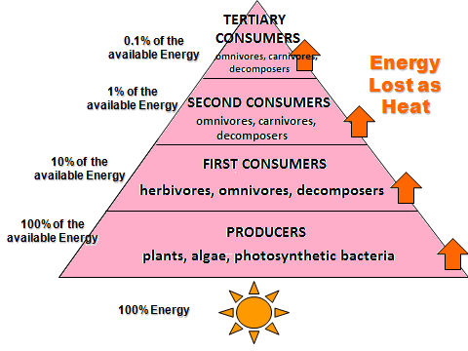
Which organisms perform cellular respiration?
ALL organisms with mitochondria (eukaryotes), both autotrophs and heterotrophs, producers, and consumers.
Remember even producers need to use ATP to grow, develop, and reproduce.

Slide 19
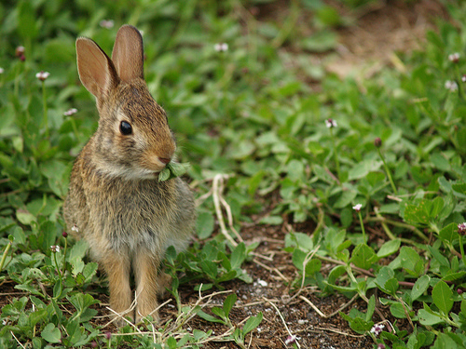
Organisms who “eat” Labels
“Heterotrophs”
“Consumers”
Organisms who can not make their own energy molecules (food) and must eat other organisms.
Organisms who eat other organisms to obtain energy.
How are these two labels different?

Slide 20
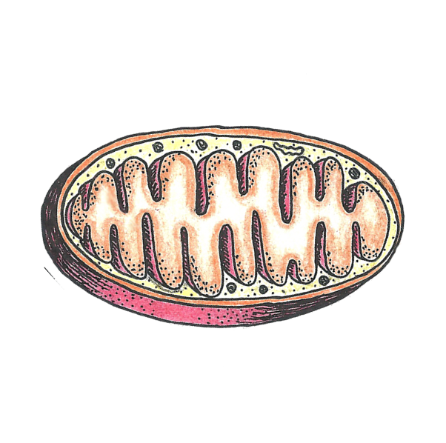
STEPS OF CELLULAR RESPIRATION
Glycolysis (cytoplasm)
Oxidative decarboxylation of pyruvate (mitochondria matrix)
Krebs Cycle (Citric Acid Cycle) (mitochondria matrix)
Electron Transport Chain (cristae)
Oxidative Phosphorylation (Chemiosmosis) (cristae)
Ribosome
cDNA
Cristae
Cytoplasm
Outer membrane
Inner membrane
Mitochondria matrix

Slide 21
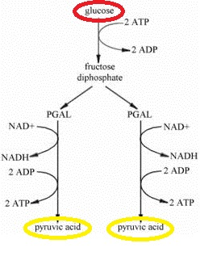
OUTSIDE THE MITOCHONDRIA (Takes place with or without oxygen present.)
Glycolysis = Ten step chemical reaction which uses 2 ATP to break glucose (6 carbon molecule) into two pyruvates (3 carbon molecules) , 2 NADH and 4 ATPs.
Net ATP = 2

Slide 22
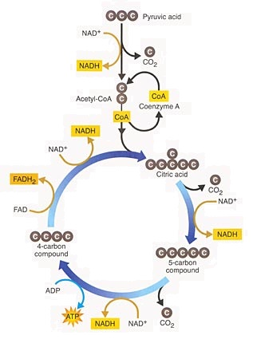
INSIDE THE MITOCHONDRIA (Can only take place if oxygen is present.)
2. Oxidative decarboxylation of pyruvate= Pyruvate has a carbon removed by oxygen to form CO₂ and become acetyl-CoA.

Slide 23
INSIDE THE MITOCHONDRIA (Can only take place if oxygen is present.)
3. Krebs Cycle (Citric Acid Cycle) = The two acetyl-CoA enter the cycle, have carbon removed by oxygen and form energy molecules NADH, FADH2 and ATP.
Net ATP: 2

Slide 24
INSIDE THE MITOCHONDRIA (Can only take place if oxygen is present.)
4. Electron Transport Chain = The NADH and FADH₂ release their energy and electrons unto the ETC. Protons (H+) are pumped into the intermembrane space.

Slide 25
INSIDE THE MITOCHONDRIA (Can only take place if oxygen is present.)
5. Oxidative Phosphorylation (Chemiosmosis) = The H+ shoot through the ATP synthase causing it to spin and bond phosphate to ADP forming ATP molecules. (ATP synthase is a protein.) Total ATP=30
TOTAL Net ATP: 34 Theoretical ATP: 38

Slide 26
In the ABSENCE of OXYGEN:
Pyruvic acid can not enter the mitochondria, it stays in the cytoplasm to enter another reaction;
Lactic Acid Fermentation or Alcohol fermentation.
Lactic Acid fermentation takes place in animal cells.
Alcohol fermentation takes place in plant and yeast cells.

Slide 27
Lactic Acid Fermentation
Instead of the two pyruvic aids entering the mitochondria, they remain in the cytoplasm.
The energy of two NADHs turns the two pyruvic acids into two molecules of lactic acid.
Once oxygen is present lactic acid reverts into pyruvic acid and can enter the mitochondria.
REVERSIBILE

Slide 28
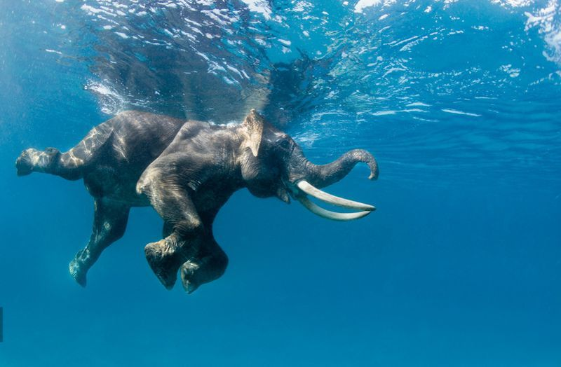
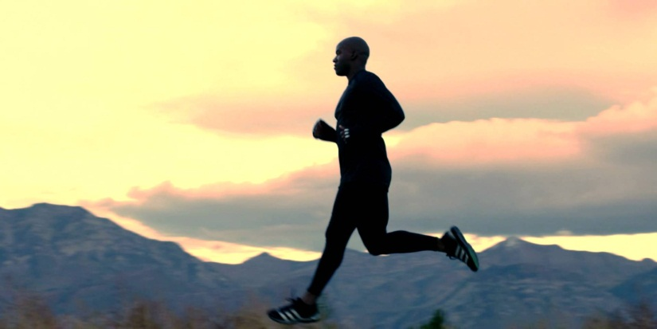
Lactic Acid Fermentation
When your muscles begin to burn during physical activity it is the lactic acid building up inside your muscle cells.
While exercising your muscles use up the oxygen supply quickly so the pyruvate remains in the cytoplasm becoming lactic acid.
Once you slow down and breath deeply, the oxygen is restored to the muscle cells reversing the lactic acid buildup and relieving you of the burning sensation.

Slide 29
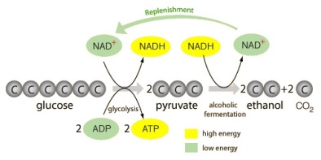
Alcohol Fermentation
Instead of the two pyruvic acid molecules entering the mitochondria, they remain in the cytoplasm.
The energy of two NADHs turns the two pyruvic acids into two molecules of ethanol and two molecules of CO₂.
IRREVERSIBILE

Slide 30
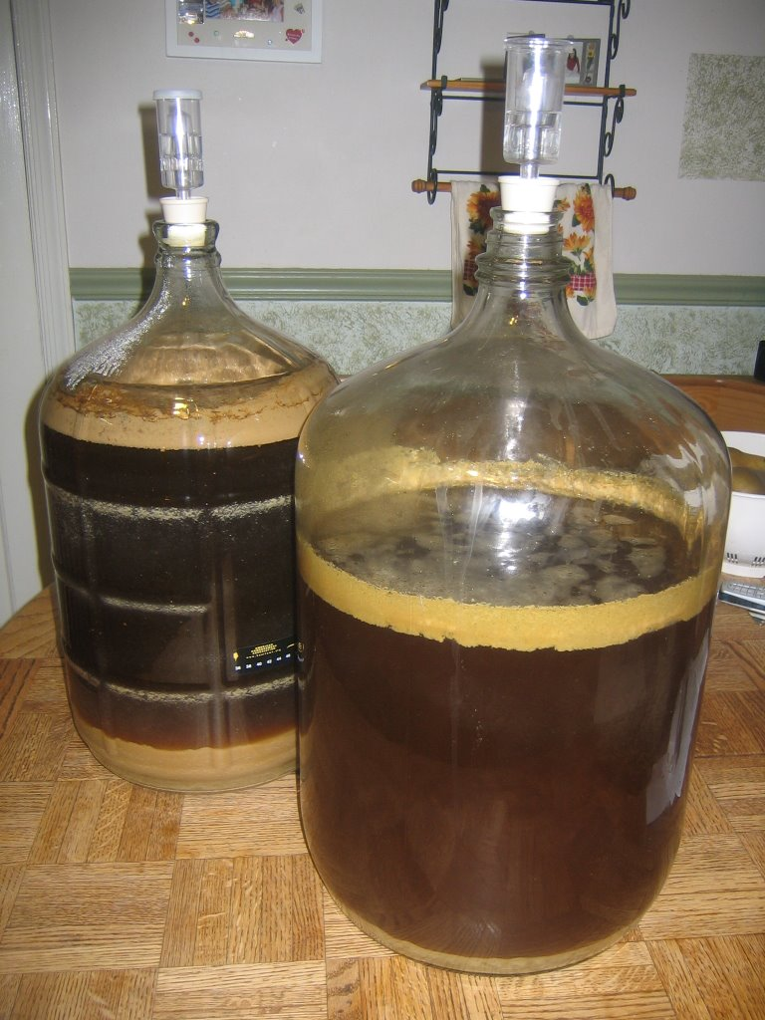
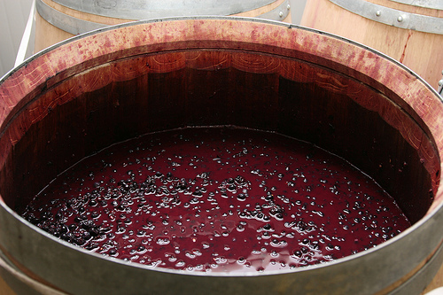
Alcohol Fermentation
This is the process that produces wine or alcohol using grapes, yeast and hops.
Beer and wine manufacturing.

Slide 31
Photosynthesis & Cellular Respiration
Photosynthesis and Cellular Respiration are vital chemical reactions which work together harnessing the sun’s light energy into chemical energy (glucose) for use by living organisms all the while recycling carbon dioxide and oxygen.

