Slide 1
Chapter 7: the critical period

Slide 2
Big Ideas
What were the weaknesses of the Confederation government?
What compromises and key principles emerged from the Constitutional Convention?
What were significant differences between the Federalists and Anti-Federalists?

Slide 3
Government by Confederation

Slide 4
Guiding questions
What was the nature and structure of the Confederation government?
What were the successes and failures of the Confederation?

Slide 5
Government by Confederation
On June 7, 1776, the Second Continental Congress voted to draw up a charter for joining the colonies into a confederation.
After more than a year of debate and revision, Congress adopted the Articles of Confederation.

Slide 6
League of States
John Dickinson proposed establishing a strong central government, but his plan was watered down by the states.
The legislature was the only component of the Confederation government.
The Congress of the Confederation was unicameral.
John Dickinson
Notes:
US History 4th/100b; Library of Congress

Slide 7
League of States
The chief executive, the president of Congress, was chosen by the legislature and was completely under its control.
Among the most important powers reserved to the states was the power to tax.
In its years of existence, the Confederation government barely had enough revenue to cover its expenses.

Slide 8
The treaty of Paris
The Treaty of Paris was the Confederation’s greatest triumph in foreign affairs.
Because the states did not enforce the treaty, Britain kept its forts in the Great Lakes region to protect the profitable British fur trade.
Notes:
https://commons.wikimedia.org/wiki/File:Treaty_of_Paris_by_Benjamin_West_1783.jpg; American Commissioners of the Preliminary Peace Agreement with Great Britain (unfinished) by Benjamin West, ca. 1783/Wikimedia Commons/Public Domain

Slide 9
Western Lands
The Treaty of Paris left the United States in control of all territory east of the Mississippi River and north of Florida and Louisiana.
North of the Ohio River, all lands that passed into the hands of the national government became known as the Northwest Territory.

Slide 10
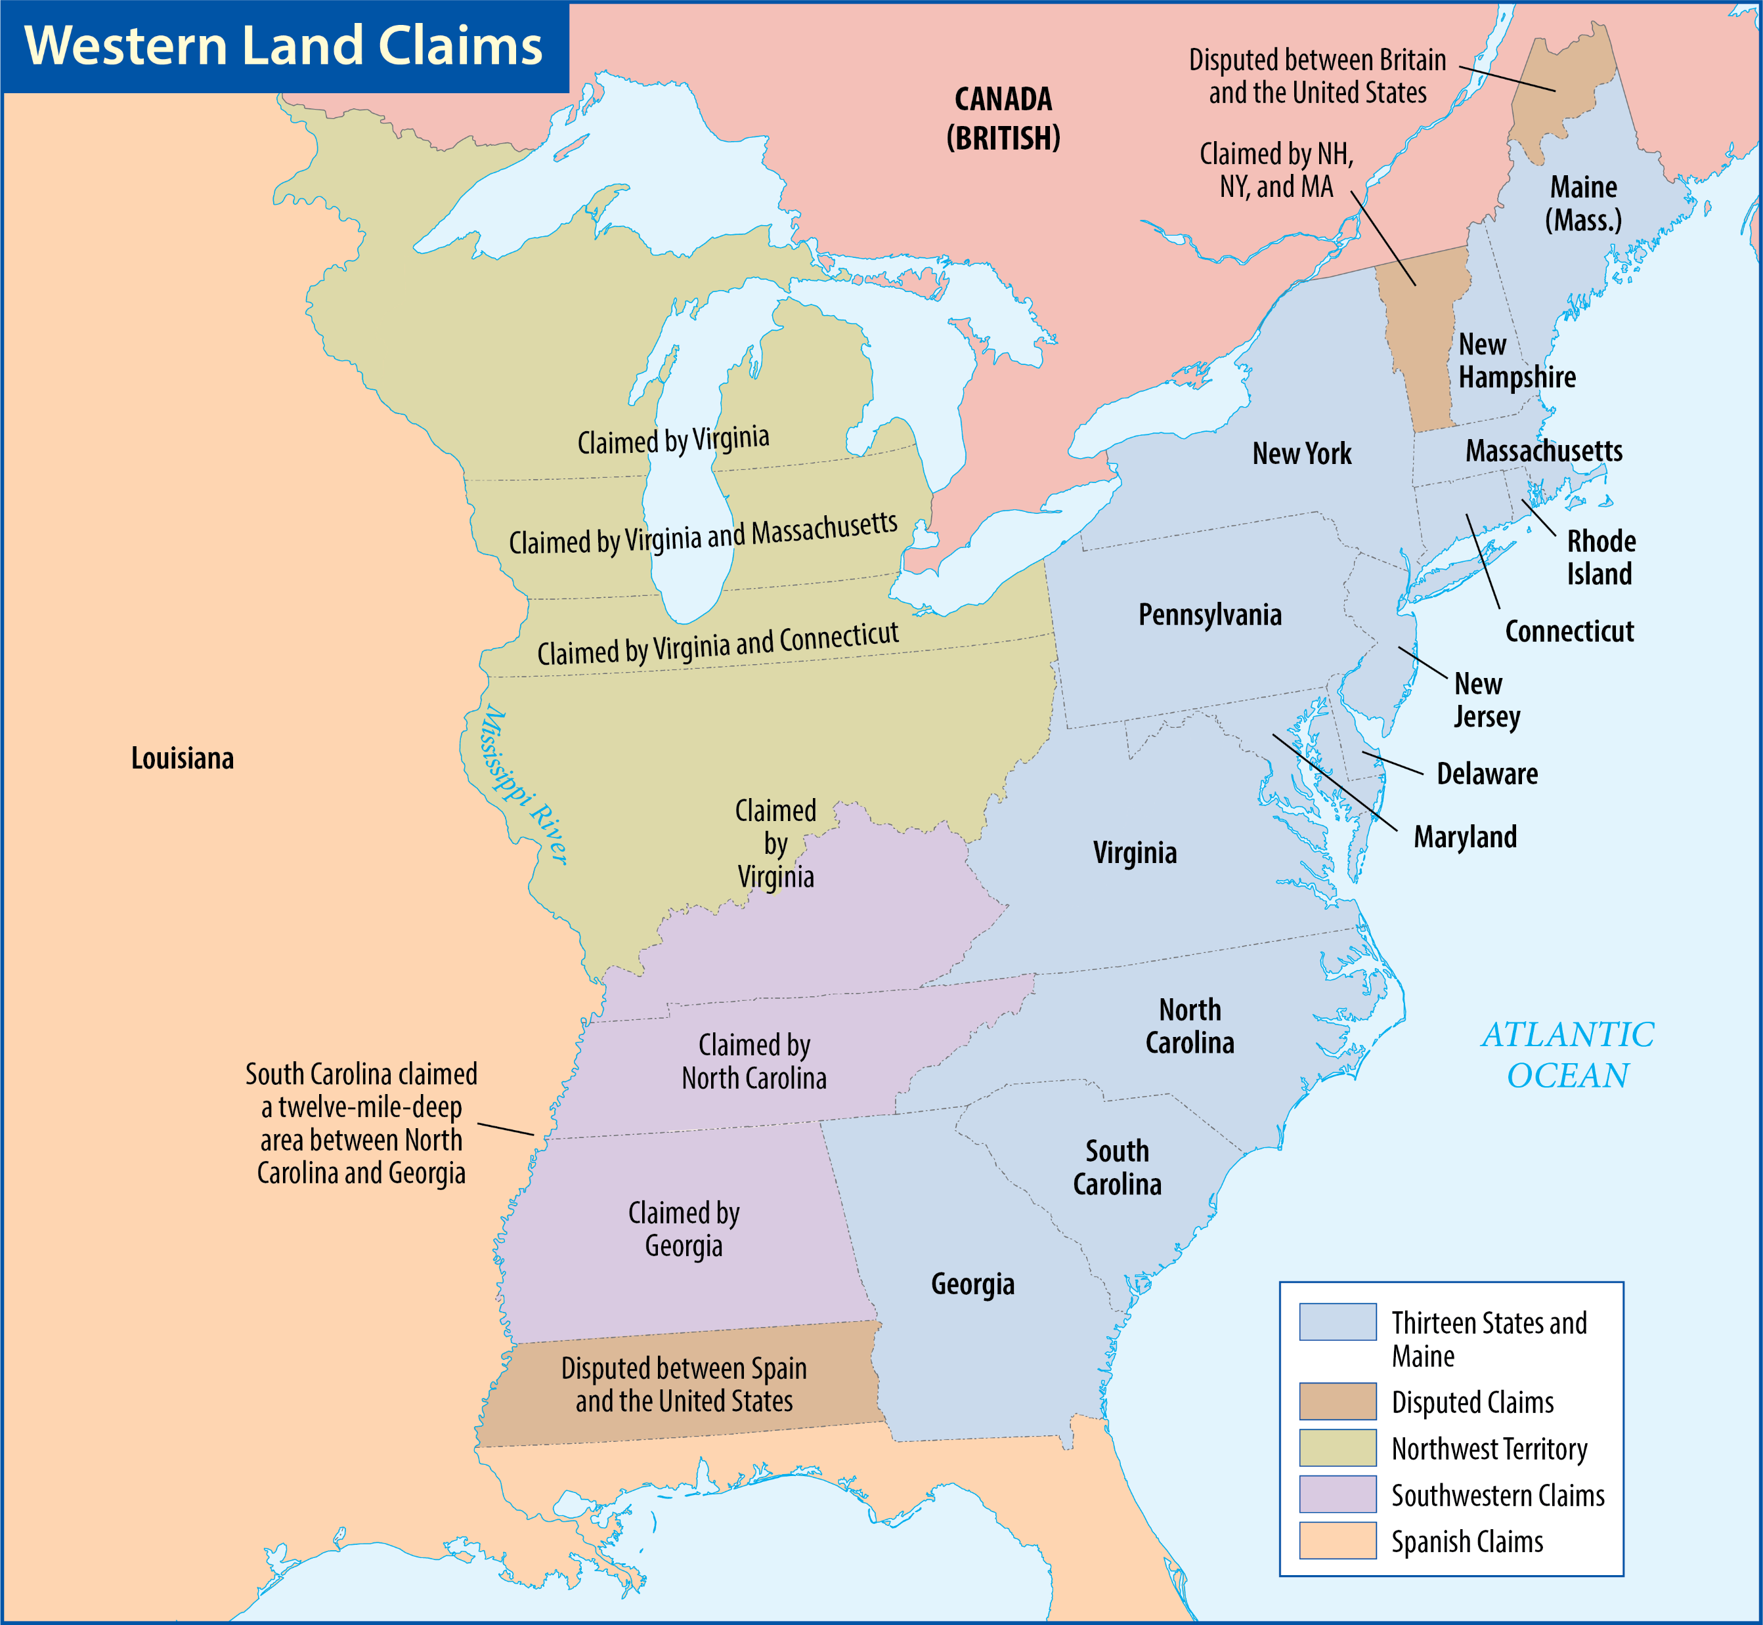
Map Resources

Slide 11
Western lands
The first and most farsighted was the Ordinance of 1784, written by Thomas Jefferson.
He proposed creating ten new states out of the territory.
He proposed banning slavery in the region and giving the land to settlers instead of selling it.
Map Resources

Slide 12
Western lands
The Land Ordinance of 1785 concentrated on the settlement of the territory.
The ordinance divided the new lands into orderly townships for sale and development.

Slide 13
Map Resources

Slide 14
Western lands
The Northwest Ordinance of 1787 focused on government.
There were three stages to become a state.
The Northwest Ordinance of 1787 explicitly emphasized the importance of education.
The ordinance also prohibited slavery.
These ordinances were the greatest success of the Confederation government.

Slide 15
Financial Weakness
The national government was almost always in debt, and the individual states were not much better off.
Hard money (silver and gold) was scarce.
During the war, the national government had printed so much money that paper money’s value plummeted, and merchants would not accept it.
Notes:
https://commons.wikimedia.org/wiki/File:Three_pence_note_John_Dunlap.jpg; Three pence note (reverse) printed by John Dunlap/Wikimedia Commons/Public Domain

Slide 16
Financial Weakness
Compounding the problem was each state’s ability to print its own currency.
Notes:
https://commons.wikimedia.org/wiki/File:Three_pence_note_John_Dunlap.jpg; Three pence note (reverse) printed by John Dunlap/Wikimedia Commons/Public Domain

Slide 17
Foreign Weakness
European powers such as Britain, Spain, and France learned that they could play on jealousies among the states to undercut the United States’ bargaining position.
When the United States ran afoul of the Barbary pirates in northern Africa, the nation could not even pay the demanded bribes, let alone build and arm a naval squadron to protect American shipping.

Slide 18
Domestic Weakness
In the Newburgh Conspiracy, officers intended to force Congress and the states to grant them their back pay.
Washington reassured the men by reading a favorable letter from a congressman.
The Newburgh Conspiracy collapsed.
Notes:
https://commons.wikimedia.org/wiki/File:Newburgh_Address.jpg; Newburgh Address by George Washington, 1783/Wikimedia Commons/Public Domain

Slide 19
Domestic Weakness
Daniel Shays, a veteran of the Revolution, led an insurrection of farmers against the courts in the western part of the state.
Shays’s Rebellion was quelled only a few weeks before the delegates of the Constitutional Convention met at Philadelphia in 1787.

Slide 20
Section review
What was the greatest accomplishment in foreign affairs by the Confederation government?
the Treaty of Paris with Great Britain (p. 121)
What were the most controversial provisions of the proposed Ordinance of 1784?
the creation of ten new states; the banning of slavery in the Northwest Territory; giving the land to settlers rather than selling it (p. 122)

Slide 21
Section review
According to the provisions of the Northwest Ordinance of 1787, what were the three steps a region went through to become a state?
In the first stage, a region was under the direct control of the federal government. When a region had at least five thousand free inhabitants, it entered the second stage and became a territory. Then the people could elect a legislature and send a representative to Congress. However, the federally appointed governor could veto legislative acts, and the representative could not vote in Congress. In the third stage, once a territory had sixty thousand free inhabitants, it could write a state constitution and be admitted to the Union. (p. 123)

Slide 22
Section review
What were the two serious domestic threats to the government’s authority under the Articles of Confederation?
the Newburgh Conspiracy and Shays’s Rebellion (p. 125)
How did the American core value of individualism cause problems in the Confederation?
Individualism led the states to seek their own interests even if it resulted in the neglect of the common good.

Slide 23
Section review
What was the biblical root of problems in the Confederation?
Humanity’s fallen nature causes individualism to be twisted into selfishness.

Slide 24
A New Charter

Slide 25
Guiding questions
What circumstances brought the delegates of the Constitutional Convention together?
What three major compromises occurred at the convention?

Slide 26
A New Charter
The Annapolis Convention was not well attended; only five states sent representatives.
Alexander Hamilton wrote a resolution calling for another convention to remedy the weaknesses of the Confederation government.
Alexander Hamilton
Notes:
American Government 3rd/327t; “Alexander Hamilton portrait by John Trumbull 1806”/John Trumbull/Wikimedia Commons/Public Domain

Slide 27
The Constitutional Convention
The delegates met at the Pennsylvania State House.
Virginian James Madison’s ideas earned him the title “Father of the Constitution.”
The Constitutional Convention was a collection of regional and individual interests.
James Madison
Notes:
US History 5th/126; "James Madison" by Gilbert Stuart/National Gallery of Art/Wikimedia Commons/Public Domain

Slide 28
The Constitutional Convention
Twelve independent states (Rhode Island refused to participate) were represented.
The delegates unanimously elected George Washington to chair the proceedings.
George Washington
Notes:
https://commons.wikimedia.org/wiki/File:George_Washington_by_Gilbert_Stuart,_1795-96.png; Portrait of George Washington by Gilbert Stuart/Wikimedia Commons/Public Domain

Slide 29
The Great Compromise
How the states were to be represented was the most difficult question.
Edmund Randolph introduced James Madison’s Virginia Plan.
It advocated a bicameral Congress, with the number of representatives based on state population.
Edmund Randolph
Notes:
US History 4th/147b; Library of Congress

Slide 30
The Great Compromise
Since representation under the Virginia Plan was based on state population, it naturally favored the states with larger populations.
William Paterson presented the New Jersey Plan.
It advocated a unicameral Congress, with each state having only one vote regardless of its population.
The convention deadlocked over the issue of representation.

Slide 31
The Great Compromise
Roger Sherman put together a compromise that saved both the convention and the Constitution.
The Great Compromise (or Connecticut Compromise) proposed that representation in the lower house be based on state population, whereas representation in the Senate be equal for all states regardless of size.
Roger Sherman
Notes:
US History 4th/141a; Library of Congress

Slide 32
The Three-Fifths Compromise
The next divisive issue that confronted the delegates of the Constitutional Convention was how to count slaves when determining representation for states.
The Three-Fifths Compromise stated that three-fifths of the total slave population of a state would be included for representation purposes in the House, but those states would also have to pay taxes on the slave population at the same rate.
The wording of the Constitution recognized slaves as persons rather than property.

Slide 33
The Trade Compromise
Congress was given power over foreign and interstate commerce.
The legislature was forbidden to impose any export taxes on the states, and Article V of the Constitution prevented making any amendments regarding the slave trade until 1808.

Slide 34
Constitutional Principles
Republican philosophy
Limited government
Separation of powers
Checks and balances
Federalism
Popular sovereignty

Slide 35
Popular Sovereignty
The Preamble introduces the Constitution: “We the people…”
The principle of popular sovereignty is best expressed in the Constitution through the document’s provisions for representation and amendment.
The president and the senators were elected indirectly by the people.
The president is elected through the indirect means of the Electoral College.
Constitutional amendments are an expression of the people’s sovereignty.

Slide 36
Section review
How did the Constitutional Convention reach a compromise on the issue of representation?
by creating an upper house (Senate) in which representation was equal and a lower house (House of Representatives) in which representation was according to population (p. 128)
What compromise allowed the convention to settle the problem of slavery in relation to taxation and representation?
the Three-Fifths Compromise (p. 129)

Slide 37
Section review
Between what two qualities did the Constitutional Convention seek a balance?
liberty and order (p. 130)
What are the six principles of government contained in the American Constitution?
republican philosophy, limited government, separation of powers, checks and balances, federalism, and popular sovereignty (pp. 130–32)

Slide 38
Section review
Has the system of checks and balances been successful in preventing any one branch of government from expanding its powers? Use examples to support your answer.

Slide 39
Section review
In many instances, no. At several points in U.S. history, one branch has increased its powers beyond what the Constitution grants. Once power is assumed, it is rarely surrendered. When there is a weak president, Congress oftens exerts itself, and the executive branch recedes. This was true with the Radical Republican Congress and President Andrew Johnson during Reconstruction. When the president is strong, the executive branch tends to exert itself over Congress, as was the case with Franklin Roosevelt during the Depression and World War II. The overall tendency, however, has been for the federal government to assume more and more powers at the expense of state and local governments and often individual rights.

Slide 40
Section review
Did the Three-Fifths Compromise encourage, discourage, or remain neutral regarding slavery? Defend your answer and propose an alternative if you think the compromise was counter-productive.
The alternative of representation based on number of eligible voters would eliminate any benefit in representation for ownership of slaves. It would, however, have placed pressure on expanding the right to vote to more people, and the founders were concerned about those pressures.

Slide 41
The Struggle for Ratification

Slide 42
Guiding questions
What were the Federalists’ arguments favoring ratification of the Constitution?
What were the Anti-Federalists’ arguments opposing ratification of the Constitution?
Why was ratification of the Constitution significant?

Slide 43
The Struggle for Ratification
On September 17, 1787, Washington offered the final draft of the new charter to the convention.
After the delegates signed and sent it to the Confederation Congress, the document would pass to the states for their consent.
Notes:
American Government 3rd/48; “Scene at the Signing of the Constitution of the United States” by Howard Chandler Christy/Wikimedia Commons/Public Domain

Slide 44
War of Words
The battle lines were drawn between supporters of the Constitution, called Federalists, and those who opposed it, the Anti-Federalists.
“Cato” (George Clinton of New York) denounced the Constitution.
He was soon joined by “Sidney,” “Brutus,” and others in a series of Anti-Federalist articles.
George Clinton
Notes:
http://www.loc.gov/pictures/item/94505261/; Library of Congress, LC-USZ62-110647

Slide 45
War of Words
Alexander Hamilton responded by writing some Federalist articles under the pen name “Publius.”
Hamilton also enlisted the help of James Madison and John Jay in a war of words.
The essays were compiled and published under the title The Federalist, or The Federalist Papers.
Alexander Hamilton
Notes:
American Government 3rd/327t; “Alexander Hamilton portrait by John Trumbull 1806”/John Trumbull/Wikimedia Commons/Public Domain

Slide 46
War of Words
The Federalist was a persuasive force, particularly in those states where ratification hung in the balance.
But The Federalist is also a comprehensive commentary on republican government.
Notes:
https://commons.wikimedia.org/wiki/File:The_Federalist_(1st_ed,_1788,_vol_I,_title_page)_-_02.jpg; Title page from The Federalist (vol. 1), 1788/Rare Books and Special Collections Division in Madison's Treasures/Library of Congress

Slide 47
War of Words
Less well known are The Anti-Federalist Papers, the collected writings and speeches by opponents of the new Constitution.
The Anti-Federalists included patriots such as Patrick Henry, Edmund Randolph, James Monroe, George Mason, George Clinton, and William Paterson.

Slide 48
Thirteen Battles
Delaware led the states by giving the Constitution its unanimous consent on December 7, 1787.
Within a month, four more states—Pennsylvania, New Jersey, Georgia, and Connecticut—ratified the Constitution.
Massachusetts approved the Constitution in a close vote in February 1788.
Three more states—Maryland, South Carolina, and New Hampshire—joined the six ratifying states to make the nine necessary for the Constitution to become law.

Slide 49
Thirteen Battles
After James Madison promised to introduce amendments for a bill of rights in the first session of Congress, the Virginia Federalists won a narrow victory for ratification, 89 to 79.
Madison’s concession was a catalyst for the final great state battle raging in New York.
North Carolina and Rhode Island held out for some time.

Slide 50
A Rising Sun
The office of chief executive was one of the most significant and least controversial departures from the old Confederation government.
On February 4, 1789, George Washington was unanimously elected president by the Electoral College.
John Adams was elected as the first vice president.
George Washington
Notes:
https://www.whitehouse.gov/photos-and-video/photogallery/official-portraits-us-presidents; Portrait of George Washington by Gilbert Stuart, 1797/whitehouse.gov/Public Domain

Slide 51
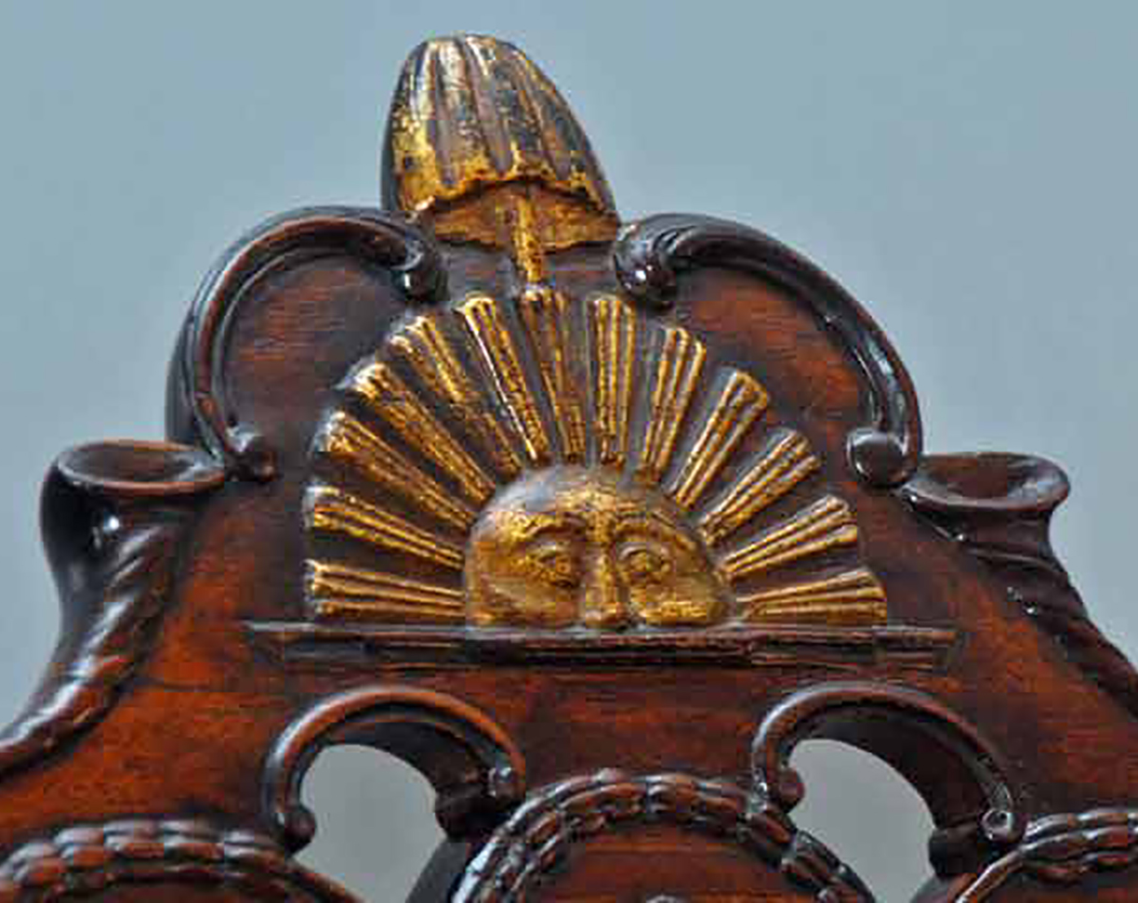
“. . . I have the happiness to know that It is a rising and not a setting sun.” – Benjamin Franklin
Notes:
https://commons.wikimedia.org/wiki/File:Rising_Sun_Chair_Detail_from_NPS.jpg; Detail of "Rising Sun" chair/NPS

Slide 52
Section review
Why did Edmund Randolph, George Mason, and Elbridge Gerry oppose the Constitution?
They objected to the expanded powers of the national government and the absence of a bill of rights. (p. 133)
Who were “Cato” and “Publius”?
“Cato” was the pseudonym of New York governor George Clinton, who denounced the Constitution. “Publius” was the pseudonym of Alexander Hamilton, who defended the Constitution. (pp. 133–34)

Slide 53
Section review
How did James Madison win approval for the Constitution in Virginia?
He promised amendments for a bill of rights in the first session of Congress. (p. 135)
What does the opposition of Edmund Randolph, Patrick Henry, and George Mason to the Constitution say about their beliefs on human nature?
They had a healthy mistrust of human nature. They foresaw the many ways in which centralized powers would tempt leaders to sacrifice the rights and liberties of the people and the states for more personal power.

Slide 54
People, Places, and Things to Remember
confederation
Articles of Confederation
unicameral
Northwest Territory
Ordinance of 1784
Land Ordinance of 1785
Northwest Ordinance of 1787
hard money
Newburgh Conspiracy
Shays’s Rebellion
Annapolis Convention
James Madison
Constitutional Convention (1787)
Virginia Plan
bicameral
New Jersey Plan
Roger Sherman
Great Compromise

Slide 55
People, Places, and Things to Remember
Three-Fifths Compromise
limited government
separation of powers
checks and balances
federalism
popular sovereignty
Preamble
Electoral College
amendments
Federalists
Anti-Federalists
“Cato”
“Publius”
The Federalist
The Anti-Federalist Papers

