Slide 1
Chapter 9:
The Powers of Congress
Notes:
WIN-Initiative/Stone/Getty Images

Slide 2
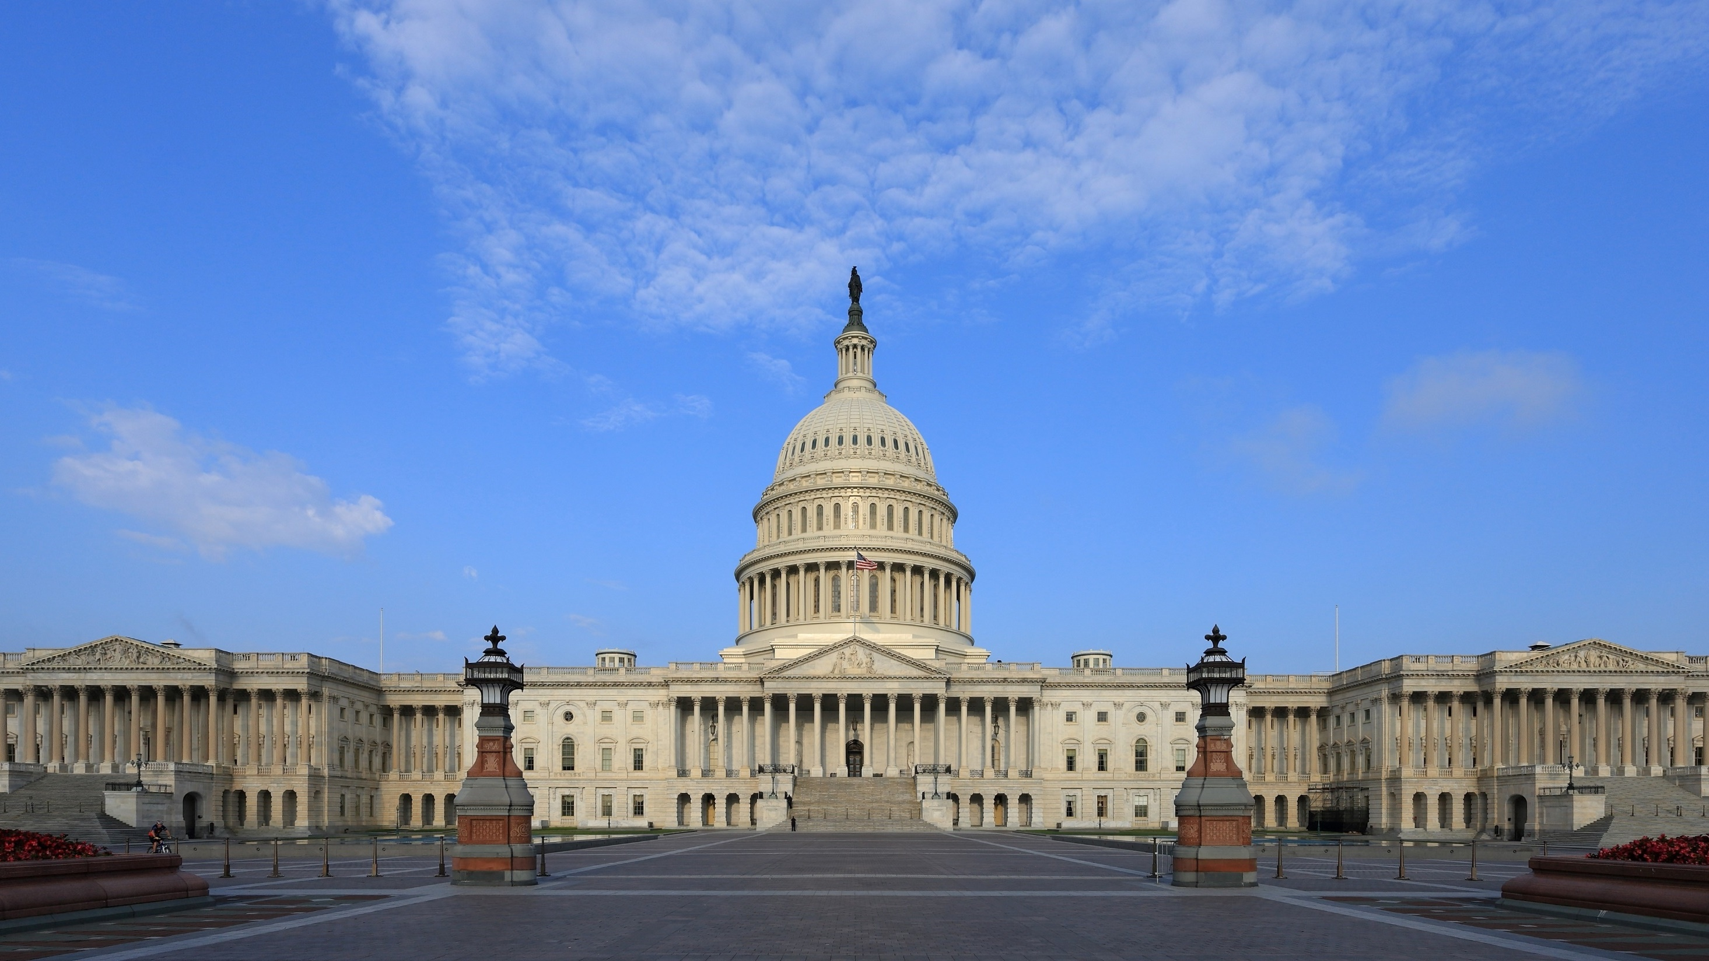
I. Enumerated Powers
Chapter 9.1
Notes:
By Martin Falbisoner - Own work, CC BY-SA 3.0, https://commons.wikimedia.org/w/index.php?curid=28359026
https://commons.wikimedia.org/w/index.php?sort=relevance&search=capitol+building&title=Special:Search&profile=advanced&fulltext=1&advancedSearch-current=%7B%7D&ns0=1&ns6=1&ns12=1&ns14=1&ns100=1&ns106=1&searchToken=denfs69ywocry8amjbet61zty#%2Fmedia%2FFile%3AUS_Capitol_east_side.JPG

Slide 3
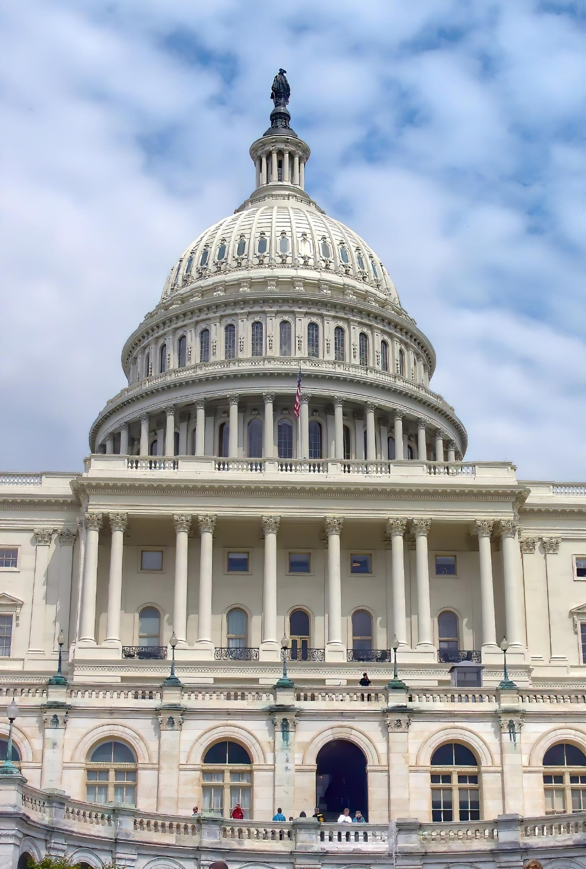
I. Enumerated Powers
The most important power of the legislative branch is the power to make laws.
Enumerated powers are powers listed in the Constitution.
Notes:
Image by Francine Sreca from Pixabay
https://pixabay.com/photos/capitol-dome-congress-government-5139530/

Slide 4
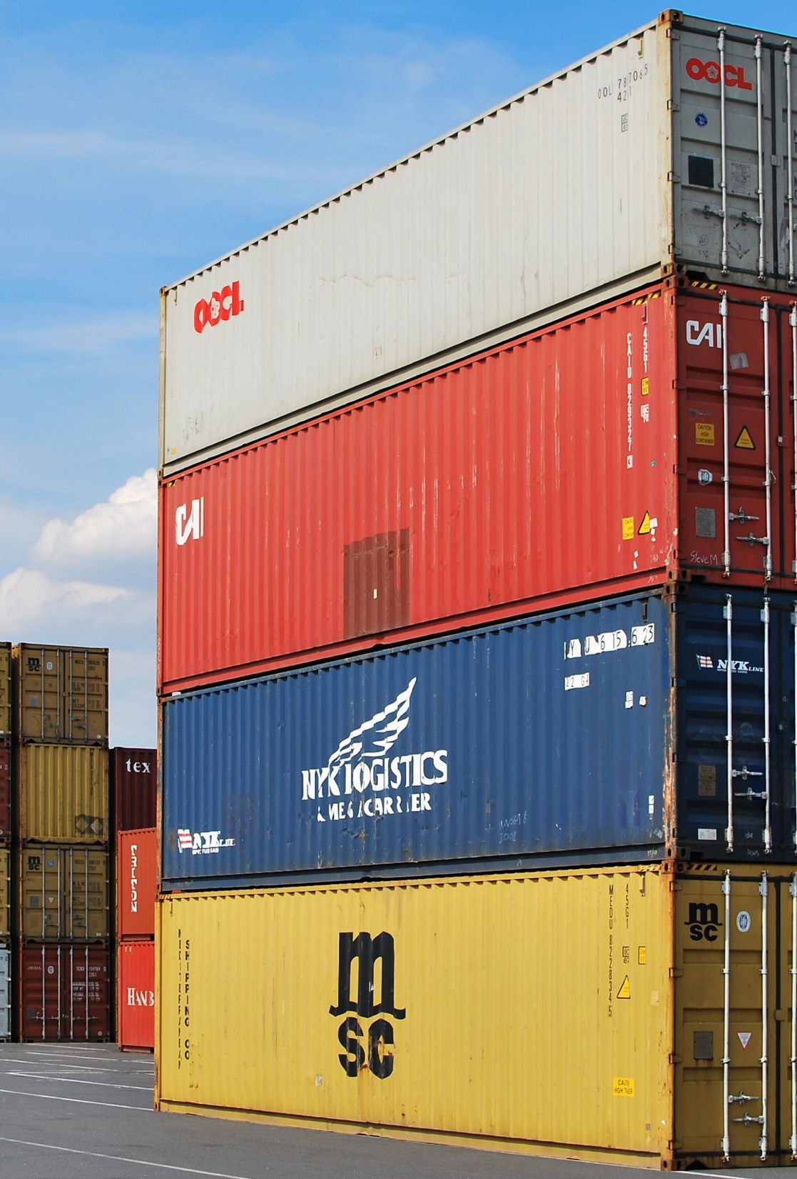
A. Financial Powers
Article I, Section 8 gives Congress the power to tax.
  A duty is a tax on select imports.
  Excises are taxes on the nation’s internal production, sale, or use of certain items and business practices.
In 1913, the Sixteenth Amendment was passed and instituted the income tax.
Notes:
Image by Jarosław Bialik from Pixabay
https://pixabay.com/photos/dock-container-export-cargo-441989/

Slide 5
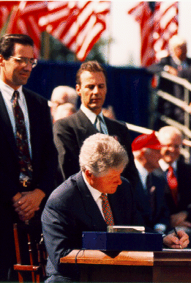
A. Financial Powers
In 1994, the North American Free Trade Agreement (NAFTA) was signed.
  It eliminated many tariffs on Canadian and Mexican goods.
  In 2018, President Trump signed a new agreement he believed was more favorable to the US.
President Clinton signs NAFTA
Notes:
By White House - United States Government-White House http://clinton1.nara.gov/White_House/Family/images/raw/nafta_signing.gif, Public Domain, https://commons.wikimedia.org/w/index.php?curid=34915137
https://commons.wikimedia.org/w/index.php?sort=relevance&search=bill+clinton+nafta&title=Special:Search&profile=advanced&fulltext=1&advancedSearch-current=%7B%7D&ns0=1&ns6=1&ns12=1&ns14=1&ns100=1&ns106=1&searchToken=6u85y4s0e6u1pd0qtvenug52i#%2Fmedia%2FFile%3ABill_Clinton_signing_Nafta.png

Slide 6
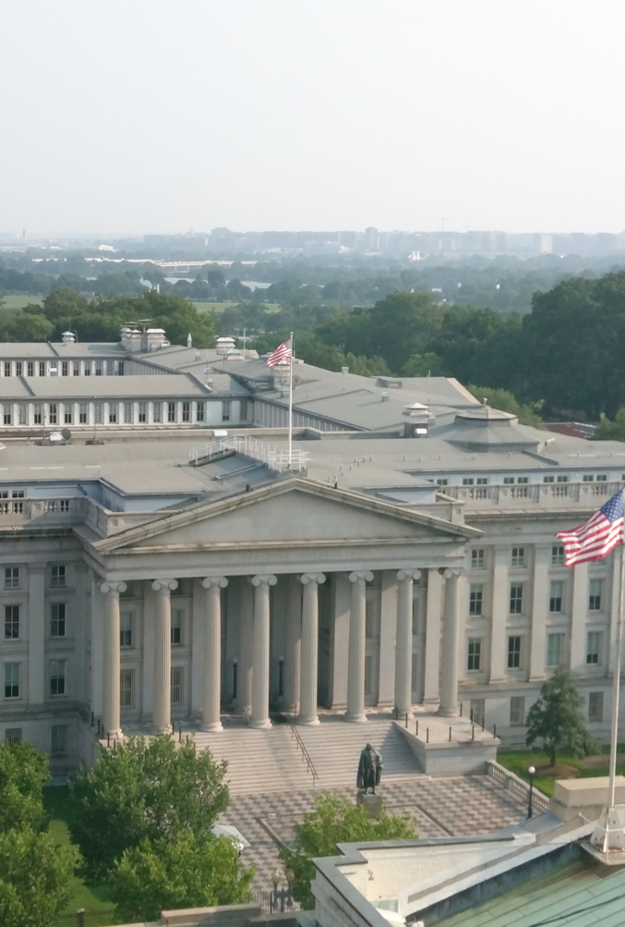
A. Financial Powers
Section I, Clause 2 gives Congress the power to borrow money.
The US borrows money from:
  Other countries
  Private banks
  Individuals (through the sale of bonds)
US Treasury Department,
Washington D.C.
Notes:
By MeanieHyaena - Own work, CC BY 4.0, https://commons.wikimedia.org/w/index.php?curid=41821877
https://commons.wikimedia.org/w/index.php?sort=relevance&search=US+Treasury&title=Special:Search&profile=advanced&fulltext=1&advancedSearch-current=%7B%7D&ns0=1&ns6=1&ns12=1&ns14=1&ns100=1&ns106=1#/media/File:Us-treasury-building.jpg

Slide 7
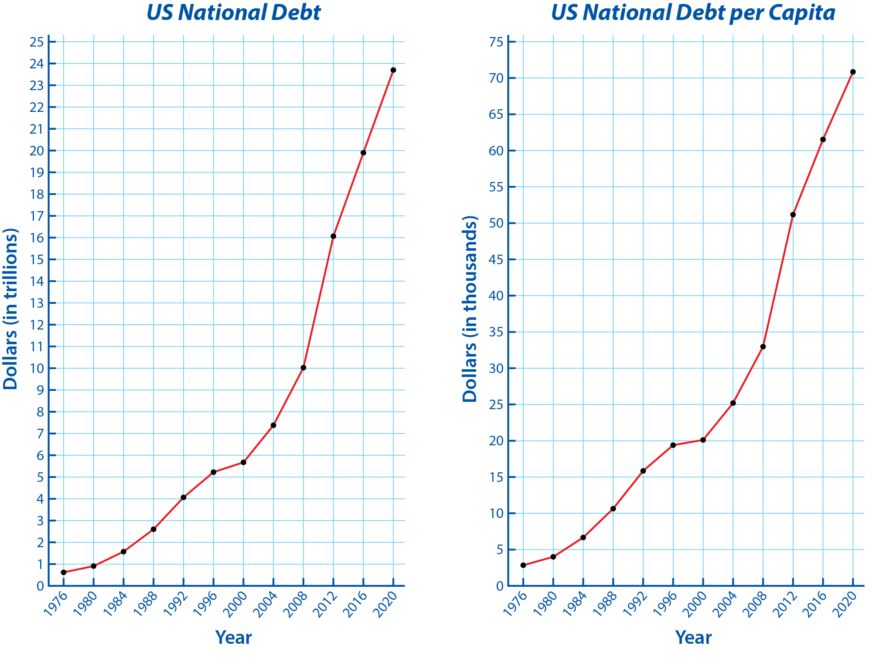
Notes:
BJU Press Art

Slide 8
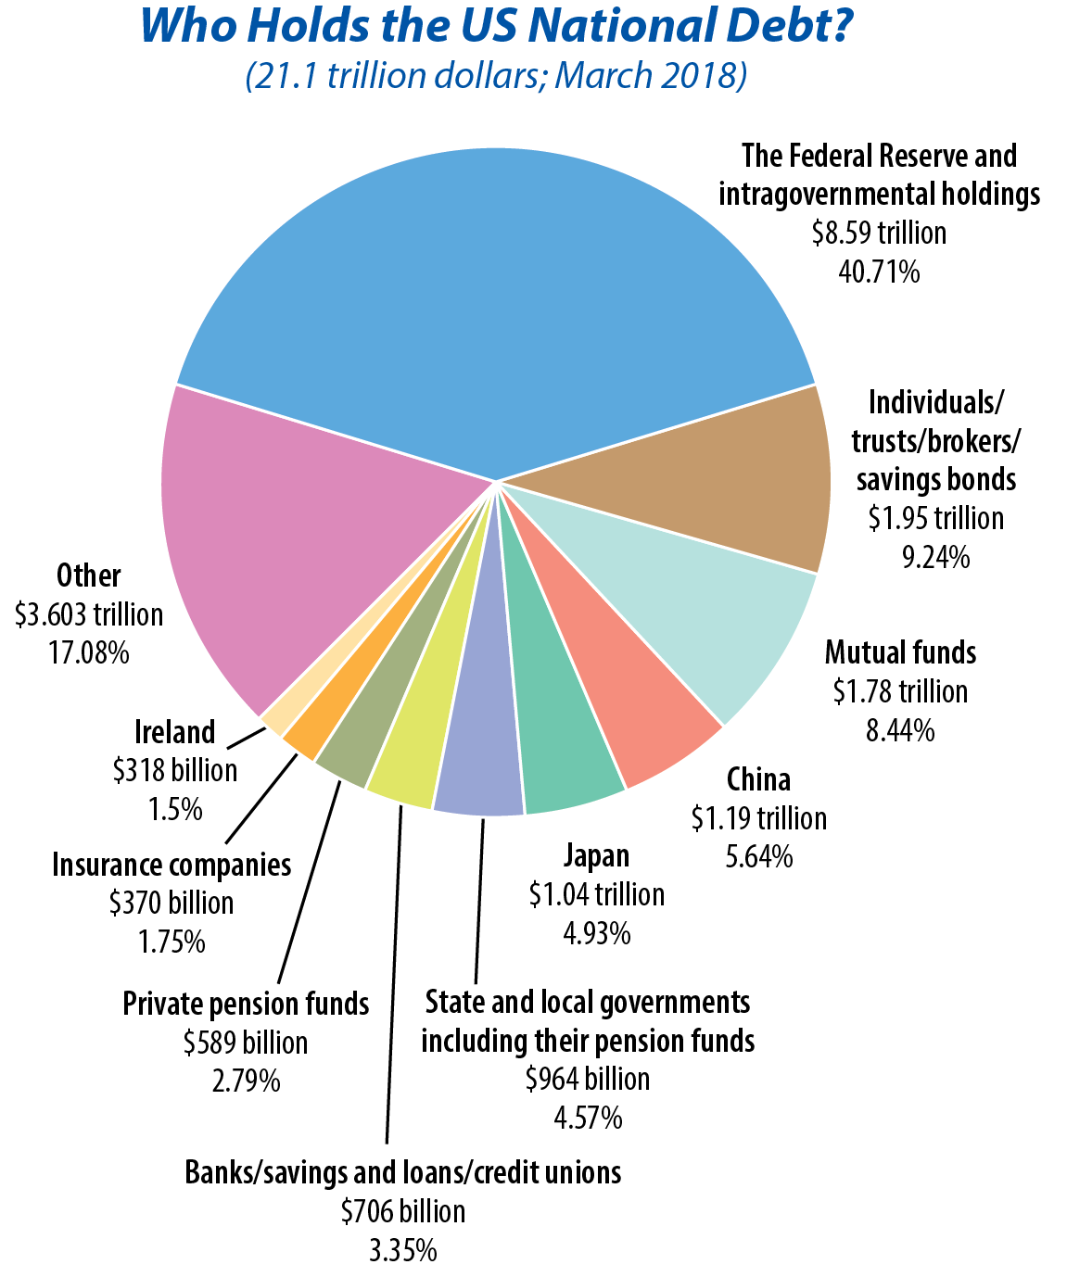
Notes:
BJU Press Art

Slide 9
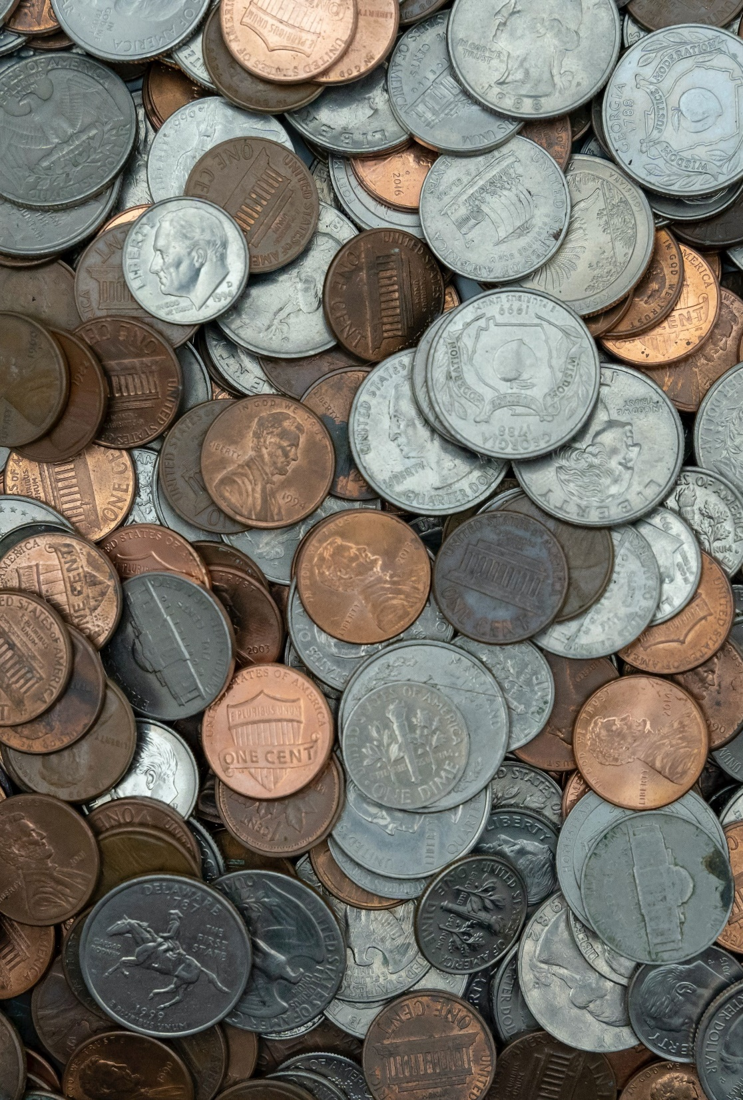
A. Financial Powers
Section I, Clause 5 gives Congress the power to coin money and regulate its value.
Section I also gives Congress the responsibility to provide for the “general welfare” of the country.
Notes:
Photo by Michael Longmire on Unsplash
https://unsplash.com/photos/3Mu0iQgLQto

Slide 10

B. Commercial Powers
Clause 3 gives Congress the power to regulate commerce.
Congress was given broad power to regulate interstate commerce by the Gibbons v. Ogden (1824) court case.
Notes:
Photo by Matthew T Rader on Unsplash
https://unsplash.com/photos/1shWwOrkxEM

Slide 11
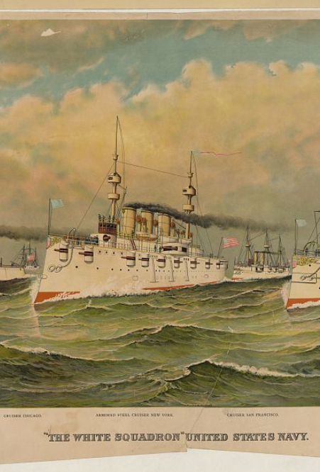
C. Defense and Military Powers
Clauses 10–16 describe the specific military powers of Congress.
Clause 10 authorizes Congress to legislate in the area of international law and to prosecute war crimes.
Notes:
Currier & Ives. "The white squadron" United States Navy. New York: Published by Currier & Ives. Photograph. Retrieved from the Library of Congress, <www.loc.gov/item/2002698814/>.

Slide 12
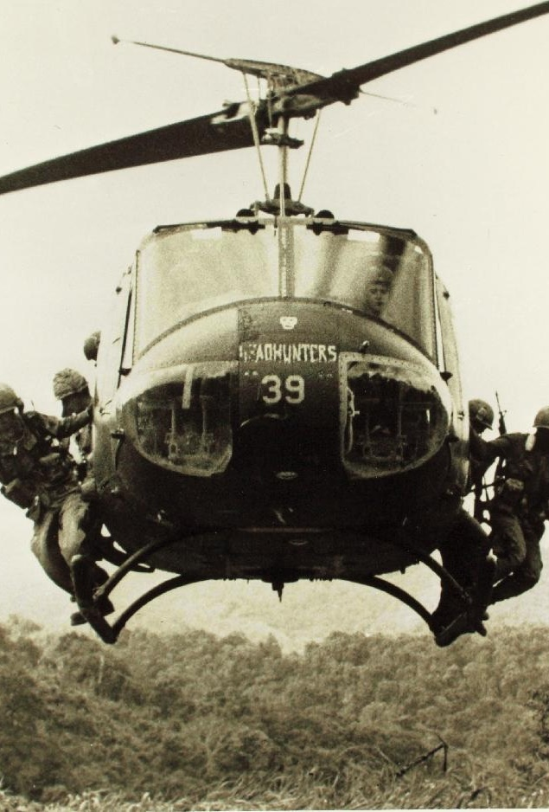
C. Defense and Military Powers
Clause 11 gives Congress the right to declare war.
  Despite this, the President has often wielded this power, resulting in many American wars not being declared.
  Congress attempted to rein in the President’s power with the War Powers Act (1973).
Notes:
Image by WikimediaImages from Pixabay
https://pixabay.com/photos/bell-uh-1-helicopter-iroquois-huey-906516/

Slide 13

C. Defense and Military Powers
Clause 11 also mentions two technical matters:
  Granting of a letter of marque – allows private citizens to capture merchant ships of another nation
  Power of reprisal – retaliating against another nation when provoked, such as the seizure of property or people.
Notes:
Image by Youssef Jheir from Pixabay
https://pixabay.com/photos/sunset-sailing-boat-boat-sea-ship-675847/

Slide 14
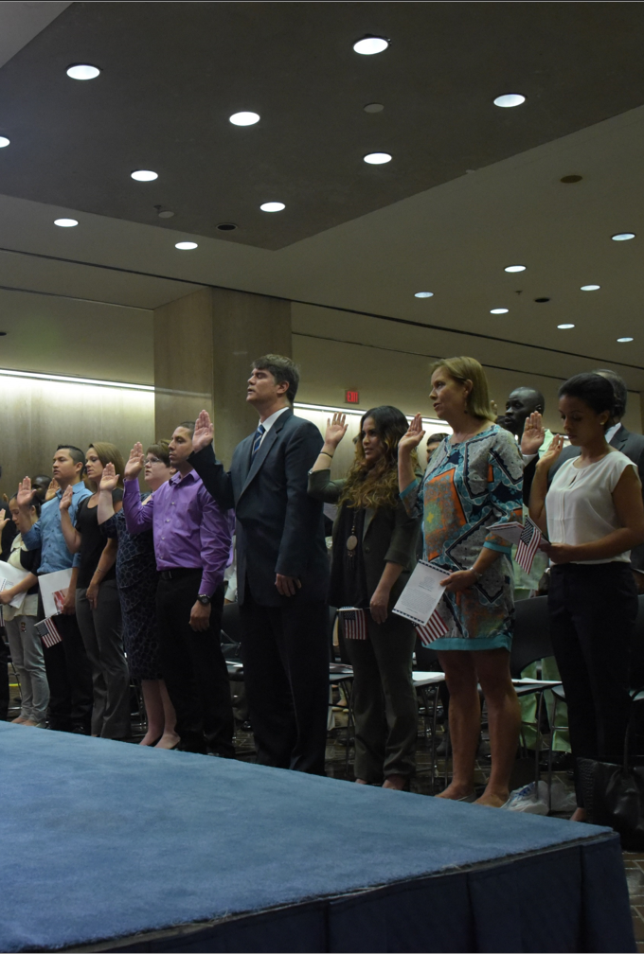
D. Other Powers
Clause 4 lists two unrelated provisions – naturalization and bankruptcies.
  Citizenship is granted automatically to those born in the United States.
  Congress has often used its power to regulate immigration and take away citizenship.
Notes:
By U.S. Department of Homeland Security (DHS) - Naturalization Ceremony, Public Domain, https://commons.wikimedia.org/w/index.php?curid=52189725
https://commons.wikimedia.org/w/index.php?sort=relevance&search=naturalization+ceremony&title=Special:Search&profile=advanced&fulltext=1&advancedSearch-current=%7B%7D&ns0=1&ns6=1&ns12=1&ns14=1&ns100=1&ns106=1&searchToken=e97i45p2bz3l3bidtz01ox6gi#%2Fmedia%2FFile%3ANaturalization_Ceremony_%2829665269276%29.jpg

Slide 15
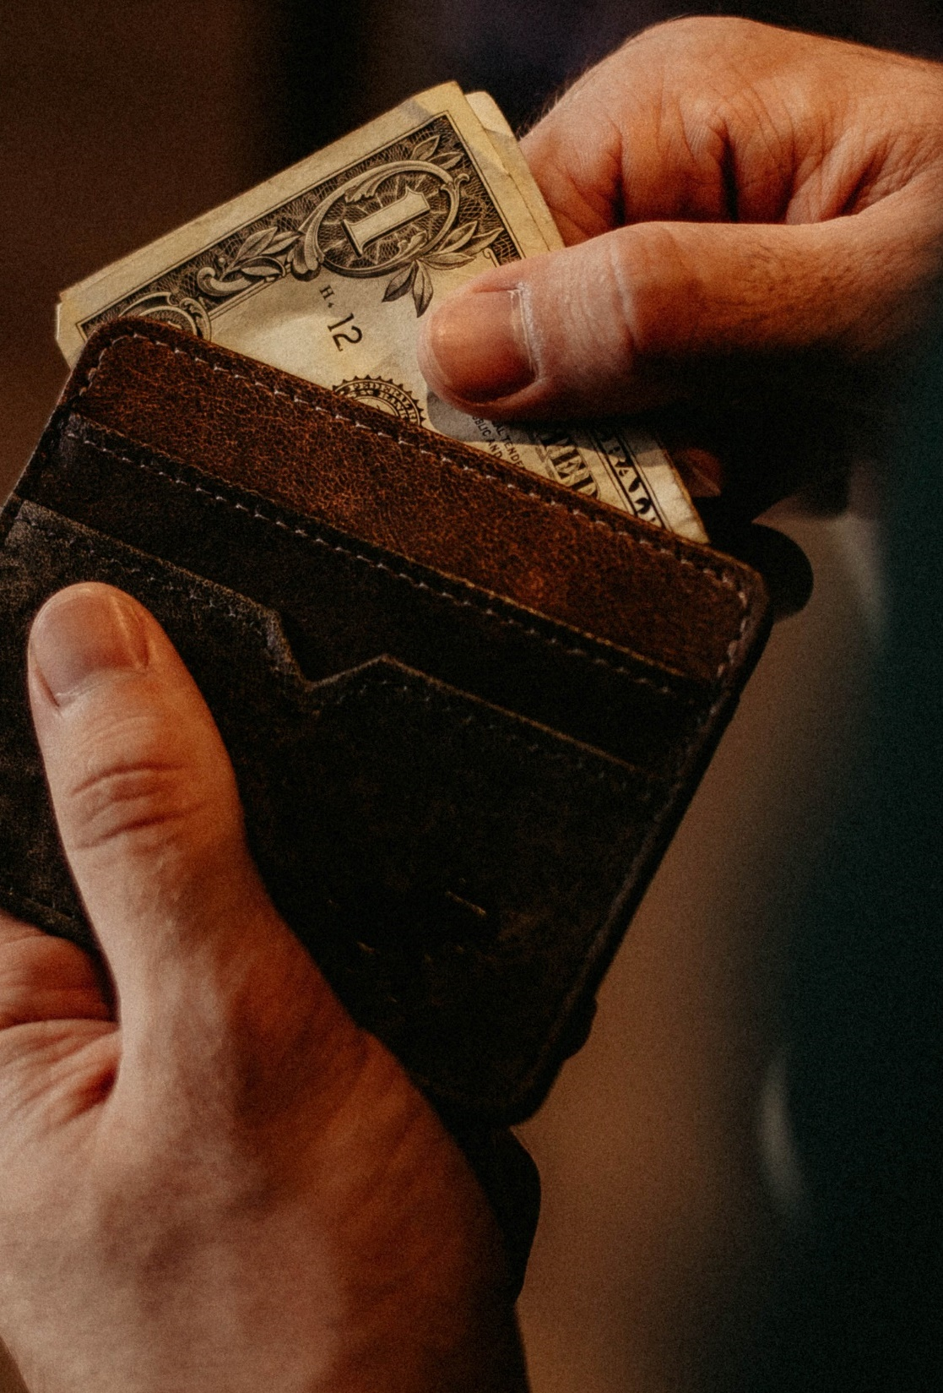
D. Other Powers
Clause 4’s bankruptcy provision was another attempt to promote uniformity among the states.
It is important that the assets of a debtor be equally divided among his creditors.
Notes:
Photo by Allef Vinicius on Unsplash
https://unsplash.com/photos/fJTqyZMOh18

Slide 16
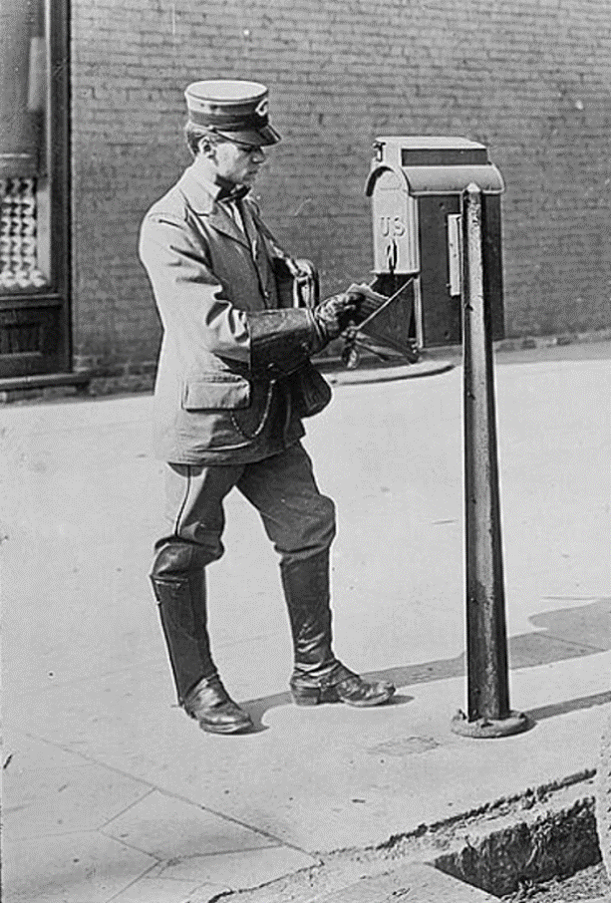
E. Mail Service
Alexander Hamilton expected the US Post Office to generate revenue for the Treasury.
By 1896, the mail service had been expanded to include free rural delivery.
Notes:
U.S. mailman & motorcycle. [Between 1909 and 1940] Photograph. Retrieved from the Library of Congress, <www.loc.gov/item/2016823048/>.

Slide 17
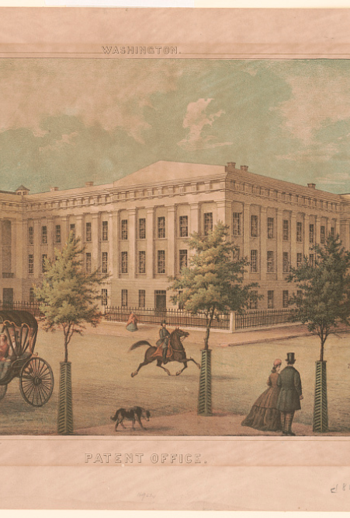
F. Patents and Copyrights
Congress’s power to grant patents and copyrights is critical in a democracy and is found in Clause 8.
Today, intellectual property rights have been expanded to protect photos, movies, computer programs, and prescription drugs.
Notes:
E. Sachse & Co., Lithographer. Washington. Patent Office / lith. by E. Sachse & Co., Balto. [Between 1865 and 1869] Photograph. Retrieved from the Library of Congress, <www.loc.gov/item/2012648853/>.

Slide 18
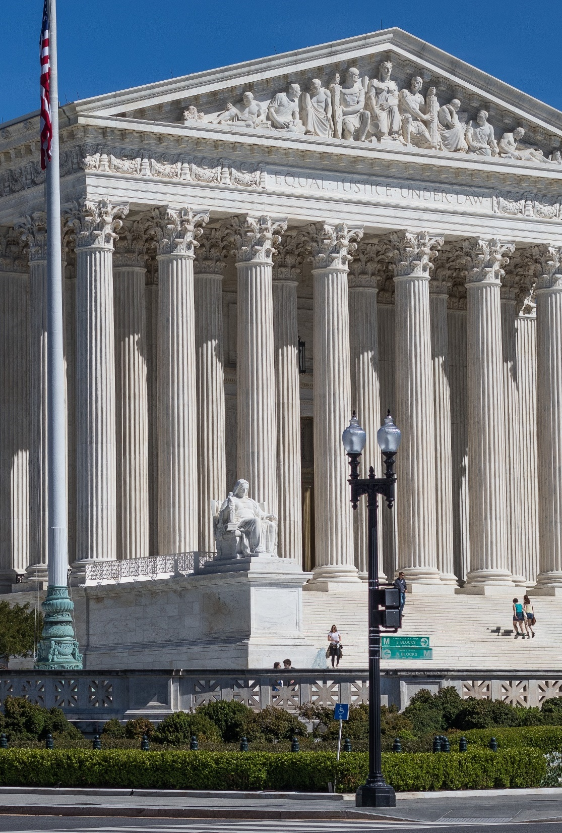
G. Federal Courts
The Constitution gave Congress the authority to organize the Supreme Court and create federal courts beneath it.
This was first done through the Judiciary Act of 1789.
Notes:
Image by Mark Thomas from Pixabay
https://pixabay.com/photos/us-supreme-court-building-2225765/

Slide 19
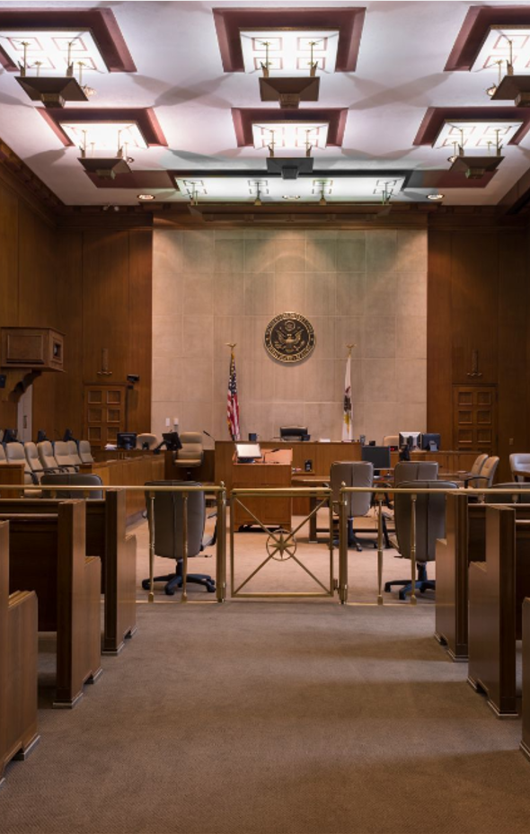
G. Federal Courts
The size and structure of the court system has changed several times over the years.
Today, there are nine justices on the Supreme Court, thirteen circuit courts of appeals, and ninety-four district courts.
Notes:
Highsmith, Carol M, photographer. Courtroom at Federal Building and U.S. Court House, Peoria, Illinois. April. Photograph. Retrieved from the Library of Congress, <www.loc.gov/item/2013634269/>.

Slide 20
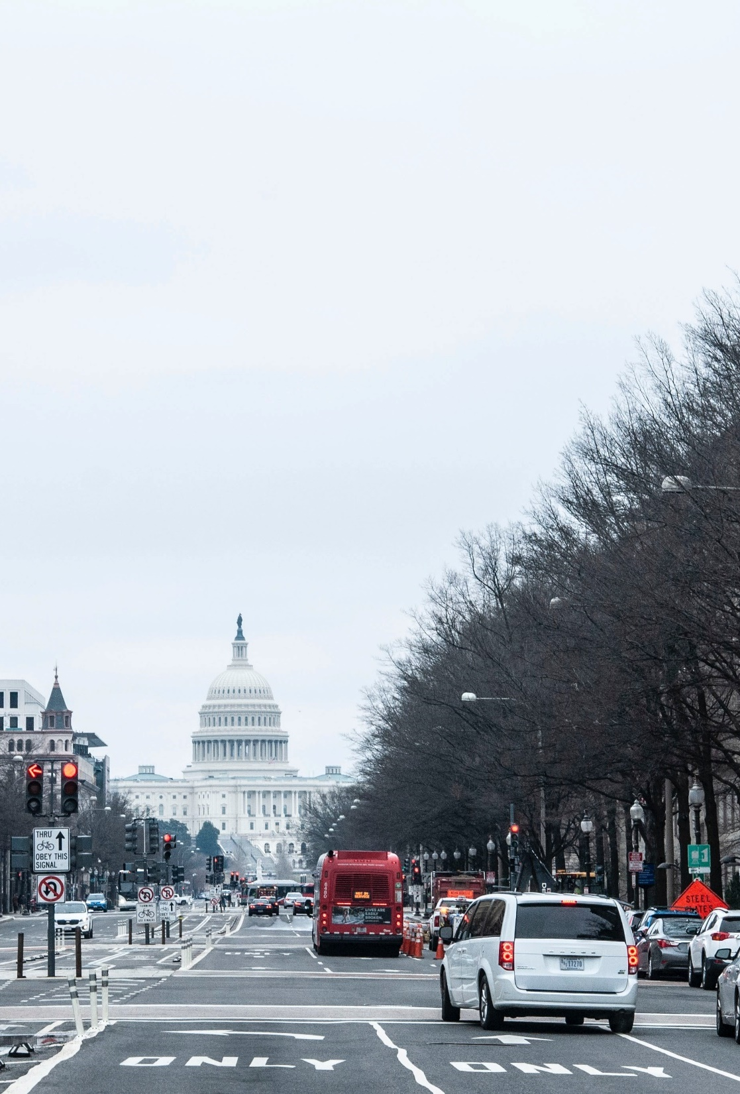
H. District of Columbia
Clause 17 gives Congress control over the District of Columbia.
Over time, the District of Columbia has gained increased autonomy from Congress but has not yet attained statehood.
Notes:
Photo by Maria Oswalt on Unsplash
https://unsplash.com/photos/TRkDaJGK2yE

Slide 21
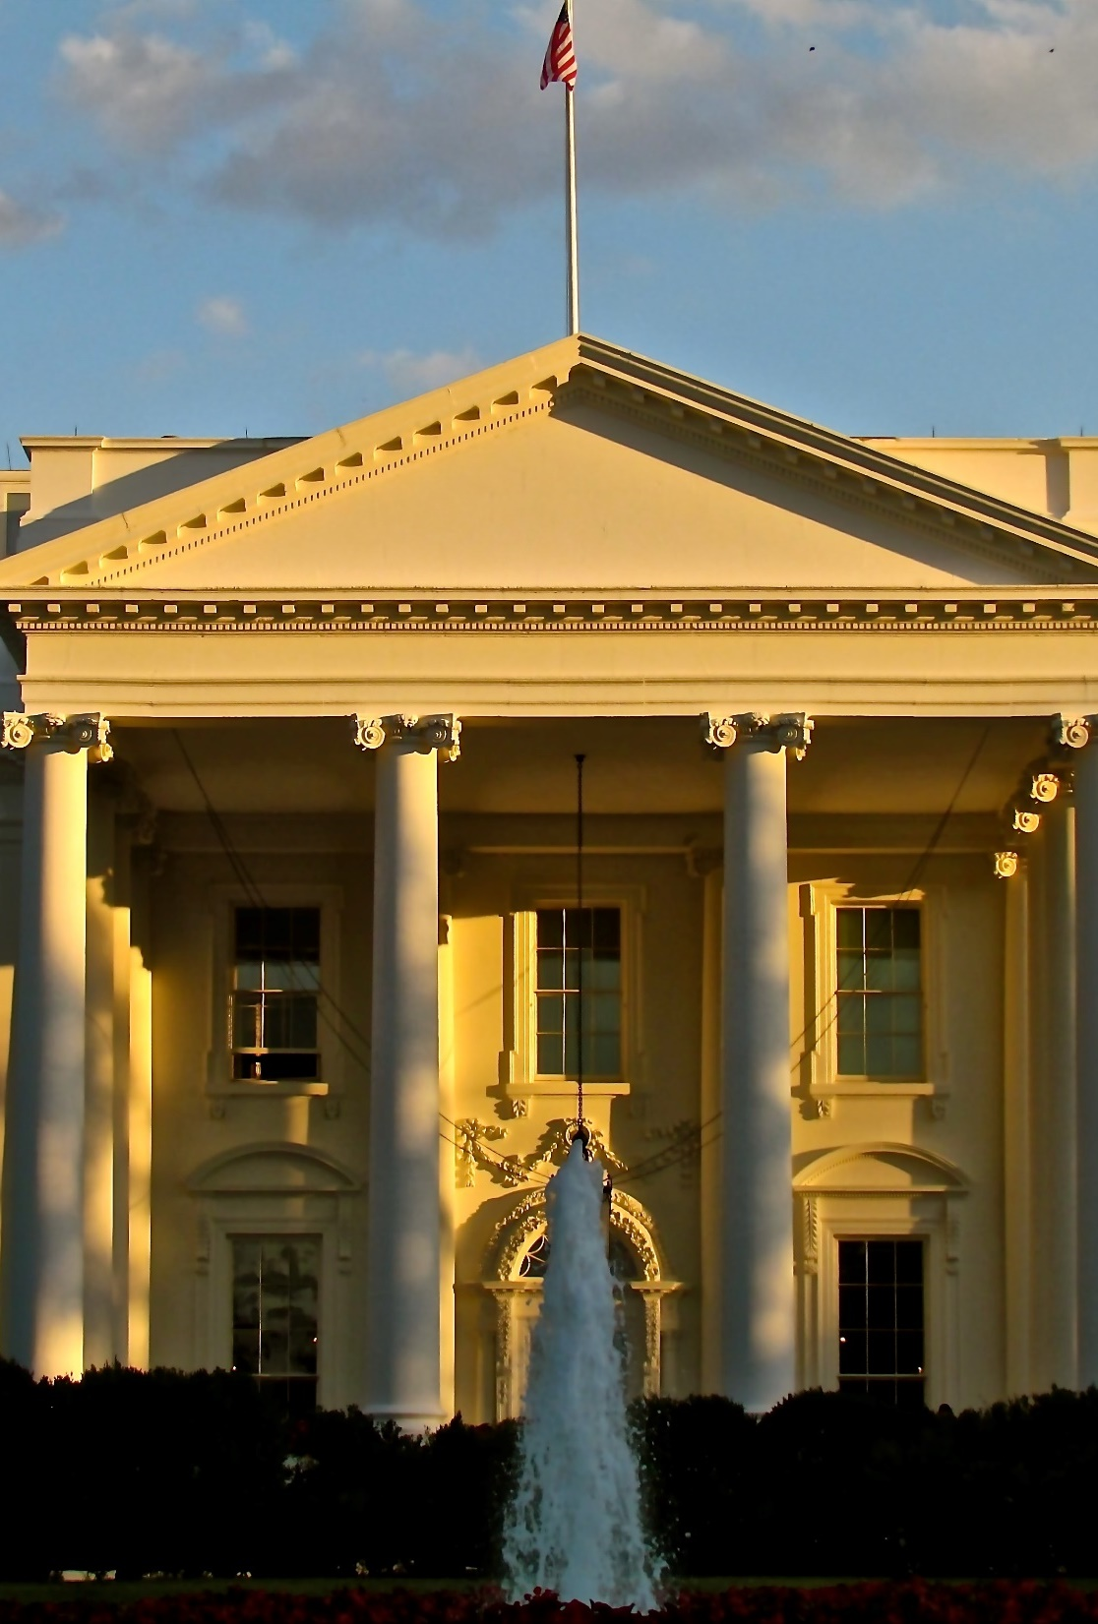
I. Necessary and Proper Clause
Clause 18, the necessary and proper clause, is the basis for the extraordinary powers of the national government.
It has been debated since the days of President Washington and has been used to greatly expand the powers of the government.
Notes:
Photo by Suzy Brooks on Unsplash
https://unsplash.com/photos/BbpEbkAy818

Slide 22
Section Review – Chapter 9.1
1. Explain why Article I, Section 8, of the Constitution is so important for Congress.
It clearly lists the powers of Congress (p. 187)
2. Describe NAFTA and explain why it was controversial.
The North American Free Trade Agreement (NAFTA) removed many of the tariffs on goods coming from both Mexico and Canada. Historically, some have welcomed tariffs to protect domestic industry against foreign competition. Others resented the tariffs, especially if it forced them to pay higher prices for US-made goods (p. 168)

Slide 23
Section Review – Chapter 9.1
3. From what sources does the federal government borrow money?
Other countries, private banks, and individuals (through sale of bonds) (pp. 188–189)

Slide 24
Section Review – Chapter 9.1
4. Explain why statehood for the District of Columbia is a controversial issue.
The District of Columbia is heavily Democratic, and thus Republicans are not excited about the possibility of adding more Democratic members to Congress. Many scholars argue that Congress does not have the constitutional authority to grant statehood to DC because it was established to serve as the seat of national government and designed as separate from any state. However, other scholars disagree with this assessment. (p. 196)

Slide 25
Section Review – Chapter 9.1
Using the two graphs on page 187, what are some of the conclusions you can reach concerning the national debt?
The national debt is fast increasing. If the national debt were split up among the American population, many would not have the funds on hand to pay for their portion. By 2020, the debt was more than $23 trillion dollars (nearly $70,000 per person).

Slide 26
Section Review – Chapter 9.1
Why is the necessary and proper clause important?
It has been used to expand the government’s enumerated powers.

Slide 27
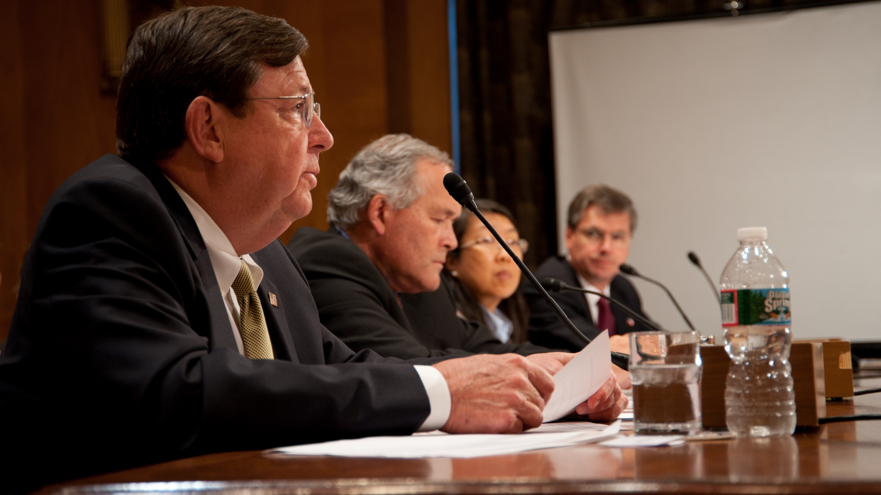
II. Implied and Nonlegislative Powers
Chapter 9.2
Notes:
By Bill Koplitz - This image is from the FEMA Photo Library., Public Domain, https://commons.wikimedia.org/w/index.php?curid=11648143
https://commons.wikimedia.org/w/index.php?title=Special:Search&limit=500&offset=0&profile=default&search=congressional+hearing&advancedSearch-current=%7B%7D&ns0=1&ns6=1&ns12=1&ns14=1&ns100=1&ns106=1&searchToken=b7q2qmt9d0u5qg1spt3f1e3pj#%2Fmedia%2FFile%3AFEMA_-_45466_-_FEMA%27s_Bill_Carwile_testifies_at_a_Senate_Hearing.jpg

Slide 28
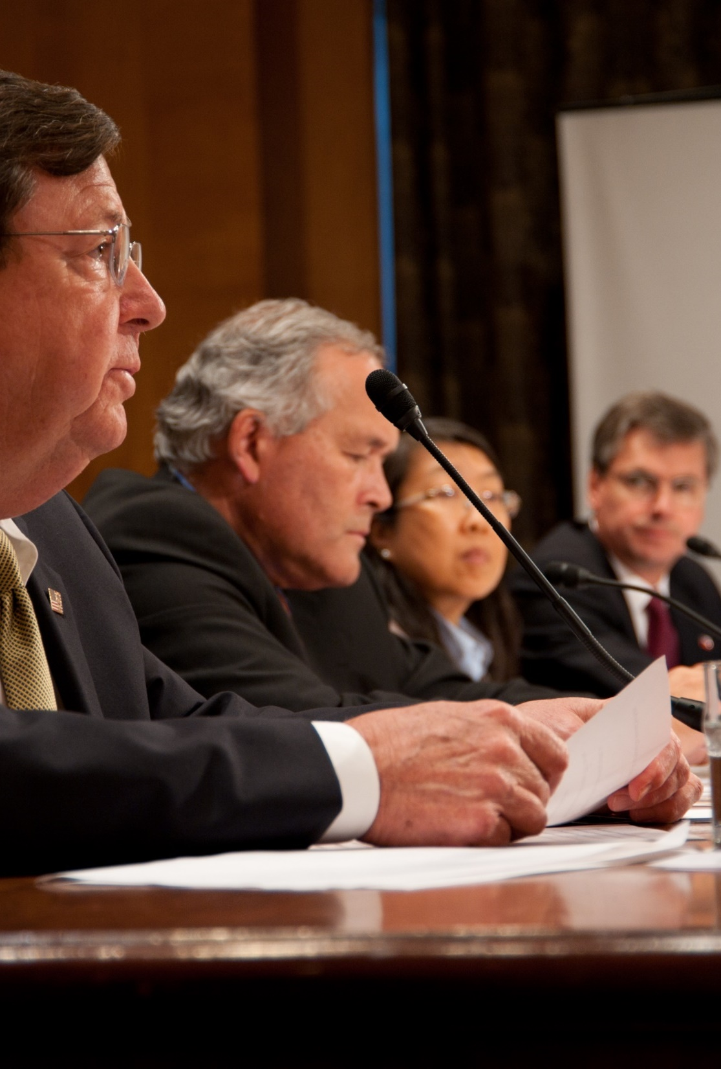
A. Implied Powers
The necessary and proper clause gives Congress many implied powers – powers that are needed to exercise enumerated powers.
Congress has the power to pass resolutions – declarations that are not law but express the opinion of Congress.
Notes:
By Bill Koplitz - This image is from the FEMA Photo Library., Public Domain, https://commons.wikimedia.org/w/index.php?curid=11648143
https://commons.wikimedia.org/w/index.php?title=Special:Search&limit=500&offset=0&profile=default&search=congressional+hearing&advancedSearch-current=%7B%7D&ns0=1&ns6=1&ns12=1&ns14=1&ns100=1&ns106=1&searchToken=b7q2qmt9d0u5qg1spt3f1e3pj#%2Fmedia%2FFile%3AFEMA_-_45466_-_FEMA%27s_Bill_Carwile_testifies_at_a_Senate_Hearing.jpg

Slide 29
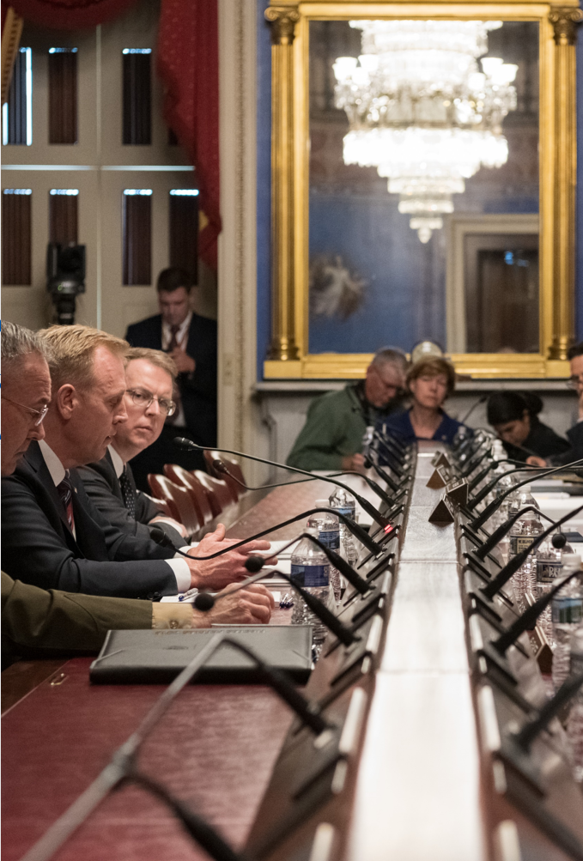
A. Implied Powers
Congress has certain implied judicial powers.
  It can hold investigations.
  It can issue a subpoena – a legal order to appear as a witness.
  Members of Congress have some immunity from prosecution.
Notes:
By United States Senate - Office of Richard Shelby - https://www.flickr.com/photos/senatorrichardshelby/32863117587, Public Domain, https://commons.wikimedia.org/w/index.php?curid=86796852
https://commons.wikimedia.org/w/index.php?sort=relevance&search=congress+hearing&title=Special:Search&profile=advanced&fulltext=1&advancedSearch-current=%7B%7D&ns0=1&ns6=1&ns12=1&ns14=1&ns100=1&ns106=1&searchToken=xhy35bspax7063mfjgj4r5hx#%2Fmedia%2FFile%3ASenator_Shelby_at_Hearing_to_Review_Pentagon_Budget.jpg

Slide 30
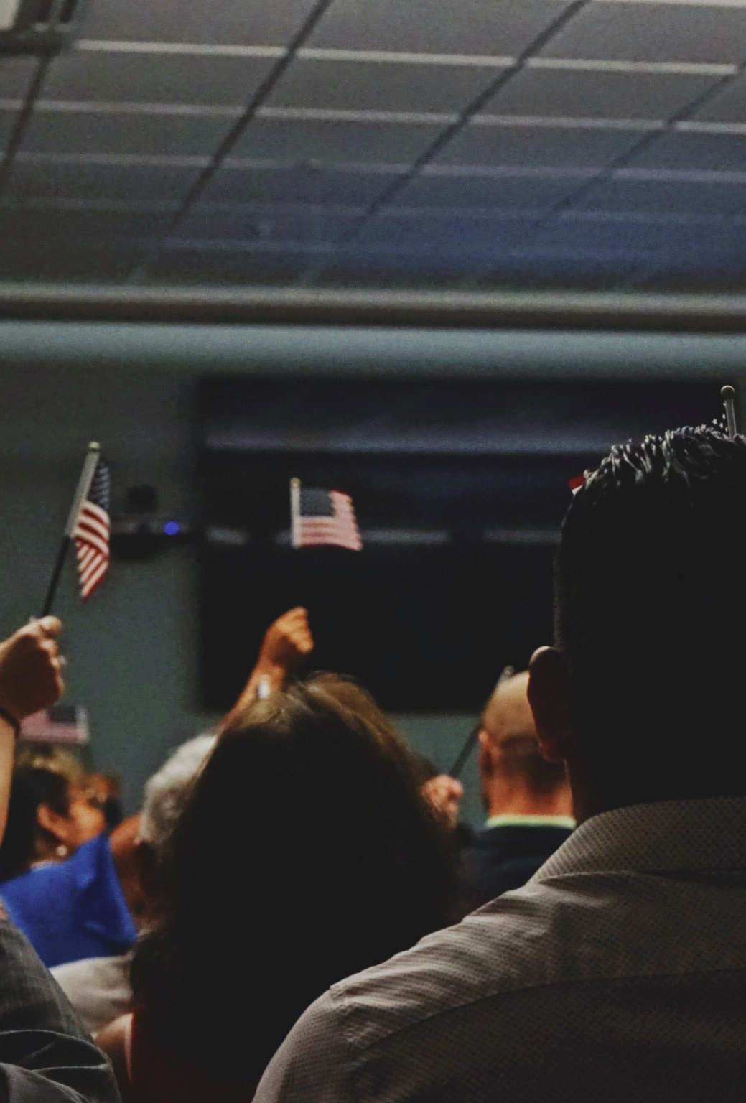
A. Implied Powers
Congress can acquire and govern new territories.
During Reconstruction, the Supreme Court ruled that Congress can manage war-induced problems during peacetime.
Congress can also make laws dealing with immigration and naturalization.
Notes:
Photo by Elias Castillo on Unsplash
https://unsplash.com/photos/TKE02PRu97k

Slide 31
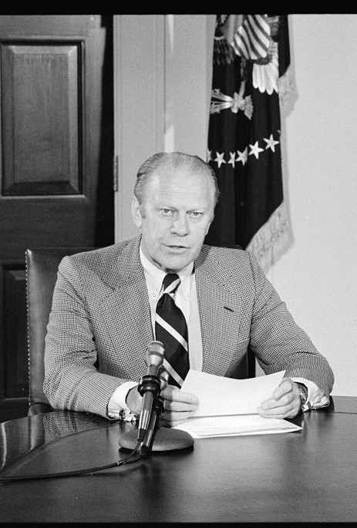
B. Nonlegislative Powers
Congress has the power to elect the president if no candidate receives a majority of electoral votes.
The Twenty-Fifth Amendment (1967) requires that if the office of vice president is empty, the president can nominate a new one who must be approved by Congress.
President Gerald Ford
Notes:
O'Halloran, Thomas J, photographer. President Gerald Ford announcing amnesty for draft evaders at the White House, Washington, D.C. Photograph. Retrieved from the Library of Congress, <www.loc.gov/item/2005684076/>.

Slide 32
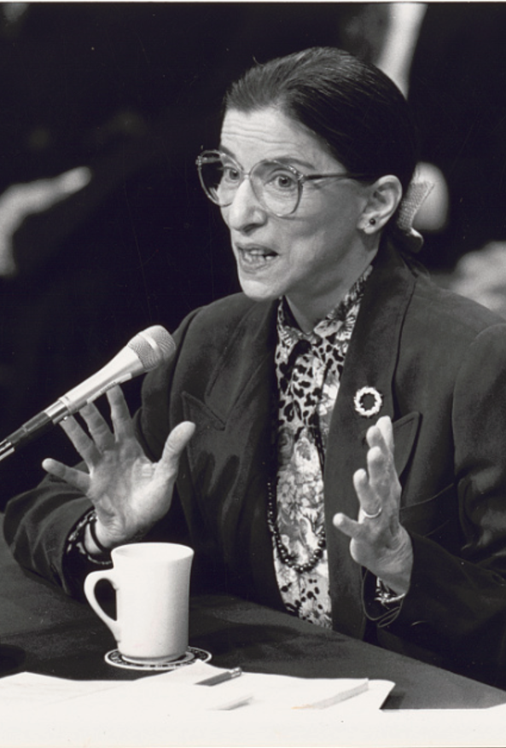
B. Nonlegislative Powers
The Senate has the power of treaty ratification (formal approval).
Executive and judicial appointees from the president are subject to the Senate confirmation process before taking their post.
Justice Ruth Ginsburg at her confirmation hearing
Notes:
Jenkins, R. Michael, photographer. Ruth Bader Ginsburg at her confirmation hearing / R. Michael Jenkins, Congressional Quarterly. [Washington, D.C.: Congressional Quarterly, 7-21-93 21 July] Photograph. Retrieved from the Library of Congress, <www.loc.gov/item/2019630722/>.

Slide 33
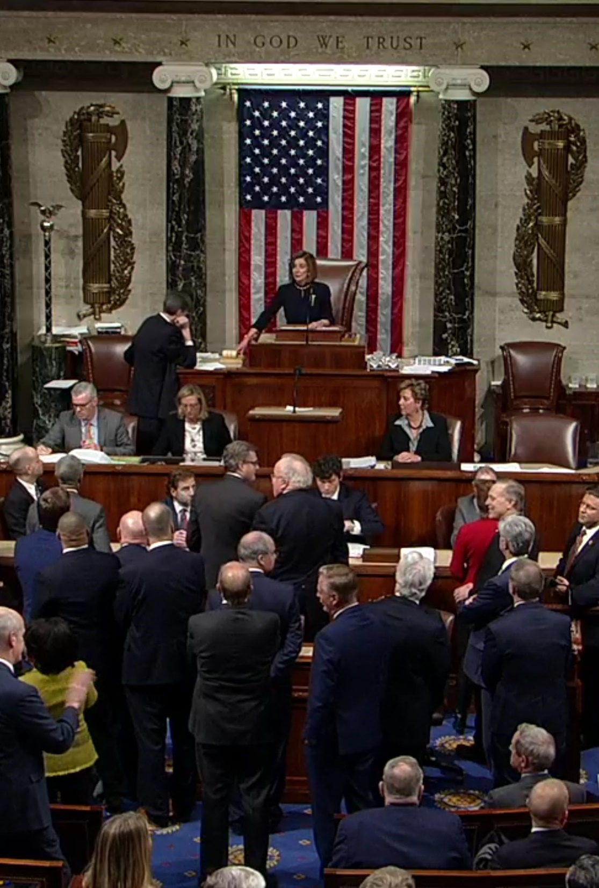
B. Nonlegislative Powers
Both houses of Congress share the power of impeachment – formally charging a top government official with a serious crime.
If the House votes for impeachment, the Senate will conduct an impeachment trial and can convict with a two-thirds majority vote.
The House votes to impeach President Trump in December 2019
Notes:
By United States House of Representatives - House Floorcast – Clerk of the U.S. House of Representatives, Public Domain, https://commons.wikimedia.org/w/index.php?curid=85037886
https://commons.wikimedia.org/w/index.php?sort=relevance&search=impeachment+donald+trump&title=Special:Search&profile=advanced&fulltext=1&advancedSearch-current=%7B%7D&ns0=1&ns6=1&ns12=1&ns14=1&ns100=1&ns106=1&searchToken=ce39qrwwpc0ouw64w6r5bebpo#%2Fmedia%2FFile%3AHouse_of_Representatives_Votes_to_Adopt_the_Articles_of_Impeachment_Against_Donald_Trump.jpg

Slide 34
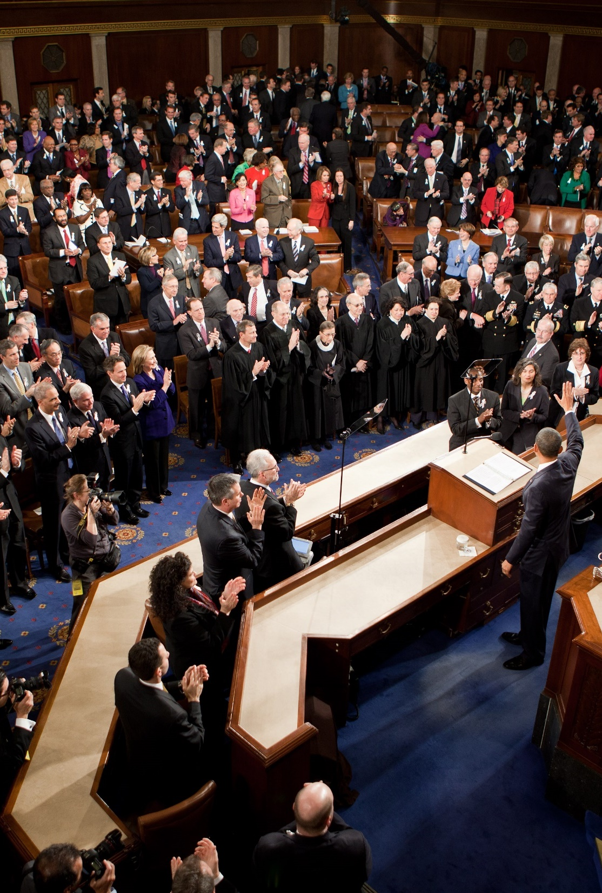
B. Nonlegislative Powers
Congress has the power to manage its own members.
  It can expel members.
  Members can be censured for their behavior.
  The House also uses a lesser punishment called a reprimand.
Notes:
By Chuck Kennedy (Executive Office of the President of the United States) - http://www.whitehouse.gov/state-of-the-union-2011, Public Domain, https://commons.wikimedia.org/w/index.php?curid=12833046
https://commons.wikimedia.org/w/index.php?title=Special:Search&limit=500&offset=0&ns0=1&ns6=1&ns12=1&ns14=1&ns100=1&ns106=1&search=state+of+the+union+address+obama&advancedSearch-current=%7B%7D&searchToken=9meehbj2z7fn1mm3g1lqxg12f#%2Fmedia%2FFile%3AObama_waves_State_of_the_Union_2011.jpg

Slide 35
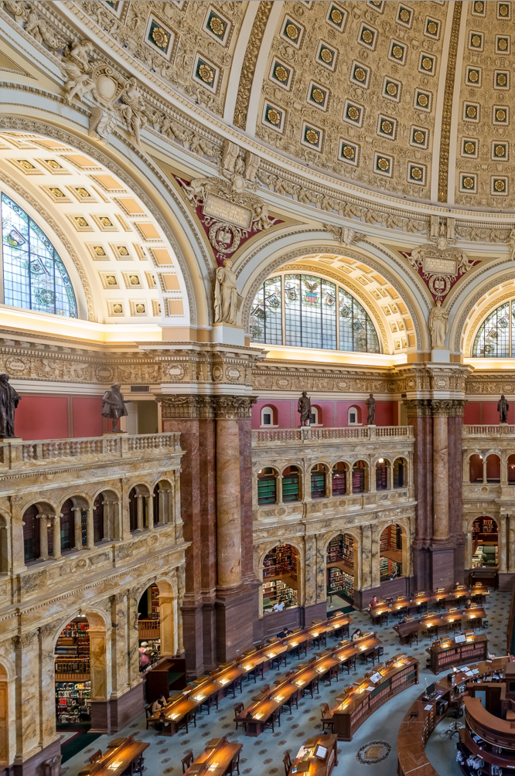
B. Nonlegislative Powers
Article V gives Congress the power to propose amendments and choose how they will be ratified.
Only the Twenty-First Amendment has been ratified by state conventions.
The Library of Congress
Notes:
Photo by Stephen Walker on Unsplash
https://unsplash.com/photos/C0LTuu3_Qw8

Slide 36
Section Review – Chapter 9.2
1. Define resolutions.
declarations that lack the authority of law and merely express congressional opinion (p. 198)
2. How did Congress expand its war powers during Reconstruction?
Congress believed (and the Supreme Court agreed) that it could deal with peacetime problems that resulted from wars.
(p. 198)

Slide 37
Section Review – Chapter 9.2
3–4. In what two ways may Congress propose amendments to the Constitution?
by a two-thirds vote of both houses or by calling for a “convention for proposing amendments” at the request
of two-thirds of the states (p. 200)

Slide 38
Section Review – Chapter 9.2
Distinguish between enumerated, implied, and nonlegislative powers of Congress.
Enumerated powers are specifically listed in the Constitution. Implied powers are needed for Congress to exercise its enumerated powers, but are not specifically noted in the document. Enumerated and implied powers may deal with both legislative and nonlegislative functions of Congress. Nonlegislative powers given to Congress would include such matters as impeachment, approval of presidential appointments and treaties, and determining qualifications of members of Congress.

Slide 39
Section Review – Chapter 9.2
How can the Senate shape the federal judiciary?
The Senate can exercise its power of confirmation by accepting, rejecting, or influencing executive appointments.

Slide 40
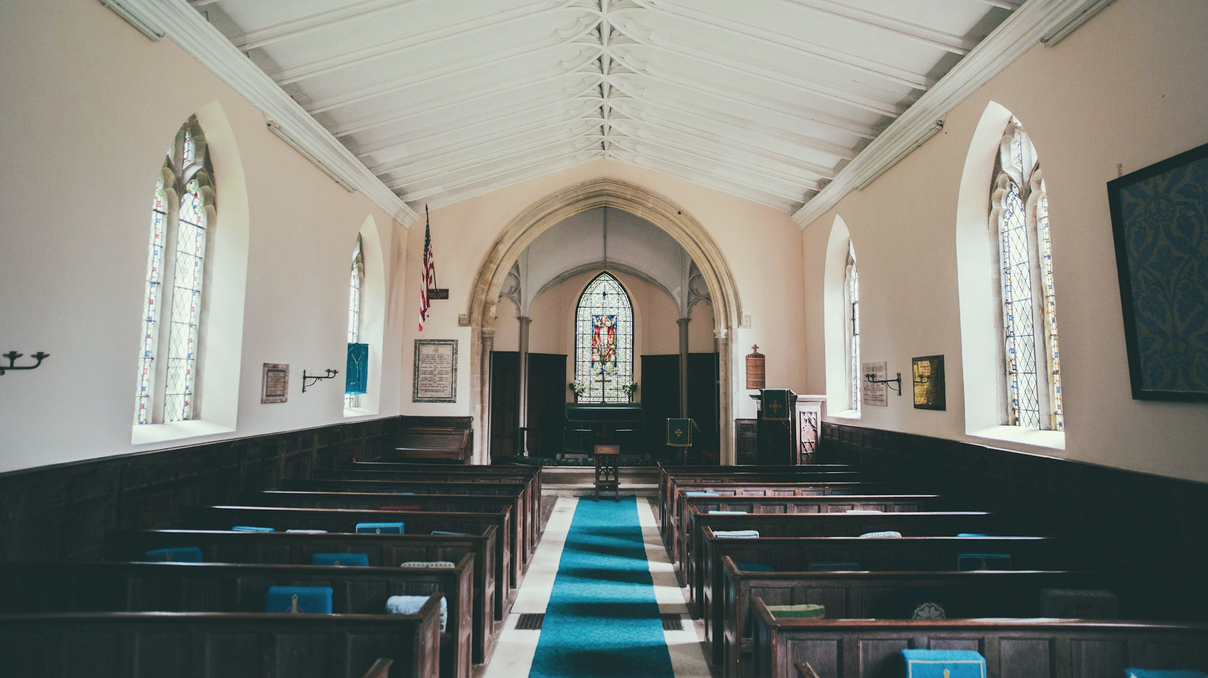
III. Denied Powers
Chapter 9.3
Notes:
Photo by Joseph Pearson on Unsplash
https://unsplash.com/photos/_LprD9HAl3w

Slide 41
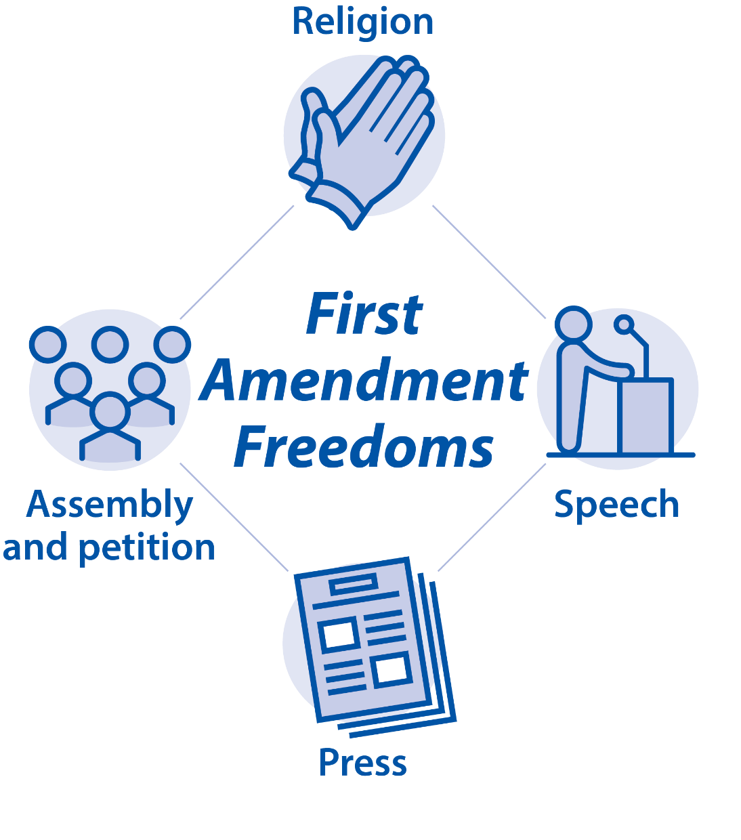
III. Denied Powers
The Constitution states that reserved powers are to be reserved for the states or the people.
The First Amendment denies several powers to Congress.
  Restricting religious liberty, speech, press, and assembly
Notes:
BJU Press Art

Slide 42
III. Denied Powers
The Constitution states that reserved powers are to be reserved for the states or the people.
Article I, Section 9 also denies several powers to Congress.
  Cannot suspend the writ of habeas corpus, pass a bill of attainder, pass an ex post facto law, or tax exports from any state
Notes:
BJU Press Art

Slide 43
Section Review – Chapter 9.3
1. Which amendment reserves certain powers to the state?
the Tenth Amendment (p. 201)

Slide 44
Section Review – Chapter 9.3
How does the First Amendment restrict Congress’s powers?
Congress cannot restrict religious freedom, freedoms of speech and the press, or freedoms to assemble and petition the government. [Article I, Section 9 adds that] Congress may not suspend the writ of habeas corpus, pass a bill of attainder or ex post facto law, or tax exports from any state.

Slide 45
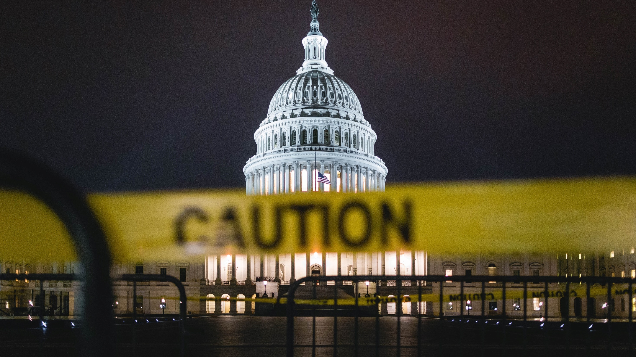
IV. Congressional Criticism
Chapter 9.4
Notes:
Photo by Andy Feliciotti on Unsplash
https://unsplash.com/photos/8cvjI48SFtY

Slide 46
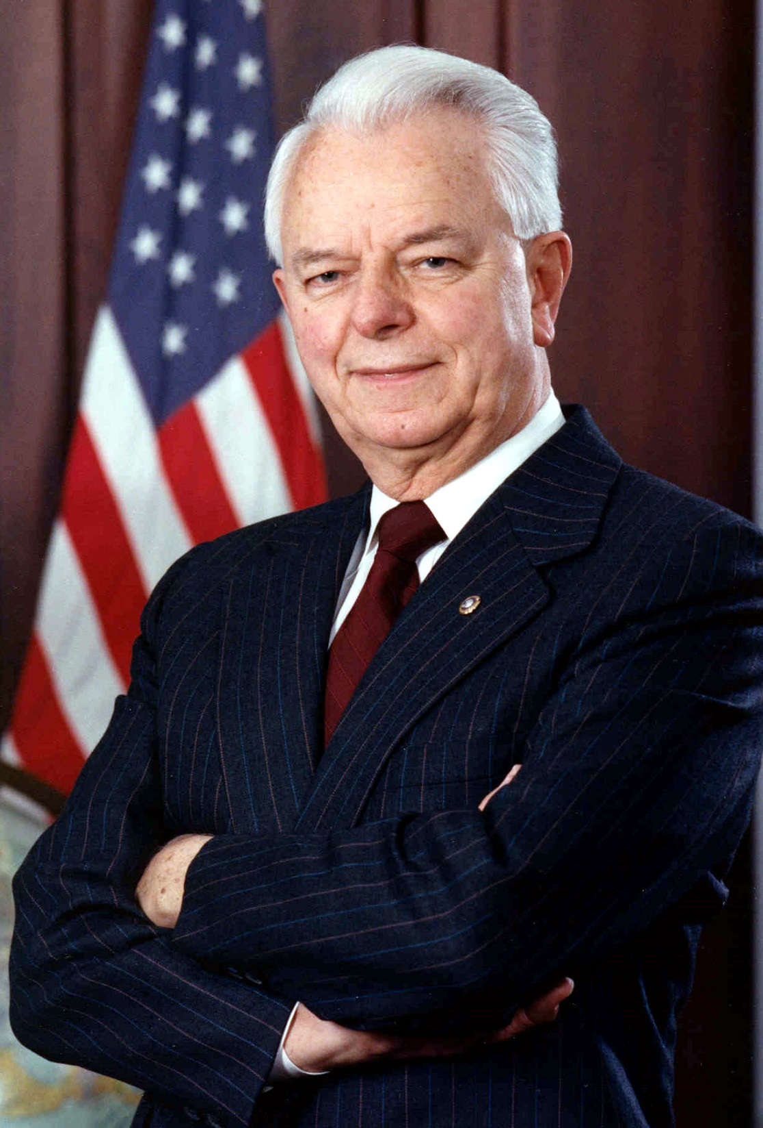
A. Pork-Barrel Politics
Many accuse members of Congress of obtaining expensive favors for their own states, often called pork-barrel projects.
Members of Congress may support each others’ pork-barrel projects in return for support for their own – a practice called logrolling.
Senator Robert Byrd
Notes:
By U. S. Senate - http://byrd.senate.gov/newsroom/photos/byrd_formal_smile_highres.jpg, Public Domain, https://commons.wikimedia.org/w/index.php?curid=217778
https://commons.wikimedia.org/w/index.php?title=Special:Search&limit=500&offset=0&ns0=1&ns6=1&ns12=1&ns14=1&ns100=1&ns106=1&search=senator+robert+byrd&advancedSearch-current=%7B%7D&searchToken=e41hsc11quoig5gy7422zoh09#%2Fmedia%2FFile%3ARobert_Byrd_official_portrait.jpg

Slide 47
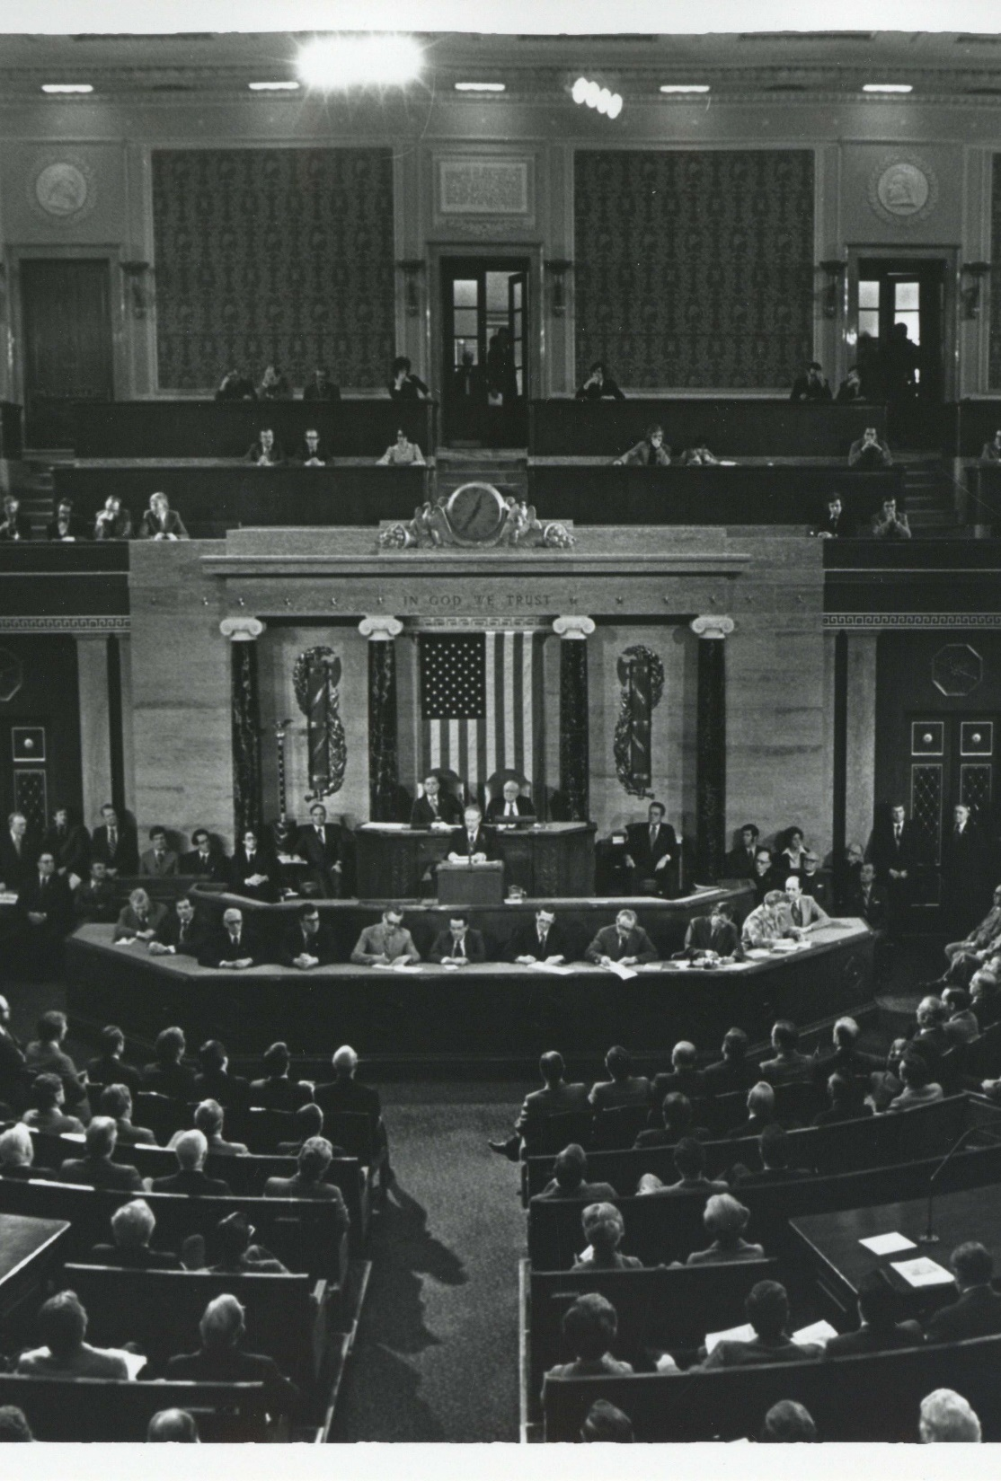
B. Seniority System
Generally, members who have served the longest receive the most important positions within Congress.
Critics argue that this honors political longevity rather than merit.
Notes:
By CarlAlbertArchives - Carl Albert Center, CC BY-SA 4.0, https://commons.wikimedia.org/w/index.php?curid=82273629

Slide 48
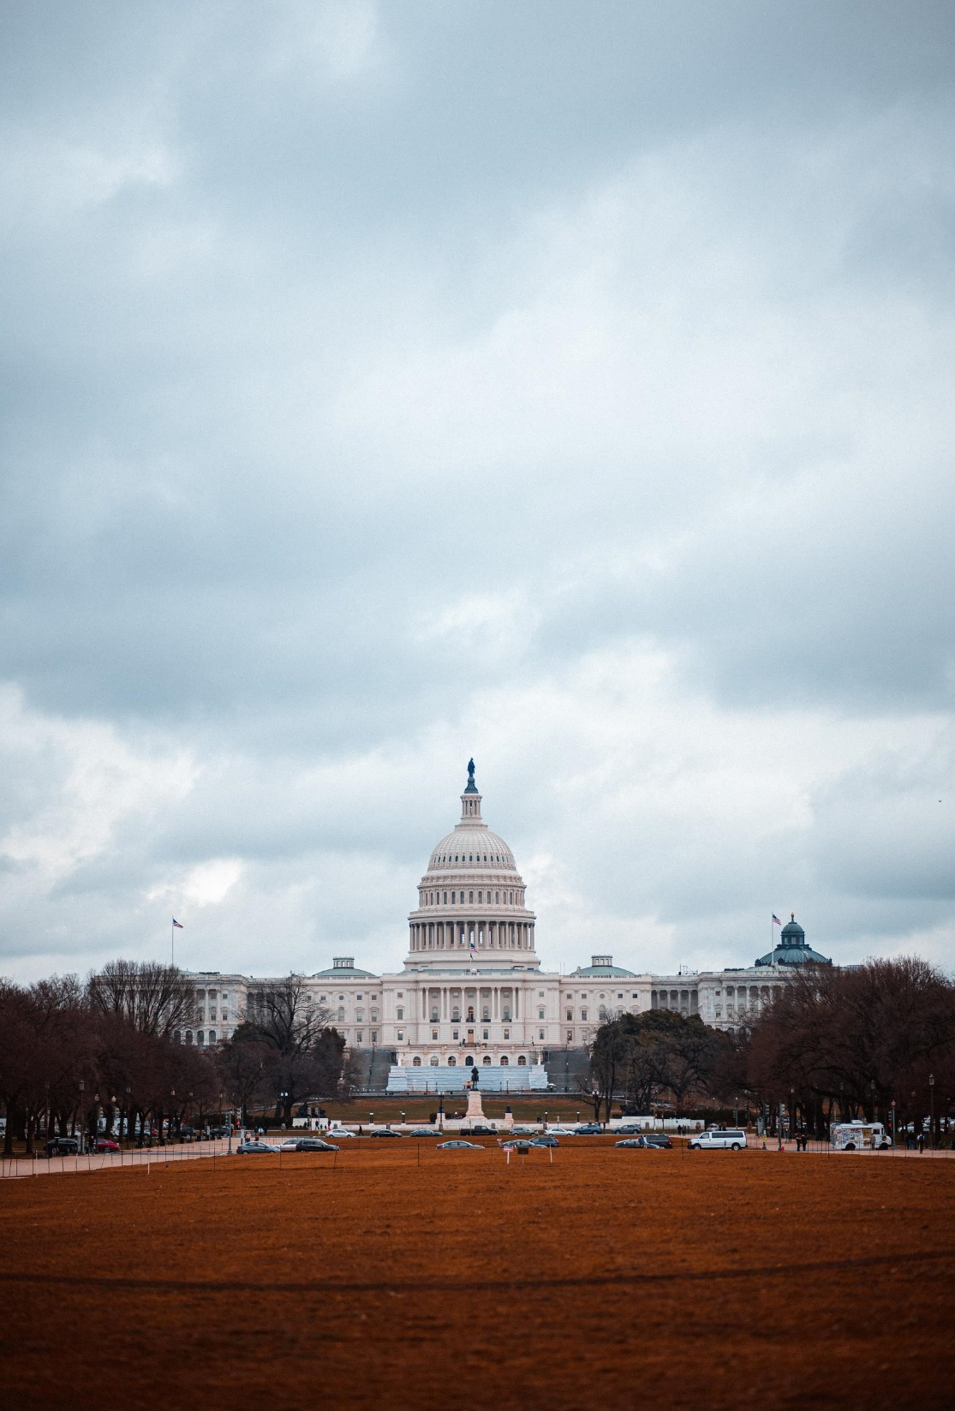
C. Balance
The Christian should ensure that his criticism of Congress is balanced and fair.
We should also remember that Congress works slowly by design and sometimes doing nothing is the right decision.
Notes:
Photo by Andy Montes de Oca on Unsplash
andy-montes-de-oca-RS9tqy-ex6U-unsplash

Slide 49
C. Balance
Congress provides an important check on the power of the other branches.
Notes:
Photo by Andy Montes de Oca on Unsplash
andy-montes-de-oca-RS9tqy-ex6U-unsplash

Slide 50
Section Review – Chapter 9.4
1. Explain how Christians should be careful about their criticisms of Congress.
Christians should ensure that their criticisms of Congress are biblically grounded. They should be cautious about denouncing governmental officials (Acts 23:5; Titus 3:1–2). While corruption, immorality, injustice, or policies contrary to Scripture should be condemned, the Christian must speak only truth about such matters (Isa. 10:1–2; Dan. 4:27; James 1:19–20). Citizens ought to hold members of Congress accountable and demand that they follow the highest ethical standards. (pp. 201–202)

Slide 51
Section Review – Chapter 9.4
2. What are the benefits of a bicameral congress?
A slow, deliberate legislative process protects society from ineffective, dangerous, or ill-conceived laws. It also provides an essential balance to presidential leadership. (pp. 203–204)

Slide 52
Section Review – Chapter 9.4
3–4. What are two factors that often make it difficult to prevent the defeat of pork-barrel measures?
Pork-barrel projects are difficult to prevent because of logrolling and the combining of pork-barrel projects with important spending bills. Logrolling occurs when a congressman supports the proposal of another congressman who supported one of his bills.

Slide 53
Section Review – Chapter 9.4
3–4. What are two factors that often make it difficult to prevent the defeat of pork-barrel measures?
Without such deals, some congressmen might vote against the pork that many spending bills contain. Attaching pork projects to an important bill forces representatives to either accept the entire bill, including the pork (which may contain measures he supports), or reject the whole bill. (pp. 202–203)

Slide 54
Section Review – Chapter 9.4
Read the feature box about Senator Robert Byrd on p. 202. Based on the information there, what is your opinion of his fondness for pork? Explain your view.
Senator Robert Byrd believed strongly that the national government should help his state by supporting government projects there. Consequently, he garnered as many funds for his state as possible. Many in his state appreciated these funds and recognized him as a hero.

Slide 55
Section Review – Chapter 9.4
Read the feature box about Senator Robert Byrd on p. 202. Based on the information there, what is your opinion of his fondness for pork? Explain your view.
Some will say that states should focus on funding their own projects rather than looking to the federal government for funds. Some will question if many projects Byrd supported were really worthwhile.

Slide 56
Section Review – Chapter 9.4
Read the feature box entitled “Pass It, Then Read It?” on this page. What is your opinion on the information presented?
Some will say that it is unfortunate that legislators often do not know the full details of a bill on which they are asked to vote. They may say the process should be slowed to give members more time to read bills. Others will say that members must, out of necessity, rely on summaries of bills that their staff members provide. Consequently, it is important to choose staff members wisely.

Slide 57
Chapter 9
Special Section:
A Trip to
Washington, DC
Notes:
This presentation only includes a sampling of important sites in Washington, DC.

Slide 58
Government Buildings

Slide 59
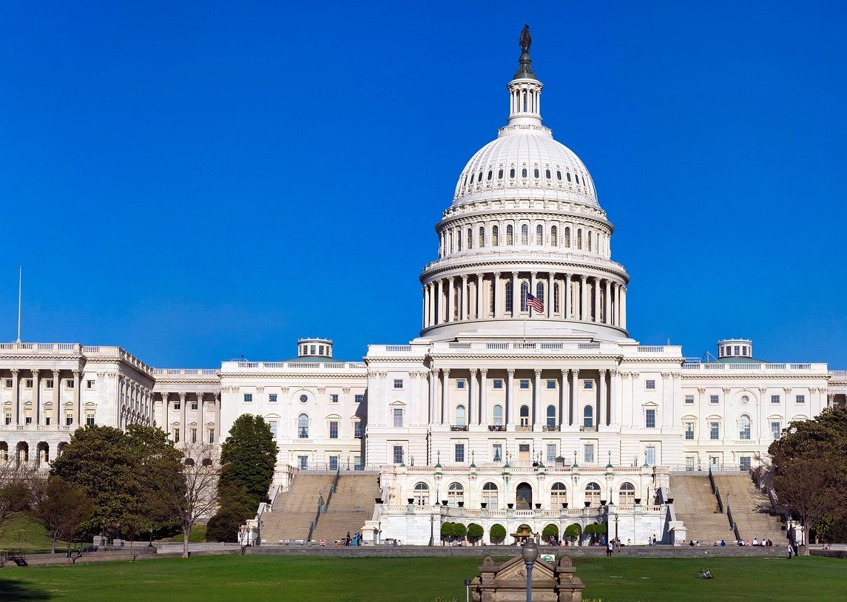
The Capitol Building
Notes:
https://pixabay.com/photos/us-capitol-building-washington-dc-4077168/; pixabay/CC0

Slide 60
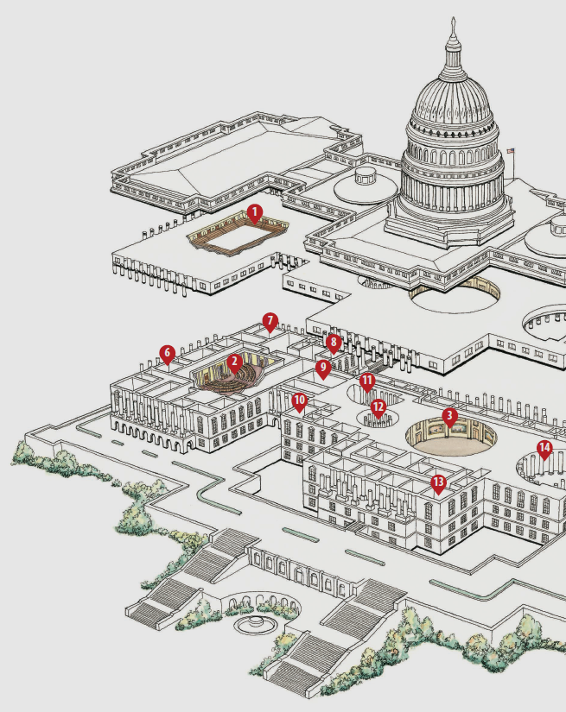
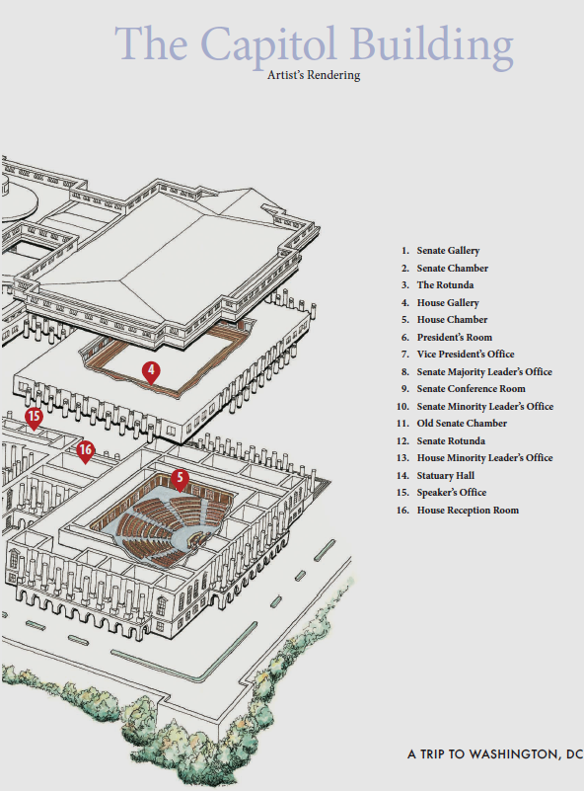
Notes:
BJU Press Art

Slide 61
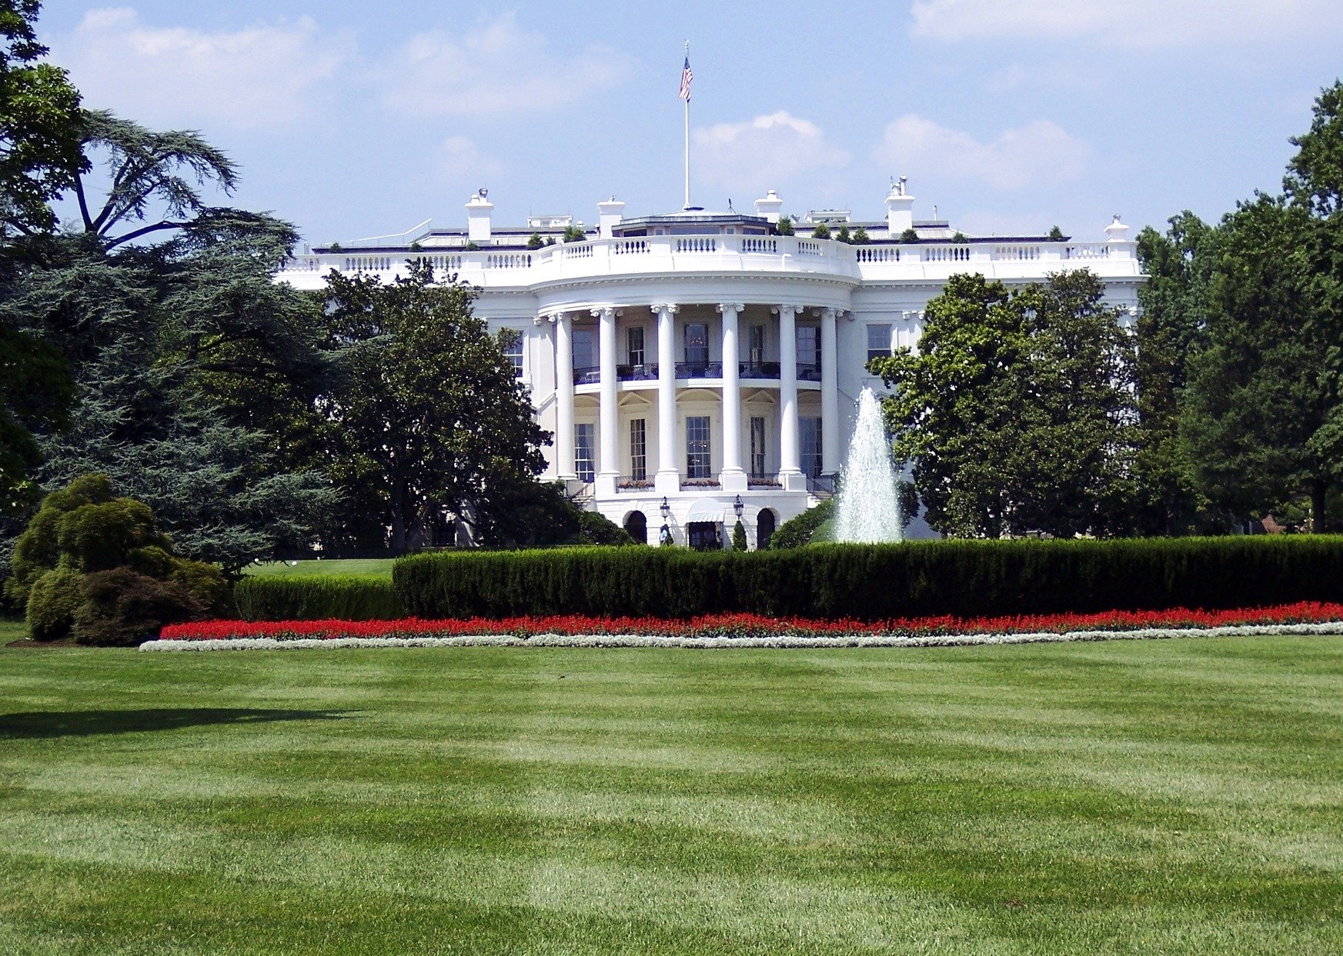
The White House
Notes:
https://pixabay.com/photos/administration-architecture-building-1846270/; pixabay/CC0

Slide 62
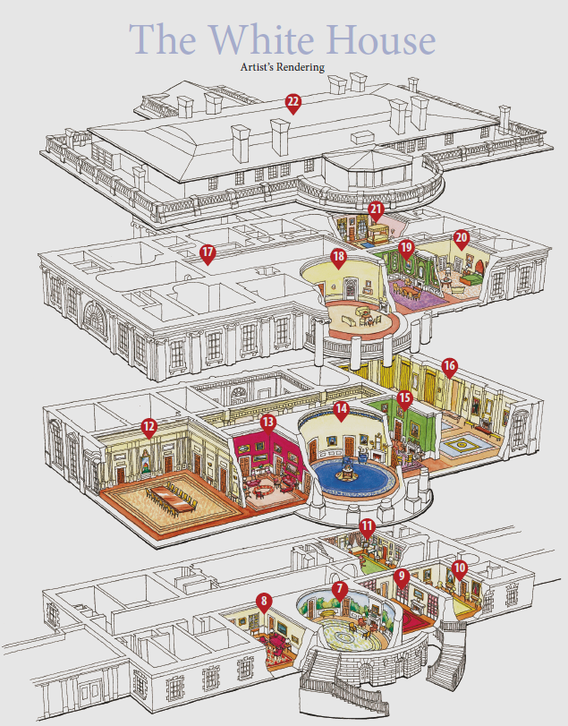
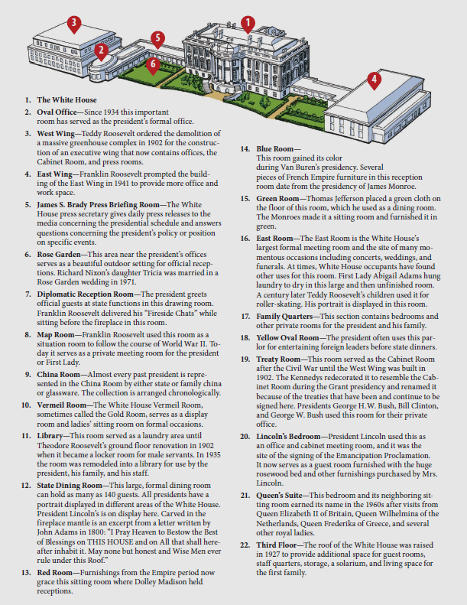
Notes:
BJU Press Art

Slide 63
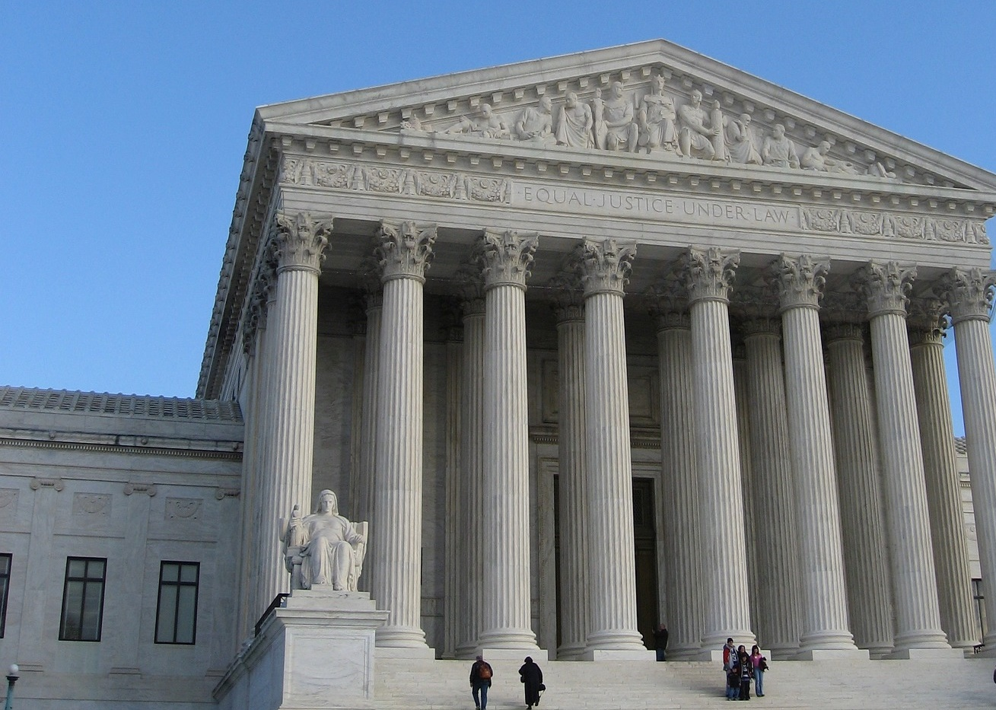
Supreme Court of the United States
Notes:
https://pixabay.com/photos/supreme-court-us-supreme-court-1039653/; pixabay/CC0

Slide 64
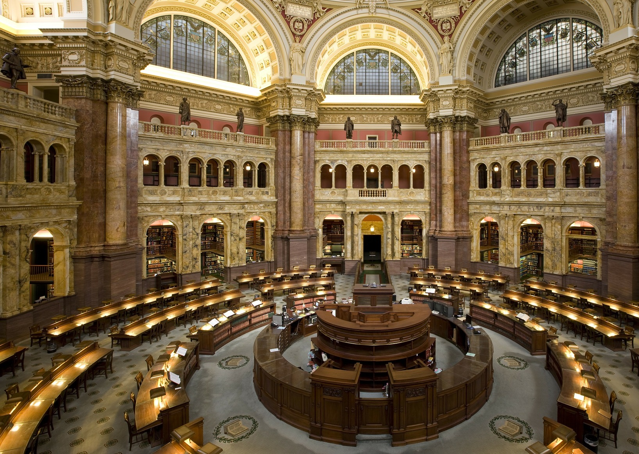
Library of Congress
Notes:
https://pixabay.com/photos/library-library-of-congress-loc-74038/; pixabay/CC0

Slide 65
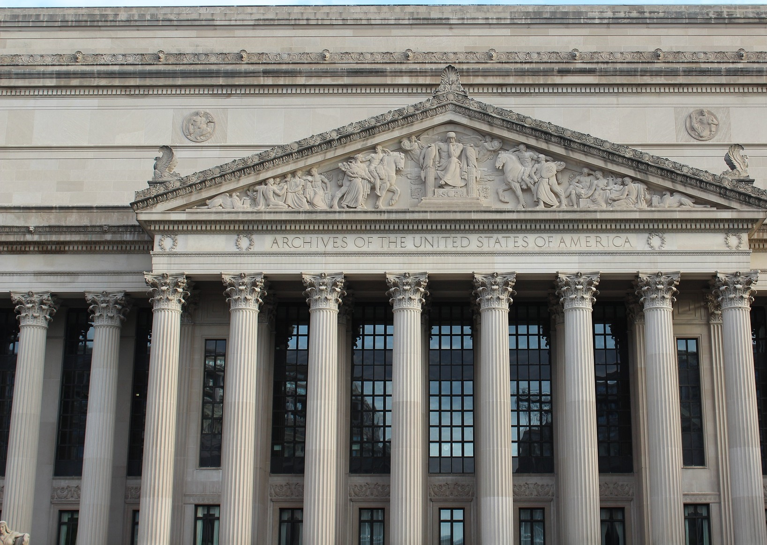
National Archives
Notes:
https://pixabay.com/photos/national-archives-washington-dc-4242949/; pixabay/CC0

Slide 66
Memorials

Slide 67
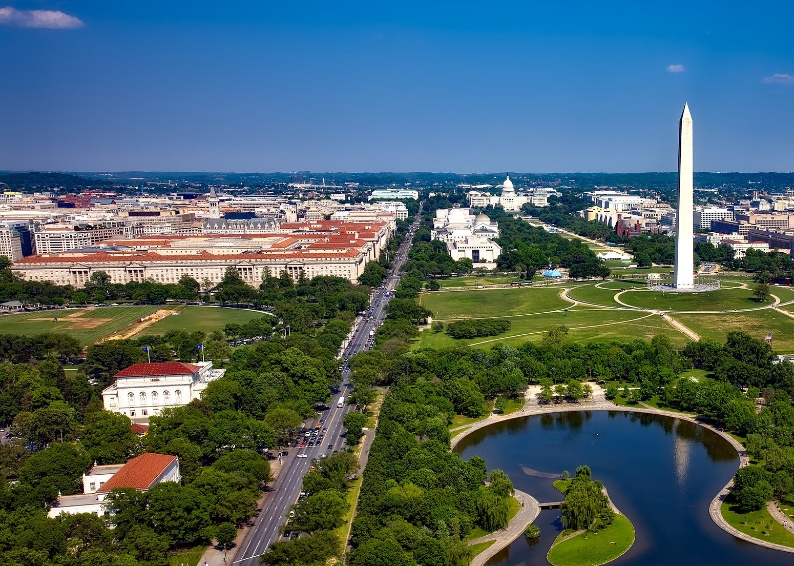
Washington Monument and National Mall
Notes:
https://pixabay.com/photos/washington-dc-c-city-urban-1622643/; pixabay/CC0

Slide 68
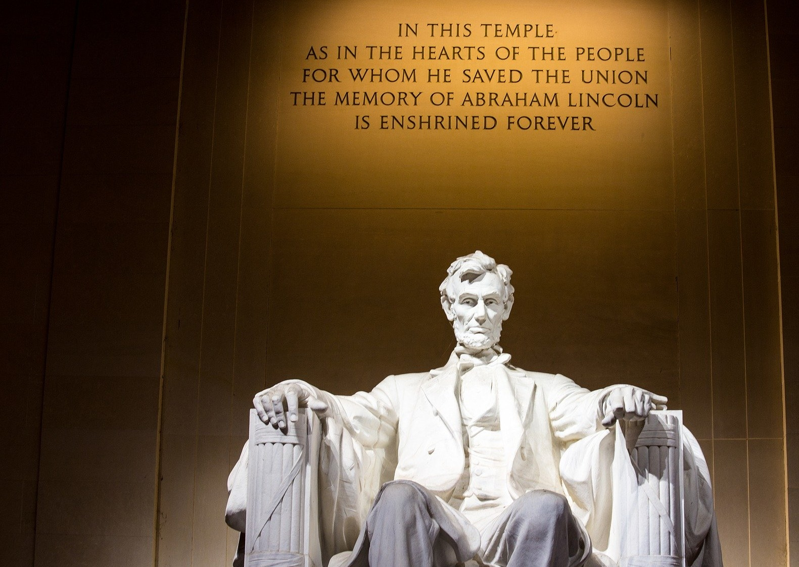
Lincoln Memorial
Notes:
https://pixabay.com/photos/lincoln-memorial-washington-dc-1809428/; pixabay/CC0

Slide 69
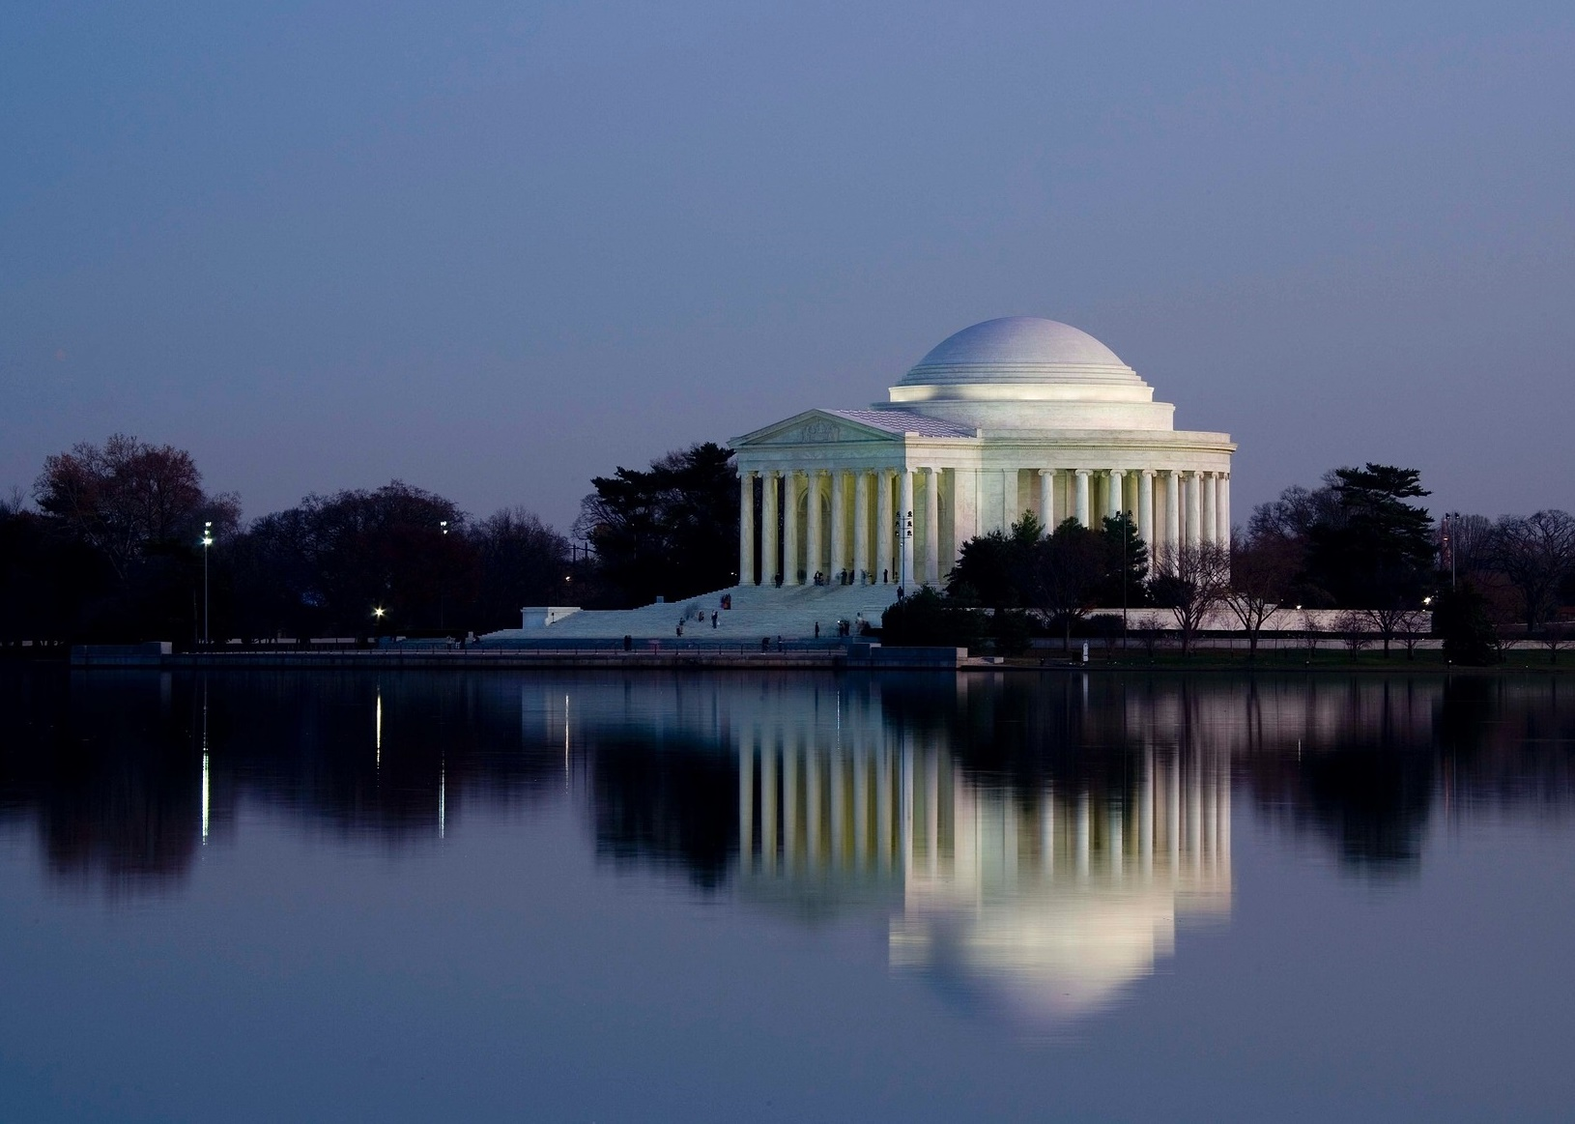
Jefferson Memorial
Notes:
https://pixabay.com/photos/jefferson-memorial-washington-d-c-1746794/; pixabay/CC0

Slide 70
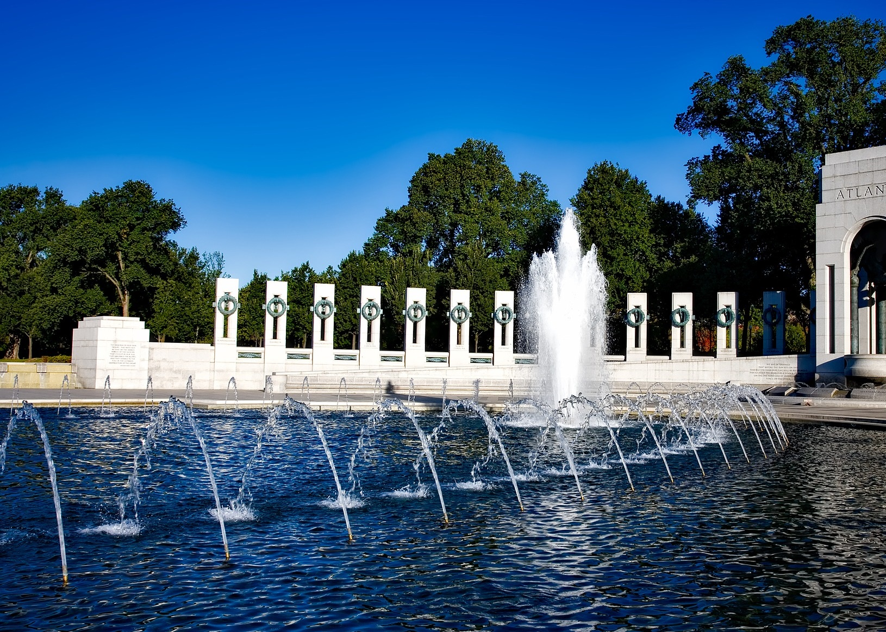
World War II Memorial
Notes:
https://pixabay.com/photos/world-war-ii-memorial-washington-dc-1627186/; pixabay/CC0

Slide 71
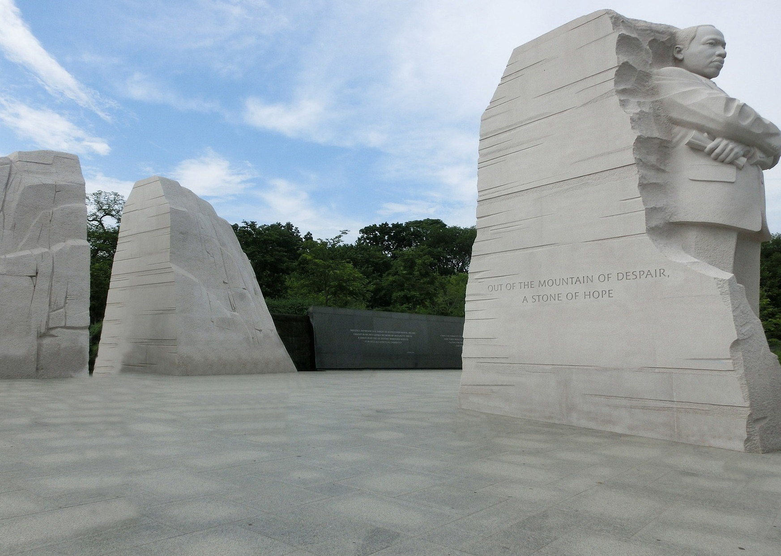
Martin Luther King Jr. Memorial
Notes:
https://pixabay.com/photos/martin-luther-king-jr-1933334/; pixabay/CC0

Slide 72
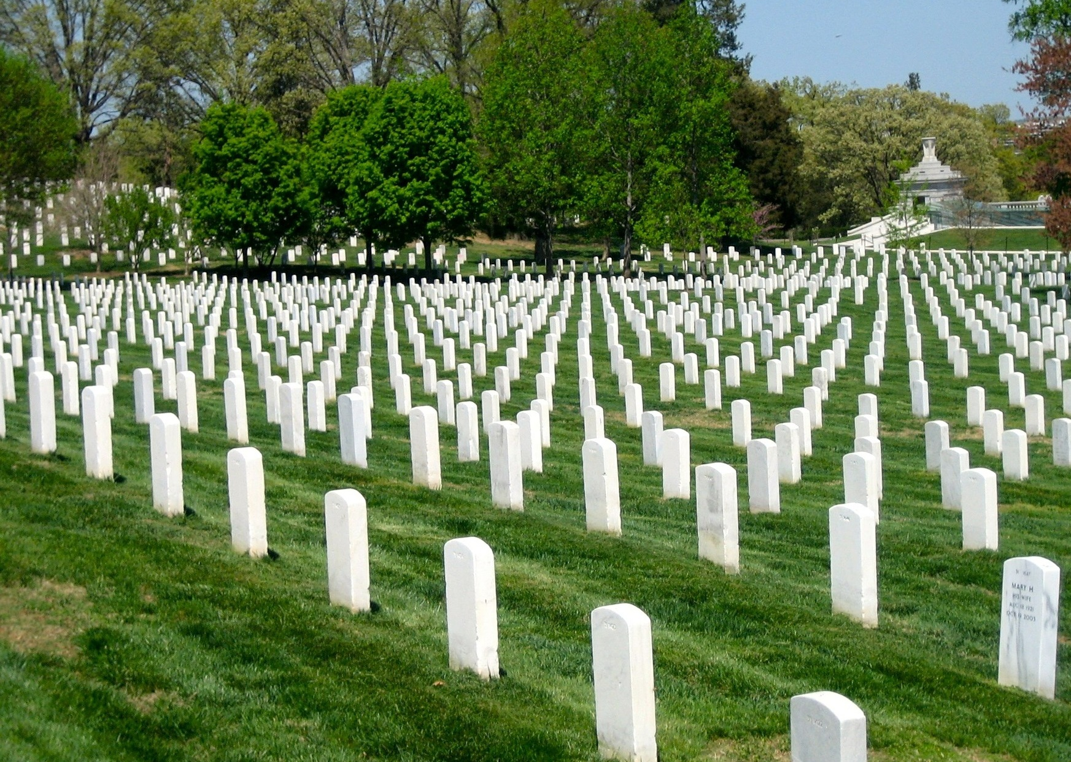
Arlington National Cemetery
Notes:
https://pixabay.com/photos/arlington-national-cemetery-354846/; pixabay/CC0

Slide 73
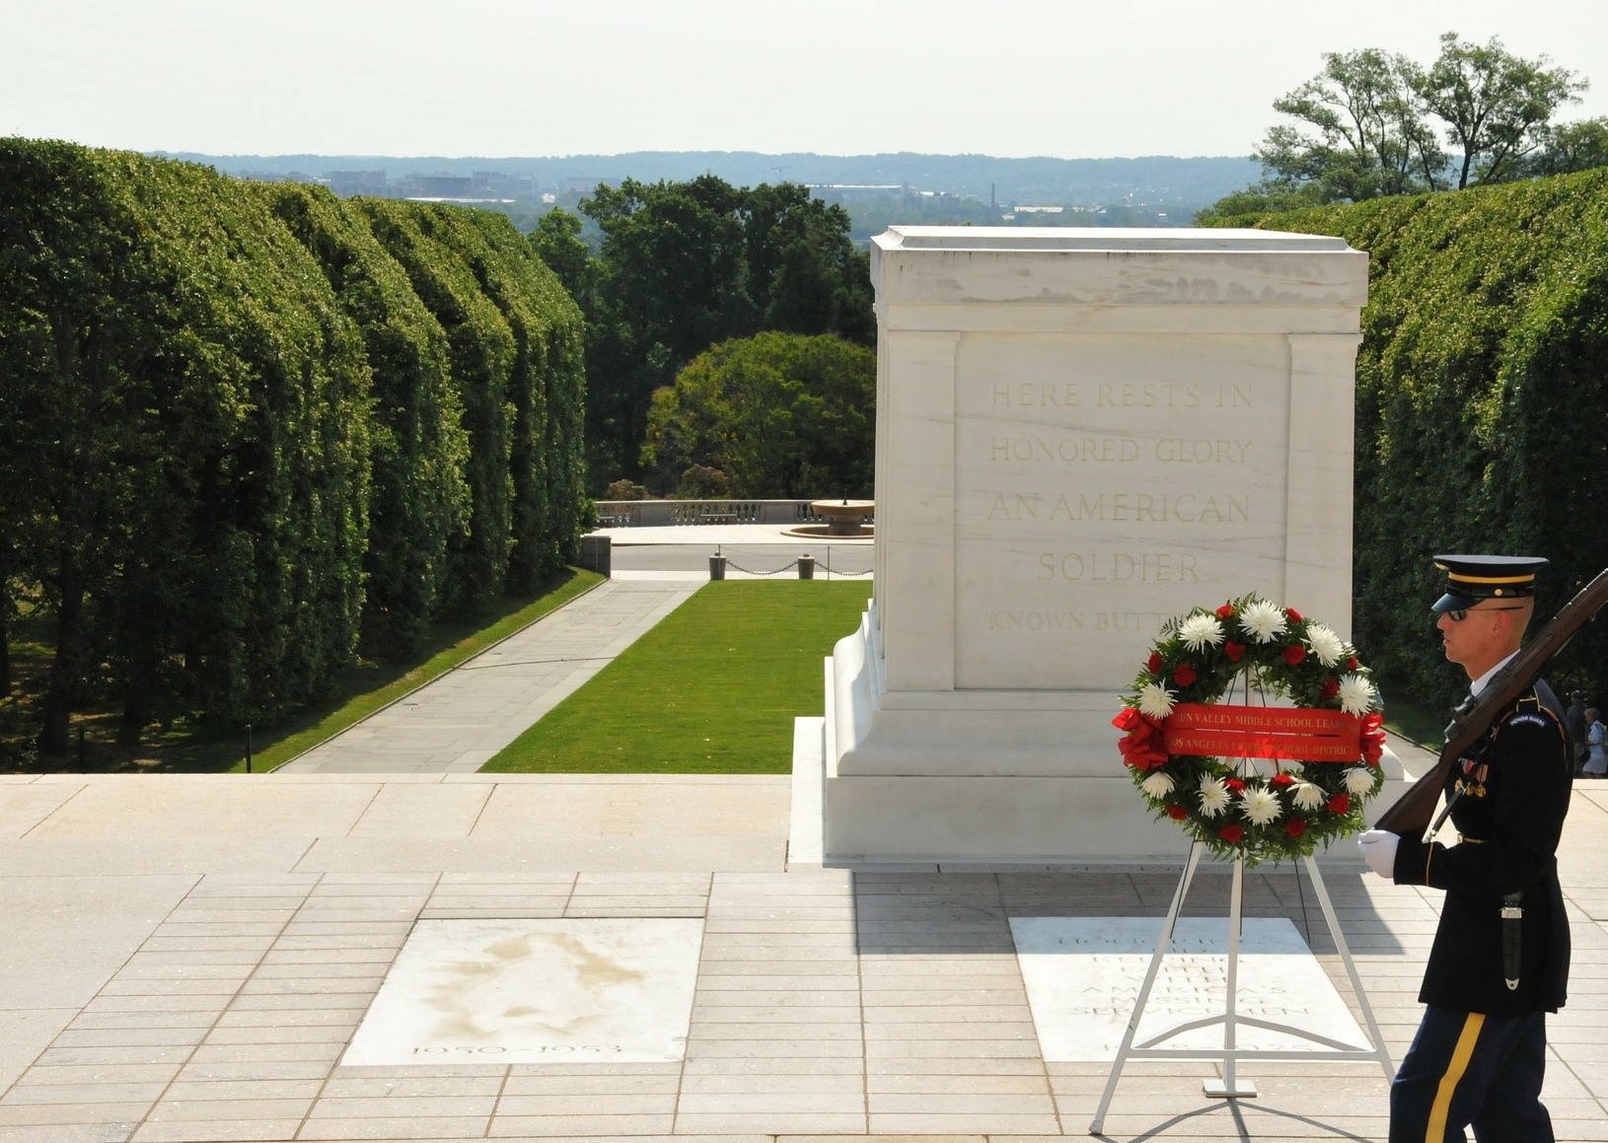
Tomb of the Unknown Soldier
Notes:
https://pixabay.com/photos/unknown-soldier-dc-109237/; pixabay/CC0

Slide 74
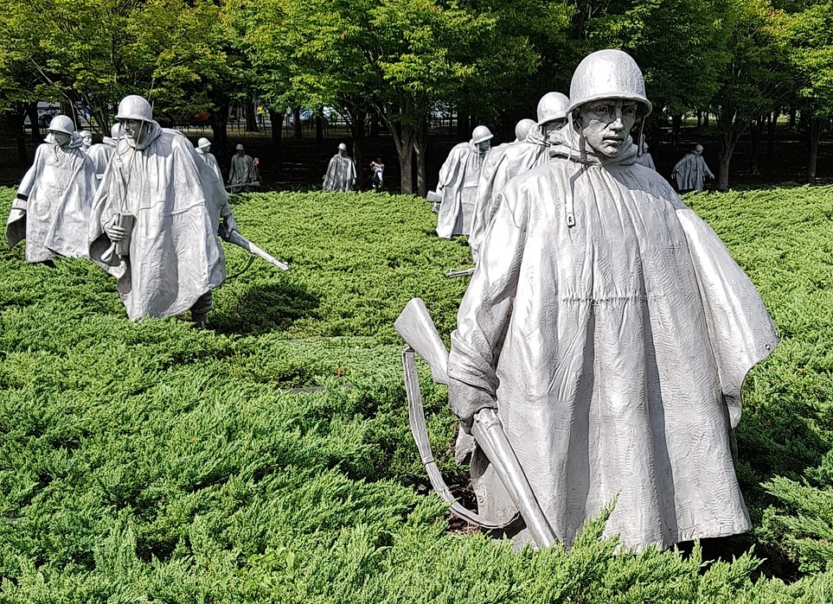
Korean War Veterans Memorial
Notes:
https://pixabay.com/photos/korean-veterans-war-memorial-3426779/; pixabay/CC0

Slide 75

Vietnam Veterans Memorial
Notes:
https://pixabay.com/photos/memorial-memorial-day-flag-flags-5228067/; pixabay/CC0

Slide 76
Museums

Slide 77

Smithsonian Castle
Notes:
https://pixabay.com/photos/smithsonian-institute-washington-67707/; pixabay/CC0

Slide 78

Smithsonian National Air and Space Museum
Notes:
https://pixabay.com/photos/airplanes-smithsonian-aircraft-286345/; pixabay/CC0

