Slide 1
Chapter 10:
The Road to the White House
Notes:
WIN-Initiative/Stone/Getty Images

Slide 2
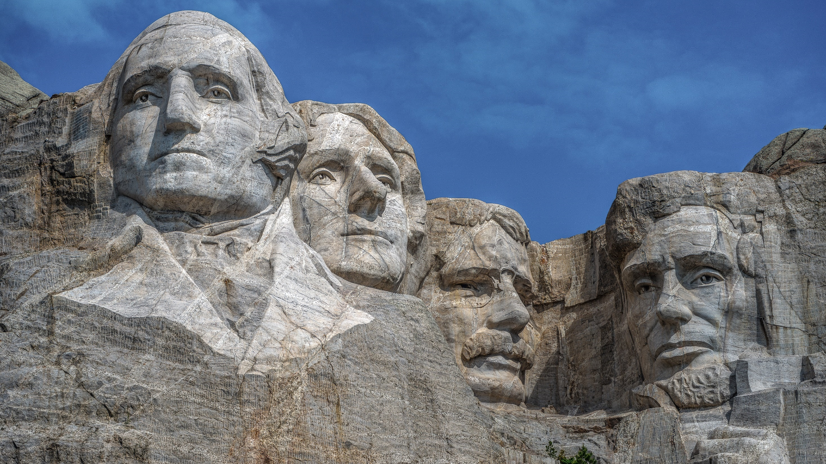
I. Presidential Qualifications
Chapter 10.1
Notes:
Photo by Stephen Walker on Unsplash
https://unsplash.com/photos/1aToMYVnbwg

Slide 3
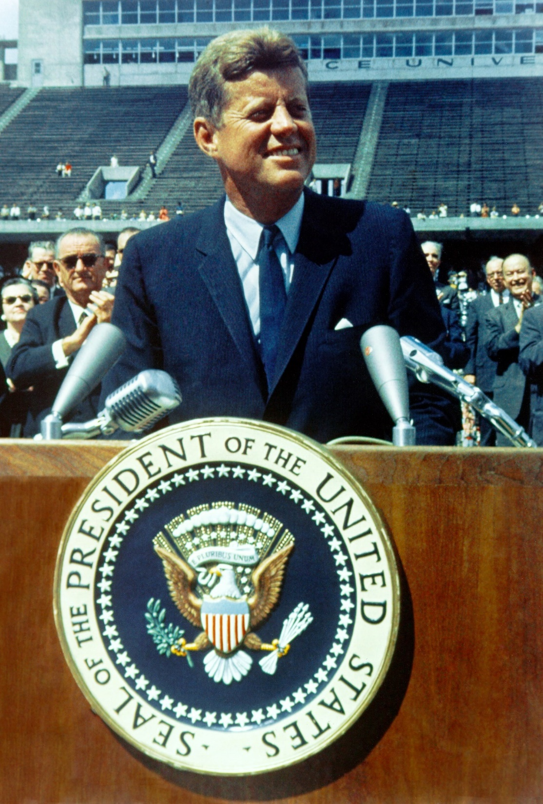
I. Presidential Qualifications
The qualifications for president are broad and nonrestrictive:
  Must be a natural-born citizen of the United States
  Must be at least 35 years old
  Must have lived within the United States for at least 14 years
Notes:
Photo by History in HD on Unsplash
https://unsplash.com/photos/rHIiT1Q6GIg

Slide 4
I. Presidential Qualifications
Many former presidents attained the office because of successful military or government careers.
Notes:
Photo by History in HD on Unsplash
https://unsplash.com/photos/rHIiT1Q6GIg

Slide 5
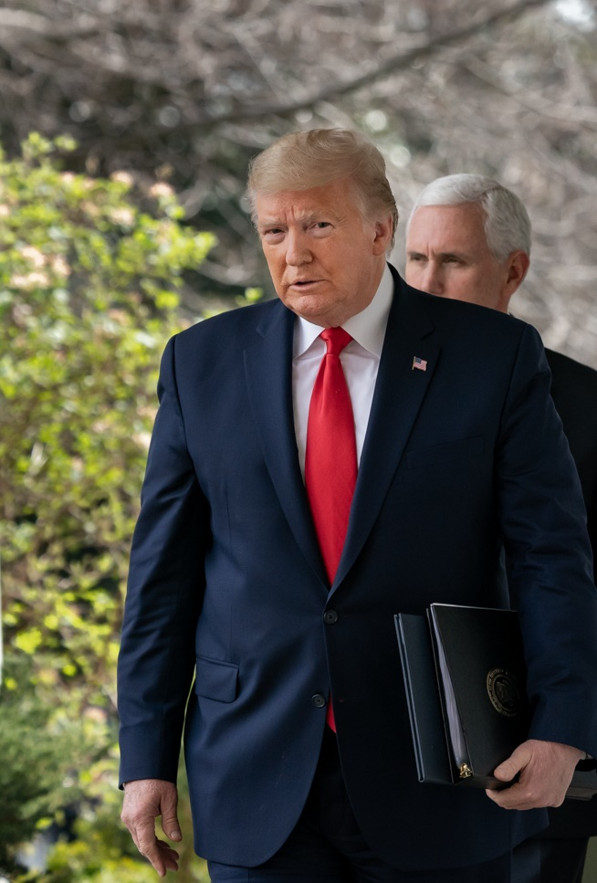
I. Presidential Qualifications
Donald Trump is the only president with no prior military or political experience.
Regardless of background, the president has played a critical role in America’s past and will do so in the future.
Notes:
By The White House - https://www.flickr.com/photos/148748355@N05/49659517252/, Public Domain, https://commons.wikimedia.org/w/index.php?curid=88085978
https://commons.wikimedia.org/w/index.php?title=Special:Search&limit=500&offset=0&profile=default&search=president+trump&advancedSearch-current=%7B%7D&ns0=1&ns6=1&ns12=1&ns14=1&ns100=1&ns106=1&searchToken=r5y08ik7v76grb7rszzbdio0#%2Fmedia%2FFile%3APresident_Trump_Holds_a_News_Conference_on_the_Coronavirus_-_49659517252.jpg

Slide 6
Section Review – Chapter 10.1
1–3. What are the three qualifications to be a president?
A person must be a natural-born citizen, be at least thirty-five years of age, and have been a US resident for at least fourteen years. (p. 223)
4–5. What two main avenues have traditionally led to the presidency?
a successful military career or holding important government offices (pp. 223–224)

Slide 7
Section Review – Chapter 10.1
Read the quote from Supreme Court Justice Joseph Story on page 223. What qualities did he view as necessary for a president? Next, note that one item he listed was “ripe virtues.” Read 2 Samuel 23:3; Proverbs 28:2; 29:12; and
Titus 3:1–3. What virtues are mentioned in these passages?
A. Joseph Story’s qualities for a president: elevated talents, ripe virtues, incorruptible integrity (Prov. 16:2), tried patriotism, one who forgets his own interests and interests of party and represents the whole nation

Slide 8
Section Review – Chapter 10.1
Read the quote from Supreme Court Justice Joseph Story on page 223. What qualities did he view as necessary for a president? Next, note that one item he listed was “ripe virtues.” Read 2 Samuel 23:3; Proverbs 28:2; 29:12; and
Titus 3:1–3. What virtues are mentioned in these passages?
B. virtues of a president: just (2 Sam. 23:3); wisdom, understanding or knowledge; honest (Prov. 29:12);
respectful (Titus 3:1–3)

Slide 9
Section Review – Chapter 10.1
In addition to the items addressed in the questions above, what additional qualifications do you think are needed for a person to be president?
Answers may include such qualities as ability to communicate, vision, physical stamina, military experience, business experience, government experience, exemplary character,
and firm support for traditional values.

Slide 10
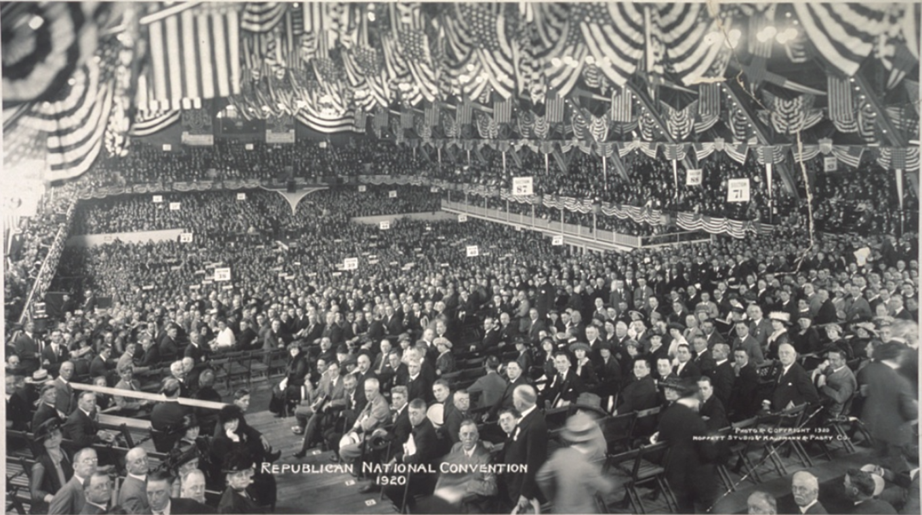
II. Nomination
Chapter 10.2
Notes:
Moffett Studio, Copyright Claimant, and Copyright Claimant Kaufmann & Fabry Co, photographers by Moffett Studio, and Kaufmann & Fabry Co. Republican National Convention. Photograph. Retrieved from the Library of Congress, <www.loc.gov/item/2007663528/>.

Slide 11
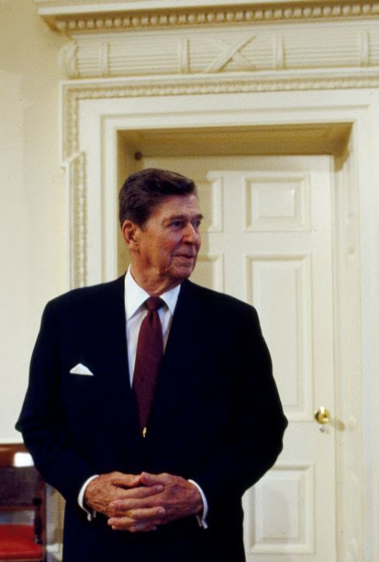
A. Primary Hurdles
The Framers of the Constitution hoped that the best qualified candidates for president would naturally rise to prominence.
This system was quickly replaced and today, candidates are selected through primaries.
Notes:
Photographs in the Carol M. Highsmith Archive, Library of Congress, Prints and Photographs Division
https://www.loc.gov/resource/highsm.14732/

Slide 12
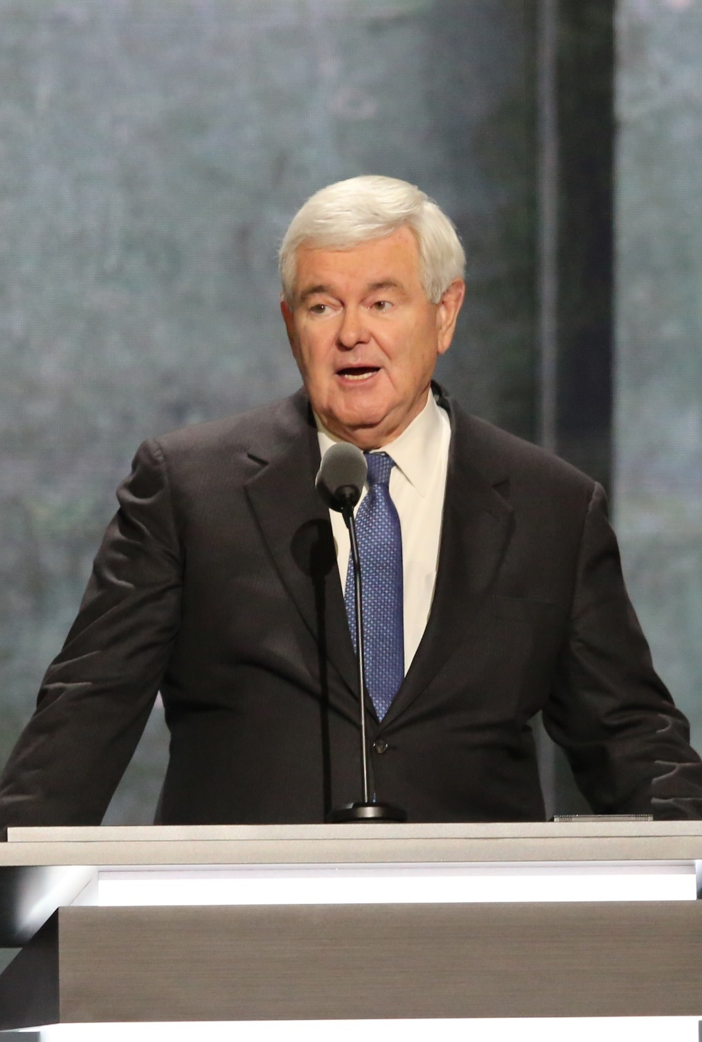
A. Primary Hurdles
In the 20th century, closed door party meetings were replaced by direct primaries for government offices.
Presidential primaries were created for selecting delegates to be sent to the party’s national convention.
Notes:
By Ali Shaker/VOA - https://media.voltron.voanews.com/Drupal/01live-166/styles/sourced/s3/2019-04/4ADB7440-74E1-4CEF-A7DE-F9AE8AED0432.jpg?itok=eRH78A1M, Public Domain, https://commons.wikimedia.org/w/index.php?curid=81151236
https://commons.wikimedia.org/w/index.php?sort=relevance&search=republican+national+convention+2016&title=Special:Search&profile=advanced&fulltext=1&advancedSearch-current=%7B%7D&ns0=1&ns6=1&ns12=1&ns14=1&ns100=1&ns106=1&searchToken=1dnmvrojxutv4lm2o3c663j9x#%2Fmedia%2FFile%3ANewt_Gingrich_-_Republican_National_Convention_2016-07-20_%28cropped%29.jpg

Slide 13
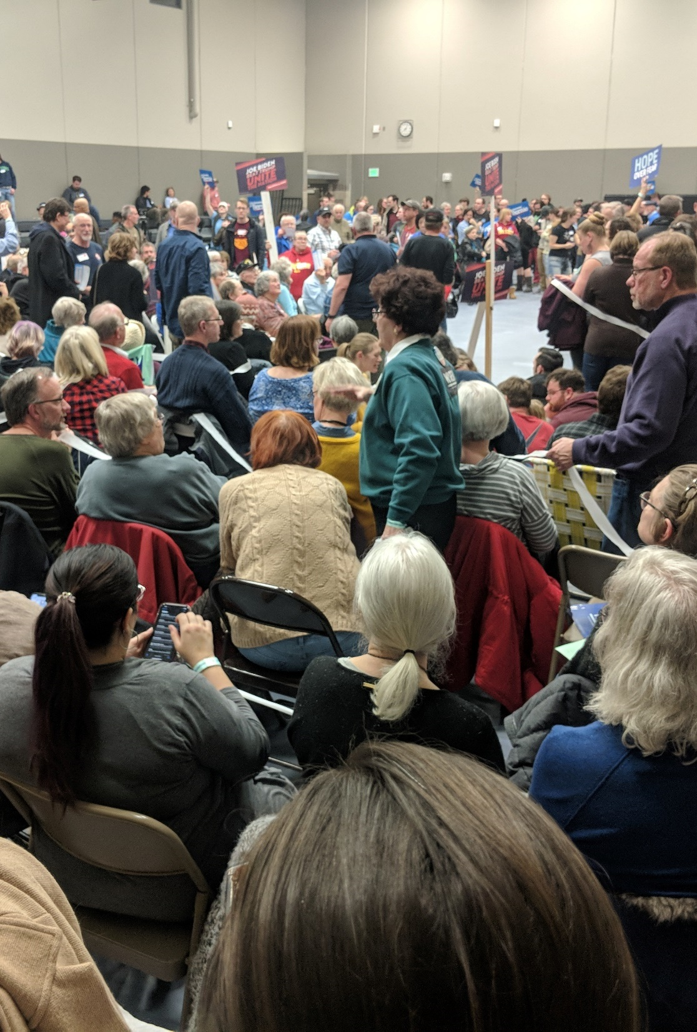
A. Primary Hurdles
In 2016, forty-one states held a presidential primary for one or both major parties.
States that do not have primaries use a convention known as a caucus.
Notes:
By Rbreidbrown - Own work, CC BY-SA 4.0, https://commons.wikimedia.org/w/index.php?curid=87250210
https://commons.wikimedia.org/w/index.php?sort=relevance&search=iowa+caucus&title=Special:Search&profile=advanced&fulltext=1&advancedSearch-current=%7B%7D&ns0=1&ns6=1&ns12=1&ns14=1&ns100=1&ns106=1&searchToken=ylfv2ih0pbdom7ac5z7sc0hl#%2Fmedia%2FFile%3AIowa_Caucus_Precinct_15_in_Ames_%282020%29_During_First_Alignment.jpg

Slide 14
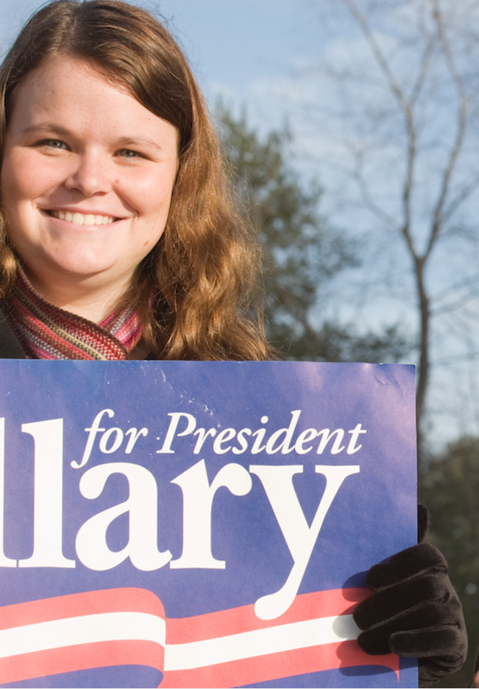
A. Primary Hurdles
Primaries have two basic purposes:
  Open the field to more candidates
  Make national delegate selection more democratic
Notes:
By Roger H. Goun from Brentwood, NH, USA - 20080108-9772, CC BY 2.0, https://commons.wikimedia.org/w/index.php?curid=62809478
https://commons.wikimedia.org/w/index.php?title=Special:Search&search=new+hampshire+primary&fulltext=1&ns0=1&ns6=1&ns12=1&ns14=1&ns100=1&ns106=1&searchToken=5ybc15iilvp3pc4nyj5gd6p88#%2Fmedia%2FFile%3AHillary_New_Hampshire_primary_%282179190607%29.jpg

Slide 15
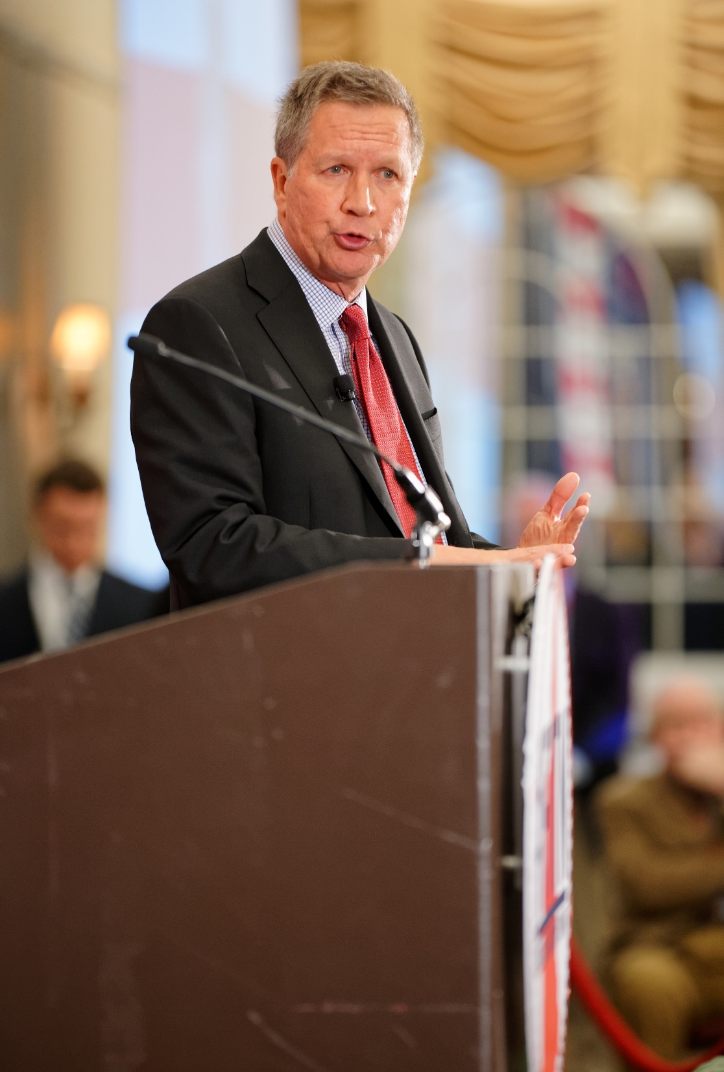
A. Primary Hurdles
There are different types of primaries:
  Closed primaries – voters must declare their party membership
  Open primaries – voters do not have to declare party membership
Crossover voting may occur in open primaries and possibly lead to raiding – the intentional support of a party’s weakest candidate.
Notes:
By Michael Vadon - Own work, CC BY-SA 4.0, https://commons.wikimedia.org/w/index.php?curid=39734469
https://commons.wikimedia.org/w/index.php?title=Special:Search&limit=500&offset=0&profile=default&search=new+hampshire+primary&advancedSearch-current=%7B%7D&ns0=1&ns6=1&ns12=1&ns14=1&ns100=1&ns106=1&searchToken=bph4bwlz3hcrv8464ow2ditre#%2Fmedia%2FFile%3AGovernor_of_Ohio_John_Kasich_at_FITN_in_Nashua%2C_NH_by_Michael_Vadon_04.jpg

Slide 16
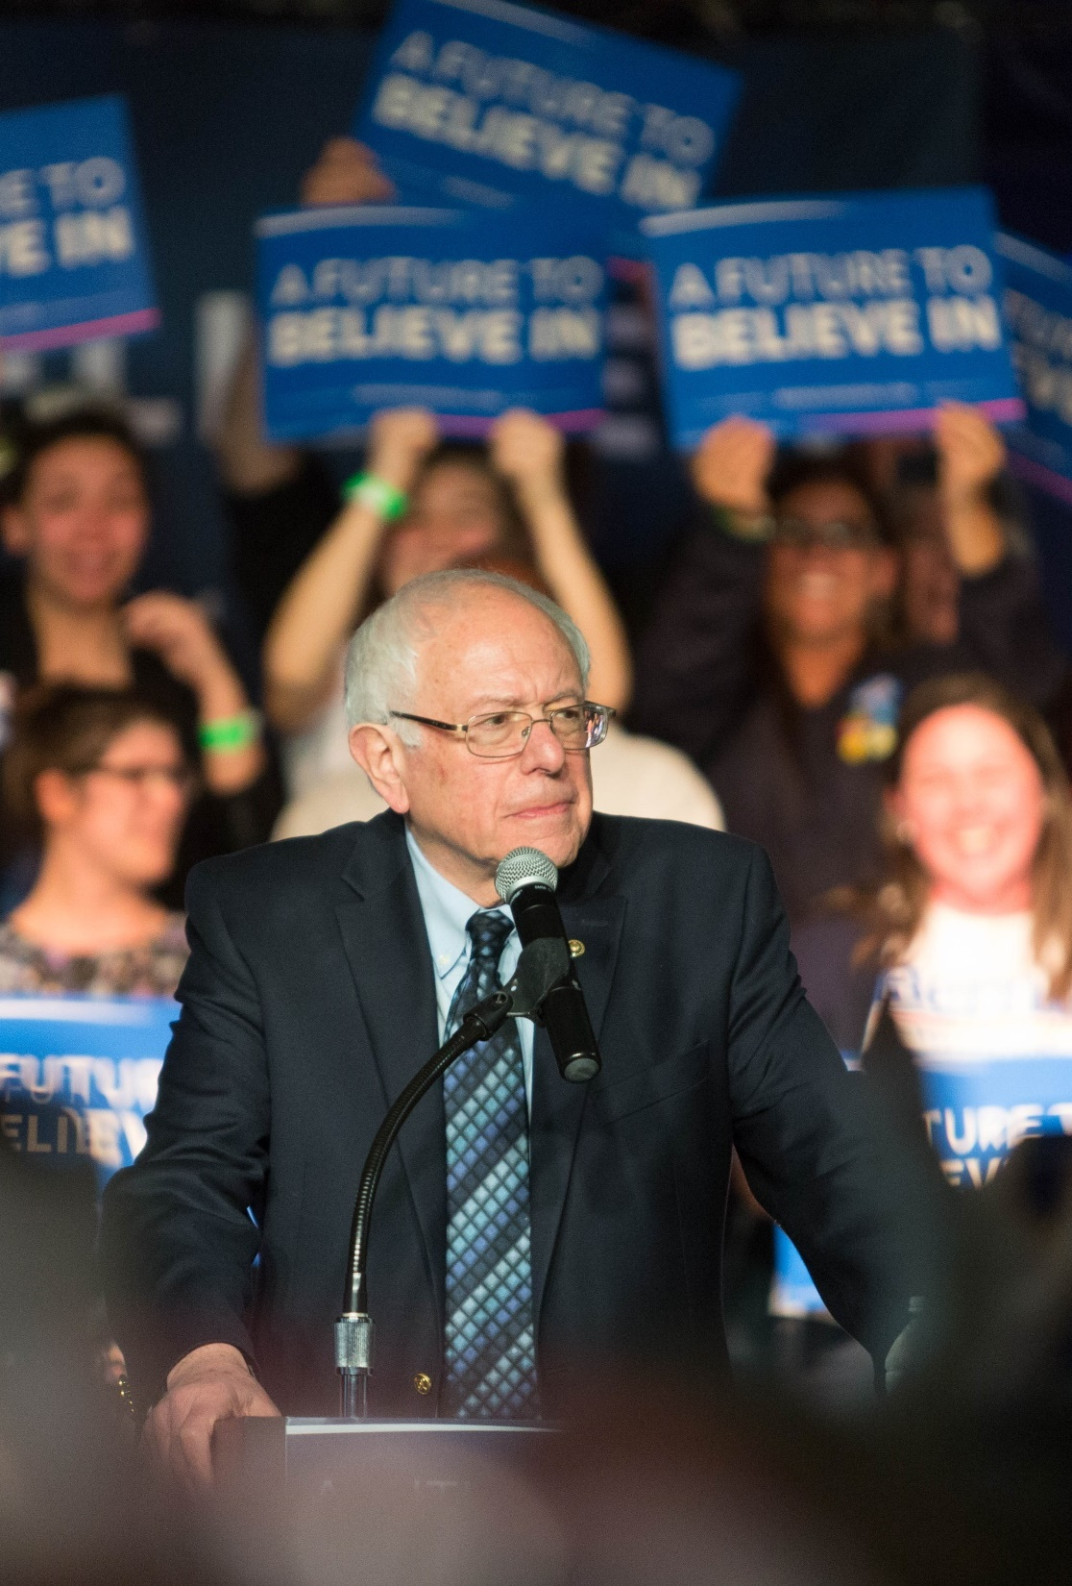
A. Primary Hurdles
Primaries present two problems for political parties to overcome:
  They eliminate the party leaders’ ability to choose a moderate compromise candidate.
  Intense support for candidates can create rifts within a party.
Notes:
By Todd Church - Bernie Sanders 112 03/04/2016, CC BY 2.0, https://commons.wikimedia.org/w/index.php?curid=47350318
https://commons.wikimedia.org/w/index.php?sort=relevance&search=bernie+sanders&title=Special:Search&profile=advanced&fulltext=1&advancedSearch-current=%7B%7D&ns0=1&ns6=1&ns12=1&ns14=1&ns100=1&ns106=1&searchToken=28ym9cm3kz6mtumkwlc3l1l32#%2Fmedia%2FFile%3ABernie_Sanders_112_03-04-2016_%2825395661382%29.jpg

Slide 17
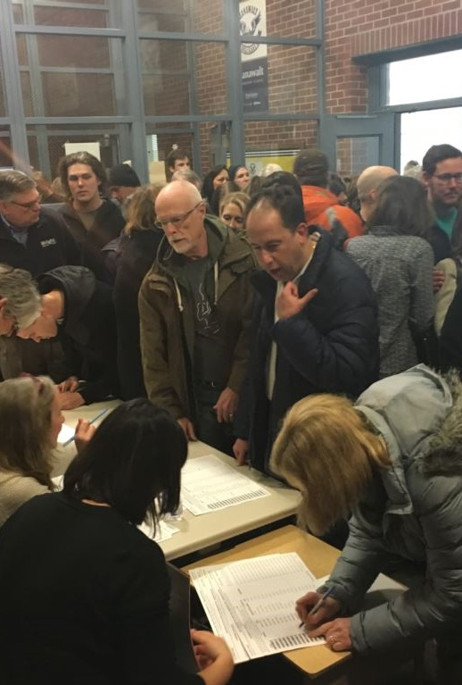
A. Primary Hurdles
The primaries begin in January and February of the election year.
The Iowa caucuses and New Hampshire primary establish the front-runners of the election.
In March, the largest number of primaries occur on the same day – “Super Tuesday.”
Notes:
By K. Farabaugh/VOA - https://www.voanews.com/a/iowa-caucus/3172810.html, Public Domain, https://commons.wikimedia.org/w/index.php?curid=66357332
https://commons.wikimedia.org/w/index.php?sort=relevance&search=iowa+caucus+voting&title=Special:Search&profile=advanced&fulltext=1&advancedSearch-current=%7B%7D&ns0=1&ns6=1&ns12=1&ns14=1&ns100=1&ns106=1&searchToken=60hl635ia71ujlesdpsw5jzjc#%2Fmedia%2FFile%3AVoting_6667448F.jpg

Slide 18
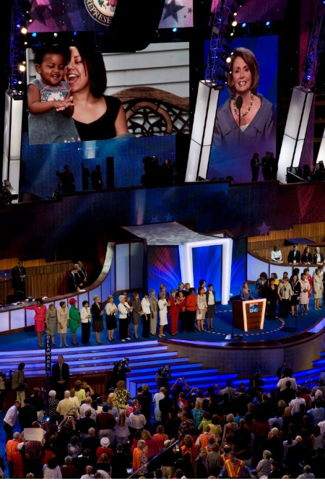
B. National Conventions
National conventions are used to formally nominate each party’s candidate.
Because of the rise of primaries, the leading candidate often enters the convention with enough delegates to secure the nomination.
Notes:
Highsmith, Carol M, photographer. House Speaker Nancy Pelosi speaks at the Democratic National Convention, Denver, Colorado, August 25-28. Photograph. Retrieved from the Library of Congress, <www.loc.gov/item/2010719291/>.

Slide 19
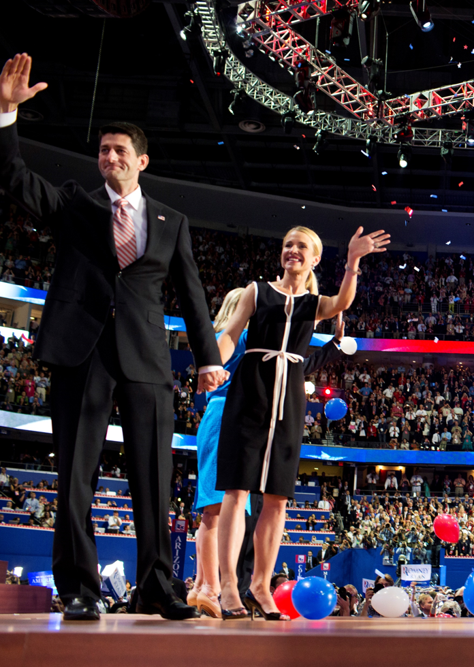
B. National Conventions
Conventions normally meet in July or August.
At the convention, a formal statement of a party’s position on current issues called a party platform is created.
Delegates to the convention were formerly only made up of party elites but have become more diverse today.
Notes:
By PBS NewsHour from Arlington, Va., USA - 083012_MittRomney_032, CC BY 2.0, https://commons.wikimedia.org/w/index.php?curid=54633944
https://commons.wikimedia.org/w/index.php?title=Special:Search&limit=500&offset=0&ns0=1&ns6=1&ns12=1&ns14=1&ns100=1&ns106=1&search=republican+national+convention+2016&advancedSearch-current=%7B%7D&searchToken=28zy1kwomz3pgiofhj4vyzmzp#%2Fmedia%2FFile%3A083012_MittRomney_032_%287900939468%29.jpg

Slide 20
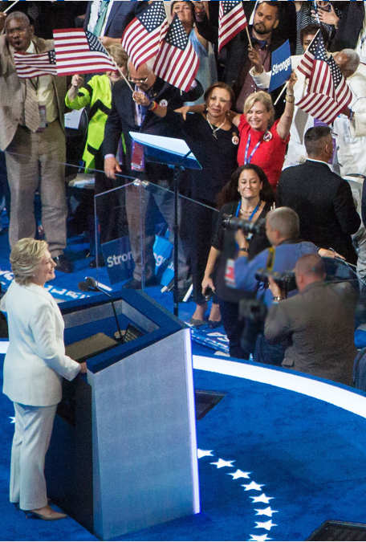
B. National Conventions
The Democratic party has a group of uncommitted delegates for their conventions called superdelegates.
Their purpose is to moderate the party’s choice of candidate.
In 2018, the superdelegates were reformed to be less influential at the convention.
Notes:
By Maggie Hallahan - Own work, CC BY-SA 4.0, https://commons.wikimedia.org/w/index.php?curid=57176155
https://commons.wikimedia.org/w/index.php?sort=relevance&search=democratic+national+convention&title=Special:Search&profile=advanced&fulltext=1&advancedSearch-current=%7B%7D&ns0=1&ns6=1&ns12=1&ns14=1&ns100=1&ns106=1&searchToken=5gvtvwl1xc32mirpt2ablflo#%2Fmedia%2FFile%3AHillary_Clinton_Speech_at_Democratic_National_Convention_%28July_28%2C_2016%29_%28cropped2%29.jpg

Slide 21
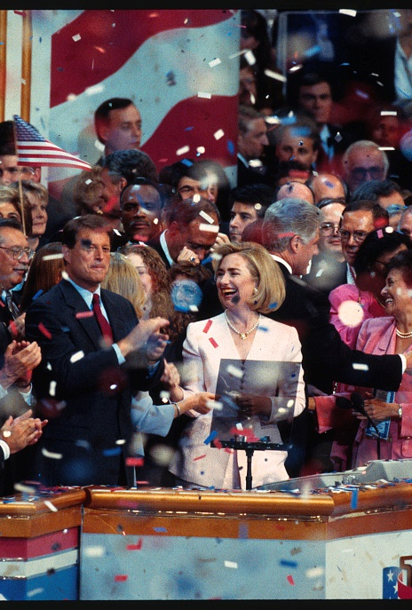
B. National Conventions
The first days of a convention are usually concerned with organizational procedures.
A leading party member may give a keynote address.
Notes:
By Laura Patterson - https://www.loc.gov/item/2015645159/, Public Domain, https://commons.wikimedia.org/w/index.php?curid=55877432
https://commons.wikimedia.org/w/index.php?title=Special:Search&limit=500&offset=0&ns0=1&ns6=1&ns12=1&ns14=1&ns100=1&ns106=1&search=national+convention+speech&advancedSearch-current=%7B%7D&searchToken=7311v8ds207rpjrkdtbadh0us#%2Fmedia%2FFile%3A1996_Democratic_National_Convention.jpg

Slide 22
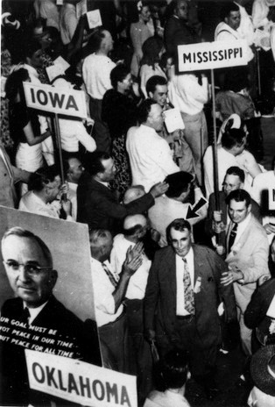
B. National Conventions
After a series of speeches, the delegates of the party begin to vote.
The leading candidate usually secures the nomination on the first ballot.
If this is not the case, then candidates must bargain and compromise in a brokered convention.
Notes:
By Harry S. Truman Library & Museum - https://www.trumanlibrary.org/photographs/view.php?id=58438, Public Domain, https://commons.wikimedia.org/w/index.php?curid=77028887
https://commons.wikimedia.org/w/index.php?sort=relevance&search=democratic+national+convention+1984&title=Special:Search&profile=advanced&fulltext=1&advancedSearch-current=%7B%7D&ns0=1&ns6=1&ns12=1&ns14=1&ns100=1&ns106=1&searchToken=1tju1zmue5ydnqx76lsbfh0vg#%2Fmedia%2FFile%3AMississippi_Delegates_Walk_Out_of_Democratic_Convention_2013-3717.jpg

Slide 23
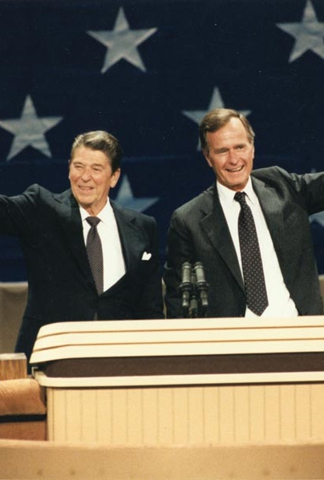
B. National Conventions
The final item of business is nominating a vice-presidential candidate.
Candidates often choose someone who will broaden their appeal and balance the ticket.
The candidate then accepts the nomination and moves on to the general election.
Notes:
By This media is available in the holdings of the National Archives and Records Administration, cataloged under the National Archives Identifier (NAID) 198555., Public Domain, https://commons.wikimedia.org/w/index.php?curid=2042128
https://commons.wikimedia.org/w/index.php?sort=relevance&search=Ronald+Reagan+and+George+H.W.+Bush&title=Special:Search&profile=advanced&fulltext=1&advancedSearch-current=%7B%7D&ns0=1&ns6=1&ns12=1&ns14=1&ns100=1&ns106=1&searchToken=6ex2duc3689xzcaxe9rnu0uv8#%2Fmedia%2FFile%3AReagan_Bush_1984.jpg

Slide 24
Section Review – Chapter 10.2
1. What was introduced in the early 1900s as a way of circumventing the control that party bosses held at political party conventions?
presidential or direct primaries (p. 225)
2. Identify a second method used by many states to give citizens an opportunity to indicate their preferred presidential candidate.
caucuses (p. 226)

Slide 25
Section Review – Chapter 10.2
3. Why is Iowa significant in a presidential election year?
That state has the first caucuses. (p. 229)
4. Why is New Hampshire important in a presidential election year?
That state has the first presidential primary. (p. 229)

Slide 26
Section Review – Chapter 10.2
5. In recent years, how has the composition of national convention delegates changed?
There are a greater number of women, young people,
and minorities, and superdelegates have a large role.
(pp. 230–231)

Slide 27
Section Review – Chapter 10.2
6–7. What causes a brokered convention to occur? What happened at the most famous such convention of the twentieth century?
A brokered convention may occur if large blocks of committed delegates are split among three or more candidates. At the 1924 Democratic convention, John W. Davis had to wait nine days through 103 ballots before he finally won the nomination. (p. 233)

Slide 28
Section Review – Chapter 10.2
Do you think that “balancing the ticket” is a good strategy or a bad one? Explain your view.
Some may say that balancing the ticket makes political sense in our diverse society. Others may mention that it can damage a candidate’s credibility with his main supporters.

Slide 29
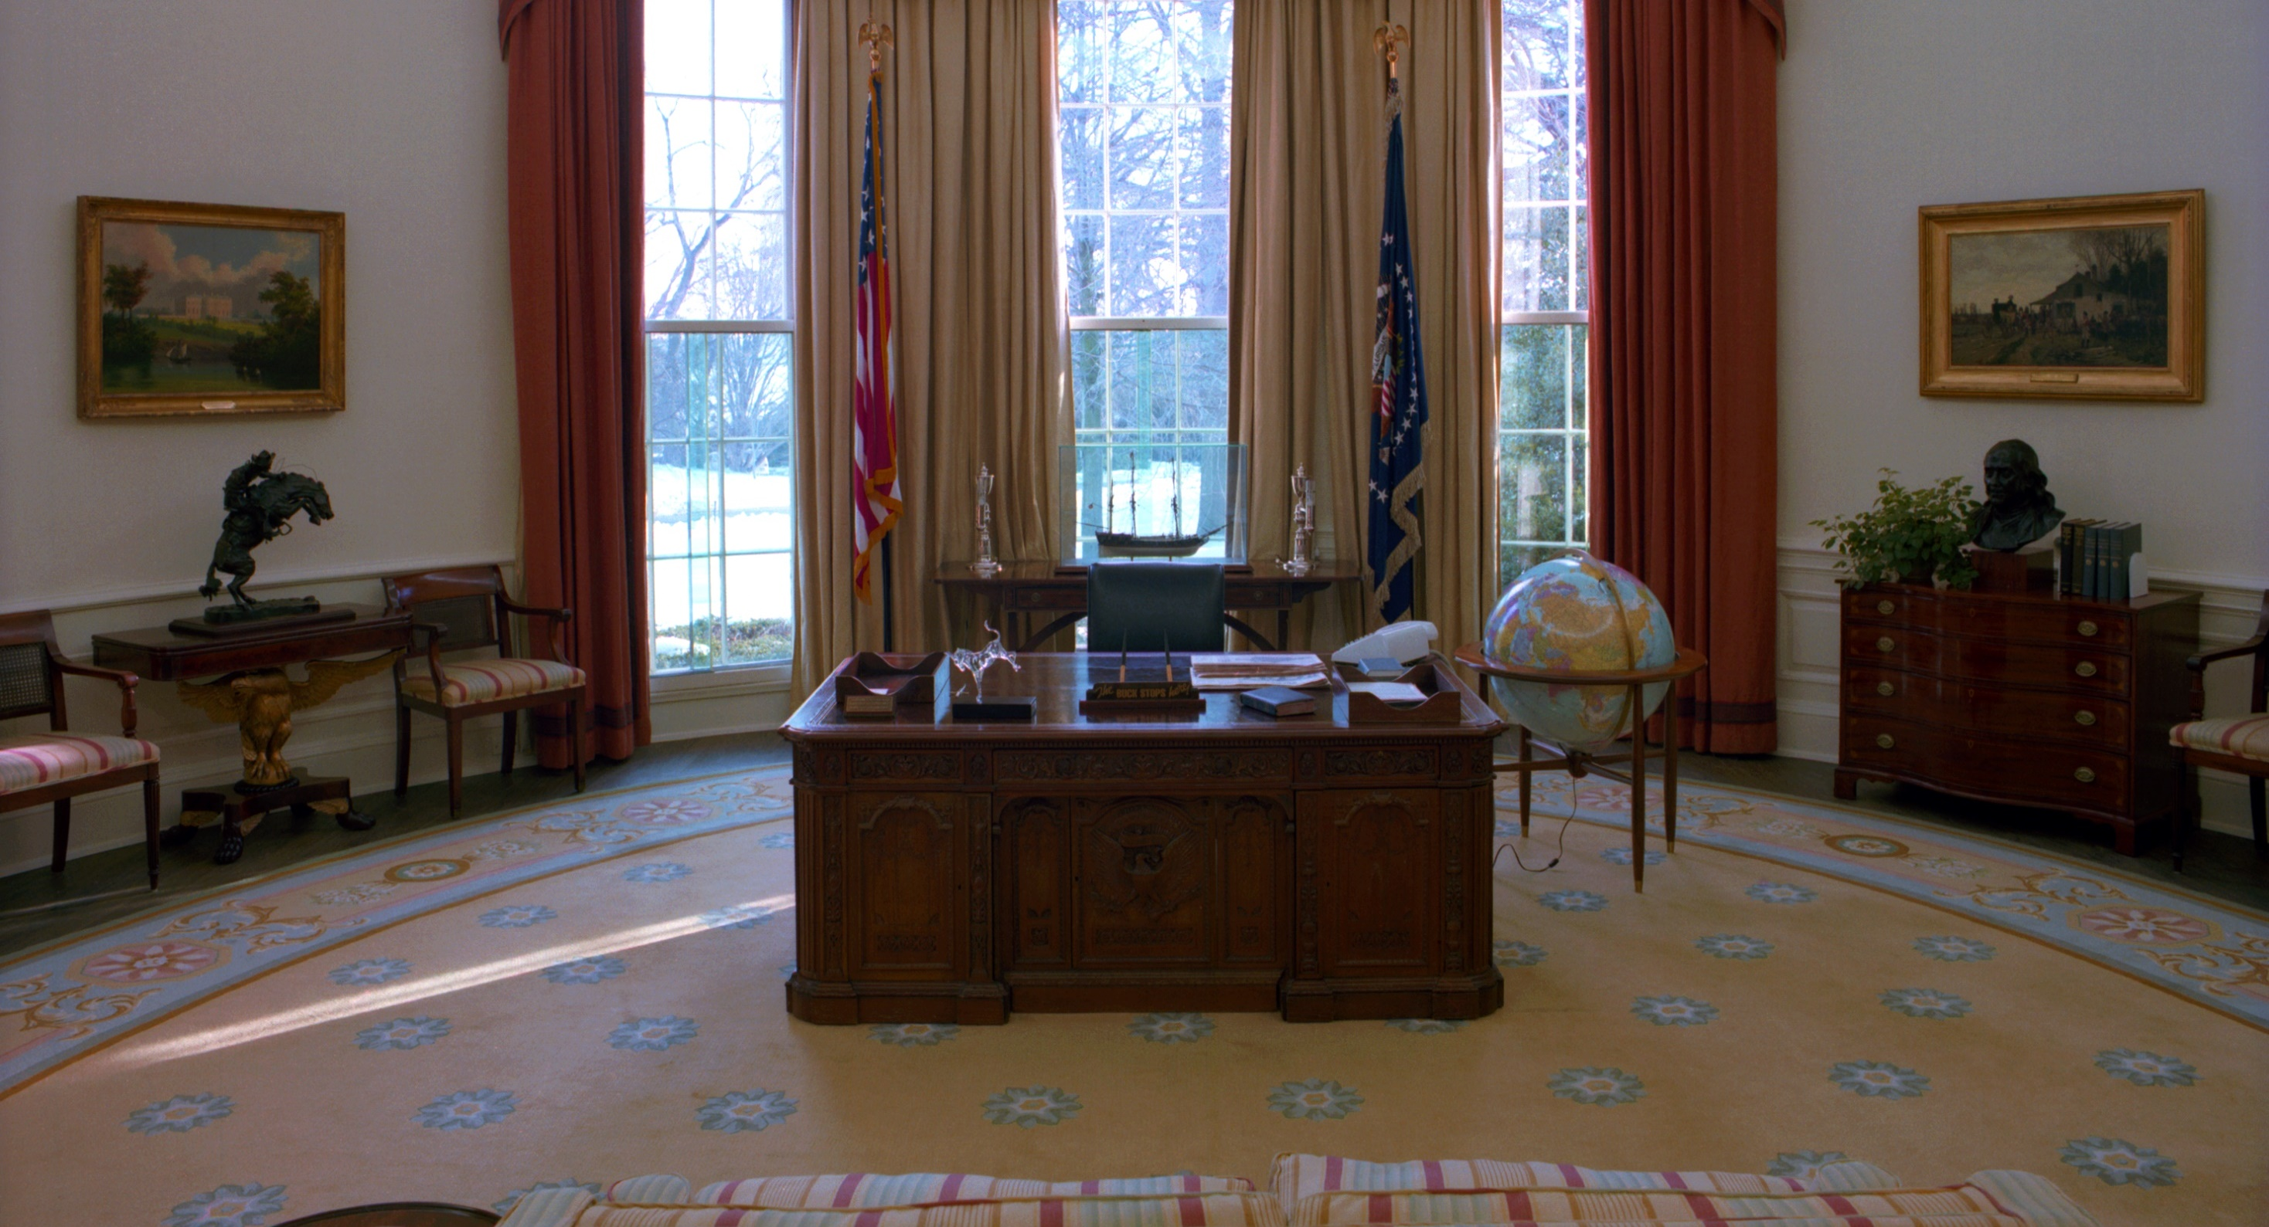
III. Election
Chapter 10.3
Notes:
By Unknown author or not provided - U.S. National Archives and Records Administration, Public Domain, https://commons.wikimedia.org/w/index.php?curid=16583394
https://commons.wikimedia.org/w/index.php?title=Special:Search&limit=500&offset=0&ns0=1&ns6=1&ns12=1&ns14=1&ns100=1&ns106=1&search=the+oval+office&advancedSearch-current=%7B%7D&searchToken=9dsxpidt4q1ys41760c7by9xg#%2Fmedia%2FFile%3AThe_Oval_Office_-_NARA_-_177693.tif

Slide 30
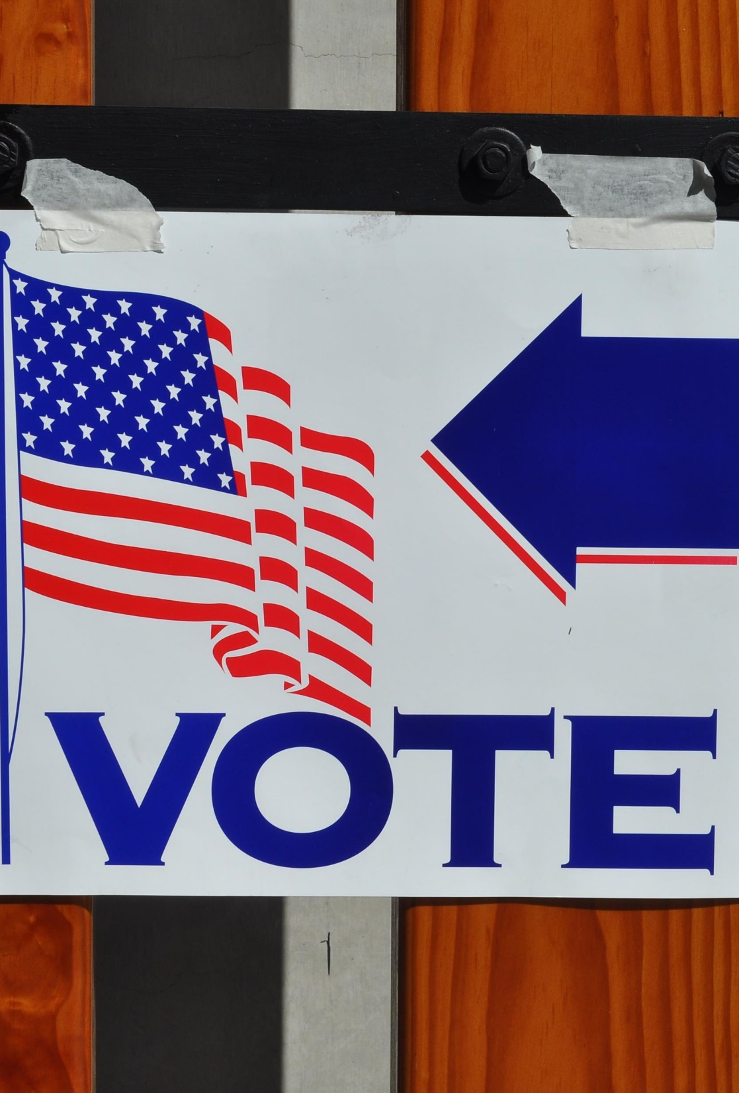
III. Election
The candidates who win their party’s nomination begin the final part of their race – the general election.
The election is held on the Tuesday after the first Monday in November.
Notes:
By Tom Arthur from Orange, CA, United States - vote for better tape, CC BY-SA 2.0, https://commons.wikimedia.org/w/index.php?curid=5131677
https://commons.wikimedia.org/w/index.php?title=Special:Search&limit=500&offset=0&ns0=1&ns6=1&ns12=1&ns14=1&ns100=1&ns106=1&search=united+states+voting&advancedSearch-current=%7B%7D&searchToken=co8anwdga6jg5a5cirthwgfzg#%2Fmedia%2FFile%3AVoting_United_States.jpg

Slide 31
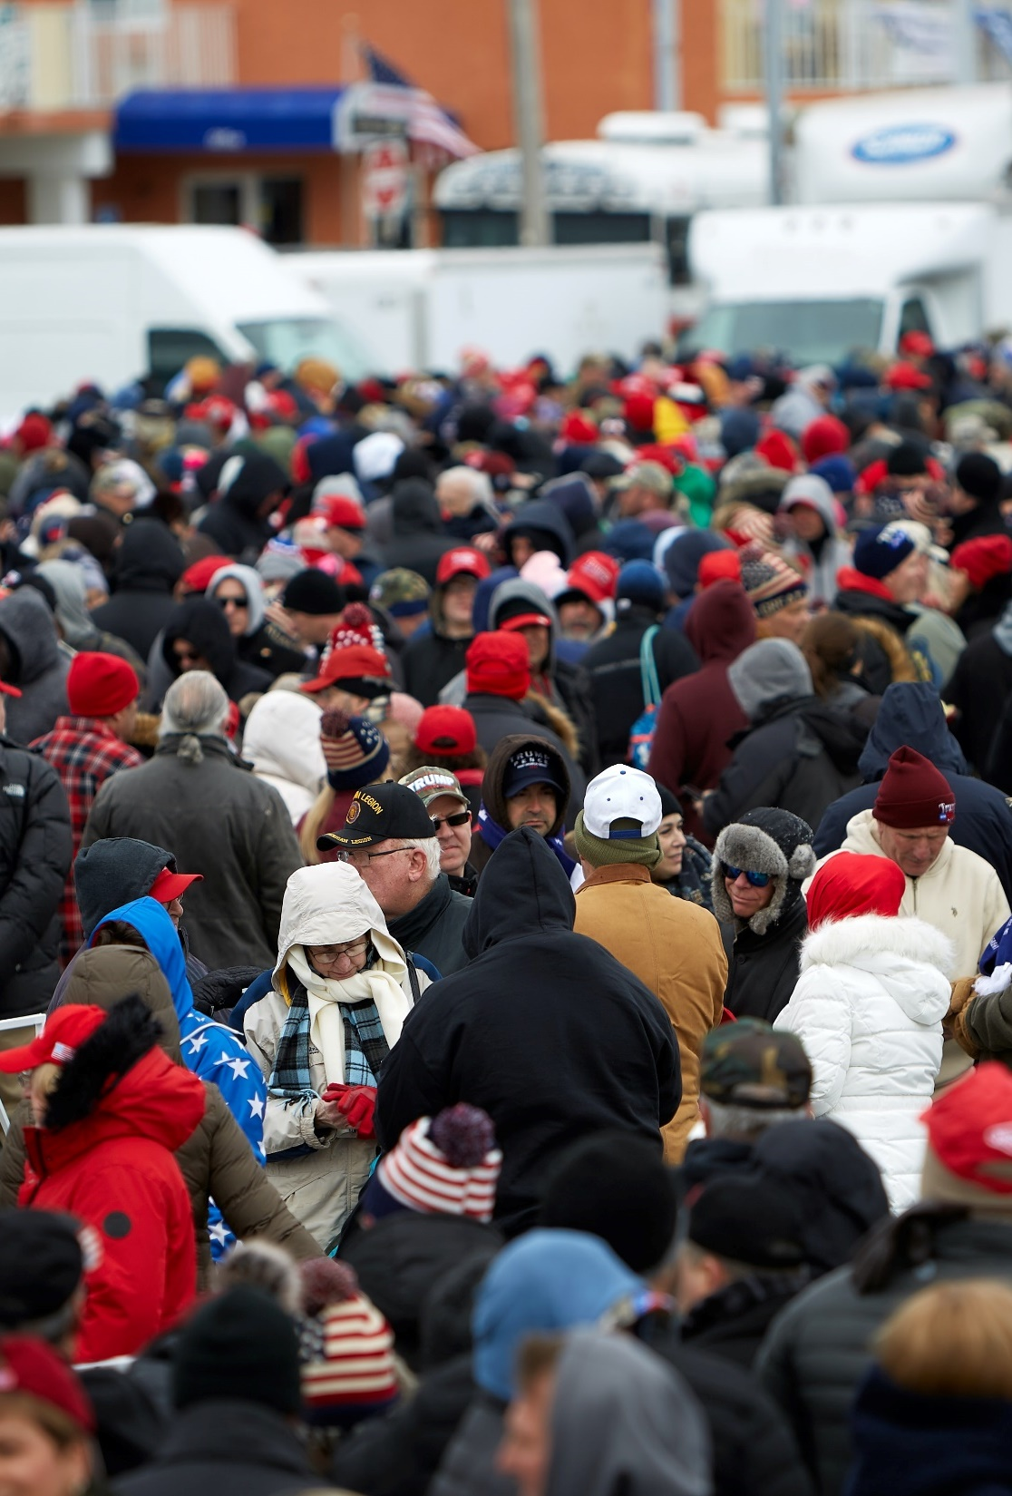
A. Campaign Strategy
A candidate’s strategy hinges on the Electoral College’s winner-take-all system.
A candidate must capture at least 270 electoral votes to win the election.
Notes:
Photo by David Todd McCarty on Unsplash
https://unsplash.com/photos/UrdKjYlgN7k

Slide 32
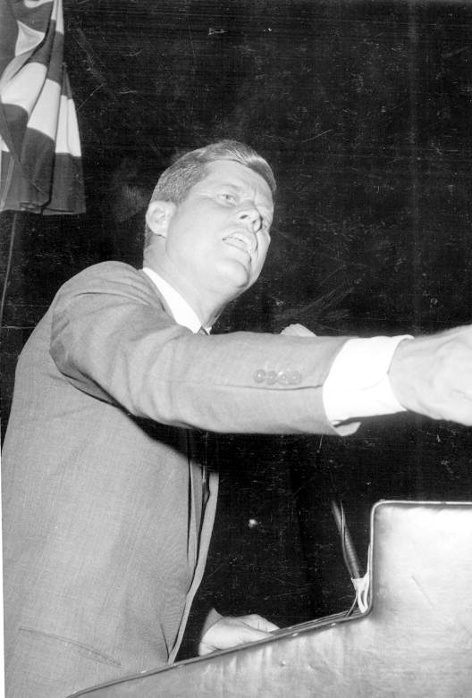
A. Campaign Strategy
Each candidate must choose where to spend his time and which issues to focus on.
Campaigns often include intense criticism of the other candidate, which can be challenging for a Christian.
Notes:
By Unknown author - https://www.floridamemory.com/items/show/40585, Public Domain, https://commons.wikimedia.org/w/index.php?curid=87451394
https://commons.wikimedia.org/w/index.php?sort=relevance&search=campaign+speech&title=Special:Search&profile=advanced&fulltext=1&advancedSearch-current=%7B%7D&ns0=1&ns6=1&ns12=1&ns14=1&ns100=1&ns106=1&searchToken=5sg8dkv3z335awj78orfwn8rr#%2Fmedia%2FFile%3ASenator_John_F._Kennedy_delivering_campaign_speech_for_the_presidency_-_Jacksonville%2C_Florida.jpg

Slide 33
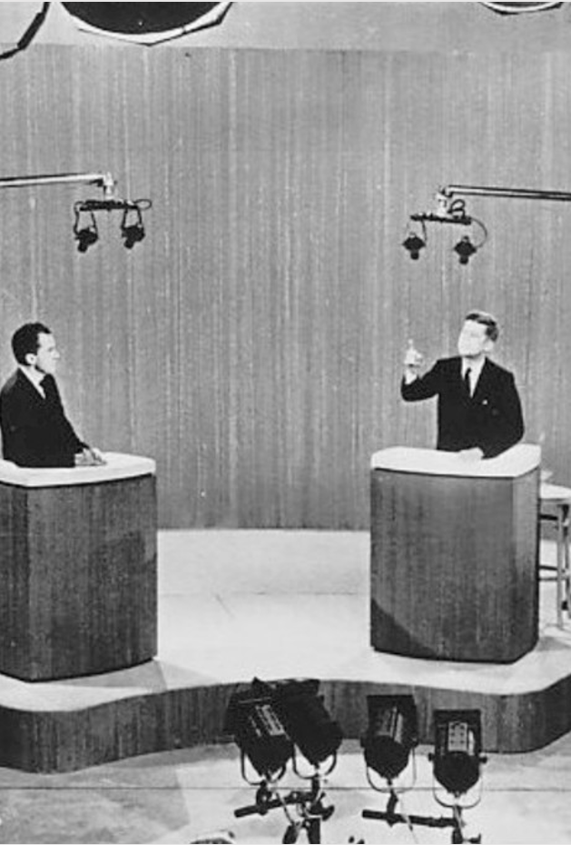
B. Debates
Debates have long been part of the political process and can play an important role in a campaign.
Debates were dramatically changed in 1960 when the debates between John F. Kennedy and Richard Nixon were broadcast on TV.
Notes:
By Associated Press - eBayfrontback, Public Domain, https://commons.wikimedia.org/w/index.php?curid=35968212
https://commons.wikimedia.org/w/index.php?title=Special:Search&limit=500&offset=0&ns0=1&ns6=1&ns12=1&ns14=1&ns100=1&ns106=1&search=nixon+Kennedy+debates&advancedSearch-current=%7B%7D&searchToken=y7w3h3n6ocsna66z1w7x68zd#%2Fmedia%2FFile%3AKennedy_Nixon_debate_New_York_1960.jpg

Slide 34
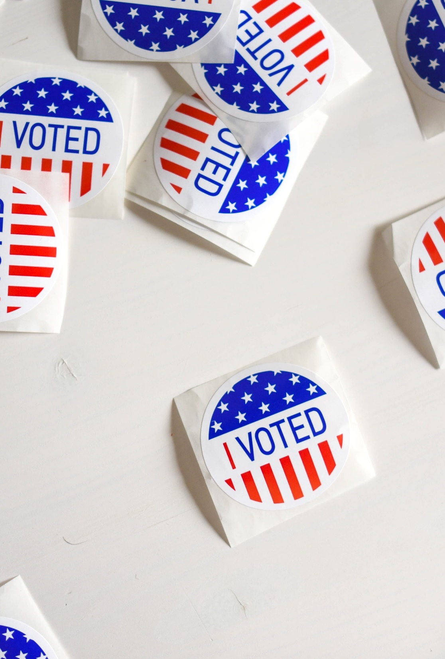
C. Election Day
On election day, the news media conduct exit polls – surveys of sample voters as they leave their polling places.
In the evening, the news media will begin making projections though they are often criticized for doing so.
Notes:
Photo by Element5 Digital on Unsplash
https://unsplash.com/photos/ls8Kc0P9hAA

Slide 35
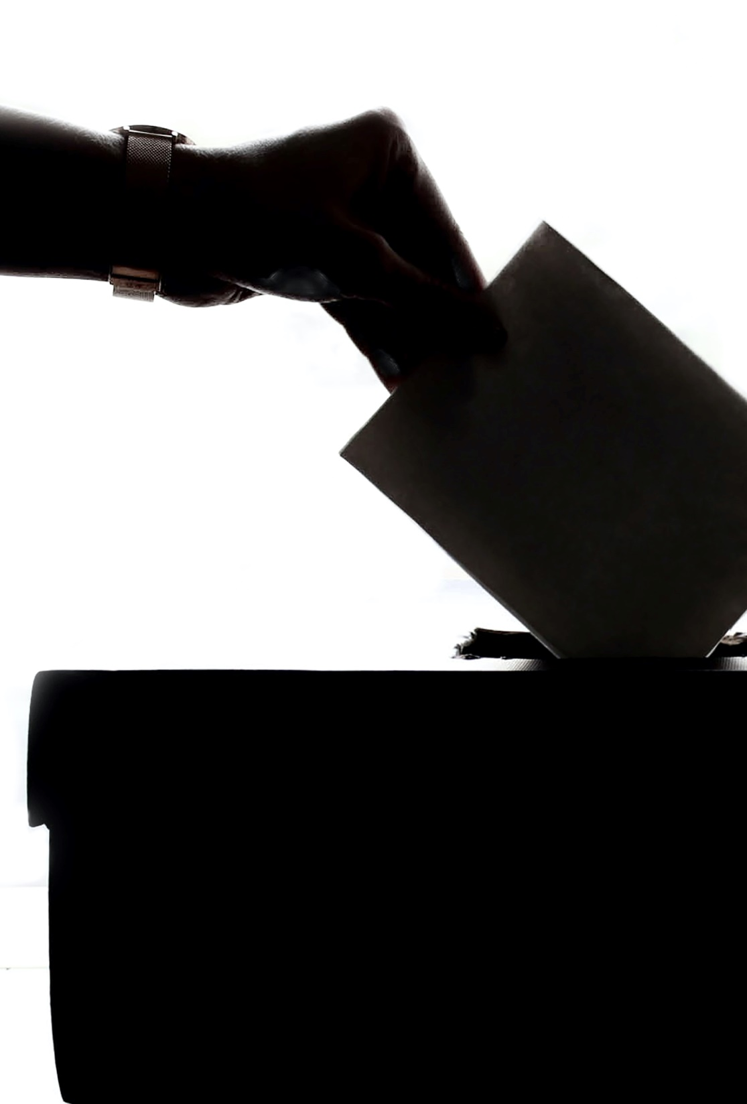
C. Election Day
Although voting is one of America’s most important civil rights, often less than half of eligible voters will vote.
As citizens, Christians in democratic countries are responsible for helping select good rulers.
Notes:
Photo by Element5 Digital on Unsplash
https://unsplash.com/photos/T9CXBZLUvic

Slide 36
C. Election Day
However, some Christians feel they cannot in good conscience vote for any candidate if they are all morally undesirable.
Notes:
Photo by Element5 Digital on Unsplash
https://unsplash.com/photos/T9CXBZLUvic

Slide 37
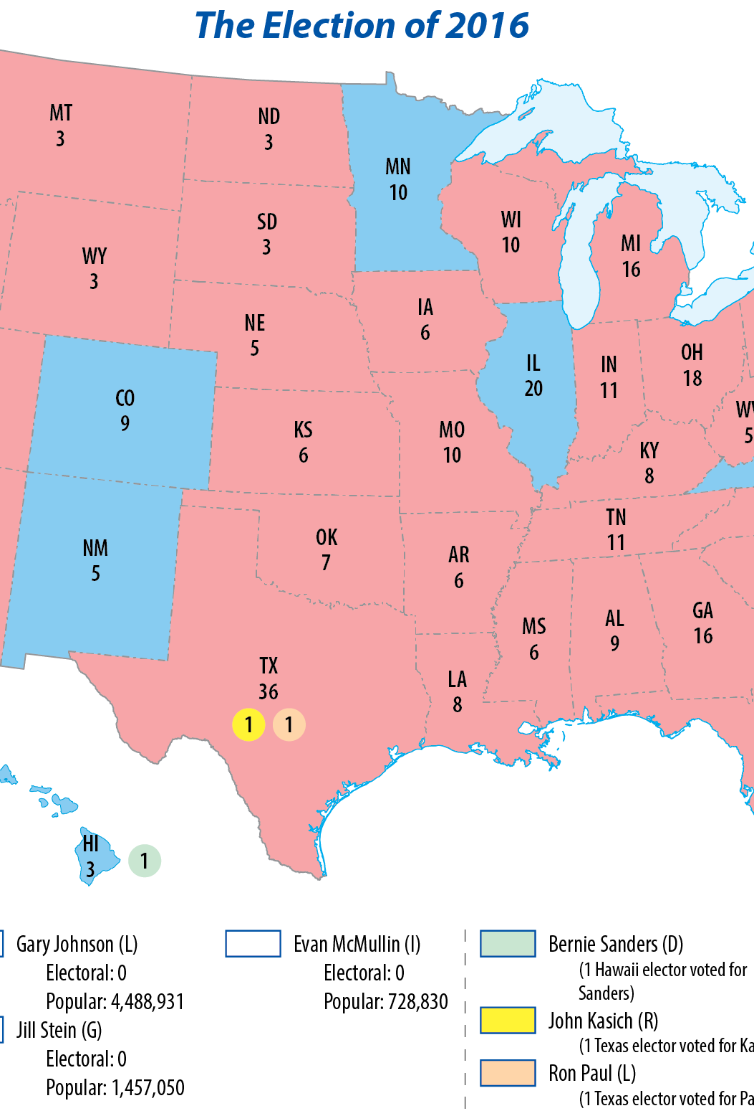
D. Electoral College
Map Resources
Technically, the winner of the election is not official until the Electoral College votes and its ballots are counted by the Senate.
The Electoral College was intended to protect smaller, less populous states.

Slide 38
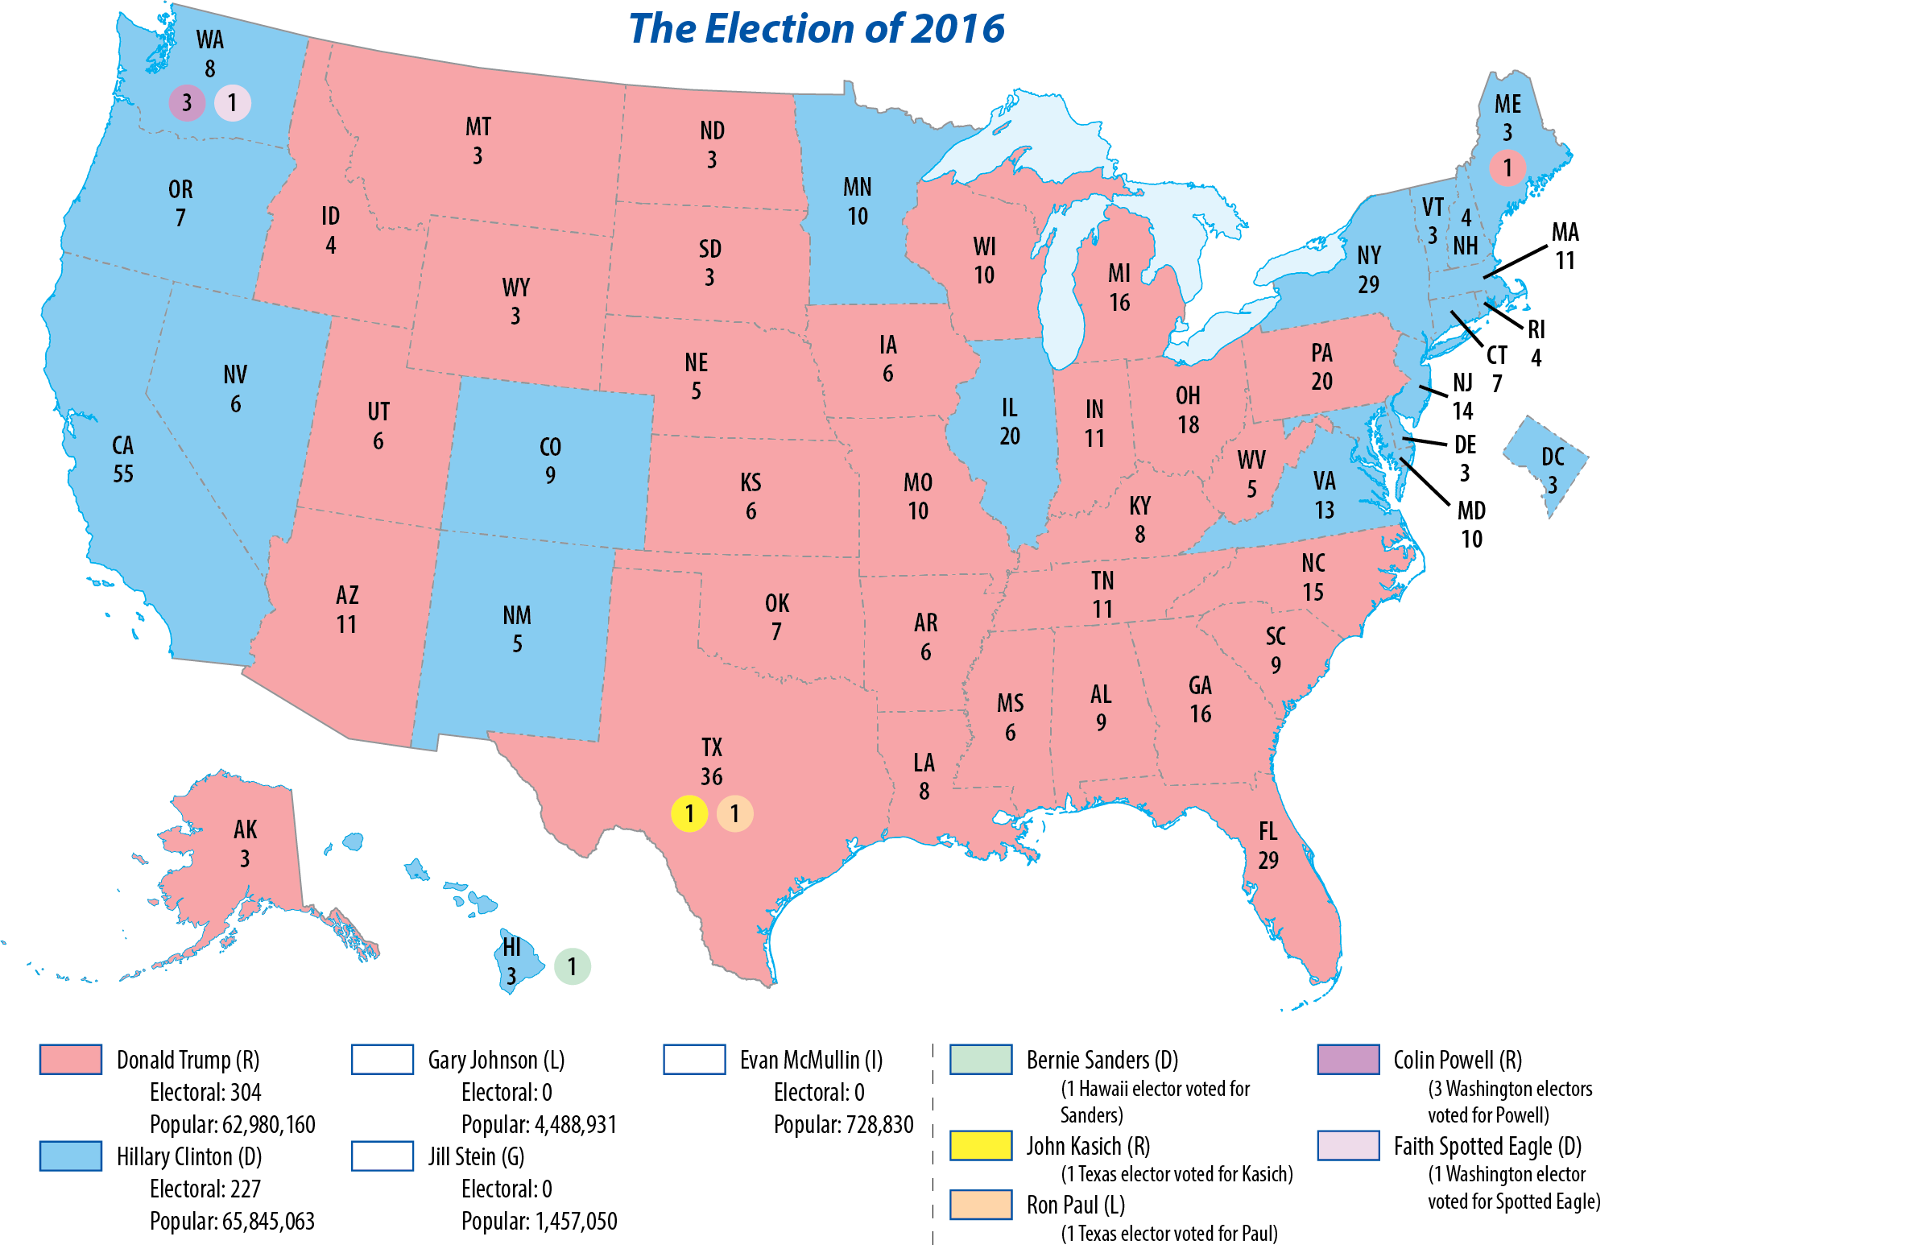
Map Resources

Slide 39
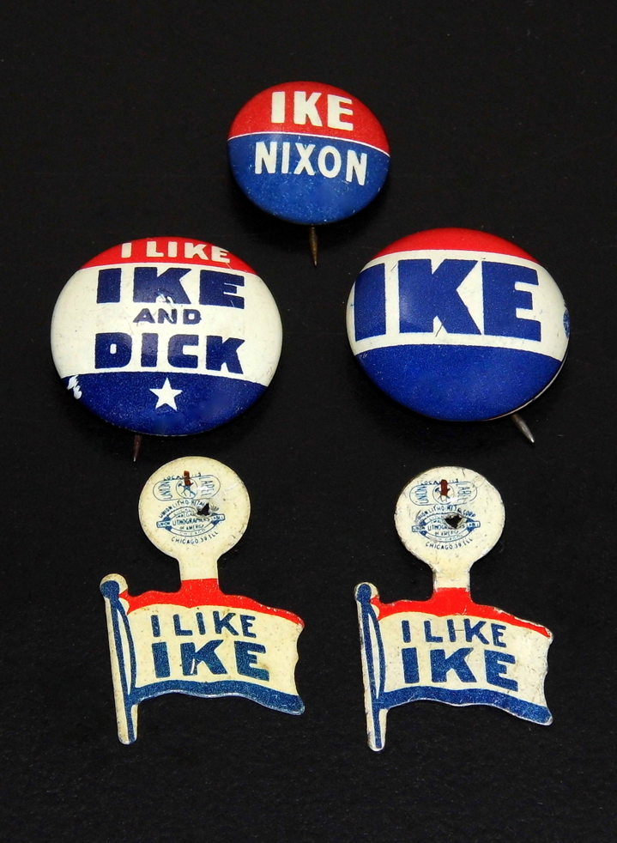
D. Electoral College
There is no federal law that requires electors to vote according to their state’s vote.
  29 states have laws that require that they support the winner in their state.
  “Faithless electors”, electors who vote contrary to how their state voted, are rare.
Notes:
By Joe Haupt from USA - Vintage 1952 And 1956 Presidential Campaign Buttons - Dwight Eisenhower And Richard Nixon, CC BY-SA 2.0, https://commons.wikimedia.org/w/index.php?curid=59519726
https://commons.wikimedia.org/w/index.php?title=Special:Search&limit=500&offset=0&ns0=1&ns6=1&ns12=1&ns14=1&ns100=1&ns106=1&search=campaign+buttons&advancedSearch-current=%7B%7D&searchToken=fdcdw0i6crorni6dm4189i88#%2Fmedia%2FFile%3AVintage_1952_And_1956_Presidential_Campaign_Buttons_-_Dwight_Eisenhower_And_Richard_Nixon_%2823406642859%29.jpg

Slide 40
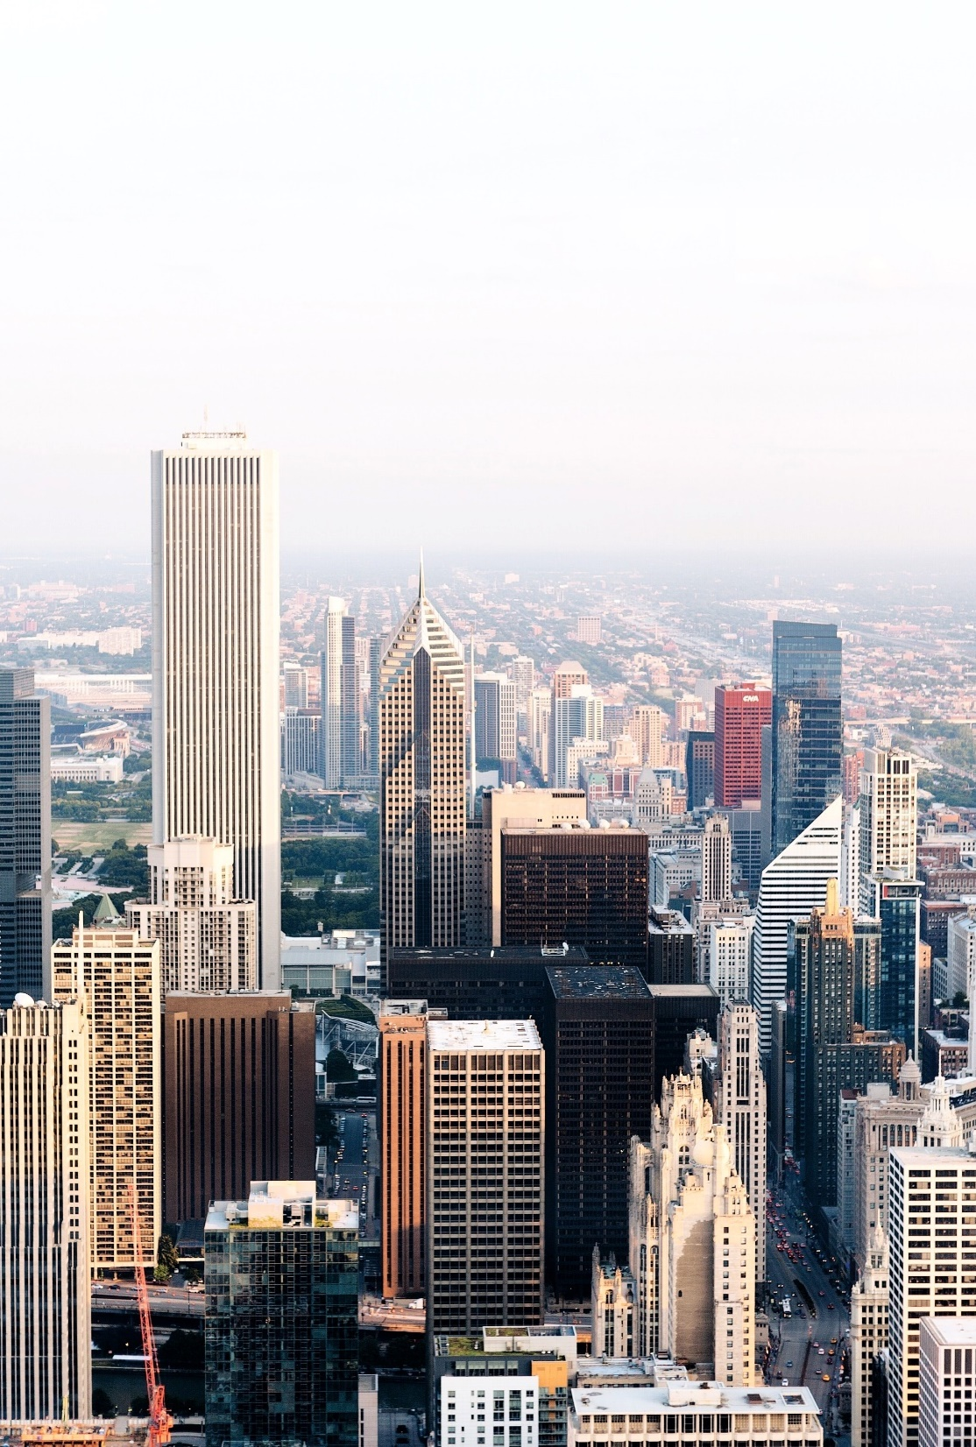
D. Electoral College
States receive electoral votes based on their representation in Congress.
A change in population based on a census may change the number of electoral votes a state is given.
Notes:
Photo by Erol Ahmed on Unsplash
https://unsplash.com/photos/mfEeaOfacTQ

Slide 41
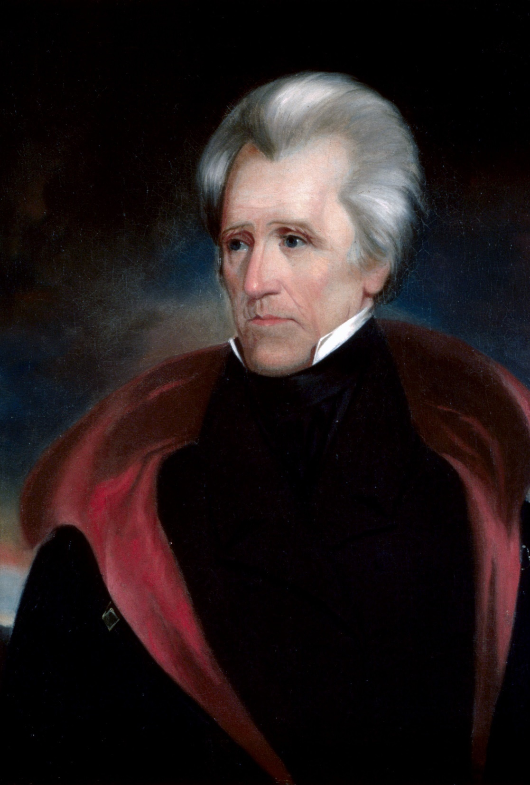
D. Electoral College
If no candidate wins a majority in the Electoral College, the House of Representatives chooses the president from the three leading candidates.
Two elections have been decided this way – 1800 and 1824.
Notes:
By Ralph Eleaser Whiteside Earl - This file was derived from: Andrew jackson head.jpg:, Public Domain, https://commons.wikimedia.org/w/index.php?curid=71259730
https://commons.wikimedia.org/w/index.php?sort=relevance&search=andrew+jackson&title=Special:Search&profile=advanced&fulltext=1&advancedSearch-current=%7B%7D&ns0=1&ns6=1&ns12=1&ns14=1&ns100=1&ns106=1&searchToken=85v5llew3neusoxku79ect6sa#%2Fmedia%2FFile%3AAndrew_jackson_headFXD.jpg

Slide 42
Section Review – Chapter 10.3
1. What day is the general election held?
on the Tuesday after the first Monday in November (p. 234)
2. Explain how the Electoral College arrangement influences campaign strategy.
Candidates concentrate time and resources on states that have the most electoral votes and in states where the race is close. (pp. 234–236)

Slide 43
Section Review – Chapter 10.3
3–4. What determines the number of electoral votes a state receives? Why does this number change?
The electoral vote of each state is equal to the total number of the state’s House and Senate members; it may change if a state’s population (and thus its number of representatives) changes. (p. 240)

Slide 44
Section Review – Chapter 10.3
How should Christians show love to their political opponents (remembering that Christians are to love their neighbors and even their enemies)? Use 1 Corinthians 13:4–7 to structure your answer.
Christians should be kind to political opponents, even when criticizing them (I Cor. 13:4). Christians should not be arrogant or rude when interacting with rivals (I Cor. 13:4–5) or be resentful if their rival wins the race (I Cor. 13:5).

Slide 45
Section Review – Chapter 10.3
How should Christians show love to their political opponents (remembering that Christians are to love their neighbors and even their enemies)? Use 1 Corinthians 13:4–7 to structure your answer.
If a political opponent is caught in wrongdoing, Christians should be glad that the truth is known, but they should not be glad for another’s misfortune (I Cor. 13:6). Christians should care more about the truth than whether statements help or hurt their sides (I Cor. 13:6–7).

Slide 46
Section Review – Chapter 10.3
Why does the United States have the Electoral College?
Some may say that the Electoral College is a check on pure democratic majority rule; it protects the minority and prevents any section of the country from being dominated by the other. For example, without the Electoral College, a few heavily populated states with large urban areas might dominate smaller states or those with mostly rural areas.

Slide 47
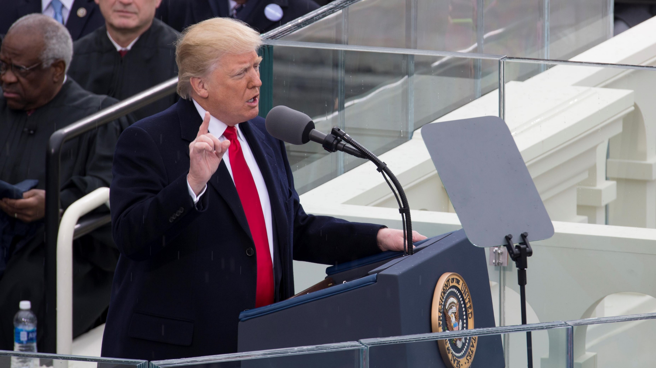
IV. Inauguration
Chapter 10.4
Notes:
By U.S. Marine Corps Lance Cpl. Cristian L. Ricardo - https://www.dvidshub.net/image/3110897/58th-presidential-inaugural-ceremony, Public Domain, https://commons.wikimedia.org/w/index.php?curid=55190865
https://commons.wikimedia.org/w/index.php?sort=relevance&search=trump+inauguration&title=Special:Search&profile=advanced&fulltext=1&advancedSearch-current=%7B%7D&ns0=1&ns6=1&ns12=1&ns14=1&ns100=1&ns106=1&searchToken=53n9hnck3qmzyktjyzr4r8vm1#%2Fmedia%2FFile%3ADonald_Trump_delivering_inauguration_speech_2017-01-20.jpg

Slide 48
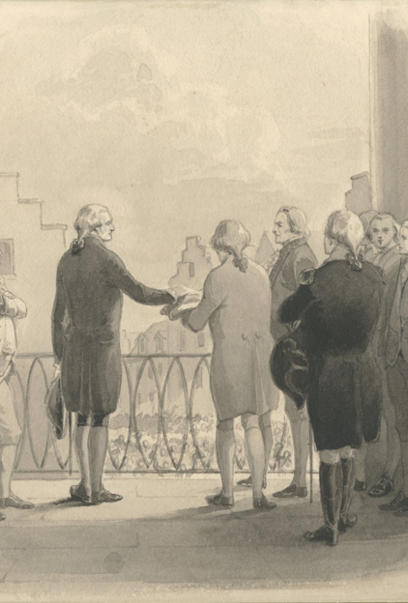
IV. Traditions
President Washington set the precedent for giving a speech after his first swearing-in, now known as the inaugural address.
Washington also established the tradition of having a Supreme Court justice administer the oath.
Notes:
By Scan by NYPL - https://digitalcollections.nypl.org/items/510d47da-24f2-a3d9-e040-e00a18064a99, Public Domain, https://commons.wikimedia.org/w/index.php?curid=48521600
https://commons.wikimedia.org/w/index.php?sort=relevance&search=george+washington+oath&title=Special:Search&profile=advanced&fulltext=1&advancedSearch-current=%7B%7D&ns0=1&ns6=1&ns12=1&ns14=1&ns100=1&ns106=1&searchToken=9t1bduqn4pidqvf63onbuji5o#%2Fmedia%2FFile%3AWashington_swearing_the_oath_of_office_%28NYPL_NYPG97-F85-420814%29.jpg

Slide 49
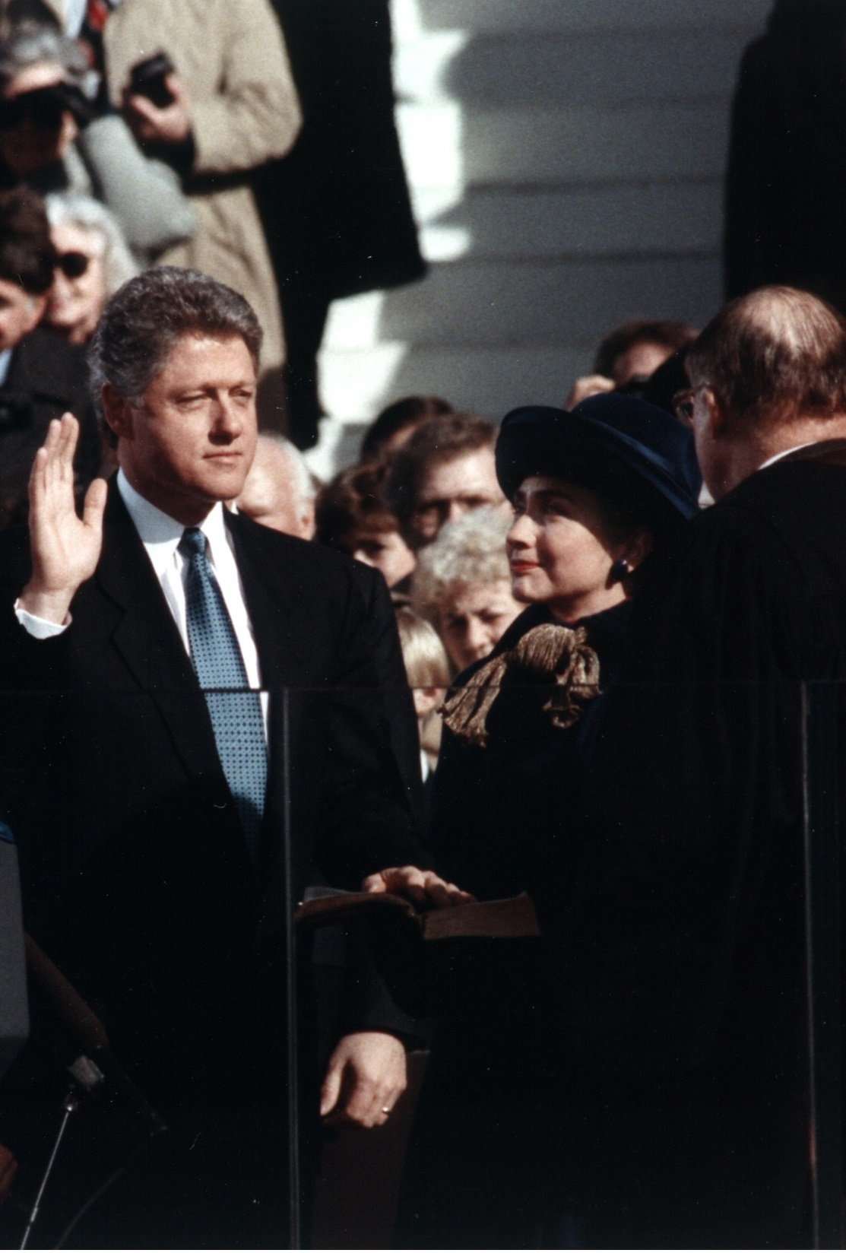
B. Transfer of Power
The president-elect normally has about eleven weeks to develop his new administration.
Outgoing presidents have little influence but may still accomplish tasks through executive orders and pardons.
Notes:
By Official White House photograph - This image is available from the United States Library of Congress's Prints and Photographs divisionunder the digital ID ppmsc.02865.This tag does not indicate the copyright status of the attached work. A normal copyright tag is still required. See Commons:Licensing for more information., Public Domain, https://commons.wikimedia.org/w/index.php?curid=12045389
https://commons.wikimedia.org/w/index.php?sort=relevance&search=oath+of+office&title=Special:Search&profile=advanced&fulltext=1&advancedSearch-current=%7B%7D&ns0=1&ns6=1&ns12=1&ns14=1&ns100=1&ns106=1&searchToken=e2yqcuow997m7uvm9hdfg9yms#%2Fmedia%2FFile%3ABill_Clinton_taking_the_oath_of_office%2C_1993.jpg

Slide 50
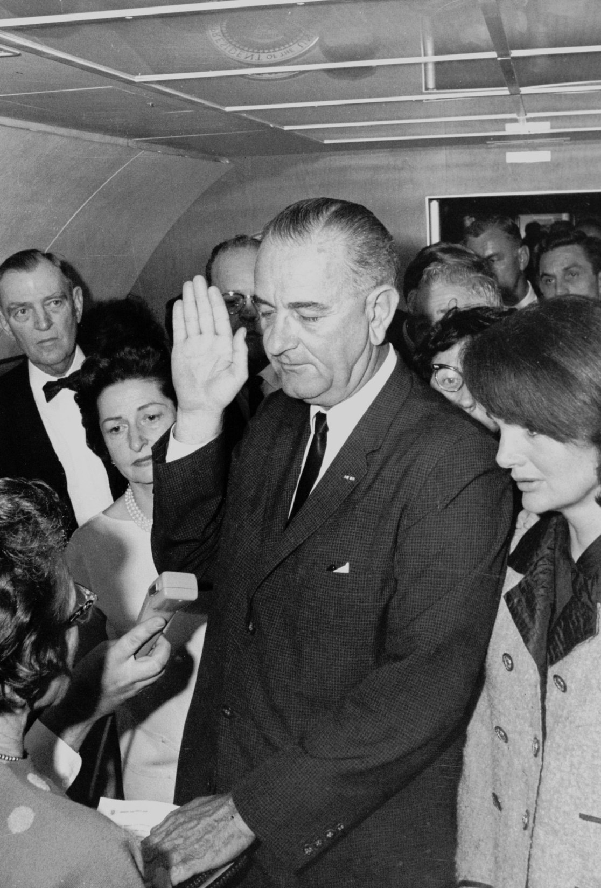
B. Transfer of Power
In 1963, Congress passed the Presidential Transition Act which aided in the transition of power by paying the expenses of the new president and his staff.
When a new president takes office, thousands of positions become vacant and are replaced with new personnel.
Notes:
By Cecil W. Stoughton - http://photolab.lbjlib.utexas.edu/detail.asp?id=18319, Public Domain, https://commons.wikimedia.org/w/index.php?curid=548657
https://commons.wikimedia.org/w/index.php?sort=relevance&search=oath+of+office&title=Special:Search&profile=advanced&fulltext=1&advancedSearch-current=%7B%7D&ns0=1&ns6=1&ns12=1&ns14=1&ns100=1&ns106=1&searchToken=e2yqcuow997m7uvm9hdfg9yms#%2Fmedia%2FFile%3ALyndon_B._Johnson_taking_the_oath_of_office%2C_November_1963.jpg

Slide 51
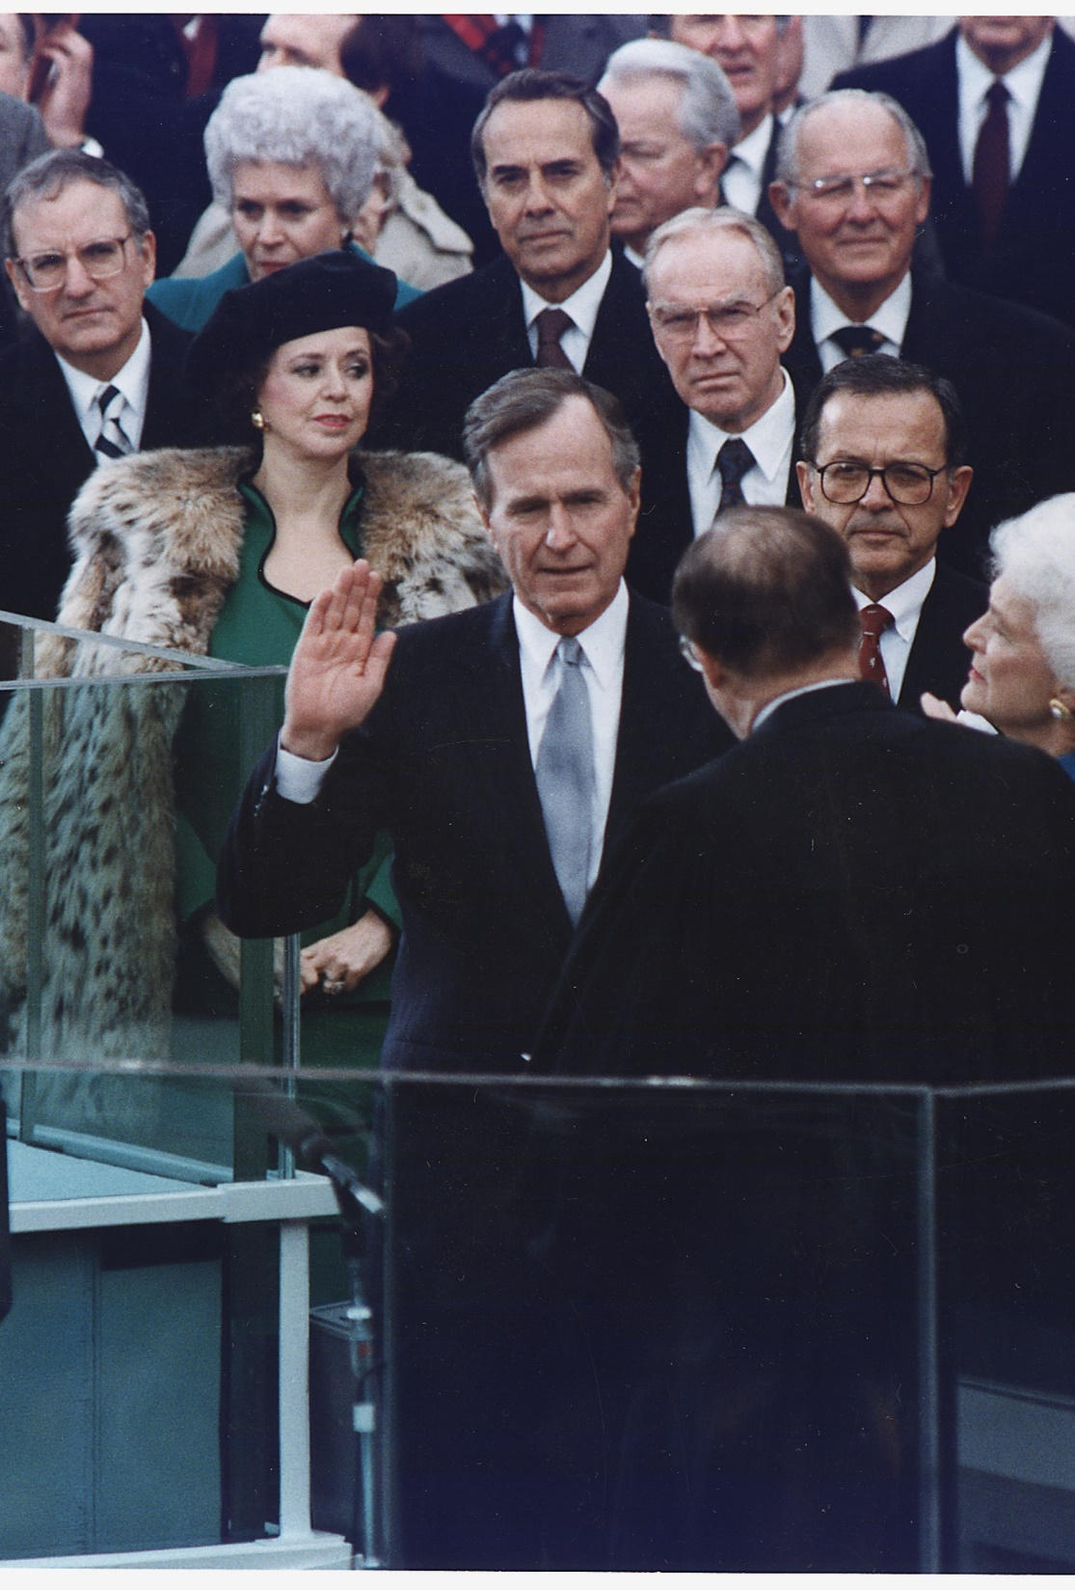
B. Transfer of Power
The Twentieth Amendment changed the inauguration date from March 4th to January 20th.
Since Ronald Reagan, the presidential inauguration has taken place on the terrace of the West Front of the Capitol.
Notes:
By Unknown author or not provided - U.S. National Archives and Records Administration, Public Domain, https://commons.wikimedia.org/w/index.php?curid=16645210
https://commons.wikimedia.org/w/index.php?sort=relevance&search=george+washington+oath&title=Special:Search&profile=advanced&fulltext=1&advancedSearch-current=%7B%7D&ns0=1&ns6=1&ns12=1&ns14=1&ns100=1&ns106=1&searchToken=9t1bduqn4pidqvf63onbuji5o#%2Fmedia%2FFile%3AGeorge_Bush_takes_the_Oath_of_Office_as_the_41st_President_of_the_United_States_-_NARA_-_186387.tif

Slide 52
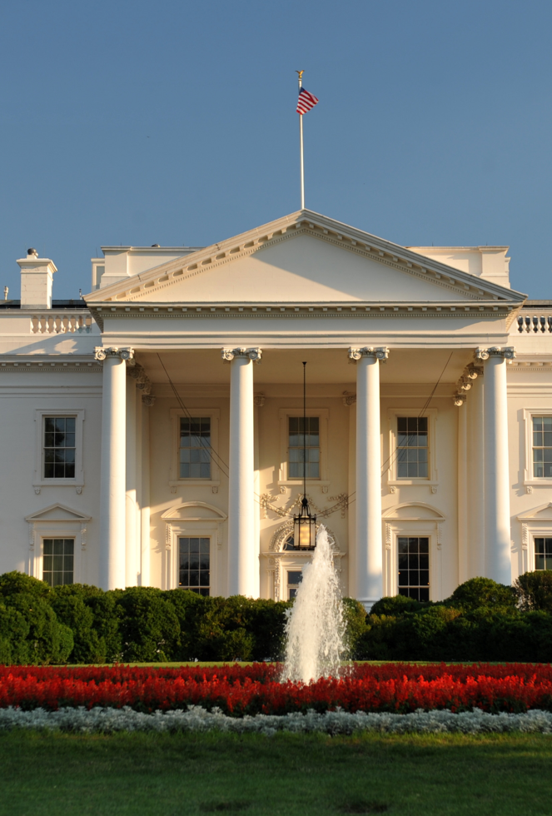
B. Transfer of Power
The inauguration itself includes several days of celebrations, parades, and speeches before the new president moves into the White House and a new chapter of American history begins.
Notes:
By Cezary p - Own work, CC BY-SA 4.0, https://commons.wikimedia.org/w/index.php?curid=4399222
https://commons.wikimedia.org/w/index.php?sort=relevance&search=the+white+house+washington+dc&title=Special:Search&profile=advanced&fulltext=1&advancedSearch-current=%7B%7D&ns0=1&ns6=1&ns12=1&ns14=1&ns100=1&ns106=1&searchToken=cfnu9lm9aa3ayqvwtoz9sxyq1#%2Fmedia%2FFile%3AWhite_House_Washington.JPG

Slide 53
Section Review – Chapter 10.4
1. What is the most visible symbol of a presidential transition?
the presidential inauguration (p. 242)
2. Why do presidents often issue executive orders?
Presidents will often issue an executive order to achieve a goal that does not have sufficient support to receive congressional approval. (p. 244)

Slide 54
Section Review – Chapter 10.4
3. Why was the presidential transition fund established?
Congress thought that the presidential transition is so important and has such an effect on government that it should be paid for by the government. (p. 244)
4. What day was designated as Inauguration Day from 1789 until 1933?
March 4 (p. 245)

Slide 55
Section Review – Chapter 10.4
5. Since 1937, what date has been designated as Inauguration Day?
January 20 (p. 245)
6–8. Which three cities have served as the capital for the US (list in order)?
New York City, Philadelphia, Washington, DC (p. 245)

Slide 56
Section Review – Chapter 10.4
Do you think it was wise for the Founding Fathers to give the president the right to pardon individuals? What do you think about the manner in which presidents have used this privilege?
Some may say that it is right for presidents to be able to extend mercy through the from of a pardon. Others may say that this power has been abused by granting pardons to underserving people.

Slide 57
Section Review – Chapter 10.4
Read the quote from Supreme Court Justice Joseph Story on page 245. How could you best summarize his statements?
The president should take the oath of office seriously and seek to fulfill it. Violating the oath might not bring rebuke from humans; however, God will judge those who violate their oaths.

