Slide 1
Chapter 11: America’s
Highest Office
Notes:
WIN-Initiative/Stone/Getty Images

Slide 2
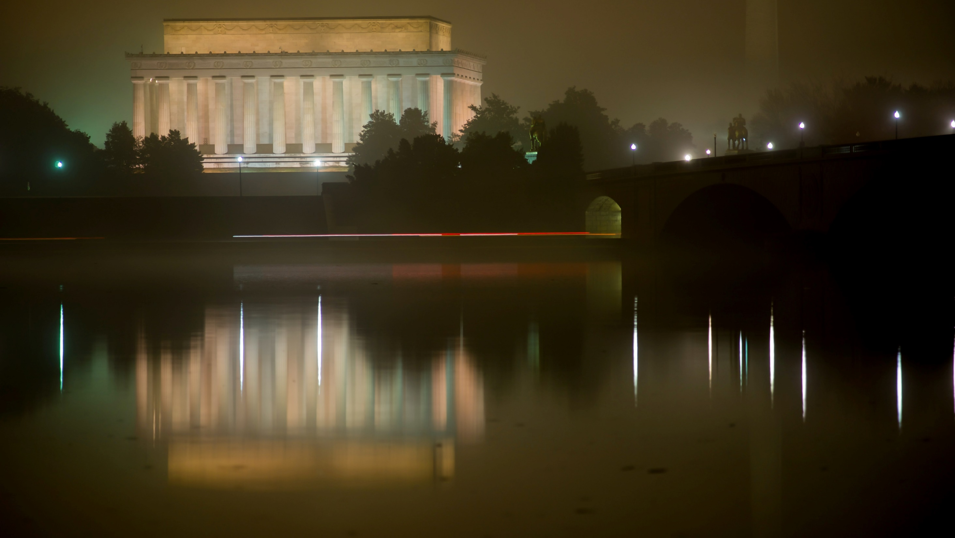
I. Presidential Powers
Chapter 11.1
Notes:
Photo by NOAA on Unsplash
https://unsplash.com/photos/NT9KMamCC_E

Slide 3
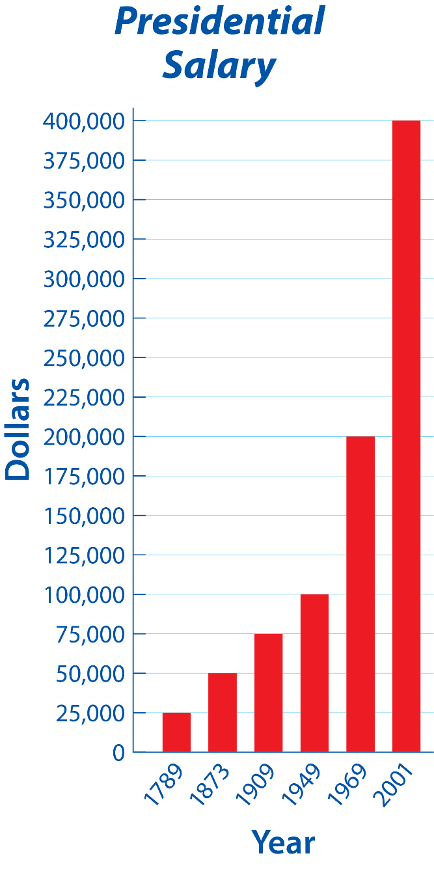
Notes:
BJU Press Art

Slide 4
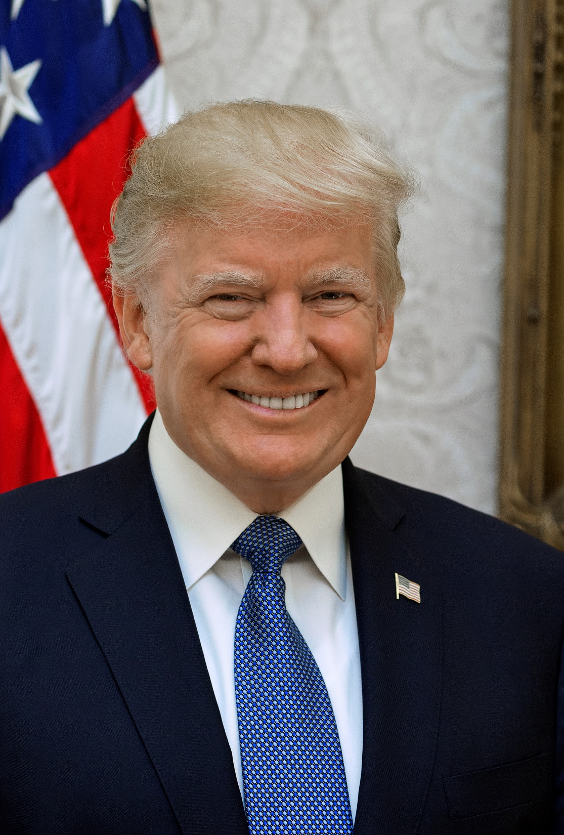
A. Chief Executive
The president enforces the law through various departments under his control.
The president administers a vast bureaucracy of two million employees.
Notes:
By Shealah Craighead - White House, Public Domain, https://commons.wikimedia.org/w/index.php?curid=63768460
https://commons.wikimedia.org/w/index.php?sort=relevance&search=president+donald+trump&title=Special:Search&profile=advanced&fulltext=1&advancedSearch-current=%7B%7D&ns0=1&ns6=1&ns12=1&ns14=1&ns100=1&ns106=1&searchToken=6g2dz2lgkbc6agrtz8gfq5j7c#%2Fmedia%2FFile%3ADonald_Trump_official_portrait.jpg

Slide 5
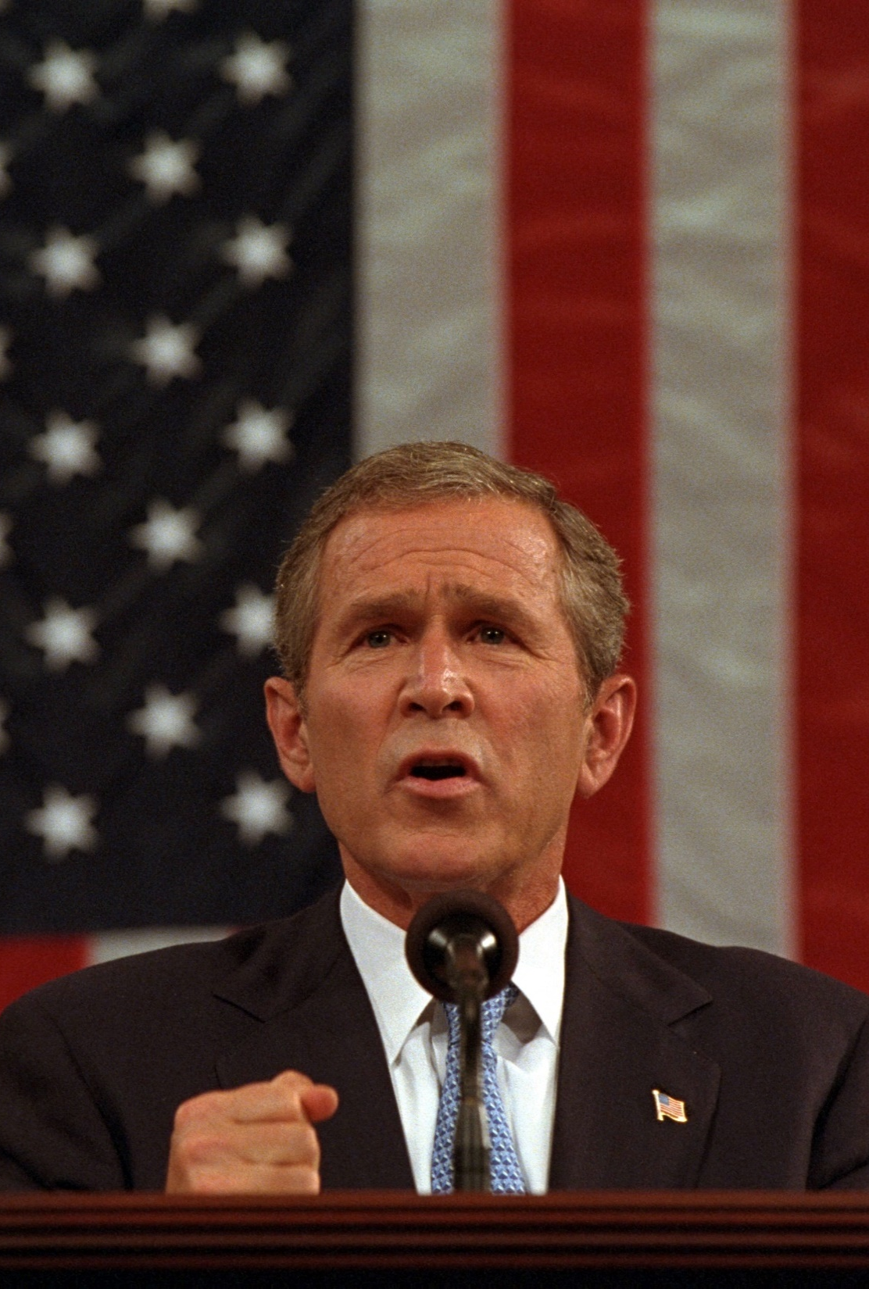
B. Commander in Chief
Civilian control of the military is maintained by the president.
The president uses his power to quickly respond to an emergency.
  Washington led troops to subdue the Whiskey Rebellion.
  George W. Bush created a coalition to attack the Taliban after the 9/11 terrorist attacks in 2001.
Notes:
By The U.S. National Archives - This media is available in the holdings of the National Archives and Records Administration, cataloged under the National Archives Identifier (NAID) 5997340., No restrictions, https://commons.wikimedia.org/w/index.php?curid=53400426
https://commons.wikimedia.org/w/index.php?title=Special:Search&limit=500&offset=0&ns0=1&ns6=1&ns12=1&ns14=1&ns100=1&ns106=1&search=president+george+w.+bush+september+11%2C+2001&advancedSearch-current=%7B%7D&searchToken=e7zxitlr00elx33oqfn6w6sqq#%2Fmedia%2FFile%3A911-_President_George_W._Bush_Addresses_Joint_Session_of_Congress%2C_09-20-2001._%286124236009%29.jpg

Slide 6
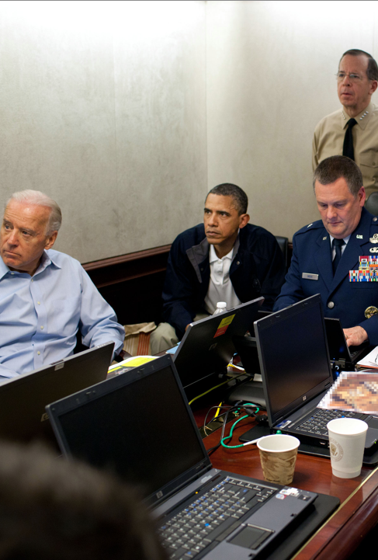
B. Commander in Chief
The president has the authority to carry out covert operations – activities unknown to the public and sometimes even Congress.
Other organizations such as the Central Intelligence Agency (CIA) oversee the security of the nation.
President Obama receives an update on the mission against Osama Bin Laden.
Notes:
By Pete Souza - White House Flickr Feed, Public Domain, https://commons.wikimedia.org/w/index.php?curid=15098315
https://commons.wikimedia.org/w/index.php?sort=relevance&search=osama+bin+laden+operation&title=Special:Search&profile=advanced&fulltext=1&advancedSearch-current=%7B%7D&ns0=1&ns6=1&ns12=1&ns14=1&ns100=1&ns106=1&searchToken=e7ilallmiohuz9cx6v2oaed5#%2Fmedia%2FFile%3AObama_and_Biden_await_updates_on_bin_Laden.jpg

Slide 7
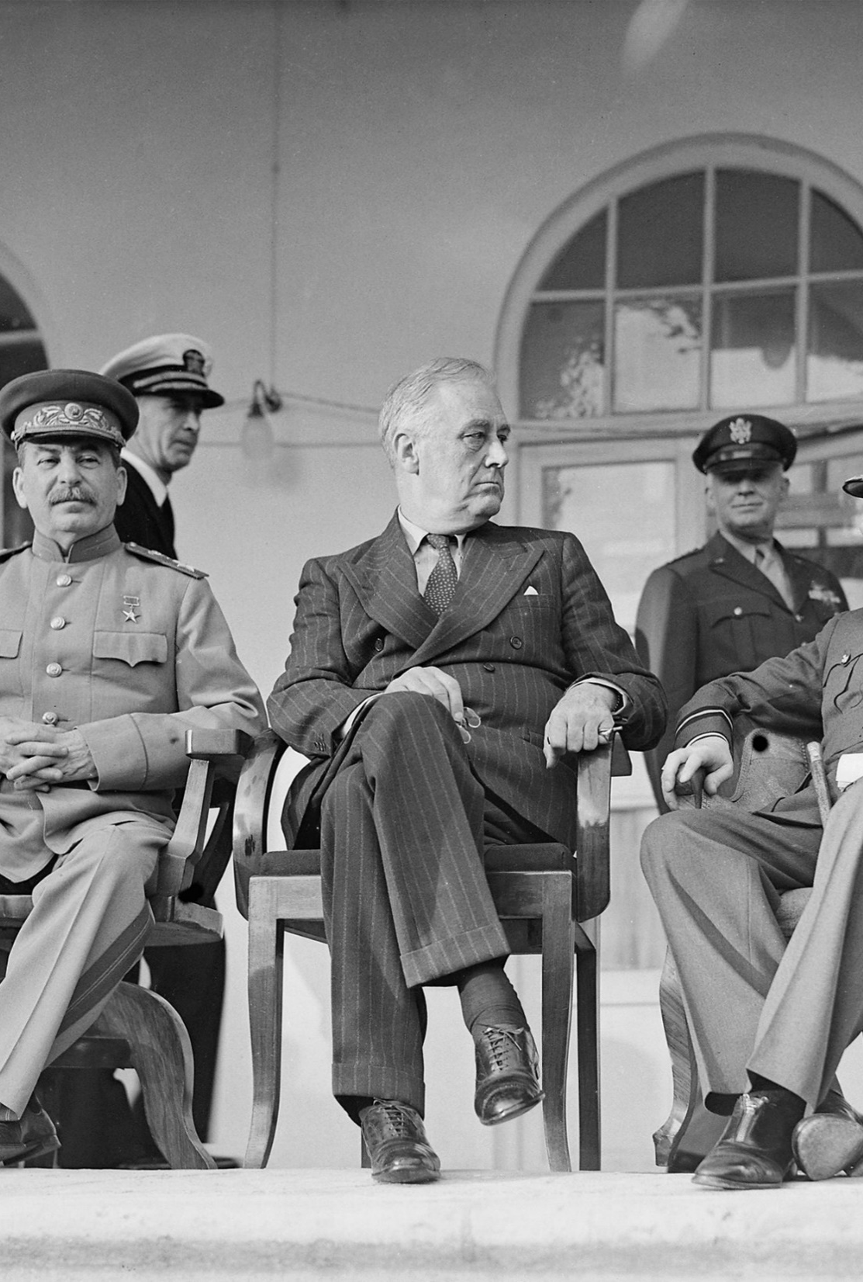
C. Diplomatic Leader
While the president’s diplomatic power is shared with Congress, he still has great influence.
The president has the power of executive agreement – a written “understanding” with another head of state to take a particular action.
Notes:
By Oulds, D C (Lt), Royal Navy official photographer - File:Joseph Stalin, Franklin D Roosevelt and Winston Churchill on the veranda of the Soviet Legation in Teheran, during the first 'Big Three' Conference, November 1943. A20710.jpg http://media.iwm.org.uk/iwm/mediaLib//30/media-30412/large.jpg, Public Domain, https://commons.wikimedia.org/w/index.php?curid=70630657
https://commons.wikimedia.org/w/index.php?sort=relevance&search=president+roosevelt&title=Special:Search&profile=advanced&fulltext=1&advancedSearch-current=%7B%7D&ns0=1&ns6=1&ns12=1&ns14=1&ns100=1&ns106=1&searchToken=8wug55sdc2d1o802mhgdmwvph#%2Fmedia%2FFile%3AJoseph_Stalin%2C_Franklin_D_Roosevelt_and_Winston_Churchill%2C_in_Teheran%2C_1943%2C_edit.jpg

Slide 8
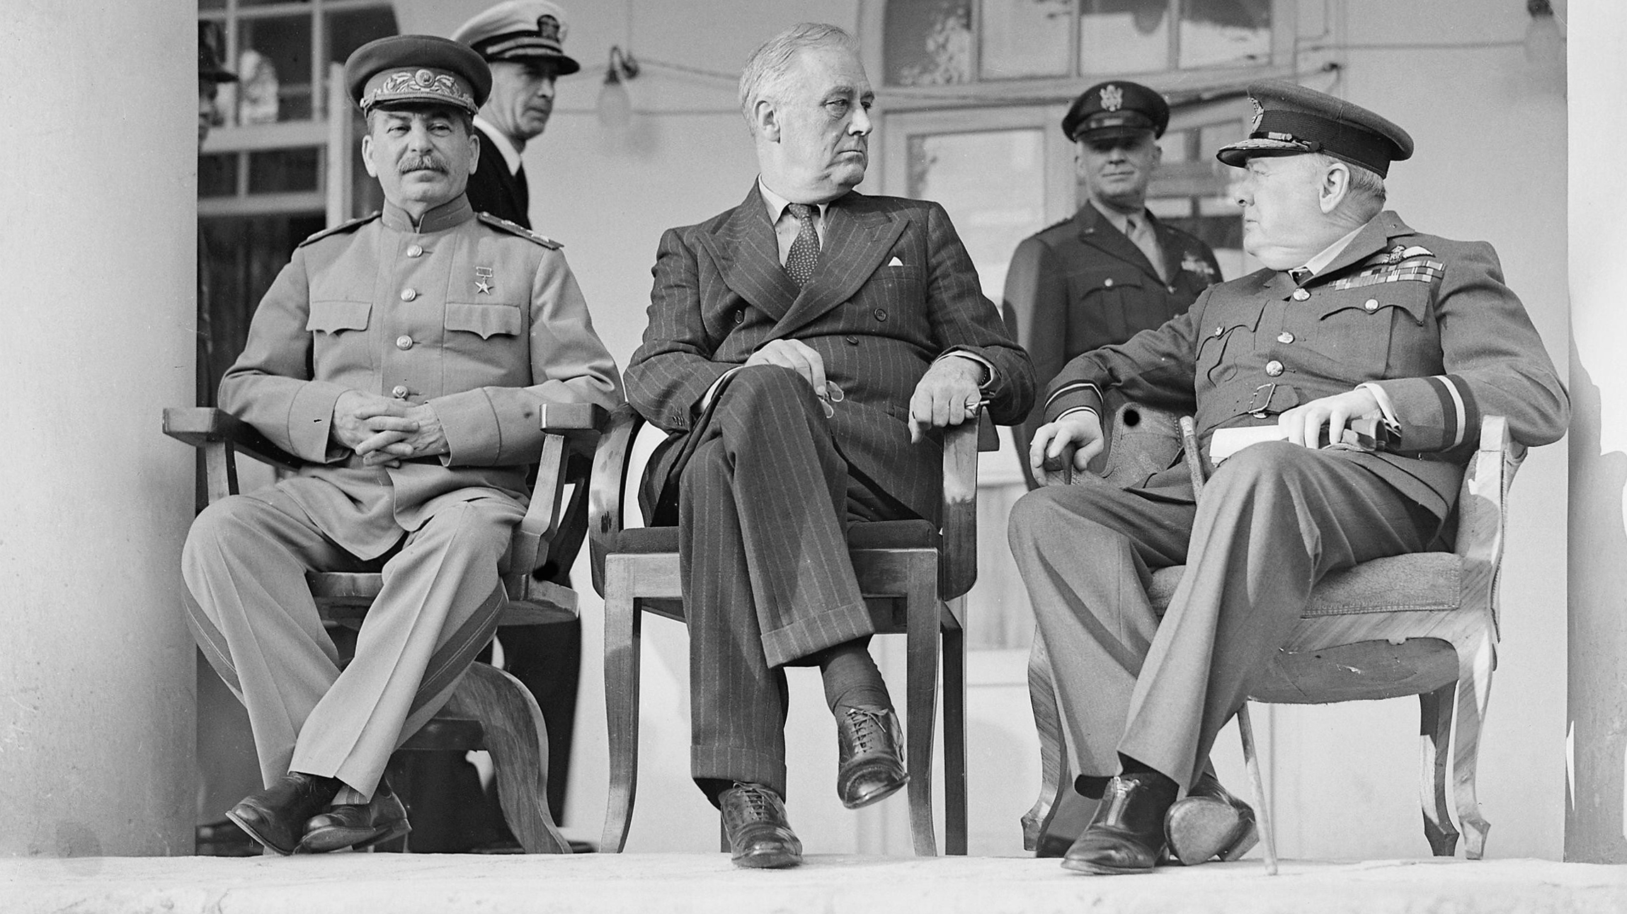
President Roosevelt at the Tehran Conference
Notes:
By Oulds, D C (Lt), Royal Navy official photographer - File:Joseph Stalin, Franklin D Roosevelt and Winston Churchill on the veranda of the Soviet Legation in Teheran, during the first 'Big Three' Conference, November 1943. A20710.jpg http://media.iwm.org.uk/iwm/mediaLib//30/media-30412/large.jpg, Public Domain, https://commons.wikimedia.org/w/index.php?curid=70630657
https://commons.wikimedia.org/w/index.php?sort=relevance&search=president+roosevelt&title=Special:Search&profile=advanced&fulltext=1&advancedSearch-current=%7B%7D&ns0=1&ns6=1&ns12=1&ns14=1&ns100=1&ns106=1&searchToken=8wug55sdc2d1o802mhgdmwvph#%2Fmedia%2FFile%3AJoseph_Stalin%2C_Franklin_D_Roosevelt_and_Winston_Churchill%2C_in_Teheran%2C_1943%2C_edit.jpg

Slide 9
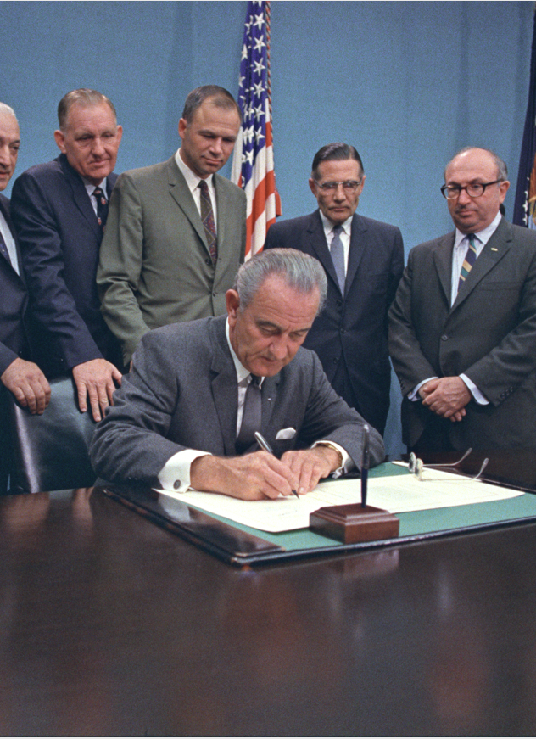
D. Legislative Leader
The president’s legislative powers grew during times of crisis such as the World Wars and the Great Depression.
He also has the power to veto bills passed by Congress – a decision which is rarely overturned.
Notes:
By White House Photograph Office - https://catalog.archives.gov/id/6037517, Public Domain, https://commons.wikimedia.org/w/index.php?curid=88817583
https://commons.wikimedia.org/w/index.php?sort=relevance&search=president+signing+a+bill&title=Special:Search&profile=advanced&fulltext=1&advancedSearch-current=%7B%7D&ns0=1&ns6=1&ns12=1&ns14=1&ns100=1&ns106=1&searchToken=4eura8x5wgzse9339zmg6mpls#%2Fmedia%2FFile%3APresident_Lyndon_B._Johnson_Signing_HR_18763.jpg

Slide 10
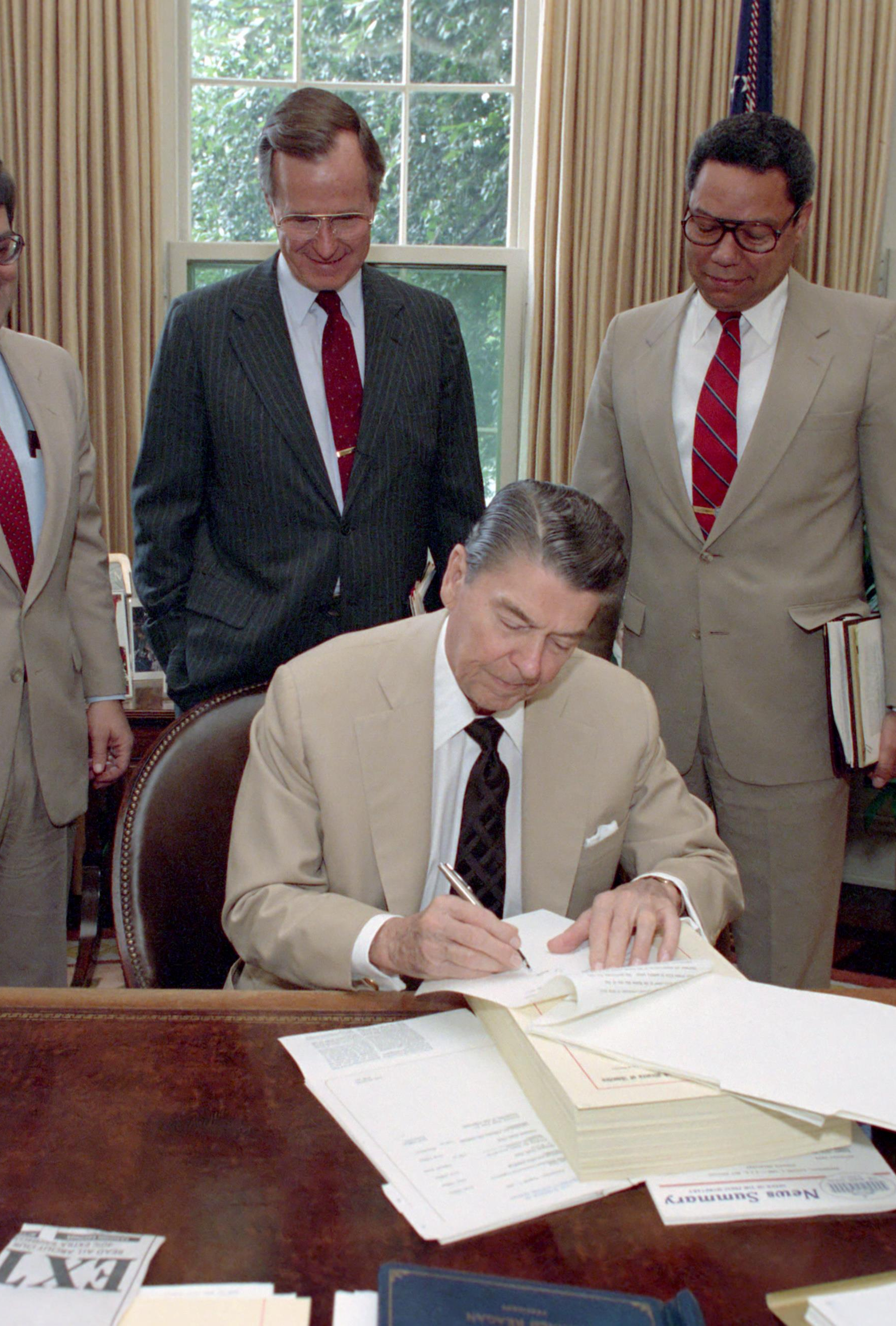
D. Legislative Leader
A pocket veto occurs when the president does not sign a bill for ten days while Congress is adjourned.
In the 1990’s the president briefly had the power of line-item veto which allowed the president to veto only part of a bill.
Notes:
By Series: Reagan White House Photographs, 1/20/1981 - 1/20/1989Collection: White House Photographic Collection, 1/20/1981 - 1/20/1989 - https://catalog.archives.gov/id/75856223, Public Domain, https://commons.wikimedia.org/w/index.php?curid=91033091
https://commons.wikimedia.org/w/index.php?title=Special:Search&limit=500&offset=0&ns0=1&ns6=1&ns12=1&ns14=1&ns100=1&ns106=1&search=president+veto&advancedSearch-current=%7B%7D&searchToken=228mo3i7cawcuk28hmtgshapt#%2Fmedia%2FFile%3APresident_Ronald_Reagan_signing_veto_of_defense_authorization_bill.jpg

Slide 11
D. Legislative Leader
This power was declared unconstitutional by the Supreme Court in 1998.
Notes:
By Series: Reagan White House Photographs, 1/20/1981 - 1/20/1989Collection: White House Photographic Collection, 1/20/1981 - 1/20/1989 - https://catalog.archives.gov/id/75856223, Public Domain, https://commons.wikimedia.org/w/index.php?curid=91033091
https://commons.wikimedia.org/w/index.php?title=Special:Search&limit=500&offset=0&ns0=1&ns6=1&ns12=1&ns14=1&ns100=1&ns106=1&search=president+veto&advancedSearch-current=%7B%7D&searchToken=228mo3i7cawcuk28hmtgshapt#%2Fmedia%2FFile%3APresident_Ronald_Reagan_signing_veto_of_defense_authorization_bill.jpg

Slide 12
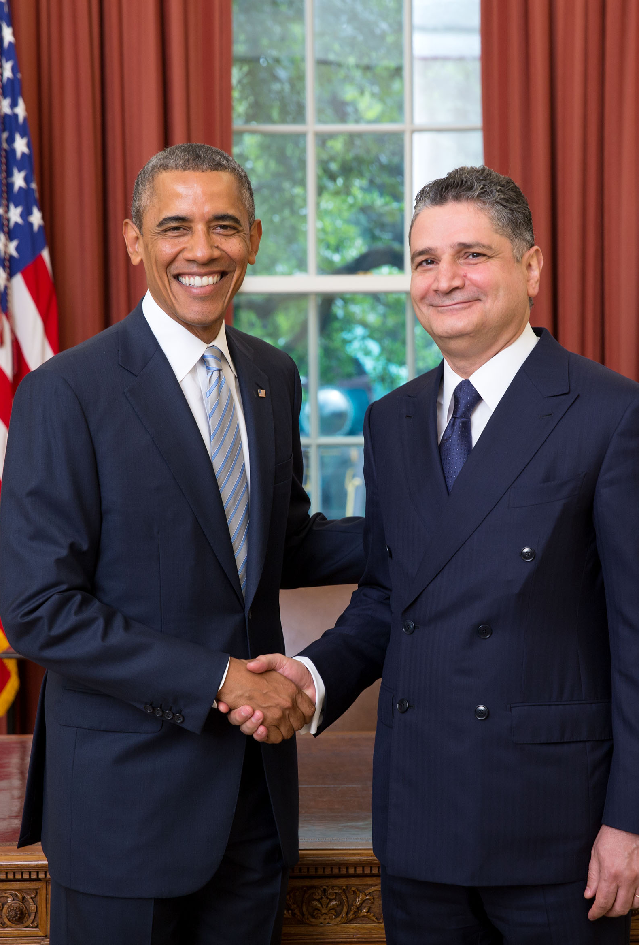
E. Chief of State
The president represents America at home and abroad by hosting or visiting foreign dignitaries.
He also participates in important ceremonial events such as laying a wreath at the Tomb of the Unknown Soldier.
Notes:
By Lawrence Jackson - Whitehouse.gov, CC BY 3.0, https://commons.wikimedia.org/w/index.php?curid=44273537
https://commons.wikimedia.org/w/index.php?sort=relevance&search=president+obama&title=Special:Search&profile=advanced&fulltext=1&advancedSearch-current=%7B%7D&ns0=1&ns6=1&ns12=1&ns14=1&ns100=1&ns106=1&searchToken=9zdkswzwpz91qj00dcbx7xpbp#%2Fmedia%2FFile%3ASargsyan-Obama.jpg

Slide 13
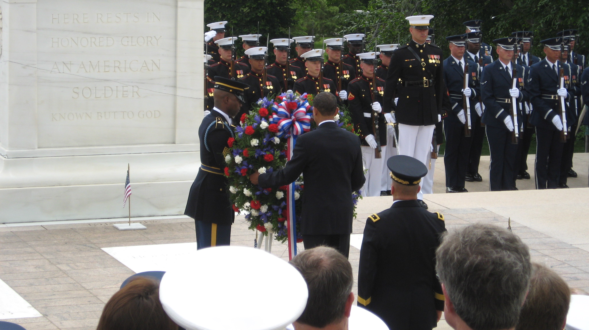
Notes:
By USCG Press - President Obama laying a wreath at the Tomb of the Unknown Solider, Public Domain, https://commons.wikimedia.org/w/index.php?curid=65656036
https://commons.wikimedia.org/w/index.php?sort=relevance&search=tomb+of+the+unknown+soldier+wreath+laying&title=Special:Search&profile=advanced&fulltext=1&advancedSearch-current=%7B%7D&ns0=1&ns6=1&ns12=1&ns14=1&ns100=1&ns106=1&searchToken=dd886t93vlze1i7pmrzuhfgp7#%2Fmedia%2FFile%3APresident_Obama_laying_a_wreath_at_the_Tomb_of_the_Unknown_Soldier_%283563784538%29.jpg

Slide 14
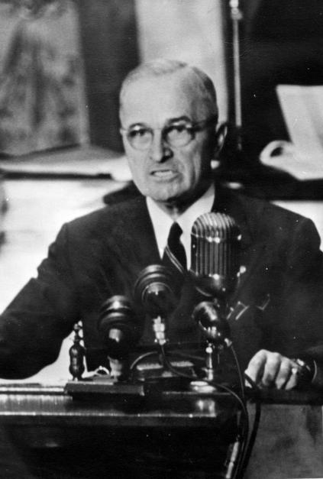
F. Party Leader
The president is the spokesman for his party.
The president often campaigns for other candidates in his party to help them win congressional or gubernatorial positions.
Notes:
By Harry S. Truman Library & Museum - http://www.trumanlibrary.org/photographs/view.php?id=14687, Public Domain, https://commons.wikimedia.org/w/index.php?curid=52529182
https://commons.wikimedia.org/w/index.php?title=Special:Search&limit=500&offset=0&ns0=1&ns6=1&ns12=1&ns14=1&ns100=1&ns106=1&search=president+truman+speech&advancedSearch-current=%7B%7D&searchToken=cmpdxg8b7gn6aiotpmv313ire#%2Fmedia%2FFile%3ASpecial_Message_to_Congress_on_Greece_and_Turkey_The_Truman_Doctrine.jpg

Slide 15
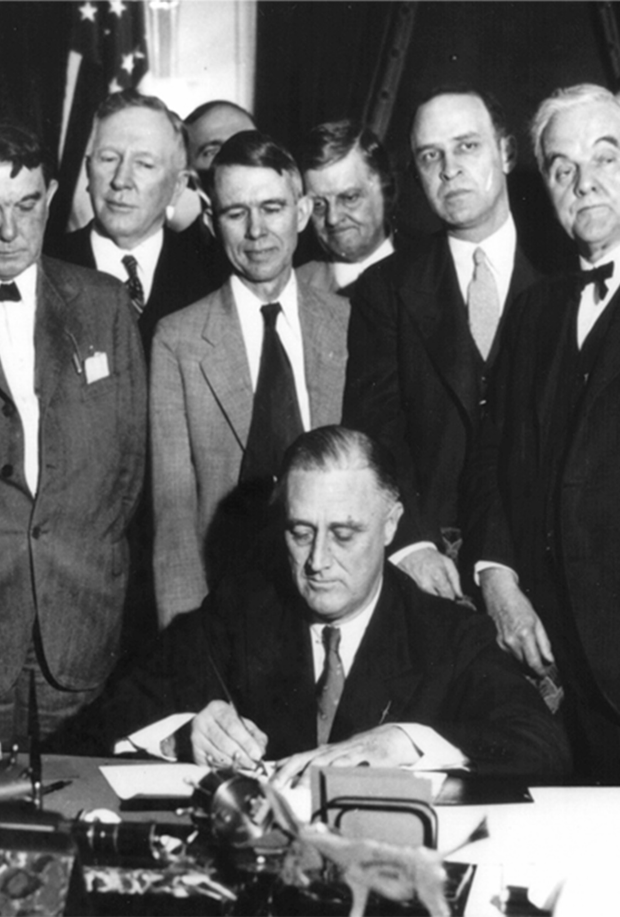
G. Restrictions
The president is restricted by his tenure (term of office), which is four years.
The Twenty-Second Amendment restricted the president to being able to serve only two terms.
A VP who succeeds a president cannot be president for more than ten years.
Notes:
By Tennessee Valley Authority - http://www.tva.gov/75th/quilt/3.htm (direct link), Public Domain, https://commons.wikimedia.org/w/index.php?curid=11812115
https://commons.wikimedia.org/w/index.php?sort=relevance&search=president+franklin+D.+roosevelt&title=Special:Search&profile=advanced&fulltext=1&advancedSearch-current=%7B%7D&ns0=1&ns6=1&ns12=1&ns14=1&ns100=1&ns106=1&searchToken=4nj5hlkwvh0rum0sbmbjwc67t#%2Fmedia%2FFile%3ARoosevelt_signing_TVA_Act_%281933%29.jpg

Slide 16
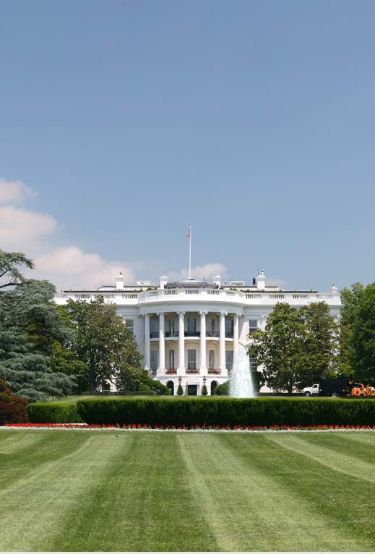
G. Restrictions
A president who has been defeated in an election or cannot run for another term is considered a lame duck after the election because his power and influence is reduced.
Presidents generally have a more difficult time during a second term.
Notes:
By I, Daniel Schwen, CC BY-SA 3.0, https://commons.wikimedia.org/w/index.php?curid=4156824
https://commons.wikimedia.org/w/index.php?sort=relevance&search=the+white+house&title=Special:Search&profile=advanced&fulltext=1&advancedSearch-current=%7B%7D&ns0=1&ns6=1&ns12=1&ns14=1&ns100=1&ns106=1&searchToken=afvwn8x1xlovfks6oyb16jfiw#%2Fmedia%2FFile%3AWhite_House_lawn.jpg

Slide 17
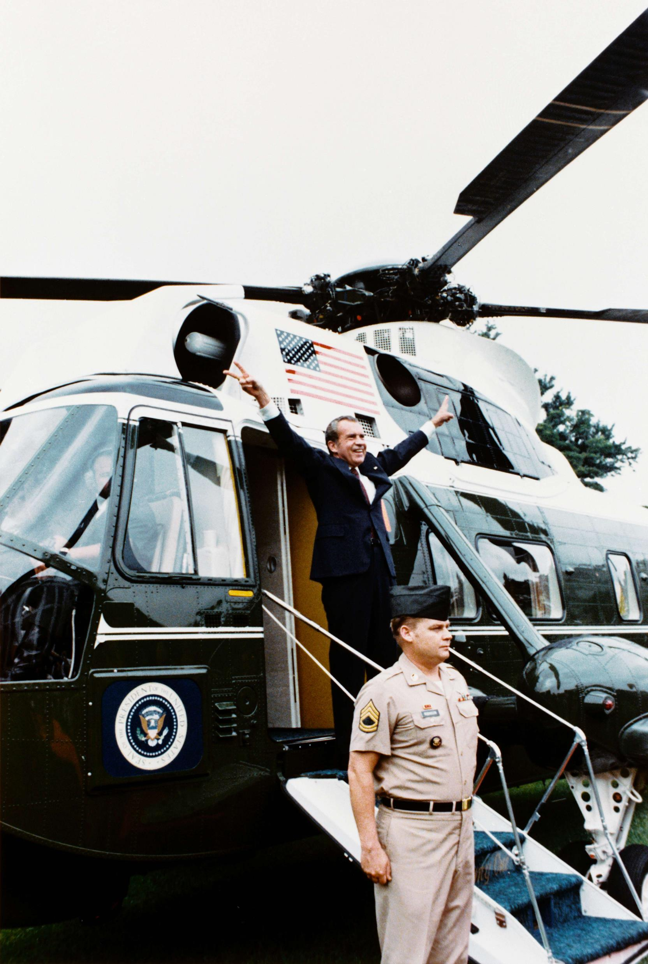
G. Restrictions
The ultimate check on the president is Congress’s power of impeachment – bringing charges against the president or another major federal official.
  Richard Nixon resigned in 1974 because it was likely he was going to be impeached.
Notes:
By Ollie Atkins - http://sca.gmu.edu/exhibit/atkins_1.htm#nixon, Public Domain, https://commons.wikimedia.org/w/index.php?curid=526901
https://commons.wikimedia.org/w/index.php?sort=relevance&search=president+nixon+resign&title=Special:Search&profile=advanced&fulltext=1&advancedSearch-current=%7B%7D&ns0=1&ns6=1&ns12=1&ns14=1&ns100=1&ns106=1&searchToken=25ud80s12ijqxplarrdl2e0di#%2Fmedia%2FFile%3ANixon-depart.png

Slide 18
G. Restrictions
The ultimate check on the president is Congress’s power of impeachment – bringing charges against the president or another major federal official.
  During Reconstruction, Andrew Johnson was impeached but acquitted by one vote.
Notes:
By Ollie Atkins - http://sca.gmu.edu/exhibit/atkins_1.htm#nixon, Public Domain, https://commons.wikimedia.org/w/index.php?curid=526901
https://commons.wikimedia.org/w/index.php?sort=relevance&search=president+nixon+resign&title=Special:Search&profile=advanced&fulltext=1&advancedSearch-current=%7B%7D&ns0=1&ns6=1&ns12=1&ns14=1&ns100=1&ns106=1&searchToken=25ud80s12ijqxplarrdl2e0di#%2Fmedia%2FFile%3ANixon-depart.png

Slide 19
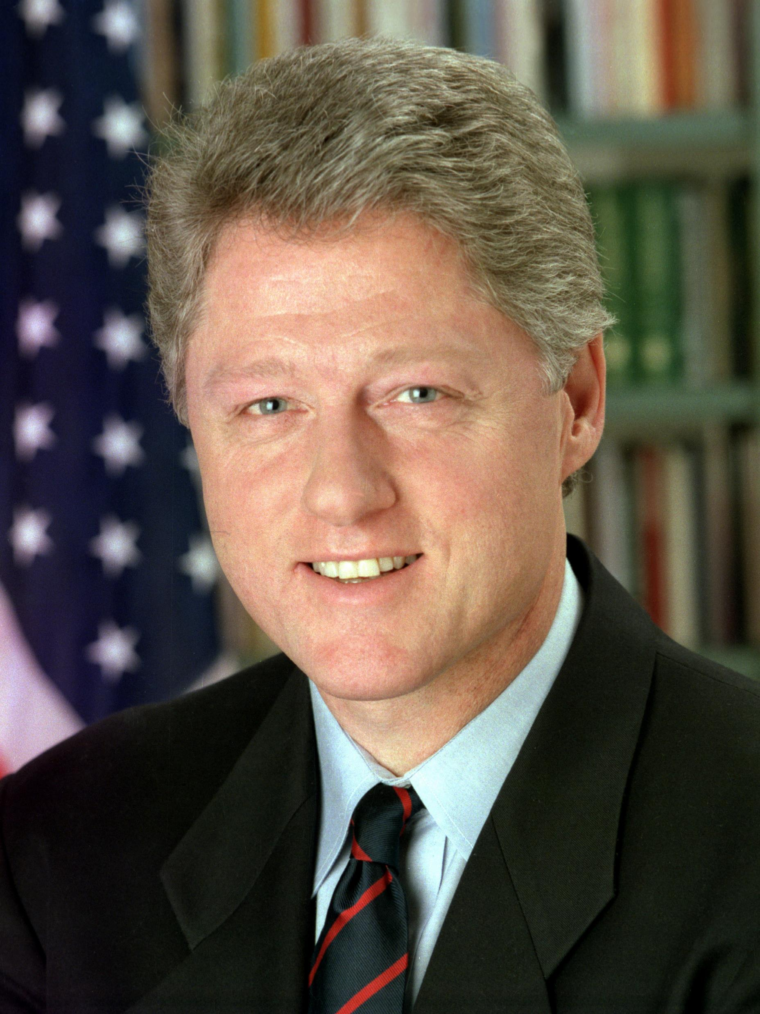
G. Restrictions
The ultimate check on the president is Congress’s power of impeachment – bringing charges against the president or another major federal official.
  Bill Clinton was impeached in 1998 but was acquitted as well.
Notes:
By Bob McNeely, The White House[1] - http://www.dodmedia.osd.mil/DVIC_View/Still_Details.cfm?SDAN=DDSC9304622&JPGPath=/Assets/Still/1993/DoD/DD-SC-93-04622.JPG, Public Domain, https://commons.wikimedia.org/w/index.php?curid=3164287
https://commons.wikimedia.org/w/index.php?sort=relevance&search=president+Bill+Clinton&title=Special:Search&profile=advanced&fulltext=1&advancedSearch-current=%7B%7D&ns0=1&ns6=1&ns12=1&ns14=1&ns100=1&ns106=1&searchToken=5n16hkhae0mdhj404yrmpqace#%2Fmedia%2FFile%3A44_Bill_Clinton_3x4.jpg

Slide 20
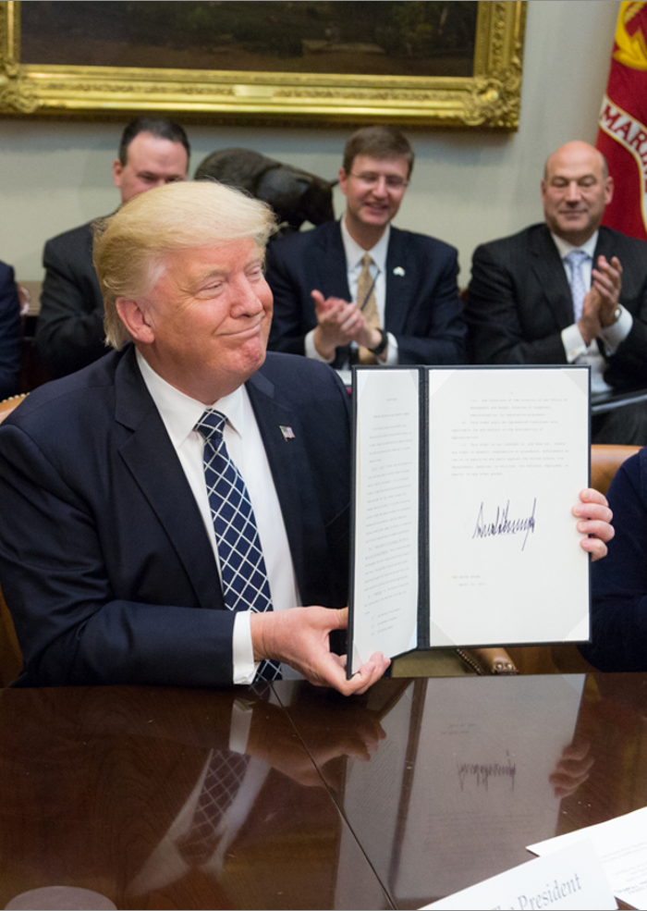
H. Additional Powers
The president has the power to issue executive orders – presidential directives having the force of law.
The president has the power to appoint individuals to fill positions in the executive branch.
Notes:
By Shealah Craighead - https://www.whitehouse.gov/blog/2017/04/27/president-trump-signs-executive-order-promoting-agriculture-and-rural-prosperity, Public Domain, https://commons.wikimedia.org/w/index.php?curid=58380071
https://commons.wikimedia.org/w/index.php?title=Special:Search&limit=500&offset=0&ns0=1&ns6=1&ns12=1&ns14=1&ns100=1&ns106=1&search=President+Donald+Trump&advancedSearch-current=%7B%7D&searchToken=5j2pdh04cus0firb04yu5bob#%2Fmedia%2FFile%3ADonald_Trump_displays_the_signed_Executive_Order_promoting_Agriculture_and_Rural_Prosperity.jpg

Slide 21
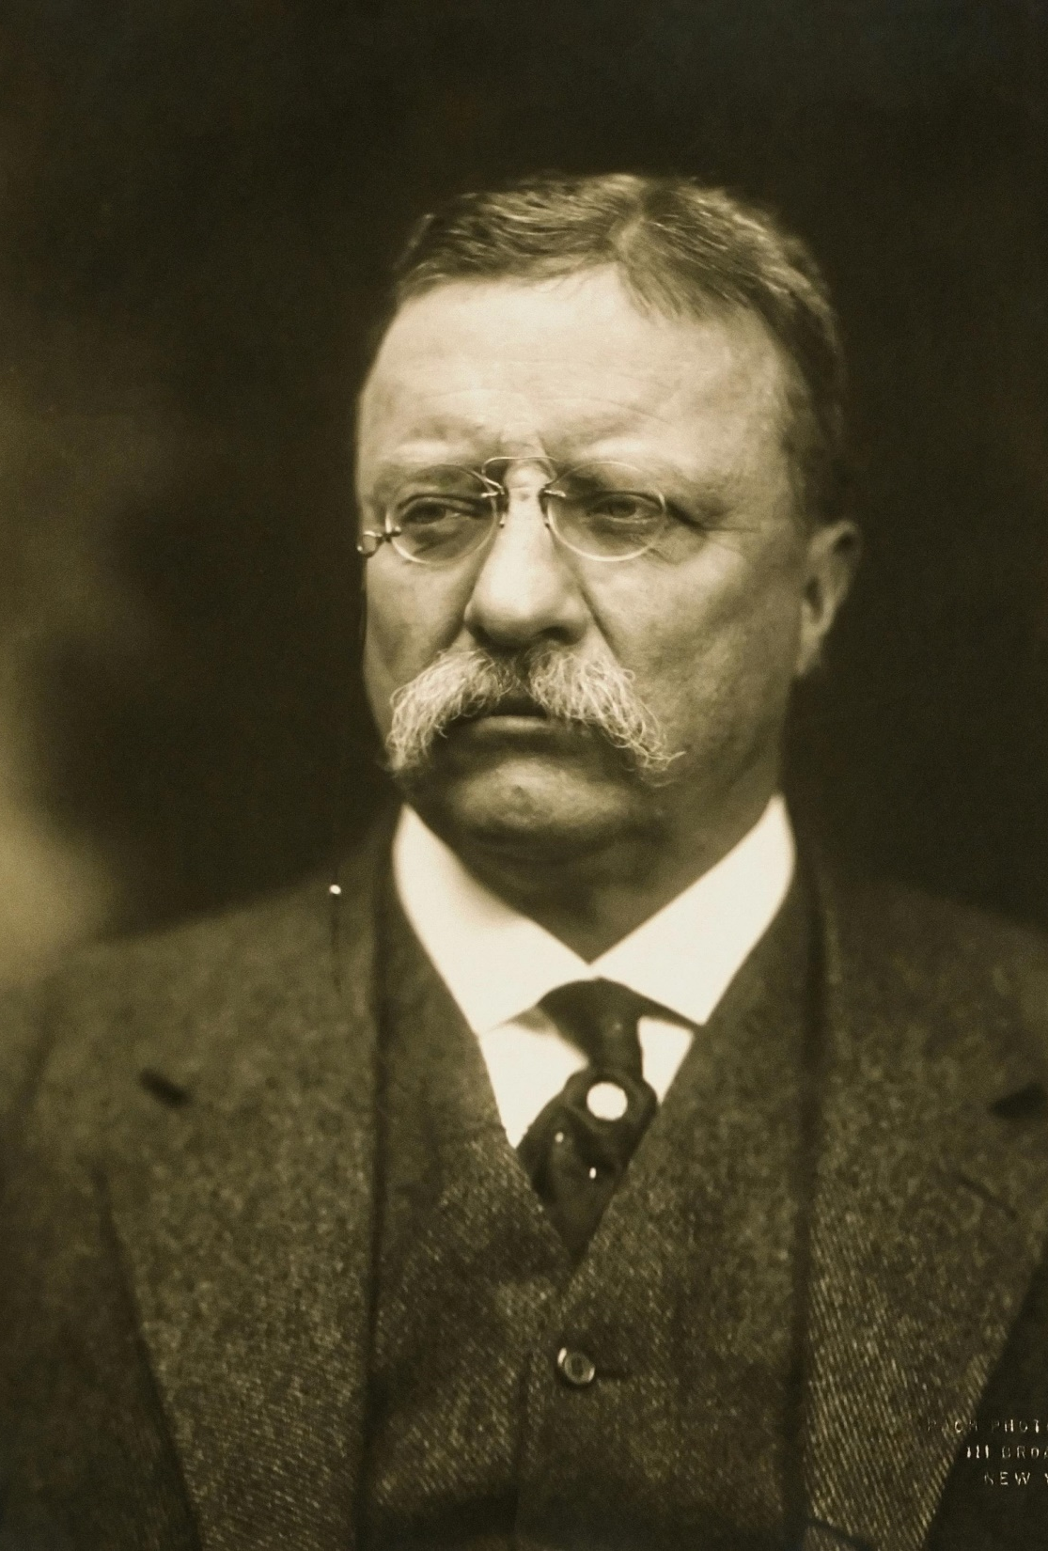
I. Use of Powers
Some presidents have been more passive, while others have been more active in using the powers of the president.
The Constitution gives the president many roles and responsibilities to carry out.
Notes:
By Pach Brothers (photography studio) - This image is available from the United States Library of Congress's Prints and Photographs division under the digital ID cph.3f06209. See Commons:Licensing for more information., Public Domain, https://commons.wikimedia.org/w/index.php?curid=179171
https://commons.wikimedia.org/w/index.php?sort=relevance&search=president+roosevelt&title=Special:Search&profile=advanced&fulltext=1&advancedSearch-current=%7B%7D&ns0=1&ns6=1&ns12=1&ns14=1&ns100=1&ns106=1&searchToken=8wug55sdc2d1o802mhgdmwvph#%2Fmedia%2FFile%3AT_Roosevelt.jpg

Slide 22
Section Review – Chapter 11.1
1. Explain the president’s responsibility to “faithfully execute” the nation’s laws.
The president enforces and administers the law through the various departments under his control and also administers a vast bureaucracy. (p. 249)

Slide 23
Section Review – Chapter 11.1
2–3. Distinguish between the president’s treaty-making powers and executive agreements.
Treaties must be ratified by a two-thirds vote of the Senate, but executive agreements do not require congressional approval. Executive agreements give the president more flexibility but are less permanent. (p. 252)

Slide 24
Section Review – Chapter 11.1
4–5. What is the difference between a regular veto and a pocket veto?
A regular veto occurs when a president refuses to sign a bill into law; it can be overridden by a two-thirds vote in both houses of Congress. A pocket veto occurs when the president leaves a bill unsigned for ten days during a congressional adjournment; it cannot be overridden. (p. 254)
6. Why was the Secret Service originally established?
to stop the counterfeiting of money (p. 257)

Slide 25
Section Review – Chapter 11.1
7. Explain the limits on how long a president can serve that were enacted in the Twenty-Second Amendment.
The Twenty-Second Amendment restricted the president to two terms. A vice president who succeeds to the presidency to finish an uncompleted term may not exceed a total of ten years as president (up to two years of his predecessor’s term plus two full terms of his own). (p. 258)

Slide 26
Section Review – Chapter 11.1
8–10. Who were the only two presidents ever to be impeached? For what constitutional reason were they not removed from office?
Andrew Johnson and Bill Clinton; two-thirds of the Senate did not vote to convict either president (pp. 259–260)

Slide 27
Section Review – Chapter 11.1
How did the various State of the Union addresses mentioned in this chapter differ? Why do you think they differed?
Washington’s address was the shortest. Jefferson sent a written message to Congress, and that tradition continued until 1913 when Woodrow Wilson reinstated delivering the address in person. Clinton’s address was the longest. The various addresses reflect the presidents’ personalities and the circumstances at the time of their speeches.

Slide 28
Section Review – Chapter 11.1
When is the president considered a lame duck? What does this mean?
A president is considered a lame duck when he has lost an election or is ineligible for reelection and yet must serve the remainder of his term. The term lame duck describes the president’s decreased effectiveness with Congress because he cannot gather widespread support for a future election.

Slide 29
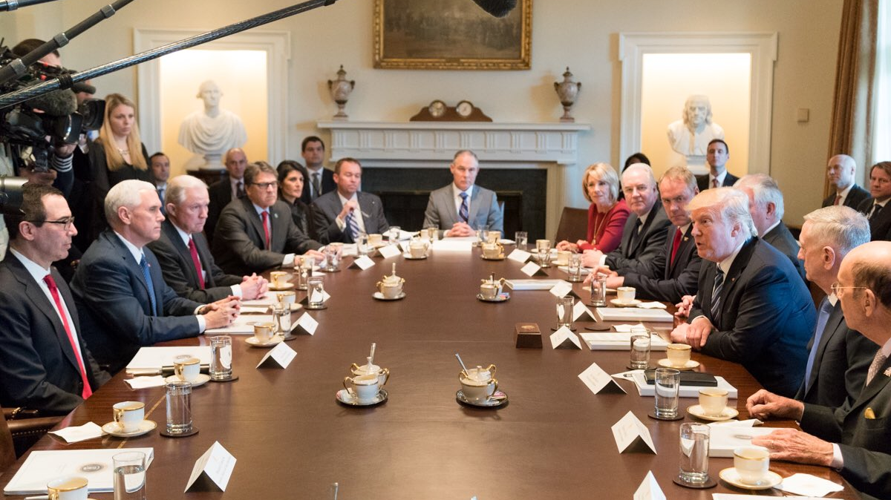
II. Executive Organization
Chapter 11.2
Notes:
By Office of the President of the United States - @realDonaldTrump on Twitter, Public Domain, https://commons.wikimedia.org/w/index.php?curid=57074297
https://commons.wikimedia.org/w/index.php?sort=relevance&search=donald+trump+cabinet&title=Special:Search&profile=advanced&fulltext=1&advancedSearch-current=%7B%7D&ns0=1&ns6=1&ns12=1&ns14=1&ns100=1&ns106=1&searchToken=b943isd2f3g2fibhaahpq9u77#%2Fmedia%2FFile%3ADonald_Trump_Cabinet_meeting_2017-03-13_04.jpg

Slide 30
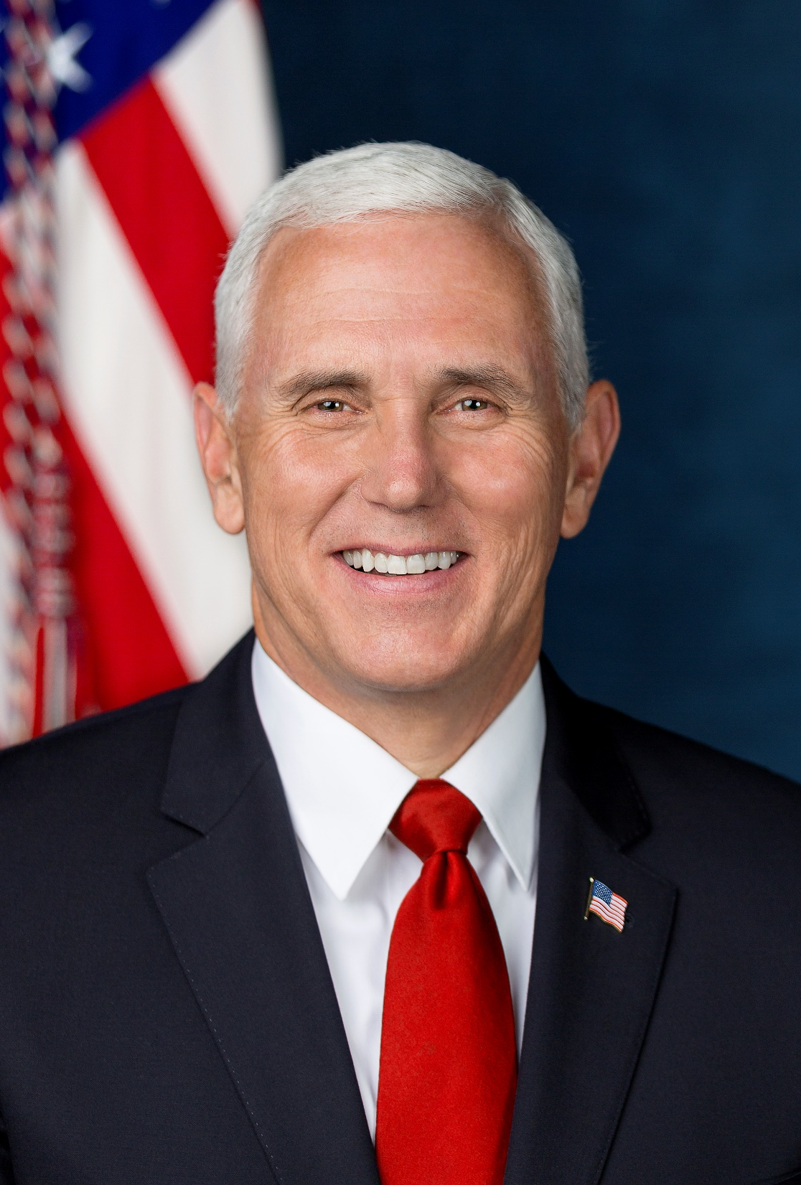
A. Vice President
The Constitution lists two responsibilities of the vice-president:
  Serve as president of the Senate, only voting if there is a tie
  Succeed the president if he is unable to carry out his duties
Recently, the vice president has assumed greater responsibility and leadership roles.
Notes:
By D. Myles Cullen - White House, Public Domain, https://commons.wikimedia.org/w/index.php?curid=63768461
https://commons.wikimedia.org/w/index.php?sort=relevance&search=mike+pence&title=Special:Search&profile=advanced&fulltext=1&advancedSearch-current=%7B%7D&ns0=1&ns6=1&ns12=1&ns14=1&ns100=1&ns106=1&searchToken=bxu2pncrdp7vepgejzv2g1710#%2Fmedia%2FFile%3AMike_Pence_official_Vice_Presidential_portrait.jpg

Slide 31
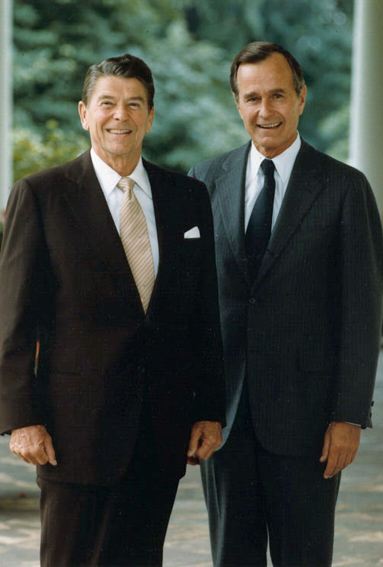
A. Vice President
The Twenty-Fifth Amendment requires any vice-presidential vacancy to be filled by a presidential appointment and confirmed by Congress.
This amendment also clarified that a vice president who succeeds the president has the full power and position of president.
Notes:
By staff - http://www.reagan.utexas.edu/archives/photographs/official.html, Public Domain, https://commons.wikimedia.org/w/index.php?curid=257857
https://commons.wikimedia.org/w/index.php?sort=relevance&search=bush+and+reagan&title=Special:Search&profile=advanced&fulltext=1&advancedSearch-current=%7B%7D&ns0=1&ns6=1&ns12=1&ns14=1&ns100=1&ns106=1&searchToken=5hyurfr5benwjpn1ym92wh0vb#%2Fmedia%2FFile%3AOfficial_portrait_of_President_Reagan_and_Vice_President_Bush_1981.jpg

Slide 32
A. Vice President
Vice presidents can temporarily take on the duties of president if the president is incapacitated for a brief period.
Notes:
By staff - http://www.reagan.utexas.edu/archives/photographs/official.html, Public Domain, https://commons.wikimedia.org/w/index.php?curid=257857
https://commons.wikimedia.org/w/index.php?sort=relevance&search=bush+and+reagan&title=Special:Search&profile=advanced&fulltext=1&advancedSearch-current=%7B%7D&ns0=1&ns6=1&ns12=1&ns14=1&ns100=1&ns106=1&searchToken=5hyurfr5benwjpn1ym92wh0vb#%2Fmedia%2FFile%3AOfficial_portrait_of_President_Reagan_and_Vice_President_Bush_1981.jpg

Slide 33
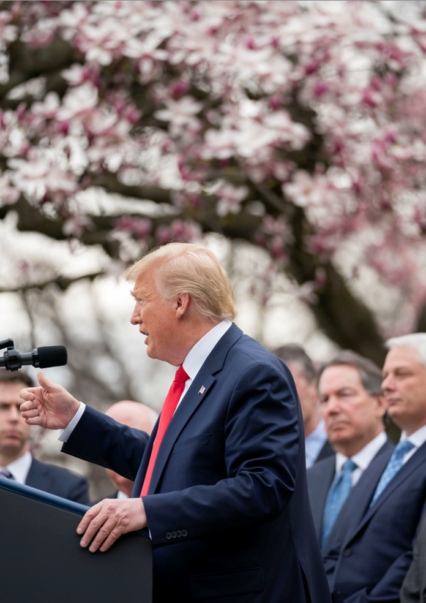
B. The Executive Office of the President
In 1939, the Executive Office of the President (EOP) was created to help develop and implement the president’s programs and policies.
The White House Office (part of the EOP) includes 400 members such as press secretary, legal advisor and physician.
Notes:
By The White House - https://www.flickr.com/photos/148748355@N05/49658697563/, Public Domain, https://commons.wikimedia.org/w/index.php?curid=88085914
https://commons.wikimedia.org/w/index.php?title=Special:Search&limit=500&offset=0&ns0=1&ns6=1&ns12=1&ns14=1&ns100=1&ns106=1&search=The+Executive+Office+of+the+President&advancedSearch-current=%7B%7D&searchToken=77xoxqmfe6tuy0b0j5duo3z6h#%2Fmedia%2FFile%3APresident_Trump_Holds_a_News_Conference_on_the_Coronavirus_-_49658697563.jpg

Slide 34
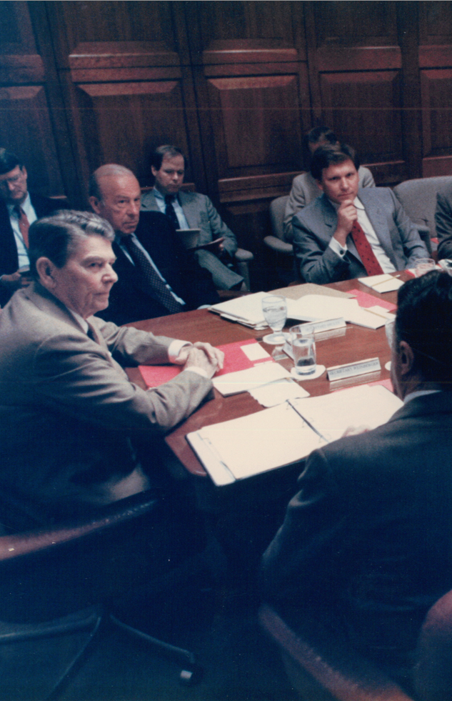
B. The Executive Office of the President
The National Security Council (NSC) plays an important role in intelligence gathering, policy formation, and crisis management.
The Office of Management and Budget (OMB) prepares the nation’s annual budget for Congress.
Notes:
By RepubFan12, CC BY-SA 3.0, https://commons.wikimedia.org/w/index.php?curid=54702797
https://commons.wikimedia.org/w/index.php?title=Special:Search&limit=500&offset=0&ns0=1&ns6=1&ns12=1&ns14=1&ns100=1&ns106=1&search=National+Security+Council&advancedSearch-current=%7B%7D&searchToken=bjou3ql923fzc74n408ds3vrs#%2Fmedia%2FFile%3AWilliam_Flynn_Martin_at_National_Security_Council_meeting.jpg

Slide 35
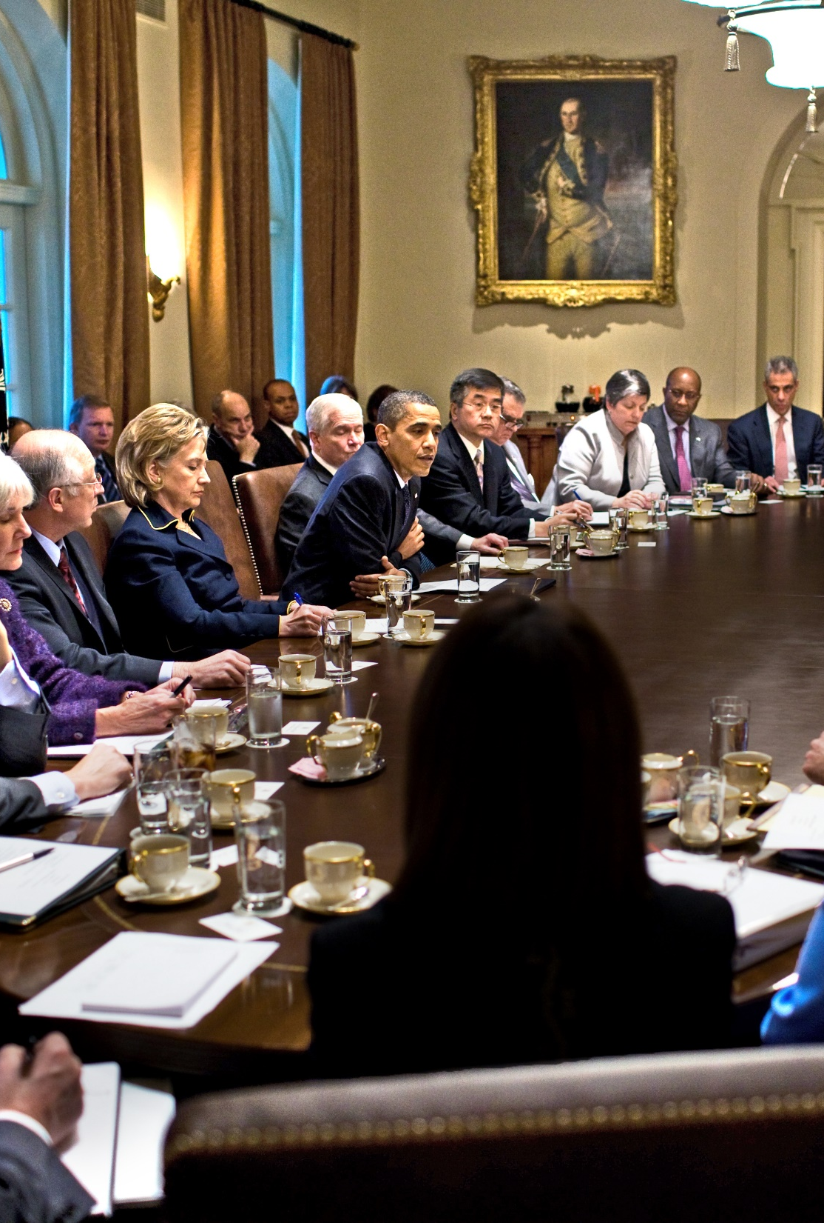
C. The Cabinet
The cabinet offices of the executive branch were developed to assist the president in his constitutional duties.
Cabinet secretaries are responsible to the president for the departments that they head.
Notes:
By White House (Pete Souza) / Maison Blanche (Pete Souza) - The Official White House Photostream [1], Public Domain, https://commons.wikimedia.org/w/index.php?curid=8760182
https://commons.wikimedia.org/w/index.php?sort=relevance&search=president+clinton+cabinet&title=Special:Search&profile=advanced&fulltext=1&advancedSearch-current=%7B%7D&ns0=1&ns6=1&ns12=1&ns14=1&ns100=1&ns106=1&searchToken=1d449qhi9a4fvav02zbhf1q6v#%2Fmedia%2FFile%3AObama_cabinet_meeting_2009-11.jpg

Slide 36
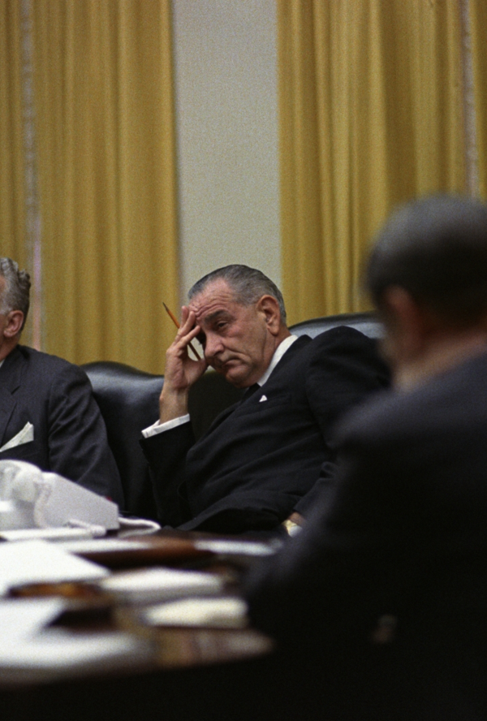
D. Administrative Agencies
More than fifty agencies and service commissions exist under the cabinet departments managing a wide variety of concerns.
The directors of these agencies are nominated by the president and confirmed by the Senate.
Notes:
Public Domain, https://commons.wikimedia.org/w/index.php?curid=1441972
https://commons.wikimedia.org/w/index.php?title=Special:Search&limit=500&offset=0&ns0=1&ns6=1&ns12=1&ns14=1&ns100=1&ns106=1&search=president+cabinet&advancedSearch-current=%7B%7D&searchToken=7otm1sy6htskm61148d0so12c#%2Fmedia%2FFile%3ANSC_meeting_15_09_1966.jpg

Slide 37
Section Review – Chapter 11.2
1–3. What are the two responsibilities that the Constitution places on the vice president? Identify duties that have been added to those responsibilities.
He is to succeed the president if the president dies, resigns, or becomes incapacitated. He presides over the Senate, where he can vote only to break a tie. Added extraconstitutional responsibilities include representing the president at various state functions, such as funerals for heads of state;

Slide 38
Section Review – Chapter 11.2
1–3. What are the two responsibilities that the Constitution places on the vice president? Identify duties that have been added to those responsibilities.
making speeches in support of administration-favored policies; and helping members of the president’s party get elected to office. He also serves on the National Security Council and leads presidential commissions. (p. 267)

Slide 39
Section Review – Chapter 11.2
4–5. What is the EOP? What is its function?
The Executive Office of the President consists of White House offices and agencies that help develop and implement presidential programs and policies. (pp. 269–270)

Slide 40
Section Review – Chapter 11.2
6–7. What are the two primary agencies of the EOP?
Its two primary agencies are the National Security Council (NSC) and the Office of Management and Budget (OMB).
(p. 270)

Slide 41
Section Review – Chapter 11.2
Do you think the Twenty-Fifth Amendment was needed? Why or why not?
Some will say the amendment was needed to provide a process for a new vice president when that position was vacated. Others may say that it is fine to have a vacant position rather than to fill it with someone who was not elected.

Slide 42
Section Review – Chapter 11.2
How do cabinet offices assist the president in the performance of his duties?
The cabinet members advise the president and head the various departments of the executive branch.

Slide 43
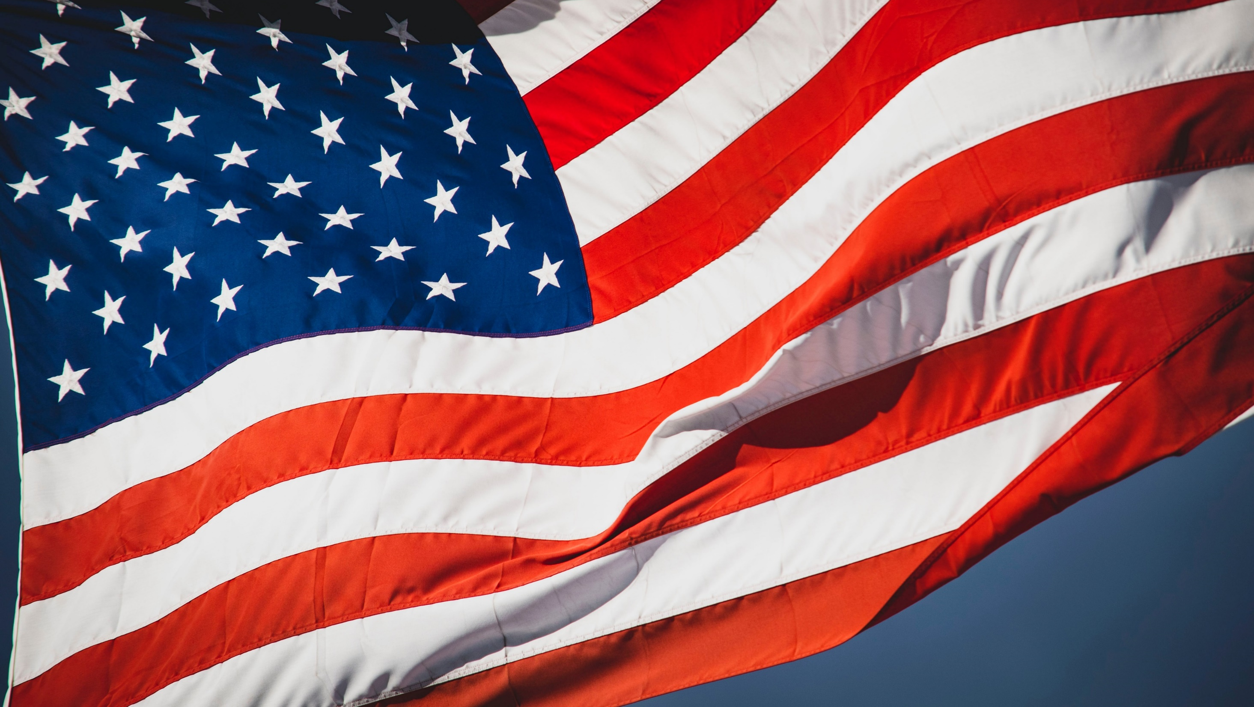
III. Governing Wisely
Chapter 11.3
Notes:
Photo by Jon Sailer on Unsplash
https://unsplash.com/photos/8JYxCF00X3Y

Slide 44
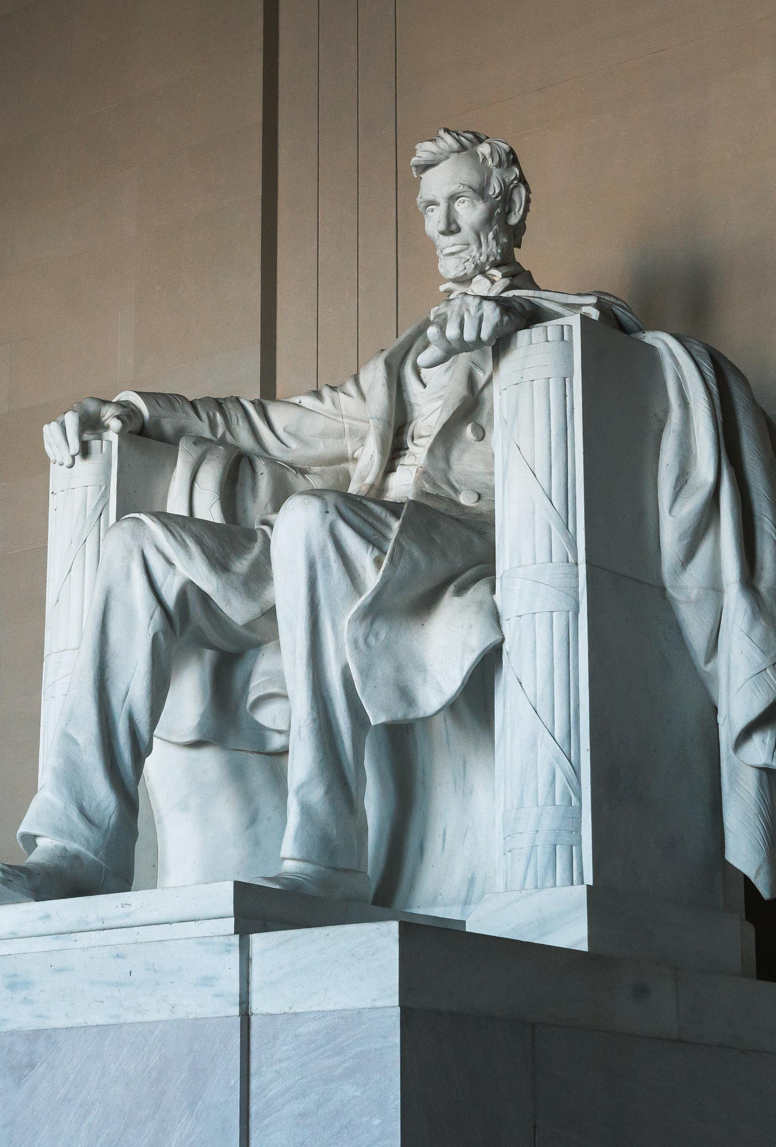
A. Avoiding Pitfalls
Presidents must be careful not to let the power of their position divert them from the just use of their authority.
Any president who wants to rule well must seek wisdom beyond himself – which only comes from God.
Notes:
Photo by Josue Aguazia on Unsplash
https://unsplash.com/photos/3l8YJ9_on5Q

Slide 45
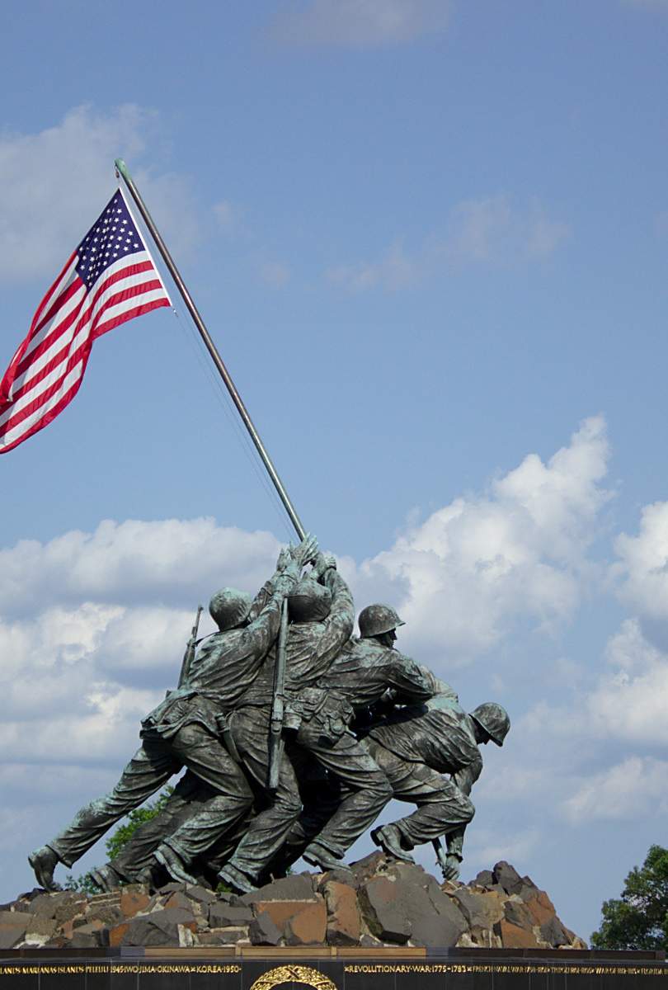
B. Assessing Presidents
Great presidents have been clear about their goals.
They have successfully met the challenge of national crises.
Good presidents avoid choosing incompetent or corrupt advisors.
Notes:
By Brandon Sorensen - Imported from 500px (archived version) by the Archive Team. (detail page), CC BY 3.0, https://commons.wikimedia.org/w/index.php?curid=71314118
https://commons.wikimedia.org/w/index.php?sort=relevance&search=iwo+jima+memorial&title=Special:Search&profile=advanced&fulltext=1&advancedSearch-current=%7B%7D&ns0=1&ns6=1&ns12=1&ns14=1&ns100=1&ns106=1&searchToken=cr9a0rx9g2yp6d2rwwfc2q7c9#%2Fmedia%2FFile%3AIwo_Jima_Memorial_%2829680035%29.jpeg

Slide 46

B. Assessing Presidents
How presidents are ranked depends on who is passing judgement and what their political philosophy is like.
Popularity is not the same as greatness.
Greatness comes through following Christ’s example.
Notes:
Photo by Aaron Burden on Unsplash
https://unsplash.com/photos/9zsHNt5OpqE

Slide 47
Section Review – Chapter 11.3
1. Describe the pitfalls each president faces.
the tendency to use powers illegally and immorally or to allow attention he receives to divert him from using his authority justly
(p. 271)
2–3. What is the difference between popularity and greatness?
Popularity means having many people’s favor, and it does not usually last very long. In contrast, greatness transcends popular acclaim and focuses on immortal things. True greatness comes through giving, serving, and following Christ’s example.
(pp. 271–272)

Slide 48
Section Review – Chapter 11.3
Who do you think are the five greatest presidents? Explain your choices.
Who do you think was the worst president? Why?

