Slide 2
Latin America has two main subregions: Middle America and South America.

Slide 3
Throughout history, there has been much conflict for control of Middle America.
The United States has tried to use its influence in the region.

Slide 4
I. Mexico

Slide 5
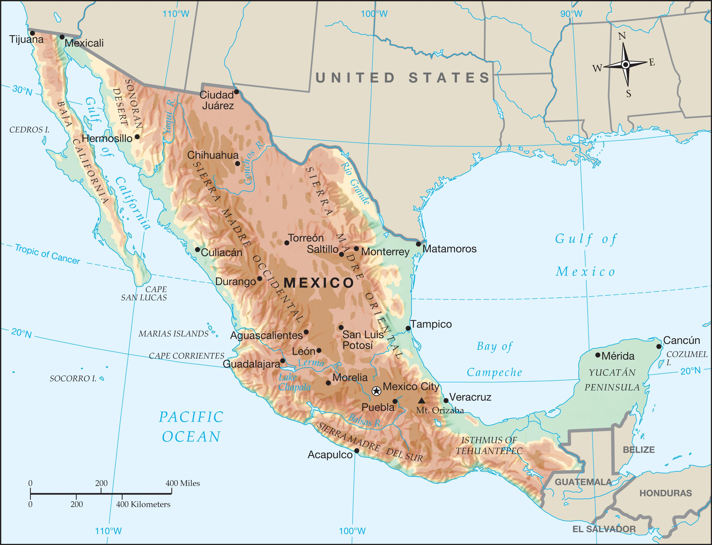

Slide 6
Mexico- The largest Spanish speaking population in the world
Southern tip of the spout curves N and E to form the Yucatan Peninsula
A. Northern Mexico
1. Geography and climate
2. Deserts, Mines, and Ranches of the Northern Plateau

Slide 7
The Sierra Madre Occidental is a dominant feature of this region.
The state of Chihuahua- the largest state is named after the desert.

Slide 8
3. Oil and Tourism on the Gulf
a. Gulf Coastal Plain- States have grown in importance since the discovery of oil in the Gulf
b. Veracruz
c. Tourism- Cancun on the tip of the Yucatan Peninsula is a major tourist place

Slide 9
4. Gulf of California
B. Mesa Central- most of Mexico is too dry for farming
1. Mexican Plateau- Guadalajara is the 3rd largest Mexican city
2. Altitude zones
3. Location of Mexico City

Slide 10
4. Conquest of the Aztec Capital- Hernando Cortez aided by tribes who hated the Aztecs conquered the Aztecs.
5. The Seat of Government
a. History of Revolt- Mestizos- people of mixed Indian and Spanish Ancestry
b. Reforms Since the Revolution- Constitution of 1917 created a government like the US, but Mexico has not always been a true republic

Slide 11
Southern Mexico has a rainy season and a dry season.

Slide 12
C. The Southern Tropics
1. Poverty of the Southern Highlands
a. Tarascan Indians
b. Chiapas-Southernmost state. 1/3 of people are full-blooded Indians. Few speak Spanish.

Slide 13
2. Mayas in the Yucatán- most famous ruin is Chichen Itza.
3. A Religious Nation

Slide 14
D. U.S.–Mexican Relations
1. Exchange of cultures
2. Exchange of goods
3. Poor past relationship
4. Current concerns
5. NAFTA

Slide 15
II. Central America

Slide 16
Central America is very similar to southern Mexico.
A plantation economy was introduced by Europeans.

Slide 17
II. Central America
A. Lands of the Mayas- most famous because they left written records.
1. Guatemala- center of Mayan Civilization.
Highest population in Central America. Guatemala city largest city in C.A. 30% are Protestant.
2. Belize- settled by British. Has smallest population
3. El Salvador- Volcanoes
Smallest area in Central America

Slide 18
4. Honduras- Major crop is bananas.
Called a banana republic because they rely on one crop
5. Nicaragua- Largest country in C.A.
6. Costa Rica- means rich coast.
1st to grow coffee in C.A.
7. Panama- Most developed C.A. country.
Called “Crossroads of the World.” Canal cuts the distance by 2/3rds.

Slide 19
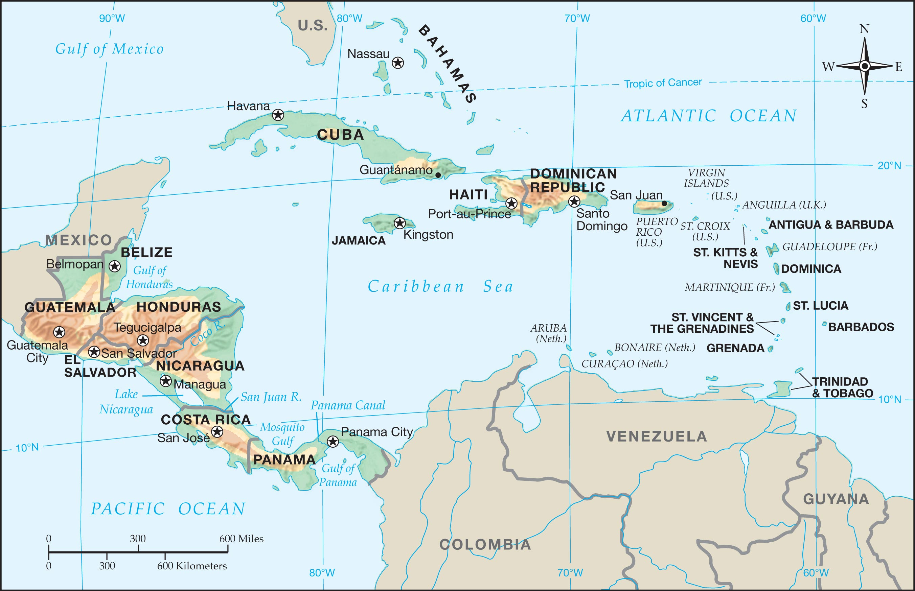

Slide 20
III. The West Indies

Slide 21
The West Indies fall into three main groups: the Bahamas, the Greater Antilles, and the Lesser Antilles.

Slide 22
III. The West Indies
A. The Bahamas- an independent member of the British Commonwealth
B. The Greater Antilles
1. Cuba- Spain lost in the Spanish- American War
a. Sugar, tobacco (cigars)
b. Communism- Fell to Fidel Castro in 1959. Ist Communist government in Western Hemisphere
Havana (capital) was a thriving commercial center during democracy

Slide 23
2. Hispaniola- Haiti west, Dominican Republic east
a. Haiti- Speak Creole- mix of French and African words
b. Dominican Republic
3. Jamaica- Port Royal- once a haven for pirates
4. U.S. Commonwealth of Puerto Rico- commonwealth of the US. American citizens but cannot vote in Pres elections.

Slide 24
The Lesser Antilles form the eastern boundary of the Caribbean Sea.
Tourism, fishing, and farming are the main economic activities.

Slide 25
C. The Lesser Antilles
1. Leeward Islands
2. Windward Islands
3. Outlying Lesser Antilles

