Slide 2
The geographic features of South America have tended to isolate people groups.

Slide 3
Pope Alexander VI drew a line to divide the world between Spain and Portugal the result was that Portugal got Brazil.

Slide 4
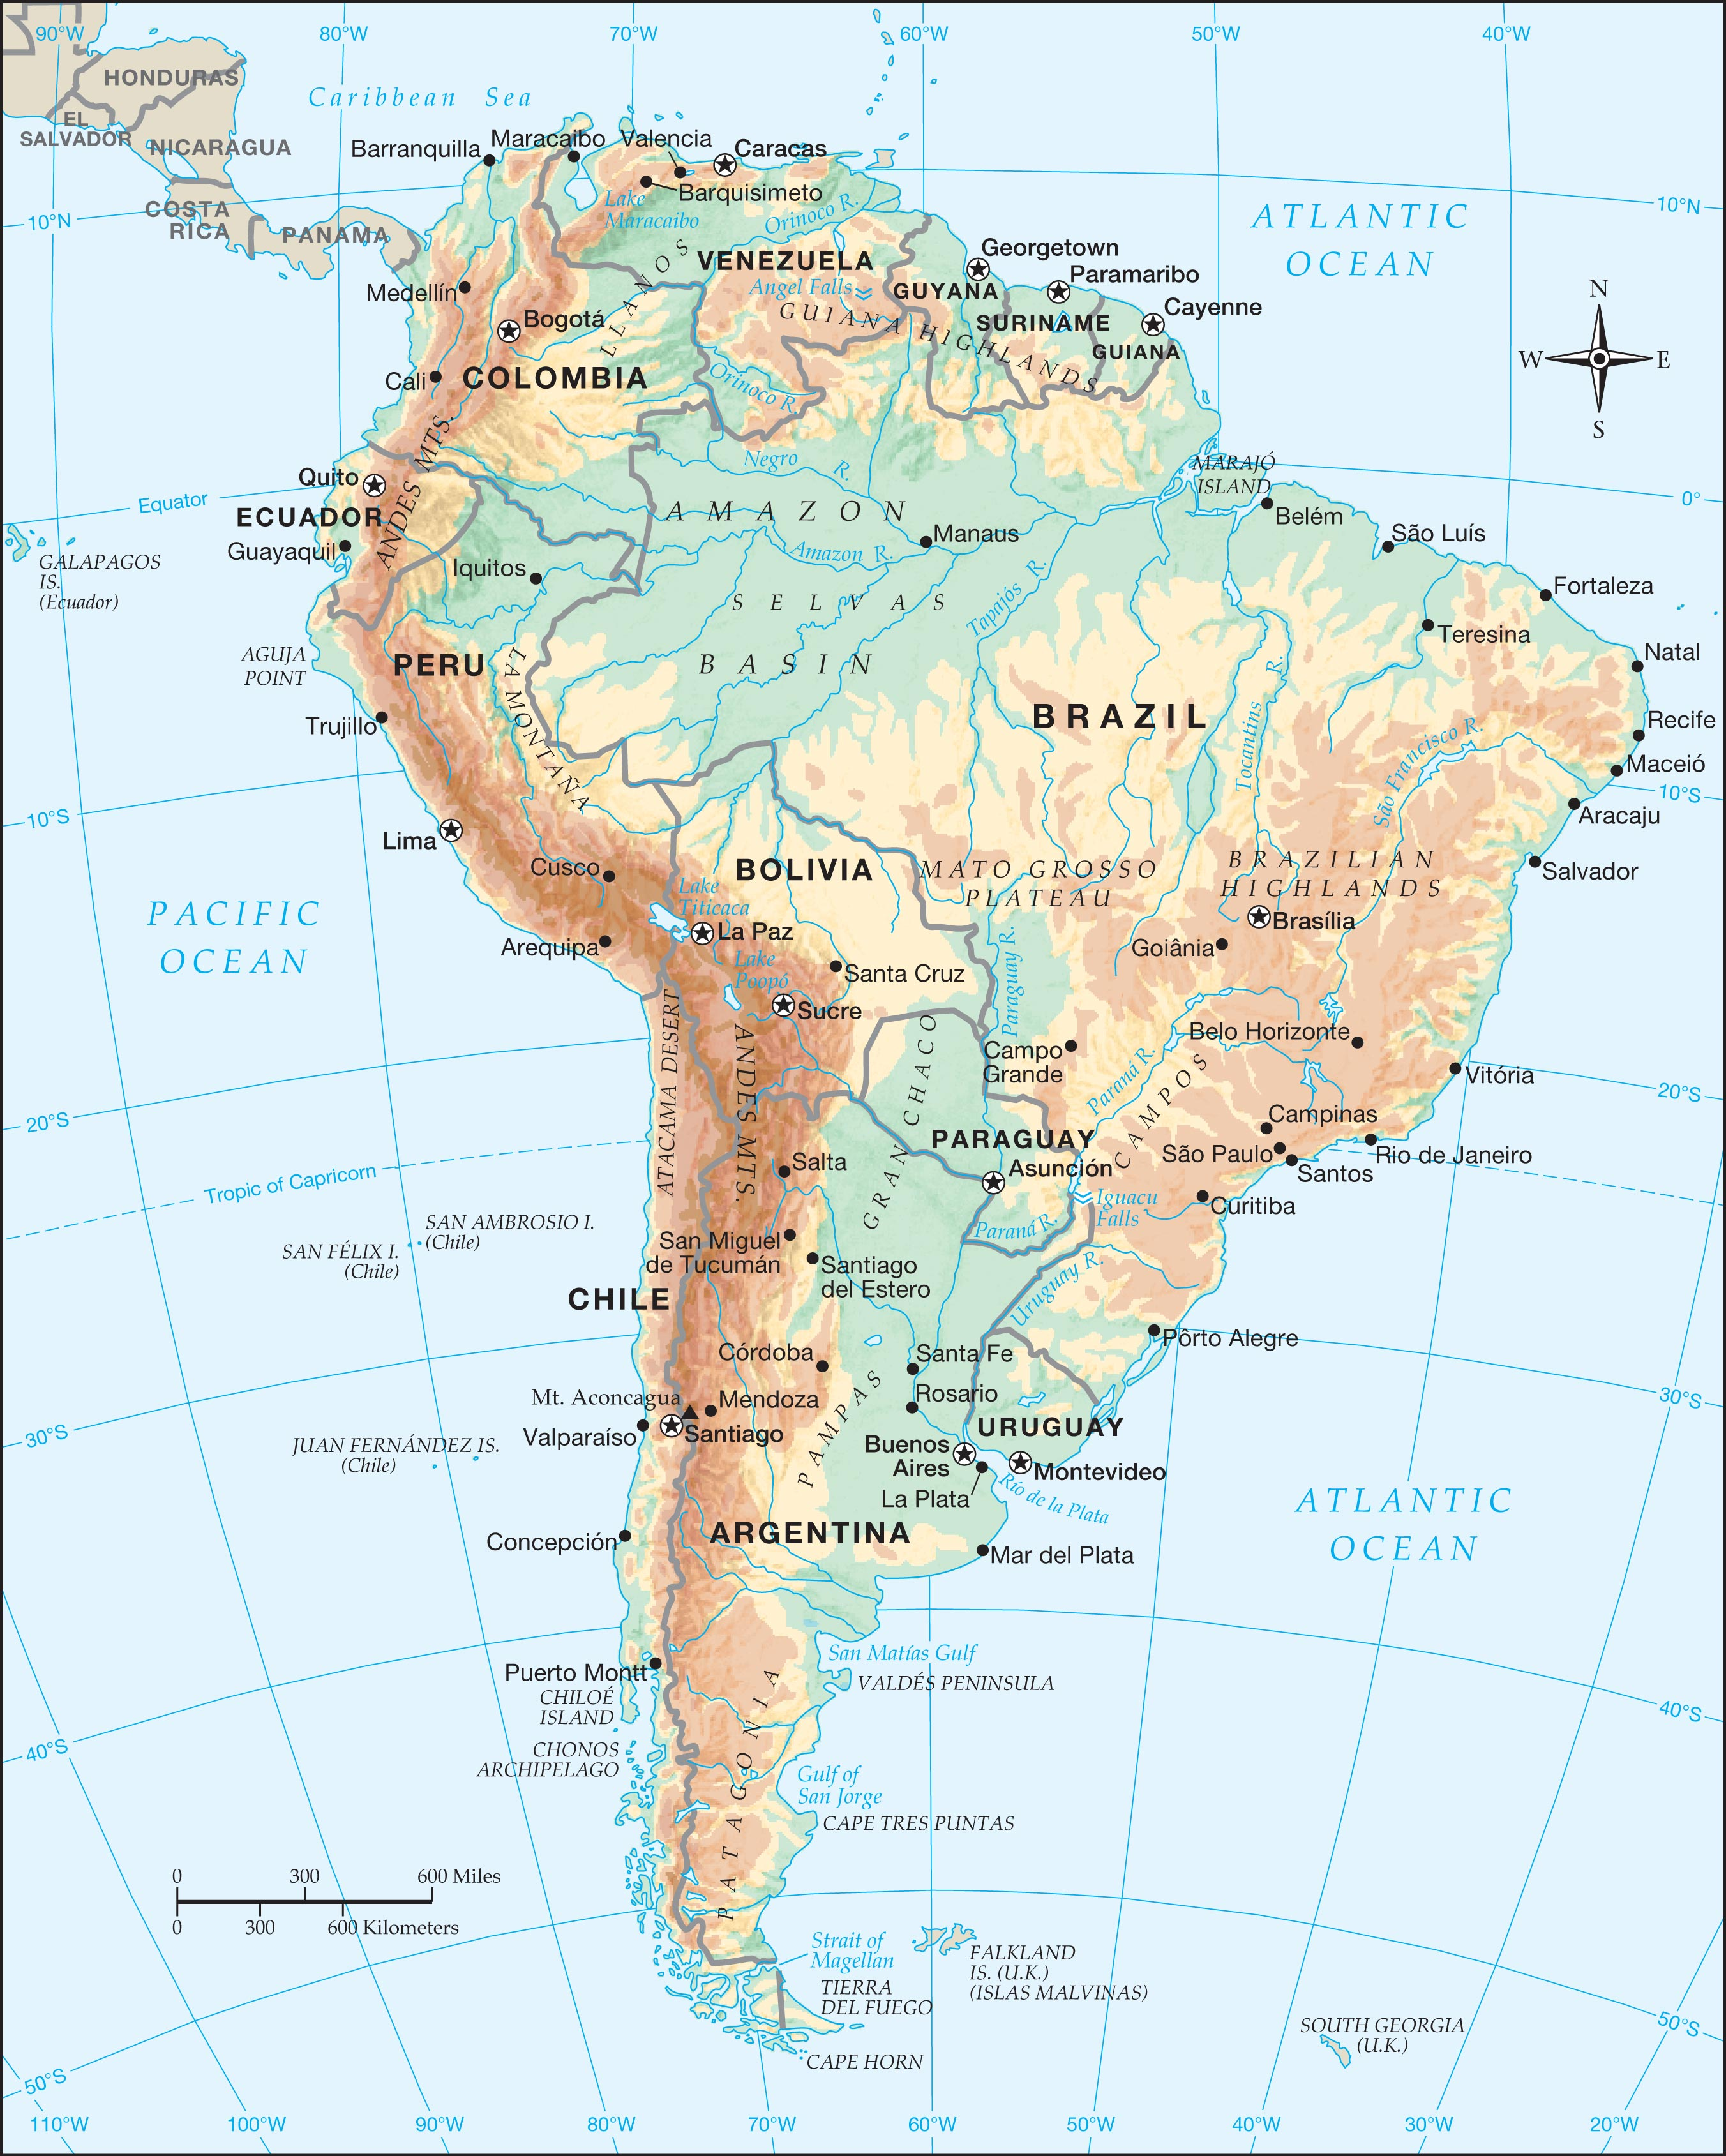

Slide 5
I. The Caribbean Countries

Slide 6
Simón Bolívar became the greatest hero of Latin America.
People are descendants from native Indians, Spanish, and African slaves

Slide 7
I. The Caribbean Countries
A. Colombia- 100 mile border with Panama connects it to N. America
1. Caribbean and Pacific Lowlands- coasts on both sides
2. The Mountainous Interior- Cordillera Oriental reaches into Venezuela
a. Capital: Bogatá
b. Llanos- broad grassy plains that make up 60% of Columbia.

Slide 8
B. Venezuela
1. Coastal Mountains
2. The Interior Wilderness

Slide 9
II. The Guiana Highlands

Slide 10
The Guiana Highlands are the rugged plateau that separates the Caribbean coast from the Amazon Basin.
Three European countries founded colonies known as the Guianas.

Slide 11
II. The Guiana Highlands
A. Guyana- British. Huge block shaped mountains called tepuis
B. Suriname- formerly Dutch Guiana
C. Guiana (formerly French Guiana)- Only country in South America still under European control.

Slide 12
III. The Andean Countries

Slide 13
The Andes Mountains are the highest mountains in the Western Hemisphere.

Slide 14
III. The Andean Countries
A. Ecuador- means equator
1. Capital: Quito
2. Cotopaxi- one of the highest active volcanoes in the world
3. Galapagos Islands

Slide 15
B. Peru
1. Highest railroad, deepest canyons, highest mines
2. Children of the Sun
a. Incas
b. Speak Quechua- most widely spoken native language in South America
c. Built Machu Picchu- last refuge of the Incas

Slide 16
3. Desert Coasts
a. Peru Current keeps the air cold and dry.
b. Pizarro established the capital at Lima
4. Llamas
a. Camels of the Western Hemisphere
b. Have no humps

Slide 17
C. Bolivia
1. The Altiplano- High Plain
a. Lake Titicaca- 2nd largest lake in S.A.
b. La Paz- world’s highest capital
2. The Yungas and the Eastern Lowlands

Slide 18
D. Chile
1. The Atacama Desert- Driest desert on earth. Deposits of sodium nitrate.
2. The Central Valley- Santiago is the capital. One of the most successful countries in S.A. Augusto Pinochet introduced free market reforms.

Slide 19
3. The Archipelago
a. below S. tip is Strait of Magellan
b. Drake Passage separates Cape Horn from Antarctica

Slide 20
IV. The Río de la Plata

Slide 21
The Río de la Plata is an estuary on the Atlantic coast.

Slide 22
IV. The Río de la Plata
A. Argentina- Juan Peron led the country into economic ruin.
1. The Pampas- the low lying area around the Rio de la Plata. Buenos Aires is the capital.
2. The Andes Border
3. Patagonia
4. Northern Argentina

Slide 23
B. Uruguay
1. Capital: Montevideo
2. Population is mostly of European
descent

Slide 24
C. Paraguay
1. Capital: Asuncíon
2. Bilingual

Slide 25
V. Brazil

Slide 26
Brazil is the fifth-largest nation in the world, and the fifth-most populous.

Slide 27
V. Brazil
A. The Atlantic Coast
1. Portuguese Settlers
2. Independence- Dom Pedro declared independence and became their king.

Slide 28
3. Modern Coastal Cities
a. Cities in the South
b. Life on the Northeast Coast

Slide 29
B. The Brazilian Highlands
1. Cities in the South
2. Poverty of the Northeast
3. Brasilia- capital
4. Iguacu Falls- the widest waterfall in the world

Slide 30
C. The Amazon- drains the largest area
1. Life of the Remote Indians
2. Modern Development and Deforestation
3. Leaching- constant rains dissolve nutrients and carry them away.

