Slide 1
Unit III: Nation (1801–1861)
1811
Battle of Tippecanoe
1820
Missouri Compromise
1803
Louisiana Purchase
1812–15
War of 1812
1823
Monroe Doctrine proclaimed
1800
1810
1820
ca. 1800–ca. 1825
Second Great Awakening
1828
The “Tariff of Abominations”

Slide 2
1845
The Annexation of Texas
1836
Texas independence
1846
The Oregon controversy settled
1857–59
Prayer Meeting Revival
1830
1840
1850
1846–48
Mexican War

Slide 3
Chapter 9: The Jeffersonian era

Slide 4
Big Ideas
How did the Jeffersonian Republican and the Federalist political philosophies differ?
Did Jefferson effectively deal with foreign powers?
What was the significance of the Fallen Timbers campaign?
What were the causes of the War of 1812?
What was America’s foreign policy under President Monroe?

Slide 5
THE JEFFERSONIAN ERA
On March 4, 1801, Thomas Jefferson took the oath of office as the third president of the United States.
The administrations of Jefferson, Madison, and Monroe constitute the era of Jeffersonian Republicanism (1801–25).
Thomas Jefferson
Notes:
https://www.whitehouse.gov/photos-and-video/photogallery/official-portraits-us-presidents; Portrait of Thomas Jefferson by Rembrandt Peale, 1800/whitehouse.gov/Public Domain

Slide 6
The Revolution of 1800

Slide 7
Guiding questions
What were the political views of the Jeffersonian Republicans?
What were the political views of the Federalists?
How did the policies of the Republican-dominated branches of government differ from the Federalist-dominated judicial branch?
How did Supreme Court decisions during this period affect the nation?

Slide 8
Nature of Jeffersonian Republicanism
Farmers were the basis of the country.
Man was essentially good.
A world of small governments without standing armies or debts was the ideal.
Leadership should govern with the common man in mind.

Slide 9
Making Changes
The Republicans repealed the Judiciary Act of 1801 and let the Alien and Sedition Acts expire.
Congress adopted the Twelfth Amendment, which enabled electors to cast separate ballots for president and vice president.
Jefferson wanted to reduce taxes and eliminate the national debt.

Slide 10
John Marshall and the Supreme Court
The Supreme Court remained under Federalist control, and its first great chief justice was John Marshall.
The Marshall Court upheld the authority of the national government and increased the scope of the Court’s authority.
John Marshall
Notes:
American Government 3rd/302; “John Marshall by Henry Inman, 1832”/Wikimedia Commons/Public Domain

Slide 11
Marbury v. Madison
The first major case before the Marshall Court involved the Judiciary Act of 1801.
James Madison refused to deliver William Marbury’s commission.
In Marbury v. Madison the Supreme Court established the principle of judicial review, the right of the Court to declare a law unconstitutional.
William Marbury
Notes:
US History 5th/161b; Rembrandt Peale, Collection of the Supreme Court of the United States

Slide 12
Gibbons v. Ogden
Another important ruling protected the federal government’s delegated powers.
This case involved the right to regulate interstate commerce.
In Gibbons v. Ogden the Court ruled that the delegated powers given to the national government by the Constitution could not be limited by state boundaries.

Slide 13
McCulloch v. Maryland
Perhaps the most far-reaching decision of the Marshall Court was McCulloch v. Maryland (1819).
The state of Maryland opposed the idea of a national bank and tried to tax the Baltimore branch of the Bank of the United States out of existence.
The Court overruled the state’s action.
“Necessary and proper” powers that enable the government to carry out the delegated powers are called implied powers.

Slide 14
Section review
How did the Federalists and the Republicans disagree concerning the power of the central government?
The Federalists wanted a strong central government, whereas the Republicans wanted a weaker one. (p. 160)
What is judicial review?
the right of the Supreme Court to declare a law unconstitutional (p. 161)

Slide 15
Section review
List three important court cases in which the Marshall Court ruled. Each case established a different long-range principle. Identify those principles.
Marbury v. Madison established the principle of judicial review; Gibbons v. Ogden protected the federal government’s constitutionally delegated powers from state interference; McCulloch v. Maryland protected the government’s right to enact laws that are “necessary and proper” to carry out its delegated powers. (pp. 161–62)

Slide 16
Section review
Assess whether or not Jefferson’s election was truly a “revolution.”
There was no wholesale rejection or overturning of the Federalist method of governing. It only altered the practices that contradicted Republican principles and philosophy. It was rather a step away from what some saw as Federalist elitism and a step toward government by the common man.

Slide 17
Jefferson and Foreign Affairs

Slide 18
Guiding questions
What was the significance for the United States of fighting with the Barbary States?
Why was the Louisiana Purchase a difficult constitutional issue for President Jefferson?
How important was the Louisiana Purchase for the United States?

Slide 19
To the Shores of Tripoli
The Barbary states raided Mediterranean shipping and occasionally ventured out into the Atlantic.
Jefferson sent a squadron of warships to Tripoli to frighten the most important Barbary state.
The fighting ended with an agreement in 1805.
Notes:
American Republic 4th/167; Official U.S. Navy Photograph

Slide 20
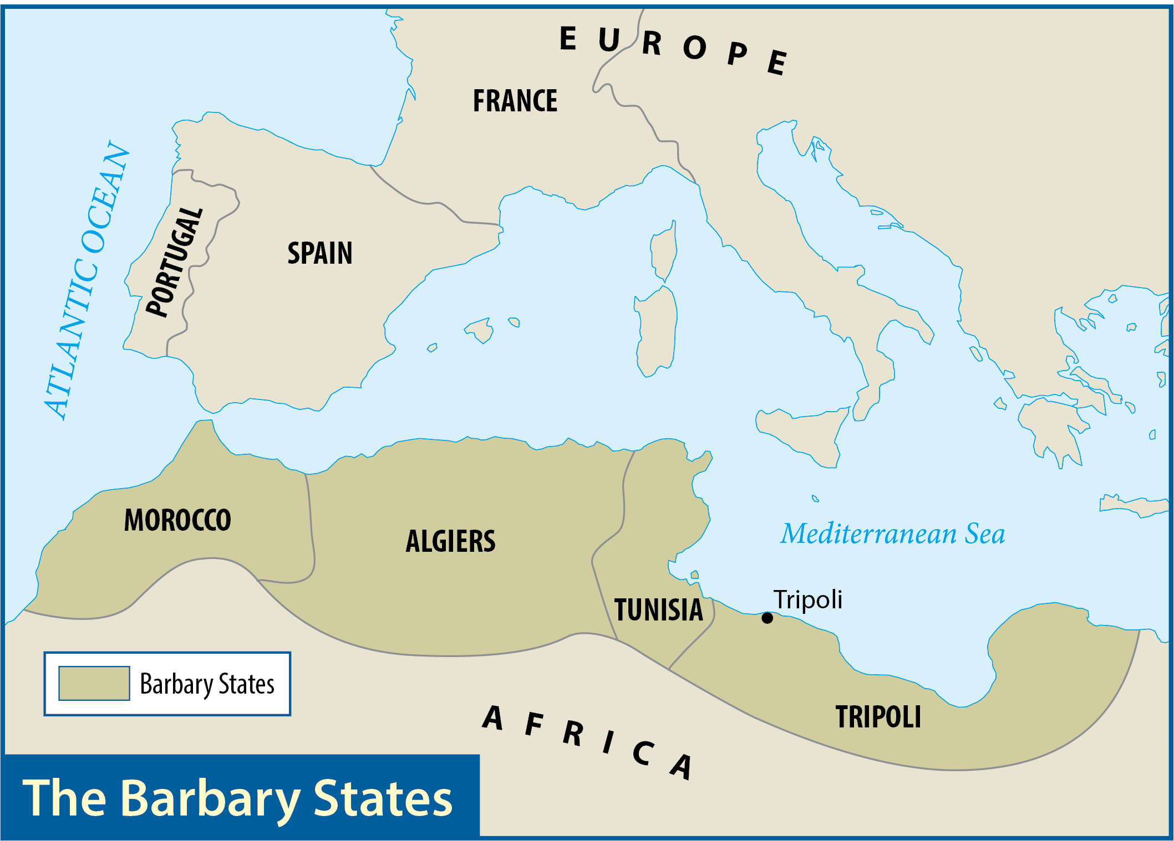
Map Resources

Slide 21
The Louisiana Purchase
Napoleon Bonaparte offered the Americans all the Louisiana Territory for $15 million.
The Constitution gave the government no specific authority to purchase land.
With the Louisiana Purchase, the United States more than doubled its size.
Napoleon Bonaparte
Notes:
https://commons.wikimedia.org/wiki/File:Napoleon_Bonaparte.jpg; The Emperor Napoleon in His Study at the Tuileries by Jacques-Louis David, 1812/Wikimedia Commons/Public Domain

Slide 22
Exploring the New Lands
Jefferson sent Meriwether Lewis and William Clark to lead an expedition to explore the Louisiana Territory.
The party traveled up the Missouri River, through the Dakotas and Montana, and across the Rocky Mountains.
Meriwether Lewis
Notes:
US History 5th/164tl; "Meriweather Lewis-Charles Willson Peale"/Wikimedia Commons/Public Domain

Slide 23
Exploring the New Lands
Accompanying Lewis and Clark through the Pacific Northwest was a Shoshone Indian woman named Sacagawea, wife of a French fur trader.
The explorers reached the Pacific and gazed at an ocean they had never seen.
William Clark
Notes:
US History 5th/164tr; "William Clark-Charles Willson Peale"/Wikimedia Commons/Public Domain

Slide 24
Exploring the New Lands
Zebulon Pike directed two other important expeditions about the same time as Lewis and Clark’s trip.
The first (1805) went northward to the upper reaches of the Mississippi River.
The second trip crossed the Great Plains to the Colorado Rockies, where Pike discovered Pikes Peak.
Pikes Peak
Notes:
https://pixabay.com/photos/pikes-peak-mountain-1273566/; pixabay/CC0

Slide 25
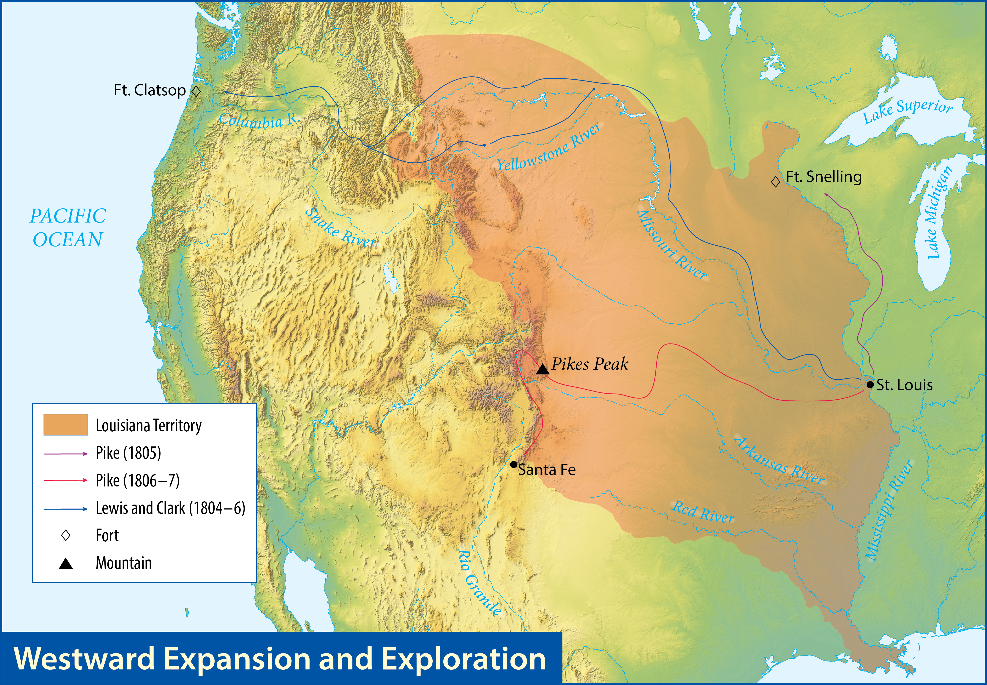
Map Resources

Slide 26
Section review
What were Jefferson’s two successes in foreign affairs?
the war against the Barbary pirates and the Louisiana Purchase (p. 162)
Why did Napoleon sell the Louisiana Territory to the United States?
Since it would have been difficult for Napoleon to defend Louisiana if war broke out with Britain, he decided to sell the territory to the United States to raise funds for his war with Britain and to build favor with the United States. (p. 164)

Slide 27
Section review
Who were the three great explorers of the American West during Jefferson’s administration?
Meriwether Lewis, William Clark, Zebulon Pike (pp. 164–65)
How was Jefferson’s decision to buy the Louisiana Territory a violation of his principles of limited government?
He was a strict constructionist, saying that the federal government could do only those things specifically permitted by the Constitution, but the Constitution makes no provision for the president to purchase territory for the United States.

Slide 28
Section review
Explain why the Lewis and Clark expedition was so important.
Jefferson had limited knowledge of the area purchased. The size/dimensions of the territory and what it contained needed to be documented.

Slide 29
Indians and the Northwest Territory

Slide 30
Guiding questions
How did American Indians and white Americans differ in their views of Indian land?
What was the wide-ranging significance of the Fallen Timbers campaign for the development of the United States?
Who were the major figures and what were the major events in the conflict over the Northwest Territory?

Slide 31
Aaron Burr
Alexander Hamilton opposed Burr’s run for governor of New York.
In the Burr-Hamilton duel, Burr shot Hamilton.
Burr was tried for treason when people suspected he wanted to build his own empire out West.
Though Burr lived until 1836, his political career was over.
Aaron Burr
Notes:
US History 5th/153b; "Vanderlyn Burr"/Wikimedia Commons/Public Domain

Slide 32
Fallen Timbers and the Opening of Ohio
The Indians believed that the land belonged to everyone.
Settlers believed that the land’s potential had to be tapped.
In 1790 and 1791, the Indians inflicted two stinging and humiliating defeats on the American army.

Slide 33
Fallen Timbers and the Opening of Ohio
President Washington appointed Revolutionary War hero “Mad Anthony” Wayne to crush the Indians.
In the Battle of Fallen Timbers, Wayne’s forces soundly defeated the Indians.
In 1803, Ohio was admitted to the Union as the first state from the Northwest Territory.
“Mad Anthony” Wayne

Slide 34
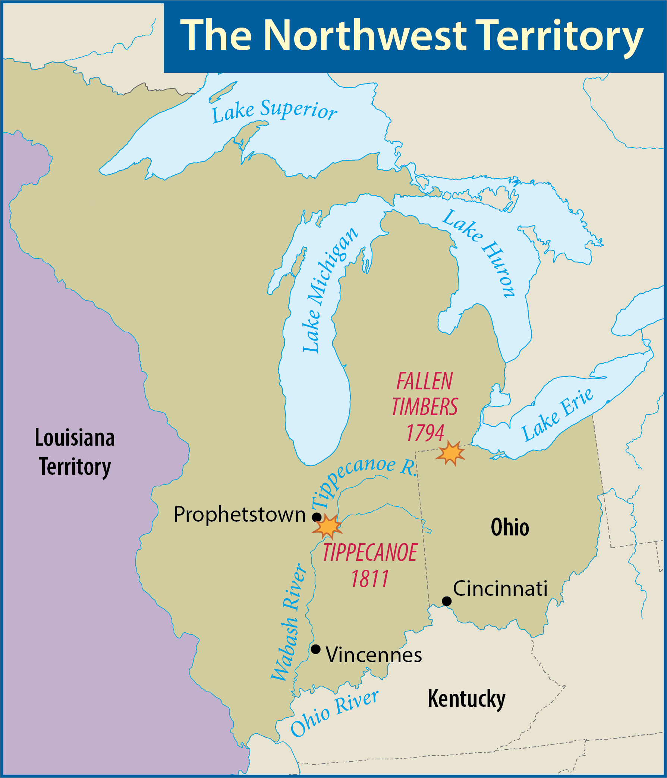
Map Resources

Slide 35
William Henry Harrison
In 1800, William Henry Harrison was appointed governor of the Indiana Territory (modern Indiana, Illinois, Michigan, and Wisconsin), and he served in that office until 1812.
Harrison wanted the Indians to abandon much of their hunting and devote themselves to farming.
William Henry Harrison
Notes:
US History 4th/180a; Rembrandt Peale/Wikimedia Commons/Public Domain

Slide 36
Tecumseh
Harrison’s chief adversary was Tecumseh who led the last great Indian challenge to the United States in the Northwest Territory.
Tecumseh proposed joining all the Indian tribes into a single confederation with himself as head.
Tecumseh

Slide 37
The Prophet
Contributing to Tecumseh’s success was a religious movement led by his brother, a man known as the Prophet.
When the Prophet predicted a solar eclipse, Indians flocked to Tecumseh’s army.
At their headquarters, the brothers built a village called Prophetstown.
The Prophet
Notes:
https://commons.wikimedia.org/wiki/File:Shawnee_Prophet,_Tenskwatawa.jpg; Portrait of Tenskwatawa by Charles Bird King, ca. 1820/Wikimedia Commons/Public Domain

Slide 38
The Battle of Tippecanoe
Tecumseh announced that no more Indian lands would be opened to the white man without the consent of all the tribes.
Tecumseh wasn’t there when Harrison camped on the banks of the Tippecanoe River.
In the Battle of Tippecanoe, Harrison’s forces drove off the Indians but took heavy losses.
Notes:
US History 5th/169; Library of Congress, LC-USZC4-782

Slide 39
Section review
What battle opened the Ohio Territory to white settlement?
the Battle of Fallen Timbers (p. 167)
Who were the single most important white and Indian leaders, respectively, in the Northwest Territory?
William Henry Harrison and Tecumseh (pp. 167–68)

Slide 40
Section review
How did Harrison’s plea to the Indians to test the Prophet backfire?
The Prophet used an eclipse of the sun to pretend that he had made the sun stand still and thereby persuaded many more Indians to support him. (pp. 168–69)

Slide 41
Section review
Assess the quotation from Tecumseh regarding selling Indian land to white settlers.
Tecumseh believed that the land in this region was owned by all Indians. He said no land sale could occur unless all Indians agreed. With this, he was criticizing those chiefs who had signed treaties and the whites who had sought them.

Slide 42
Section review
Describe the Battle of Tippecanoe and its significance.
The Battle of Tippecanoe resulted in heavy losses for Harrison’s forces and the destruction of Prophetstown. Tecumseh now had to rebuild his support. He was fortunate to obtain some help from the British.

Slide 43
War of 1812

Slide 44
Guiding questions
What led to the War of 1812?
What were the major battles in the War of 1812?
Who were the important leaders in each military campaign?
What were the results of the war?

Slide 45
Worsening relations
When France and Britain went to war again, neutral America was caught between the two.
Impressment outraged the United States.
In June 1807, the American warship Chesapeake was fired upon by a British warship.
The Chesapeake affair nearly brought war.
Notes:
https://commons.wikimedia.org/wiki/File:M_Dubourg,_Boarding_and_Taking_the_American_Ship_Chesapeake,_by_the_Officers_and_Crew_of_H.M._Ship_Shannon,_Commanded_by_Capt._Broke,_June_1813_(c._1813).jpg; U.S. Naval Historical Center Photograph, NH 65811-KN

Slide 46
Worsening relations
Jefferson persuaded Congress to adopt the Embargo Act which banned all American trade with the rest of the world.
Those most hurt by the embargo were Americans.
Thomas Jefferson
Notes:
https://www.whitehouse.gov/photos-and-video/photogallery/official-portraits-us-presidents; Portrait of Thomas Jefferson by Rembrandt Peale, 1800/whitehouse.gov/Public Domain

Slide 47
Worsening relations
Jefferson persuaded the Republicans to nominate his secretary of state, James Madison, as his successor.
Macon’s Bill Number Two stated that if either Britain or France would repeal its anti-trade regulations, the United States would continue trade with that side and refuse to trade with the other.
James Madison
Notes:
https://www.whitehouse.gov/photos-and-video/photogallery/official-portraits-us-presidents; Portrait of James Madison by John Vanderlyn, 1816/whitehouse.gov/Public Domain

Slide 48
Worsening relations
France reopened trade with America.
This action hastened America’s entering into a real war against Britain.
James Madison
Notes:
https://www.whitehouse.gov/photos-and-video/photogallery/official-portraits-us-presidents; Portrait of James Madison by John Vanderlyn, 1816/whitehouse.gov/Public Domain

Slide 49
The war hawks
The “War Hawks,” led by Henry Clay of Kentucky and John C. Calhoun of South Carolina, pushed for war with Britain.
They believed that the British were supporting the Indians under Tecumseh in the Northwest.
The group saw British acts as insults to American honor.
Henry Clay
Notes:
American Government 3rd/159bl; Henry Clay by Matthew Harris Jouett/Wikimedia Commons/Public Domain

Slide 50
Declaration, Division, and Disarray
Madison asked Congress to declare war on the British for these reasons:
Impressment of American sailors
Interference with American trade (including seizure of American ships)
Encouragement of Indians against Americans
The United States entered what became known as the War of 1812 divided and unprepared.

Slide 51
Disasters in Canada
Conquering Canada would accomplish two things:
Eliminate British influence among the Indians
Provide a new area for land-hungry Americans
The task was difficult because of Canada’s enormous size and pro-British population.
The British took Detroit, opening the Northwest to invasion.
The Americans were driven back into New York.

Slide 52
The War at Sea
The USS Constitution (“Old Ironsides”) and other ships defeated British ships in combat.
The early triumphs on the high seas had encouraged the American public.

Slide 53
Recovery of the Northwest
Oliver Hazard Perry defeated the British fleet in the Battle of Lake Erie.
In the Battle of the Thames, Harrison crushed the British-Indian force.
Oliver Hazard Perry
Notes:
https://commons.wikimedia.org/wiki/File:Oliver_Hazard_Perry_by_Jane_Stuart.jpg; Portrait of Oliver H. Perry by Jane Stuart, 1857/Wikimedia Commons/Public Domain

Slide 54
The British Drive for Victory
The British devised a threefold plan to win the war:
An army would descend from Canada and separate New York and New England from the rest of the states
A naval force would attack and raid major cities on the eastern coast
Another force would attack and capture New Orleans
The first part of the plan failed.

Slide 55
The British Drive for Victory
In the Battle of Bladensburg, the British scattered a large force of American militia and cleared a path to the American capital.
Soldiers soon set fire to the Capitol, the president’s mansion, and several other important government buildings.
Notes:
https://commons.wikimedia.org/wiki/File:BritishBurnTheCapitol-CoxMural.jpg; British Burn the Capitol, 1814 by Allyn Cox, 1973/Architect of the Capitol

Slide 56
The British Drive for Victory
The British next attacked Baltimore which was protected by the Fort McHenry.
After three days of fighting, the British abandoned the task.
Notes:
US History 5th/173; National Park Service

Slide 57
“By the Dawn’s Early Light”
Francis Scott Key watched the British fleet shell Fort McHenry.
He wrote the poem “The Defense of Fort McHenry” (“The Star-Spangled Banner”).
In 1931, Congress officially proclaimed “The Star-Spangled Banner” the national anthem of the United States.
Francis Scott Key

Slide 58
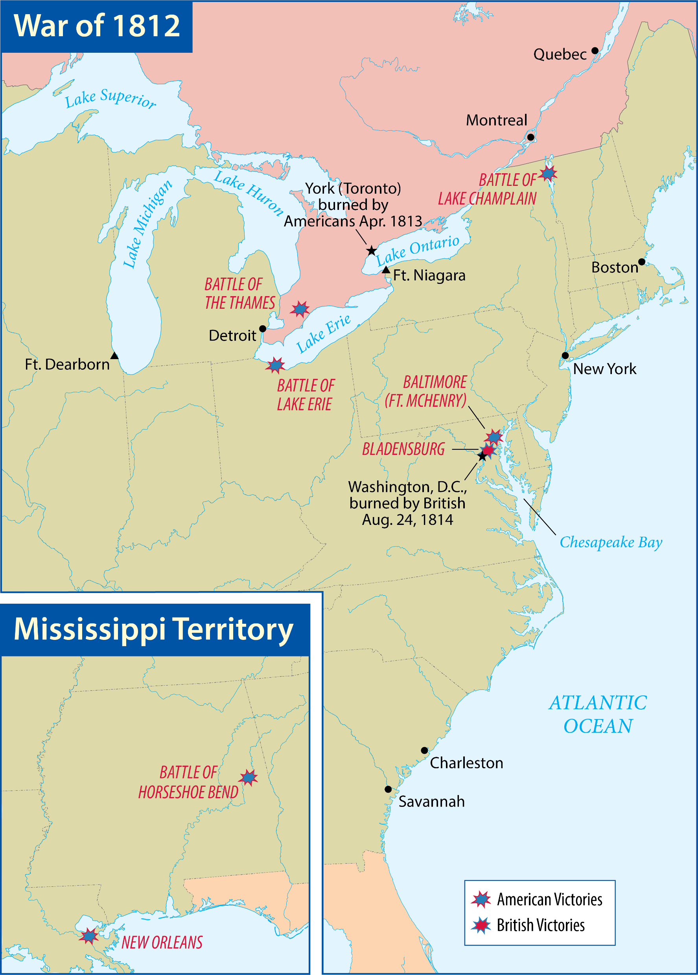
Map Resources

Slide 59
The War in the South
The government authorized Tennessee general Andrew Jackson to help the Creeks that were friendly toward Americans and to defend the South against the British.
Jackson’s force won a series of victories against the unfriendly Creeks, climaxing in the Battle of Horseshoe Bend (1814).
Andrew Jackson
Notes:
US History 4th/185; Library of Congress

Slide 60
The War in the South
At New Orleans Jackson stationed his troops and artillery behind fortifications that included cotton bales.
The Battle of New Orleans was the most stunning victory of the War of 1812, but it was fought after the war was over.
Notes:
US History 5th/158; Library of Congress

Slide 61
The War in the South
The Treaty of Ghent had ended hostilities two weeks before the Battle of New Orleans.
The battle made Jackson the greatest hero of the war.
Notes:
US History 5th/175b; “The Signing of the Treaty of Ghent, Christmas Eve, 1814” by Amédée Forestier/Smithsonian American Art Museum, Washington D.C./Wikimedia Commons/Public Domain

Slide 62
Results of the War
Opening of the Northwest to settlement
Growth of American industry and manufacturing
Desire for isolationism
Sense of national pride and honor

Slide 63
Section review
By what two pieces of legislation did the United States hope to apply economic pressure to avoid war with Great Britain?
the Embargo Act and Macon’s Bill Number Two (pp. 170–71)
Name three reasons President Madison gave for going to war against Britain.
the impressment of American sailors, British interference with American trade (including seizure of American ships), and their encouragement of Indians against Americans (p. 171)

Slide 64
Section review
What was Britain’s threefold plan for winning the War of 1812? How did each stage of the plan fare in the actual fighting?
First, an army would descend from Canada and separate New York and New England from the other states; second, a naval force would attack and raid major cities on the eastern coast; third, another force would attack and capture New Orleans. The first stage failed after the Americans won control of Lake Champlain; the second stage succeeded in capturing Washington, D.C., but failed to capture Baltimore; the third stage failed when the Americans defeated the British in the Battle of New Orleans. (pp. 173–75)

Slide 65
Section review
Both Britain and France seized American ships and interfered with American trade. Explain why the United States was more upset with Britain.
Britain seized more than twice as many ships as France. Britain also captured American sailors and forced them to serve in the British navy (impressment).

Slide 66
Section review
Some people have suggested that “The Star-Spangled Banner” should be replaced with a new national anthem. Do you agree or disagree? Why? If you agree, what song would you substitute as the anthem?
Agree; It is hard to sing, and it seems to glorify war.
Disagree; The profound lyrics outweigh the difficulty in singing it, and the war in which it originated was thrust upon the United States. The nation was simply defending itself from a foreign invader.

Slide 67
The Era of Good Feelings

Slide 68
Guiding questions
What led to the demise of the Federalist Party?
What was the significance of the Rush-Bagot and Adams-Onis Treaties?
How significant was the Monroe Doctrine?

Slide 69
The Era of Good Feelings
Secretary of State James Monroe was elected to succeed James Madison.
The president’s popularity and the collapse of all political opposition to the Republicans caused Monroe’s two terms to be known as the Era of Good Feelings.
James Monroe
Notes:
US History 5th/176; "Portrait of James Monroe" by John Vanderlyn/Daderot/Wikimedia Commons/Public Domain

Slide 70
Collapse of the Federalists
Throughout the War of 1812, the Federalists opposed the progress and conduct of the war.
The Hartford Convention opposed the war and hinted that New England might secede from the Union if its demands were not met.
After the war, the Federalist Party collapsed.

Slide 71
Mending Fences with Britain
The Rush-Bagot Treaty (1817) limited the number of British and American warships in the Great Lakes.
Its provisions were eventually extended along the entire U.S.-Canadian border as the nations advanced westward.
In 1818, the United States and Britain agreed to occupy jointly the Oregon Territory.

Slide 72
Conflict in Florida
Although Spain owned Florida, Andrew Jackson was sent to crush Indian opposition.
Secretary of State John Quincy Adams took a firm stand with the Spanish government.
Under the provisions of the Adams-Onis Treaty, the U.S. gained Florida in 1821 at a cost of $5 million.
John Quincy Adams
Notes:
https://www.whitehouse.gov/photos-and-video/photogallery/official-portraits-us-presidents; Portrait of John Quincy Adams by Gilbert Stuart, 1818/whitehouse.gov/Public Domain

Slide 73
The Monroe Doctrine
The Monroe Doctrine established two principles:
European nations couldn’t intervene in the Western Hemisphere.
America wouldn’t meddle in European affairs.
The Monroe Doctrine formalized America’s determination to remain isolated from Europe.
James Monroe
Notes:
US History 5th/176; "Portrait of James Monroe" by John Vanderlyn/Daderot/Wikimedia Commons/Public Domain

Slide 74
Section review
Why was Monroe’s time in office called the Era of Good Feelings?
because of President Monroe’s personal popularity and the collapse of all political opposition to the Republicans (p. 176)
Which commander’s military campaign in Florida motivated Spain to sell that territory to the United States?
General Andrew Jackson’s (p. 177)

Slide 75
Section review
What treaty enabled the U.S. to purchase Florida from Spain?
the Adams-Onis Treaty (p. 177)
Who was secretary of state when Monroe was president?
John Quincy Adams (p. 177)

Slide 76
Section review
What are the two basic principles of the Monroe Doctrine?
European nations could not intervene in the Western Hemisphere (except where they already held colonies), and the United States would not meddle in European affairs. (p. 178)
Explain the factors that led to the collapse of the Federalist Party.
James Monroe was a popular Republican president. Many Americans opposed the Hartford Convention, which was composed mainly of Federalists.

Slide 77
Section review
Assess why the Monroe Doctrine was necessary for the regions south of the United States but not for those north.
Most areas in the region to the south of the United States (the Caribbean, Central America, and South America) had recently obtained independence from European nations. Americans feared those nations would try to regain control. There was only one country north of the United States, Canada, and it was still controlled by Britain.

Slide 78
People, Places, and Things to Remember
Thomas Jefferson
Jeffersonian Republicanism
Twelfth Amendment
John Marshall
Marbury v. Madison
judicial review
delegated powers
Gibbons v. Ogden
McCulloch v. Maryland
implied powers
Barbary states
Napoleon Bonaparte
Louisiana Purchase
Meriwether Lewis
William Clark
Zebulon Pike
Burr-Hamilton duel
“Mad Anthony” Wayne

Slide 79
People, Places, and Things to Remember
Battle of Fallen Timbers
William Henry Harrison
Tecumseh
the Prophet
Battle of Tippecanoe
impressment
Chesapeake affair
Embargo Act
James Madison
Macon’s Bill Number Two
War Hawks
Henry Clay
John C. Calhoun
USS Constitution (“Old Ironsides”)
Oliver Hazard Perry
Battle of Lake Erie
Battle of Bladensburg
Fort McHenry

Slide 80
People, Places, and Things to Remember
Francis Scott Key
Andrew Jackson
Battle of New Orleans
Treaty of Ghent
James Monroe
Era of Good Feelings
Hartford Convention
John Quincy Adams
Adams-Onis Treaty
Monroe Doctrine

