Slide 1
Chapter 10: The age of Jackson

Slide 2
Big Ideas
What was the impact of nationalism, sectionalism, and democratization on the United States during this period?
What were the major issues that Andrew Jackson faced as president?
What political and economic turmoil followed the Jackson administration?

Slide 3
THE AGE OF JACKSON
Although the period from 1820 to 1840 is often named for Andrew Jackson, it was well under way before Jackson’s 1829 inauguration.
Widespread currents of nationalism, sectionalism, and democratization originated before Jackson’s presidency.
Andrew Jackson
Notes:
https://www.whitehouse.gov/photos-and-video/photogallery/official-portraits-us-presidents; Portrait of Andrew Jackson by Ralph E.W. Earl, 1835/whitehouse.gov/Public Domain

Slide 4
crosscurrents

Slide 5
Guiding questions
What were the major national issues of this period?
What events resulted in greater sectionalism during this period?
What factors led to greater democratization of American life?
What were the strengths and weaknesses of nationalism, sectionalism, and democratization in this period?

Slide 6
Nationalism
The years immediately following the War of 1812 saw a growing spirit of nationalism.
Seven new states were added.
Henry Clay was the chief advocate of economic nationalism, called the American System.
Henry Clay
Notes:
US History 5th/186bc; "Portrait of Henry Clay" by John Neagle/Wikimedia Commons/Public Domain

Slide 7
Protective Tariff
Stimulating the growth of American manufacturing was an important step toward economic independence from Europe.
A tariff is a tax on imported goods, and a protective tariff is an unusually high tariff designed to shield a nation’s manufactures from foreign competition.
The Tariff of 1816 was America’s first such protectionist legislation.
Although it encouraged some American economic growth and increased the sale of American products, it meant higher prices for customers.

Slide 8
Second national bank
In 1816, nationalistic Republicans approved a twenty-year charter on a second Bank of the United States.
The bank would assist economic growth by providing uniform currency, a source for loans to the public and private sectors, and a place to deposit government funds.

Slide 9
Internal Improvements
Another key element of the American System was internal improvements.
Internal improvements were the least successful aspect of the American System.
One important step was approved: the building of the National Road.

Slide 10
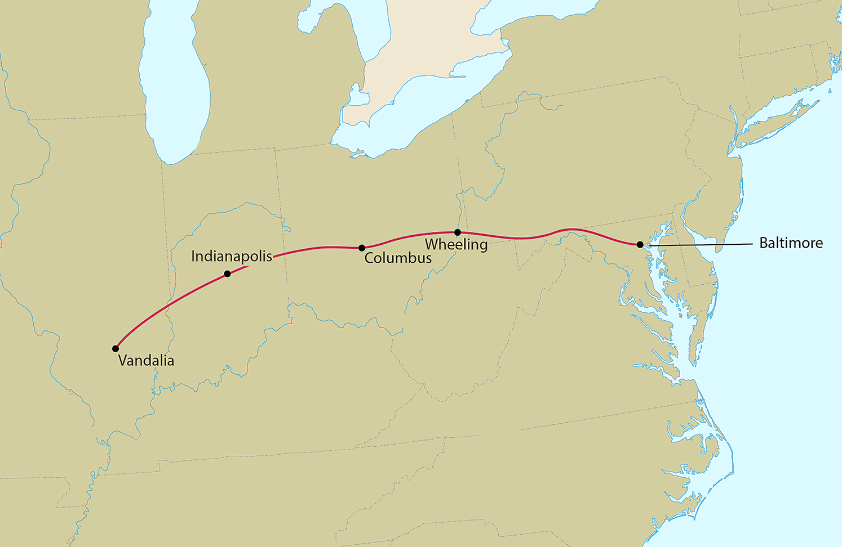
National Road
Map Resources

Slide 11
Panic of 1819
Two unrelated events resulted in a depression called the Panic of 1819.
Fall of cotton prices in Great Britain
Irresponsible actions of state banks and the National Bank
Notes:
https://pixabay.com/photos/cotton-cotton-field-white-farming-4649804/; pixabay/CC0

Slide 12
Missouri Compromise
When Missouri applied for statehood that year, the question of political balance between the South and the North lay at the heart of the debate.
James Tallmadge proposed a resolution that prohibited slaveholders from bringing new slaves into Missouri.
James Tallmadge
Notes:
https://commons.wikimedia.org/wiki/File:James_Tallmadge_portrait.jpg; Portrait of James Tallmadge from Hunt's Merchants' Magazine and Commercial Review, vol. 23, 1850/Wikimedia Commons/Public Domain

Slide 13
Missouri Compromise
Maine’s application for statehood and Henry Clay’s skillful handling of the controversy helped provide a compromise.
The Missouri Compromise proposed that Maine be admitted as a free state and Missouri as a slave state and that in the rest of the Louisiana Territory slavery not be permitted north of 36° 30ʹ, Missouri’s southern boundary.
The Missouri Compromise drew political lines between the regions.

Slide 14
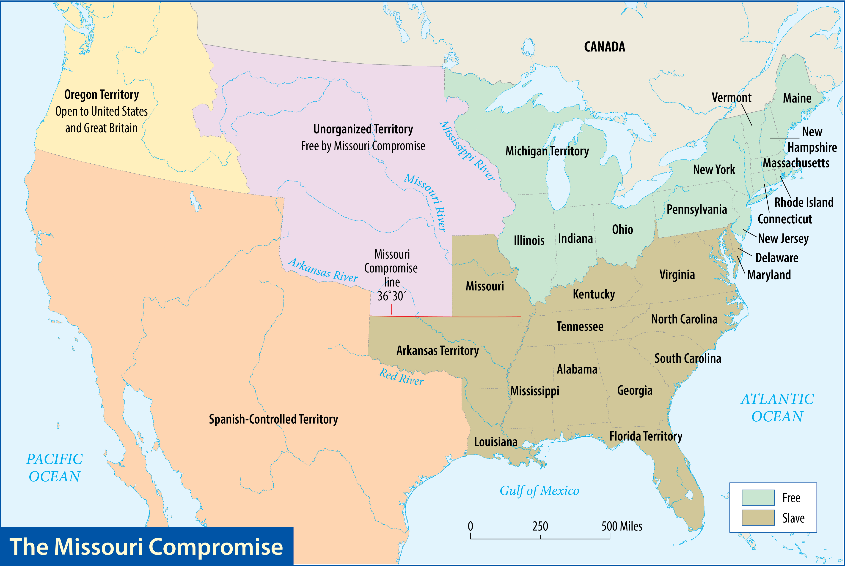
Map Resources

Slide 15
Democratization
Political expansion was evident in three major changes during the period.
The emergence of universal manhood suffrage for white men
The people’s gain of a greater voice in presidential elections
The fracturing of the one-party system

Slide 16
Death of “King Caucus”
A caucus is a closed meeting of party leaders.
The caucus system of nominating candidates was completely discredited, and the divisive presidential campaign of 1824 ended the idea of a nonpartisan government.

Slide 17
A “Corrupt Bargain”
Four men threw their hats into the ring as candidates for president in 1824.
William H. Crawford
John Quincy Adams
Henry Clay
General Andrew Jackson

Slide 18
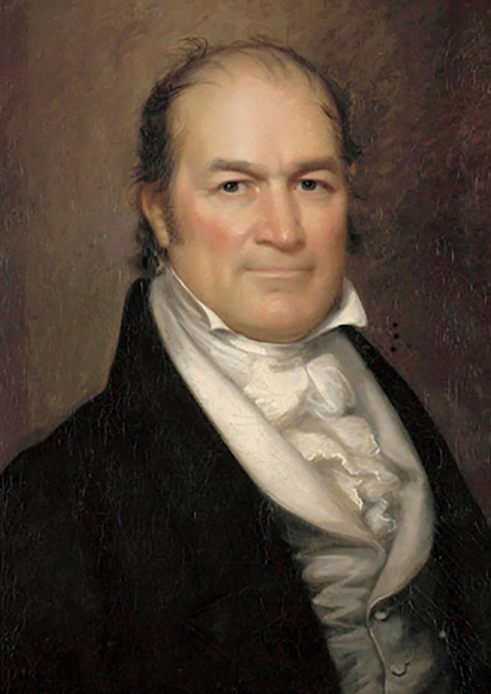
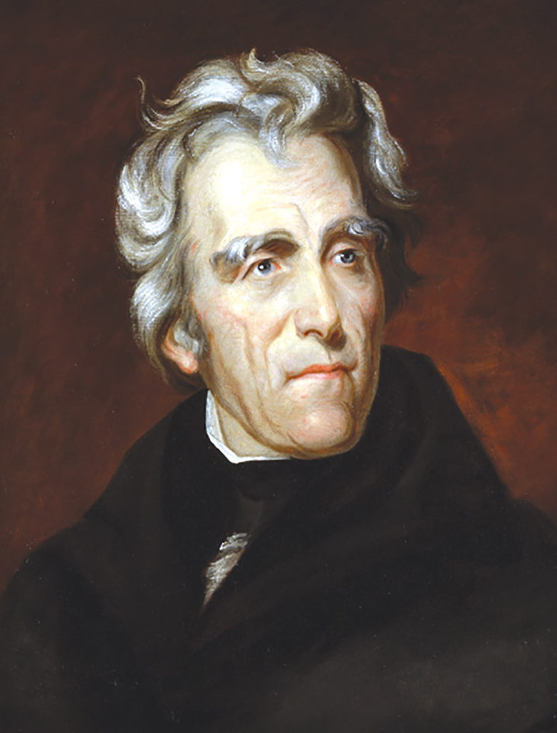
Adams, Clay, Crawford, and Jackson
Notes:
US History 5th/186t; "John Quincy Adams" by George Peter Alexander Healy/Wikipedia/Public Domain
US History 5th/186bl; "WilliamHCrawford" by John Wesley Jarvis/Wikimedia Commons/Public Domain
US History 5th/186bc; "Portrait of Henry Clay" by John Neagle/Wikimedia Commons/Public Domain
US History 5th/186br; "Andrew Jackson" by Thomas Sully/Wikipedia/Public Domain

Slide 19
A “Corrupt Bargain”
No candidate won a majority, so the election was decided by the House of Representatives.
Clay supported Adams.
Jackson’s supporters claimed that Adams and Clay had made a “corrupt bargain,” an underhanded deal to give Adams the presidency in return for making Clay Secretary of State.

Slide 20
Map Resources

Slide 21
A “Corrupt Bargain”
Adams was an ineffective president.
Adams worked for higher protective tariffs to encourage American manufacturing and internal improvements.
John Quincy Adams
Notes:
US History 5th/186t; "John Quincy Adams" by George Peter Alexander Healy/Wikipedia/Public Domain

Slide 22
A “Corrupt Bargain”
Adams’s wing of the Democratic-Republicans became known as the National Republicans.
The Jackson wing kept the old name, Democratic-Republicans, but eventually dropped the “Republican” part, keeping the name by which the party is still called, the Democratic Party.

Slide 23
Rematch and Revenge
The 1828 election was an Adams-Jackson rematch.
Martin Van Buren helped organize the Democratic effort and urged Jackson to emphasize a symbolic campaign—Old Hickory, the friend of the common man.
Martin Van Buren
Notes:
https://www.whitehouse.gov/photos-and-video/photogallery/official-portraits-us-presidents; Portrait of Martin Van Buren by Francis Alexander, 1838/whitehouse.gov/Public Domain

Slide 24
Rematch and Revenge
In the end, Jackson and his running mate, John C. Calhoun, won by a landslide.
For the first time, more than one million voters cast ballots for the presidency, triple the number in the 1824 election.
John C. Calhoun
Notes:
American Republic 4th/196a; U.S. Senate Collection

Slide 25
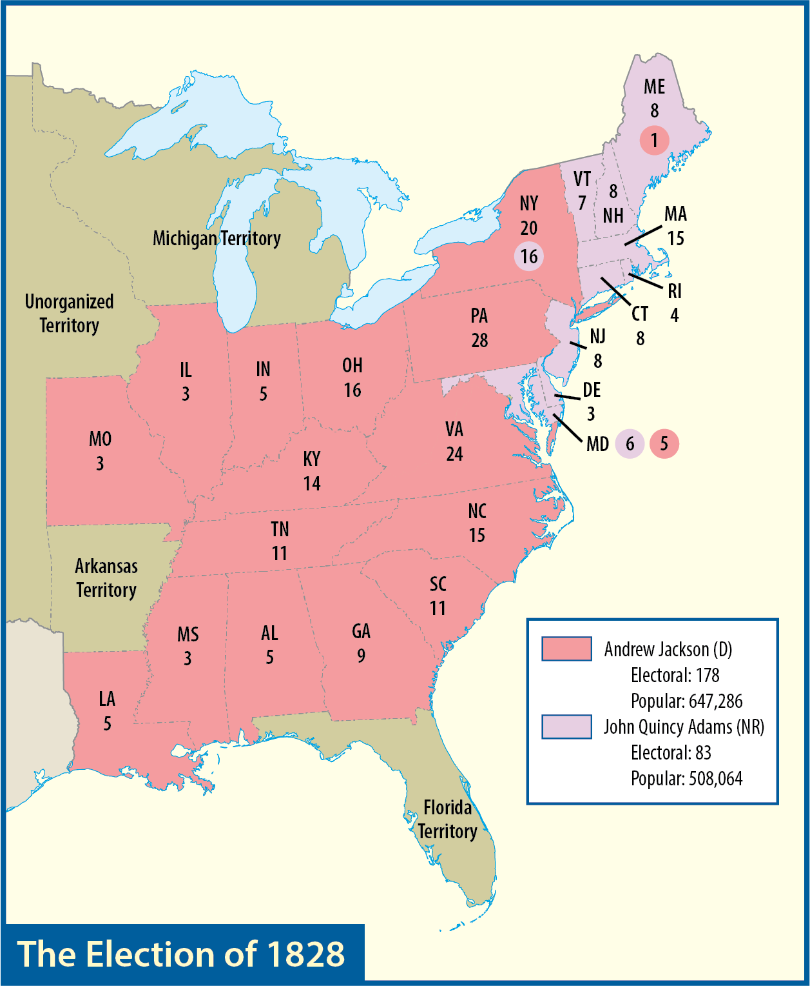
Map Resources

Slide 26
Rematch and Revenge
In March 1829, record numbers attended the inauguration.
The invading army of Jackson’s supporters provided a fitting start to a new American era—the age of Jacksonian democracy, the age of the common man.
Notes:
US History 5th/189; Library of Congress

Slide 27
Section review
What were the three components of Henry Clay’s American System?
protective tariffs, internal improvements, and renewal of the National Bank (p. 181)
What was America’s first protectionist legislation?
the Tariff of 1816 (p. 181)

Slide 28
Section review
What two factors contributed to the Panic of 1819?
the price of American cotton fell because of competition from cotton grown in India and the irresponsible actions of state banks and the National Bank (p. 183)
List the three provisions of the Missouri Compromise.
It admitted Maine as a free state, admitted Missouri as a slave state, and prohibited slavery in the remainder of the Louisiana Territory north of 36° 30’, Missouri’s southern boundary. (pp. 184–85)

Slide 29
Section review
What two men did Andrew Jackson’s supporters accuse of making a “corrupt bargain” in the presidential election of 1824?
John Quincy Adams and Henry Clay (p. 187)

Slide 30
Section review
Evaluate the costs and benefits of the democratization of American politics and religion.
In politics, democratization removed the power of a few well-connected men from controlling the options people had in elections. In religion, democratization allowed the quick expansion of the church into the frontier because an educated clergy was no longer as widely demanded. Negatively, democratization led to the rise of demagogy in politics. Furthermore, the crowd is often wrong. In religion, democratization gave a platform to unorthodox teachers.

Slide 31
Section review
Assess the significance of the election of 1828.
This was the first election after the Democratic-Republican Party split into two parts—the Democrats and the National Republicans. The number of voters tripled compared to the 1824 election. Andrew Jackson easily defeated John Quincy Adams.

Slide 32
The Jackson years

Slide 33
Guiding questions
What kind of person was Andrew Jackson?
What were the significant decisions of Jackson’s administration?

Slide 34
Old hickory
Young Andrew’s early life was rugged and difficult.
Jackson became a state judge and in 1796 was elected to a term in Congress.
Jackson displayed many flaws in the years before he won the presidency.
Andrew Jackson
Notes:
US History 5th/186br; "Andrew Jackson" by Thomas Sully/Wikipedia/Public Domain

Slide 35
Spoils of Victory
Jackson believed that public service should not be a lifelong career.
The spoils system would endure for half a century.
The spoils system removed some highly qualified individuals from office and replaced them with highly unqualified individuals.

Slide 36
Kitchen Cabinet
Jackson’s real advisors were a close circle of friends that critics called his “Kitchen Cabinet.”
Jackson’s administration was torn by infighting, particularly between Martin Van Buren and Vice President Calhoun.
Martin Van Buren
Notes:
https://www.whitehouse.gov/photos-and-video/photogallery/official-portraits-us-presidents; Portrait of Martin Van Buren by Francis Alexander, 1838/whitehouse.gov/Public Domain

Slide 37
Nullification Crisis
In 1828 Congress passed a new higher protective tariff which was dubbed the “Tariff of Abominations.”
The issue of nullification was drawn from an anti-tariff pamphlet published anonymously by Vice President Calhoun.
John C. Calhoun
Notes:
American Republic 4th/196a; U.S. Senate Collection

Slide 38
Nullification Crisis
Senator Robert Y. Hayne rebuked New England’s opposition to secession as inconsistent since it had considered secession itself.
Daniel Webster defended New England and insisted that the people of the United States had ratified the Constitution.
Therefore, a state could neither secede nor nullify an act.
Robert Y. Hayne

Slide 39
Nullification Crisis
John C. Calhoun resigned as vice president and returned to the Senate.
He and Jackson openly opposed each other on key issues.
Jackson encouraged Congress to pass the Force Bill, which gave the president the power to use the military against South Carolina.
John C. Calhoun
Notes:
American Republic 4th/196a; U.S. Senate Collection

Slide 40
Nullification Crisis
Henry Clay proposed the Compromise Tariff of 1833, which greatly reduced the Tariff of 1832, making it acceptable to South Carolina.
Henry Clay
Notes:
US History 5th/186bc; "Portrait of Henry Clay" by John Neagle/Wikimedia Commons/Public Domain

Slide 41
Busting the Bank
The major campaign issue as Jackson faced reelection in 1832 was the future of the Bank of the United States.
Nicholas Biddle submitted the Bank’s charter for renewal, though the existing charter had not expired.
The Bank had such strong support in Congress that Clay believed he had a winning campaign issue.
The renewal charter passed Congress, but Jackson vetoed it.

Slide 42
Busting the Bank
The election of 1832 introduced three new political ideas.
Third party
Platform
National convention
Jackson swept to victory with his old ally Van Buren as his new vice president.

Slide 43
Busting the Bank
Jackson appointed Roger B. Taney as Treasury secretary in September 1833.
Taney began removing federal deposits and placing them in state banks—Jackson’s “pet banks.”
In 1836, when its charter expired, the Bank of the United States ceased to exist.
Roger B. Taney
Notes:
American Republic 4th/265a; Library of Congress, LC-USZ62-107588

Slide 44
Indian Removal
The United States had discussed moving all Indian tribes in the East to lands west of the Mississippi River and east of the Rockies.
Jackson pursued this Indian removal policy vigorously.
At his urging, Congress passed the Indian Removal Act of 1830 that authorized such actions.

Slide 45
Indian Resistance
In 1832 a group of Sauk and Fox Indians under Chief Black Hawk crossed the Mississippi River back into northern Illinois to reclaim their land.
The resulting Black Hawk War was brief but bloody.
Black Hawk
Notes:
https://commons.wikimedia.org/wiki/File:Chief_Black_Hawk3.jpg; Illustration of Chief Black Hawk by Charles Bird King from History of the Indian Tribes of North America, 1872/Public Domain

Slide 46
Indian Resistance
More challenging was the Seminole War (1835–42).
The Seminoles, led by the canny Osceola, hid in the swamplands and marshes of Florida as American troops tried in vain to track them down.
Most Seminoles were captured and sent west, but some hid in Florida until the government gave up and left them to live in peace.

Slide 47
Indian Resistance
The Cherokees adopted many features of white civilization.
A brilliant Cherokee named Sequoyah even developed a written Cherokee alphabet, allowing the Indians to publish newspapers and the Bible in their own language.
Christian missionaries were the Cherokees’ strongest defenders against removal.
Sequoyah
Notes:
US History 5th/195; Library of Congress

Slide 48
Indian Resistance
Georgia forbade white people to live among the Cherokees without government approval.
Two missionaries, Samuel Worcester and Elizur Butler, were arrested for continuing their ministry.
Samuel Worcester
Notes:
https://en.wikipedia.org/wiki/File:Worcester.jpg; Photo of Samuel Worcester by unknown artist/Wikimedia Commons/Public Domain

Slide 49
Indian Resistance
In Worcester v. Georgia, Chief Justice John Marshall ordered Georgia to release the missionaries and told President Jackson to send troops to remove white settlers who had moved onto Cherokee lands.
Georgia and President Jackson ignored the Court.
Samuel Worcester
Notes:
https://en.wikipedia.org/wiki/File:Worcester.jpg; Photo of Samuel Worcester by unknown artist/Wikimedia Commons/Public Domain

Slide 50
Indian Resistance
By 1838 troops had forcibly moved Cherokees who had not already gone west to the Indian Territory (now Oklahoma).
These forced marches west began in the summer, and sickness and drought killed many of the travelers.
The Indians called the relocation the Trail of Tears.

Slide 51
Section review
What were the three new political ideas introduced in the presidential election of 1832?
the first third party (the Anti-Masonic Party), the first party platform, and the first national nominating convention (p. 194)

Slide 52
Section review
How did the reactions of the Seminoles and the Cherokees to Indian removal differ? What was the result for each tribe?
The Seminoles resisted with armed force; the Cherokees took the government to court. Most of the Seminoles were eventually relocated, but a number managed to stay in Florida, though only after the death of many Seminoles and American soldiers. The Cherokees won their case, but the government refused to recognize the decision, and most of the Cherokees were moved west. (pp. 195–96)

Slide 53
Section review
Evaluate the idea of a protective tariff.
A protective tariff increases the sale of products manufactured within a country.
It results in price increases for consumers.
It is needed, as a temporary measure, in a country that is just beginning to industrialize.

Slide 54
Section review
Who was responsible for the forced removal of the Cherokees? Explain your answer.
Jackson was responsible because he refused to enforce the Supreme Court ruling in the Cherokees’ favor.
The settlers in Georgia (because they wanted the Cherokee land where gold had been discovered) or the state of Georgia was responsible.

Slide 55
Party Politics

Slide 56
Jackson and Anti-Jackson
During Jackson’s second term, opposition to him was growing.
These anti-Jackson forces formed a political alliance in the early 1830s that became known as the Whig Party.
The Whigs dubbed the so-called people’s president “King Andrew the First.”
Andrew Jackson
Notes:
US History 5th/186br; "Andrew Jackson" by Thomas Sully/Wikipedia/Public Domain

Slide 57
Whigs | Democrats
Followed the ideas of John Quincy Adams and the National Republicans; primary leader was Henry Clay | Followed the ideas of Thomas Jefferson and Andrew Jackson
Favored a mixed economy of commerce, manufacturing, and agriculture | Favored an economy dominated by agriculture
Supported a protective tariff to help developing American industries | Supported a small revenue tariff
Wanted federally funded internal improvements | Wanted internal improvements to be financed primarily by state and/or local governments

Slide 58
Whigs | Democrats
Supported a national bank | Opposed a national bank; favored state banks
Usually opposed territorial expansion | Usually supported territorial expansion
Were inclined to support rights of Indians | Were inclined to violate rights of Indians
Opposed the growing power of the president | Usually supported increased power of the president
Usually were pro-British | Usually were pro-French

Slide 59
Van’s Victory
Election of 1836 candidates
Democrat: Martin Van Buren
Whig: Daniel Webster
Whig: William Henry Harrison
Whig: Hugh White
Jackson’s endorsement was really the deciding vote in Van Buren’s favor.
Martin Van Buren
Notes:
https://www.whitehouse.gov/photos-and-video/photogallery/official-portraits-us-presidents; Portrait of Martin Van Buren by Francis Alexander, 1838/whitehouse.gov/Public Domain

Slide 60
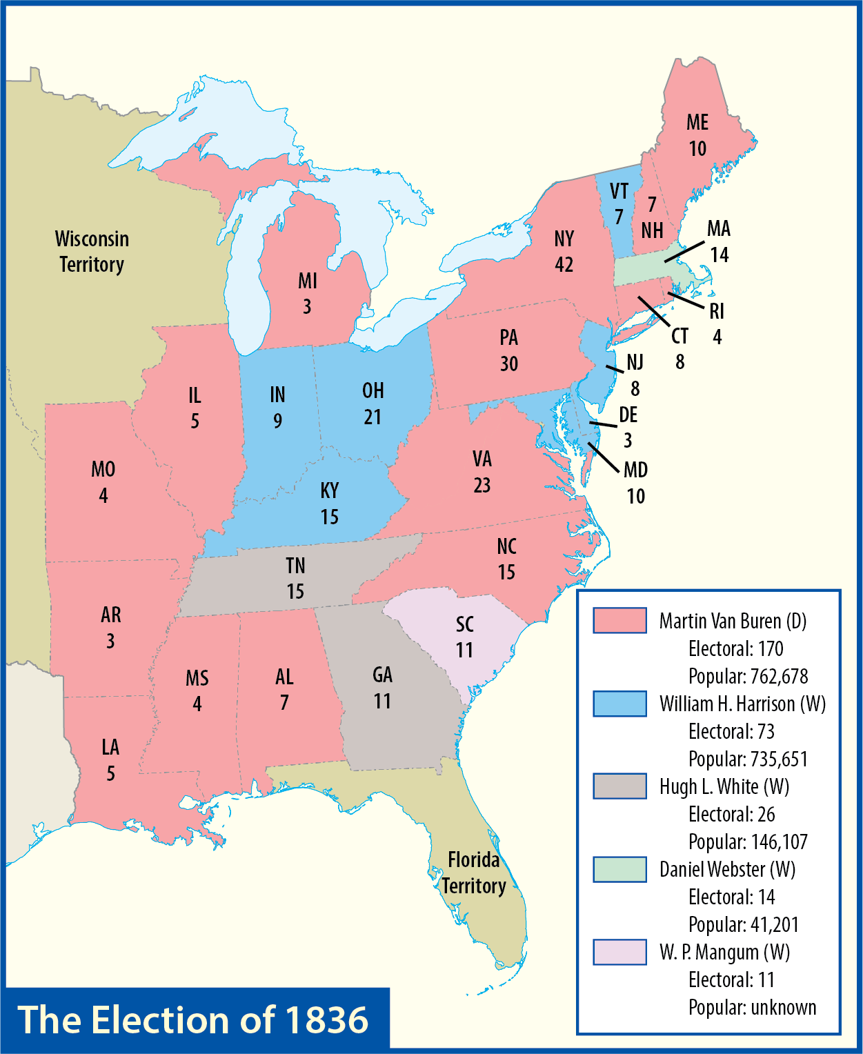
Map Resources

Slide 61
Hard Times
The economy collapsed, pulling the country into a deep five-year depression known as the Panic of 1837.
Causes
Jackson’s economic policies
Irresponsible practices among the state banks
Massive wheat crop failure
Collapse of cotton prices
Van Buren proposed an independent treasury to replace the state banks as a depository for federal funds.

Slide 62
Log Cabin Campaign
The Whigs nominated William Henry Harrison, the hero of the Battle of Tippecanoe.
They added John Tyler as running mate to broaden the ticket’s appeal.
The Whigs presented Harrison as a humble, yet heroic backwoodsman symbolized by a log cabin.
The famous campaign slogan was “Tippecanoe and Tyler too!”
William Henry Harrison
Notes:
American Republic 4th/202b; "William Henry Harrison by James Reid Lambdin, 1835"/Wikimedia Commons/Public Domain

Slide 63
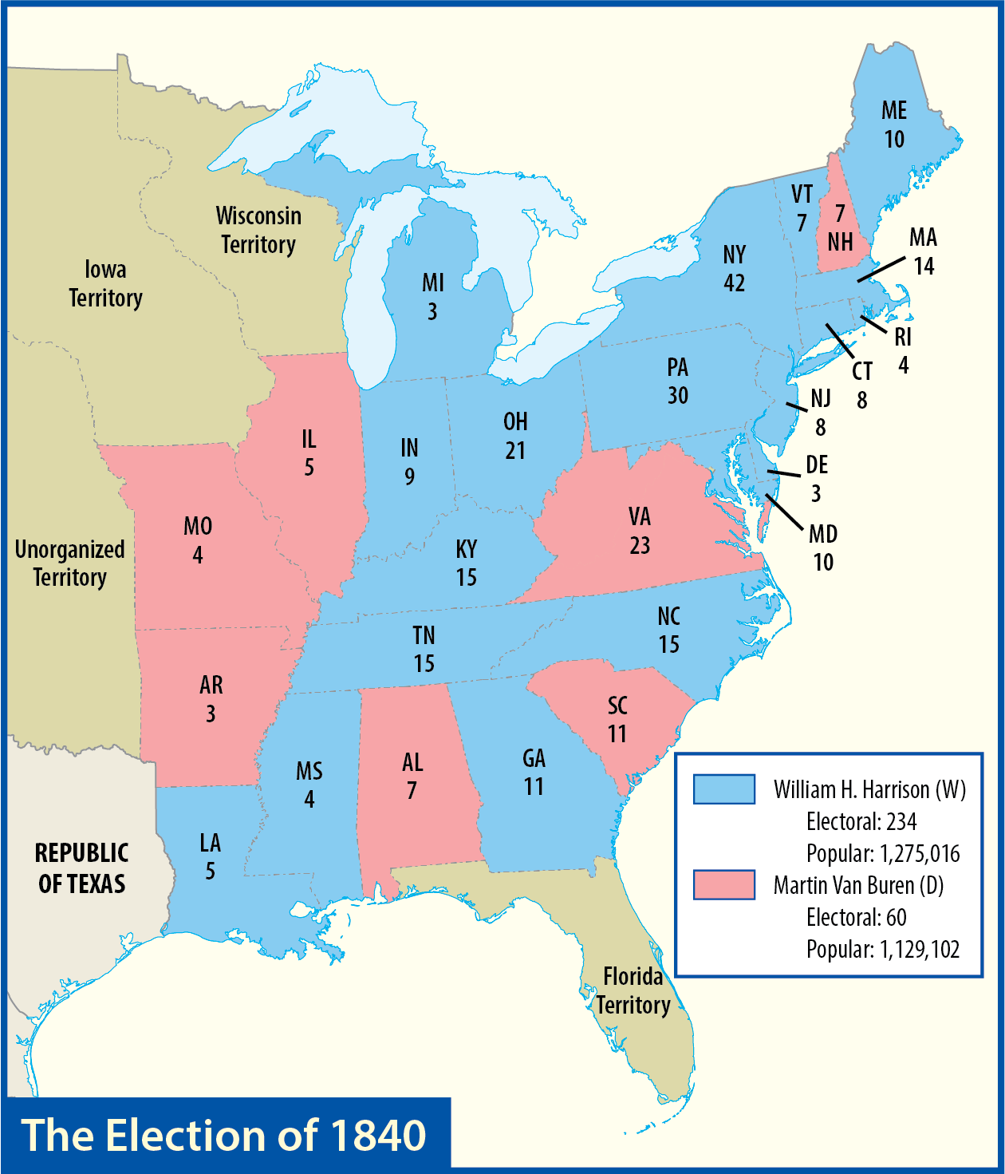
Map Resources

Slide 64
Log Cabin Campaign
Harrison won and at his inauguration he delivered the longest speech in American history.
Harrison died of pneumonia in April; he was the first president to die in office.
William Henry Harrison
Notes:
American Republic 4th/202b; "William Henry Harrison by James Reid Lambdin, 1835"/Wikimedia Commons/Public Domain

Slide 65
Log Cabin Campaign
The nation now faced its future under the leadership of John Tyler, a man whom most had never expected would govern.
John Tyler
Notes:
https://www.whitehouse.gov/photos-and-video/photogallery/official-portraits-us-presidents; Portrait of John Tyler by George P.A. Healy, 1859/whitehouse.gov/Public Domain

Slide 66
Section review
Name three of Jackson’s views that angered his opponents. These disagreements with him led them to form the Whig Party.
his opposition to the National Bank; his opposition to the federal government paying for internal improvements, his willingness to lower tariffs, and his rough treatment of South Carolina (p. 197)

Slide 67
Section review
What was the Whig strategy in the presidential election of 1836? What was the result?
The Whigs had three candidates (William Henry Harrison, Daniel Webster, and Hugh White) who were strong in different sections of the country. They hoped to deny any candidate a majority of the electoral votes and throw the election into the House of Representatives. The plan failed when Van Buren won a majority of the electoral votes. (pp. 197–98)

Slide 68
Section review
Name four causes of the Panic of 1837.
Jackson’s economic policies (such as destroying the National Bank), irresponsible practices among state banks, a massive wheat crop failure, and the collapse of cotton prices (p. 198)

Slide 69
Section review
Assess the election of 1840. What do you think were the most important factors that led to Harrison’s victory?
Many blamed the depression on Van Buren. The Whigs had as their candidate a popular general. The Whigs conducted an effective campaign using parades, songs, slogans, and hard cider.

Slide 70
Section review
What important lesson does the vice presidency of John Tyler teach us about presidential elections?
It is a stark reminder that the vice-presidential candidate should be chosen with the idea that he might become the president should anything happen to the president. The vice president is literally a heartbeat away from the highest office in the land, so he should not be chosen merely because he balances the ticket, garners votes, or is a good fundraiser, or for any reason other than that he would be a good president.

Slide 71
People, Places, and Things to Remember
Andrew Jackson
Henry Clay
American System
tariff
protective tariff
Tariff of 1816
internal improvements
National Road
Panic of 1819
Missouri Compromise
caucus
John Quincy Adams
corrupt bargain
National Republicans
Democratic Party
Martin Van Buren
John C. Calhoun
spoils system

Slide 72
People, Places, and Things to Remember
Kitchen Cabinet
Tariff of Abominations
nullification
Robert Y. Hayne
Daniel Webster
Force Bill
Compromise Tariff of 1833
Bank of the United States
Nicholas Biddle
third party
platform
national convention
pet banks
Indian removal policy
Black Hawk War
Seminole War
Sequoyah
Trail of Tears

Slide 73
People, Places, and Things to Remember
Whig Party
Panic of 1837
William Henry Harrison
John Tyler

