Slide 1
Chapter 11: the growth of American society

Slide 2
Big Ideas
What was the impact of technology on the United States in the early nineteenth century?
What were some examples of early nineteenth-century American cultural achievements?
What role did slavery play in America?
What impact did American religion have on the United States in the early nineteenth century?

Slide 3
American Technology

Slide 4
Guiding questions
How did manufacturing and agriculture in the United States develop during the early nineteenth century?
What types of improvements in transportation in the United States occurred during the early nineteenth century?
What kinds of changes did technology bring to American culture?

Slide 5
Textiles
Great Britain was the world’s leader in manufacturing.
In Providence, Rhode Island, Samuel Slater constructed an English-style mill with the financial support of American investors.
Textiles became America’s first major industry.
Samuel Slater
Notes:
https://commons.wikimedia.org/wiki/File:Samuel_Slater_industrialist.jpg; Engraving of Samuel Slater from The Biographical Cyclopedia of Representative Men of Rhode Island, 1881/Wikimedia Commons/Public Domain

Slide 6
Interchangeable Parts
Although Eli Whitney was better known for inventing the cotton gin, his work with interchangeable parts was more important.
Whitney designed a gun that was made of standardized, identical, machine-manufactured parts.
Eli Whitney
Notes:
Dover Electronic Clip Art; Engraved by D. C. Hinman from a painting by Charles B. King/Dover Publications/Public Domain

Slide 7
Patents and Inventors
The government’s most important help to industry was the passage of the first national patent law in 1790.
Elias Howe perfected a mechanical sewing machine.
The sewing machine permitted the quicker, cheaper manufacture of clothing and other cloth products.
Elias Howe
Notes:
https://commons.wikimedia.org/wiki/File:Elias_Howe_portrait.jpg; Daguerreotype of Elias Howe by Albert Sands Southworth, ca. 1850/The Metropolitan Museum of Art/Gift of I. N. Phelps Stokes, Edward S. Hawes, Alice Mary Hawes, and Marion Augusta Hawes, 1937/Public Domain

Slide 8
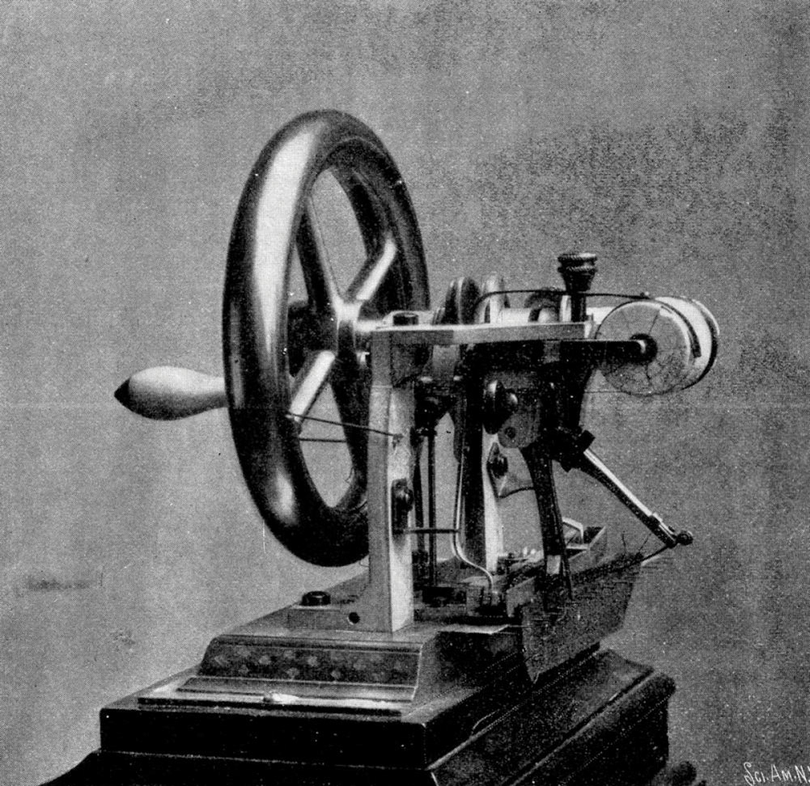
Howe’s sewing machine
Notes:
American Republic 4th/217b; "Elias Howe Sewing Machine 1846"/Wikipedia/Public Domain

Slide 9
Patents and Inventors
Samuel Colt made his mark on the firearms industry by manufacturing a “six-shooter.”
His weapon became popular during the Mexican War when it became the standard sidearm of the United States Army.
Samuel Colt
Notes:
Dover Electronic Clip Art; Engraved by H. W. Smith from a photograph by Mathew Brady/Dover Publications/Public Domain

Slide 10
Heavy Industry
Americans soon discovered large deposits of anthracite, or “hard” coal, and iron ore in western Pennsylvania.
As roads, canals, and railroads reached into the American interior, iron products also spread throughout the nation, and western Pennsylvania became a center of American heavy industry.
Towns grew up around the factories.

Slide 12
Agricultural Advances
John Deere perfected the plow.
He put an edge of steel over the iron blade of the plow, and his improved plow proved ideal for the new lands of the West.
John Deere
Notes:
https://commons.wikimedia.org/wiki/File:John_Deere_portrait.jpg; Photograph of John Deere from The Cyclopaedia of American Biography, vol. VIII, 1918/Public Domain

Slide 13
Agricultural Advances
In 1834, Cyrus McCormick received a patent for a reaping machine, a horse-drawn device that allowed one man to cut and stack ten to twelve acres of grain in a single day.
By the 1840s, more than 40 percent of Americans lived west of the Appalachian Mountains.
Cyrus McCormick
Notes:
Dover Electronic Clip Art; Dover Publications/Public Domain

Slide 15
The Cotton Kingdom
Whitney designed the cotton gin.
Cotton became the most important export of the U.S.
The growth of the cotton kingdom widened the gap between the South on the one hand and the North and the West on the other.
Cotton growing revitalized slavery.

Slide 16
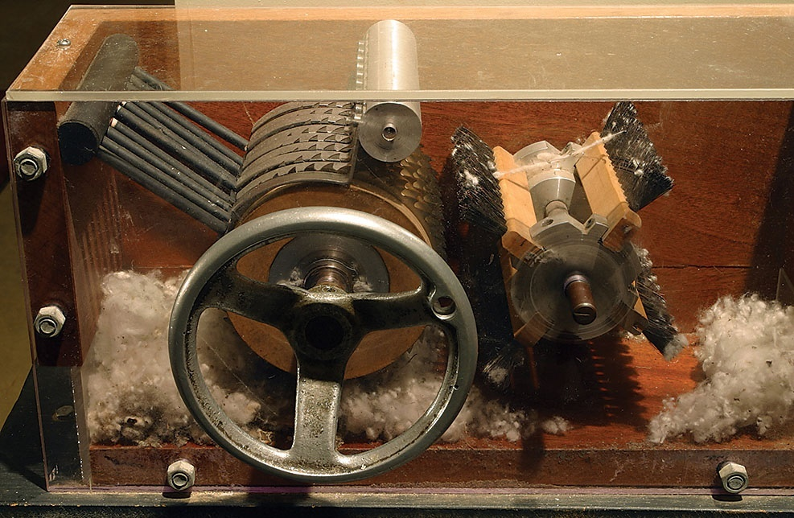
Whitney’s cotton gin
Notes:
American Republic 4th/220; Tom Murphy VII/Wikimedia Commons/Public Domain

Slide 17
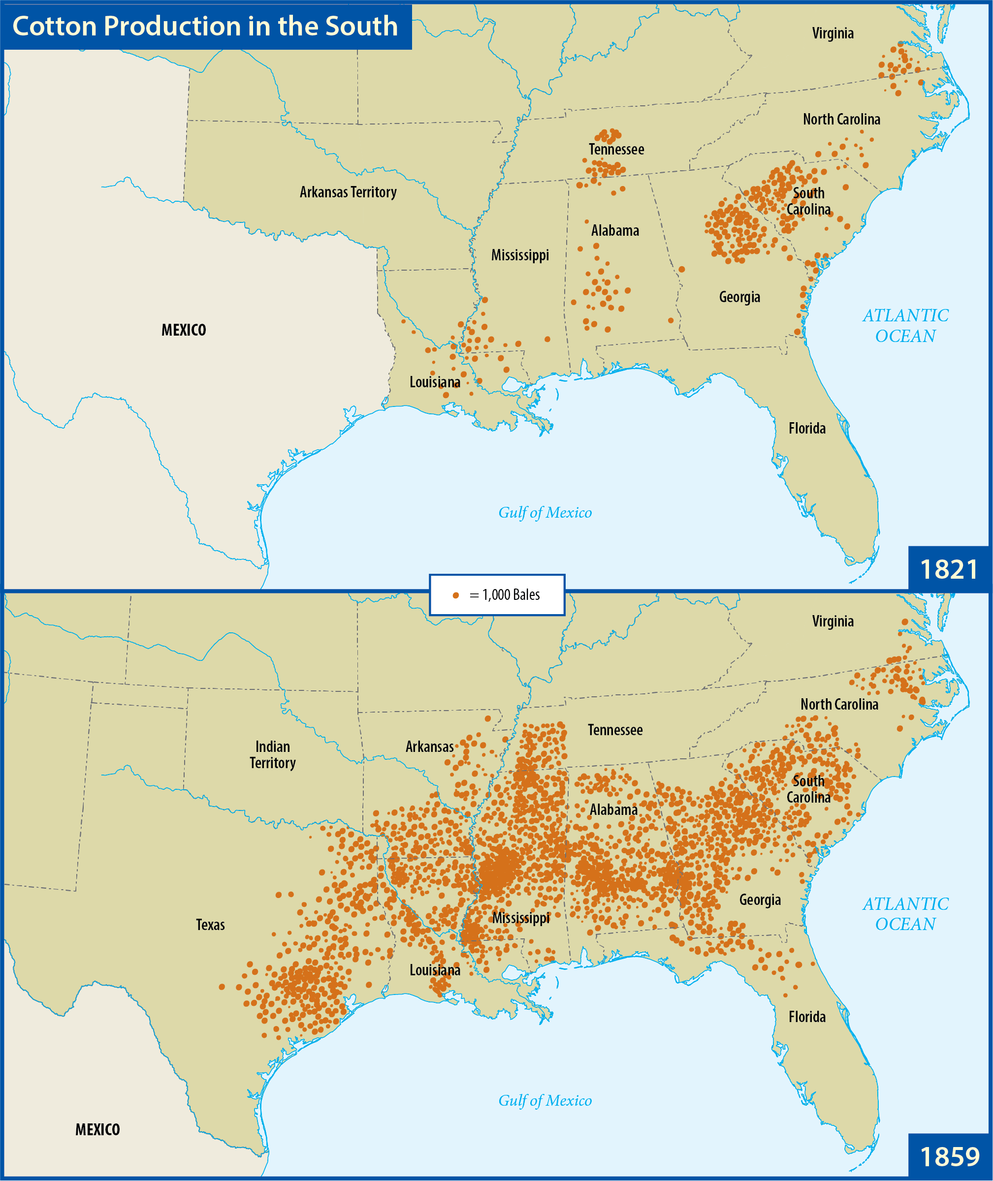
Map Resources

Slide 18
Section review
What was America’s first major industry? In what region of the nation did it center?
textiles; New England (p. 204)
Name three of this era’s important inventors and their respective inventions.
Eli Whitney (cotton gin and interchangeable parts), Elias Howe (sewing machine), Samuel Colt (revolver), John Deere (steel-edged plow), Cyrus McCormick (reaper) (pp. 204–5)

Slide 19
Section review
Why was the discovery of anthracite coal in western Pennsylvania important?
Anthracite coal burns hotter and cleaner than “soft” bituminous coal, thereby allowing manufacturers to produce better iron. Its discovery spurred American iron production and made western Pennsylvania a center of American heavy industry. (p. 205)

Slide 20
Section review
How did the invention of the cotton gin increase the differences between the South and the rest of the nation?
The cotton gin made growing cotton profitable and thereby revitalized slavery in the South even though the practice was either dying out or illegal in the rest of the nation. Also, as the profits from cotton increased, many southerners saw little benefit in developing industry and transportation networks as other parts of the nation were doing.

Slide 21
Section review
How did American development of industry and natural resources fulfill aspects of the Creation Mandate?
American development of industry and natural resources partially fulfilled the command to “subdue the earth and have dominion over it” by finding better methods for processing natural resources to improve the lives of others. Mankind was also created to find fulfillment in labor and in solving problems. These motivations were put to positive use in the development of industry and handling of natural resources.

Slide 22
River Transportation
The oldest avenues in America were rivers and streams.
Robert Fulton perfected a steam-powered ship.
The steamboat soon revolutionized river traffic.
Robert Fulton
Notes:
World History 4th/401b; Library of Congress

Slide 24
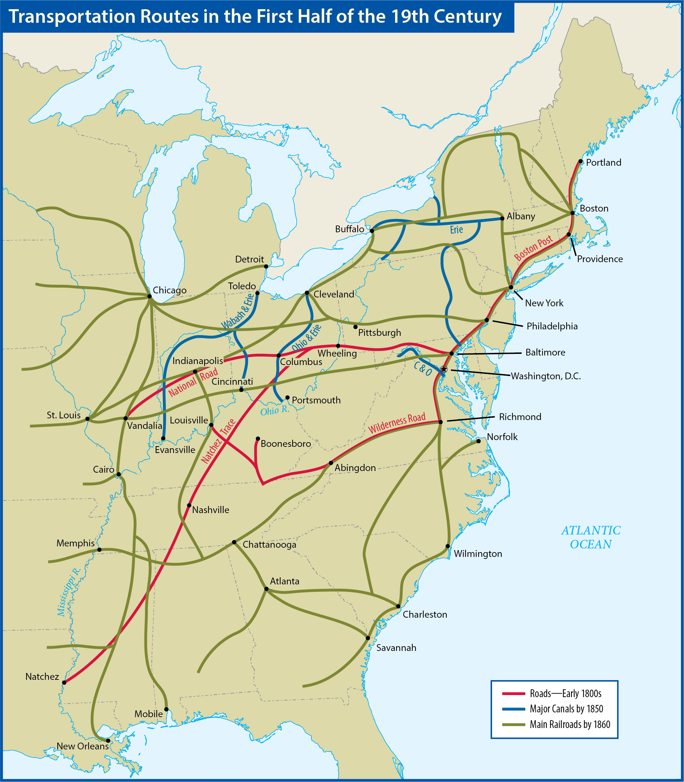
Map Resources

Slide 25
Roads
Americans built a system of roads across the countryside.
Most roads were built by private companies that paid for them by charging tolls for their use.
The most important early American road was the National Road (the Cumberland Road).
Notes:
US History 5th/209b; BJU Press Art

Slide 26
Canals
The canal era began in 1817, when New York, at the urging of Governor DeWitt Clinton, began building a canal from Albany to Lake Erie.
The Erie Canal proved such a success that it had paid for itself in tolls in less than ten years.
By the 1830s, one could travel from New York City to New Orleans completely by inland waterways.

Slide 27
Railroads
The first economically successful railroad in America was the Baltimore & Ohio Railroad.
Peter Cooper built Tom Thumb, a small but powerful steam engine.
Most railroads began using a standard gauge which allowed different companies to use the same tracks.
Notes:
https://pixabay.com/photos/steam-train-locomotive-train-501638/; pixabay/CC0

Slide 28
Sea Transportation
The clipper was one of the fastest sailing ships ever built.
From 1845 to 1860, the United States carried more sea trade than any other nation.
Soon the steamship replaced the clipper.
Notes:
https://en.wikipedia.org/wiki/File:Clipper_Ship_Southern_Cross_Leaving_Boston_Harbor_1851.jpeg; Clipper Ship 'Southern Cross' Leaving Boston Harbor by Fitz Henry Lane, 1851/Wikimedia Commons/Public Domain

Slide 29
Communication
The telegraph was the invention of Samuel F. B. Morse.
Soon telegraph lines stretched across the United States.
In 1858, the first successful transatlantic cable was laid between North America and the British Isles.
Samuel F. B. Morse
Notes:
American Republic 4th/214a; Library of Congress, LC-USZ62-12900

Slide 30
Section review
Name two methods of surfacing roads in the nineteenth century.
laying gravel, boards (“plank roads”), or logs (“corduroy roads”) (p. 209)
What was America’s most important method of transportation by 1861?
the railroad (p. 210)

Slide 31
Section review
What was the first economically successful railroad in America?
the B & O (Baltimore & Ohio) (p. 210)

Slide 32
Section review
What are the advantages of government-funded roads, canals, or railroads? What are the disadvantages? What role does private business play in such projects?
Government collects tax revenues and then uses those revenues to pay for infrastructure including roads, canals, and railroads.

Slide 33
Section review
Disadvantages would include the problem of government engaging in activity not clearly authorized by the Constitution.
Also, private businesses must invest their monies wisely in order to survive, whereas government could simply increase taxes to pay for additional construction. Private builders depend on customer service for future business, whereas government bureaucracy has less incentive to satisfy customer needs.

Slide 34
American culture

Slide 35
Guiding questions
What were the leading reform movements and artistic schools in the United States during the early nineteenth century?
What were the major characteristics of early nineteenth-century American culture?

Slide 36
Education
Two important trends developed in the reform of American education during this period: the growth of both public education and teacher education.
Horace Mann believed that people could find deliverance from ignorance and social problems through sound moral education.
Horace Mann
Notes:
American Republic 4th/226; Library of Congress, LC-USZC4-7396

Slide 37
Education
Massachusetts became a model for public education to the rest of the country.
Teaching as a profession itself became an important part of educational reform.
Horace Mann
Notes:
American Republic 4th/226; Library of Congress, LC-USZC4-7396

Slide 38
Education
In a series of elementary reading books, William McGuffey taught generations of Americans rules for living as well as rules for grammar.
McGuffey believed that biblical values had a natural and necessary role for shaping character in the classroom, and his work was enormously successful.
William McGuffey
Notes:
https://commons.wikimedia.org/wiki/File:William_Holmes_McGuffey.jpg; Photograph of William Holmes McGuffey by unknown artist/Wikimedia Commons/Public Domain

Slide 39
Prohibition
Reformers replaced their call for temperance with a call for the outright prohibition of the sale and consumption of alcohol.
The Prohibition movement’s greatest success came in the early twentieth century with the passage of the Eighteenth Amendment.

Slide 40
Dorothea Dix
One of the most important reformers of the era was a quiet schoolteacher and writer, Dorothea Dix.
Through her efforts, legislatures in several eastern states voted to improve the sanitary conditions and treatment of inmates in asylums.
Dorothea Dix
Notes:
US History 5th/213b; "Samuel Bell Waugh - Dorothea Lynde Dix - Google Art Project-crop"/Wikimedia Commons/Public Domain

Slide 41
Women’s Rights
In 1848, women reformers held a convention in Seneca Falls, New York, in which they passed resolutions calling for equal rights for women.
The Seneca Falls Convention is now commonly regarded as the birth of the modern women’s rights movement.

Slide 42
Utopian Reformers
Utopian reformers sought to establish small, perfect communities that would serve as models for the reform of society at large.
Robert Owen sought to establish a perfect society at New Harmony, Indiana, but it failed.
The transcendentalists tried to establish Brook Farm, which was an experiment in communal living based on the idea that man could transcend feelings by coming into harmony with his inner being.

Slide 43
Utopian Reformers
Transcendentalism was primarily the creation of writer and lecturer Ralph Waldo Emerson.
Emerson taught that man was essentially good and ultimately perfectible.
Among those influenced by transcendentalism were author Henry David Thoreau and poet Walt Whitman.
Ralph Waldo Emerson
Notes:
Dover Electronic Clip Art; Engraving by J. A. J. Wilcox/Dover Publications/Public Domain

Slide 44
Painting and Architecture
The Federalist approach emphasized balance, emotional restraint, and a respect for the artistic styles of ancient Greece and Rome.
Benjamin West, America’s first great painter, often painted New World subjects.
Benjamin West
Notes:
Dover Electronic Clip Art; Painting by Gilbert Stuart/Dover Publications/Public Domain

Slide 45
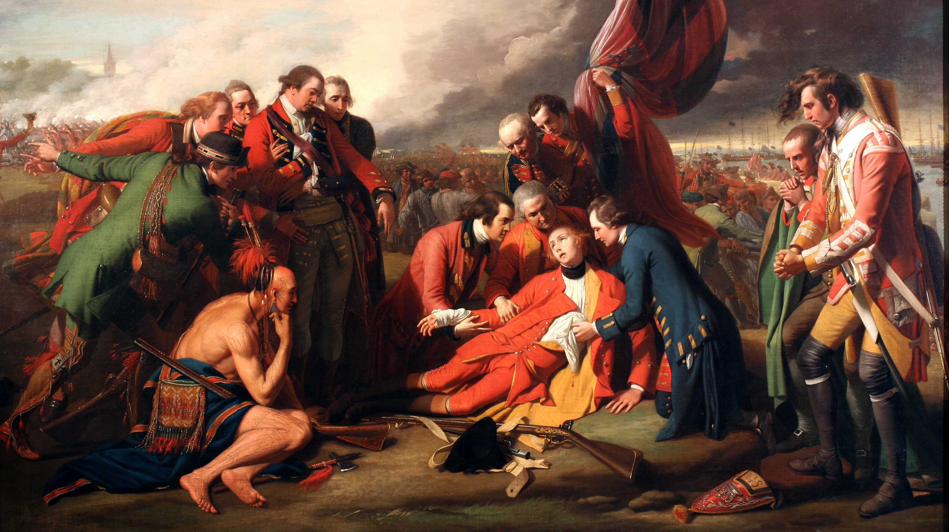
Death of General Wolfe by Benjamin West
Notes:
https://commons.wikimedia.org/wiki/File:The_Death_of_General_Wolfe_B.West,1770.jpg; The Death of General Wolfe by Benjamin West, 1770/Wikimedia Commons/Public Domain

Slide 46
Painting and Architecture
Gilbert Stuart was one of the young nation’s finest portrait painters.
He is best known for his different portraits of George Washington, especially his “unfinished” portrait which appears on the $1 bill.
Gilbert Stuart

Slide 47
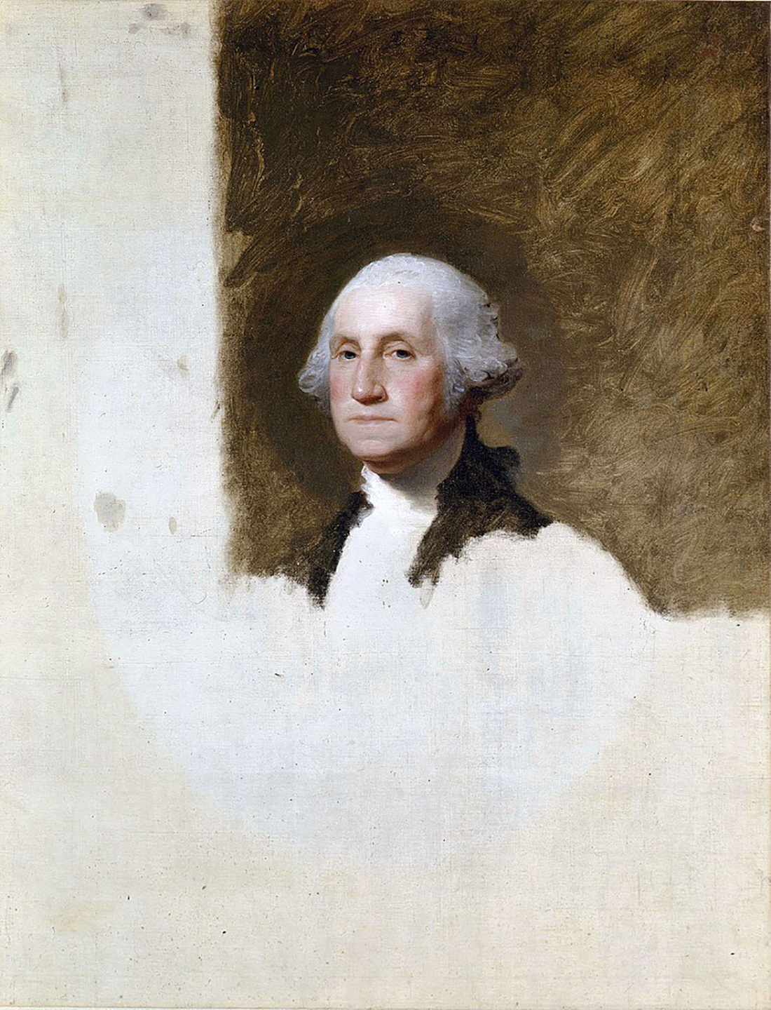
Unfinished portrait of George Washington by Gilbert Stuart
Notes:
https://commons.wikimedia.org/wiki/File:Gilbert_Stuart_1796_portrait_of_WashingtonFXD.jpg; Unfinished portrait of George Washington by Gilbert Stuart, 1796/Wikimedia Commons/Public Domain

Slide 48
Painting and Architecture
Possibly the greatest of the Federalist artists was John Trumbull.
Trumbull specialized in realistic historical paintings.
John Trumbull

Slide 49
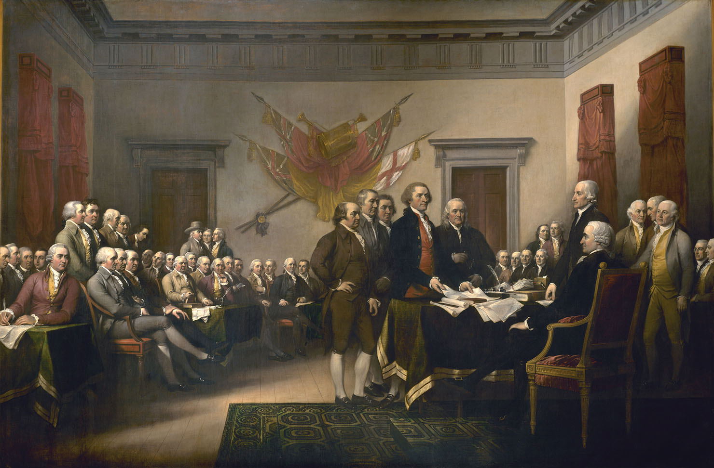
The Declaration of Independence, 4 July 1776 by John Trumbull
Notes:
US History 5th/105bl; "Declaration independence" by John Trumbull/US Capitol/Wikipedia/Public Domain

Slide 50
Painting and Architecture
The formal portraits of the Federalist era gave way to casual portrayals of the common man in everyday life.
George Caleb Bingham captured the boisterous, sometimes crude, but always lively activity of American politicking.
The Hudson River school of painters specialized in landscapes, capturing the land in its serene and majestic beauty.

Slide 51
Painting and Architecture
Thomas Cole became one of the best-known painters of the Hudson River school.
His landscapes captured the beauty and sublimity of nature and subtly minimized the role of man in contrast with its majesty.
Thomas Cole
Notes:
Dover Electronic Clip Art; Dover Publications/Public Domain

Slide 52
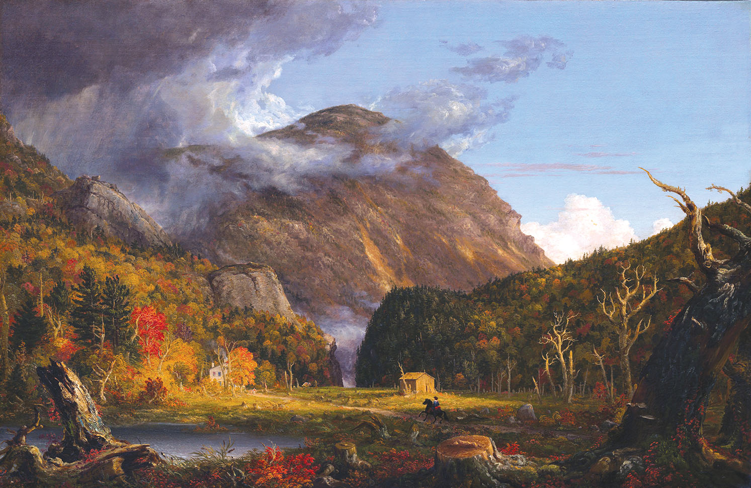
A View of the Mountain Pass Called the Notch of the White Mountains (Crawford Notch) by Thomas Cole
Notes:
Dover Electronic Clip Art; A View of the Mountain Pass Called the Notch of the White Mountains (Crawford Notch) by Thomas Cole, 1839/Dover Publications/Public Domain

Slide 53
Painting and Architecture
Federalist architecture also borrowed from ancient classical civilizations.
Charles Bulfinch and Benjamin Henry Latrobe designed America’s most famous Federalist-style building, the United States Capitol.
Among Jefferson’s designs were his home in Virginia (Monticello), the Virginia state capitol, and the University of Virginia rotunda.

Slide 54
Literature
The first great age of American literature began with the romantic movement (1820–65).
The first American writer to gain fame outside America was novelist James Fenimore Cooper.
With “Rip Van Winkle” and “The Legend of Sleepy Hollow,” Washington Irving put a distinctively American twist on short stories.
James Fenimore Cooper

Slide 55
Literature
Romanticism’s central belief in the goodness of man and the glory of nature was expounded by Ralph Waldo Emerson in his works Nature and Self-Reliance.
Essayist Henry David Thoreau, author of Walden, and poet Walt Whitman, in his work Leaves of Grass, both celebrated the glory and nobility of man.
Ralph Waldo Emerson
Notes:
Dover Electronic Clip Art; Engraving by J. A. J. Wilcox/Dover Publications/Public Domain

Slide 56
Literature
Nathaniel Hawthorne’s The Scarlet Letter criticizes what Hawthorne considered the narrow, hypocritical views of Puritanism.
Edgar Allan Poe delved deep into the dark, tortured depths of man’s soul.
Poe became the master short-story writer of America before the Civil War.
Nathaniel Hawthorne
Notes:
https://commons.wikimedia.org/wiki/File:Nathaniel_Hawthorne.jpg; Portrait of Nathaniel Hawthorne by Charles Osgood, 1840/Wikimedia Commons/Public Domain

Slide 57
Music
Popular music dominated the United States.
America’s most important composer of the period was Stephen Foster who wrote lyrical ballads.
Hymnwriter Lowell Mason published several popular hymnbooks and composed the tunes for hymns.
Stephen Foster
Notes:
US History 4th/227; Library of Congress

Slide 58
Section review
What were the two important trends in American education in the early 1800s?
the growth of public education and teacher education (p. 212)
What is the difference between temperance and prohibition?
Temperance is moderate drinking of alcohol; prohibition is the banning of the sale and consumption of alcohol. (p. 213)

Slide 59
Section review
How did utopian reformers differ from other reformers?
Utopian reformers sought to establish small, perfect communities that would be models for the reform of society at large. Other reformers focused on a single major problem in society and sought to eliminate that problem throughout society. (p. 214)

Slide 60
Section review
Critique the excerpt of Ralph Waldo Emerson in the margin box on p. 216.
Emerson minimizes the significance of consistency and the problem of contradicting oneself. However, the Bible stresses the importance of speaking the truth (Phil. 4:8), which is not possible if one is not consistent and is content to contradict previous statements. The Bible and the Christian life are predicated on consistency. God provided a clear testimony of creation, fall, and redemption. Christians must be consistent in their lives and testimonies in order to draw the unsaved to the Savior.

Slide 61
Section review
What is at the heart of the failure of every attempted utopian society?
They all believe in the ultimate goodness of man’s nature and that man can produce a perfect society. They deny the need for a divine Savior.

Slide 62
American slavery

Slide 63
Guiding questions
How did Americans resist slavery?
Who were leading abolitionists in America?
What does the Bible teach about slavery?

Slide 64
work
Most slaves worked in the fields caring for cotton or tobacco.
Some slaves worked in the house, cooking or caring for the master’s children.
Some slave owners understood that slaves were too valuable to be treated poorly.

Slide 65
Family and Personal Life
Family was very important to the slaves.
The slaves had to depend on their owners to meet family needs.
The greatest fear of a slave was to have a family member sold to another region.
Notes:
American Republic 4th/251; Library of Congress

Slide 66
Slave Responses
The “Underground Railroad” developed as a means of hiding fleeing slaves and leading them to safety and freedom in the North.
The most famous member of the Underground Railroad was Harriet Tubman.
Harriet Tubman
Notes:
US History 5th/262t; Library of Congress

Slide 67
Slave Responses
In August of 1831, a slave and radical preacher named Nat Turner led a slave rebellion in Southampton County, Virginia.
Several states made it illegal to teach slaves to read and write in order to diminish the possibility of slave revolts.
Nat Turner
Notes:
https://commons.wikimedia.org/wiki/File:Nat_Turner_captured.jpg; Engraving of the discovery of Nat Turner from A Popular History of the United States, 1882/Wikimedia Commons/Public Domain

Slide 68
Defenses of Slavery
Some Southerners believed that they were more virtuous than Northerners who participated in wage slavery.
Some believed that slavery promoted virtue.
Some believed that slavery allowed the Africans to be exposed to Christianity.
Some believed that God did not forbid slavery but regulated it.

Slide 69
Abolitionism
Abolitionism was the movement to eliminate slavery immediately and entirely.
The most important abolitionist leader was William Lloyd Garrison.
His newspaper, the Liberator, attacked the moral evil of slavery.
Garrison said that black Americans in the North were sometimes little better off than slaves in the South.
William Lloyd Garrison
Notes:
US History 5th/220t; "William Lloyd Garrison by Southworth and Hawes, c1850"/Wikimedia Commons/Public Domain

Slide 70
Abolitionism
Women like the Grimké sisters also played prominent roles in the abolitionist movement.
Frederick Douglass was a former slave who wrote and spoke about his experience.
Frederick Douglass
Notes:
US History 5th/317t; National Archives

Slide 71
Gradual Emancipation
Men such as John Quincy Adams, Henry Clay, and Abraham Lincoln initially favored emancipating the slaves gradually.
Gradual emancipation would free the slaves over time without causing catastrophic economic problems for the slaveholders.
It would also allow time to educate the slaves and train them with skills so they could support themselves.
Many abolitionists and slaveholders opposed the idea of gradual emancipation and it was abandoned.

Slide 72
The Bible and Slavery
Close examination of the Bible reveals that it does not support American slavery.
God’s commands to Israel regarding slavery were nothing like the American system of slavery.
American slavery went against broad biblical principles.
Early Christians were not socially powerful enough to end slavery.
If the New Testament practices were followed by those Christians who claimed the New Testament justified slavery, the institution of slavery would have ceased.

Slide 73
Section review
Who was the most important leader of the abolitionist movement?
William Lloyd Garrison (p. 220)
Name two former slaves who became active in opposing slavery.
Harriet Tubman and Frederick Douglass (pp. 219–20)

Slide 74
Section review
What two skills did some slave owners oppose being taught to slaves?
reading and writing (p. 219)

Slide 75
Section review
How did American slavery differ from the slavery that God permitted in Israel?
American slavery was based on the stealing of men, which the Bible teaches merits the death penalty (Exod. 21:16).
American slavery was based on race, and the Bible teaches that all humans are image bearers of God (Gen. 1:26–28; Eph. 6:9).
The Bible did not permit slaves to be slaves for life against their will (Deut. 15:16–17; 1 Cor. 7:21).

Slide 76
Section review
If the United States had adhered to the Bible, it would not have required the return of runaway slaves (Deut. 23:15–16).
American slavery allowed for the beating and threatening of slaves, whereas the Bible does not (Ex. 21:26–27; Eph. 6:9).
The Bible teaches that we should do to others as we would wish them to treat us, but American slave owners did not wish to be treated as they treated their slaves (Matt. 7:12).

Slide 77
Section review
Why should Americans have concluded that the Bible condemned American slavery?
The two systems were so different that some wonder if they should be identified with the same word.

Slide 78
American religion

Slide 79
Guiding questions
What was the background and course of the Second Great Awakening?
How did the teachings of major unorthodox religions in America differ from biblical doctrine?
What was the background and course of the Prayer Meeting Revival?

Slide 80
The Second Great Awakening
Shortly after the ratification of the Constitution, America experienced its second great revival of religion.
The Second Great Awakening was longer and more complex in nature than the first.

Slide 81
Background
Deism believed that reason rather than Scripture was the way men came to know God.
One of the brightest spots for Christianity was the growth of American Methodism.
The Methodists were followers of the teachings of English minister John Wesley.
John Wesley
Notes:
World History 5th/329; "John Wesley by George Romney"/Wikimedia Commons/Public Domain

Slide 82
Background
Francis Asbury was the Father of American Methodism and he developed the idea of circuit riding.
“Circuit riders” traveled on horseback from settlement to settlement, ministering to Christians and preaching to the lost.
Francis Asbury
Notes:
US History 5th/224; Library of Congress

Slide 83
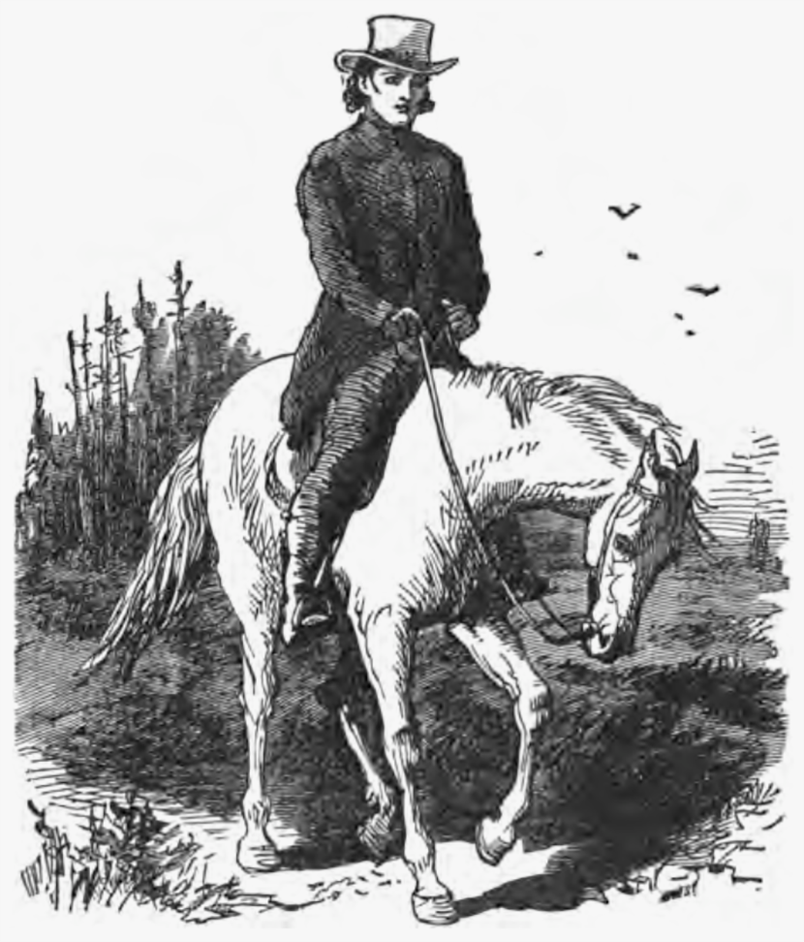
A circuit rider
Notes:
https://commons.wikimedia.org/wiki/File:Circuit_rider_illustration_Eggleston.png; Illustration "Going to Conference" from The Circuit Rider: A Tale of the Heroic Age by Edward Eggleston, 1902/Wikimedia Commons/Public Domain

Slide 84
Revival in the East
Eastern revival centered in the churches and colleges.
Timothy Dwight became the president of Yale in 1795.
His preaching resulted in a series of revivals in which at least a third of Yale’s students were converted.
Timothy Dwight
Notes:
https://commons.wikimedia.org/wiki/File:Timothy_Dwight_IV_by_John_Trumbull_1817.jpeg; Portrait of Timothy Dwight by John Trumbull, 1817/Wikimedia Commons/Public Domain

Slide 85
Revival in the West
The chief feature of the western revivals was the camp meeting, a series of religious services lasting several days and often held outdoors.
The most significant camp meeting was held at Cane Ridge, Kentucky, in 1801.
Notes:
US History 4th/211; Library of Congress

Slide 86
Foreign Missions
The first great American missions movement resulted from this revival.
Adoniram Judson and Luther Rice went to India in 1812.
Judson moved to Burma, where his translation work and preaching made him a hero of the American missions movement.
Adoniram Judson

Slide 87
Charles Finney and the “New Measures”
Charles Finney developed what others dubbed “New Measures,” new and unusual methods for conducting revivals.
Finney claimed that sinners had the responsibility and ability to change their own hearts without the gracious working of God.
Charles Finney
Notes:
US History 5th/226; "Charles g finney"/Wikimedia Commons/Public Domain

Slide 88
Results of the Awakening
Thousands were converted to Christ and joined churches.
America’s foreign missions movement was born and grew.
Moral sins declined.
New methods of evangelism developed.

Slide 89
Unitarianism
One of the most prestigious unorthodox religions is Unitarianism which denies the Trinity and therefore the deity of Christ.
Harvard became a center of Unitarian teaching, and many of the old Congregationalist churches in the East declined from orthodoxy to Unitarianism.

Slide 90
Millerites
Miller was a Baptist minister in New York who began to attract attention because he was a premillennialist.
While Miller abandoned his efforts to predict the Lord’s return, others continued to do so.
Seventh-Day Adventists developed from the Millerites.

Slide 91
Other Unorthodox Movements
The Shakers began in England in the 1700s but enjoyed their greatest growth in America in the early 1800s.
Shakers believed that their founder, Mother Ann Lee, was an incarnation of God, just as Jesus was.
The Shakers built prosperous, well-ordered farms in New England, New York, Ohio, Indiana, and Kentucky.

Slide 92
Other Unorthodox Movements
The most significant unorthodox religion to arise at this time was Mormonism, also known as the Church of Jesus Christ of Latter-Day Saints.
Mormonism was founded by Joseph Smith in 1830.
Mormons teach that salvation rests on good works and that one who is good enough becomes a god.
Joseph Smith
Notes:
https://commons.wikimedia.org/wiki/File:Joseph_Smith_Jr_3_generation_albumen_print.jpg; Library of Congress, LC-DIG-ppmsca-19968

Slide 93
Other Unorthodox Movements
Mormons stirred up controversy by their practice of polygamy.
Brigham Young assumed the leadership of the Mormons after Joseph Smith was killed.
The Mormons moved west and built a huge temple in Salt Lake City.
Brigham Young
Notes:
American Republic 4th/239b; Library of Congress, LC-DIG-cwpbh-01671

Slide 94
Other Unorthodox Movements
Mary Baker Eddy founded Christian Science.
Christian Science denies the Trinity, the inspiration of Scripture, miracles, the atonement, and other key Christian doctrines.
The group also denies sickness and death.
Mary Baker Eddy
Notes:
US History 5th/228b; Library of Congress

Slide 95
The Prayer Meeting Revival
The climax of religious life came just before the Civil War in what was called by some the “third great awakening,” or the Prayer Meeting Revival of 1857–59.
There was no formal organization to the prayer meetings.
The overall impact of the revival was remarkable.

Slide 96
The Prayer Meeting Revival
Results:
Nearly a million people were converted.
Money was raised to start Christian schools and support foreign missionaries.
Laymen were the leadership.
The revival prepared the hearts of men to endure the trials of the Civil War.

Slide 97
Section review
What system did Francis Asbury develop to solve the problem of having too few ministers to cover a large area of land?
circuit riding (p. 224)
Give four results of the Second Great Awakening.
Thousands were converted and joined churches; America’s foreign missions movement was born; moral sins declined, and the drive for social reform increased; new methods of evangelism, such as camp meetings and many of the “New Measures,” became features of American Christianity. (p. 227)

Slide 98
Section review
Name four unorthodox religious movements of the era.
Unitarianism, the Millerites, the Shakers, the Mormons, or the Christian Scientists (pp. 227–28)

Slide 99
Section review
In what ways did the revivalism of this era reflect the American values of liberty, equality, individualism, and growth?
Liberty: The era of established churches was past. New denominations and religions were formed, and older denominations competed with one another for congregants.
Equality: The role of a pastor was no longer restricted to educated clergy. Now anyone who could gather a hearing could be a preacher.

Slide 100
Section review
Individualism: Instead of interpreting Scripture in line with a denomination’s creed or confession, individuals asserted their own competence in interpretation.
Growth: Numerical growth not only occurred but was often tabulated and promoted.

Slide 101
Section review
Critique Finney’s description of sinners in light of Romans 3:10–12 and Ephesians 2:8–9.
Finney claimed that sinners could change their own hearts without the work of God. Romans 3 declares that all have sinned (missed the mark) and fallen short of God’s glory, thus needing God to work in their hearts to be saved. Finney claimed that sinners could be justified apart from faith alone. Ephesians 2 declares that salvation is by grace through faith, apart from their own works (“and that not of yourselves”), and that salvation is a gift from God.

Slide 102
People, Places, and Things to Remember
Samuel Slater
Eli Whitney
John Deere
Cyrus McCormick
cotton gin
Robert Fulton
National Road
Erie Canal
Baltimore & Ohio Railroad
Samuel F. B. Morse
Horace Mann
William H. McGuffey
utopian reformers
Robert Owen
Benjamin West
Gilbert Stuart
John Trumbull
Thomas Cole

Slide 103
People, Places, and Things to Remember
James Fenimore Cooper
Ralph Waldo Emerson
Nathaniel Hawthorne
Stephen Foster
Lowell Mason
Underground Railroad
Harriet Tubman
Nat Turner
abolitionism
William Lloyd Garrison
Frederick Douglass
Second Great Awakening
deism
Methodists
Francis Asbury
Timothy Dwight
camp meeting
Cane Ridge

Slide 104
People, Places, and Things to Remember
Adoniram Judson
Charles Finney
Unitarianism
Shakers
Mormonism
Joseph Smith
Brigham Young
Mary Baker Eddy
Christian Science
Prayer Meeting Revival

