Slide 1
Chapter 12:
The Federal Bureaucracy
Notes:
WIN-Initiative/Stone/Getty Images

Slide 2
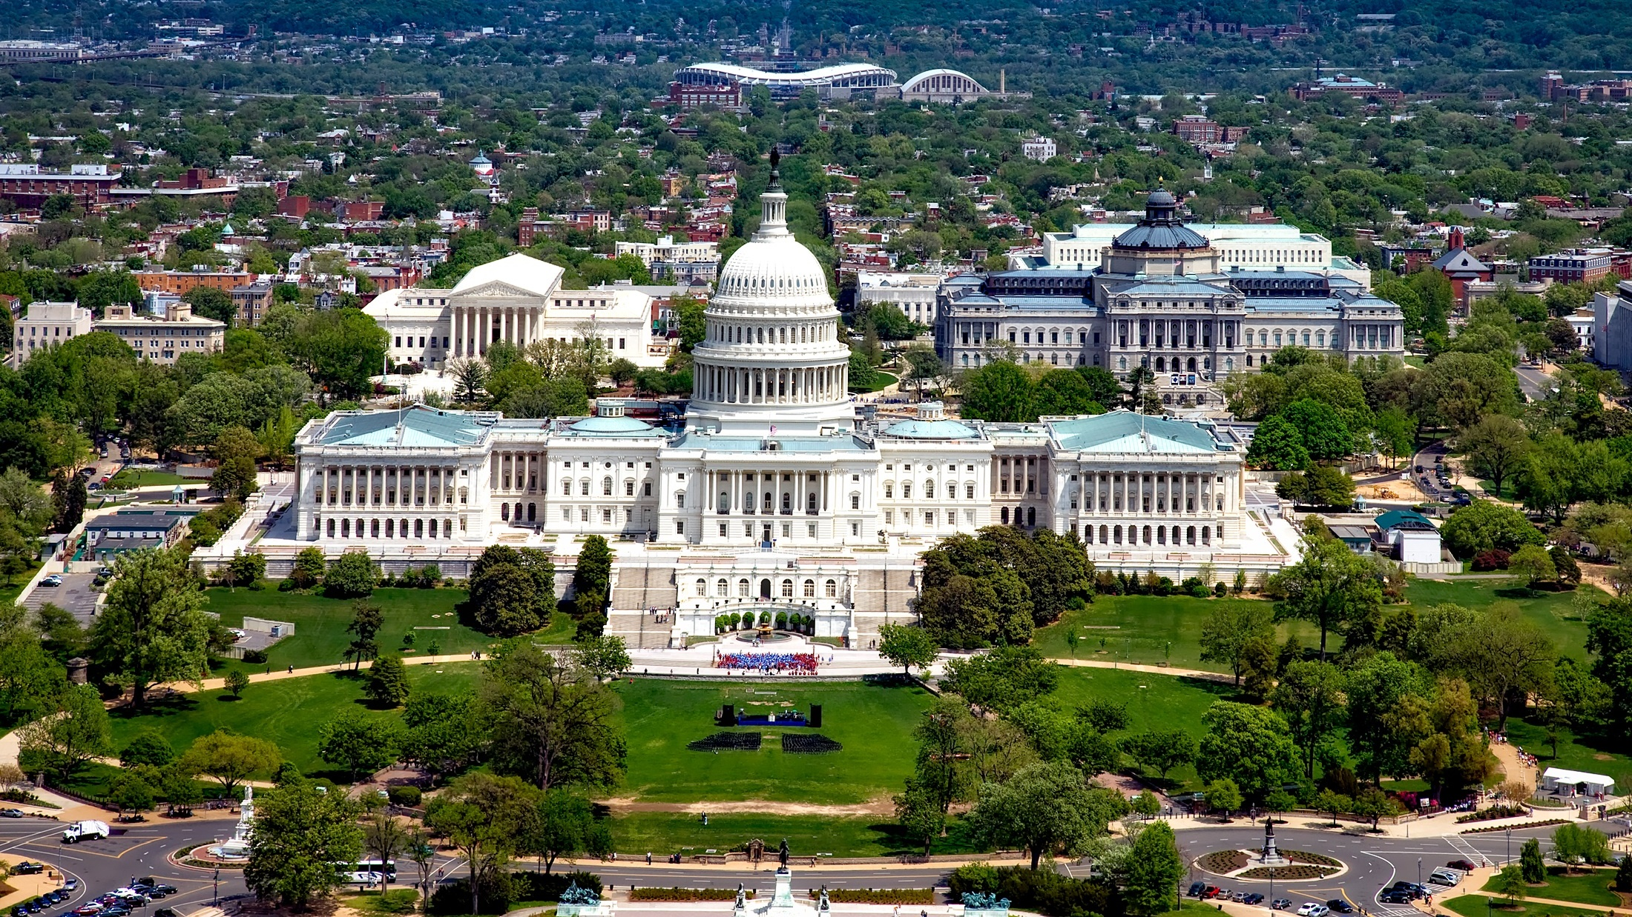
I. Bureaucratic Development
Chapter 12.1
Notes:
Image by David Mark from Pixabay
https://pixabay.com/photos/washington-dc-c-city-cities-urban-1624419/

Slide 3

A. Overview
The term bureaucracy refers to an administrative system staffed largely by nonelected officials.
The executive branch contains many bureaucrats (civil servants).
Notes:
Image by StartupStockPhotos from Pixabay
https://pixabay.com/photos/office-startup-business-home-office-594132/

Slide 4
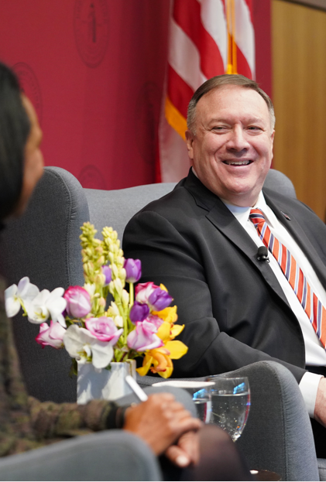
A. Overview
Government bureaucracy makes use of the principle of delegation – entrusting a task or power to another.
Bureaucracy is necessary because the president cannot fulfill his duties by himself.
Notes:
By U.S. Department of State from United States - Secretary Pompeo Delivers Remarks at the Hoover Institution, Public Domain, https://commons.wikimedia.org/w/index.php?curid=85878021
https://commons.wikimedia.org/w/index.php?sort=relevance&search=mike+pompeo&title=Special:Search&profile=advanced&fulltext=1&advancedSearch-current=%7B%7D&ns0=1&ns6=1&ns12=1&ns14=1&ns100=1&ns106=1&searchToken=beuitcldqa9qrp6r90qhc190y#%2Fmedia%2FFile%3ASecretary_Pompeo_Delivers_Remarks_at_the_Hoover_Institution_%2849380885247%29.jpg

Slide 5
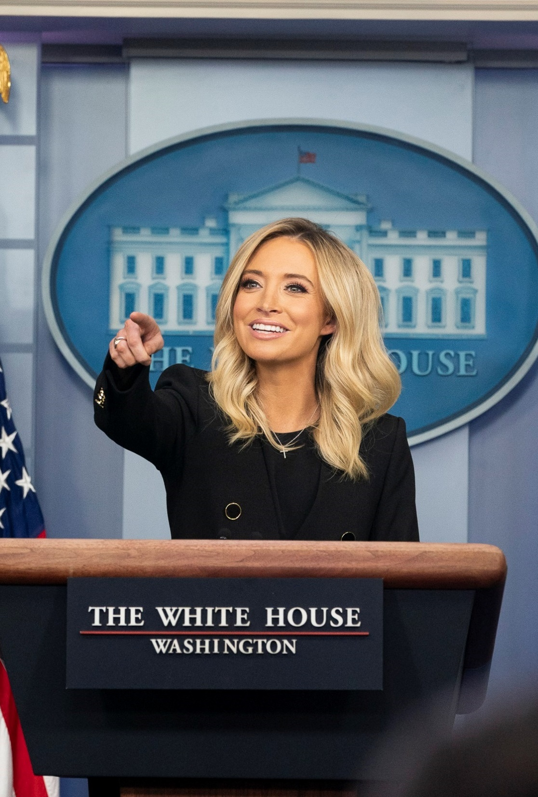
A. Overview
America’s bureaucracy has three key features:
  Hierarchical authority
  Job specialization
  Formalized rules
Notes:
By The White House from Washington, DC - https://commons.wikimedia.org/wiki/File:White_House_Press_Briefing_(49842842011).jpg, Public Domain, https://commons.wikimedia.org/w/index.php?curid=89728493
https://commons.wikimedia.org/w/index.php?sort=relevance&search=press+secretary&title=Special:Search&profile=advanced&fulltext=1&advancedSearch-current=%7B%7D&ns0=1&ns6=1&ns12=1&ns14=1&ns100=1&ns106=1&searchToken=5aif8jw3xvhk1j2yyqr67vb05#%2Fmedia%2FFile%3AWhite_House_Press_Briefing_%2849842842011%29_%28cropped%29.jpg

Slide 6
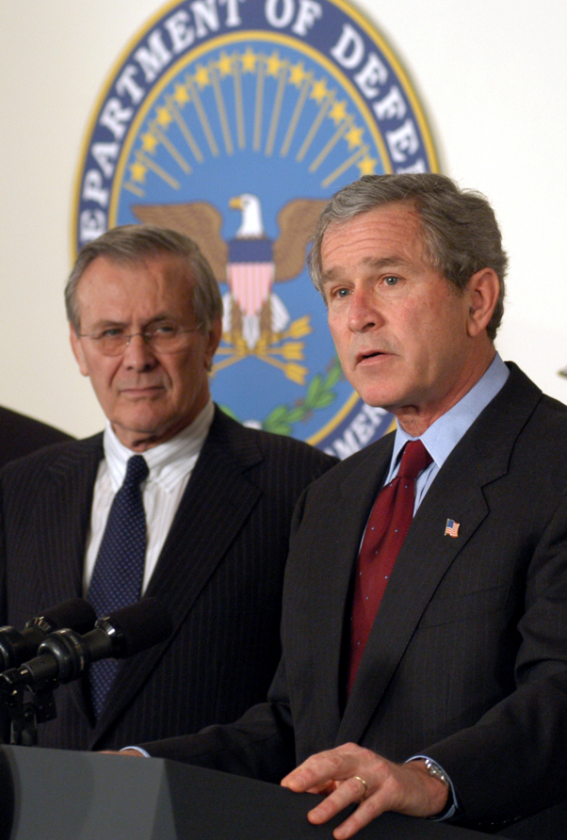
A. Overview
These bureaucratic features produce three benefits:
  Limits conflicts concerning who has the authority to make decisions
  Specialization encourages efficiency and productivity
  Defined standards ensure that work can continue when employees leave and are replaced by new workers
Notes:
Public Domain, https://commons.wikimedia.org/w/index.php?curid=592706
https://commons.wikimedia.org/w/index.php?title=Special:Search&limit=500&offset=0&ns0=1&ns6=1&ns12=1&ns14=1&ns100=1&ns106=1&search=secretary+of+defense&advancedSearch-current=%7B%7D&searchToken=1wv7v6repbq3lfnbu371gaylu#%2Fmedia%2FFile%3ABush_War_Budget_2003.jpg

Slide 7
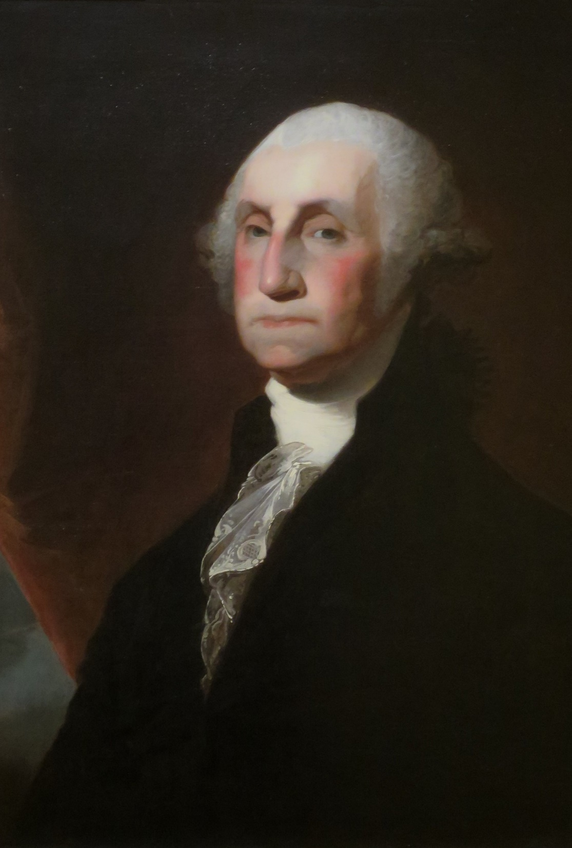
B. History and Growth
In 1789, James Madison successfully argued that the president should be able to remove officials from the State Department.
The Washington administration set the early standards for the civil service – civilian employees who perform the administrative tasks of government.
Notes:
By Gilbert Stuart - Own work, Public Domain, https://commons.wikimedia.org/w/index.php?curid=39493581
https://commons.wikimedia.org/w/index.php?title=Special:Search&limit=500&offset=0&ns0=1&ns6=1&ns12=1&ns14=1&ns100=1&ns106=1&search=president+george+washington&advancedSearch-current=%7B%7D&searchToken=z6y7pdbiybt34xmlp9z8vh7h#%2Fmedia%2FFile%3A%27President_George_Washington%27_by_Gilbert_Stuart%2C_El_Paso_Museum_of_Art.JPG

Slide 8
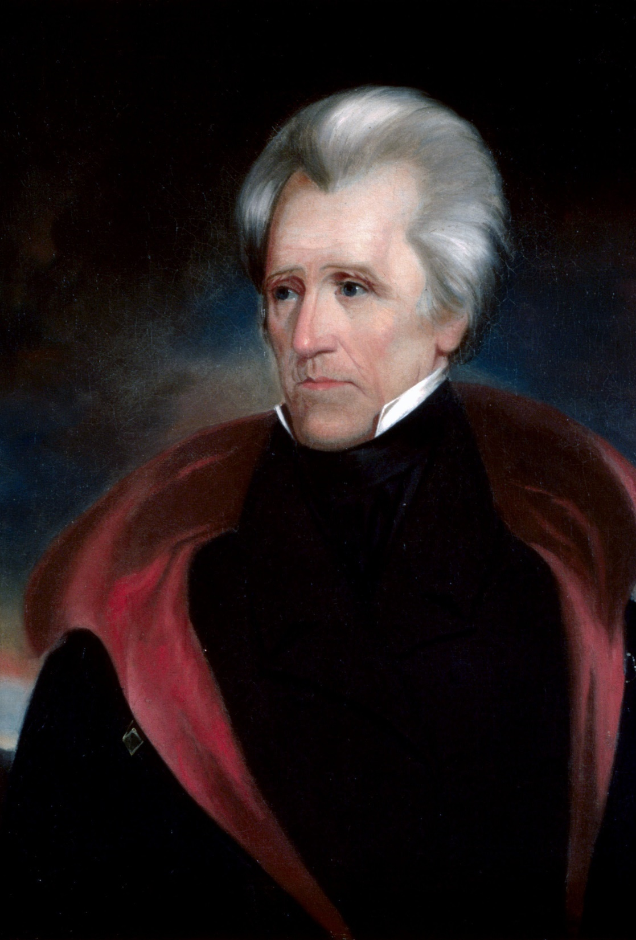
B. History and Growth
In 1829, Andrew Jackson created the spoils system when he gave government posts to supporters regardless of merit.
During the Civil War, the bureaucracy grew to meet the demands of industrialization.
Notes:
By Ralph Eleaser Whiteside Earl - This file was derived from: Andrew jackson head.jpg:, Public Domain, https://commons.wikimedia.org/w/index.php?curid=71259730
https://commons.wikimedia.org/w/index.php?sort=relevance&search=president+Andrew+Jackson&title=Special:Search&profile=advanced&fulltext=1&advancedSearch-current=%7B%7D&ns0=1&ns6=1&ns12=1&ns14=1&ns100=1&ns106=1&searchToken=7oqi1i1v2wg8jyb1p4pa15fsr#%2Fmedia%2FFile%3AAndrew_jackson_headFXD.jpg

Slide 9
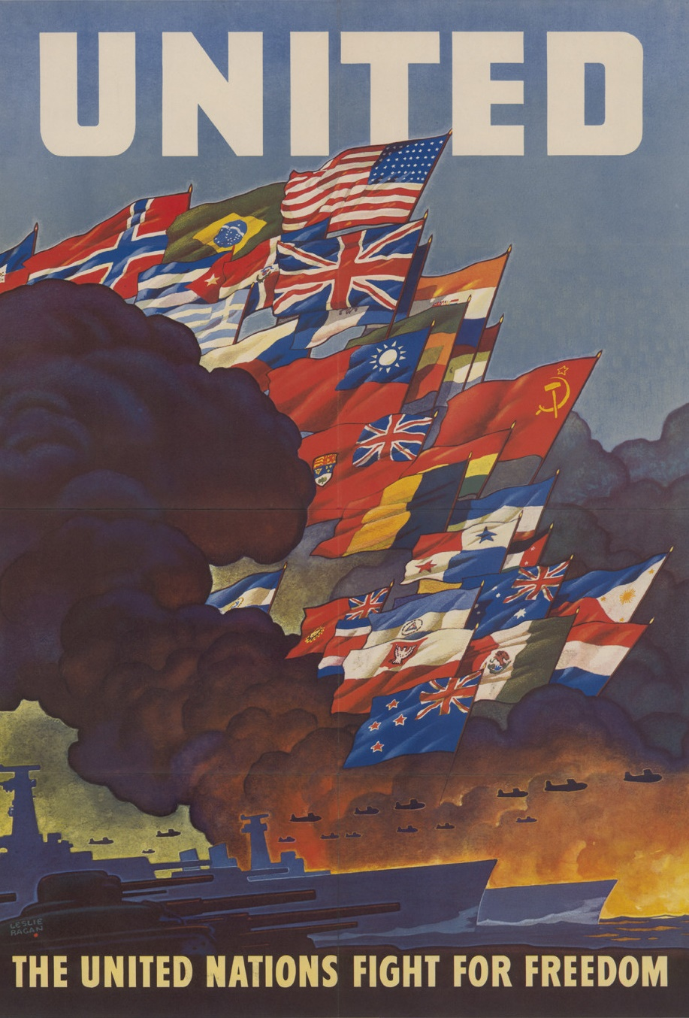
B. History and Growth
The bureaucracy was reformed by the Pendleton Act of 1883 which stated that merit would be the standard for hiring government officials.
Government regulation of the economy greatly expanded during World War I, the New Deal, and World War II.
Notes:
By Naciones_Unidas_3.jpg: The original uploader was Commanderraf at English Wikipedia.derivative work: Beao - Naciones_Unidas_3.jpg, Public Domain, https://commons.wikimedia.org/w/index.php?curid=9545130
https://commons.wikimedia.org/w/index.php?sort=relevance&search=World+War+II+posters&title=Special:Search&profile=advanced&fulltext=1&advancedSearch-current=%7B%7D&ns0=1&ns6=1&ns12=1&ns14=1&ns100=1&ns106=1&searchToken=3nz5l6cnee86fhgwaijjx9zbl#%2Fmedia%2FFile%3AUnited_Nations_%22Fight_For_Freedom%22_poster.jpg

Slide 10
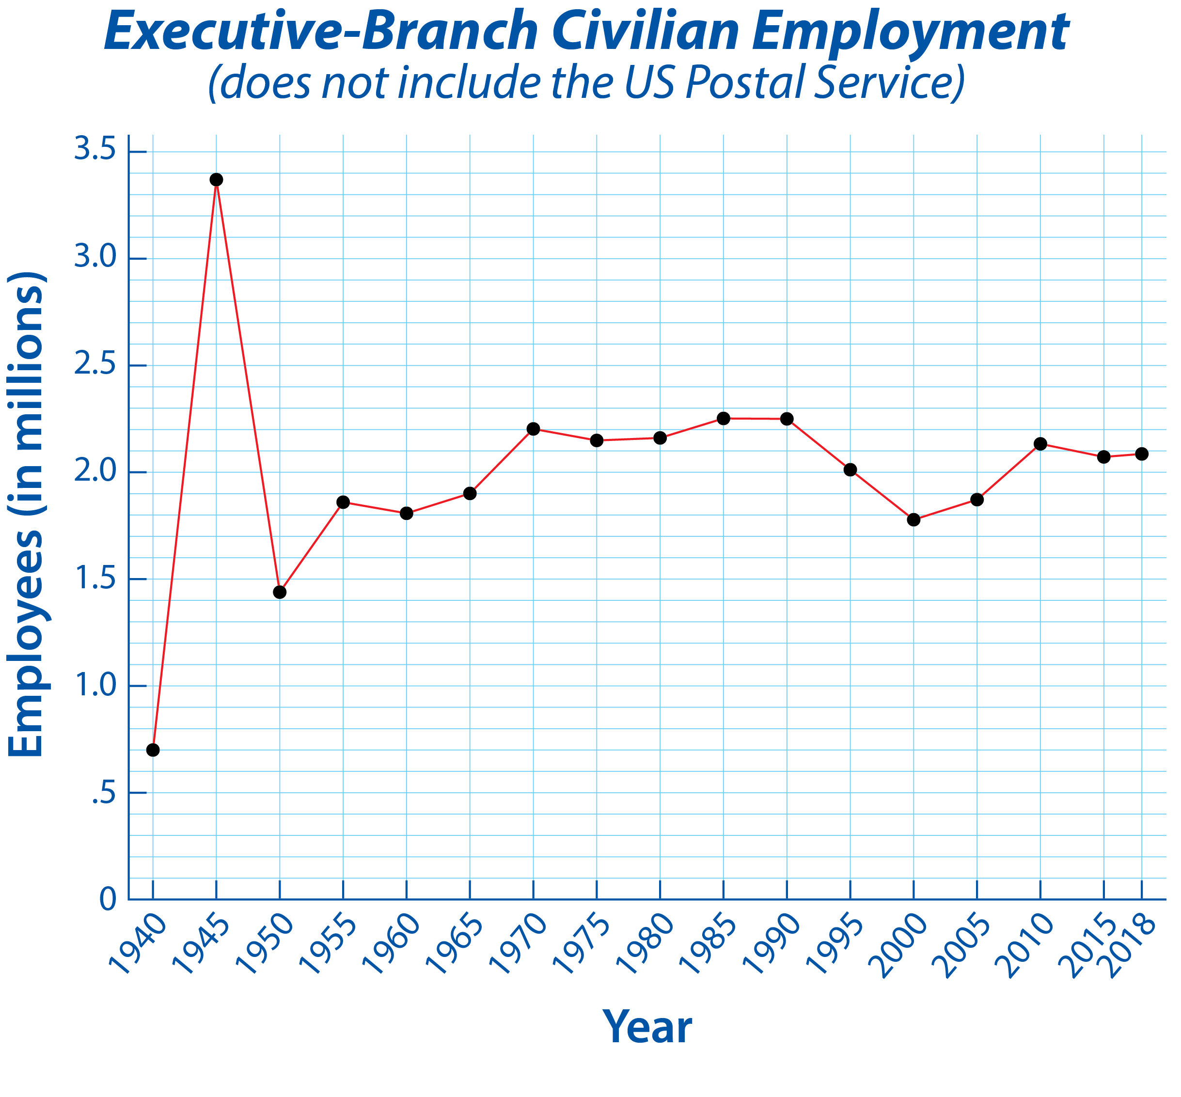
Notes:
BJU Press Art

Slide 11

B. History and Growth
Congress sets the pay and other job conditions for federal workers.
Generally, pay for upper-level positions does not compete well with private-sector salaries.
Notes:
Photo by Hunters Race on Unsplash
https://unsplash.com/photos/MYbhN8KaaEc

Slide 12
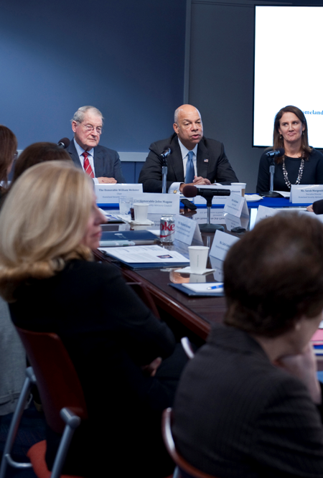
B. History and Growth
Federal employees may not be a candidate in partisan elections or participate in party activities while on the job.
Today, bureaucrats are promoted based on merit, may hold lifetime tenure if they wish, and are protected from being fired for partisan reasons.
Notes:
By U.S. Department of Homeland Security (DHS) - Homeland Security Advisory Council, Public Domain, https://commons.wikimedia.org/w/index.php?curid=68955870
https://commons.wikimedia.org/w/index.php?title=Special:Search&limit=500&offset=0&ns0=1&ns6=1&ns12=1&ns14=1&ns100=1&ns106=1&search=United+States+Department+of+Homeland+Security&advancedSearch-current=%7B%7D&searchToken=3tl8ihupxaefl3qwewcgl07uo#%2Fmedia%2FFile%3AHomeland_Security_Advisory_Council_%2831258664241%29.jpg

Slide 13
Section Review – Chapter 12.1
1. Define bureaucracy.
an administrative system in which agencies staffed largely by nonelected officials perform specific tasks in accordance with standard procedures (p. 275)

Slide 14
Section Review – Chapter 12.1
2–4. Identify three benefits of bureaucracy.
It has a hierarchical structure that can increase agency speed by limiting conflicts over who has decision-making authority; it promotes efficiency and productivity through job specialization; and it allows work continuity as decisions are based on defined standards rather than personal preferences. (p. 276)

Slide 15
Section Review – Chapter 12.1
5–6. Contrast the spoils system and the merit system.
Under the spoils system, the president used government positions to reward campaign supporters. Since the president could hire or fire at will, the bureaucracy was highly responsive to his wishes. But the spoils system did not necessarily put the most qualified people in office. The merit system, established by the Pendleton Act, based employment on quality (merit).
(pp. 277–278)

Slide 16
Section Review – Chapter 12.1
How does war expand bureaucracy?
During wartime, restrictions on administrative actions are often set aside to meet the increased needs and demands brought about by war; thus, the number of government employees increases. After the war, many remain in their positions, causing a net growth in government.

Slide 17
Section Review – Chapter 12.1
Do you think the limitations on the political activities of federal employees are justified? Why or why not?
Some will say that the limitations are not justified and cite the First Amendment (though the Supreme Court has rejected several such arguments). Others will say that the limits are justified in order to prevent the use of their positions to influence an election.

Slide 18
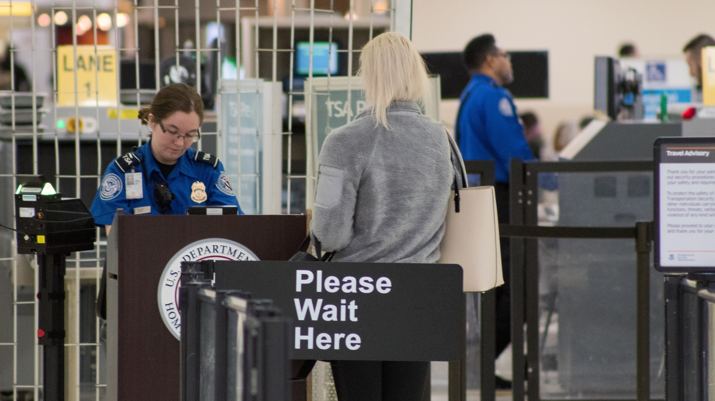
II. Bureaucratic Structure
Chapter 12.2
Notes:
By Michael Ball - Own work, CC0, https://commons.wikimedia.org/w/index.php?curid=77279000
https://commons.wikimedia.org/w/index.php?title=Special:Search&search=transportation+security+administration&fulltext=1&ns0=1&ns6=1&ns12=1&ns14=1&ns100=1&ns106=1&searchToken=j1wbe0xf5aku9vk5ysz13iyj#%2Fmedia%2FFile%3ATransportation_Security_Administration_Checkpoint_at_John_Glenn_Columbus_International_Airport.jpg

Slide 19
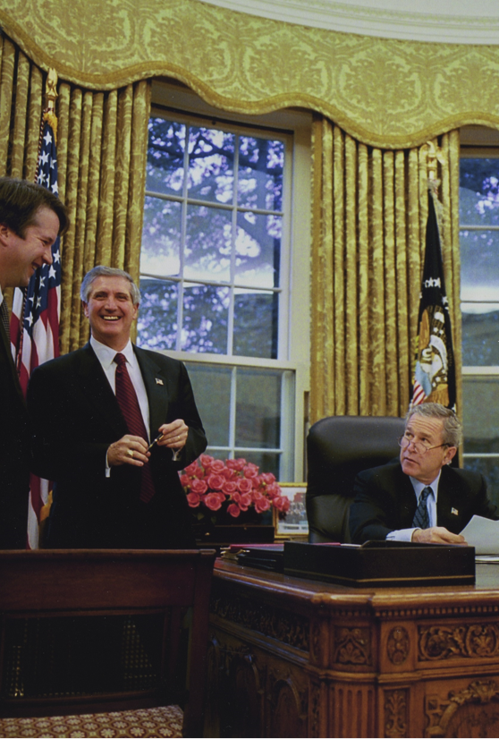
A. Executive Office of the President
The first level of bureaucracy beneath the president is the Executive Office of the President (EOP).
The EOP assists the president with policymaking and management.
Notes:
By Unknown author - WhiteHouse.gov: A Remarkable Career in Photos: Judge Kavanaugh to Testify Before the Senate, CC BY 3.0, https://commons.wikimedia.org/w/index.php?curid=72408528
https://commons.wikimedia.org/w/index.php?title=Special:Search&limit=500&offset=0&ns0=1&ns6=1&ns12=1&ns14=1&ns100=1&ns106=1&search=white+house+staff&advancedSearch-current=%7B%7D&searchToken=9fgwvydrenpzbxgo8jcljgtgs#%2Fmedia%2FFile%3AGeorge_W._Bush_with_White_House_Staff.jpg

Slide 20
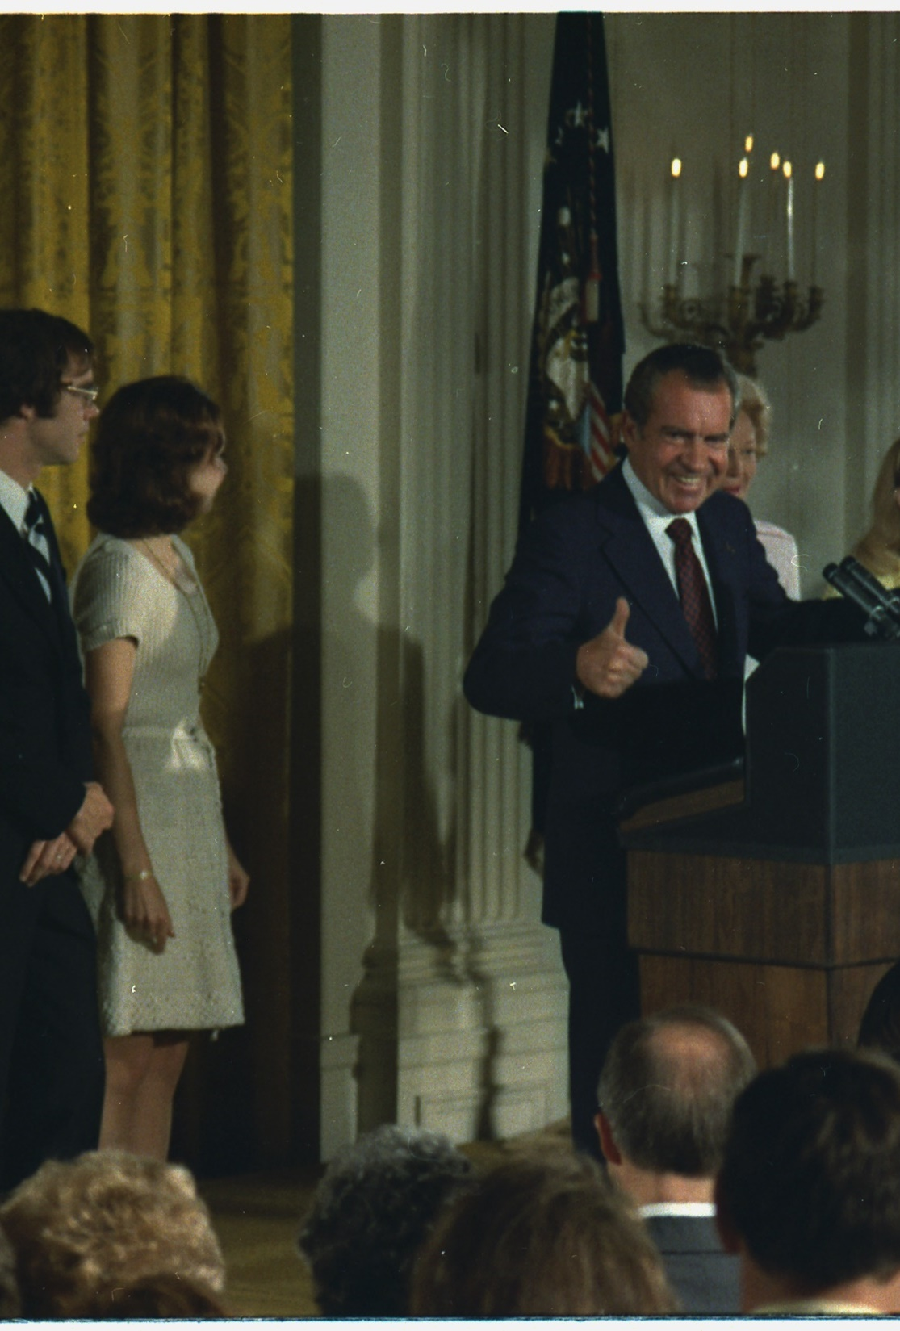
A. Executive Office of the President
The EOP includes the White House staff who serve the president by communicating his policies to agencies and the public.
The chief of staff advises the president and selects key people for the White House staff.
Notes:
By Moore, Robert, White House photographer, Photographer (NARA record: 5445197) - U.S. National Archives and Records Administration, Public Domain, https://commons.wikimedia.org/w/index.php?curid=16457656
https://commons.wikimedia.org/w/index.php?title=Special:Search&limit=500&offset=0&ns0=1&ns6=1&ns12=1&ns14=1&ns100=1&ns106=1&search=white+house+staff&advancedSearch-current=%7B%7D&searchToken=9fgwvydrenpzbxgo8jcljgtgs#%2Fmedia%2FFile%3ANixon_addressing_this_cabinet_and_White_House_staff_in_the_East_Room_of_the_White_House_prior_to_his_departure._-_NARA_-_194596.tif

Slide 21
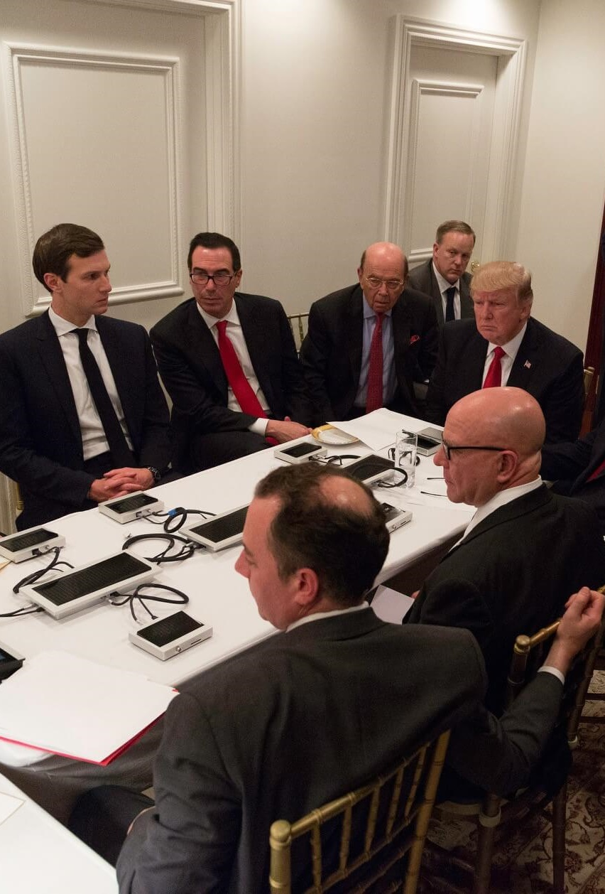
A. Executive Office of the President
Key members of the White House staff include:
  Personnel director
  Counsel for the president
  Press secretary
  Communications director
Notes:
By Shealah Craighead - Photo of the Day: April 7, 2017 on whitehouse.gov, Public Domain, https://commons.wikimedia.org/w/index.php?curid=57795087
https://commons.wikimedia.org/w/index.php?title=Special:Search&limit=500&offset=0&ns0=1&ns6=1&ns12=1&ns14=1&ns100=1&ns106=1&search=donald+trump+white+house+staff&advancedSearch-current=%7B%7D&searchToken=b4uv6bgy1m9z0i7oowz76f7bw#%2Fmedia%2FFile%3APresident_Donald_Trump_receives_a_briefing_on_a_military_strike.jpg

Slide 22
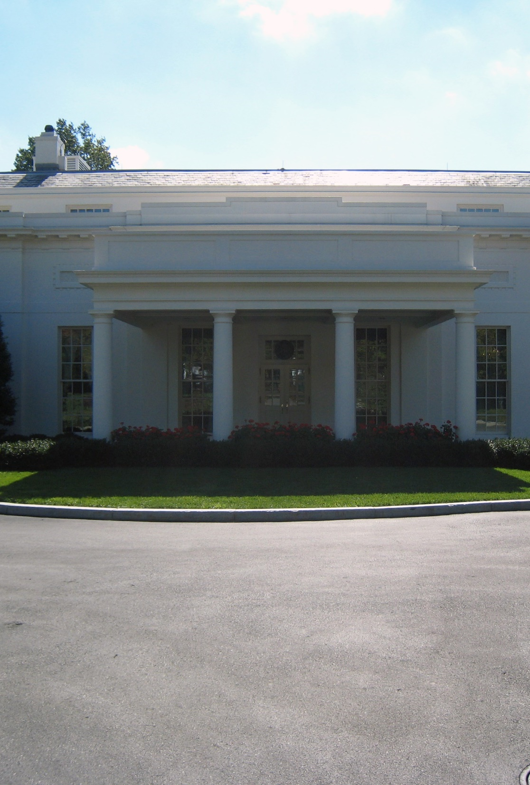
A. Executive Office of the President
The West Wing is the center of activity for the White House staff and includes:
  The Oval Office
  Offices of the executive staff
  Cabinet Room
  Roosevelt Room
  Brady Press Briefing Room
Notes:
By Josh Berglund from Richardson, United States - The West Wing, CC BY 2.0, https://commons.wikimedia.org/w/index.php?curid=3469849
https://commons.wikimedia.org/w/index.php?sort=relevance&search=white+house+the+west+wing&title=Special:Search&profile=advanced&fulltext=1&advancedSearch-current=%7B%7D&ns0=1&ns6=1&ns12=1&ns14=1&ns100=1&ns106=1&searchToken=a5nurox8o2flpmo7s4nke8car#%2Fmedia%2FFile%3AWhite_House_West_Wing.jpg

Slide 23
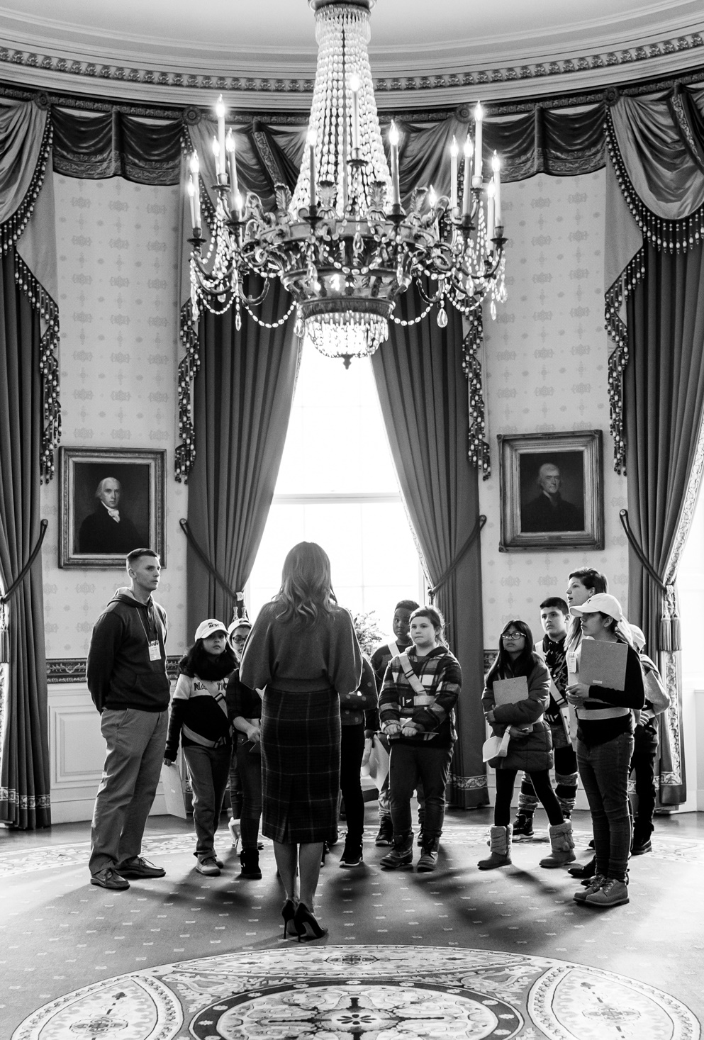
A. Executive Office of the President
The East Wing includes space for the First Lady and her staff.
Notes:
By The White House from Washington, DC - First Lady Melania Trump at an East Wing Tour, Public Domain, https://commons.wikimedia.org/w/index.php?curid=85875927
https://commons.wikimedia.org/w/index.php?title=Special:Search&limit=500&offset=0&ns0=1&ns6=1&ns12=1&ns14=1&ns100=1&ns106=1&search=white+house+east+wing&advancedSearch-current=%7B%7D&searchToken=nf6lfsubxmza36yd8665bgtr#%2Fmedia%2FFile%3AFirst_Lady_Melania_Trump_at_an_East_Wing_Tour_%2849379471068%29.jpg

Slide 24
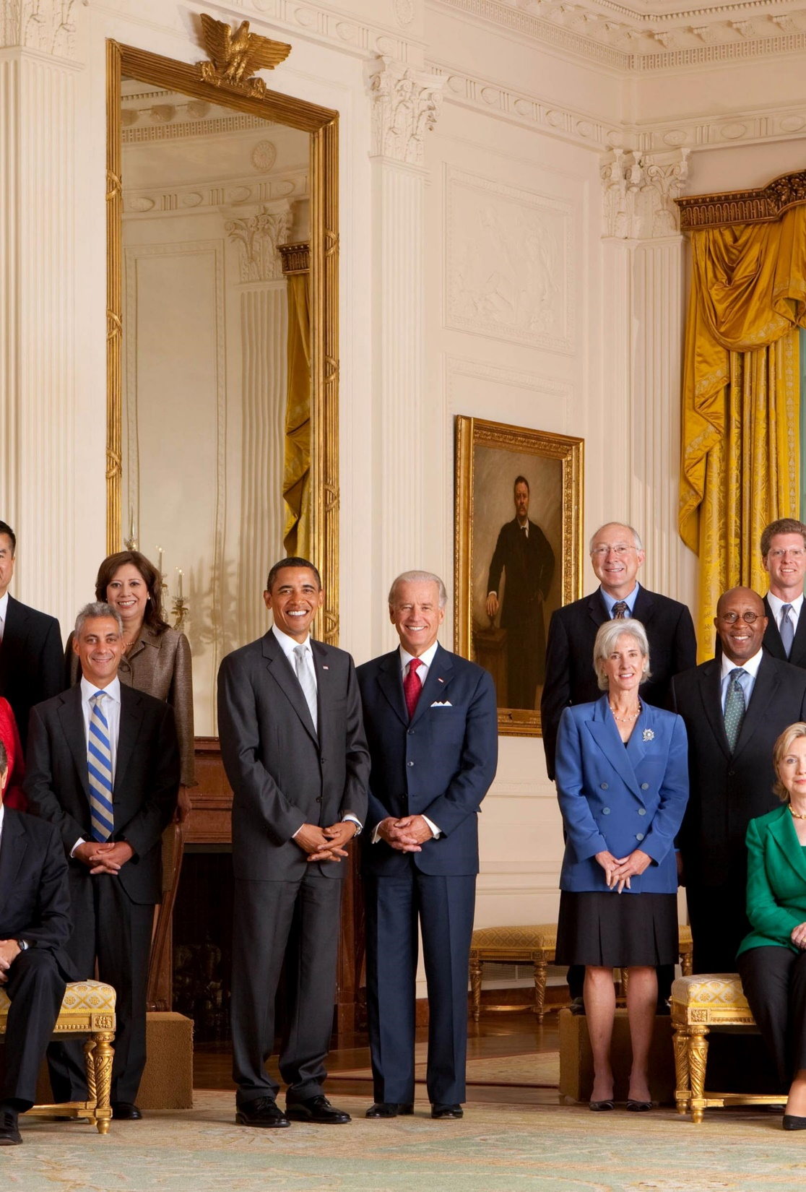
B. Cabinet
The cabinet offices of the executive branch assist the president in his constitutional duties.
Though not mentioned in the Constitution, many presidents depend on advice from their cabinets while others preferred the counsel of close friends.
Notes:
By Chuck Kennedy - P091009CK-0040.jpg on The Official White House Photostream, Public Domain, https://commons.wikimedia.org/w/index.php?curid=7814091
https://commons.wikimedia.org/w/index.php?sort=relevance&search=white+house+staff&title=Special:Search&profile=advanced&fulltext=1&advancedSearch-current=%7B%7D&ns0=1&ns6=1&ns12=1&ns14=1&ns100=1&ns106=1&searchToken=blwtiqhzskztafx6uuh7podmv#%2Fmedia%2FFile%3APresident_Barack_Obama_with_full_cabinet_09-10-09.jpg

Slide 25
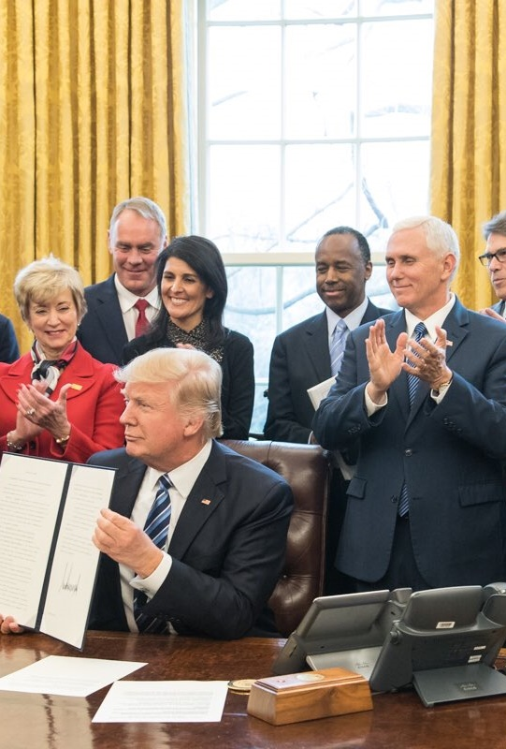
B. Cabinet
Today, there are fifteen cabinet divisions each led by a secretary.
  Department of State
  Department of the Treasury
  Department of Defense
  Department of Justice
  Department of the Interior
  Department of Agriculture
Notes:
By Office of the President of the United States - @realDonaldTrump on Twitter, Public Domain, https://commons.wikimedia.org/w/index.php?curid=57074244
https://commons.wikimedia.org/w/index.php?sort=relevance&search=trump+cabinet&title=Special:Search&profile=advanced&fulltext=1&advancedSearch-current=%7B%7D&ns0=1&ns6=1&ns12=1&ns14=1&ns100=1&ns106=1&searchToken=306vn4lfkszz1fa9ycq74s6hk#%2Fmedia%2FFile%3ADonald_Trump_Cabinet_meeting_2017-03-13_02.jpg

Slide 26
B. Cabinet
Today, there are fifteen cabinet divisions each led by a secretary.
  Department of Commerce
  Department of Labor
  Department of Health and Human Services
  Department of Housing and Urban Development
  Department of Transportation
Notes:
By Office of the President of the United States - @realDonaldTrump on Twitter, Public Domain, https://commons.wikimedia.org/w/index.php?curid=57074244
https://commons.wikimedia.org/w/index.php?sort=relevance&search=trump+cabinet&title=Special:Search&profile=advanced&fulltext=1&advancedSearch-current=%7B%7D&ns0=1&ns6=1&ns12=1&ns14=1&ns100=1&ns106=1&searchToken=306vn4lfkszz1fa9ycq74s6hk#%2Fmedia%2FFile%3ADonald_Trump_Cabinet_meeting_2017-03-13_02.jpg

Slide 27
B. Cabinet
Today, there are fifteen cabinet divisions each led by a secretary.
  Department of Energy
  Department of Education
  Department of Veterans Affairs
  Department of Homeland Security – oversees the Transportation Security Administration (TSA)
Notes:
By Office of the President of the United States - @realDonaldTrump on Twitter, Public Domain, https://commons.wikimedia.org/w/index.php?curid=57074244
https://commons.wikimedia.org/w/index.php?sort=relevance&search=trump+cabinet&title=Special:Search&profile=advanced&fulltext=1&advancedSearch-current=%7B%7D&ns0=1&ns6=1&ns12=1&ns14=1&ns100=1&ns106=1&searchToken=306vn4lfkszz1fa9ycq74s6hk#%2Fmedia%2FFile%3ADonald_Trump_Cabinet_meeting_2017-03-13_02.jpg

Slide 28

C. Independent Agencies
Independent agencies are not part of any cabinet department and have specialized functions.
They include:
  Independent executive agencies
  Government corporations
  Independent regulatory commissions
Notes:
By NASA - http://spaceflight.nasa.gov/gallery/images/shuttle/sts-130/html/iss022e066880.html, Public Domain, https://commons.wikimedia.org/w/index.php?curid=9501141
https://commons.wikimedia.org/w/index.php?sort=relevance&search=NASA&title=Special:Search&profile=advanced&fulltext=1&advancedSearch-current=%7B%7D&ns0=1&ns6=1&ns12=1&ns14=1&ns100=1&ns106=1&searchToken=6umk72ik42zfd12qx0hel55lf#%2Fmedia%2FFile%3ASTS-130_EVA3_Nicholas_Patrick_1.jpg

Slide 29
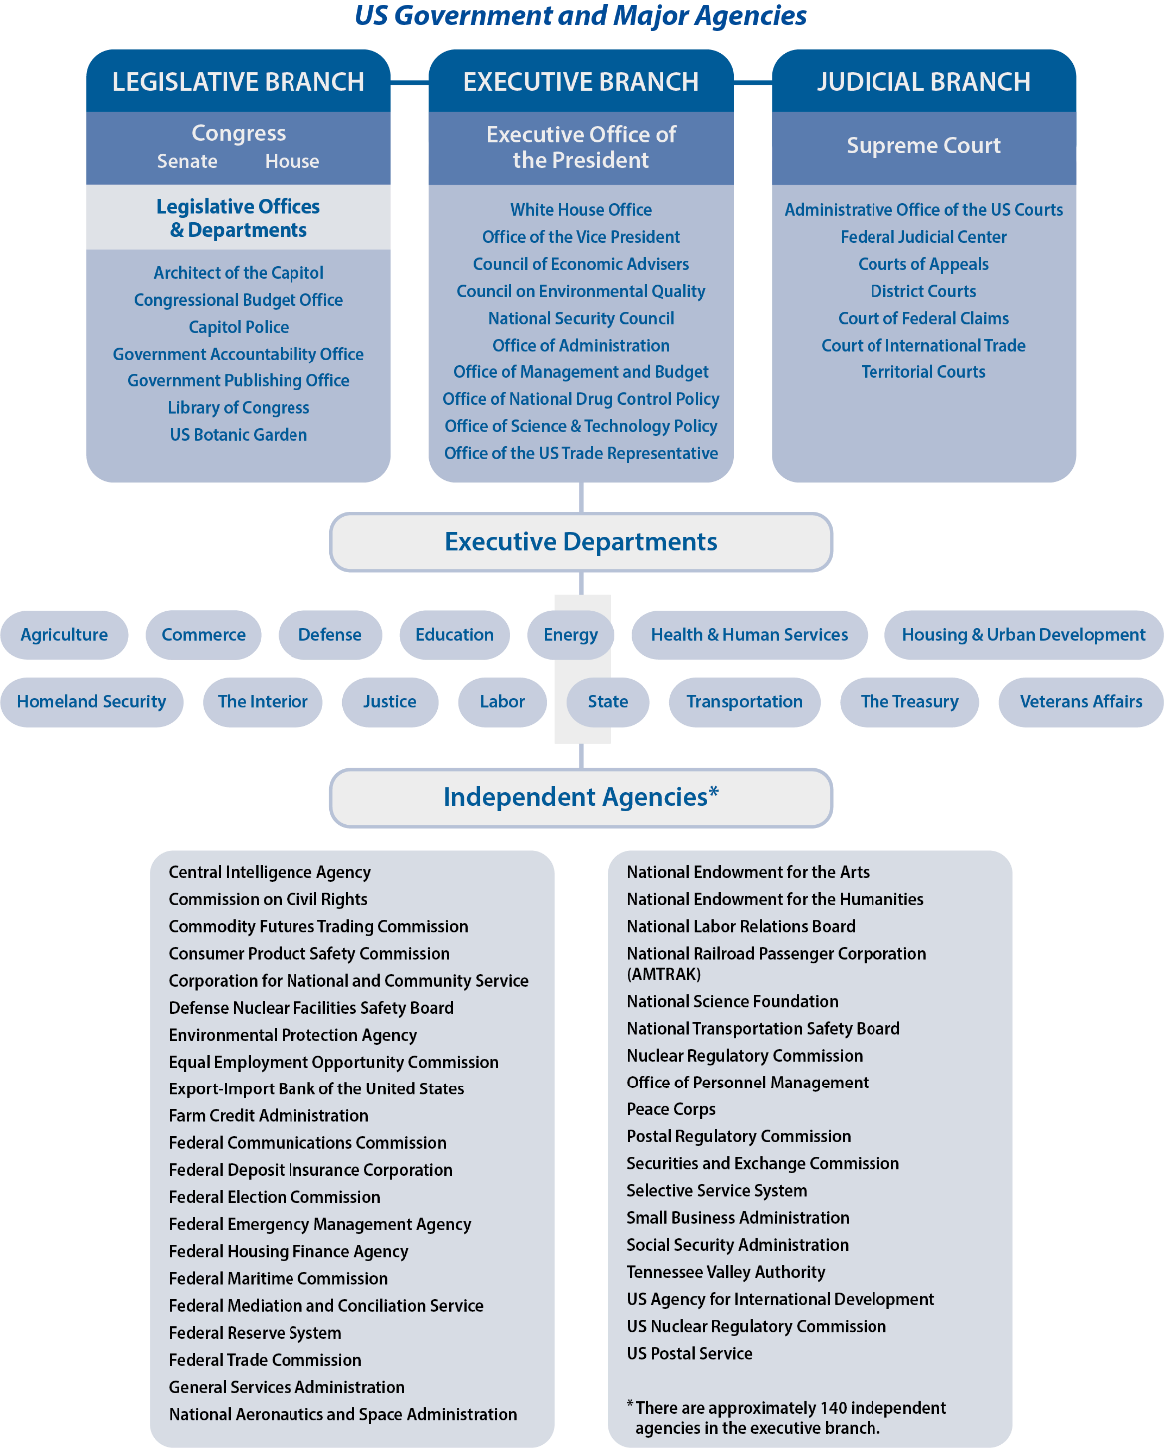
Notes:
BJU Press Art

Slide 30
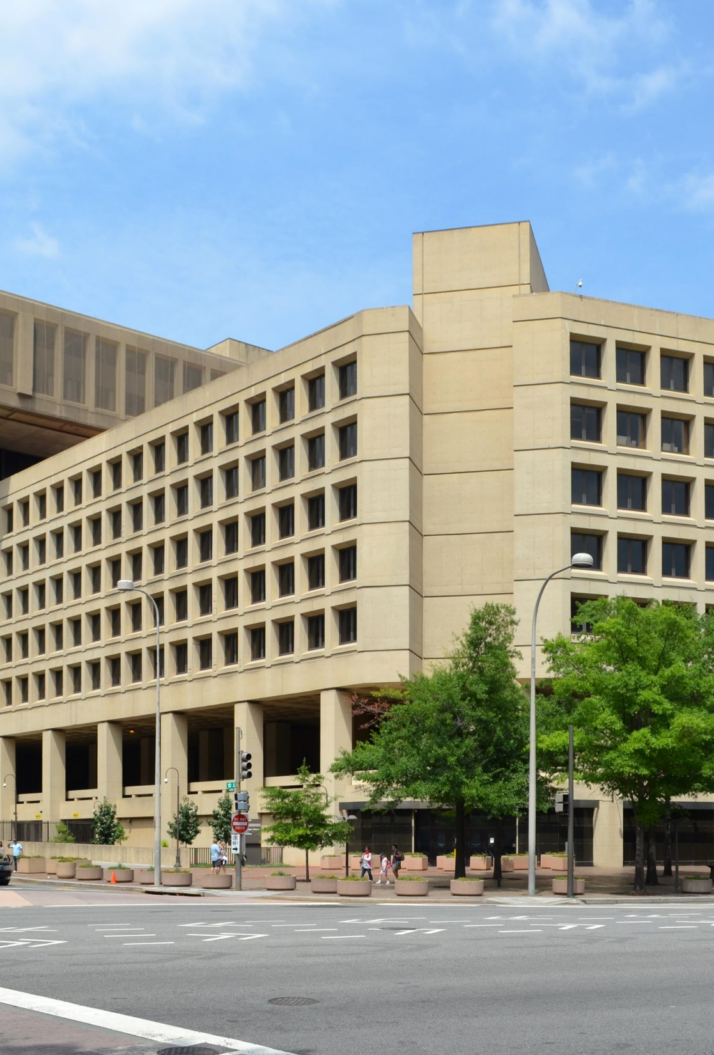
D. Operation of the Bureaucracy
The federal bureaucracy has legislative, executive, and judicial responsibilities.
While Congress passes bills that become statutory law, regulations created by the bureaucracy are known as administrative law.
Notes:
By Brunswyk - Own work, CC BY-SA 3.0, https://commons.wikimedia.org/w/index.php?curid=20359850
https://commons.wikimedia.org/w/index.php?sort=relevance&search=FBI+building&title=Special:Search&profile=advanced&fulltext=1&advancedSearch-current=%7B%7D&ns0=1&ns6=1&ns12=1&ns14=1&ns100=1&ns106=1&searchToken=5ex41oot0kp4hf6t4c0per33x#%2Fmedia%2FFile%3AWashington_DC_FBI_J._Edgar_Hoover_Building_Brunswyk_%282012%29._Edgar_Hoover_Building_Brunswyk_%282012%29_retouched.jpg

Slide 31


D. Operation of the Bureaucracy
Most agencies serve a particular group called a client.
Agencies use clearly defined procedures known as standard operating procedures (SOPs).
Notes:
By Brunswyk - Own work, CC BY-SA 3.0, https://commons.wikimedia.org/w/index.php?curid=20359850
https://commons.wikimedia.org/w/index.php?sort=relevance&search=FBI+building&title=Special:Search&profile=advanced&fulltext=1&advancedSearch-current=%7B%7D&ns0=1&ns6=1&ns12=1&ns14=1&ns100=1&ns106=1&searchToken=5ex41oot0kp4hf6t4c0per33x#%2Fmedia%2FFile%3AWashington_DC_FBI_J._Edgar_Hoover_Building_Brunswyk_%282012%29._Edgar_Hoover_Building_Brunswyk_%282012%29_retouched.jpg
By The original uploader was K. Aainsqatsi at English Wikipedia. - Transferred from en.wikipedia to Commons., Public Domain, https://commons.wikimedia.org/w/index.php?curid=2302384
https://commons.wikimedia.org/w/index.php?sort=relevance&search=Department+of+energy&title=Special:Search&profile=advanced&fulltext=1&advancedSearch-current=%7B%7D&ns0=1&ns6=1&ns12=1&ns14=1&ns100=1&ns106=1&searchToken=92et9hja04ltbzv2e1nj2gmr0#%2Fmedia%2FFile%3ASeal_of_the_United_States_Department_of_Energy.svg

Slide 32
Section Review – Chapter 12.2
1. What is the first level of bureaucracy beneath the president?
Executive Office of the President (EOP) (p. 280)
2–3. State the purpose of the National Security Council. Describe its origin.
To serve as the president’s policymaking group concerning security and intelligence matters; it was formed in 1947, during the Cold War, to advise the president on military policy and covert operations and to serve as a crisis management team.
(p. 282)

Slide 33
Section Review – Chapter 12.2
4. Define cabinet.
offices of the executive branch developed to assist the president in his constitutional duties and to meet the demands of America’s growth (pp. 283–284)
5. Discuss the Constitution’s possible reference to the cabinet.
Article II, Section 2, clause 1, gives the president the power to “require the opinion, in writing, of the principal officer in each of the executive departments, upon any subject relating to the duties of their respective offices.” (p. 283)

Slide 34
Section Review – Chapter 12.2
6. How do cabinet members obtain their positions?
by presidential appointment with Senate approval (p. 284)
7. What was the first government corporation in the United States?
the Bank of the United States (p. 291)

Slide 35
Section Review – Chapter 12.2
8–9. Contrast statutory and administrative law.
Statutory law is passed by the legislature and signed by the president. Administrative law is the collection of regulations developed by the federal bureaucracy to implement congressional statutes. (p. 293)
10. Which agency regulates the development and use of pesticides?
Environmental Protection Agency (EPA) (p. 292)

Slide 36
Section Review – Chapter 12.2
Why is the Executive Office of the President such a powerful segment of the executive branch?
It has the greatest access to the president and is the most responsive to his ideas.

Slide 37
Section Review – Chapter 12.2
Why is regulation by the government necessary?
Students may say that humans are sinners and will not always do right. Many regulations fulfill the government’s obligations to its citizens in promoting the general welfare.

Slide 38
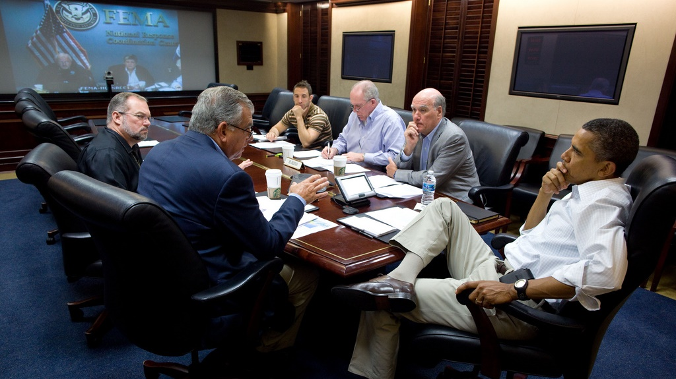
III. Bureaucratic Practices
Chapter 12.3
Notes:
By The White House - https://www.flickr.com/photos/whitehouse/6088867979/, Public Domain, https://commons.wikimedia.org/w/index.php?curid=16317105
https://commons.wikimedia.org/w/index.php?sort=relevance&search=White+House+Situation+Room&title=Special:Search&profile=advanced&fulltext=1&advancedSearch-current=%7B%7D&ns0=1&ns6=1&ns12=1&ns14=1&ns100=1&ns106=1&searchToken=7m42d73sv9p61cq3ccmxat2ql#%2Fmedia%2FFile%3AObama_in_Situation_Room_receiving_update_on_Hurricane_Irene.jpg

Slide 39
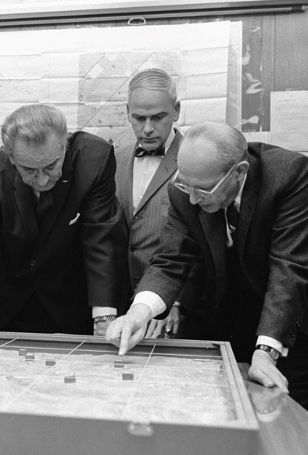
A. The Fourth Branch
Given its size and power, the federal bureaucracy is sometimes viewed as the fourth branch of government.
There are four causes for this:
  Size
  Skills
  Separation of powers
  Desire for security
Notes:
Public Domain, https://commons.wikimedia.org/w/index.php?curid=596039
https://commons.wikimedia.org/w/index.php?sort=relevance&search=White+House+Situation+Room&title=Special:Search&profile=advanced&fulltext=1&advancedSearch-current=%7B%7D&ns0=1&ns6=1&ns12=1&ns14=1&ns100=1&ns106=1&searchToken=7m42d73sv9p61cq3ccmxat2ql#%2Fmedia%2FFile%3AL_B_Johnson_Model_Khe_Sanh.jpeg

Slide 40
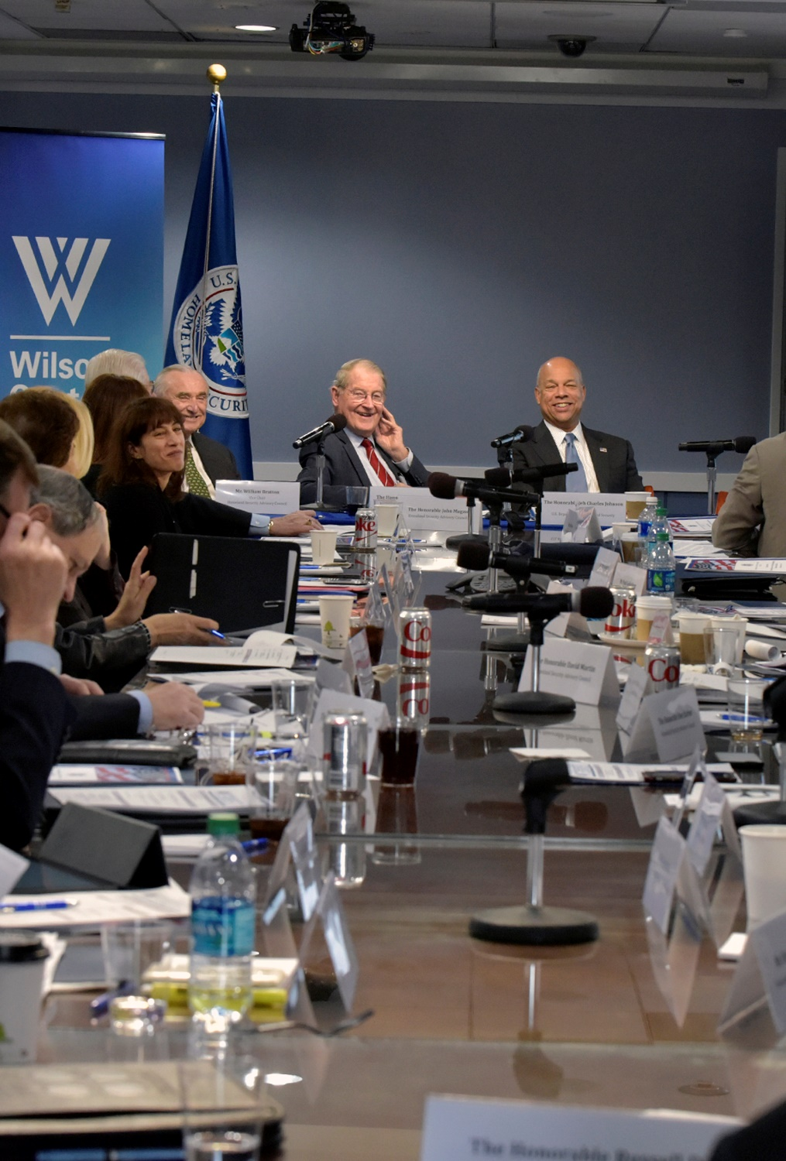
B. Accountability
Bureaucrats operate under congressional oversight.
Since the 1960s, Congress has tended to restrict how agencies spend appropriations – money budgeted by Congress to fund programs.
Notes:
By U.S. Department of Homeland Security (DHS) - Homeland Security Advisory Council, Public Domain, https://commons.wikimedia.org/w/index.php?curid=68955871
https://commons.wikimedia.org/w/index.php?title=Special:Search&limit=500&offset=0&ns0=1&ns6=1&ns12=1&ns14=1&ns100=1&ns106=1&search=Department+of+Homeland+Security&advancedSearch-current=%7B%7D&searchToken=9mjjf1j9o69vyoyxpfngp4pfe#%2Fmedia%2FFile%3AHomeland_Security_Advisory_Council_%2831337240816%29.jpg

Slide 41
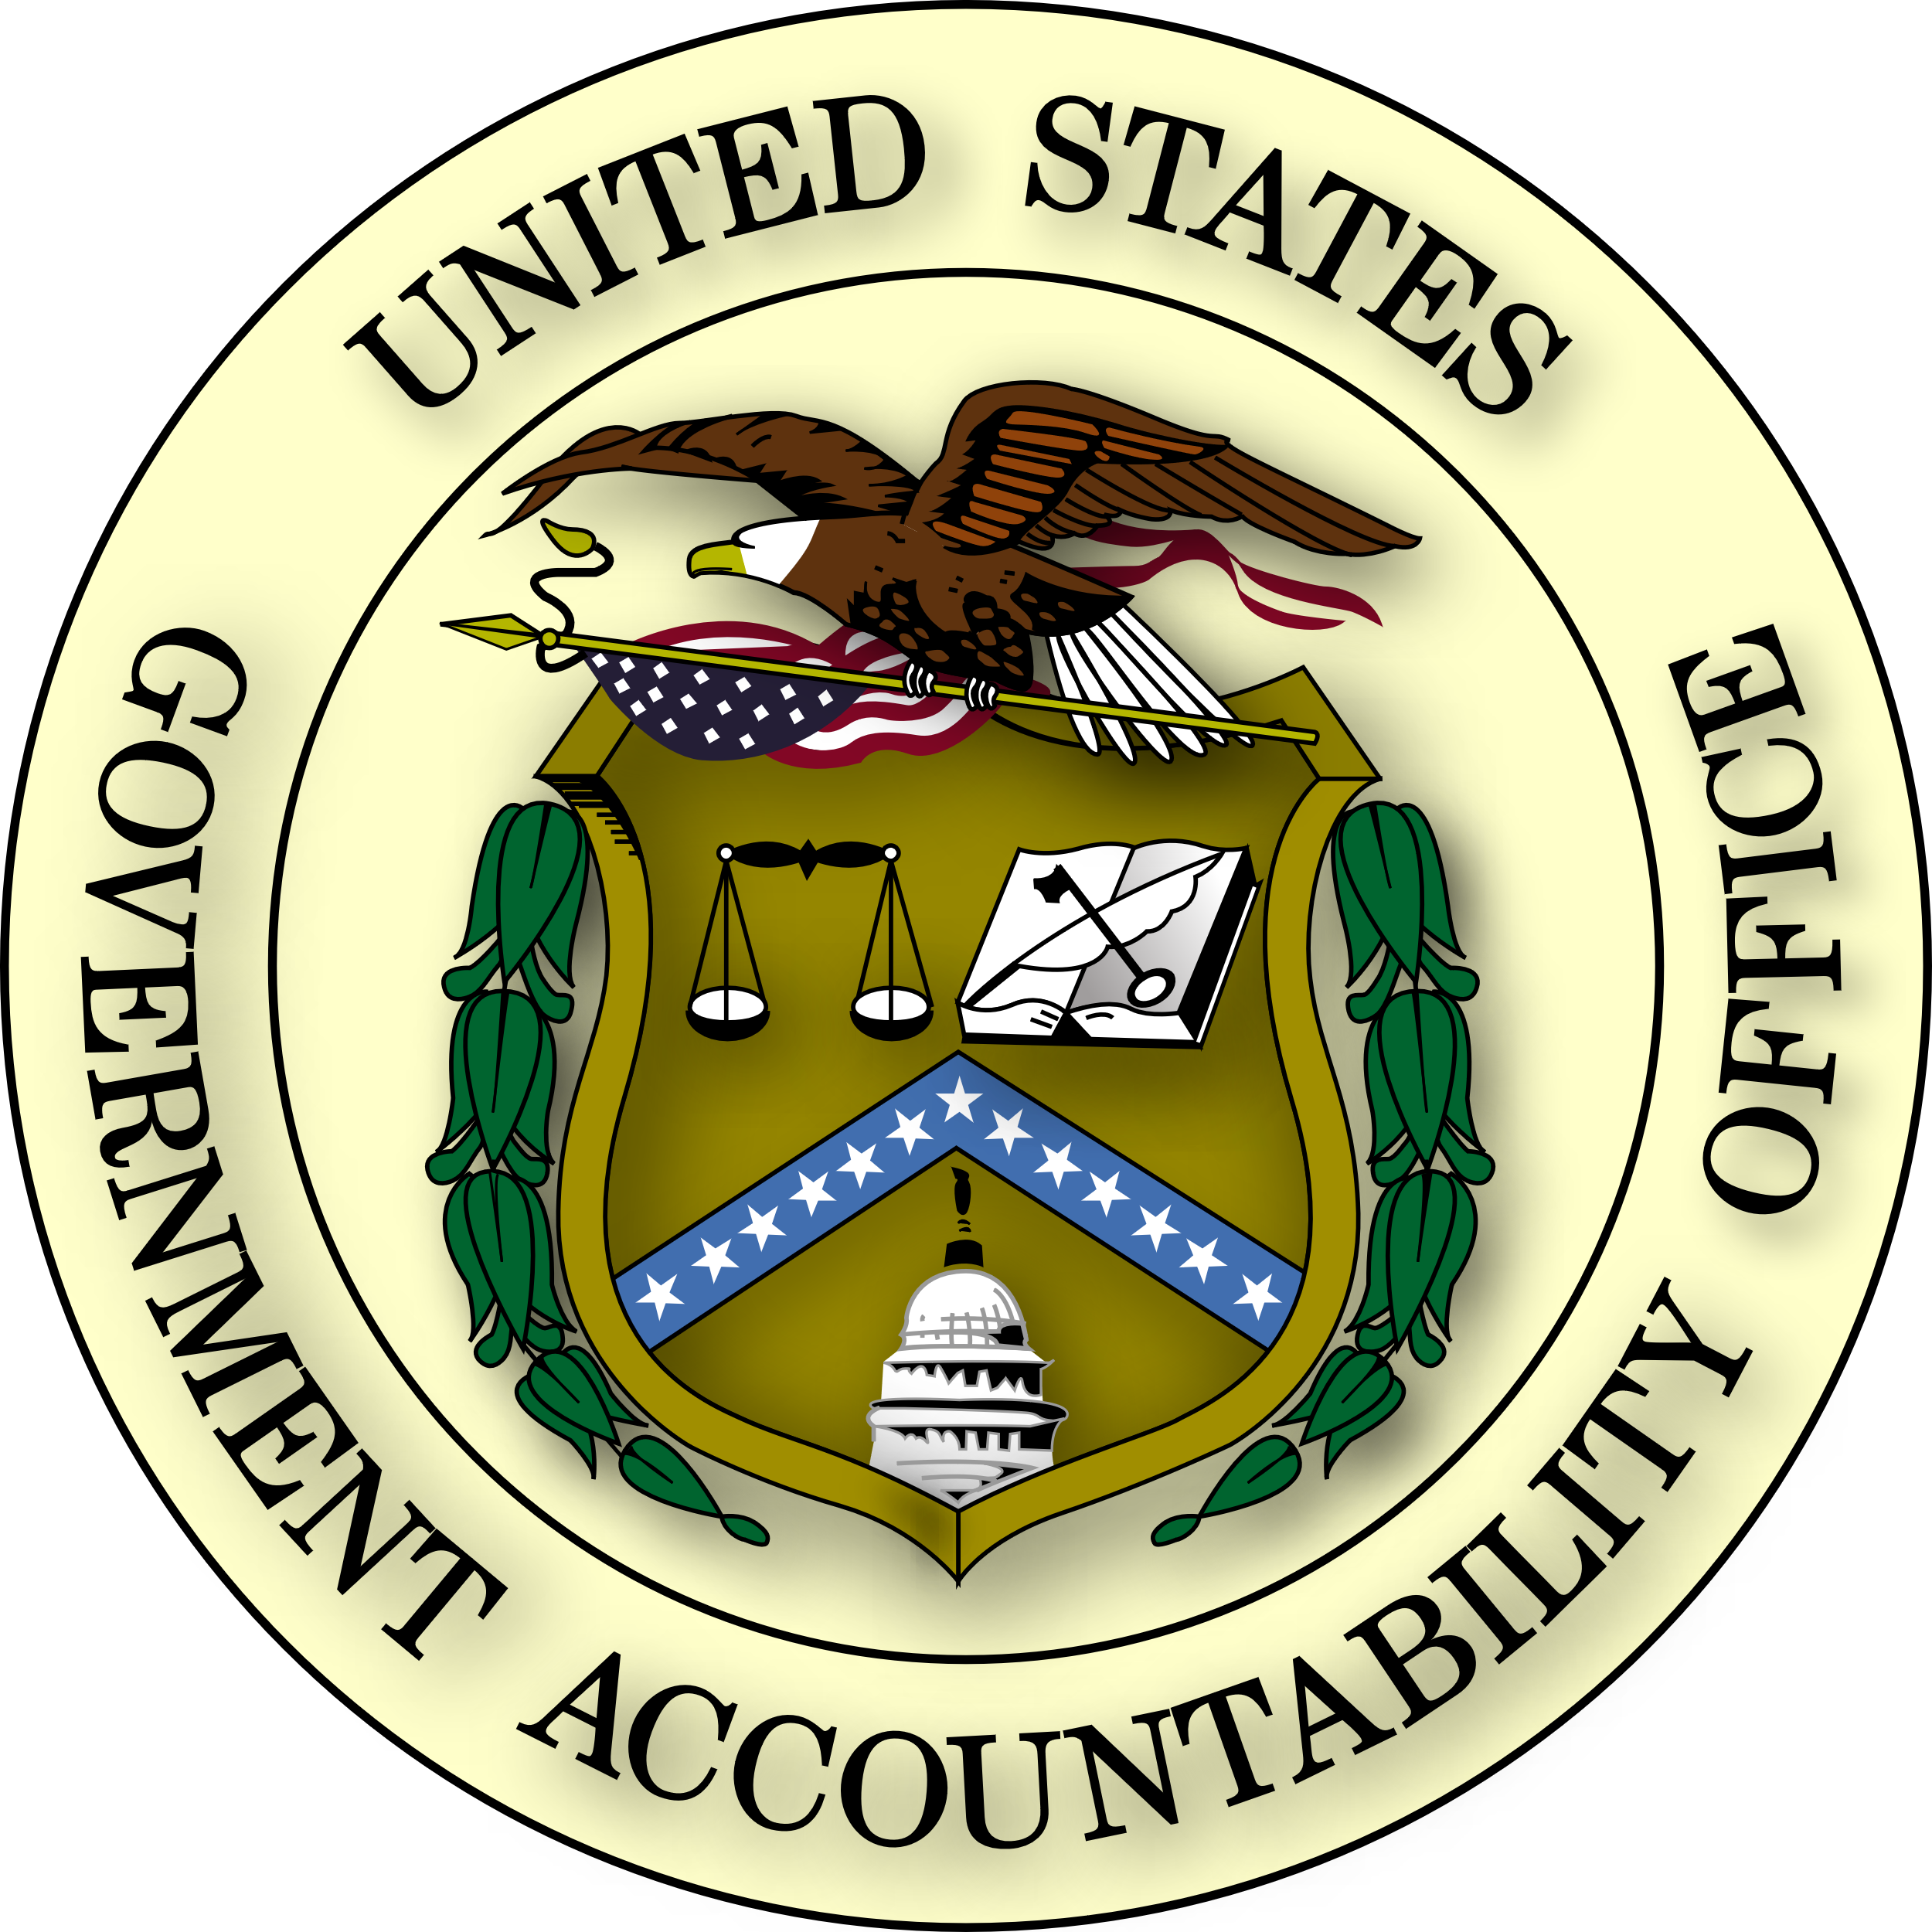
B. Accountability
The power of the bureaucracy can be checked by various means:
  Congress can authorize the Government Accountability Office (GAO) to audit an agency’s finances.
  The president can reorganize agencies.
  The Freedom of Information Act (FOIA) gives citizens information about bureaucratic activities.
Notes:
By U.S. Government - Extracted from PDF version of Volume 1 of the Exposure Draft GAO/PCIE Financial Audit Manual (direct PDF URL [1]), and colorized based on Image:US Government Accountability Office seal.gif. The eagle's head and tail feathers are now white, based on the GAO seal page (direct image of new version here)., Public Domain, https://commons.wikimedia.org/w/index.php?curid=3764498
https://commons.wikimedia.org/w/index.php?sort=relevance&search=Government+Accountability+Office&title=Special:Search&profile=advanced&fulltext=1&advancedSearch-current=%7B%7D&ns0=1&ns6=1&ns12=1&ns14=1&ns100=1&ns106=1&searchToken=7h9kiw2z8ez44jzgrvmh5hf5a#%2Fmedia%2FFile%3ASeal_of_the_United_States_Government_Accountability_Office.svg

Slide 42
B. Accountability
The power of the bureaucracy can be checked by various means:
  The Sunshine Act (1976) required many bureaucratic hearings to be made public.
Notes:
By U.S. Government - Extracted from PDF version of Volume 1 of the Exposure Draft GAO/PCIE Financial Audit Manual (direct PDF URL [1]), and colorized based on Image:US Government Accountability Office seal.gif. The eagle's head and tail feathers are now white, based on the GAO seal page (direct image of new version here)., Public Domain, https://commons.wikimedia.org/w/index.php?curid=3764498
https://commons.wikimedia.org/w/index.php?sort=relevance&search=Government+Accountability+Office&title=Special:Search&profile=advanced&fulltext=1&advancedSearch-current=%7B%7D&ns0=1&ns6=1&ns12=1&ns14=1&ns100=1&ns106=1&searchToken=7h9kiw2z8ez44jzgrvmh5hf5a#%2Fmedia%2FFile%3ASeal_of_the_United_States_Government_Accountability_Office.svg

Slide 43

C. Problems
Criticism of the bureaucracy focuses on seven problem areas:
  Waste – mismanagement of money, time, and personnel
  Conflict
  Duplication
  Red tape – bureaucratic paperwork
Notes:
Image by Free-Photos from Pixabay
https://pixabay.com/photos/writing-pen-man-ink-paper-pencils-1149962/

Slide 44
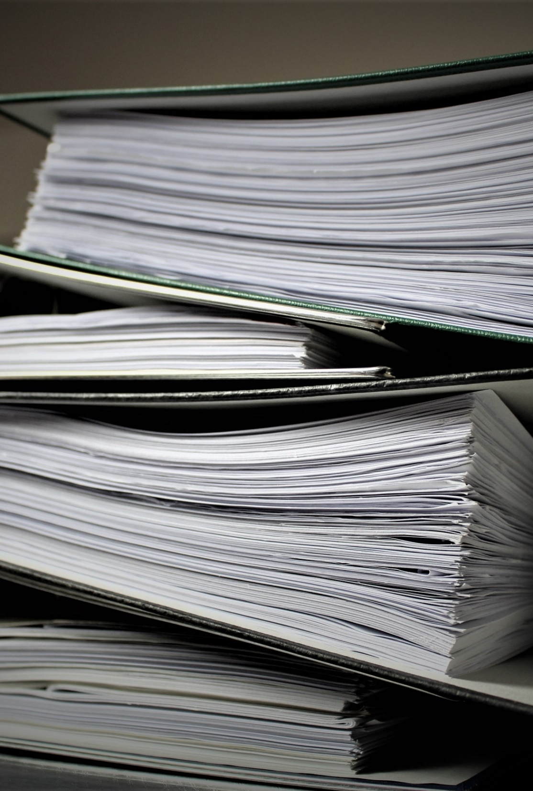
C. Problems
Criticism of the bureaucracy focuses on seven problem areas:
  Vague goals
  Bureaucratic language – bureaucratese is the use of vague, jargon-filled words
  Resistance to change
Notes:
Image by Jana Schneider from Pixabay
https://pixabay.com/photos/bureaucracy-aktenordner-paperwork-2106924/

Slide 45

D. Distinctiveness
Four aspects of the United States’ bureaucracy give it a distinctive character:
  The president and Congress share authority over it.
  Most agencies share functions with other agencies.
Notes:
Photo by Patrick Tomasso on Unsplash
https://unsplash.com/photos/a1bicKTYqMo

Slide 46
D. Distinctiveness
Four aspects of the United States’ bureaucracy give it a distinctive character:
  Americans are very interested in preserving their rights.
  The US does not extensively regulate its economy.
Notes:
Photo by Patrick Tomasso on Unsplash
https://unsplash.com/photos/a1bicKTYqMo

Slide 47
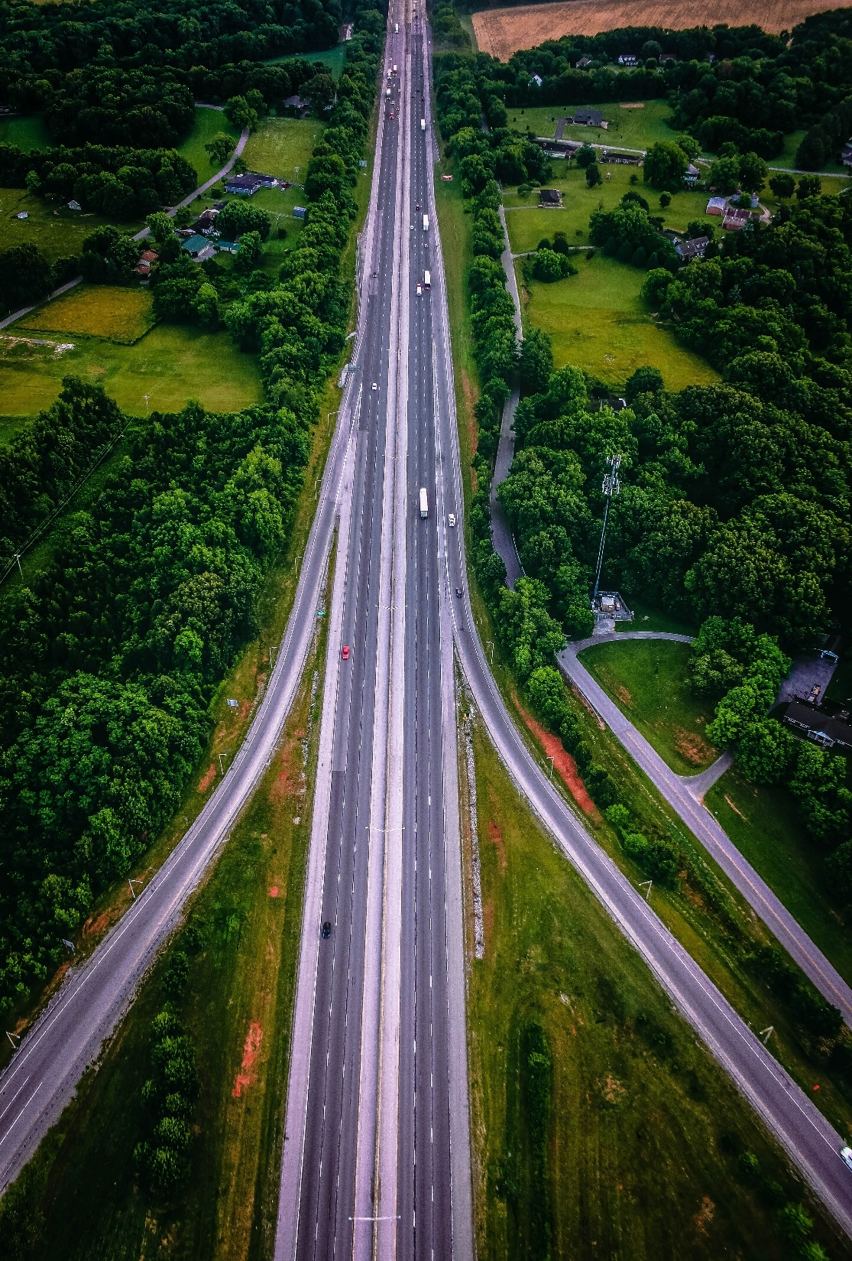
E. Achievements
Achievements of the bureaucracy include:
  The Manhattan Project
  US Postal Service
  Interstate highway system
Notes:
Photo by David Barajas on Unsplash
https://unsplash.com/photos/RIQyCVb5IQY

Slide 48
Section Review – Chapter 12.3
1–4. Summarize four reasons why the bureaucracy is sometimes called the fourth branch of government.
Size: the bureaucracy is the largest segment of the national government. Skills: bureaucrats, partly because of their expertise, have much influence within the government. Separation of powers: Bureaucracy tends to increase its independence by taking advantage of the separation of powers between the major branches of government. Desire for security: the bureaucracy seeks to control its internal affairs and sometimes hides details regarding bunglings. (pp. 294–295)

Slide 49
Section Review – Chapter 12.3
5. Describe how Congress uses the Government Accountability Office to check the federal bureaucracy.
It can authorize the GAO to audit an agency’s finances and monitor its activities. It can also request public hearings about the agency’s programs. (pp. 295–296)

Slide 50
Section Review – Chapter 12.3
6–7. Name two ways in which the president can restrict bureaucratic power.
by reorganizing parts of the bureaucracy which might eliminate jobs; by appointing an investigative task force (p. 299)

Slide 51
Section Review – Chapter 12.3
What are the advantages and disadvantages of the Freedom of Information Act (FOIA)?
Having access to information dealing with bureaucratic activities permits concerned citizens to more effectively challenge the government and have greater control over its work. It can be a helpful tool in restricting bureaucracy. However, there are dangers as well.

Slide 52
Section Review – Chapter 12.3
What are the advantages and disadvantages of the Freedom of Information Act (FOIA)?
Someone could try to acquire and exploit sensitive information about national security by using the FOIA. Information about medical records and law enforcement activities may be shared that could cause harm to individuals or investigations. Consequently, some information can be redacted (blacked out). This can make some documents meaningless.

Slide 53
Section Review – Chapter 12.3
List seven categories of bureaucratic problems. Which do you think is the worst? Explain your answer.
Bureaucratic problems fall under the categories of waste, conflict, duplication, red tape, vague goals, obscure bureaucratic language, and resistance to change.

Slide 54
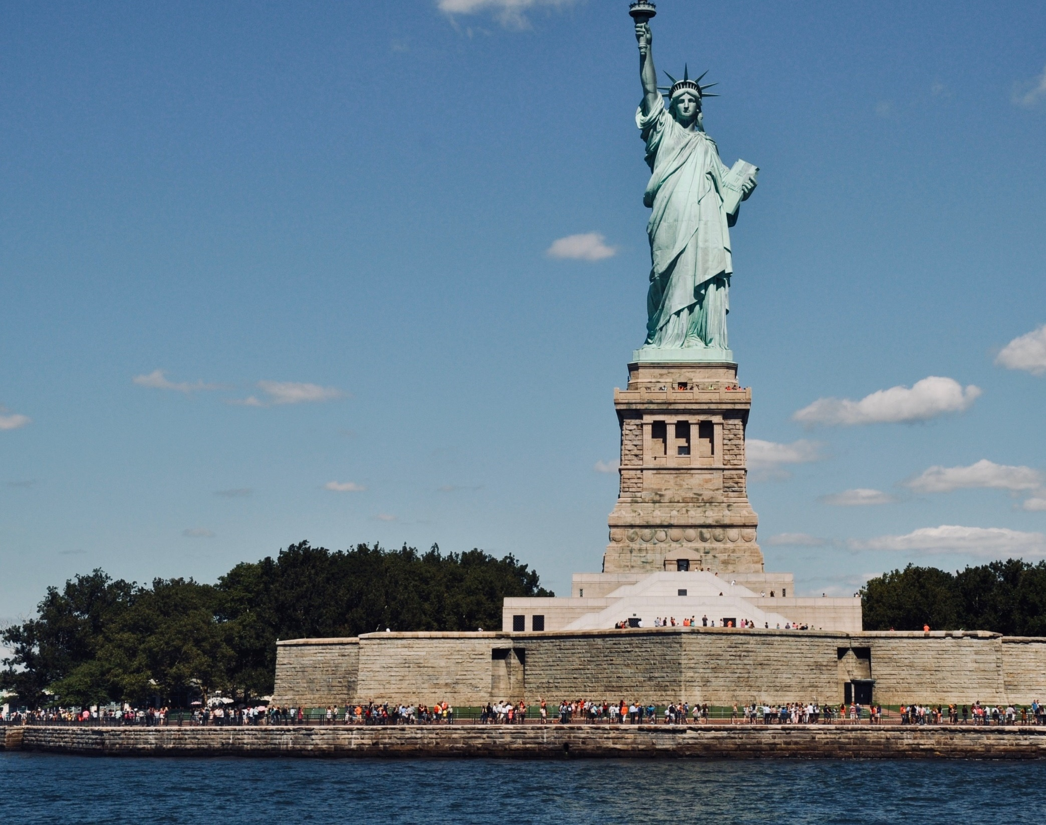
Chapter 12 Terms
Notes:
Image by dariasophia from Pixabay
https://pixabay.com/photos/new-york-usa-manhattan-3425660/

Slide 55
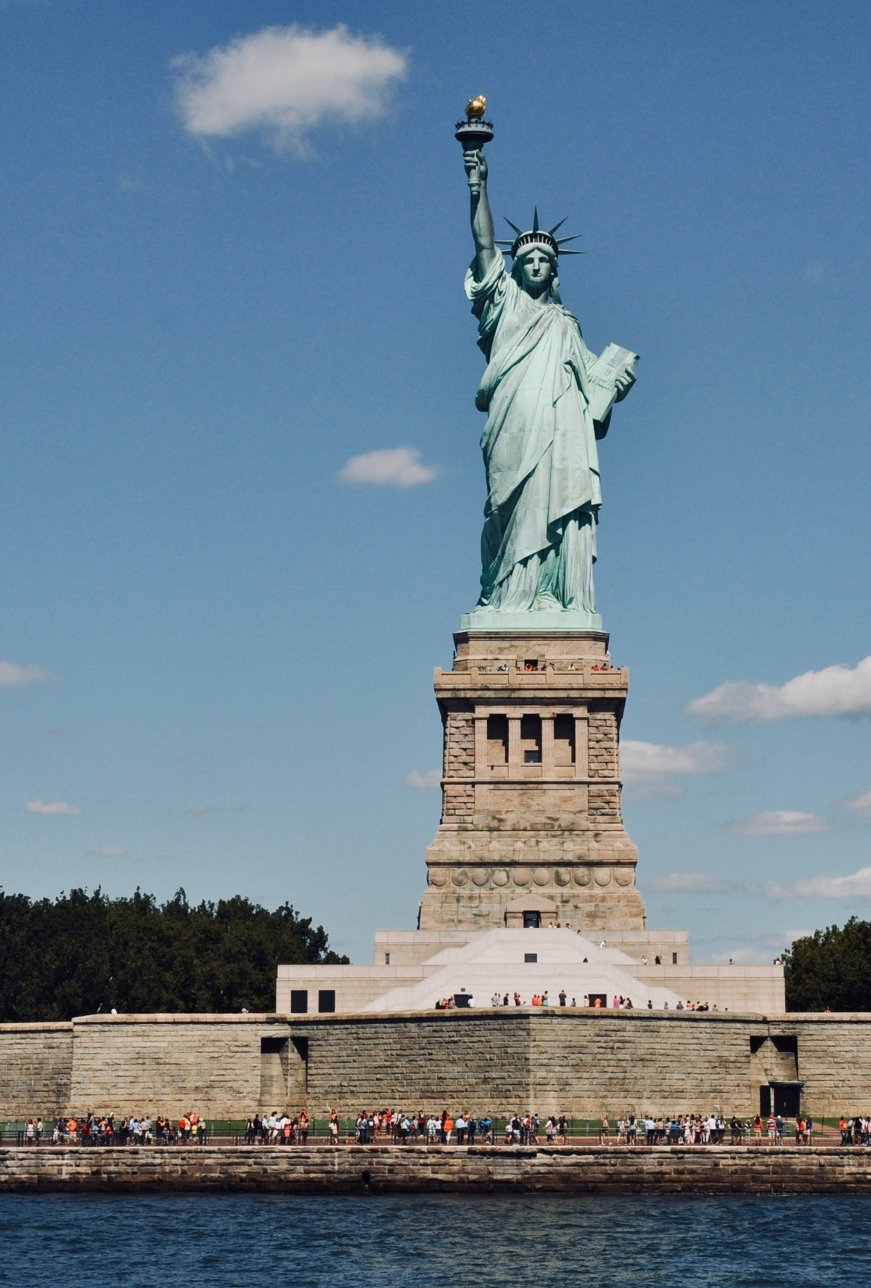
bureaucracy
an administrative system staffed largely by nonelected officials who perform specific tasks in accordance with standard procedures; much of this work involves the implementation and administration of laws and programs
Notes:
Image by dariasophia from Pixabay
https://pixabay.com/photos/new-york-usa-manhattan-3425660/

Slide 56
bureaucrat
a civil servant dedicated to the details of administrative procedure
Notes:
Image by dariasophia from Pixabay
https://pixabay.com/photos/new-york-usa-manhattan-3425660/

Slide 57
delegation
the act of committing, or entrusting,
a task or power to another
Notes:
Image by dariasophia from Pixabay
https://pixabay.com/photos/new-york-usa-manhattan-3425660/

Slide 58
civil service
the civilian employees of the bureaucracy who carry out the administrative tasks of the government
Notes:
Image by dariasophia from Pixabay
https://pixabay.com/photos/new-york-usa-manhattan-3425660/

Slide 59
Pendleton Act
established the Civil Service Commission; set quality of work as the new standard for hiring and promotion of civil employees and abolished the old patronage (spoils) system
Notes:
Image by dariasophia from Pixabay
https://pixabay.com/photos/new-york-usa-manhattan-3425660/

Slide 60
merit
the quality of one’s work; in the civil service, the standard for employment
Notes:
Image by dariasophia from Pixabay
https://pixabay.com/photos/new-york-usa-manhattan-3425660/

Slide 61
Executive Office of the President (EOP)
the first level of bureaucracy beneath the president
Notes:
Image by dariasophia from Pixabay
https://pixabay.com/photos/new-york-usa-manhattan-3425660/

Slide 62
White House staff
part of the EOP; its members serve the president by communicating his policies to both the appropriate agencies and the American public
Notes:
Image by dariasophia from Pixabay
https://pixabay.com/photos/new-york-usa-manhattan-3425660/

Slide 63
chief of staff
member of the president’s staff who advises the president on issues of politics, policy, and management; selects key people for the White House staff; controls and manages staff members, their work, and the information and paperwork that reach the Oval Office
Notes:
Image by dariasophia from Pixabay
https://pixabay.com/photos/new-york-usa-manhattan-3425660/

Slide 64
press secretary
official spokesman for the White House administration who meets daily with the White House press corps
Notes:
Image by dariasophia from Pixabay
https://pixabay.com/photos/new-york-usa-manhattan-3425660/

Slide 65
West Wing
the center of activity for the White House staff
Notes:
Image by dariasophia from Pixabay
https://pixabay.com/photos/new-york-usa-manhattan-3425660/

Slide 66
East Wing
the section of the White House accommodating the First Lady and her staff
Notes:
Image by dariasophia from Pixabay
https://pixabay.com/photos/new-york-usa-manhattan-3425660/

Slide 67
cabinet
offices of the executive branch developed to assist the president in his constitutional duties and to meet the demands of America’s growth; currently consists of fifteen departments
Notes:
Image by dariasophia from Pixabay
https://pixabay.com/photos/new-york-usa-manhattan-3425660/

Slide 68
secretary
the head of a cabinet department appointed by the president
Notes:
Image by dariasophia from Pixabay
https://pixabay.com/photos/new-york-usa-manhattan-3425660/

Slide 69
Transportation Security Administration (TSA)
agency created after the 9/11 terrorist attacks that screens all passengers and baggage at airports
Notes:
Image by dariasophia from Pixabay
https://pixabay.com/photos/new-york-usa-manhattan-3425660/

Slide 70
statutory law
law that has been passed by the legislature and signed by the president
Notes:
Image by dariasophia from Pixabay
https://pixabay.com/photos/new-york-usa-manhattan-3425660/

Slide 71
administrative law
regulations that have the force of law and are drawn up by government bureaucracy to implement congressional statutes
Notes:
Image by dariasophia from Pixabay
https://pixabay.com/photos/new-york-usa-manhattan-3425660/

Slide 72
clients
members of groups whose needs are served by government agencies
Notes:
Image by dariasophia from Pixabay
https://pixabay.com/photos/new-york-usa-manhattan-3425660/

Slide 73
standard operating procedures
clearly defined procedures that bureaucracies operate within
Notes:
Image by dariasophia from Pixabay
https://pixabay.com/photos/new-york-usa-manhattan-3425660/

Slide 74
fourth branch
term applied to the federal bureaucracy because of the bureaucracy’s power and pervasiveness
Notes:
Image by dariasophia from Pixabay
https://pixabay.com/photos/new-york-usa-manhattan-3425660/

Slide 75
oversight
the process by which Congress examines a government department’s compliance with the law and scrutinizes its budget requests
Notes:
Image by dariasophia from Pixabay
https://pixabay.com/photos/new-york-usa-manhattan-3425660/

Slide 76
appropriations
a grant of money allocated (budgeted) by Congress
to finance government programs
Notes:
Image by dariasophia from Pixabay
https://pixabay.com/photos/new-york-usa-manhattan-3425660/

Slide 77
Government Accountability Office (GAO)
congressional office that is authorized to audit an agency’s finances, monitor its activities, and request public hearings about its programs
Notes:
Image by dariasophia from Pixabay
https://pixabay.com/photos/new-york-usa-manhattan-3425660/

Slide 78
Freedom of Information Act (FOIA)
an act of Congress that gives individual citizens and the media the right to access and examine previously withheld government files and information
Notes:
Image by dariasophia from Pixabay
https://pixabay.com/photos/new-york-usa-manhattan-3425660/

Slide 79
Sunshine Act
a congressional act requiring federal agencies to hold well-announced public hearings and allowing citizens access to agency officials and a stronger voice in bureaucratic proceedings
Notes:
Image by dariasophia from Pixabay
https://pixabay.com/photos/new-york-usa-manhattan-3425660/

Slide 80
waste
bureaucratic mismanagement of money, time, and personnel
Notes:
Image by dariasophia from Pixabay
https://pixabay.com/photos/new-york-usa-manhattan-3425660/

Slide 81
red tape
bureaucratic paperwork
Notes:
Image by dariasophia from Pixabay
https://pixabay.com/photos/new-york-usa-manhattan-3425660/

Slide 82
bureaucratese
the vague, sprawling language and wordy jargon used in bureaucratic regulations and documents
Notes:
Image by dariasophia from Pixabay
https://pixabay.com/photos/new-york-usa-manhattan-3425660/

