Slide 1
Chapter 13:
Foreign Policy
Notes:
WIN-Initiative/Stone/Getty Images

Slide 2
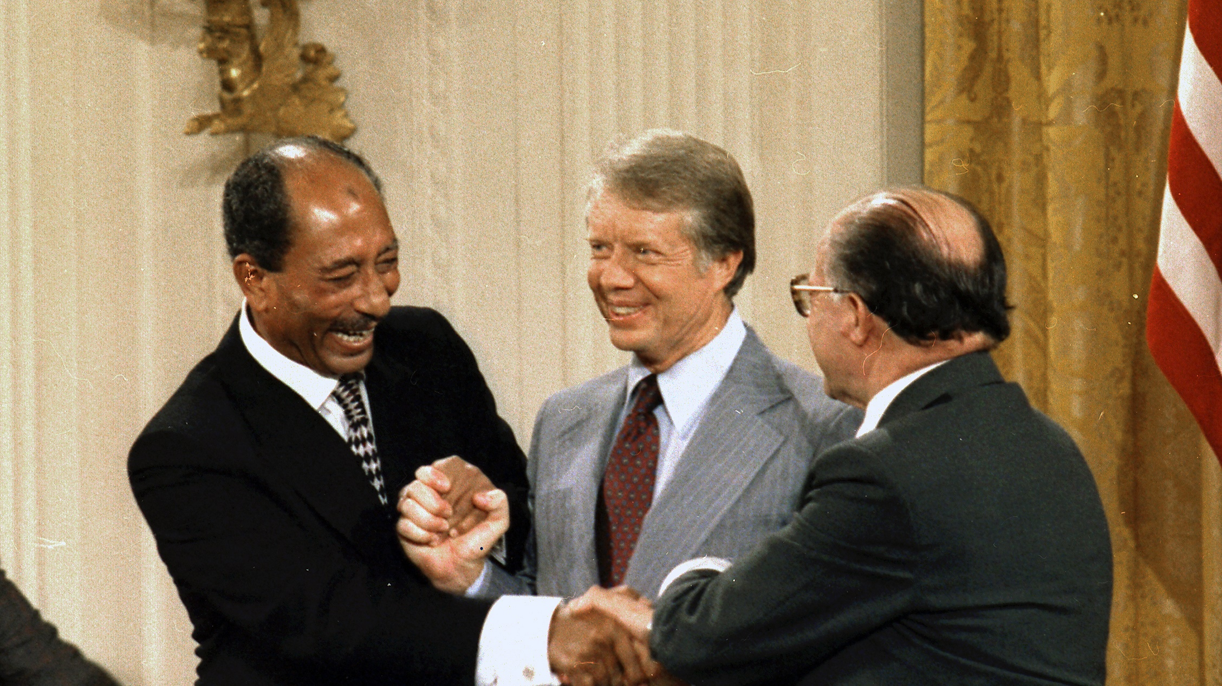
I. Foreign Policy Goals
Chapter 13.1
Notes:
By Not know or unknown - U.S. National Archives and Records Administration, Public Domain, https://commons.wikimedia.org/w/index.php?curid=35847743
https://commons.wikimedia.org/w/index.php?sort=relevance&search=Camp+David+accords&title=Special:Search&profile=advanced&fulltext=1&advancedSearch-current=%7B%7D&ns0=1&ns6=1&ns12=1&ns14=1&ns100=1&ns106=1&searchToken=53bli60rxo9cmt1i6dr2esqog#%2Fmedia%2FFile%3AAnwar_Sadat_Jimmy_Carter_Menachem_Begin_sign_Camp_David_Accords-1978.jpg

Slide 3
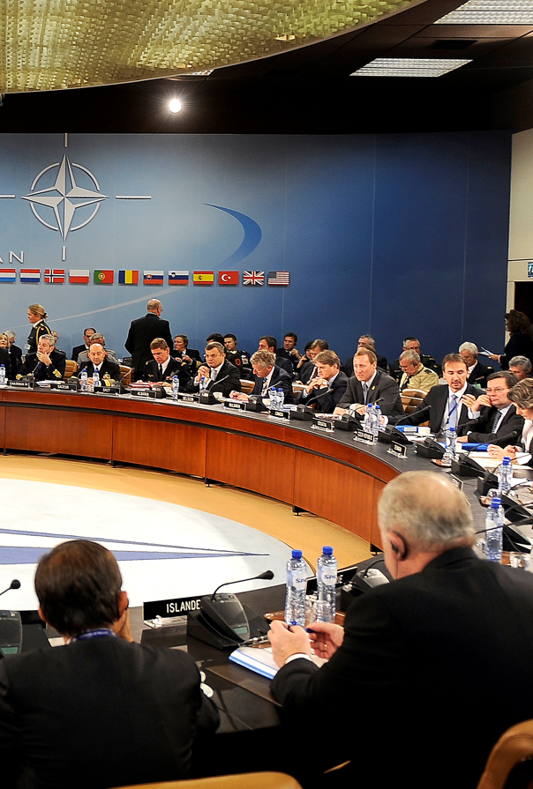
I. Foreign Policy Goals
The United States maintains certain basic goals of foreign policy:
  National security
  Alliance security
  International stability
  Economic development
A meeting of NATO officials
Notes:
By DOD photo by U.S. Air Force Master Sgt. Jerry Morrison - http://www.defense.gov/PhotoEssays/PhotoEssaySS.aspx?ID=1904 http://www.defense.gov/dodcmsshare/photoessay/2010-10/hires_101014-F-6655M-005a.jpg, Public Domain, https://commons.wikimedia.org/w/index.php?curid=11785168
https://commons.wikimedia.org/w/index.php?sort=relevance&search=NATO+meeting&title=Special:Search&profile=advanced&fulltext=1&advancedSearch-current=%7B%7D&ns0=1&ns6=1&ns12=1&ns14=1&ns100=1&ns106=1&searchToken=94tv05rg83l3yol3nacfwmmxf#%2Fmedia%2FFile%3ANATO_Ministers_of_Defense_and_of_Foreign_Affairs_meet_at_NATO_headquarters_in_Brussels_2010.jpg

Slide 4
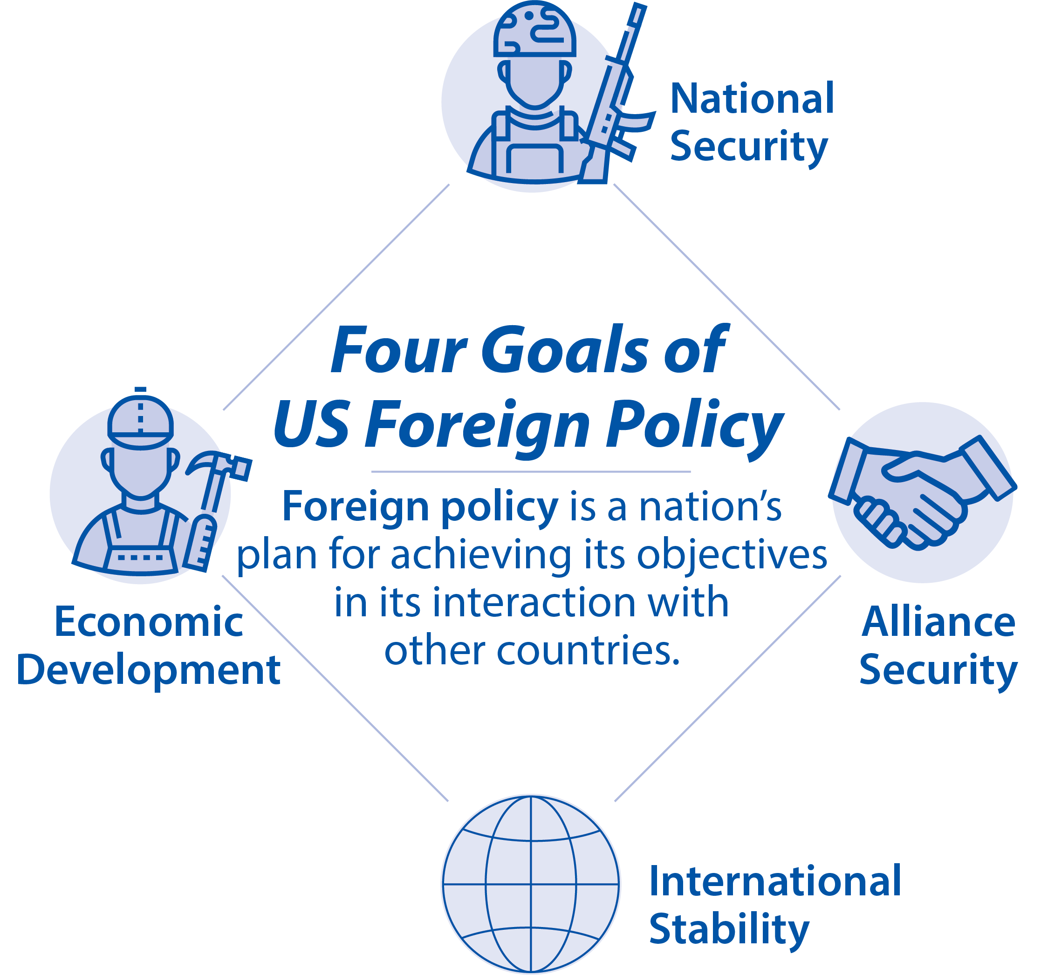
Notes:
BJU Press Art

Slide 5
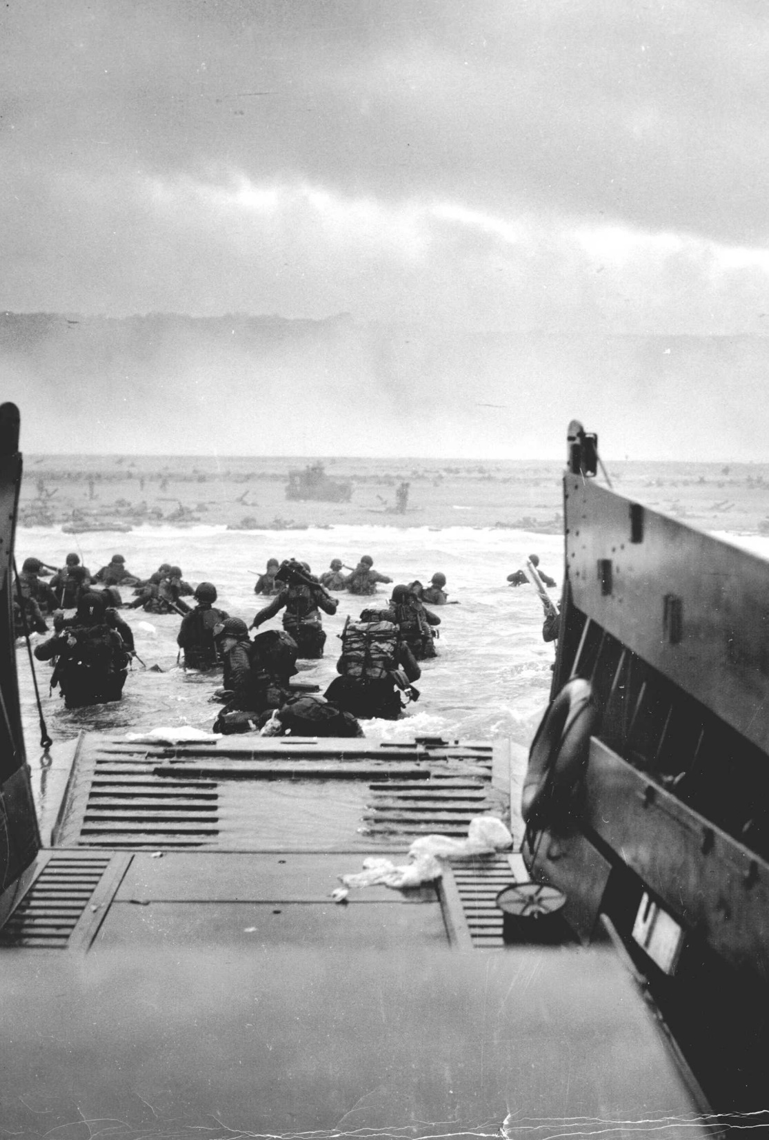
A. National Security
National security is the protecting of the nation and its citizens and property abroad.
America faced few foreign threats during the 19th century.
After World War II, threats against America increased as the Cold War began.
Notes:
Image by WikiImages from Pixabay
https://pixabay.com/photos/landing-dropship-normandy-d-day-60527/

Slide 6
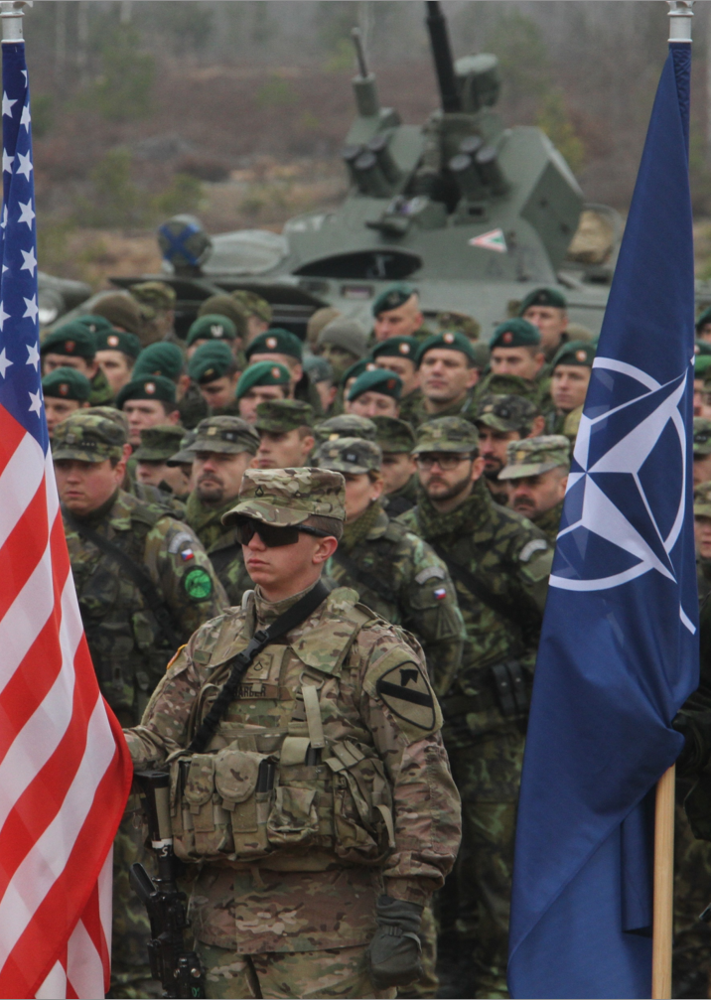
B. Alliance Security
One way for the government to protect America is to support allies abroad through treaties called alliances.
The North Atlantic Treaty Organization (NATO) was formed to protect Europe from the Soviet Union and remains an important alliance today.
Notes:
By Staff Sgt. Keith Anderson - https://www.dvidshub.net/image/1657360, Public Domain, https://commons.wikimedia.org/w/index.php?curid=39650499
https://commons.wikimedia.org/w/index.php?sort=relevance&search=NATO+exercise&title=Special:Search&profile=advanced&fulltext=1&advancedSearch-current=%7B%7D&ns0=1&ns6=1&ns12=1&ns14=1&ns100=1&ns106=1&searchToken=xycl3ue5i51b4xi9wu0qt96m#%2Fmedia%2FFile%3ANATO_exercise_141113-A-WU248-603.jpg

Slide 7
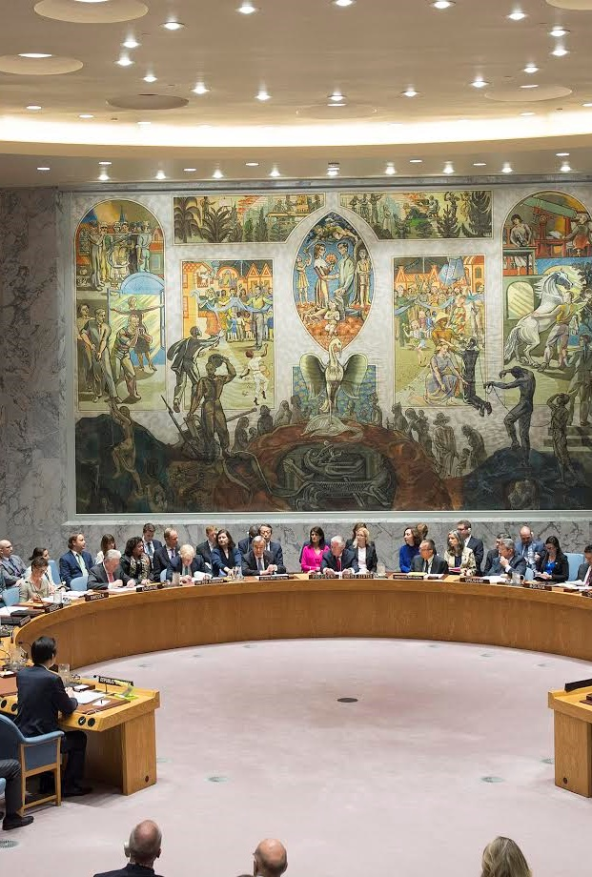
C. International Stability
The US often attempts to prevent wars from starting or spreading to maintain international stability.
This is especially true in places like the Middle East where the US has economic interests.
The UN Security Council
Notes:
By Cancillería Argentina - https://www.flickr.com/photos/mrecic-argentina/34192880001/, CC BY 2.0, https://commons.wikimedia.org/w/index.php?curid=81386779
https://commons.wikimedia.org/w/index.php?title=Special:Search&limit=500&offset=0&ns0=1&ns6=1&ns12=1&ns14=1&ns100=1&ns106=1&search=united+nations+security+council+meeting&advancedSearch-current=%7B%7D&searchToken=9yx60sc42dpufvg1vryfxwvfx#%2Fmedia%2FFile%3AUnited_Nations_Security_Council_-_Meeting_about_DPRK.jpg

Slide 8
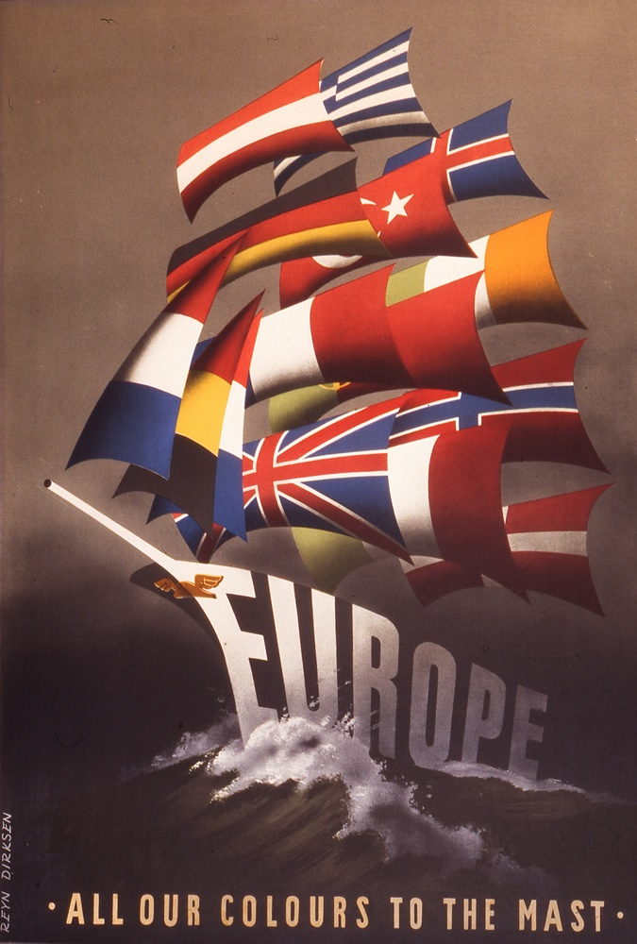
D. Economic Development
The US goals are to stimulate economic development in developing countries and to increase political freedom.
After World War II, the US donated billions of dollars through the Marshall Plan to help rebuild western Europe.
An American poster promoting the Marshall Plan
Notes:
By Reijn Dirksen, published Economic Cooperation Administration - Source, Public Domain, https://commons.wikimedia.org/w/index.php?curid=3745164
https://commons.wikimedia.org/w/index.php?title=Special:Search&limit=500&offset=0&ns0=1&ns6=1&ns12=1&ns14=1&ns100=1&ns106=1&search=the+marshall+plan&advancedSearch-current=%7B%7D&searchToken=dcuram2x3qiykz46w8i0xgdta#%2Fmedia%2FFile%3AEurope_Plan_Marshall._Poster_1947.JPG

Slide 9
Section Review – Chapter 13.1
1–4. What are the four basic goals of American foreign policy?
national security, alliance security, international stability, and economic development (p. 303)
5. Why did concern for national security increase during the Cold War?
the Soviet nuclear threat (p. 303)

Slide 10
Section Review – Chapter 13.1
6. After the collapse of the Soviet Union, why was national security still an important concern?
international terrorism (p. 304)
7. How has the growing interdependence of nations affected foreign policy?
Interdependence makes intervention to halt the spread of violence crucially important. (p. 304)

Slide 11
Section Review – Chapter 13.1
What is the relationship between foreign policy and the biblical purposes of government?
A primary goal of foreign policy is national security. One of the biblical purposes of government is to provide national defense and public safety for a nation’s citizens.

Slide 12
Section Review – Chapter 13.1
What are the potential effects of economic development for both the receiving nation and the donor country? In your opinion, which country benefits more?
Answers may mention that the recipient country could move toward greater economic success and greater political freedom while the donor country could gain markets for its goods and a better relationship with the recipient nation.

Slide 13
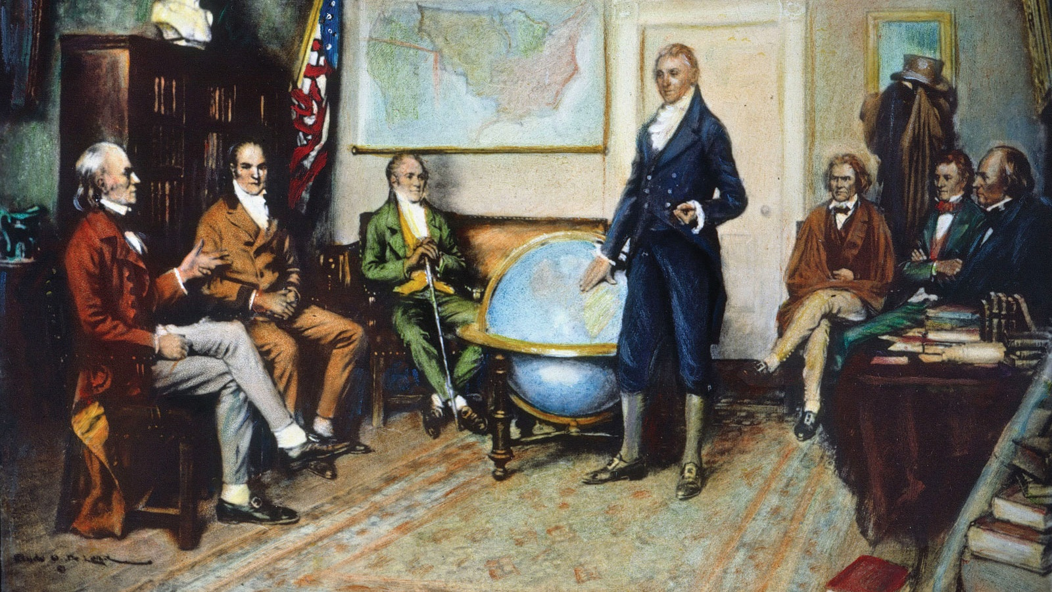
II. Foreign Policy Development
Chapter 13.2
Notes:
By Clyde O. DeLand - Image of Monroe Doctrine, 1823. Granger - Historical Picture Archive. The Granger Collection. Retrieved on 2018-09-02., Public Domain, https://commons.wikimedia.org/w/index.php?curid=20237245
https://commons.wikimedia.org/w/index.php?title=Special:Search&limit=500&offset=0&ns0=1&ns6=1&ns12=1&ns14=1&ns100=1&ns106=1&search=monroe+doctrine&advancedSearch-current=%7B%7D&searchToken=2af8onbcwxlhzxsxu6gux7s4t#%2Fmedia%2FFile%3AJames_Monroe_Cabinet.jpg

Slide 14
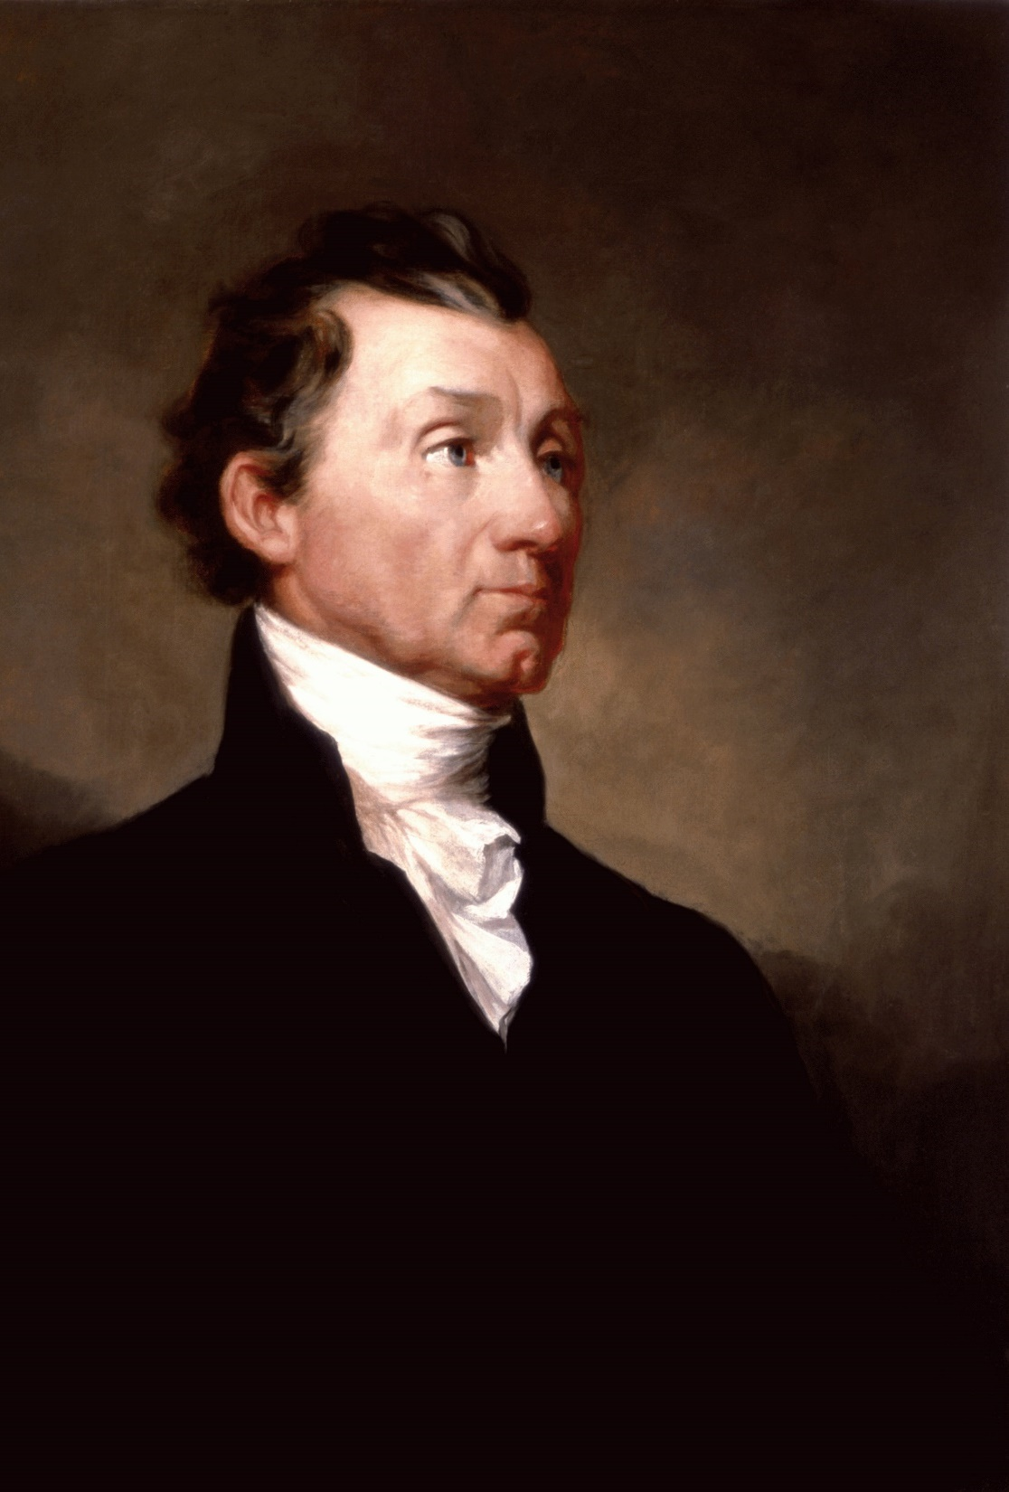
A. Isolation:
1790–1890
The dominant theme of foreign policy during America’s first century was isolationism.
The Monroe Doctrine declared America’s neutrality in European affairs while opposing European interference in Latin America.
Notes:
By Samuel Morse - https://www.whitehousehistory.org/photos/james-monroe, Public Domain, https://commons.wikimedia.org/w/index.php?curid=71911950
https://commons.wikimedia.org/w/index.php?sort=relevance&search=monroe+doctrine&title=Special:Search&profile=advanced&fulltext=1&advancedSearch-current=%7B%7D&ns0=1&ns6=1&ns12=1&ns14=1&ns100=1&ns106=1&searchToken=a452wgulaa40flv3gnqmjfkhr#%2Fmedia%2FFile%3AJames_Monroe_White_House_portrait_1819.jpg

Slide 15
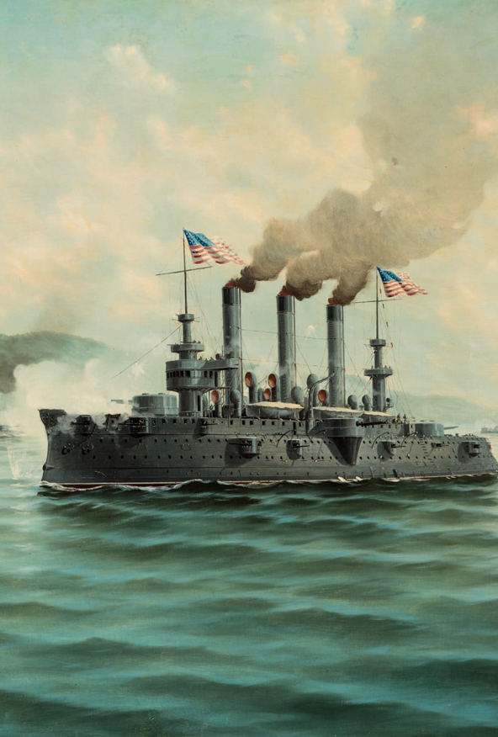
B. Expansion:
1890–1910
In the late 19th century, America’s economic growth spurred interest in expanding overseas.
In 1898, the US annexed Hawaii and acquired the Philippines, Guam, and Puerto Rico from Spain, cementing the US as a major world power.
Notes:
By Alfonso Sanz - ARMY AND NAVY CLUB OF WASHINGTONMarylanders All: Ten Unsung Heroes of Dorchester County by By Earl E. Brannock, Public Domain, https://commons.wikimedia.org/w/index.php?curid=87083761
https://commons.wikimedia.org/w/index.php?sort=relevance&search=battle+of+santiago+de+cuba&title=Special:Search&profile=advanced&fulltext=1&advancedSearch-current=%7B%7D&ns0=1&ns6=1&ns12=1&ns14=1&ns100=1&ns106=1&searchToken=cfo4xsqzv5j38mclfss2nnvh7#%2Fmedia%2FFile%3AAdm._William_T._Sampson%2C_commanding%2C_U._S._Navy_fleet%2C_Santaigo_Cuba%2C_1898.jpg

Slide 16
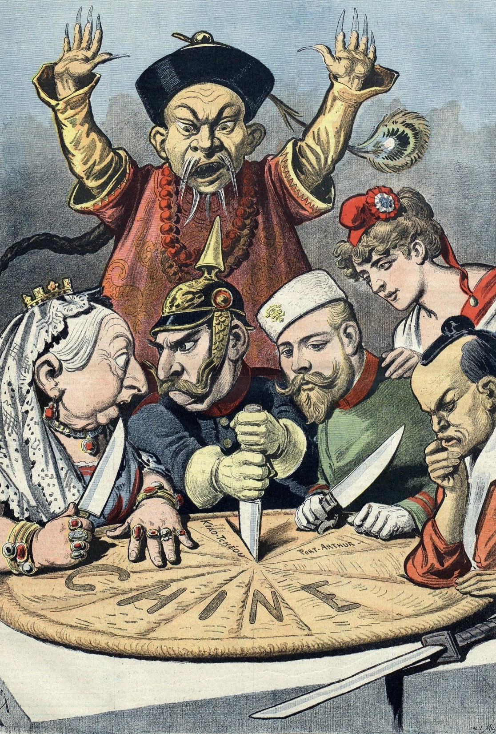
C. Vacillation and Uncertainty: 1910–40
America’s participation in 19th century imperialism was brief but intense.
Despite participating in World War I, the US returned to isolationism until World War II.
Notes:
By Henri Meyer - Bibliothèque nationale de France, Public Domain, https://commons.wikimedia.org/w/index.php?curid=62229
https://commons.wikimedia.org/w/index.php?sort=relevance&search=imperialism+cartoon&title=Special:Search&profile=advanced&fulltext=1&advancedSearch-current=%7B%7D&ns0=1&ns6=1&ns12=1&ns14=1&ns100=1&ns106=1&searchToken=1vt8lve7w5ff7vgcw6usvuyyu#%2Fmedia%2FFile%3AChina_imperialism_cartoon.jpg

Slide 17
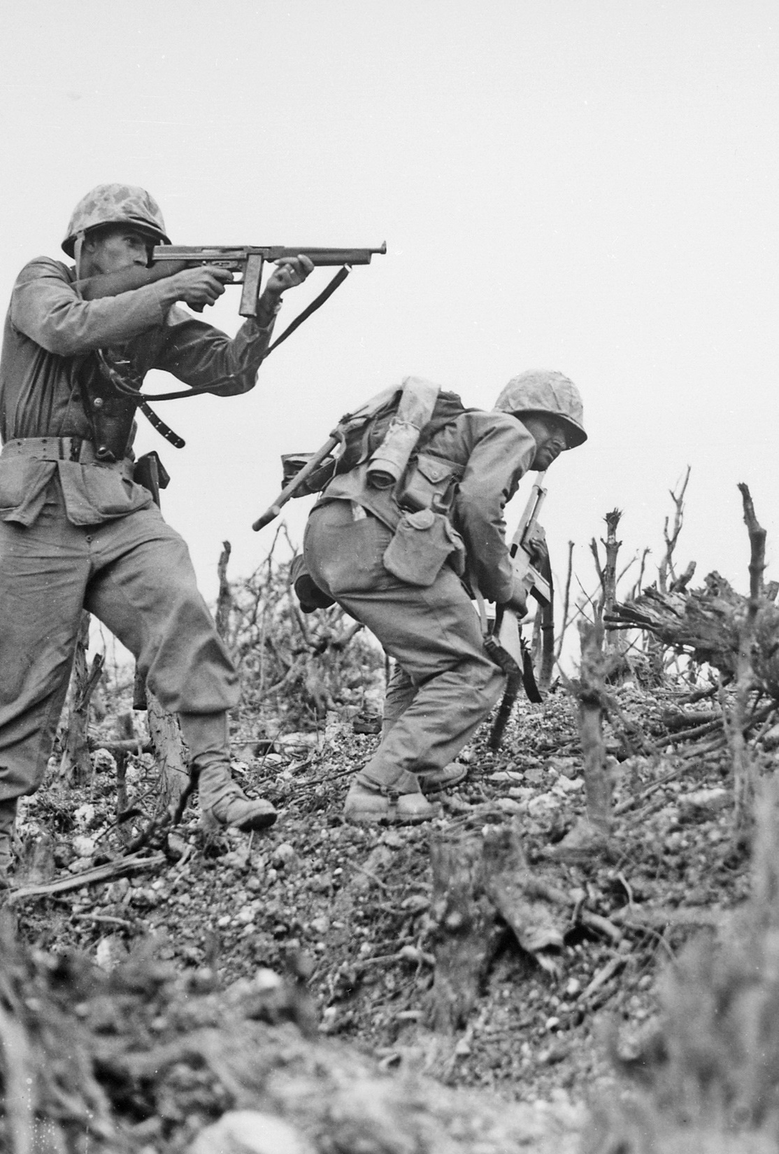
D. Obligation:
1941–91
America’s involvement in World War II helped propel it to superpower status.
After the war, hostilities between the US and USSR led to the Cold War.
Notes:
Image by Welcome to all and thank you for your visit ! ツ from Pixabay
https://pixabay.com/photos/war-soldiers-marine-1172111/

Slide 18
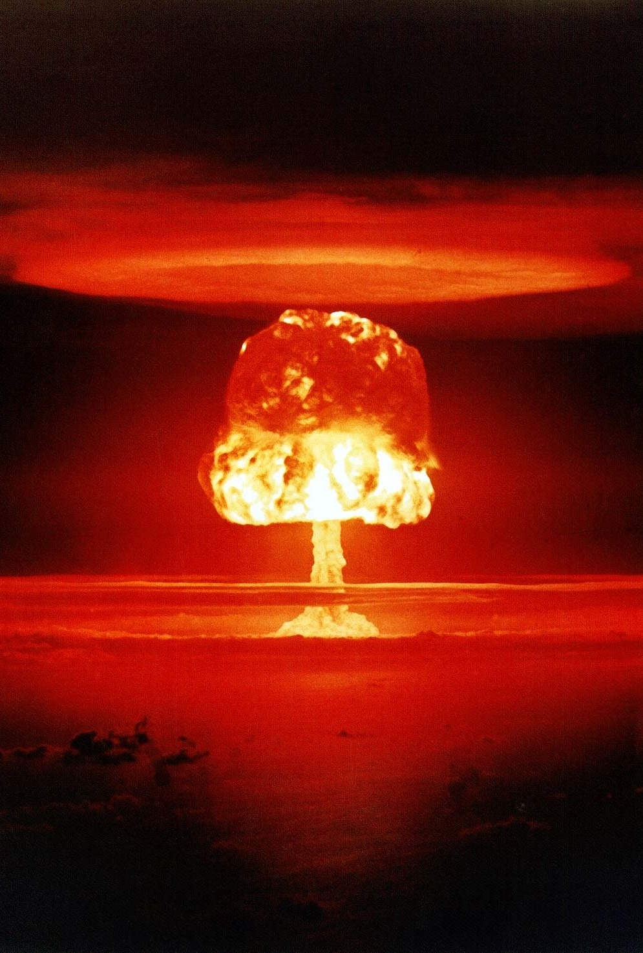
D. Obligation:
1941–91
Three strategies shaped American foreign policy during this period:
  Nuclear deterrence
  Mutual assured destruction (MAD)
  containment
Notes:
Image by Gerd Altmann from Pixabay
https://pixabay.com/photos/atomic-bomb-mushroom-cloud-explosion-1011738/

Slide 19
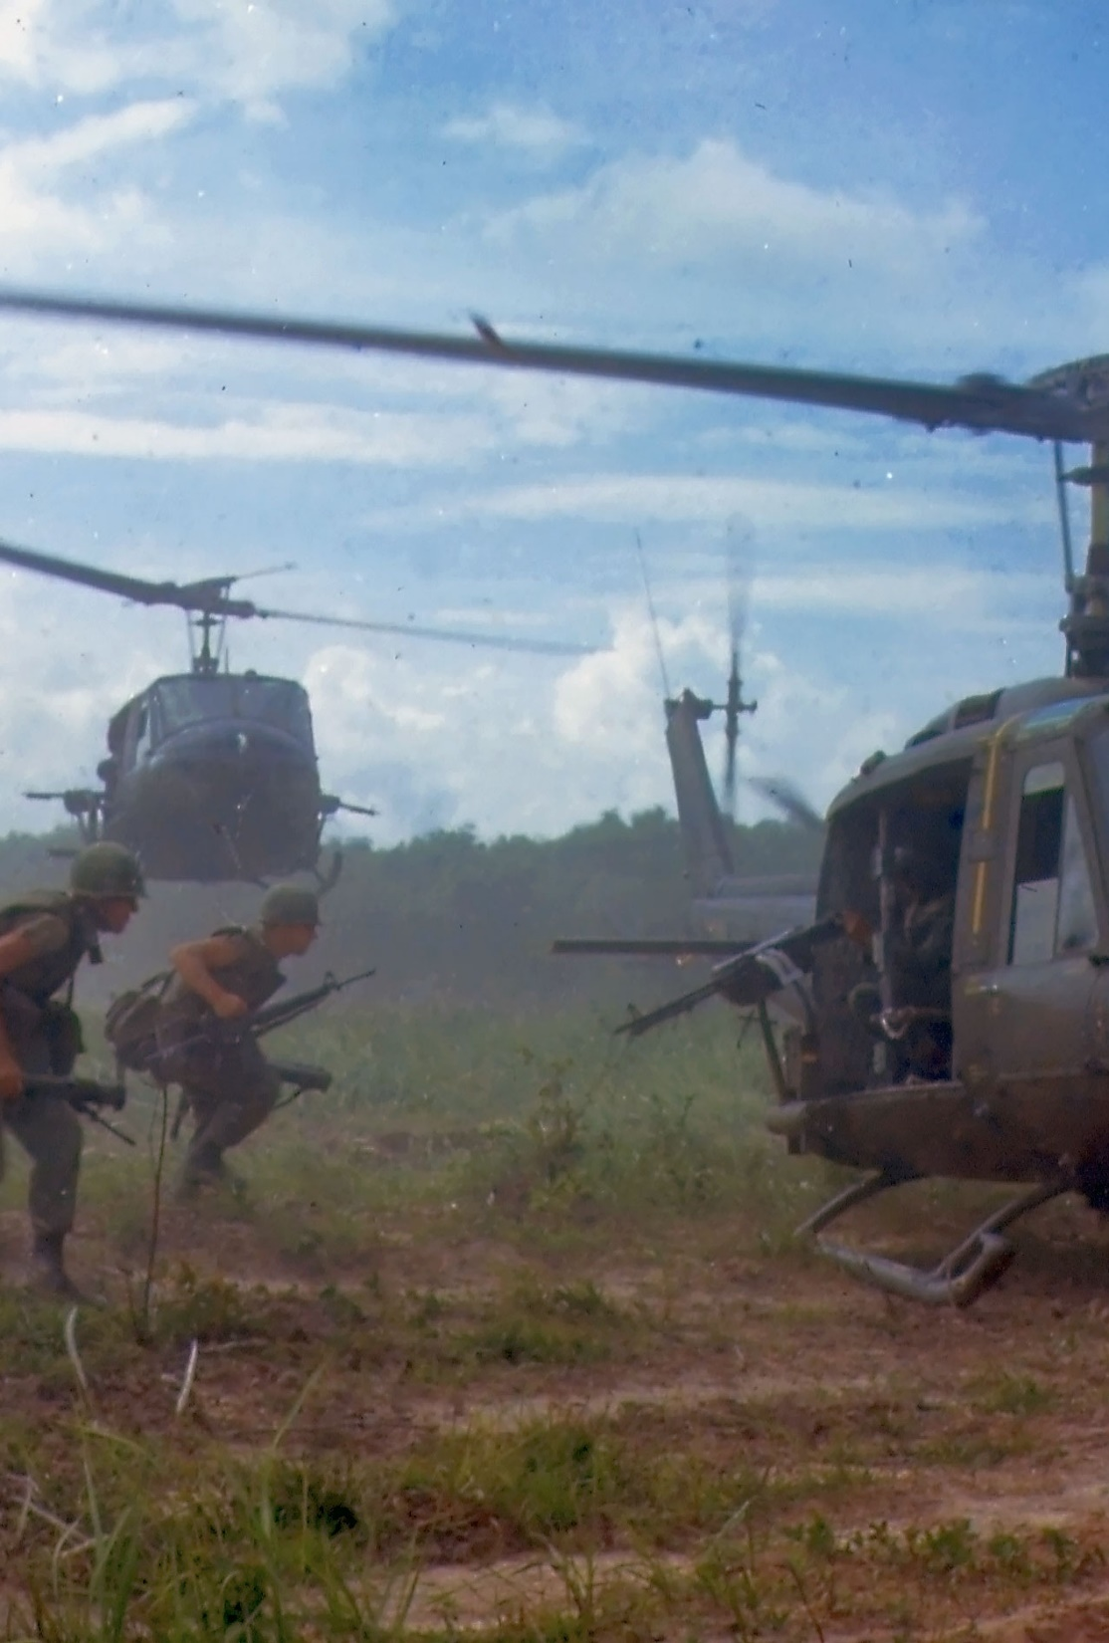
D. Obligation:
1941–91
America’s foreign policy was severely challenged by its defeat in Vietnam.
Weakened by its war in Afghanistan and its weak economy, the Soviet Union collapsed in 1991.
Notes:
Image by Welcome to all and thank you for your visit ! ツ from Pixabay
https://pixabay.com/photos/military-vietnam-war-soldiers-1348281/

Slide 20
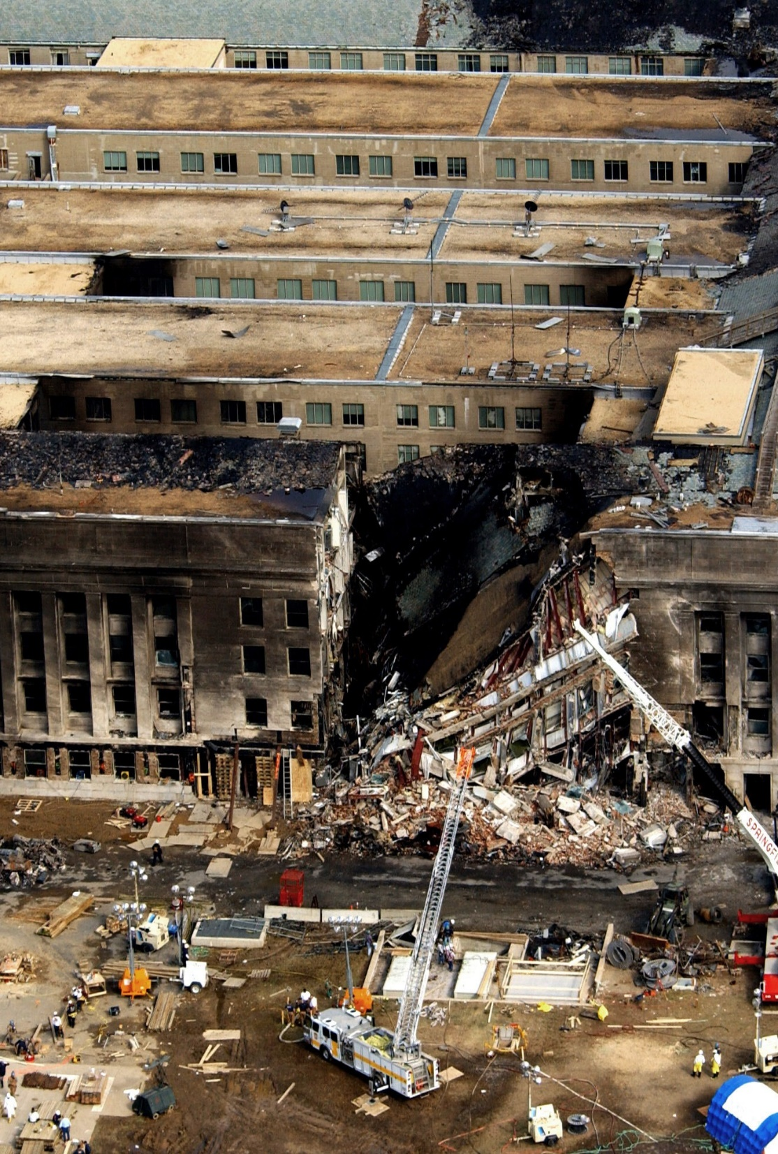
E. Transition: 1991 to the Present
After the end of the Cold War, US foreign policy focused on smaller, less predictable threats.
The 9/11 terrorist attacks by
al-Qaeda led to American wars in Afghanistan and Iraq.
Notes:
Image by WikiImages from Pixabay
https://pixabay.com/photos/pentagon-stop-11-september-2001-60569/

Slide 21
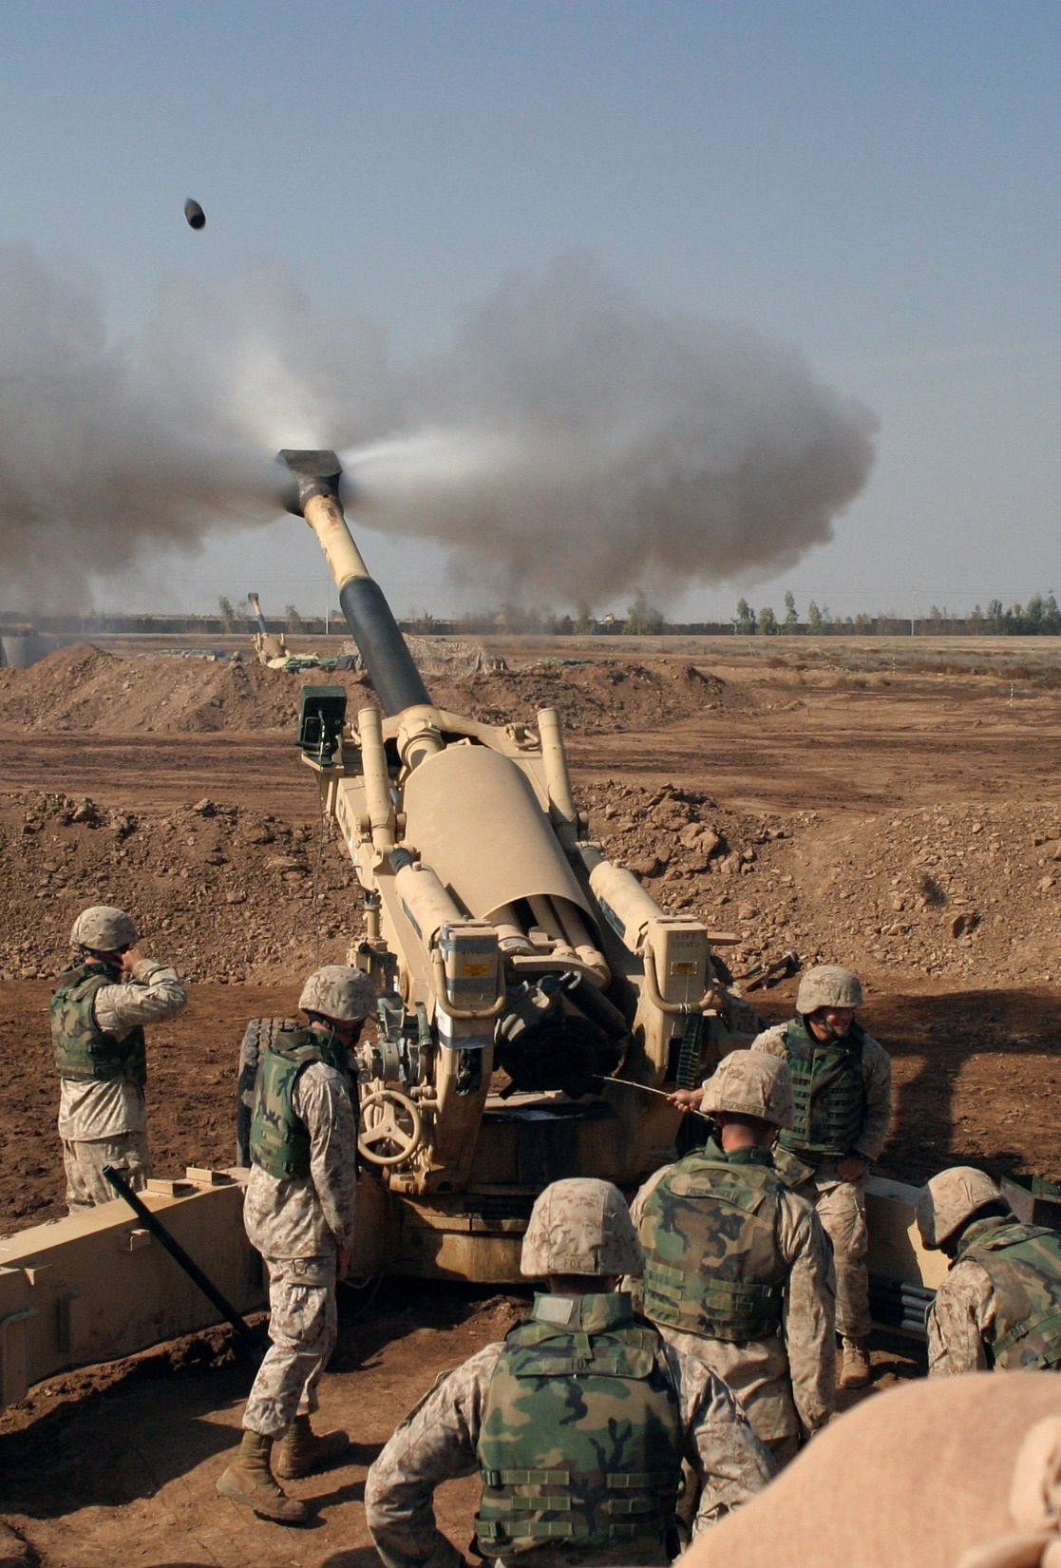
E. Transition: 1991 to the Present
The complicated problem of maintaining American security remains a challenge.
Notes:
Image by WikiImages from Pixabay
https://pixabay.com/photos/howitzer-mortar-grenade-weapon-60542/

Slide 22
Section Review – Chapter 13.2
1. Explain how the Monroe Doctrine demonstrated isolationism.
The Monroe Doctrine sought to preserve American independence (isolationism) by ensuring that other countries were not involved in the affairs of the Western Hemisphere. (pp. 306–307)
2–7. List six areas the United States acquired during the 1890s.
the Hawaiian Islands, the Philippines, Guam, Puerto Rico, some of the Samoan Islands, and Wake Island (p. 307)

Slide 23
Section Review – Chapter 13.2
8. Explain why the period from 1910 to 1940 is referred to as a time of vacillation in American foreign policy.
During this period, America moved between a policy of isolation (which it followed before and after World War I) and a policy of global involvement (which it followed during the world wars). (pp. 307–308)

Slide 24
Section Review – Chapter 13.2
9–11. Explain the three strategies that shaped US foreign policy during the Cold War.
The three strategies that shaped US foreign policy during the Cold War were nuclear deterrence (discouraging Soviet aggression by building a nuclear arsenal so large that the Soviets faced massive retaliation if they attacked the United States or its allies), mutual assured destruction (also called MAD, this policy was based on the idea that the superpowers would refrain from attacking each other because of the certainty that each would be destroyed), and containment (confronting the Communists with counterforce whenever they tried to expand their empire). (p. 308)

Slide 25
Section Review – Chapter 13.2
12. What was the greatest blow to the idea of containment?
the fall of South Vietnam to communism (p. 309)

Slide 26
Section Review – Chapter 13.2
How did the terrorist attacks of September 11, 2001, affect American foreign policy? Evaluate the success of the actions taken after the 9/11 attacks.
The attacks precipitated two foreign wars (in Afghanistan and Iraq). Those wars had mixed results. The Taliban was driven out of Afghanistan temporarily, but it has retaken control of some areas. The war in Iraq removed Saddam Hussein from power, but infighting between Muslim factions continues, and US prestige in the region has suffered.

Slide 27
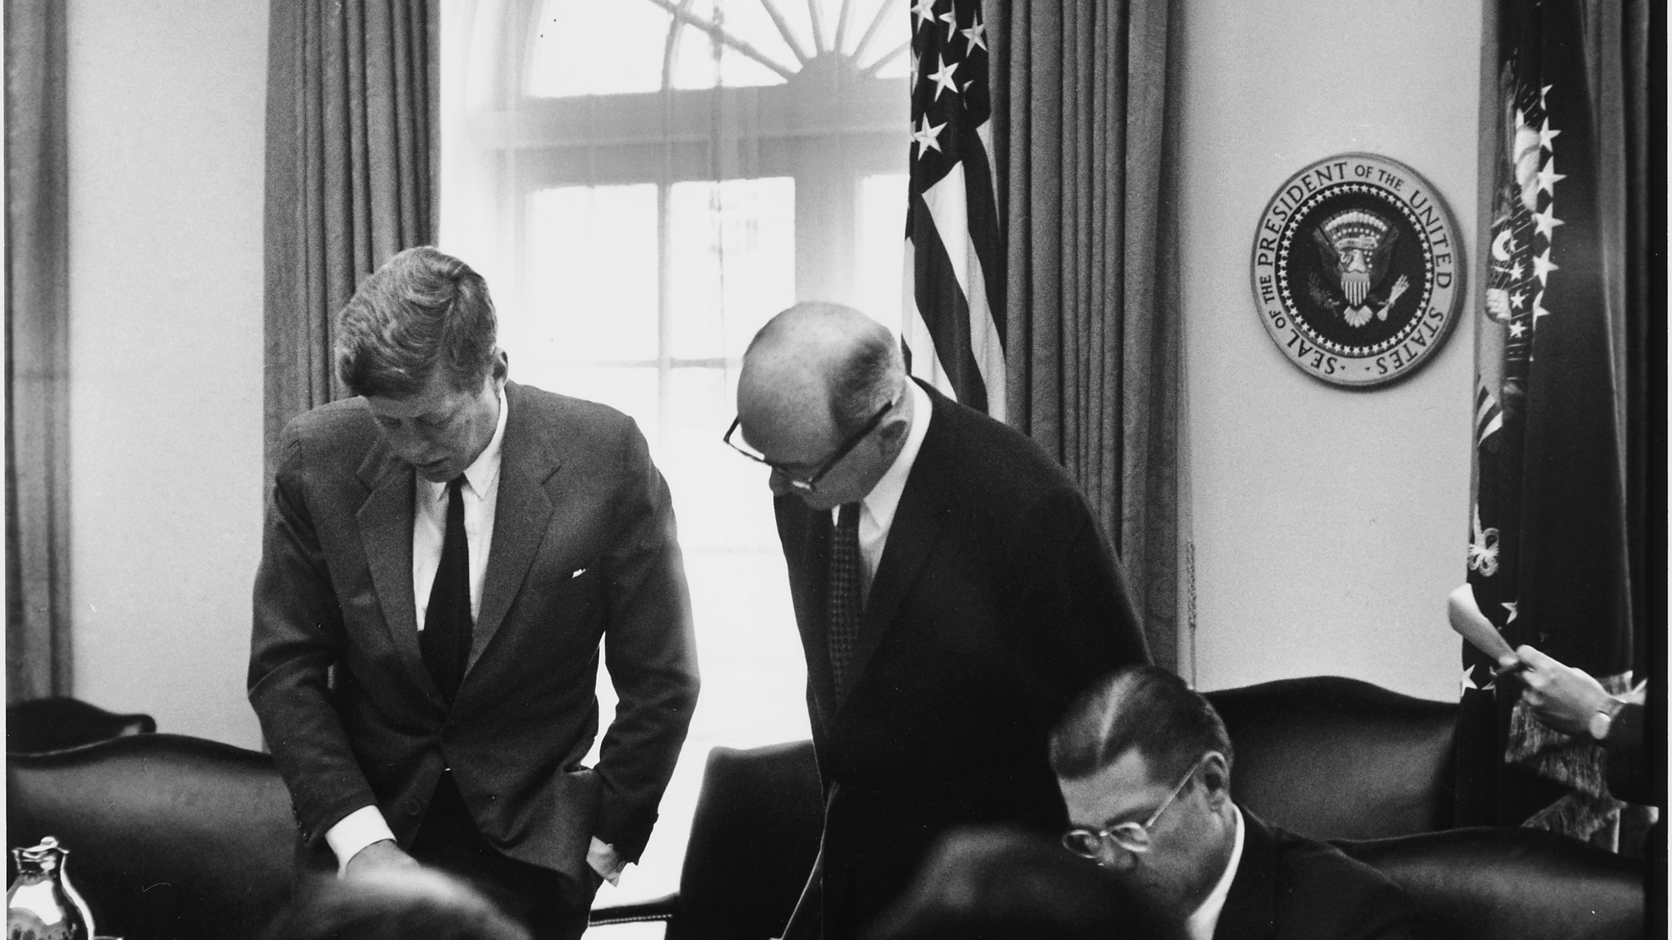
III. Policymakers
Chapter 13.3
Notes:
By Cecil (Cecil William) Stoughton, 1920-2008, Photographer (NARA record: 4538278) - U.S. National Archives and Records Administration, Public Domain, https://commons.wikimedia.org/w/index.php?curid=16097837
https://commons.wikimedia.org/w/index.php?title=Special:Search&limit=500&offset=0&ns0=1&ns6=1&ns12=1&ns14=1&ns100=1&ns106=1&search=national+security+council+meeting&advancedSearch-current=%7B%7D&searchToken=6vf811olkyosv3maos2y0c63f#%2Fmedia%2FFile%3AMeeting_of_the_Executive_Committee_of_the_National_Security_Council-_Cuba_Crisis._President_Kennedy%2C_Secretary_of..._-_NARA_-_194246.tiff

Slide 28
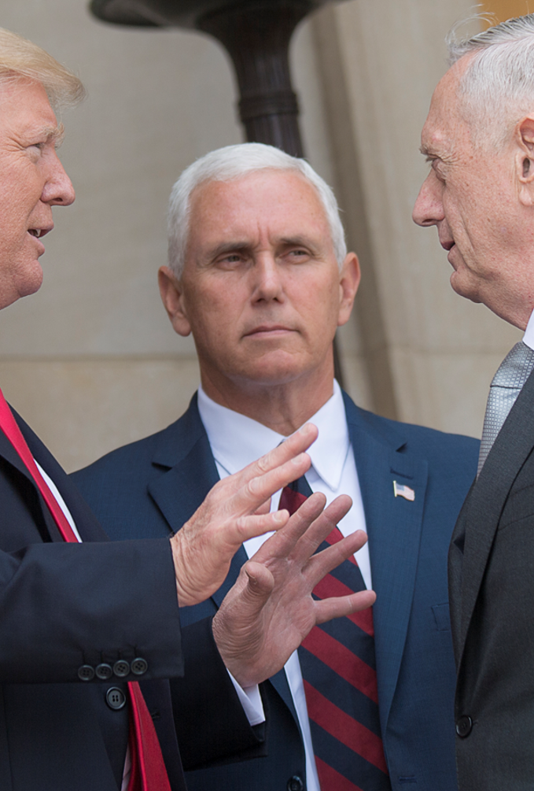
A. The President
The president occupies center stage in the making of foreign policy.
Some presidents have used American power aggressively to deter potential enemies.
These policies sometimes alienate other nations who resent American interference in their nations.
Notes:
By Petty Officer 2nd Class Dominique Pineiro - https://www.dvidshub.net/image/3591185/sd-national-security-council-with-potus-and-vpotus, Public Domain, https://commons.wikimedia.org/w/index.php?curid=61759052
https://commons.wikimedia.org/w/index.php?title=Special:Search&limit=500&offset=0&ns0=1&ns6=1&ns12=1&ns14=1&ns100=1&ns106=1&search=national+security+council+trump&advancedSearch-current=%7B%7D&searchToken=bo0a3n6y6a03op5b59xzhsmk1#%2Fmedia%2FFile%3ASD_National_Security_Council_with_POTUS_and_VPOTUS_170720-D-PB383-002.jpg

Slide 29
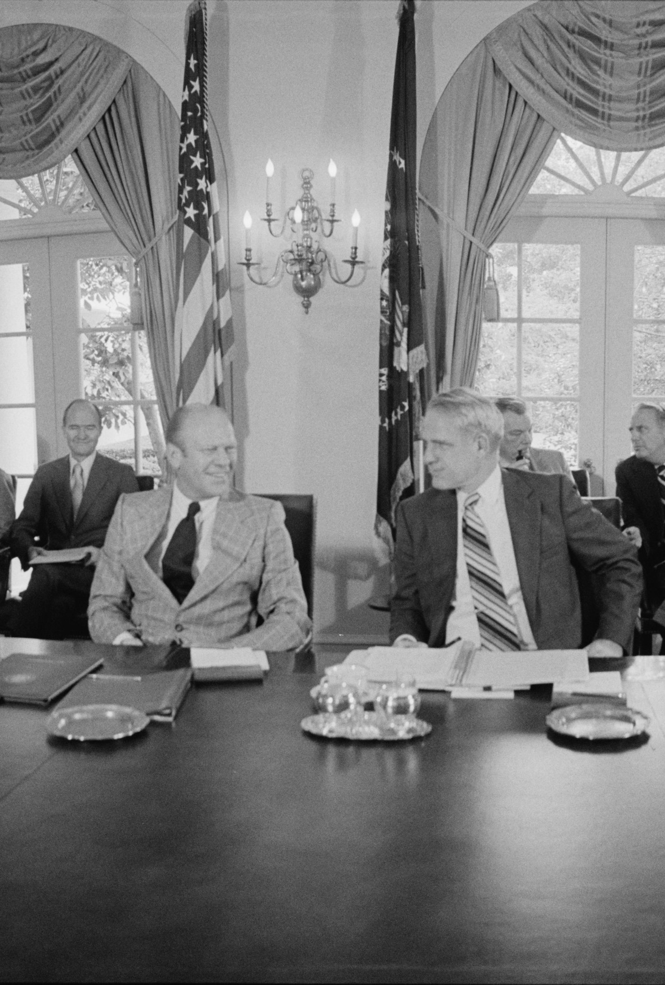
B. The Foreign Policy Bureaucracy
Five agencies within the executive branch are heavily involved in foreign policy.
The National Security Council (NSC) supplies information and guidance for the president and is led by the national security advisor.
Notes:
By Thomas J. O'Halloran and Warren K. Leffler, U.S. News & World Report Magazine - This image is available from the United States Library of Congress's Prints and Photographs divisionunder the digital ID ppmsca.08441.This tag does not indicate the copyright status of the attached work. A normal copyright tag is still required. See Commons:Licensing for more information., Public Domain, https://commons.wikimedia.org/w/index.php?curid=1596950
https://commons.wikimedia.org/w/index.php?title=Special:Search&limit=500&offset=0&ns0=1&ns6=1&ns12=1&ns14=1&ns100=1&ns106=1&search=National+Security+Council&advancedSearch-current=%7B%7D&searchToken=1712fx90a155dc38tbxi1zt13#%2Fmedia%2FFile%3AFord_National_Security_Council.jpg

Slide 30
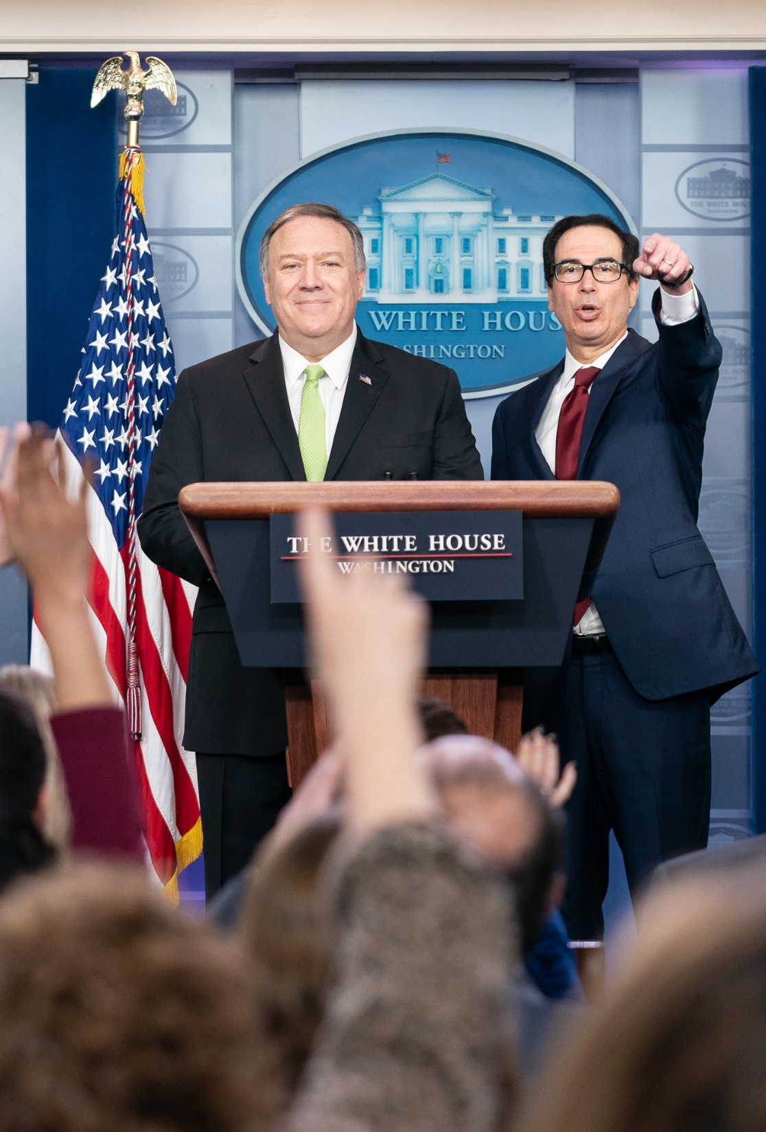
B. The Foreign Policy Bureaucracy
The secretary of state leads the State Department and oversees US diplomatic relations with more than 180 countries.
State Department embassies are located in foreign capital cities and each is headed by an ambassador.
Notes:
By The White House from Washington, DC - Secretary of the Treasury Steven Mnuchin and Secretary of State Mike Pompeo Participate in a Press Conference, Public Domain, https://commons.wikimedia.org/w/index.php?curid=85878354
https://commons.wikimedia.org/w/index.php?sort=relevance&search=secretary+of+state+mike+pompeo&title=Special:Search&profile=advanced&fulltext=1&advancedSearch-current=%7B%7D&ns0=1&ns6=1&ns12=1&ns14=1&ns100=1&ns106=1&searchToken=23ix1xw7zp2fgnut04h2ifuw8#%2Fmedia%2FFile%3ASecretary_of_the_Treasury_Steven_Mnuchin_and_Secretary_of_State_Mike_Pompeo_Participate_in_a_Press_Conference_%2849380113462%29.jpg

Slide 31
B. The Foreign Policy Bureaucracy
Major cities may host a consulate which offers legal assistance to traveling Americans and provides immigration advice.
Notes:
By The White House from Washington, DC - Secretary of the Treasury Steven Mnuchin and Secretary of State Mike Pompeo Participate in a Press Conference, Public Domain, https://commons.wikimedia.org/w/index.php?curid=85878354
https://commons.wikimedia.org/w/index.php?sort=relevance&search=secretary+of+state+mike+pompeo&title=Special:Search&profile=advanced&fulltext=1&advancedSearch-current=%7B%7D&ns0=1&ns6=1&ns12=1&ns14=1&ns100=1&ns106=1&searchToken=23ix1xw7zp2fgnut04h2ifuw8#%2Fmedia%2FFile%3ASecretary_of_the_Treasury_Steven_Mnuchin_and_Secretary_of_State_Mike_Pompeo_Participate_in_a_Press_Conference_%2849380113462%29.jpg

Slide 32
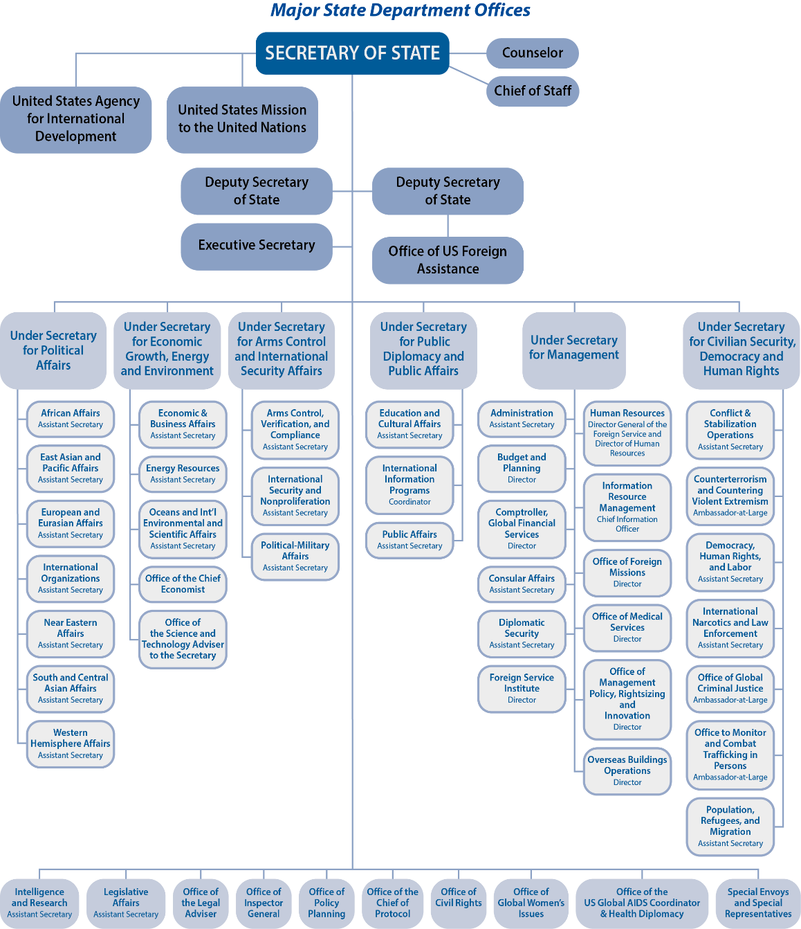
Notes:
BJU Press Art

Slide 33
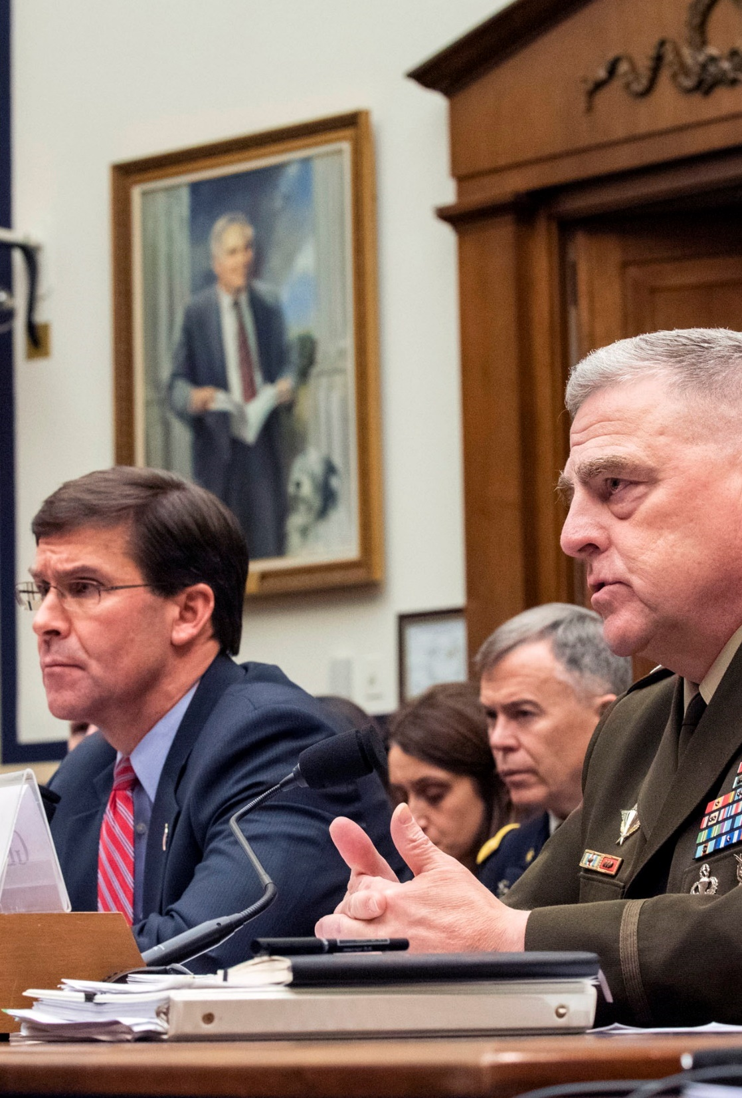
B. The Foreign Policy Bureaucracy
The secretary of defense leads the Defense Department which oversees about 1.3 million service members and 700,000 civilian employees.
The Pentagon is the headquarters of the Defense Department and hosts the Joint Chiefs of Staff (JCS).
Notes:
By Army Sgt. 1st Class Chuck Burden - This Image was released by the United States Department of Defense with the ID 191211-D-HD608-0008 (next).This tag does not indicate the copyright status of the attached work. A normal copyright tag is still required. See Commons:Licensing.العربية | বাংলা | Deutsch | English | español | euskara | فارسی | français | italiano | 日本語 | 한국어 | македонски | മലയാളം | Plattdüütsch | Nederlands | polski | پښتو | português | svenska | Türkçe | українська | 中文 | 中文（简体）‎ | +/−, Public Domain, https://commons.wikimedia.org/w/index.php?curid=84908265
https://commons.wikimedia.org/w/index.php?sort=relevance&search=Mark+T.+Esper&title=Special:Search&profile=advanced&fulltext=1&advancedSearch-current=%7B%7D&ns0=1&ns6=1&ns12=1&ns14=1&ns100=1&ns106=1&searchToken=4ucyc55xq57jypwl7vd0otts4#%2Fmedia%2FFile%3AMilley_Esper_Testify_to_Congress_on_Syria_and_ME.jpg

Slide 34
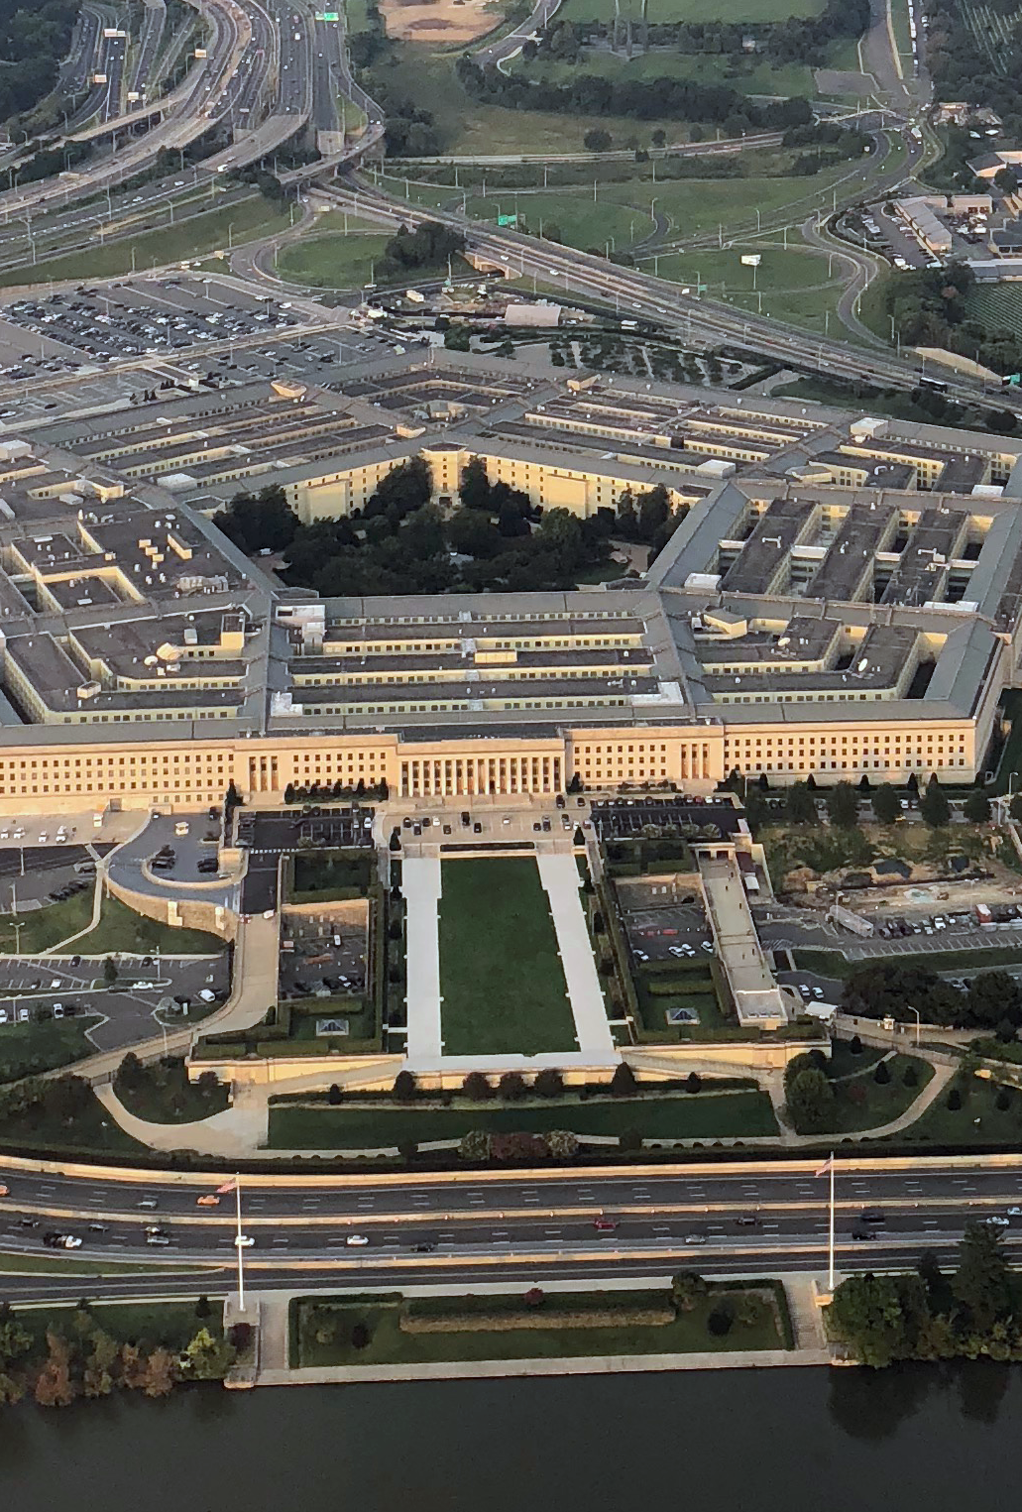
B. The Foreign Policy Bureaucracy
The US military is further divided into branches:
  Army
  Navy
  Marine Corps
  Air Force
Notes:
By Touch Of Light - Own work, CC BY-SA 4.0, https://commons.wikimedia.org/w/index.php?curid=72600649
https://commons.wikimedia.org/w/index.php?sort=relevance&search=the+pentagon&title=Special:Search&profile=advanced&fulltext=1&advancedSearch-current=%7B%7D&ns0=1&ns6=1&ns12=1&ns14=1&ns100=1&ns106=1&searchToken=66ia64wzmz7ub131r521sk0k#%2Fmedia%2FFile%3AThe_Pentagon%2C_cropped_square.png

Slide 35
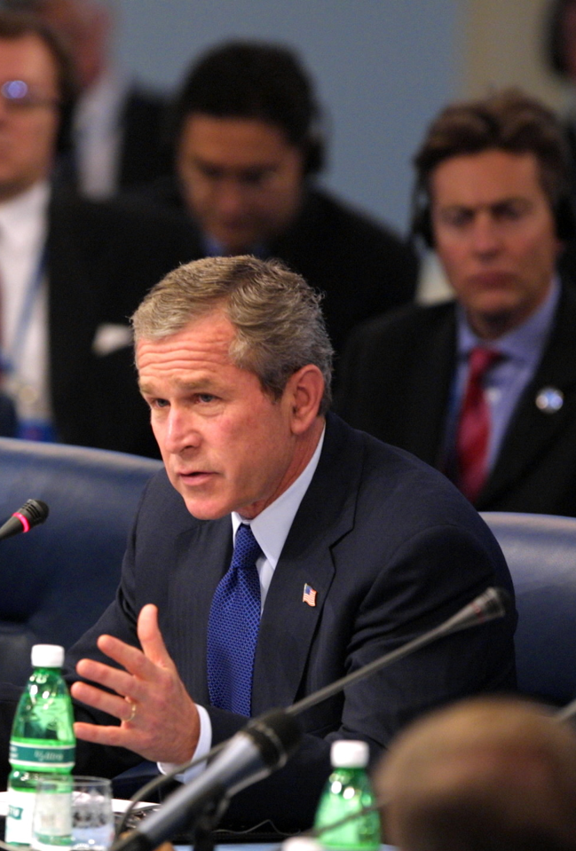
B. The Foreign Policy Bureaucracy
In 2001, President George W. Bush created the Department of Homeland Security which is tasked with preventing terrorist attacks.
Many older agencies were reassigned into this new department including the Secret Service and the Coast Guard.
Notes:
By Paul Morse - This media is available in the holdings of the National Archives and Records Administration, cataloged under the National Archives Identifier (NAID) 7369347., Public Domain, https://commons.wikimedia.org/w/index.php?curid=69900142
https://commons.wikimedia.org/w/index.php?sort=relevance&search=president+george+w+bush&title=Special:Search&profile=advanced&fulltext=1&advancedSearch-current=%7B%7D&ns0=1&ns6=1&ns12=1&ns14=1&ns100=1&ns106=1&searchToken=7wa93amh0izcaqc8drmborlzu#%2Fmedia%2FFile%3APresident_George_W._Bush_and_Prime_Minister_Tony_Blair_of_Great_Britain_at_Meeting_of_the_NATO-Russia_Council.jpg

Slide 36
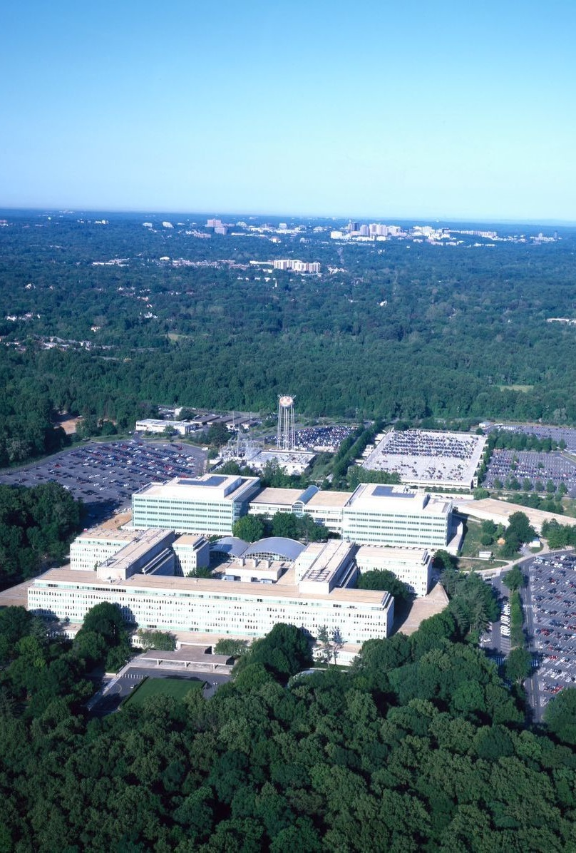
B. The Foreign Policy Bureaucracy
The Central Intelligence Agency (CIA) is the chief gatherer of intelligence in foreign countries.
The CIA gathers information from obvious sources like newspapers and radio broadcasts as well as through covert operations and satellites.
Notes:
http://loc.gov/pictures/resource/highsm.16449/; Library of Congress, LC-HS503-6307

Slide 37
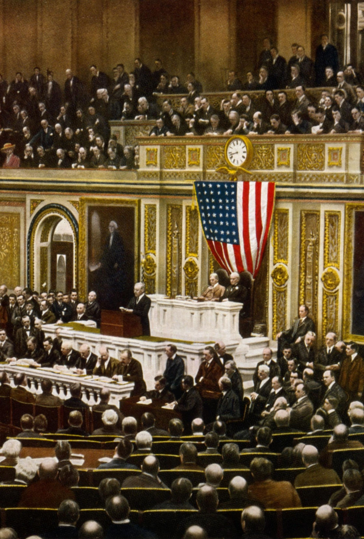
C. Congress
The president’s power to make foreign policy is at least nominally shared with Congress.
The Senate has the power to ratify treaties and approve nominees for the State and Defense Departments.
Notes:
By Unknown author - The Library of Congress, Public Domain, https://commons.wikimedia.org/w/index.php?curid=11224175
https://commons.wikimedia.org/w/index.php?sort=relevance&search=woodrow+wilson+speech&title=Special:Search&profile=advanced&fulltext=1&advancedSearch-current=%7B%7D&ns0=1&ns6=1&ns12=1&ns14=1&ns100=1&ns106=1&searchToken=92u0rw16lxmnovz4syho2wtu4#%2Fmedia%2FFile%3APresident_Woodrow_Wilson_asking_Congress_to_declare_war_on_Germany%2C_2_April_1917.jpg

Slide 38
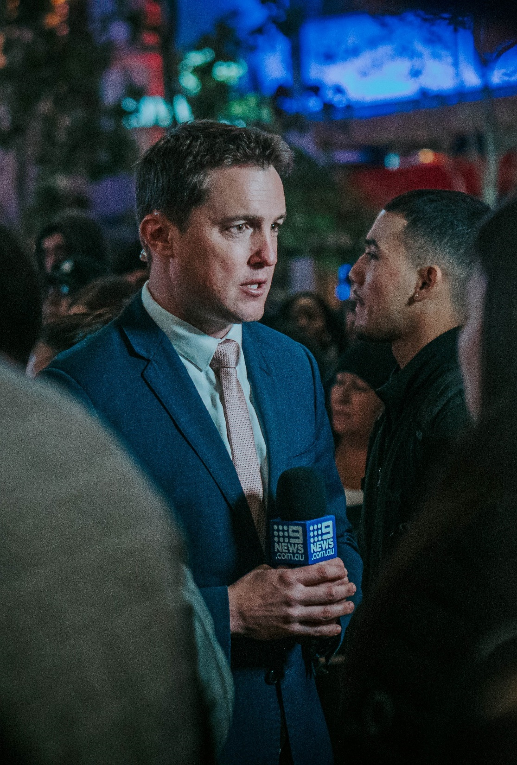
D. The Media
The media’s power to provide world news almost instantly is a powerful force in shaping public opinion.
The media makes the government more accountable, but it can also be accused of bias when it decides what news is covered and how it is presented.
Notes:
Photo by Fred Kearney on Unsplash
https://unsplash.com/photos/56XYfmP-NGs

Slide 39
Section Review – Chapter 13.3
1–3. Identify three of the president’s constitutional roles that give him primary control over foreign policy.
commander in chief, chief diplomat, and chief executive
(p. 311)
4. What is the purpose of the National Security Council?
to supply information and guidance for the president concerning matters of national security (p. 311)

Slide 40
Section Review – Chapter 13.3
5. What is the difference between an embassy and a consulate?
Embassies are government offices or residences, typically located in foreign capitals, that are headed by ambassadors, who act as personal representatives for the president. The United States has just one ambassador and one embassy in a foreign nation. However, the United States may have several consular offices, or consulates, in large nations; they are usually located in main cities of states or provinces. (p. 312)

Slide 41
Section Review – Chapter 13.3
6–7. How has Congress sought to ensure that military power in the United States is subordinate to civilian power at both the first and second levels of the Department of Defense?
The secretary of defense must be a civilian who has not served in an active duty position for at least seven years. Many civilian officials, including the secretaries of the army, navy, and air force, also work to shape defense policy. (p. 314)

Slide 42
Section Review – Chapter 13.3
Of the five areas for which the Department of Homeland Security is responsible, which two do you think are most important? Why?

Slide 43
Section Review – Chapter 13.3
Does media coverage help or hinder American foreign policy? Explain your answer.
Some will say that the media’s ability to influence public opinion can make government more responsible by making citizens aware of events. Others will argue that the media can be selective in reporting or present distorted analyses of foreign events.

Slide 44
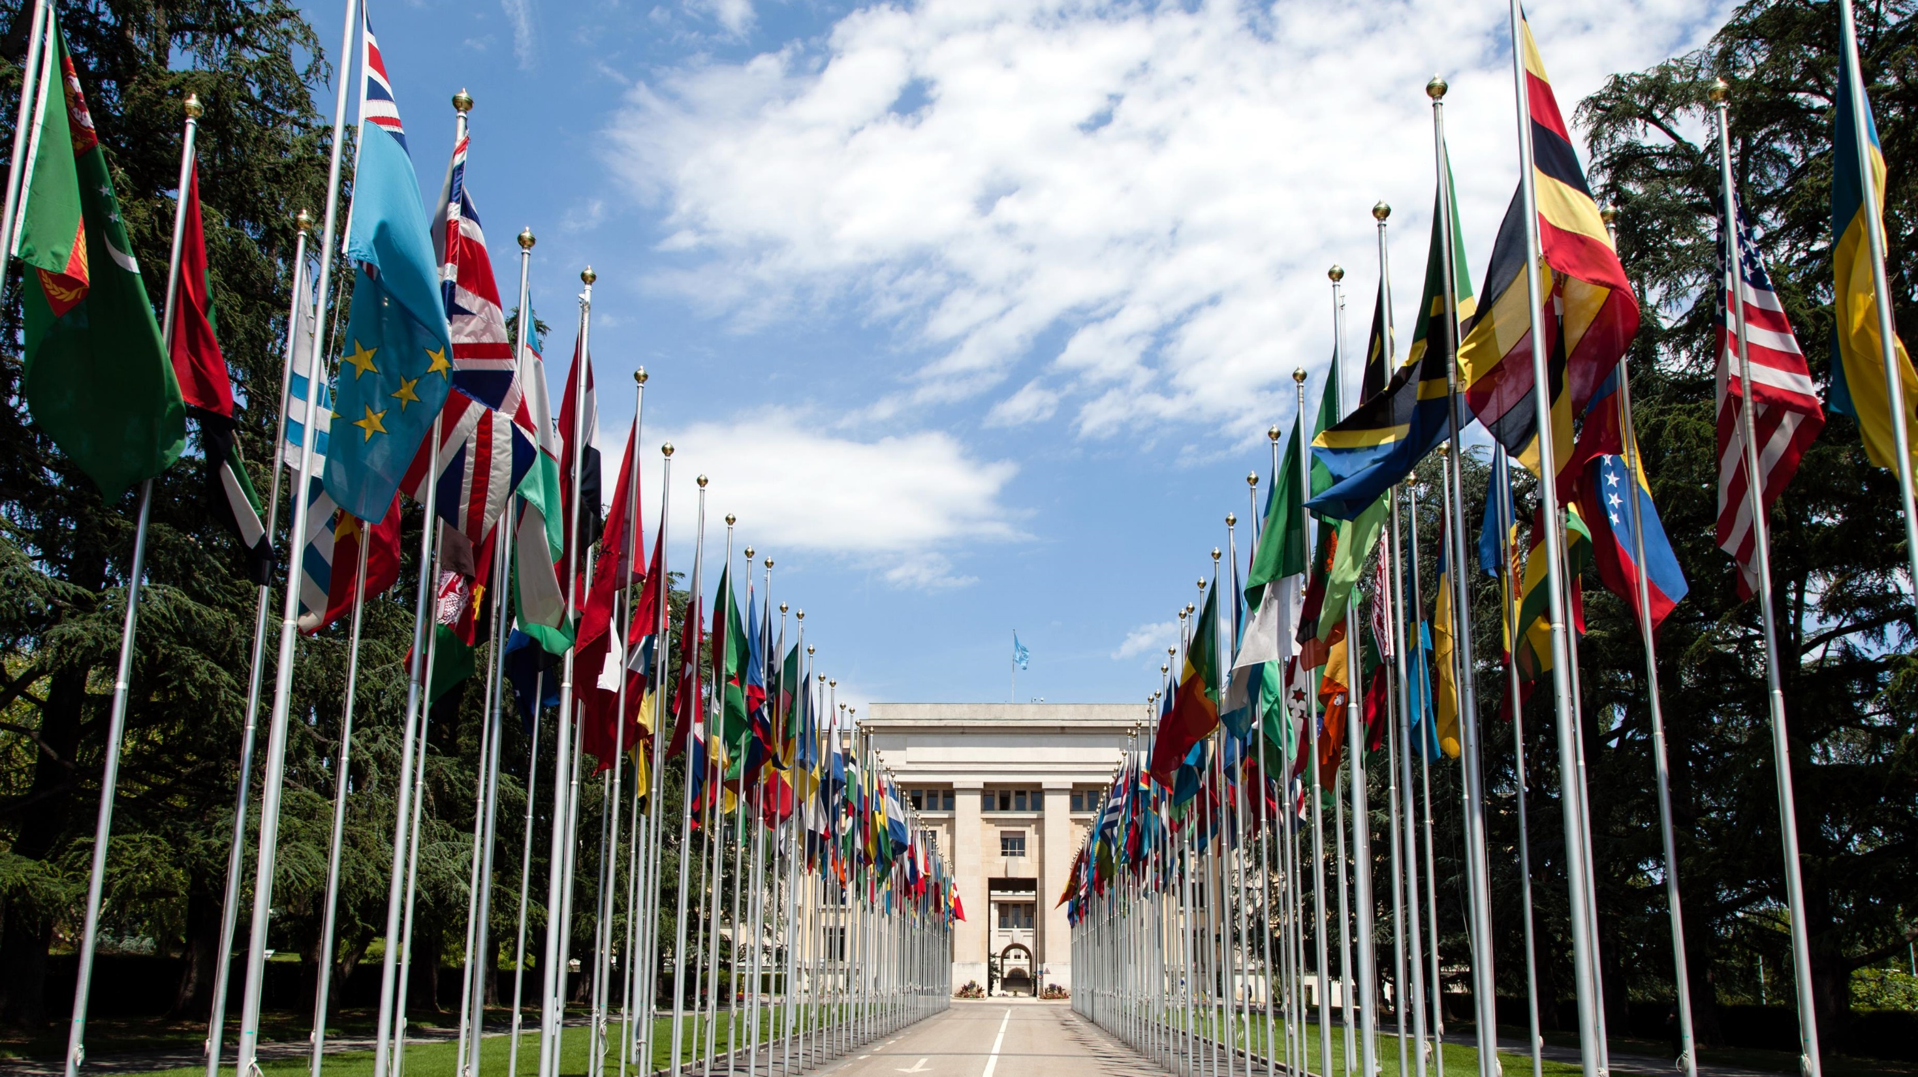
IV. Policy Methods
Chapter 13.4
Notes:
By Tom Page - Flickr: IMG_1965, CC BY-SA 2.0, https://commons.wikimedia.org/w/index.php?curid=25912446
https://commons.wikimedia.org/w/index.php?sort=relevance&search=united+nations&title=Special:Search&profile=advanced&fulltext=1&advancedSearch-current=%7B%7D&ns0=1&ns6=1&ns12=1&ns14=1&ns100=1&ns106=1&searchToken=4afx04fztuls0yz6hpoz30hg6#%2Fmedia%2FFile%3AUnited_Nations_Flags_-_cropped.jpg

Slide 45
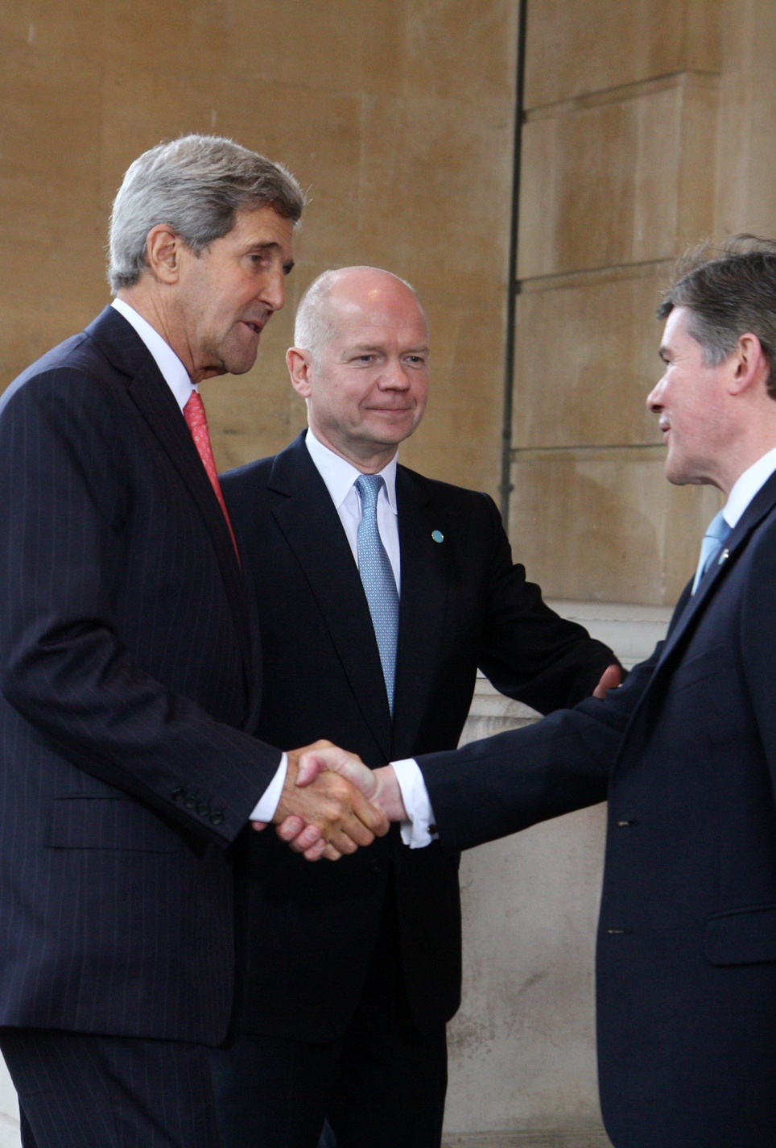
A. Diplomacy
The US maintains diplomatic relations with allies and hostile countries around the world.
The US often uses indirect diplomacy to encourage negotiations between other countries.
Notes:
By Foreign and Commonwealth Office - Flickr, OGL v1.0, https://commons.wikimedia.org/w/index.php?curid=32107727
https://commons.wikimedia.org/w/index.php?sort=relevance&search=secretary+of+state+john+kerry&title=Special:Search&profile=advanced&fulltext=1&advancedSearch-current=%7B%7D&ns0=1&ns6=1&ns12=1&ns14=1&ns100=1&ns106=1&searchToken=72dzejc5kmvf0hqf2lppbfmq0#%2Fmedia%2FFile%3AForeign_Secretary_William_Hague_%26_US_Secretary_of_State_John_Kerry_%2810420046584%29.jpg

Slide 46
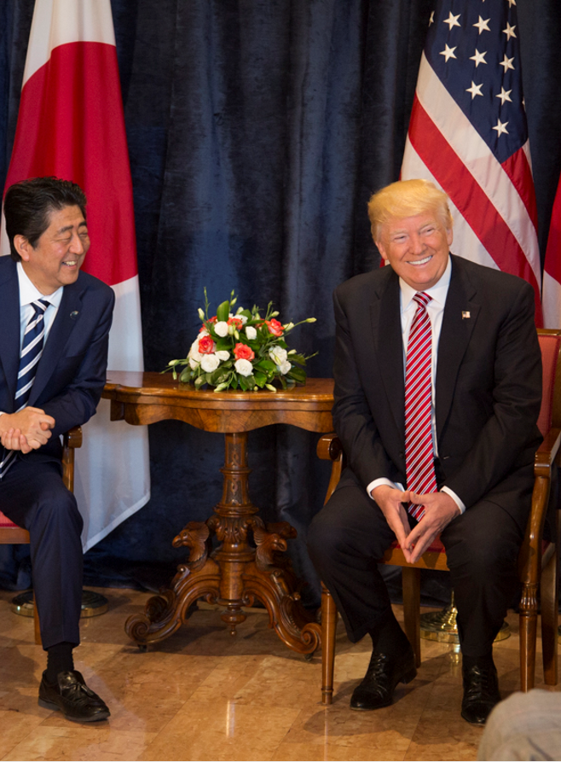
B. Treaties and Multinational Organizations
Treaties are formal agreements made between nations or groups of nations.
While the Senate must approve treaties, the president does have the power to make executive agreements with other heads of state.
Notes:
By Shealah Craighead - www.whitehouse.gov, Public Domain, https://commons.wikimedia.org/w/index.php?curid=59450339
https://commons.wikimedia.org/w/index.php?sort=relevance&search=Donald+Trump+meeting&title=Special:Search&profile=advanced&fulltext=1&advancedSearch-current=%7B%7D&ns0=1&ns6=1&ns12=1&ns14=1&ns100=1&ns106=1&searchToken=d7ibq89130e29cqpx96i4p6jr#%2Fmedia%2FFile%3ADonald_Trump_and_Shinz%C5%8D_Abe_at_43rd_G7_summit.jpg

Slide 47
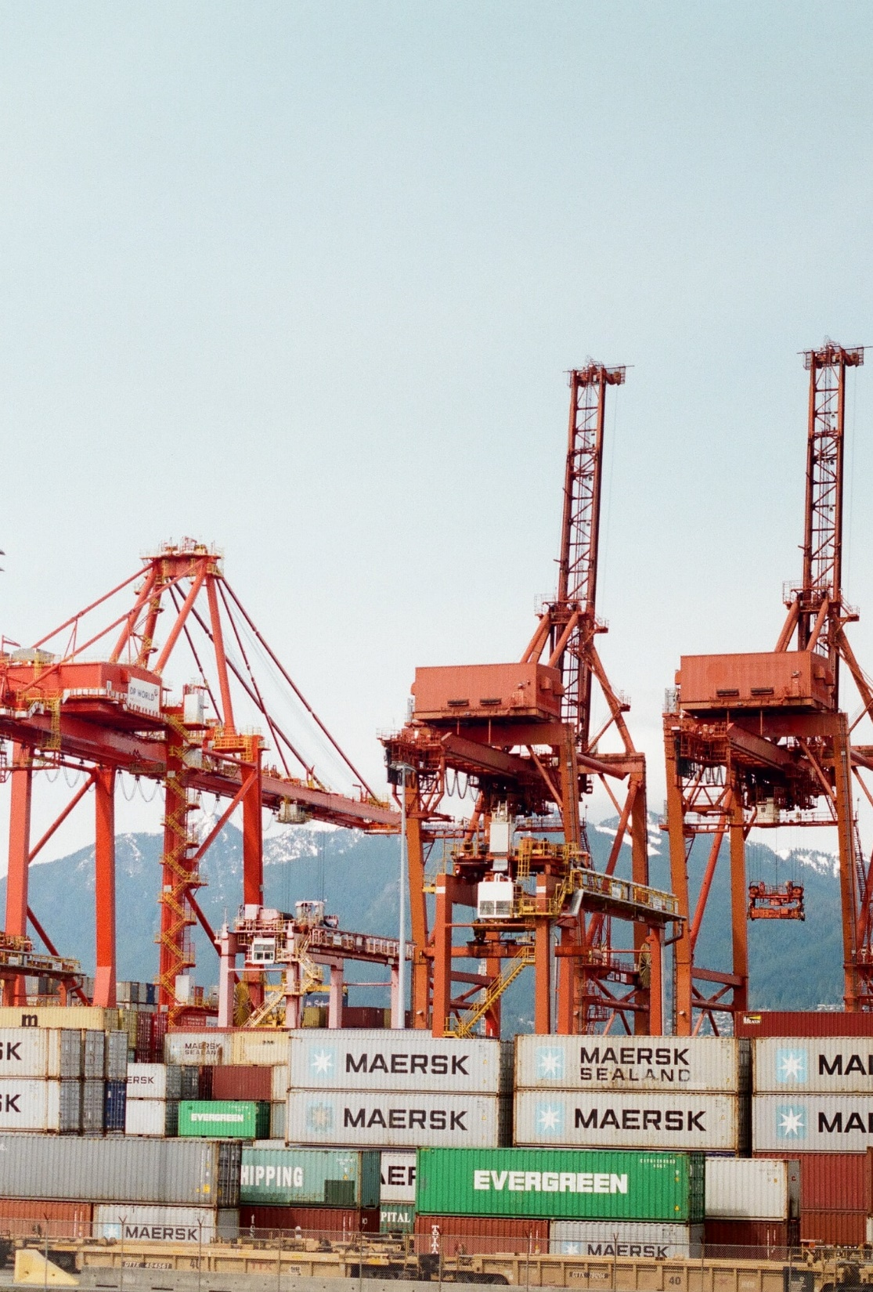
B. Treaties and Multinational Organizations
Multinational organizations are bodies established to allow nations to work collectively on certain issues.
Globalization has made an isolationist foreign policy practically impossible.
Notes:
Photo by Kyle Ryan on Unsplash
https://unsplash.com/photos/pSyfecRCBQA

Slide 48
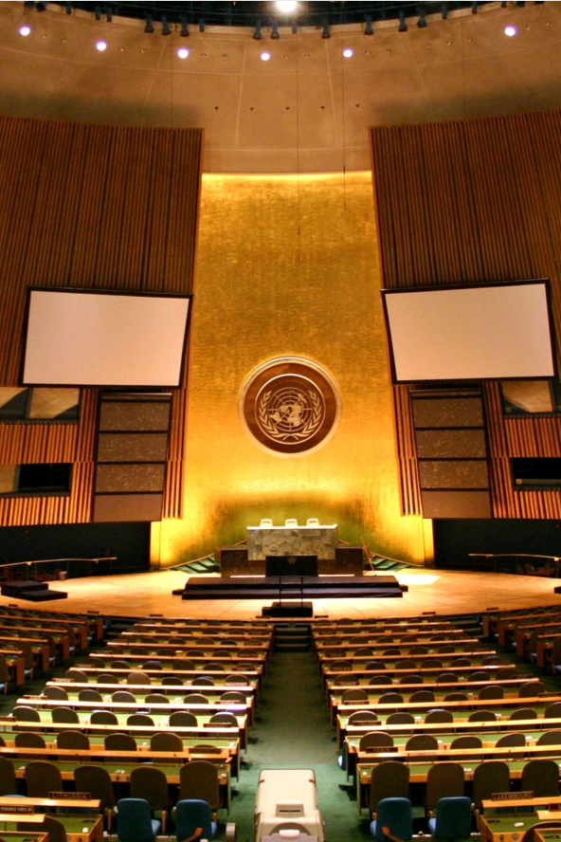
B. Treaties and Multinational Organizations
The United Nations (UN) was created in 1945 with the purpose of maintaining world peace and upholding human rights.
  The Secretariat is the main administrative body and is led by the secretary-general.
  The General Assembly is the primary representative body of the UN.
Notes:
By Patrick Gruban, cropped and downsampled by Pine - originally posted to Flickr as UN General Assembly, CC BY-SA 2.0, https://commons.wikimedia.org/w/index.php?curid=4806869
https://commons.wikimedia.org/w/index.php?sort=relevance&search=united+nations+general+assembly&title=Special:Search&profile=advanced&fulltext=1&advancedSearch-current=%7B%7D&ns0=1&ns6=1&ns12=1&ns14=1&ns100=1&ns106=1&searchToken=cumvthjqyyo3c0h46nosiel5g#%2Fmedia%2FFile%3AUN_General_Assembly_hall.jpg

Slide 49
B. Treaties and Multinational Organizations
The United Nations (UN) was created in 1945 with the purpose of maintaining world peace and upholding human rights.
  The Security Council consists of 15 nations (5 of which are permanent) and deals with peace and security issues.
  The Economic and Social Council promotes fundamental human rights as defined by the UN.
Notes:
By Patrick Gruban, cropped and downsampled by Pine - originally posted to Flickr as UN General Assembly, CC BY-SA 2.0, https://commons.wikimedia.org/w/index.php?curid=4806869
https://commons.wikimedia.org/w/index.php?sort=relevance&search=united+nations+general+assembly&title=Special:Search&profile=advanced&fulltext=1&advancedSearch-current=%7B%7D&ns0=1&ns6=1&ns12=1&ns14=1&ns100=1&ns106=1&searchToken=cumvthjqyyo3c0h46nosiel5g#%2Fmedia%2FFile%3AUN_General_Assembly_hall.jpg

Slide 50
B. Treaties and Multinational Organizations
The United Nations (UN) was created in 1945 with the purpose of maintaining world peace and upholding human rights.
  The International Court of Justice is located at The Hague in the Netherlands and is the main judicial body of the United Nations.
Notes:
By Patrick Gruban, cropped and downsampled by Pine - originally posted to Flickr as UN General Assembly, CC BY-SA 2.0, https://commons.wikimedia.org/w/index.php?curid=4806869
https://commons.wikimedia.org/w/index.php?sort=relevance&search=united+nations+general+assembly&title=Special:Search&profile=advanced&fulltext=1&advancedSearch-current=%7B%7D&ns0=1&ns6=1&ns12=1&ns14=1&ns100=1&ns106=1&searchToken=cumvthjqyyo3c0h46nosiel5g#%2Fmedia%2FFile%3AUN_General_Assembly_hall.jpg

Slide 51
B. Treaties and Multinational Organizations
The United Nations (UN) was created in 1945 with the purpose of maintaining world peace and upholding human rights.
  The US pays about 22% of the UN’s overall budget; this remains a controversial issue today.
Notes:
By Patrick Gruban, cropped and downsampled by Pine - originally posted to Flickr as UN General Assembly, CC BY-SA 2.0, https://commons.wikimedia.org/w/index.php?curid=4806869
https://commons.wikimedia.org/w/index.php?sort=relevance&search=united+nations+general+assembly&title=Special:Search&profile=advanced&fulltext=1&advancedSearch-current=%7B%7D&ns0=1&ns6=1&ns12=1&ns14=1&ns100=1&ns106=1&searchToken=cumvthjqyyo3c0h46nosiel5g#%2Fmedia%2FFile%3AUN_General_Assembly_hall.jpg

Slide 52
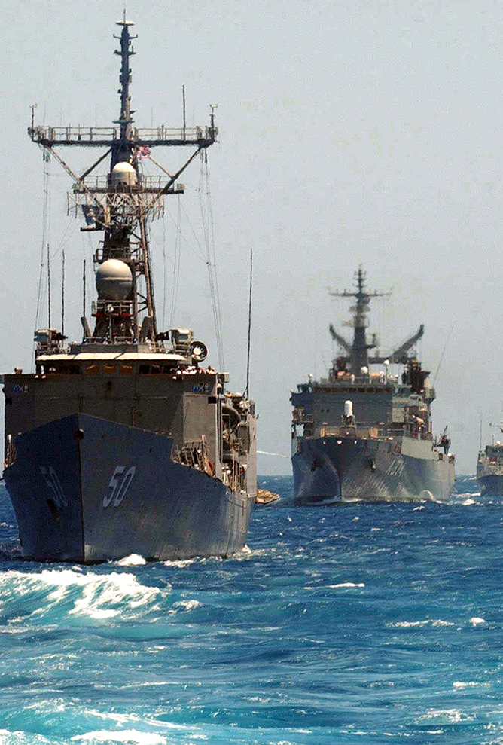
B. Treaties and Multinational Organizations
To contain the Soviet Union after World War II, the United States and its allies created the North Atlantic Treaty Organization (NATO).
In addition to the UN and NATO, the US has many bilateral treaties with other nations – agreements that involve only two nations.
Notes:
By U.S. Navy photo by Paul Farley - This Image was released by the United States Navy with the ID 050520-N-0780F-003 (next).This tag does not indicate the copyright status of the attached work. A normal copyright tag is still required. See Commons:Licensing.العربية | বাংলা | Deutsch | English | español | euskara | فارسی | français | italiano | 日本語 | 한국어 | македонски | മലയാളം | Plattdüütsch | Nederlands | polski | پښتو | português | svenska | Türkçe | українська | 中文 | 中文（简体）‎ | +/−, Public Domain, https://commons.wikimedia.org/w/index.php?curid=8203641
https://commons.wikimedia.org/w/index.php?sort=relevance&search=North+Atlantic+Treaty+Organization&title=Special:Search&profile=advanced&fulltext=1&advancedSearch-current=%7B%7D&ns0=1&ns6=1&ns12=1&ns14=1&ns100=1&ns106=1&searchToken=18lviwvr6olqiaome5ti91go6#%2Fmedia%2FFile%3AUS_Navy_050520-N-0780F-003_Guided_missile_frigate_USS_Taylor_%28FFG_50%29_is_followed_by_other_North_Atlantic_Treaty_Organization_%28NATO%29_nations%27_vessels.jpg

Slide 53
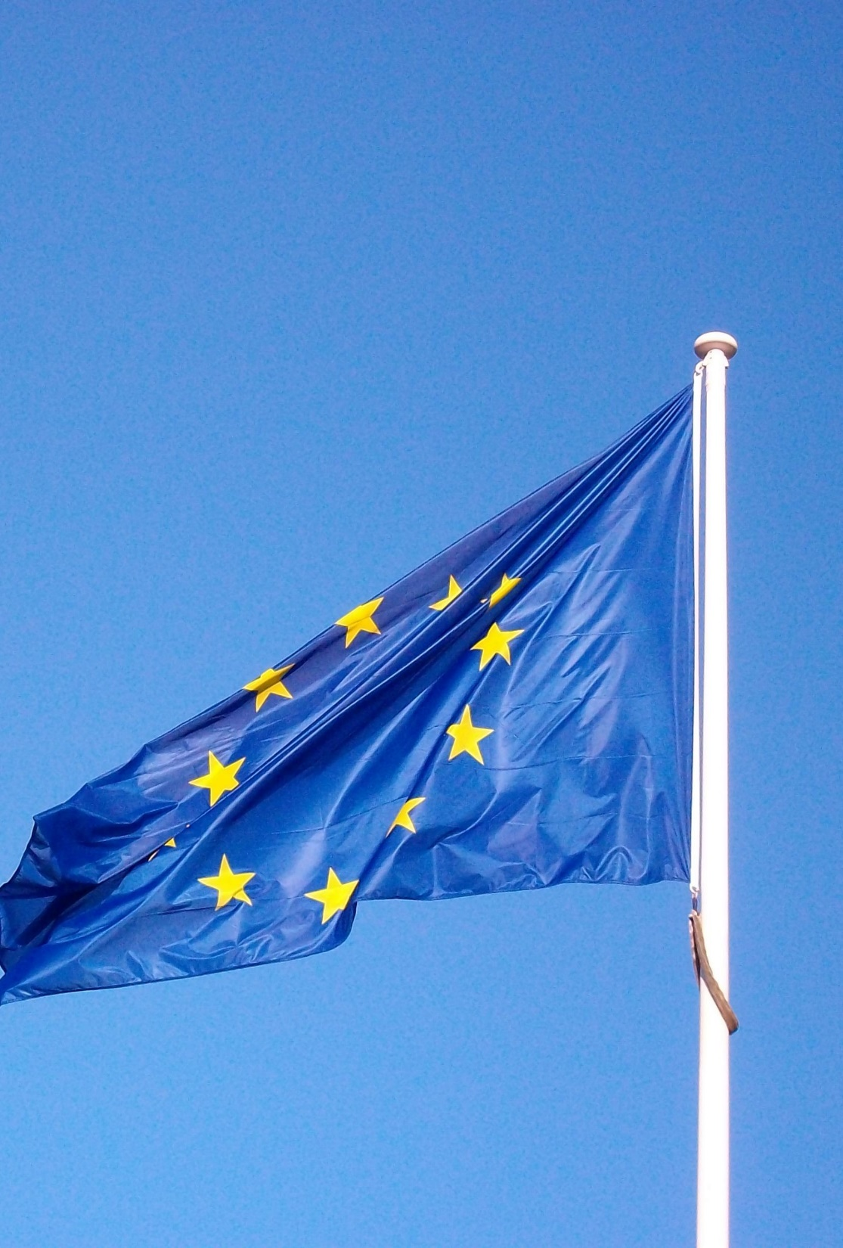
B. Treaties and Multinational Organizations
Economic ties between nations have largely been the product of regional agreements such as the European Union (EU).
In 1994, the North American Free Trade Agreement (NAFTA) opened markets between Canada, the US, and Mexico.
Notes:
By fdecomite - European flagUploaded by tm, CC BY 2.0, https://commons.wikimedia.org/w/index.php?curid=27906965
https://commons.wikimedia.org/w/index.php?title=Special:Search&limit=500&offset=0&ns0=1&ns6=1&ns12=1&ns14=1&ns100=1&ns106=1&search=European+Union+flag&advancedSearch-current=%7B%7D&searchToken=4o6d3x4hmju2v9i44s89i4vm5#%2Fmedia%2FFile%3AEuropean_flag_%285089731954%29.jpg

Slide 54
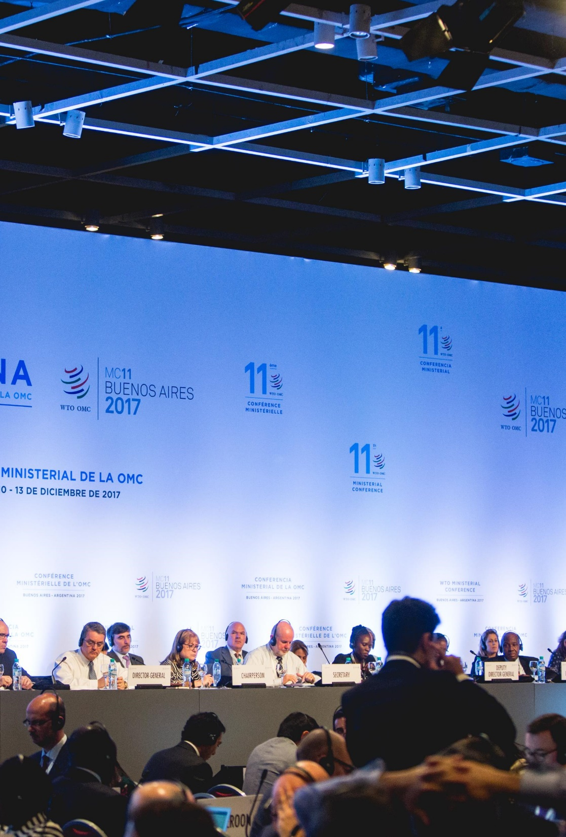
B. Treaties and Multinational Organizations
The US is also part of the World Trade Organization (WTO) which works to lower trade barriers around the world.
The International Monetary Fund (IMF) provides funds to nations that are in financial crisis.
Notes:
By World Trade Organization from Switzerland - Heads of Delegation meeting, 11 December, CC BY-SA 2.0, https://commons.wikimedia.org/w/index.php?curid=80093899
https://commons.wikimedia.org/w/index.php?sort=relevance&search=World+Trade+Organization&title=Special:Search&profile=advanced&fulltext=1&advancedSearch-current=%7B%7D&ns0=1&ns6=1&ns12=1&ns14=1&ns100=1&ns106=1&searchToken=9eidnhxt7eil6ntmgboifmi37#%2Fmedia%2FFile%3AHeads_of_Delegation_meeting%2C_11_December_%2824152874237%29.jpg

Slide 55
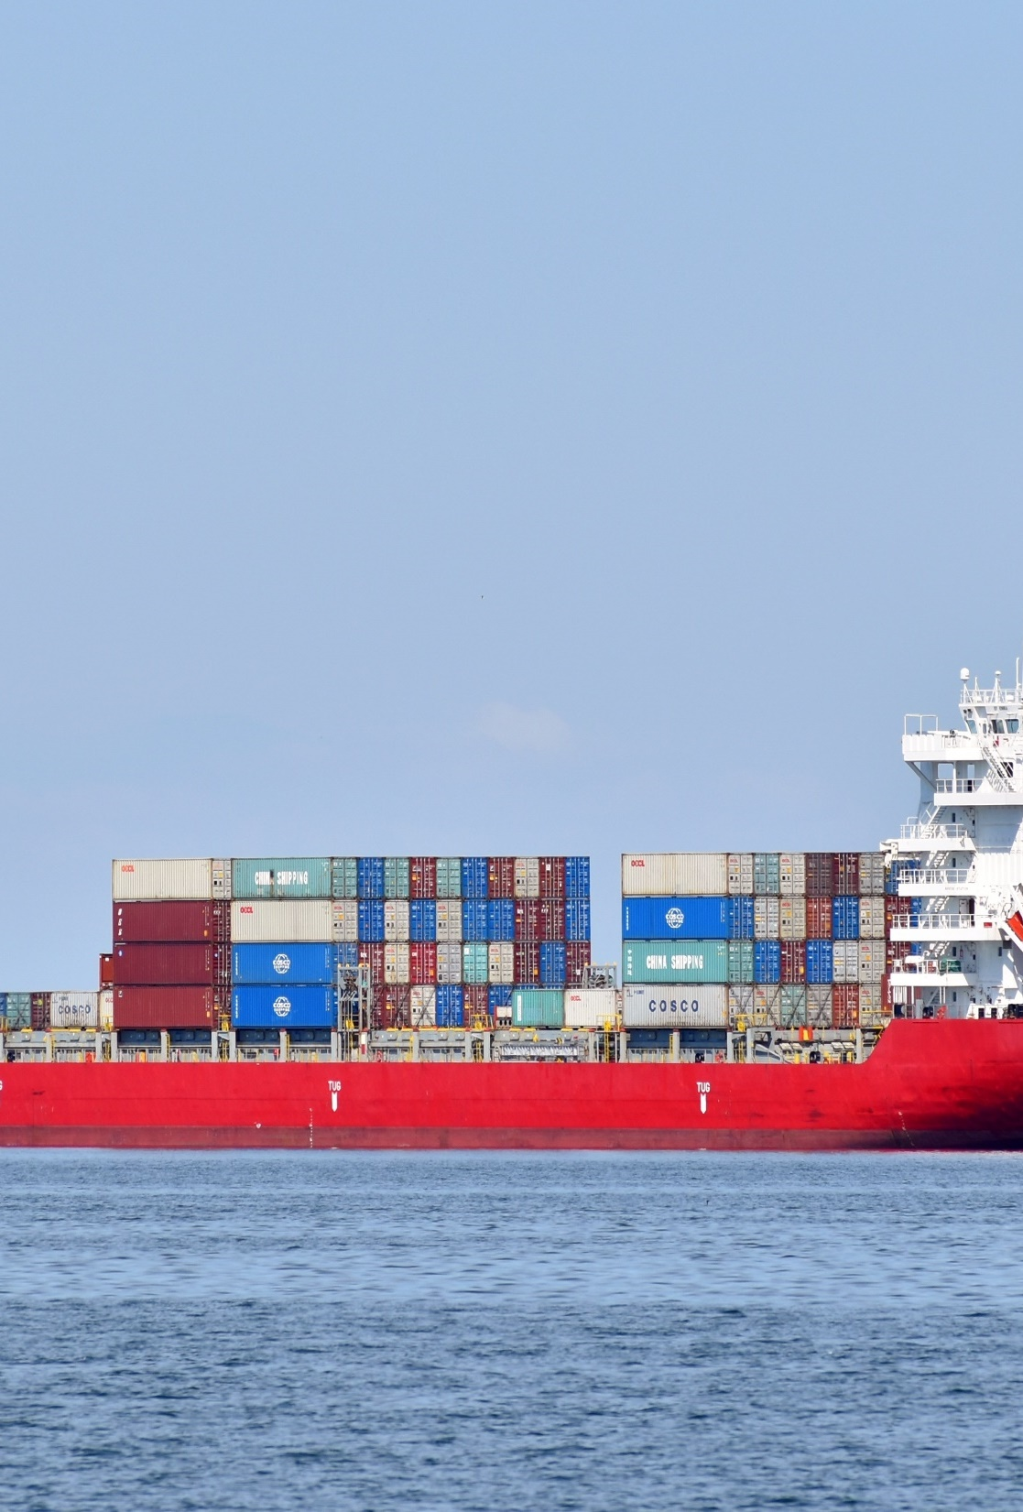
C. Foreign Aid
The US Agency for International Development (USAID) is chiefly responsible for delivering foreign aid to other nations.
One goal of foreign aid to help nations achieve economic prosperity.
Notes:
Image by Thanasis Papazacharias from Pixabay
https://pixabay.com/photos/ship-cargo-vessel-container-5215108/

Slide 56
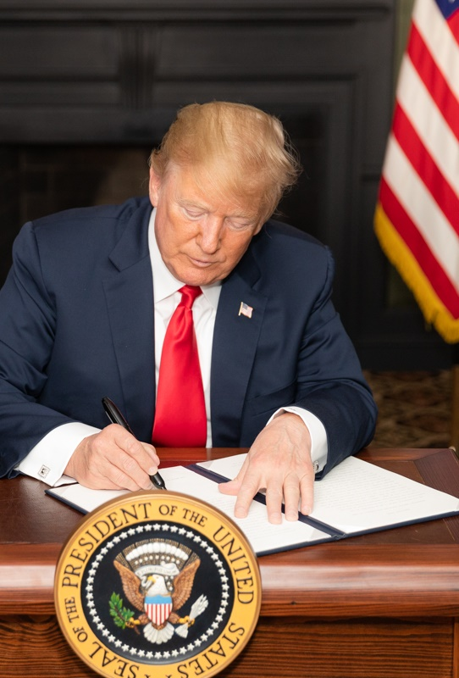
D. Sanctions
Sanctions are usually economic measures taken against a nation to influence its actions.
Both the president and Congress have the power to impose sanctions.
Notes:
By Shealah Craighead - https://www.whitehouse.gov/briefings-statements/statement-president-reimposition-united-states-sanctions-respect-iran/, Public Domain, https://commons.wikimedia.org/w/index.php?curid=71468881
https://commons.wikimedia.org/w/index.php?title=Special:Search&limit=500&offset=0&ns0=1&ns6=1&ns12=1&ns14=1&ns100=1&ns106=1&search=sanctions&advancedSearch-current=%7B%7D&searchToken=9vefn4pnwi2q861l78fp2mte#%2Fmedia%2FFile%3ADonald_Trump_signing_EO_on_Iran_sanctions_P20180805SC-0480.jpg

Slide 57
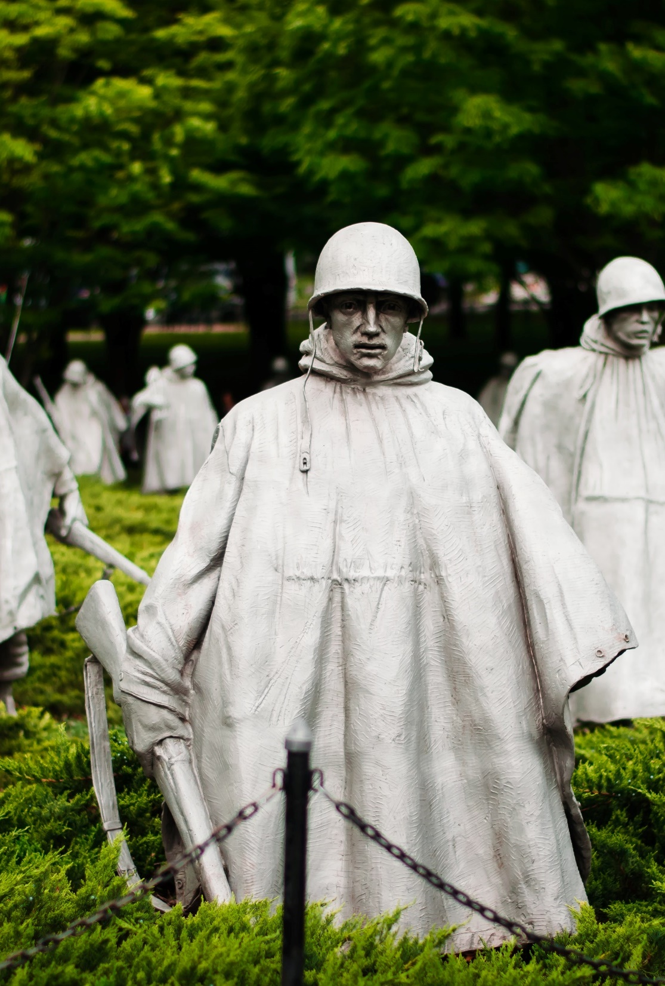
E. Military Action and Espionage
Military action is usually only taken when diplomacy has failed and may be in response to a threat or may be a preemptive action.
While the Bible does not forbid wars, they should still be fought only for just causes such as self-defense rather than conquest or economic gain.
Notes:
Photo by Brittany Colette on Unsplash
https://unsplash.com/photos/zKj_cKc0fWU

Slide 58
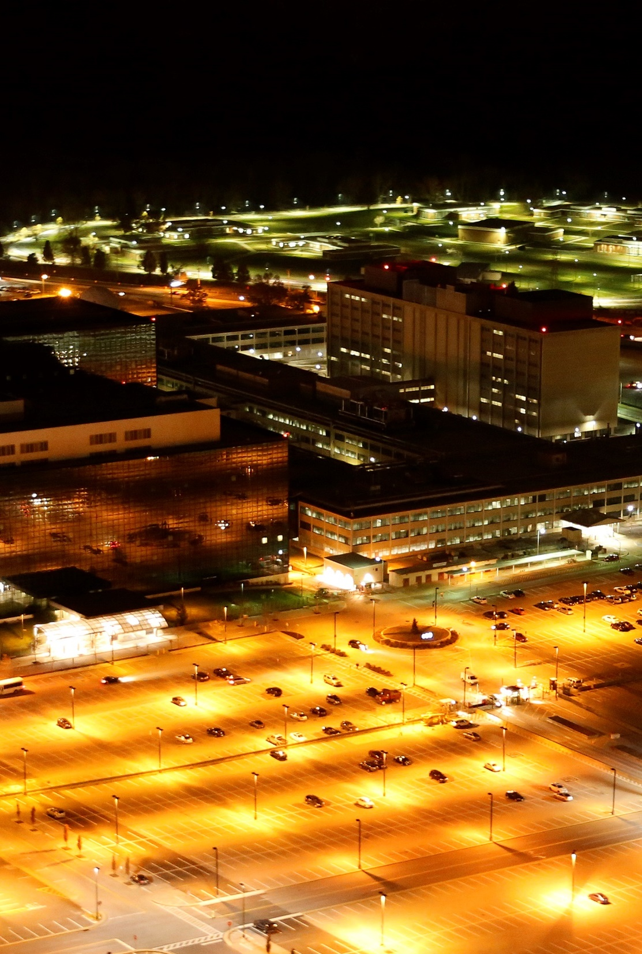
E. Military Action and Espionage
The National Security Agency (NSA) collects and processes information and data relating to national security.
Intelligence agencies have the responsibility of investigating terrorist activities at home and abroad.
Notes:
By Trevor Paglen - Own work, CC0, https://commons.wikimedia.org/w/index.php?curid=31089891
https://commons.wikimedia.org/w/index.php?title=Special:Search&limit=500&offset=0&ns0=1&ns6=1&ns12=1&ns14=1&ns100=1&ns106=1&search=National+Security+Agency&advancedSearch-current=%7B%7D&searchToken=livagzqzc1tmyy3g46759gmj#%2Fmedia%2FFile%3ANational_Security_Agency%2C_2013.jpg

Slide 59
Section Review – Chapter 13.4
1–2. What is the difference between a treaty and an executive agreement?
A treaty is a formal agreement made between nations or groups of nations that requires Senate approval. An executive agreement is an agreement between heads of state that does not require Senate approval. (pp. 318–319)
3–8. Identify the six major divisions of the United Nations.
the Secretariat, General Assembly, Security Council, Economic and Social Council, Trusteeship Council, and International Court of Justice (p. 319)

Slide 60
Section Review – Chapter 13.4
9–11. Name three countries with which the United States has bilateral treaties to assist if they are attacked.
Japan, Philippines, and South Korea (p. 320)
12. Why do critics of foreign aid say that it is often unsuccessful?
They say funds are often wasted and that people who need assistance the most receive only a small portion due to corruption and mismanagement in the nation receiving the funds. They say that some recipient countries discourage land reform and private enterprise. (p. 322)

Slide 61
Section Review – Chapter 13.4
Interpret the phrase “speak softly and carry a big stick” in relation to diplomacy.
The mere existence of force, even when unused, can powerfully influence diplomacy by serving as a deterrent to undesirable conduct.

Slide 62
Section Review – Chapter 13.4
Assess the financial support the United States provides the United Nations. Discuss the amount and whether it is a wise or unwise use of American funds.
Some may say that the United States is justified in supporting the United Nations at such a high percentage due to the United States’ large role in global peacekeeping. Reasons students might cite for not providing so much support to the UN include that funds are not always managed well and that the US support is very large considering it is just one of the 193 members.

Slide 63
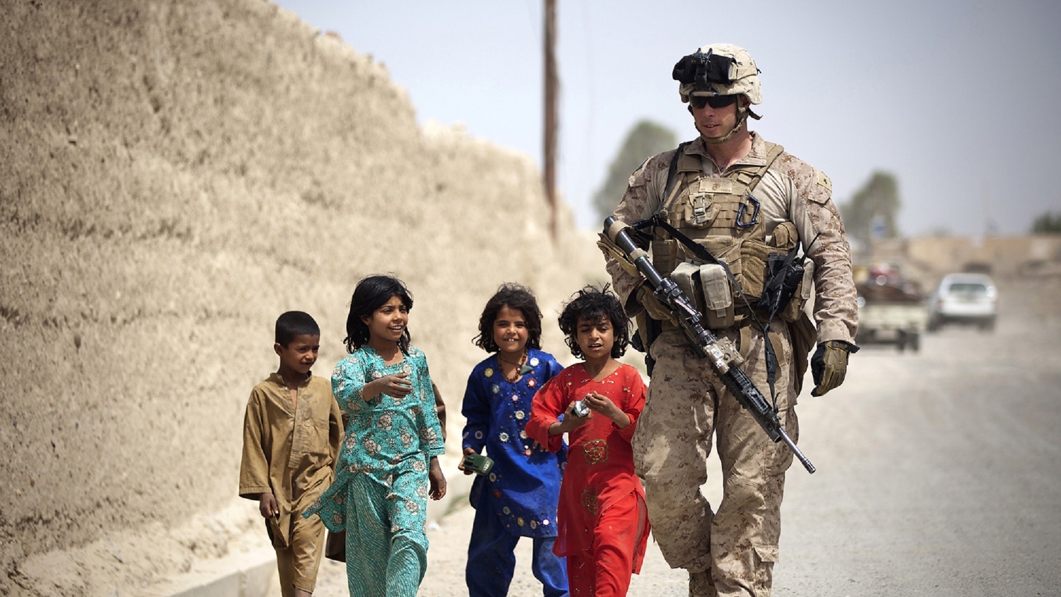
V. Challenges Abroad
Chapter 13.5
Notes:
Image by skeeze from Pixabay
https://pixabay.com/photos/american-soldier-humanity-marine-381847/

Slide 64
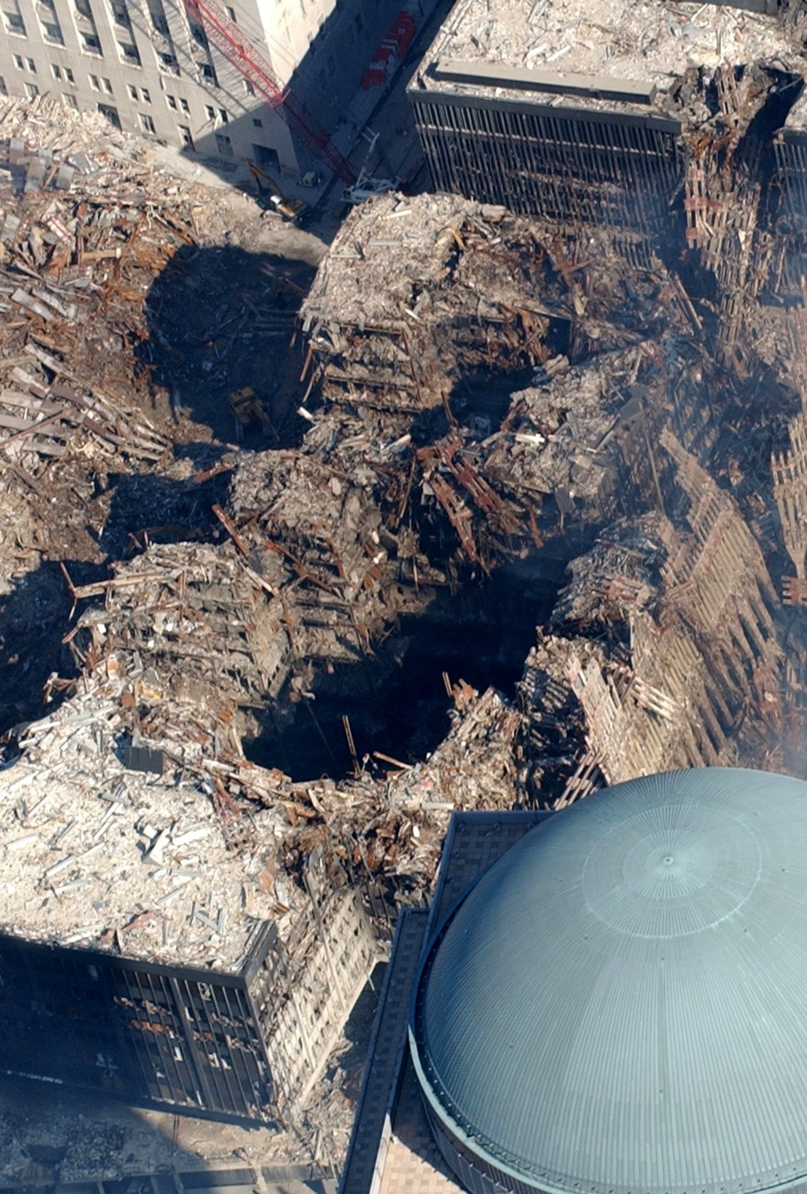
A. Wars and Weapons
Terrorism is an attempt to achieve goals by using fear to intimidate people and governments.
The Islamic State in Iraq and Syria (ISIS) is one of the most well-known Muslim extremist groups.
Notes:
Image by David Mark from Pixabay
https://pixabay.com/photos/ground-zero-new-york-city-terrorism-81886/

Slide 65
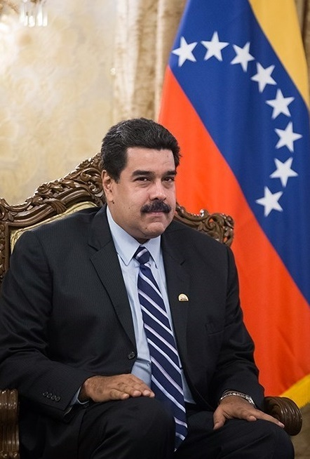
A. Wars and Weapons
The term rogue nation often refers to nations that threaten the security of other nations through a disregard of international law.
Some seek to acquire weapons of mass destruction (WMDs) such as chemical or biological weapons.
Notes:
By Tasnim News Agency, CC BY 4.0, https://commons.wikimedia.org/w/index.php?curid=47896520
https://commons.wikimedia.org/w/index.php?sort=relevance&search=iran+president&title=Special:Search&profile=advanced&fulltext=1&advancedSearch-current=%7B%7D&ns0=1&ns6=1&ns12=1&ns14=1&ns100=1&ns106=1&searchToken=c8zq2d7k92avafhsvxt5mufss#%2Fmedia%2FFile%3ANicol%C3%A1s_Maduro_in_meeting_with_Iranian_President_Hassan_Rouhani_in_Saadabad_Palace.jpg

Slide 66
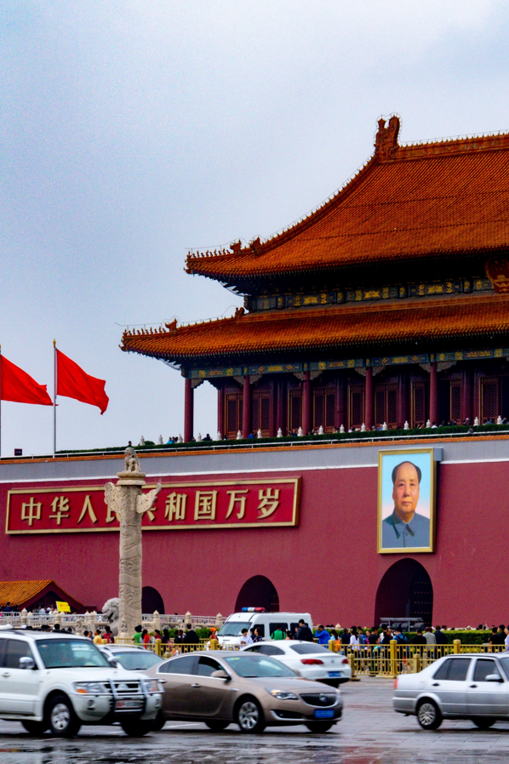
A. Wars and Weapons
Regional conflicts continue to cause tensions throughout the world.
  India and Pakistan
  China and Taiwan
  Israel and its neighbors
Notes:
Photo by Nick Fewings on Unsplash
https://unsplash.com/photos/zqwV28pcUTg

Slide 67
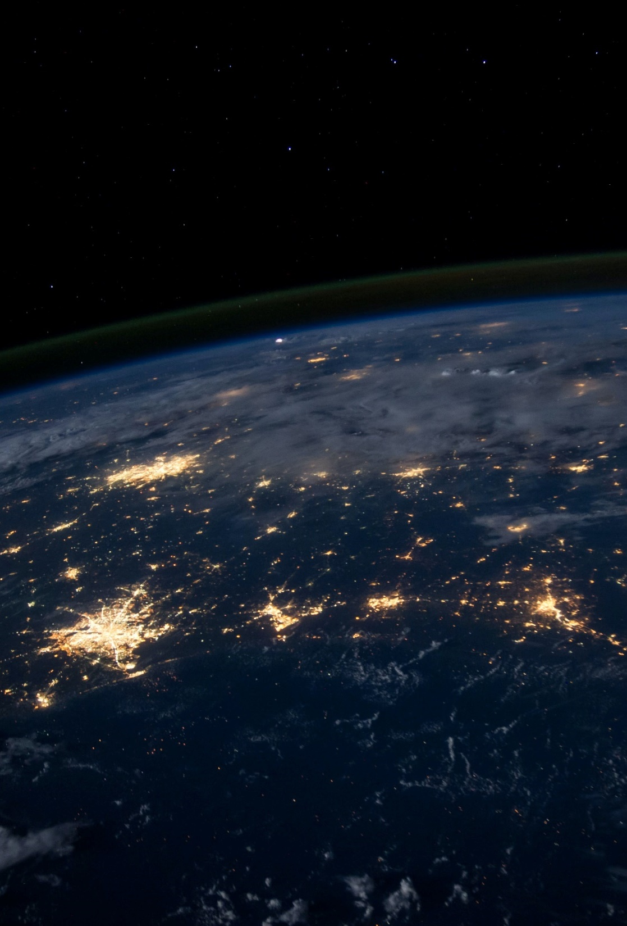
B. Globalization
Economically, globalization is the integration of world markets through increased communications, foreign investment, and free trade.
Globalization presents several challenges including security issues and the debate between free trade and protectionism.
Notes:
Photo by NASA on Unsplash
https://unsplash.com/photos/Q1p7bh3SHj8

Slide 68
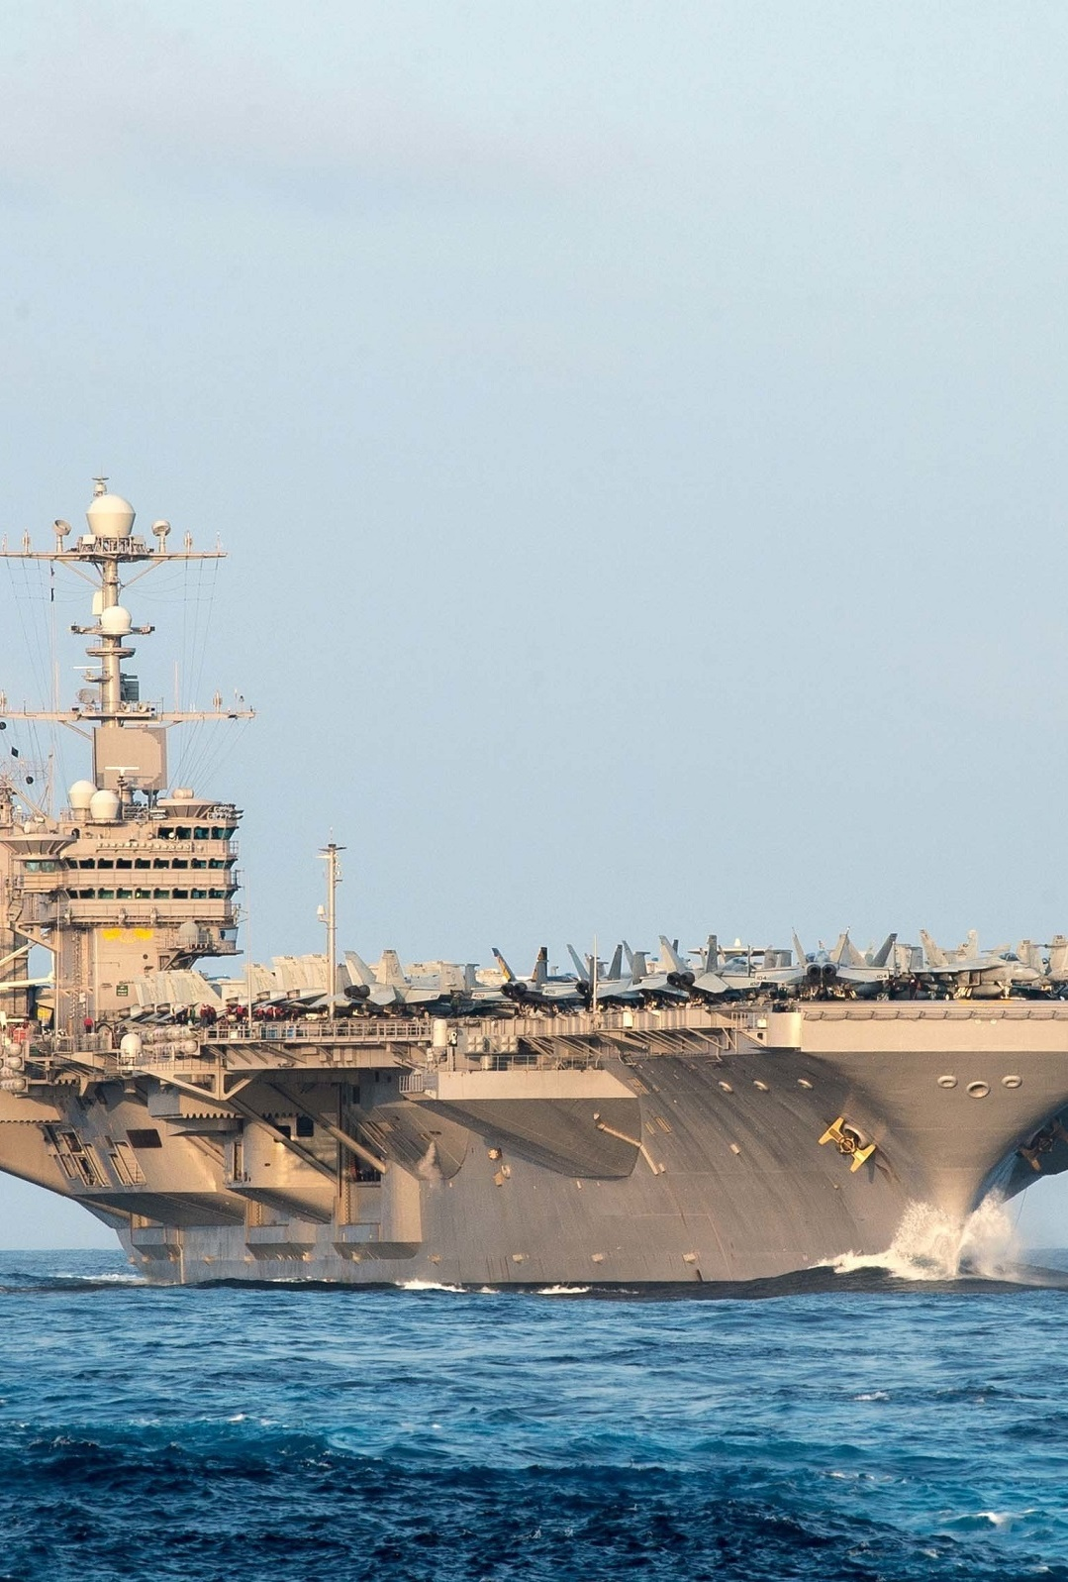
C. Anti-Americanism
Globalization has also increased the power of the United States, leading to a resentment of American “cultural imperialism.”
America’s strong military power is also troubling for many nations since no other power currently exists to balance the strength of the United States.
Notes:
Image by skeeze from Pixabay
https://pixabay.com/photos/ship-aircraft-carrier-us-navy-1906870/

Slide 69

D. Conclusion
Foreign policy is closely connected with issues important to Christians, issues which are often complicated.
Many questions about how to use American power confront Christians today, and we must rely on Scripture for wisdom.
Notes:
Image by reenablack from Pixabay
https://pixabay.com/photos/prayer-bible-christian-folded-hands-1308663/

Slide 70
Section Review – Chapter 13.5
1. Define terrorism.
Terrorism is an attempt to achieve goals by using fear to intimidate people and governments and thereby coerce them to do what the terrorists want. (p. 323)
2–4. Name three reasons terrorism has become so effective.
Terrorism has become more effective because of improved communications, the ability to carry out terrorism with minimal expense, and technological advances that make it cheaper and easier than in the past. (p. 324)

Slide 71
Section Review – Chapter 13.5
5–8. Identify four regional conflicts that continue to influence foreign policy.
(any four) India and Pakistan’s struggle over Kashmir, tensions between Taiwan and China, tensions between Chechnya and Russia, and tensions between Israel and Palestinians and between Israel and Muslim countries (pp. 324–325)

Slide 72
Section Review – Chapter 13.5
What challenges face US foreign policy as a result of globalization? If you were president, how would you address these challenges?
Globalization gives terrorists greater access to other countries and technology, heightens debate between free trade and protectionism, disseminates different ideas and cultures, and heightens anti-Americanism.

