Slide 1
Chapter 11: Western Europe

Slide 2
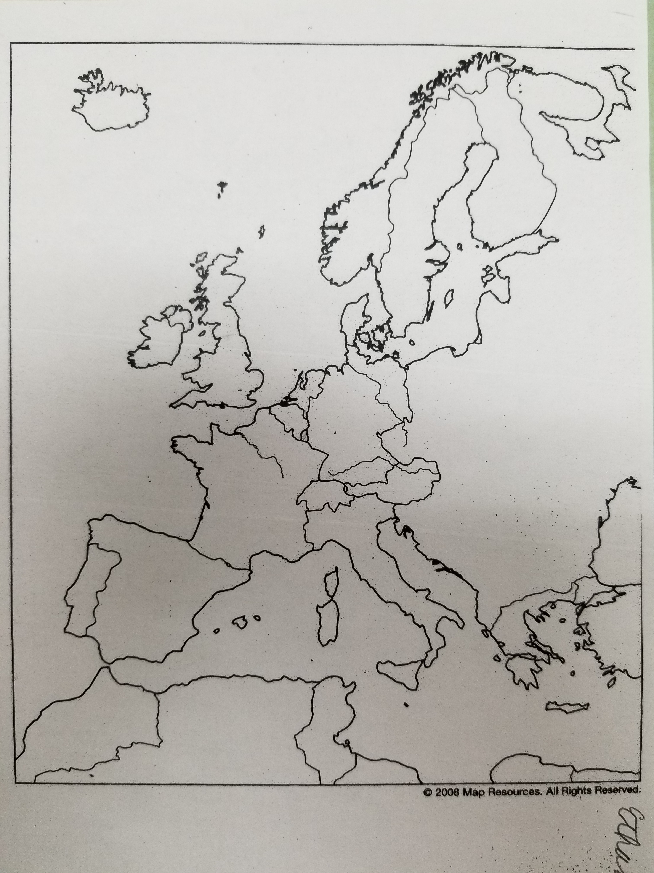

Slide 3
Western Europe
Northern Europe
United Kingdom
England
Wales
Scotland
Northern Ireland
Ireland

Slide 4
Scandinavia
Norway
Sweden
Finland
Denmark
Iceland

Slide 5
Continental Europe
France
Low Countries
The Netherlands
Belgium
Luxembourg
Germany
The Alpine Region
Switzerland
Liechtenstein
Austria

Slide 6
Mediterranean Europe
Iberian Peninsula
Spain
Andorra
Portugal
Italian Peninsula
Italy
Monaco
San Marino
Vatican City
Greece

Slide 7
Northern Europe

Slide 8
Introduction
Europe is a peninsula on the Eurasian (the continents of Europe and Asia) landmass.
Because it is one large peninsula with many smaller peninsulas, it has been called a “peninsula of peninsulas.”
Europe illustrates the idea of the nation-state.
Three continents—North America, South America, and Australia—are populated primarily by descendants of Western Europeans.

Slide 9
Northern Europe
Northern Europe consists of the British Isles and Scandinavia.
With the exception of Ireland, northern Europe is primarily Protestant.
The North Atlantic Drift coming off the coast of Canada warms northern Europe so that even the harbors of Norway remain ice-free year-round.

Slide 10
United Kingdom
Great Britain, the largest island in Europe, lies at the heart of the United Kingdom.
The United Kingdom also includes land on the neighboring island of Ireland as well as numerous smaller islands surrounding Great Britain.
The United Kingdom sits astride northern Europe’s major water routes.
Off the east coast lies the North Sea, the main route to the peninsulas of Scandinavia.
Between Great Britain and Ireland lies the choppy Irish Sea.
South of Great Britain is the English Channel, a narrow body of water between the island and the European mainland.

Slide 11
The United Kingdom has four political divisions—England in southern Great Britain, Wales in western Great Britain, Scotland in northern Great Britain and Northern Ireland.
In 1707, the kingdoms of Great Britain were officially united, with one parliament, forming the United Kingdom.
In 1801 the entire island of Ireland was brought into the United Kingdom, but most of Ireland became its own nation in 1921.
At that time, Northern Ireland voted to remain in the United Kingdom.

Slide 12
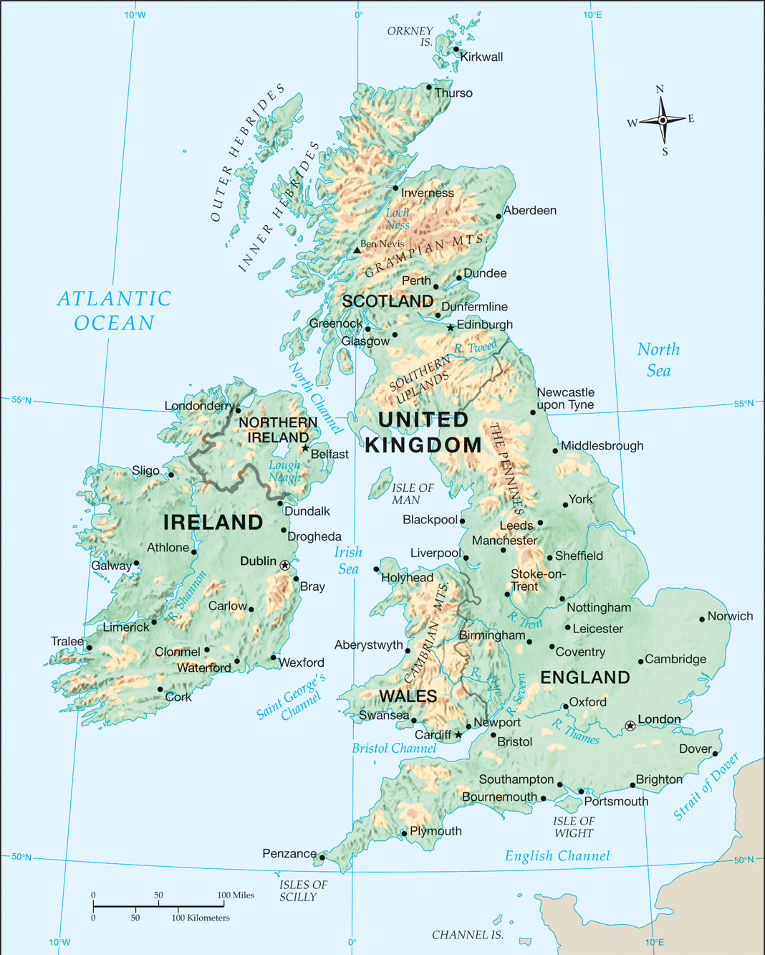
Notes:
Map Resources

Slide 13
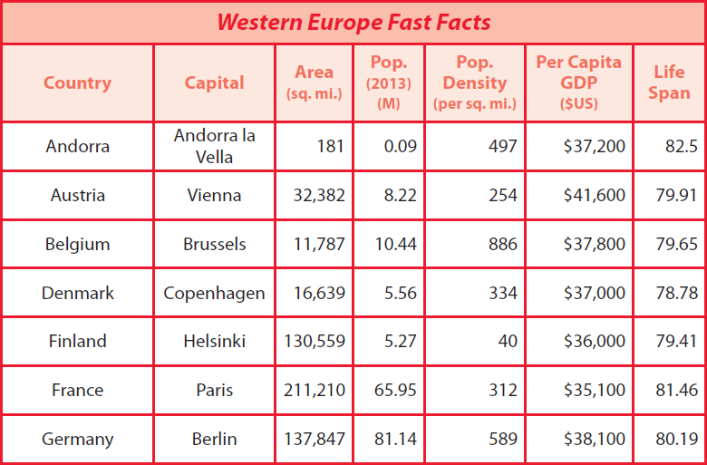
Notes:
Cultural Geography, 4th edition, p. 250

Slide 14
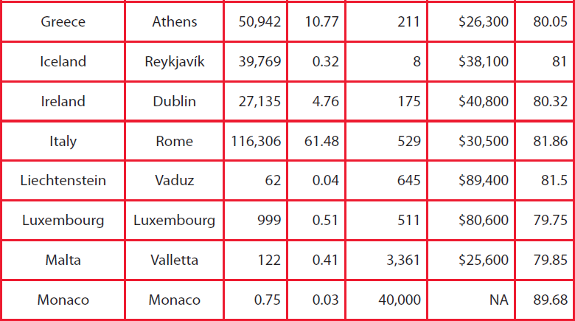
Notes:
Cultural Geography, 4th edition, p. 250

Slide 15
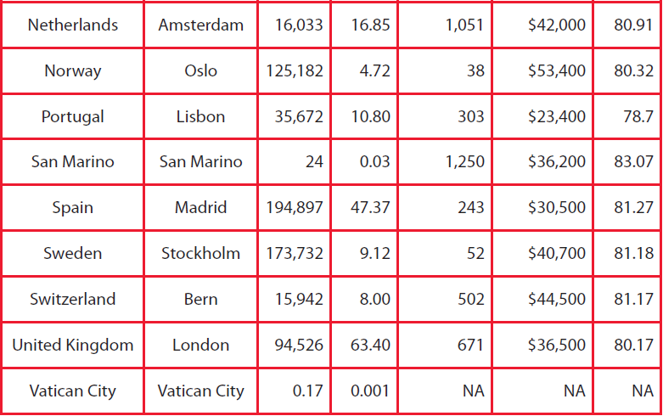
Notes:
Cultural Geography, 4th edition, p. 250

Slide 16
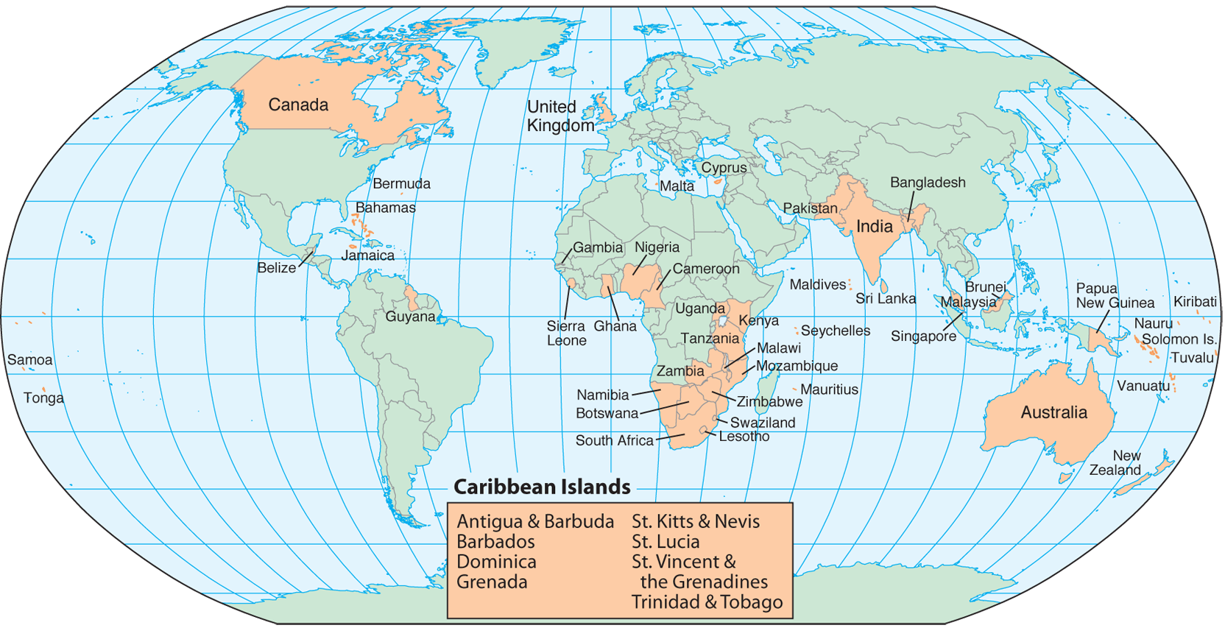
Notes:
Map Resources

Slide 17
England
England is the largest division of the United Kingdom.
England’s agricultural heartland is the rolling plains and hills of southern England.
The River Thames (temz) flows through the center of this region.
The largest city on the Thames is London.
Off the southeast coast of England, the English Channel separates Great Britain from the continent.
Downs are another feature of southeast England.
These chalk hills cannot support trees, but they have plenty of grass for cattle and sheep.

Slide 18
Several good ports lie on the coast of south-central England.
The deep Bristol Channel, an arm of the Atlantic Ocean, extends into the western side of Great Britain.
Unlike south-central England, southwestern England consists of a low plateau with scattered granite highlands.
Two national parks, Dartmoor and Exmoor, protect the moor—a wasteland on a high, treeless plateau.
Central England is the home of the Industrial Revolution.
The Industrial Revolution started in Central England in the eighteenth century.

Slide 19
The Pennines (PEN eyenz), a mountain system extending south from Scotland to the Midlands, form the backbone of England.
Sherwood Forest—the fabled haunt of Robin Hood—is located at the southern tip of the Pennines, around Nottingham.
Manchester, located at the foot of the Pennines, is the third-largest metropolitan area in the British Isles.
England is the most secular nation in the United Kingdom.

Slide 20
Notes:
iStock.com/retosteffen

Slide 21
Notes:
Clipart.com; Image # 34808472

Slide 22
Wales
Wales occupies a broad peninsula on the western side of England.
Wales is mostly mountainous except for a narrow coastal plain in the south.
Another geographical feature is the Rhondda Valley in southern Wales.
Coal mines began operating in the Rhondda Valley during the Industrial Revolution, and for many years the Welsh economy was dependent on the coal industry.
However, the coal has been exhausted, and the country has been forced to find alternative incomes.

Slide 23
One in five people still speak the Celtic dialect of Wales, along with the main language—English.

Slide 24
Scotland
Scotland lies north of England.
It is known for green glens (narrow valleys carved by glaciers) and blue lochs (loks; deep, narrow lakes carved by glaciers).
The Scots, descendants of the Celts, held off many invaders who tried to take their rugged and isolated homeland.
Though part of the United Kingdom, Scots have preserved a culture distinctly their own.
Scotland’s border with England’s Pennines is called the Southern Uplands.
The range that divides Scotland from England is the Cheviot Hills and is crowned by Hadrian’s Wall, which Rome built to stop raids from the unconquered Scots north of Britannia.

Slide 25
Seventy-four miles long and twenty feet high, Hadrian’s Wall is the largest Roman ruin in Britain.
North of the border, a belt of lowlands stretches across central Scotland.
The flat lands and relatively fertile soil make it Scotland’s most populated area.
About 75 percent of the Scottish people are crowded around Glasgrow, Scotland’s largest city, in the west and Edinburgh, Scotland’s capital in the east.
North of the populous lowlands are the Grampian Mountains, the principal range of the Scottish Highlands.

Slide 26
They include Ben Nevis, the highest mountain in the British Isles (4,406 ft.).
North of the mountain system is a deep valley, called Glen More or the Great Glen.
The Caledonian Canal cuts through this valley and includes the waters of Loch Ness.

Slide 27
Hadrian’s Wall
Notes:
“Hadrian’s wall2” by Mim42/Wikimedia Commons/Public Domain

Slide 28
Northern Ireland
Northern Island, also called Ulster (UL stuhr), is on the island of Ireland, the second-largest island in the British Isles.
This Protestant country, first populated by Protestants from Britain in the early seventeenth century, shares the island with Catholic Ireland.
Many crystal lakes, called loughs (LOKS), dot the interior.
Belfast, the capital and largest city, is an industrial city once famed for shipbuilding.
Belfast shipyards built many warships and ocean liners, including the Titanic.

Slide 29
Ireland
The Republic of Ireland covers five-sixths of the island of Ireland.
Ireland’s thin, rocky soil was apparently caused by massive glaciers—the same forces that scraped New England.
Although farther north than New England, Ireland’s climate is much warmer because of the North Atlantic Drift, which carries warm water from the Gulf Stream.
A rim of mountains surrounds the coast of Ireland.
In the central and western parts of the island are many bogs, where the water sits without access to the ocean.

Slide 30
Here, partly decayed mosses have been compressed to form thick layers of peat.
Since Ireland lacks coal, many people burn peat for heating and cooking.
According to legend, Irish giant Finn McCool (Fingal) made a pier, or causeway, out of rock so that he could walk across the Irish Sea from Ireland to Scotland.
Around thirty-seven thousand columns, some of them twenty feet high, descend into the ocean on the coast of Northern Ireland.
Similar columns rise up out of the sea in Scotland.
The rocks are basalt, formed from lava.
When the lava cooled, it cracked into prism-shaped pillars having four to eight sides.

Slide 31
The history of English-Irish relations has been tragic.
Over the centuries England instituted harsh measures discriminating against Catholics, including a law that once prevented them from buying or inheriting land.
Ireland was joined to the United Kingdom in 1801.
However, in 1921, the Anglo-Irish Treaty created an Irish Free State, and in 1949, the Republic of Ireland cut all ties with Britain.
For centuries Ireland was a land of poor farmers.
Their young men left the farms and went to the cities seeking jobs.
Then, in the 1990s, there was a great turnaround.
Ireland became known as “the Celtic Tiger” for its rapid economic progress.

Slide 32
Ireland from space
Notes:
“Ireland from space edit”/NASA/Wikimedia Commons/Public Domain

Slide 33
What river runs through the heart of Southern England?
River Thames
What is the “backbone of England”?
Pennine Mountains

Slide 34
3. What is Gaelic?
ancient Celtic language

Slide 35
Why do you think Ireland is referred to as the Emerald Isle?
Ireland receives regular rains, and the countryside is considered emerald green

Slide 36
Scandinavia
Scandinavia is the Land of the Midnight Sun.
There are five countries in Scandinavia: Norway, Sweden, Finland, Denmark, and Iceland.
Iceland and Finland are republics, while the other three Scandinavian nations have constitutional monarchies.
Parts of Scandinavia lie above the Arctic Circle, where the sun never sets for more than two months each summer and where it never rises for two months each winter.
During the sun’s absence, the northern lights (aurora borealis ) are visible.

Slide 37
The people are called Scandinavians from an ancient center of the Norsemen called Scandia.

Slide 38
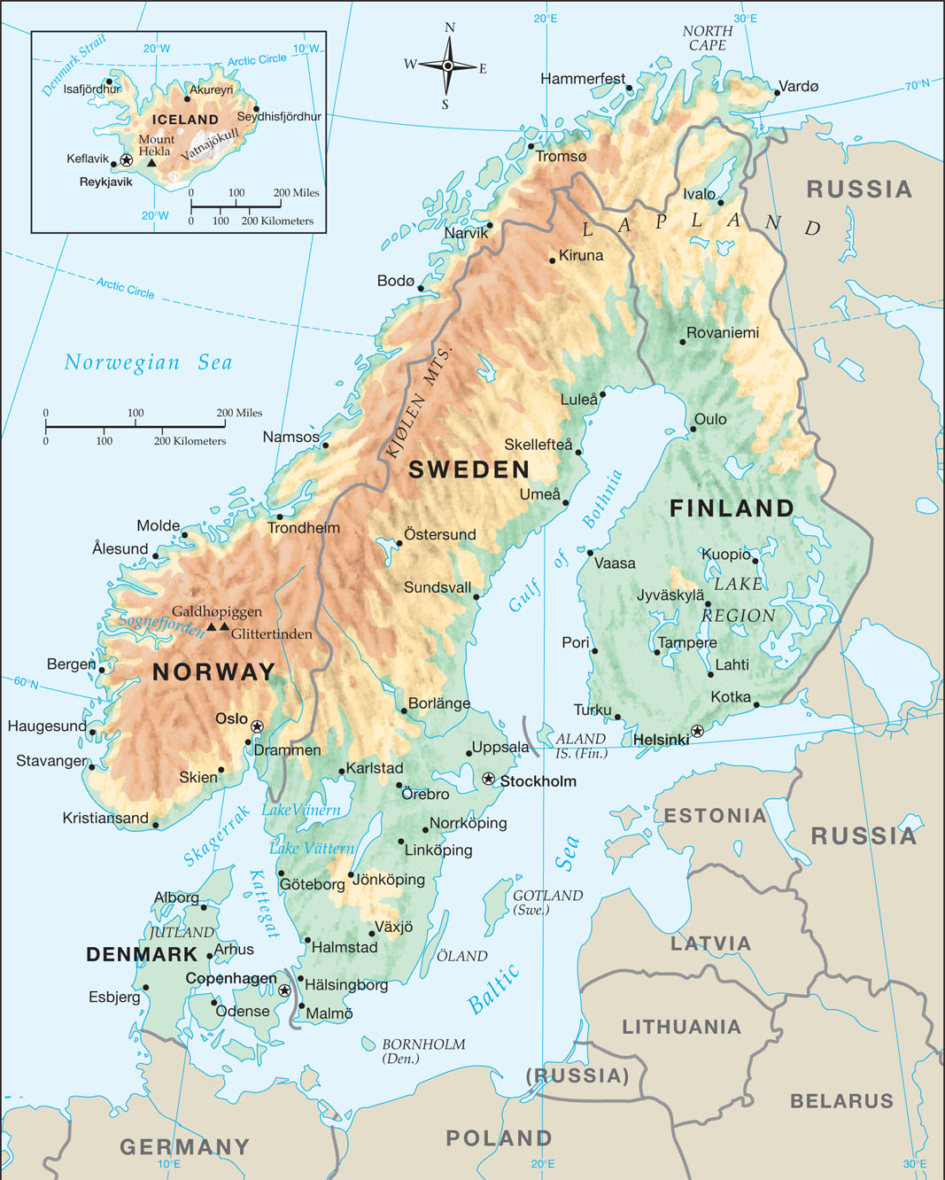
Notes:
Map Resources

Slide 39
Norway
Scandinavia is known for its peninsulas.
Norway and Sweden share the largest peninsula, the Scandinavian Peninsula, with Norway facing the North Sea.
The coast is splintered by numerous fjords.
Norway’s longest fjord, Sogne (SAWNG nuh) Fjord, cuts 127 miles inland.
Including long fjords, numerous small islands, and minor indentations, the full length of Norway’s shore stretches 15,626 miles, or more than half the circumference of the earth.
Norway includes about 50,000 islands.

Slide 40
Norway’s important cities lie on the coast, where the ocean moderates the climate.
Most Norwegian cities also take advantage of fjords as natural harbors.
The area surrounding Oslo Fjord is the largest lowland in the country and contains most of the arable land.
A high plateau covers most of Norway.
The plateau includes several mountain ranges.
The Kölen (CHUHL uhn) Mountains form Norway’s border with Sweden.
Galdhøpiggen (GAHL huh[r] pig uhn; 8,100 ft.), the highest peak in Scandinavia, rises in the south.
Norway’s merchant fleet, one of the world’s largest, transports goods around the world.

Slide 41
Sweden
Sweden is the largest Scandinavian country and the fourth-largest country in Europe.
About one-third of Sweden is lowland plains in the south.
A mild climate and fertile soil make it Sweden’s best agricultural region.
Stockholm, the nation’s capital, is the largest city in Scandinavia.
The city covers fourteen islands and is connected by fifty bridges.
Most of Sweden’s western border is shared with Norway.
In the south, however, the west coast lies along the Skagerrak (SKAG uh rak) and Kattegat (KAT ih gat), two arms of the North Sea.

Slide 42
Sweden’s sparsely populated Northland is considered the last frontier of Europe.
Sweden joined the European Union in 1995, but it does not use the euro.
The country has one of the highest life expectancies in the world while having one of the lowest birth rates.

Slide 43
Finland
Finland has been independent only since 1917.
Prior to that time, the Finns spent a century under Russian control and seven centuries under Swedish control.
Unlike the rest of Scandinavia, Finland’s language and physical features are related to those of northern Russia.
Finns work hard to keep their environment one of the cleanest in the world.
Finland’s only access to the ocean is the Baltic Sea.
It has a long coastline along the Gulf of Bothnia.

Slide 44
Helsinki is the nation’s capital, main seaport, and largest city.
The city often hosts peace talks between warring nations.
Finland has been called the “Land of Ten Thousand Lakes” because of its southern interior.
Northern Finland contains the heart of Lapland, which extends into Sweden, Norway, and Russia.
The Lapps, who call themselves Sami, have tended reindeer in this region for thousands of years.

Slide 45
Denmark
Denmark has been an independent country since 950 and even ruled England from 1013 to 1042.
Its islands and mainland peninsula lie farther south than the rest of Scandinavia, making its winters less severe.
Lacking mineral resources, the country depends heavily on agriculture and trade.
The Danes are firm believers in welfare; they pay one of the highest tax rates in the world.
The Jutland Peninsula extends northward from Germany and accounts for about 70 percent of Denmark’s land area.

Slide 46
The capital city, Copenhagen, is on Denmark’s largest island, Zeeland.
Copenhagen houses nearly one-quarter of the country’s population and is one of the largest metropolitan areas in Scandinavia.
The name Copenhagen means “merchant’s harbor,” and it is indeed a strategic port.
Denmark’s overseas territories have included Iceland, Greenland, and the Faeroe Islands, a group of seventeen inhabited islands north of Scotland.
Denmark granted Iceland independence in 1918 but retained the other islands.
The Faeroe Islands and Greenland are currently self-ruling provinces within the kingdom of Denmark.

Slide 47
Greenland is the largest island in the world, fifty times larger than Denmark and thirteen hundred miles west of Denmark in North America.
Vikings deceptively named the island Greenland to attract settlers.
In reality, 75 percent of Greenland lies under an ice cap.

Slide 48
Iceland
About 650 miles west of Norway is the “Land of Fire and Ice.”
Large glaciers glide down the active volcanoes on Iceland.
The glacier-carved fjords are reminiscent of Norway, but not the island’s two hundred volcanoes, one of which erupts about every five years.
Surtsey, an island off the south coast, was created by an undersea volcano in 1963. Mount Hekla (4,892 ft.) was once thought by some to conceal the gates of hell.
Icelanders are proud of their heritage.
The Althing (AHL thing), their national assembly founded in 930, is the oldest parliamentary assembly still in existence in the world.

Slide 49
Almost all the population and the island’s 1 percent of arable land is found along Iceland’s fjords.
The main crop is hay for the sheep, which in turn provide food and clothing.
The capital, Reykjavik (RAY kyuh veek), houses half the population.
Iceland is known for its rugged beauty.
The plateau has the largest glacier in Europe, Vatnajökull (VAHT nah yuh koot ul).
Iceland has more hot springs than any other country in the world.
The English word geyser comes from Iceland’s most spectacular hot spring, the Great Geysir, which spews water almost two hundred feet in the air.

Slide 50
Greenland has more ice than green, and Iceland, to the southeast, is greener.

Slide 51
What peninsula contains both Norway and Sweden?
Scandinavian Peninsula
2. Greenland belongs to which country?
Denmark

Slide 52
3. Where do most Icelanders live? Why?
Most Icelanders live along the fjords. The 1 percent of arable land is located along the fjords.

Slide 53
Why might geographers exclude Finland from Scandinavia? Why might they exclude Iceland?
Finland’s language belongs to a different language family, reflecting a major difference between the early history of the Finnish people and the history of the other Scandinavian peoples. Iceland is an island, not a peninsula connected to the Scandinavian Peninsula.

Slide 54
Continental Europe

Slide 55
Continental Europe
France
The Low Countries
The Netherlands
Belgium
Luxembourg
Germany
The Alpine Region
Switzerland
Liechtenstein
Austria

Slide 56
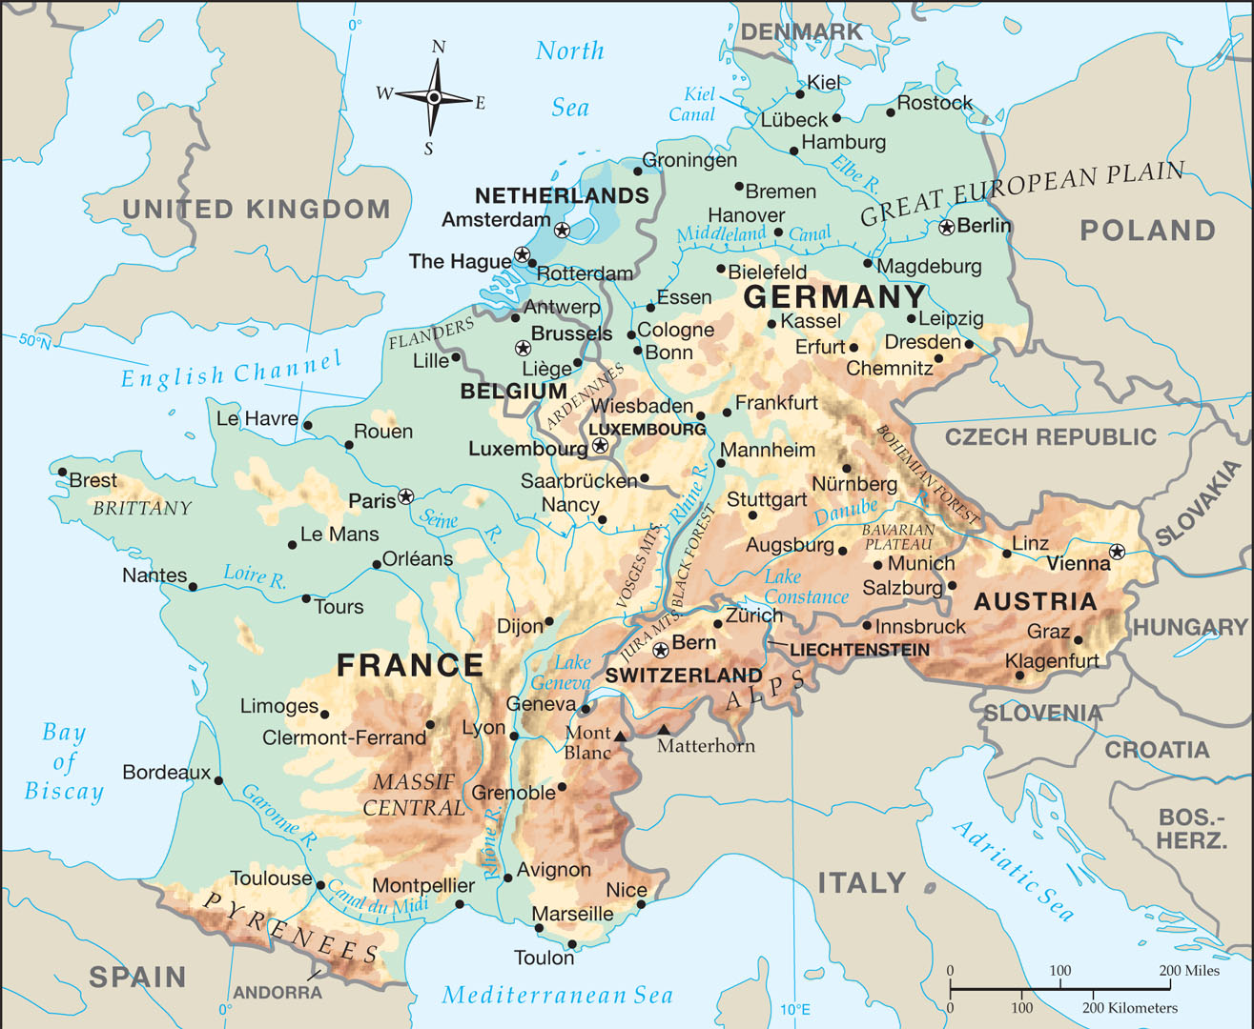
Notes:
Map Resources

Slide 57
Continental Europe
Continental Europe refers to the main landmass of Western Europe, as opposed to the islands and peninsulas.
Much of the continent is a wide coastal lowland with a marine-west-coast climate.
The countries on this continent have greatly influenced the history and culture of the world.
The Reformation divided the continent.
Today Roman Catholicism dominates the south and west, and Protestant denominations are prominent in the north.

Slide 58
France
France is the largest country in Western Europe (by landmass).
Over four-fifths of the people are Roman Catholic.
France has few Protestants and Jews but has a growing Muslim population.
Since 1815, France has gone through four kings and five republics.
The present constitution was passed in 1958.
Generally, northern France is lower and flatter than the southern regions.
Three of the five major French rivers flow through northern France.

Slide 59
On the Seine (sayn) River lies the capital of France, Paris.
With 2.2 million people, Paris is among the largest cities in Europe.
The plains also extend south of Paris to the basin of the Loire River (luh WAHR), the longest river in France.
East of Brittany is the historic Normandy region, which runs along the coast to the Seine River.
This region is famous for the Allied invasion of France during World War II on June 6, 1944.
The Alps divide France from Italy, and the border has been disputed between the two countries.
Mont Blanc (mawnt blangk) is the highest mountain in the Alps at 15,771 feet.

Slide 60
Mont Blanc lies near the Italian and Swiss borders.
Nearby is the deepest cave in the world, the Jean Bernard Cave, which reaches depths of about one mile below the surface.
The water from the snowcapped Alps drains west into the Rhone River, which flows south into the Mediterranean Sea.
The valley and adjacent coasts are unique in Continental Europe because of the Mediterranean climate.
Lyon (lee OHN), the third-largest city in France, lies in the Rhone River valley.

Slide 61
This valley, which cuts deep into France, was historically the main overland route between Mediterranean Europe and Northern Europe.
The Alps descend into the Mediterranean Sea and form the island of Corsica.
Corsica’s mountains rise to 8,878 feet at Monte Cinto.
The island’s most famous native was Napoleon, whom the British called the Corsican Ogre.
The capitals of the four central provinces, Toulouse (too LOOZ), Limoges (lee MOHZH), Clermont-Ferrand, and Montpellier (mohn pel YAY), lie at the corners of the Massif (ma SEEF) Central. This mountainous plateau in south-central France has poor soils that make the region useful only for grazing livestock.

Slide 62
The Pyrenees (PEER uh neez) Mountains rise south of Toulouse and form the border with Spain.
The region boasts many deep caves, including the Cave of Pierre-St. Martin.
These caves descend three times deeper than the deepest caves in North America.
The Basques (BASKS) live in this mountainous area.
The two provinces of southwest France are mostly lowlands.
The region is called the Aquitainian Lowlands.
The Lascaux (la SKOH) Cave is famous for its prehistoric cave paintings.

Slide 63
Historically, France has been a staunchly Roman Catholic nation.
Many Protestants died for daring to preach and witness in this country.
That changed in 1789 with the French Revolution.
Since that violent upheaval in France, the country has remained a secular state and has avoided supporting any form of organized religion.

Slide 64
Notes:
Clipart.com; Image # 26814627

Slide 65
Notes:
Clipart.com; image #109265754

Slide 66
The Low Countries
The Low Countries are so named because they lie entirely on the coastal lowlands and low plateaus.
The Low Countries are located at the crossroads of Western Europe, between the French and the Germans.
Because these countries are small in area and are situated on desirable plains, they are some of the most densely populated countries in Continental Europe.

Slide 67
The Netherlands
The Netherlands has fought a great battle against the sea.
Sand dunes twenty feet high protect the inland regions from the North Sea.
Much of the land farther inland is below sea level.
The Dutch have built strong walls of stone and earth, called dikes, to hold back the seawater.
Parcels of land reclaimed from the sea are polders.
The polder region of the Netherlands covers a wide strip of territory behind the dunes and dikes.

Slide 68
Two of the Netherland’s twelve provinces form the region of Holland, which contains 40 percent of the population and all three of the nation’s largest cities.
Amsterdam, the capital and largest city, is on a polder in the province of North Holland.
The same tolerance that made the Netherlands a refuge for Protestants in Catholic Europe has secularized the nation today.
The province of South Holland includes both Rotterdam and The Hague (HAYG).
Amsterdam has been called the capital since Napoleon moved it there, but the national government of the constitutional monarchy meets in The Hague.

Slide 69
One of Europe’s busiest ports, Rotterdam lies in the delta of the busiest river on the continent, the Rhine River.
The Rhine River is one of the most important rivers in Europe and flows through or borders six countries.
During the Reformation, the people of the Netherlands bravely fought against Spain to obtain religious liberty.
However, during the last few decades this country has embraced almost every form of moral vice and sought freedom from moral restraint, with dire consequences.

Slide 70
Belgium
Belgium has one of the most developed free market economies.
Perhaps the country’s best known product is Belgian chocolate, and several of its products are named for the capital: Brussels lace, Brussels carpet and Brussels sprouts.
Brussels is the largest city in the country.
Many international organizations are headquartered in Brussels, including the Parliament of the European Union and NATO, the defensive alliance for Western Europe.
The nation is divided into two regions, with three official languages—Dutch, French, and German.

Slide 71
Flanders in the north, much like the Netherlands, is a region of polders and sand plains where people speak Dutch.
The northern lowlands of Flanders give way to a low plateau in central Belgium.
In the far south is a series of rolling hills called the Ardennes (ahr DEN).
Belgium’s southern district is called Wallonia.
The Ardennes is dotted by many villages and hiking trails; most of the cities are on the Meuse River system, which begins in France and flows through central Belgium.

Slide 72
Luxembourg
Luxembourg is one of Europe’s oldest settlements, dating back to 963.
Luxembourg is also one of the few remaining duchies.
A duchy is a country ruled by a duke, and the Grand Duke is Luxembourg’s hereditary monarch.
The official title of the constitutional monarchy is the Grand Duchy of Luxembourg.
The capital is also called Luxembourg.
Seventy-nine percent of the people are Catholic, and most people speak all three official languages.

Slide 73
Luxembourg is now one of the world’s most industrialized countries.
It has the highest GDP per capita of any country in the world.
Luxembourg plays a leading role in Europe today.
Its small size and central location make it a prime neutral location for international endeavors.
Freedom of religion is guaranteed in this country, and 82 percent profess some form of Christianity, while 18 percent have no religious affiliation.

Slide 74
What is France’s capital city, longest river, and highest alpine peak?
Paris; Loire River; Mont Blanc
What does the Netherlands do to reclaim land?
build dikes, pump out the water, and develop polders

Slide 75
3. What city in the Low Countries is home to the headquarters of the European Union?
Brussels

Slide 76
Why do you think the Low Countries have been at the center of efforts to unite Europe?
The Low Countries benefit from a united Europe because their low plains are vulnerable to conquest by larger neighbors.

Slide 77
Germany
Germany is the birthplace of the Reformation.
Martin Luther was born in northern Germany, studied in its schools, was converted, and spent the rest of his life preaching to and teaching the German people.
Berlin is the heart of Germany, both ancient and modern.
With 3.5 million people, it is one of the largest cities in Western Europe.
After World War II, Berlin lay in ruins—isolated within Soviet-occupied territory.
The peace agreement allowed the Allies in the West—the United States, Great Britain, and France—to occupy the western part of Berlin.

Slide 78
Refugees escaping the Communists flooded into West Berlin, prompting the Soviets to build a wall around that part of the city in 1961.
The Berlin Wall became a hated symbol of the division caused by the Cold War, until its removal in 1989.
The first chancellor of West Germany, Konrad Adenauer (AD n ow ur; 1949–63), utilized free-market ideas, the natural waterways and strong ports of the land, and funds from the Marshall Plan to create the Wirtschaftswunder (VIRT shahfts vun duh), meaning “economic miracle.”
He rebuilt German industry and revived the German economy.
By 1955, the nation was producing more goods than it had before the war, despite the loss of East Germany.

Slide 79
In contrast, East Germany fell further and further behind.
Its Communist government greatly hindered economic development.
As the 1980s drew to a close, protests started all across Eastern Europe and could not be stopped.
In October 1989, East Germany’s Communist leader resigned and was later placed under house arrest.
Protesters, joined by the wall’s guards, tore down the Berlin Wall in November.
The two Germanies formally reunited into one nation on October 3, 1990.
The northern plains in western Germany cover five states. Two of them are city-states—Bremen and Hamburg.

Slide 80
Hamburg, located downstream from Berlin on the Elbe River, is the main seaport and the third-largest city in Germany.
Another important harbor lies on the north coast at Kiel (KEEL).
The important Kiel Canal directly links the North Sea with the Baltic Sea.
This gives German vessels a shortcut to avoid going around Denmark’s Jutland Peninsula.
Germany is the most populous country in Europe.
Farthest west is Germany’s most important river, the Rhine River, which flows through several important regions of Germany before it winds west into the Netherlands.
At the lower end of the river, where the Ruhr (ROOR) River flows into the Rhine, is an industrial megalopolis called the Ruhr, the largest industrial region in Europe and perhaps in the whole world.

Slide 81
The Ruhr, centered on the city of Essen, is one of the most crowded regions in Europe.
Germany’s plateaus are part of a wider system of plateaus that begins with the Massif Central of France and stretches through the low Jura Mountains and Ardennes eastward through Germany into the Czech Republic.
The whole system is sometimes called the Central Uplands.
The largest state in Germany, Bavaria, lies in the southeast.
The Bavarian Alps stretch along Germany’s entire southern border with Austria, not far south of Munich.

Slide 82
While Lutheran and Roman Catholic Churches enjoy a special relationship with the German government, freedom of religion is guaranteed.

Slide 83
Notes:
Clipart.com; image # 109899811

Slide 84
Notes:
iStockphoto.com/Prill Mediendesign & Fotografie

Slide 85
The Alpine Region
The Alpine Mountain system forms a great snowy barrier severing the southern peninsulas of Europe from the rest of the continent.
The system runs from France all the way to Albania.
It forms the third-largest mountain system in the world (after the Himalayan system of Asia and the Western Cordillera of the Americas).
The primary range in the system is the Alps, up to 160 miles wide and 660 miles long, which curves across Italy’s northern border.
These mountains display the splendor of God’s creation in many ways.
They are home to golden eagles, marmots, and exotic mountain goats, such as chamois and ibex.

Slide 86
The Alps are grouped into three main divisions: the Western Alps, Central Alps, and Eastern Alps.
The Western Alps lie in France and Italy, while Switzerland contains the Central Alps.
The Eastern Alps spread south from Germany across Austria and into Eastern Europe.

Slide 87
Switzerland
The rugged Jura Mountains of France and Germany cross over into the northern part of Switzerland.
Rhine Falls in this area is the most powerful falls in Europe.
The third-largest city in Switzerland, Basel (BAH zuhl), is located in the Rhine River valley.
Basel contains part of the vital canal system that links Germany’s Rhine River and France’s Rhone River.
The Swiss Plateau, or Mittelland, lies between the Jura Mountains in the north and the Swiss Alps in the south.

Slide 88
The Jura Mountains protect the plateau from cold northern winds, while a warm, dry wind, called a foehn (FUHRN), blows from the Alps in the south.
Glaciers apparently gouged out several long, narrow lake basins on the plateau.
The two largest are Lakes Constance and Geneva, at each end of the plateau.
Switzerland’s second-largest city, Geneva, lies on the lake.
German, spoken by about 64 percent of the people, is one of four official languages.
Bern, the capital of Switzerland, is on the Aare (AHR uh) River, a tributary of the Rhine.

Slide 89
The largest city in Switzerland is Zurich, located at the northern tip of Lake Zurich.
The Alps cover 60 percent of Switzerland, but less than 10 percent of the population lives in that area.
The Swiss Alps, or Central Alps, stretch across southern Switzerland and consist of four principal ranges.
Visitors to the resort of Interlaken enjoy the highest waterfall in the Alps, the Giessbach, which spills 1,982 feet down the mountainside.
The other three major ranges in the Swiss Alps lie farther south along the Italian border.
The Pennine Alps in the west include both Monte Rosa (15,203 ft.) and the Matterhorn (14,692 ft.).

Slide 90
Notes:
iStock.com/Mariha-kitchen

Slide 91
Notes:
Clipart.com; image # 24232053

Slide 92
Monte Rosa is the highest mountain in Switzerland, but the Matterhorn is more famous because of its rare triple-cirque peak.
The Rhaetian (REE shun) Alps cover southeast Switzerland.
Switzerland is divided into cantons.
The cantons were once Catholic Church districts, like parishes, but they later became self-governing districts.
These cantons eventually joined together into the country of Switzerland.
In 1515, Switzerland adopted a policy of neutrality regarding Europe’s wars.

Slide 93
France violated this neutrality in 1798 by invading Switzerland.
Swiss neutrality was guaranteed by the victorious countries following Napoleon’s defeat in 1815.
Since this time, the Swiss have refused to join organizations that could jeopardize their neutrality.
Religious freedom is guaranteed in Switzerland.

Slide 94
Liechtenstein
Between Switzerland and Austria is the tiny principality of Liechtenstein (LIK tun s[h]tine), located on the east side of the Rhine.
A prince from Vienna first bought land in the area in 1699, and his descendants—the von Liechtensteins—have ruled ever since.
The prince now serves under a constitutional monarchy.
Liechtenstein uses Swiss currency and lets Switzerland represent it internationally.
Like Switzerland, it has remained neutral in wars and has not even had an army since 1868.
The official language is German, but most people speak a dialect called Alemannic (al uh MAN ik).

Slide 95
Before 1950, Lichtenstein was primarily a farming country.
Today, only 1 percent of the people farm.
Now highly industrialized, it has one of the highest standards of living in the world.
Over five thousand businesses have headquarters in Liechtenstein because of its reasonable tax rates.
The government also earns a large portion of its money from the sale of beautiful postage stamps.
Religious freedom and religious equality are part of the modern state of Liechtenstein.

Slide 96
Austria
Austria adopted a strict policy of neutrality in the Cold War because of its precarious position between the East and the West.
The country maintains close cultural and economic ties to Eastern Europe.
Austrians speak German, and over 70 percent of them are Catholic.
Most people live in the north, where the Danube River winds through the foothills of the Alps.
With almost two million people, Vienna, Austria’s capital, is the largest city in the country.
Vienna is known for baroque architecture and its outstanding musicians, including Franz Haydn, Wolfgang Mozart, Franz Shubert, and Johann Strauss.

Slide 97
The Alps dominate southern Austria.
Most people in this region live in the mountain valleys.
Austria’s forests have allowed it to become a leading exporter of wood in continental Europe.
The highest and most famous mountain in Austria is Grossglockner (GROHS GLAHK nur; 12,461 ft.), located southeast of Innsbruck.
The primary mountain pass that German invaders and merchants have used to reach Italy is Brenner Pass, south of Innsbruck.
It is the lowest major pass through the Central Alps, and warm foehns keep it open all year long.

Slide 98
Roman Catholic and Reformed Churches enjoy a special status in Austria.
Other religious groups are allowed but operate at a disadvantage.

Slide 99
What is the best-known feature of southwest Germany?
Black Forest
What river dominates the most populated region of Austria?
Danube River

Slide 100
Which tiny European country transitioned from farming to industry and has no army?
Liechtenstein

Slide 101
Why do you think the Alpine countries have traditionally stayed out of European politics?
The Alpine countries have traditionally stayed out of European politics because the Alps provide natural protection from invasion.

Slide 102
Mediterranean Europe
Iberian Peninsula
Spain
Andorra
Portugal
Italian Peninsula
Italy
Monaco
San Marino
Vatican City
Malta
Greece

Slide 103
Mediterranean Europe
Notes:
Map Resources

Slide 104
Mediterranean Europe
Mediterranean Europe consists of three large peninsulas jutting into the Mediterranean Sea.
The sea offers food, provides harbors, and moderates the climate.
Mediterranean Europe has a subtropical mild climate with rainy winters and hot, dry summers.
Because of the easy access to trade, this region was the cradle of Western civilization, which eventually spread across the globe.

Slide 105
Iberian Peninsula
The Iberian Peninsula contains the modern-day countries of Spain, Andorra, and Portugal.
The waters of the Atlantic Ocean and Mediterranean Sea surround almost 90 percent of the peninsula.
The short land border on the north runs through the rugged Pyrenees Mountains.

Slide 106
Iberian Peninsula
Notes:
NASA Jet Propulsion Laboratory (NASA-JPL)

Slide 107
Spain
Over 80 percent of the Iberian Peninsula lies in Spain.
Spain’s main provinces were united in 1469 when Isabella I, queen of Castile, married Ferdinand II of Aragon.
Most Spaniards are Roman Catholic, and Castilian Spanish is the primary language of business and government.
In 1936, the country was engulfed in a bloody civil war when Spain’s military revolted against the country’s newly formed Republican government.
The fascist victor, Francisco Franco, ruled as a dictator from 1939 to 1973.

Slide 108
After Franco’s death Juan Carlos became king of Spain.
He pushed democratic reforms, and in 1978 Spain adopted a constitution.
The capital city of Spain, Madrid, perched on a plateau over two thousand feet high, is the highest capital in Europe and the most populous among Europe’s Mediterranean nations.
A high plateau extends from Madrid across most of interior Spain.
The plateau is called the Meseta, meaning “tableland.”
The Meseta, sprinkled with rocky hills and mountains, is the heartland of Spain.
Spain’s longest river, the Tagus (TAY gus), cuts the Meseta in half as it flows west to the Atlantic through Portugal.
Madrid lies on a tributary of the Tagus upstream from the historic city of Toledo.

Slide 109
The mountains of the Sierra Nevada rise in the far south.
This part of Spain is separated from North Africa by the eight-mile-wide Strait of Gibraltar.
The narrowness of this strait makes Spain a land bridge between Africa and Europe.
Two rivers, the Ebro and Guadalquivir, flow from the Meseta into fertile lowland basins.
In the south, the Guadalquivir River flows west to the Atlantic just beyond Gibraltar.
Located in the northeast corner of Spain, Barcelona has been an important seaport throughout Spain’s history.
Today it is the nation’s most important manufacturing and trading center.

Slide 110
Today, Catalonia is one of three regions of Spain in which there is a second official language.
The mountainous north is the only part of Spain that receives adequate rainfall.
In the summer, Spaniards flock to the cool mountains and the northern beaches.
The Cantabrian Mountains rise from the north and northwestern edge of the Meseta and run parallel to the Atlantic.
Until 1992, religious groups not recognized by the state were subject to persecution.
Modern Spain is rapidly becoming a multi-religious society in a secular state.

Slide 111
Andorra
Nestled high in the Pyrenees Mountains, Andorra lies between Spain and France.
Its name may have come from an old Moorish word meaning “thickly wooded place,” but it is indeed a mixture of Spain and France.
The official language is Catalán, and both French francs and Spanish pesetas were legal tender until the euro was adopted.
Isolated by steep mountains in their fertile valleys, the Andorrans lived as farmers and shepherds when Charlemagne, according to tradition, granted them independence in exchange for help in fighting the Moors.
When roads to Spain and France opened in the 1950s, tourism developed.

Slide 112
Portugal
The country of Portugal lies on the west coast of the Iberian Peninsula.
This small country once ruled large regions of the world.
During the sixteenth century, Portugal’s empire included Brazil, much of India, and colonies in Africa, the East Indies, and a few ports in China.
Today only three small territories remain from the once great Portuguese empire.
The Spanish Meseta extends into Portugal almost to the coast.
North of Tagus, the climate is cool and rainy.
South of the Tagus River, the climate is warmer and the terrain less rugged.

Slide 113
With a metropolitan population of almost three million, Lisbon is Portugal’s capital and largest city.
Lisbon’s harbor, at the mouth of the Tagus River, is one of the finest natural harbors in the world.
The official language is Portuguese, and most people are Roman Catholic.
The government at Lisbon was tyrannical in the past.
From 1928 to 1968, a dictator denied the people basic civil rights.
In 1974, a military group seized control of the government and vowed to restore democracy.
Two years later Portugal held its first free elections in more than fifty years.

Slide 114
The standard of living improved as some state-owned industries were privatized.
Porto is Portugal’s second-largest city, and it stands at the mouth of the second-most important river, the Duero River.
Freedom of religion was granted in Portugal in 1974, and the nation remains a nominally religious state with 94 percent of the Portuguese identifying with some form of Christianity.

Slide 115
Notes:
iStockphoto.com/tane-mahuta

Slide 116
What peninsula contains Spain and Portugal?
Iberian Peninsula
What mountainous plateau covers most of Spain, including the capital, Madrid?
Meseta

Slide 117
3. Which river cuts the Meseta in half as it flows through Portugal to the Atlantic Ocean?
Tagus

Slide 118
Why has Portugal’s government been unstable at times? What event ended this instability?
A dictator denied the people basic rights from 1928 to 1968; a military group seized control in 1974.

Slide 119
Italian Peninsula: Italy
Italy occupies a long and narrow boot-shaped peninsula.
The Alps form the top of the boot, while its toe stretches almost to Africa.
Although Italy usually has a sunny and mild climate, its extremes are exceptional.
Italy’s coastline stretches for 4,722 miles and is known more for its beautiful beaches and resorts than its natural harbors.
Areas isolated by the mountains have their own unique customs, dialects, and cuisine.
The Alps form the northern border of Italy.
People who live along the Austrian border speak German rather than Italian.

Slide 120
The Apennine (AP uh nine) Mountains stretch the length of the Italian peninsula.
The highest peak, Corno Grande, reaches only 9,554 feet, and its once-thick forests have been indiscriminately cleared for crops, resulting in serious erosion.
The Po River is the longest river in Italy.
From its origin in Italy’s northwest corner, the Po flows east until it empties into the Adriatic.
Large ships navigate inland on the Po as far as Turin.
The region from Turin to Milan is the industrial center of Italy.
Large power plants on the upper reaches of the Po provide electricity for factories producing cars, chemicals, and candy.

Slide 121
Notes:
iStockphoto.com/aprott

Slide 122
Milan, Italy’s second-largest city, is also a banking center and contains the world-famous opera house La Scala.
A wide coastal plain lies along the west coast of the Italian Peninsula.
Rome, the capital, stands along the Tiber River, surrounded by seven steep hills.
Rome blends the ancient and the modern.
Every year thousands of tourists flock to the “Eternal City” to view the antiquities that testify of Rome’s past greatness.
The city boasts the Colosseum, the remains of the luxurious Roman baths, and the foundations of opulent palaces built for Roman Emperors.

Slide 123
Notes:
iStock.com/elisalocci

Slide 124
Although a parliamentary republic was established in 1946, competing interests in the country have prevented the government from forming a lasting coalition.
Over fifty governments rose and fell in the first fifty years after World War II.
The heel of the boot is called Apulia (uh POOL yuh).
This region is cut off from the rest of Italy by the Apennines.
Most of the Apulia is a plateau which ends in steep cliffs that drop into the Adriatic Sea.
Italy controls several islands in the Mediterranean Sea.
The large islands of Sicily and Sardinia are very important.

Slide 125
Sicily, the most populated island in the Mediterranean Sea, is situated just two miles from mainland Italy’s toe.
Mount Etna, Europe’s highest volcano, rises to a height of 10,902 feet on the east coast of Sicily.
The island of Sardinia is located about one hundred miles off Italy’s west coast and nine miles south of the French island of Corsica.
While religious freedom is the law of the land in Italy, it is not consistently enforced.

Slide 126
Monaco
Monaco is a tiny principality on the French Riviera about ten miles from the Italian border.
Much of Monaco is built on cliffs overlooking the sea.
Italians from Genoa first ruled the area in the twelfth century and built a fort in 1215.
Since 1308, the Italian prince has been from the Grimaldi family.
The official language is French, most of the citizens are of French ancestry, and France is their main trade partner.
The palace and fortress is called Monaco-Ville.
To the west lies the industrial area of Fontvieille, while to the east lies the secluded harbor and port area of La Condamine.

Slide 127
San Marino
San Marino is located in the central Apennines.
Mount Titano (ti TAHN oh; 2,424 ft.) lies at the heart of the country.
The people speak Italian, and most are Roman Catholic.
Grapes, leather, and cheese are the main products.
According to tradition, a Christian stonecutter named Marinus and his followers used this mountain refuge to escape religious persecution by Emperor Diocletian in the year 301.

Slide 128
Vatican City
The pope leads the Roman Catholic Church from Vatican City, sometimes referred to as the Holy See.
The tiny country, completely surrounded by the city of Rome, obtained independence by the Treaty of Lateran in 1929.
With less than one thousand residents and an area of only one-sixth of a square mile, it is the smallest country in the world.
Vatican City also has its own bank, post office, newspaper, and even a rarely used jail.

Slide 129
Notes:
iStock.com/adisa

Slide 130
Malta
The island country of Malta is located about sixty miles south of Sicily in the Mediterranean Sea.
The country consists of the two islands of Gozo and Malta as well as a few smaller islands.
Around AD 60 the apostle Paul was shipwrecked on Malta (Acts 27:27–28:11) in the bay which now bears his name.
Today most Maltese are Roman Catholic, and Catholic doctrine is required teaching in the public schools.
Malta’s harbors and its location in the Mediterranean Sea have given the country tactical importance.

Slide 131
Malta was long held by the British as a naval base, but the British colony gained its independence in 1964.
Though the British navy has departed, English remains an official language together with Maltese.
The state religion is Roman Catholicism, but freedom of religion is guaranteed in the state’s constitution.

Slide 132
Greece
Greece occupies the southern tip of the Balkan Peninsula that juts out of Europe at the eastern end of the Mediterranean.
Greece’s terrain is mostly rough and mountainous, but about 30 percent of the country has arable soil.
The ancient Roman province of Achaia occupied the heart of Greece around the city of Athens.
The mainland portion is Central Greece.
Achaia also included a large peninsula in the south, called the Peloponnesus (pel uh puh NEE sus).

Slide 133
Athens sits on a plain in southeastern Greece.
About a third of the population resides here, a city which sprawls over 165 square miles.
The Peloponnesus is the large, hand-shaped peninsula in southern Greece.
Though rugged, it is less mountainous than Central Greece.
The ruins of Mycenae stand on the northeast side of the peninsula.
Mycenae was the first civilization on mainland Europe and was the center of culture recounted in Homer’s epic poem the Iliad.
On the mainland north of Central Greece is Thessaly, a valley coveted by cities in Achaia and people farther north.

Slide 134
The valley is ringed by mountains.
The highest and most famous is Mount Olympus (9,570 ft.) at the north end of the valley.
North of Thessaly is a region known as Macedonia.
It is one part of a larger historical region where Alexander the Great rose to power.
It is now divided between Greece, Bulgaria, and the modern nation of Macedonia.
The Macedonian region of Greece stretches along Greece’s northern border east to a three-fingered peninsula on the Aegean coast, called Khalkidhiki Peninsula.

Slide 135
Throughout its history, Greece has had trouble with the territories that lie on its outer edges.
The ancient kingdom of Epirus lay west of Macedonia in the Pindus Mountains, and Thrace lay east on the coastal plain that touches the Black Sea.
Greece took Epirus and much of Macedonia from Turkey during the Balkan War of 1912.
It received part of Thrace from Turkey in 1919 after World War I.
The eastern half of Thrace remains in Turkish hands.
About one-fifth of Greece's territory consists of more than 500 islands—166 of which are inhabited.

Slide 136
Ever since Greece obtained independence, it has fought to regain control of the islands off the coast of Turkey.
The Greeks have a name for their goal—the Megali Idea, meaning “Great Idea.”
The island of Crete lies southeast of mainland Greece at the south end of the Aegean Sea.
The largest of the Greek isles, it is known as the “Great Island.”
The Ionian Islands lie off the west coast of Greece in the Ionian Sea.
The majority of Greece’s islands are Aegean Islands in the sparkling Aegean Sea.
The Sporades stretch across the center of the Aegean to the Turkish coast.

Slide 137
The Dodecanese (“twelve islands”) lie southeast of the Cyclades off the coast of Turkey.
The largest Dodecanese island is Rhodes.
Historically the Greek Orthodox Church has enjoyed a special relationship with the Greek government, but that is gradually changing.

Slide 138
What mountain range forms the backbone of the Italian Peninsula?
Apennine Mountains
What is the smallest country in the world?
Vatican City

Slide 139
3. What peninsula contains such famous sites as Mycenae and Olympia?
Peloponnesus

Slide 140
Compare and contrast Mediterranean Europe and Continental Europe.
Both have a moderate climate, good harbors, and influential civilizations; Continental Europe has a greater population and richer economy, while the Mediterranean is drier and cut off by the Alpine Mountain system.

Slide 141
People, Places, and Things to Know

Slide 142
North Atlantic Drift
comes off the coast of Canada and warms northern Europe so even the harbors of Norway remain ice-free year-round

Slide 143
River Thames
river flowing through the center of England

Slide 144
downs
feature of southeast England; chalk hills

Slide 145
moors
wastelands on a high, treeless plateau that cannot be cultivated but that often has patches of peat bog or sphagnum moss; often called a heath because of the heather that grows on it

Slide 146
The Pennines
a mountain system extending south from Scotland to the Midlands

Slide 147
glens
narrow valleys carved by glaciers

Slide 148
lochs
deep, narrow lakes carved by glaciers

Slide 149
Ben Nevis
highest mountain in the British Isles at 4,406 feet

Slide 150
loughs
crystal lakes dotting the interior of Northern Ireland

Slide 151
Sogne Fjord
Norway’s largest fjord; cuts 127 miles inland

Slide 152
Galdhøpiggen
highest peak in Scandinavia at 8,100 feet

Slide 153
Lapps
people who call themselves Sami and have tended reindeer in Finland for thousands of years

Slide 154
Mount Hekla
one of the most active volcanoes in Iceland

Slide 155
Althing
Iceland’s national assembly

Slide 156
Vatnajökull
largest glacier in Europe; located in Iceland

Slide 157
Seine River
river in France; the capital of France, Paris, lies on this river

Slide 158
Loire River
longest river in France

Slide 159
Normandy
runs along the coast of France to the Seine River; this region is famous for the Allied invasion of France during World War II on June 6, 1944

Slide 160
Mont Blanc
highest mountain in the Alps at 15,771 feet; lies near the Italian and Swiss borders

Slide 161
Massif Central
mountainous plateau in south-central France

Slide 162
Pyrenees Mountains
mountains in France that rise south of Toulouse and form the border with Spain

Slide 163
Basques
ethnic group in France that also live in Spain; fiercely independent and work hard to maintain their language and culture in both countries

Slide 164
polders
a parcel of land reclaimed from the sea

Slide 165
Rhine River
one of the most important rivers in Europe, flowing through or bordering six countries

Slide 166
Brussels
largest city in Belgium

Slide 167
Flanders
a region of polders and sand plains where people speak Dutch; located in Belgium

Slide 168
Ardennes
a forest that covers southern Belgium and much of Luxembourg

Slide 169
Wallonia
Belgium’s southern district

Slide 170
duchy
a country, such as Luxembourg, that is ruled by a duke

Slide 171
Berlin
capital of Germany; one of the largest cities in Western Europe

Slide 172
Kiel Canal
a canal that links the North Sea with the Baltic Sea

Slide 173
Ruhr
largest industrial region in Europe; centered on the city of Essen, Germany; one of the most crowded areas in Germany

Slide 174
Central Uplands
wider system of plateaus that begins with the Massif Central of France and stretches through the low Jura Mountains and Ardennes eastward through Germany into the Czech Republic

Slide 175
Bavarian Alps
stretches along Germany’s entire southern border with Austria

Slide 176
Alps
mountain range that is up to 160 miles wide and 660 miles long, which curves across Italy’s northern border

Slide 177
foehn
warm, dry wind that blows over Switzerland from the Alps in the south

Slide 178
Swiss Alps
central Alps that stretch across southern Switzerland and consist of four principal ranges

Slide 179
Matterhorn
located in Switzerland; 14,692 feet tall; famous for its rare triple-cirque peak

Slide 180
cantons
self-governing districts in Switzerland

Slide 181
Danube River
river that runs through Austria; most people in Austria live around this area; Europe’s second longest river, running through or touching the borders of ten countries

Slide 182
Vienna
Austria’s capital and largest city; known for its baroque architecture and outstanding musicians

Slide 183
Brenner Pass
mountain pass in Austria; lowest pass through the Central Alps; primary mountain pass that German invaders and merchants have used to reach Italy

Slide 184
Madrid
capital city of Spain

Slide 185
Meseta
a high plateau that extends from Madrid across most of interior Spain; means “tableland”

Slide 186
Tagus
Spain’s longest river

Slide 187
Strait of Gibraltar
eight-mile-wide strait that separates Spain from North Africa

Slide 188
Barcelona
an important seaport throughout Spain’s history; today it is the nation’s most important manufacturing and trading center

Slide 189
Catalonia
one of three regions of Spain in which there is a second official language

Slide 190
Cantabrian Mountains
mountains that rise from the northern and north-western edge of the Meseta and run parallel to the Atlantic

Slide 191
Lisbon
Portugal’s capital and largest city

Slide 192
Apennine Mountains
mountain range stretching the length of the Italian peninsula

Slide 193
Po River
longest river in Italy

Slide 194
Apulia
region at the heel of the boot of Italy

Slide 195
Sardinia
island located about one hundred miles off Italy’s west coast and nine miles south of the French island of Corsica

Slide 196
Mount Titano
mountain that lies at the heart of the country of San Marino

Slide 197
Peloponnesus
large peninsula in Greece

Slide 198
Athens
capital of Greece

Slide 199
Macedonia
region north of Thessaly, along Greece’s northern border

