Slide 2
Manifest Destiny (1840–1848)
12

Slide 3
What motivated increased settlement west of the Missouri River?
How effective were the administrations of John Tyler and James K. Polk?
What led to war with Mexico?

Slide 4
“Our manifest destiny [is] to overspread and to possess the whole of the continent which Providence has given us for the development of the great experiment of liberty and federated self-government entrusted to us.”
John Louis O’Sullivan

Slide 5
The idea of Manifest Destiny dominated American thinking in the 1840s. The two main factors in Manifest Destiny were land and gold.

Slide 6
What role did missionaries play in promoting American settlement of Oregon?
How did Texas change from a Mexican possession to a republic?
What were three major trails to the West?

Slide 7
Across the Wide Missouri
Joint Occupation of Oregon Territory
Britain initially did more to develop the territory
Fur trade
Things changed rapidly in the 1840s

Slide 8
Across the Wide Missouri
Missions to the Northwest
Marcus and Narcissa Whitman
Near present-day Walla Walla, WA
Murdered by Cayuse Indians in 1847
Henry and Eliza Spaulding
Present-day northern Idaho
Nez Perce Indians

Slide 9
Across the Wide Missouri
Growing Numbers
A thousand settlers came to Oregon in 1841, and many more followed
Attractive to settlers
Oregon became more American than British

Slide 10
Across the Wide Missouri
American Settlement of Texas
Stephen F. Austin led American settlers into the region
Transplanted Americans prospered
Cotton growing and cattle raising

Slide 11
Across the Wide Missouri
Many Americans wanted to split Texas from Mexico
Mexico closed its borders and raised taxes on the Texans
Many American settlers ignored the new Mexican laws

Slide 12
Sam Houston proposed a rebellion that would lead to full independence from Mexico.

Slide 13
Across the Wide Missouri
“Remember the Alamo”
Santa Anna declared himself a dictator in 1834
Texans prepared to fight
Santa Anna approached with troops
Texans then demanded outright independence

Slide 14
Across the Wide Missouri
Santa Anna’s first stop was the Alamo in San Antonio
The Alamo’s commanders decided to hold the Alamo
All of the defenders were killed
Texas became a new country, the Republic of Texas

Slide 15
Across the Wide Missouri
Sam Houston was named commander of the new nation’s army
Battle of San Jacinto
Brief battle, major victory
Santa Anna was captured

Slide 16
Across the Wide Missouri
The Republic of Texas
Mexico did not recognize the treaty Santa Anna signed
Texas annexation was a problem for the United States
Slavery
Possible war with Mexico

Slide 17
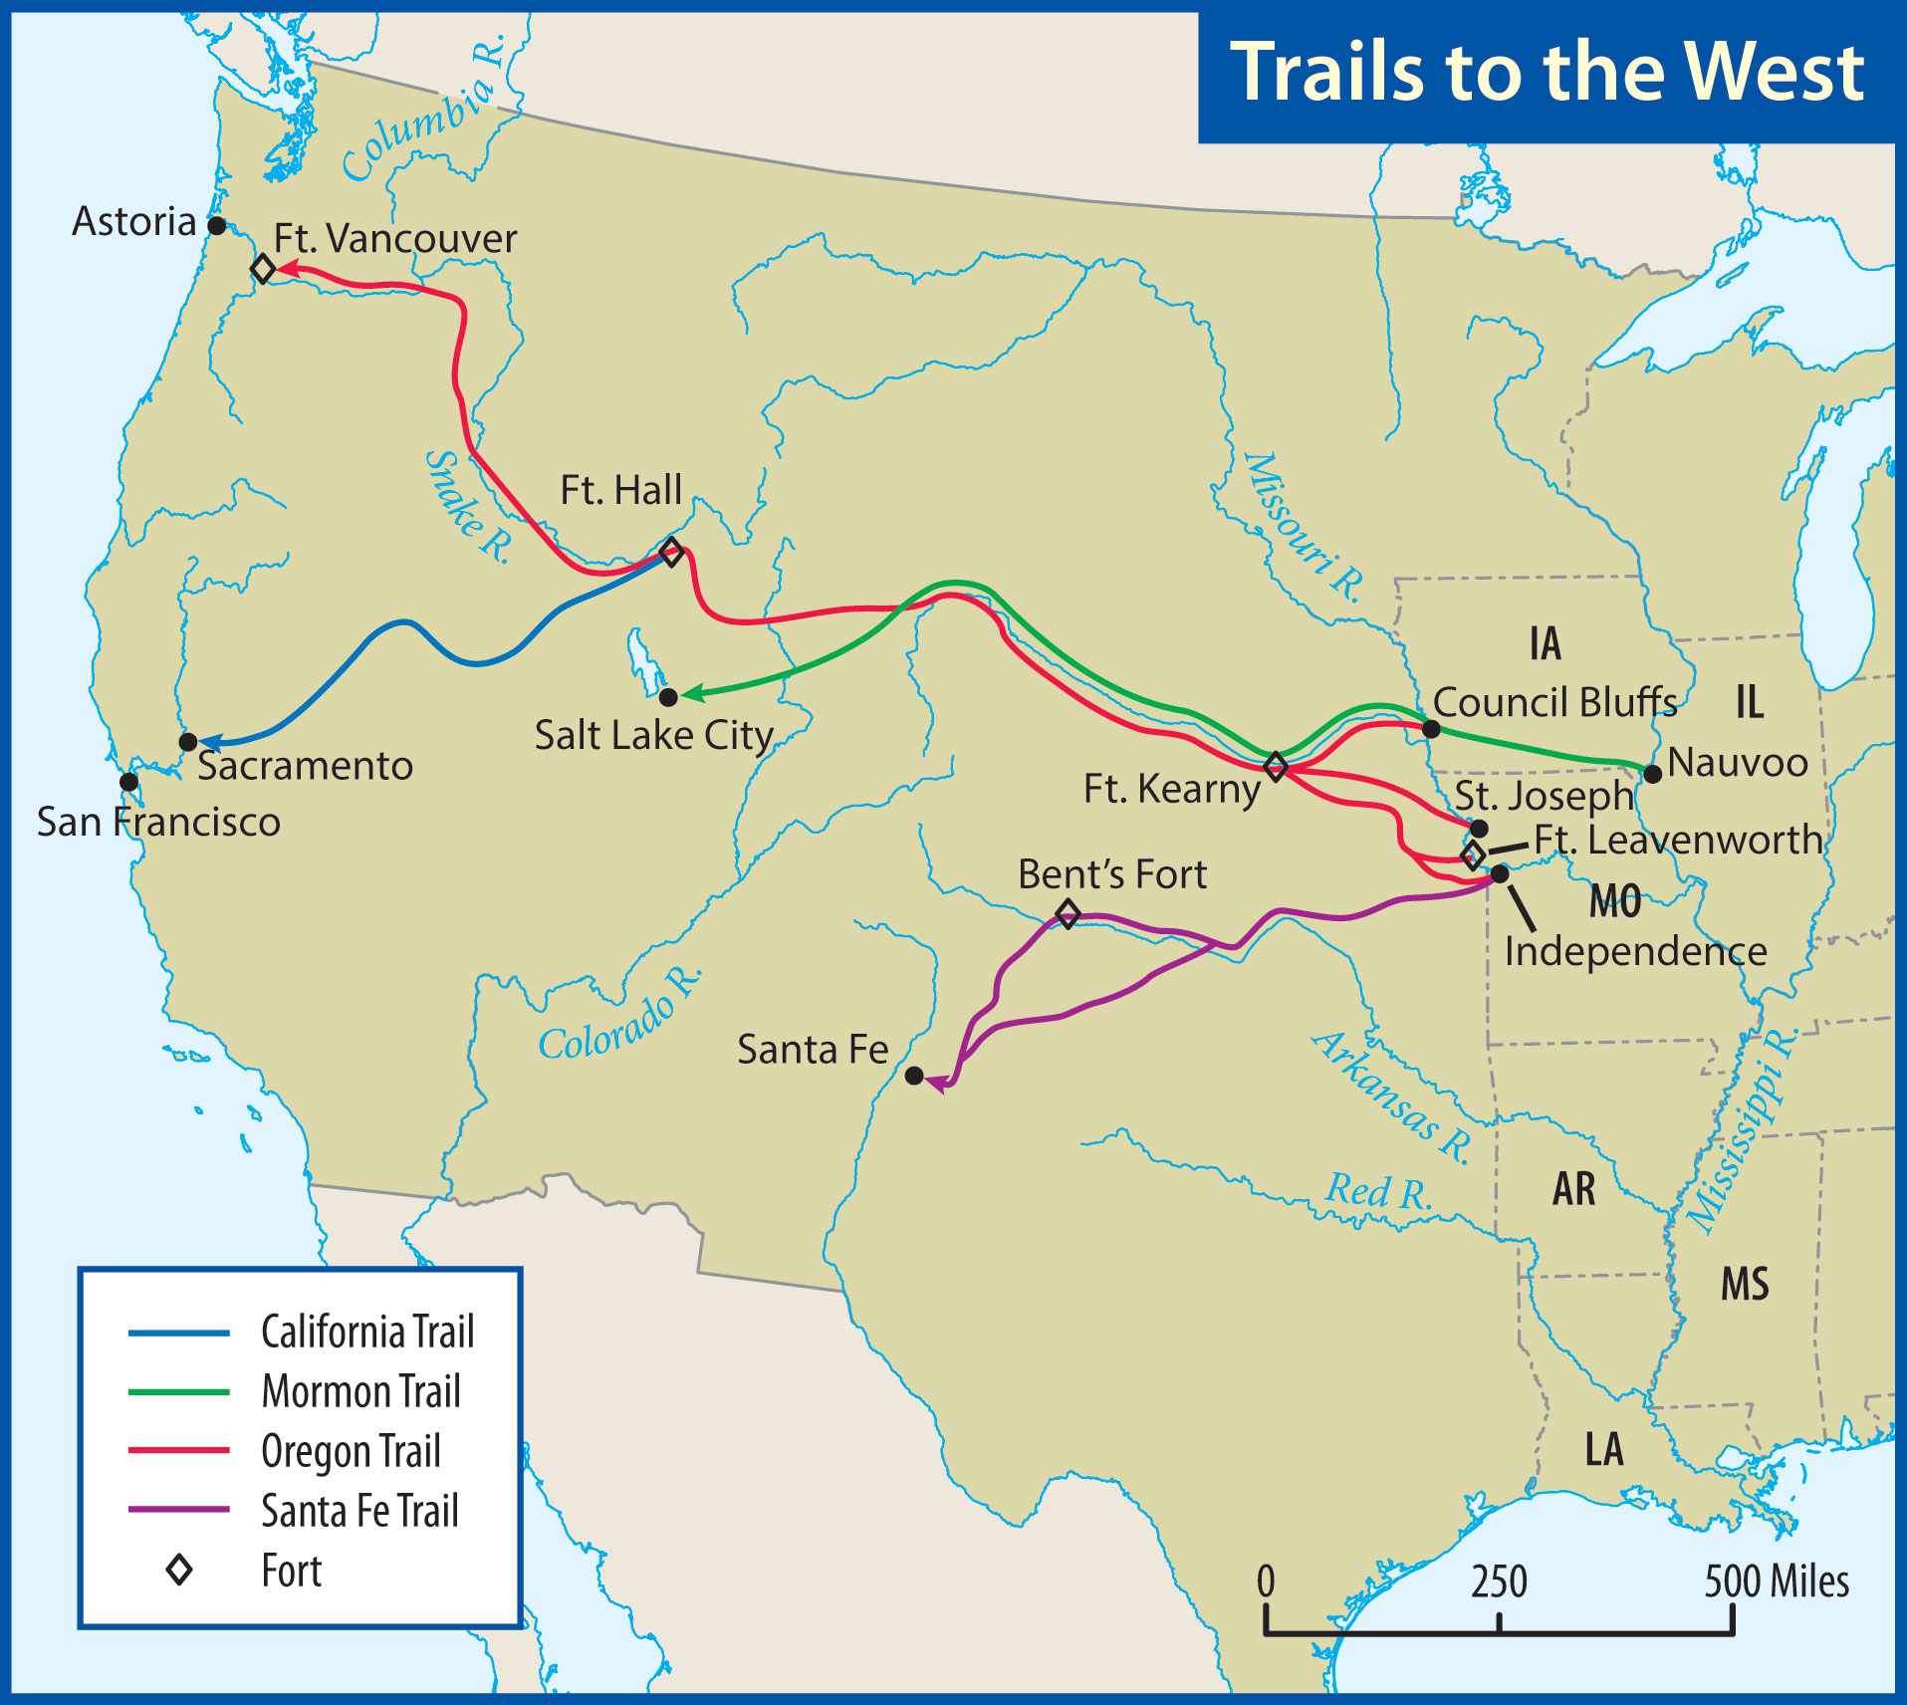

Slide 18
Across the Wide Missouri
Trails West
Many had to discard belongings
Indian attacks were a possibility
Other dangers existed
Mundane problems
Storms, floods, and weather

Slide 19
Across the Wide Missouri
Oregon Trail
Had cutoffs to California
Santa Fe Trail
Commercial route
Mormon Trail
Nauvoo, IL, to Salt Lake City

Slide 20
What were the successes and failures of John Tyler’s administration?
What four goals did Polk set for his administration?

Slide 21
Southerners and Democrats tended to support expansion; Whigs and New Englanders usually opposed it.

Slide 22
Tyler and Polk
And Tyler Too
Tyler became president after the death of William Henry Harrison
He believed that he had the full powers of the presidency, and acted accordingly

Slide 23
Tyler and Polk
More of an anti-Jackson Democrat than a true Whig
The Whigs voted him out of their party
Most of his cabinet resigned
Nicknamed “His Accidency” by embittered Whigs

Slide 24
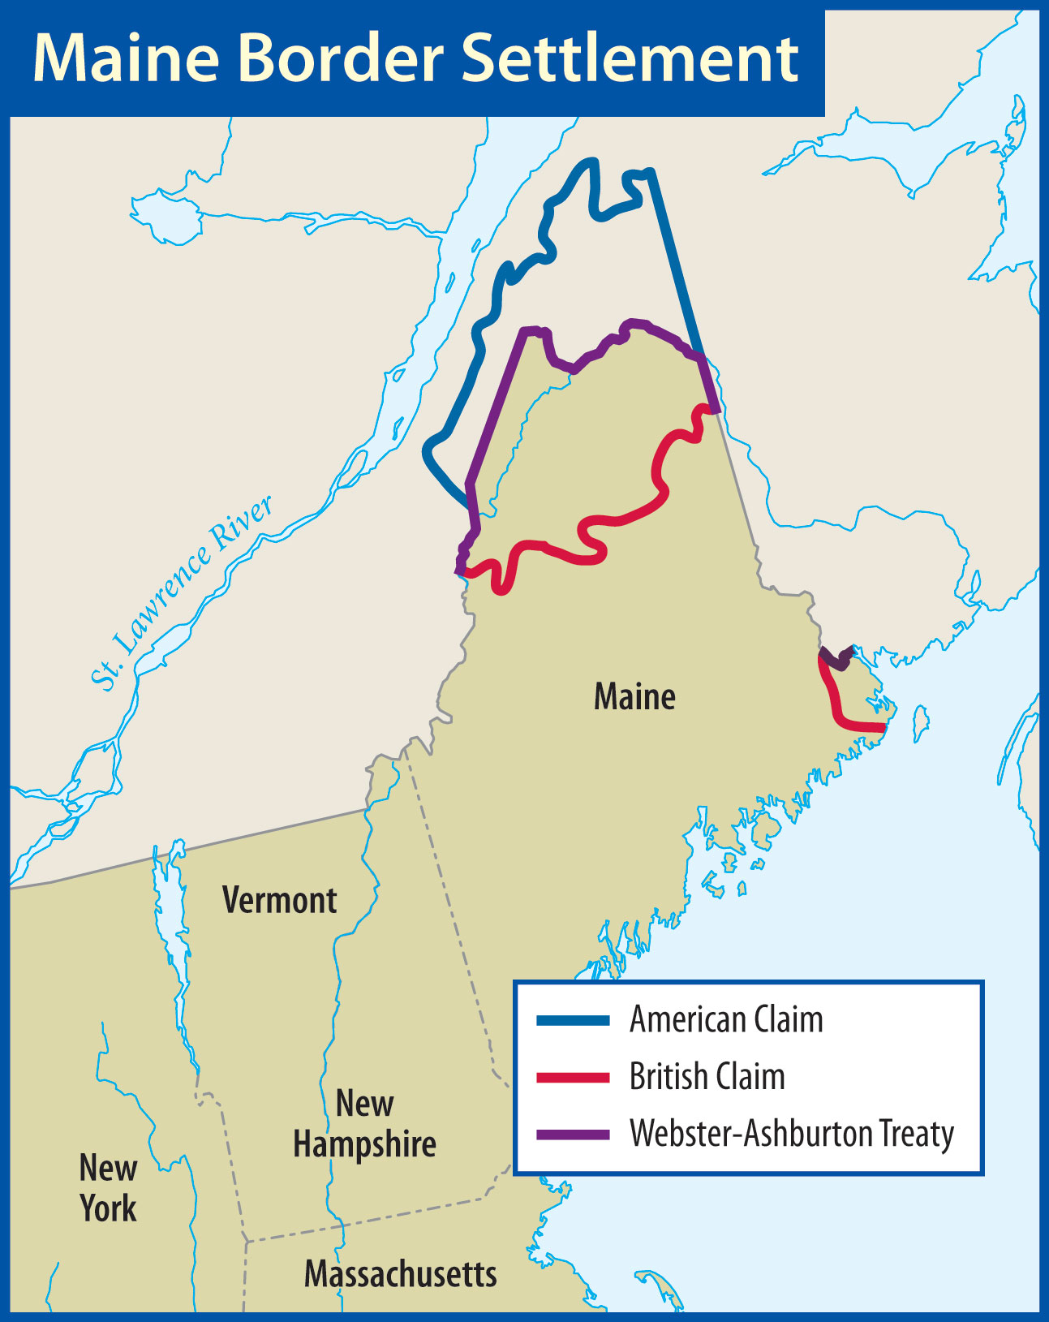
Daniel Webster remained in Tyler’s cabinet, in part, to complete the Webster-Ashburton Treaty to settle parts of the boundary between the United States and Canada.

Slide 25
Tyler and Polk
Campaign of 1844
Clay was the Whig candidate
Tyler wanted to be the Democratic candidate
Supported annexing Texas
Martin Van Buren was the leading Democratic candidate

Slide 26
Tyler and Polk
A Dark Horse
Neither Tyler nor Van Buren received the Democratic nomination
James K. Polk
Experienced politician from TN
“Young Hickory”
Strongly favored annexing Texas

Slide 27
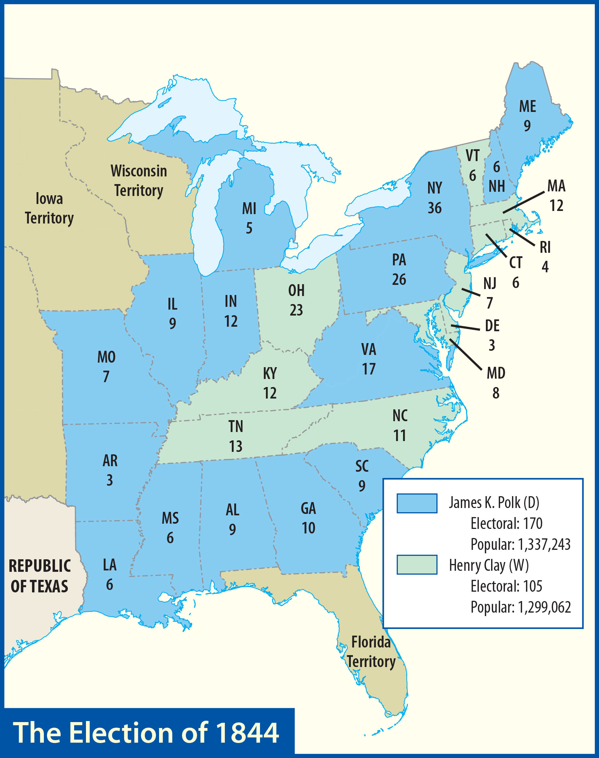
Polk won the election, but had Clay carried New York, Clay would have been America’s eleventh president.

Slide 28
Tyler and Polk
Texas Annexed
Sam Houston sought support from Great Britain and the United States
The British had outlawed slavery
Many U.S. lawmakers opposed annexation

Slide 29
Tyler and Polk
After the 1844 election, Tyler pushed to annex Texas through a joint resolution
Required only a majority vote
The resolution passed, and Texas became the twenty-eighth state

Slide 30
Tyler and Polk
A Disciplined Executive
Hard-working and self-disciplined
Pledged to serve only one term

Slide 31
Tyler and Polk
Polk had four goals:
Lower the tariff
Restore the independent treasury system
Settle the Oregon question
Acquire California from Mexico
Polk achieved all four goals

Slide 32
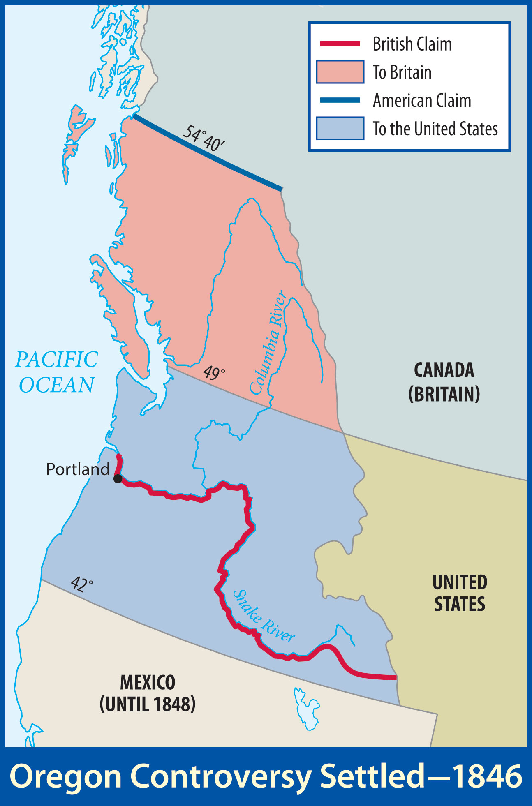
The United States and Great Britain signed a treaty in 1846 that made the 49th parallel the international boundary.

Slide 33
What events led to the Mexican War?
What were the major military campaigns of the Mexican War?
What were the results of the Mexican War?

Slide 34
The Mexican War was the climax and the most violent phase of Manifest Destiny.

Slide 35
War With Mexico
Causes
History of hostility
Desire for expansion to California and New Mexico
Fear that some other power might seize these lands

Slide 36
War With Mexico
Mexico had never recognized Texan independence
Failure of an attempt to reach a peaceful settlement
Dispute over the Texas-Mexico boundary
This was the real spark of the conflict

Slide 37
After Mexican troops attacked Americans on the north side of the Rio Grande River, President Polk requested a declaration of war.
Congress approved the request.

Slide 38
War With Mexico
Problems at Home
Many considered the war unjus
The House of Representatives passed a resolution opposing the war
The military was not ready for war

Slide 39
War With Mexico
Campaigns of the War
Taylor’s campaign in northern Mexico
The New Mexico campaign
The California campaign
Scott’s campaign in central Mexico

Slide 40
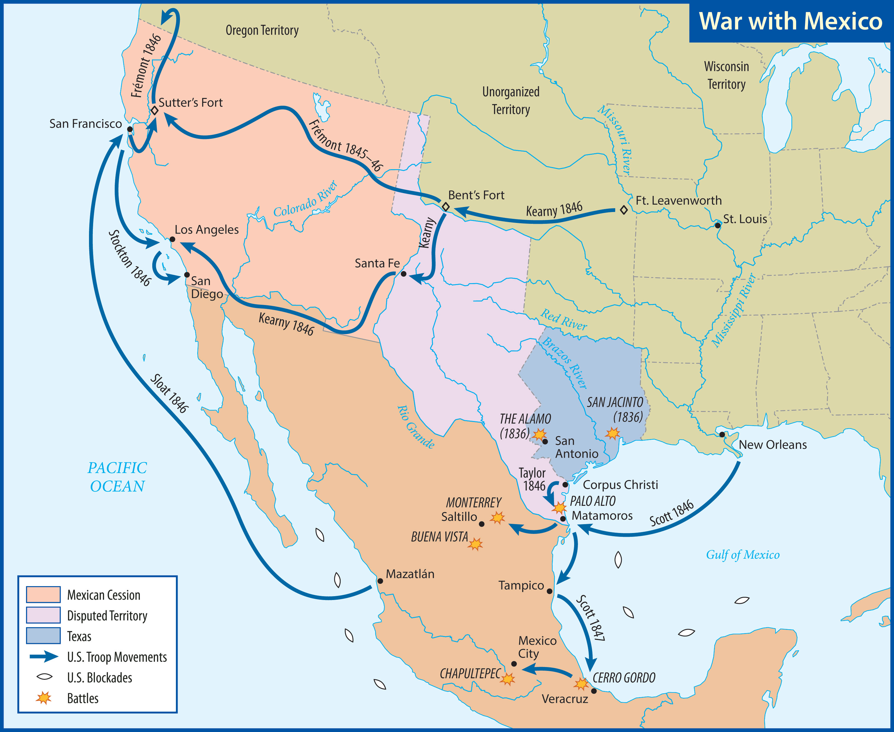

Slide 41
War With Mexico
Taylor in Northern Mexico
His men were devoted to him
Drove the Mexicans away from the Rio Grande
Victory at Monterrey

Slide 42
War With Mexico
The Mexican government was not ready to make peace
Many of Taylor’s troops were given to Winfield Scott
Santa Anna had returned to Mexico
Victory at the Battle of Buena Vista

Slide 43
War With Mexico
New Mexico campaign
General Stephen Kearny
Desert march to easily capture Santa Fe
Kearny took part of his men to California

Slide 44
War With Mexico
California campaign
Captain John C. Frémont
Bear Flag Republic
American forces quickly subdued California
Spanish recaptured Los Angeles
Americans took it back

Slide 45
War With Mexico
Scott in Central Mexico
Brilliant strategy
Captured Veracruz in March 1847
Overland to Mexico City
Kept outwitting the enemy

Slide 46
General Scott led the victorious Americans into Mexico City on September 14, 1847.

Slide 47
War With Mexico
Results of the War
Treaty of Guadalupe Hidalgo
Texas claims land to the Rio Grande
New Mexico and California are ceded to the United States
United States paid Mexico $15 million
United States agreed to pay debts

Slide 48
War With Mexico
Gadsden Purchase
United States paid Mexico $10 million
Negotiated by Santa Anna

Slide 49
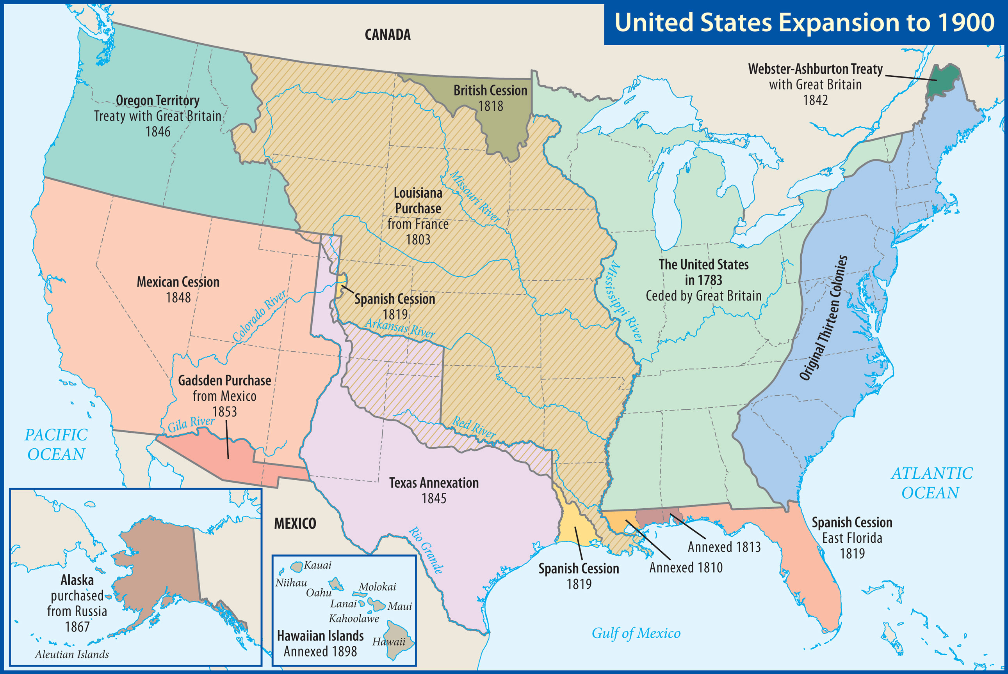

Slide 50
Xxx
Xxx

