Slide 2
Crisis
4
1848–1877

Slide 3
1860
Election of Abraham Lincoln; South Carolina secedes
1850
Compromise of 1850
1854
Kansas-Nebraska Act
1857
Dred Scott decision
1850
1855
1860
1859
John Brown’s raid on Harpers Ferry
1849
California gold rush
1861
Firing on Fort Sumter

Slide 4
1866
Military Reconstruction Act
1863
Emancipation Proclamation takes effect
1868
Impeachment of Andrew Johnson
1865
1870
1875
1865
Surrender at Appomattox; Lincoln assassinated
1877
Compromise of 1877

Slide 5
A House Dividing (1848–1861)
13

Slide 6
How was the slavery issue handled in the newly acquired American territories?
What political events set the stage for the Civil War?
What actions left the United States in a state of crisis by 1860?

Slide 7
The 1850s was perhaps America’s most decisive decade since nationhood, the 1860s its most divisive.

Slide 8
What were three positions regarding slavery in the American territories?
How did the gold rush influence sectional divisions during this period?
What conflicts preceded the start of the Civil War?

Slide 9
Controversy
Wilmot Proviso
David Wilmot was a Democratic representative from PA
Prohibit slavery in any territory acquired from Mexico
Defeated multiple times in the Senate

Slide 10
Controversy
Calhoun Resolutions
Southern view of the status of slavery in the territories
Neither Congress nor the territorial legislatures could prohibit slavery
Only a state could prohibit slavery within its borders

Slide 11
Controversy
Popular Sovereignty
The residents of a territory should decide the status of slavery in their territory
Favored primarily by Democrats
Lewis Cass, Stephen Douglas

Slide 12
Controversy
Election of 1848
Democrats nominated Lewis Cass
Champion of popular sovereignty
Whigs nominated Zachary Taylor
Slaveholder from Mississippi
Avoided the adoption of a platform

Slide 13
Controversy
Free-Soilers and antislavery groups formed the Free-Soil Party
Supported the Wilmot Proviso
Nominated Martin Van Buren
Taylor won a narrow victory

Slide 14
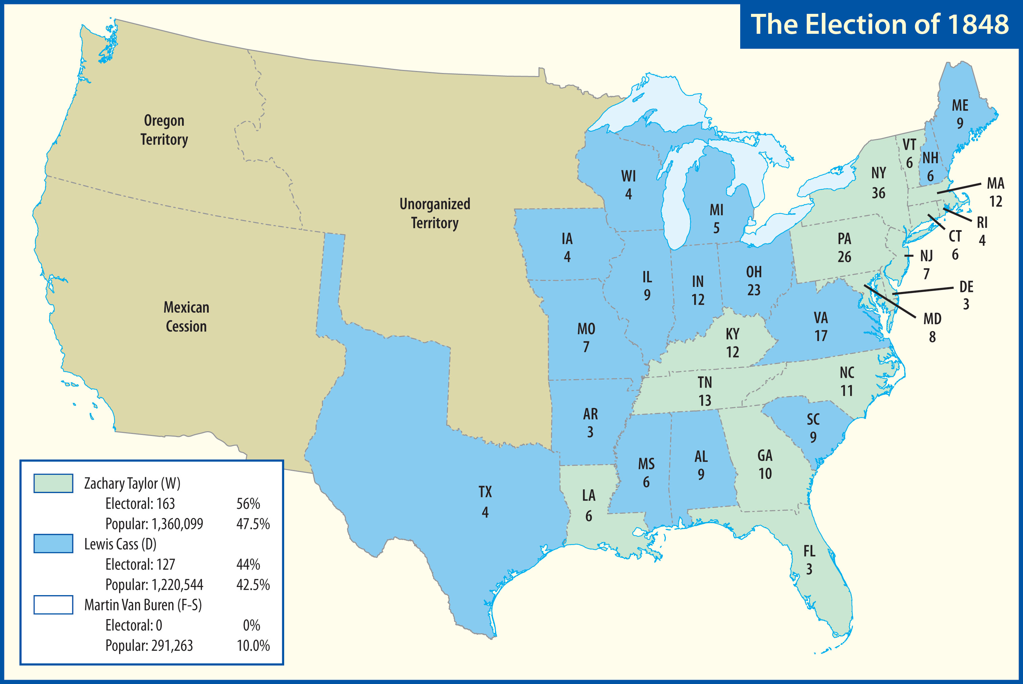

Slide 15
Controversy
California Gold Rush
John Sutter
Gold was discovered in 1848
Tens of thousands of men came to California in 1849
“Forty-niners”

Slide 16
Controversy
They came by various routes
Only a few ever became wealthy
Few of the prospectors ever left California

Slide 17
Controversy
Statehood Question
California organized a government, wrote a constitution, and applied for statehood
Opposed by southerners

Slide 18
Controversy
Compromise of 1850
Henry Clay formulated a compromise
To the North:
California admitted as a free state
Slave trade abolished in DC

Slide 19
Controversy
To the South:
New fugitive slave law
Protection of slavery in DC
Organization of New Mexico and Utah Territories
Popular sovereignty in those territories

Slide 20
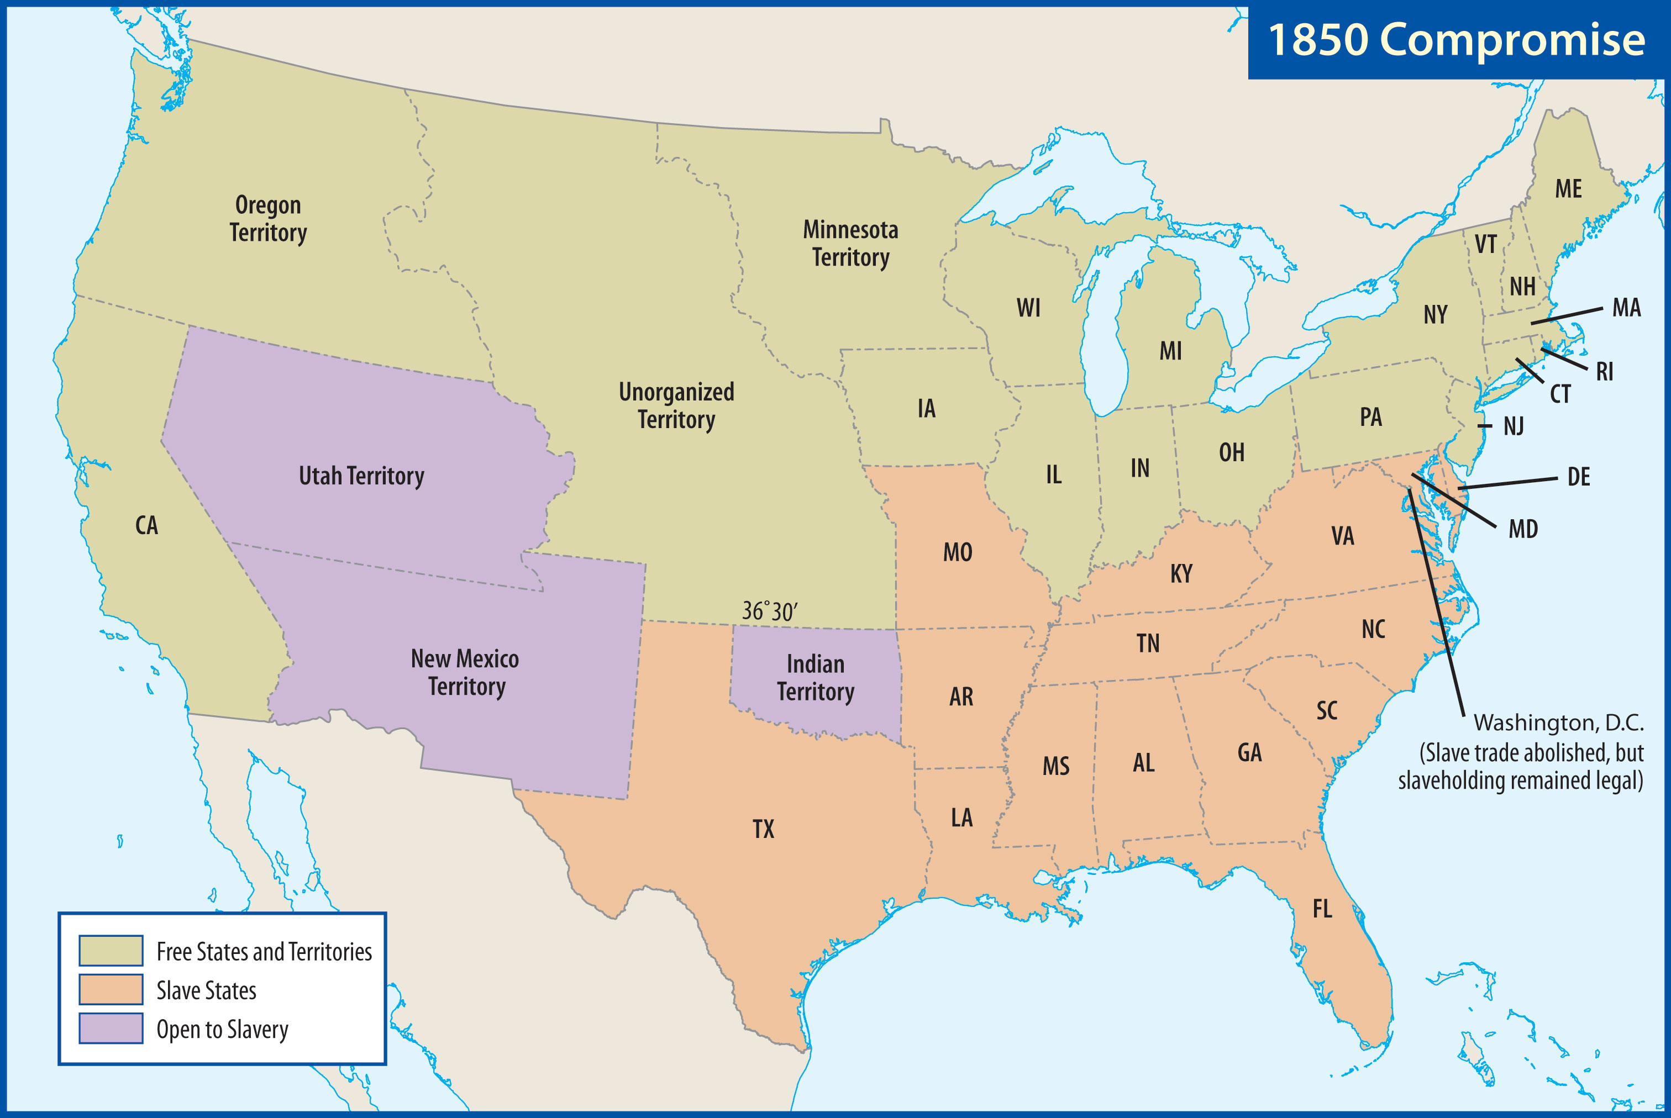

Slide 21
Controversy
Calhoun presented a speech
Argued that southern states might secede
Webster gave a speech
Favored the union and compromise
Abolitionists railed on him

Slide 22
Millard Fillmore, who favored the Compromise of 1850, became president after the death of Zachary Taylor, who was critical of the Compromise.

Slide 23
Controversy
Sectional Strains
The Election of 1852
Franklin Pierce (Democrat)
Favored the Compromise
Winfield Scott (Whig)
Pierce won a lopsided victory

Slide 24
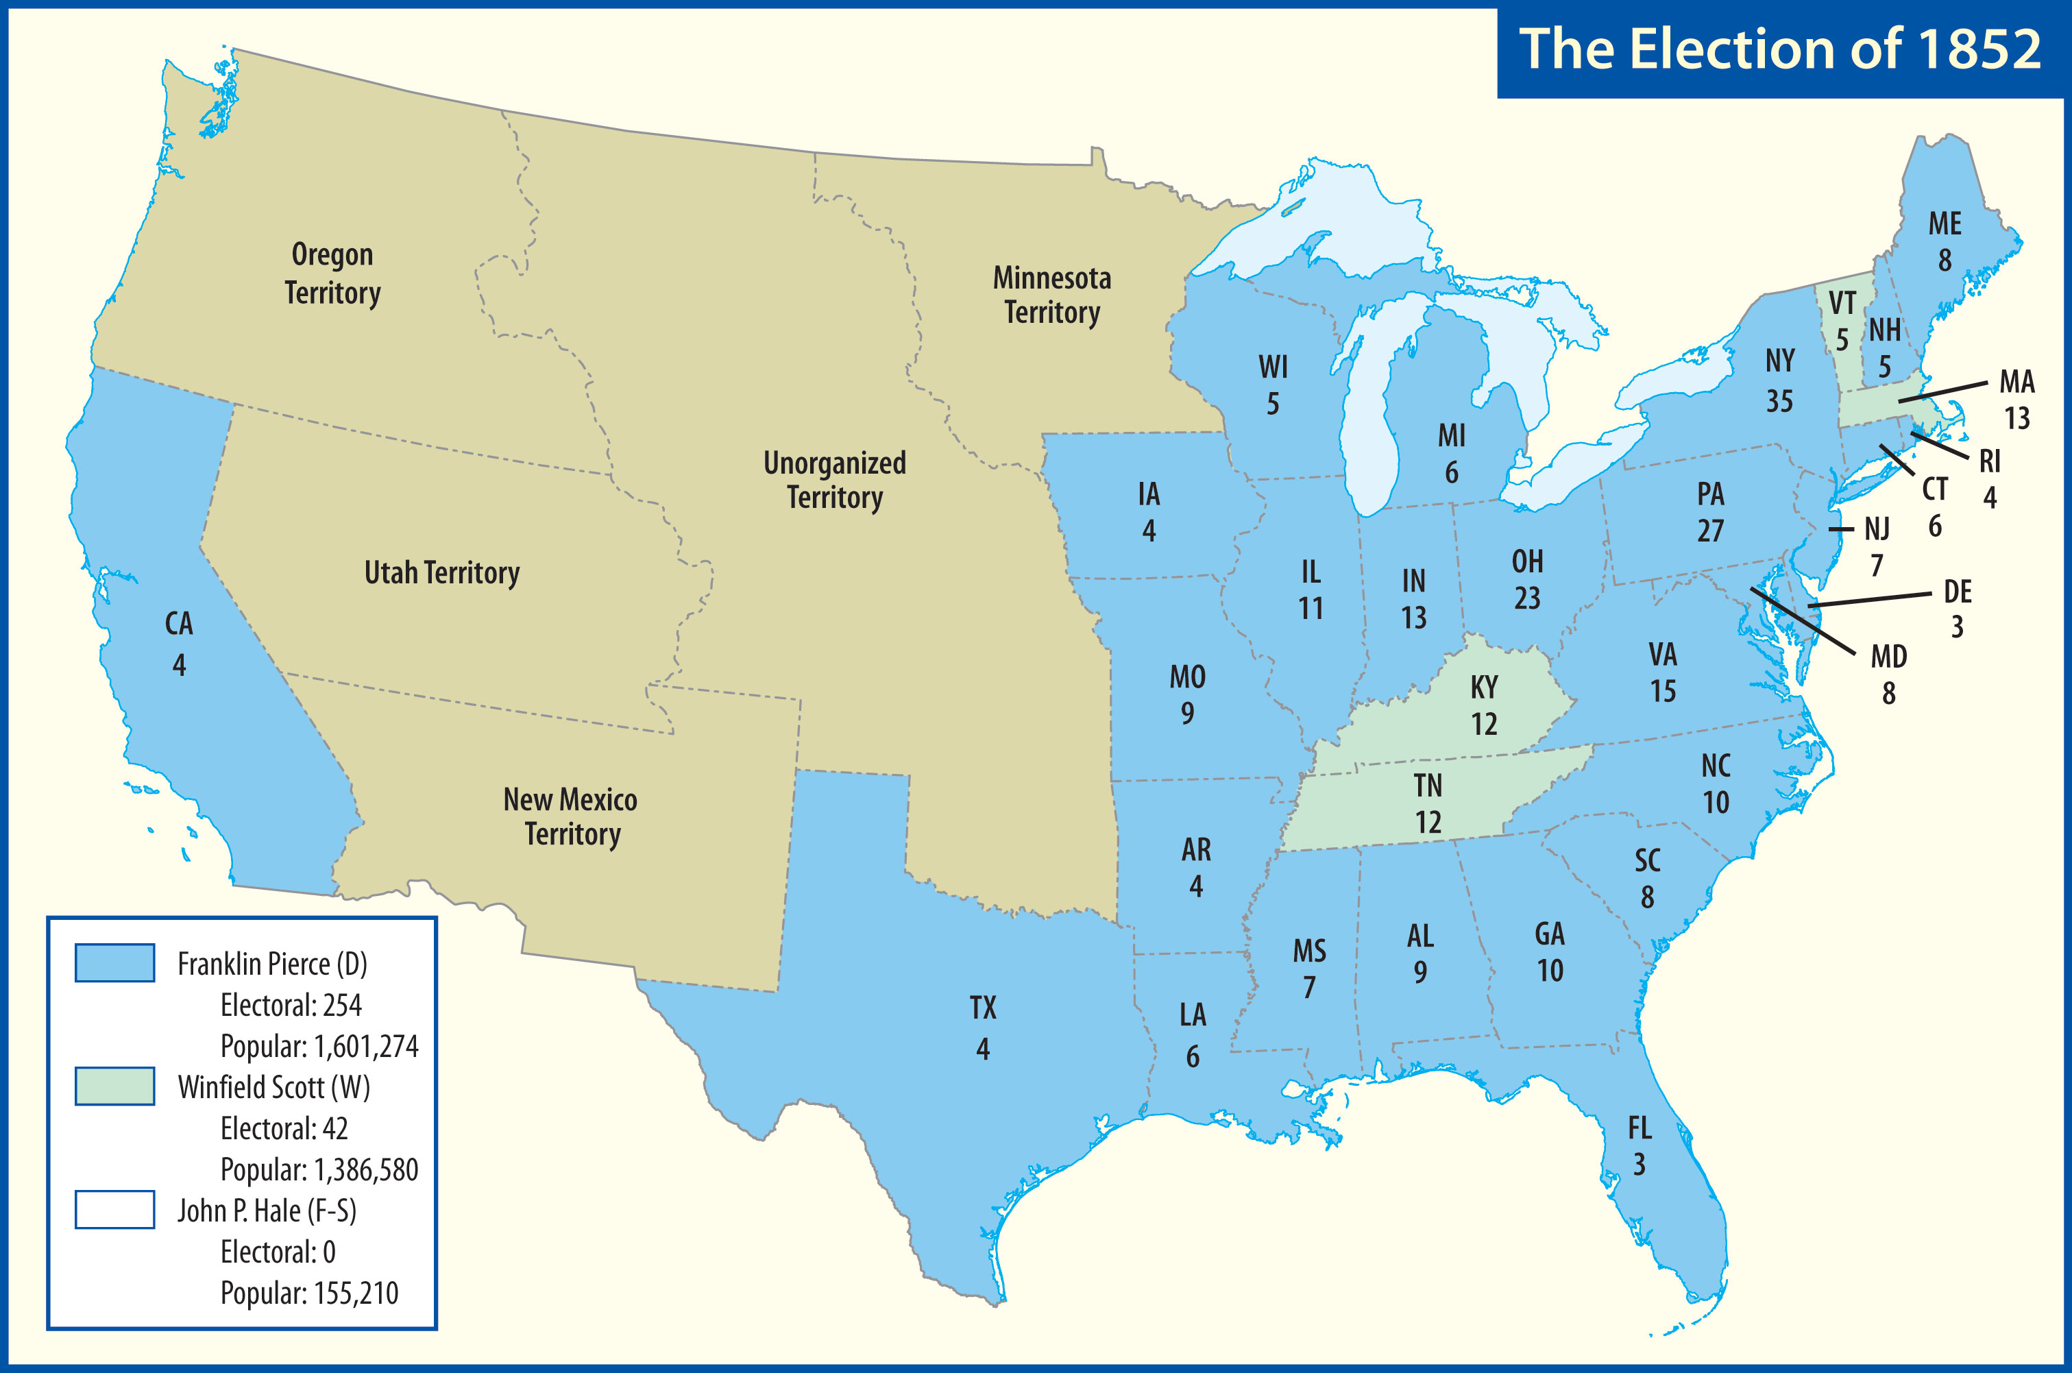

Slide 25
Controversy
Fugitive Slave Act
Opposed in the North
Turned public opinion in the North
Many were now verbally attacking the South itself as an evil culture
Fire-Eaters in the South were advocating secession

Slide 26
What was the impact of the Kansas-Nebraska Act?
What were the political positions of the Whig, Know-Nothing, Republican, and Democratic parties?

Slide 27
What events led to the rise of the term “Bleeding Kansas”?
What was the impact of the Dred Scott decision?

Slide 28
Conflict
Kansas-Nebraska Act
Stephen A. Douglas
Desire for a railroad running west from IL
Organization of KS and NE Territories
Popular sovereignty in those territories
Repeal of provision of 1820 Compromise banning slavery north of 36°30′

Slide 29
Conflict
Northern Democrats and southerners were able to pass the bill
Southerners were pleased that it expanded slavery
People in the North and West were outraged
Democrats suffered in the next election

Slide 30
Conflict
Collapse of the Whigs
Weakened in 1852, destroyed by the Kansas-Nebraska Act
Southern Whigs supported the Act
Northern Whigs opposed the Act

Slide 31
Conflict
The Know-Nothings
Arose in reaction to increased immigration
Won big gains in 1854 in both Congress and state legislatures
They were a passing fad

Slide 32
Conflict
The Republicans
A generally “antislavery party”
Attracted abolitionists and Free-Soilers
Many Know-Nothings joined
Adopted many pro-business, nationalistic Whig ideas
Nonexistent in the South

Slide 33
Conflict
Election of 1856
The Republicans nominated John C. Frémont
The Democrats nominated James Buchanan
The Know-Nothings nominated Millard Fillmore

Slide 34
James Buchanan seemed like an ideal candidate to many people.
He won a plurality of popular votes and a majority of the Electoral College.

Slide 35
Conflict
“Bleeding Kansas”
Slavery would be decided by popular sovereignty there
Proslavery and antislavery advocates streamed into the territory
Savage fighting occurred

Slide 36
Conflict
Lawrence
An army of “border ruffians” attacked the town of Lawrence
One man died
The town was burned, looted, and destroyed
“Sack of Lawrence”

Slide 37
Conflict
Sumner-Brooks Episode
Sumner spent two days attacking colleagues who supported slavery
Especially Senator Andrew Butler (SC)
Preston Brooks, Butler’s cousin, beat Sumner with his cane
Many Southerners praised Brooks

Slide 38
Conflict
Pottawatomie Massacre
John Brown
Revenge for the Sack of Lawrence
Five men were killed
Brown was never arrested or tried
Many abolitionists praised Brown

Slide 39
Conflict
The Dred Scott Decision
Scott sought his freedom
Chief Justice Roger Taney ruled that a slave is not a citizen and has no right to sue

Slide 40
“[Black men] had no rights which the white man was bound to respect.”
Roger Taney in the Dred Scott Decision

Slide 41
Conflict
Taney also ruled the Missouri Compromise unconstitutional
Slavery was now theoretically legal in all territories
The decision caused animosity to grow

Slide 42
Conflict
Lincoln-Douglas Debates
Douglas: Freeport Doctrine
A territory could still prohibit slavery
Douglas opposed Buchanan on whether Kansas should be the next slave state

Slide 43
Kansans overwhelmingly rejected the proposed pro-slavery Constitution.
Kansas would not become a state until 1861.

Slide 44
Conflict
Abraham Lincoln
Grew up in frontier poverty
Moved to Illinois
Became interested in politics
Served in the state legislature and one term in Congress

Slide 45
Conflict
Believed that slavery was wrong
“All men are created equal”
Believed the federal government had no right to interfere with slavery where it already existed
Condemned popular sovereignty
Aroused by the Kansas-Nebraska Act

Slide 46
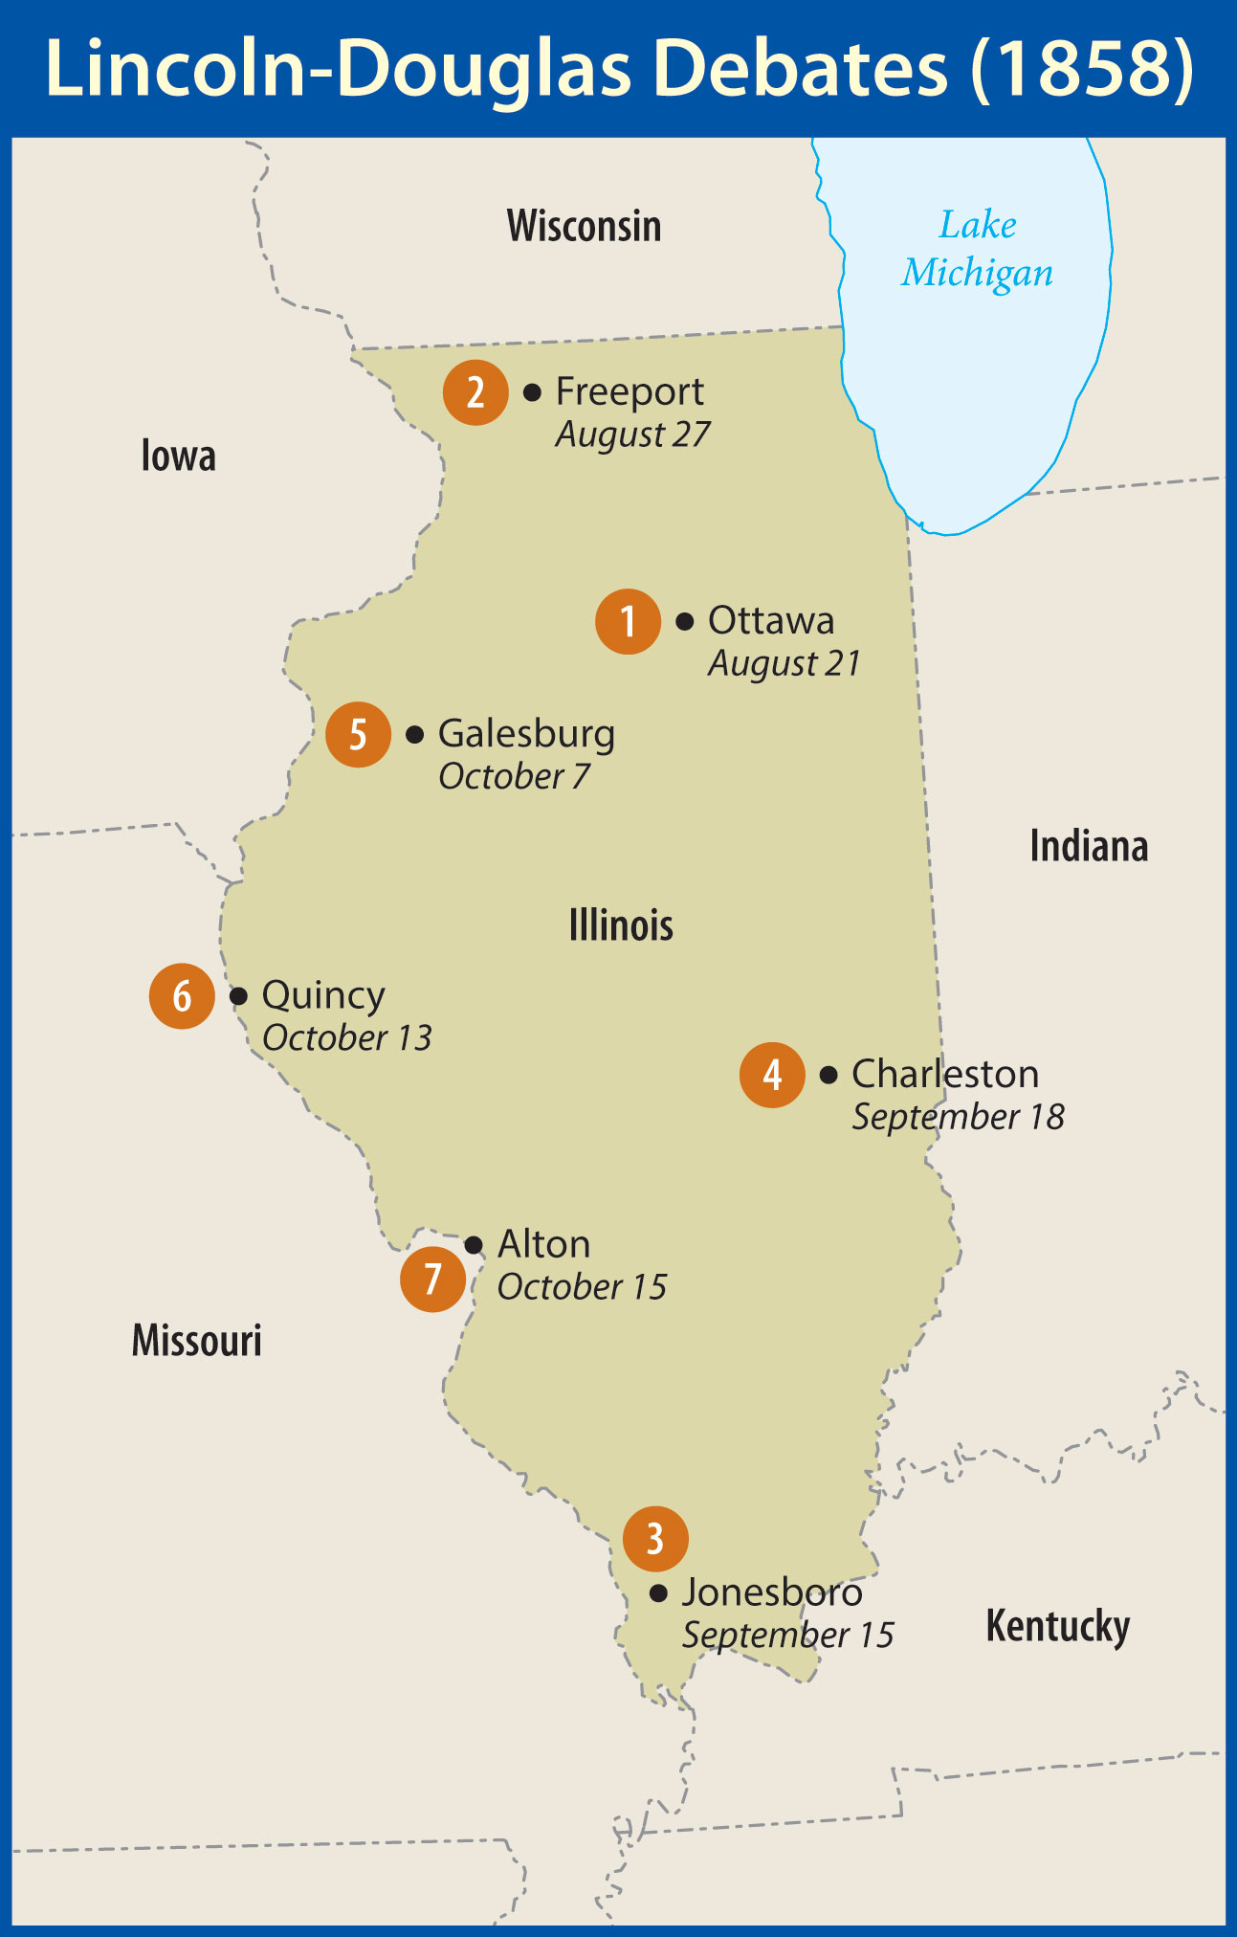
Conflict
The Debates
Seven debates
Douglas promoted popular sovereignty
Lincoln stated that slavery was immoral and must not be expanded

Slide 47
“The real issue in this controversy . . . is the sentiment on the part of one class that looks upon the institution of slavery as a wrong, and of another class that does not look upon it as a wrong.”
Abraham Lincoln

Slide 48
When the state legislature chose a senator, Douglas won the close election and continued to serve in the Senate.

Slide 49
How did John Brown’s raid affect sectional strife?
What were some of the unusual aspects of the 1860 election?
What were arguments for and against secession?

Slide 50
Crisis
John Brown’s Raid
Planned to start a slave revolt in the South
Had well-placed supporters

Slide 51
Crisis
Raid on Harpers Ferry
Attacked the federal arsenal
Quickly surrounded
Colonel Robert E. Lee and others captured Brown and his gang
Several were killed on both sides

Slide 52
Crisis
Aftermath
Southerners and many Republicans looked forward to his punishment
Excessive mourning in the North

Slide 53
Northern voices of moderation were not being heard in the South.

Slide 54
Many Southerners feared what would happen if a Republican became president.
The election of 1860 was probably the most critical contest in American politics.

Slide 55
Crisis
Democratic Division
The Charleston convention split over the platform
Both sectional factions reconvened later in Baltimore
Northern Democrats nominated Stephen Douglas (IL)

Slide 56
Crisis
Southern Democrats nominated Vice-President John C. Breckinridge (KY)
A group calling itself the Constitutional Union Party nominated John Bell (TN)
Concise platform
Democratic division virtually guaranteed Republican victory

Slide 57
Crisis
Lincoln’s Victory
Nominated at the Chicago convention
Coalition platform
Douglas made a nationwide tour
Lincoln won a plurality of the popular vote but a solid majority of the electoral vote

Slide 58
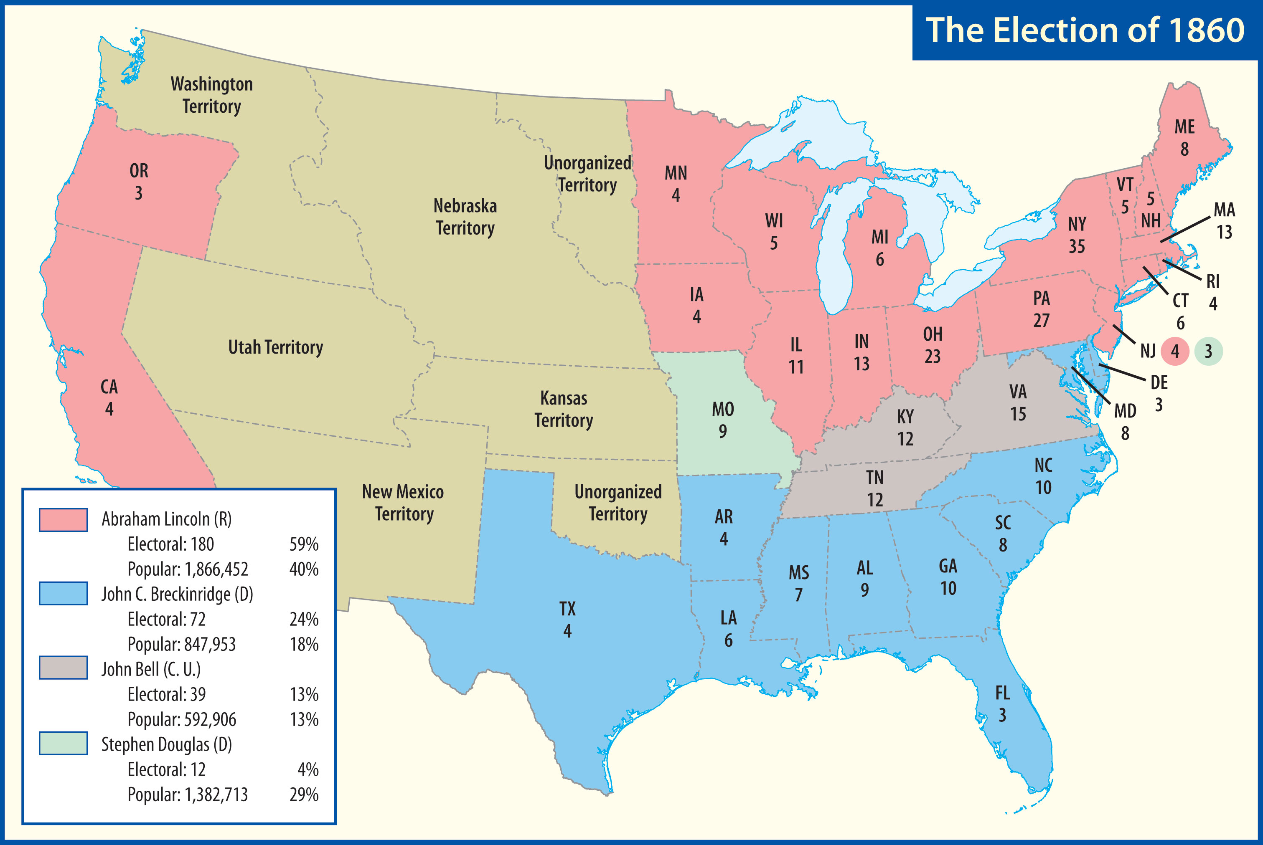

Slide 59
secede
the action of a state to leave the Union

Slide 60
Crisis
Secession
South Carolina unanimously approved an Ordinance of Secession
Six more Deep South states followed
Confederate States of America
Jefferson Davis elected president

Slide 61
Crisis
Attempts at Compromise
President Buchanan was indecisive
President-elect Lincoln refused to commit himself to any course of action
Senator John J. Crittenden proposed a series of constitutional amendments
These ultimately failed

Slide 62
Crisis
First Fire
Fort Sumter, in Charleston Harbor, remained under Union control
Lincoln became president
Sent supplies to Fort Sumter
He was opposed to surrendering the fort

Slide 63
Crisis
Confederate General Beauregard opened fire on Fort Sumter
Major Robert Anderson was forced to surrender
Union troops were permitted to leave
War had begun

Slide 64
Crisis
Lincoln called for soldiers
Four more states seceded

Slide 65
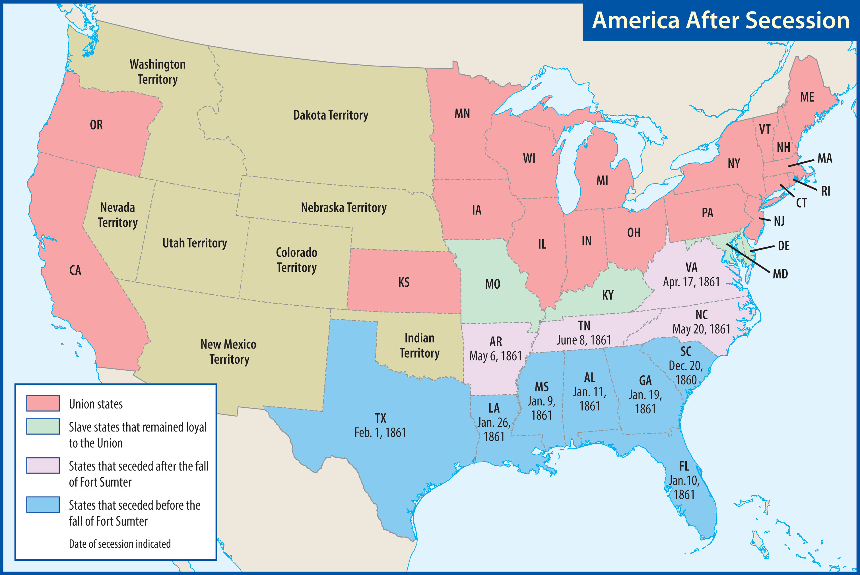

Slide 66
Xxx
Xxx

