Slide 1
Chapter 14:
The Judiciary
Notes:
WIN-Initiative/Stone/Getty Images

Slide 2
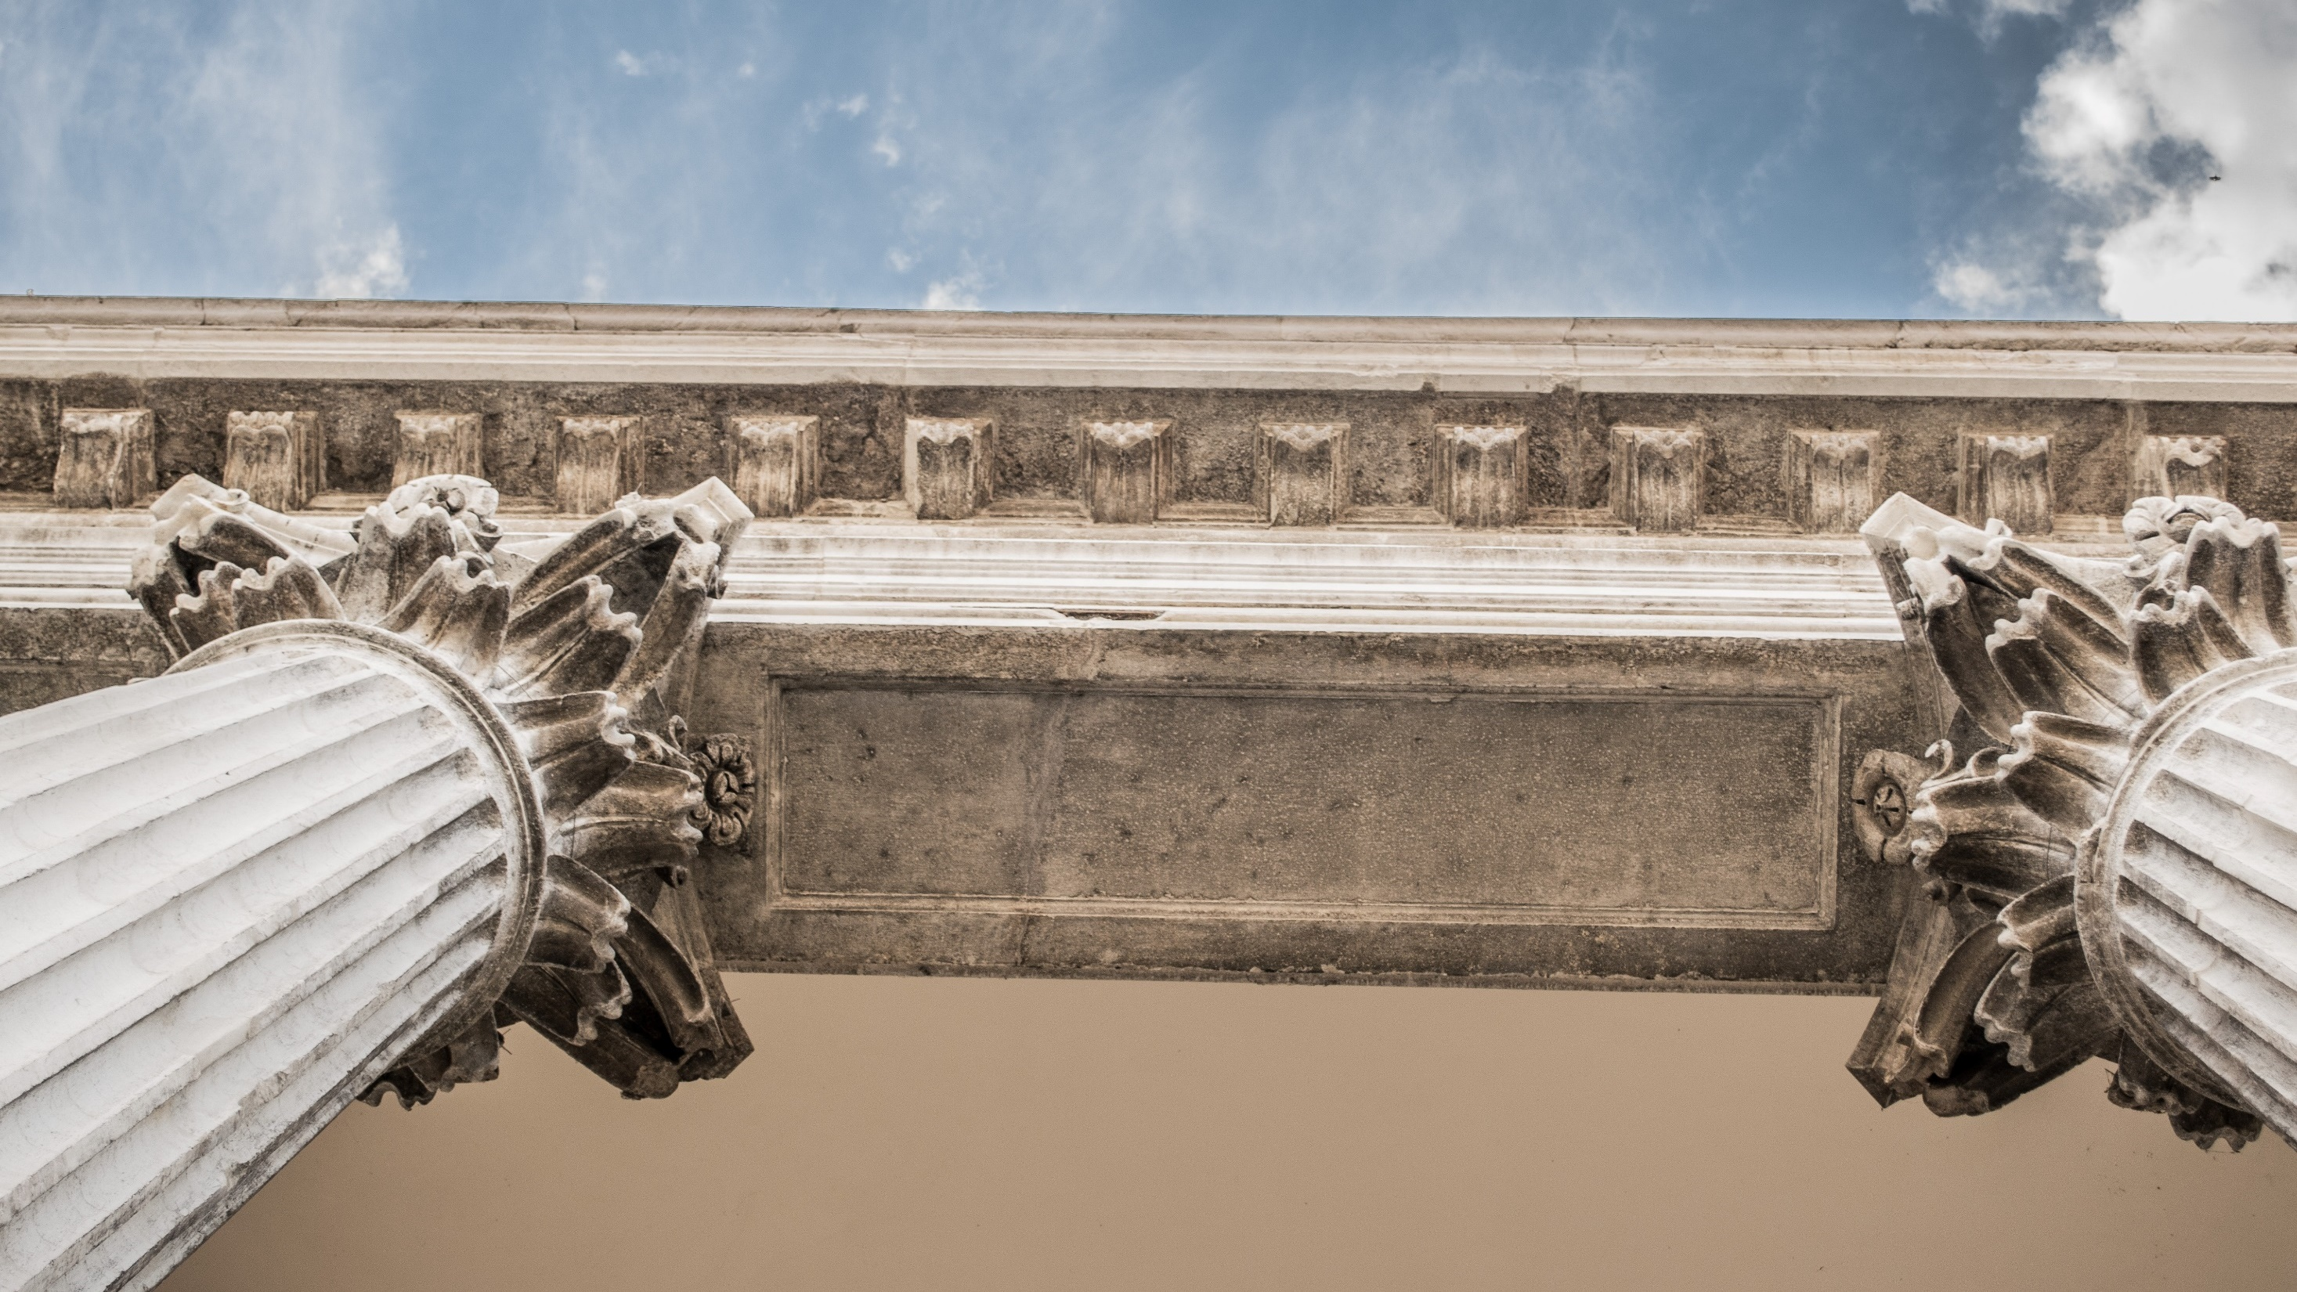
I. Sources of American Law
Chapter 14.1
Notes:
Photo by Macu ic on Unsplash
https://unsplash.com/photos/PbN_Gl_ZoMk

Slide 3

A. Scriptural Foundation
Ensuring justice is one of the fundamental obligations that people have toward one another.
To be just is to respect the rights that another human being has.
Notes:
Photo by Aaron Burden on Unsplash
https://unsplash.com/photos/QJDzYT_K8Xg

Slide 4
A. Scriptural Foundation
God’s standard of justice is His own character (Deut. 32:4).
Justice is, therefore, conformity to God’s character.
Notes:
Photo by Aaron Burden on Unsplash
https://unsplash.com/photos/QJDzYT_K8Xg

Slide 5
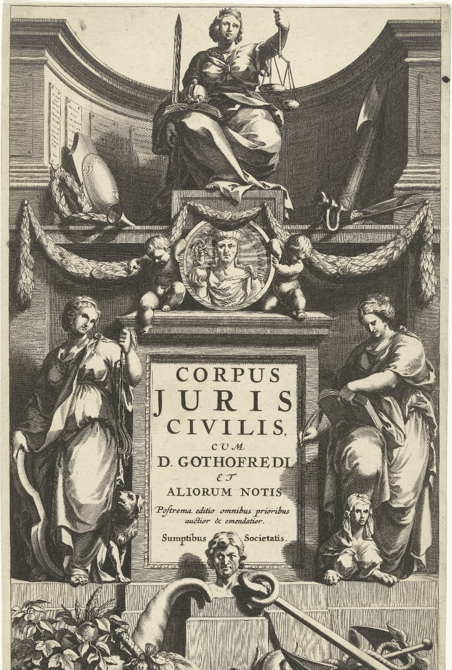
B. Historical Foundation
The Code of Hammurabi is one of the earliest and most famous ancient law codes (18th century BC).
In 533 AD, Roman emperor Justinian published an organized compilation of Roman legal materials called the Corpus Juris Civilis.
Notes:
By Rijksmuseum - http://hdl.handle.net/10934/RM0001.COLLECT.100740, CC0, https://commons.wikimedia.org/w/index.php?curid=83556287
https://commons.wikimedia.org/w/index.php?sort=relevance&search=Corpus+Juris+Civilis&title=Special:Search&profile=advanced&fulltext=1&advancedSearch-current=%7B%7D&ns0=1&ns6=1&ns12=1&ns14=1&ns100=1&ns106=1&searchToken=8gmeww3w2vmcdzorvqb7fls02#%2Fmedia%2FFile%3ARechtvaardigheid_troont_boven_portret_van_Justinianus_op_sokkel_met_titel_geflankeerd_door_Matigheid_en_Voorzichtigheid_Titelpagina_voor_Corpus_juris_civilis%2C_Amsterdam_1663_Corpus_juris_civilis_%28titel_op_object%29%2C_RP-P-1886-A-10397.jpg

Slide 6
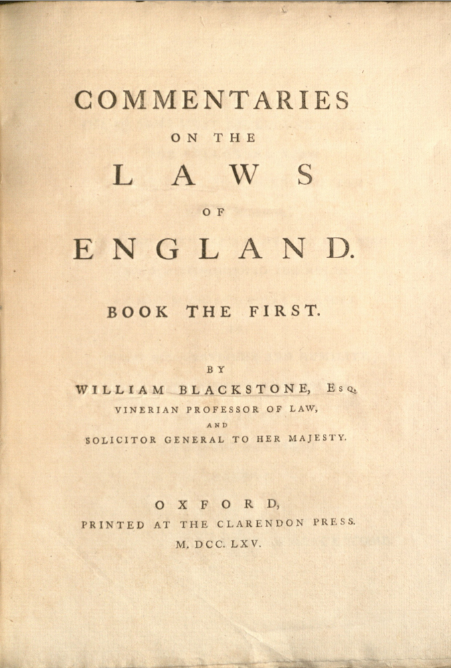
B. Historical Foundation
William Blackstone’s Commentaries on the Laws of England strongly influenced the American founders.
Blackstone believed that common law was derived from God’s law.
  Natural law – expressed through creation
  Revealed law – expressed through the Bible
Notes:
By William Blackstone - https://flickr.com/photos/yalelawlibrary/8978107441/, CC BY 2.0, https://commons.wikimedia.org/w/index.php?curid=88015842
https://commons.wikimedia.org/w/index.php?sort=relevance&search=Commentaries+on+the+Laws+of+England&title=Special:Search&profile=advanced&fulltext=1&advancedSearch-current=%7B%7D&ns0=1&ns6=1&ns12=1&ns14=1&ns100=1&ns106=1&searchToken=7mqxlbxw8p02glbi3qrgkmor1#%2Fmedia%2FFile%3ACommentaries_on_the_Laws_of_England_%281765%29.jpg

Slide 7
Section Review – Chapter 14.1
1. What is one of the fundamental obligations that people have toward one another?
ensuring justice (p. 333)
2. Explain God’s standard for justice.
God’s standard for justice is His own character (p. 334)

Slide 8
Section Review – Chapter 14.1
3–4. Who compiled the Corpus Juris Civilis? What is it?
Justinian (a Roman emperor); an organized compilation of Roman legal materials from previous centuries (p. 334)
5–6. What was English common law? How was it different from the legal systems used in most of Europe?
Common law was common throughout the whole realm of England. It was grounded in case law, a body of opinions written by royal judges who, at least in theory, followed precedents. The legal systems of continental Europe were based on codified Roman law. (pp. 334–335)

Slide 9
Section Review – Chapter 14.1
7. Explain how William Blackstone’s Commentaries on the Laws of England affected the American colonies.
It probably restrained any urge Americans had to abandon common law for a new legal code; it also taught that God expressed law through His Word as well as through nature.
(p. 337)

Slide 10
Section Review – Chapter 14.1
Why was adopting English common law advantageous for the colonies?
The common law was a product of human experience; it was the source of the ruler’s power; it emphasized a law that existed before civilization, thereby reflecting Christian truth.

Slide 11
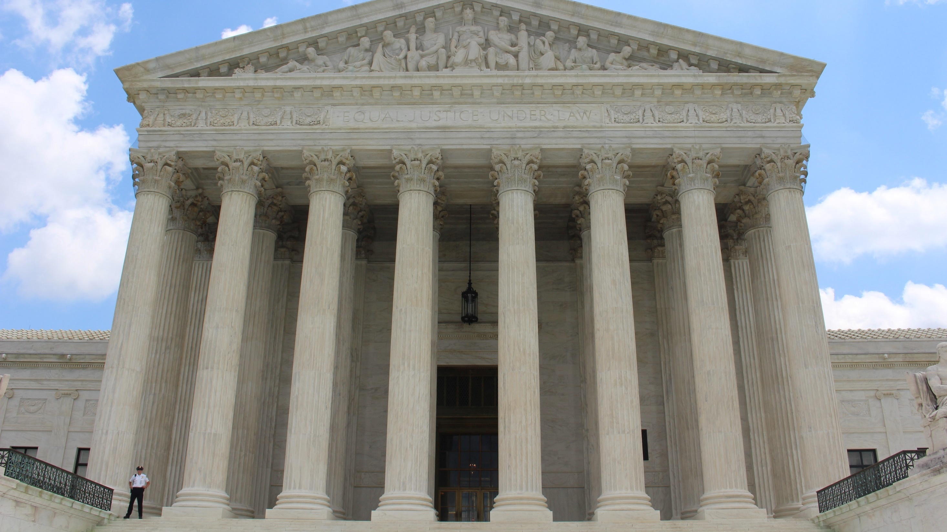
II. Structure of the Courts
Chapter 14.2
Notes:
Photo by Claire Anderson on Unsplash
https://unsplash.com/photos/Vq__yk6faOI

Slide 12
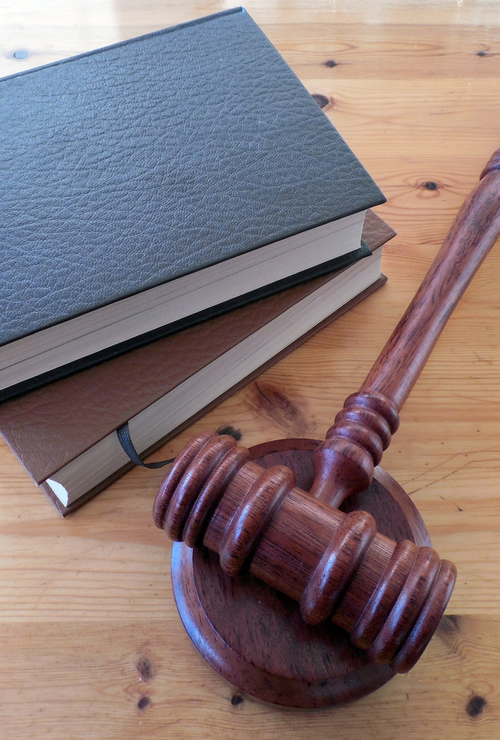
A. Judicial Federalism
Each of the new American states already had common-law courts in place when the Constitution was written.
The Founders created a unique system of coexisting federal and state courts – judicial federalism.
Notes:
Image by succo from Pixabay
https://pixabay.com/photos/hammer-books-law-court-lawyer-620011/

Slide 13
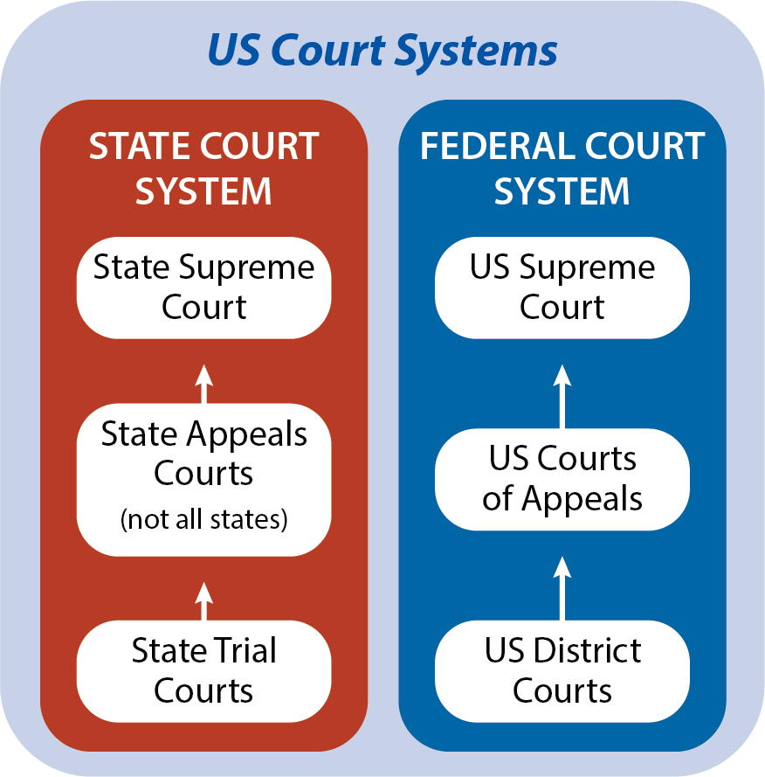
Notes:
BJU Press Art

Slide 14
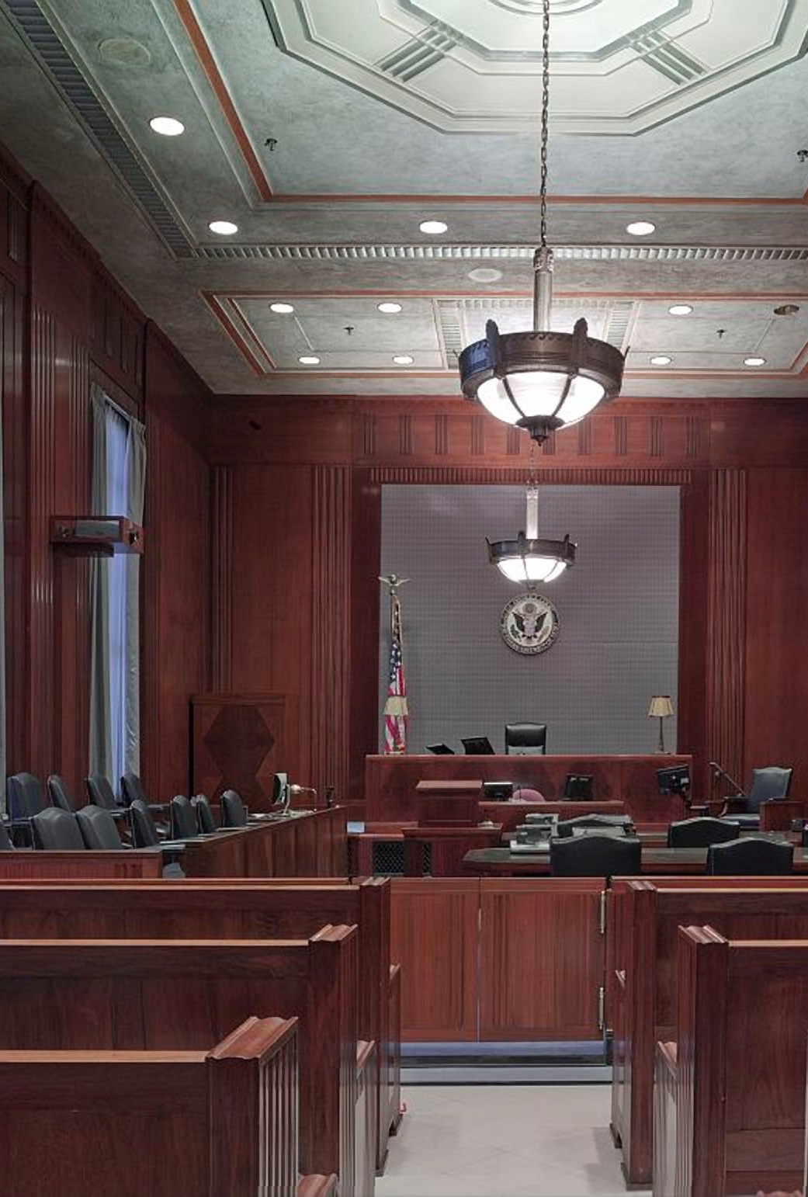
B. District Courts
By passing the Judiciary Act of 1789, the first Congress created a system of inferior courts and launched the United States Supreme Court as well.
The act created thirteen district courts, the trial courts of the federal judicial system.
Notes:
Image by David Mark from Pixabay
https://pixabay.com/photos/courtroom-benches-seats-law-898931/

Slide 15

B. District Courts
District courts exercise original jurisdiction, meaning that they are the first to hear a case before any other court considers it.
District courts use a grand jury to determine whether there is enough evidence to warrant a jury trial.
Notes:
Photo by Clarisse Meyer on Unsplash
https://unsplash.com/photos/jKU2NneZAbI

Slide 16
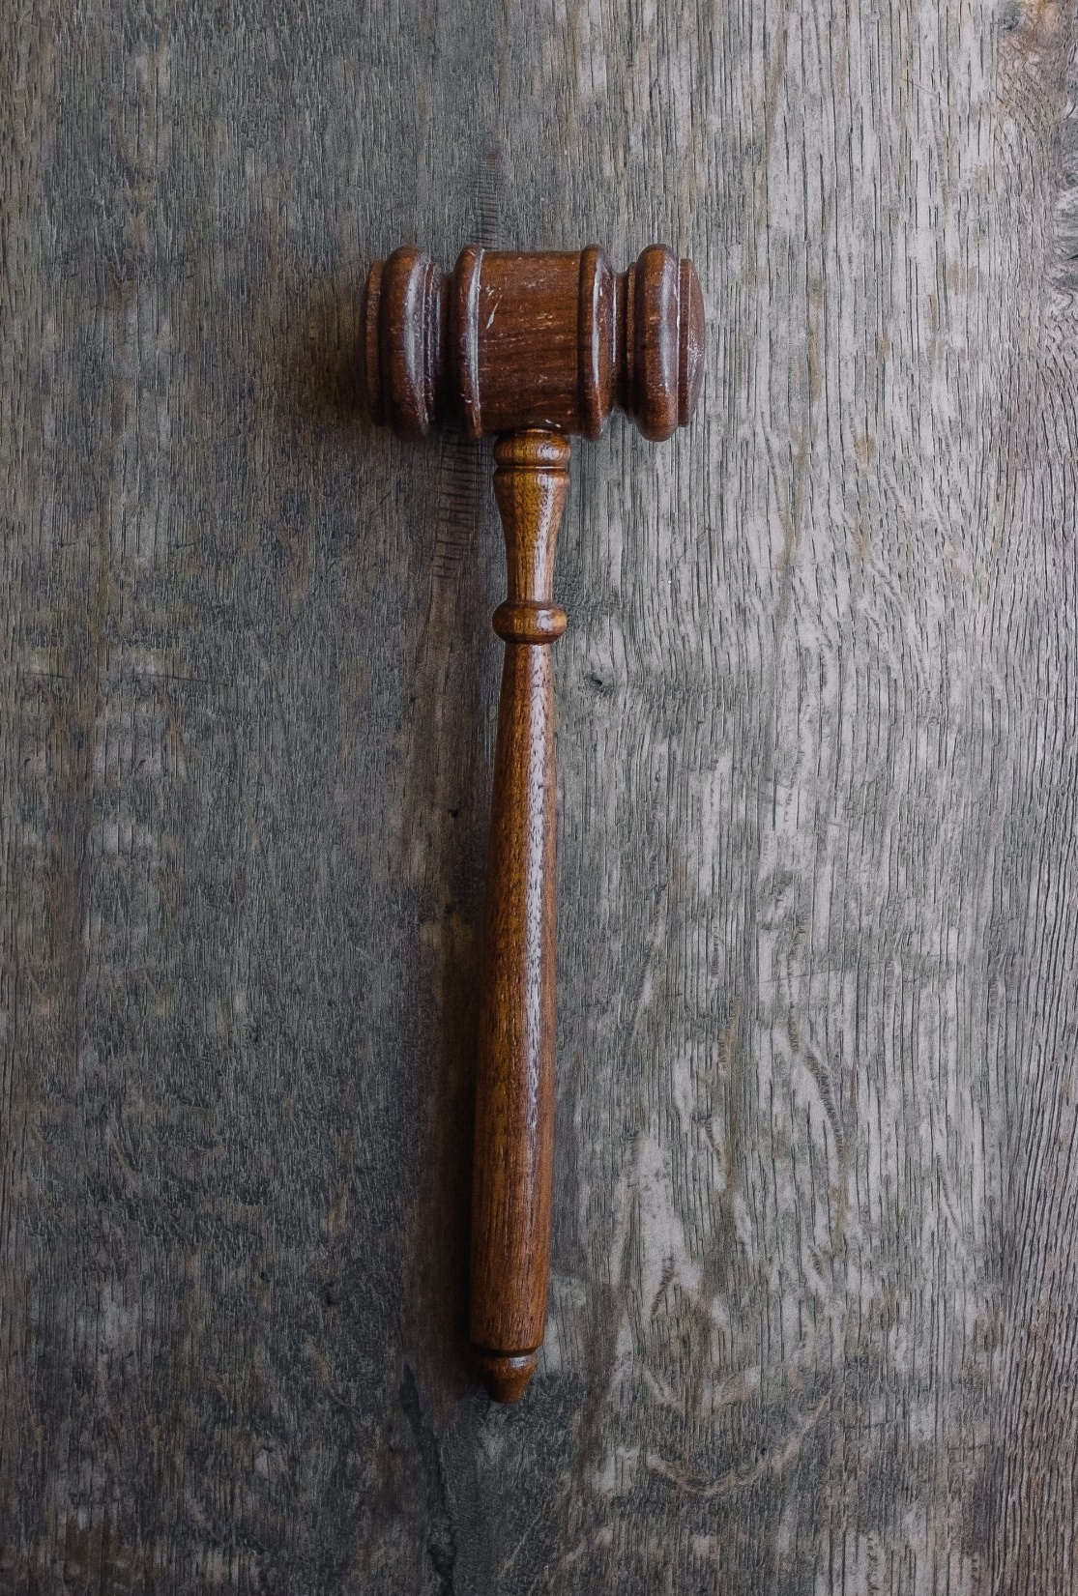
B. District Courts
A petit jury, or trial jury, then hears a case and decides its outcome.
The district courts hear about 85% of the federal judicial workload each year.
Notes:
Photo by Wesley Tingey on Unsplash
https://unsplash.com/photos/9z9fxr_7Z-k

Slide 17
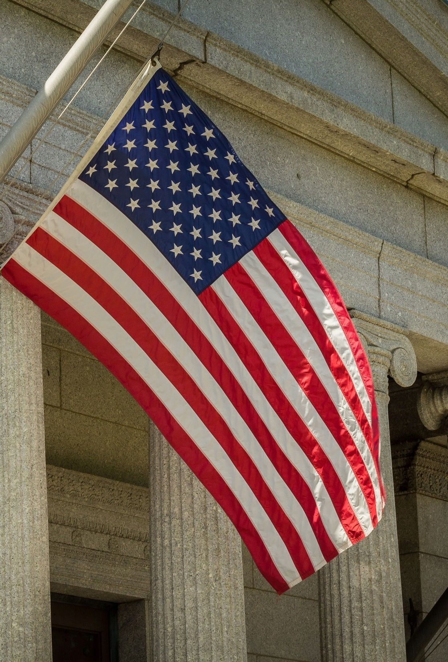
C. Circuit Courts of Appeals
The circuit courts of appeals are the second tier of the federal judicial system.
Today, there are thirteen circuit courts of appeals.
Notes:
Photo by Bonnie Kittle on Unsplash
https://unsplash.com/photos/2ERdMv4LGm8

Slide 18
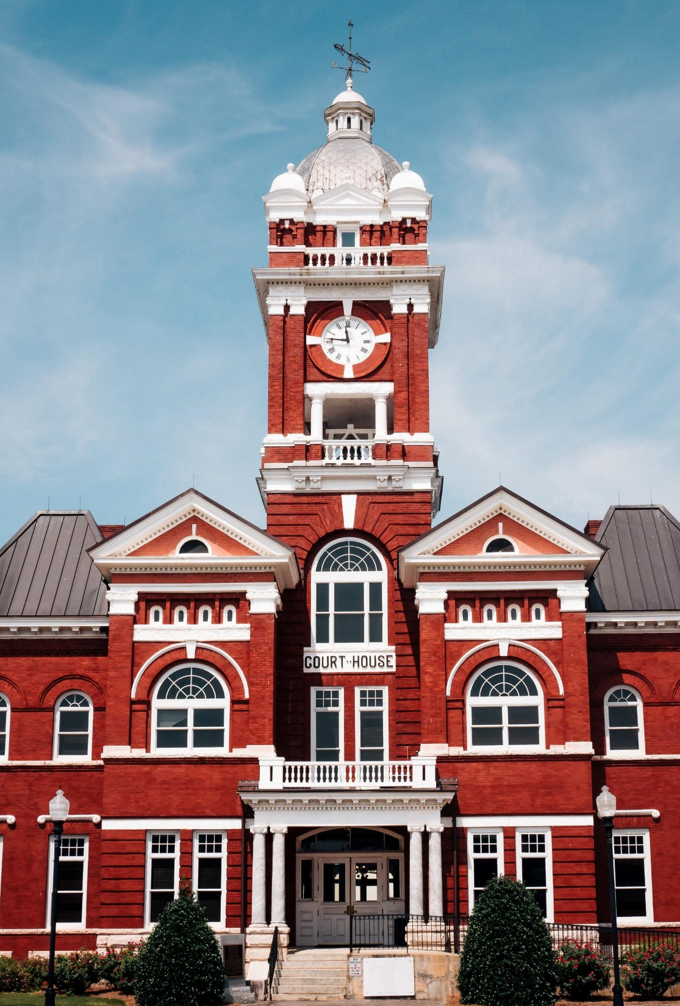
C. Circuit Courts of Appeals
Circuit courts of appeals have appellate jurisdiction – they do not hold trials but only hear appeals from the district courts.
Circuit-court judges usually sit in rotating panels of three and decide most cases based on written briefs, although occasionally they sit en banc (as a group).
Notes:
Photo by Timothy L Brock on Unsplash
https://unsplash.com/photos/DsGM_TUN2h8

Slide 19
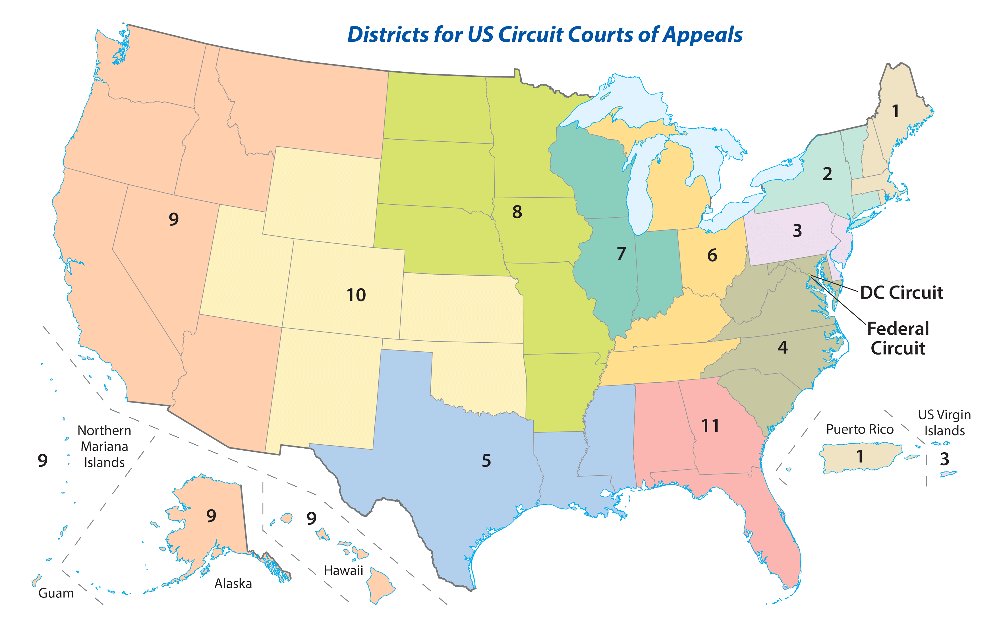
Notes:
BJU Press Art

Slide 20
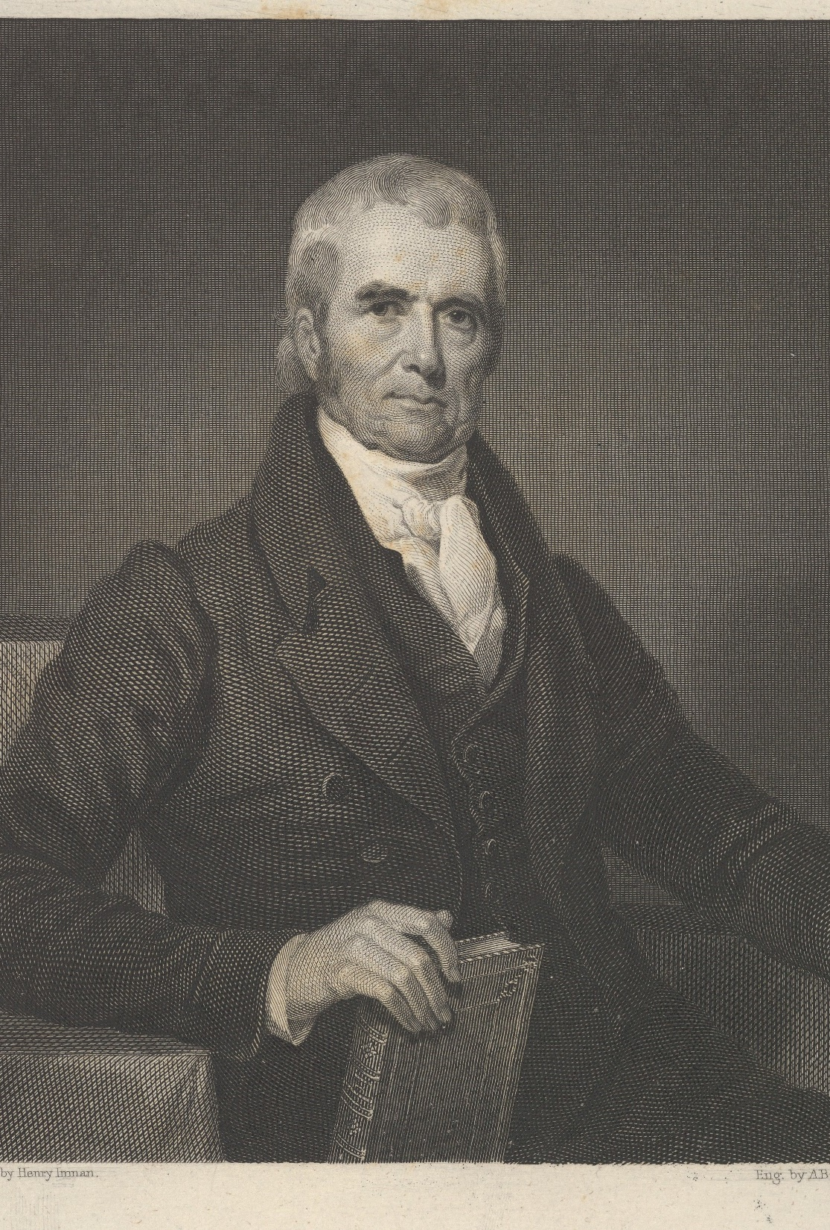
D. Supreme Court
The United States Supreme Court is the third and highest tier of the federal judicial system.
While initially weak and unimportant, the Court’s prestige gradually grew after John Marshall became chief justice in 1801.
Notes:
By Asher Brown Durand - This file was donated to Wikimedia Commons as part of a project by the Metropolitan Museum of Art. See the Image and Data Resources Open Access Policy, CC0, https://commons.wikimedia.org/w/index.php?curid=60889951
https://commons.wikimedia.org/w/index.php?sort=relevance&search=chief+justice+john+marshall&title=Special:Search&profile=advanced&fulltext=1&advancedSearch-current=%7B%7D&ns0=1&ns6=1&ns12=1&ns14=1&ns100=1&ns106=1&searchToken=1av8hp7ukpze68g0fhwxm09qx#%2Fmedia%2FFile%3AChief_Justice_John_Marshall_MET_DP837760.jpg

Slide 21
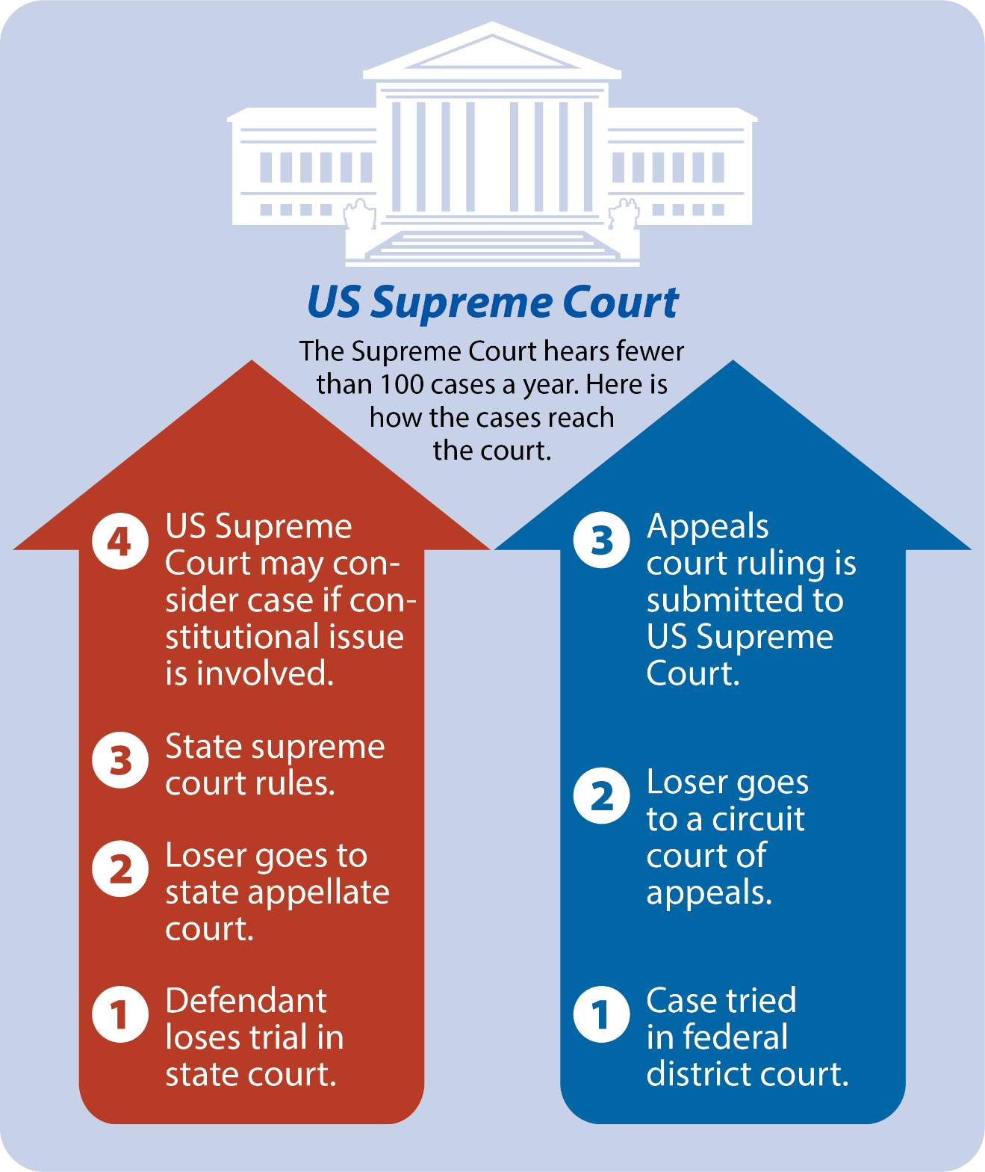
Notes:
BJU Press Art

Slide 22
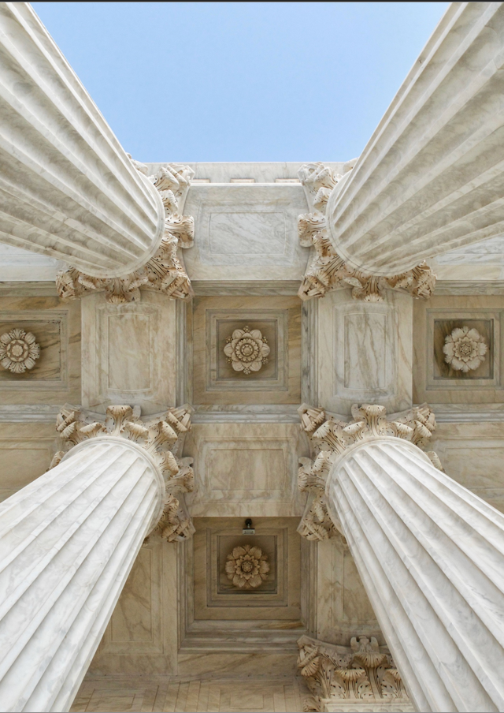
D. Supreme Court
Supreme Court judges are known as justices.
Since 1869, the Supreme Court has been composed of one chief justice and eight associate justices.
Notes:
Photo by Jesse Collins on Unsplash
https://unsplash.com/photos/ICXMkhRdquA

Slide 23
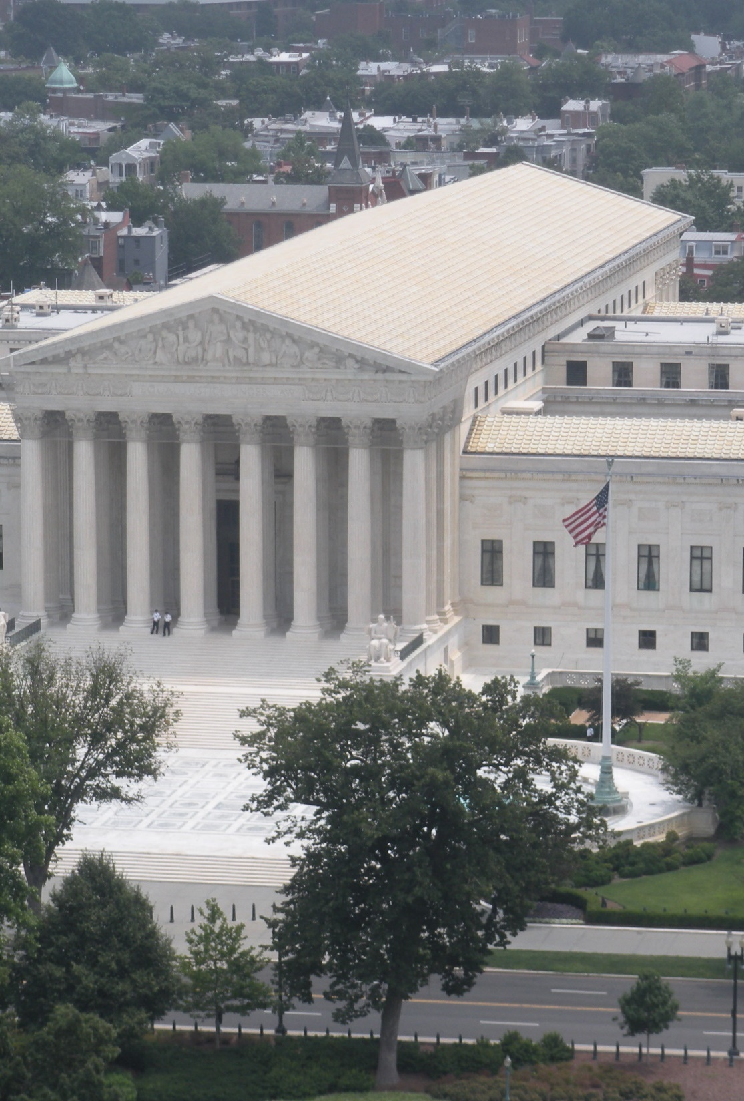
D. Supreme Court
Most cases come to the Supreme Court on writ of certiorari (“to be made more certain”) from the federal circuit courts and state supreme courts.
The Court only takes cases that lower courts have disagreed on or those that involve significant matters of public policy.
Notes:
By Philosophicalswag - Own work, CC BY-SA 3.0, https://commons.wikimedia.org/w/index.php?curid=16956225
https://commons.wikimedia.org/w/index.php?sort=relevance&search=Supreme+Court+of+the+United+States&title=Special:Search&profile=advanced&fulltext=1&advancedSearch-current=%7B%7D&ns0=1&ns6=1&ns12=1&ns14=1&ns100=1&ns106=1&searchToken=ejfpdkkrwacqoqc54g3xi1v5u#%2Fmedia%2FFile%3ASupreme_Court_of_the_United_States_-_Philosophical_Swag.jpg

Slide 24
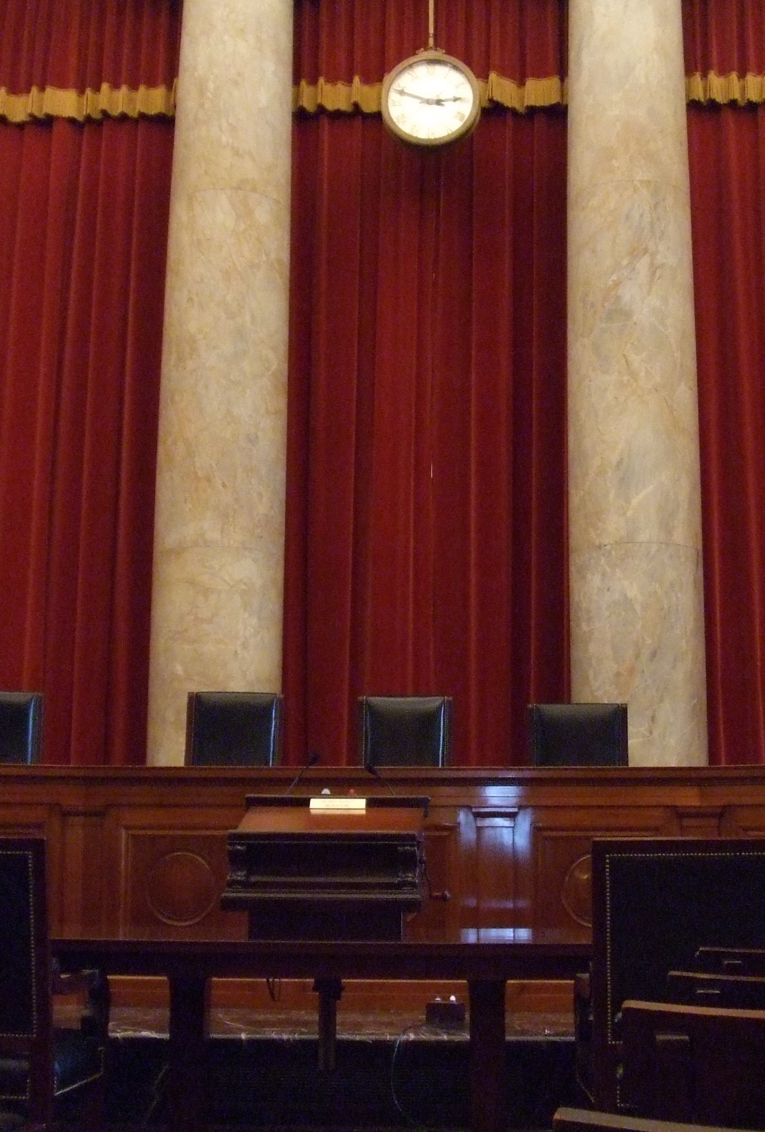
D. Supreme Court
Supreme Court sessions begin on the first Monday in October and continue through the following June.
A case is won by a simple majority vote of the justices.
If the chief justice votes with the majority, he (or someone he assigns) writes the majority opinion.
Notes:
By John L Marino - Transferred from en.wikipedia to Commons by Weatherman1126 using CommonsHelper., Public Domain, https://commons.wikimedia.org/w/index.php?curid=4287465
https://commons.wikimedia.org/w/index.php?sort=relevance&search=united+states+Supreme+Court+building&title=Special:Search&profile=advanced&fulltext=1&advancedSearch-current=%7B%7D&ns0=1&ns6=1&ns12=1&ns14=1&ns100=1&ns106=1&searchToken=1ary2bjzf9x987hv4aky5qxu1#%2Fmedia%2FFile%3AUssupremecourtinterior.JPG

Slide 25
D. Supreme Court
Justices on the losing side often issue dissenting opinions.
Justices who agree with the majority or the minority for different reasons than those presented in the decision or dissent may issue concurring opinions.
Notes:
By John L Marino - Transferred from en.wikipedia to Commons by Weatherman1126 using CommonsHelper., Public Domain, https://commons.wikimedia.org/w/index.php?curid=4287465
https://commons.wikimedia.org/w/index.php?sort=relevance&search=united+states+Supreme+Court+building&title=Special:Search&profile=advanced&fulltext=1&advancedSearch-current=%7B%7D&ns0=1&ns6=1&ns12=1&ns14=1&ns100=1&ns106=1&searchToken=1ary2bjzf9x987hv4aky5qxu1#%2Fmedia%2FFile%3AUssupremecourtinterior.JPG

Slide 26
Section Review – Chapter 14.2
1. Define judicial federalism.
a system of coexisting state and federal courts (p. 338)
2–4. Identify the three tiers of federal courts.
district courts, circuit courts of appeals, and the Supreme Court (pp. 339–341)

Slide 27
Section Review – Chapter 14.2
5–6. Distinguish between the work of a grand jury and a petit jury.
A grand jury is a panel of citizens who considers the prosecution’s case against the accused and determines whether there is enough evidence against the accused to warrant a jury trial to determine guilt or innocence. A petit jury, or trial jury, is used to hear a case and decide its outcome. (pp. 339–340)

Slide 28
Section Review – Chapter 14.2
7–9. Describe the three kinds of opinions that a Supreme Court justice may write about a decided case.
A majority opinion is written to justify and explain the decision. A dissenting opinion is written by a judge who wants to explain why he rejects the majority position. A concurring opinion is written by a judge who agrees with the majority opinion but for reasons different from those presented in the majority opinion. (p. 343)

Slide 29
Section Review – Chapter 14.2
Why do few cases reach the Supreme Court?
Congress gave the Supreme Court the authority to choose which cases and what issues it wants to decide.

Slide 30
Section Review – Chapter 14.2
Do you think the Supreme Court should listen to more cases each year? Explain your answer.
Some may agree that the Supreme Court should be able to decide the number of cases it takes to keep its workload manageable and thus should limit the number of cases they consider. Others may say the Supreme Court should be willing to hear additional cases because there are many that involve issues of national importance that are never considered.

Slide 31
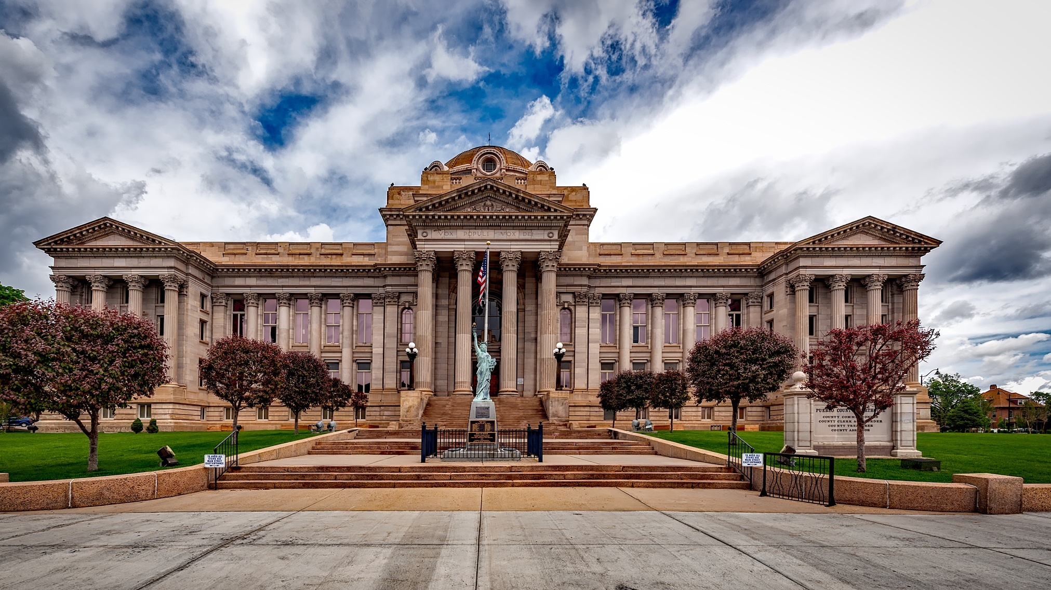
III. Selection of Judges
Chapter 14.3
Notes:
Image by David Mark from Pixabay
https://pixabay.com/photos/pueblo-colorado-courthouse-city-1680297/

Slide 32
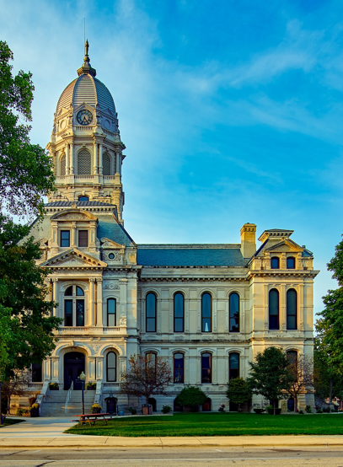
A. State Judges
State judges are chosen in three basic ways:
  Popular election
  Appointment by the governor
  Appointment by the legislature
Notes:
Image by David Mark from Pixabay
https://pixabay.com/photos/courthouse-kosciusko-county-indiana-1933325/

Slide 33
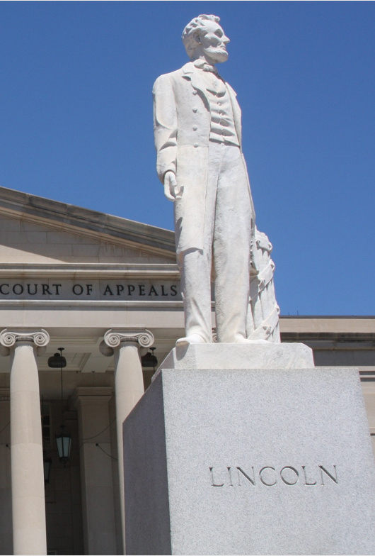
A. State Judges
States that allow the governor to choose state judges often restrict his power in some way.
The Missouri Plan requires that the governor choose a candidate from a list and that nominee must then face an election after taking office.
Notes:
https://pixabay.com/photos/lincoln-statue-historic-courthouse-2705001/; pixabay/CC0

Slide 34
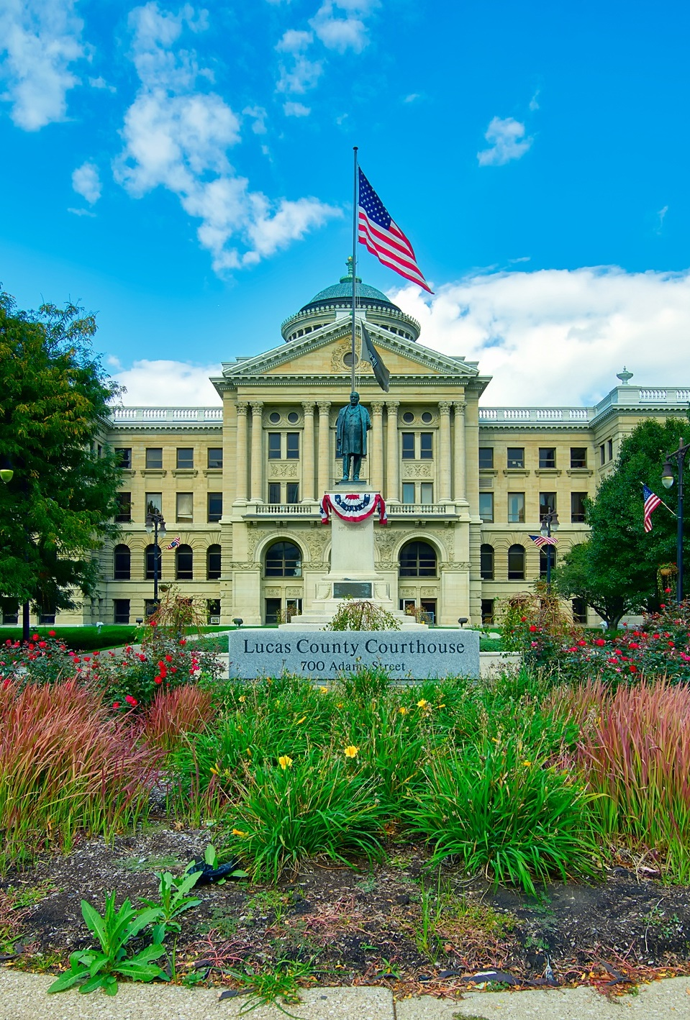
A. State Judges
Most state judges serve terms ranging from four to twelve years.
Most states have mandatory retirement ages ranging from seventy to seventy-five years old.
Notes:
Image by David Mark from Pixabay
https://pixabay.com/photos/lukas-county-courthouse-toledo-ohio-1937446/

Slide 35
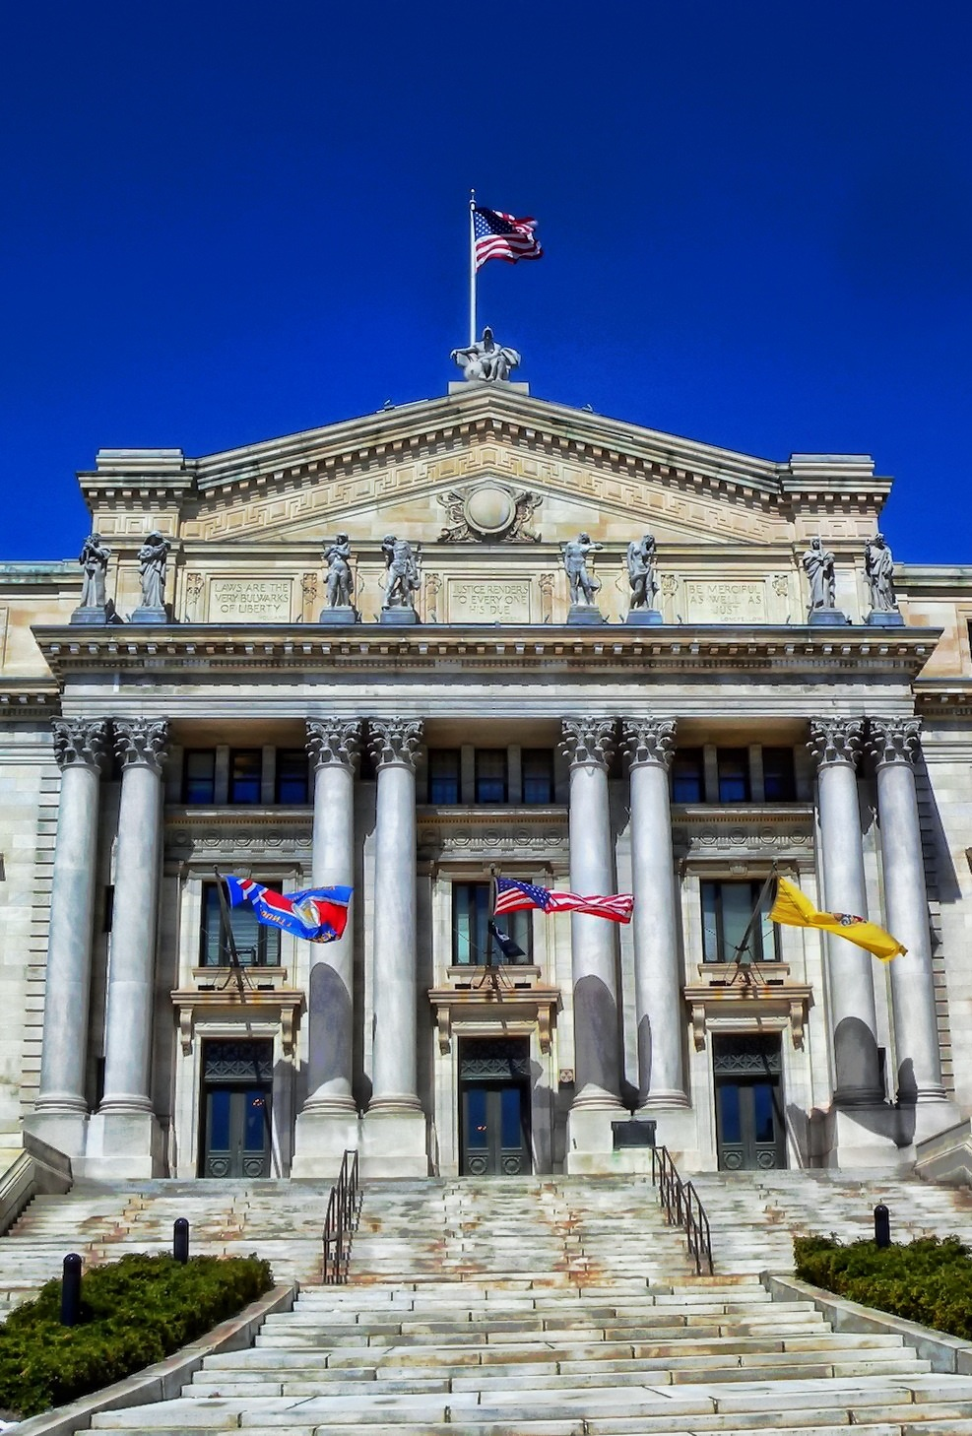
B. Federal Judges
Presidents almost always select judges from their own political party.
The unwritten tradition of senatorial courtesy allows the senator from the nominee’s home state to block their approval.
Notes:
Image by David Mark from Pixabay
https://pixabay.com/photos/courthouse-essex-county-new-jersey-373961/

Slide 36
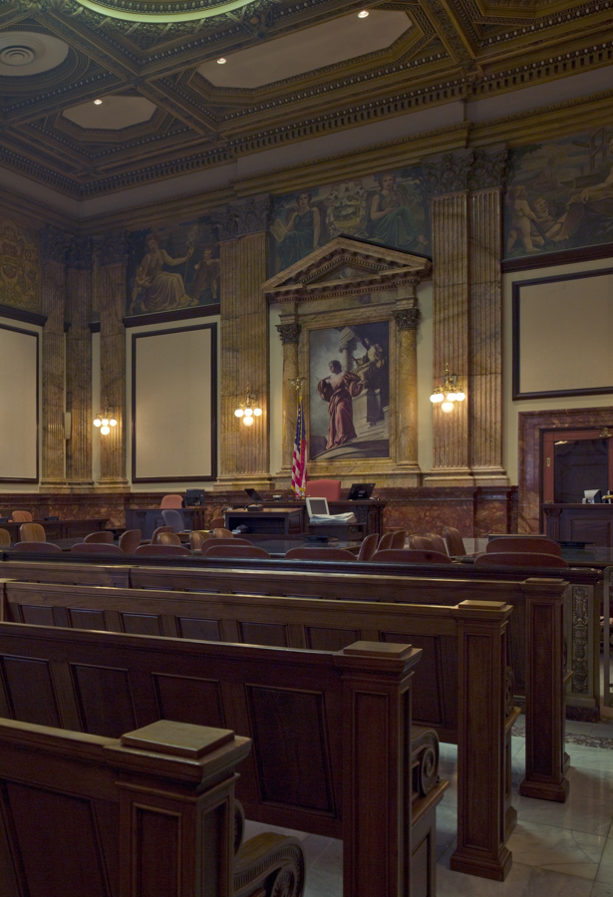
B. Federal Judges
Supreme Court nominees are rare and very important.
The president will often consider gender and ethnicity in selecting a nominee.
Today, increased politicization of the confirmation process for judges has slowed down the process of selecting judges.
Notes:
By Carol M. Highsmith - Library of CongressCatalog: http://lccn.loc.gov/2010719398Image download: https://cdn.loc.gov/master/pnp/highsm/10500/10541a.tifOriginal url: http://hdl.loc.gov/loc.pnp/highsm.10541, Public Domain, https://commons.wikimedia.org/w/index.php?curid=50969427
https://commons.wikimedia.org/w/index.php?sort=relevance&search=birch+bayh+federal+building&title=Special:Search&profile=advanced&fulltext=1&advancedSearch-current=%7B%7D&ns0=1&ns6=1&ns12=1&ns14=1&ns100=1&ns106=1&searchToken=6fgxhayy9i7sdpotmtaynx2oc#%2Fmedia%2FFile%3AEast_courtroom%2C_Birch_Bayh_Federal_Building%2C_Indianapolis%2C_Indiana_LCCN2010719398.tif

Slide 37
B. Federal Judges
Even after a nominee is confirmed, there is no guarantee that the new justice will push the Court in the direction the president intended.
Notes:
By Carol M. Highsmith - Library of CongressCatalog: http://lccn.loc.gov/2010719398Image download: https://cdn.loc.gov/master/pnp/highsm/10500/10541a.tifOriginal url: http://hdl.loc.gov/loc.pnp/highsm.10541, Public Domain, https://commons.wikimedia.org/w/index.php?curid=50969427
https://commons.wikimedia.org/w/index.php?sort=relevance&search=birch+bayh+federal+building&title=Special:Search&profile=advanced&fulltext=1&advancedSearch-current=%7B%7D&ns0=1&ns6=1&ns12=1&ns14=1&ns100=1&ns106=1&searchToken=6fgxhayy9i7sdpotmtaynx2oc#%2Fmedia%2FFile%3AEast_courtroom%2C_Birch_Bayh_Federal_Building%2C_Indianapolis%2C_Indiana_LCCN2010719398.tif

Slide 38
Section Review – Chapter 14.3
1–3. Identify three ways that state judges are chosen.
State judges are chosen by popular election (the vote of the people), appointment by the governor, or appointment by the legislature. (p. 345)
4–5. Distinguish between partisan and nonpartisan elections.
In a partisan election, a candidate runs as a member of a political party. In a nonpartisan election, a candidate runs without a party label. (p. 344)

Slide 39
Section Review – Chapter 14.3
6. Explain the Missouri Plan.
In the Missouri Plan, the governor appoints a judicial candidate from a short list nominated by a judicial commission. The new judge assumes office but then must be approved by voters in a later election, usually a year or more later. No opposition is allowed; the voters can only approve or disapprove of the
new judge. (p. 346)

Slide 40
Section Review – Chapter 14.3
7. How has the judicial confirmation process changed in recent decades?
Until recent decades, nominees to district and circuit court positions normally met only token resistance in the Senate. But today the increased politicization of the confirmation process and the importance (or near finality) of decisions made at the circuit-court level have led to Senate challenges, filibusters, and foot-dragging on presidential nominees to federal courts. Supreme Court nominees are subjected to the most scrutiny. (p. 349)

Slide 41
Section Review – Chapter 14.3
Do you think federal judges should serve for life? Explain your answer.
Some will favor judges serving for life, citing reasons such as protection from political pressure and the benefit of judges having long years of experience. Some will oppose, citing that judges might be tempted to continue in office even after they have clearly become mentally or physically unfit to serve.

Slide 42
Section Review – Chapter 14.3
How did Robert Bork’s nomination become a milestone in the confirmation process?
In the Bork confirmation hearings, liberal senators were candid in their determination to not allow a seat on the Supreme Court to go to a staunch conservative like Bork. Bork was the last Supreme Court nominee to fully discuss his legal views during a Senate hearing; other nominees have had meager paper trails and tend to shroud their true beliefs in mystery or have avoided questions during the hearings about political ideology.

Slide 43
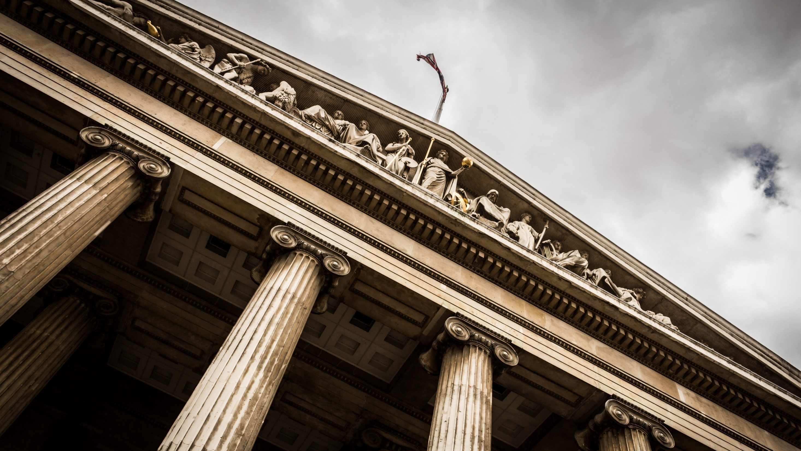
IV. Constitutional and Legal Change
Chapter 14.4
Notes:
Photo by Sebastian Pichler on Unsplash
https://unsplash.com/photos/bAQH53VquTc

Slide 44
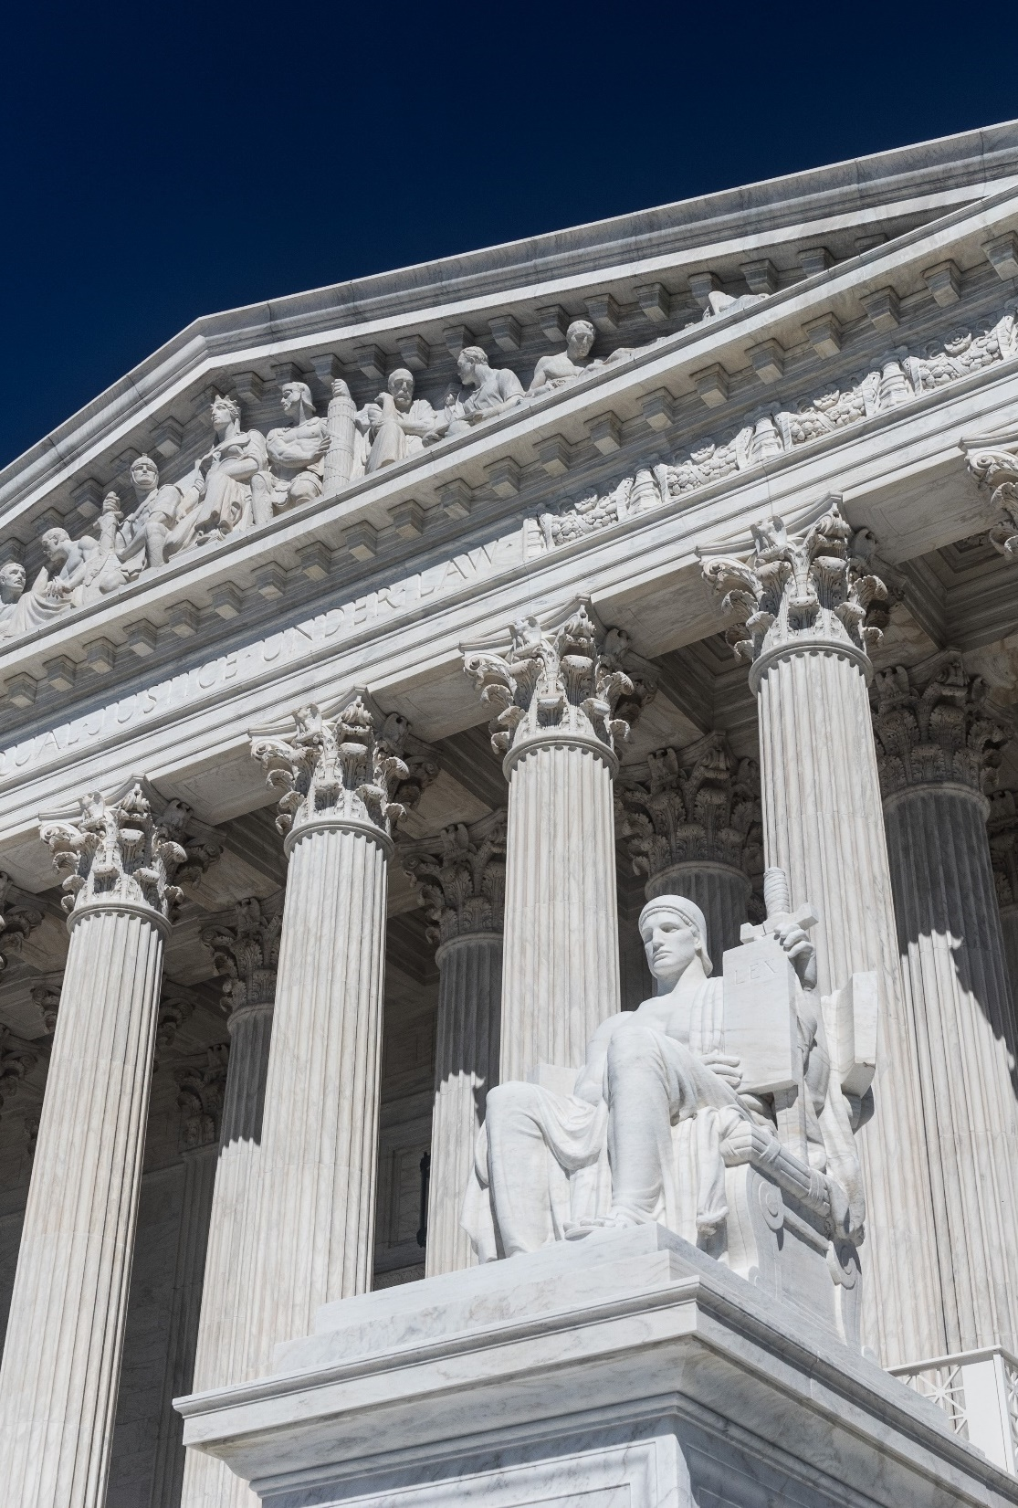
IV. Constitutional and Legal Change
In Marbury v. Madison (1803) the Supreme Court ruled that it possessed the power of judicial review.
Chief Justice John Marshall strongly believed in the supremacy clause and ruled in McCulloch v. Maryland that states could not tax federal institutions.
Notes:
Image by Mark Thomas from Pixabay
https://pixabay.com/photos/us-supreme-court-building-2225766/

Slide 45
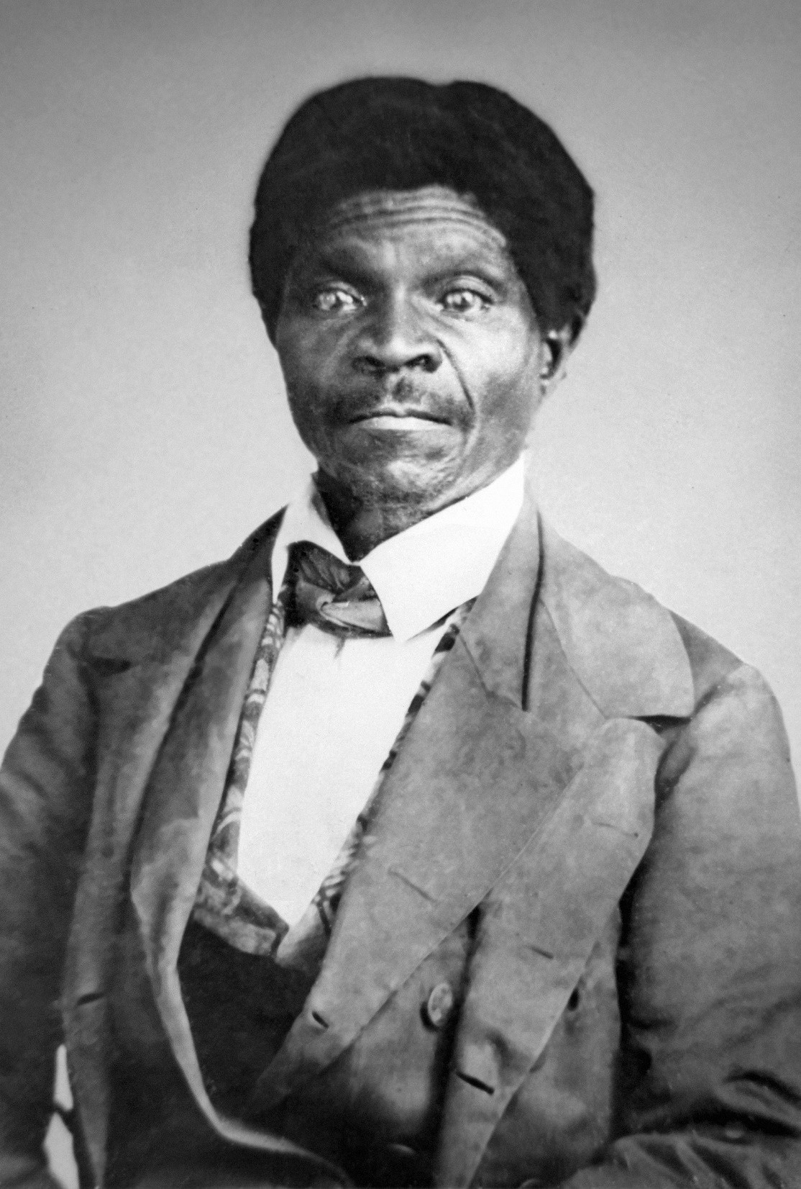
IV. Constitutional and Legal Change
This increase in judicial power indirectly enhanced the Dred Scott case (1857) which declared that African Americans could not be citizens.
The Supreme Court attempted to reduce discrimination but often ignored cases involving Black Americans.
Dred Scott
Notes:
By Uncredited - http://www.picturehistory.com/product/id/612#, Public Domain, https://commons.wikimedia.org/w/index.php?curid=24909488
https://commons.wikimedia.org/w/index.php?sort=relevance&search=Dred+Scott&title=Special:Search&profile=advanced&fulltext=1&advancedSearch-current=%7B%7D&ns0=1&ns6=1&ns12=1&ns14=1&ns100=1&ns106=1&searchToken=8ireri1xv3jvonqiy102jt5r1#%2Fmedia%2FFile%3ADred_Scott_photograph_%28circa_1857%29.jpg

Slide 46
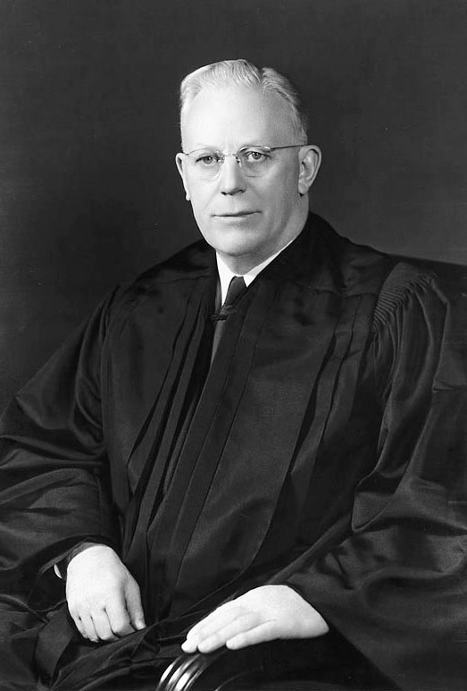
IV. Constitutional and Legal Change
Chief Justice Earl Warren led one of the most influential courts in US history.
Brown v. Board of Education of Topeka, Kansas called for an end to segregation in schools.
Chief Justice Earl Warren
Notes:
By Harris & Ewing photography firm - Scan of original print courtesy of the en:Harvard Law School Library Legal Portrait Project,[2] whose librarian was gracious enough to confirm this image's copyright status in e-mail to User:Postdlf., Public Domain, https://commons.wikimedia.org/w/index.php?curid=4352772
https://commons.wikimedia.org/w/index.php?sort=relevance&search=chief+justice+earl+warren&title=Special:Search&profile=advanced&fulltext=1&advancedSearch-current=%7B%7D&ns0=1&ns6=1&ns12=1&ns14=1&ns100=1&ns106=1&searchToken=adqnw26ldfnfj9bw39zq48ye5#%2Fmedia%2FFile%3AEarl_Warren.jpg

Slide 47
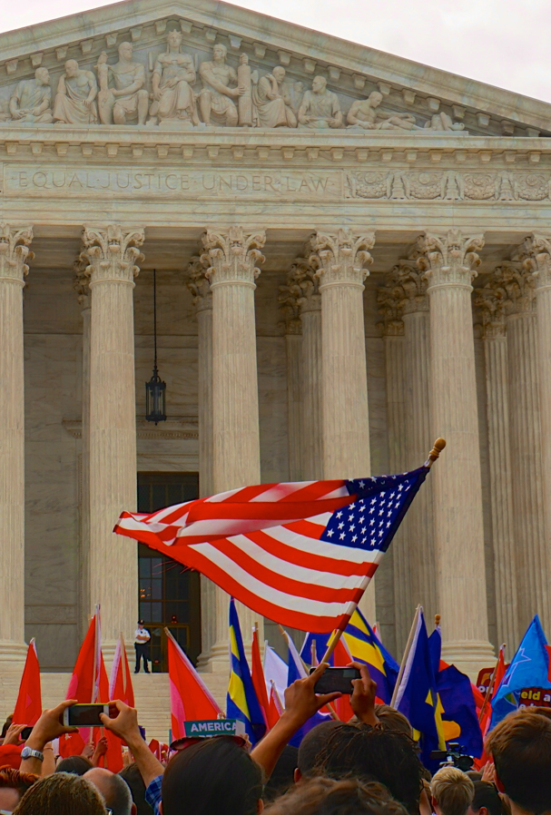
IV. Constitutional and Legal Change
The Court’s ruling in Roe v. Wade (1973) legalized abortion and created the “right to privacy.”
In Obergefell v. Hodges (2015) the Court ruled that all states must recognize same-sex marriages.
Notes:
By Ted Eytan from Washington, DC, USA - SCOTUS Marriage Equality 2015 58151, CC BY-SA 2.0, https://commons.wikimedia.org/w/index.php?curid=41225279
https://commons.wikimedia.org/w/index.php?sort=relevance&search=Obergefell+v.+Hodges&title=Special:Search&profile=advanced&fulltext=1&advancedSearch-current=%7B%7D&ns0=1&ns6=1&ns12=1&ns14=1&ns100=1&ns106=1&searchToken=6mtlfl8uvb2m80eawbjsw4m84#%2Fmedia%2FFile%3ASCOTUS_Marriage_Equality_2015_%28Obergefell_v._Hodges%29_-_26_June_2015.jpg

Slide 48
Section Review – Chapter 14.4
1. Why was the Marbury v. Madison decision so significant?
Marbury v. Madison established the concept of judicial review, whereby the Supreme Court determines whether government actions are constitutional. (p. 349)

Slide 49
Section Review – Chapter 14.4
2. Summarize Chief Justice John Marshall’s ruling in McCulloch v. Maryland.
State taxation of the second Bank of the United States was unconstitutional. Though chartering banks was not a power specifically granted to Congress in the Constitution, the chartering power could be implied from the necessary and proper clause. The Maryland law must therefore be unconstitutional because “the power to tax involves the power
to destroy.” (p. 349)

Slide 50
Section Review – Chapter 14.4
3–4. Contrast the philosophies of judicial restraint and judicial activism.
Advocates of judicial restraint argue that judges should apply only the clear statements of the Constitution to make their decisions. Judicial activists seek to correct injustices and shape policy even if it means departing from the clear meaning of the law. (p. 351)

Slide 51
Section Review – Chapter 14.4
Why was the Obergefell v. Hodges ruling significant?
Answers may include the ruling showed the continued decay in reliance on biblical principles from US judges and justices.

