Slide 1
Chapter 13: Russia

Slide 2
Russia
History and Government
From the Czars to the Present
Czarist Russia
Soviet Rule
Soviet Collapse
A Nation in Transition
Federation Government
Political Divisions
Branches of Government

Slide 3
Northern European Russia
Moscow
The Kremlin
Northwest Russia
St. Petersburg
Volga-Baltic Waterway
Karelia
Kola Peninsula

Slide 4
Southern European Russia
The Volga River
Middle Volga
Lower Volga
The Don River Basin
Russia’s Agricultural Heartland
Shipping
Caucasus Mountains

Slide 5
Asian Russia
Ural Mountains
Siberia
West Siberian Plain
Central Siberian Plateau
East Siberian Upland

Slide 6
Notes:
Cultural Geography, 4th edition, p. 313

Slide 7
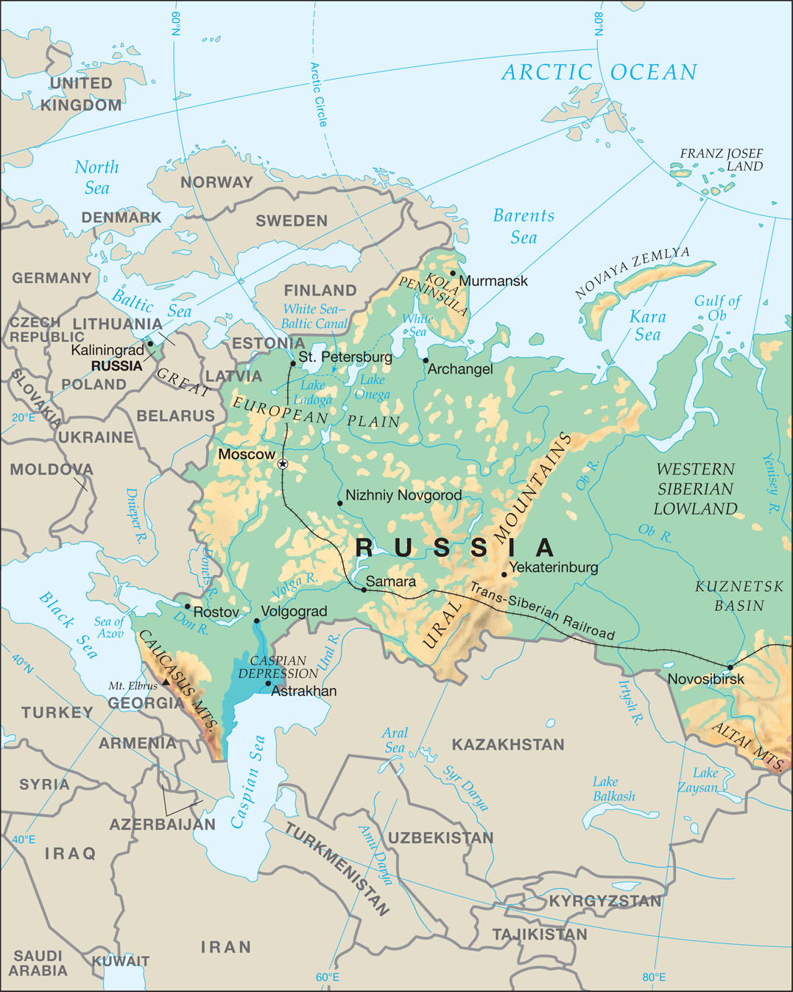
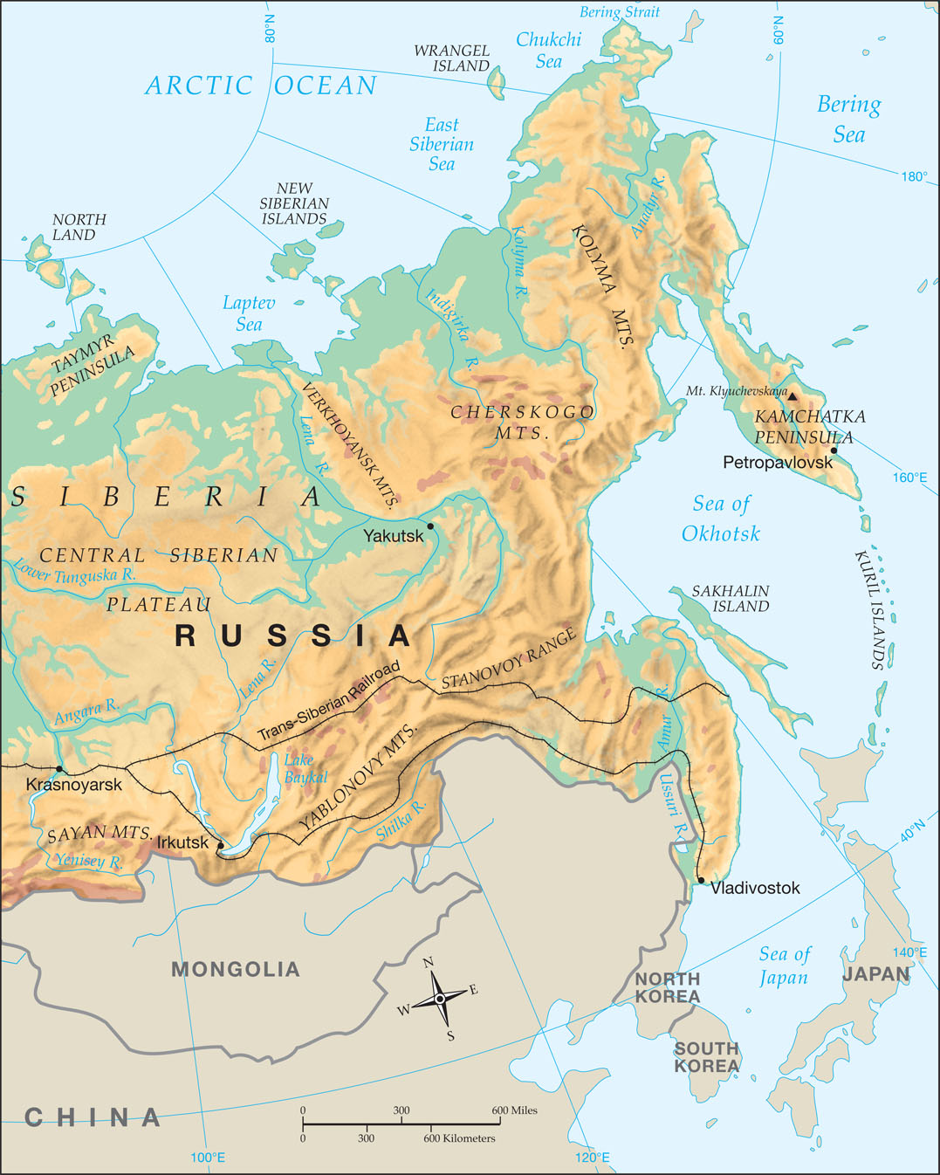
Notes:
Map Resources

Slide 8
History and Government

Slide 9
Introduction
With more than one-tenth of the world’s land area, Russia is easily the largest country on earth.
From east to west, Russia is approximately 4,800 miles across.
From north to south, Russia is about 1,850 miles.
Russia borders fourteen countries; the only other country to join Russia in this achievement is China.
These neighboring countries range from very stable to potentially explosive.
Russia has a vast wealth of natural resources.

Slide 10
Perhaps Russia’s greatest obstacle is its Soviet past.
Russia was the largest part of the Union of Soviet Socialist Republics for most of the twentieth century.
The Soviets misused many of Russia’s physical and human resources.
Despite its size, Russia has only a handful of ports that are ice-free the whole year.
The lack of warm-water ports has influenced Russian foreign policy historically.

Slide 11
History and Government
Russia looks both east and west.
Its culture has borrowed elements from both—the authoritarianism of Asia and the longing for individual rights in Europe.
The Great European Plain, which has played a major role in European history, extends into Russia and has played a decisive role there as well.
Like the countries of Eastern Europe, Russia has suffered under the heel of many Asian tribes, including Scythians, Huns, and Slavs.

Slide 12
Czarist Russia
A total of twenty-four czars (also spelled tsars ) ruled Russia from 1547 to 1917.
The czars and czarinas (female rulers) were autocrats; they had no established limits on their authority and power.
During World War I under the last czar, Nicholas II, Russia experienced humiliating defeats.
In the resulting confusion, Vladimir Ilich Lenin led the Russian Revolution in 1917 and executed the last czar the following year.

Slide 13
Soviet Rule
In 1922, Lenin created the Union of Soviet Socialist Republics (USSR).
This union gave limited power to several “republics.”
Communists claimed Russia was no longer an empire but a land of equals.
Joseph Stalin, Lenin’s brutal successor, extended the empire deeper into Europe than any czar could have dreamed possible.
After a secret agreement with Adolf Hitler, Stalin seized Moldova, Lithuania, Latvia, and Estonia in 1940, bringing the total number of Soviet republics to fifteen.
After the defeat of Hitler during World War II, Stalin extended the “Iron Curtain,” the area under Soviet control, to lands as far west as Germany.

Slide 14
After World War II, the USSR (also known as the Soviet Union) was in competition with the Western Allies.
Soon the competition involved primarily the USSR and the United States.
As the USSR expanded Communist influence, the United States sought to limit this expansion.
Both powers built up weapon arsenals, including nuclear weapons.
Both the United States and the USSR feared that the other power would attack.
This period was known as the Cold War.

Slide 15
Soviet Collapse
By the 1980s the Soviet economy lagged far behind the West.
Soviet premier Mikhail Gorbachev instituted the reforms known as perestroika (pehr ih STROY kuh), or “restructuring,” and glasnost (GLAHS nawst), or “openness.”
The whole system collapsed in 1991, as the leaders of the various republics declared independence.
Boris Yeltsin, the president of the largest republic—Russia—joined the others.
By December 25, Gorbachev was a ruler without a country, and he quietly resigned.

Slide 16
In the place of the Soviet Union, Yeltsin formed the Commonwealth of Independent States (CIS) to retain economic ties among the former Soviet states.
Yeltsin’s tenure was marked by political and economic turmoil, and those conditions (along with declining health) led to his resignation in 1999.
His successor Vladimir Putin, increased the power of the president and moved Russia back toward a more centralized government.

Slide 17
A Nation in Transition
The Soviets were poor stewards of the rich resources that Russia contained.
This misuse has left the country in ruins, with deteriorating buildings, antiquated machinery, and polluted lakes and rivers.
A major concern among Russians is the strength of criminal elements.
Although it has declined by about half in recent years, the murder rate in Russia is 10.2 per hundred thousand people, double the rate of the United States.

Slide 18
Federation Government
Russia is experiencing problems of devolution, a passing down or “de-evolution” of power.
Under the Soviet Union, Moscow regulated everything.
With the breakup, Moscow has shifted some responsibilities to local governments.

Slide 19
Political Divisions
Whereas the United States has states as its main political divisions, Russia has many different names for these divisions.
An oblast is a large region or administrative district similar to a state or province. Russia has fifty of these.
There are also ten large, sparsely populated areas, mostly in the north, that are called okrugs (areas).
Moscow and St. Petersburg stand alone as Russia’s two federal cities.
Russia also has six krais, or territories, governed by Moscow.
Over thirty ethnic minorities have their own districts and have signed treaties with the government that give them a measure of self-rule.

Slide 20
The twenty-one autonomous republics (autonomous means “self-ruling”) have the most population, power, and status.
To deal with this difficulty, Putin grouped the various political divisions into seven federal districts based on geography.

Slide 21
Notes:
Map Resources

Slide 22
Branches of Government
The United States has had various levels of government throughout its history—each with its own clearly defined responsibilities and taxing powers.
In contrast, the Russian government has generally been centralized throughout its history.
In 1993, the people voted for a new constitution, which separated powers among three branches of government.
The new country is called the Russian Federation.
Most of the power resides in the executive branch.
The executive branch is led by a president, but there is no vice president.

Slide 23
Instead, the president chooses a premier with the consent of the State Duma.
The government is run by the premier and cabinet.
In the event that the president dies, the premier takes charge until the next election, which must be held within three months.
In 1996, each oblast began electing its own governor.
In 2005, Putin gained the authority to appoint the governors in lieu of elections.
The Federation Assembly, the legislature, is divided into two houses.
Russia’s judicial branch of government has a Supreme Court that functions much like the Supreme Court of the United States.

Slide 24
What religion is dominant in Russia?
Russian Orthodox
What was the title of those who ruled Russia for over 350 years before the Russian Revolution?
czar (or tsar)

Slide 25
3. What kind of government did Lenin initiate?
centralized socialism (or Communist)
What was Putin’s solution to the problem of administrating the various political divisions throughout Russia?
to group the various political divisions into seven federal districts

Slide 26
Why has Russia sought a warm-water port throughout its history?
It has only a few ports that remain ice-free year-round.

Slide 27
Northern European Russia

Slide 28
Northern European Russia
Moscow
The Kremlin
Northwest Russia
St. Petersburg
Volga-Baltic Waterway
Karelia
Kola Peninsula

Slide 29
Moscow
With about 11.5 million people, Moscow is the largest city in all of Europe.
Its architecture, landmarks, galleries, and theaters display the great achievements of Russian culture.
Moscow is colder than most capitals of Europe.
Moscow lies in the center of Moscow Oblast.
Moscow and several other oblasts compose the Central Federal District.

Slide 30
Notes:
iStock.com/yulenochekk

Slide 31
Notes:
iStock.com/yulenochekk

Slide 32
The Kremlin
The Kremlin is a massive fortress at the heart of Moscow.
Many kremlins (walled enclosures) are located throughout Russia, but the one in Moscow has special significance.
The highest building in the Kremlin, the onion-domed Bell Tower of Ivan the Great, is more than 260 feet tall.
Ivan recruited Italian architects from the West to build the Palace of Facets, completed in 1491.
Outside the Kremlin is a large open area called Red Square.
Once a marketplace, it now hosts parades and public entertainment.
Lenin’s tomb stands outside the Kremlin wall in Red Square.

Slide 33
Northwest Russia
The northwest includes all of Russia’s European holdings north of Greater Moscow.
The climate permits dairy farms.
The main crop is flax, which is raised for both flaxseed oil and fiber.

Slide 34
St. Petersburg
Russia’s second-largest city and main port is St. Petersburg, with a population of over five million.
Peter the Great hired Italian architects to design the city.
St. Petersburg displays the unusual phenomenon of “white nights.”
No other city of over one million people is as far north as St. Petersburg (60˚N).
At such a high latitude, it has virtually no sunsets from the middle of June to early July.
During those days, for about five hours each day, the city has a whitish twilight instead of a sunset.
In contrast, the winter nights are long and dark.

Slide 35
Notes:
iStock.com/Delpixart

Slide 36
Volga-Baltic Waterway
In spite of its great size, Russia has very few good ports with access to oceans and world trade.
St. Petersburg’s importance was enhanced by the completion of the Volga-Baltic Waterway and an interior network of railroads in the nineteenth century.
Ships can reach inland to Moscow and beyond.
Improved in 1964, the waterway connects several rivers in the interior, including the outlets of Lake Onega and Lake Ladoga.
Located east of St. Petersburg, these two lakes are the largest in Europe.

Slide 37
Karelia
Karelia is a flat glaciated plain north of St. Petersburg.
Karelians are much like the neighboring Finns in language and culture.
However, because of Russian dominance in the region, ethnic Karelians now constitute only a small part of the population.
With the completion of the White Sea-Baltic Canal in 1939, Russia successfully linked Karelia’s Arctic coast to St. Petersburg.
The 141-mile canal links the White Sea to the Volga-Baltic Waterway.

Slide 38
Kola Peninsula
The Kola Peninsula lies north of Karelia.
Murmansk is the key Arctic port because the currents of the Barents Sea keep the port free of ice most of the year, and icebreakers break through even when there is ice.
Murmansk is north of the Arctic Circle and is the world’s northernmost large city.
The Barents Sea provides herring and cod, two of the world’s most important commercial fishes, as well as other fish.
The Kola Peninsula is sparsely inhabited by Lapps, who also live in Finland, but it has important mineral resources.
Russia is a leading producer of nickel.

Slide 39
What is the most important industrial area in Russia?
the Central Federal District, which includes Moscow and its vicinity
What is Russia’s main port?
St. Petersburg

Slide 40
3. What two canal systems link the northern ports with Moscow?
Volga-Baltic Waterway and White Sea-Baltic Canal
What Russian port is separated from the rest of the country?
Kaliningrad

Slide 41
St. Petersburg was called Leningrad during the Soviet era. Why do you think the name has been changed back?
Russia distanced itself from its Soviet past. Lenin fell out of favor, and the traditional names replaced the former Soviet names.

Slide 42
Southern European Russia

Slide 43
The Volga River
The Volga River is the longest river in Europe at 2,193 miles long.
Canals make it the hub of Russia’s shipping system.
Central Russia lies along the Upper Volga River.
Russia’s second great industrial area, the Greater Volga, includes most of the rest of the Volga and its major tributary, the Kama River.

Slide 44
Middle Volga
The Middle Volga extends from Nizhniy Novgorod to Samara.
Nizhniy Novgorod (NIZH-nee NAHV-guh-rod; formerly Gorki) is the third-largest city in Russia with over one and a half million people, while Samara ranks sixth with over one million people.
Novgorod was the first Russian city.
Ivan the Terrible became the first czar of Russia in 1547.
Though Ivan the Terrible conquered the Tatars and tried to destroy their culture, Tatars remain the most numerous ethnic minority in Russia.
Tatars compose about one-half of the population of Tatarstan, one of six Greater Volga republics.
Russia is one of the leading producers of petroleum in the world.

Slide 45
Lower Volga
The Lower Volga begins below Samara and flows to the Caspian Sea.
Volgograd, called Stalingrad during the Soviet era from 1925 until 1961, has about one million people.

Slide 46
The Don River Basin
The 1,224-mile-long Don River is second only to the Volga in importance.
Flowing south through a fertile region of Russia very similar to neighboring Ukraine, it loops east and then west before emptying into the Sea of Azov.
This important region includes part of the Donets Basin (also called the Donbas), Ukraine’s mineral-rich eastern territory.

Slide 47
Russia’s Agricultural Heartland
The Don drainage basin consists of grasslands called steppes (STEPS).
Rich in humus and nutrients, this productive land is called the Black Earth region of Russia.
The steppes are famous for the Cossacks, fiercely independent nomads whose place in Russian lore is very similar to that of the Plains Indians in America.
The semiarid climate of the steppes provides less than twenty inches of rain annually.
The Black Earth region helped make Russia the world’s fourth-largest producer of wheat in 2011.
Russia is also a leading producer of rye, oats, and barley.
The abundant grains make this area the “Breadbasket of Russia.”

Slide 48
Shipping
The vital port at the mouth of the Don is Rostov (or Rostov-on-Don).
Much of the Don is shallow, but large ships sailing on the Black Sea can reach over three hundred miles upriver to the Volga-Don Canal.
The Volga-Don Canal links the Don with the Volga.
Completed in 1952, this sixty-three-mile-long canal with thirteen locks is Russia’s final link in its European shipping system.
Ships from Moscow can now reach any Russian port in Europe.

Slide 49
Notes:
Map Resources

Slide 50
Caucasus Mountains
The Caucasus Mountains divide Europe from Asia between the Black Sea and the Caspian Sea.
Catherine the Great conquered this area, which lies south of the Don and Volga Rivers.
The Russian part of the region consists of two large krais (territories) and eight autonomous republics.
The name Caucasian republics generally refers to these eight republics of the Caucasus region.
The mountains along the southern border are the highest in Europe.
The highest of these is Mount Elbrus (18,510 ft.).

Slide 51
The greatest challenge to the Russian Federation came from a small republic called Chechnya.
When the Soviet Union broke apart in 1991, the Chechens took the opportunity to secede from the Russian Federation.
In 1994, Yeltsin made a fateful decision to send in his army, but the campaign was a disaster.

Slide 52
What is Europe’s longest river?
Volga River
Name two ethnic republics where descendants of the Tatars now live.
Tatarstan and Bashkortostan

Slide 53
3. What group of people had their cultural center near the mouth of the Don River?
Cossacks
In what range is the highest mountain in Europe found?
Caucasus Mountains

Slide 54
What ethnic republic in the Caucasus declared independence after the fall of the Soviet Union?
Chechnya

Slide 55
Why do you think so many ethnic minorities survived on the Volga, despite Russian conquest?
The ethnic minorities on the Volga developed the resources available to them to thrive and resist attacks by Russian armies.

Slide 56
Asian Russia

Slide 57
Asian Russia
Ural Mountains
Siberia
West Siberian Plain
Central Siberian Plateau
East Siberian Upland

Slide 58
Asian Russia
Russia’s supply of mineral and fuel resources is among the greatest in the world.
Deposits of almost every industrial mineral from aluminum (bauxite) to zinc are found in Russia.
Many of these resources, however, lie in remote parts of its vast Asian landmass.
Compared to European Russia, Asiatic Russia is sparsely populated with very few population centers.

Slide 59
Ural Mountains
The Ural Mountains form a geographic border between the continents of Europe and Asia.
The Ural Mountains are low with several passes that enable people to cross freely.
The southern Urals are more populous and have a unique culture.
Important industrial cities have grown up near the mineral resources.
Yekaterinburg and Chelyabinsk each have over one million people and rank as Russia’s fourth- and ninth-largest cities, respectively.

Slide 60
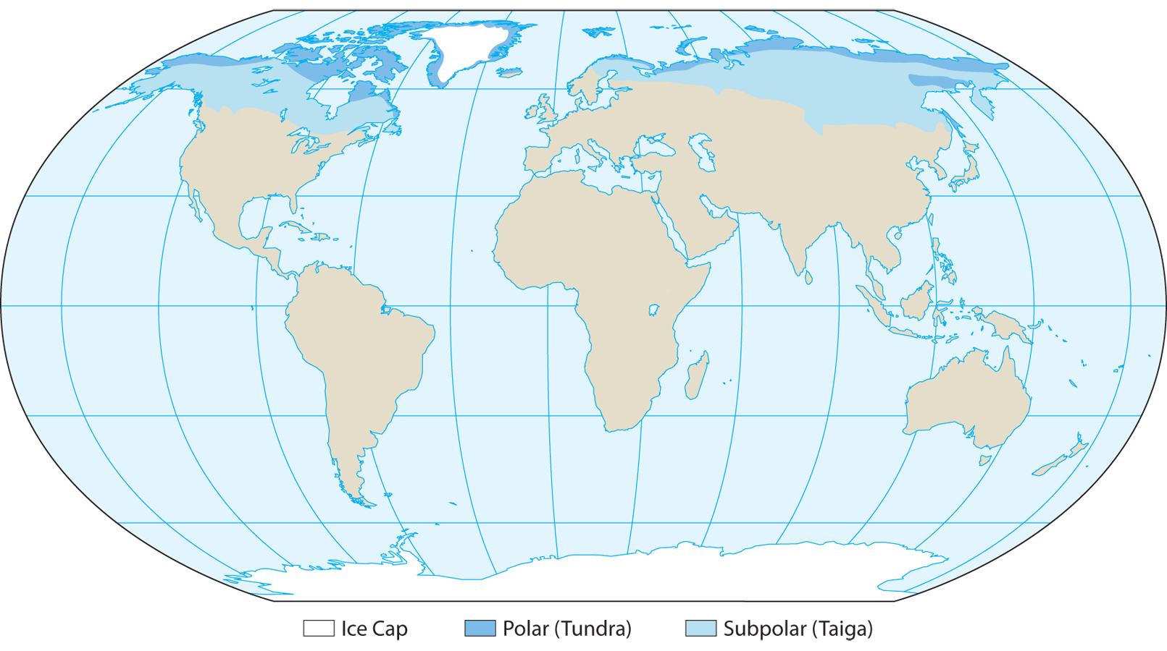
Notes:
Map Resources

Slide 61
Siberia
All of Asian Russia east of the Urals is broadly termed Siberia.
Russia’s interior has no east-west mountain ranges to block cold fronts that push down from the Arctic.
The taiga—great coniferous forests of spruce, pine, fir, and larch—is an important source of wood products.
Southwest and southeast Siberia, where most Siberians live, have a more hospitable climate similar to that of Moscow.
The Trans-Siberian Railway links these regions, resulting in a ribbon development.

Slide 62
West Siberian Plain
The West Siberian Plain is possibly the largest plain in the world and covers over one million square miles, amounting to about one-seventh of Russia’s area.
Extending from the Ural Mountains to the Yenisey River, it is a vast marshy plain drained by the Ob River and its tributaries.
The Gulf of Ob and the Kara Sea in the north remain frozen, while snow melts in the south.
The ice blocks the water flow, causing annual flooding along the Ob.
Novosibirsk (New Siberia), with about one and a half million people, is the largest city in Siberia.

Slide 63
Central Siberian Plateau
The Central Siberian Plateau covers one-third of Siberia and stretches between the Yenisey and Lena Rivers.
It averages about two thousand feet in elevation. The lower north coast, or Taymyr Peninsula, is the northernmost mainland area in the world.
The Trans-Siberian Railroad enters the central plateau at Krasnoyarsk, the largest city of the plateau with almost one million people, which lies on the Yenisey River.
Two ethnic republics of southern Siberia—Altaya and Tuva—retain their ethnic majority.
Remote Altaya is especially interesting because it is at the sensitive border between four large nations: Russia, China, Mongolia, and Kazakhstan.

Slide 64
Altaya contains Mt. Belukha (14,783 ft.), the highest peak of the Altai Mountains.
The mountainous republic also contains the headwaters of the Ob.
There are four Altaic republics in this region of Siberia.

Slide 65
East Siberian Upland
The East Siberian Upland is a mountain wilderness between the Lena River and the Pacific Ocean.
The Lena River is the eleventh-longest river in the world.
Interior
The largest Russian republic is Sakha (formerly Yakutia); it has the world’s harshest climate of any inhabited area.
Ethnic Yakuts speak a Turkic language and constitute over one-third of the population, while Russians constitute over one-half.
Growth has come from mining in the Yakutsk Basin along the Lena and in the mountains.

Slide 66
The Far East
Russia has more Pacific coastline than any other country.
The Pacific coast has a more moderate climate and includes some farmland.
The ports still freeze in winter, but some ports, such as Vladivostok, can be opened with ice breakers.
Russia’s Far East has land within a few miles of all the great Pacific powers.
Its land borders China and North Korea, while Japan is across a narrow channel from Russia’s Sakhalin Island (SAK uh leen).
Russia’s Kuril Islands also extend in a chain from the Kamchatka (kam CHAT kuh) Peninsula to Japan.

Slide 67
Notes:
Map Resources

Slide 68
The Far East
The United States (Alaska) is just across the Bering Strait.
The Trans-Siberian Railway links Vladivostok, Russia’s main Pacific port, with Russia’s European ports.
Two peninsulas dominate the far northern coast.
The Chukchi Peninsula reaches toward Alaska and divides the Bering Sea from the Chukchi Sea.
The Kamchatka Peninsula extends south into the Pacific.
Kamchatka contains twenty-nine active volcanoes, including Siberia’s highest peak, snow-capped Mount Klyuchevskaya (15,584 ft.).

Slide 70
What mountain range divides Europe and Asia and forms the western border of Siberia?
Ural Mountains
On what group of islands did the Soviets conduct nuclear testing?
Novaya Zemlya

Slide 71
3–5. What are the three major geographic regions of Siberia?
Western Siberian Plain, Central Siberian Plateau, and East Siberian Upland

Slide 72
6. What is the main seaport in Siberia?
Vladivostok

Slide 73
Why is Asiatic Russia so important to European Russia?
Almost all of Russia’s most important minerals for industrial production are found in Asian Russia.

Slide 74
People, Places, and Things to Know

Slide 75
czars
autocratic rulers of Russia from 1547 to 1917

Slide 76
autocrats
rulers who have no established limits on their authority or power

Slide 77
Vladimir Illich Lenin
led the Russian Revolution in 1917 and created the USSR

Slide 78
USSR
Union of Soviet Socialist Republics; created in 1922 by Lenin; gave limited power to several “republics”

Slide 79
Cold War
period after World War II during which both the USSR and the United States feared the other power would attack

Slide 80
CIS
Commonwealth of Independent States; Yeltsin formed this after the collapse of the USSR in 1991

Slide 81
devolution
passing down or “de-evolution” of power

Slide 82
oblast
large region or administrative district similar to a state or province

Slide 83
okrugs
large, sparsely populated areas of northern Russia

Slide 84
krais
territories governed by Moscow

Slide 85
autonomous republic
a self-governing republic

Slide 86
federal districts
political divisions of a large country, like Russia, based on geography

Slide 87
Federation Assembly
Russia’s legislature; divided into two houses

Slide 88
Supreme Court
Russia’s judicial branch of government; functions much like the Supreme Court of the United States

Slide 89
Moscow
largest city in all of Europe with 11.5 million people; capital of Russia

Slide 90
the Kremlin
the large walled fortress in Moscow that is the center of the government of Russia

Slide 91
Central Federal District
composed of Moscow and seventeen other oblasts; Russia’s most important industrial area

Slide 92
Peter the Great
important czar in Russian history; built St. Petersburg

Slide 93
St. Petersburg
Russia’s second-largest city and main port

Slide 94
Volga-Baltic Waterway
Russian waterway that connects several rivers

Slide 95
Karelia
flat glaciated plain north of St. Petersburg

Slide 96
White Sea-Baltic Canal
links Karelia’s Arctic coast to St. Petersburg

Slide 97
Kaliningrad
the only other Russian port besides St. Petersburg on the Baltic Sea

Slide 98
Kola Peninsula
peninsula in far northwestern Russia

Slide 99
Volga River
longest river in Europe at 2,193 miles

Slide 100
Nizhniy Novgorod
third-largest city in Russia

Slide 101
Tatarstan
one of six Greater Volga republics

Slide 102
Volgograd
called Stalingrad during the Soviet era from 1925 to 1961; Russia’s southern shipping hub

Slide 103
Cossacks
fiercely independent nomads; name comes from the Turkic word Kazakh, or “adventurer”

Slide 104
Don River
Russian river second only to the Volga in importance; 1,224 miles long

Slide 105
steppes
a rolling grassland area, particularly of Central Asia and Eastern Europe

Slide 106
Black Earth
productive land rich in humus and nutrients

Slide 107
Volga-Don Canal
links the Don River with the Volga River

Slide 108
Mount Elbrus
highest mountain in Europe

Slide 109
Ural Mountains
mountain chain that forms a geographic border between the continents of Europe and Asia

Slide 110
Yekaterinburg
Russia’s fourth-largest city

Slide 111
Siberia
term for all of Asian Russia east of the Urals

Slide 112
Trans-Siberian Railway
connects the regions of southwest and southeast Siberia

Slide 113
Lake Baikal
deepest lake in the world

Slide 114
Novosibirsk
largest city in Siberia

Slide 115
Taymyr Peninsula
northernmost mainland area in the world

Slide 116
Altai Mountains
mountain range near Russia’s borders with Kazakhstan, China, and Mongolia; Mt. Belukha (14,783 feet) is the highest mountain in this range

Slide 117
Sakha
largest Russian republic; has the world’s harshest climate of any inhabited area

Slide 118
Yakutsk Basin
basin where mining takes place in the East Siberian Upland

Slide 119
Sakhalin Island
Russian island north of Japan

Slide 120
Kuril Islands
Russian islands that extend in a chain from the Kamchatka Peninsula to Japan

Slide 121
Bering Strait
strait that separates Russia from the United States

Slide 122
Vladivostok
Russia’s main Pacific port

Slide 123
Kamchatka Peninsula
Russian peninsula that extends into the Pacific; contains twenty-nine active volcanoes including Siberia’s highest peak

Slide 124
Mount Klyuchevskaya
Siberia’s highest peak at 15,584 feet

