Slide 2
The Civil War (1861–1865)
14

Slide 3
How did the North and South differ at the beginning of the Civil War?
What Civil War battles occurred in the East?
What Civil War battles occurred in the West?

Slide 4
What significant matters arose on the home front during the Civil War?
What strategies resulted in a Northern victory in the Civil War?

Slide 5
The Southern soldier heroically fought in the face of overwhelming odds; the Northern soldier pursued victory in the face of devastating casualties.

Slide 6
What were the causes of the Civil War?
How did the natural and human resources differ between the North and the South in the Civil War?

Slide 7
War of Brothers
Union vs. Secession
The nature of the Union was the central issue
Could a state voluntarily leave?
Still an open constitutional question
States’ rights view

Slide 8
The North argued that the Union must be preserved above all else; the South argued that the rights and liberties of the states must be preserved, even at the expense of the Union.

Slide 9
War of Brothers
Economics
Northern economy was largely industry and manufacturing
Southern economy was largely agriculture
Slavery was a significant part
North generally favored high tariffs
South generally opposed high tariffs

Slide 10
War of Brothers
Slavery
Part of the Southern culture
Important role in decision making
Most northerners did not want slavery to expand further
Only about one-quarter of Southern families owned slaves

Slide 11
Northern opposition to slavery was seen as interference with the core of Southern society.

Slide 12
War of Brothers
Concerns
The people of each section did not all have uniform sympathies and motives
Robert E. Lee chose to fight for his state
Extremism and fanaticism

Slide 13
When it came to comparing the resources of the North and the South, the North had substantial advantages.

Slide 14
War of Brothers
Resources
The North had more than twice the population of the South
Many in the South were slaves
The North produced much more food than the South
Cotton and tobacco in the South

Slide 15
War of Brothers
The North had many more factories and industrial workers
The North had twice the railroad mileage of the South

Slide 16
War of Brothers
Leaders
In the early years of the war, the South had an advantage
Especially obvious in the eastern campaigns

Slide 17
War of Brothers
Strategy
Winfield Scott: The Anaconda Plan
Blockade Southern ports
Control the Mississippi River
Divide and conquer the Southern heartland
Capture Richmond, Virginia

Slide 18
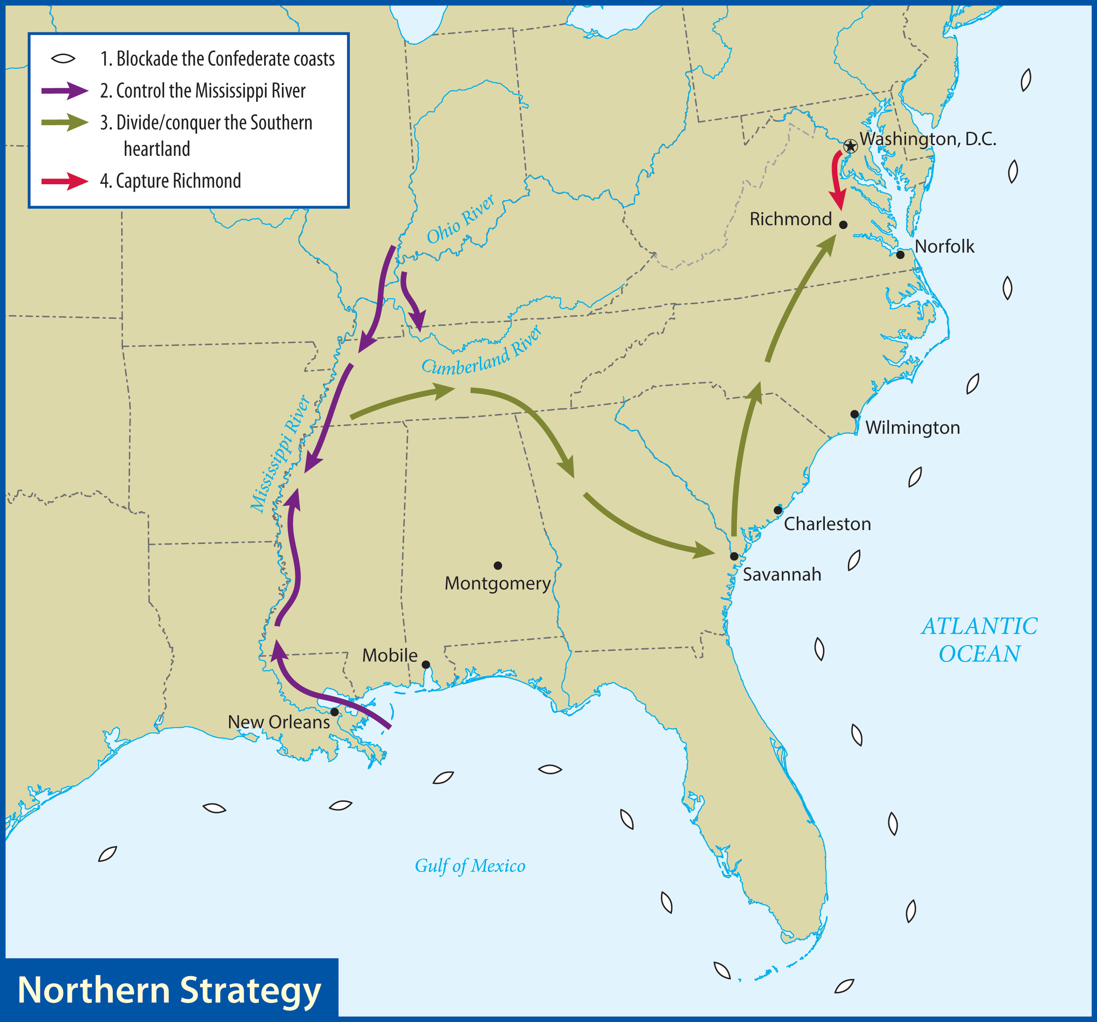
General Winfield Scott’s Anaconda Plan proved to be both realistic and successful.

Slide 19
War of Brothers
The Confederate strategy was defensive
Defending the home front

Slide 20
What major battles occurred in the East?
Why were these battles significant?

Slide 21
Lincoln’s initial call for troops was for an enlistment of three months.

Slide 22
War in the East
First Battle of Bull Run (July 1861)
Union: General Irwin McDowell
Confederate: General P.G.T. Beauregard
Spectators came to see the battle
Initial Union success
Confederate victory
“Stonewall” Jackson

Slide 23
Lincoln replaced McDowell with George B. McClellan the next day.
Congress voted for a half million more troops for three years.

Slide 24
War in the East
Peninsular Campaign (March–July 1862)
McClellan drilled his army
Lincoln ordered him toward Richmond
McClellan’s strategy was to attack Richmond from the east, not the north

Slide 25
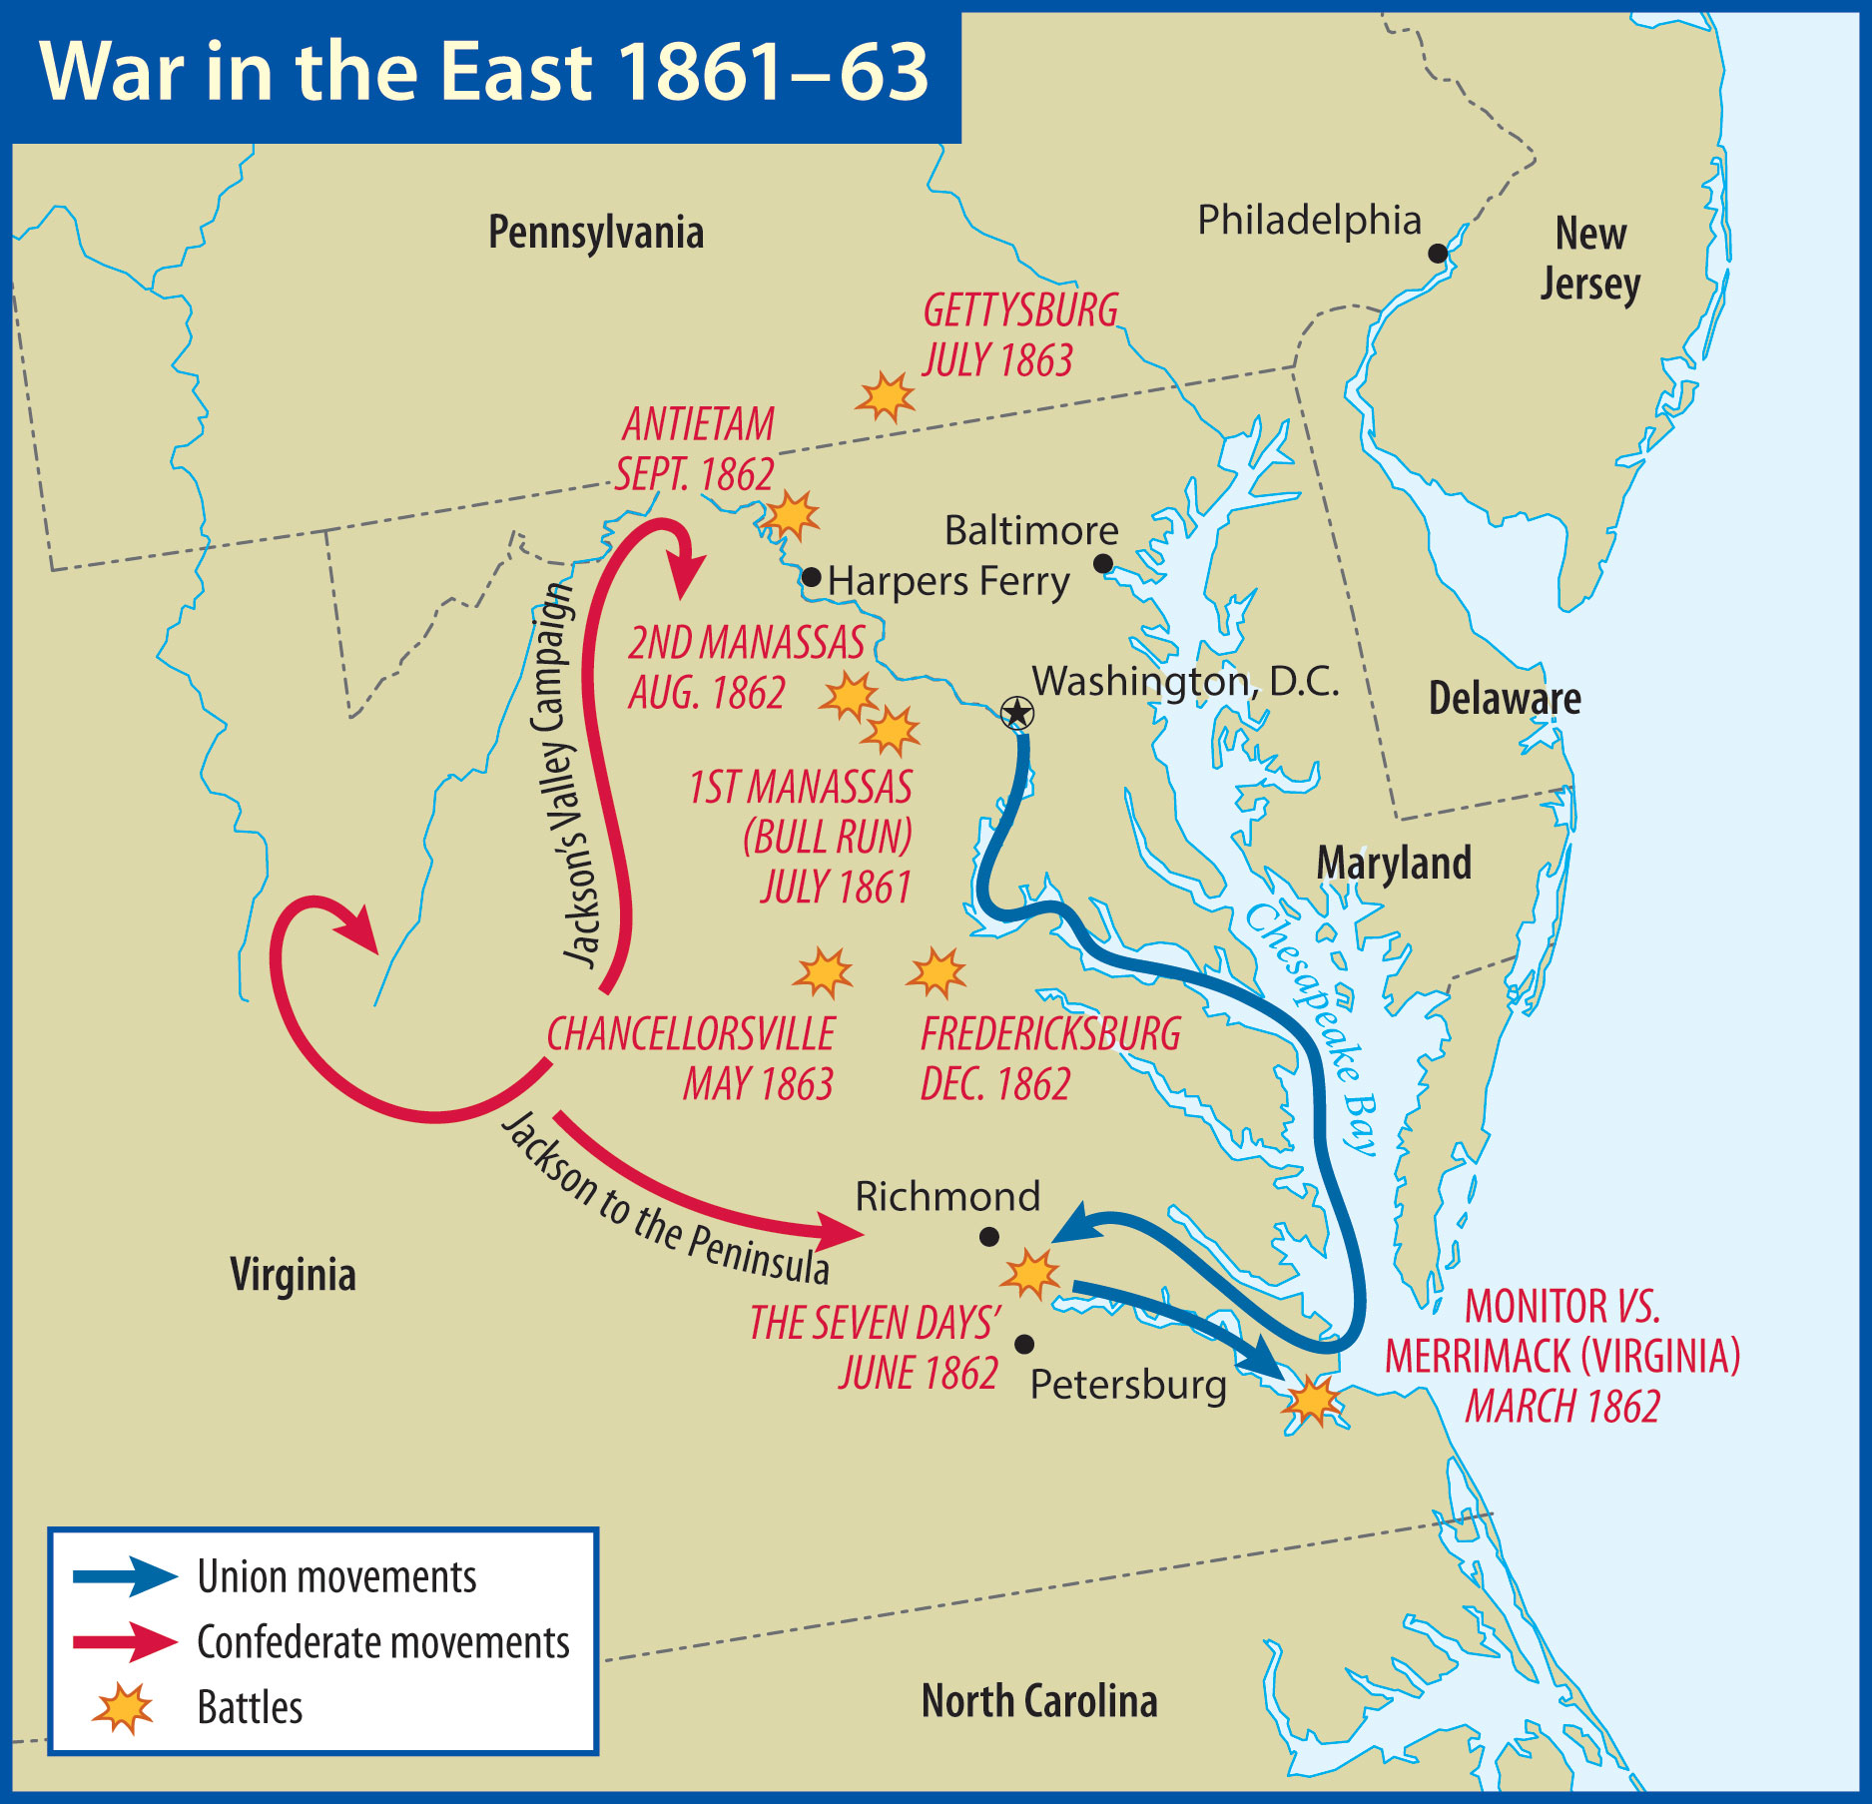
The Union army was never able to capture Richmond until the very end of the war.

Slide 26
War in the East
The Monitor and the Merrimack (March 1862)
The USS Merrimack (now called the CSS Virginia) promptly sunk two Northern ships
The USS Monitor appeared the next day
They fought to a draw

Slide 27
The battle between the Monitor and the Merrimack was the first clash of two iron warships.

Slide 28
War in the East
Diversion in the Valley (March–June 1862)
Stonewall Jackson was able to keep 50,000 Federal troops pinned down
Slipped out of the valley to help stop McClellan

Slide 29
War in the East
On to Richmond!
McClellan and the Union forces came within sight of Richmond
General Joseph Johnston struck back
Johnston was badly wounded
General Robert E. Lee took command
Seven Days’ Battles: Union pushed back

Slide 30
War in the East
Second Battle of Bull Run (August 1862)
Pope was first attacked by J.E.B. Stuart’s cavalry
Jackson moved around Pope’s army
Lee’s army arrived
Pope’s army was pushed back toward Washington

Slide 31
The Confederate forces in Virginia had been quite successful in the summer of 1862.

Slide 32
War in the East
Antietam (September 1862)
Lee decided to move into enemy territory
Lee’s plans were discovered
He set up a defensive line
Union forces attacked
Lee withdrew his troops back into Virginia

Slide 33
Antietam was the bloodiest one-day battle in American history.

Slide 34
Lincoln used news of the victory at Antietam to announce the Emancipation Proclamation.

Slide 35
War in the East
Fredericksburg (December 1862)
McClellan was replaced by General Ambrose Burnside
Union attacks failed badly
Burnside was replaced with General “Fighting Joe” Hooker

Slide 36
War in the East
Chancellorsville (May 1863)
Hooker took a huge force of men into Virginia
Lee, with half the troops, defeated Hooker
Stonewall Jackson was mortally wounded
The Union army retreated again

Slide 37
War in the East
Importance of the Confederacy’s victories:
Frustrated the Union war aim of capturing Richmond
Raised the morale of the South and lowered the morale of the North
Increased likelihood that a European power would support the Confederacy

Slide 38
War in the East
Gettysburg (July 1863)
The armies did not choose to fight there
Pickett’s Charge was the last major assault
50,000 total casualties
Lee retreated into Virginia
Meade did not pursue

Slide 39
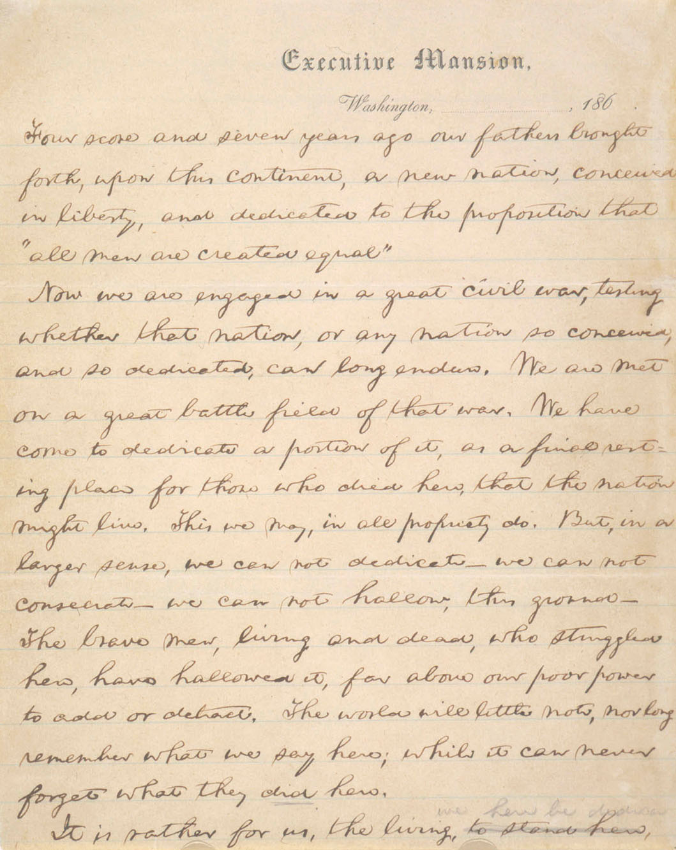
War in the East
Gettysburg Address
Edward Everett had spoken for two hours
Abraham Lincoln spoke ten sentences
Library of Congress, Prints & Photographs Division

Slide 40
What were the major battles of the Mississippi River campaign?
Who were the significant leaders on both sides in the West?

Slide 41
What were the major battles of the Kentucky-Tennessee campaign?
What was the significance of the Battle of Chattanooga?

Slide 42
War in the West
Mississippi River Campaign
The North’s best commanders rose to fame in the West
Control of the Mississippi River was a vital component of the Union’s strategy
The Union had ironclad gunboats

Slide 43
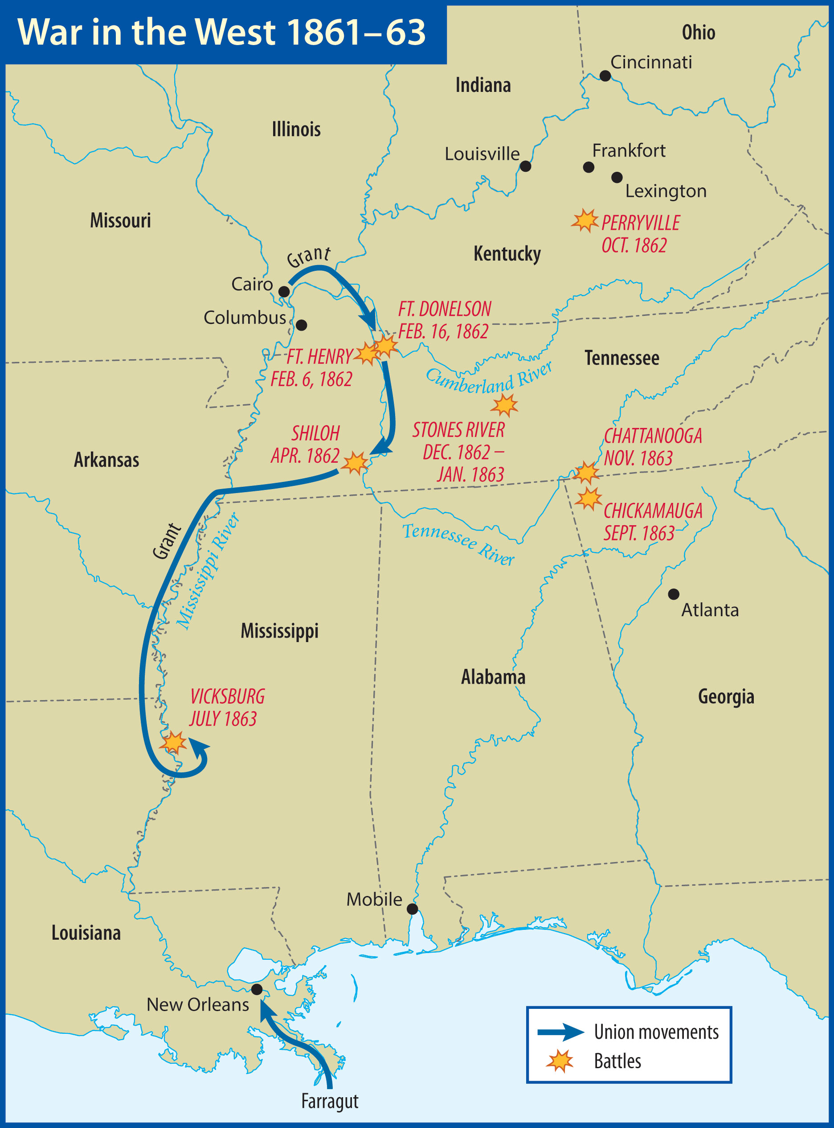

Slide 44
War in the West
Forts Henry and Donelson (February 1862)
Grant easily captured Fort Henry
Fort Donelson was more difficult
Grant demanded “unconditional surrender”
Confederates abandoned Columbus, KY
Nashville, TN, also fell into Union hands

Slide 45
War in the West
Shiloh (April 1862)
Grant had moved south
General Albert Sidney Johnston surprised the Union army with an attack
Johnston died in the battle
The Union pushed back the Confederates
Heavy losses on both sides

Slide 46
Union naval commander David Farragut captured New Orleans in April 1862.
Vicksburg was the last remaining Confederate stronghold on the Mississippi River.

Slide 47
War in the West
Vicksburg (July 1863)
Natural fortress
Grant made a daring move to outmaneuver the Confederates
Assaults of the city did not work, so Grant laid siege to Vicksburg
Surrender: July 4, 1863

Slide 48
War in the West
Kentucky-Tennessee Campaign
Kentucky was a very divided state
Union troops had already pushed Confederate troops out of Kentucky
General Braxton Bragg invaded Kentucky
Forced to retreat to Tennessee

Slide 49
War in the West
Chickamauga (September 1863)
The Union had been pushing the Confederate armies south
Bragg counterattacked and won a major victory
The Union army was trapped
General George Thomas

Slide 50
General George Thomas replaced General Rosecrans after the disaster at Chickamauga.
Lincoln placed Grant in charge of all Union forces in the West.

Slide 51
War in the West
Fighting for Chattanooga (November 1863)
Grant had broken the Confederate siege
Lookout Mountain, “The Battle Above the Clouds,” was a Union victory
Union soldiers swept up Missionary Ridge and surprised the Confederates
The Confederates retreated into GA

Slide 52
Jefferson Davis placed Joseph E. Johnston in command.
President Lincoln promoted Grant to commander of all Union forces.

Slide 53
How did life differ on the home front in the North and South?
What constitutional questions arose as a result of the Civil War?
What was the significance of the Emancipation Proclamation?

Slide 54
On the Home Front
In the South
Confederate paper money plummeted in value
Shortages of food and clothing
Some violence occurred
Blockade runners
Became less profitable over time

Slide 55
On the Home Front
In the North
Some inflation and shortages
A period of prosperity
Farms produced more
Heavy industries

Slide 56
On the Home Front
Filling the Ranks
Both armies were initially filled with volunteers
Conscription was used on both sides
Some hired substitutes or paid exemption fees
Georgia and North Carolina exemptions

Slide 57
The New York draft riot in July 1863 resulted in the deaths of 119 people.

Slide 58
On the Home Front
Many northern immigrants had no desire to participate in the war
Racial animosity also played a part
Black men were used in nonmilitary roles in the South
Black men served as soldiers, sailors, and civilian workers in the North

Slide 59
On the Home Front
Border States
Missouri remained in the Union despite local guerrilla warfare
Delaware never seriously considered seceding
Kentucky eventually joined the Union cause

Slide 60
On the Home Front
Maryland
Lincoln ordered military occupation
Pro-Confederacy leaders were jailed without trials
These rules were eventually lifted
West Virginia broke away from Virginia

Slide 61
Congress admitted West Virginia to the Union on June 20, 1863, despite the Constitutional concerns this raised.

Slide 62
On the Home Front
Lincoln and the Constitution
Complaints
Writs of habeas corpus were suspended
Congress eventually gave the president this power officially
These concerns lessened during the course of the war

Slide 63
Copperheads
Northerners who were sympathetic to the South

Slide 64
The main goal of Southern diplomacy was to persuade a European power to accept the independence of the Confederacy.

Slide 65
On the Home Front
Southern Efforts
Economics: Britain’s economy depended on Southern cotton
Cotton from India and Egypt
The Trent Affair
Britain demanded, and received, an apology from the US government

Slide 66
On the Home Front
Britain would recognize the Confederacy only if it thought the South could win
No great military victory was forthcoming

Slide 67
Emancipation Proclamation
Slaves in rebel-controlled territories would be freed
A use of war powers

Slide 68
On the Home Front
Four main purposes:
Keep Britain from recognizing the South
Encourage black people to join the war effort and fight for the Union
Give Northerners another reason for fighting in addition to preserving Union
Take the first step toward freeing slaves

Slide 69
Lincoln achieved his goals with the Emancipation Proclamation, and it was an important step toward eliminating slavery.

Slide 70
What were the significant battles in the 1864 Wilderness and Georgia campaigns?
How was total war implemented against the South?

Slide 71
How did Northern victories affect the outcome of the presidential election in 1864?
What events led to the defeat of the Confederate forces?

Slide 72
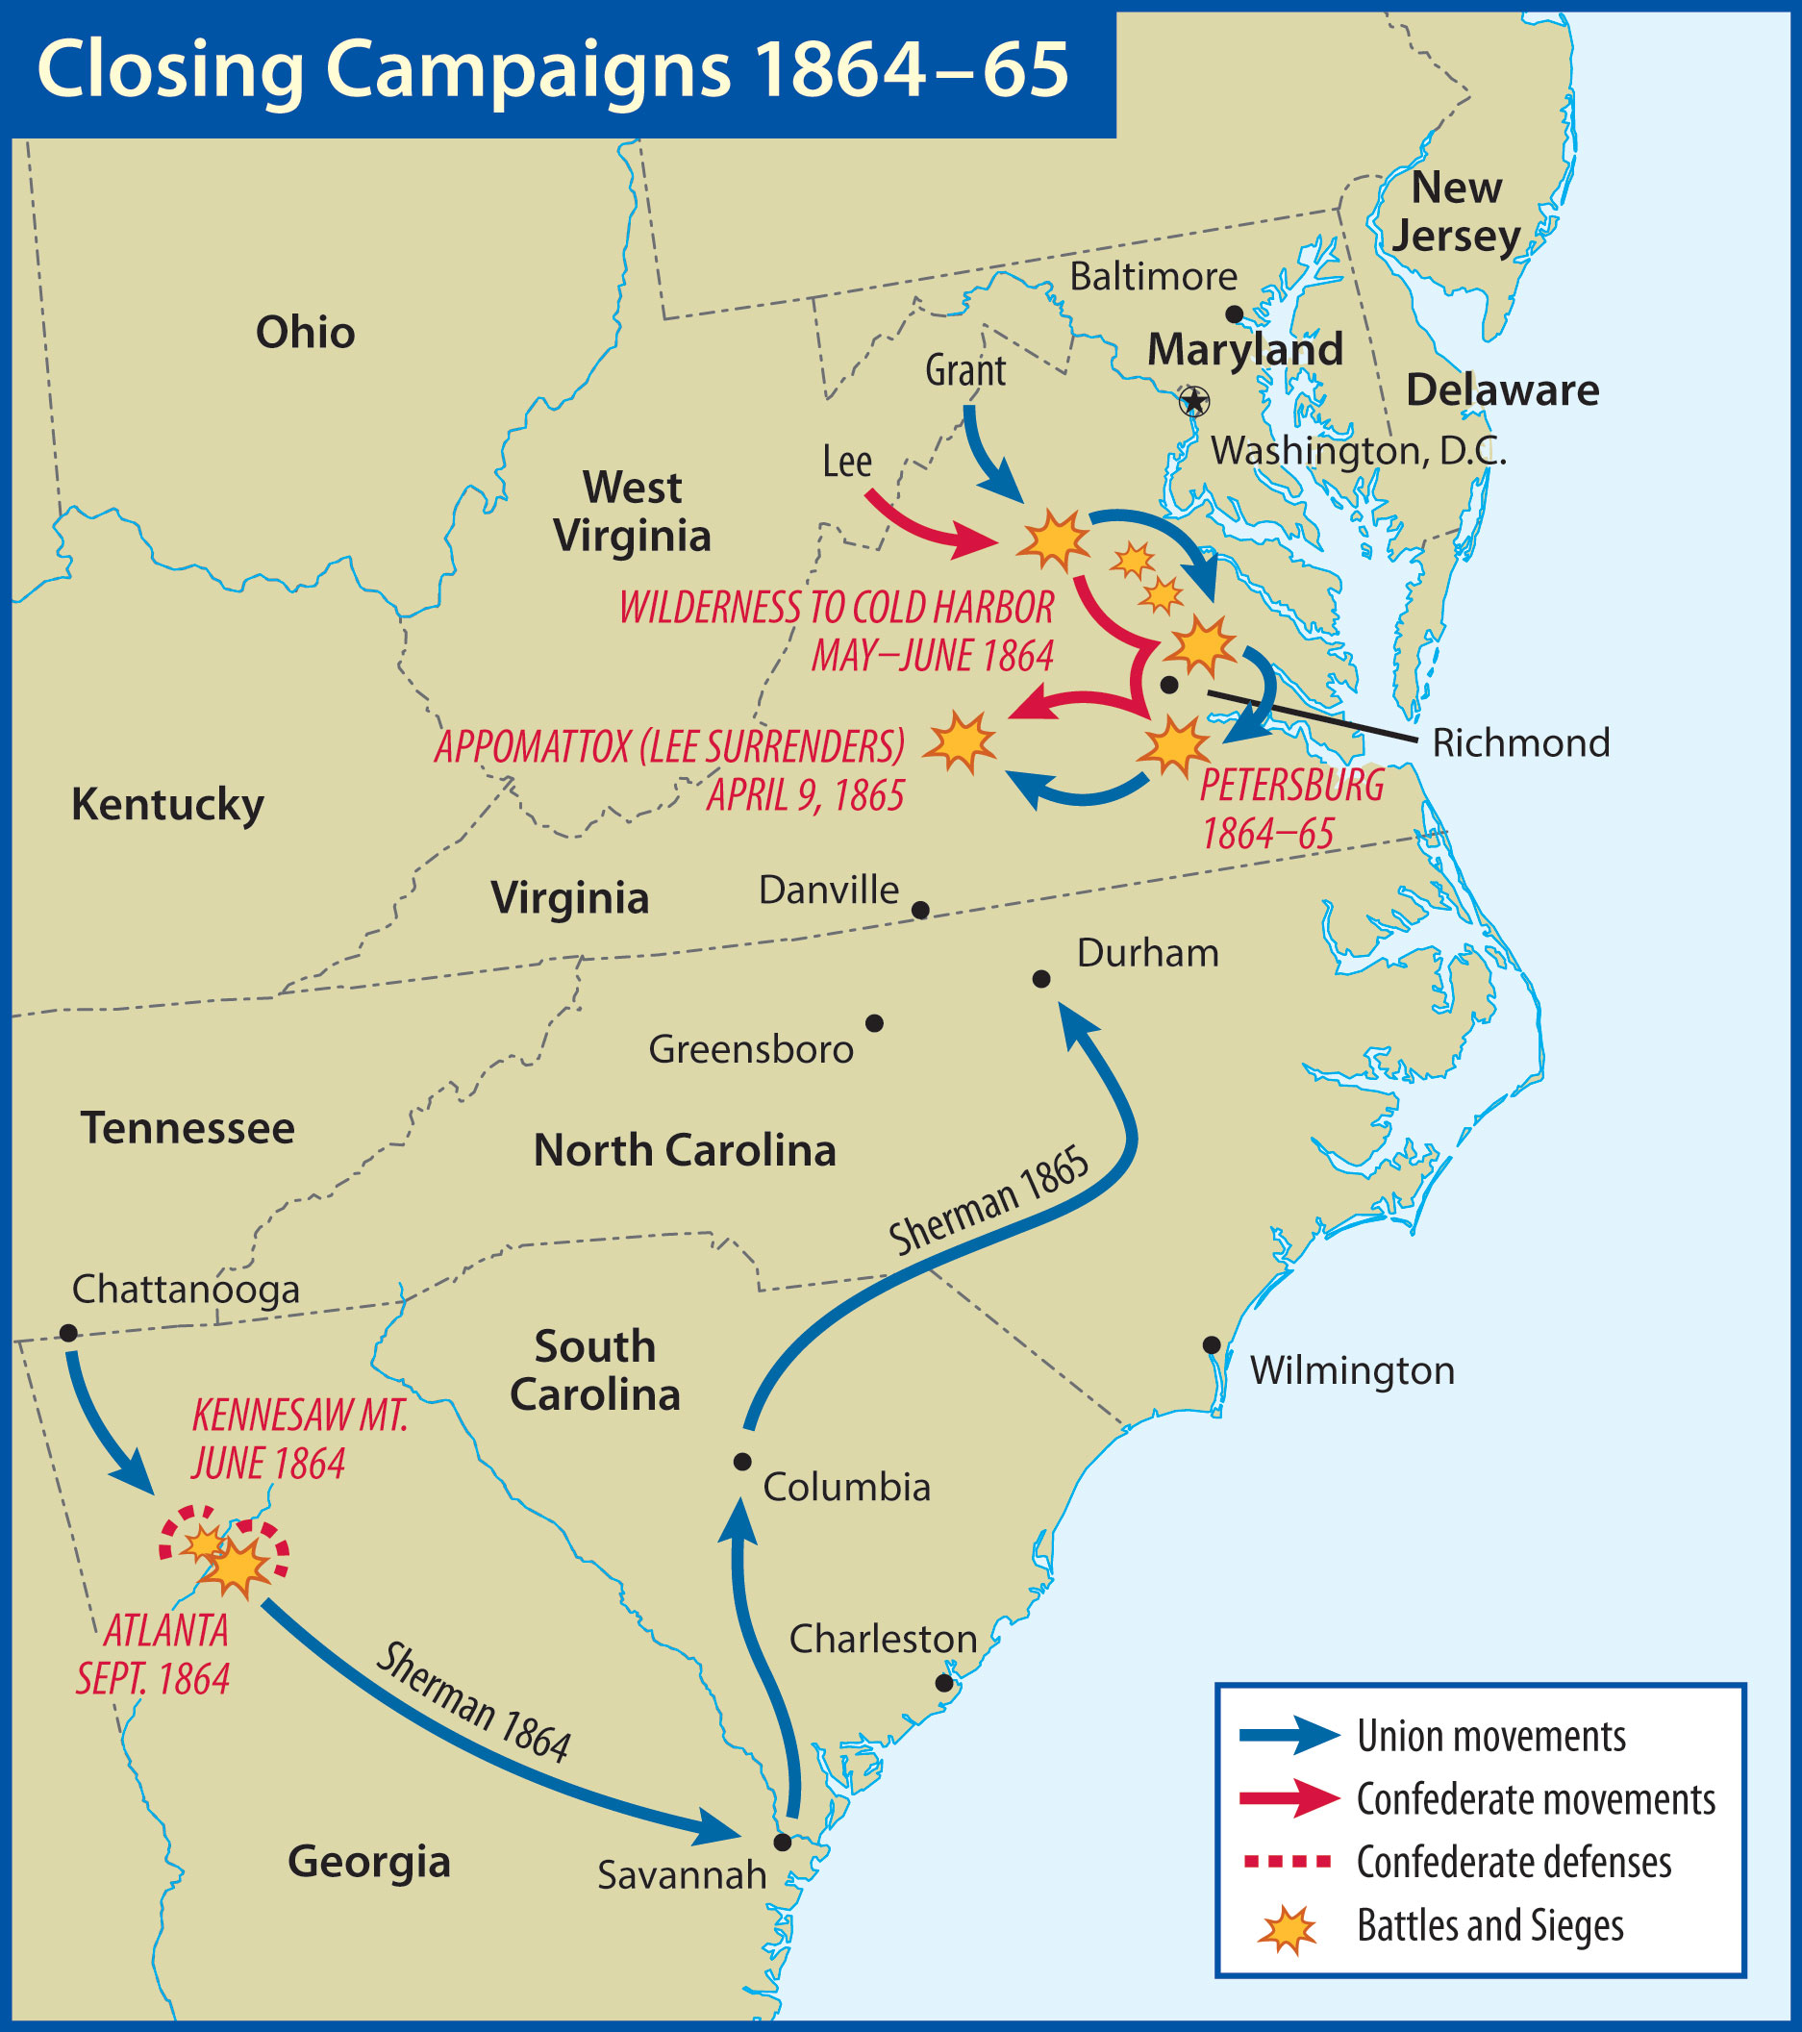

Slide 73
Road to Appomattox
Wilderness Campaign
Grant advanced toward Richmond
Lee blocked his advance
Several battles were fought
Grant continued to move south despite large numbers of casualties

Slide 74
Road to Appomattox
Cold Harbor
Grant made a costly mistake
Several thousand of his troops died
Grant could replace his lost soldiers
Southern lines kept getting thinner
Southern soldiers were starving

Slide 75
When Grant took command in Virginia, he left General William Tecumseh Sherman to destroy Johnston’s army and to capture Atlanta.

Slide 76
Road to Appomattox
Atlanta Campaign (May–September 1864)
Johnston played defense but was gradually forced back toward Atlanta
Jefferson Davis finally replaced Johnston with General Hood
Hood attacked Union forces in the Battle of Atlanta

Slide 77
Sherman continued toward Atlanta and began to encircle the city.
Hood abandoned Atlanta on September 2.

Slide 78
Road to Appomattox
The March to the Sea (Nov.–Dec. 1864)
Total war
Destruction of supplies
Showed Confederacy that it was rapidly losing the ability to resist
Trail of destruction 50–60 miles wide
Vandals and bummers

Slide 79
Road to Appomattox
Election of 1864
That summer, Lincoln’s chances for reelection looked slim
Democrat: George McClellan
After the victories of the fall, Lincoln won by a wide margin

Slide 80
Road to Appomattox
Siege of Petersburg (July 1864–March 1865)
Major railroad junction
Death and disease took their toll
Union forces were successful elsewhere
Lee abandoned Richmond on April 1
Could not escape Grant’s army

Slide 81
Road to Appomattox
Appomattox (April 9, 1865)
Grant offered generous terms
Lee accepted
Other Confederate forces surrendered soon thereafter

Slide 82
Road to Appomattox
Bitter Harvest
Over 600,000 men had died
Thousands were maimed for life
John Wilkes Booth shot President Lincoln on April 14, 1865

Slide 83
Lincoln was concerned that there were men in Congress who “possessed feelings of hate and vindictiveness.”

Slide 84
Xxx
Xxx

