Slide 1
Chapter 14: The Caucasus, Central Asia, and South Asia

Slide 2
The Caucasus, Central Asia, and South Asia
The Countries of the Caucasus
Georgia
Central Lowlands
Highland Rebels
Armenia
History
Life
Azerbaijan

Slide 3
Central Asia
Kazakhstan
Europeans on the Northern Steppes
Eastern Kazakh Uplands
Southern and Western Deserts
Turkmenistan
Uzbekistan
Desert Oases
The Crowded Foothills
Kyrgyzstan
Tajikistan
Afghanistan

Slide 4
South Asia
India
Major Geographic Features
Religions
Hinduism
Government and Economy
Pakistan and Bangladesh
Pakistan
Bangladesh
Nepal and Bhutan
Nepal
Bhutan

Slide 5
Sri Lanka and Maldives
Sri Lanka
Maldives

Slide 6
Introduction
This region extends from the Caucasus Mountains east of the Black Sea to the Western and Eastern Ghat Mountains along the southern borders of India.
This area is populated by people with deeply held religious beliefs.
Islam has a strong influence in many of these countries.
However, Buddhism, Hinduism, and other religions also have many followers in this region.
Christians make up a minority of the people.
The peoples of this region also share another characteristic—conquest or attempted conquest by foreign powers.

Slide 7
Notes:
Map Resources

Slide 8
The Countries of the Caucasus
The Caucasus Mountains lie at the crossroads between Europe, Asia, and the Middle East.
A diversity of people arose in the isolated valleys of the Caucasus Mountains.
The Arabs call the Caucasus the “mountains of a thousand languages.”

Slide 9
Notes:
Cultural Geography, 4th edition, p. 336

Slide 10
Georgia
From about AD 1000 to 1212, Georgia enjoyed independence and prosperity.
In 1990, Georgia became the second Soviet republic to declare independence from a weakened Soviet Union.
Seventy-six percent of the people are Georgians and worship in the Georgian Orthodox Church, a type of Eastern Orthodoxy.

Slide 11
Central Lowlands
The central valley of Georgia is formed from two river basins.
Georgia is the only Caucasian country with ocean ports.
Tbilisi (tuh BIL eh see) has been the capital of Georgia for more than fifteen hundred years.

Slide 12
Highland Rebels
Dissatisfied Muslim minorities are concentrated in two breakaway regions on the northern borders.
Abkhazia (ab KAHZ ee ah) lies along the Black Sea, and South Ossetia (ah SEE shah) is located across the border from Russia’s republic of North Ossetia.

Slide 13
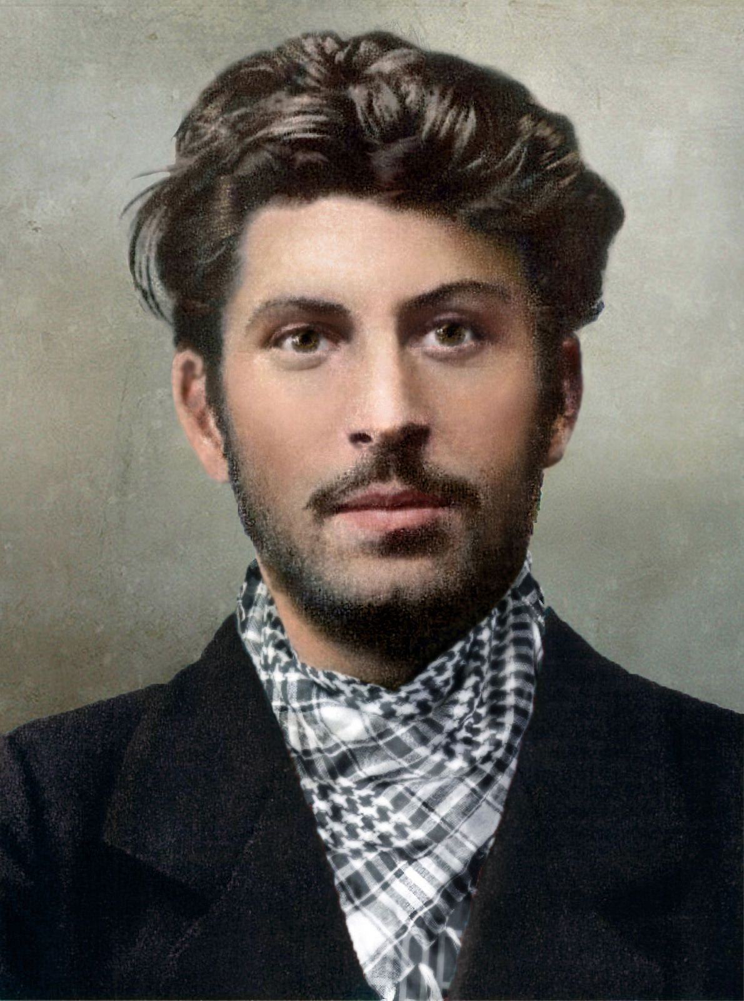

Slide 14
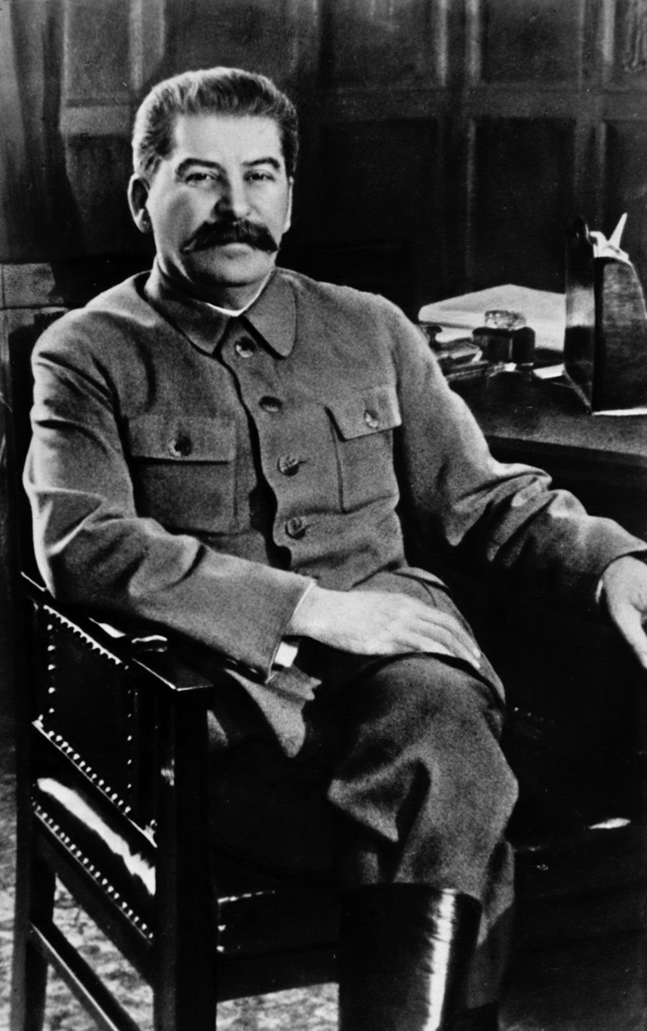

Slide 15
Armenia
The Armenians (ahr MEE nee uns) live in a landlocked mountainous region in the Caucasus Mountains.
In the fourth century, their nation became the first in the world to officially adopt Christianity.

Slide 17
Notes:
Map Resources

Slide 18
History
Throughout most of Armenia’s history, it has endured frequent invasion and conflict as Byzantine forces opposed Turkish forces and Russian forces fought with Persians.
Current tensions result from concern over the status of ethnic Armenians in Nagorno-Karabakh, Azerbaijan.
Leading up to World War I, Turkish leaders decided to eliminate the possibility that Armenians would side with Turkey’s enemies, the Russians.
By 1917, Turkish forces and their allies had murdered up to 1.5 million Armenian men, women, and children.
This became known as the Armenian Genocide.

Slide 19
Life
Despite Armenia’s dry climate that provides only twenty inches of rainfall annually, farmers grow barley, wheat, and potatoes.
Armenia is a densely populated nation in the Caucasus with nearly 98 percent of the population consisting of native Armenians.
The legacy of the Armenian Apostolic Church has endured for over 1700 years.
While many Armenians identify with the church for traditional reasons, a growing number of Armenians are embracing the truth of the gospel.

Slide 20
Azerbaijan
Iran (formerly Persia) has had the greatest influence over Azerbaijan.
Persians controlled the region from 700 BC to AD 600 (except for the brief interruption of the Greek Empire) and from the sixteenth century to 1813 (except for a brief period under the Ottoman Turks).
Recent conflict with neighboring Armenia has left this state unsettled and ready for war.
The Kura River, which provides water for textile and chemical plants, empties into the Caspian Sea, the largest lake in the world.
The most important resource of the Caspian has been an abundance of oil and natural gas reserves.

Slide 21
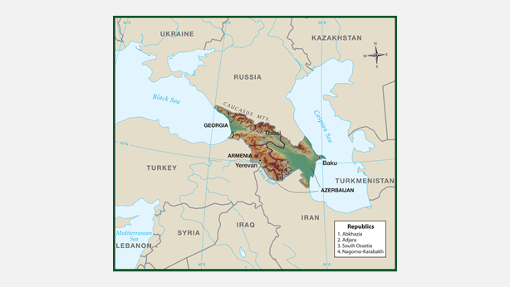

Slide 22
The region could become a major battleground in the twenty-first century, as nations—including China, a nearby international giant—compete for the Caspian's oil wealth.

Slide 23
1. Why are there so many languages and cultures in the Caucasus?
because the region lies in remote mountains at the crossroads of Europe, Asia, and the Middle East.

Slide 24
2. Which country in the Caucasus became the first to officially adopt Christianity?
Armenia

Slide 25
3. Why do Shia and Sunni Muslims persecute one another?
They disagree over who should be the leader of Islam, and each considers the other to be apostate.

Slide 26
4. What gives Azerbaijan an economic advantage over the other two Caucasus nations?
Its position on the Caspian yields key resources, such as fish and petroleum.

Slide 27
Why do you think Russia is concerned about conditions in the Caucasus?
Answers will vary but may include the vital oil pipelines and political instability there, especially if any of the countries should gain nuclear capability.

Slide 28
Central Asia

Slide 29
Central Asia
Kazakhstan
Europeans on the Northern Steppes
Eastern Kazakh Uplands
Southern and Western Deserts
Turkmenistan
Uzbekistan
Desert Oases
The Crowded Foothills

Slide 30
Kyrgyzstan
Tajikistan
Afghanistan
Geographic Divisions

Slide 31
Central Asia
Central Asia is a wide-ranging term that includes all of the arid plains between the Caspian Sea and western China.
This region is isolated from other regions by deserts and high mountains.
Because so many of the modern-day countries in Central Asia have mainly Turkic populations, the entire region is sometimes referred to as Turkistan.
Central Asia was once a major trade route between the East and the West.
The Silk Road linked the two great ancient empires: Rome and China.
The new nations of Central Asia are struggling to find their place in the modern world.
They suffer from a devastating shortage of water and landlocked borders that isolate them from international trade.

Slide 32
Notes:
Cultural Geography, 4th edition, p. 339

Slide 33
Notes:
Map Resources

Slide 34
Kazakhstan
Kazakhstan (KAH zahk stan), the “giant” of Central Asia, is the only Central Asian nation that borders Russia.
A major problem, however, is that while northern Kazakhstan is heavily Russified, the southern part is influenced more by its Turkish background.
When the country was under Soviet rule, the capital was Almaty (ahl MAH tee) in the south, which put strong Russian authority in the heart of Kazakh territory.

Slide 35
Europeans on the Northern Steppes
Kazakhstan’s northern steppes are good for grazing sheep and cattle.
Russian and Ukrainian farmers began arriving on the northern borders in the 1730s, and Russian armies had conquered the region by the 1850s.

Slide 36
Eastern Kazakh Uplands
The Kazakh Uplands cover the eastern lake regions around Lake Balkhash and Lake Zaysan.
Karaganda and Ekibastuz are important industrial centers.
The major industrial city at the south end of the uplands is Almaty.
With 1.3 million people, Almaty is Kazakhstan’s largest city and its cultural center.

Slide 37
Southern and Western Deserts
Most of the south is a desert that contains great wealth.
In the middle of these deserts, the Syr Darya flowed into the Aral (AHR ul) Sea until the Soviets diverted it for irrigation in the 1960s.
At its lowest point, the Caspian Depression is 433 feet below sea level.
Kazakhstan is a corridor between the oil-rich Caspian Sea and China.

Slide 38
Turkmenistan
Turkmenistan (turk mehn ih STAN) lies south of Kazakhstan.
This country is 96 percent Sunni Muslim with a Christian population of around 2 percent.
Although this country’s constitution guarantees freedom of religion, Christians, Jews, and non-Sunni Muslim groups are severely persecuted and strictly forbidden.
The Kara-Kum (kah-rah KOOM) is a desert that covers 80 percent of Turkmenistan.

Slide 39
Uzbekistan
Uzbekistan is in the heart of Central Asia, completely surrounded by other Central Asian nations.
It borders every other nation in the region and is the only double landlocked state in Central Asia.
The nation has several religious groups, but 85 percent of the people are Muslim.
When Central Asia broke from the Soviet Union, Uzbekistan hoped that the Turkic peoples of Central Asia would unite into a single nation called Turkistan.
Uzbekistan has natural resources in the form of oil, natural gas, and mineral deposits.

Slide 40
Desert Oases
The Kyzyl-Kum (kih-ZIL KOOM) is a vast desert that covers 80 percent of Uzbekistan, except for a few mountains on the eastern edge.
Most of the Kyzyl-Kum is wilderness, but it does have a few oases and mining towns.
The greatest oasis lies at Bukhara (BOO kah rah), north of the Amu Darya.
In the tenth century, Bukhara was the capital of a Muslim dynasty, the Samanids, and was second only to Mecca as an Islamic holy place.

Slide 41
The Crowded Foothills
Most of Uzbekistan’s population lives in the foothills of the great Asian mountain system.
The capital, Tashkent, has 2.2 million people and is the largest city in the Caucasus and Central Asia.
Samarqand (SAM er kand; sometimes spelled Samarkand) lies near the eastern border of Uzbekistan, where the Kyzyl-Kum Desert reaches the first spur of the mountains.

Slide 42
1. What product ruled trade across Central Asia?
silk

Slide 43
2–3. What desert covers most of Turkmenistan? Why is Turkmenistan the richest nation in Central Asia?
Kara Kum; petroleum and natural gas

Slide 44
4. What is the most populous nation in Central Asia?
Uzbekistan

Slide 45
What role did the Silk Road play in Central Asia in the past? What caused this route to become insignificant?
It linked the two great ancient empires: Rome and China; a new water route to China avoided Central Asia.

Slide 46
Kyrgyzstan
Kyrgyzstan (KIHR gee stahn) is dominated by the Tien Shan (tee-EHN SHAHN), or the “Celestial Mountains.”
This northern range runs one thousand miles from Tashkent to Urumqi in China and divides Kyrgyzstan from China.
A major problem for the country is that its boundaries divide similar ethnic groups and put dissimilar groups together, yielding a situation that is ripe for friction and conflict.
The people of Kyrgyzstan are primarily involved in pastoral occupations—raising yaks (for both milk and meat), sheep, and cattle.

Slide 47
Tajikistan
Tajikistan (tah JEEK ih stahn) is the mountain hub of Central Asia.
The Pamir (pah MEER) Mountains cover the eastern half of Tajikistan.
This range is sometimes called the Pamir Knot because it ties together the great ranges: the Tien Shan, the Hindu Kush, the Himalaya (and Karakoram), and the Kunlun.
Tajikistan is unique in Central Asia.
Its language is more Iranian than Turkic.
Tajikistan has few resources except its rivers.
Some of the world’s highest dams, Rogun Dam (1,099 feet) and Nurek Dam (984 feet), harness waterpower for industries at the capital, Dushanbe.

Slide 48
Afghanistan
The mountains of Afghanistan harbor more than twenty ethnic groups, including Turkic, Mongol, Arab, Aryan, and Persian peoples.
The two largest, the Pashtuns and Tajiks, constitute about three-quarters of the Afghan population.
Following decades of wars during the nineteenth century, Afghanistan became a buffer state, a neutral state between two rivals who agreed to keep their armies out.
From 1978 to 1989, Russia waged a costly and ultimately unsuccessful campaign to set up and maintain a Communist dictatorship in Afghanistan.

Slide 49
The United States supported the opposition to the Soviets, a coalition of Muslim tribes known collectively as the Mujahideen (moo jah heh DEEN; “strugglers”).
After the Soviet Union gave up and withdrew its troops, Afghanistan broke into warring factions, and anarchy reigned.
Islamic extremists known as the Taliban (TAL uh ban; “seekers” or “students”) eventually prevailed and restored order by enforcing rigid adherence to sharia (severe Islamic law), including such punishments as amputation of hands and arms.
They also allowed Islamic terrorists to set up training camps in the country, and some of their students carried out attacks against the West, including the attack on the World Trade Center and the Pentagon on September 11, 2001.

Slide 50
Consequently, the United States invaded Afghanistan, overthrew the Taliban, and chased down terrorists who had taken refuge in the mountains along the Afghan-Pakistani border.

Slide 51
Geographic Divisions
Geographically, Afghanistan is divided into three zones: the fertile northern plains; the rugged, earthquake-shaken central highlands (the Hindu Kush); and the desert of the southern plateaus.
The Hindu Kush, Persian for “Hindu Death,” is a mountain barrier extending southwest from the Pamirs and across central Afghanistan.
It has thirty-four seven-thousand-meter-high peaks.
All of them lie in the eastern Wakhan (wah KAHN) Corridor, a narrow panhandle that Russia and Great Britain created to stretch the buffer zone to China.
The Pashtun (PUSH toon) people predominate.

Slide 52
The Pashtun domain includes the nation’s largest city and capital, Kabul (KAH bul), which lies in one of the many mountain valleys of the Hindu Kush.
Kabul became important because of the thirty-three-mile Khyber (KYE ber) Pass, one hundred miles southeast of the city, which allows easy passage through the Hindu Kush.

Slide 53
1. What mountains cross into Kyrgyzstan? Tajikistan? Afghanistan?
Tien Shan; Pamirs; Hindu Kush

Slide 54
2. Which nation speaks a language closer to Iranian than to Turkish?
Tajikistan

Slide 55
3. What famous pass links Central Asia with India?
Khyber Pass

Slide 56
Why has Afghanistan had so much difficulty building a strong nation?
Afghanistan has a history of local rivalry, ethnic diversity, isolation due to mountains, and competition between powerful neighbors seeking control of vital trade routes.

Slide 57
South Asia

Slide 58
South Asia
India
Major Geographic Features
Religions
Hinduism
Government and Economy

Slide 59
Pakistan and Bangladesh
Pakistan
Bangladesh
Nepal and Bhutan
Nepal
Bhutan
Sri Lanka and Maldives
Sri Lanka
Maldives

Slide 60
Notes:
Map Resources

Slide 61
Notes:
Cultural Geography, 4th edition, p. 348

Slide 62
South Asia
Asia is an exotic region of contrast between wealth and poverty, high culture and demonic paganism, insurmountable peaks and broad river plains.
Mountains and deserts have long isolated Asia from the West, creating distinct differences in culture and history.
Because South Asia is separated from the rest of Asia by the formidable Himalayas on the north and by the Indian ocean on the south, and because it is bigger than a peninsula and smaller than a continent, it is sometimes called a subcontinent.

Slide 63
The Himalayas dominate the weather system of the region.
Because the cold air north of the mountains cannot rise over them to spill into South Asia, the cold temperatures do not reach into the subcontinent.
As the summer heat rises in the south, a low-pressure system results, drawing warm, moist air from the Indian Ocean in the form of winds called monsoons.
A reverse monsoon pushes cool, dry winds across the mountains into South Asia, causing a dry season.
The monsoon rains begin in June or July and supply the rain necessary for the agriculture on which all South Asian countries depend.

Slide 64
India
India, the largest country in south Asia, is also the seventh-largest country in area in the world and the second-largest in population.
India is often called the world’s largest democracy.
It is a federal republic with twenty-five states and six territories.

Slide 65
Notes:
Clipart.com; image 109902024

Slide 66
Major Geographic Features
India resembles a giant triangle or an upside-down pyramid.
It is bounded on the southeast by the Bay of Bengal, on the south by the Indian Ocean, and on the southwest by the Arabian Sea.
India is bounded by three major mountain ranges: The Himalayas on the northeast and the Eastern and Western Ghats, which run down either coast of the country.

Slide 67
The Himalayas
The northeastern limit of South Asia is delineated by the Himalaya Mountains, the highest mountain range on earth.
The name Himalaya is Sanskrit for “House of Snow.”
It includes Mt. Everest (29,028 ft.), the highest mountain in the world.
The Himalayan Mountain System forms the great mountain barrier that runs fifteen hundred miles along the south border of China.
The Indus and Brahmaputra river valleys divide the Himalayan system into three distinct ranges.
The Himalayas proper extend twelve hundred miles from the Indus River to the great eastern curve of the Brahmaputra River.

Slide 68
The Western and Eastern Ghats
The Ghats are two ranges of long, low, hardwood-covered mountains that run along the coasts of India.
The Western Ghats run for about a thousand miles along the west coast from just north of Mumbai southward to the southernmost tip of the country.
The Eastern Ghats stretch for about nine hundred miles along the east coast from the Mahanadi Valley in the north, where rice cultivation is a major economic activity, to the Nilgiri Hills in the south.

Slide 69
The Vindhya Mountains
The remaining major mountain range cuts from just north of where the Western Ghats begin, inland from the Gulf of Cambay and the city of Surat, almost due east into the heart of India.
Actually more like high hills (approximately 3,000 feet in elevation), the sandstone Vindhya (VIHN dyuh) Mountains have historically been the natural dividing line between northern India and southern India.

Slide 70
The Ganges River
Rivers also play an important role in India’s geography.
The northern portions of the country are delineated by the great river systems and the plains that they drain: the Indus River in the northwest, the Ganges River in the north and northeast, and the Brahmaputra in the extreme northeast.
The Ganges is very muddy and deposits an estimated 15 billion tons of sediment a year. In 2007, the river was also ranked among the five most polluted rivers in the world, and the subsequent efforts to reduce the level of pollution have had little success.
The river holds great significance in Hinduism, the largest religion in India.

Slide 71
The Brahmaputra River
The headwaters of the Brahmaputra (brah muh POO truh) River are in Tibet.
The river flows about 1,864 miles through four countries (Tibet, China, India, and Bangladesh) before joining the Ganges in the Ganges delta and emptying into the Bay of Bengal.
The Jumna (JUHM nuh) River is another important tributary of the Ganges in the plains.
Delhi (DEL ee), India’s second-largest city, stands on the Jumna River between Uttar Pradesh and Haryana.
Its suburb, New Delhi, is the national capital.

Slide 72
The Indus River
The Indus River flows from its headwaters in China through the states of Jammu and Kashmir and the entire length of Pakistan, emptying into the Arabian Sea.
Although only a small portion of the river is within the borders of India, the valley holds great significance in history as the birthplace of one of the earliest civilizations.

Slide 73
The Great Indian Desert
Within the bounds created by the major Indian mountains and rivers are two other geographic features: the Great Indian Desert south of the Indus River and the Deccan Plateau in central India.
Southwest of where the Indus flows through India and into Pakistan is a region called the Thar (TAHR), or the Great Indian Desert.
The state of Punjab (pun JAHB), north of the Thar, contains the Punjab plains.
Most people there speak Punjabi and worship as Sikhs (SEEKS).
Sikhs are followers of Guru Nanak (1469–1539), who sought to reconcile Islam with Hinduism; their religion is known as Sikhism.

Slide 74
Notes:
iStock.com/Roop_Dey

Slide 75
The Deccan Plateau
The Deccan (DEK uhn) Plateau is the heart of the Indian peninsula.
The Deccan includes eight states, parts of two others, and three territories.
Mumbai (muhm BYE), formerly called Bombay, is located on the northern half of the coast.
With 19.85 million people, Mumbai is the largest city in India and is the capital and major manufacturing center of the state of Maharashtra.
The coast on the Bay of Bengal is called the Coromandel (kohr uh MAN dul) Coast.
The Deccan has most of India’s mineral resources.

Slide 76
Chennai (chuh NYE), formerly known as Madras, is India’s fourth-largest city, with a population of 8.9 million.
It is a famous source of spices, such as turmeric and cardamon.
With Mumbai and Kolkata, Chennai was a center of the British East India Company from its inception in 1600.
In fact, the city was founded by the East India Company.
The company relinquished rule to the British government in 1858.
Disputed Border Regions
India’s border regions lie at the extreme edges adjacent to other nations.

Slide 77
Uniting a mixed bag of regions and peoples into one nation has not been easy, and religious violence has racked the border regions of the nation from its birth.
A Hindu assassinated Mahatma Gandhi (muh-HAHT-muh GAHN-dee) in 1948 because Gandhi wanted to make peace with the Muslims in India.
Since 1980, an extremist Hindu party called the Bharatiya Janata Party has resorted to violence in its efforts to replace the secular state with a pure Hindu kingdom, or Hindutva.
The Himalayas follow the border of China from Pakistan to Myanmar (formerly called Burma). Many of India’s Himalayan people practice Lamaistic Buddhism.
The Himalayas cover three widely separated states of India in addition to the disputed area called Kashmir (kazh MIHR), which is claimed by both India and Pakistan.

Slide 78
First Modern Missionary
William Carey (1761–1834) was the first modern missionary to seek to reach these exotic cultures.
He translated the Bible into many of the region’s languages.

Slide 79
1. What geometric shape does India resemble?
inverted triangle

Slide 80
2. What three major bodies of water border India?
the Bay of Bengal, the Indian Ocean, and the Arabian Sea

Slide 81
3. Which mountain range forms much of India’s northern border?
the Himalayas

Slide 82
4. Which two mountain ranges frame the coast of the Indian peninsula?
the Eastern and Western Ghats

Slide 83
5. Which three rivers are of greatest importance to India?
the Ganges River, the Brahmaputra River, and the Indus River

Slide 84
What issue more than any other divides India and its neighbors?
The diversity of religions and violence that has erupted among them

Slide 85
Religions
Hinduism
Seventy-four percent of the people of India are Hindus, so religious traditions greatly influence life there.
For Hindus, two of the most sacred things are cattle and the Ganges.
India has more cattle than any other nation in the world, and they are allowed to wander unhindered wherever they choose to go.
Hindus consider cattle to be especially sacred, the symbol of all life.
Each class, called a caste, strictly determines one’s social status.
According to the Hindu caste system, a Hindu must fulfill his or her role.

Slide 86
Brahmins (BRAH mihns; priests and teachers) and Ksatriyas (kuh SHAT ree uhs; rulers and warriors) occupy the highest castes.
Merchants, skilled craftsman (artisans), and farmers—the Vaisyas (VYE shuhs)—belong to the mid-level caste.
Sudras (SOO druhs; unskilled laborers) are the lowest caste.
Some despised occupations, such as tanners and garbage collectors are considered so low that they are beneath caste.
They are called “untouchables” and make up approximately one-seventh of the Indian population.

Slide 87
Islam
The second-largest religion in India is Islam, with approximately 172 million adherents, representing 14.2 percent of the population.
The introduction and early growth of Islam in India were primarily by violence.

Slide 88
Christianity
According to tradition, the apostle Thomas came to India in AD 50 and established several churches on India’s west coast before being martyred.
William Carey (1761–1834) was the first modern missionary to seek to reach these exotic cultures.
European explorers of the fifteenth century were surprised to find groups of Christians, called the St. Thomas Christians, in India.
Other people believe that St. Bartholomew was the one who introduced Christianity to India.
Over the years, however, the Indian countries became bound by ritual and tradition with no real understanding of the gospel.
A renewal of Christian outreach has recently occurred.

Slide 89
Sikhism
The religion of Sikhism arose in the early sixteenth century in the northern Indian state of Punjab when a guru named Nanak sought to combine the teachings of Hinduism and Islam.
His disciples compiled his teachings in the Guru Granth Sahib, which became the holy book of the Sikhs.
In 1984, Sikh terrorists assassinated India’s prime minister, Indira Gandhi.
Recent peace talks between India and Pakistan have resulted in a significant decrease in violence.

Slide 90
Jainism
Jainism (JYE nihz uhm) is another religion of the region and is thought to be related to both Hinduism and Buddhism.
Jains believe that humans can become gods, or Jina, by being “enlightened” through the worship of twenty-four Jinas who serve as inspirational bridges.
Jainism has even more rigorous practices than Hinduism, including the rule of no violence against any life form.
For instance, Jains cannot kill any living creature and must not eat meat.

Slide 91
Government and Economy
Britain increased Indian representation in the government in appreciation for India’s help in World War I and continued to grant Indians an increasing role in government.
The most famous leader in the protests that resulted from this was Mahatma Gandhi, the Father of the Nation.
He led the people in nonviolent protests, encouraging the people to destroy British power nonviolently simply by making their own goods rather than trading for them (i.e., economic self-sufficiency).
One of his most famous marches was a march to the sea in 1930 to protest a salt tax.

Slide 92
When Japan conquered Burma and then invaded eastern India in the early years of World War II, India joined the British cause.
Britain granted the country full independence in 1947.
The long British occupation had given Indians many practical benefits.
It spread English among the educated, and English is still used for administrative purposes.
The British also developed a vast railroad transportation network and established a strong judicial and administrative tradition.
Today, India is a federal republic: a national government, with its capital in New Delhi, that shares ruling powers with twenty-eight states and seven territories, each with its own government and capital.

Slide 93
Although India is an economic powerhouse in South Asia, it faces its share of problems, all of which affect its economy in some way. Natural disasters, population, poverty and pollution are some of the big problems.
India’s economy is rapidly becoming more diverse, with increasingly more emphasis on industry and services.

Slide 94
Hinduism
Hinduism is often used to describe the religion of India.
Though not every religion in India is considered Hindu (Buddhism for example), the Hindu religions do not all share the same beliefs or practices.
The Hindu belief in god provides an example of these contradictions.
Some Hindus believe in a personal god.
Other Hindus believe that god is not a person but a divine being that pervades everything.
Most Hindus do agree on two key beliefs: samsara and moksha.
Samsara is the law of reincarnation—a cycle of birth, death and rebirth—governed by karma (KAHR muh).

Slide 95
Doing good works gives a person good karma.
Bad actions give a person bad karma.

Slide 96
1. What religious belief prompts Indians to give cows free rein to do as they please?
reincarnation

Slide 97
2. Which river holds special significance to Hindus, and by what practice do they show that regard?
Ganges; they wash in it to cleanse their souls

Slide 98
3. Which Indian leader promoted nonviolent protest as a means for political reforms?
Mahatma Gandhi

Slide 99
4. What type of government does India have?
a federal republic (a national government with 28 states and 7 territorial governments)

Slide 100
What are some of the effects of poverty in India?
Malnourished population, children who are underweight and have stunted growth, a large homeless population

Slide 101
Pakistan and Bangladesh
The histories and cultures of India, Pakistan, and Bangladesh are very closely linked because they were all India until 1947.
Britain’s offer of independence for India depended on India’s deciding on a system of government.
When Hindu and Muslim conflicts prevented agreement, Britain separated the main Muslim regions from Hindu India to form the nation of Pakistan.
Pakistan (PAK ih stan) initially consisted of two parts: East Pakistan and West Pakistan, indicating the opposite sides of northern India.
India and Pakistan went to war over Kashmir three times (1947–48; 1965; 1971).

Slide 102
Following the third war, East Pakistan, encouraged by India, sought and gained independence from West Pakistan and became known as Bangladesh (bahn gluh DESH).
Since this change, the western part has been known simply as Pakistan.

Slide 103
Pakistan
Pakistan is often in the news because of both its ongoing dispute with India over control of Kashmir and its support of the Western allies in the war against terrorism.
Physical Features and Society
The Indus River valley makes up most of Pakistan.
Most Pakistanis live in the two provinces along the Indus River system.
The province of Punjab contains Pakistan’s portion of the Punjab Plains.
The province includes the capital, Islamabad (pop. 1.15 million), and the cities of Lahore (pop. 7.1 million) and Multan (pop. 1.7 million).

Slide 104
About fifty miles downstream from Sukkur lies a ruined city now known as Mohenjo-Daro (moh-HEN-joh DAHR-oh).
The ancient civilization that flourished there along the Indus Valley from 2500 to 1700 BC was one of the earliest on earth.
The people of North-West Frontier Province are called Pashtuns (PUHSH toonz). They live in the mountain valleys where precipitation is adequate.
The capital of the province, Peshawar, is south of Chitral and just east of the Khyber Pass, the only opening for travel through the rugged and formidable Hindu Kush Mountains.
The region also became a haven for the Taliban and other terrorists when the United Sates invaded Afghanistan following the September 11, 2001, terrorist attacks on the United States.

Slide 105
Government and Economy
About 96 percent of all Pakistanis are Muslims.
While Pakistan has laws guaranteeing religious freedom, persecution of Christians, minority Muslim groups, Hindus, and others is common and tolerated by the government.
The Pakistani government is officially designated a federal republic, with a president, a prime minister, a bicameral parliament, and like India, dozens of political parties.

Slide 106
Bangladesh
Poor. Overpopulated. Ill-governed. These words probably best describe the tiny nation of Bangladesh.
The rich delta soils hold potential for many crops, but the country’s location also makes is susceptible to frequent natural disasters, including typhoons (tye FOONS; hurricane-like storms), tsunamis (soo NAH mees; sometimes called tidal waves), droughts, and floods, especially during the monsoons.
Physical Features and Society
It is one of the most densely populated countries in the world.
About 14.6 million people live in Dhaka (DAH kuh), the capital.

Slide 107
Living conditions in Bangladesh are terrible, poverty is rampant, the risk of disease is extremely high, and medical care is scarce.
Eighty-nine percent of Bangladeshis are Muslim.
Nine percent are Hindu.
The remaining 2 percent represent a variety of tribal religions, animism, and Christians.
Government and Economy
Bangladesh is a parliamentary democracy.
Its government is run by a president, a prime minister, and a unicameral parliament.
Although the ruling party has sufficient numbers to push through the economic reforms necessary for improving the country, fundamental changes have not been made.

Slide 108
1. What is the major religion of both Pakistan and Bangladesh?
Islam

Slide 109
2. From what country did Pakistan obtain independence?
India

Slide 110
3. What region is the object of dispute between India and Pakistan?
Kashmir

Slide 111
4. What are the major products of Pakistan? Bangladesh?
Pakistan—sheep and goats and minor deposits of oil and coal; Bangladesh—rice and jute

Slide 112
5. Which country is known for its high population density?
Bangladesh

Slide 113
Why is Bangladesh unable to make full use of its natural resources?
It is located in a region that is susceptible to frequent typhoons and tsunamis, drought, and floods.

Slide 114
Nepal and Bhutan
Nepal
The nation of Nepal (neh PAHL) is landlocked, technologically backward, poverty stricken, and prone to natural disasters, and its people are at high risk of disease.
Physical Features and Society
A little larger than Arkansas, Nepal contains eight of the world’s ten highest peaks, including Mt. Everest.
It is susceptible to floods, landslides, droughts, and famine, depending on the timing, intensity, and duration of the monsoons.
Sherpas (SHUR puhz) are frequently hired as guides and porters by the approximately 600,000 foreign tourists who come to climb Nepal’s peaks every year.

Slide 115
Gurkhas (GOOR kuhz) are famed for their fighting abilities.
Great Britain first recruited Gurkhas for its army during the Age of Imperialism, and the Brigade of Gurkhas is still a part of the British army today.
Government and Economy
The capital is Kathmandu, with a population of just over one million.
The country has at least eight political parties, including the Communist Party, which is heavily influenced by China.
A Maoist-dominated government took office in 2008, but continued internal conflict led the prime minister to resign in 2010.
The economy is one of the poorest in the world.

Slide 116
Bhutan
Bhutan (boo TAN), landlocked like Nepal, is about half the size of Indiana.
It is bordered by China and India, but it controls some key passes in the Himalayas.
Physical Features and Society
The climate of Bhutan ranges from severe cold in the Himalayas to tropical in the southern plains.
Its very name means “Land of the Thunder Dragon.”
Its terrain is moistly mountainous, so it has frequent landslides, especially during the rainy season.

Slide 117
Under a Buddhist monarchy and the predominant Buddhist influence, other religions are barely tolerated.
Government and Economy
Bhutan is officially an independent state, but in practical terms it is very closely linked to India.
The country has a treaty with India whereby Bhutan controls its own domestic affairs and India controls its foreign policy.
Bhutan has one of the world’s smallest economies, and even that is closely linked to the Indian economy.

Slide 118
1. What political/religious fact makes Nepal unique?
It is the only officially Hindu state in the world.

Slide 119
2. Which two groups of Nepalese are famous, and for what special skills is each known?
Sherpas—famous guides and porters; Gurkhas—famous fighters

Slide 120
3. What do Nepal and Bhutan have in common that make them unique among the countries of South Asia?
They are both landlocked, are technologically backward, and struggle economically.

Slide 121
What does Bhutan’s name literally mean, and why is it called that?
“Land of the Thunder Dragon”; so named because of its violent thunderstorms

Slide 122
Sri Lanka and Maldives
Several islands lie off the Indian subcontinent in the Indian Ocean.
Two of them are independent nations, while several others are territories.
The two nations are the only South Asian nations with normal life expectancies and high literacy rates.

Slide 123
Sri Lanka
The island country of Sri Lanka (sree LAHNG-kuh) lies twenty miles off the southeast coast of India. Formerly known as Ceylon.
Physical Features and Society
The terrain is low, flat-to-rolling plains with mountains in the south-central interior of the island.
The island is hit occasionally by fierce cyclones and tornadoes.
Combined with monsoons, these storms cause a great deal of soil erosion.
Most Sri Lankans (70 percent) are Buddhists.

Slide 124
While Sri Lankan law declares the right to exercise freedom of worship, political and religious leaders restrict the actual practice of this freedom.
The island has been influenced somewhat by both Portuguese and Dutch traders, but the greatest European influence was exerted by Great Britain, which claimed the island in 1796.
The British controlled it until they granted it independence in 1948.
The banyan is a very large and interesting tree found in South Asia.
The tree grows from the top down.
The largest banyan tree has 350 large trunks and three thousand smaller ones.

Slide 125
Government and Economy
Today Sri Lanka has a republican form of government, with a president, a prime minister, and a unicameral legislature.

Slide 126
Maldives
Maldives (MAWL deevz) is the smallest nation in Asia, not quite twice the size of Washington, D.C.
Its 1,190 coral islands, arranged in 26 atolls, sprinkle the sea southwest of India over a region 475 miles long and 80 miles wide.
Physical Features and Society
The islands of Maldives have a hot, humid climate.
Ninety-nine percent of the people in the Maldives are Sunni Muslims, descendants of Sinhalese people from Sri Lanka, and the national language is Divehi, which is related to Sinhalese.

Slide 127
Government and Economy
The history of Maldives was influenced by first the Dutch and then the British.
It obtained its independence from Britain in 1965 and became a republic three years later.
The government operates by secular Muslim law.
The economy is dominated by fishing and tourism.

Slide 128
1. Which European nation exerted the most influence over Sri Lanka?
Great Britain

Slide 129
2. What two groups were at war in Sri Lanka until they signed a ceasefire in 2002?
Sinhalese and Tamils

Slide 130
3. What is the majority religion in Sri Lanka?
Buddhism

Slide 131
4. What fishing nation occupies a group of coral islands near India?
Maldives

Slide 132
5. Of what religion are almost all of the inhabitants of those islands?
Islam

Slide 133
What conditions make life difficult in Sri Lanka and Maldives?
Sri Lanka is subject to monsoons, and much of the terrain is low. These storms, combined with occasional cyclones and tornadoes, cause significant soil erosion. Maldives, likewise, is subject to rainy monsoons in the Southwest. The islands also have a limited supply of fresh water.

Slide 134
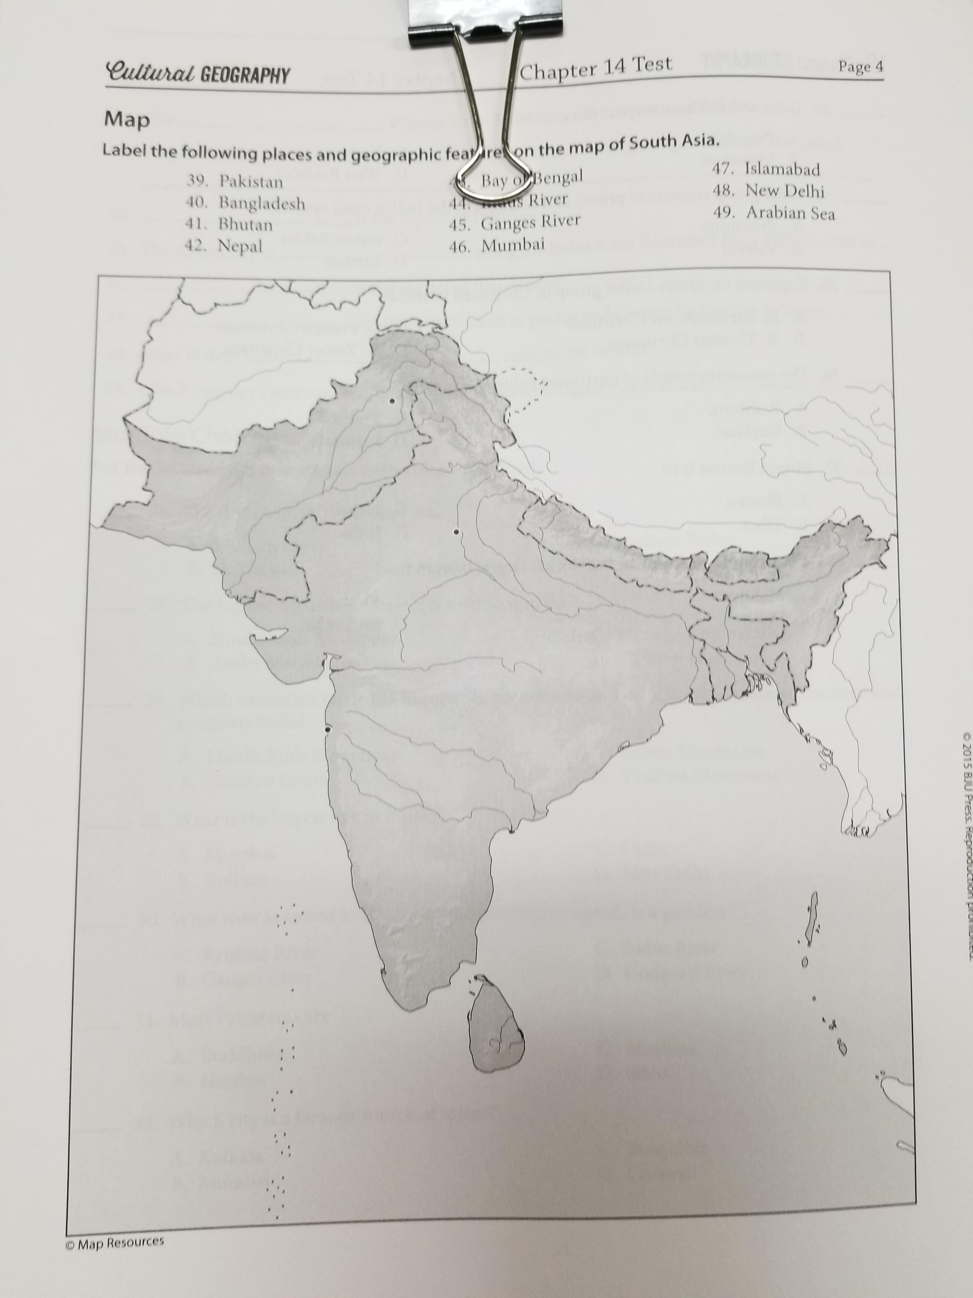

Slide 135
People, Places, and Things to Know

Slide 136
Caucasus Mountains
mountains that lie at the crossroads between Europe, Asia, and the Middle East

Slide 137
Armenians
a people that live in the landlocked mountainous region in the Caucasus Mountains

Slide 138
Shiite
the largest minority sect of Islam (about 20 percent of all Muslims)

Slide 139
Sunnis
the largest sect of Islam (about 80 percent of all Muslims)

Slide 140
Caspian Sea
the largest lake in the world

Slide 141
Central Asia
wide-ranging term that includes all of the arid plains between the Caspian Sea and western China

Slide 142
Silk Road
a major trading route that linked the two great ancient empires: Rome and China

Slide 143
Aral Sea
a sea that was once the fourth-largest lake in the world; Soviets diverted it for irrigation in the 1960s

Slide 144
Caspian Depression
at its lowest spot this depression is 433 feet below sea level

Slide 145
Kara-Kum
a desert that covers 80 percent of Turkmenistan

Slide 146
Turkistan
a general term for the region of Central Asia

Slide 147
Kyzyl-Kum
vast desert that covers 80 percent of Uzbekistan

Slide 148
Bukhara
a great oasis that lies north of the Amu Darya

Slide 149
Tashkent
capital of Uzbekistan

Slide 150
Samarqand
city in Uzbekistan that is famous for its excellent architecture

Slide 151
Tien Shan
mountain system that dominates Kyrgyzstan

Slide 152
Pamir Mountains
mountains that cover the eastern half of Tajikistan

Slide 153
buffer state
a neutral state between two rivals that is intended to prevent conflict

Slide 154
Mujahideen
a coalition of Muslim tribes that opposed the Soviets in Afghanistan

Slide 155
Taliban
Islamic extremists

Slide 156
Hindu Kush
a mountain barrier extending southwest from the Pamirs and across central Afghanistan

Slide 157
Wakhan Corridor
a narrow panhandle of Afghanistan that Russia and Great Britain created

Slide 158
Kabul
Afghanistan’s largest city and capital

Slide 159
Khyber Pass
thirty-three-mile pass that allows easy passage through the Hindu Kush

Slide 160
Himalayas
mountain range that separates south Asia from the rest of Asia; highest mountain range on earth

Slide 161
subcontinent
the general term applied to the area of Asia that is bounded by the Himalayas on the north and by the Indian Ocean on the south; bigger than a peninsula but smaller than a continent

Slide 162
monsoons
seasonal winds caused by the heating and cooling of large landmasses

Slide 163
Mt. Everest
highest mountain in the world at 29,028 feet

Slide 164
Ghats
two ranges of long, low, hardwood-covered mountains that run along the coasts of India

Slide 165
Vindhya Mountains
range of high hills that have been the natural dividing line between northern India and southern India

Slide 166
Ganges River
one of the world’s longest rivers; one of the most important rivers in India

Slide 167
Hinduism
the prevalent religion of India that emphasizes reincarnation, a supreme being with many forms, and the caste system

Slide 168
Brahmaputra River
a river that starts in Tibet and flows about 1,864 miles through four countries before joining the Ganges

Slide 169
Jumna River
important tributary of the Ganges

Slide 170
Delhi
India’s second largest city

Slide 171
New Delhi
India’s capital

Slide 172
Indus River
only a small portion of this river is in India; important because the Indus Valley was the birthplace of one of the earliest civilizations

Slide 173
Great Indian Desert
also called the Thar; only small desert plants grow here

Slide 174
Sikhism
an Indian religion founded by Nanak that tries to combine the teachings of Hinduism with Islam

Slide 175
Deccan Plateau
heart of the Indian peninsula

Slide 176
Mumbai
largest city in India with 19.85 million people

Slide 177
Coromandel Coast
the eastern coast of India on the Bay of Bengal

Slide 178
Chennai
India’s fourth-largest city with a population of 8.9 million; famous for spices such as turmeric and cardamom

Slide 179
Mahatma Gandhi
father of the nation of India; led people in nonviolent protests and encouraged the people to destroy British power nonviolently

Slide 180
Kashmir
disputed area claimed by both India and Pakistan

Slide 181
caste
a system within Hinduism that assigns people to different classes, each with its own privileges and responsibilities but also limitations, and strictly determines one’s social status

Slide 182
Brahmins
priests and teachers, who, along with the Ksatriyas (rulers and warriors), occupy the highest caste of Hinduism

Slide 183
samsara
law of reincarnation

Slide 184
moksha
means “release”; refers to the freedom from the law of samsara

Slide 185
reincarnation
a belief in a repeated cycle of birth and death; each person supposedly lives one life after another

Slide 186
karma
this governs the law of reincarnation; belief that if a person has good karma good things will happen to them and if they have bad karma bad things will happen to them

Slide 187
untouchables
people at the bottom of the Hindu caste system who are considered outcasts

Slide 188
Jainism
a religion of India related to both Hinduism and Buddhism; sometimes classified as a heretical version of Hinduism

Slide 189
Mohenjo-Daro
ancient city in modern-day Pakistan; an ancient civilization flourished there along the Indus Valley from 2500 to 1700 BC

Slide 190
typhoon
a hurricane that occurs over the waters near eastern Asia

Slide 191
tsunamis
a seismic sea wave caused by an earthquake

Slide 192
Sherpas
frequently hired as guides and porters by foreign tourists who climb Nepal’s peaks each year

Slide 193
Gurkhas
Nepalese famed for their fighting abilities

