Slide 1
Chapter 15: Southeast Asia

Slide 2
Southeast Asia
Indochina
  Myanmar
    Buddhism
  Thailand
    Elephant Roundup
  Laos
  Cambodia
  Vietnam

Slide 3
The Malay Archipelago
  Malaysia
  Singapore
  Brunei
  Indonesia
  Timor-Leste
  The Philippines

Slide 4
Introduction
The region known as Southeast Asia is as large as the contiguous United States.
It borders both India and China and stretches from the Indian Ocean in the west to the Pacific Ocean in the east.
The countries within the region have many similarities, such as climate and resources; but they also have many contrasts, ranging from tribal societies to modern, computer-driven societies.
The population centers of Southeast Asia tend to cluster around rivers, especially the fertile delta regions of the Mekong and Irrawaddy Rivers, and along the narrow coastal plains where available harbor facilities make trade more feasible. More than half live on islands.

Slide 5
Most immigrants to the region are from China.
The region is part of the Pacific “ring of fire,” experiencing numerous earthquakes, volcanic eruptions, and tsunamis.
Because of the seasonal changes that accompany the monsoons—heavy rains and sometimes severe droughts—much of life in the region is regulated by the climate.
The people of Southeast Asia rely daily on their rice production, and many more in other areas eat it regularly, too.
More people in the world rely on rice than on any other staple.
Five of the top ten rice-producing countries of the world are in Southeast Asia. (Nine of the ten are in the broader Asian region.)

Slide 6
Southeast Asia has also been the focus of intense competition and power struggles among European colonial powers.
Of the Southeast Asian countries, only Thailand remained free of European colonialism.
Thailand was instrumental in the era of imperialism as a buffer zone between British forces in Myanmar and French forces in French Indochina (encompassing Laos, Cambodia, and Vietnam).
In the decades following World War II, all of the countries of the region gained independence from colonial powers.
One positive effect of colonialism was the unifying influence exerted among various tribal groups throughout Southeast Asia, which made independence possible and practical.

Slide 7
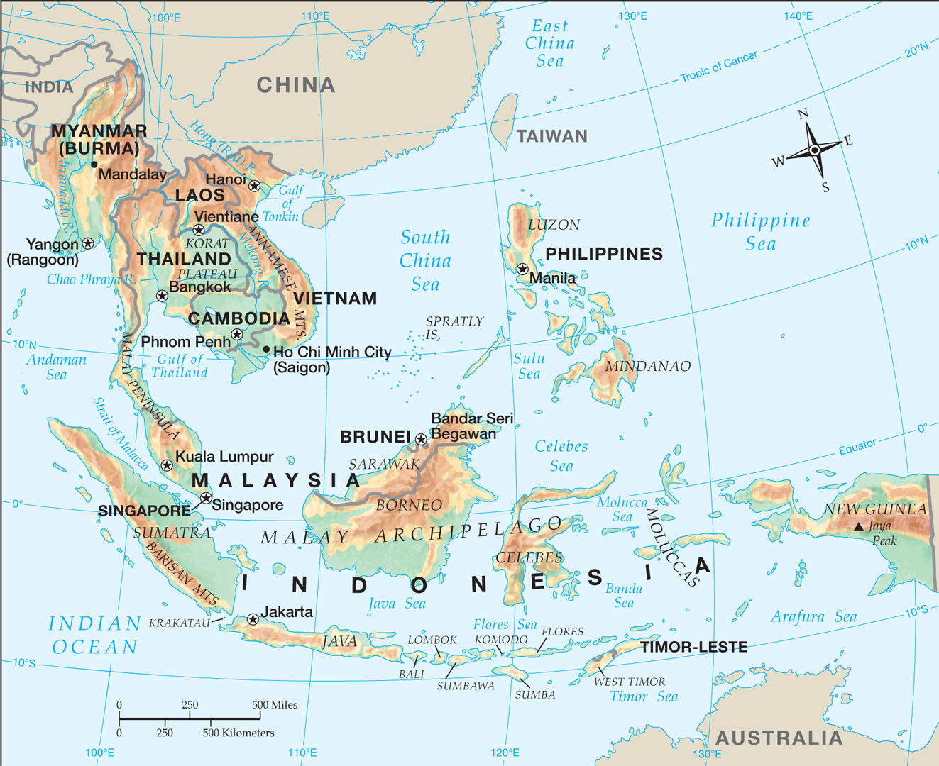
Notes:
Map Resources

Slide 8
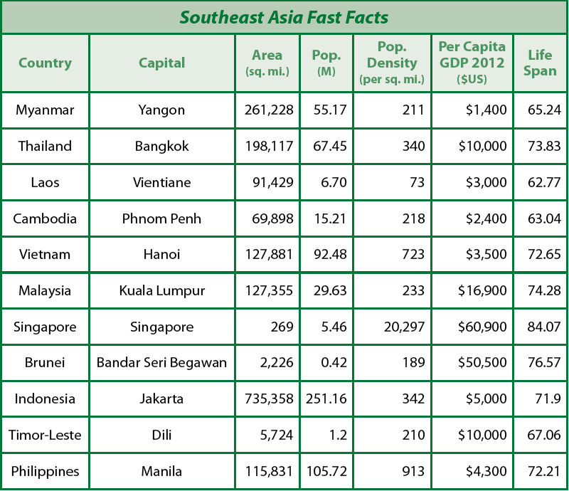
Notes:
Cultural Geography, 4th edition, p. 370

Slide 9
Indochina
Southeast Asia is divided into two major subregions.
The mainland portion is called Indochina, so named because of the dominant neighbors on either side of the region: India and China.
These two countries exert strong influence on the culture, politics, and economy of the entire region.
South of Indochina is the second subregion, the insular countries of the Malay Archipelago: Malaysia, Singapore, Indonesia, Brunei, Timor-Leste, and the Philippines.
An archipelago (ahrk uh PEHL uh goh) is a large group of islands.

Slide 10
Myanmar
As one moves eastward from India, the first country of Indochina one enters is Myanmar (myahn MAHR), formerly known as Burma, which is the largest country in Indochina and the second largest in Southeast Asia.
Most of the people of Myanmar live along the coastal lowlands, where the rain forest offers sufficient water for rice paddies.
The capital, Yangon (formerly called Rangoon), and its four million residents (2007) are in the lowlands of the delta of the Irrawaddy (ihr uh WAHD ee) River the main river of Myanmar, which runs from the rugged eastern highlands down to the Andaman Sea.
Seventy percent of the work force is employed in agriculture, which contributes 39 percent of the GDP.

Slide 11
Sadly, farmers in the “Golden Triangle,” where the borders of Myanmar, Laos, and Thailand meet, also grow poppies for opium production.
Since Myanmar gained its independence in 1948, much of its history has been a succession of military dictatorships.
Eighty percent of the people of Myanmar are Buddhist.
Despite the improvement in human rights, Christians are still targeted by the military and referred to as the “C-virus.”
Foreign workers were expelled in 1996, and Christians were left without mature leaders or organization.
Myanmar was once the richest country in Southeast Asia, but its military regime adopted socialist economic practices that hindered productivity and prosperity.

Slide 12
Buddhism
Buddhism is a religion that promotes the teachings of Siddhartha Gautama, who lived about five hundred years before Christ.
Buddha means “enlightened one.”
Buddha lived in India and was influenced by Hindu ideas such as karma and samsara (the cycle of reincarnation).
The goal is to escape from samsara into nirvana a state of complete happiness and rest.
Nirvana is not a place where souls go.
Buddhists do not believe souls exist; nor is nirvana mere nothingness.

Slide 13
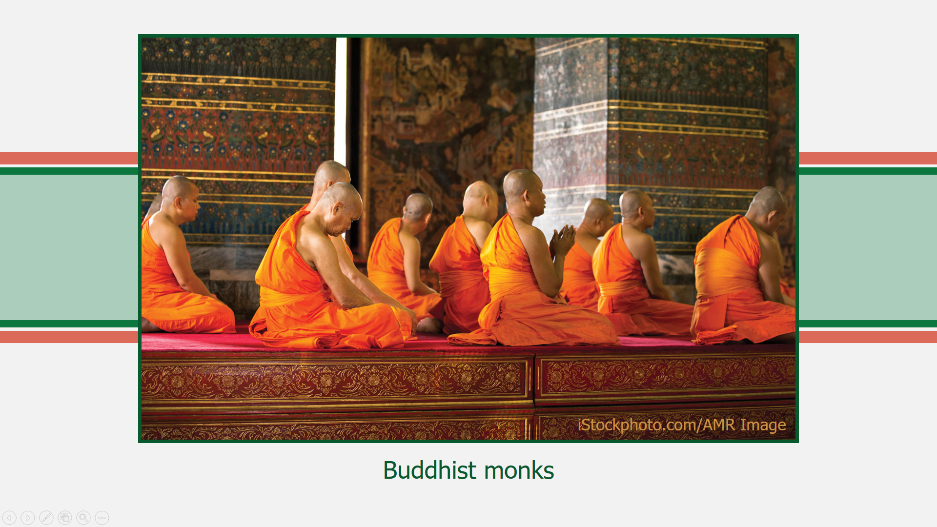
Notes:
iStockphoto.com/AMR Image

Slide 14
Thailand
East of Myanmar is Thailand (TYE land), which until 1939 was known as Siam (sy AM). It is the only country of Southeast Asia that was never controlled by a European colonial power.
It is also the strongest economic power in Indochina because it has not only abundant resources that it has developed wisely but also a sound free market economy.
Thailand borders Laos, Cambodia, and Malaysia.
Like Myanmar, Thailand has a major river, the Chao Phraya (CHOU prah-YAH), flowing from the northern highlands.
It empties into the Gulf of Thailand near Bangkok, the capital.

Slide 15
Much of Thailand’s territory encompasses the Malay Peninsula, which is almost one thousand miles long.
In the mid-fourteenth century, what was then known as Siam was founded as a kingdom.
It switched from an absolute monarchy to a constitutional monarchy in 1932 and remains so today.
Although the country has a hereditary king, its effective head is the prime minister, who is elected from among the members of the House of Representatives.
The greatest problem facing the government today comes from three Muslim-majority provinces in the south, which are in armed rebellion, most likely spurred on by the spread of radical Islam around the world.

Slide 16
Elephant Roundup
The elephant, Thailand’s national symbol, is used in the timber industry of the country.
Workers gather many elephants once a year in a big roundup that is something like a Western rodeo—but using elephants rather than horses.
People from near and far come to watch the huge animals display their skills.
Their trainers, called mahouts (muh HOUTZ), sit proudly on the shoulders of the beasts, giving commands by nudging the beasts behind the ears with their feet.

Slide 17
1. Which country in this region has a modern history characterized by military dictatorships?
Myanmar

Slide 18
2–3. Which country in this region is the only one never colonized by a European power, and what is that country’s former name?
Thailand; Siam

Slide 19
4. Which country has an elephant roundup?
Thailand

Slide 20
Why has Myanmar gone from the richest country in Southeast Asia to one characterized by inefficiency and poverty?
Adoption of socialist economic practices, oppressive government controls, inefficient economic policies, and economic sanctions by its military regime

Slide 21
Laos
The only landlocked country in Southeast Asia is Laos (LOUSE).
It is surrounded by Myanmar and Thailand on the west, Cambodia on the south, China on the north, and Vietnam on the east.
It is a largely undeveloped mountainous country.
Much of its border with Thailand is the Mekong (MAY KONG) River.
In 1975, a Communist organization called the Pathet Lao took over and closely aligned the country with Communist Vietnam.
In recent years, Laos has tried to move back toward a free market economy with positive results.
The Communist party retains control of the government, and freedoms are severely limited.

Slide 22
Cambodia
South of Laos is the country of Cambodia (kam BOH dee uh).
It also shares borders with Vietnam on the east and Thailand on the north and west.
Its southern border is the Gulf of Thailand.
The terrain of Cambodia, which is slightly smaller than Oklahoma, is primarily low, flat plains, although it does have some mountains in the southwest and north.
The country was under the colonial authority of France from 1863 until it gained independence in 1953.
The Communist Khmer Rouge (kuh-MEHR ROOZH) took over in 1975 after a five-year struggle.

Slide 23
The Communist leader, Pol Pot, had the idea that the solution to the country’s problems was to erase all memories of colonial times and return everyone to a rural, agricultural lifestyle.
In the process, the Khmer Rouge sought to eliminate all opposition.
To accomplish this goal, the Communists murdered all military personnel, civil servants, doctors, teachers, and their family members as well as anyone who had a basic education or who was wealthy.
When they finished, the Khmer Rouge had killed nearly two million Cambodians. 50% of the population is 20 years or younger.
Today, the country has a king who rules with a bicameral legislature composed of representatives of three recognized political parties.

Slide 24
Vietnam
The country of Vietnam (vee eht NAHM) can be visualized as a long, thin S reaching from southern China in the north to the Gulf of Thailand in the southwest.
The northern third of the country is shaped like an inverted triangle with the Gulf of Tonkin on the east and Laos on the west.
It is bisected from northwest to southeast by the Hong (Red) River, which flows through the capital, Hanoi (ha NOY), and empties through a low, flat delta into the Gulf of Tonkin (TAHN kihn).
The chief seaport is Haiphong (hye FONG) in the northern portion of the delta.

Slide 25
The southern portion is a little more than one-third of the total length of the country.
It widens, and the coast, washed by the South China Sea, curves first southward and then southwestward near Cam Ranh.
The largest city in the southern portion of the country, Ho Chi Minh (hoh chee mihn) City (formerly Saigon), is at the northern edge of the delta.
The culture of modern Vietnam reflects a variety of influences, both Western and Oriental.
It became a French colony in 1858.
Although the Vietnamese declared their independence at the end of World War II, they did not break free of French control until 1954, when Vietnamese rebels led by Communist Ho Chi Minh defeated the French forces at Dien Bien Phu (dyehn byehn FOO). He also defeated S. Vietnam

Slide 26
The United Nations proposed free elections to allow the Vietnamese to determine their country’s future.
Vietnamese living in the southern half of the country voted to remain free.
However, when the Communists who controlled the northern half of the country refused, the UN divided the country at the 17th parallel, creating North and South Vietnam.
Not willing to let the richer South remain free and separate, the North Vietnamese invaded the south, supported by a guerilla group known as the Viet Cong.
Based on the domino theory (the idea that if one country of Southeast Asia fell to communism, the others would soon fall too, just like dominoes), the United States sent progressively more troops to help the South.

Slide 27
However, the Vietnam War proved to be so divisive in the United States that U.S. troops were withdrawn in 1973.
In 1975, the South fell, and millions of Vietnamese people were killed or imprisoned or died trying to escape the country.
Under international pressure to improve its human rights record, Vietnam finally began to liberalize its economic policies in 2001, and the country is making vast improvements economically.
Vietnam still has a Communist government that allows no opposition party.
The president is elected by the unicameral National Assembly.
Vietnam is considered closed to formal missionary activity.
Vietnam ranks 1st in the world in cashew production.

Slide 28
1. Which river not only forms much of the border between Laos and Thailand but also flows through Cambodia and Vietnam?
Mekong River

Slide 29
2. What group came to power in Cambodia and used extreme violence to return the nation to an agricultural lifestyle?
Khmer Rouge

Slide 30
3. What European country was defeated in the battle at Dien Bien Phu?
France

Slide 31
4. Vietnamese in which half of the country desired to be free of communism?
South

Slide 32
Did the fall of South Vietnam prove or disprove the domino theory?
Answers will vary.
In the short term, it seemed to prove the domino theory because Cambodia also fell to the Communist Khmer Rouge. However, in the long term it did not prove the domino theory because no other countries in the region fell to communism.

Slide 33
The Malay Archipelago

Slide 34
The Malay Archipelago
Malaysia
Singapore
Brunei
Indonesia
Timor-Leste
The Philippines

Slide 35
The Malay Archipelago
The Malay Archipelago is the largest group of islands in the world.
In begins near the lower half of the Malay Peninsula and encompasses two major groups of islands: the East Indies and the Philippines.
Most of the islands are volcanic, and mountains dominate many of them.
Apart from those highland areas, all of the islands have a tropical wet climate.

Slide 36
Malaysia
The first country a person traveling southward from Thailand enters is Malaysia (muh LAY zhuh).
Part of it is on the lower portion of the Malay Peninsula, and the rest of it is on the northern side of Borneo, located to the east of the peninsula.
Eighty percent of Malaysia’s people live on the peninsula.
The capital, Kuala Lumpur (KWAHL-uh loom-POOR; pop. 1.6 million), is there.
Malaysia was a British colonial power in the eighteenth and nineteenth centuries and was occupied by Japan during World War II.
In 1948, the Federation of Malaya was formed, and in 1957 the country gained full independence.

Slide 37
Singapore
At the southern tip of the Malay Peninsula is an island that is only a little more than three and a half times the size of Washington, D.C.
Singapore (SING uh poor) is the name of not only the island but also the country and the capital.
It has been a major trade and shipping location since the time of Christ, and it remains the focal point of trade in the region today.
The population of Singapore is heavily Chinese (74 percent).
Singapore has taken steps to increase its amount of space by reclaiming land from the sea (resulting in a 10 percent increase in its space).

Slide 38
Singapore is the financial and high-tech hub of Southeast Asia.
The government of Singapore is a parliamentary republic with a president and a unicameral parliament led by a prime minister.

Slide 39
Brunei
Nestled between the Malayian states of Sabah and Sarawak on the north central coast of the island of Borneo is the tiny (a little smaller than Delaware) country of Brunei (broo NYE).
Brunei has been important for traders since the seventh century.
In 1888, the British made it one of their protectorates to stop pirates there who were preying on British shipping.
It gained independence from Britain in 1984.
The government is a constitutional sultanate.
It has a legal system based on English common law, but Islamic sharia law supersedes civil law in some areas.

Slide 40
Indonesia
By far the largest country of not only the Malay Archipelago but almost all of Southeast Asia is Indonesia (ihn doh NEE zhuh).
It is a nation of 17,508 separate islands, but only about 6,000 of them are populated.
Indonesia has the fourth-largest population in the world (behind only China, India, and the United States.)
The important factor that tends to unite so many different peoples of such different languages and cultures over such vast distances is religion.
With 80 percent of Indonesians being Muslims, Indonesia is the largest Islamic country in the world.

Slide 41
The hub of Indonesian civilization has been the island of Java (JAH vuh), which is southeast of Sumatra and due south of Borneo.
Today, Java is the most densely populated of Indonesia’s islands, and the capital, Jakarta (juh KAHR tuh; pop 9.2 million), is one of the largest cities in the world.
Indonesia includes all or part of four of the world’s eleven largest islands.
Java ranks thirteenth worldwide, but four other Indonesian islands are even larger, of which New Guinea is the largest.
The rest of Indonesia consists of two island chains, the first of which is the Lesser Sunda Islands east of Java, which stretch from Bali to Timor.
Timor (TEE mohr) is the largest of the Lesser Sunda Islands.
Bali (BAH lee) is the most famous of the Lesser Sundas.

Slide 42
The second chain of islands is the Moluccas (muh LUHK uhz), which were at one time called the Spice Islands.
Indonesia is a republic with a unicameral legislature as well as a president and a vice president who are elected by the people for five-year terms.

Slide 43
Timor-Leste
Timor (TEE mohr) is the largest of the Lesser Sunda Islands.
Following the end of Portuguese rule in 1974, civil war between West and East Timor and Indonesian suppression resulted in the death of one hundred thousand Timorese people.
In 1999, the Timorese people in East Timor began to demand independence from Indonesia and West Timor.
The new country Timor-Leste (“East-East”) gained international recognition in 2002.
Timor-Leste, one of only two nations in Asia with a Roman Catholic majority (80.5 percent), had four centuries of Portuguese rule.
The Catholic Church retained strong support as a result of its support of independence.

Slide 44
The Philippines
The Philippine (FIHL uh peen) Islands lie due east of Vietnam across the South China Sea, south of Taiwan, north of the Moluccas, and west of the Philippine Sea.
Luzon (loo ZAHN) is the largest and most populous island.
The Philippines includes both the capital, Manila (muh NIH luh; pop. 1.7 million), and the largest city in the country, Quezon City (pop. 2.8 million).
Mindanao (mihn dihn NOW) is the second-largest island, and its largest city is the port of Davao (dah VOW; pop. 1.5 million).
The islands of the Philippines are in the middle of the “typhoon belt.”
They are usually affected by about fifteen typhoons a year and are hit directly by about five or six a year.

Slide 45
The Philippine Islands were a Spanish colony from the time of their discovery by Ferdinand Magellan in 1521 until the Spanish Empire was defeated in the Spanish-American War in 1898, giving the United States control of the country.
Japanese occupation during World War II delayed the Philippines’ scheduled independence, but it was finally gained in 1946.
The Philippines is a republic with an elected president.
It has a bicameral legislature with a House of Representatives and a Senate.

Slide 46
1. Which two Malaysian states are located on the island of Borneo?
Sabat and Sarawak

Slide 47
2. Which country in the Malaysian archipelago is one of the busiest seaports by volume in the world?
Singapore

Slide 48
3. What tiny country is located on Borneo’s northwest side between the two Malaysian states?
Brunei

Slide 49
4. What is the largest country (in both area and population) in Southeast Asia?
Indonesia

Slide 50
5. What are the names of the two largest islands of the Philippines?
Luzon and Mindanao

Slide 51
Why does Singapore enjoy the highest GDP in Southeast Asia?
Answers may include the following: it is a major exporter; industry includes manufacturing and construction; it is the financial and high-tech hub of southeast Asia; government is supportive of economic growth.

Slide 52
People, Places, and Things to Know

Slide 53
Indochina
the mainland portion of Southeast Asia, including Vietnam, Laos, Cambodia, Thailand, and Myanmar

Slide 54
insular countries
countries that are isolated or cut off from other countries

Slide 55
Malay Archipelago
includes the countries of Malaysia, Singapore, Indonesia, Brunei, Timor-Leste, and the Philippines

Slide 56
archipelago
a large group of islands

Slide 57
Irrawaddy River
runs from the rugged eastern highlands of Myanmar down to the Andaman Sea

Slide 58
“Golden Triangle”
where the borders of Myanmar, Laos, and Thailand meet

Slide 59
nirvana
a spiritual state in Buddhism in which one frees himself from desires and worldly things, finds release from suffering, and reaches a state of complete happiness and rest

Slide 60
Siam
the former name of Thailand

Slide 61
ASEAN
Association of Southeast Asian Nations; a political and economic organization formed in 1967

Slide 62
Mekong River
forms much of the border between Thailand and Laos

Slide 63
Khmer Rouge
Communists who came to power in Cambodia and used extreme violence to return the country to an agricultural lifestyle

Slide 64
Pol Pot
Communist leader of the Khmer Rouge; had the idea that the solution to Cambodia’s problems was to erase all memories of colonial times and return everyone to a rural, agricultural lifestyle

Slide 65
Hong (Red) River
the river that flows through Hanoi and bisects Vietnam from northwest to southeast

Slide 66
Hanoi
capital of Vietnam

Slide 67
Gulf of Tonkin
body of water to the east of northern Vietnam

Slide 68
Haiphong
chief seaport of Vietnam

Slide 69
South China Sea
body of water to the east of southern Vietnam

Slide 70
Ho Chi Minh City
largest city in the southern portion of Vietnam

Slide 71
Ho Chi Minh
led the Communist defeat of the French
at Dien Bien Phu in Vietnam

Slide 72
Dien Bien Phu
the battle at which Ho Chi Minh defeated the French forces

Slide 73
domino theory
the idea that if one country of Southeast Asia fell to communism, the others would soon fall too

Slide 74
Kuala Lumpur
capital of Malaysia

Slide 75
Java
hub of Indonesian civilization; an island of Indonesia

Slide 76
Jakarta
capital of Indonesia

Slide 77
Moluccas
a chain of islands in Indonesia; was once called the Spice Islands

Slide 78
Timor-Leste
means “East-East”; country that was formed from a civil war between West and East Timor

Slide 79
Luzon
largest and most populous island of the Philippines

Slide 80
Mindanao
second-largest island of the Philippines

