Slide 2
Reconstruction (1865–1877)
15

Slide 3
How did the early plans for Reconstruction differ?
What were the highlights of the congressional Reconstruction period?

Slide 4
What were examples of corruption during the years Ulysses S. Grant served as president?
What were the long-term consequences of the Civil War and Reconstruction?

Slide 5
“With malice toward none, with charity for all,…to do all which may achieve and cherish a just and lasting peace among ourselves and with all nations.”
Abraham Lincoln, March 4, 1865

Slide 6
The period from 1865 to 1877 is usually known as the era of Reconstruction.

Slide 7
What were the different approaches of Lincoln, Congress, and Johnson when Reconstruction began?
What was the significance of the Thirteenth Amendment?

Slide 8
What role did the black codes play in the course of Reconstruction?

Slide 9
Presidential Reconstruction
Lincoln’s Ten Percent Plan
Lincoln had appointed military governors for each captured state
10% of citizens (who voted in 1860) had to take an oath of allegiance
Relatively lenient plan

Slide 10
The Radical Republicans, led by Thaddeus Stevens and Charles Sumner, intended to treat the South far more harshly.

Slide 11
Presidential Reconstruction
Radicals’ View
Wade-Davis Bill
Military governors until 50% of adult white males signed oath of allegiance
New state constitutions with several required provisions

Slide 12
Presidential Reconstruction
Lincoln vetoed the Wade-Davis Bill
The motives of the Radicals varied
Secure and protect the rights of blacks
Revenge
Control

Slide 13
Presidential Reconstruction
Johnson’s Plan
More similar to Lincoln’s plan
Offered amnesty to Southerners who would swear loyalty to the Union
The wealthiest people would have to apply directly to the president
Required state conventions

Slide 14
Presidential Reconstruction
Changes in Southern States
The economy of the South was in shambles
Johnson’s lenient approach encouraged the South
By the end of 1865, most of the former Confederate states met Johnson’s terms

Slide 15
Presidential Reconstruction
Black codes
Severely limited the rights of black people
Affected where blacks could live, work, and travel

Slide 16
Congress had not been in session from the time Johnson became president until December.

Slide 17
Presidential Reconstruction
Congressional Response
A large number of new Southern congressmen were Confederate leaders
Congress refused to seat the newly elected Southern members of Congress
Joint Committee on Reconstruction was formed

Slide 18
The actions of Congress outraged Johnson, and he lashed out at his opponents.

Slide 19
Thaddeus Stevens
Charles Sumner
Andrew Johnson

Slide 20
What major pieces of legislation did Congress enact regarding Reconstruction?
Why was President Johnson impeached?

Slide 21
What were the varying assessments of carpetbaggers and scalawags?
How did some Southerners react violently to Reconstruction?

Slide 22
Congressional Reconstruction
Freedmen’s Bureau
Helped former slaves and refugees
Schools and hospitals
1866: Congress enlarged it
Had power to deal with the injustices of the black codes
Had power to help negotiate contracts

Slide 23
Congressional Reconstruction
Johnson vetoed the bill
Congress overrode the veto
General Oliver O. Howard headed the bureau
Schools became the primary mission of the bureau

Slide 24
Congressional Reconstruction
Civil Rights Act
March 1866
Granted citizenship to African Americans
“Full and equal benefit of all laws”
Johnson vetoed the bill
Congress overrode the veto

Slide 25
Congressional Reconstruction
Fourteenth Amendment
Granted freedmen full citizenship and full protection of the laws
A state’s representation in Congress would be based on its full population

Slide 26
Congressional Reconstruction
Restrictions on voting or holding office on certain former Confederates
Neither federal nor state governments could pay Confederate debts or provide compensation to former slaveholders
Johnson urged Southern states to vote against the amendment

Slide 27
Congressional Reconstruction
Johnson campaigned against Radical candidates
His strategy backfired
His leadership was questioned
Republicans won a landslide victory in the 1866 elections and had even greater control in Congress

Slide 28
Johnson continued to veto bills.
Congress continued to override Johnson’s vetoes.

Slide 29
Congressional Reconstruction
Reconstruction Act of 1867
Military occupation of the South
Divided the South into five military districts
Gave black people the right to vote and hold office

Slide 30
Congressional Reconstruction
States wanting to reenter the Union had to have conventions with black and white voting delegates
To write new state constitutions
States had to submit their new constitutions to Congress for approval
Required states to ratify 14th Amendment

Slide 31
Congressional Reconstruction
Only once a state met all the requirements could it reenter the Union
Tennessee was exempt
Southern Unionists, Northerners, and black Americans began to hold public offices

Slide 32
Congressional Reconstruction
Impeachment
Tenure of Office Act
Intended to protect Edwin Stanton
Johnson decided to remove Stanton

Slide 33
The Constitution provides that the House of Representatives, by majority vote, can bring charges against the president.
This is called impeachment.

Slide 34
Congressional Reconstruction
The House voted 126–47 to impeach Johnson on eleven charges
The Senate tried the president
There were a number of questions and opinions

Slide 35
Congressional Reconstruction
The Senate vote was 35–19, one vote shy of the two-thirds majority required to remove Johnson from office

Slide 36
Years later, the Supreme Court ruled the Tenure of Office Act unconstitutional.

Slide 37
Congressional Reconstruction
Farming
Land was the most important Southern resource
Shortage of cash and slave labor
Sharecropping became popular
Both blacks and poor whites participated

Slide 38
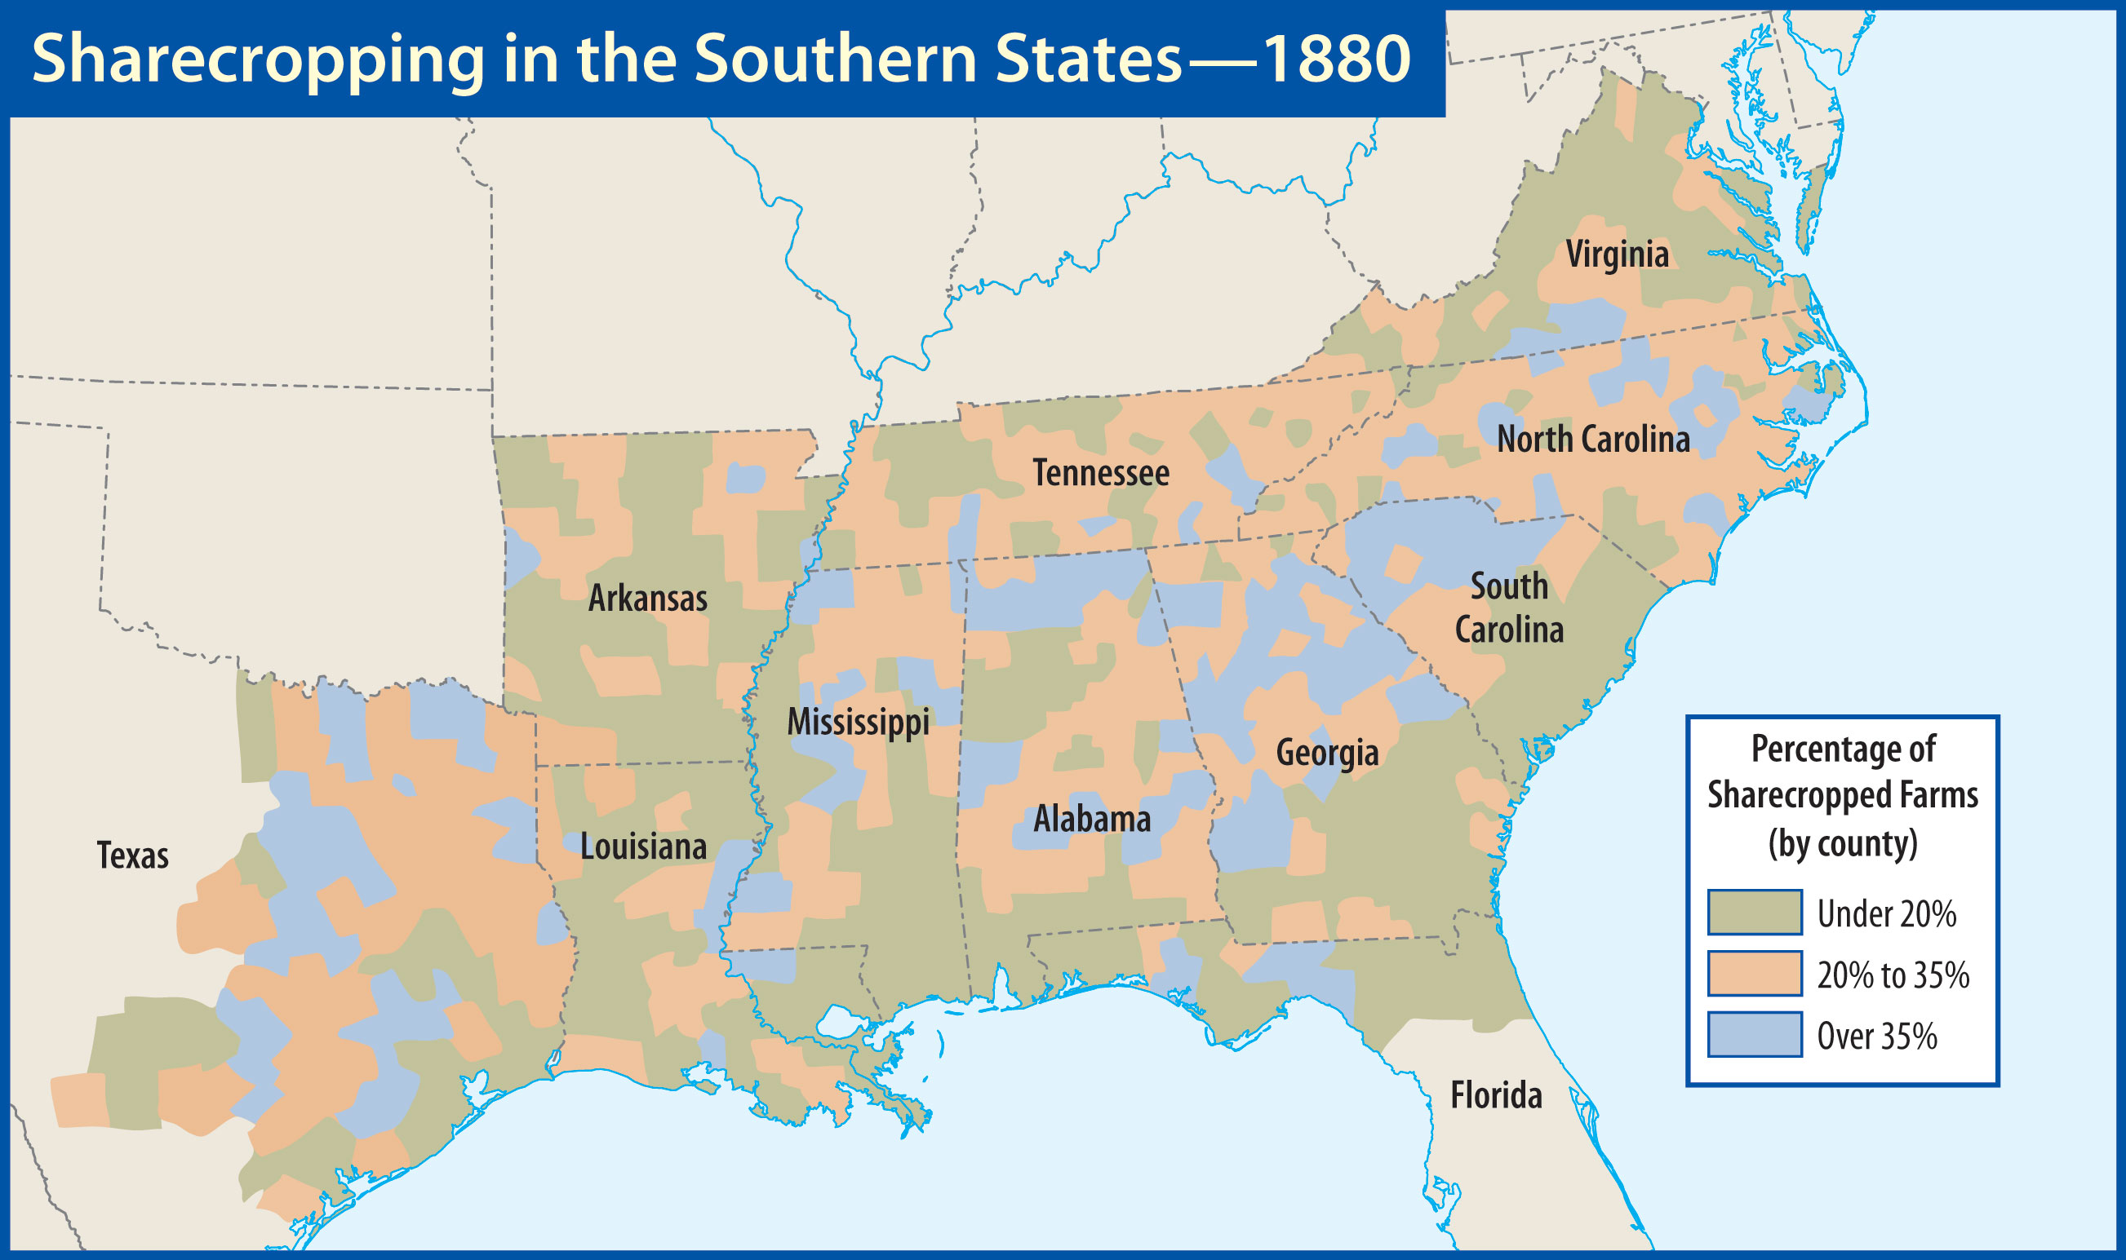

Slide 39
Congressional Reconstruction
Many sharecroppers got trapped in debt
Some were required to grow tobacco or cotton
Prices were often low
Tenant farmers rented their farmland

Slide 40
carpetbaggers
Northerners who came South during Reconstruction

Slide 41
scalawags
Southerners who cooperated with carpetbaggers during Reconstruction

Slide 42
Congressional Reconstruction
Carpetbaggers and Scalawags
Some who moved to the South had sincere motives; others did not
Both groups were despised by most Southerners

Slide 43
The Reconstruction governments in the South had instances of both corruption and real accomplishments.

Slide 44
disenfranchisement
denial of the right to vote

Slide 45
Congressional Reconstruction
Violence
Ku Klux Klan
Targeted blacks and white Republicans
Included many prominent citizens

Slide 46
Congressional Reconstruction
Many freedmen were lynched
Local law enforcement often could or would not deal with the KKK
Federal laws were passed
The Klan’s power was eventually diminished

Slide 47
What scandals occurred during the years Grant served as president?
What was the significance of the Fifteenth Amendment?
What conditions led to the Panic of ’73?

Slide 48
Why was the Election of 1876 so significant?

Slide 49
Years of Corruption
Election of 1868
Republican: Ulysses S. Grant
“Let us have peace”
Democrat: Horatio Seymour
Grant won by a comfortable margin

Slide 50
Years of Corruption
Grant lacked political experience
He had untrustworthy friends and associates
“Grantism”

Slide 51
Years of Corruption
Fifteenth Amendment
Guaranteed that “race, color, or previous condition of servitude” would not cause a man’s right to vote to be revoked
Some Northern states had still not legalized black suffrage

Slide 52
Years of Corruption
Scandals
Crédit Mobilier
Defrauded government for railroad construction expenses
Fish and Gould
Attempt to manipulate the gold market

Slide 53
Years of Corruption
William Belknap
Whiskey Ring
Grant’s private secretary was accused
There is no evidence that Grant personally profited from any of this

Slide 54
Sadly, the Grant administration was one of the most scandal-ridden of any American president.

Slide 55
Years of Corruption
Tammany Hall
William “Boss” Tweed
Controlled most of NY’s political affairs
Enormous financial fraud
Bribes
Tweed was finally arrested in 1871

Slide 56
Years of Corruption
Thomas Nast
Political cartoonist
Repeatedly attacked Tweed and Tammany Hall
Feared by Tweed

Slide 57
Years of Corruption
Liberal Republicans
This group supported an end of military occupation of the South
Opposed corruption in government
Nominated Horace Greeley

Slide 58
Grant crushed Greeley in the 1872 presidential election, destroying the Liberal Republican movement.

Slide 59
Years of Corruption
Economic Boom and Bust
The economy had been doing well during Grant’s first term
Panic of ’73
Began a six-year depression
Worst depression in American history up to that time

Slide 60
Years of Corruption
Greenbacks
Not “hard money”
Some wanted the greenbacks taken out of circulation
Debtors and the poor tended to favor the greenbacks
Compromise

Slide 61
The government’s action restricting the amount of money in circulation made the depression worse.

Slide 62
Years of Corruption
The Redeemers
Northerners became less concerned with Reconstruction
Southern Democrats wanted to regain control
General Amnesty Act

Slide 63
Years of Corruption
Some African Americans participated in Southern politics

Slide 64
Years of Corruption
Republicans found they could not match the Southerners seeking to “redeem the South”
White Democrats were replacing black officials and white Republicans
Election fraud played a role

Slide 65
By 1876, federal troops remained only in Louisiana, Florida, and South Carolina.

Slide 66
Years of Corruption
Election of 1876
Republican: Rutherford B. Hayes
Known for his honesty
Democrat: Samuel J. Tilden
Known for fighting the “Tweed ring”

Slide 67
Years of Corruption
A Disputed Election
Tilden won the popular vote
185 electoral votes were needed to win
Tilden had 184 electoral votes
19 electoral votes were disputed in three southern states

Slide 68
Years of Corruption
Congress established a commission
Voted 8–7 to give the disputed electoral votes to the Republicans
Hayes won by one electoral vote
There had been corruption on both sides

Slide 69
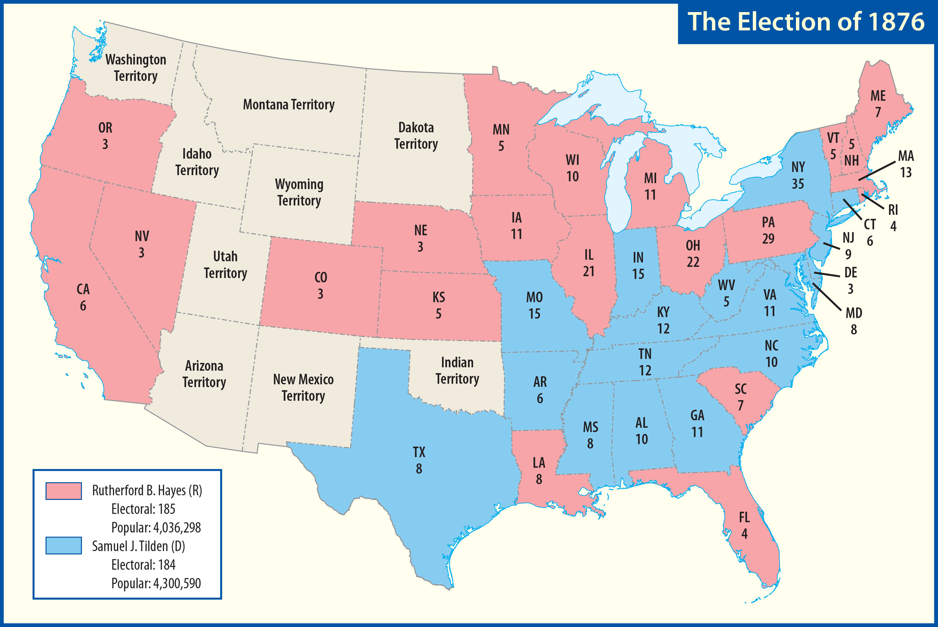

Slide 70
Years of Corruption
Compromise of 1877
Southern Democrats would allow the votes to be counted in Hayes’s favor
Hayes would remove the last federal troops from the South
Both sides upheld their ends of the deal

Slide 71
Why were some people dissatisfied with Reconstruction?
How did Reconstruction impact the nation?

Slide 72
A Reconstructed Nation
African Americans
White Southerners
Northerners

Slide 73
A Reconstructed Nation
Many argue that Reconstruction should have been more extensive
Civil rights advances were eventually lost
Three constitutional amendments
Slaves were freed, granted citizenship, and given the right to vote

Slide 74
A Reconstructed Nation
A stronger and more centralized federal government
The South soon became known as “the Solid South”

Slide 75
Xxx
Xxx

