Slide 2
America Expands (1850–1900)
17

Slide 3
How did Americans expand to the West and what were their motivations for this expansion?
What was the American government’s Indian policy?

Slide 4
What were the results of the international expansion of the United States in the second half of the nineteenth century?

Slide 5
Some Americans began to look across the seas to other lands where they could plant the Stars and Stripes.

Slide 6
How did the transcontinental railroads affect westward expansion?
What were the vast potentials and hazards of developing resources in the West?

Slide 7
How did pioneers overcome the difficulties of settling the Great Plains?

Slide 8
Western Expansion
Rails to the West
Trains carried settlers to the West
Trains carried products and resources to the East
Railroads were the main instrument of developing the American West

Slide 9
Western Expansion
The Transcontinental Idea
Congress passed two railroad acts
Land grants for railroad companies
Loans to the railroad companies
Union Pacific began in Omaha, NE
Central Pacific began in Sacramento, CA

Slide 10
Although the Union Pacific had mostly plains to cross, both companies had difficulties.

Slide 11
Western Expansion
Building the Line
Union Pacific hired mostly Irish immigrants
Central Pacific hired mostly Chinese immigrants
Both sets of builders made rapid progress
Quality problems

Slide 12
Western Expansion
Promontory Point, Utah
Central Pacific: 688 mi.
Union Pacific: 1,086 mi.
Four transcontinental railroad lines followed
Great Northern used no government subsidies

Slide 13
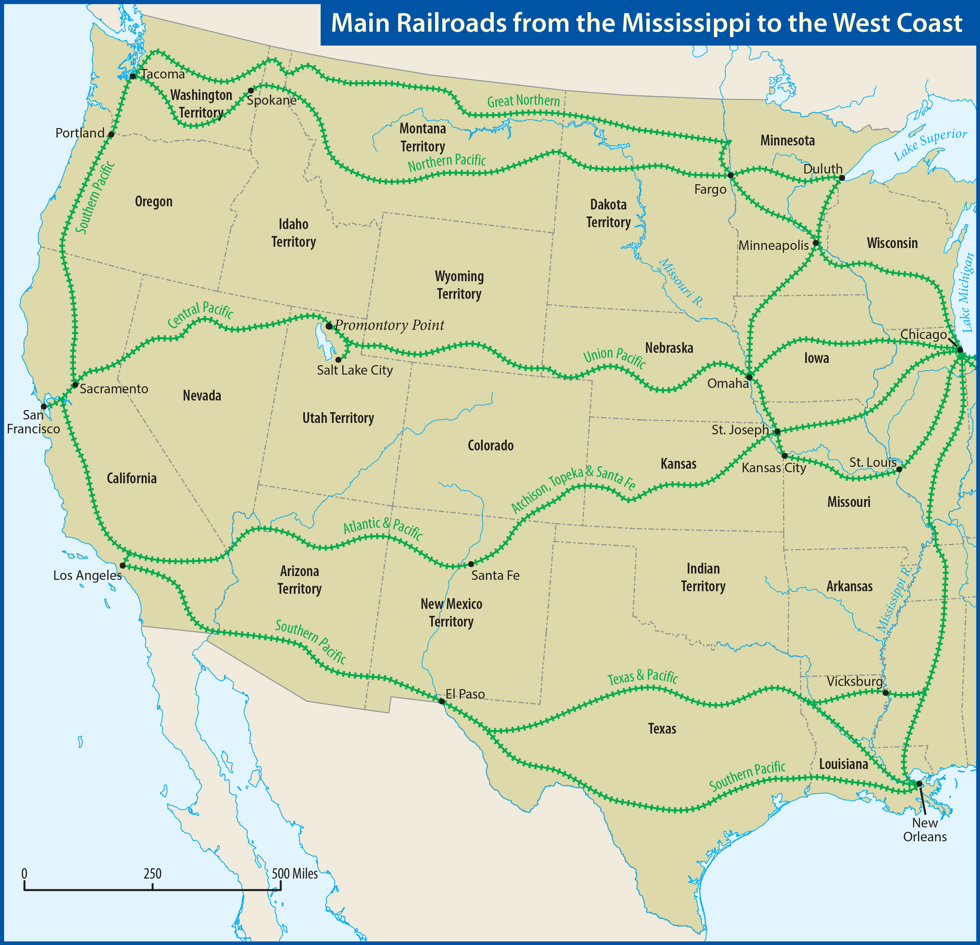

Slide 14
Western Expansion
Mining
California gold rush (1849)
Pikes Peak gold rush (1859)
Leadville: gold and other metals; lead
Comstock Lode: gold and silver
Big business

Slide 15
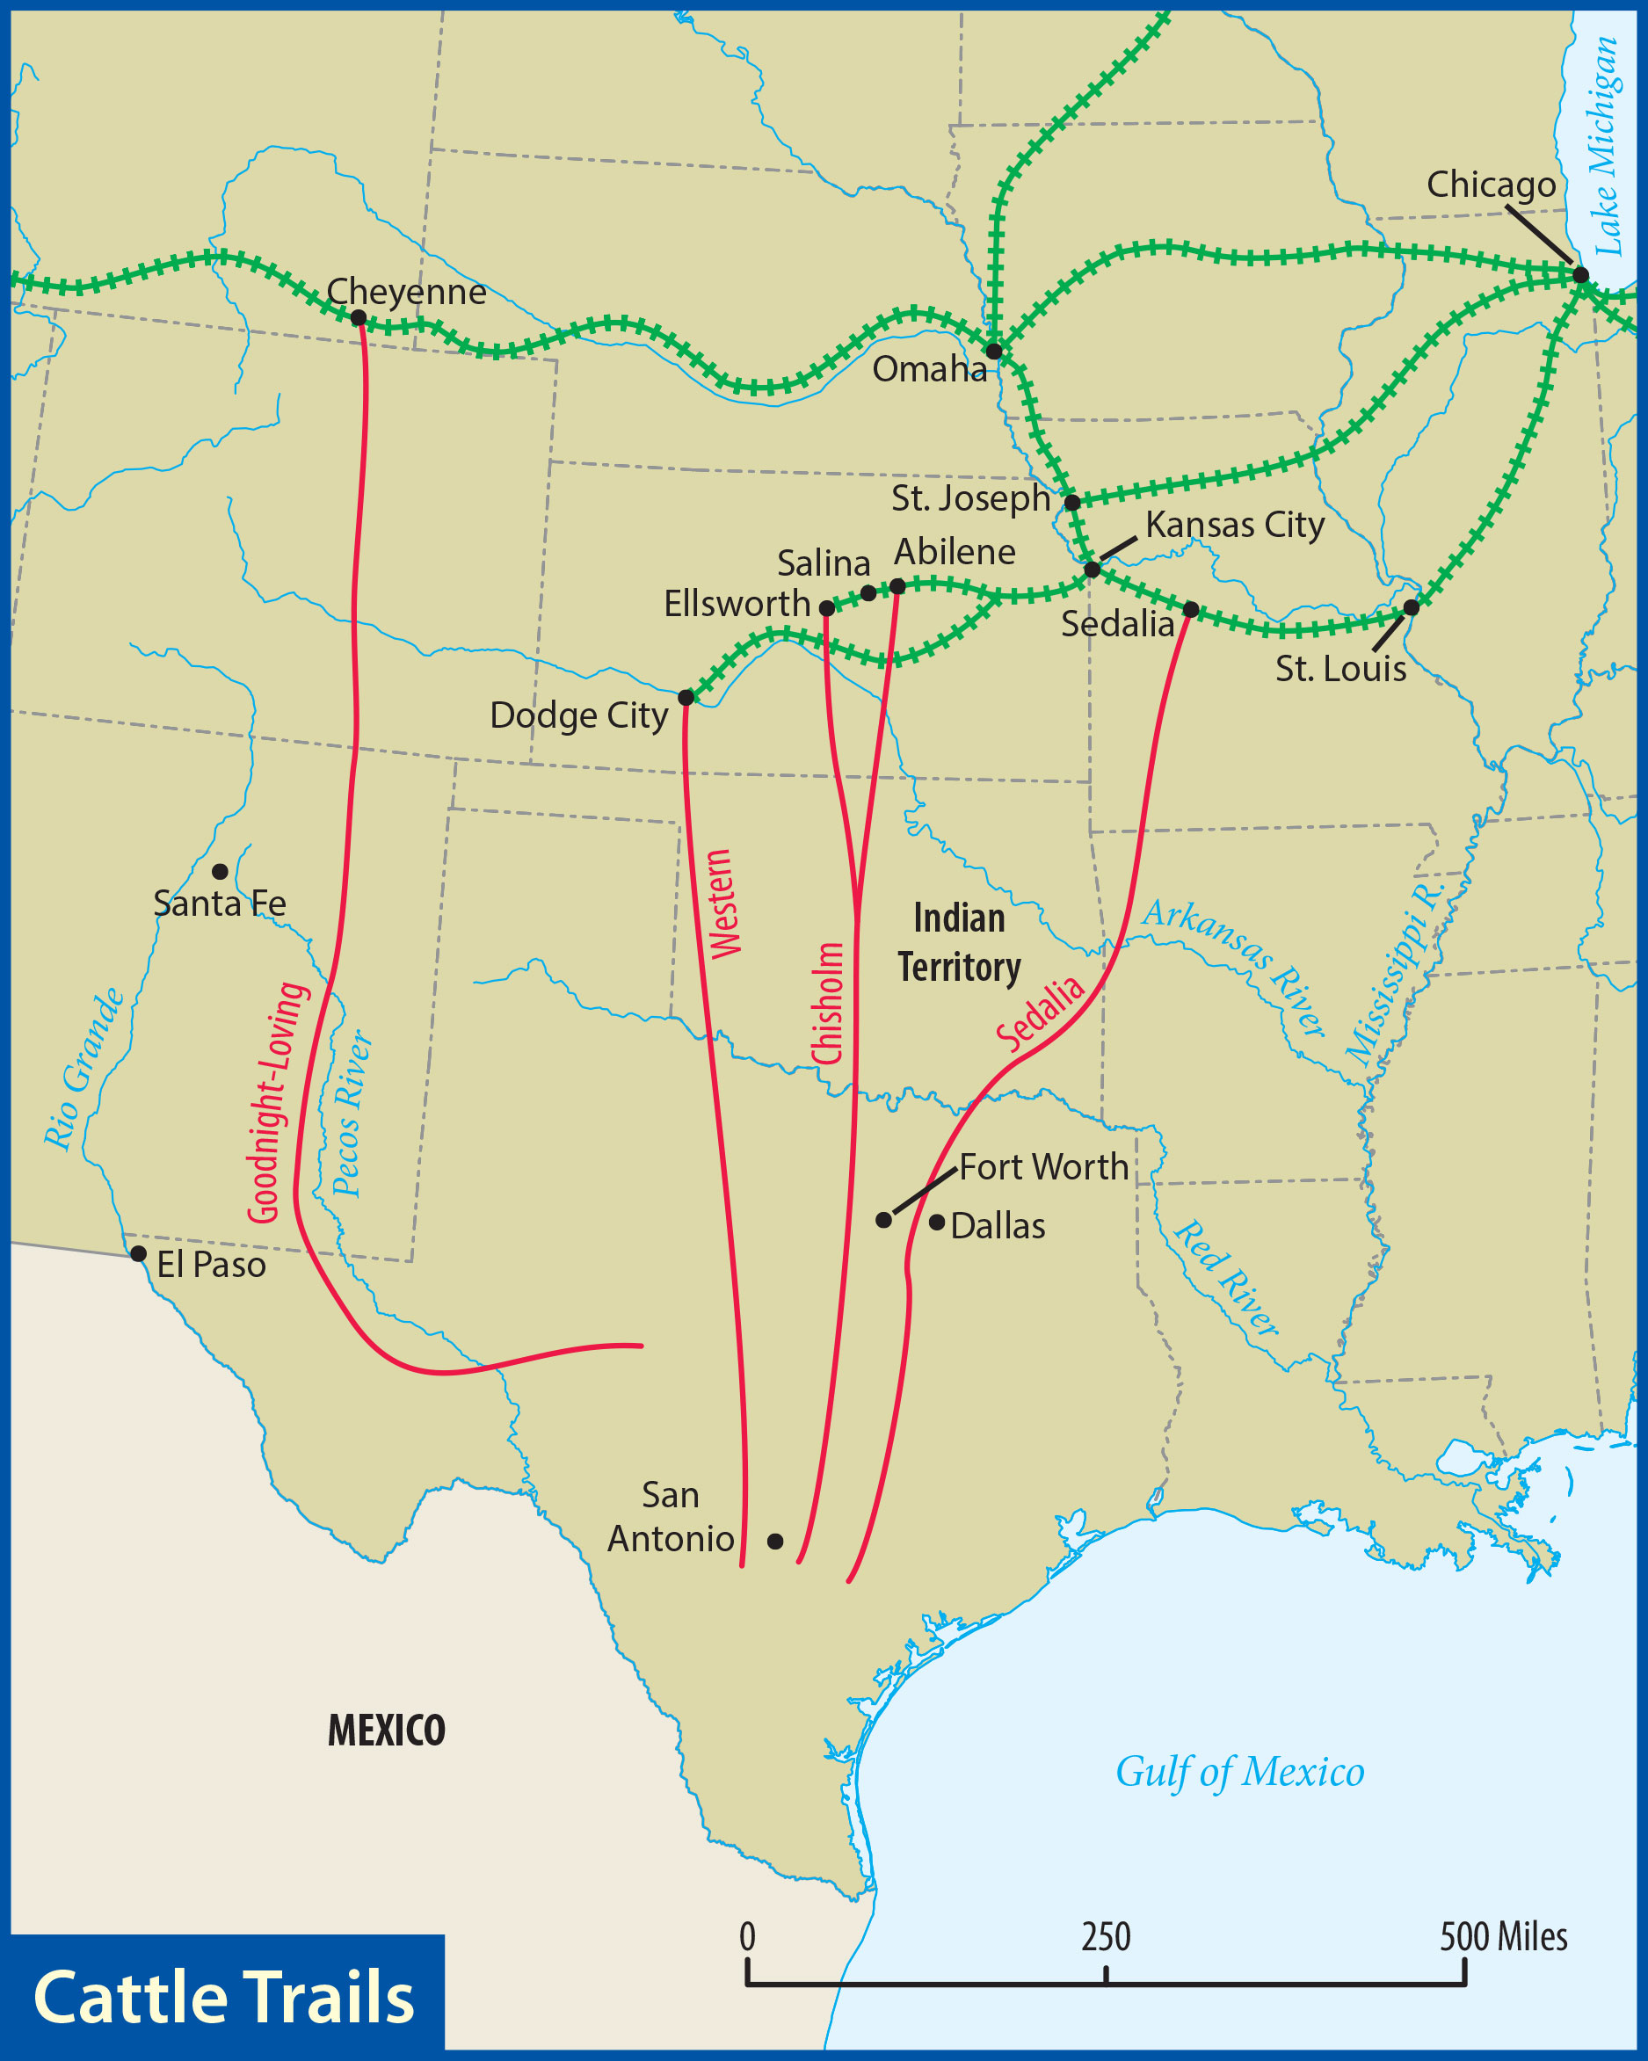
Western Expansion
Cattle
Cattle drives
Demand for beef in the East
Cowboys
Open ranges
Grueling and dangerous

Slide 16
Western Expansion
Meatpacking plants
Refrigerated railcars
Open-range cattle grazing ended in the 1880s

Slide 17
Western Expansion
Settlers and Sod-busters
Farmers soon far outnumbered cowboys
Range wars

Slide 18
Western Expansion
Acquiring Land
Railroads sold their land grants
Homestead Act (1862)
160 acres given to settlers who lived on and improved the land for five years
Oklahoma land rushes

Slide 19
Western Expansion
Developing the Land
Great Plains
Infrequent rainfall
Dry farming
Wheat
Sod houses
Barbed wire

Slide 20
Western Expansion
Law and Order
Law enforcement was difficult
Gunfighters

Slide 21
Western Expansion
Lawmen
Town marshals
County sheriff
U.S. marshals
Judges
Deputies

Slide 22
Western Expansion
Lynchings
Vigilante justice
Pinkerton detectives
Isaac Charles Parker: “the Hanging Judge”

Slide 23
What was the Plains Indians’ way of life?
What were the major battles, and who were the leaders in the Indian Wars?
How did the federal government treat the American Indians?

Slide 24
This time, the conflict would be the final, climactic struggle between white and Indian for control of the rest of the American continent.

Slide 25
Indian Affairs
Plains Indians
Cheyenne, Comanche, Sioux
Key to survival: buffalo
Nearly all buffalo were killed by 1900
Skilled warriors
Proud of their heritage

Slide 26
Indian Affairs
Indian Wars
First Sioux War (1866–68)
Sioux won the battles
Goal: force Indians onto reservations
Quality of reservation land was often low

Slide 27
The result of the Indian Wars was a foregone conclusion, but it took long, hard fighting for the American army to emerge victorious.

Slide 28
Indian Affairs
The Sioux War
1876–77
George Armstrong Custer
Battle of the Washita River (1868)
Sitting Bull and Crazy Horse

Slide 29
Indian Affairs
Battle of the Little Bighorn (1876)
Custer split his forces
Major Reno’s force took heavy losses
Custer’s force was totally wiped out in less than an hour

Slide 30
The U.S. Army sent more men and supplies west to defeat the Sioux.
Within months, the army forced the Indians to accept peace on the government’s terms.

Slide 31
Indian Affairs
Later Indian Affairs
Some still resisted
Some continued to fight
Some tried to flee to Canada
Wounded Knee massacre
A Century of Dishonor

Slide 32
Indian Affairs
Dawes Act
Parceled out Indian lands to families
1924: Indians given full citizenship
1934: Indian Reorganization Act

Slide 33
What were the main goals of American foreign policy in the last half of the nineteenth century?
What imperialistic methods did the United States use to acquire territory?

Slide 34
How did the North American foreign missions movement expand during this period?
What were the motives for and results of the Spanish-American War?

Slide 35
International Expansion
Three main foreign-policy goals:
Defend the Western Hemisphere from intervention by European powers
Create new economic opportunities for American trade
Extend the territory of the United States

Slide 36
International Expansion
France in Mexico
French troops remained in Mexico
Napoleon III installed Maximilian I as the Mexican ruler (1864)
After the Civil War, troops were sent to the Rio Grande

Slide 37
The French quietly withdrew their troops. Maximilian was executed in 1867.

Slide 38
International Expansion
Treaty of Washington
International tribunals set up to settle three longstanding differences
United States received damages from Britain related to commerce raiders
Possession of certain islands off Vancouver given to the United States

Slide 39
International Expansion
United States paid Canada for special fishing privileges
Led to greater friendship among the United States, Britain, Canada

Slide 40
International Expansion
Perry in Japan (1854)
Commodore Matthew Perry and four warships
Treaty of Kanagawa
Allowed western influence into Japan

Slide 41
International Expansion
Pan-Americanism
Desire to trade with Latin America
Greater cooperation and unity
Promoted by James G. Blaine
First Pan-American Congress (1889)
Not a resounding success

Slide 42
International Expansion
An Open Door in China
“Spheres of influence”
Open Door Policy
Formulated by John Hay
Suited other major powers

Slide 43
International Expansion
Boxer Rebellion (1900)
Against foreigners and foreign influence
International military force
Included 2,500 Americans
Peace terms were harsh
The United States returned money it collected

Slide 44
imperialism
the extension of power by one people or country over another people or country

Slide 45
International Expansion
Territorial Expansion: Imperialism
Purchase, annexation, or conquest
Numerous negative effects
Some improvements
Infrastructure, education, etc.
Missionaries

Slide 46
International Expansion
Seward’s Folly
Alaska was purchased from Russia in 1867 for $7,200,000
Treaty easily passed the Senate
Enormous wealth was found there
Alaska became the 49th state in 1959

Slide 47
International Expansion
Pacific Expansion
Annexed the Midway Islands
Hawaii
American businessmen
Queen Liliuokalani was overthrown in 1893

Slide 48
International Expansion
President Cleveland opposed annexation
Sanford Dole led the independent country
Annexed in 1898
Hawaii became the 50th state in 1959

Slide 49
International Expansion
Missions
Hiram Bingham in Hawaii
China
Jonathan & Rosalind Goforth
Lottie Moon

Slide 50
International Expansion
Mission boards
Denominational
Faith missions
Many were focused on a single region

Slide 51
The height of American imperialism came in 1898, when the United States went to war with Spain.

Slide 52
International Expansion
Causes
Yellow journalism
Sensationalized news reporting
Papers were trying to outdo each other
The de Lôme letter
Insulted President McKinley

Slide 53
International Expansion
Sinking of the USS Maine
Exploded in Manila Harbor
Claimed to be the work of a mine
No one really knows
McKinley sent a war message to Congress

Slide 54
Congress demanded Spain’s withdrawal from Cuba and authorized the president to use force, if necessary, to establish Cuba’s independence.

Slide 55
International Expansion
Manila Bay
Commodore George Dewey
Wrecked the Spanish fleet at the Battle of Manila Bay
The Philippines was now in American hands

Slide 56
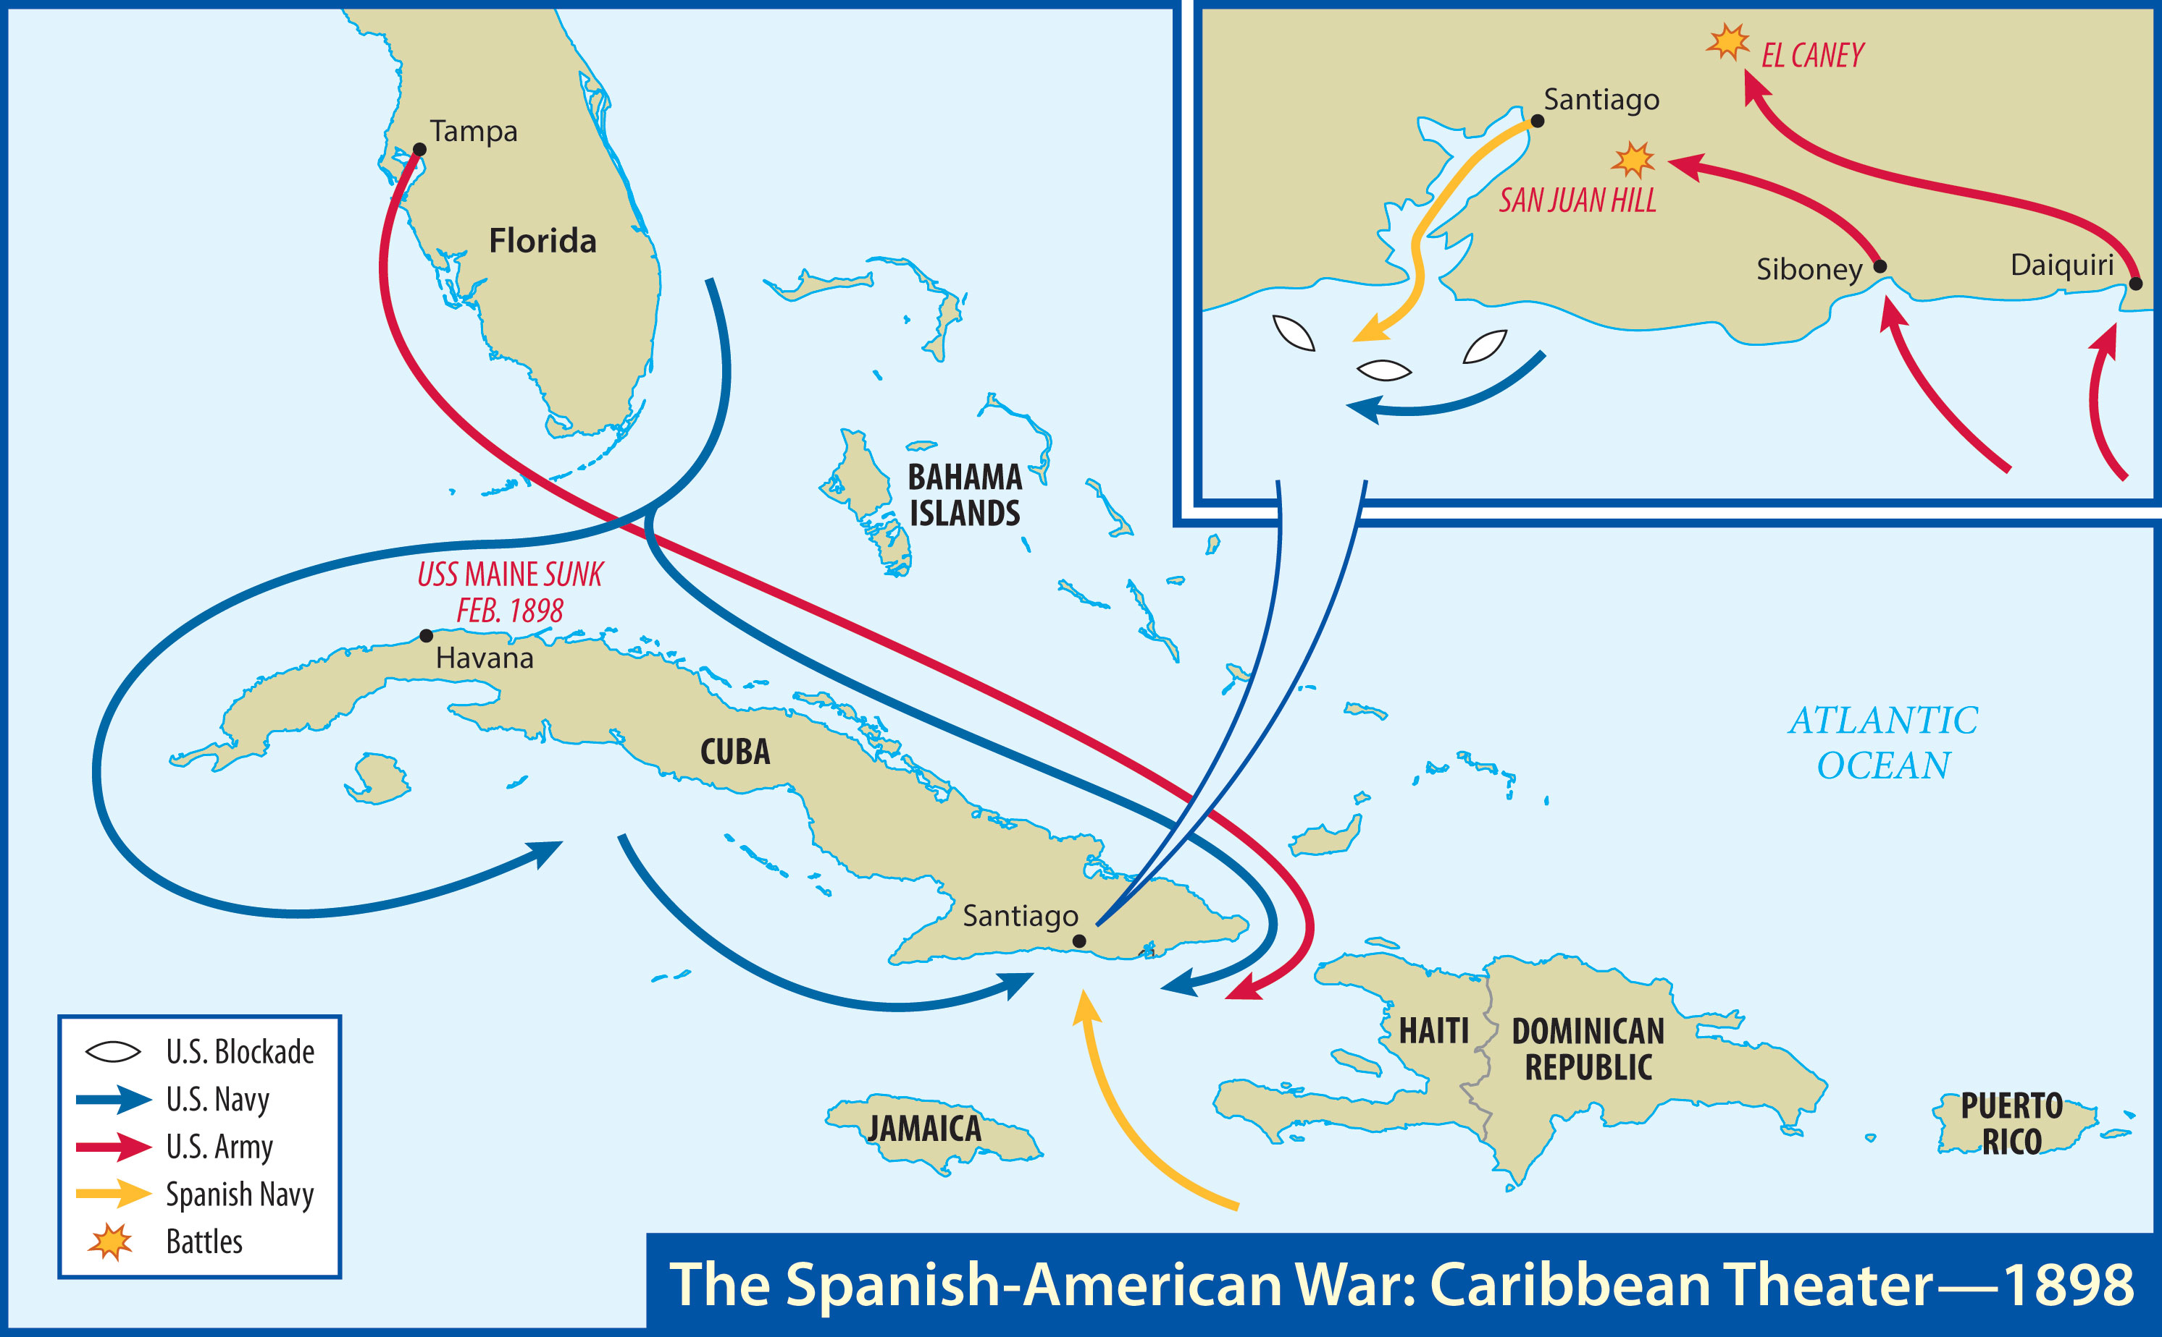

Slide 57
International Expansion
Santiago
Spanish fleet blockaded in the harbor
American soldiers, including the Rough Riders, landed in Cuba
The Spanish fleet was destroyed
Battle of Santiago Bay

Slide 58
The Americans also captured the island of Puerto Rico.
The Spanish called for peace.

Slide 59
International Expansion
Aftermath
The United States wanted no territory in Cuba
The United States obtained Puerto Rico, Guam, and the Philippines
Payment to Spain for the Philippines

Slide 60
International Expansion
Annexation of Hawaii
A large peacetime army and navy were required
Rebellion in the Philippines
Emilio Aguinaldo
Putting down the revolt was more expensive than the war had been

Slide 61
International Expansion
1900 presidential campaign
McKinley vs. Bryan again
Republicans embraced imperialism
McKinley won an electoral landslide

Slide 62
Xxx
Xxx

