Slide 1
Chapter 16:
The Party System
Notes:
WIN-Initiative/Stone/Getty Images

Slide 2
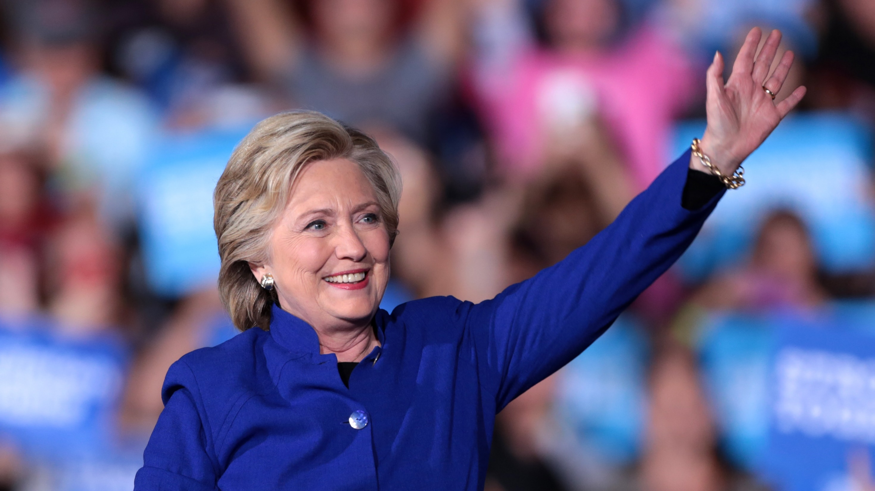
I. Parties and Their Functions
Chapter 16.1
Notes:
By Gage Skidmore from Peoria, AZ, United States of America - Hillary Clinton, CC BY-SA 2.0, https://commons.wikimedia.org/w/index.php?curid=52783268
https://commons.wikimedia.org/w/index.php?sort=relevance&search=campaign+rally&title=Special:Search&profile=advanced&fulltext=1&advancedSearch-current=%7B%7D&ns0=1&ns6=1&ns12=1&ns14=1&ns100=1&ns106=1&searchToken=76jb9ldc0qhmaiscqr3tgs5mw#%2Fmedia%2FFile%3AHillary_Clinton_%2830648676192%29.jpg

Slide 3
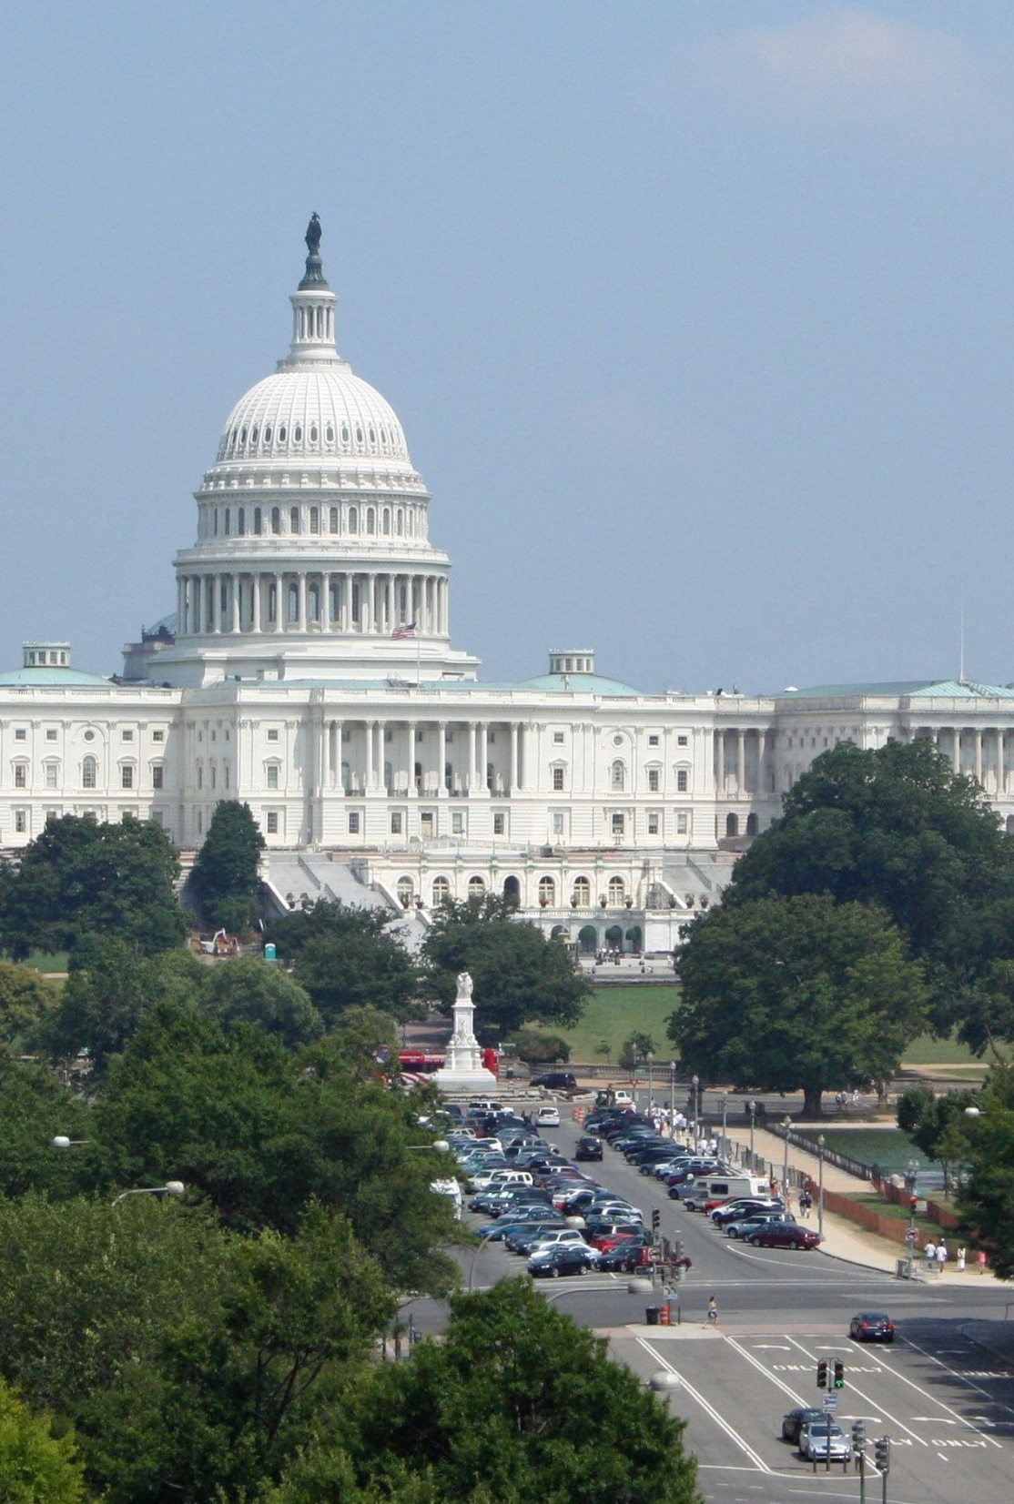
A. Party Defined
Political parties are organized to gain power by winning elections.
Two major parties have been the dominant political competitors – the Democratic and Republican parties.
Notes:
Image by JamesDeMers from Pixabay
https://pixabay.com/photos/capitol-washington-dc-architecture-22546/

Slide 4
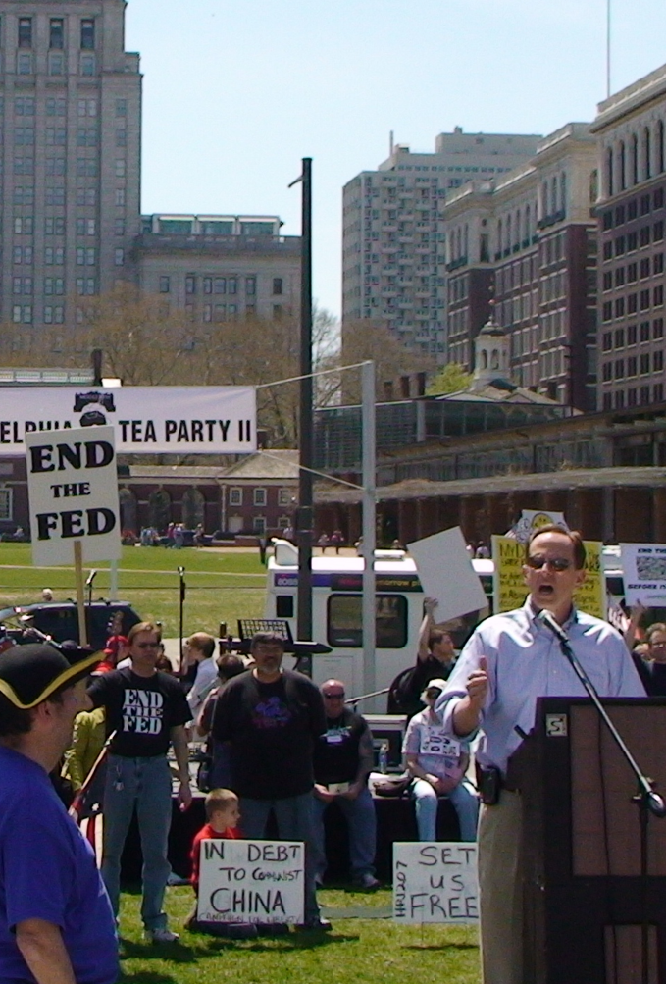
A. Party Defined
Minor parties, or third parties are smaller and usually organized around a particular issue.
While many of the Founders distrusted political factions, they are natural in a diverse society.
Notes:
By Surfsupusa at English Wikipedia - Transferred from en.wikipedia to Commons by Blargh29 using CommonsHelper., Public Domain, https://commons.wikimedia.org/w/index.php?curid=9440425
https://commons.wikimedia.org/w/index.php?sort=relevance&search=tea+party&title=Special:Search&profile=advanced&fulltext=1&advancedSearch-current=%7B%7D&ns0=1&ns6=1&ns12=1&ns14=1&ns100=1&ns106=1&searchToken=cfzuaclfie564qkune5ufd29j#%2Fmedia%2FFile%3APat_Toomey_-_Philadelphia_Tea_Party_II_2009.jpg

Slide 5
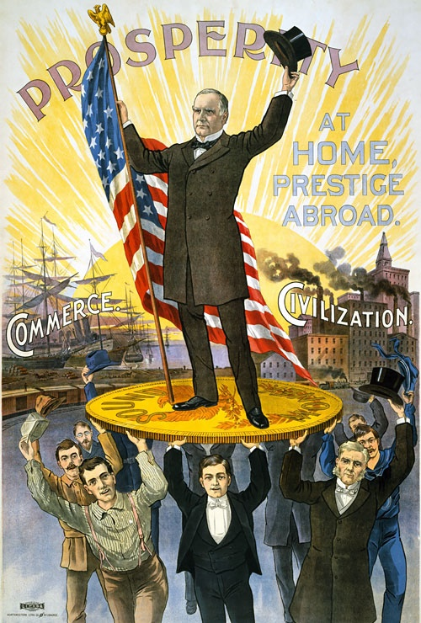
B. Party Functions
Political parties provide a bridge between the governed and their government.
A political party’s major purpose is to nominate candidates for office.
Notes:
By Per above, Public Domain, https://commons.wikimedia.org/w/index.php?curid=2985832
https://commons.wikimedia.org/w/index.php?sort=relevance&search=political+campaign+poster&title=Special:Search&profile=advanced&fulltext=1&advancedSearch-current=%7B%7D&ns0=1&ns6=1&ns12=1&ns14=1&ns100=1&ns106=1&searchToken=7qe6pp03l88uicpz8g2h96or4#%2Fmedia%2FFile%3A1900McKinley.JPG

Slide 6
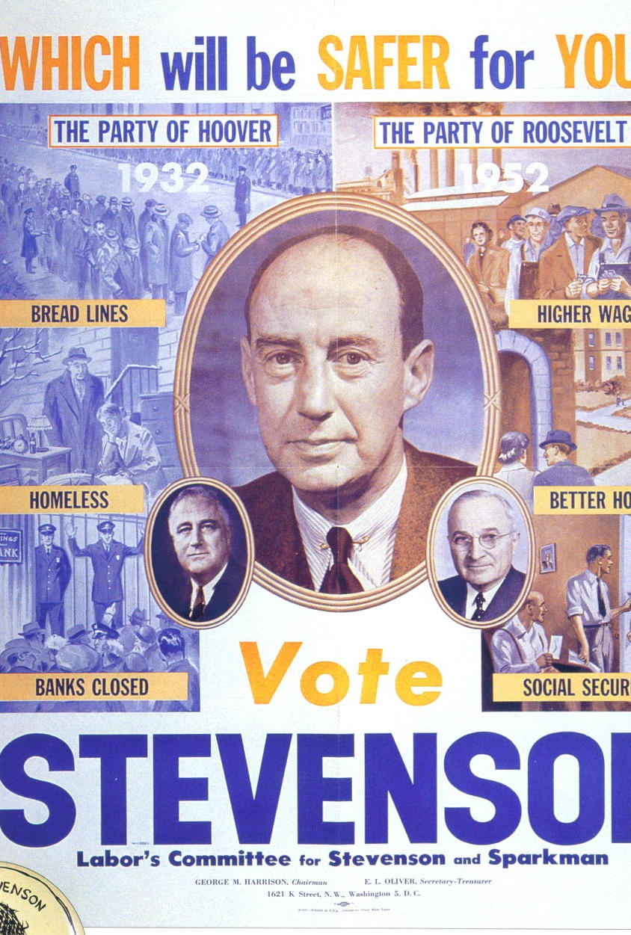
B. Party Functions
Parties play an important role in governing and much of their activity is based on partisanship (strong devotion to a political party).
Parties also act as watchdogs over each other and tend to have a moderating effect over political forces.
Notes:
By Labor's Committee for Stevenson & Sparkman campaign. - Democratic party poster 1952 for Adlai Stevenson., Public Domain, https://commons.wikimedia.org/w/index.php?curid=12230292
https://commons.wikimedia.org/w/index.php?sort=relevance&search=political+campaign+poster&title=Special:Search&profile=advanced&fulltext=1&advancedSearch-current=%7B%7D&ns0=1&ns6=1&ns12=1&ns14=1&ns100=1&ns106=1&searchToken=7qe6pp03l88uicpz8g2h96or4#%2Fmedia%2FFile%3AAdlai_Stevenson_1952_campaign_poster.JPG

Slide 7
Section Review – Chapter 16.1
1–2. Explain the differences between major and minor political parties.
Major parties emphasize gaining power by winning elections; minor (third) parties are smaller, are usually organized around a particular issue, and often influence the major parties.
(p. 377)

Slide 8
Section Review – Chapter 16.1
3. Summarize James Madison’s conclusion about the causes of political division.
Madison believed that political divisions originate in the
nature of humanity, which is motivated significantly by
“fallible…reason and…self love.” (pp. 377–378)

Slide 9
Section Review – Chapter 16.1
4. What is the major purpose of a political party?
The primary purpose of political parties is to nominate, or name, candidates for public office. (p. 378)

Slide 10
Section Review – Chapter 16.1
5. What role does a political party play in governing the nation?
Party ties provide a basis for legislative cooperation and obstruction; the majority party in the House and in the Senate controls top committee posts and sets the legislative agenda; and the president can use party ties to push legislation through Congress, uphold vetoes, and make executive and judicial appointments. (p. 378)

Slide 11
Section Review – Chapter 16.1
How do political parties serve as a moderating influence?
The major parties tend to reduce extremism and bring diverse interests together in a consensus over broad principles.
(pp. 378–379)

Slide 12
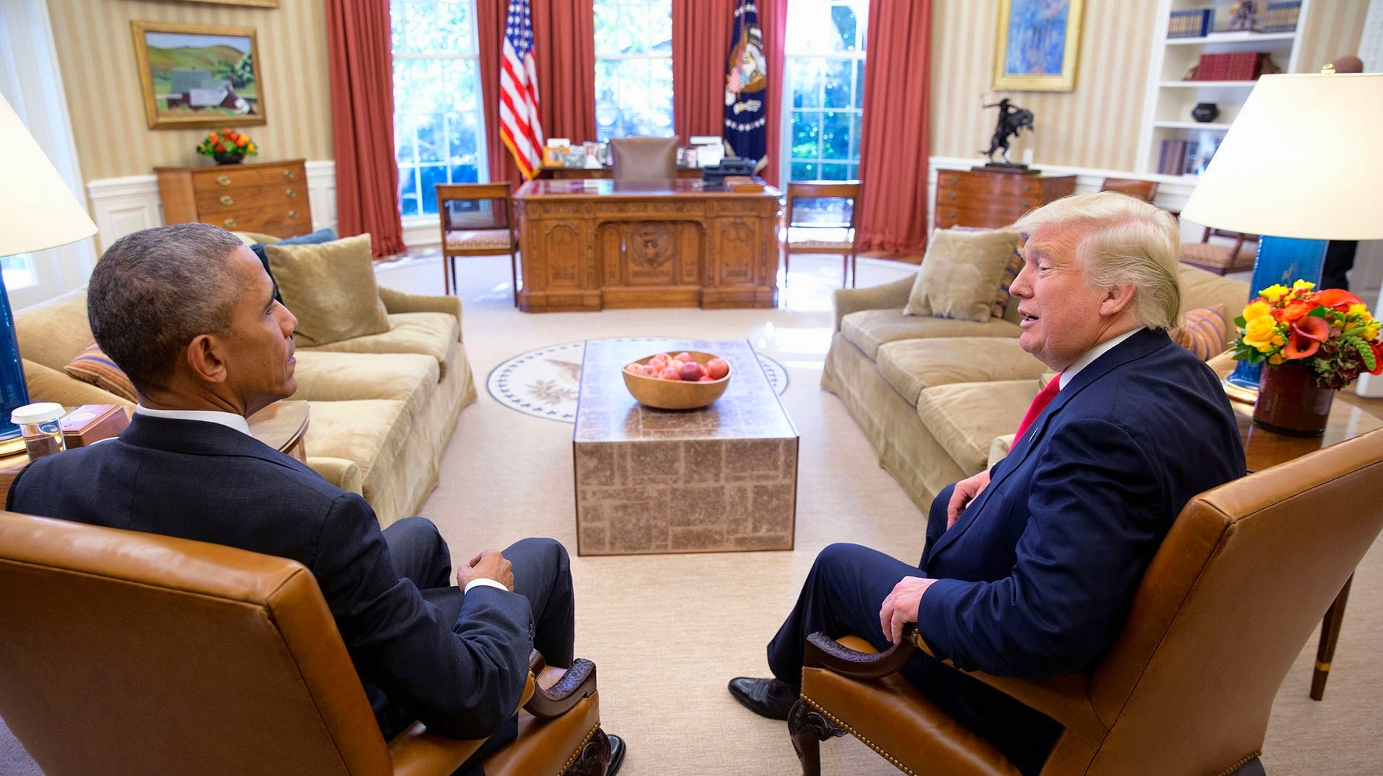
II. The Two-Party System
Chapter 16.2
Notes:
By Pete Souza - JANUS-Tête-à-Tête: Sitting President & President-elect, Barack Obama & Donald Trump squatting next to each other on arm-chairs in the Oval Office on November 10th 2016., Public Domain, https://commons.wikimedia.org/w/index.php?curid=54943207
https://commons.wikimedia.org/w/index.php?title=Special:Search&limit=500&offset=0&ns0=1&ns6=1&ns12=1&ns14=1&ns100=1&ns106=1&search=clinton+trump+debate&advancedSearch-current=%7B%7D&searchToken=10qbhnreg1a6y6ecygrsoapct#%2Fmedia%2FFile%3AJANUS-T%C3%AAte-%C3%A0-T%C3%AAte-_Sitting_President_%26_President-elect%2C_Barack_Obama_%26_Donald_Trump_squatting_next_to_each_other_on_arm-chairs_in_the_Oval_Office_on_November_10th_2016._%2831196987133%29.jpg

Slide 13
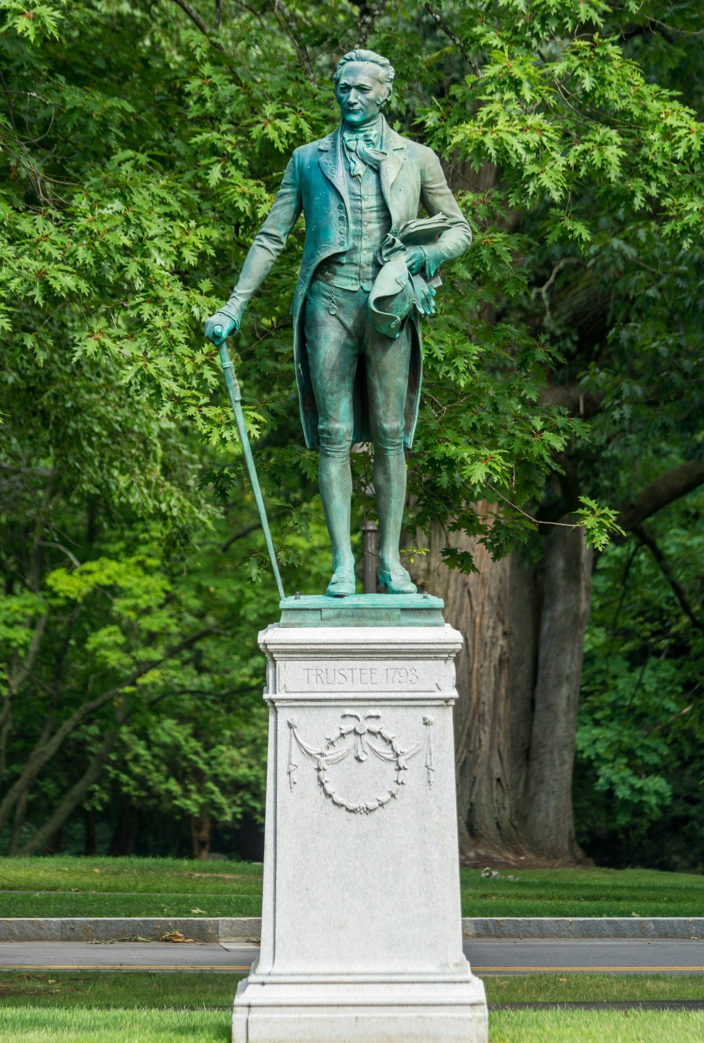
A. Reasons for Formation
Most Americans identify with either the Republican or Democratic parties – the two-party system.
This tradition dates back to the ratification of the Constitution.
Notes:
By Kenneth C. Zirkel - Own work, CC BY-SA 3.0, https://commons.wikimedia.org/w/index.php?curid=81804354
https://commons.wikimedia.org/w/index.php?sort=relevance&search=alexander+hamilton&title=Special:Search&profile=advanced&fulltext=1&advancedSearch-current=%7B%7D&ns0=1&ns6=1&ns12=1&ns14=1&ns100=1&ns106=1&searchToken=45gf3wkwbmu1r09frcs6192tn#%2Fmedia%2FFile%3AStatue_of_Alexander_Hamilton_at_Hamilton_College%2C_New_York.jpg

Slide 14
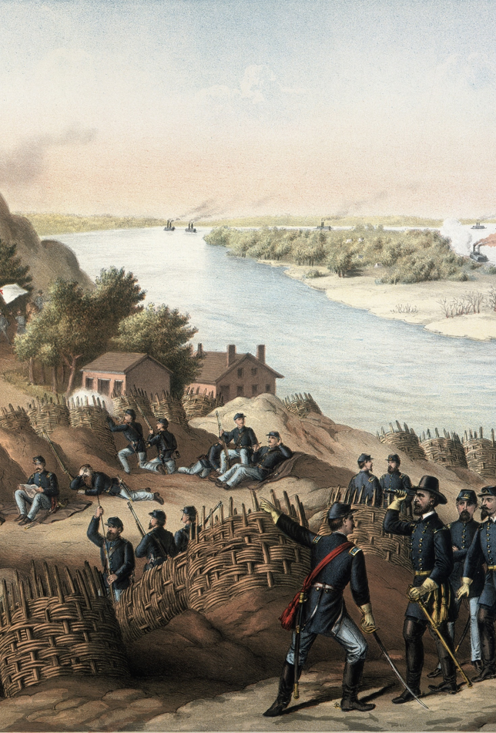
A. Reasons for Formation
Competition between the two parties varies across the country with some areas having a practical one-party system (such as the “Solid South” after the Civil War).
Competitive presidential races show the two parties are relatively evenly matched.
Notes:
By Kurz and Allison - Missouri History MuseumURL: http://images.mohistory.org/image/2662BF83-448A-4EBB-9199-36872A9FD379//original.jpgGallery: http://collections.mohistory.org/resource/148074, Public Domain, https://commons.wikimedia.org/w/index.php?curid=61735591
https://commons.wikimedia.org/w/index.php?sort=relevance&search=american+civil+war+siege+of+vicksburg&title=Special:Search&profile=advanced&fulltext=1&advancedSearch-current=%7B%7D&ns0=1&ns6=1&ns12=1&ns14=1&ns100=1&ns106=1&searchToken=9ck70383s99fjjwpzukhm3bpx#%2Fmedia%2FFile%3ASiege_of_Vicksburg.jpg

Slide 15
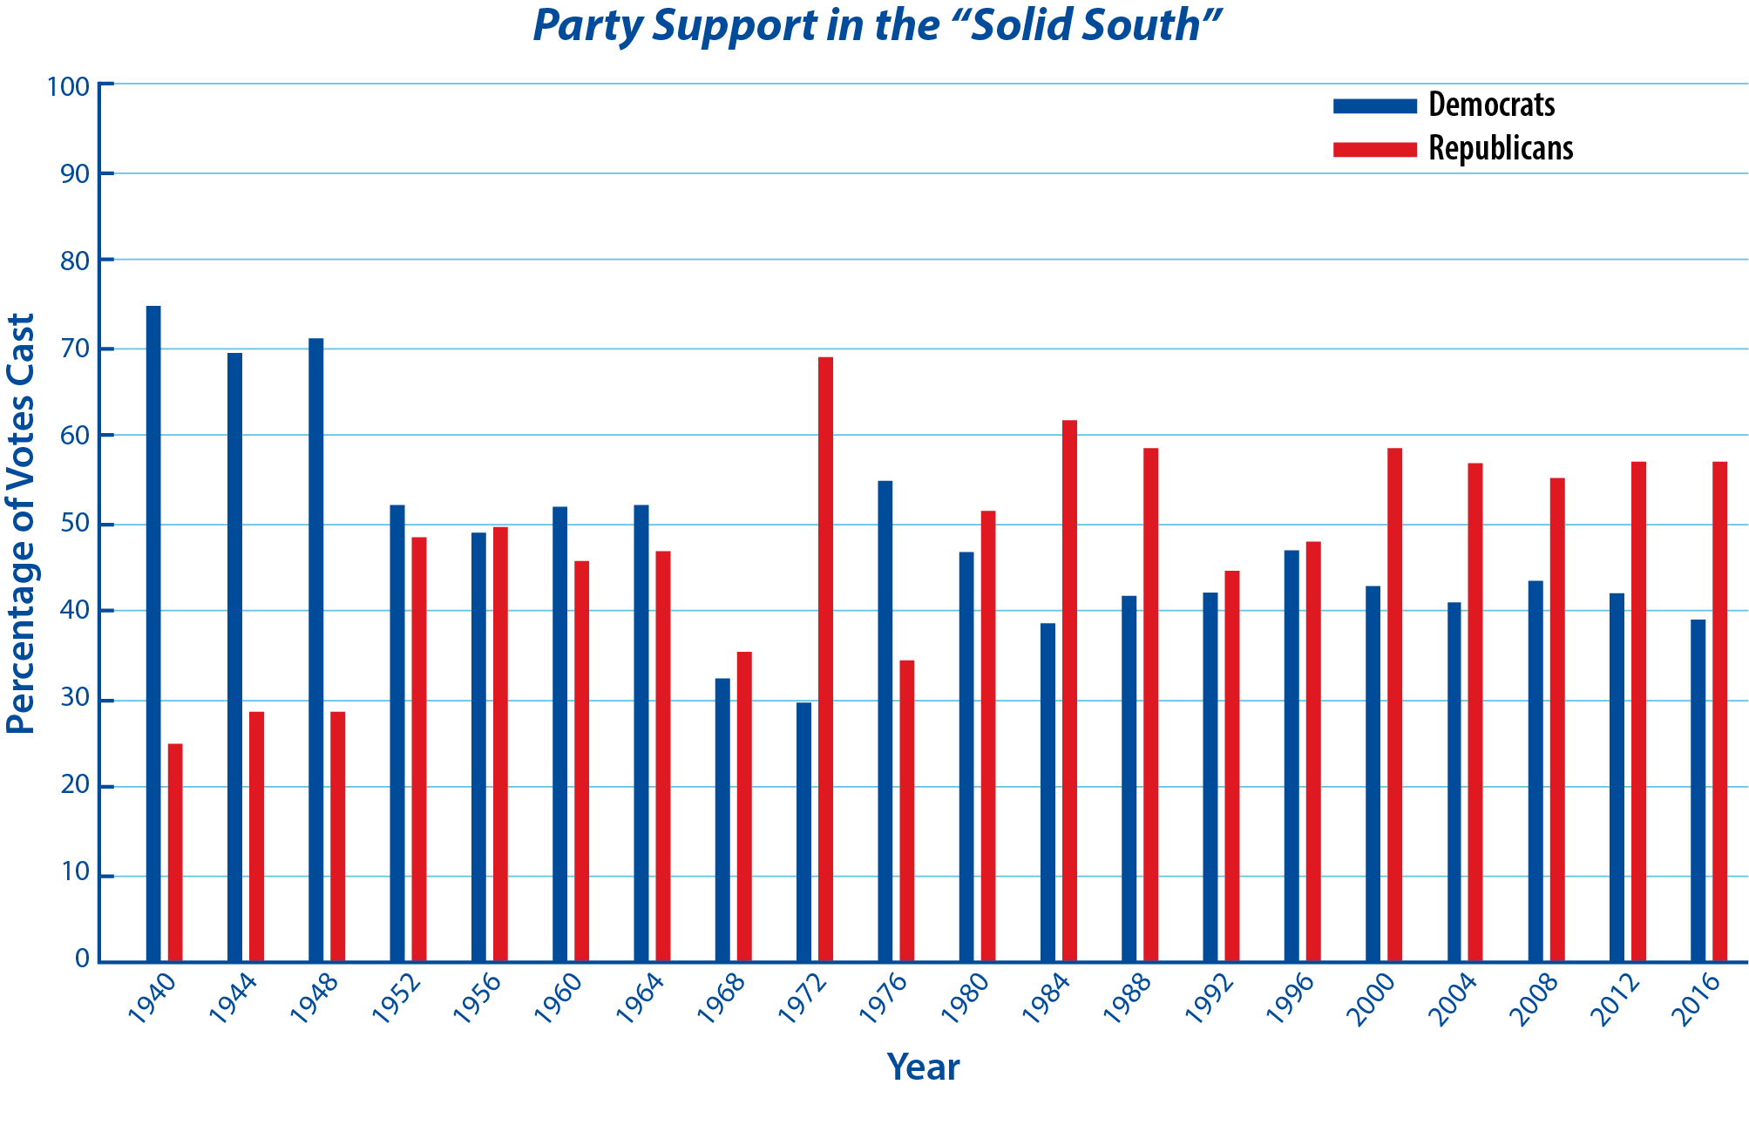
Notes:
BJU Press Art

Slide 16
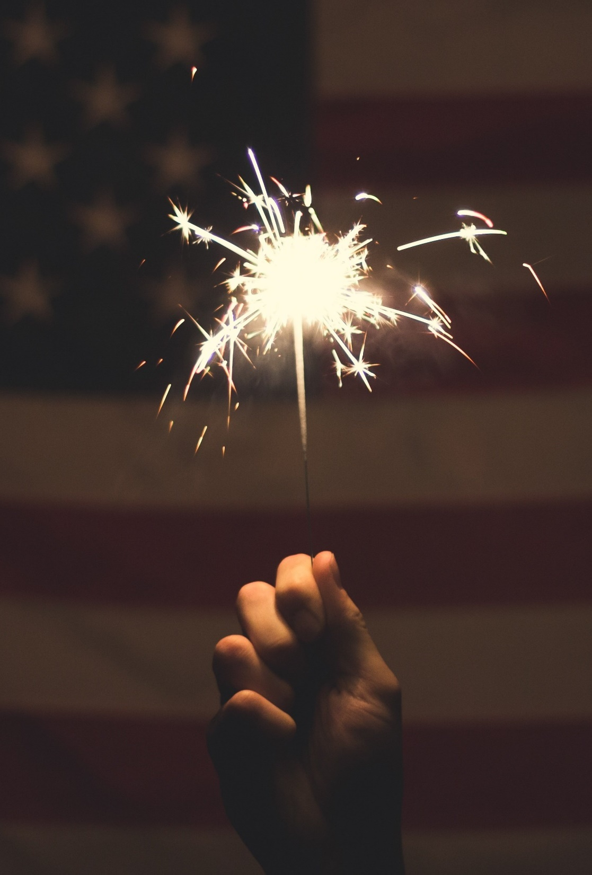
A. Reasons for Formation
The electoral system also encourages a two-party system through single-member districts – legislative districts that have only one representative.
The two major parties work together in a bipartisan manner to shape laws that favor the two-party system.
Notes:
Image by Free-Photos from Pixabay
https://pixabay.com/photos/sparkler-america-sparkle-fireworks-801902/

Slide 17
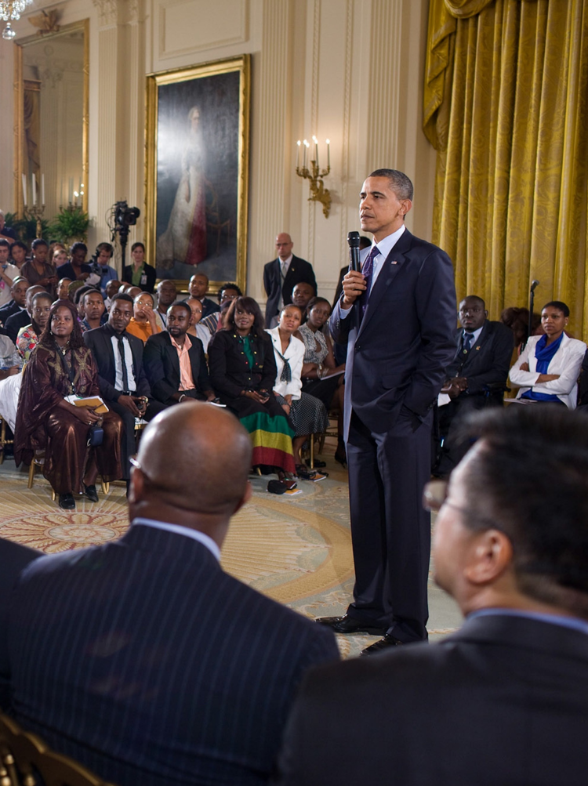
B. Characteristics
Both parties seek diverse support through broad appeal since extreme candidates usually do not win elections.
Each party declares its position on current issues through its party platform.
Notes:
Image by David Mark from Pixabay
https://pixabay.com/photos/president-obama-government-democrat-69213/

Slide 18
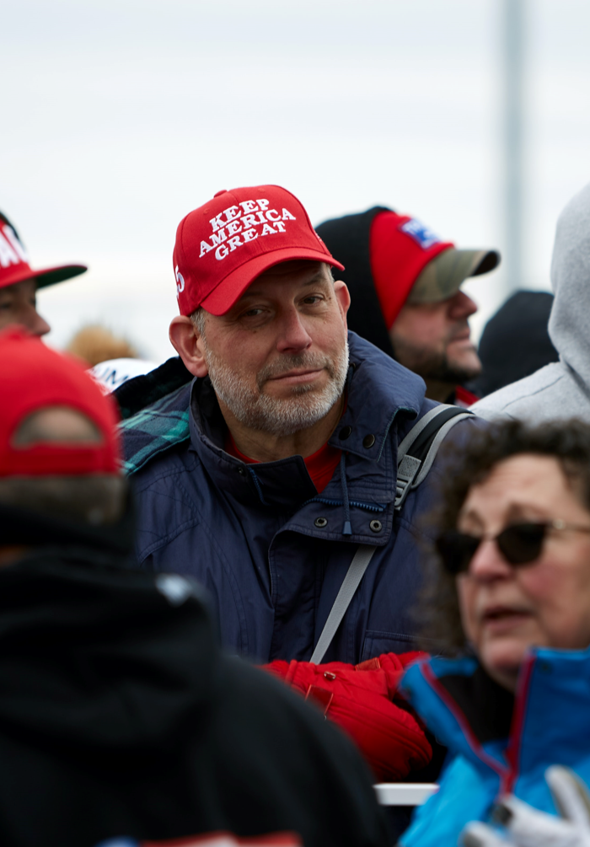
B. Characteristics
The Democratic party tends to attract voters who identify as liberal while many members of the Republican party identify as conservative.
Party membership is a matter of personal identification and does not require formal admittance.
Notes:
Photo by David Todd McCarty on Unsplash
https://unsplash.com/photos/hdbcARBkIPE

Slide 19
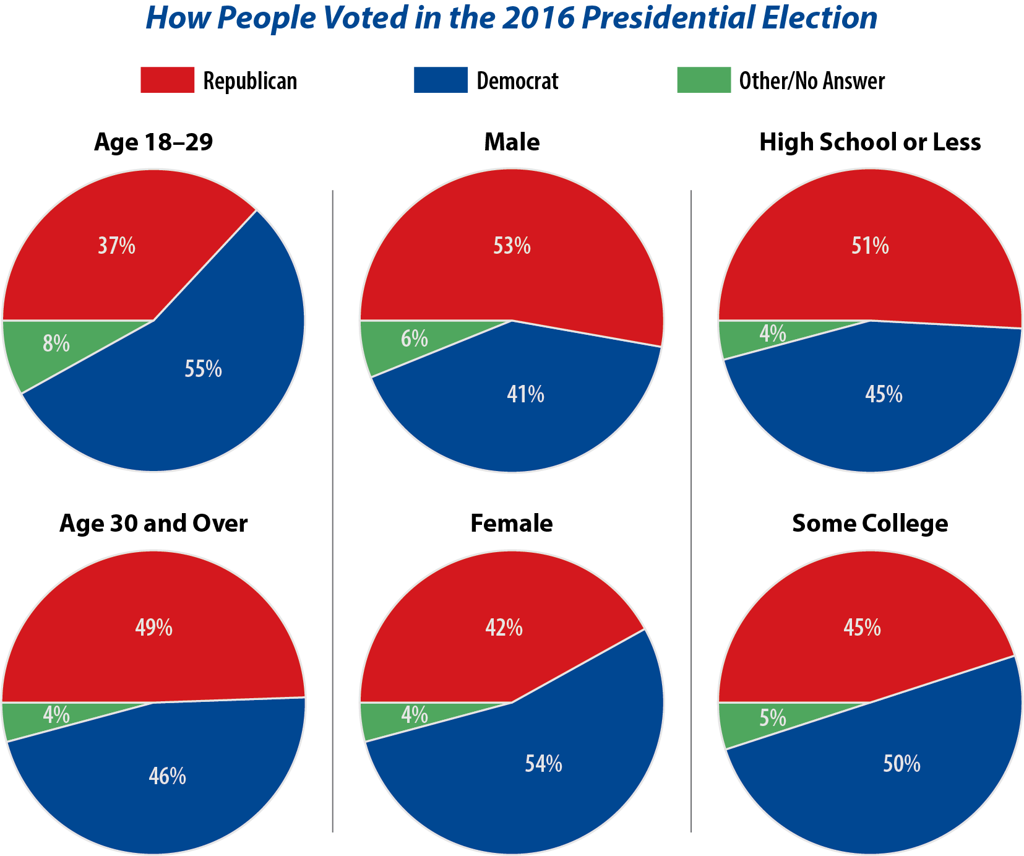
Notes:
BJU Press Art

Slide 20
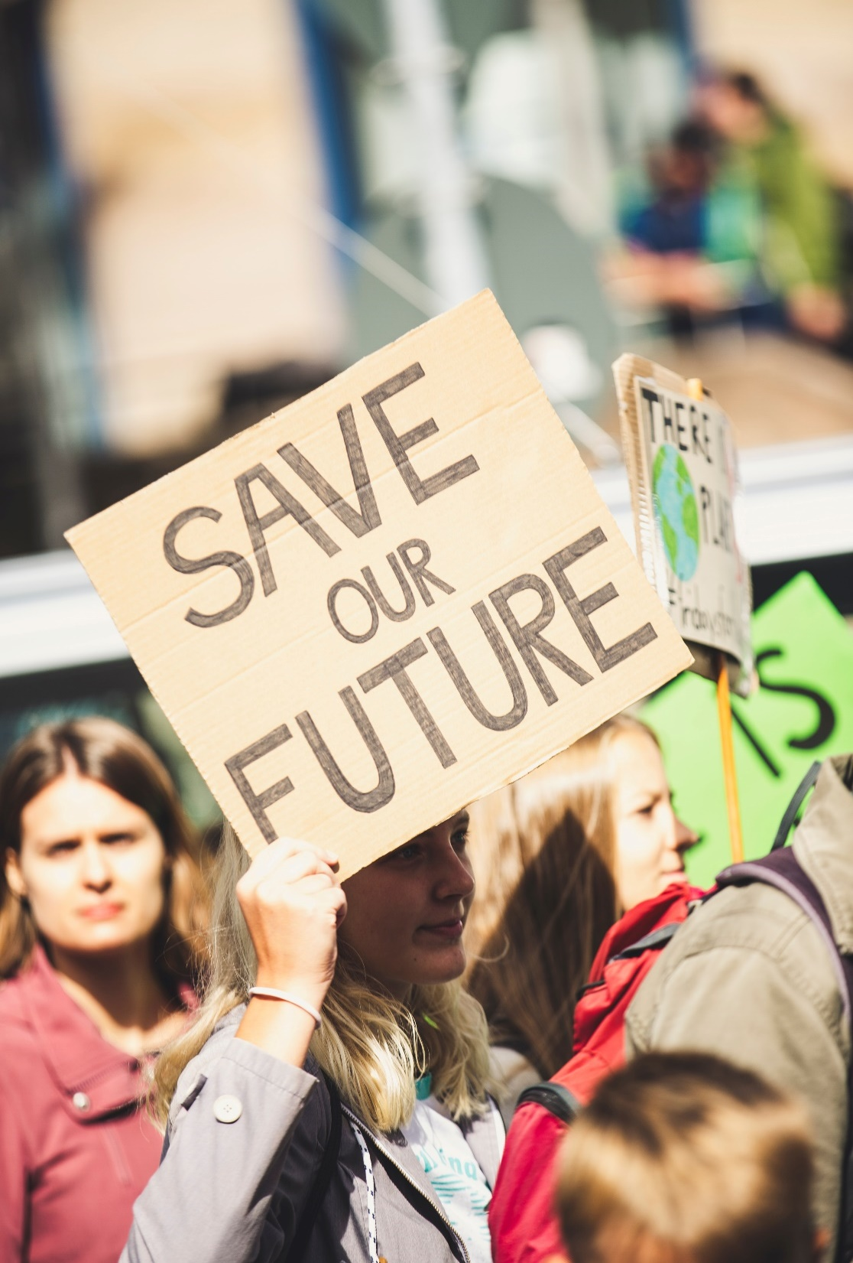
B. Characteristics
Several factors influence which party a voter might join:
  Major issues
  Ideology
  Family background
Notes:
Photo by Markus Spiske on Unsplash
https://unsplash.com/photos/xH8_bSnpH5Q

Slide 21
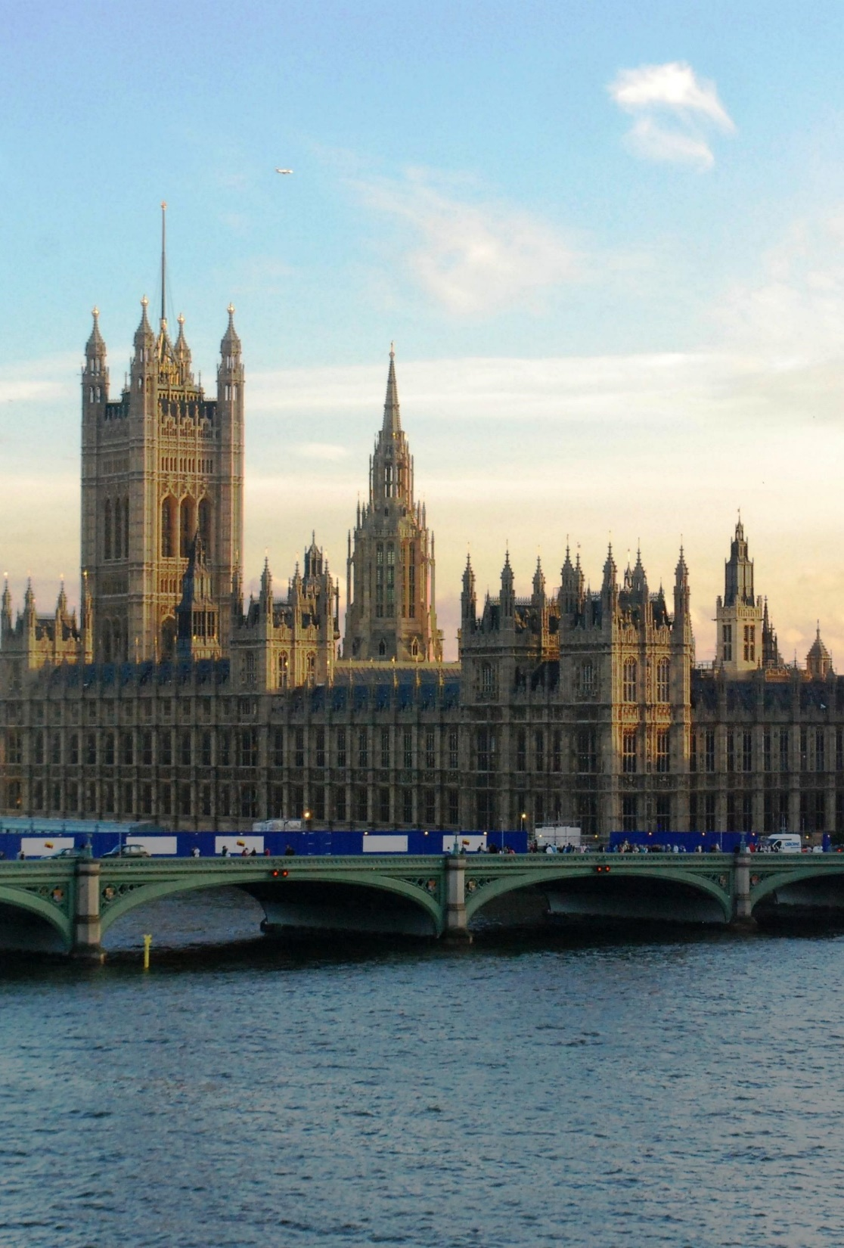
B. Characteristics
The two-party system provides more stability than a multiparty system which often requires a coalition to control the government.
The two-party system is more flexible than a one-party system which is often used by dictators.
Notes:
Image by skeeze from Pixabay
https://pixabay.com/photos/parliament-london-england-sunset-544751/

Slide 22
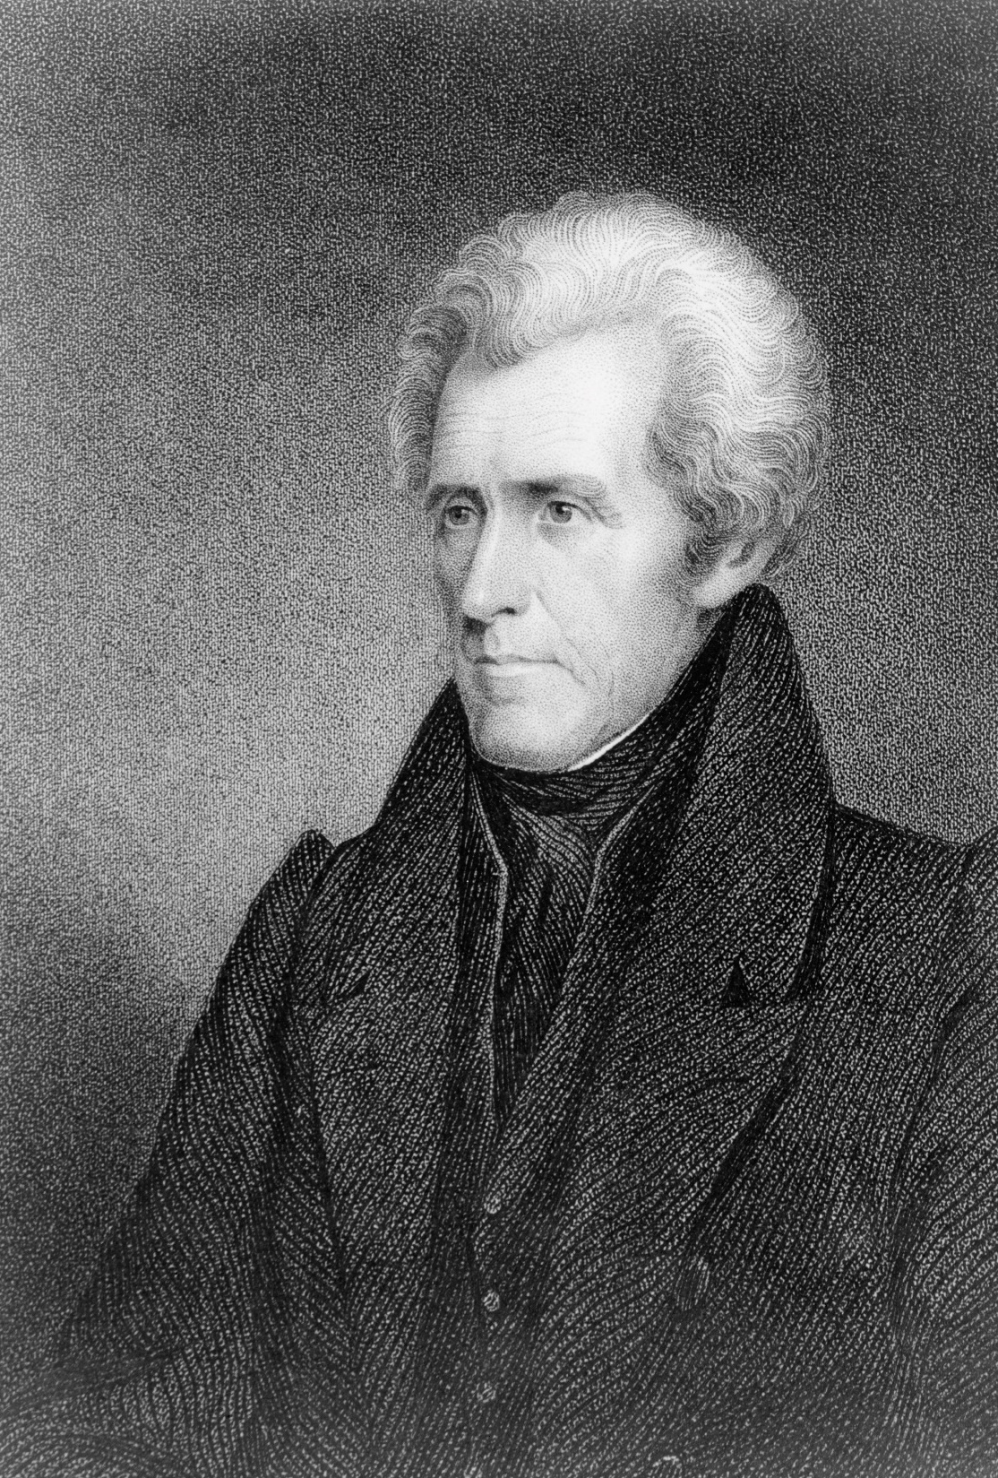
C. Development and Direction
After the decline of the Federalist party, the Democratic-Republican party ruled unopposed until it split in 1828.
Notes:
Photo by Library of Congress on Unsplash
https://unsplash.com/photos/O6QwImy8MD0

Slide 23
C. Development and Direction
Andrew Jackson’s victory in that year produced notable results:
  Higher voter turnout
  Use of the convention and delegates to replace the caucus
  Use of the patronage or spoils system
  Birth of the political campaign
Notes:
Photo by Library of Congress on Unsplash
https://unsplash.com/photos/O6QwImy8MD0

Slide 24
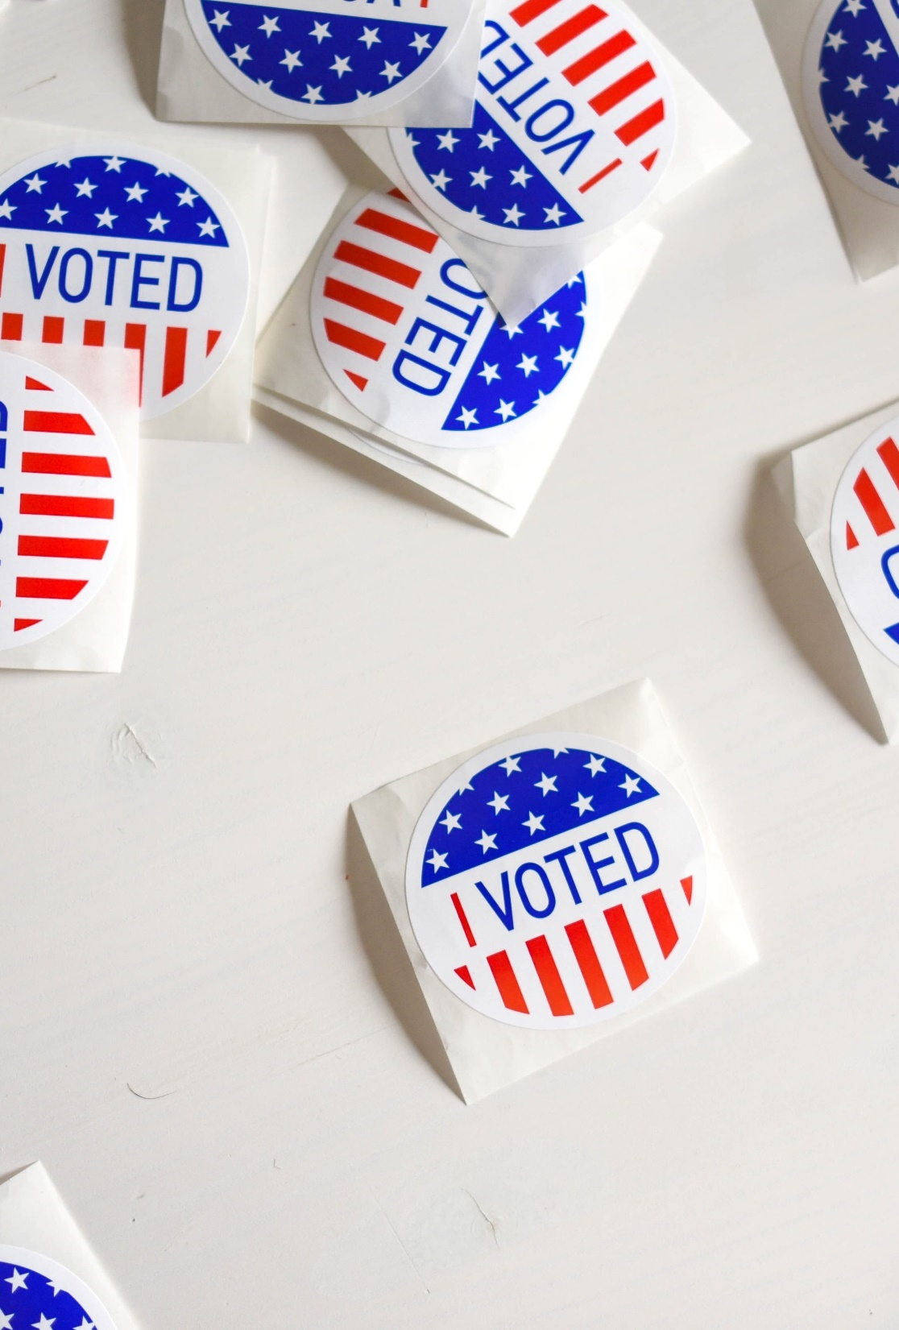
C. Development and Direction
In the early 20th century, demands for reform led parties to implement the primary for nominating candidates.
Primaries placed greater emphasis on campaign organization and the role of the candidate in deciding issues.
Notes:
Photo by Element5 Digital on Unsplash
https://unsplash.com/photos/ls8Kc0P9hAA

Slide 25
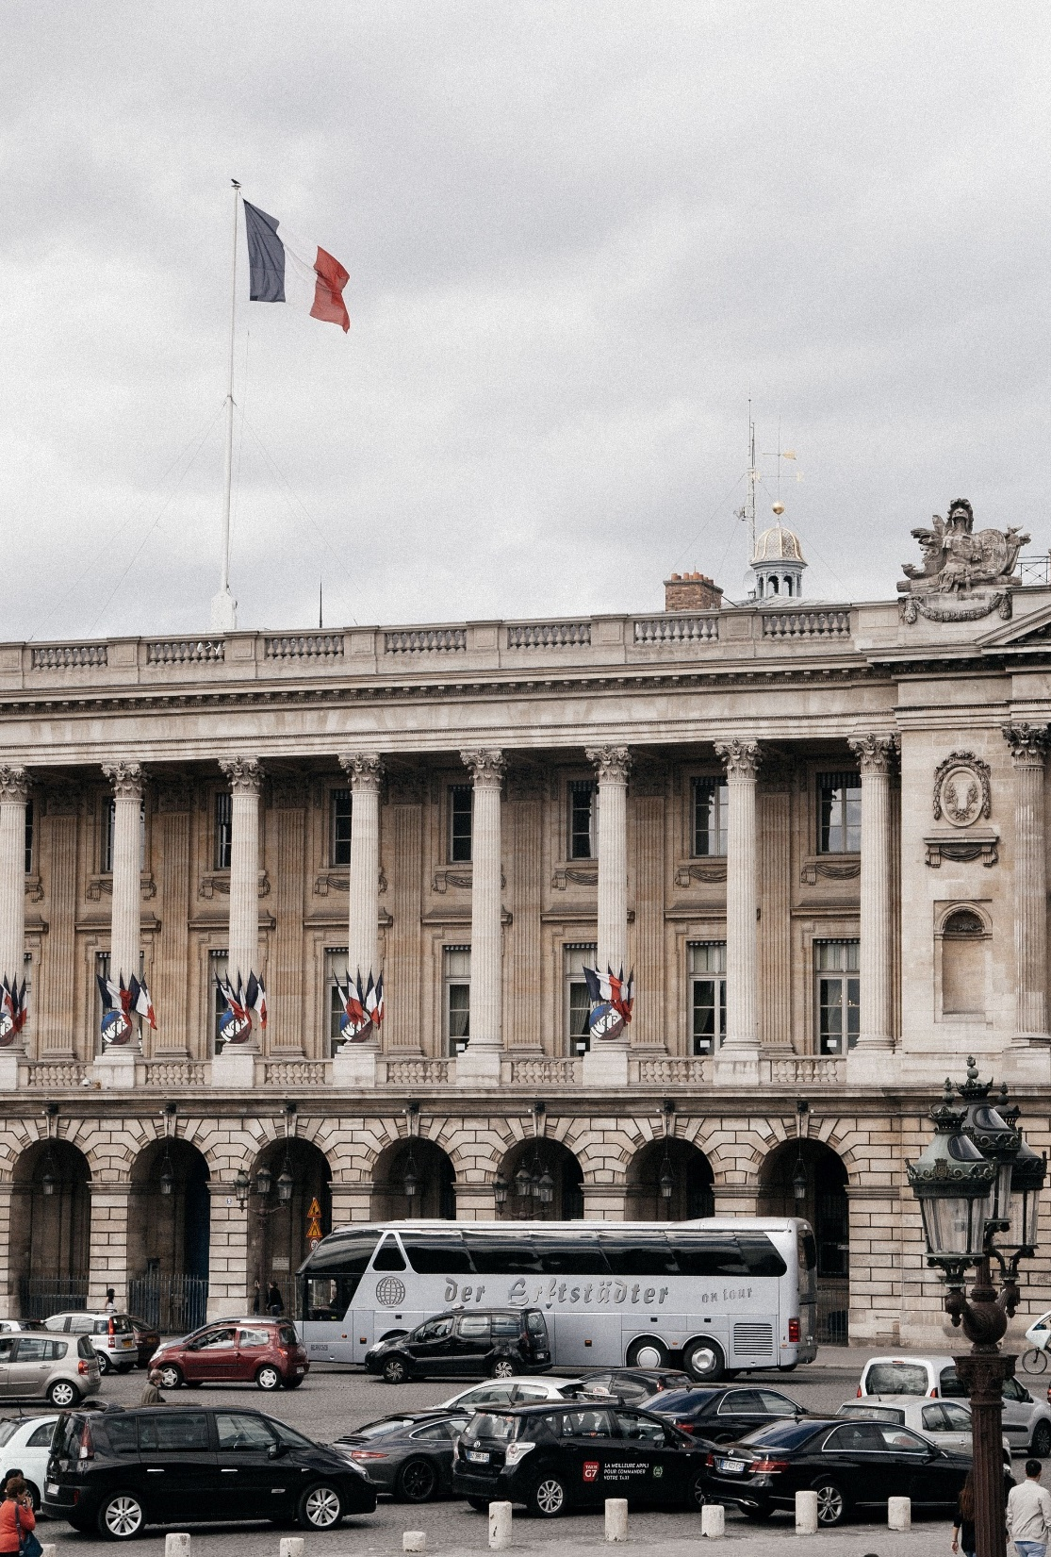
D. Other Party Systems
The multiparty system is common in most European democracies.
While this system allows for broader, more diverse representation, it is often difficult for one party to win a majority.
Notes:
Photo by Anthony DELANOIX on Unsplash
https://unsplash.com/photos/4rZ8mYsDtBk

Slide 26
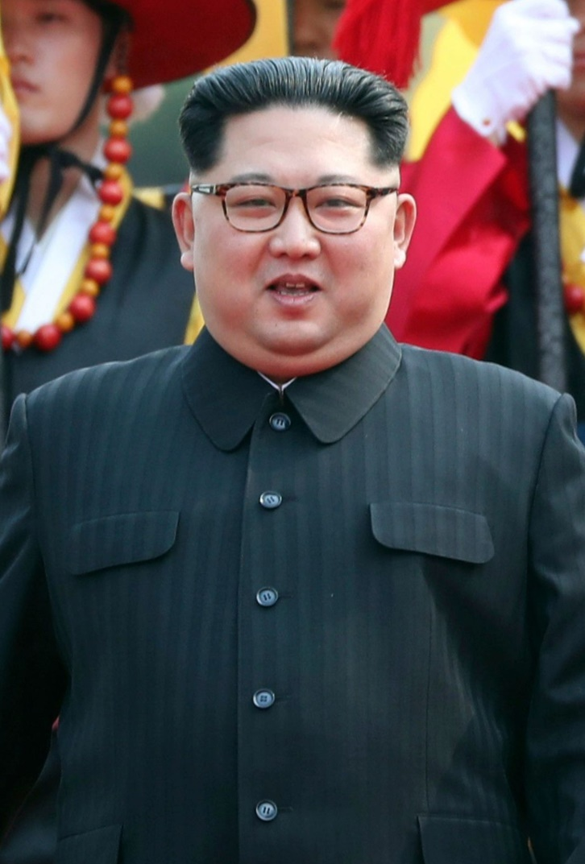
D. Other Party Systems
Most modern dictatorships have a one-party system of government.
Examples of this system can be found in Cuba and the People’s Republic of China.
Notes:
By Cheongwadae / Blue House - http://www.president.go.kr/img_KR/2018/04/2018042706.jpg, KOGL Type 1, https://commons.wikimedia.org/w/index.php?curid=69950427
https://commons.wikimedia.org/w/index.php?sort=relevance&search=kim+jong-un&title=Special:Search&profile=advanced&fulltext=1&advancedSearch-current=%7B%7D&ns0=1&ns6=1&ns12=1&ns14=1&ns100=1&ns106=1&searchToken=dk6c189bkvgw9u1yrr8fa4x13#%2Fmedia%2FFile%3AKim_Jong_Un_with_Honor_Guard_portrait.jpg

Slide 27
Section Review – Chapter 16.2
1–2. What are two ways in which the American electoral system encourages a two-party system?
single-member districts and election law (pp. 380–381)
3–7. Identify five characteristics of the two-party system.
diverse support through broad appeal, different viewpoints, party membership by personal identification, stability, and flexibility (pp. 381–384)

Slide 28
Section Review – Chapter 16.2
8–11. Identify four significant political results of Andrew Jackson’s election to the presidency in 1828.
Organized competition broadened voter participation, the nomination process expanded through the use of the convention, the spoils system was introduced, and modern political campaigning came into existence. (p. 385)

Slide 29
Section Review – Chapter 16.2
12–13. What was possibly the single most influential factor in building party organization after 1828? Why was it so influential?
Patronage, or the spoils system; the spoils system gave a person greater incentive to get involved in a party and to encourage voter turnout for his candidate. (p. 385)

Slide 30
Section Review – Chapter 16.2
14. What is a nominating primary?
Nominating primaries are state or local elections to select the party nominees for the general election. (p. 387)

Slide 31
Section Review – Chapter 16.2
Why does a two-party system provide more stability than a multiparty system?
In multiparty systems, many factions divide the electorate, making it difficult for one party to win a majority. Coalitions between these parties do not always hold together.

Slide 32
Section Review – Chapter 16.2
How have primaries changed political parties?
Primaries shift the power focus from the party organization to the campaign organization. Now candidates play a greater role in choosing the issues, raising money, and mobilizing the voters than in the past.

Slide 33
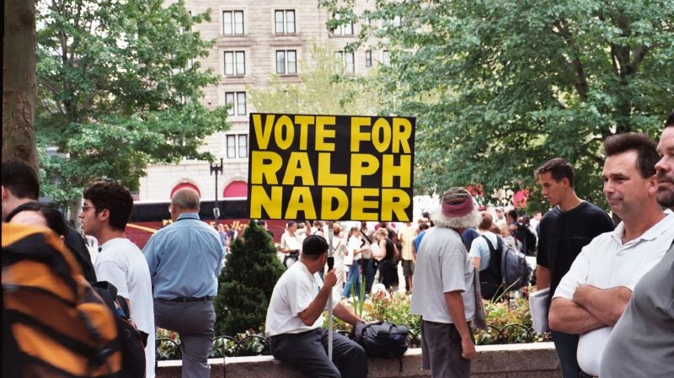
III. Third Parties
Chapter 16.3
Notes:
By Michael Bakshi from Arlington, USA - 012_10, CC BY 2.0, https://commons.wikimedia.org/w/index.php?curid=68505155
https://commons.wikimedia.org/w/index.php?sort=relevance&search=ralph+nader+campaign&title=Special:Search&profile=advanced&fulltext=1&advancedSearch-current=%7B%7D&ns0=1&ns6=1&ns12=1&ns14=1&ns100=1&ns106=1&searchToken=a2xw1edfz1elslwwzepn875mi#%2Fmedia%2FFile%3AVote_for_Ralph_Nader_%2847580167%29.jpg

Slide 34
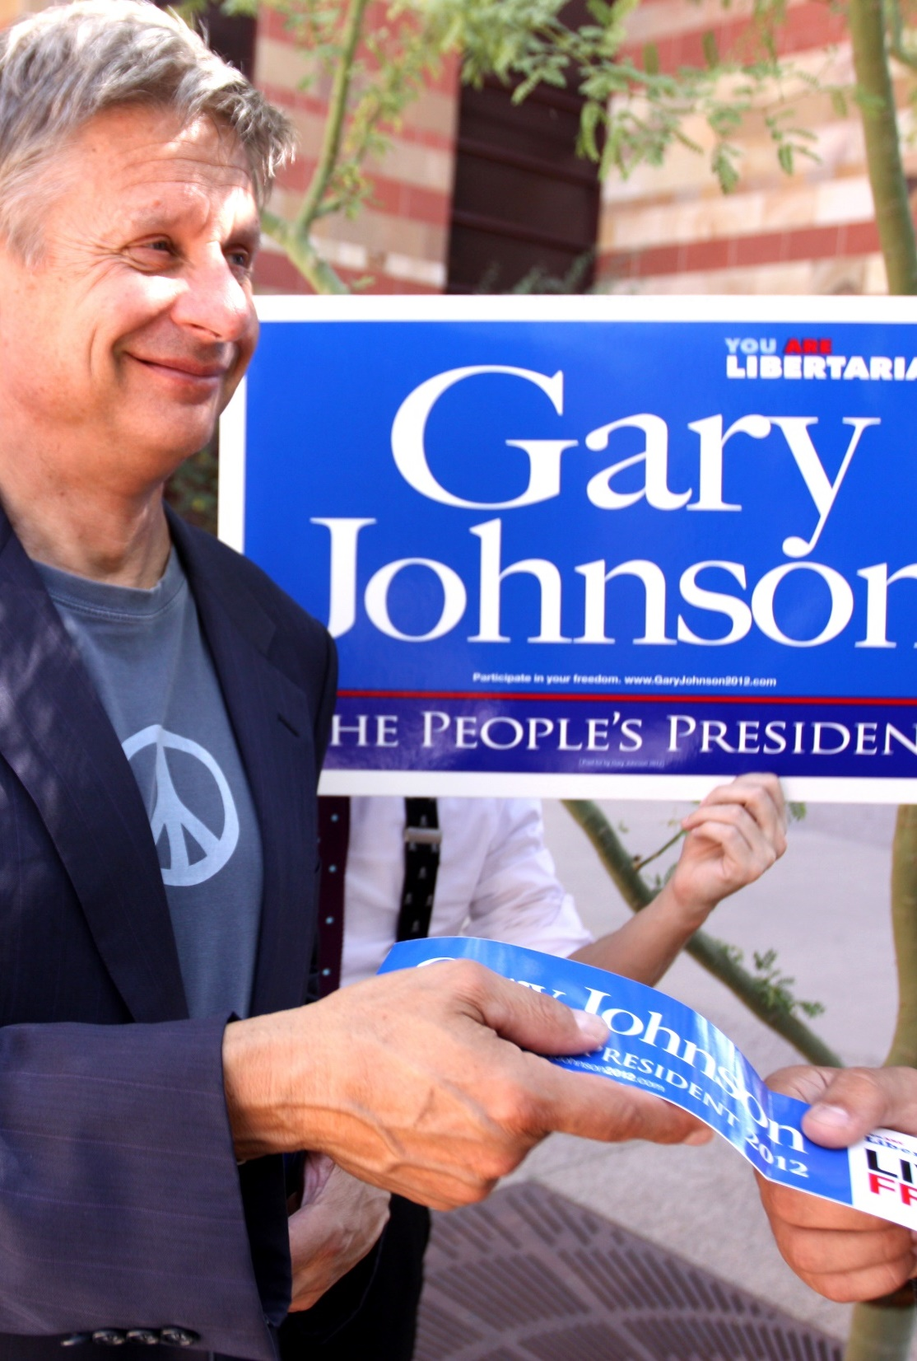
A. Types of Third Parties
Single-issue parties are formed around an issue so controversial that the major parties have avoided taking a strong stance on it.
Ideological parties rise from political and social ideas, such as the Libertarian Party.
Notes:
By Gage Skidmore from Peoria, AZ, United States of America - Gary Johnson, CC BY-SA 2.0, https://commons.wikimedia.org/w/index.php?curid=54971350
https://commons.wikimedia.org/w/index.php?title=Special:Search&limit=500&offset=0&ns0=1&ns6=1&ns12=1&ns14=1&ns100=1&ns106=1&search=gary+johnson&advancedSearch-current=%7B%7D&searchToken=wawmzxoqj9po6vx89k1yowkd#%2Fmedia%2FFile%3AGary_Johnson_%288276429061%29.jpg

Slide 35
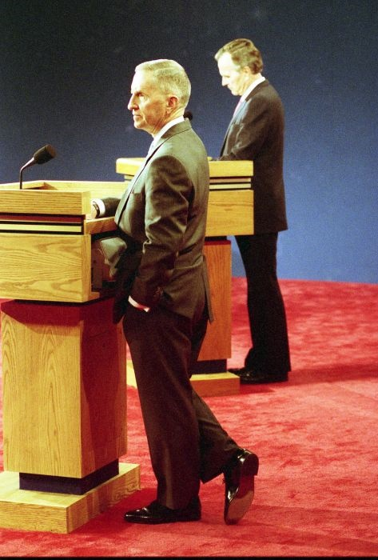
A. Types of Third Parties
Depression parties form during times of political unrest and economic hardship.
Splinter parties are minor parties that split from major parties over policy or personality conflicts.
Splinter parties often weaken their parent party, allowing the opposition
to win.
Notes:
By George Bush Presidential Library and Museum - https://bush41library.tamu.edu/audiovisual/photos/31, Public Domain, https://commons.wikimedia.org/w/index.php?curid=80391762
https://commons.wikimedia.org/w/index.php?sort=relevance&search=ross+perot+debate&title=Special:Search&profile=advanced&fulltext=1&advancedSearch-current=%7B%7D&ns0=1&ns6=1&ns12=1&ns14=1&ns100=1&ns106=1&searchToken=3w1nuxm127kfuzwtxmhi9sbg2#%2Fmedia%2FFile%3AThird_debate_3271.jpg

Slide 36
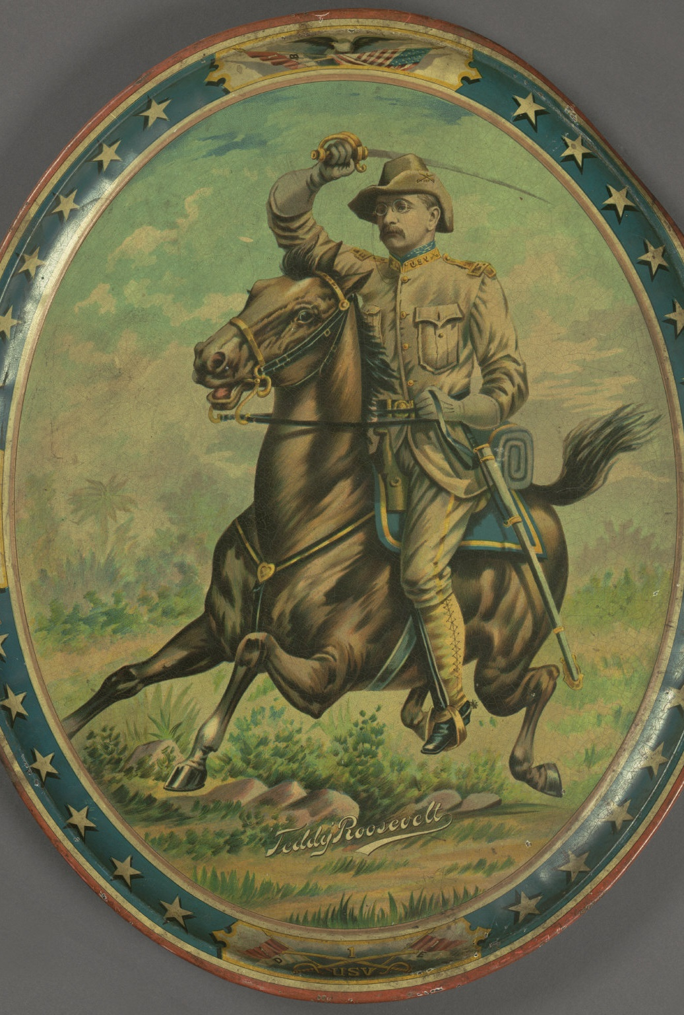
B. Importance
While no third party has ever won the presidency, they still have an important impact on politics.
Third parties call attention to important issues that are often ignored by the major parties.
Notes:
By Cornell University Library - Theodore Roosevelt Rough Rider Portrait Tray, ca. 1898, No restrictions, https://commons.wikimedia.org/w/index.php?curid=44003966
https://commons.wikimedia.org/w/index.php?sort=relevance&search=theodore+roosevelt+progressive+party&title=Special:Search&profile=advanced&fulltext=1&advancedSearch-current=%7B%7D&ns0=1&ns6=1&ns12=1&ns14=1&ns100=1&ns106=1&searchToken=3qskldwsnec0a7flcg2xj82hd#%2Fmedia%2FFile%3ATheodore_Roosevelt_Rough_Rider_Portrait_Tray%2C_ca._1898_%284360105294%29.jpg

Slide 37
Section Review – Chapter 16.3
1–4. Identify four types of third parties.
Some parties form around a single issue of great importance to their members. Others are based on commitment to a political or social idea. Still others form as a result of depressed economic conditions. Some split from major parties. (p. 389)
5–6. What are two reasons third parties that develop around a single issue decline or disappear?
because the issue is resolved or because the major political parties adopt the issue as a result of public sentiment (p. 389)

Slide 38
Section Review – Chapter 16.3
How important are third parties? Evaluate their influence on the American political system.
Although most Americans have not supported third-party candidates, third parties influence the American political system. Even a relatively small one can play an important role in a close contest. For example, in 2000, Green Party candidate Ralph Nader received almost 3 percent of the popular vote and probably took enough votes away from Democrat Al Gore to allow a victory by Republican George W. Bush.

Slide 39
Section Review – Chapter 16.3
How important are third parties? Evaluate their influence on the American political system.
In addition, third parties call attention to issues important to many voters or to the hardships faced by Americans. They often represent citizens who feel that they are ignored by the major parties.

Slide 40
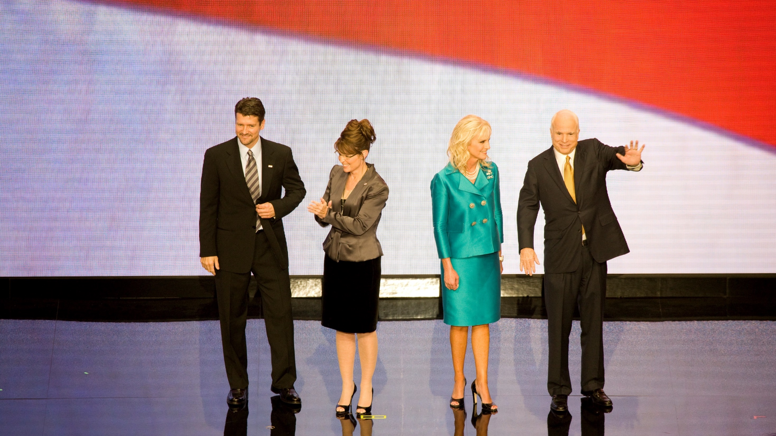
IV. Party Organization
Chapter 16.4
Notes:
Public Domain, https://commons.wikimedia.org/w/index.php?curid=56986858
https://commons.wikimedia.org/w/index.php?title=Special:Search&limit=500&offset=0&ns0=1&ns6=1&ns12=1&ns14=1&ns100=1&ns106=1&search=national+republican+convention&advancedSearch-current=%7B%7D&searchToken=26cpwc67qnril9nc3068pofnw#%2Fmedia%2FFile%3ARepublican_National_Convention%2C_September_1-4%2C_2008._Sarah_and_Todd_Pailin_with_John_and_Cindy_McCain_on_stage%2C_St._Paul%2C_Minnesota_LCCN2016648324.jpg

Slide 41
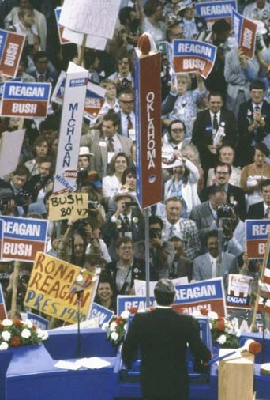
A. Reasons for Political Parties’ Fragmented Nature
American political parties are highly decentralized.
A party’s effectiveness at any level often depends on the strength of its membership.
Notes:
By The White House - http://www.reagan.utexas.edu/archives/photographs/campaign1980.html, Public Domain, https://commons.wikimedia.org/w/index.php?curid=19437607
https://commons.wikimedia.org/w/index.php?title=Special:Search&limit=500&offset=0&ns0=1&ns6=1&ns12=1&ns14=1&ns100=1&ns106=1&search=national+republican+convention&advancedSearch-current=%7B%7D&searchToken=26cpwc67qnril9nc3068pofnw#%2Fmedia%2FFile%3AReagan_giving_his_acceptance_speech_at_Republican_National_Convention_7-17-80.jpg

Slide 42
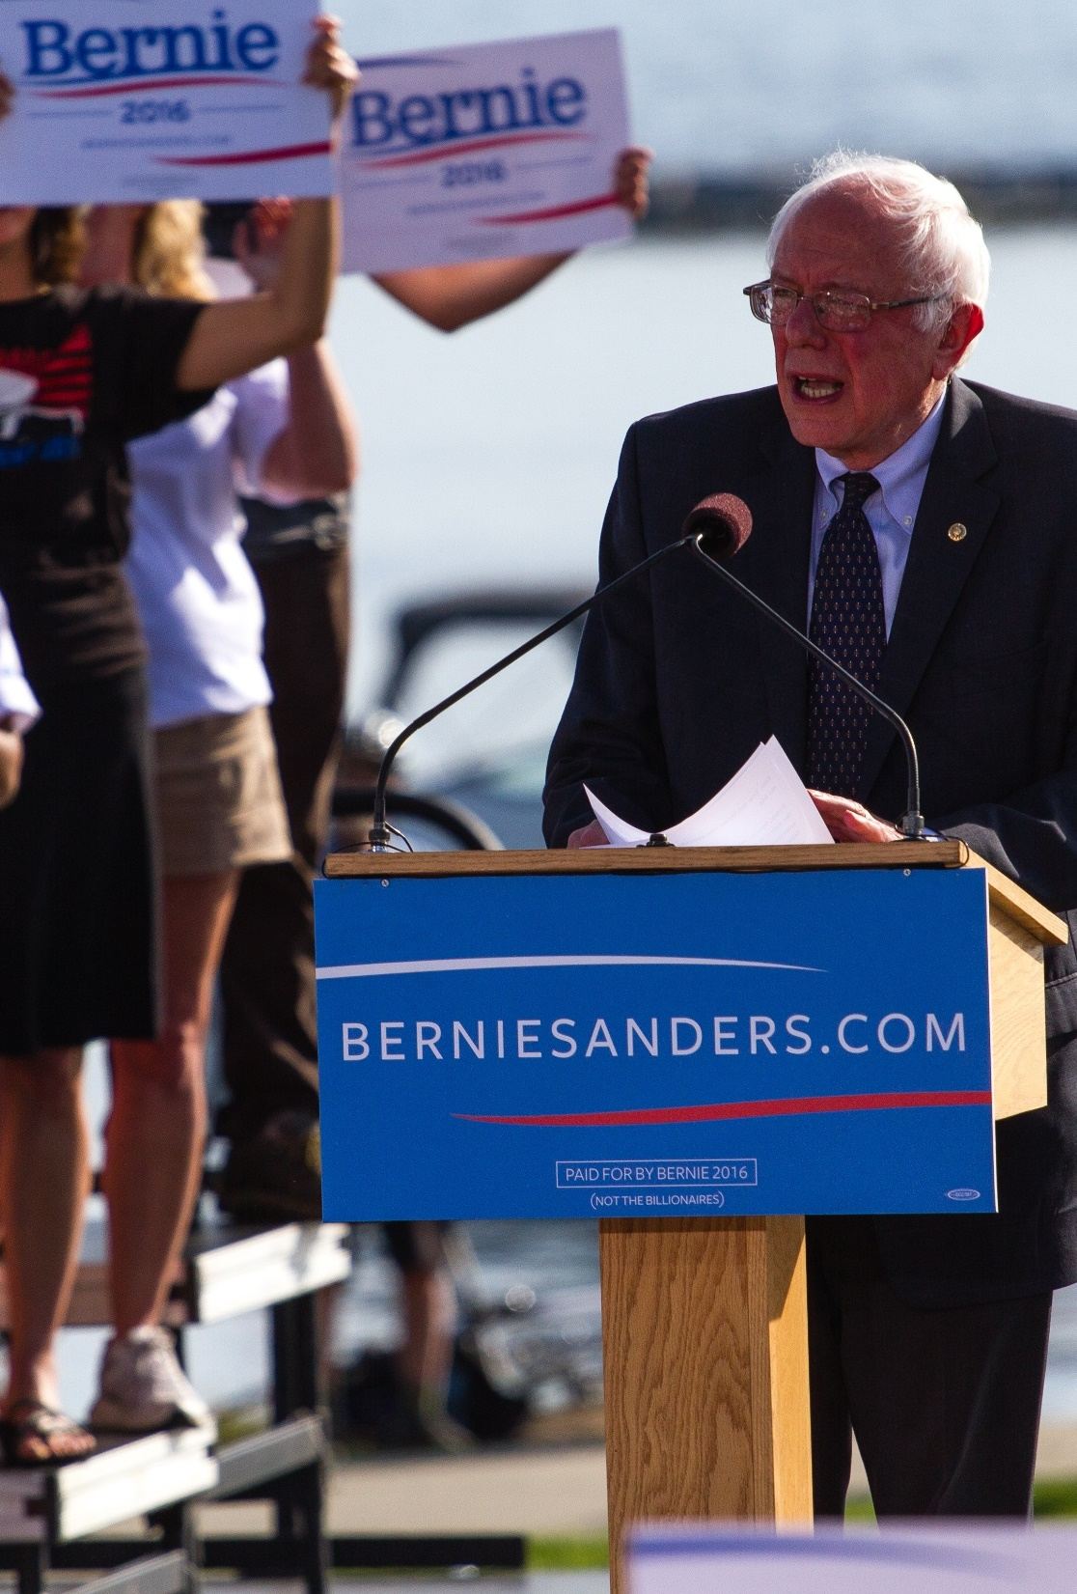
A. Reasons for Political Parties’ Fragmented Nature
The sheer number of elected positions encourages a dispersal of power and fragmentation.
Party members often become divided over nominations.
Notes:
By Jake Bucci - Bernie Sanders, CC BY 2.0, https://commons.wikimedia.org/w/index.php?curid=46941759
https://commons.wikimedia.org/w/index.php?title=Special:Search&limit=500&offset=0&ns0=1&ns6=1&ns12=1&ns14=1&ns100=1&ns106=1&search=bernie+sanders&advancedSearch-current=%7B%7D&searchToken=6a8kw7xttehhylgvl8z39ffqm#%2Fmedia%2FFile%3ASanders_presidential_campaign_kickoff%2C_May_2015_Bernie_Sanders_%2824652409450%29.jpg

Slide 43
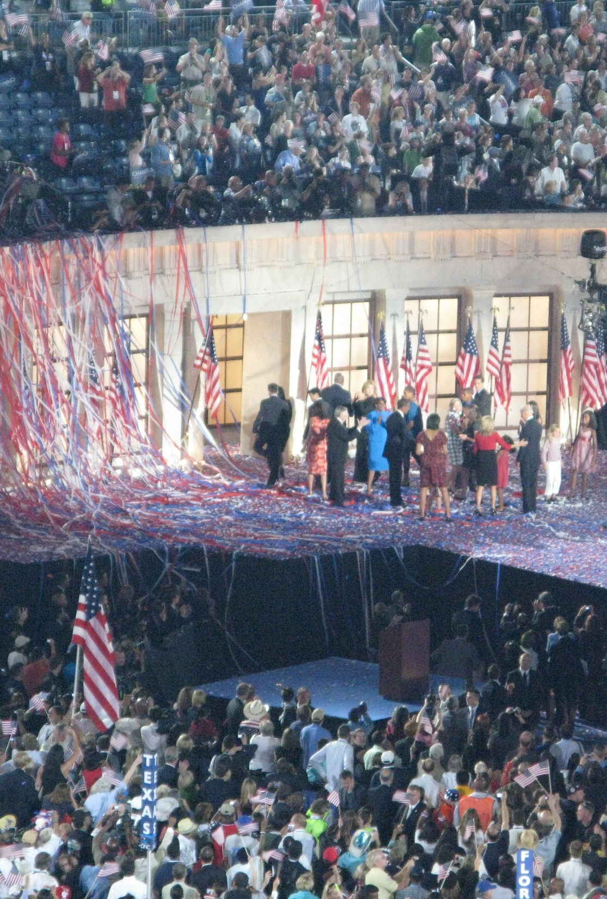
B. National Organization
A national party has four components:
  The national chairman and national committee serve largely in an administrative capacity.
  The national convention and the congressional campaign committees serve an electoral function.
Notes:
By Kelly DeLay - Democratic National Convention - Invesco, CC BY 2.0, https://commons.wikimedia.org/w/index.php?curid=54518924
https://commons.wikimedia.org/w/index.php?title=Special:Search&limit=500&offset=0&ns0=1&ns6=1&ns12=1&ns14=1&ns100=1&ns106=1&search=national+democratic+convention&advancedSearch-current=%7B%7D&searchToken=7d1xw2k7e8wunupf0d46ioebk#%2Fmedia%2FFile%3ADemocratic_National_Convention_-_Invesco_%282808866717%29.jpg

Slide 44
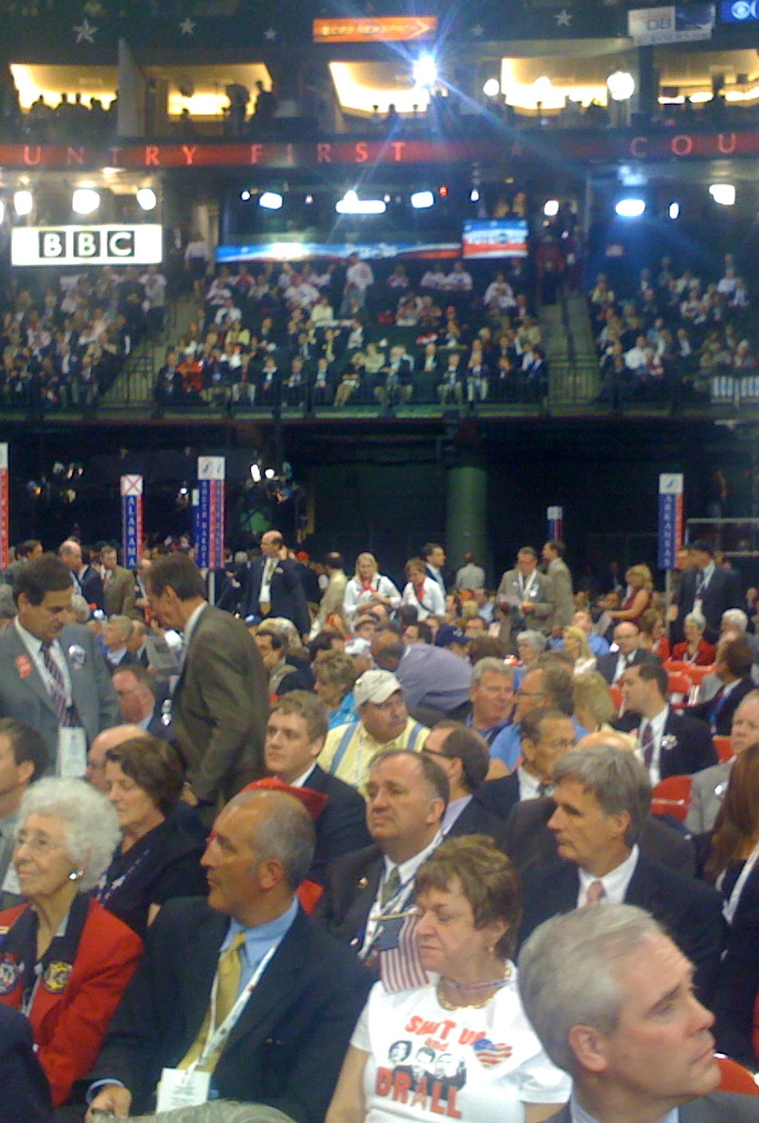
B. National Organization
Both national committees differ in their compositions.
  The Republican National Committee (RNC) includes state party chairmen.
  The Democratic National Committee (DNC) has a much larger membership.
Notes:
By William Beutler from Washinton, DC, USA - RNC Oregon delegation, CC BY-SA 2.0, https://commons.wikimedia.org/w/index.php?curid=46642496
https://commons.wikimedia.org/w/index.php?title=Special:Search&limit=500&offset=0&ns0=1&ns6=1&ns12=1&ns14=1&ns100=1&ns106=1&search=Republican+National+Committee&advancedSearch-current=%7B%7D&searchToken=b0ip7xjjgnoj4rgonhp6plguw#%2Fmedia%2FFile%3A2008_Oregon_Republican_National_Convention_delegation.jpg

Slide 45
B. National Organization
Congressional campaign committees provide money and expertise to help reelect incumbents to Congress.
Notes:
By William Beutler from Washinton, DC, USA - RNC Oregon delegation, CC BY-SA 2.0, https://commons.wikimedia.org/w/index.php?curid=46642496
https://commons.wikimedia.org/w/index.php?title=Special:Search&limit=500&offset=0&ns0=1&ns6=1&ns12=1&ns14=1&ns100=1&ns106=1&search=Republican+National+Committee&advancedSearch-current=%7B%7D&searchToken=b0ip7xjjgnoj4rgonhp6plguw#%2Fmedia%2FFile%3A2008_Oregon_Republican_National_Convention_delegation.jpg

Slide 46
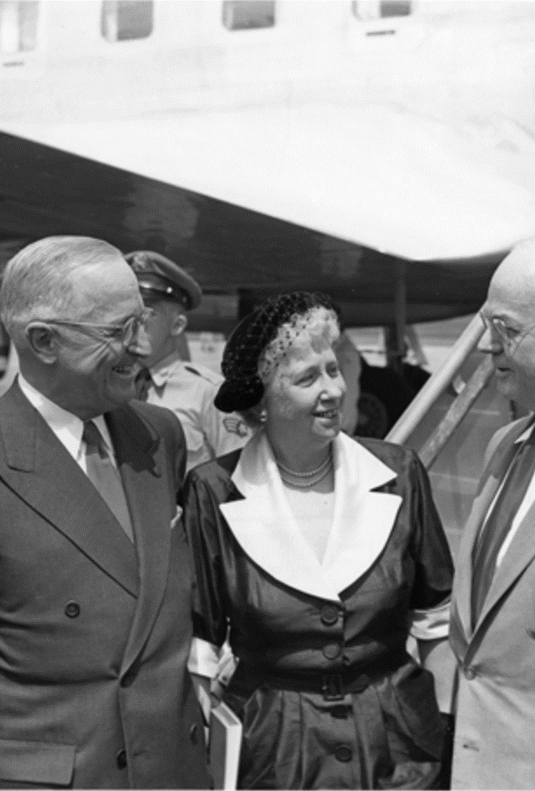
C. State and Local Levels
State party organization centers on a state committee headed by a state chairman.
Local party divisions across the country vary considerably in structure and strength and may include wards.
Notes:
By Harry S. Truman Library & Museum - https://www.trumanlibrary.org/photographs/view.php?id=40647, Public Domain, https://commons.wikimedia.org/w/index.php?curid=77014245
https://commons.wikimedia.org/w/index.php?title=Special:Search&limit=500&offset=0&ns0=1&ns6=1&ns12=1&ns14=1&ns100=1&ns106=1&search=national+democratic+convention&advancedSearch-current=%7B%7D&searchToken=7d1xw2k7e8wunupf0d46ioebk#%2Fmedia%2FFile%3ATrumans_Leave_for_1952_Democratic_National_Convention_73-3910.jpg

Slide 47
Section Review – Chapter 16.4
1–2. Identify the two major purposes of a party’s national convention.
to nominate the party’s candidates for president and vice president and to approve the party platform (p. 392)
3–4. What group manages national-party activities during the time between national conventions? Who is the party leader, at least in theory, during that time?
the national committee; the national chairman (p. 393)

Slide 48
Section Review – Chapter 16.4
What are three major factors that contribute to the fragmented nature of political parties?
membership strength, federalism, and the nominating process

Slide 49
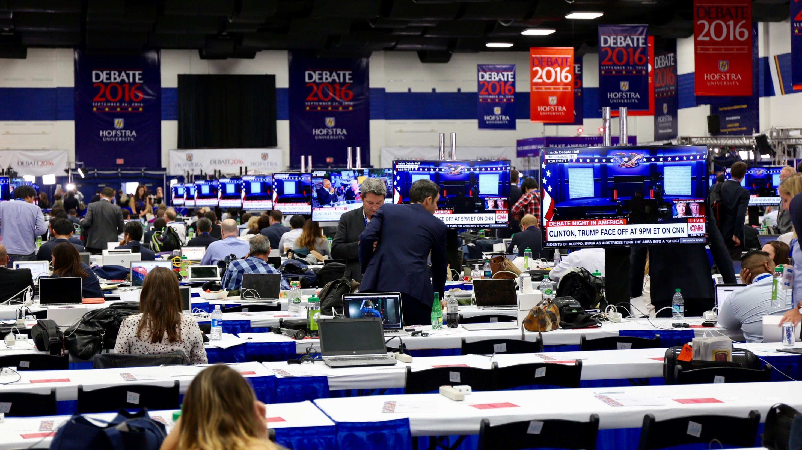
V. Party Decline
Chapter 16.5
Notes:
By Brian Allen (Voice of America) - http://www.voanews.com/a/hofstra-hosts-presidential-debates/3525216.html, Public Domain, https://commons.wikimedia.org/w/index.php?curid=55504178
https://commons.wikimedia.org/w/index.php?title=Special:Search&limit=500&offset=0&profile=default&search=trump+clinton+debate&advancedSearch-current=%7B%7D&ns0=1&ns6=1&ns12=1&ns14=1&ns100=1&ns106=1&searchToken=chtnij7ek2iifzcm3ffptlbju#%2Fmedia%2FFile%3AMedia_at_First_Presidential_Debate_2016.jpg

Slide 50
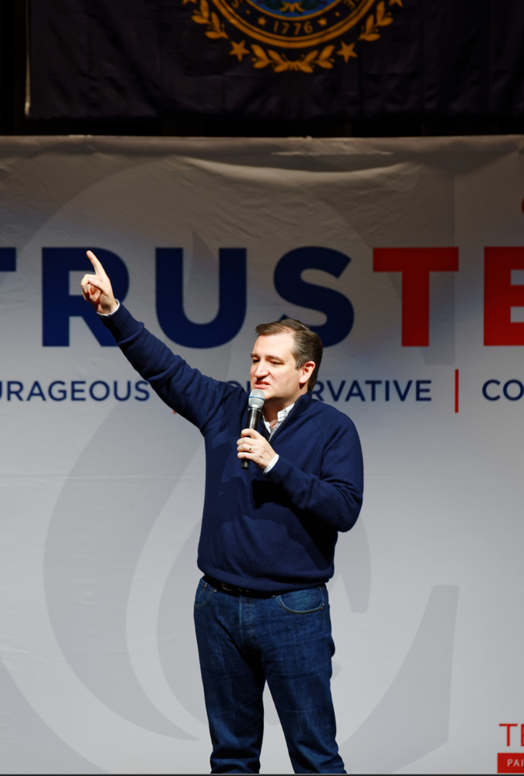
V. Party Decline
Recent changes have weakened the traditional party, making it more a vehicle for nominating than a means of governing.
Some will argue that this has forced parties to pay more attention to issues that voters care about.
Notes:
By Michael Vadon - Own work, CC BY-SA 4.0, https://commons.wikimedia.org/w/index.php?curid=46781325
https://commons.wikimedia.org/w/index.php?title=Special:Search&limit=500&offset=0&profile=default&search=trump+clinton+debate&advancedSearch-current=%7B%7D&ns0=1&ns6=1&ns12=1&ns14=1&ns100=1&ns106=1&searchToken=chtnij7ek2iifzcm3ffptlbju#%2Fmedia%2FFile%3ASenator_of_Texas_Ted_Cruz_at_Kuhner_Town_Hall_in_New_Hampshire_on_February_3rd%2C_2016_by_Michael_Vadon_13.jpg

Slide 51
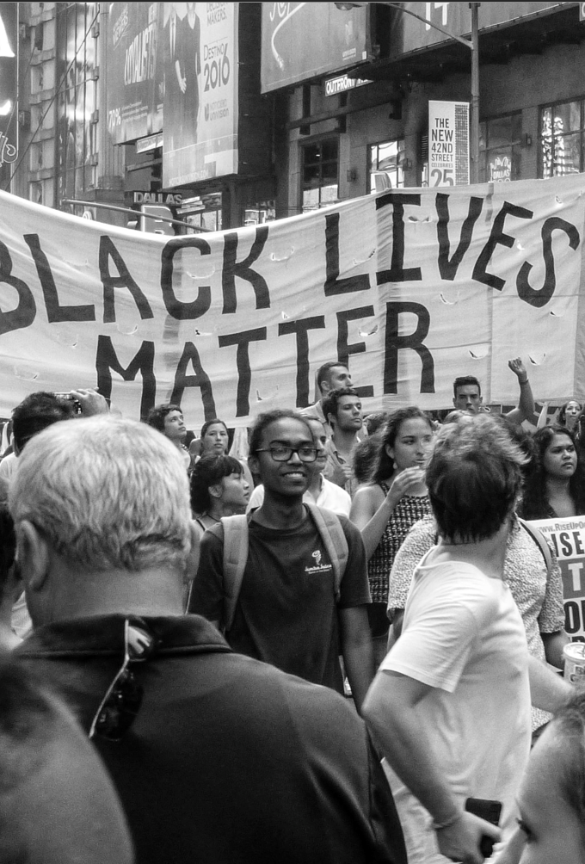
A. Changes
Presidential primaries dramatically changed the nomination process.
Social upheaval has also contributed to rapid change.
The increase in party delegates has resulted in greater involvement by interest groups.
Notes:
Photo by Nicole Baster on Unsplash
https://unsplash.com/photos/6_y5Sww0-h4

Slide 52
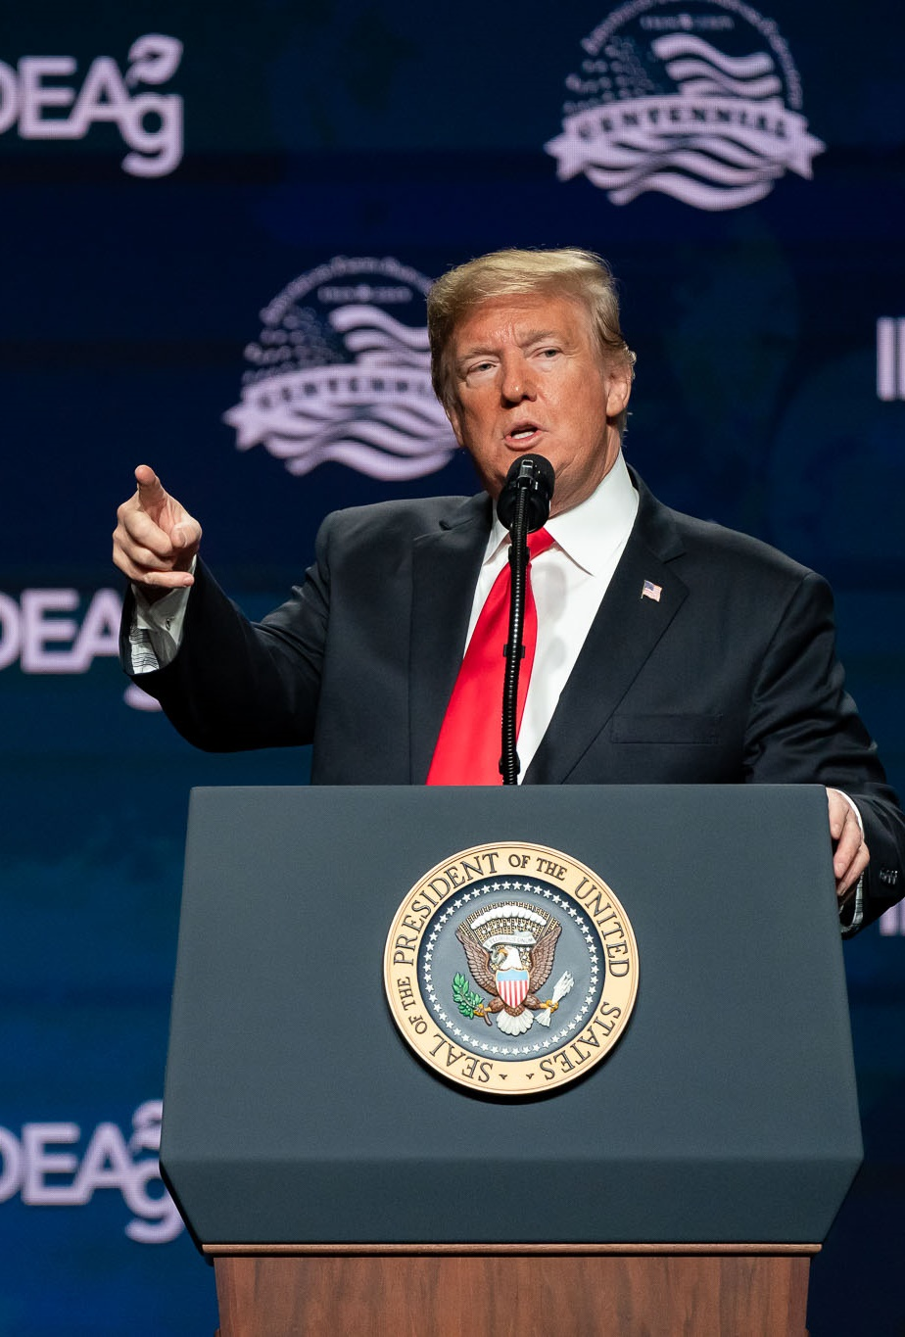
A. Changes
Modern campaigns are also much longer and more expensive than in the past.
Increased democratization has fragmented parties into competing factions.
Notes:
By Tia Dufour; Official White House Photo - https://www.flickr.com/photos/whitehouse/39779806913/in/photostream/, Public Domain, https://commons.wikimedia.org/w/index.php?curid=75862370
https://commons.wikimedia.org/w/index.php?sort=relevance&search=trump+speech&title=Special:Search&profile=advanced&fulltext=1&advancedSearch-current=%7B%7D&ns0=1&ns6=1&ns12=1&ns14=1&ns100=1&ns106=1&searchToken=ea1zre2t39c508p7fzuqpwx0k#%2Fmedia%2FFile%3ATrumpAmericanFarmBureau%2719.jpg

Slide 53
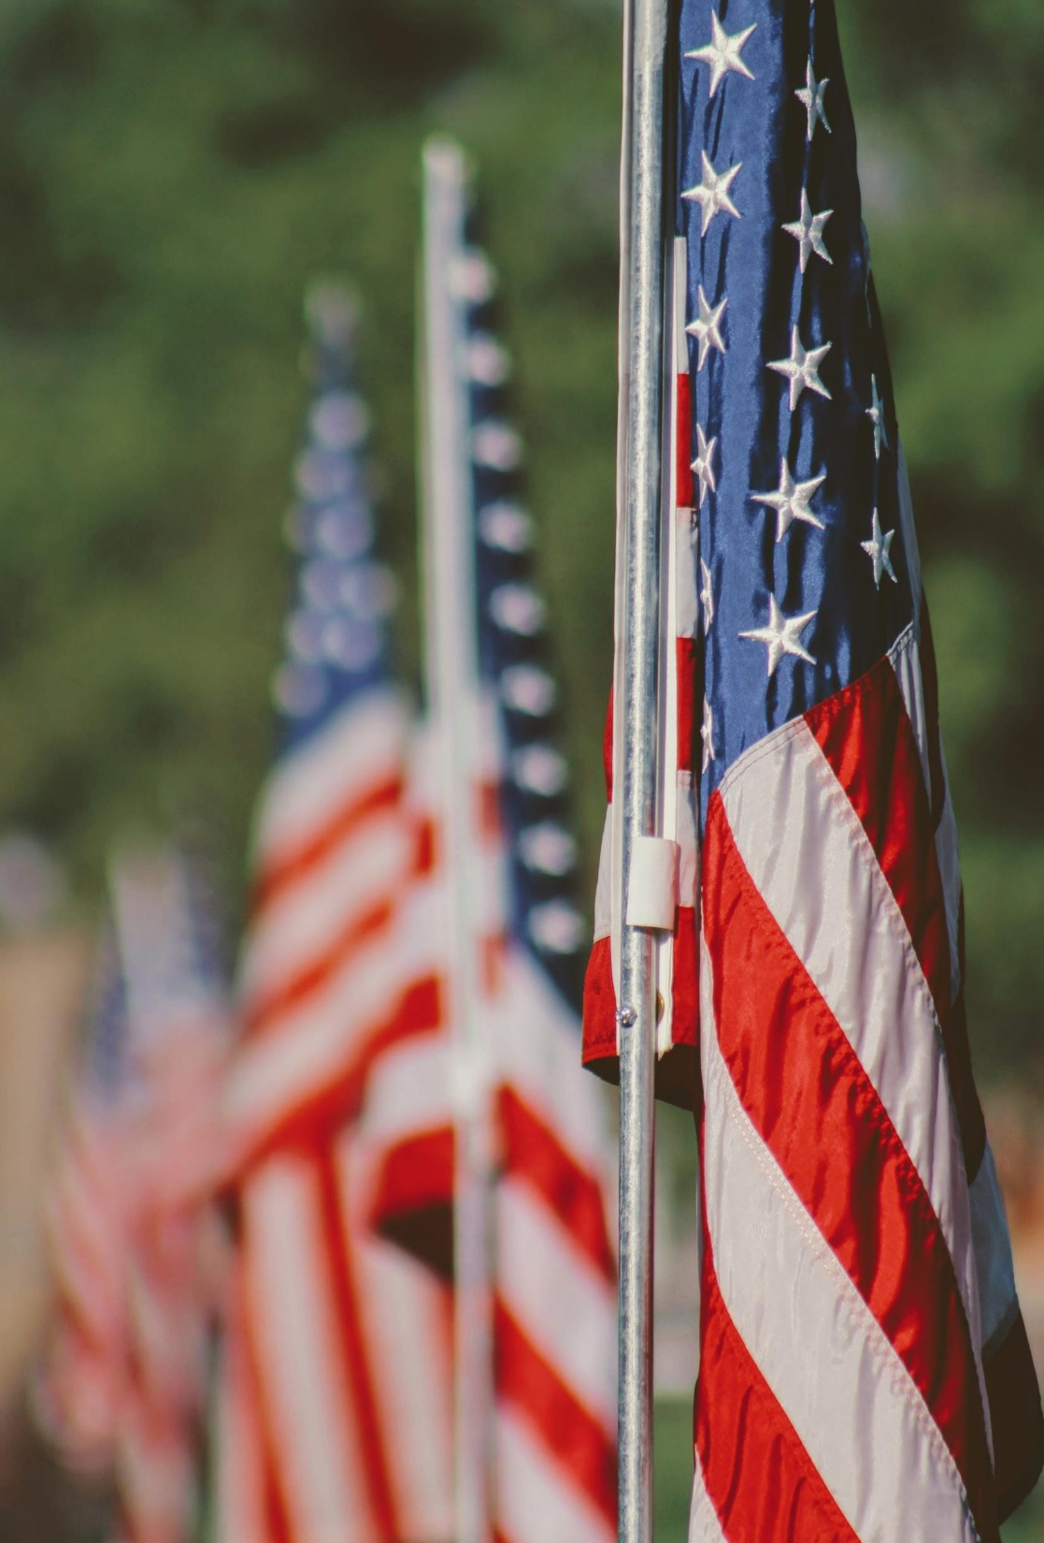
B. Independent Voters
Recently, the number of independent voters has risen dramatically.
Independents contribute to landslide victories through frequent party-switching.
Ticket splitting has also become more common.
Notes:
Photo by Joshua Hoehne on Unsplash
https://unsplash.com/photos/YQNu3U4lPdI

Slide 54
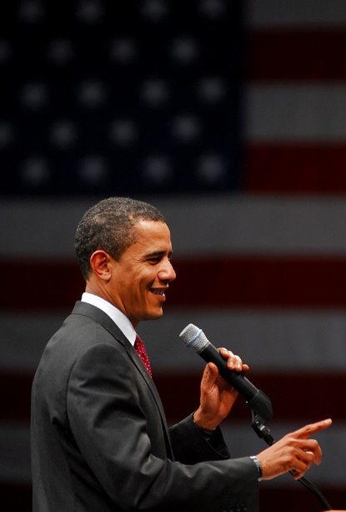
C. Media Impact
Television coverage and social media presence can have an enormous impact on a campaign.
Candidates have used the internet as an effective tool for campaign fundraising.
Despite many changes, political parties show no signs of becoming extinct.
Notes:
By Beth Rankin from Southeast Texas, United States - obama_9515, CC BY 2.0, https://commons.wikimedia.org/w/index.php?curid=68881630
https://commons.wikimedia.org/w/index.php?title=Special:Search&limit=500&offset=0&ns0=1&ns6=1&ns12=1&ns14=1&ns100=1&ns106=1&search=obama+primary&advancedSearch-current=%7B%7D&searchToken=4p8kcm3t95fposjthzt5tymqr#%2Fmedia%2FFile%3AObama_9515_%282287026145%29.jpg

Slide 55
Section Review – Chapter 16.5
1–2. Which two important party changes occurred, in part, because of the 1968 election?
an increase in the number of presidential primaries and an increased number of national delegates drawn from those primaries (p. 395)
3. What is yellow-dog voting?
the practice of casting a vote solely based on party label
(p. 396)

Slide 56
Section Review – Chapter 16.5
4–6. Many refer to yellow-dog voting as intellectually lazy because voters do not have to think about three things. Identify those.
issues, candidates’ qualifications, or their character (p. 396)

Slide 57
Section Review – Chapter 16.5
Do you think the weakening of political parties in America has been a positive or negative development? Explain your answer.
Some might describe the weakening as good, noting that President Washington warned of the dangers of political parties. They might cite the tight control past party bosses often held, negatively impacting democratic government, or might argue that strong parties often ignored issues important to the average voter.

Slide 58
Section Review – Chapter 16.5
Do you think the weakening of political parties in America has been a positive or negative development? Explain your answer.
Other students may disagree and note that in the past strong parties served as a cohesive force by controlling factions, coordinating policymaking, and promoting cooperation between the legislative and executive branches, as well as helping to identify and promote qualified candidates. Some may argue that weaker parties have increased the number of celebrity candidates and have led to greater polarization of the public.

Slide 59
Section Review – Chapter 16.5
How have television, the internet, and social media influenced election campaigns?
Television, the internet, and social media have negatively influenced election campaigning by magnifying candidates’ physical looks and personality qualities, often at the sacrifice
of debates about issues and ideological views.

Slide 60
Section Review – Chapter 16.5
How have television, the internet, and social media influenced election campaigns?
Used properly, however, media can make news almost instantaneously available to the public, enable rapid responses to candidates’ accusations or promises, and inform voters about the differences between candidates. These media also make it easy to volunteer for or donate to a campaign.

