Slide 1
Chapter 17: Campaigns and Elections
Notes:
WIN-Initiative/Stone/Getty Images

Slide 2
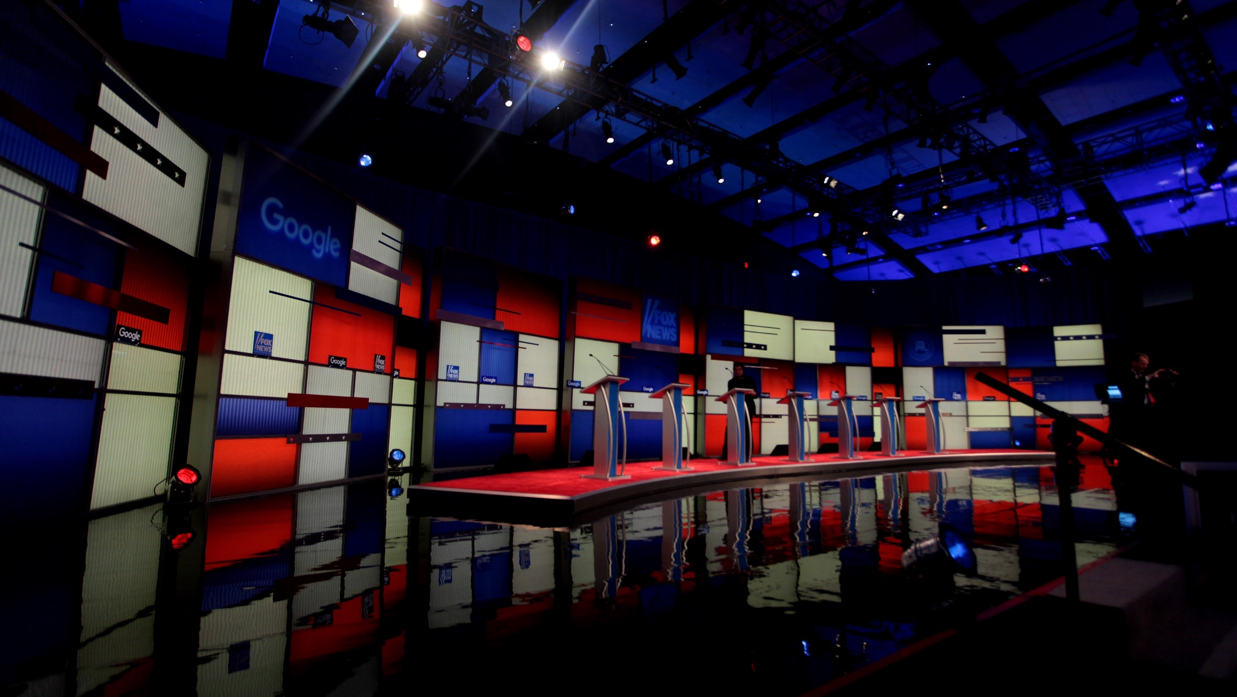
I. Candidate Nomination
Chapter 17.1
Notes:
By Gage Skidmore, CC BY-SA 3.0, https://commons.wikimedia.org/w/index.php?curid=46961212
https://commons.wikimedia.org/w/index.php?sort=relevance&search=2016+Republican+debate&title=Special:Search&profile=advanced&fulltext=1&advancedSearch-current=%7B%7D&ns0=1&ns6=1&ns12=1&ns14=1&ns100=1&ns106=1&searchToken=cvo16mvjr7x84p61hsne5c49o#%2Fmedia%2FFile%3ARepublican_Presidential_debate_2016_by_Gage_Skidmore.jpg

Slide 3
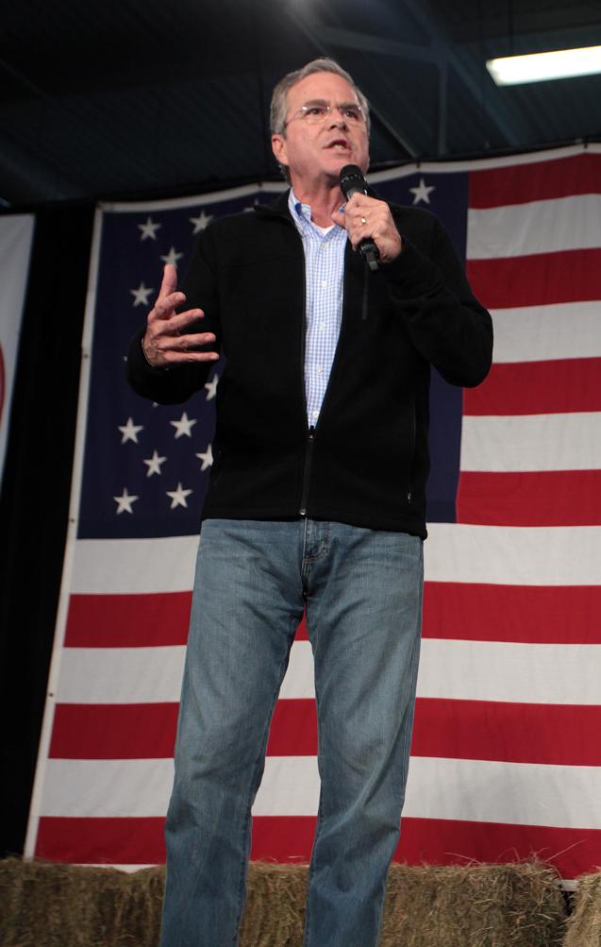
A. Preliminaries
A major function of political parties is candidate nomination – selecting a candidate to represent the party for public office.
Each nominee must meet the requirements of the position for which he will run.
Notes:
By Gage Skidmore, CC BY-SA 3.0, https://commons.wikimedia.org/w/index.php?curid=45071431
https://commons.wikimedia.org/w/index.php?sort=relevance&search=jeb+bush&title=Special:Search&profile=advanced&fulltext=1&advancedSearch-current=%7B%7D&ns0=1&ns6=1&ns12=1&ns14=1&ns100=1&ns106=1&searchToken=drol2p3k5hrrmdjama0tsyfi0#%2Fmedia%2FFile%3AJeb_Bush_by_Gage_Skidmore_8.jpg

Slide 4
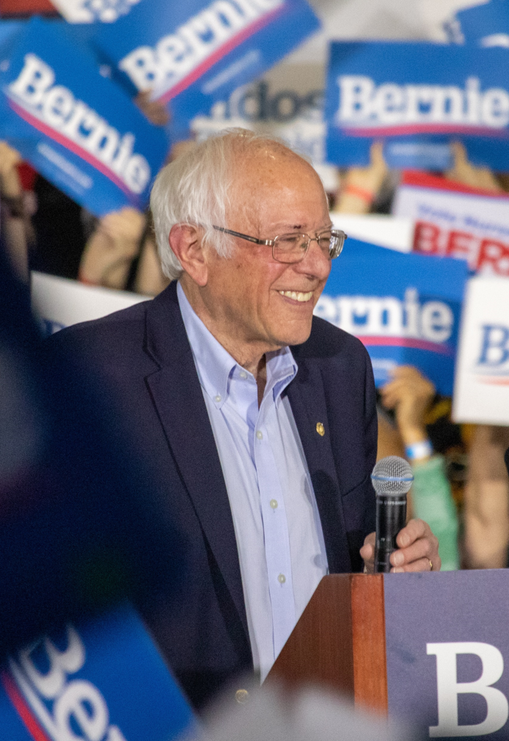
A. Preliminaries
Each candidate must recruit staff workers to run the campaign.
The incumbent (current officeholder) often enlists staff from previous campaigns.
Notes:
By Σ - Own work, CC BY-SA 4.0, https://commons.wikimedia.org/w/index.php?curid=87819262
https://commons.wikimedia.org/w/index.php?sort=relevance&search=bernie+sanders+campaign&title=Special:Search&profile=advanced&fulltext=1&advancedSearch-current=%7B%7D&ns0=1&ns6=1&ns12=1&ns14=1&ns100=1&ns106=1&searchToken=4f2kawsaisve32x3ovevgex2v#%2Fmedia%2FFile%3ABernie_Sanders_-_Rally_at_San_Jose%2C_CA_-_5.jpg

Slide 5
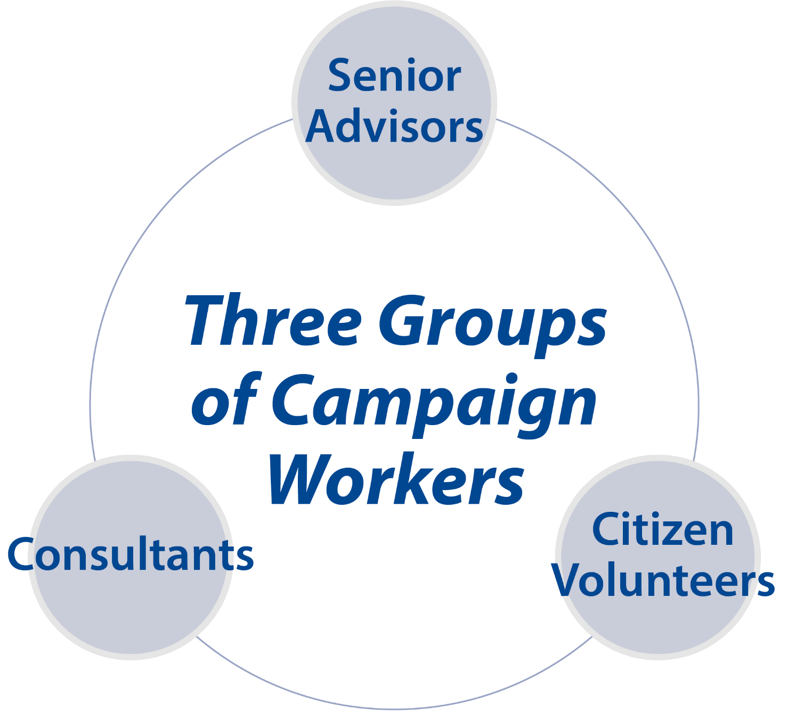
Notes:
BJU Press Art

Slide 6
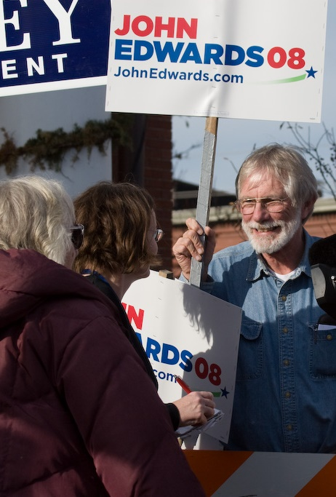
B. Methods of Nomination
Today, there are four commonly used methods of nomination:
  Petition
  Caucus
  Convention
  Direct primary
Notes:
By Roger H. Goun from Brentwood, NH, USA - 20080108-9716, CC BY 2.0, https://commons.wikimedia.org/w/index.php?curid=62808986
https://commons.wikimedia.org/w/index.php?sort=relevance&search=new+hampshire+primary&title=Special:Search&profile=advanced&fulltext=1&advancedSearch-current=%7B%7D&ns0=1&ns6=1&ns12=1&ns14=1&ns100=1&ns106=1&searchToken=1uk5p2x7kmgcips8kx2fx7szl#%2Fmedia%2FFile%3ANew_Hampshire_primary_%282179968048%29.jpg

Slide 7
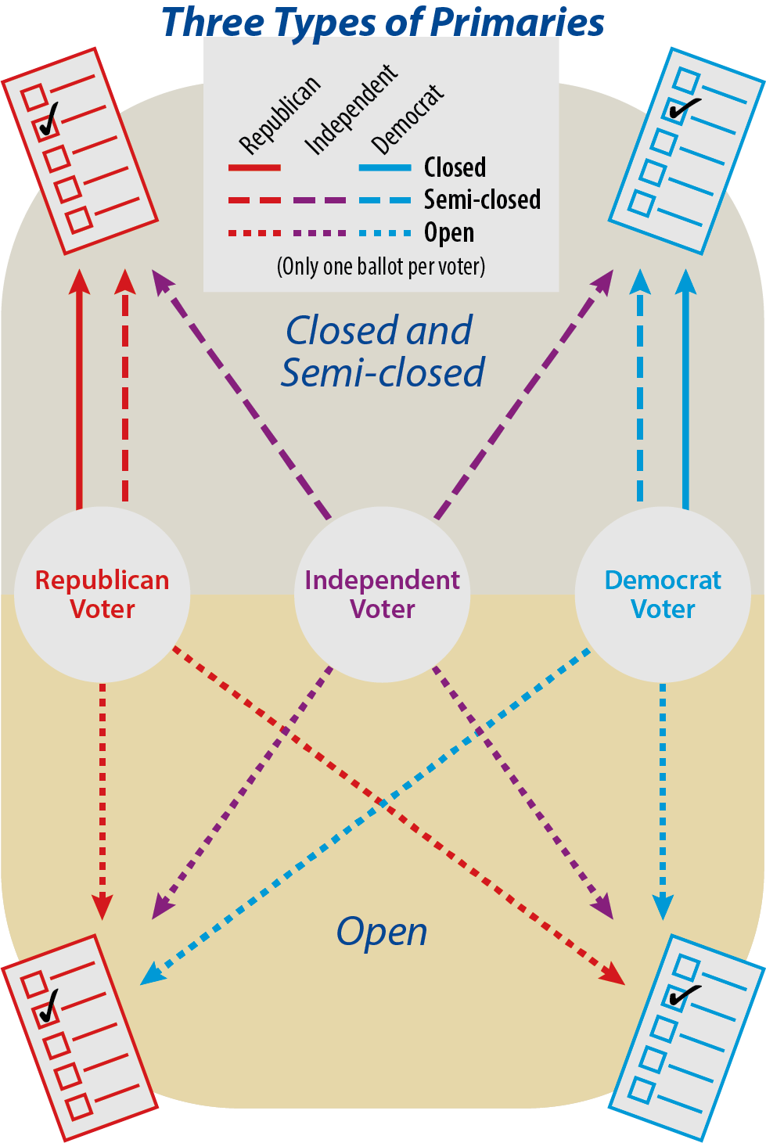
Notes:
BJU Press Art

Slide 8
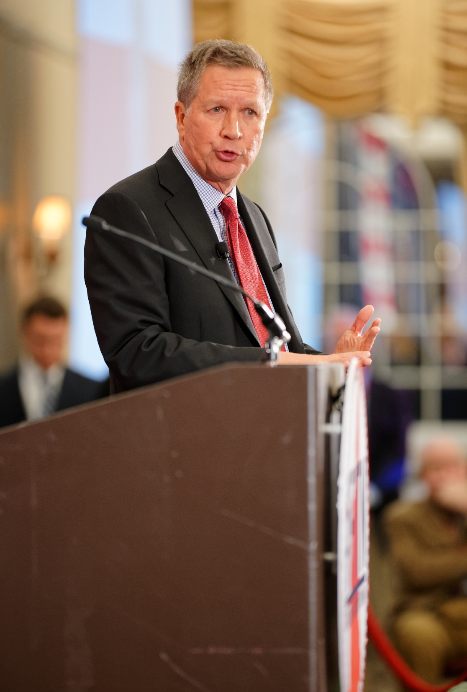
B. Methods of Nomination
In a closed primary, participants must be registered as members of one party and may only vote for candidates from that party.
Semiclosed primaries allow independents to choose a ballot from one of the two parties.
Notes:
By Michael Vadon - Own work, CC BY-SA 4.0, https://commons.wikimedia.org/w/index.php?curid=39734469
https://commons.wikimedia.org/w/index.php?title=Special:Search&limit=500&offset=0&ns0=1&ns6=1&ns12=1&ns14=1&ns100=1&ns106=1&search=new+hampshire+primary&advancedSearch-current=%7B%7D&searchToken=ac1bibbityr301ww29vtgfb5r#%2Fmedia%2FFile%3AGovernor_of_Ohio_John_Kasich_at_FITN_in_Nashua%2C_NH_by_Michael_Vadon_04.jpg

Slide 9
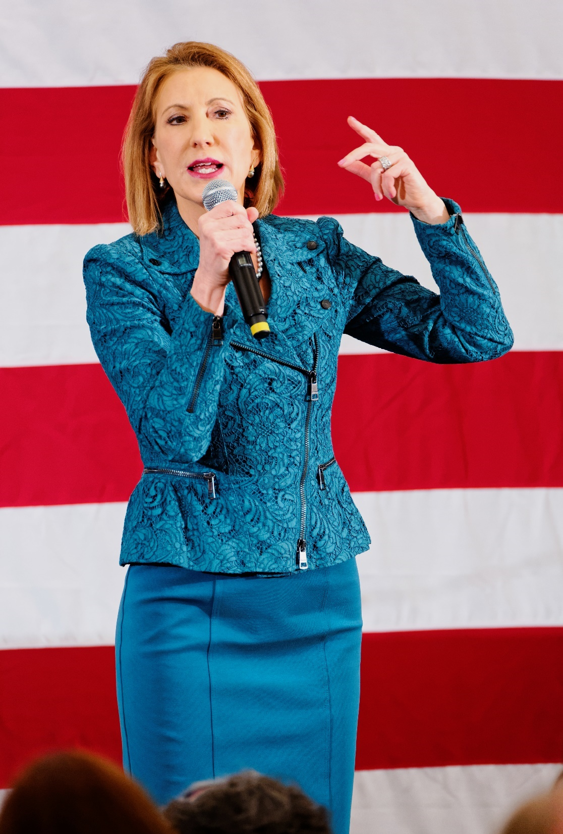
B. Methods of Nomination
In an open primary, voters do not have to declare their party membership.
Blanket primaries, which allowed voters to vote for candidates from different parties on the same ballot, are no longer used.
Notes:
By Michael Vadon - Own work, CC BY-SA 4.0, https://commons.wikimedia.org/w/index.php?curid=39730748
https://commons.wikimedia.org/w/index.php?title=Special:Search&limit=500&offset=0&ns0=1&ns6=1&ns12=1&ns14=1&ns100=1&ns106=1&search=new+hampshire+primary&advancedSearch-current=%7B%7D&searchToken=ac1bibbityr301ww29vtgfb5r#%2Fmedia%2FFile%3AFormer_HP_CEO_Carly_Fiorina_at_FITN_in_Nashua%2C_NH_by_Michael_Vadon_03.jpg

Slide 10
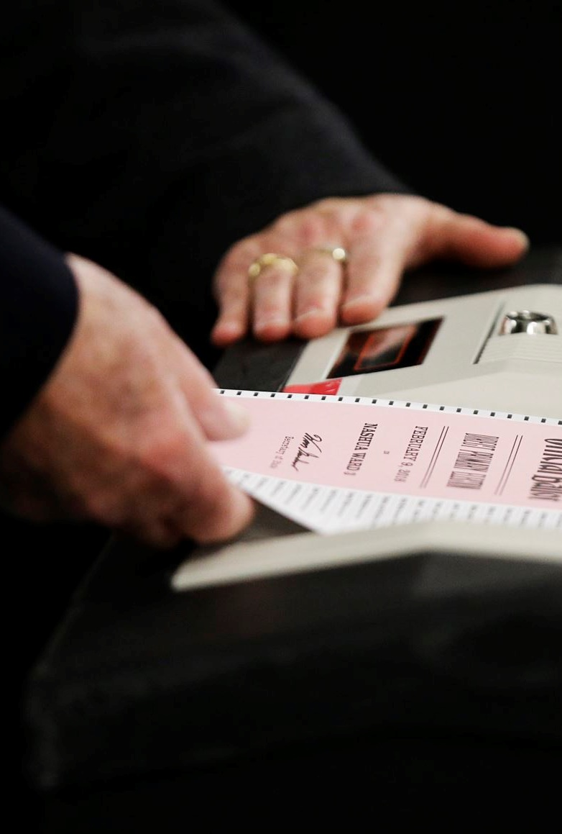
B. Methods of Nomination
A few states use the Top-Two method (or jungle primary) in which the top two candidates in the primary advance to the general election regardless of party membership.
Notes:
By Voice of America - https://www.voanews.com/a/photo-gallery-new-hampshire-primary-election/3183135, Public Domain, https://commons.wikimedia.org/w/index.php?curid=69610894
https://commons.wikimedia.org/w/index.php?title=Special:Search&limit=500&offset=0&ns0=1&ns6=1&ns12=1&ns14=1&ns100=1&ns106=1&search=new+hampshire+primary&advancedSearch-current=%7B%7D&searchToken=ac1bibbityr301ww29vtgfb5r#%2Fmedia%2FFile%3AA_ballot_for_the_New_Hampshire_primary_is_entered_into_a_machine_at_a_polling_site%2C_Feb._9%2C_2016%2C_in_Nashua%2C_N.H.jpg

Slide 11
Section Review – Chapter 17.1
1–4. Identify four preliminary tasks that a candidate faces when running for public office.
meeting the office requirements, assembling a staff,
establishing a campaign strategy, and campaigning
for the party’s nomination (p. 401)
5. Define incumbent.
the current officeholder (p. 402)

Slide 12
Section Review – Chapter 17.1
6–9. Identify four methods used to nominate candidates.
petition, caucus, convention, and direct primary (p. 403)
10. Define direct primary.
a preliminary election to select a party’s candidate for the general election, to elect delegates to a political party’s convention, or both (p. 403)

Slide 13
Section Review – Chapter 17.1
What is the difference between the blanket primary and the open primary?
In a blanket primary, all candidates from all parties are on one ballot, and the voter chooses one candidate for each elected office. In an open primary, the voters do not have to declare party membership and can choose which party ballot they desire.

Slide 14
Section Review – Chapter 17.1
Which type of direct primary do you think is best? Justify your answer.
Some students may say a closed primary is best because those voting have an honest interest in electing the best candidate for their party. Some may say the Top-Two method is better because it de-emphasizes political parties. Some may provide reasons for favoring the open primary, such as that it allows independent voters to participate.

Slide 15
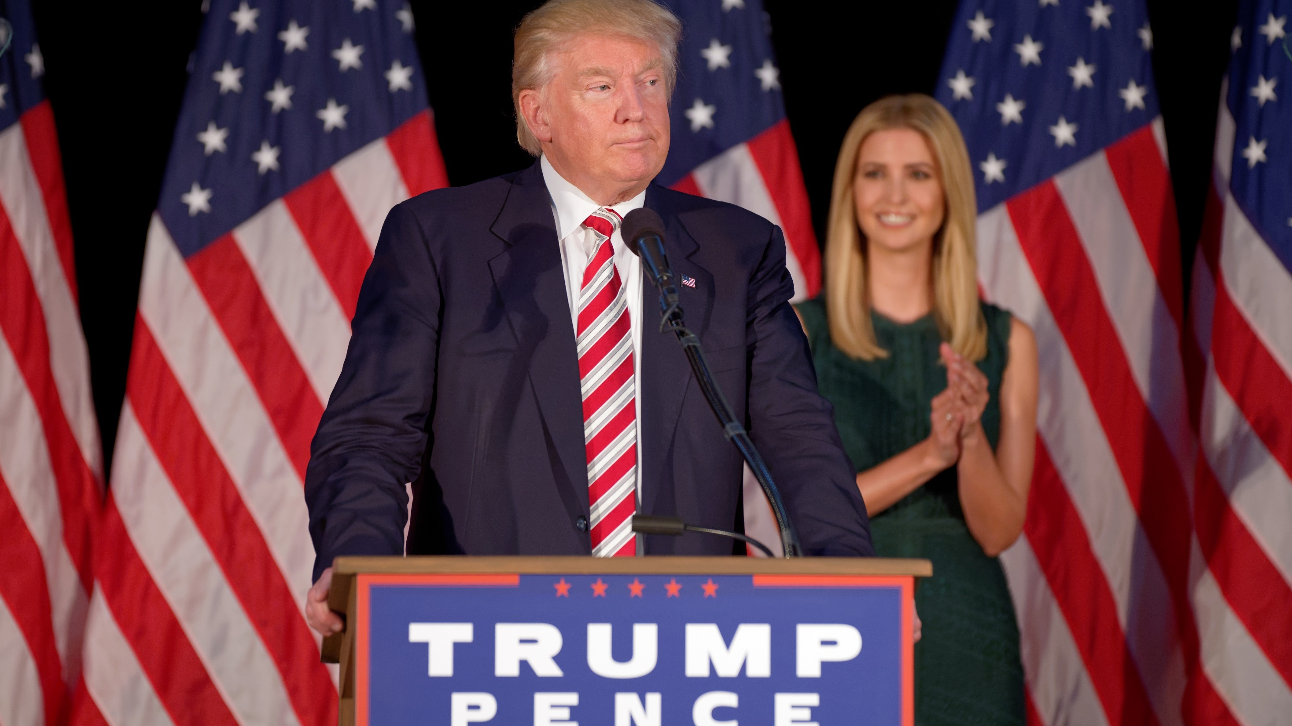
II. The Campaign Trail
Chapter 17.2
Notes:
By Michael Vadon - Own work, CC BY-SA 4.0, https://commons.wikimedia.org/w/index.php?curid=51630809
https://commons.wikimedia.org/w/index.php?title=Special:Search&limit=500&offset=0&ns0=1&ns6=1&ns12=1&ns14=1&ns100=1&ns106=1&search=donald+trump+campaign+speech&advancedSearch-current=%7B%7D&searchToken=4jorpf4vdsjplouvvazzorqpz#%2Fmedia%2FFile%3ADonald_Trump_at_Aston%2C_PA_September_13th_5a.jpg

Slide 16
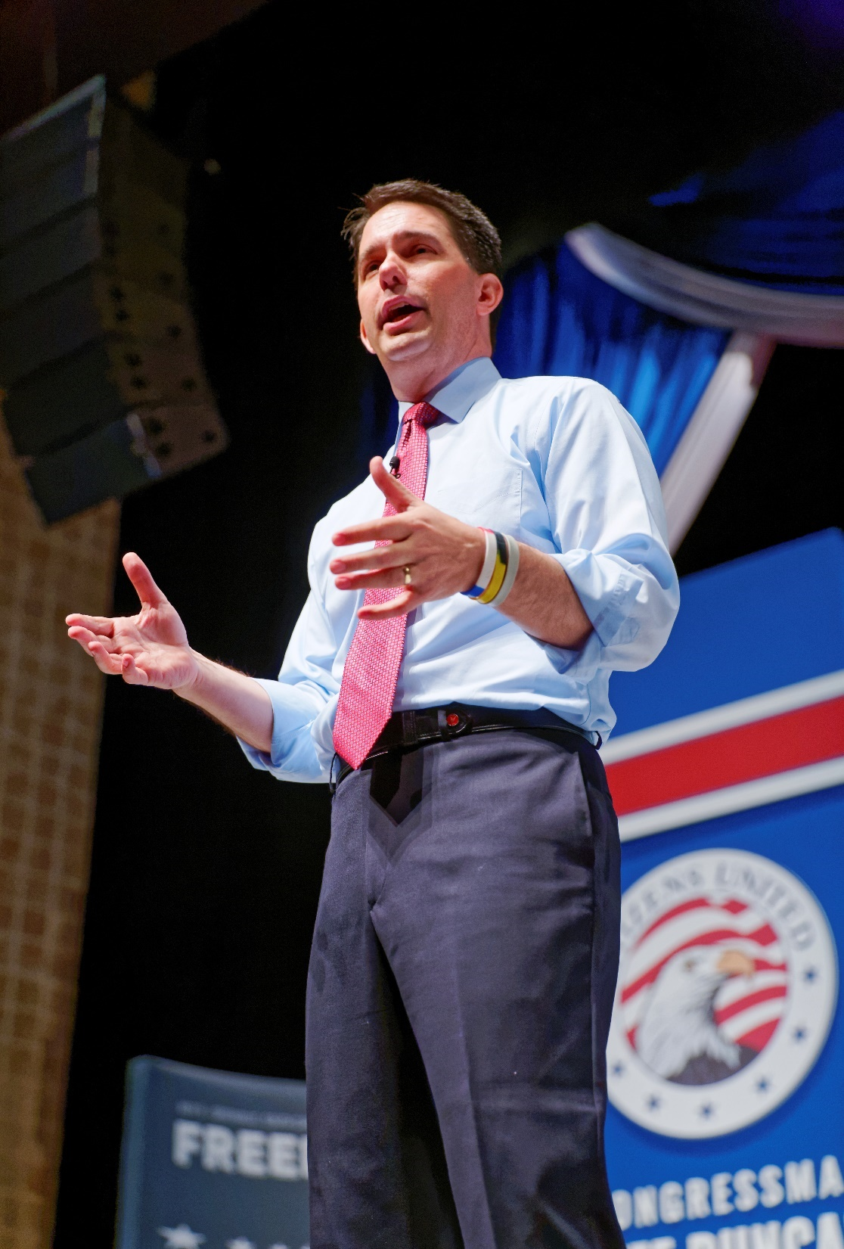
A. Campaigns, Incumbents, and Coattails
Congressional campaigns are less competitive than presidential campaigns.
Incumbents enjoy many advantages, including the goodwill they have created by assisting their constituents.
Notes:
By Michael Vadon - Own work, CC BY-SA 4.0, https://commons.wikimedia.org/w/index.php?curid=40127371
https://commons.wikimedia.org/w/index.php?title=Special:Search&limit=500&offset=0&ns0=1&ns6=1&ns12=1&ns14=1&ns100=1&ns106=1&search=wisconsin+primary&advancedSearch-current=%7B%7D&searchToken=3k0mfg6wtv97mr25etirf3ko8#%2Fmedia%2FFile%3AGovernor_of_Wisconsin_Scott_Walker_at_Citizens_United_Freedom_Summit_in_Greenville_South_Carolina_May_2015_by_Michael_Vadon_05.jpg

Slide 17
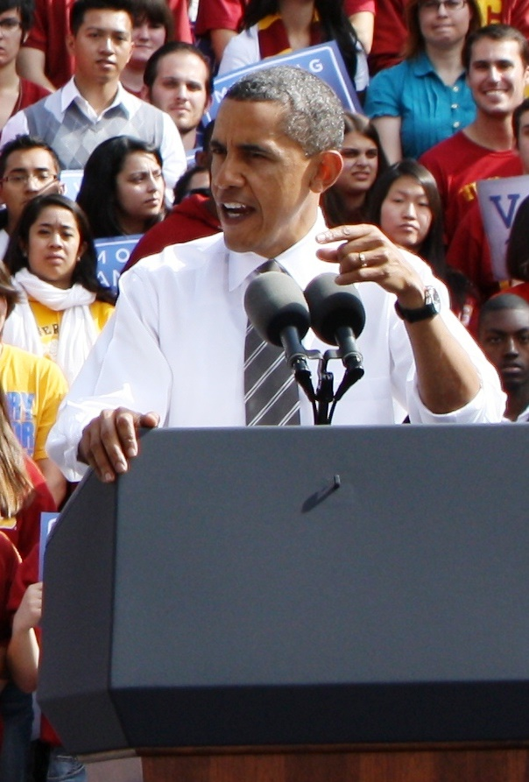
A. Campaigns, Incumbents, and Coattails
The coattail effect is the ability of a strong candidate at the top of a ticket to attract votes for other members of his party running for lesser offices.
Voters do not always vote a straight ticket – voting for all the candidates of one party.
Notes:
By Neon Tommy - Obama 91, CC BY-SA 2.0, https://commons.wikimedia.org/w/index.php?curid=65316606
https://commons.wikimedia.org/w/index.php?title=Special:Search&limit=500&offset=0&ns0=1&ns6=1&ns12=1&ns14=1&ns100=1&ns106=1&search=barack+obama+speech&advancedSearch-current=%7B%7D&searchToken=dnhgqs5pxj4yabmlxwnstssdg#%2Fmedia%2FFile%3ABarack_Obama_%285122295757%29_%28cropped%29.jpg

Slide 18
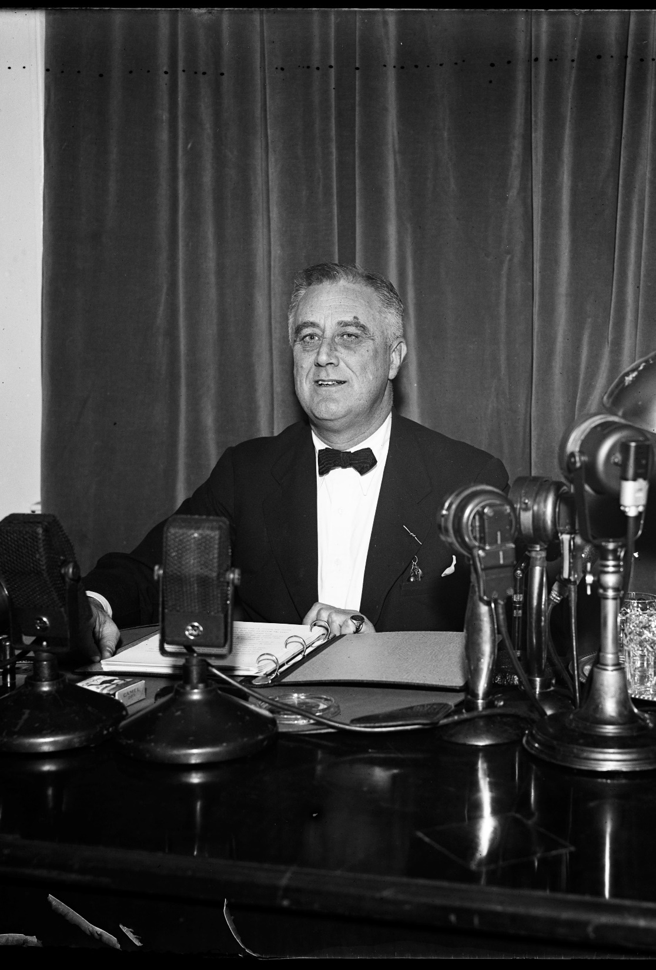
B. Campaigning and the Media
During the early twentieth century, newspapers and magazines were the major information sources for voters.
In the 1920s, radio greatly influenced politics by quickly spreading information across the country.
Notes:
By Harris & Ewing - This image is available from the United States Library of Congress's Prints and Photographs divisionunder the digital ID hec.47304.This tag does not indicate the copyright status of the attached work. A normal copyright tag is still required. See Commons:Licensing for more information., Public Domain, https://commons.wikimedia.org/w/index.php?curid=47427325
https://commons.wikimedia.org/w/index.php?sort=relevance&search=FDR+fireside+chat&title=Special:Search&profile=advanced&fulltext=1&advancedSearch-current=%7B%7D&ns0=1&ns6=1&ns12=1&ns14=1&ns100=1&ns106=1&searchToken=94zfhl15147yccy6ycrd5aeps#%2Fmedia%2FFile%3ARoosevelt_Fireside_Chat_1937.tif

Slide 19
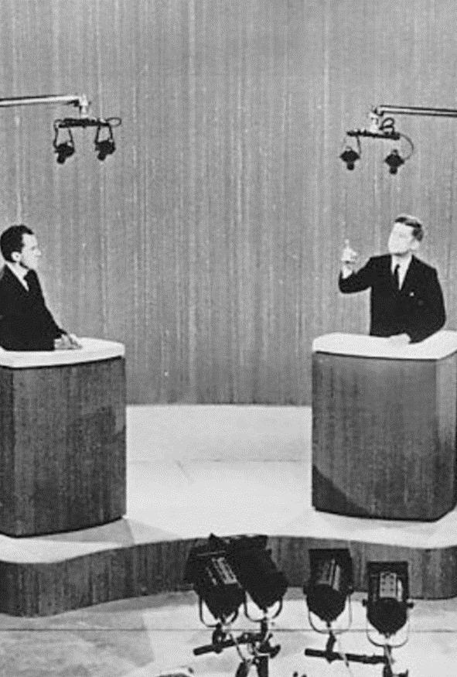
B. Campaigning and the Media
Television allowed many Americans to see politicians for the first time.
TV exposure can be a blessing or a curse for a candidate, as Richard Nixon found out in the 1960 presidential election.
Notes:
By Associated Press - eBayfrontback, Public Domain, https://commons.wikimedia.org/w/index.php?curid=35968212
https://commons.wikimedia.org/w/index.php?sort=relevance&search=nixon+kennedy+debate&title=Special:Search&profile=advanced&fulltext=1&advancedSearch-current=%7B%7D&ns0=1&ns6=1&ns12=1&ns14=1&ns100=1&ns106=1&searchToken=1e7zj4h5cvdqop24oz8ka7e0r#%2Fmedia%2FFile%3AKennedy_Nixon_debate_New_York_1960.jpg

Slide 20
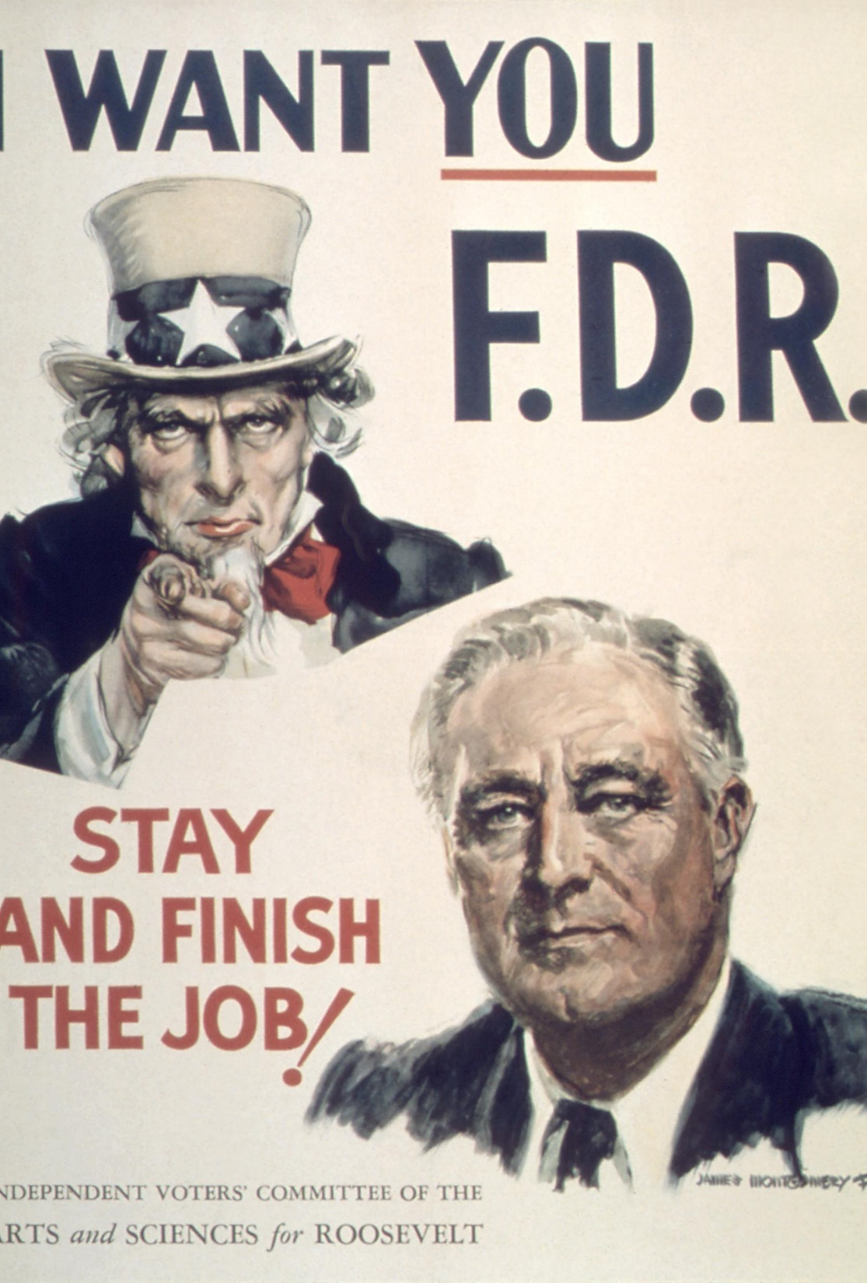
B. Campaigning and the Media
Candidates usually employ the television medium by running spots (paid advertisements) or using “free media” (coverage of campaign activities on programs, including news programs).
Free media does not cost a campaign any money and aids in name recognition for an unknown candidate.
Notes:
By Independent Voters' Committee of the Arts and Sciences for Roosevelt; illustrations by James Montgomery Flagg - National Archives and Records Administration, Public Domain, https://commons.wikimedia.org/w/index.php?curid=38466285
https://commons.wikimedia.org/w/index.php?sort=relevance&search=presidential+campaign+poster&title=Special:Search&profile=advanced&fulltext=1&advancedSearch-current=%7B%7D&ns0=1&ns6=1&ns12=1&ns14=1&ns100=1&ns106=1&searchToken=8deyrmfi9oo1ob09amovz52jz#%2Fmedia%2FFile%3AIndependent-Voters-Committee-of-the-Arts-and-Sciences-for-Roosevelt-poster.jpg

Slide 21
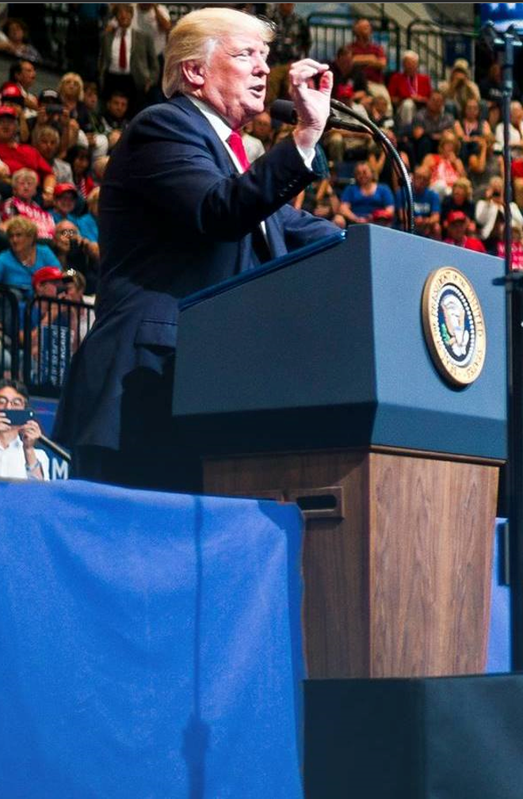
B. Campaigning and the Media
The internet has provided the latest tools to aid the candidate’s campaign.
Social media presence helps a candidate communicate his message and increase fundraising.
Social media makes it easier to spread misinformation that could affect elections.
Notes:
By https://www.facebook.com/DonaldTrump/photos/a.488852220724.393301.153080620724/10159419638630725/?type=3&theater - Donald Trump, Public Domain, https://commons.wikimedia.org/w/index.php?curid=61005514
https://commons.wikimedia.org/w/index.php?title=Special:Search&limit=500&offset=0&ns0=1&ns6=1&ns12=1&ns14=1&ns100=1&ns106=1&search=Donald+Trump+twitter&advancedSearch-current=%7B%7D#/media/File:Donald_Trump_Cedar_Rapids_rally_19679418_10159419638630725_2833632475130915488_o,jpg_(03).jpg

Slide 22
Section Review – Chapter 17.2
1–4. Name four advantages of incumbents when they seek reelection.
name recognition, financial backing, the powers of their office, and the goodwill they have created by assisting their constituents (p. 406)

Slide 23
Section Review – Chapter 17.2
5–6. Define coattail effect, and describe how it works.
The coattail effect is the ability of a strong candidate at the top of the ticket to attract votes for other members of his party who are running for lesser offices. For example, a less popular candidate for the US House of Representatives might still be elected because of the popularity of the same party’s presidential candidate. (pp. 406–407)

Slide 24
Section Review – Chapter 17.2
7–8. During the early twentieth century, which two forms of media provided the most information for voters?
newspapers and magazines (p. 408)
9–11. List three advantages of a candidate using social media.
It can bypass the traditional media and take the candidate’s message directly to the American public. It also reaches younger voters that candidates desperately want to energize politically. It is a free media. (p. 409)

Slide 25
Section Review – Chapter 17.2
What are some advantages and disadvantages of a candidate using television?
The advantages of television are that the candidate can reach millions of homes with his message, outline his plans for the nation, and target advertising to appeal to various groups. Disadvantages of television are the effects of little mistakes like embarrassing moments or ill-chosen words that gain nationwide exposure. As a visual medium, superficial factors are more noticeable. Purchasing advertising time is expensive.

Slide 26
Section Review – Chapter 17.2
What impact do televised debates have on voters?
Debates often place an emphasis on the outward image or performance ability of the candidate. One such example was the physical contrast between Kennedy and Nixon in the 1960 presidential debates. An example of poor performance was in the US Senate race in New York (in 2000) when Rick Lazio appeared to be invading Hillary Clinton’s personal space. The use of witty statements, such as that of Ronald Reagan in his 1984 debates with Walter Mondale, sometimes attracts more attention than detailed substance during a debate.

Slide 27
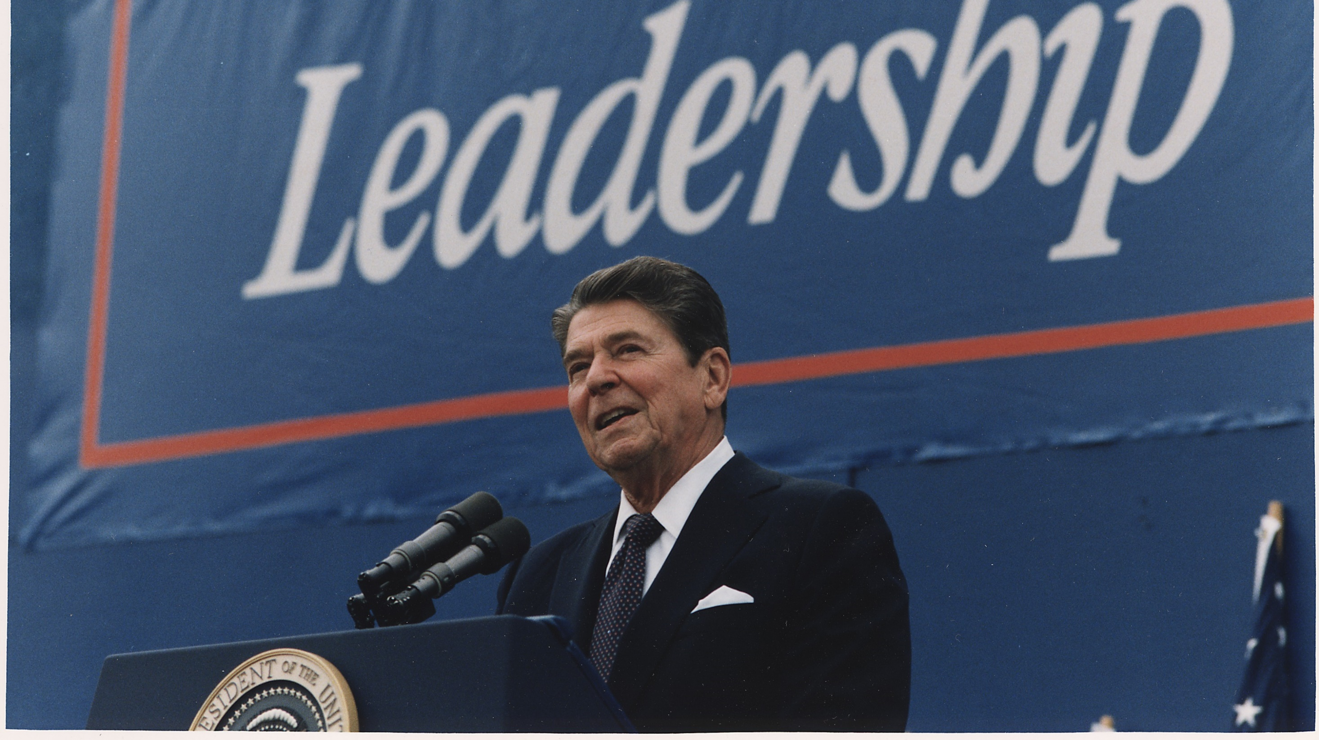
III. Elections and Voting
Chapter 17.3
Notes:
By Unknown author or not provided - U.S. National Archives and Records Administration, Public Domain, https://commons.wikimedia.org/w/index.php?curid=17112298
https://commons.wikimedia.org/w/index.php?title=Special:Search&limit=500&offset=0&ns0=1&ns6=1&ns12=1&ns14=1&ns100=1&ns106=1&search=ronald+reagan+campaign&advancedSearch-current=%7B%7D&searchToken=18fu8gu418j78wiiqmf2mwkzp#%2Fmedia%2FFile%3APhotograph_of_President_Reagan_giving_Campaign_speech_in_Texas_-_NARA_-_198551.jpg

Slide 28
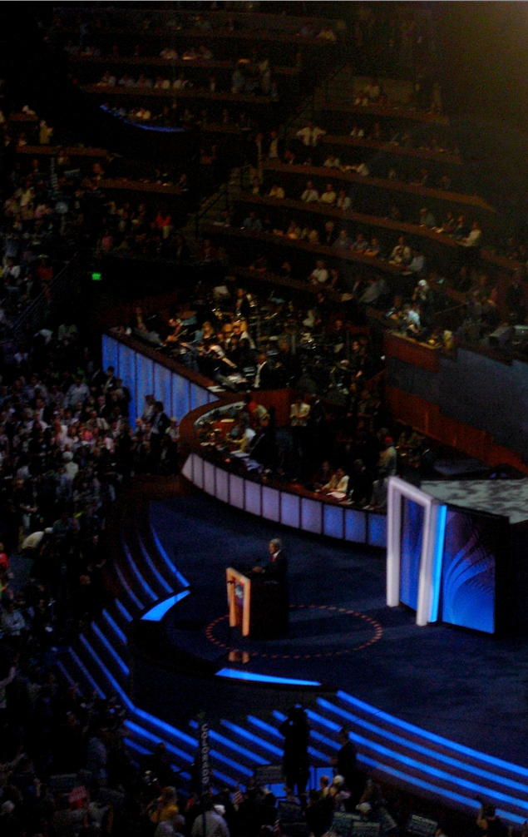
A. Federal Elections
Election laws in the United States are mainly state laws because most elected offices are state and local offices.
Only the specifics regarding the election of the president, the vice president, and both houses of Congress were established by the Constitution.
Notes:
By Qqqqqq at English Wikipedia, CC BY-SA 3.0, https://commons.wikimedia.org/w/index.php?curid=16103016
https://commons.wikimedia.org/w/index.php?sort=relevance&search=john+kerry+campaign&title=Special:Search&profile=advanced&fulltext=1&advancedSearch-current=%7B%7D&ns0=1&ns6=1&ns12=1&ns14=1&ns100=1&ns106=1&searchToken=ey6vfmninx5z4tpjh1mw2smw#%2Fmedia%2FFile%3AJohn_Kerry_DNC_2008.jpg

Slide 29
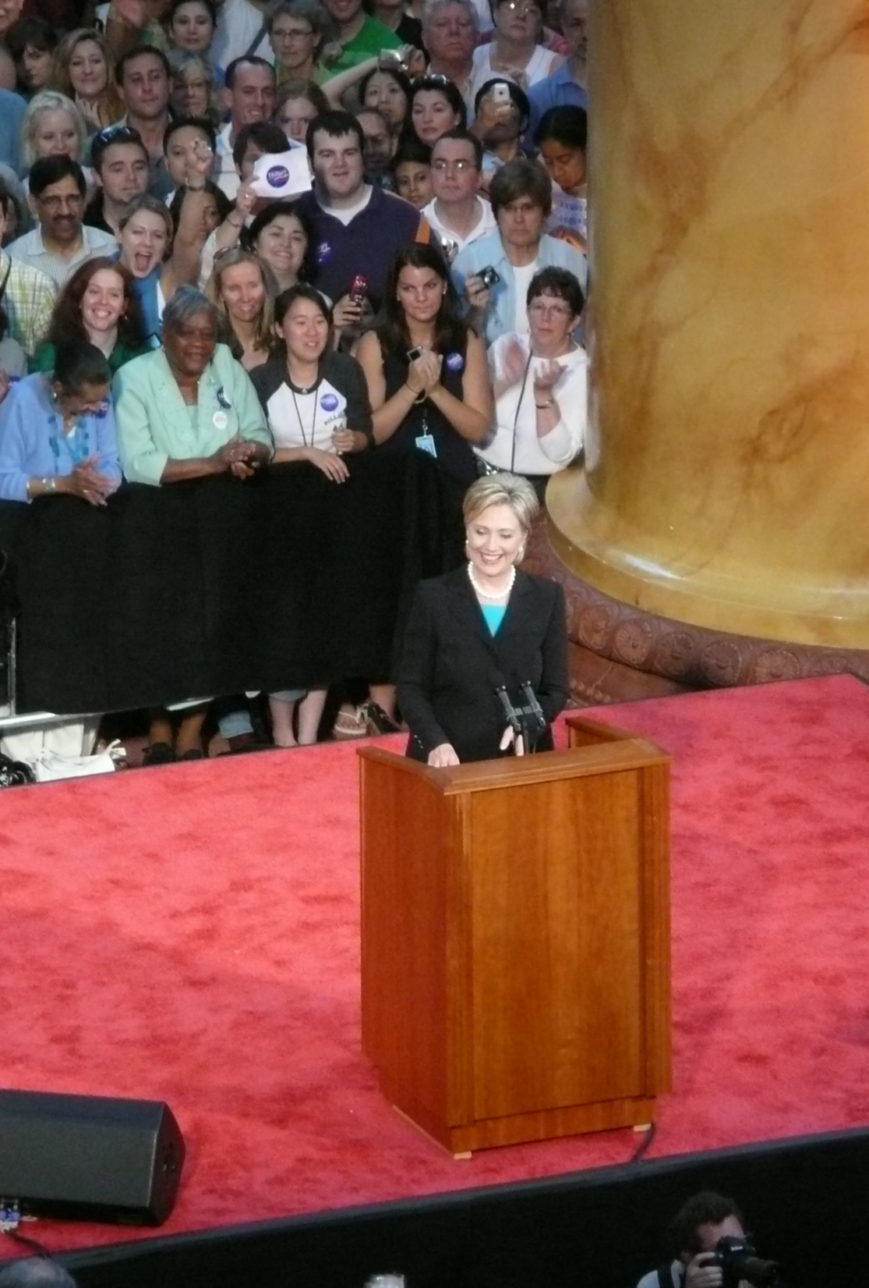
B. Election Day
Candidates prepare for Election Day by drafting two brief speeches – a victory speech and a concession speech.
Supporters vote at polling places which include schools, churches, and fire stations.
Notes:
By angela n. from Washington, DC - HRC's concession, CC BY 2.0, https://commons.wikimedia.org/w/index.php?curid=60461688
https://commons.wikimedia.org/w/index.php?title=Special:Search&limit=500&offset=0&ns0=1&ns6=1&ns12=1&ns14=1&ns100=1&ns106=1&search=concession+speech&advancedSearch-current=%7B%7D&searchToken=2g6hytrmv77h5f354s7h65k2u#%2Fmedia%2FFile%3AHRC%27s_concession_%282618965149%29_%282%29.jpg

Slide 30
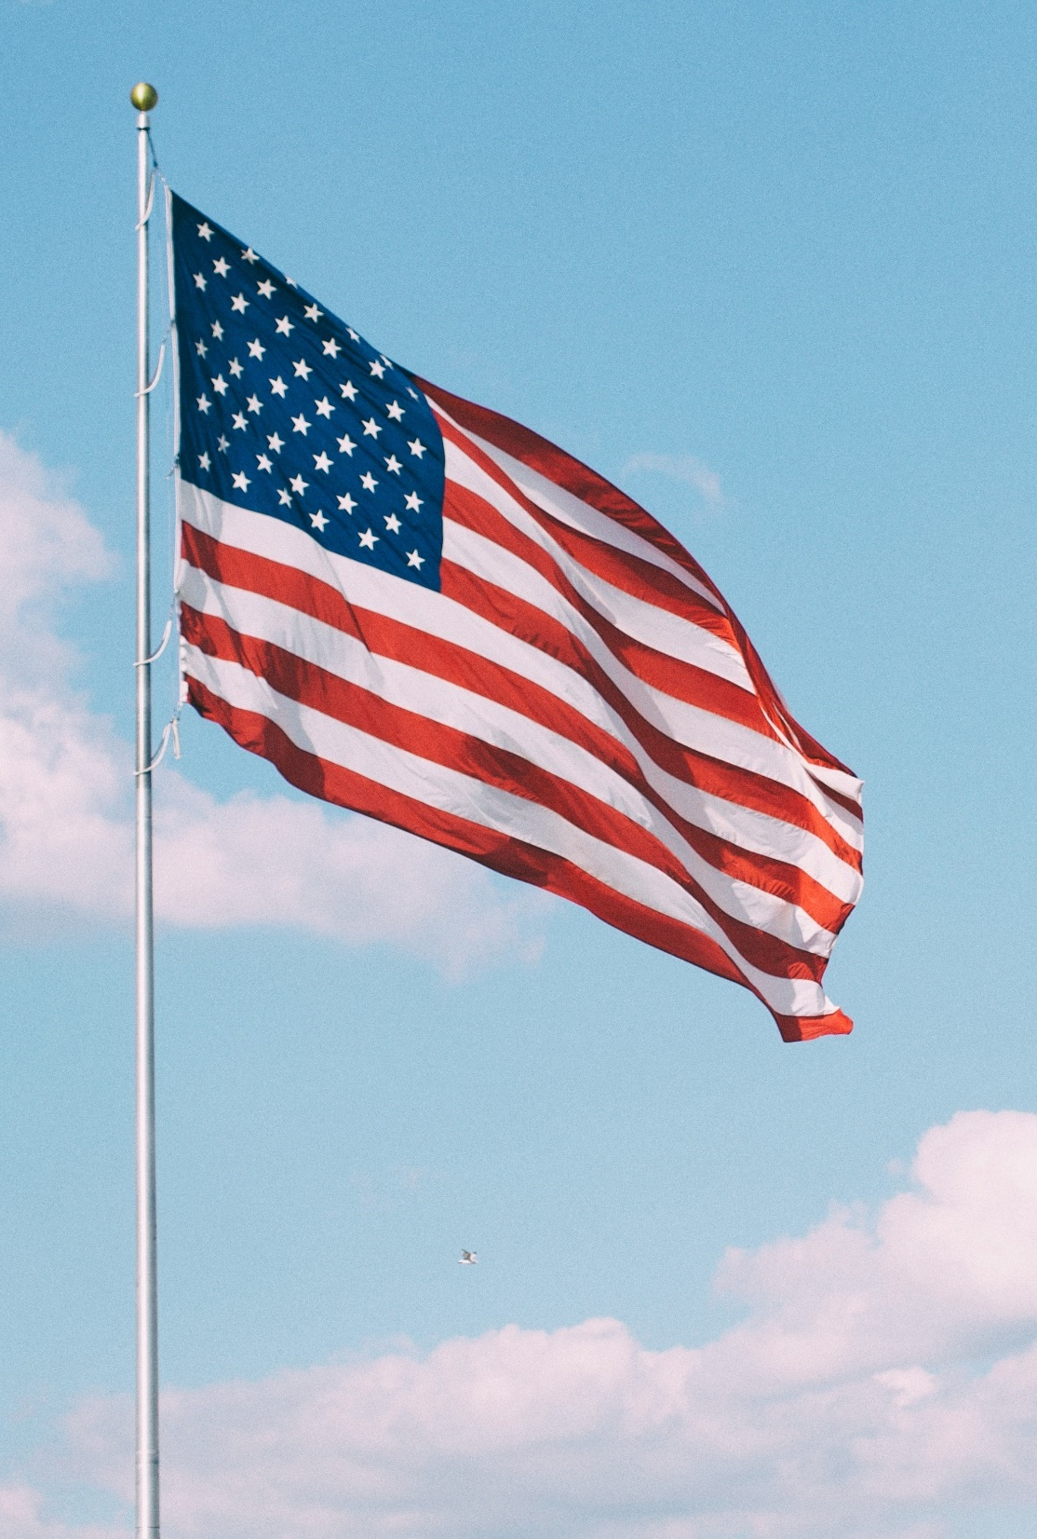
C. The Voter
The opportunity to vote in America is a responsibility, a privilege, and a constitutional guarantee.
Forty-nine states require voters to register – to officially enroll for the purpose of voting.
Notes:
Photo by Aaron Burden on Unsplash
https://unsplash.com/photos/t2b1Z-jPT-w

Slide 31
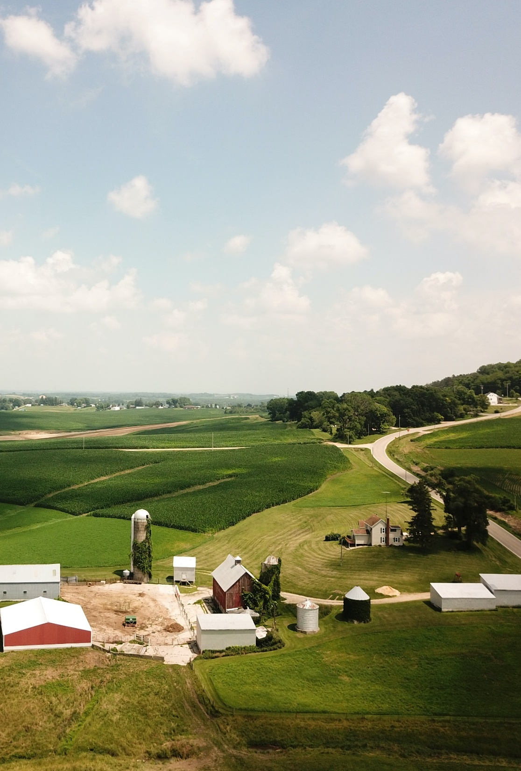
C. The Voter
Candidates must consider the diversity of American voters.
  Age
  Gender
  Urban vs. rural
  Religious beliefs
  Ethnic background
Notes:
Photo by John Reed on Unsplash
https://unsplash.com/photos/-04wiGkb8Jc

Slide 32
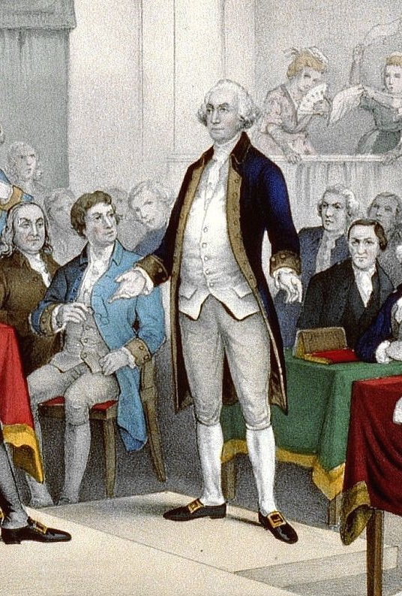
D. Methods of Voting
Early in American history, voting was done out loud.
In the 1800s, voters began writing their choices on pieces of paper.
Notes:
By Unknown artist, painting printed by Currier & Ives, 1876, part of the Library of Congress collection - Journal of the American Revolution, Public Domain, https://commons.wikimedia.org/w/index.php?curid=71465902
https://commons.wikimedia.org/w/index.php?sort=relevance&search=continental+congress+painting&title=Special:Search&profile=advanced&fulltext=1&advancedSearch-current=%7B%7D&ns0=1&ns6=1&ns12=1&ns14=1&ns100=1&ns106=1&searchToken=6kraq0h2w4m35ieilqywlabrx#%2Fmedia%2FFile%3AWashington_promotion_by_Continental_Congress.jpg

Slide 33
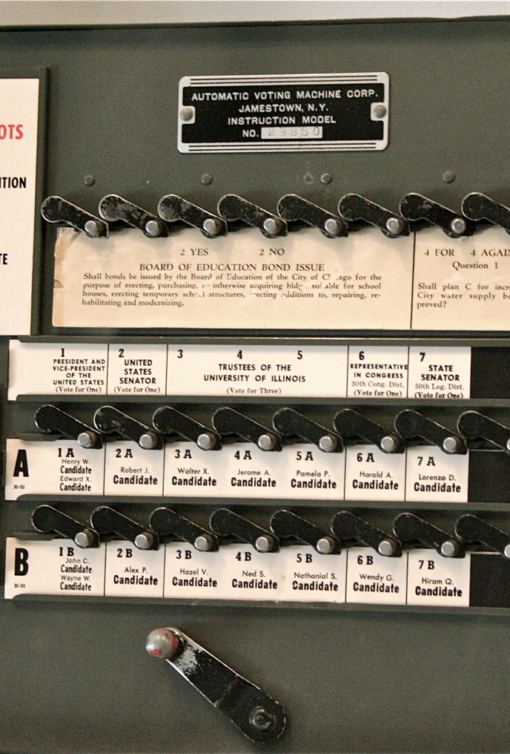
D. Methods of Voting
By 1890 almost the entire United States had switched to paper ballots.
Mechanical-lever machines were used in cities until their retirement in 2010.
Punch cards were widely used in the 20th century but were last used in 2014.
Notes:
By User:RadioFan, CC BY-SA 3.0, https://commons.wikimedia.org/w/index.php?curid=20980618
https://commons.wikimedia.org/w/index.php?sort=relevance&search=voting+machine&title=Special:Search&profile=advanced&fulltext=1&advancedSearch-current=%7B%7D&ns0=1&ns6=1&ns12=1&ns14=1&ns100=1&ns106=1&searchToken=evwr380kst3waysgbb4o5mz9p#%2Fmedia%2FFile%3AVoting_machine.png

Slide 34
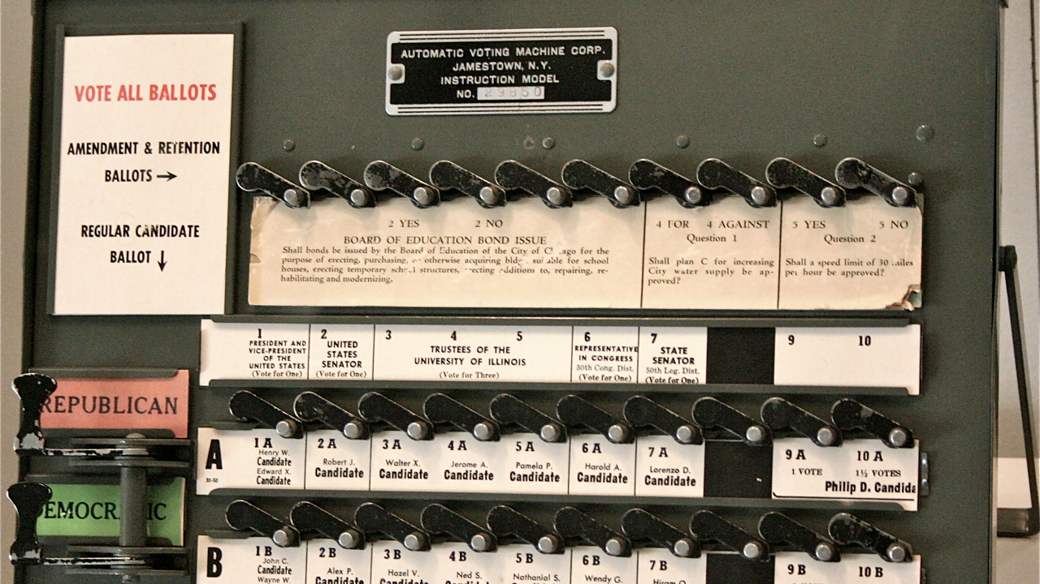
Notes:
By User:RadioFan, CC BY-SA 3.0, https://commons.wikimedia.org/w/index.php?curid=20980618
https://commons.wikimedia.org/w/index.php?sort=relevance&search=voting+machine&title=Special:Search&profile=advanced&fulltext=1&advancedSearch-current=%7B%7D&ns0=1&ns6=1&ns12=1&ns14=1&ns100=1&ns106=1&searchToken=evwr380kst3waysgbb4o5mz9p#%2Fmedia%2FFile%3AVoting_machine.png

Slide 35
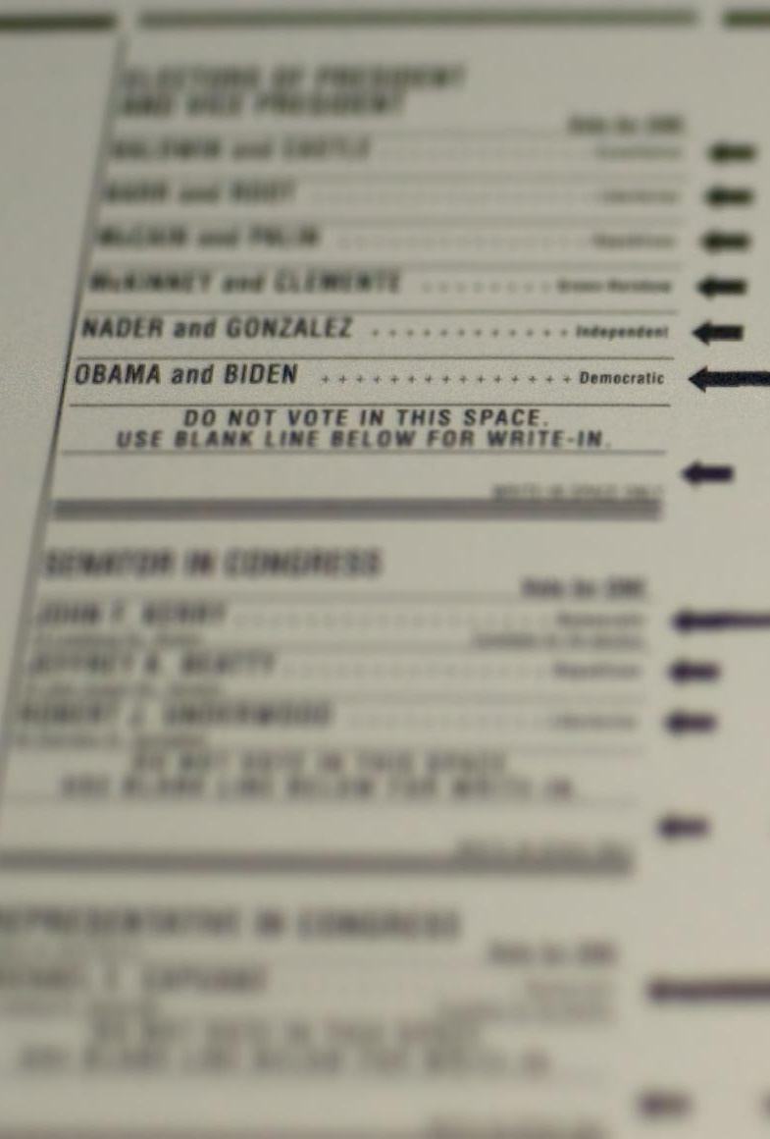
D. Methods of Voting
Optical scan ballot cards and touch screens are common voting methods today.
Voting by mail is used mostly by absentee voters – individuals unable to vote in person during the regular voting times.
Notes:
By ChefMattRock - Ballot, CC BY 2.0, https://commons.wikimedia.org/w/index.php?curid=68861112
https://commons.wikimedia.org/w/index.php?sort=relevance&search=US+election+ballot&title=Special:Search&profile=advanced&fulltext=1&advancedSearch-current=%7B%7D&ns0=1&ns6=1&ns12=1&ns14=1&ns100=1&ns106=1&searchToken=dxdcn866voif4ynimta91nu5#%2Fmedia%2FFile%3A2008_US_Election_Ballot_MA.jpg

Slide 36

D. Methods of Voting
Many hope that internet voting will become more commonly used but security issues have prevented its widespread adoption so far.
Notes:
Photo by Glenn Carstens-Peters on Unsplash
https://unsplash.com/photos/npxXWgQ33ZQ

Slide 37
Section Review – Chapter 17.3
1. Define polling place.
the location in a specific precinct where residents go to vote
(p. 410)
2–4. Which amendment extended voting rights to eighteen-year-olds? To women? To all ethnic groups?
the Twenty-Sixth Amendment, the Nineteenth Amendment, and the Fifteenth Amendment (pp. 410–411)

Slide 38
Section Review – Chapter 17.3
5–7. What are the three minimum requirements to register to vote?
A voter must be a US citizen, at least eighteen years old, and a resident of the state in which he will vote. (p. 411)
8. Explain how the 1993 “Motor Voter Law” changed voter registration.
It allowed people to register to vote when applying for or renewing a driver’s license or at various state agencies such as employment or welfare offices. (p. 412)

Slide 39
Section Review – Chapter 17.3
Why is the secret ballot so important in ensuring the integrity and reliability of elections?
The secret ballot allows voters to privately mark their choices and vote in a secure way; it thus prevents intimidation and retribution if someone does not vote the “right” way, and it ensures that votes reliably reflect the will of the people.

Slide 40
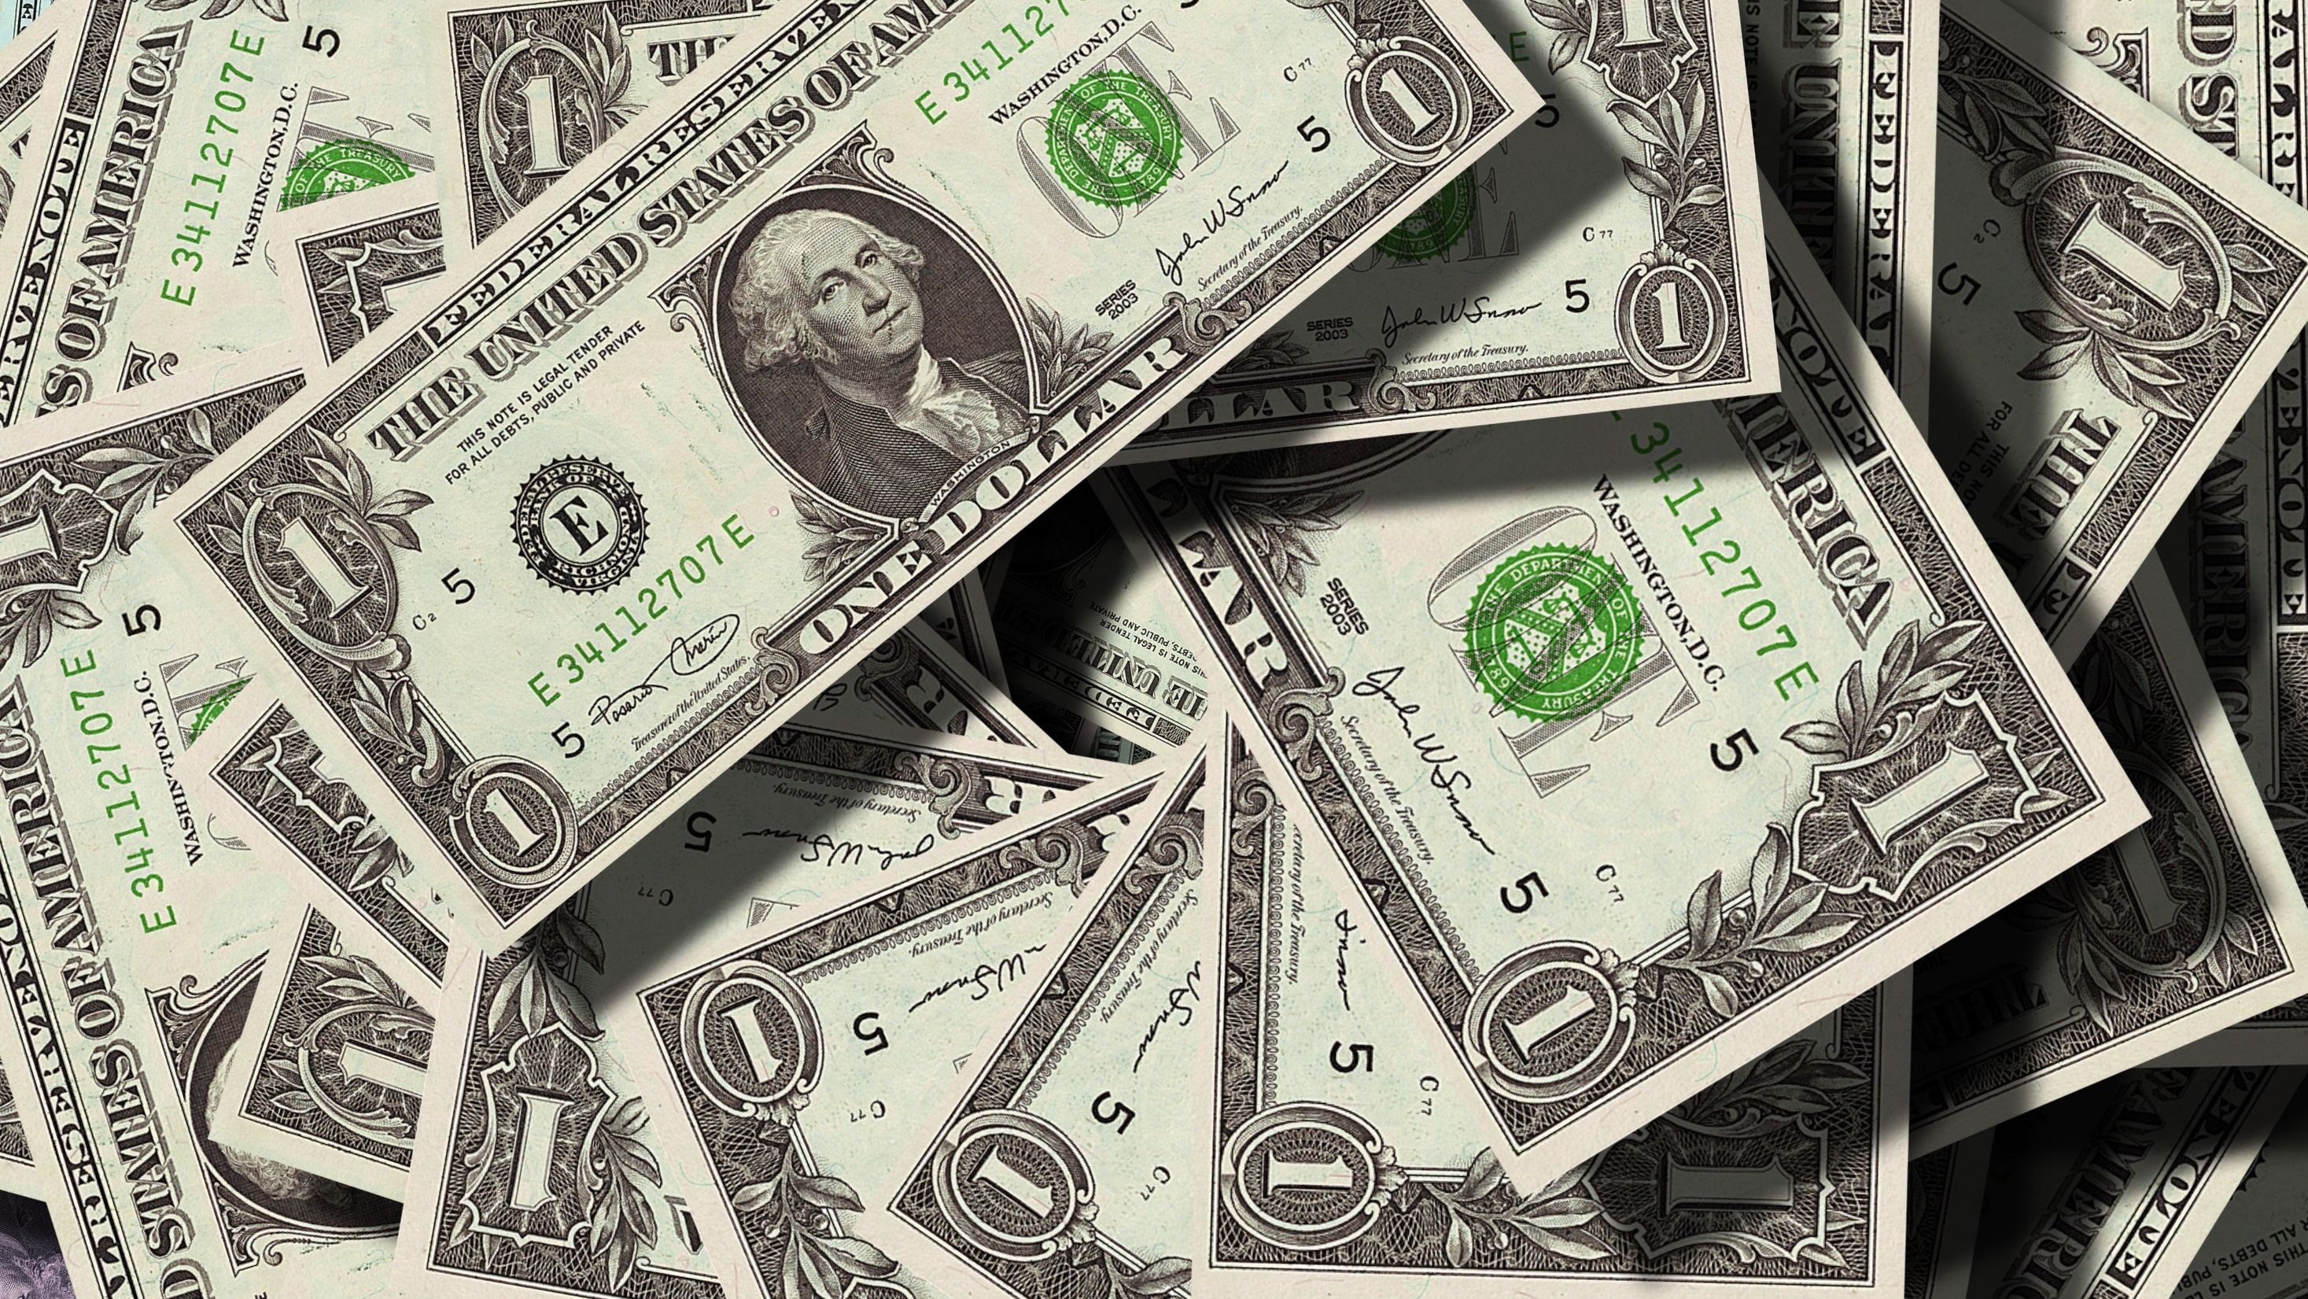
IV. Campaign Finance
Chapter 17.4
Notes:
Image by Gerd Altmann from Pixabay
https://pixabay.com/photos/dollar-currency-money-us-dollar-499481/

Slide 41
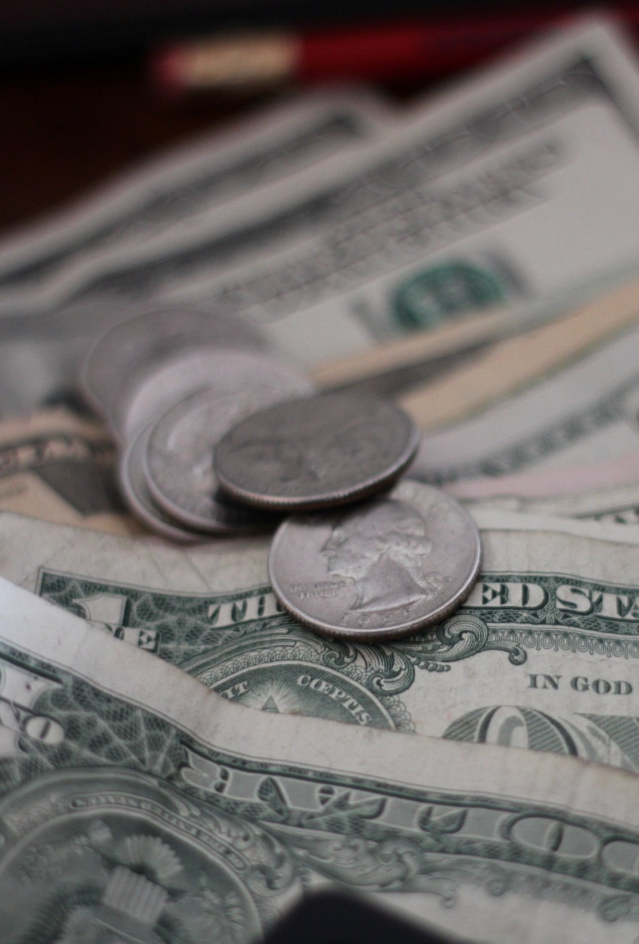
IV. Campaign Finance
Running for public office at federal and state levels has become a multimillion-dollar pursuit.
The Federal Election Commission (FEC) was established to enforce campaign reform legislation.
Notes:
Photo by Mathieu Turle on Unsplash
https://unsplash.com/photos/uJm-hfuCHm4

Slide 42
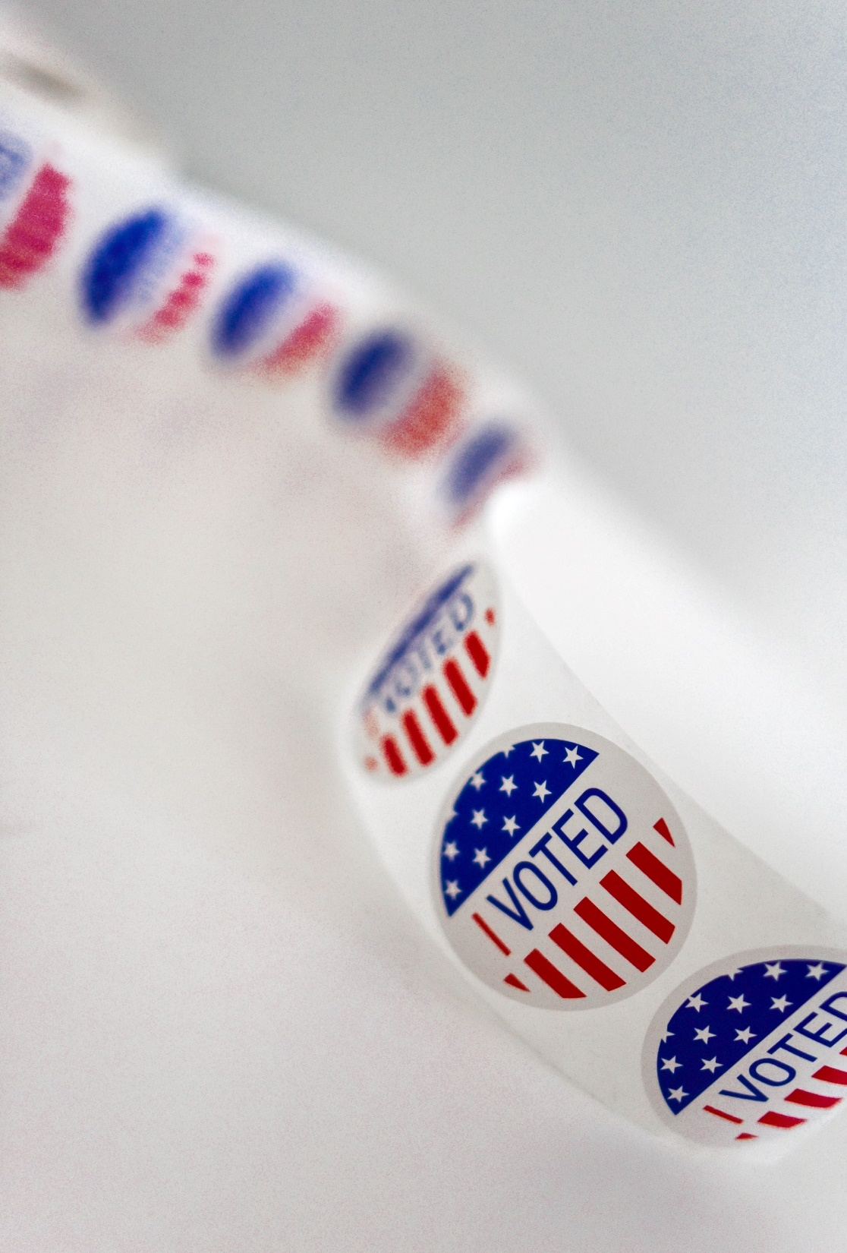
A. Laws
Campaign money raised for a specific candidate is called hard money.
Soft money includes campaign money raised apart from federal regulations, including money raised by political action committees (PACs).
Notes:
Photo by Element5 Digital on Unsplash
https://unsplash.com/photos/2i7Dn2uMEQE

Slide 43
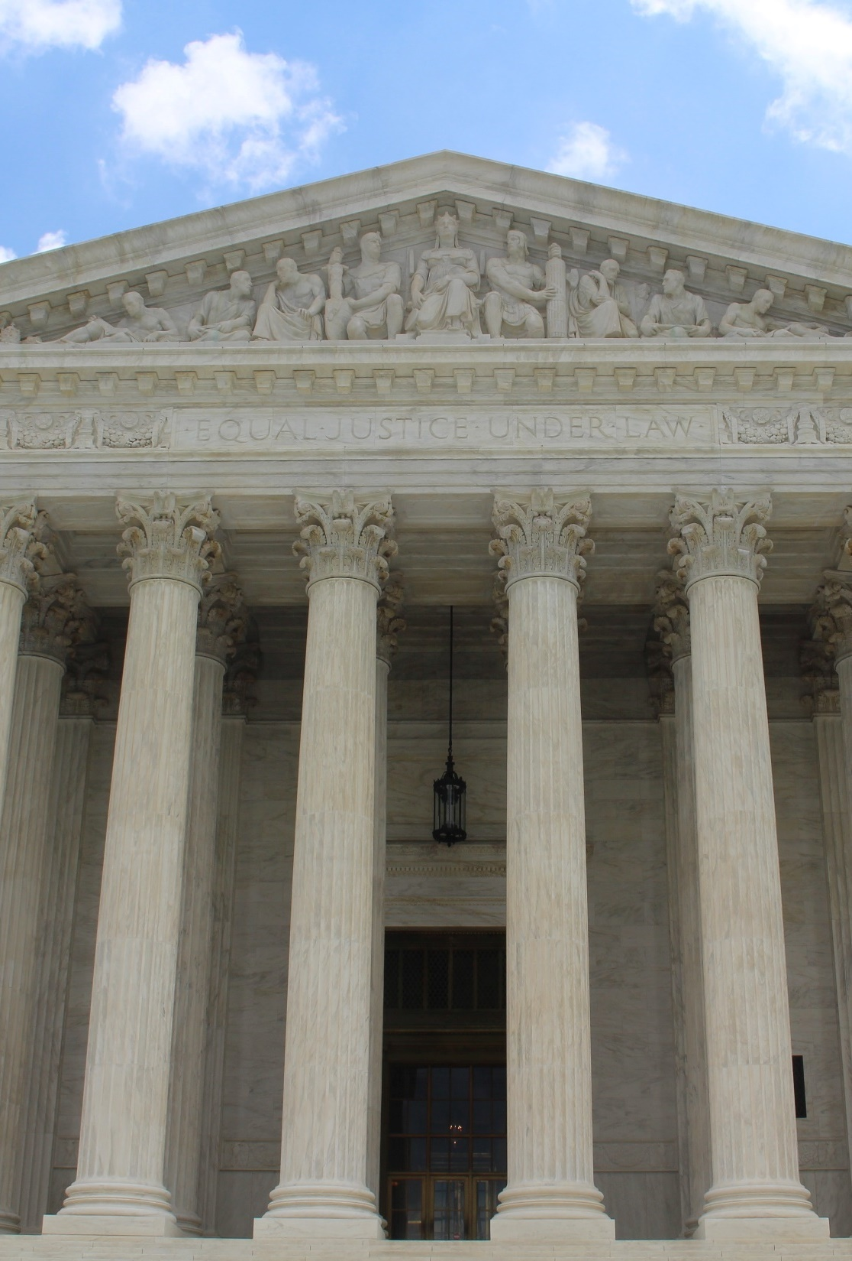
A. Laws
Legislation passed in 1974 limited candidate spending from personal and family resources, total campaign expenses, and independent expenditures.
In Buckley v. Valeo, the Supreme Court ruled that the some of these restrictions violated the First Amendment.
Notes:
Photo by Claire Anderson on Unsplash
https://unsplash.com/photos/Vq__yk6faOI

Slide 44
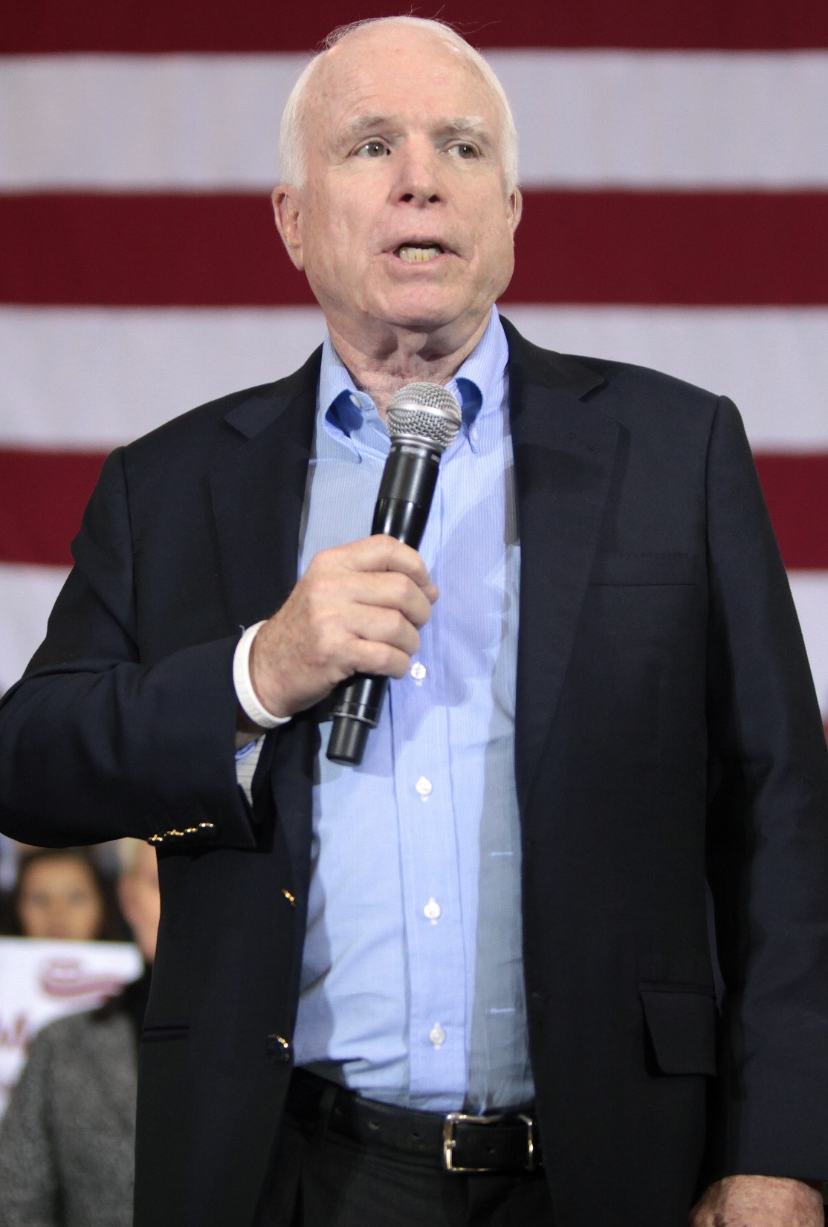
B. Additional Reform
The McCain-Feingold Act (Bipartisan Campaign Reform Act) was passed in 2002 and restricted the use of soft money and barred corporations from financing political ads.
Notes:
By Gage Skidmore from Peoria, AZ, United States of America - John McCain, CC BY-SA 2.0, https://commons.wikimedia.org/w/index.php?curid=62046336
https://commons.wikimedia.org/w/index.php?title=Special:Search&limit=500&offset=0&ns0=1&ns6=1&ns12=1&ns14=1&ns100=1&ns106=1&search=john+mccain+campaign&advancedSearch-current=%7B%7D&searchToken=94ji78v1tko1oalz82jgjuluj#%2Fmedia%2FFile%3AJohn_McCain_%2823415007910%29.jpg

Slide 45
B. Additional Reform
In Citizens United v. Federal Election Commission, the Supreme Court ruled that corporations and unions are to be treated as any individual would be treated in regard to political expression.
Notes:
By Gage Skidmore from Peoria, AZ, United States of America - John McCain, CC BY-SA 2.0, https://commons.wikimedia.org/w/index.php?curid=62046336
https://commons.wikimedia.org/w/index.php?title=Special:Search&limit=500&offset=0&ns0=1&ns6=1&ns12=1&ns14=1&ns100=1&ns106=1&search=john+mccain+campaign&advancedSearch-current=%7B%7D&searchToken=94ji78v1tko1oalz82jgjuluj#%2Fmedia%2FFile%3AJohn_McCain_%2823415007910%29.jpg

Slide 46
Section Review – Chapter 17.4
1–2. Explain the difference between hard and soft money.
Hard money is raised for a specific candidate in federal elections that must be spent according to federal laws and restrictions. Soft money is raised apart from federal regulations and given to local, state, and national party organizations for “party-building” activities. (pp. 415–416)
3. What are independent expenditures?
funds spent by a person or group trying to help elect or defeat a candidate without the candidate’s knowledge or support (p. 416)

Slide 47
Section Review – Chapter 17.4
4. What is the official name of the McCain-Feingold Act?
Bipartisan Campaign Reform Act (BCRA) of 2002 (p. 417)
5. What did the Supreme Court rule in Citizens United v. Federal Election Commission?
The court ruled unconstitutional the parts of the McCain-Feingold Act that kept corporations and unions from spending money to support or denounce individuals in elections. (p. 418)

Slide 48
Section Review – Chapter 17.3
What roles can Christians legitimately play in the electoral process?
Christians should pray for their leaders and may vote. They may also actively campaign for candidates and run for office.

Slide 49
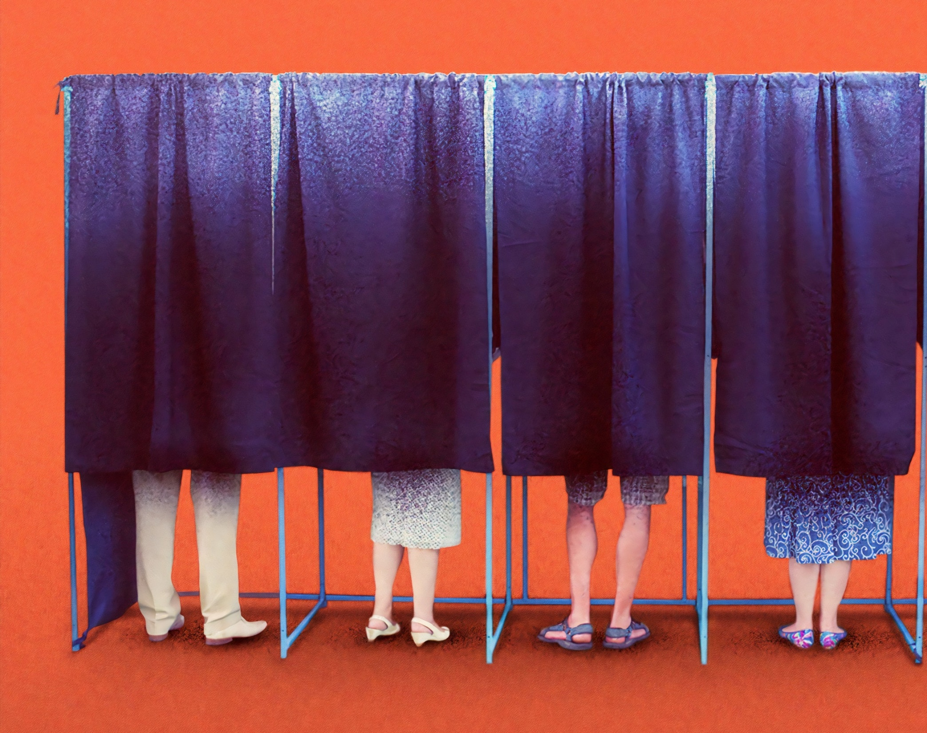
Chapter 17 Terms
Notes:
Photo by Morning Brew on Unsplash
https://unsplash.com/photos/rhFmpq6pMKU

Slide 50
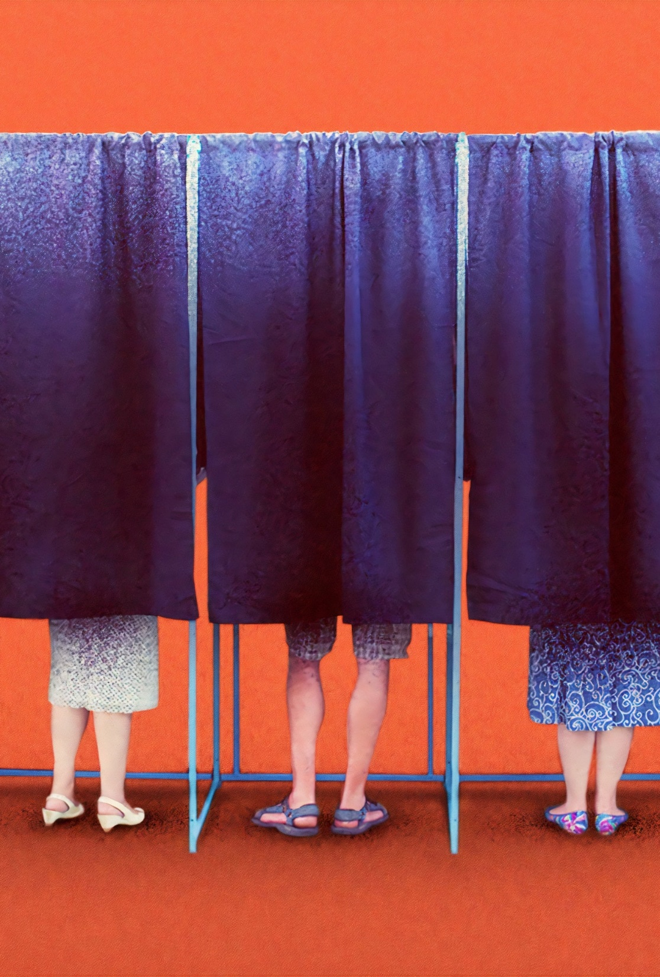
foreign policy
government policy dealing with diplomacy, trade relations, war, and other matters involving the nation’s relationship with other countries
Notes:
Photo by Morning Brew on Unsplash
https://unsplash.com/photos/rhFmpq6pMKU

Slide 51
incumbent
the current officeholder
Notes:
Photo by Morning Brew on Unsplash
https://unsplash.com/photos/rhFmpq6pMKU

Slide 52
petition
a form of nomination in which a formal document is signed by a specific number of qualified voters on behalf of a candidate in the election district
Notes:
Photo by Morning Brew on Unsplash
https://unsplash.com/photos/rhFmpq6pMKU

Slide 53
direct primary
a preliminary nominating election held to select candidates or delegates (or both) to party conventions
Notes:
Photo by Morning Brew on Unsplash
https://unsplash.com/photos/rhFmpq6pMKU

Slide 54
closed primary
a kind of primary election in which only voters registered as members of a particular party may participate in that party’s primary elections, and those voters may vote only for the candidates from the party they
belong to
Notes:
Photo by Morning Brew on Unsplash
https://unsplash.com/photos/rhFmpq6pMKU

Slide 55
semiclosed primaries
primary elections that allow independents to choose a primary ballot from one of the two major parties
Notes:
Photo by Morning Brew on Unsplash
https://unsplash.com/photos/rhFmpq6pMKU

Slide 56
open primary
a kind of primary election in which voters do not have to declare their party membership
Notes:
Photo by Morning Brew on Unsplash
https://unsplash.com/photos/rhFmpq6pMKU

Slide 57
blanket primary
a “wide-open” primary in which ballots list all candidates and voters can vote in one party’s primary for one office and another party’s primary for a different office
Notes:
Photo by Morning Brew on Unsplash
https://unsplash.com/photos/rhFmpq6pMKU

Slide 58
Top-Two method
primary election in which all candidates are listed on the ballot regardless of party affiliation; the two candidates who get the most votes (even if they are from the same party) advance to the general election; also called a jungle primary
Notes:
Photo by Morning Brew on Unsplash
https://unsplash.com/photos/rhFmpq6pMKU

Slide 59
jungle primary
primary election in which all candidates are listed on the ballot regardless of party affiliation; the two candidates who get the most votes (even if they are from the same party) advance to the general election
Notes:
Photo by Morning Brew on Unsplash
https://unsplash.com/photos/rhFmpq6pMKU

Slide 60
general election
election to fill an elective office; allows the winners of the respective party primaries to face one another; at the national level, it is held on the first Tuesday after the first Monday in November
Notes:
Photo by Morning Brew on Unsplash
https://unsplash.com/photos/rhFmpq6pMKU

Slide 61
constituents
residents of a district who are represented by an elected official
Notes:
Photo by Morning Brew on Unsplash
https://unsplash.com/photos/rhFmpq6pMKU

Slide 62
coattail effect
the ability of a strong candidate at the top of a ticket (usually a candidate for governor or president) to attract votes for other members of his party who are running for lesser offices
Notes:
Photo by Morning Brew on Unsplash
https://unsplash.com/photos/rhFmpq6pMKU

Slide 63
straight ticket
to vote for all the candidates in one party
Notes:
Photo by Morning Brew on Unsplash
https://unsplash.com/photos/rhFmpq6pMKU

Slide 64
spots
paid advertisements used by candidates for public office
Notes:
Photo by Morning Brew on Unsplash
https://unsplash.com/photos/rhFmpq6pMKU

Slide 65
free media
campaign activities covered on the nightly news or by other media outlets; does not cost a campaign any money and aids in name recognition for a candidate
Notes:
Photo by Morning Brew on Unsplash
https://unsplash.com/photos/rhFmpq6pMKU

Slide 66
polling places
locations in a specific precinct where residents go to vote
Notes:
Photo by Morning Brew on Unsplash
https://unsplash.com/photos/rhFmpq6pMKU

Slide 67
register
to officially enroll for the purpose of voting
Notes:
Photo by Morning Brew on Unsplash
https://unsplash.com/photos/rhFmpq6pMKU

Slide 68
absentee voters
voters who are unable to vote at their polling place on Election Day and who use absentee ballots to cast their votes before the election
Notes:
Photo by Morning Brew on Unsplash
https://unsplash.com/photos/rhFmpq6pMKU

Slide 69
Federal Election Commission (FEC)
established to enforce campaign reform legislation
Notes:
Photo by Morning Brew on Unsplash
https://unsplash.com/photos/rhFmpq6pMKU

Slide 70
hard money
campaign money raised for a specific candidate in federal elections and spent according to federal laws and restrictions
Notes:
Photo by Morning Brew on Unsplash
https://unsplash.com/photos/rhFmpq6pMKU

Slide 71
soft money
campaign money raised apart from federal regulations and given to local, state, and national party organizations or PACs to be used for “party-building” activities, such as voter-registration efforts and get-out-the-vote drives
Notes:
Photo by Morning Brew on Unsplash
https://unsplash.com/photos/rhFmpq6pMKU

Slide 72
political action committees (PACs)
committees formed by interest groups to raise money and make contributions to specific individuals’ campaigns or causes
Notes:
Photo by Morning Brew on Unsplash
https://unsplash.com/photos/rhFmpq6pMKU

Slide 73
independent expenditures
funds spent by a person or group that tries to help elect or defeat a candidate without the candidate’s knowledge or support
Notes:
Photo by Morning Brew on Unsplash
https://unsplash.com/photos/rhFmpq6pMKU

Slide 74
Buckley v. Valeo
Supreme Court ruling that 1974 legislation restricting candidate spending during elections violated the First Amendment
Notes:
Photo by Morning Brew on Unsplash
https://unsplash.com/photos/rhFmpq6pMKU

Slide 75
McCain-Feingold Act
a bill that prohibited, with limited exceptions, national political parties, federal candidates, and officeholders from soliciting or receiving soft money contributions in federal elections.
Notes:
Photo by Morning Brew on Unsplash
https://unsplash.com/photos/rhFmpq6pMKU

Slide 76
Citizens United v. Federal Election Commission
the Supreme Court decision that ruled as unconstitutional parts of the McCain-Feingold Act that kept corporations and unions from spending money to support or oppose individuals in elections
Notes:
Photo by Morning Brew on Unsplash
https://unsplash.com/photos/rhFmpq6pMKU

