Slide 1
Chapter 18:
Public Policy and Politics
Notes:
WIN-Initiative/Stone/Getty Images

Slide 2
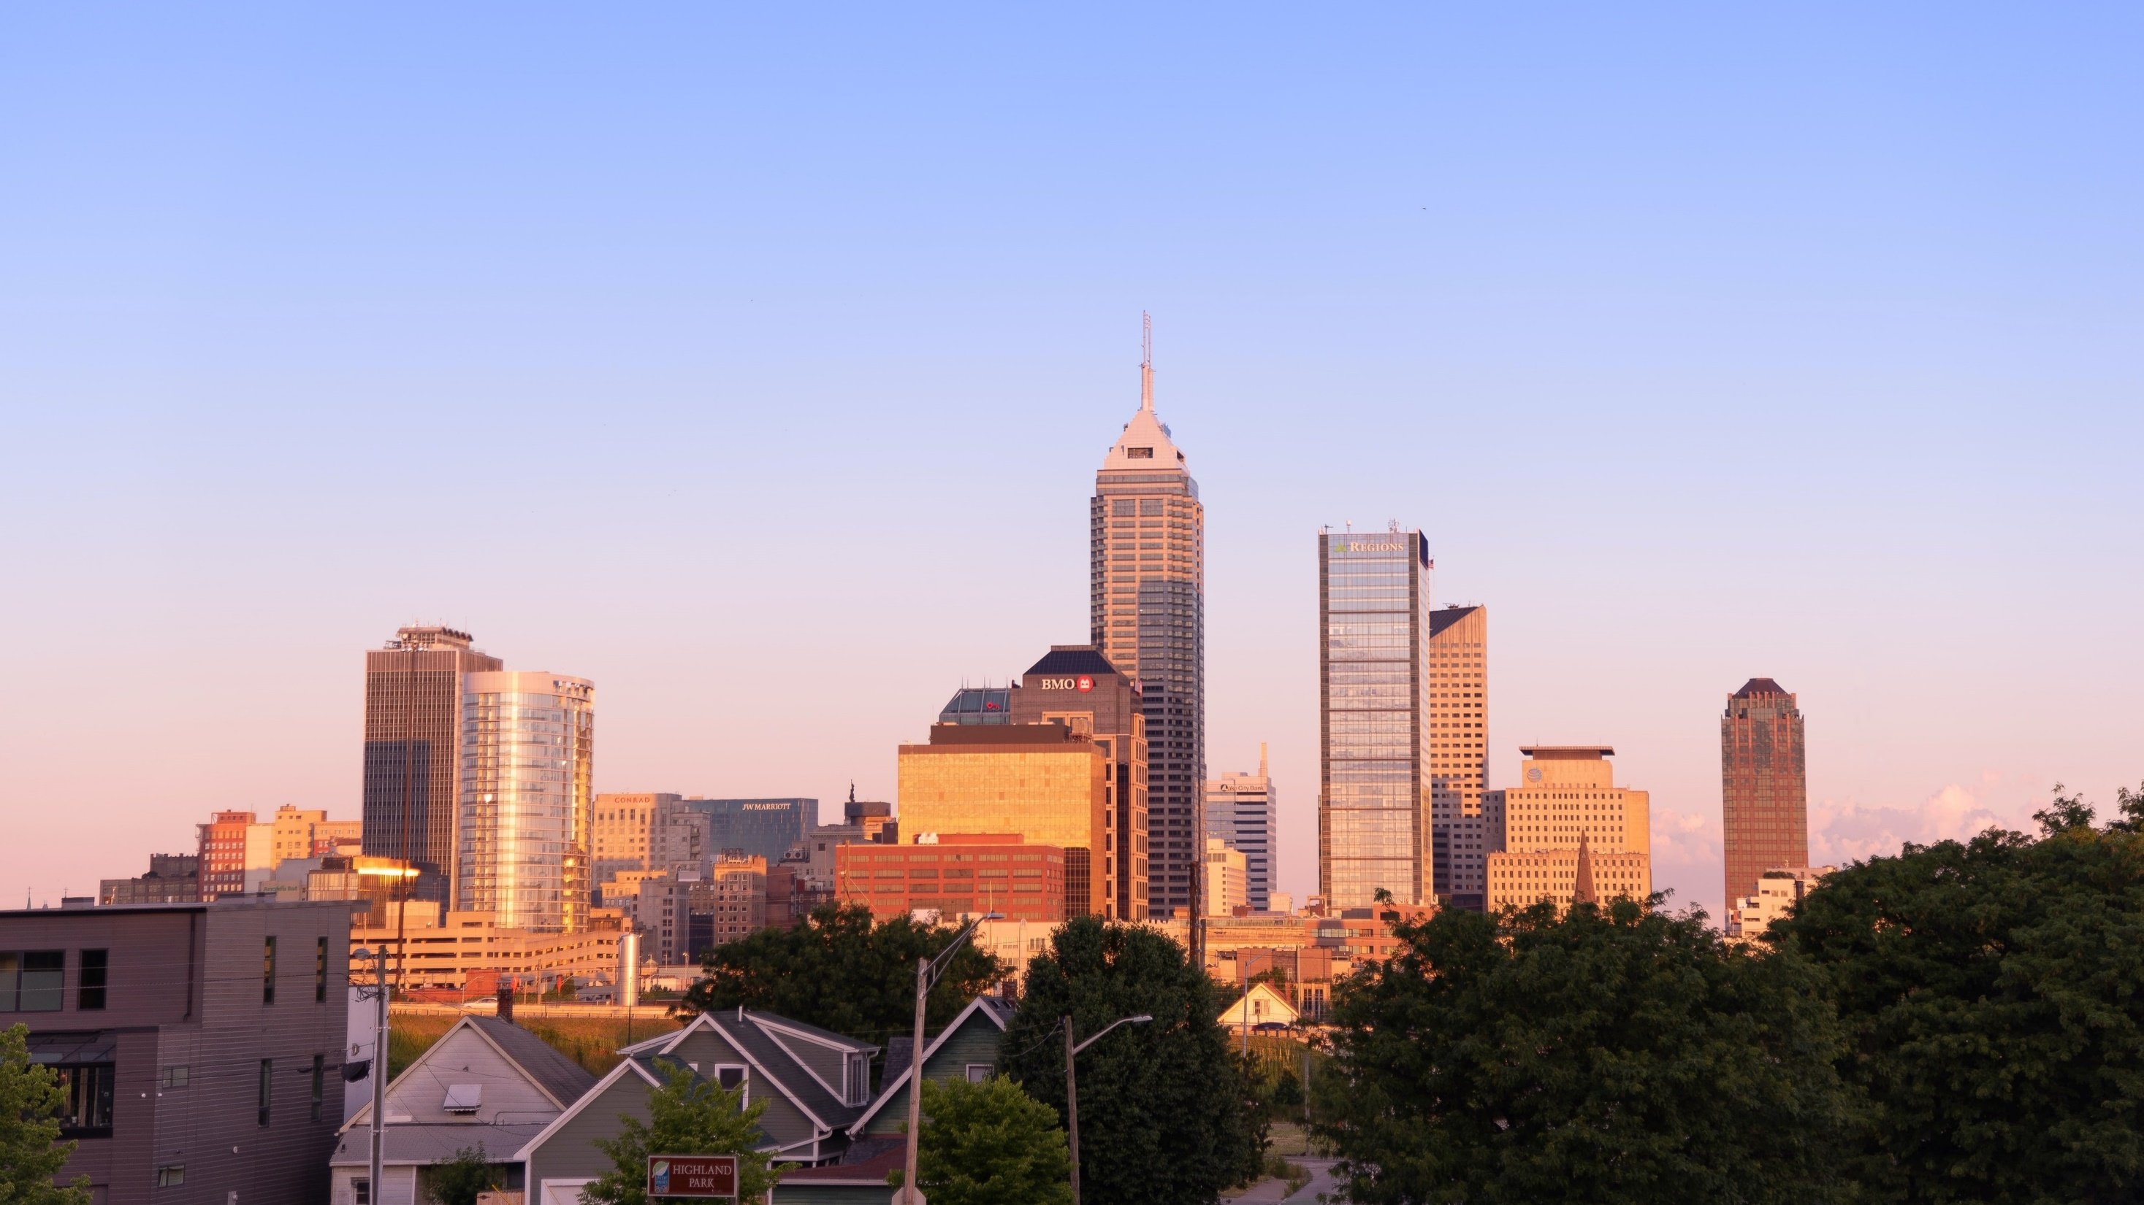
I. Government and the Public
Chapter 18.1
Notes:
Photo by Corbin Mathias on Unsplash
https://unsplash.com/photos/3tWrSC2pEuQ

Slide 3

A. Definitions
Public policy consists of the plans adopted by the government to handle problems and accomplish goals.
Public opinion can be defined in several ways because there are many “publics” and interest in issues varies.
Notes:
Image by Free-Photos from Pixabay
https://pixabay.com/photos/grand-central-station-new-york-690180/

Slide 4
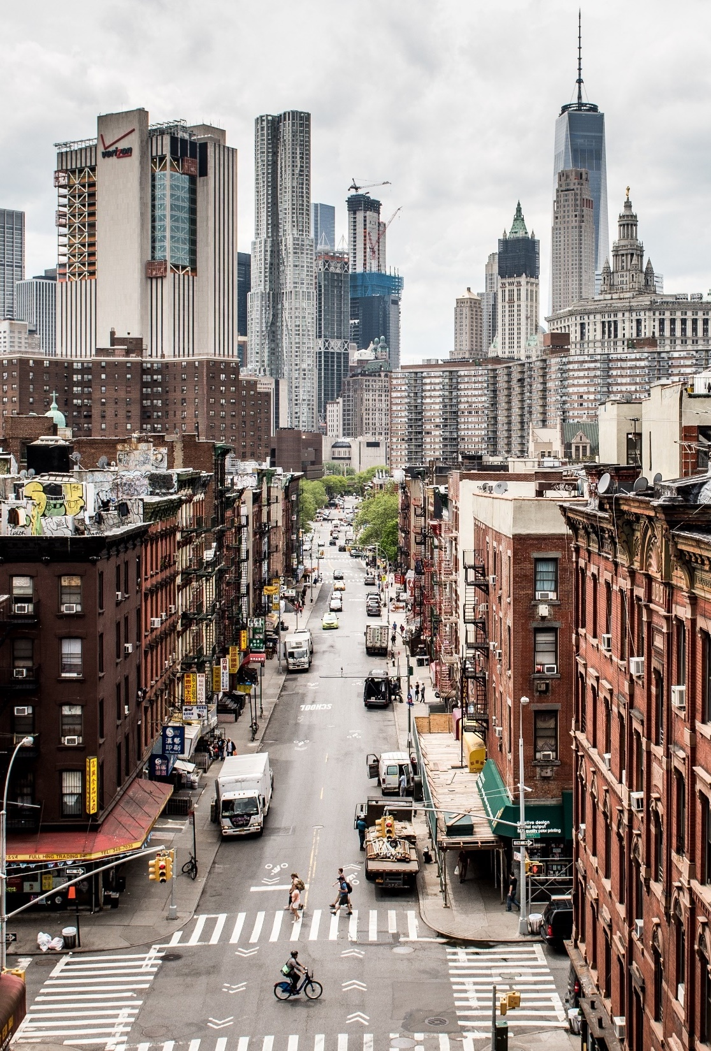
B. Liberalism and Conservatism
Liberalism has come to refer to policies that favor government action and government expansion.
Conservatism often refers to a reluctance to expand government authority.
Generally, moderates favor a middle ground between conservative and liberal positions.
Notes:
Image by Jo Wiggijo from Pixabay
https://pixabay.com/photos/usa-manhattan-contrasts-new-york-1777986/

Slide 5
Section Review – Chapter 18.1
1–2. Define public policy and public opinion.
Public policy consists of the plans adopted by the government to handle problems and accomplish goals. Public opinion consists of “those opinions held by private persons which governments find it prudent to heed.” (p. 421)

Slide 6
Section Review – Chapter 18.1
3–4. Identify two noteworthy characteristics of public opinion.
Government does not gauge public opinion simply by determining the opinions of the average American, and some issues retain lasting interest, while others are short-lived.
(p. 421)

Slide 7
Section Review – Chapter 18.1
5–6. Explain the basic modern implications of the words liberalism and conservatism.
Liberalism now refers to policies that favor government action and expansion. Conservatism generally refers to a reluctance to expand government authority, especially at the expense of individual responsibility. (p. 422)

Slide 8
Section Review – Chapter 18.1
Define the term moderate. Evaluate the wisdom of holding moderate views in politics.
To some degree, the term moderate means whatever its bearer wants it to mean. Generally, moderates favor a middle ground between conservative and liberal positions. For the second part of the question, some will criticize taking the “middle of the road” on issues and say moderates lack the fortitude to take firm stands. Other students may endorse taking a moderate position, noting that sometimes the liberal and conservative positions are both wrong.

Slide 9
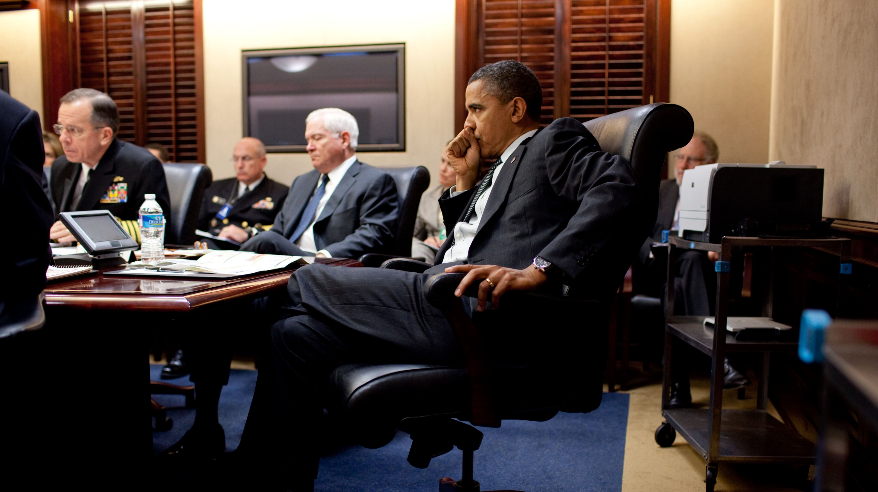
II. Public Policy
Chapter 18.2
Notes:
By Pete Souza - P110210PS-0394, Public Domain, https://commons.wikimedia.org/w/index.php?curid=46332332
https://commons.wikimedia.org/w/index.php?search=the+situation+room&title=Special:Search&go=Go&ns0=1&ns6=1&ns12=1&ns14=1&ns100=1&ns106=1&searchToken=1jcgddl0f149lmpyz0wclfwqw#%2Fmedia%2FFile%3ABarack_Obama_in_the_Situation_Room_of_the_White_House%2C_2010.jpg

Slide 10
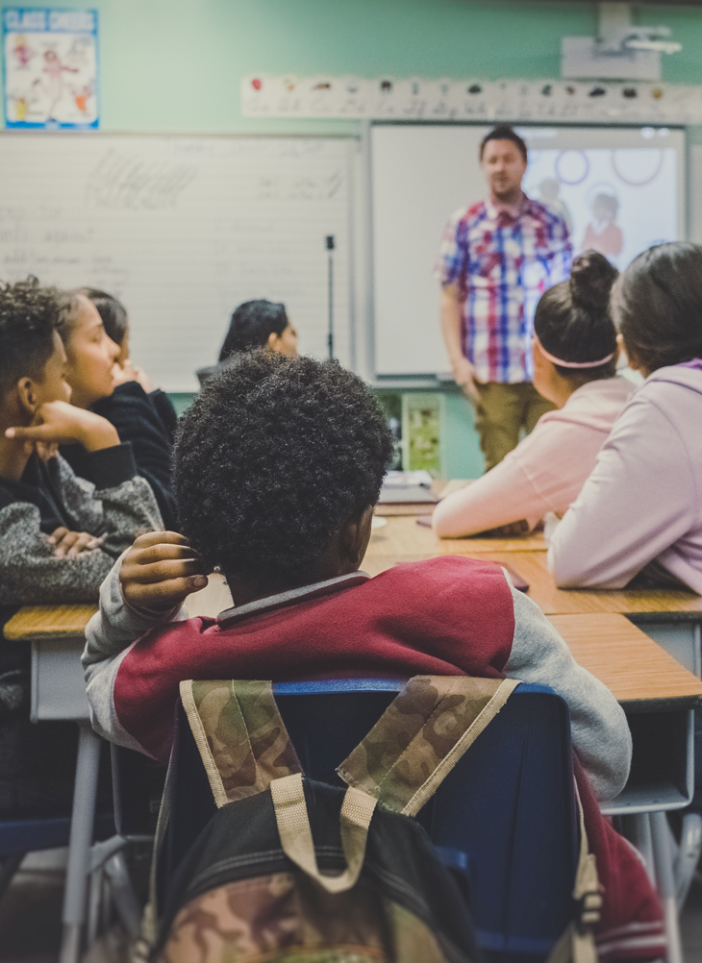
A. Divisions
Domestic policy frequently involves economics, law, education, health, energy, environment, and civil liberties within the nation’s borders.
Foreign policy includes diplomacy, trade relations, war, and other matters involving our relationship with other countries.
Notes:
Photo by NeONBRAND on Unsplash
https://unsplash.com/photos/zFSo6bnZJTw

Slide 11
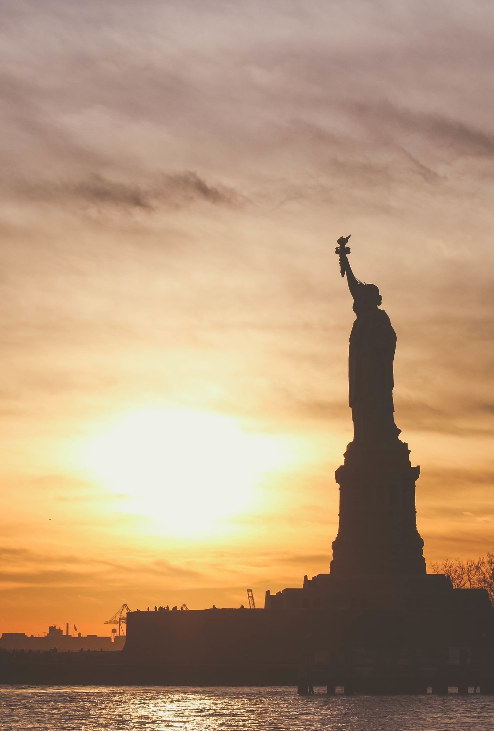
B. Development
Before public policy can be developed, government must identify which issues to deal with.
Since the Great Depression, the national government has become involved in many issues that were once handled by state or local governments.
Notes:
Image by Free-Photos from Pixabay
https://pixabay.com/photos/statue-of-liberty-landmark-liberty-1210001/

Slide 12
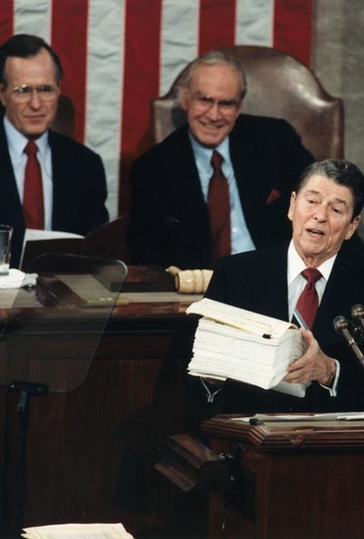
B. Development
The issues that government decides to address are said to be on its agenda.
Often, the president outlines the government’s agenda in his inaugural address and his annual State of the Union addresses.
Notes:
Public Domain, https://commons.wikimedia.org/w/index.php?curid=258008
https://commons.wikimedia.org/w/index.php?sort=relevance&search=state+of+the+union+address+president&title=Special:Search&profile=advanced&fulltext=1&advancedSearch-current=%7B%7D&ns0=1&ns6=1&ns12=1&ns14=1&ns100=1&ns106=1&searchToken=e3mzoj1o40cmumdaj2hrwvc16#%2Fmedia%2FFile%3APresident_Reagan_gives_the_State_of_the_Union_Address_to_Congress_1988.jpg

Slide 13
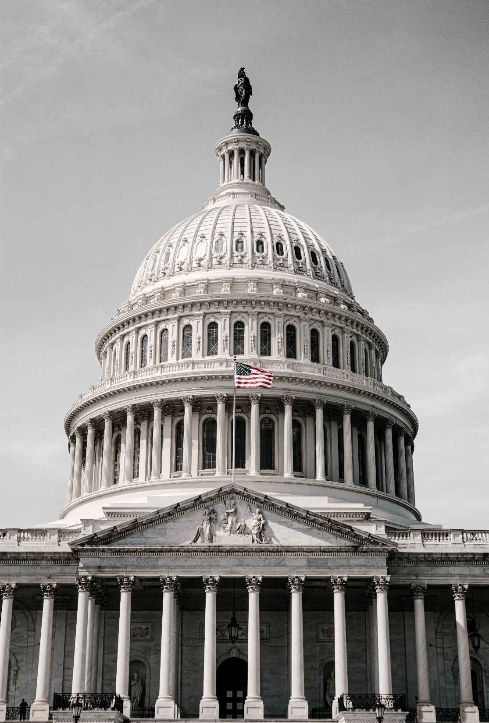
B. Development
In the next phase, policy formation, government forms a response to a problem.
Historically, the legislative branch of government has been most influential in policy formation.
Notes:
Photo by Alejandro Barba on Unsplash
https://unsplash.com/photos/ulTc9uF6YMg

Slide 14
B. Development
During the last century, both the executive and judicial branches of government have become more involved in creating public policy.
Notes:
Photo by Alejandro Barba on Unsplash
https://unsplash.com/photos/ulTc9uF6YMg

Slide 15
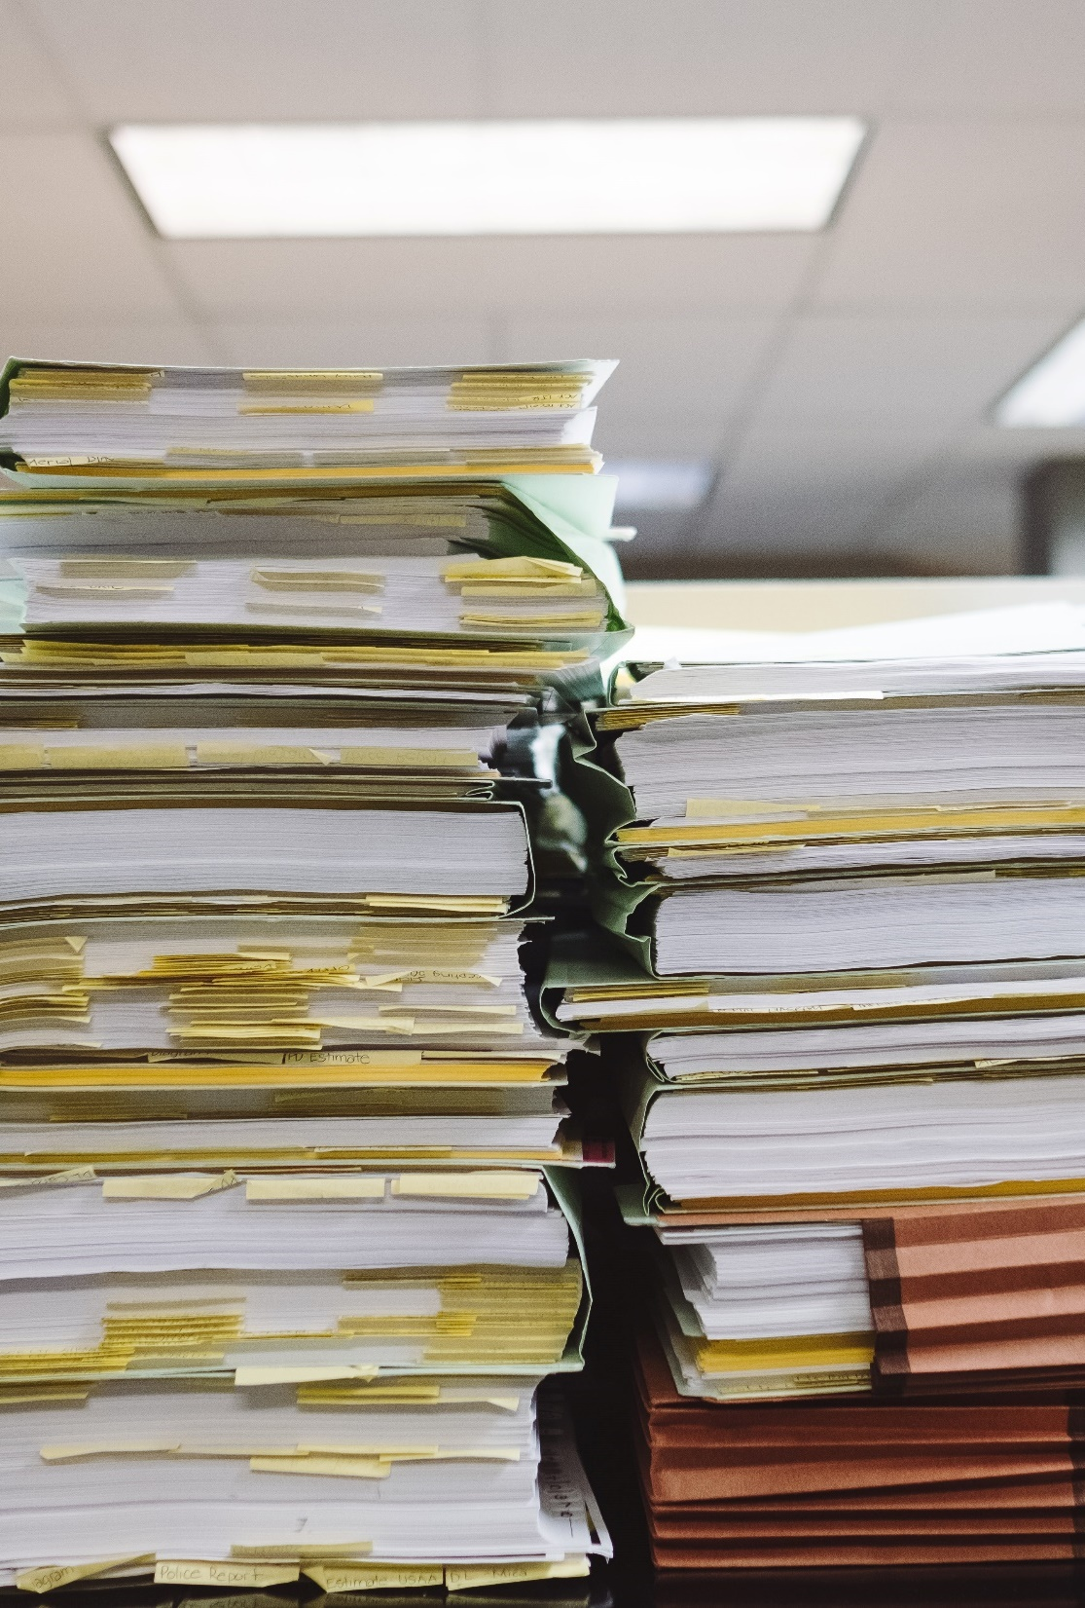
C. Implementation
After it is formed, public policy must be implemented by the executive branch and its bureaucracy.
Many factors, however, can limit the success of a public-policy decision.
Notes:
Photo by Wesley Tingey on Unsplash
https://unsplash.com/photos/snNHKZ-mGfE

Slide 16
Section Review – Chapter 18.2
1–2. Identify the two broad categories of public policy.
domestic policy and foreign policy (p. 423)
3–5. What are three stages of public-policy development?
(a) identify the issue, (b) set the agenda, (c) formulate a policy (pp. 423–424)

Slide 17
Section Review – Chapter 18.2
Contrast the involvement of the executive and judicial branches in public-policy development.
The executive branch gives its agenda in the inaugural address and the State of the Union speeches. It is also involved in public policy through executive orders and diplomatic agreements. The judicial branch affects public policy through court decisions. While the judicial branch is largely immune from public opinion, the executive branch must take it into consideration when developing public policy.

Slide 18

III. Public Opinion
Chapter 18.3
Notes:
Photo by Scott Graham on Unsplash
https://unsplash.com/photos/OQMZwNd3ThU

Slide 19

A. Origins of and Influences on Opinion
One of the most important influences on public opinion is the family.
Unfortunately, an enduring family of a father, mother, and children is becoming less common and less cherished.
Notes:
Photo by CDC on Unsplash
https://unsplash.com/photos/20YP7NENJzk

Slide 20

A. Origins of and Influences on Opinion
Peers can be extremely influential on the views and conduct of young people, especially during the teen years.
Scripture affirms the importance of choosing friends wisely to ensure positive peer influence (Prov. 13:20).
Notes:
Photo by Charlein Gracia on Unsplash
https://unsplash.com/photos/-Ux5mdMJNEA

Slide 21
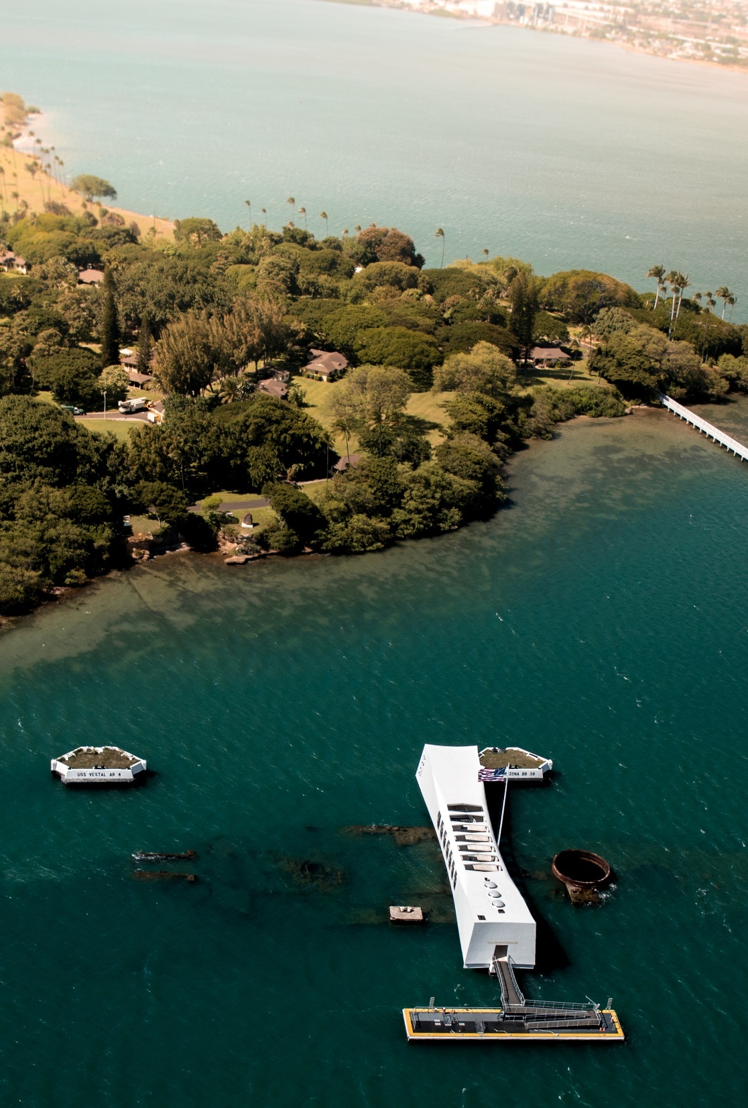
A. Origins of and Influences on Opinion
Circumstances also contribute to how people think about public issues.
An important national or international event can galvanize public opinion.
Notes:
Photo by Casey Horner on Unsplash
https://unsplash.com/photos/UqsOHO6EnP8

Slide 22
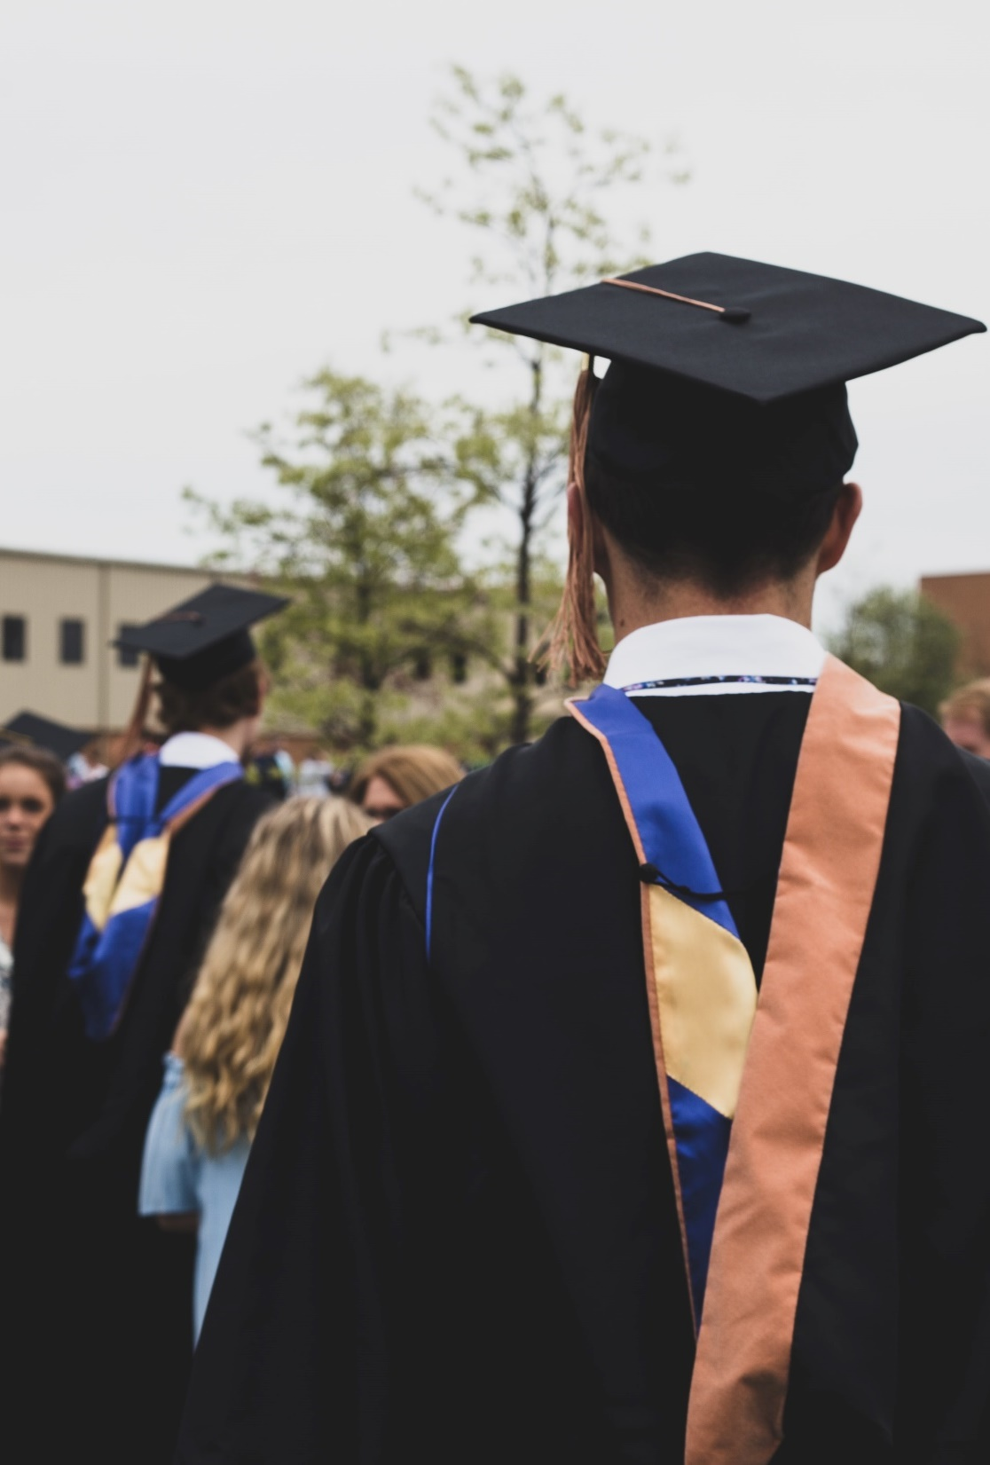
A. Origins of and Influences on Opinion
Popular entertainment often carries social or political messages, influencing public opinion.
Institutions such as schools and churches can greatly influence young people as they grow up.
Notes:
Photo by Charles DeLoye on Unsplash
https://unsplash.com/photos/2RouMSg9Rnw

Slide 23
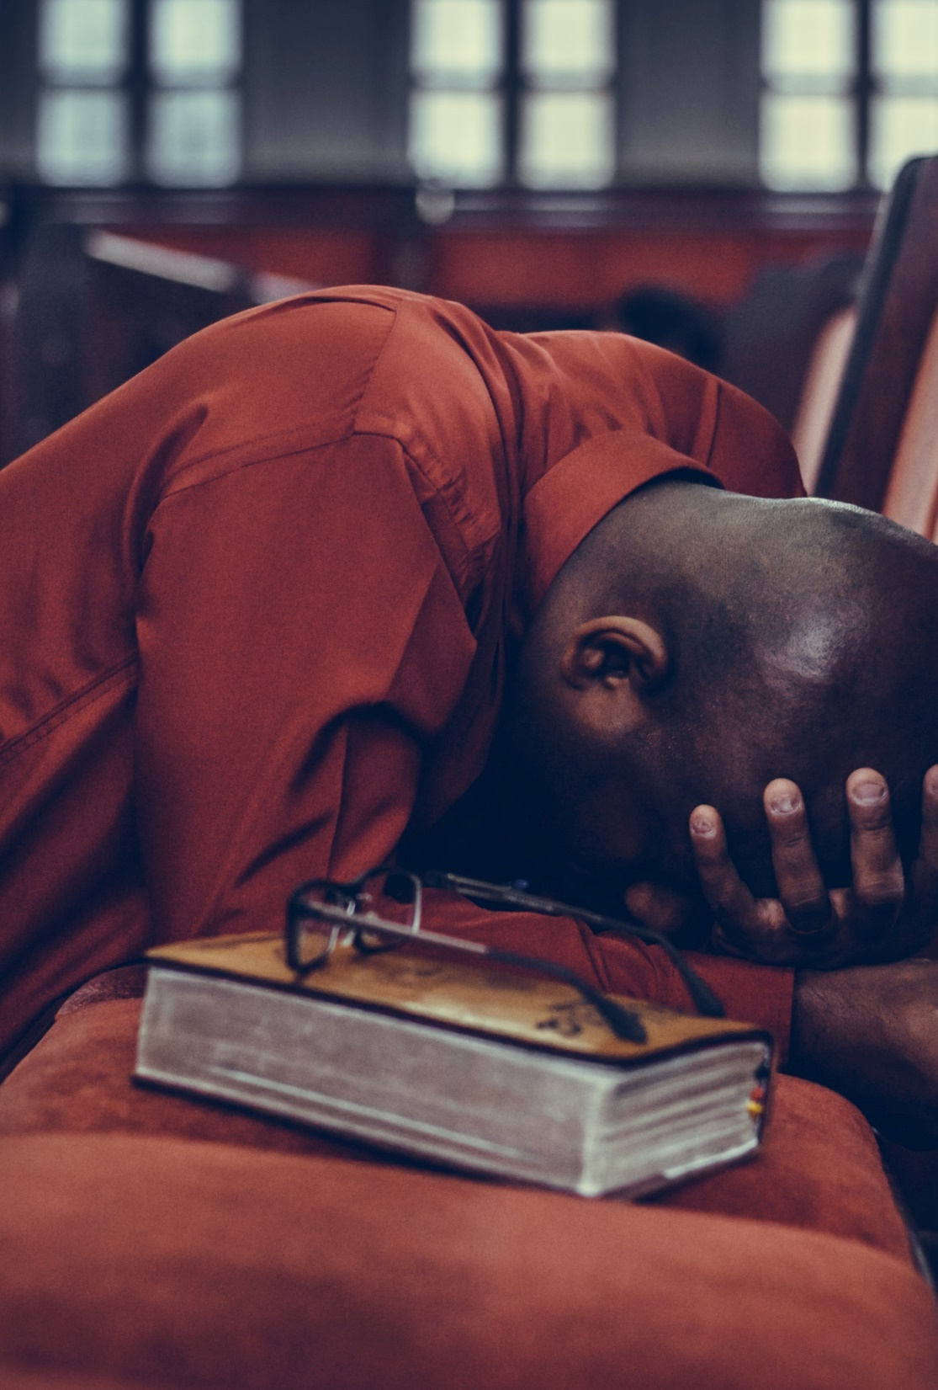
A. Origins of and Influences on Opinion
Through the Spirit’s use of Scripture, Christian minds are renewed and transformed so they are increasingly not conformed to the thinking of the present age (Rom. 12:2).
The Bible does not directly address every political issue, and wisdom is needed to apply the Bible’s teaching to various matters.
Notes:
Photo by Samuel Martins on Unsplash
https://unsplash.com/photos/3U7HcqkIbb4

Slide 24

B. Measuring Public Opinion
Although election results indicate the public’s general attitude, they are limited as a tool for measuring public opinion.
Opinion polls are surveys of what the public thinks about particular subjects.
Notes:
Photo by Scott Graham on Unsplash
https://unsplash.com/photos/5fNmWej4tAA

Slide 25

B. Measuring Public Opinion
Modern pollsters often take their samples from lists of registered voters.
Scientific polls obtain a representative sample by polling multiple kinds of voters so that the survey will represent the population expected to vote.
Notes:
Image by Andreas Breitling from Pixabay
https://pixabay.com/photos/survey-opinion-research-voting-fill-1594962/

Slide 26

B. Measuring Public Opinion
Straw polls are informal polls that do not use valid sampling techniques.
Although more than two hundred major polling organizations operate in the United States, polls are not a final authority on any public-policy issue.
Notes:
Image by Free-Photos from Pixabay
https://pixabay.com/photos/people-walking-city-urban-knapsack-1031169/

Slide 27

C. The Danger of Public Opinion
Public opinion is far from fallible and often fickle.
Making a wise but politically unpopular decision is better than making a bad decision dictated by a volatile public.
Notes:
Photo by Javier Allegue Barros on Unsplash
https://unsplash.com/photos/0nOP5iHVaZ8

Slide 28
Section Review – Chapter 18.3
1–6. What are six areas of life that influence our opinions?
family, peers, events, media, institutions, and Scripture
(pp. 425–426)
7. According to Romans 12:2, how should a Christian’s opinions be formed?
The Holy Spirit’s renewing of a Christian’s mind will transform that person’s ideas about politics, aligning them in accordance with scriptural principles. (p. 426)

Slide 29
Section Review – Chapter 18.3
8. What importance does a representative sample have for an opinion poll?
A representative sample will survey appropriate proportions of citizens in order to yield reliable information about the target group. (pp. 427–428)
9. Why is the wording of an opinion-poll question significant?
Different wordings might lead people to particular responses, especially if the question is vague or uses terms that have strong connotations. (p. 429)

Slide 30
Section Review – Chapter 18.3
Why should politicians be wary of public opinion?
Politicians must be careful because public opinion can change quickly or be based on incorrect information. Furthermore, just because the majority of people favor something does not mean that it is the correct action to take.

Slide 31
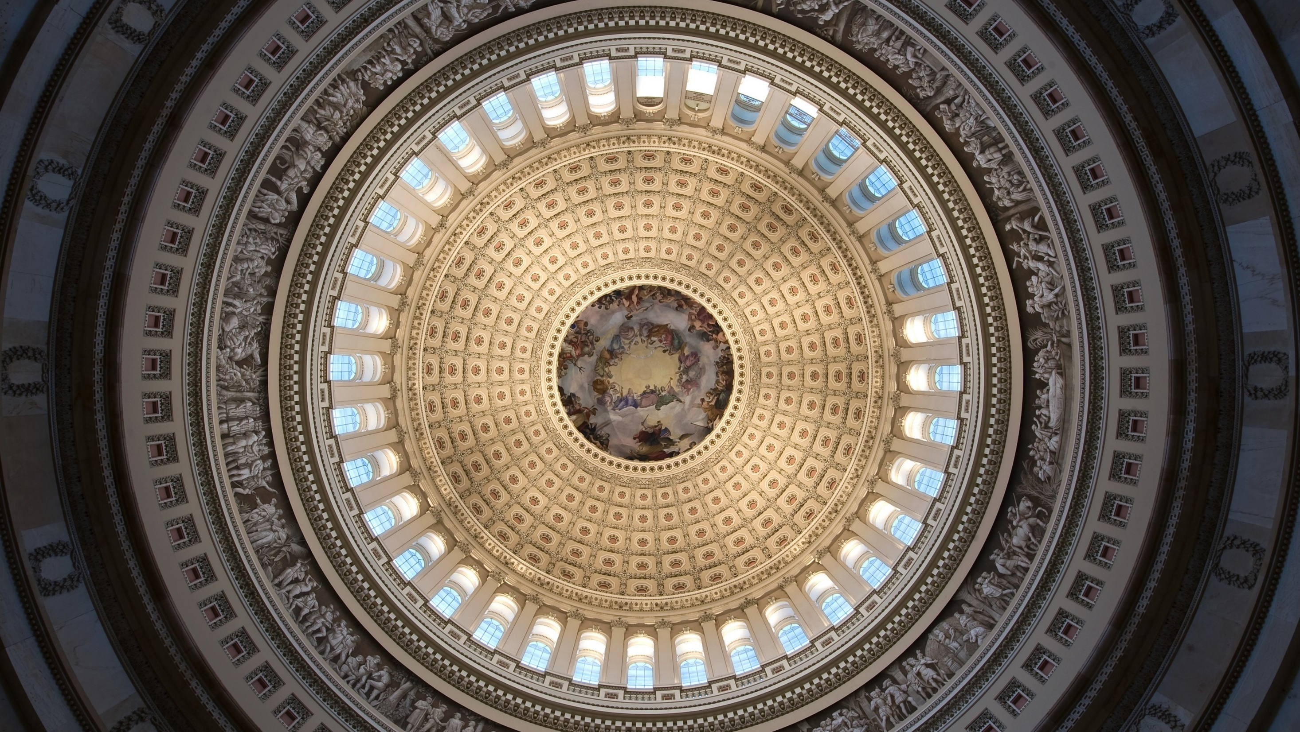
IV. Interest Groups
Chapter 18.4
Notes:
Image by David Mark from Pixabay
https://pixabay.com/photos/washington-dc-capitol-building-85544/

Slide 32

IV. Interest Groups
Citizens who hold similar opinions can form interest groups to influence government officials and the public about a political issue or group of issues.
Notes:
Photo by Mimi Thian on Unsplash
https://unsplash.com/photos/ZKBzlifgkgw

Slide 33

A. Purposes
Interest groups focus on one major issue and seek to influence government policy.
While interest groups can sometimes help the government by providing expertise and information, their arguments can be misleading or inaccurate.
Notes:
Photo by Jorge Vasconez on Unsplash
https://unsplash.com/photos/buYlndcNnjM

Slide 34

B. Kinds of Interest Groups
Approximately 70% of interest groups represented in Washington are business associations or trade organizations.
The AFL-CIO is the largest labor union in the country with over
12 million members.
Notes:
Photo by Ahsanization ッ on Unsplash
https://unsplash.com/photos/wpvEMgFV4w0

Slide 35
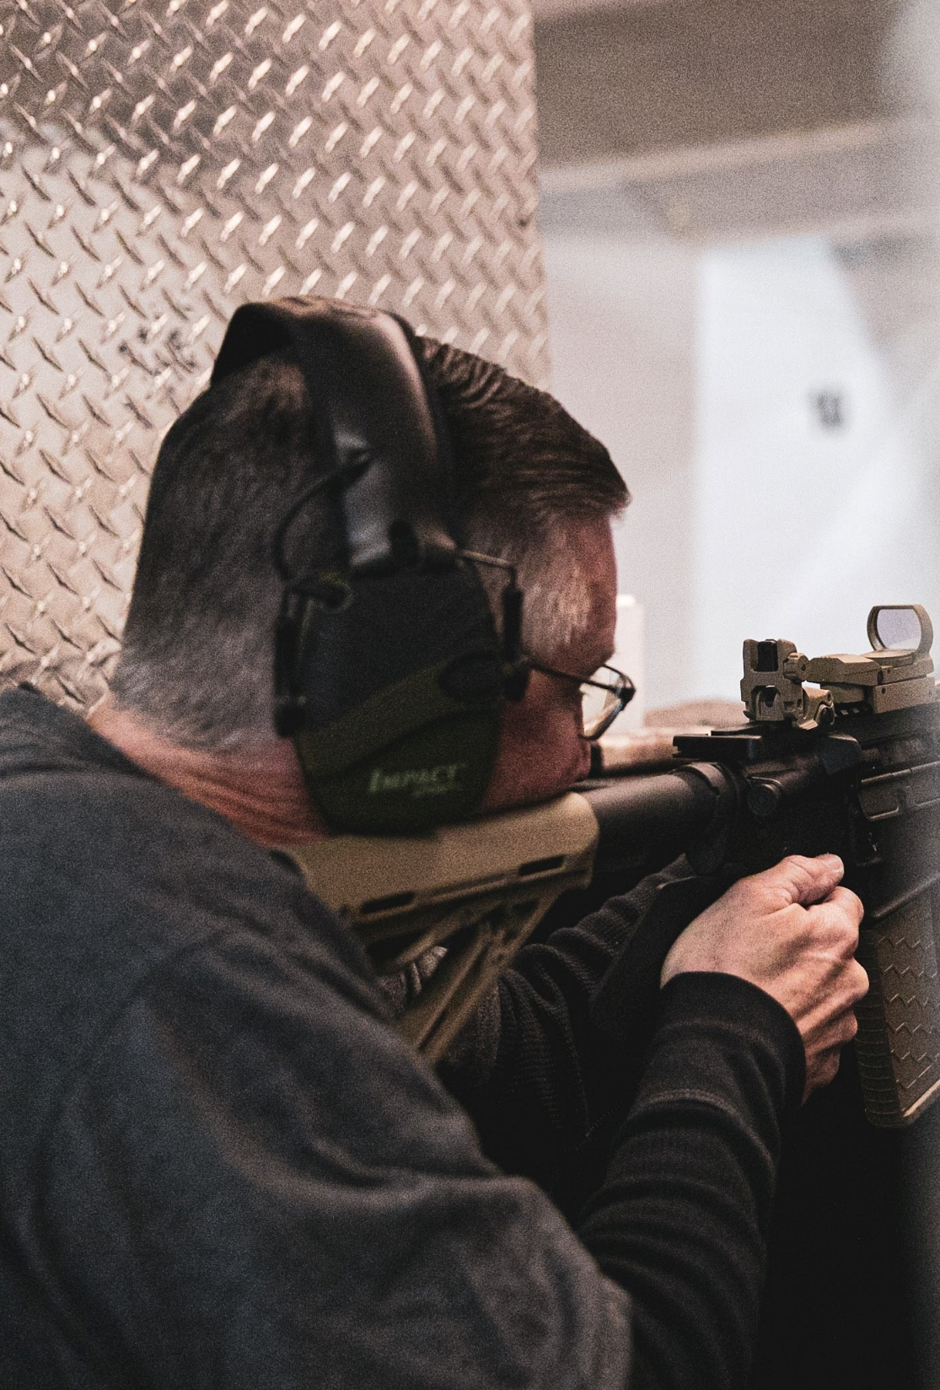
B. Kinds of Interest Groups
Other groups focus on social or civil rights issues.
Single-issue interest groups, such as the National Rifle Association (NRA), are concerned with one particular issue.
Notes:
Photo by LOGAN WEAVER on Unsplash
https://unsplash.com/photos/87LVt4_O96U

Slide 36
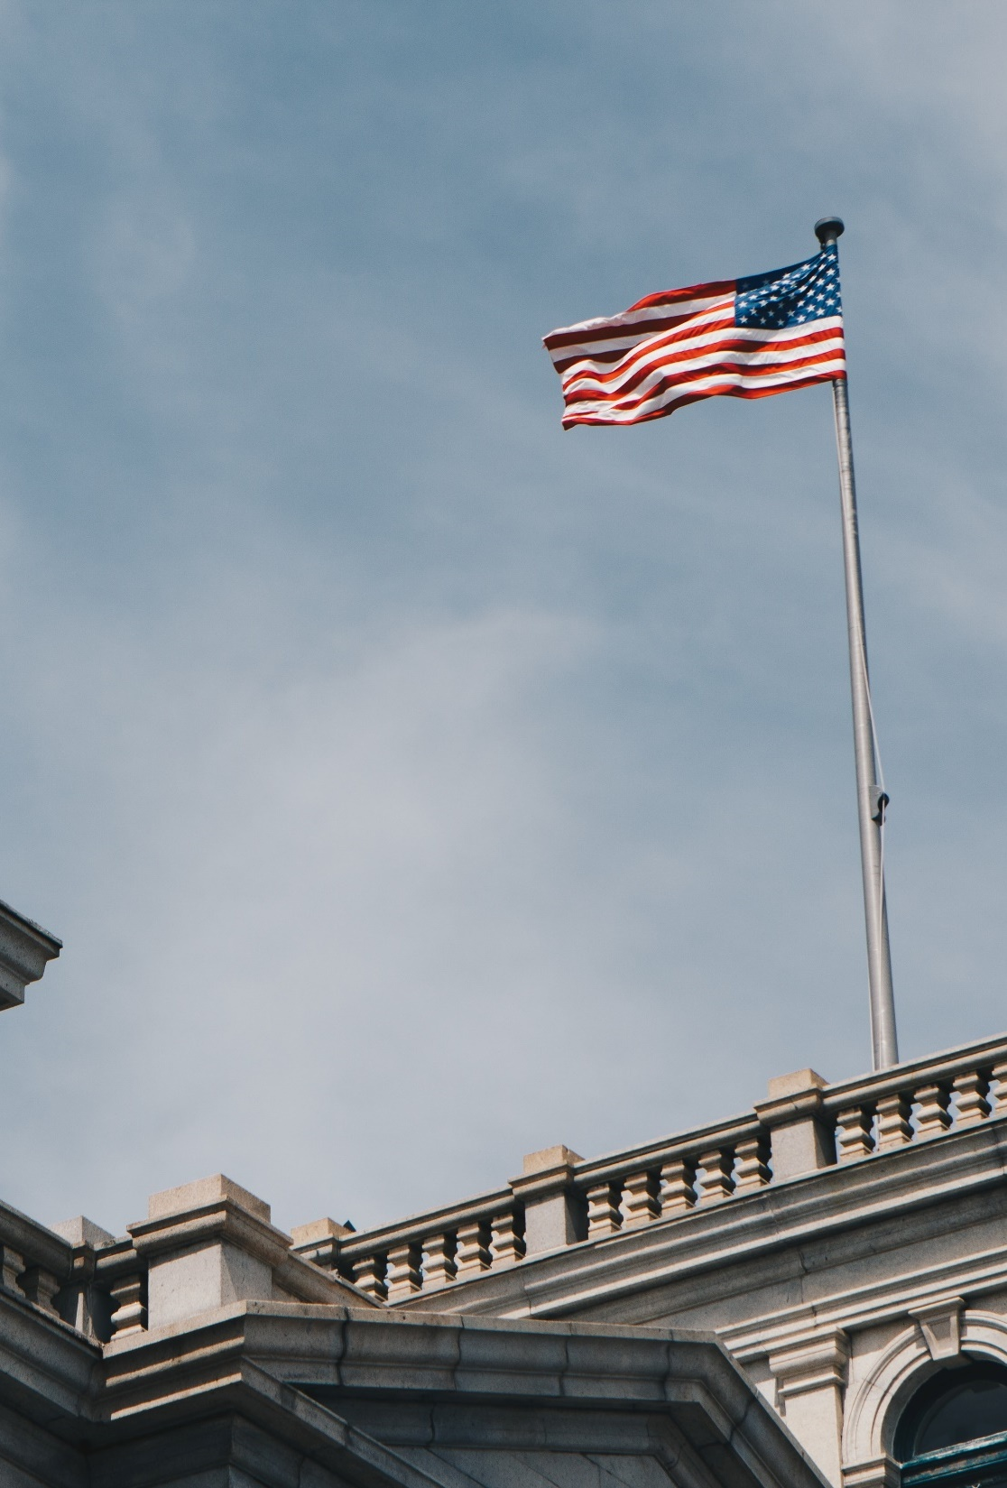
B. Kinds of Interest Groups
As American culture increasingly fragments, organizations arise to support various religious and ideological beliefs.
Other interest groups operate to further some civic cause or responsibility such as voting or government reform.
Notes:
Photo by Hayes Potter on Unsplash
https://unsplash.com/photos/AcA0KmPaifE

Slide 37

C. Interest Groups’ Activities
Interest groups use a variety of techniques to influence public policy.
Lobbying is the attempt to influence public officials to support a special interest.
Notes:
Image by StartupStockPhotos from Pixabay
https://pixabay.com/photos/startup-meeting-brainstorming-594090/

Slide 38
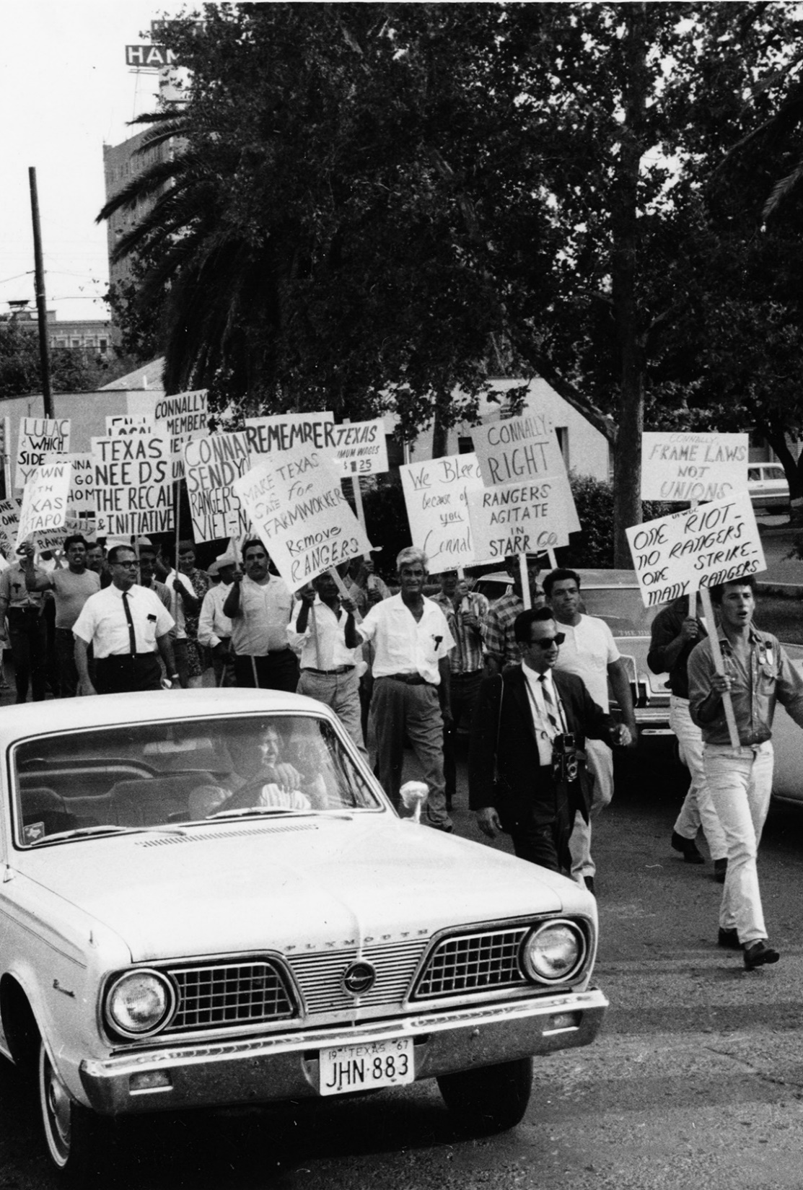
C. Interest Groups’ Activities
In addition to lobbying public officials, interest groups may try to attract public support for their causes and then use that support to influence officials.
Organizing picket lines, sit-ins, marches, and other forms of protest might form an advantageous strategy for some interest groups.
Notes:
By Pancho Medrano Papers - UTA Libraries Digital Gallery, CC BY 4.0, https://commons.wikimedia.org/w/index.php?curid=89394431
https://commons.wikimedia.org/w/index.php?sort=relevance&search=AFL-CIO&title=Special:Search&profile=advanced&fulltext=1&advancedSearch-current=%7B%7D&ns0=1&ns6=1&ns12=1&ns14=1&ns100=1&ns106=1&searchToken=dt0t8ijmd400x5jxcsuc31ing#%2Fmedia%2FFile%3AThe_AFL-CIO_strikers_picketing%2C_Laredo%2C_Texas_march%2C_June_1967_%2810002758%29.jpg

Slide 39
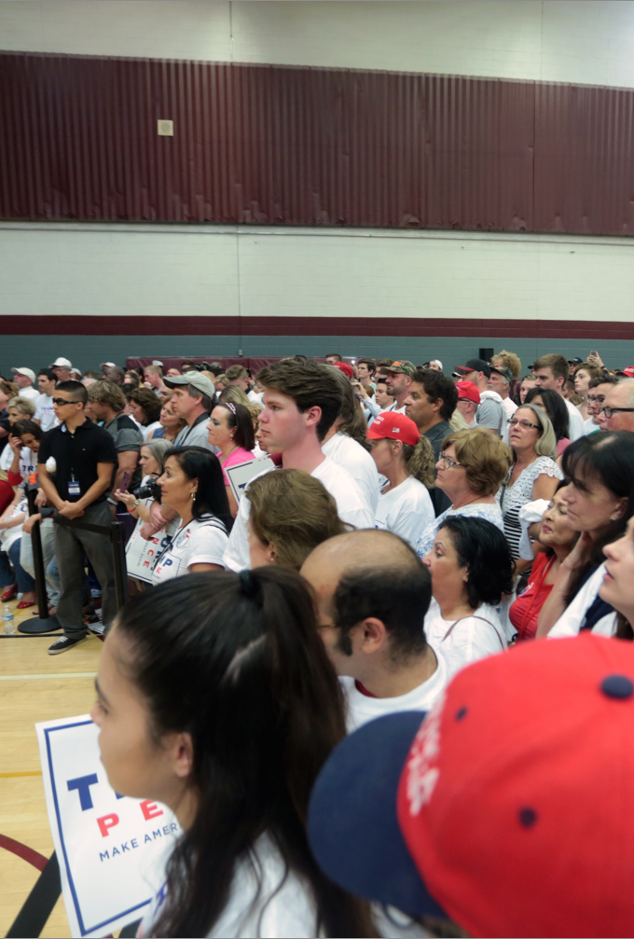
C. Interest Groups’ Activities
Another political activity of interest groups is involvement in political campaigns.
The groups usually establish political action committees (PACs) to work on behalf of candidates whom the groups deem favorable to their goals.
Notes:
By Gage Skidmore from Peoria, AZ, United States of America - Donald Trump supporters, CC BY-SA 2.0, https://commons.wikimedia.org/w/index.php?curid=52590937
https://commons.wikimedia.org/w/index.php?sort=relevance&search=Trump+rally&title=Special:Search&profile=advanced&fulltext=1&advancedSearch-current=%7B%7D&ns0=1&ns6=1&ns12=1&ns14=1&ns100=1&ns106=1&searchToken=32g8y03ktqqnjdfsdrxjgw90v#%2Fmedia%2FFile%3ADonald_Trump_supporters_at_Trump_Jr_rally_in_Tempe.jpg

Slide 40
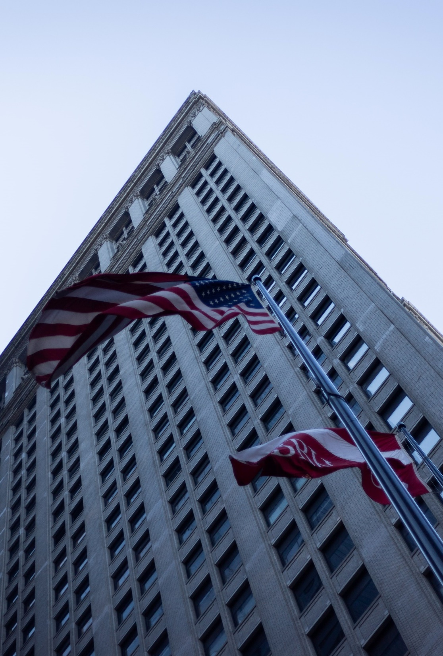
C. Interest Groups’ Activities
Some interest groups focus their efforts on the judiciary by advocating positions in court cases important to their causes.
The American Civil Liberties Union (ACLU) supports causes such as free speech and abortion rights.
Notes:
Photo by Cristina Chaparro on Unsplash
https://unsplash.com/photos/l5lphHWTYnc

Slide 41
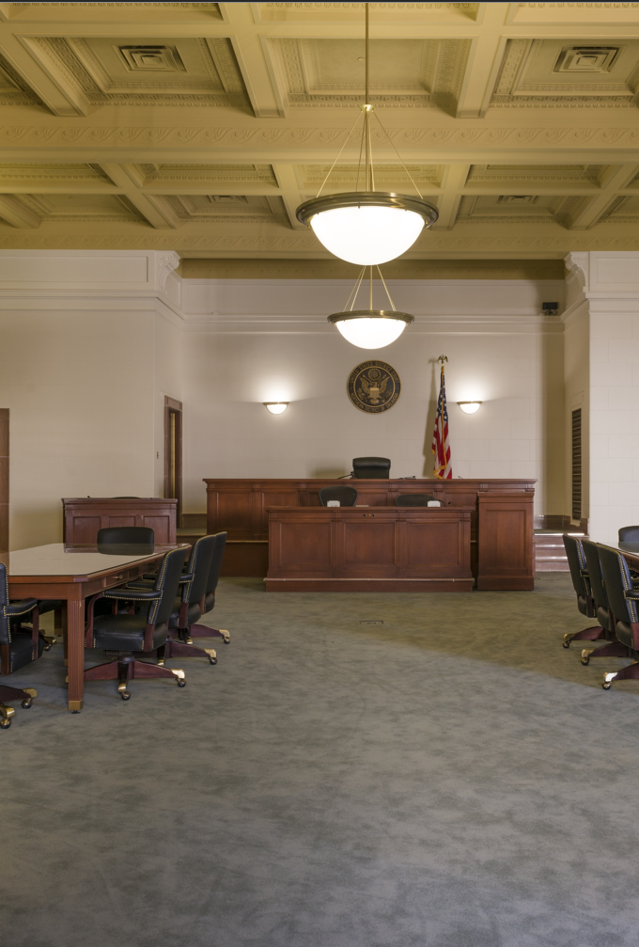
C. Interest Groups’ Activities
In court cases interest groups can testify as an amicus curiae (“friend of the court”) to try to influence the court’s decision.
The power of interest groups is limited by elections and other interest groups working against them.
Notes:
By Carol M. Highsmith - Library of CongressCatalog: http://lccn.loc.gov/2013634262Image download: https://cdn.loc.gov/master/pnp/highsm/24600/24655a.tifOriginal url: http://hdl.loc.gov/loc.pnp/highsm.24655, Public Domain, https://commons.wikimedia.org/w/index.php?curid=51110226
https://commons.wikimedia.org/w/index.php?title=Special:Search&limit=500&offset=0&ns0=1&ns6=1&ns12=1&ns14=1&ns100=1&ns106=1&search=courtroom&advancedSearch-current=%7B%7D&searchToken=8srzk2xeb2rpmkw7l5gg2aklx#%2Fmedia%2FFile%3ACourtroom_at_the_Tulsa%2C_Oklahoma_Federal_Building_LCCN2013634262.tif

Slide 42
Section Review – Chapter 18.4
1–2. What is an interest group? What is another name for an interest group?
a group sharing a similar opinion about a political issue or group of issues and uniting to further their views; pressure group (p. 430)

Slide 43
Section Review – Chapter 18.4
3–7. Identify five major kinds of interest groups, and give an example of each.
Examples may include the following: (a) economic—US Chamber of Commerce, (b) social—AARP, (c) single-issue interest—NRA, (d) religious and ideological—Moral Majority, and (e) civic—League of Women Voters. (pp. 431–433)

Slide 44
Section Review – Chapter 18.4
8. Define amicus curiae.
an individual or group that testifies or files legal briefs as a “friend of the court” to influence a court’s decision (p. 435)

Slide 45
Section Review – Chapter 18.4
Interest groups use a variety of activities to influence public policy. Explain one of these.
Interest groups can influence public policy through lobbying; the media; direct mailings; protests and rallies; campaign involvement, especially through political action committees (PACs); and court action.

Slide 46
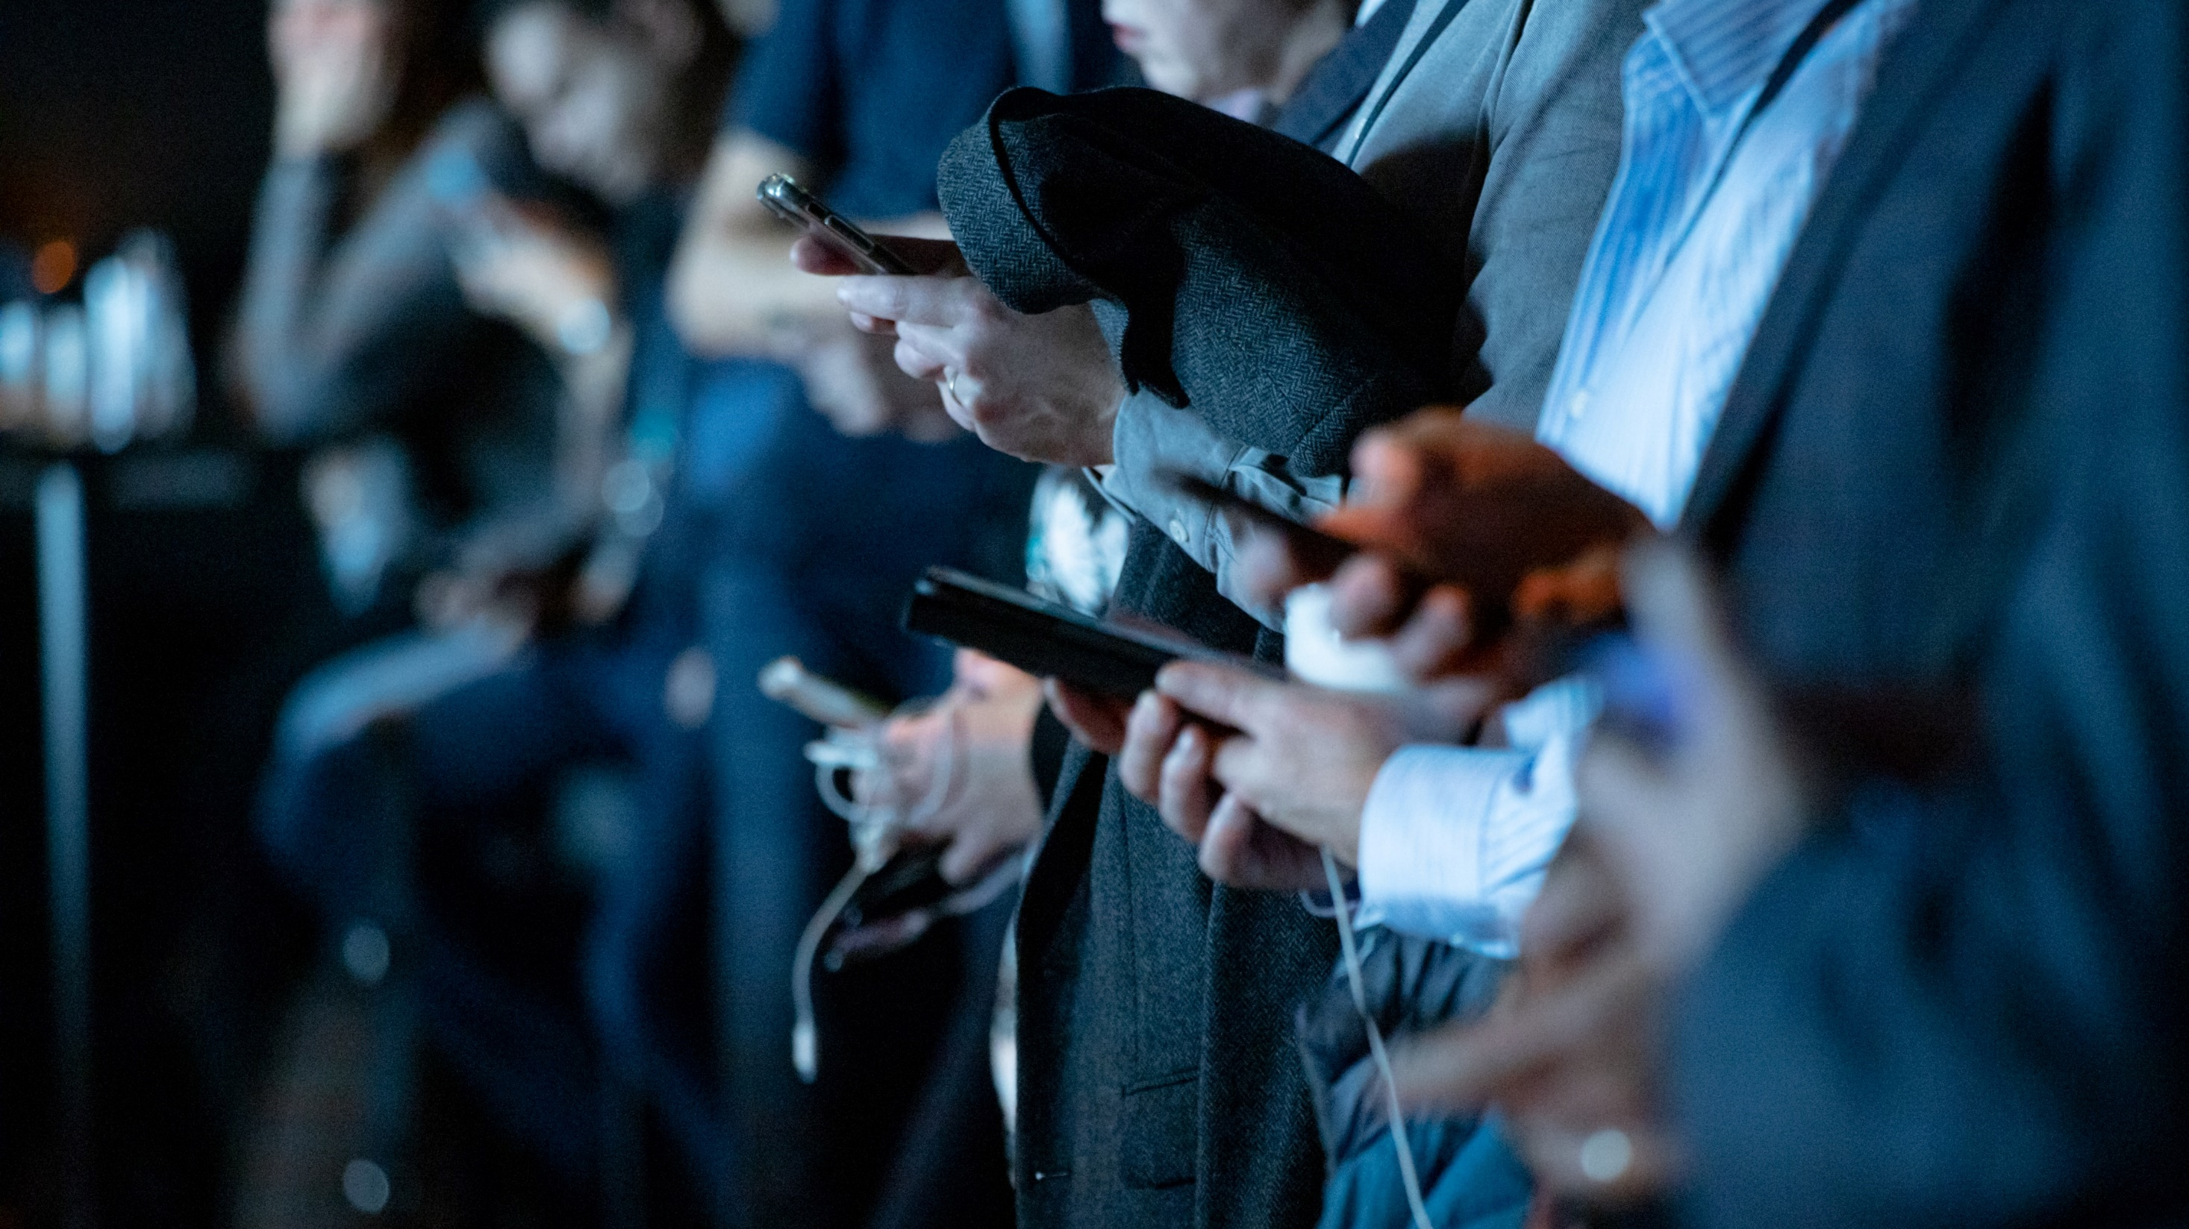
V. Mass Media
Chapter 18.5
Notes:
Photo by camilo jimenez on Unsplash
https://unsplash.com/photos/qZenO_gQ7QA

Slide 47

V. Mass Media
Politicians and interest groups use mass media to their advantage as they seek to gain public support.
Their messages can reach thousands of potential voters through radio, television, newspapers, magazines, the internet, and social media.
Notes:
Photo by Francisco Andreotti on Unsplash
https://unsplash.com/photos/MwrpaS_6f2U

Slide 48
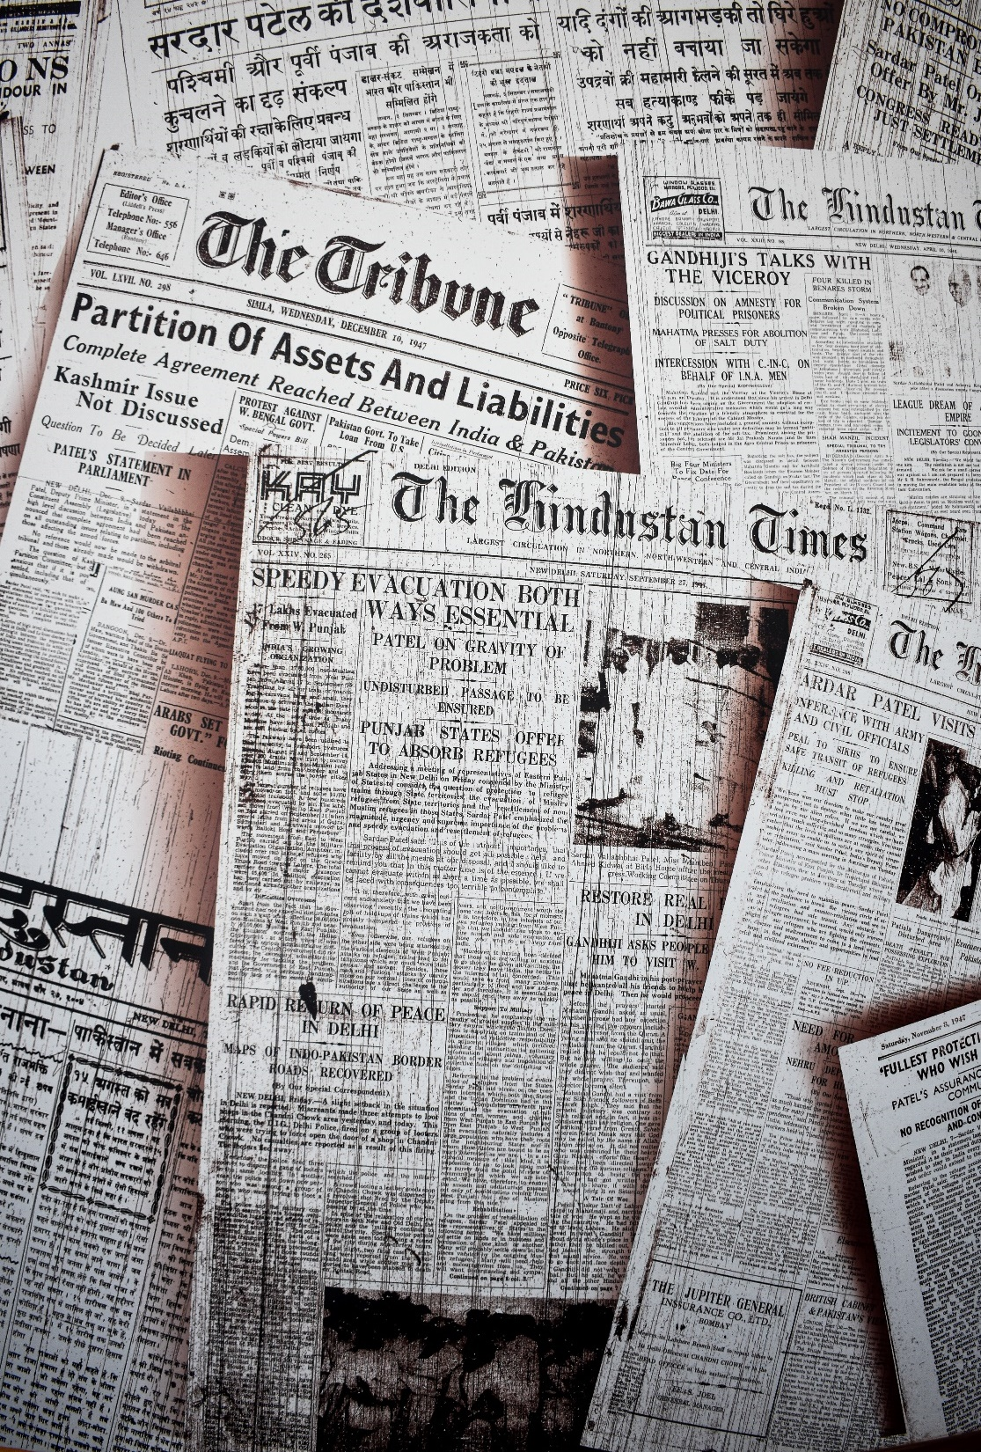
A. Major Types of Media
America’s oldest form of mass media is the newspaper.
Today, some of the US newspapers with the largest circulation, or number of readers, are USA Today, the New York Times, the Wall Street Journal, and the Washington Post.
Notes:
Photo by Rishabh Sharma on Unsplash
https://unsplash.com/photos/R-js25Pv1LQ

Slide 49
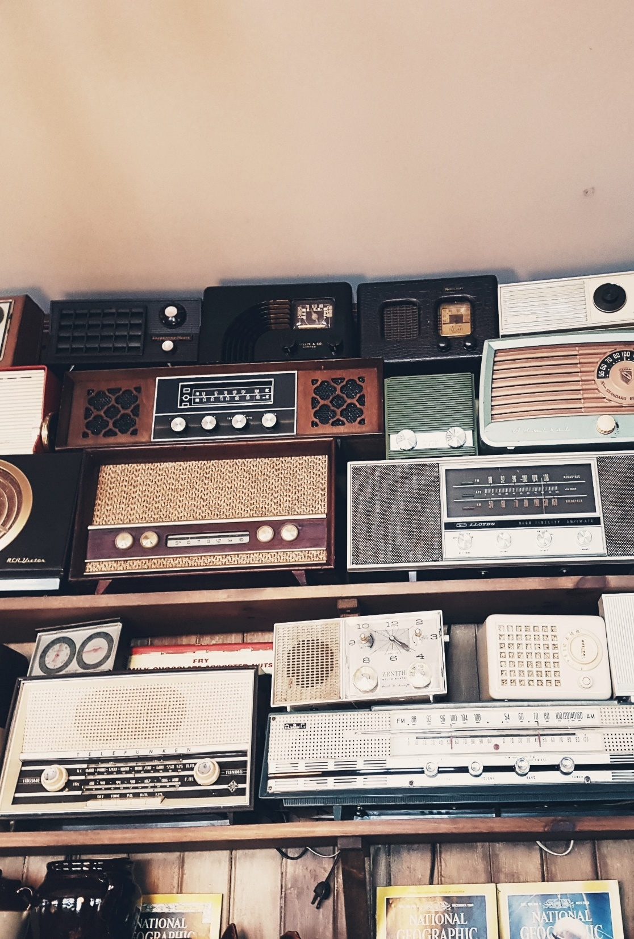
A. Major Types of Media
By 1933 two-thirds of American homes had radios, and radio broadcasts had become part of American life.
Today, there are thousands of radio stations operating in the United States, such as NPR and conservative talk radio programs.
Notes:
Photo by Abe B. Ryokan on Unsplash
https://unsplash.com/photos/7Uk-DPd0fZY

Slide 50
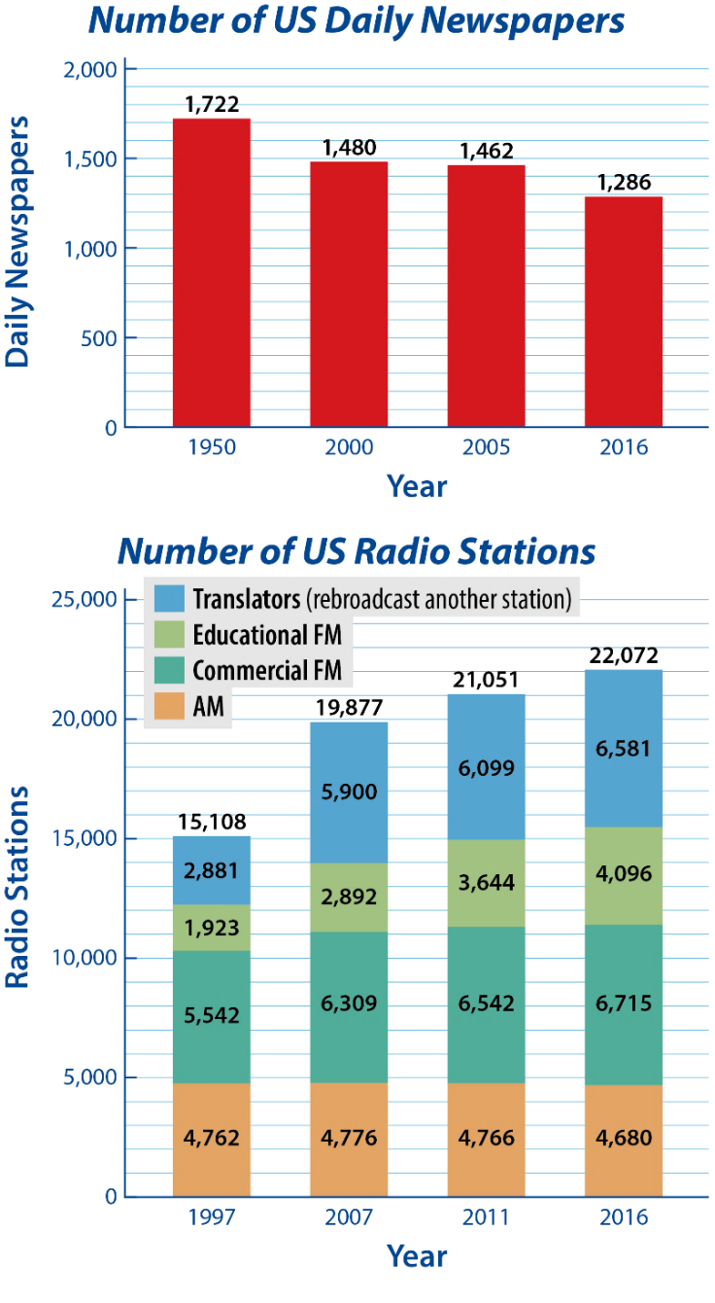

Slide 51

A. Major Types of Media
Major television networks have enormous power to influence public opinion.
An alternative to major networks’ coverage of politics is C-SPAN, a public-service network.
Notes:
Photo by Andres Jasso on Unsplash
https://unsplash.com/photos/kAxq92OhMJM

Slide 52

A. Major Types of Media
The internet and social media can be used to target specific groups of potential voters.
They allow for rapid responses to opposing campaigns’ messaging and free a candidate from the restriction of press releases or formal statements that may be filtered by the press.
Notes:
Photo by Jonathan Francisca on Unsplash
https://unsplash.com/photos/Q-y8EsExqYA

Slide 53
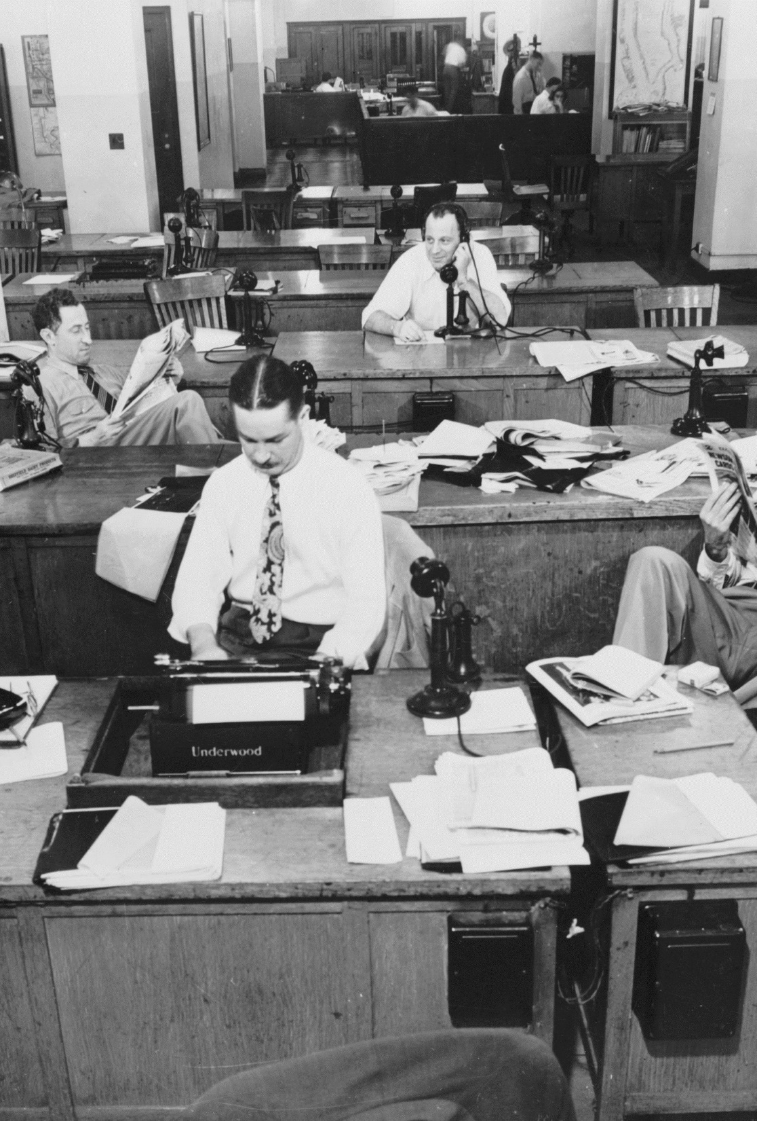
B. Powers and Limits
The First Amendment guarantees freedom of the press and thereby gives the media power to print or broadcast information without fear of government reprisal.
The press is also free from prior restraint.
Notes:
Image by Welcome to all and thank you for your visit ! ツ from Pixabay
https://pixabay.com/photos/new-york-times-newspaper-press-room-1159719/

Slide 54
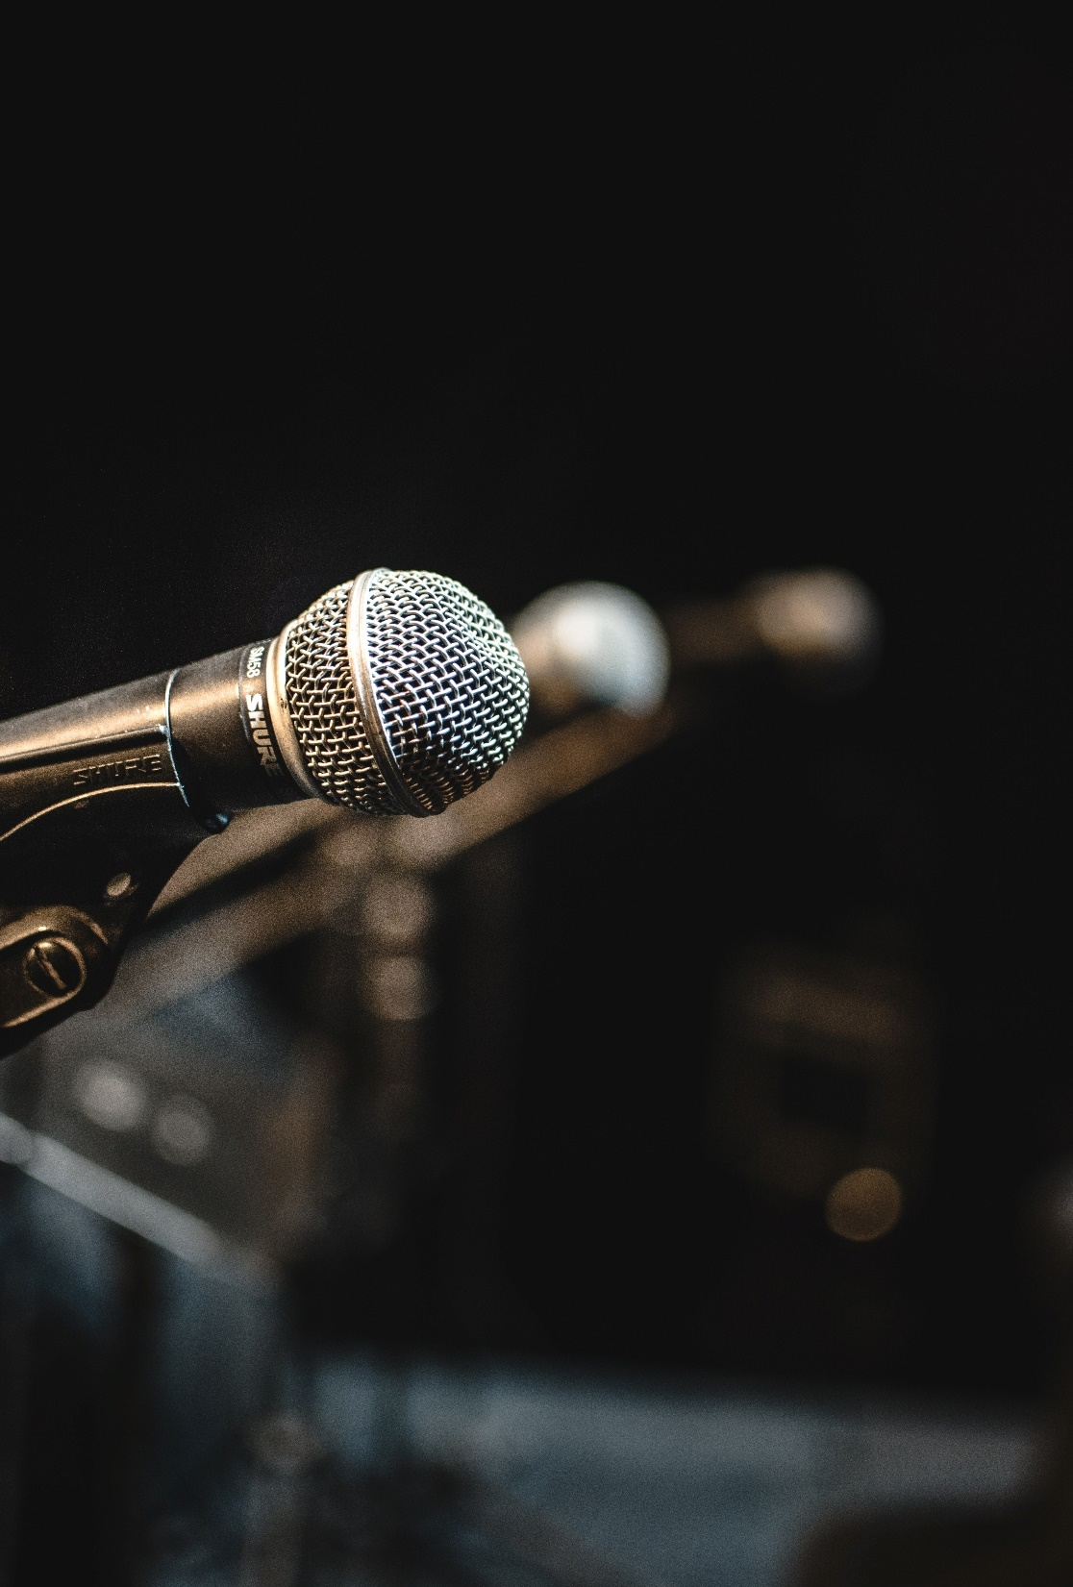
B. Powers and Limits
The Freedom of Information Act (FOIA) gives the media broad powers to investigate the federal bureaucracy’s files.
In more than forty states and the District of Columbia, the media enjoys some legal protection of confidentiality through shield laws.
Notes:
Photo by Andrew Medhat on Unsplash
https://unsplash.com/photos/0kDy7cuLVd8

Slide 55
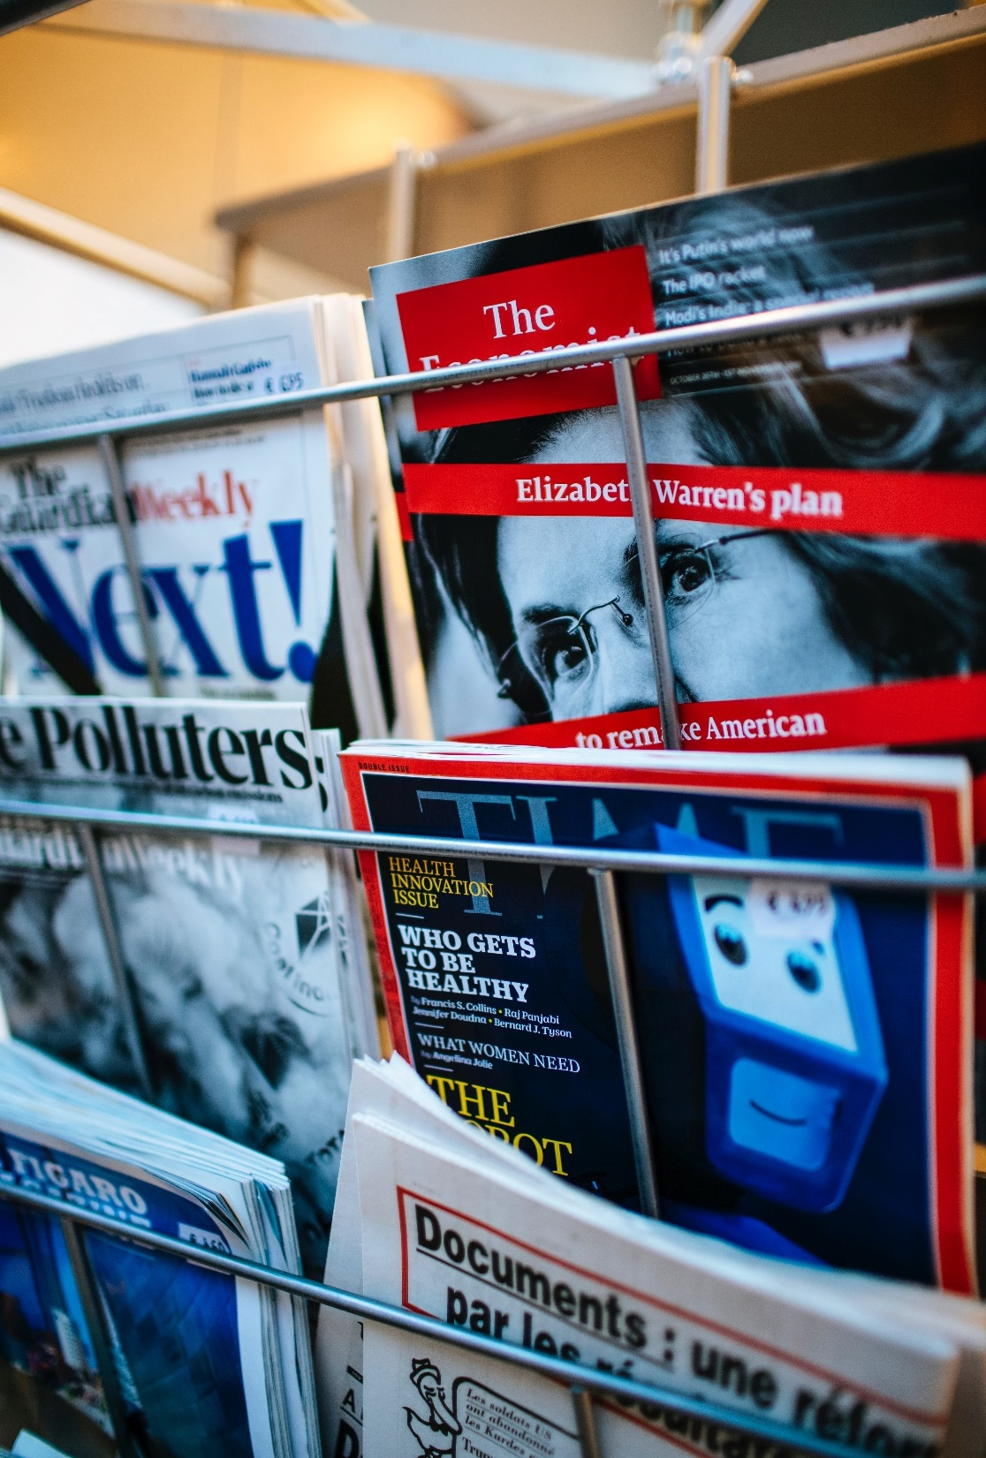
B. Powers and Limits
In addition to many legal protections, the media also possesses much freedom in how it presents the news.
Many Americans believe that the media often shows bias in its coverage of events.
Notes:
Photo by Markus Spiske on Unsplash
https://unsplash.com/photos/2G8mnFvH8xk

Slide 56
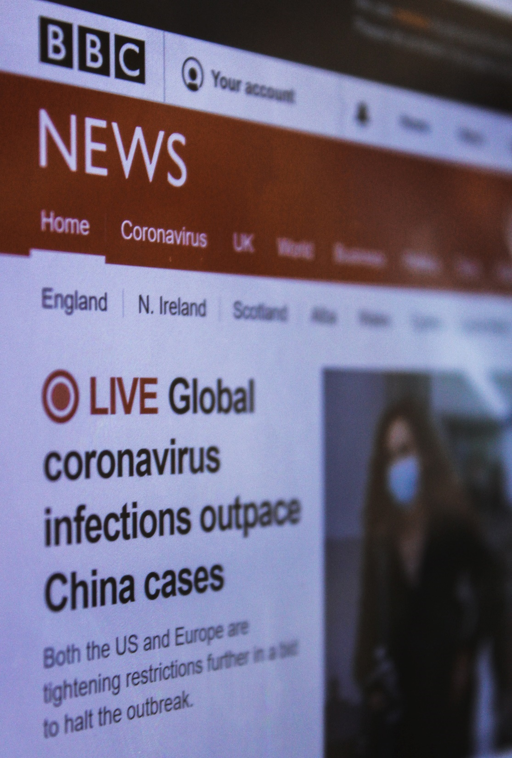
B. Powers and Limits
Two limits to the media’s freedom under the First Amendment are laws against libel and slander.
The First Amendment additionally limits the media by not protecting obscenity.
The Federal Communications Commission (FCC) regulates American radio and television stations.
Notes:
Photo by Siora Photography on Unsplash
https://unsplash.com/photos/Rm6Z-SfMOkw

Slide 57

C. Using the Media for Politics
Politicians employ press secretaries and advisors who portray their activities in the most flattering light or help them prepare for press interviews.
The political parties’ national nominating conventions have become largely media events.
Notes:
Photo by Keenan Constance on Unsplash
https://unsplash.com/photos/F7n6gixbJK0

Slide 58
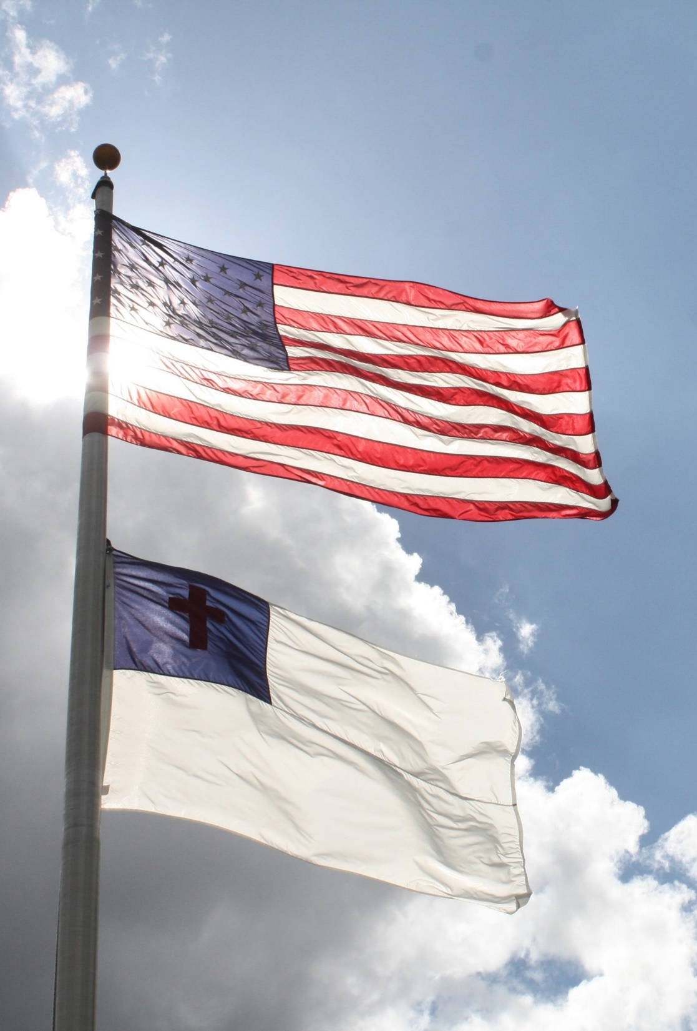
D. Using the Media for Propaganda
Propaganda is the use of various techniques to select and manipulate information to persuade or influence.
American democracy is endangered if the public allows itself to be manipulated through the clever use of propaganda into making unwise political decisions.
Notes:
Image by SEspider from Pixabay
https://pixabay.com/photos/blue-christ-christian-clouds-cross-2375915/

Slide 59
Section Review – Chapter 18.5
1–5. Identify five major forms of media.
newspapers, radio, television, the internet, and social media (pp. 436–438)
6–7. Identify what FOIA stands for and identify the rights that the FOIA provides.
FOIA stands for the Freedom of Information Act, which was passed to give the public, especially the media, access to the federal government’s bureaucratic information. (p. 440)

Slide 60
Section Review – Chapter 18.5
8. What material can be excluded from the information released by a FOIA request?
information that is vital to national security or that might jeopardize certain government actions or endanger certain people (p. 440)
9. Define propaganda.
the use of various techniques to select and manipulate information to persuade or influence people effectively
(p. 443)

Slide 61
Section Review – Chapter 18.5
How can the media manipulate the information it relays to the public?
Students may answer that the media can manipulate public perception by giving certain information more extensive or prominent coverage, omitting information, choosing connotative words and pictures in their coverage, and setting arbitrary expectations.

Slide 62
Section Review – Chapter 18.5
List seven basic propaganda techniques. Which two do you think are most effective? Explain your answer.
Name calling, plain folks, bandwagon, testimonial, card stacking, glittering generalities, and transfer. Answers will vary for the second part of the question.

