Slide 1
Chapter 16: East Asia

Slide 2
East Asia
China
The North China Plateau
The Huang He
The Chang Jiang
Shanghai
Beijing
Tianjin
Manchuria
The Great Wall of China
The Southern Uplands

Slide 3
Government and Economy
Autonomous Regions
Guangxi
Tibet (Xizang)
Xinjiang
Nei Mongol (Inner Mongolia)
Nigxia
Taiwan
Mongolia (Outer Mongolia)

Slide 4
Korea
North Korea
South Korea
Japan
Honshu
Tokyo
Kyoto
Other Industrial Centers
Shikoku
Kyushu
Hokkaido

Slide 5
Introduction
The countries of East Asia (with the exception of North Korea) are vibrant economic giants that compete with the best of the Western nations.
Geographically, East Asia is the area bounded by the Pacific Ocean on the east, Russia on the north, the Indian subcontinent and Southeast Asia on the south, and Southwest Asia on the west.
The region, which has coasts on the Yellow Sea, the East China Sea, the south China Sea, and the Pacific Ocean, is sometimes called the Pacific Rim.
Its climate ranges from tropical to subarctic.
Its terrain ranges from fertile valleys to dry deserts.

Slide 6
Notes:
Map Resources

Slide 7
Notes:
Cultural Geography, 4th edition, p. 387

Slide 8
China
China is slightly smaller in area than the US
Most of China’s most populous cities are in the east.
About 92 percent of the people in China are called Han (HAHN).
Because of its size and population, China has dominated the Far East.
China has a recorded history of over four thousand years, longer than that of any other nation.
It is susceptible to frequent typhoons (about five a year), floods, droughts, earthquakes, and tsunamis.

Slide 9
The North China Plain
The North China Plain is the heart of the People’s Republic of China and is sometimes called the “real” China.
Chinese farmers practice intensive farming, a form of subsistence farming in fertile areas that allows many individuals to raise crops on a small plot of land.
A major climate barrier is the Qin Ling Mountains, which run east to west across the middle of the plain, rising to 13,474 feet.
The two main rivers of China, the Huang He (HWAHNG HEH; formerly the Yellow River) in the north and the Chang Jiang (CHAHNG JYANG; formerly the Yangtze River) in the south, flow on either side of the range.

Slide 10
The Huang He
China is the world’s top producer of both rice and tobacco.
The Huang He flows through five of China’s twenty-three provinces.
According to legend, Chinese civilization began in this river valley about 2200 BC but was made up of several small, warring states.
Emperor Qin Shi Huang, the “first emperor,” founded the Qin (CHIN) dynasty, from which the name China is derived.
A dynasty is a series of rulers who come from the same family.
The city that is now Xi’an (SHEE AHN), on a tributary of the Huang He, was the capital of the Chinese dynasties for more than a thousand years, with only brief interruptions.

Slide 11
The temples and tombs around the city include the tomb of the first emperor, which is guarded by the now-famous terra cotta army.

Slide 12
The Chang Jiang
The southern river of the North China Plain is the Chang Jiang, which flows through four provinces.
At 3,880 miles long, the Chang is the world’s third-largest river, the longest river in Asia, and the most important river in China.
The Chang flows through the large Sichuan Basin before it leaves the mountains.

Slide 13
Shanghai
China’s largest city, Shanghai (SHANG HYE; pop. 23 million), lies on the Huang Pu River near the mouth of the Chang.
Its textile mills make cloth from the cotton of the plain, and nearby iron mines provide raw materials for heavy manufacturing.
Shanghai is now a center of world trade and banking. It and other cities have been declared special economic zones for trade, but very little of its wealth makes it into the interior of the country.
The port at Shanghai is one of the busiest in the world by volume and handles much of China’s international trade.
Shanghai was the headquarters of Hudson Taylor’s China Inland Mission.

Slide 14
Notes:
iStock.com/Eugeneonline

Slide 15
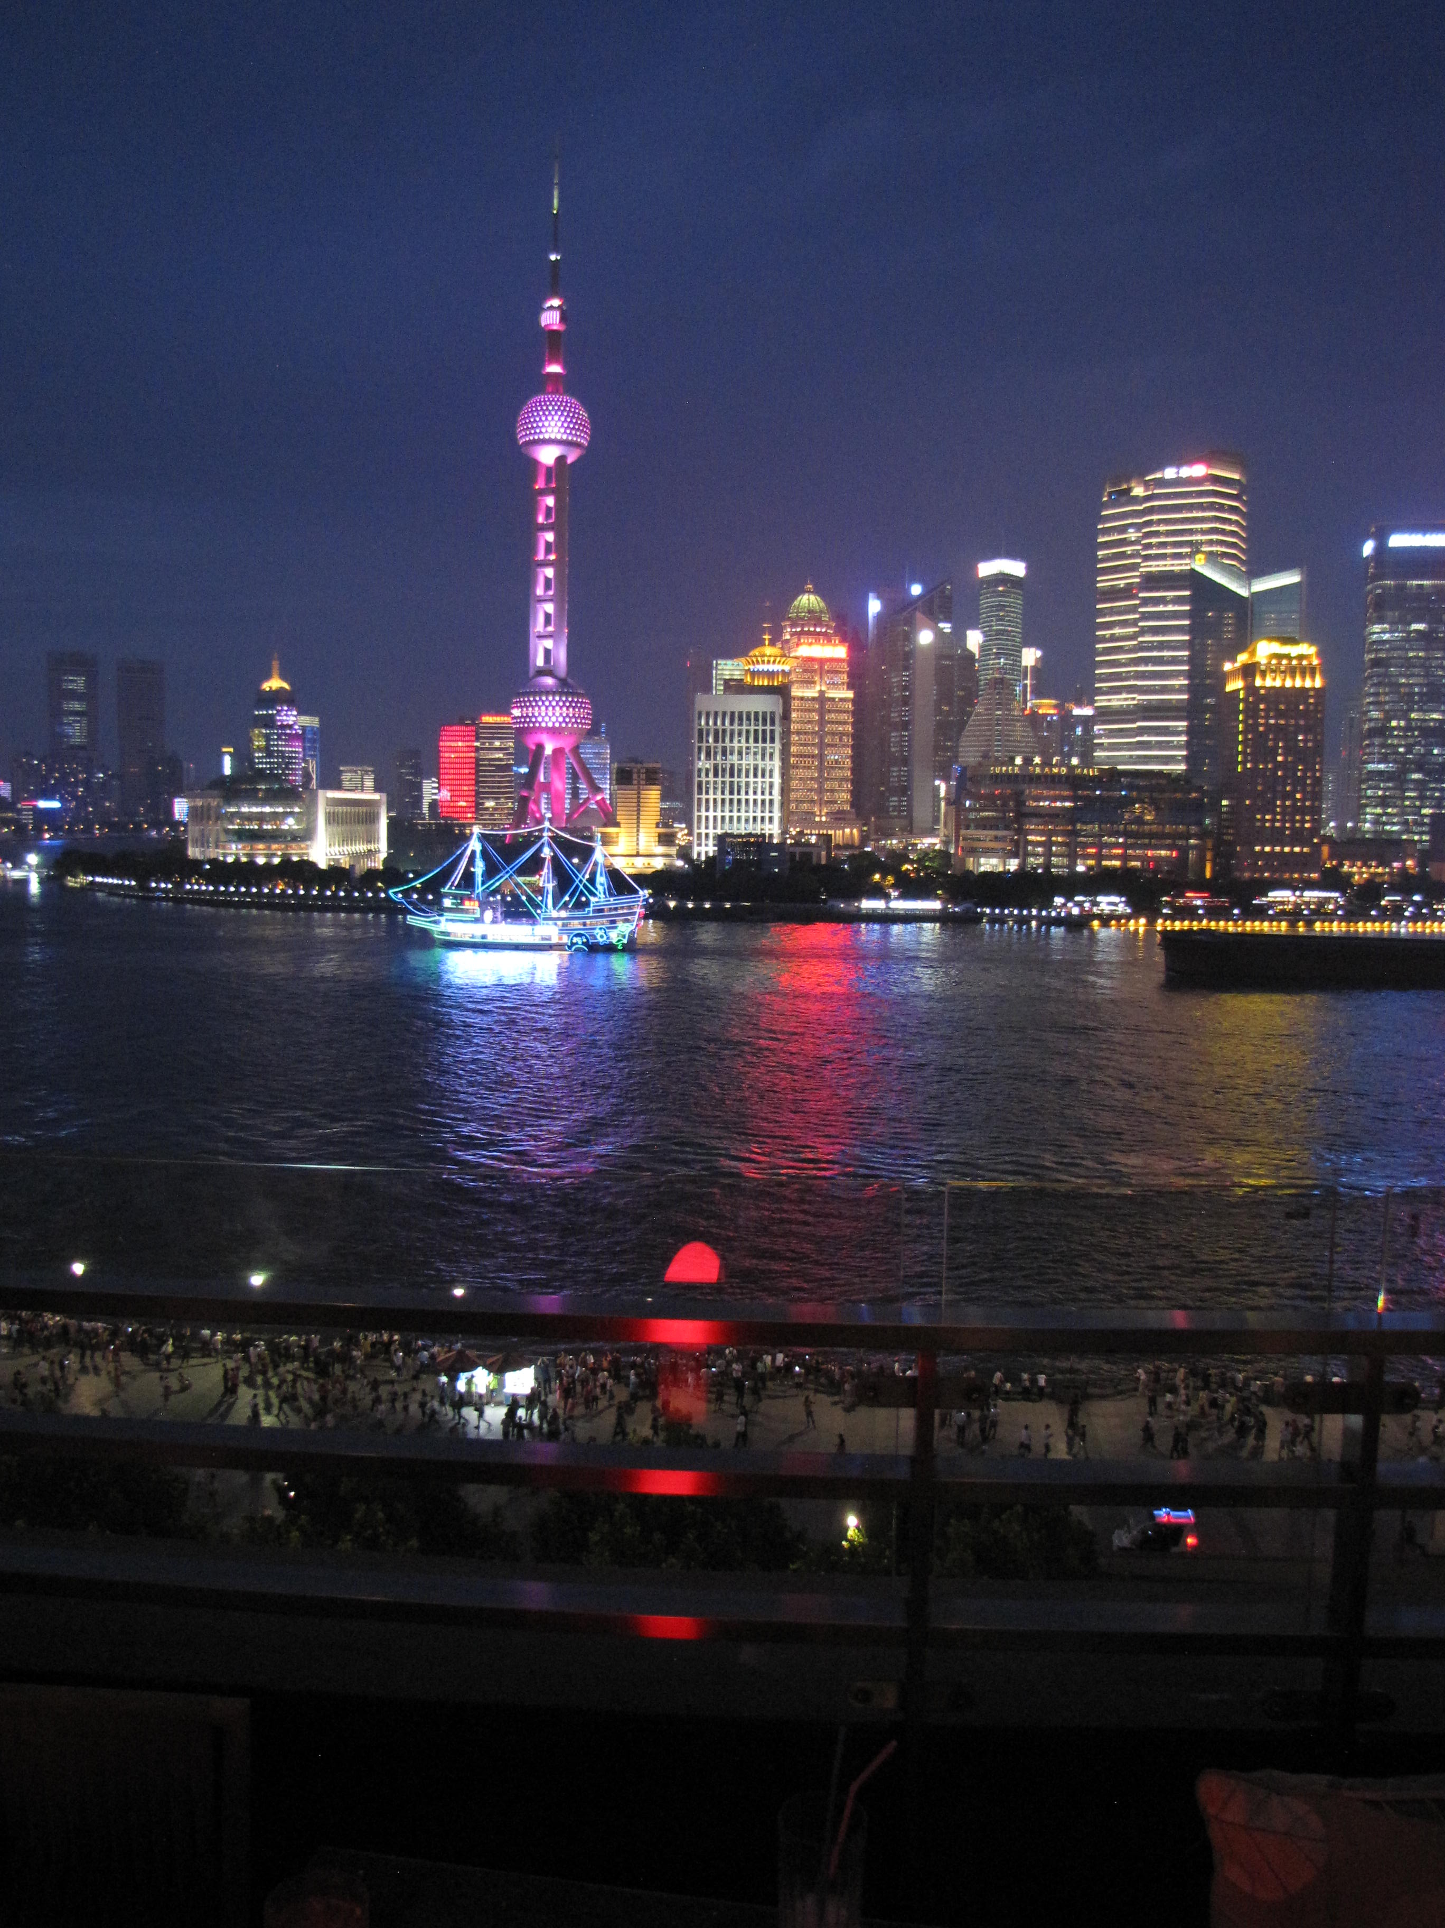

Slide 16
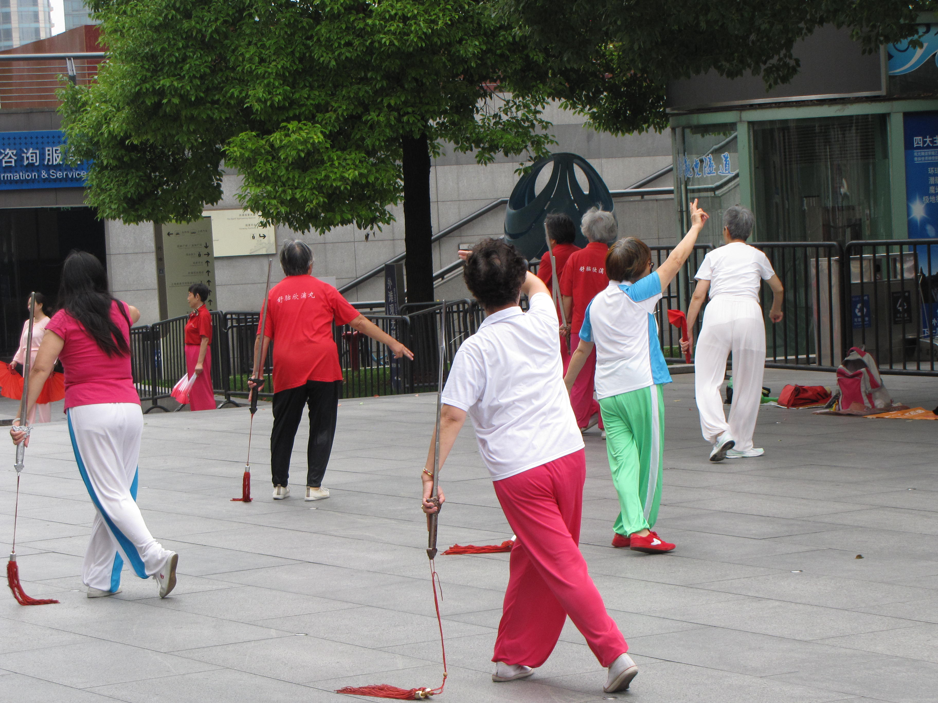

Slide 17
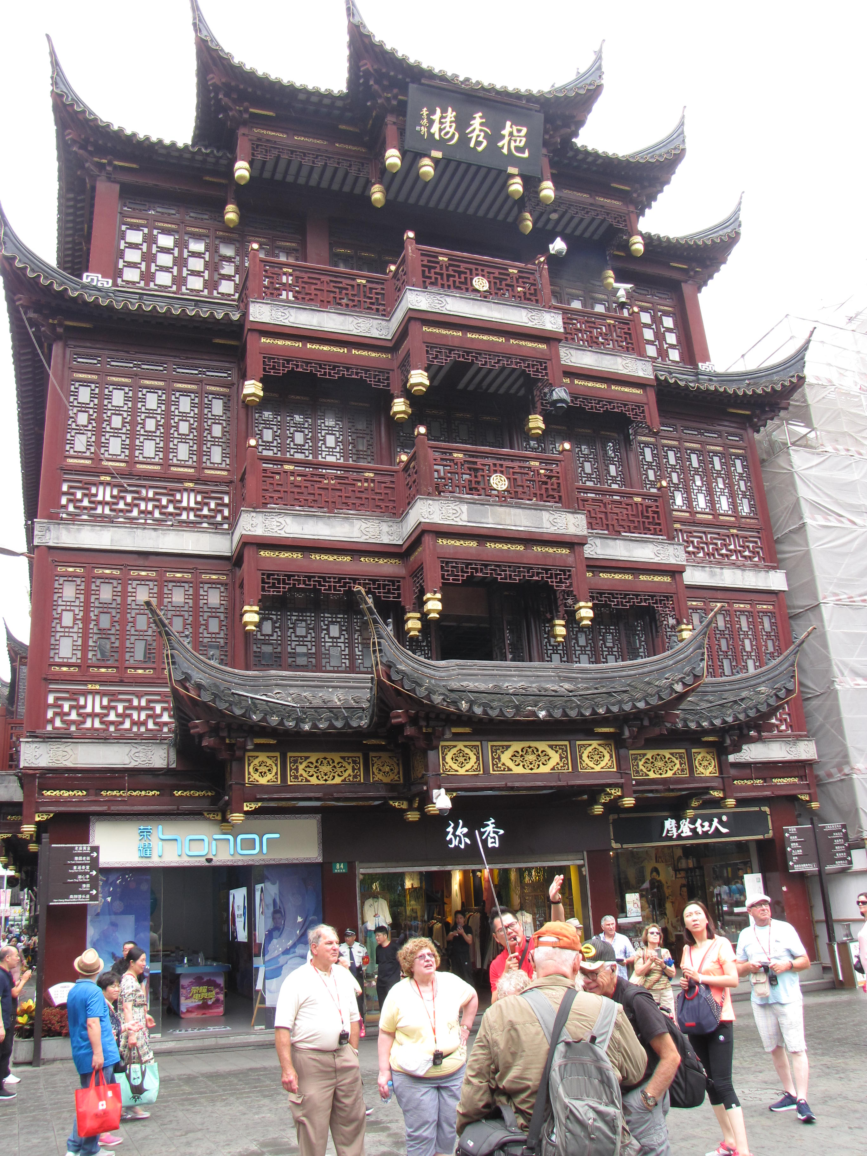

Slide 18
Beijing
With a population of 20.7 million, Beijing (BAY ZHIHNG; formerly Peking) is China’s second-largest city and the sixteenth largest in the world.
It has served as China’s capital since 1267, except for several brief periods.
In the heart of Beijing is the Forbidden City, where the Chinese emperors once lived.
To the north is the Gate of Heavenly Peace, which overlooks Tiananmen Square.
In 1989, Tiananmen Square became a symbol of the Chinese people’s dissatisfaction with the Communist regime.

Slide 19
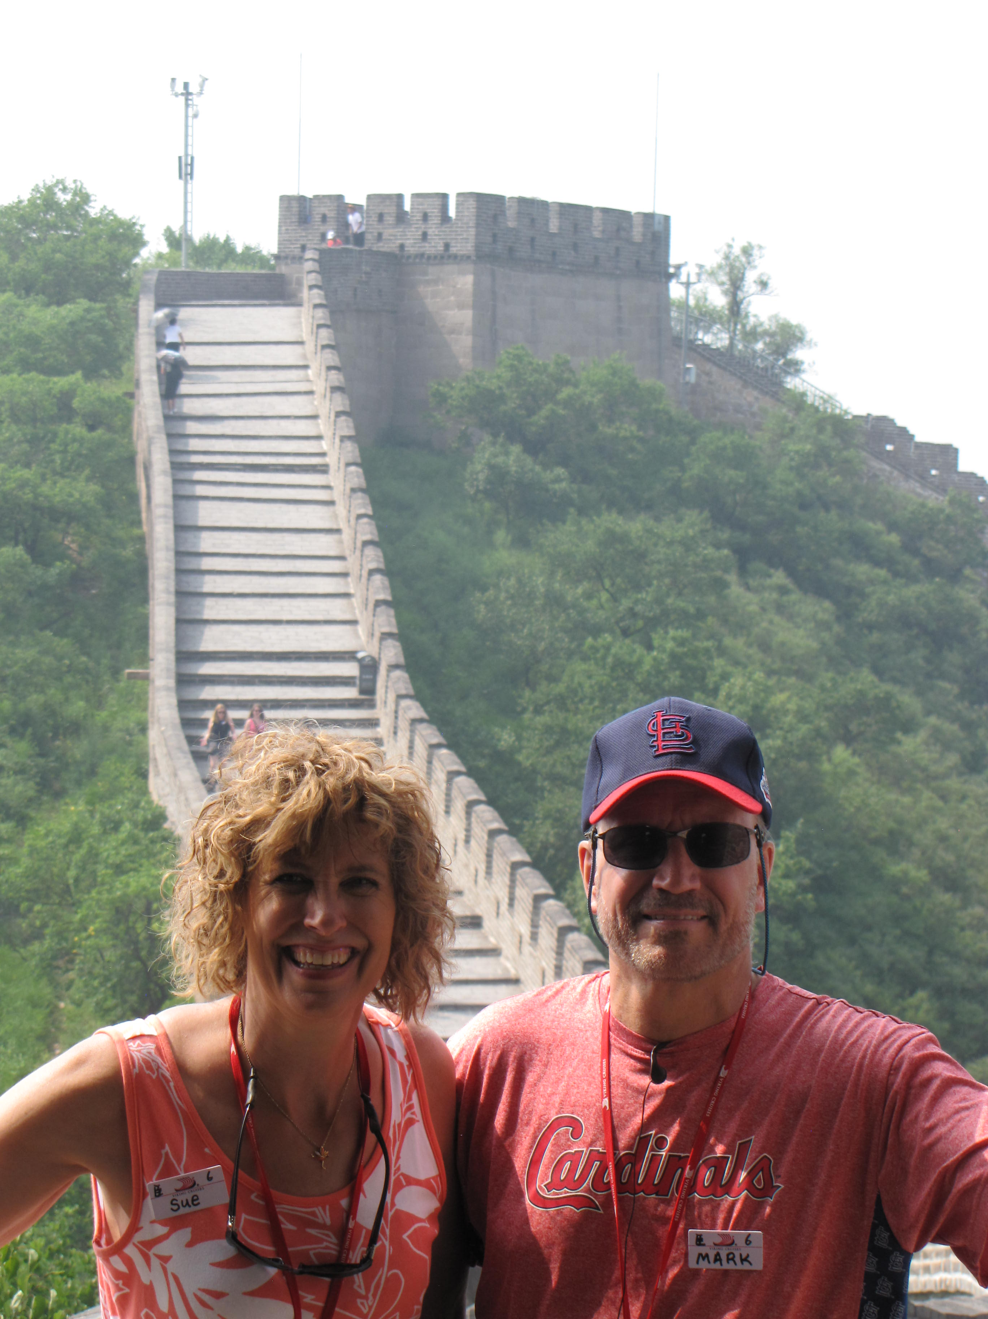

Slide 20
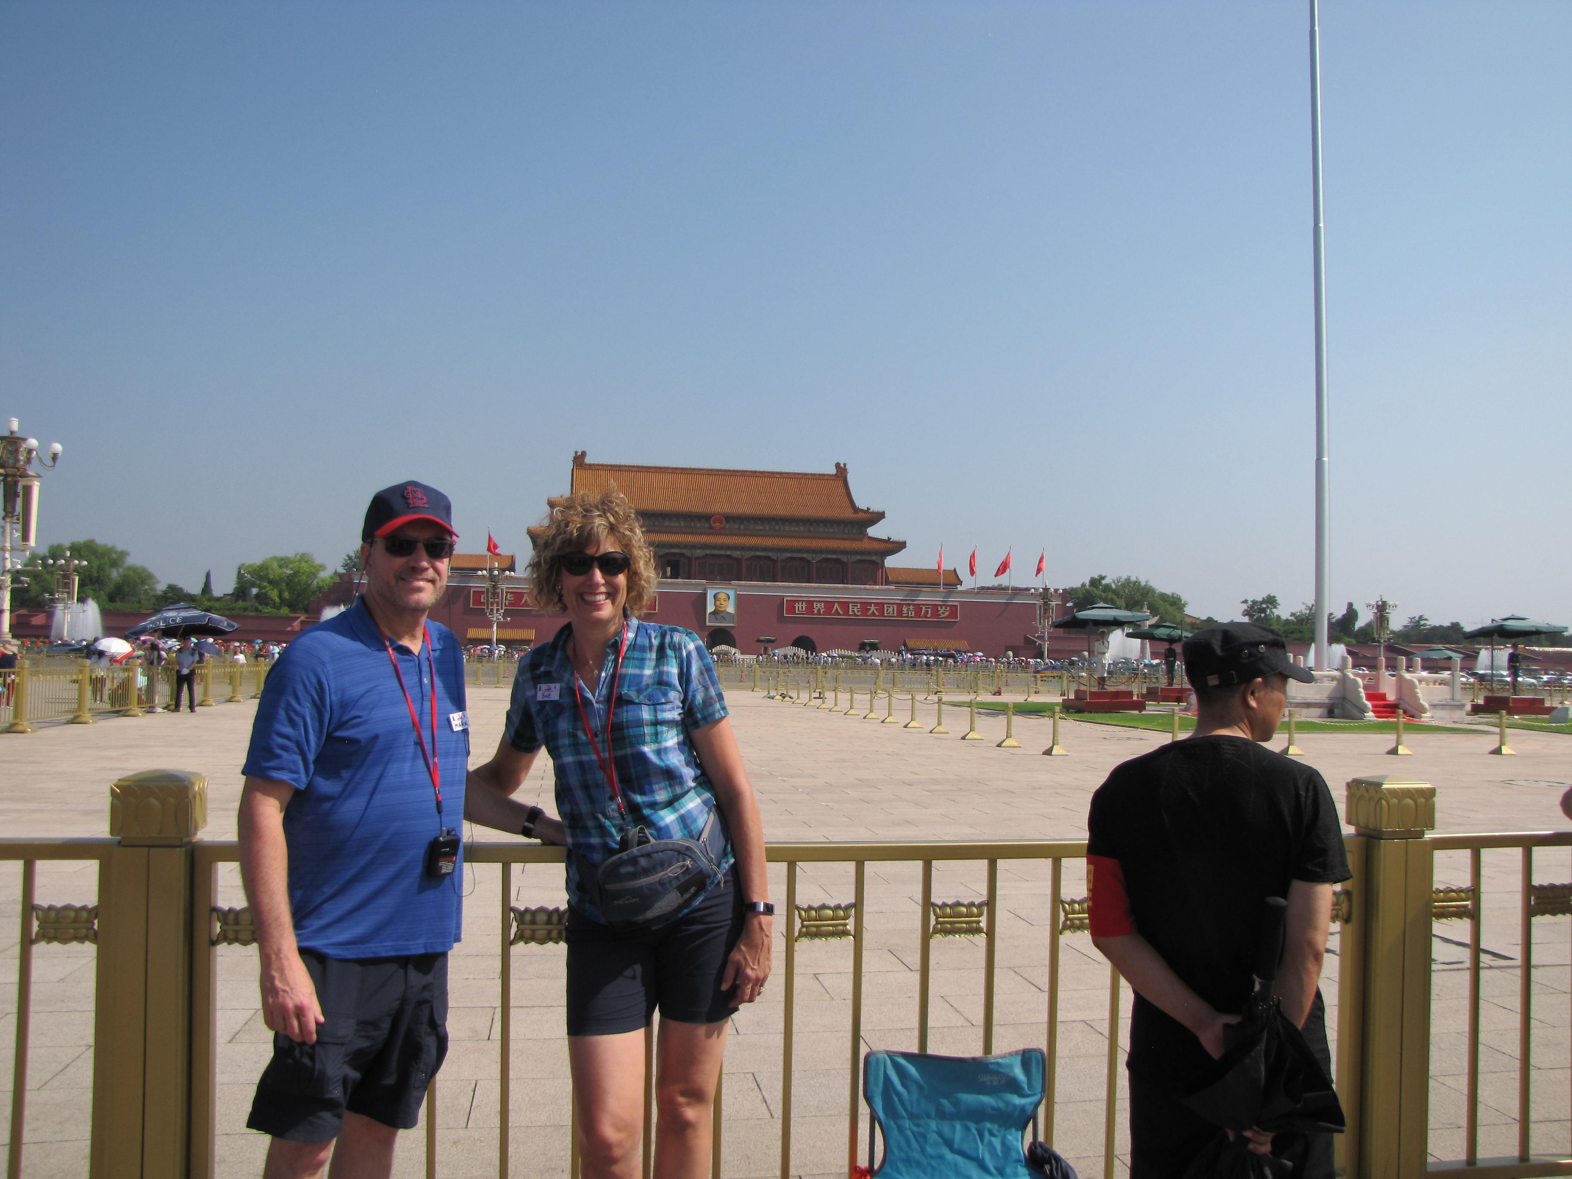

Slide 21
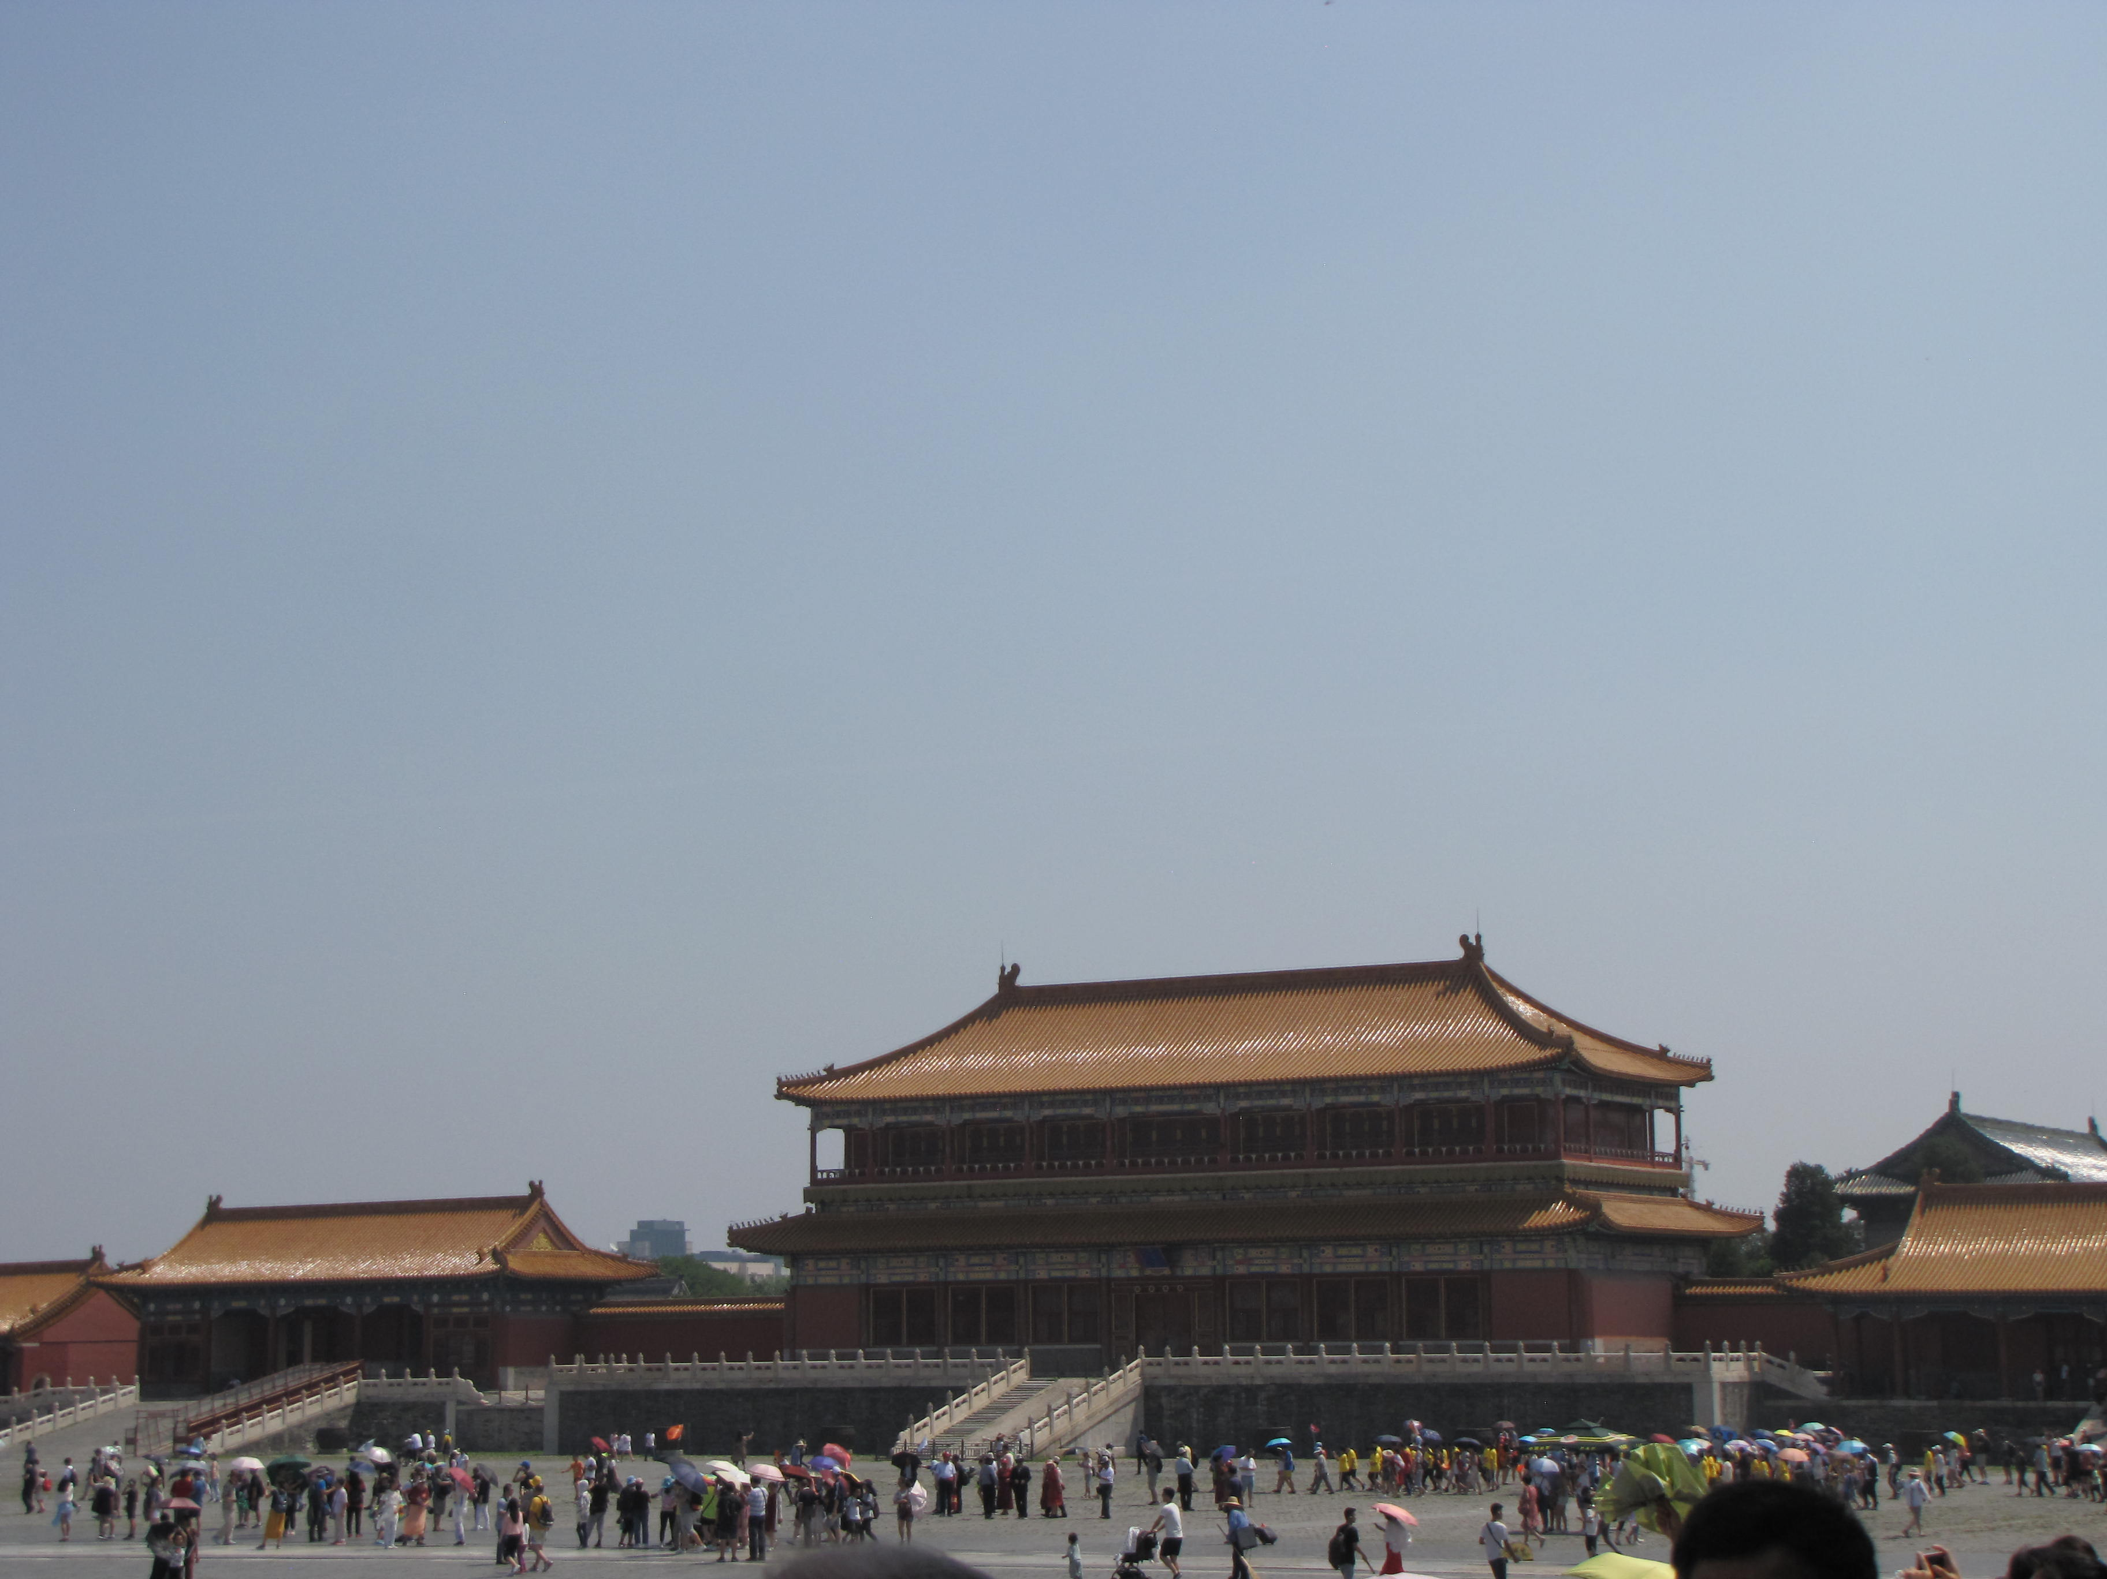

Slide 22
Tianjin
Tianjin (tee an JIN), the port of Beijing, lies at the mouth of the Hai River.
Tianjin (pop. 13.55 million) is at the north end of the Grand Canal, which permits inland shipping to Shanghai.
Shanghai, Beijing, and Tianjin are China’s leading industrial centers.

Slide 23
1. Which geographic region is considered the heart of the “real” China?
The North China Plain

Slide 24
2. What are the two major rivers of China?
Huang He and Chang Jiang

Slide 25
3. Which Chinese city has the greatest population?
Shanghai

Slide 26
4. What is China’s capital city?
Beijing

Slide 27
What are some of the environmental consequences resulting from construction of the Three Gorges Dam?
loss of scenery, landslides, pollution, buildup of sediment

Slide 28
Manchuria
Because the three provinces of Manchuria—named for the Manchus (man CHOOS), the last non-Han Chinese to control China—are located northeast of the Great Wall, the Chinese commonly refer to them as the Northeast.
The Boxers, a secret society known for its ceremonial practice of shadowboxing, struck back in 1899 in a series of uprisings that became know as the Boxer Rebellion.
Infuriated by anything they perceived as foreign or anti-Chinese, the Boxers attacked Christian missionaries and Chinese converts.
Many believers were killed when they would not renounce Christ.
Manchuria has been a hotly contested region.

Slide 29
During the 1960s, when relations between the Soviets and the Chinese soured, the two countries massed troops along the Manchurian border.
Tensions were relieved once the Soviet Empire was dissolved.

Slide 30
The Great Wall of China
Of the architectural wonders of the world, the Great Wall of China is certainly one of the most impressive.
It was built primarily during the fourteenth to the seventeenth centuries to protect China from invasions by the Mongols and Turkic tribes.

Slide 31
Notes:
iStock.com/aphotostory

Slide 32
The Southern Uplands
Eight populous provinces lie south of the Chang River basin in southeast China.
China’s Southern Uplands are one of the few places in the world that produce silk.
Silkworms spin a cocoon consisting of one long, light, strong thread, which the Chinese weave into silk.
The Southern Uplands include China’s southernmost province, Hainan (HYE NAN), which is the largest island in China.
The Xi (SHEE) River (West River) is the transportation hub of the Southern Uplands.

Slide 33
Located on the delta of the Xi is Guangzhou (GWANG JOH; formerly Canton).
Guangzhou is an important industrial and transportation center.
Foreign nations founded two colonies on China’s southern coast.
The British formed Hong Kong, which is about ninety miles southeast of Guangzhou.
During the nineteenth century, the British forced China to cede Hong Kong Island and the tip of the Kowloon Peninsula.
The colony reverted to China in 1997.
Hong Kong’s economy is one of the strongest and most varied in Asia.
For the most part, China has maintained a hands-off policy regarding the economy and internal affairs.

Slide 34
It has attempted a few encroachments on freedoms, however, and reserves all defense and foreign policy matters for the mainland government.
Christians are particularly concerned about whether Communist China will soon restrict church activities as well.
The second colony was Macau (muh COW), the oldest European colony in Asia, which the Portuguese founded in 1557.

Slide 35
Government and Economy
China has a Communist government and only one political party—the Communists.
It has a unicameral legislature called the National People’s Congress, but it is a rubber stamp for the Chinese Communist Party.
China has the second-largest economy in the world (behind only the United States).
Although in 1912 Sun Yat-sen (SOON YAHT-SEHN) had established a republican form of government and was followed by Chiang Kai-shek (JYAHNG KYE-SHEK), corruption and strife within the Nationalist (Kuomintang) Party caused dissension in the country.

Slide 36
Mao Zedong (MOU DZUH-DONG) led the Communist Red Army in a civil war that resulted in the defeat of the Nationalist army.
Mao proclaimed the birth of the People’s Republic of China (also known as Communist China or Red China) on October 1, 1949, in Tiananmen Square. He immediately began enacting ruthless programs he thought would strengthen the economy.
First, he executed more than fifty thousand wealthy landlords, abolished private property, and redistributed the land to create collective farms, or communes, on which the peasants worked as virtual slaves under government supervision.
In the Great Leap Forward of 1958, Mao further centralized farming and industry activity.

Slide 37
To eliminate opposition, both real and potential, Mao launched the Cultural Revolution in 1966, sending overzealous gangs of young people throughout China in an anti-intellectual, anti-Christian rampage.
Mao’s programs proved to be disastrous failures.
After Mao died in 1976, his successor, Deng Xiaoping (DUNG SHOU-PING), began to change China’s direction.
In the late 1980s, communism in Europe teetered on the brink of collapse.
Chinese students began protesting in Beijing, seeking increased freedoms, especially political freedom and freedom of expression.
In Tiananmen Square, they erected a thirty-foot replica of the Statue of Liberty.

Slide 38
On June 4, 1989, soldiers and tanks seized control of the square, wounding or killing as many as five thousand people.
After Tiananmen Square, however, the Communists began to institute dramatic economic reforms in the major cities.
Business and personal wealth increased dramatically.
Although some Chinese economic freedoms have increased, by Western standards the people are still repressed politically and religiously.

Slide 39
1. China is home to which of the world’s architectural wonders?
The Great Wall

Slide 40
2. Which geographic region of China has more ethnic groups and languages than any other?
the Southern Uplands

Slide 41
3. Which former British colony did China regain in 1997?
Hong Kong

Slide 42
4. Name two American businesses that have franchises in China.
McDonalds and Walmart (and others)

Slide 43
Describe the disastrous reforms of Mao Zedong.
In instituting the Great Leap Forward, which centralized all farming and industrial activity, Mao executed landlords, confiscated private property, and created collective farms. In the Cultural Revolution, he approved the execution, exile, or imprisonment of intellectuals and Christians.

Slide 44
China’s Autonomous Regions
China has five autonomous (self-governing) regions, twenty-three provinces (one of which is disputed), three special municipalities, and several Special Economic Zones and Special Administrative Regions.
Each autonomous region offers self-rule to a minority, but these minority groups have very limited powers.
The island of Taiwan has never been recognized by the Chinese Communists as an independent nation—they consider it a recalcitrant province—and the United Nations admits only China, not Taiwan, to its membership.

Slide 45
Guangxi
The autonomous region of Guangxi (GWAHNG SHEE) is on the coast at the Tonkin Gulf and the border with Vietnam.
China’s largest minority, the Zhuang (JWAHNG), live in Guangxi, with an estimated population of 17 million.
This region is one of China’s least-developed areas and one of the least evangelized.

Slide 46
Tibet (Xizang)
The Plateau of Tibet, also known as Xizang (SHEE DZAHNG) rises west of China’s Southern Uplands.
Many high peaks are in Tibet, including Mount Everest, which is on the border with Nepal.
Many of Asia’s great rivers begin on the plateau and cut through parallel gorges within a space of one hundred miles, including the Indus, the Brahmaputra, the Chang, the Huang He, the Irrawaddy, and the Mekong.
Tibet is quite rugged and is one of the world’s most isolated regions; consequently, Tibet is the least populated of all of China’s political divisions.
The capital, Lhasa (LAH sah), lies in the Tsangpo Valley.

Slide 47
Intensely religious, Tibetans follow a branch of Buddhism called Lamaism, which is led by a governmental and spiritual ruler called the Dalai Lama (DAH-lye LAH-mah).
Before communism, the Dalai Lama ruled as a theocrat (one who rules by religious or divine authority) from Potala Palace in Lhasa.
When the Chinese took over, he escaped to India and became head of “the Government of Tibet in Exile.”

Slide 50
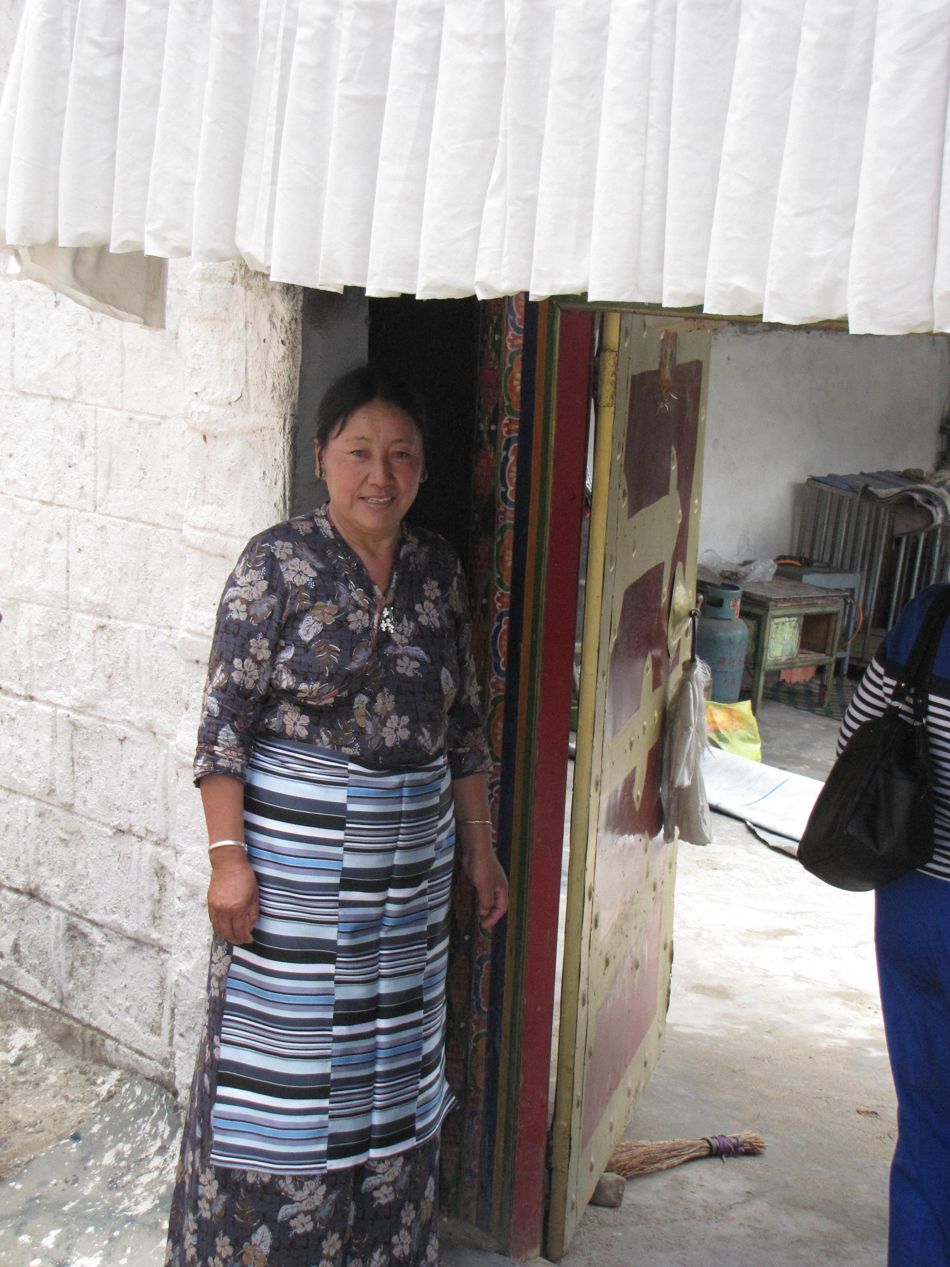
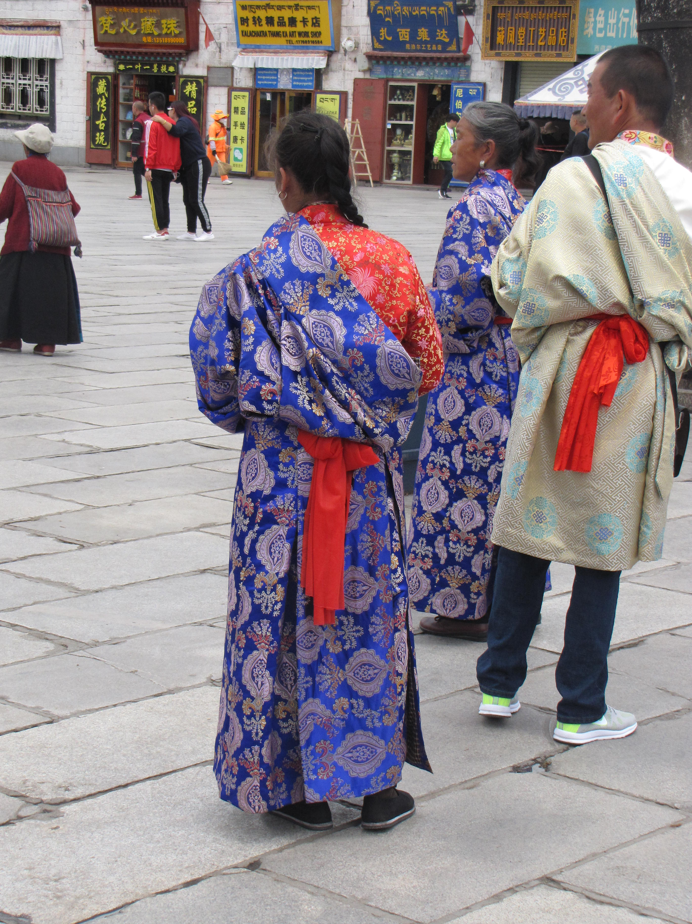

Slide 52
Xinjiang
Xinjiang (SHIN JYANG) covers an area the size of Alaska in northwest China, making it by far the largest of China’s political divisions.
Like Tibet, this large autonomous region has high mountains.
Unlike Tibet, however, Xinjiang consists mostly of desert basins.

Slide 53
Nei Mongol (Inner Mongolia)
The term Mongolia can refer to the region beyond the Great Wall of China.
Inner Mongolia, or Nei (NAY) Mongol, is the part controlled by China, between the Great Wall and the country of Mongolia.
Desert covers most of the region, but steppes (dry grasslands) mark its edges.

Slide 54
Ningxia
The last of China’s five autonomous regions is Ningxia (NIHNG shee ah), a small region that lies just inside the Great Wall where the Huang He flows into Inner Mongolia.
The Hui people are the only minority recognized for religious rather than ethnic regions.
According to the government, to be Hui is to be Muslim.

Slide 55
Taiwan
Taiwan (TYE WAHN) is an island in the South China Sea about one hundred miles off the coast of China.
In 1949, the Chinese Nationalists, led by Chiang Kai-shek, fled to Taiwan and reestablished their government at Taipei (TYE PAY).
They also claimed two tiny islands off the coast of China—Quemoy (kwi MOY), which is due west of central Taiwan, and Matsu (maht SOO), which is northwest of northern Taiwan.
Operating in a free market climate, the city and the island enjoy great personal and political freedom and economic prosperity.
The United Nations expelled Taiwan in 1971 and admitted Communist China.

Slide 56
Although mainland China claims Taiwan, Taiwan insists that the legitimate government is in Taipei, not Beijing.
Taiwan stops short of formally declaring independence for fear that China might invade.
In fact, China has repeatedly warned Taiwan not to push for formal independence.
Taiwan allows freedom of religion, and most Taiwanese profess some form of religion.

Slide 57
Notes:
Cultural Geography, 4th edition, p. 401

Slide 58
Mongolia (Outer Mongolia)
Mongolia is the ancestral home of a nomadic people called the Mongols.
A hardy and independent people, they wandered over the grassy plateaus grazing their herds.
They lived in portable round tents called gers. (The Russian term for the structures is yurts.)
The Mongols were among the most savage conquerors of all time.
Mongolia’s main urban center is the capital, Ulaanbaatar (OO lahn BAH tahr).
A railroad now traverses the six hundred miles between Ulaanbaatar and the Great Wall of China near Beijing.
The Gobi Desert is the world’s coldest and most northerly desert.

Slide 59
Notes:
Cultural Geography, 4th edition, p. 402

Slide 60
1. What region is called “The Roof of the World”?
Tibet

Slide 61
2. Who leads the Tibetan Buddhists?
the Dalai Lama

Slide 62
3. To what does the term Mongolia refer?
the region beyond the Great Wall of China

Slide 63
4. Which island does China claim as its own but exercise no control over?
Taiwan

Slide 64
5. What is the term for the portable houses in which many Mongolians live?
gers (or yurts)

Slide 65
Why is it difficult for the Hui people to become Christians in Ningxia?
The Hui people are defined as Muslim. To become a Christian is to lose their ethnic identity.

Slide 66
Korea

Slide 67
Korea
North Korea
South Korea

Slide 68
Korea
Korea is a peninsula that extends south from northeastern China.
Mountains and hills cover most of the peninsula.
Two rivers, the Yalu and the Tumen, divide the Korean Peninsula from China and Russia in the north.
Running down the east central portion of the peninsula are the Taebaek Mountains.
A minor coastal plain lies on the east coast in North Korea, but mountains dominate the eastern half of both countries.
It has been conquered at various times by China, the Mongols, Japan, and the Manchus.

Slide 69
In 1910, Japan took control of Korea and began to govern it as a colony.
After World War II, the country divided at the thirty-eighth parallel.
The United States supervised the southern half, and the Soviet Union oversaw the northern half.
North and South Korea rank among the leading producers of Tungsten and smelted zinc.

Slide 70
Notes:
Map Resources

Slide 71
North Korea
The Soviet Union refused to give up its territory.
Instead, the Soviets established a Communist satellite called the Democratic People’s Republic of Korea.
Hoping to unify the peninsula under communism, the superior North Korean army invaded South Korea in 1950.
United Nations troops, most of them Americans, were rushed to the peninsula just as the Allied forces were about to be pushed into the sea at Pusan in the southeast portion of the peninsula and in time to avert certain defeat.
After three years of warfare, a truce was declared.

Slide 72
The boundary between North and South Korea, the thirty-eighth parallel, is a demilitarized zone (DMZ), a strip of land in which no troops or weapons are allowed.
However, a peace treaty was never signed, so technically the two nations are still at war.
North Korea’s Communist ruler, “Great Leader” Kim Il Sung, isolated his country from the rest of the world.
The North Korean government owns all industries and farms and discourages all religion, except for worship of the state as represented by Kim Il Sung, a religion known as Juche (JOO chay), or Kimilsungism.
Kim Jong Il died in 2011.
His son Kim Jong Un assumed the title of supreme leader and continues to lead the country in much the same direction his father and grandfather did.

Slide 73
Despite opposition from most of the rest of the world—especially the countries of East Asia—North Korea continues to produce materials for nuclear weapons.
The capital, Pyongyang (pop. 3.14 million), has the only university.

Slide 74
Notes:
iStock.com/alexkuehni

Slide 75
South Korea
South Korea, also known as the Republic of Korea, is slightly larger than Indiana.
The favorable climate and irrigation permit the rice fields to be double cropped (producing two crops per year).
Since 1960, South Korea has undergone a rapid transformation from an agricultural society to a fast-growing industrial economy.
Seoul (SOHL), the country’s capital and manufacturing center, is currently the eighth-largest city in the world by area and easily the largest on the Korean Peninsula.
After thirty-two years of military rule, South Koreans elected their first civilian government in 1993.

Slide 76
They have a republican form of government with an elected president who appoints a prime minister.

Slide 77
1. Which mountain range forms the backbone of the east central portion of the Korean Peninsula?
the Taebaek Mountains

Slide 78
2. What do the letters DMZ refer to?
demilitarized zone

Slide 79
3. What are the names of the three Communists who have ruled North Korea?
Kim Il Sung, Kim Jong Il, and Kim Jong Un

Slide 80
4. What term refers to the centrality of and virtual worship of the state in North Korea?
Juche (or Kimilsungism)

Slide 81
5. What is the largest city in Korea?
Seoul, South Korea

Slide 82
Contrast the effects of government policies in North and South Korea.
North Korea’s repressive centralization, controlled industry, and restrictive trade policies have led to shortages, poverty, and hardship; South Korea’s free government and free market economies have led to wealth, plenty, and a high standard of living, making South Korea a “Little Dragon” in the region.

Slide 83
Japan
Honshu
Tokyo
Kyoto
Other Industrial Centers
Shikoku
Kyushu
Hokkaido

Slide 84
Japan
The Japanese refer to their country as Nippon, which means “source of the sun.”
Japan is a crescent of four main islands due east of the coast of Russia and the Korean Peninsula, along with thousands of smaller islands that stretch southwest to northeast for twelve hundred miles.
Although the islands have few mineral resources, Japan has built a thriving industrialized nation by adopting an exemplary work ethic and importing raw materials and converting them into high-tech, high-quality goods that are in great demand.
The native religion of Japan, Shinto (SHIHN toh), promotes the worship of many gods called kami, who are believed to indwell mountains, rivers, trees, and other parts of nature.

Slide 85
Honshu
Japan’s population is just over one-third the size of the United States’ population, but all of its people are concentrated in an area the size of California.
Honshu, Japan’s largest island, is home to more than 80 percent of the Japanese people.

Slide 86
Tokyo
With 13.23 million people, Tokyo (meaning “eastern capital”) is the largest city in Japan.
Yokohama, Japan’s second-largest city (pop 3.70 million) and main port, is close to Tokyo.
Tokyo is a state-of-the-art financial center.

Slide 87
Notes:
iStock.com/pigphoto

Slide 88
Kyoto
Mountains cover about 85 percent of Japan.
The highest, Mount Fuji, reaches 12,389 feet.
Kyoto was Japan’s capital for more than one thousand years in ancient times.
Warriors called samurai protected estates of feudal lords (daimyo), whose rivalries escalated into civil war.

Slide 89
Notes:
iStock.com/yongyuan

Slide 90
Other Industrial Centers
Honshu has three other major industrial regions.
Nagoya is Japan’s fourth-largest city at 2.18 million people, and the Chukyo Industrial Region around it produces many Japanese cars, synthetic fibers, ceramics, and aircraft.
The Hokuriku Region on the west coast extends from Niigata to Kanazawa and produces machinery and chemicals.
Hiroshima (heer oh SHEE muh), a city of 1.14 million people and the site where the first atomic bomb was dropped, is part of the Island Sea Region industrial area.

Slide 91
Shikoku
Shikoku, the smallest of Japan’s four main islands, lies south of Honshu.
With only 3 percent of the Japanese people, this mountainous and heavily forested island has only four prefectures.
It has remained somewhat separate from the rest of Japan.

Slide 92
Kyushu
Southeast of the Korean Peninsula is Kyushu, the southernmost and second-most-populous of Japan’s main islands.
The earliest settlers built Japan’s first cities there.
On the west coast is the port city of Nagasaki (pop. 414,415), which is often referred to as the San Francisco of Japan.
The United States dropped its second atomic bomb on Nagasaki in 1945 to end World War II.
Japan has many small islands.
The United States captured the most strategic ones to use as bases for bombers during World War II.

Slide 93
Included among the Ryuku Islands is Okinawa, Japan’s fifth-most-populous island and the only prefecture not on one of the four main islands.
The ninety-seven Bonin islands are southeast of Japan.
Iwo Jima is one of three Volcano Islands farther south.

Slide 94
Hokkaido
The northernmost of the four main Japanese islands is Hokkaido (hah KYE doh).
The population is concentrated in Sapporo, a city of 1.93 million people, the fifth-largest city in Japan.
Hokkaido compares to the American West as Japan’s last frontier.
Hokkaido also has native peoples, the Ainu, Japan’s original inhabitants.

Slide 95
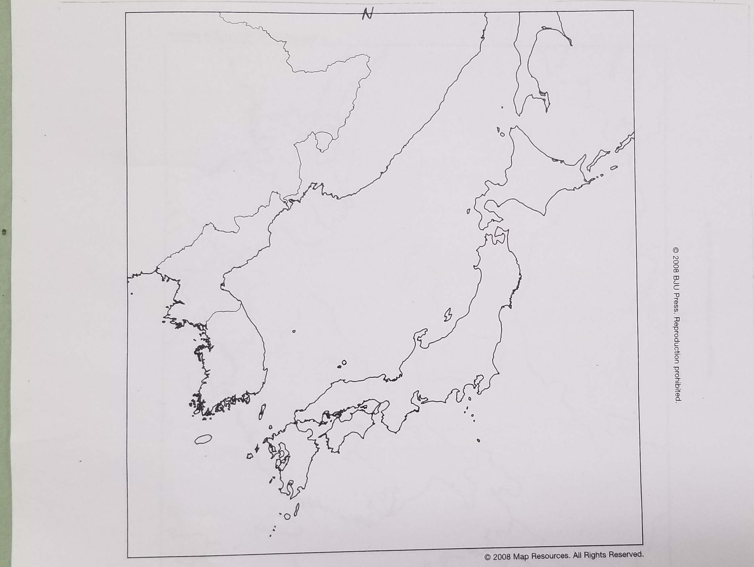

Slide 96
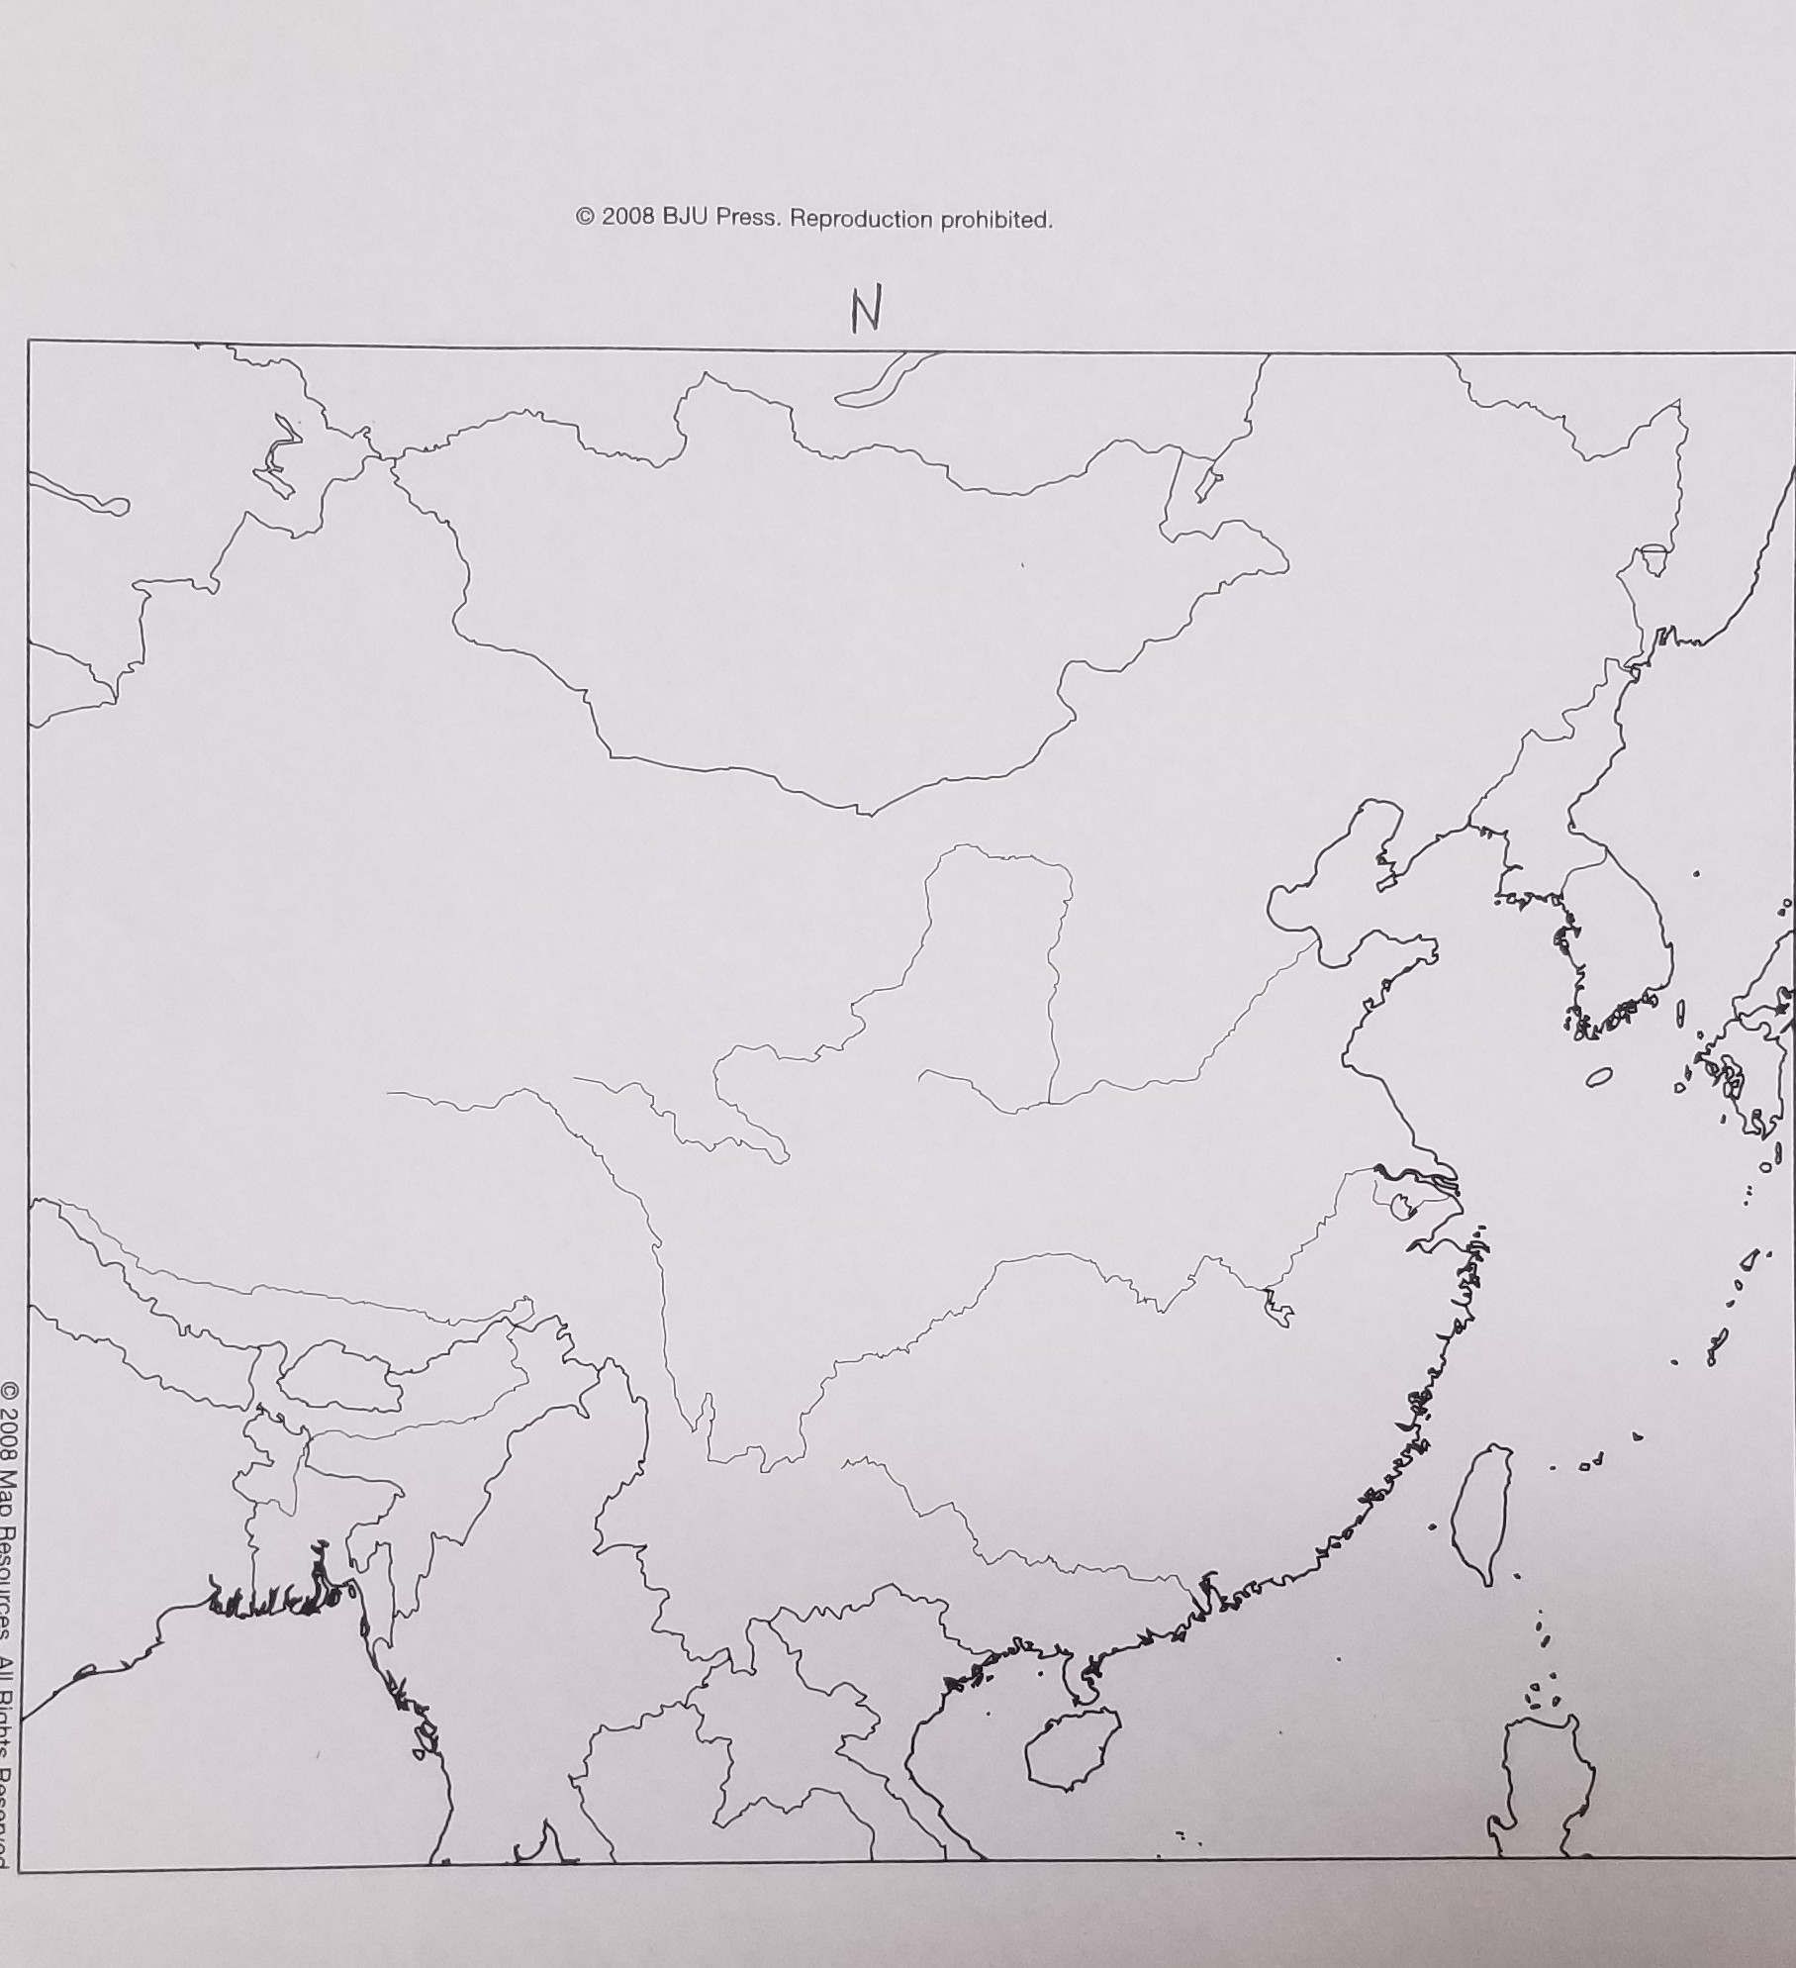

Slide 97
1. What is the religion that influences all Japanese people?
Shinto

Slide 98
2–4. Who are shoguns? samurai? Ainu?
shogun—a “great general” who ruled in the emperor’s name until 1867; samurai—a Japanese warrior who protected the estates of feudal lords; Ainu—Japan’s original inhabitants

Slide 99
5. What is the highest mountain in Japan?
Mount Fuji

Slide 100
What factors enabled Japan to recover so quickly from World War II to become the economic power it is today?
Answers will vary but might include U.S. aid, U.S. help in setting up a democratic government and a free market economy, exemplary work ethic, and devotion to quality in industry.

Slide 101
People, Places, and Things to Know

Slide 102
Pacific Rim
the countries that touch the Pacific Ocean, especially those of East Asia

Slide 103
Han
the name for 92% of the people in China

Slide 104
North China Plain
heart of the People’s Republic of China

Slide 105
Qin Ling Mountains
mountains that run east to west and rise to 13,474 feet; create a major climate barrier on the North China Plain

Slide 106
Huang He
major river in the north of China; formerly called the Yellow River

Slide 107
Chang
major river in the south of China; formerly called the Yangtze River

Slide 108
dynasty
a family whose members rule over a country for several generations

Slide 109
Shanghai
China’s largest city

Slide 110
Beijing
capital of China

Slide 111
Forbidden City
area in Beijing where the Chinese emperors once lived

Slide 112
Tiananmen Square
large square in Beijing; in 1989, it became a symbol of Chinese people’s dissatisfaction with the Communist regime

Slide 113
Tianjin
port city near Beijing

Slide 114
Manchus
last non-Han Chinese to control China

Slide 115
Southern Uplands
more ethnic groups and languages are found here than any other region of China; one of the few places in the world that produces silk

Slide 116
Hainan
largest island in China

Slide 117
Xi River
transportation hub of the Southern Uplands

Slide 118
Guangzhou
largest city in China’s Southern Uplands

Slide 119
Hong Kong
founded by the British; reverted to China in 1997

Slide 120
Macau
oldest European colony in Asia; founded by the Portuguese in 1557; reverted to China in 1999

Slide 121
Sun Yat-sen
formed a republican form of government in China in 1912

Slide 122
Chiang Kai-shek
leader of Nationalist China during the civil war against Mao Zedong

Slide 123
Mao Zedong
the first ruler of the People’s Republic of China

Slide 124
Great Leap Forward
Mao centralized farming and industrial activity during this time

Slide 125
Cultural Revolution
a movement in which overzealous gangs of young people were sent throughout China in an anti-intellectual, anti-Christian rampage

Slide 126
Deng Xiaoping
leader after Mao; pursued economic modernization

Slide 127
autonomous regions
areas that have limited self-government within a sovereign country; used especially of areas in China where ethnic minorities have been granted some autonomy

Slide 128
Guangxi
autonomous region located on the coast of the Tonkin Gulf and the border with Vietnam; one of China’s least developed areas

Slide 129
Zhuang
China’s largest minority

Slide 130
Tibet (Xizang)
plateau containing many high peaks such as Mount Everest

Slide 131
Lhasa
capital of Tibet

Slide 132
Dalai Lama
governmental and spiritual ruler in Tibet

Slide 133
theocrat
one who rules by religious or divine authority

Slide 134
Xinjiang
geographically largest of China’s political divisions

Slide 135
Nei Mongol
Inner Mongolia; the area controlled by China between the Great Wall and the country of Mongolia

Slide 136
Ningxia
small region that lies just inside the Great Wall; most of its inhabitants are Sunni Muslim

Slide 137
Taiwan
island in the South China Sea claimed by China; believes itself to be the legitimate Chinese government

Slide 138
Taipei
capital of Taiwan

Slide 139
Ulaanbaatar
capital of Mongolia

Slide 140
Gobi Desert
world’s coldest and most northerly desert

Slide 141
Taebaek Mountains
mountain range that runs down the east central portion of the Korean Peninsula

Slide 142
Juche (Kimilsungism)
worship of the North Korean state, as represented by Kim Il Sung

Slide 143
Pyongyang
capital of North Korea

Slide 144
Seoul
capital of South Korea

Slide 145
Nippon
“source of the sun”; how the Japanese refer to their country

Slide 146
Shinto
native Japanese religion; promotes the worship of many gods called kami who are believed to indwell mountains, rivers, trees, and other parts of nature

Slide 147
Honshu
Japan’s largest island

Slide 148
Tokyo
largest city and capital of Japan

Slide 149
Yokohama
second largest city in Japan and main seaport

Slide 150
Mount Fuji
highest mountain in Japan at 12,389 feet

Slide 151
Kyoto
was Japan’s capital for more than one thousand years

Slide 152
Samurai
warriors that protected estates of feudal lords

Slide 153
Nagoya
Japan’s fourth largest city; found in the Chukyo Industrial Region

Slide 154
Hiroshima
site where the first atomic bomb was dropped

Slide 155
Shikoku
smallest of Japan’s four main islands; has remained somewhat separate from the rest of Japan

Slide 156
Kyushu
southernmost and second-most-populous of Japan’s main islands

Slide 157
Okinawa
Japan’s fifth-most-populous island; the U.S. captured this island to use as a base for bombers during World War II

Slide 158
Iwo Jima
one of the three Volcano Islands; the U.S. captured this island to use as a base for bombers during World War II

Slide 159
Hokkaido
northernmost of the four main Japanese islands

